Slide 1

Structure-aware machine learning for protein design
Sagar D. Khare, PhD
Associate Professor
Department of Chemistry and Chemical Biology
Institute for Quantitative Biomedicine
Rutgers University, New Jersey, USA
E: sagar.khare@rutgers.edu T: @sagardkhare @Khare_Lab
Web: sagardkharelab.org

Slide 2
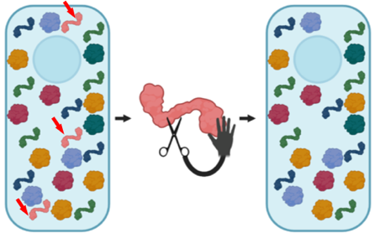
Towards Protein Editors: selectively target and edit a single type of protein am
Designed
Editor
CRISPR for proteins
With Sijian Wang, Jean Baum, Guillaume Lamoureux, Adam Gormley

Slide 3
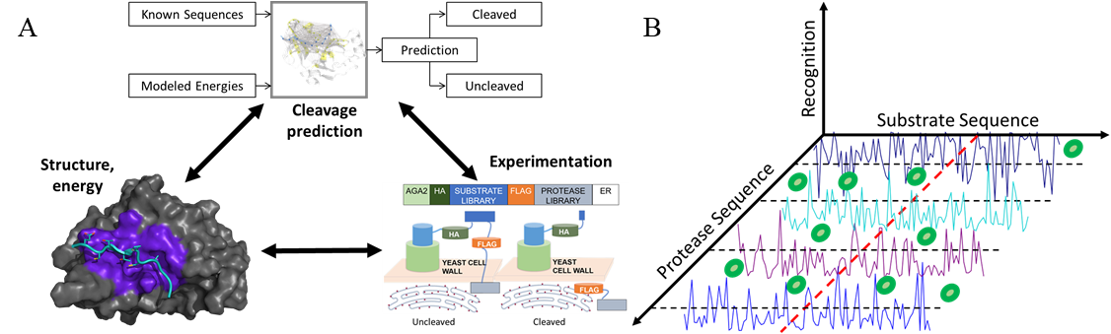
Combining experimental data and physics using machine learning
With Sijian Wang, Guanyang Wang
Proc. Natl. Acad. Sci. (2019)

Slide 4
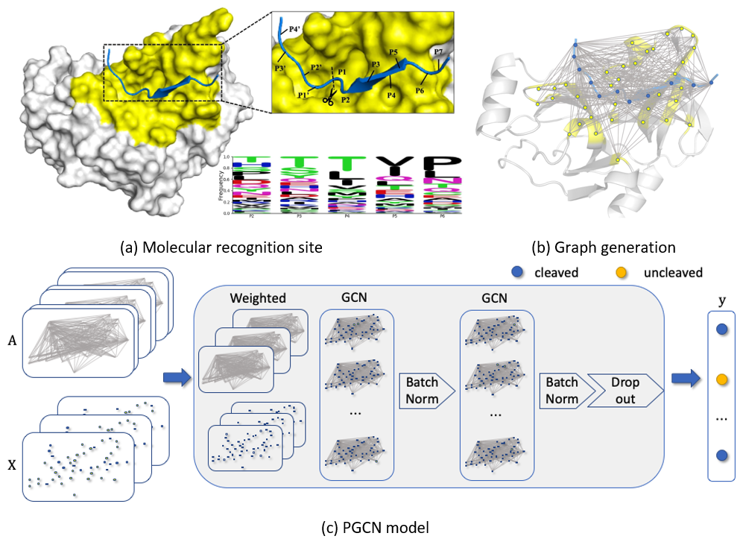
Protein graph convolutional network PGCN
Represent the binding site as a graph: learn what sub-graphs correspond to cleavage (vs non-cleavage)
Protease graph convolutional neural network (PGCN)

Slide 5
Designing protein-polymer hybrids using ML
With Adam Gormley, Meenakshi Dutt, Sanjeeva Murthy

Slide 6
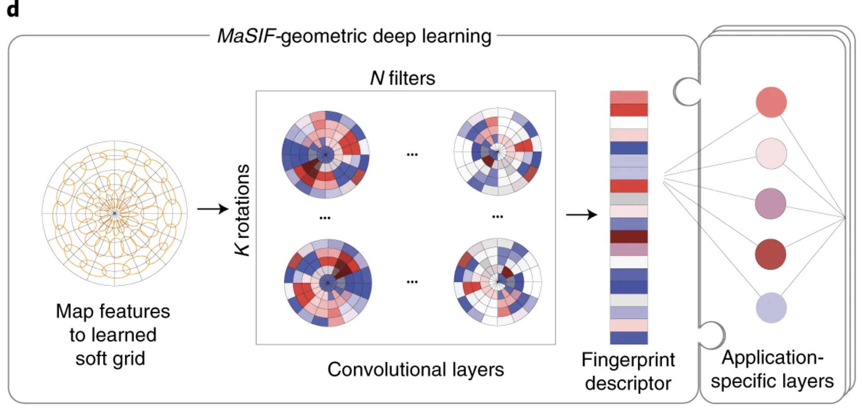
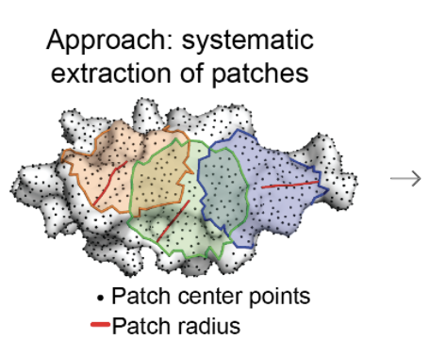
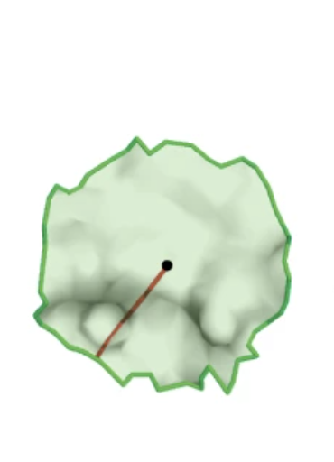
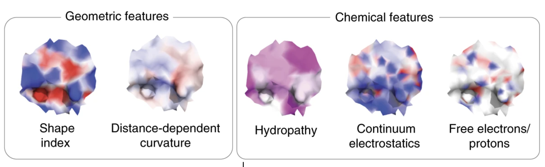
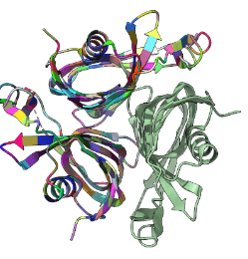
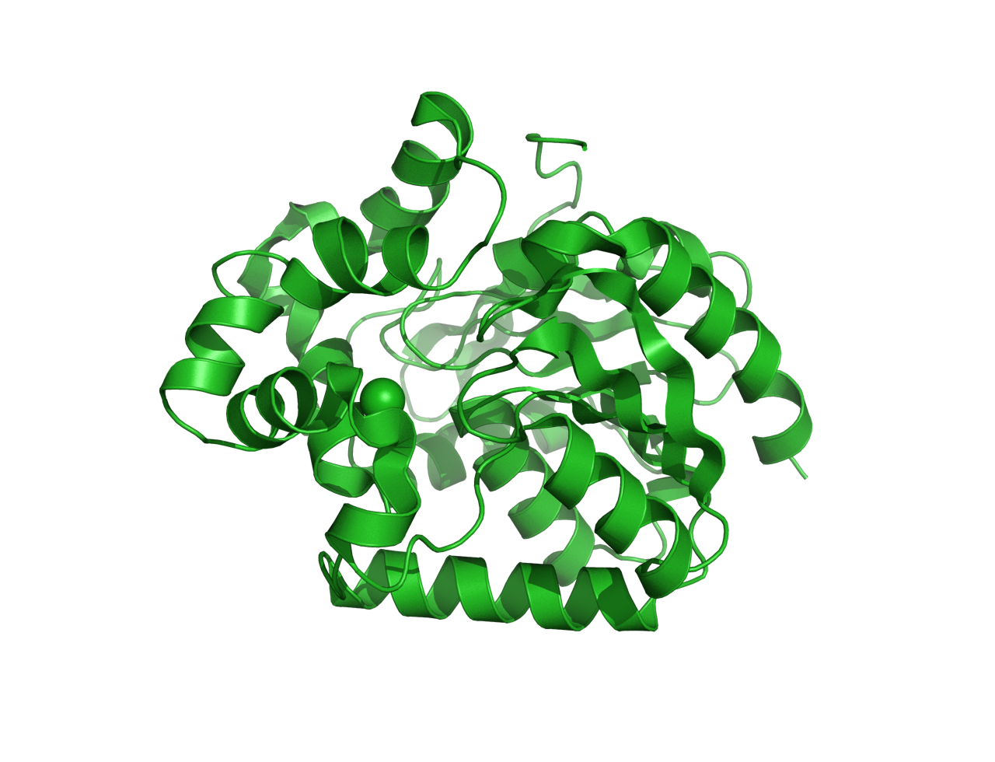
Developing generative models of protein surfaces
Query structure
Surface Design Model
Structural/Seq Search against DBs
Simulation Validation
De novo structure generation (optional)
…
Experimental Validation
Top hits from search as input
Fingerprint Encoder
Sequence/ Structure Decoder
Fingerprints generation using dMaSIF
Z
Output: Sequences/Structures
Gainza, P. et al. Nat Methods 17, 184–192 (2020).
Latent space of fingerprint distribution
Notes:
Protein featurization hope can be captured by the ML model

Slide 7

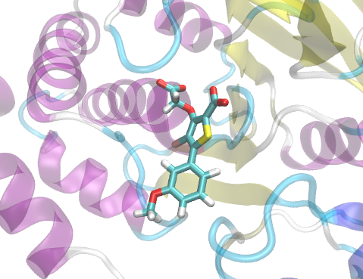
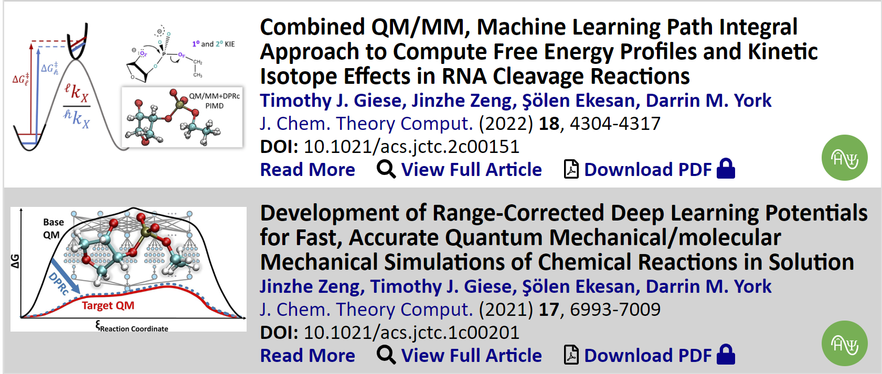
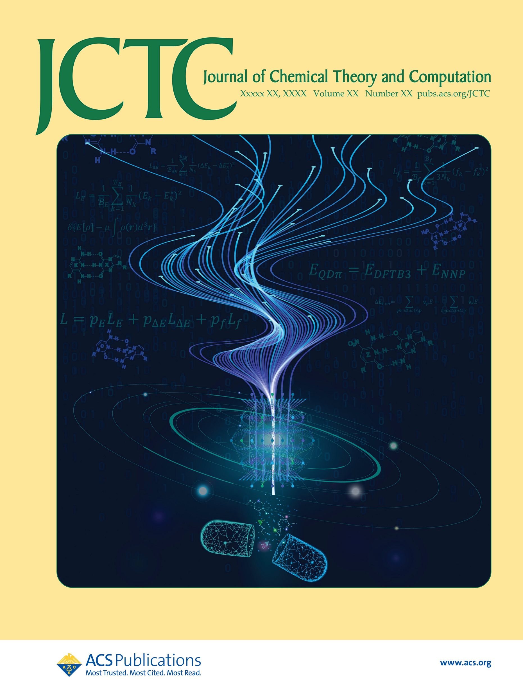

Quantum Deep-learning Potential Interaction Energy (QDπ) Model for Drug Discovery
Simulations that predict drug-target binding are transformative for drug discovery
Critical barrier to progress is accuracy of potential energy model for drugs
Ab initio quantum mechanical models are accurate, but computationally prohibitive
New QDπ model has ab initio quantum accuracy at 1000X speed-up
http://theory.rutgers.edu
Forthcoming JCTC Front Cover
Notes:
The York group develops free energy simulation methods used by pharmaceutical companies to predict drug-target binding affinities. A critical barrier to progress is the limited accuracy of the potential energy models for drug molecules. Ab initio quantum models are highly accurate, but computationally prohibitive. The York group has developed new quantum deep-learning potential interaction energy model that has the accuracy of high-level quantum mechanical models at 1/1000 the computational cost, making the QDPi model a potentially transformative technology from drug discovery.

