Slide 1
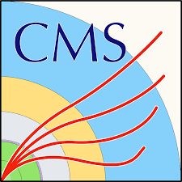



BRIL-CMS-CERN
Software and computing: Ecuadorian contributions to
CMS-BRIL
Xavier Riofrío
(Universidad San Francisco de Quito)

Slide 2


Profile
Eng. MsC. Xavier Riofrío.
Computer Science Engineer,
Universidad de Cuenca(2014).
Master of Science,
The University of Birmingham(2017).
My experience: Professor, researcher and developer at universities in Ecuador.
Currently:
CERN-CMS-BRIL developer(April 2021-Now).

Slide 3
Main Activities developed
A Generic Vectorized tool for calibrations and reprocess BRILdata
Bril-view: Fixing bugs, upgrading libraries and angular
Web monitor: Fixing bugs and quality improvements
Deployment and migration process of bril-view and bril-view-test
Research and solution for computational issues

Slide 4
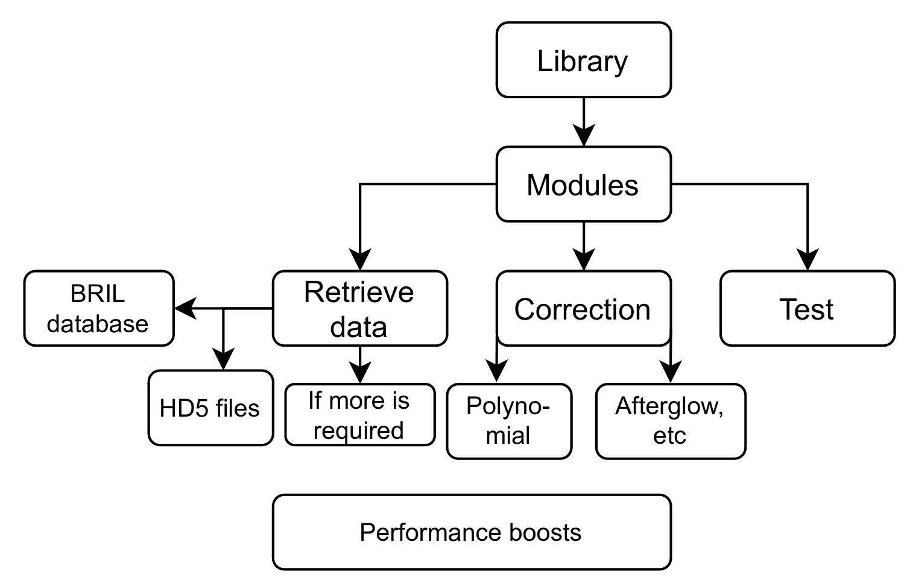


1. A Generic Vectorized tool for calibrations and reprocess BRIL data
Objective: To develop a library in Python where calibration functions are generalized.
(Bril environment)
(Python plugin)
(Python code)
(Cython)

Slide 5
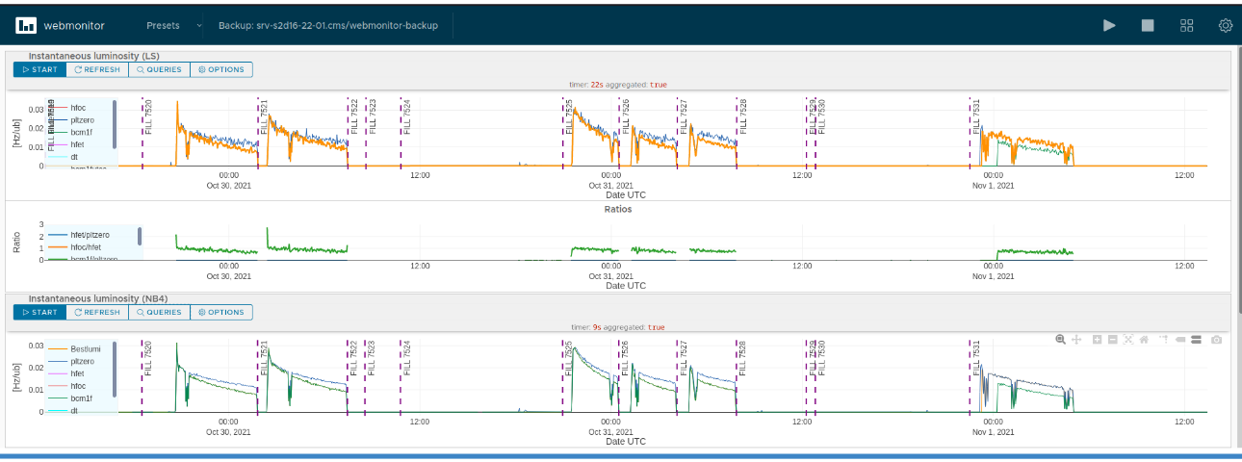


2. Web monitor: Fixing bugs and quality improvements.
BRIL DAQ web monitoring application: This is a webtool developed in Angular that shows in real time several graphs for different detectors.
Fixing bugs and updating angular.
Testing new features and performance before beam tests.
Updating documentation.

Slide 6
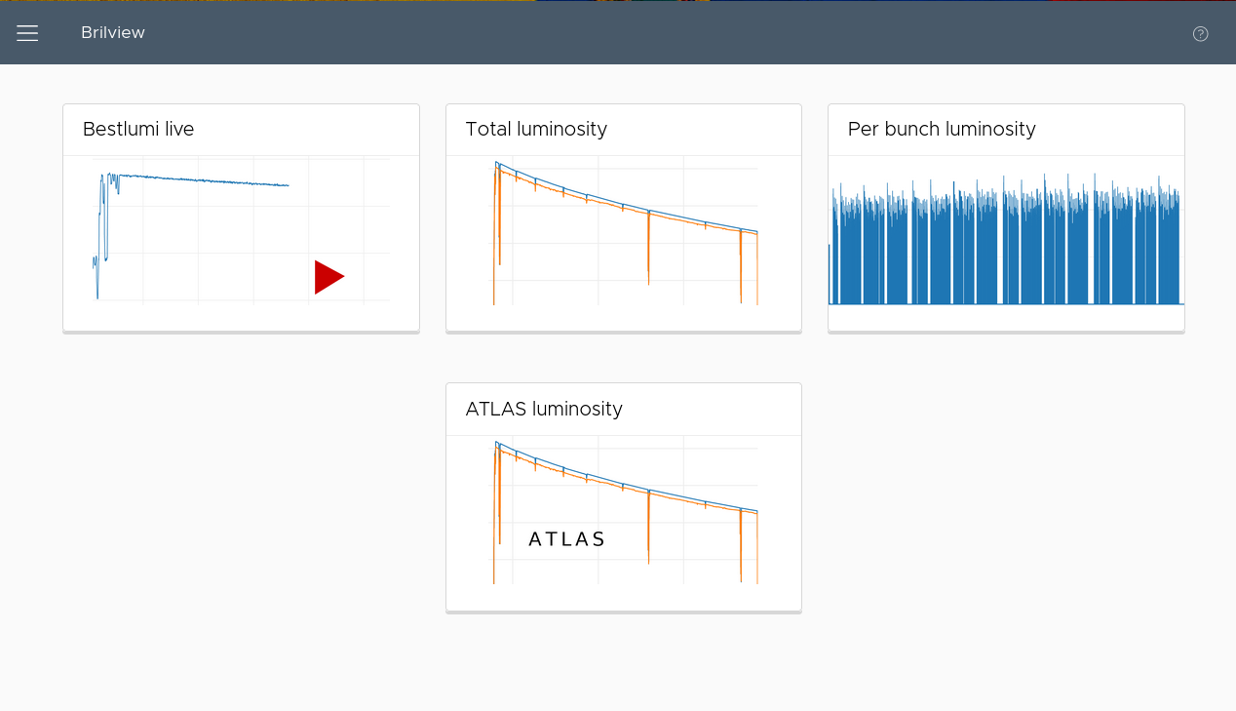
3. Bril-view: Fixing bugs, upgrading libraries and angular
Bril-view: This is a web tool developed in Angular that allows querying time for several graphs for different detectors.
Upgrading Angular 7 to Angular 12.
Fixing bugs.
Testing new features and performance before beam tests.
Updating documentation.

Slide 7
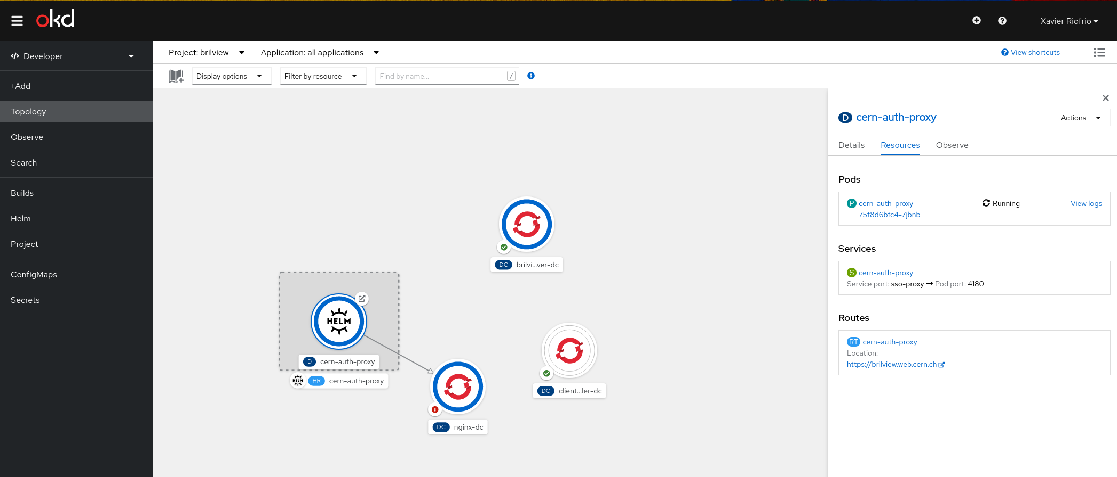

4. Deployment and migration process of bril-view and bril-view-test
The responsibility of this tool was directly assigned to me, therefore, I was in charge of the following activities:
Deployment and maintenance
Using Openshift
Updating scripts for deployment
Fixing bugs for both, such as:
  Display errors
  Deployment errors
  Logical errors
  Among others

Slide 8
5. Research and solution for computational issues
Different problems were solved, of many types such as:
Scripts for filtering data,
Solutions for common errors in brilconda environment,
Compatibility errors,
Among others.

Slide 9

Main challenges
Understand the physics stuff, or at least the basics about what is being talked within the group
In the current situation the covid restrictions
Cultural barriers

Slide 10
The most exciting:

Slide 11
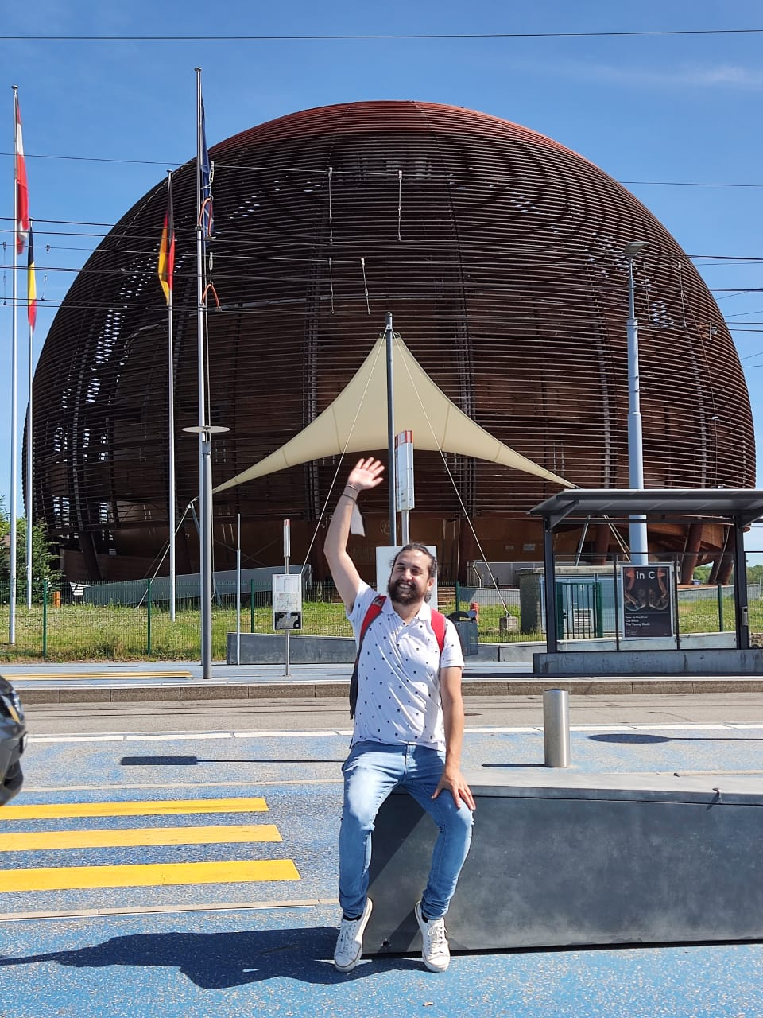
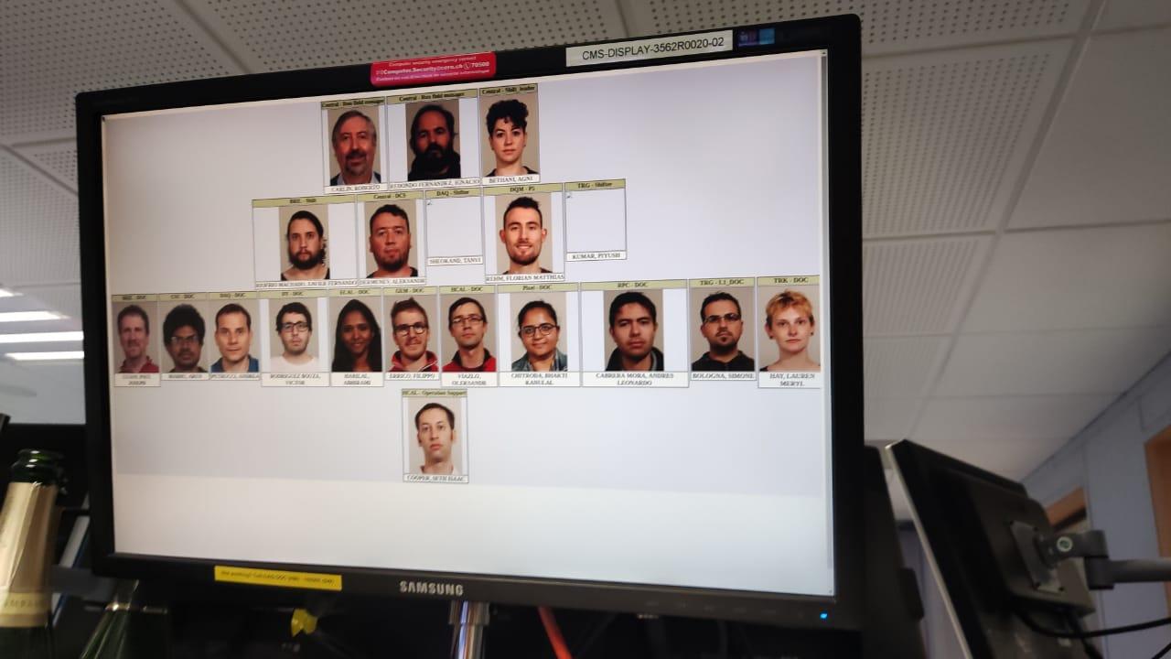
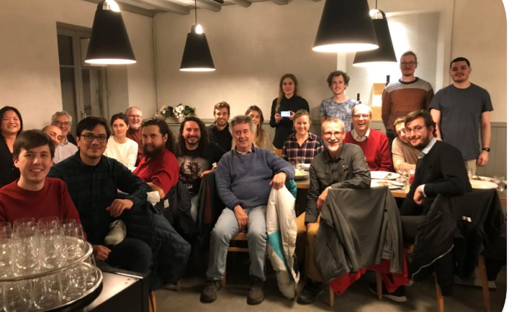
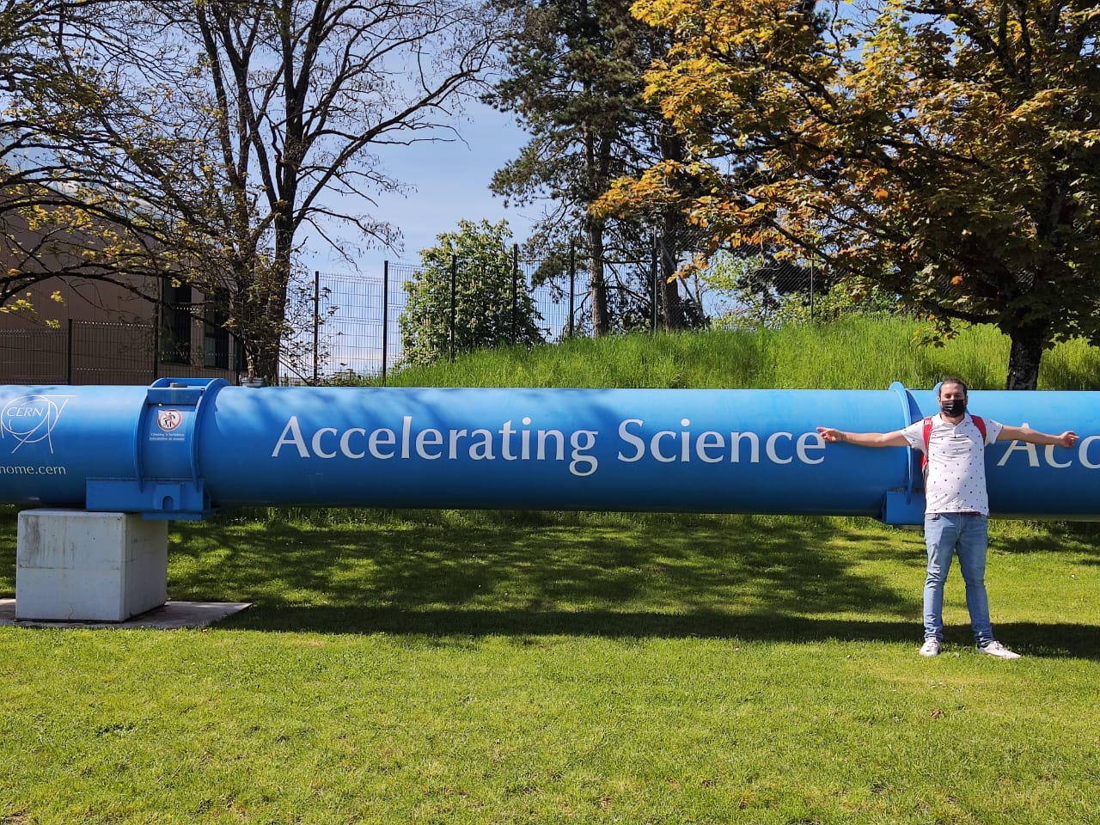
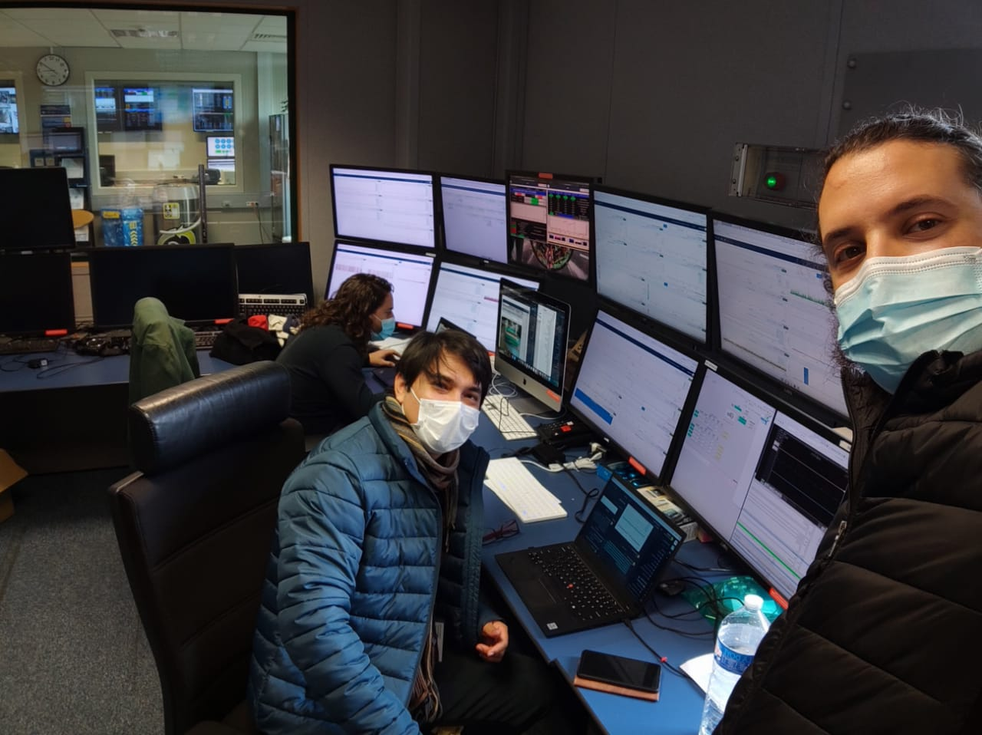

Slide 12
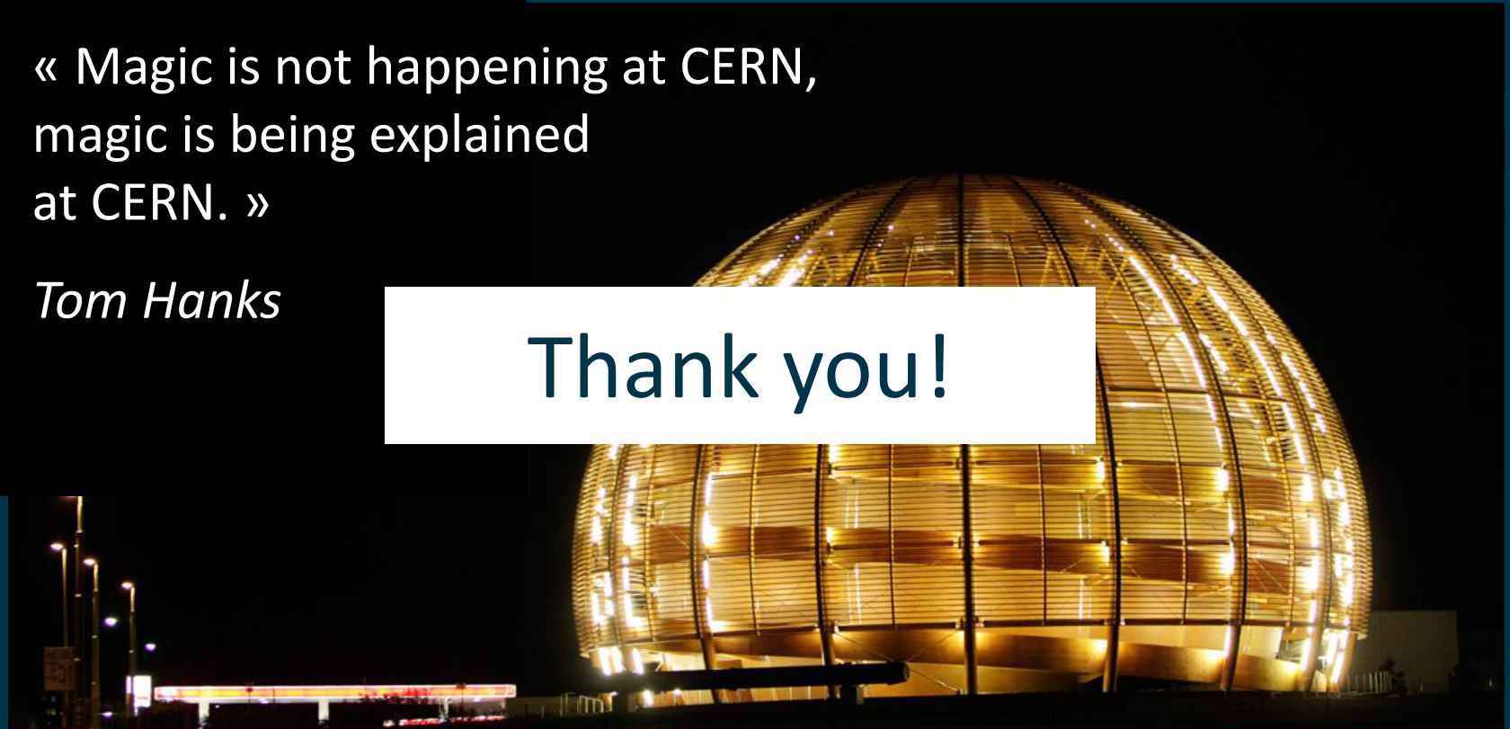
Thanks

