Slide 1

The electron-ion collider:
A collider to unravel the mysteries of visible matter
E.C. Aschenauer (BNL)
Electron Ion Collider

Slide 2
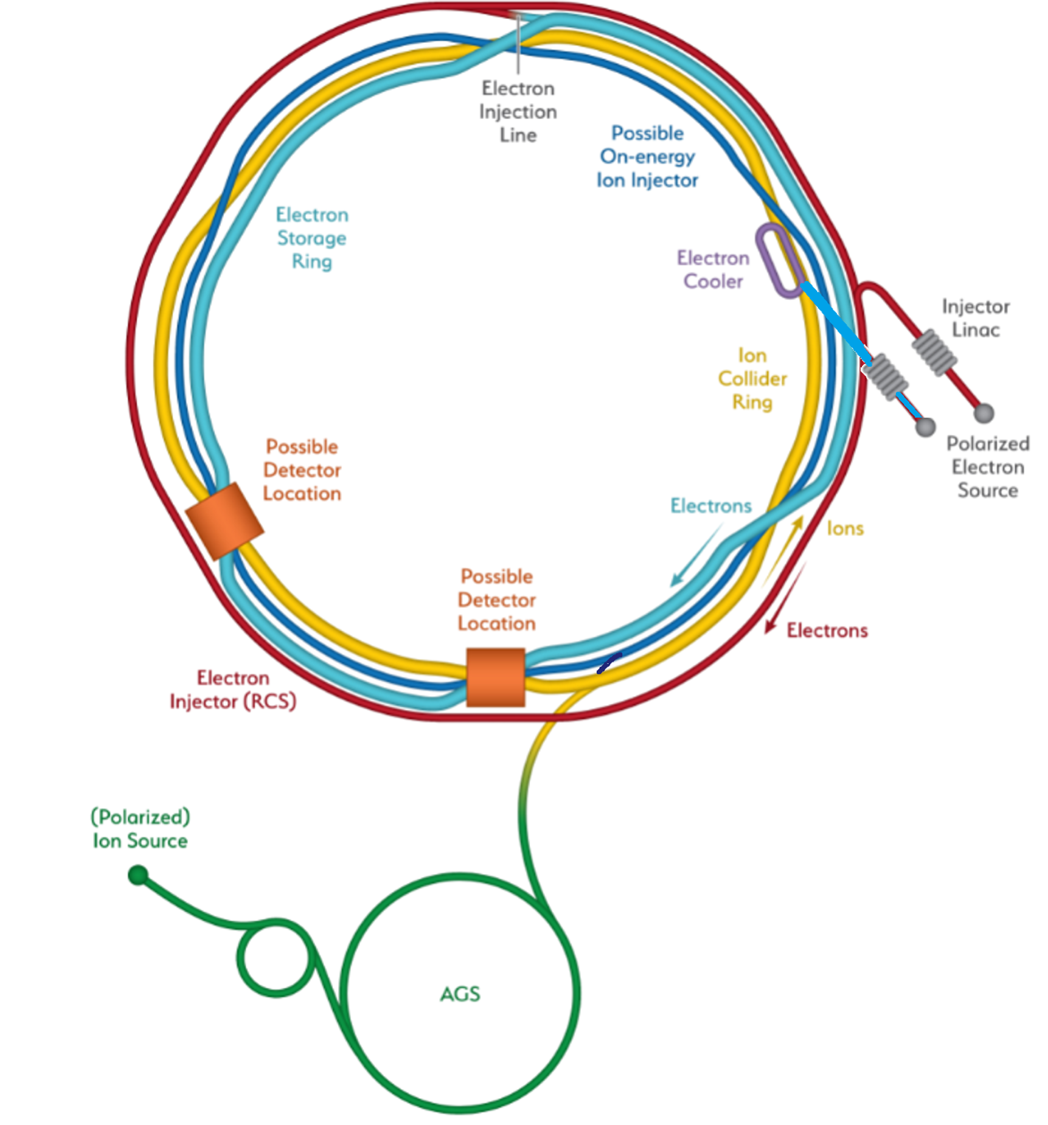
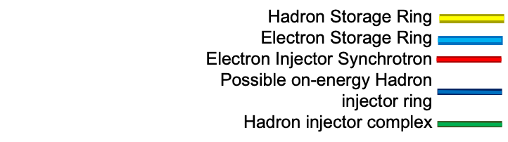
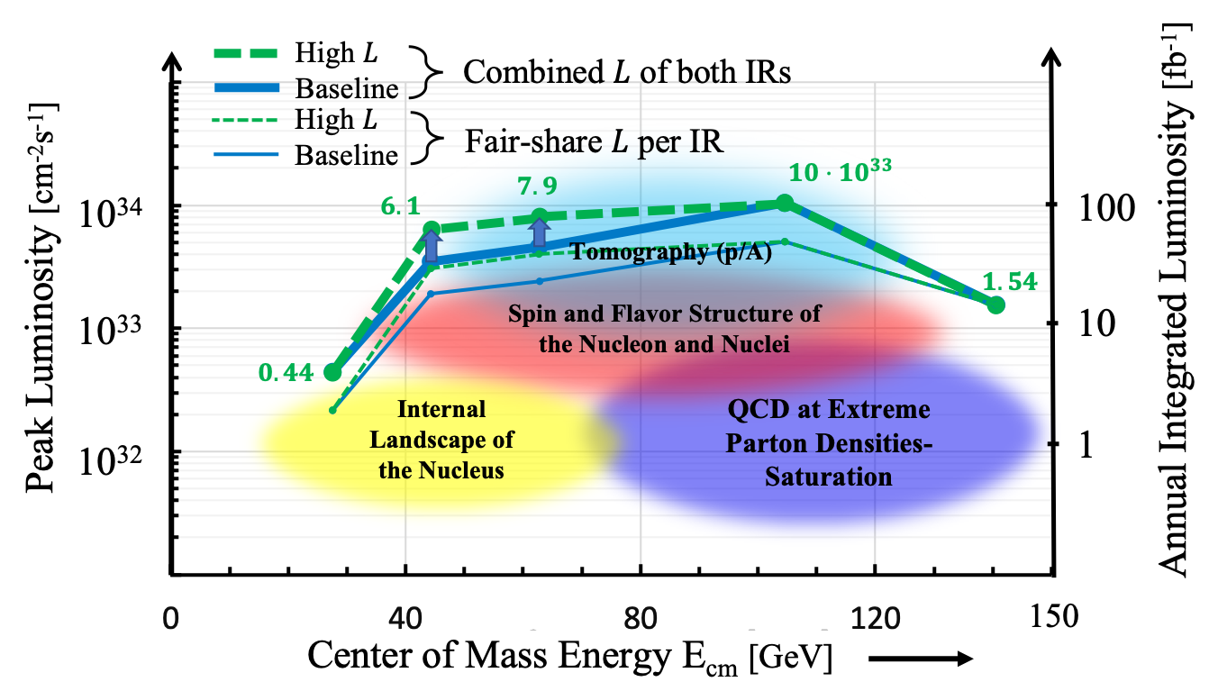
The EIC Facility
What is the EIC:
A high luminosity (10³³ – 10³⁴ cm⁻²s⁻¹) polarized electron proton / ion collider with √s_{ep} = 28 – 140 GeV
What is included in the EIC Project:
the collider & one interaction region and one general purpose detector
What can the EIC Facility support:
at minimum > 2 decades increase in kinematic coverage in x and Q²
EIC at BNL
Possible
2nd Detector
Location
Double Ring Design Based on Existing RHIC Facilities
Hadron Storage Ring: 40, 100 - 275 GeV | Electron Storage Ring: 5 - 18 GeV
RHIC Ring and Injector Complex: p to Pb | 9 MW Synchrotron Radiation
1A Beam Current | Large Beam Current - 2.5 A
1160 bunches → 9 ns bunch spacing
Light ion beams (p, d, ³He) polarized (L,T) | Polarized electron beams
Nuclear beams: d to U | Electron Rapid Cycling Synchrotron
Requires Strong Cooling: new concept →CEC | Spin Transparent Due to High Periodicity
High Luminosity Interaction Region – one on project – 2nd one possible
25 mrad Crossing Angle with Crab Cavities

Slide 3
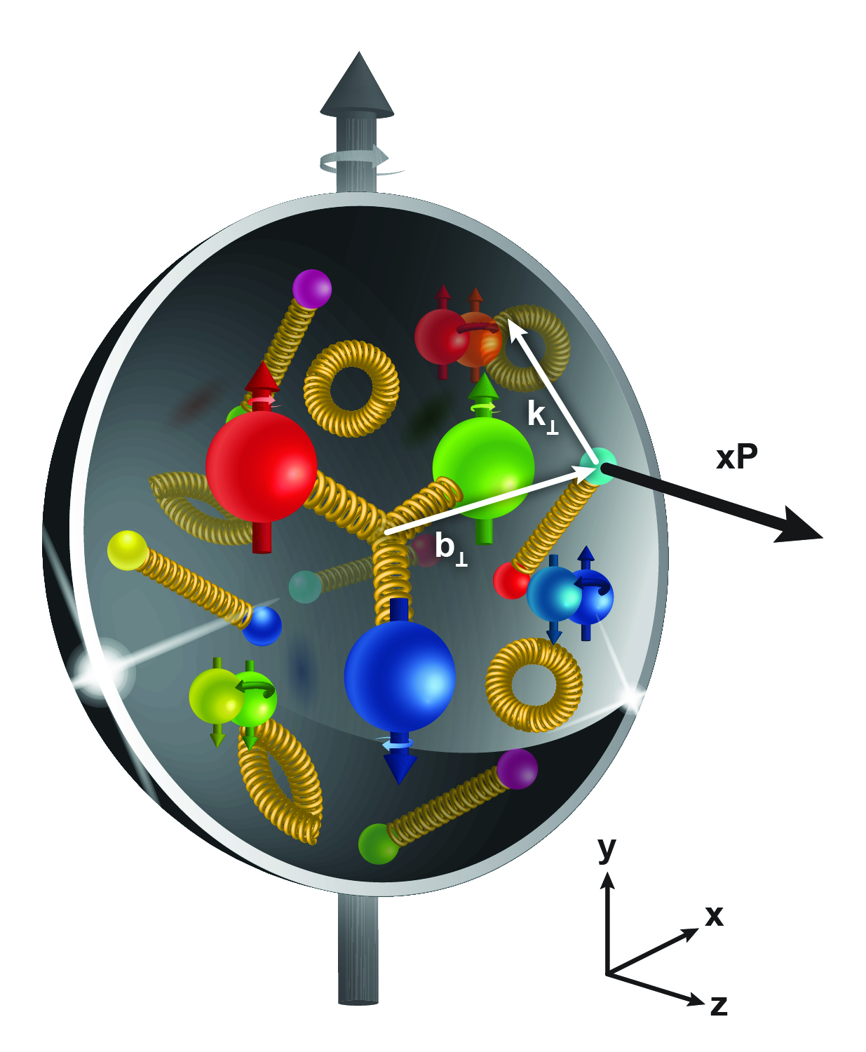
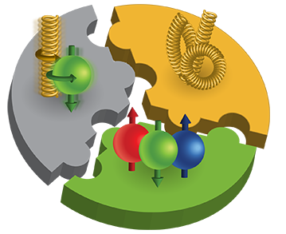
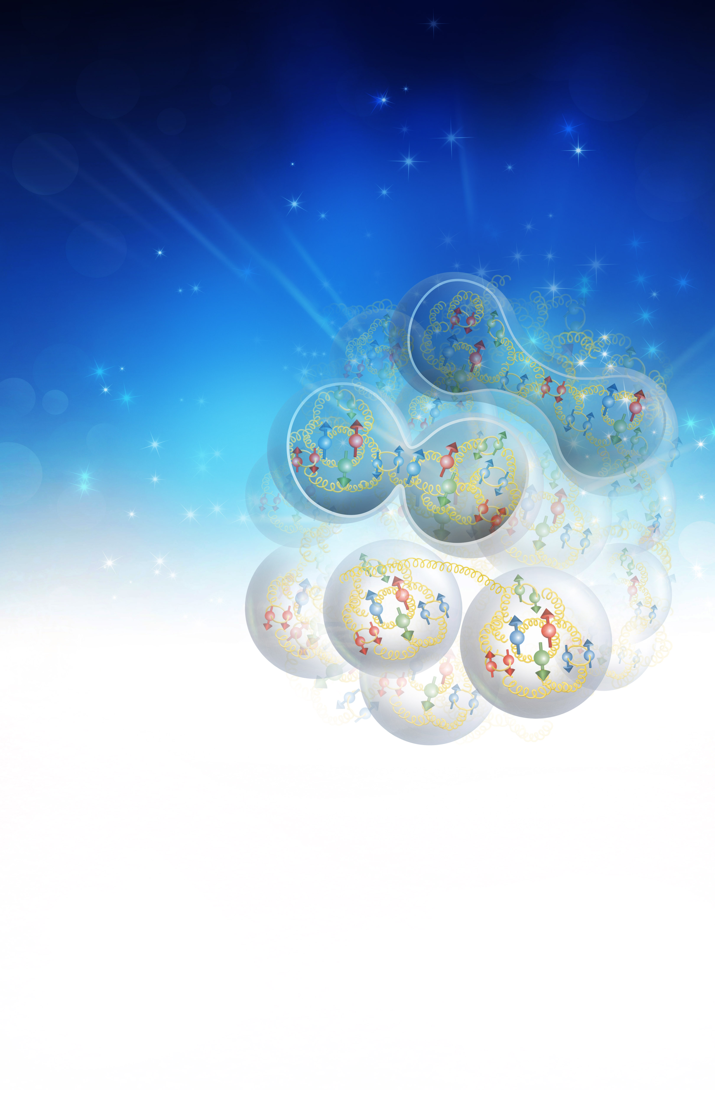
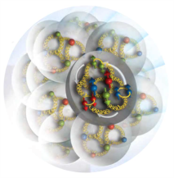
The EIC Physics
How are the sea quarks and gluons, and their spins, distributed in space and momentum inside the nucleon?
How do the nucleon properties emerge from them and
their interactions?
How do color-charged quarks and gluons, and colorless jets, interact with a nuclear medium?
How do the confined hadronic states emerge from these quarks and gluons?
How do the quark-gluon interactions create nuclear binding?
How does a dense nuclear environment affect the quarks and gluons, their correlations, and their interactions?
What happens to the gluon density in nuclei? Does it saturate at high energy, giving rise to a gluonic matter with universal properties in all nuclei, even the proton?
gluon
emission
gluon recombination
?
=

Slide 4
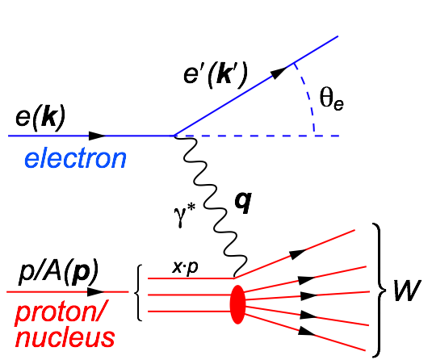

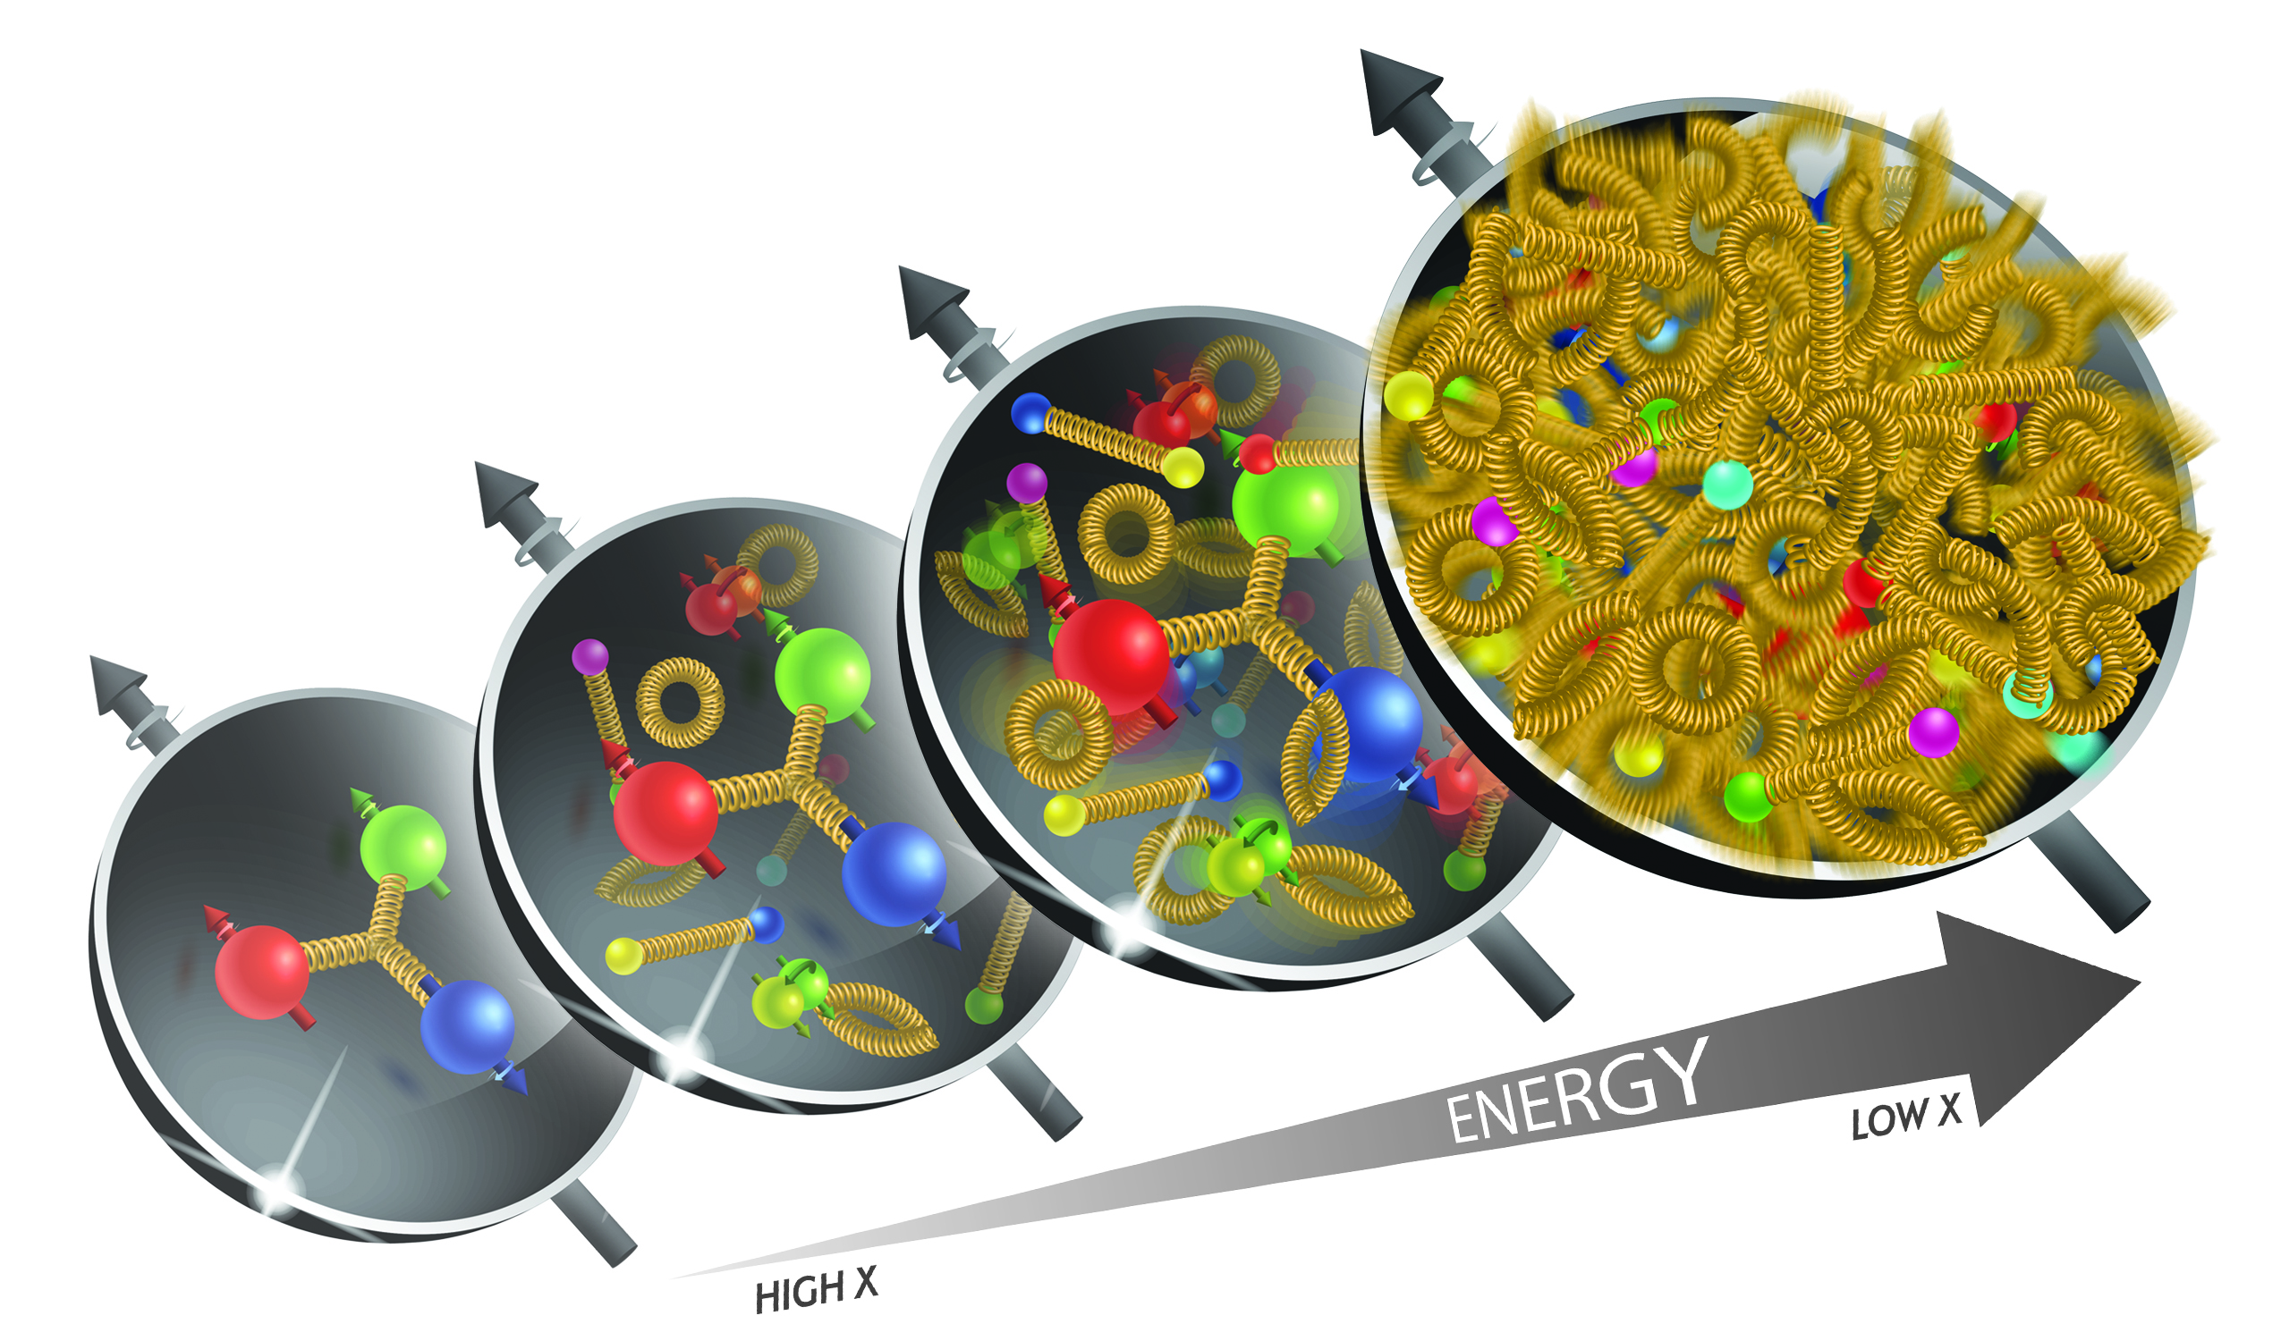
What is needed to address the EIC Physics
The Golden Process:
Deep Inelastic Scattering (DIS):
As a probe, electron beams
provide unmatched precision of
the electromagnetic interaction
Direct, model independent
determination of parton
kinematics of physics
processes
s: center-of-mass energy squared
Q²: resolution power
x: the fraction of the nucleon’s
momentum carried by the struck
quark (0<x<1)
y: inelasticity
large kinematic coverage:
center-of-mass energy √s: 20 – 140 GeV
access to x and Q² over a wide range

Slide 5
EIC: Access to terra incognita
increasing luminosity and center of mass energy
Resolving Power Q² (GeV²)
Gluons
live here
x
Fraction of overall proton momentum carried by q,g
increasing center of mass energy

Slide 6

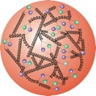

What do we know: Mass of the Proton
Visible world: mainly made of light quarks – its mass emerges from quark-gluon interactions.
Proton
GeV
MeV
quark
Quark structure: uud
Mass ~ 940 MeV (~1 GeV)
Proton Mass: 1.8×10⁻²⁷ kg
The Sum of all Quark masses accounts for 1% of the proton mass
nucleon
Where does the rest of the mass hide ?
Density of quarks or gluons
inside the proton
Most of mass generated by dynamics
Gluon rise discovered by HERA e-p
gluon ocean
quark sea
q,g Density
The proton is dominated by gluons
EIC can access gluons in different ways
to study their contribution to the nucleon

Slide 7
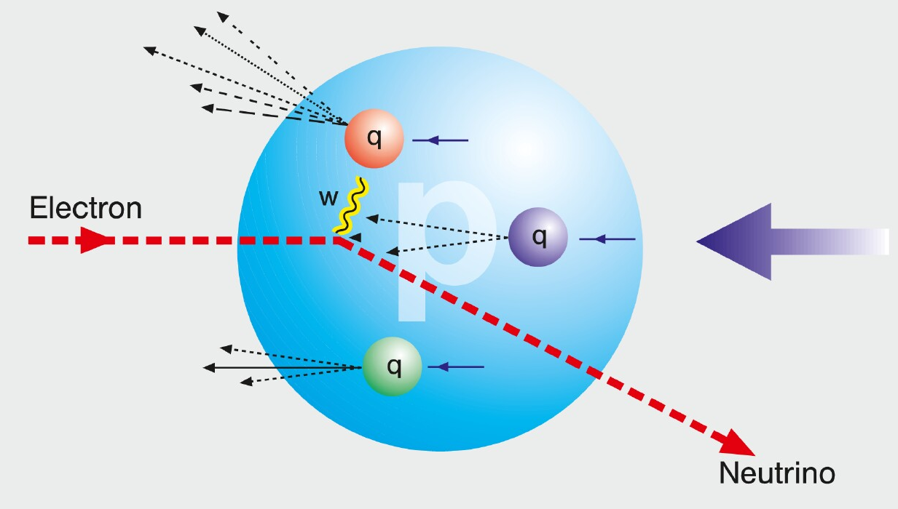
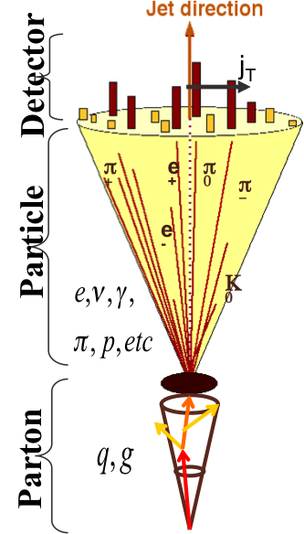
HOW TO ACCESS PARTONS IN DIS
SIDIS:
Detect scattered lepton (DIS) in coincidence with identified hadrons (SIDIS)
one can measure the correlation between different
hadrons as fct. of p_{t}, z, η
needs fragmentation functions to correlate
hadron type with parton
→ Detector: PID over a wide range of η and p
Charge Current:
W-exchange: direct access to the quark flavor
no FF – complementary to SIDIS
→ Detector: large rapidity coverage and large √s
Jets:
best observable to access parton kinematics
tag partons through the sub-processes and
jet substructure
di-jets: relative p_{t} → correlated to k_{t}
tag on PGF
→ Detector: large rapidity coverage and PID

Slide 8
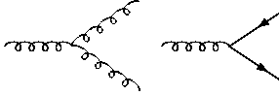
How to access Gluons in DIS
Gluons manifest themselves through
the behavior of the cross section as function of x and Q²
quark+anti-quark
momentum distributions
gluon momentum
distribution
without gluons the cross section depends only on x, no dependence on Q² → F₂(x)
Bjorken scaling
BUT:
Observe strong rise of cross section
with both x and Q²
Because of gluon initiated processes
Cross Section
Scaling violation
Gluon Distribution:
dσ(x,Q²)/dlnQ²
Resolution (Q² / GeV²)

Slide 9
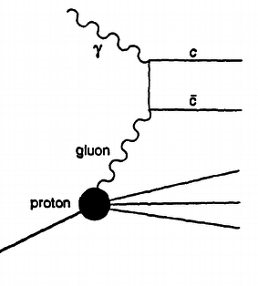
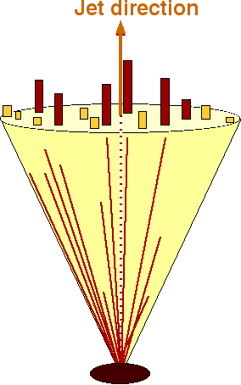
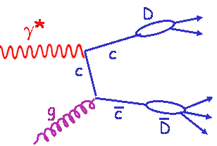
How to access Gluons in DIS
Gluons manifest themselves through
the scaling violation of the cross section as function of x and Q²
dF2(x,Q²)/dlnQ² → G(x,Q²)
Directly through the measurement of F_{L}
Through tagging of the photon gluon fusion process
  Di-jets
  charm production
quark+anti-quark
momentum distributions
gluon momentum
distribution
All these process need a wide coverage in x and Q²

Slide 10
The unpolarized Proton PDFs
At x of 0.3 the proton is dominated by gluons and sea quarks
they should drive the inner structure of the proton

Slide 11
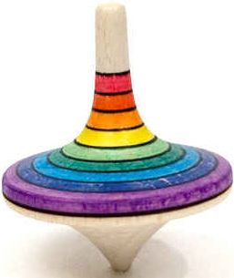
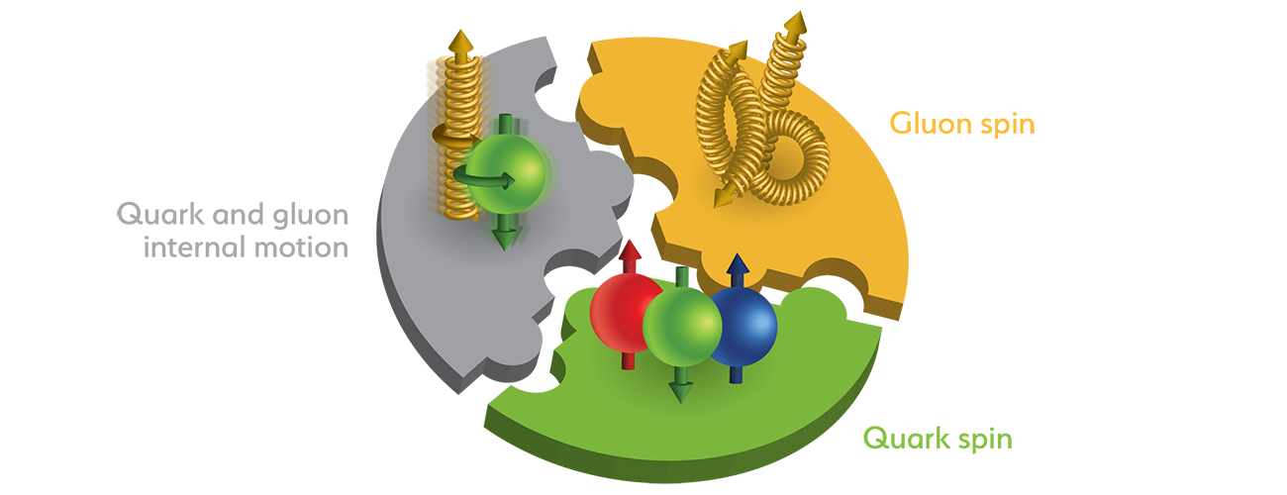
The Spin of the Proton
SPIN is one of the fundamental properties of matter
all elementary particles, but the Higgs carry spin
Spin cannot be explained by a static picture of the proton
It is more than the number ½ ! It is the interplay between
the intrinsic properties and interactions of quarks and gluons
What do we know:
total
quark spin
gluon
spin
angular
momentum

Slide 12
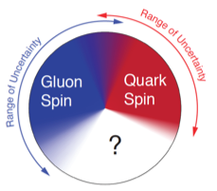
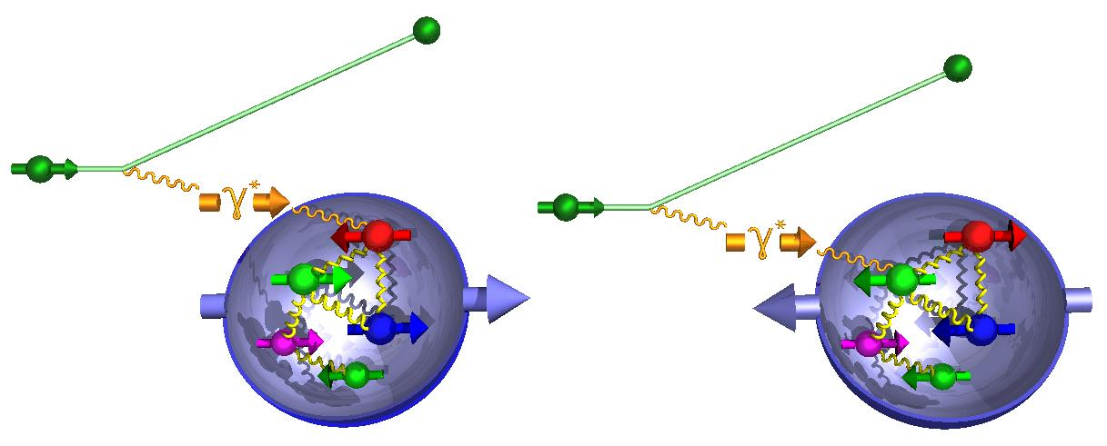
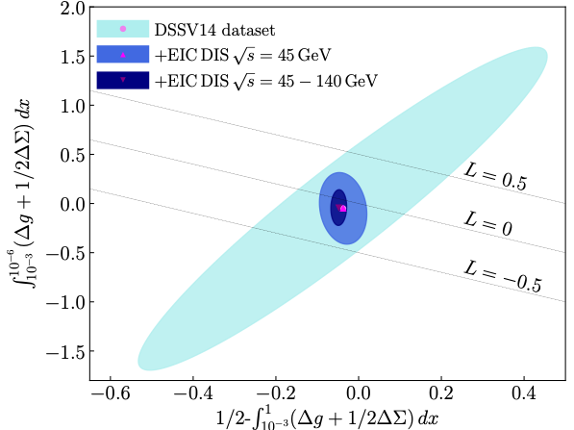
How to decompose the Spin of the Proton
To determine the contribution of quarks and gluons
to the spin of the proton, one needs to measure
the cross-section difference g₁ as function of x and Q²
The current knowledge about g₁
as function of x at Q²=10 GeV²
g₁ ~
-
quark contribution:
The integral of g₁ over x from 0 to 1
gluon contribution:
dg₁(x,Q²)/dlnQ² → Δg(x,Q²)
R. Sassot et al. arXiv:2007:083000
& 1509.06489 & 1206.6014

Slide 13
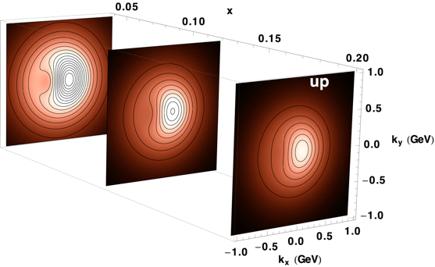
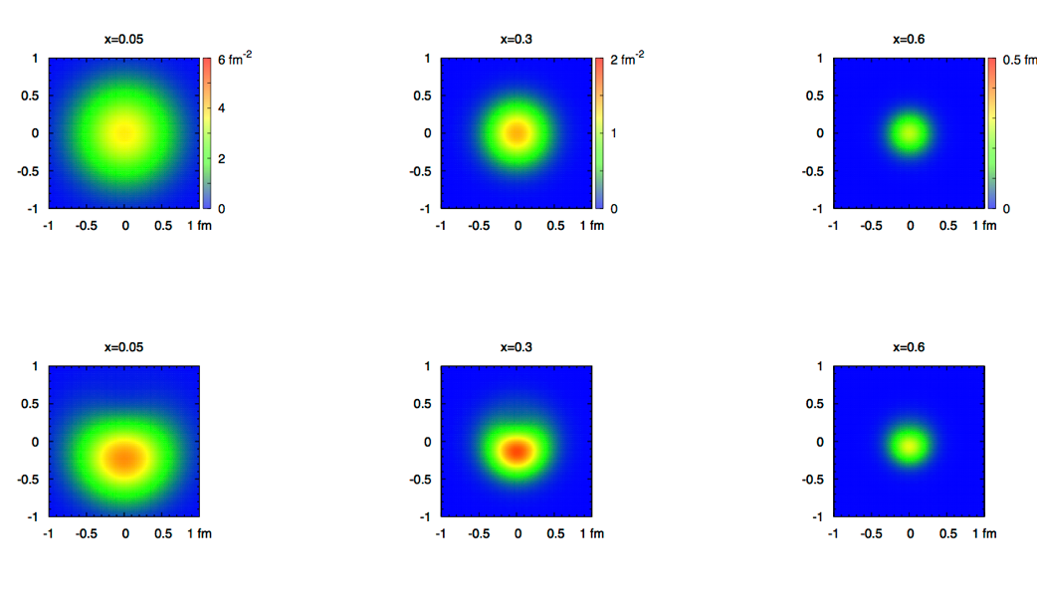
2+1 dimensional Imaging of Quarks & Gluons
Wigner function
W(x,b_{T},k_{T})
→ QCD genetic map
Momentum
space
Coordinate
space
∫d²b_{T}
∫ d²k_{T}
f(x,k_{T})
f(x,b_{T})
Quarks
Quarks
down quark
x
Spin-dependent 3D momentum space
images from semi-inclusive scattering
Spin-dependent 2+1D coordinate space images from exclusive scattering

Slide 14
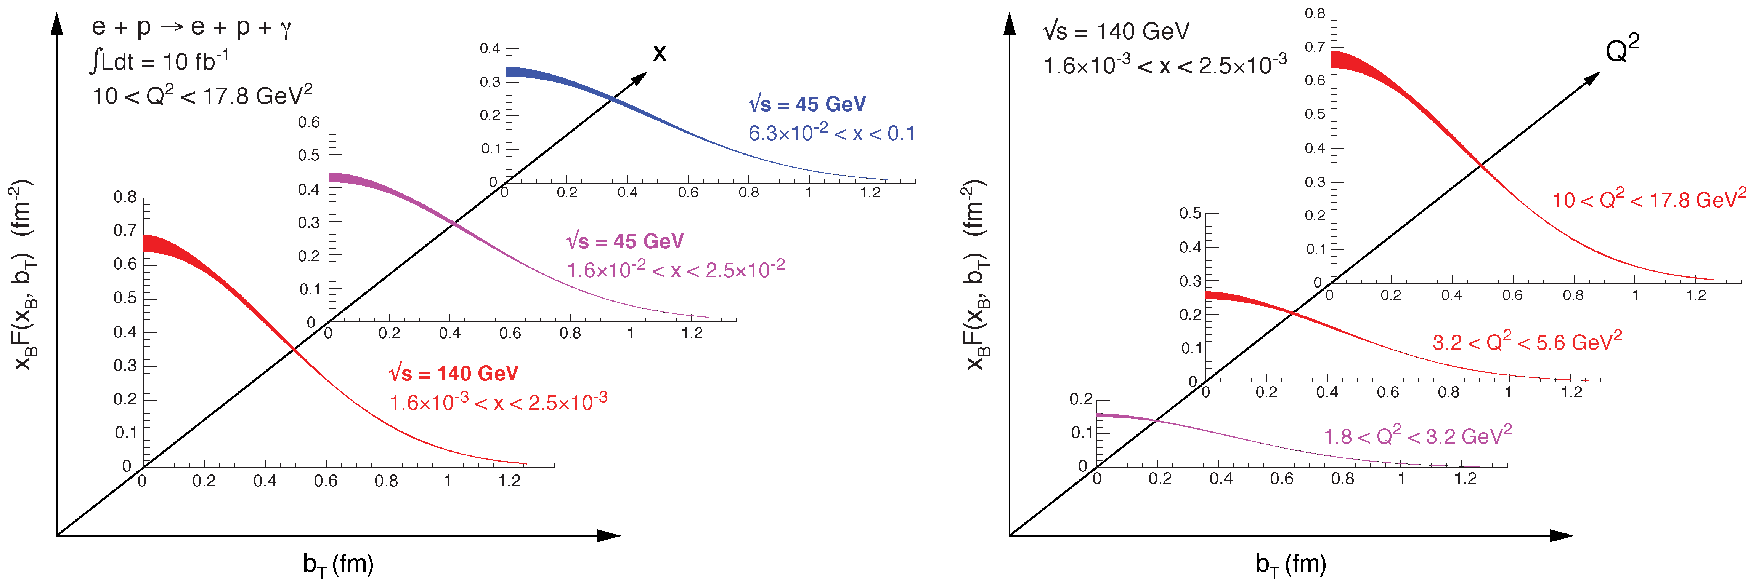

2+1d-Imaging in coordinate space
High precision
imaging at EIC
at low and high x
Golden channel:
DVCS
e’
e
γ_{L}*
γ
(Q²)
x+ξ
~
x-ξ
~
p
H, H, E, E (x,ξ,t)
p’
t
pion cloud
effects seen
at high b_{T}

Slide 15
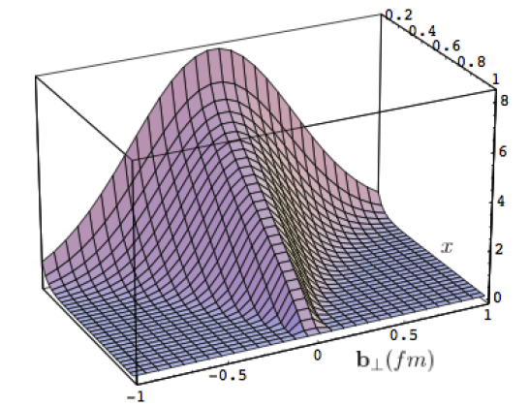
What can we learn
Model of a quark GPD
x
down valence quark
b_{T} (fm)
b_{T} decreasing as a function of x
x
EIC
Valence (high x) quarks at the center → small b_{T}
Sea (small x) quarks
at the périphérie → high b_{T} ?
GLUONS ???

Slide 16
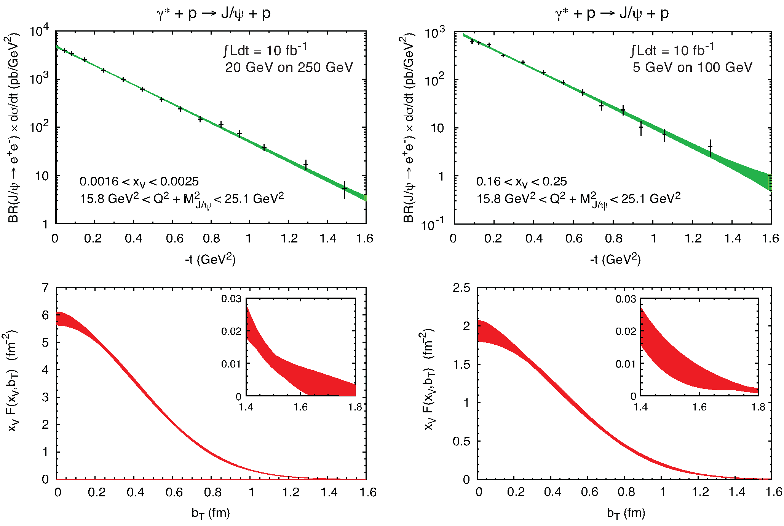
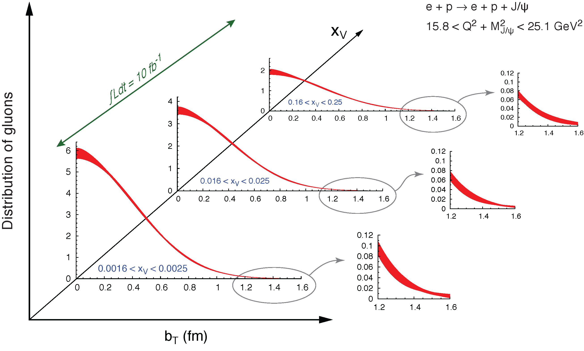
What about the gluon: J/ψ
To improve imaging on gluons
add J/ψ observables
cross section
A_{UT}
…..

Slide 17
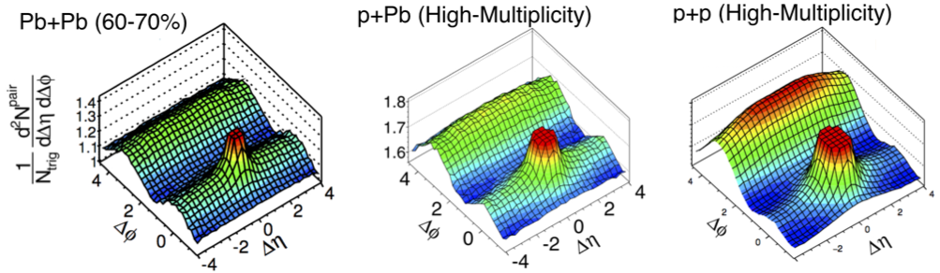
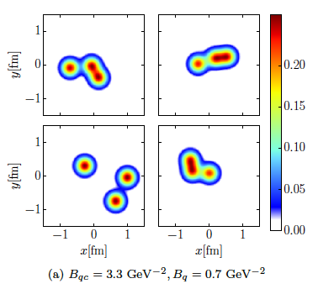
Proton structure important for QGP in small systems
Collective phenomena seen in pA collisions, i.e. ATLAS 1409.792
H. Mäntysaari & B. Schenke
arXiv:1607.01711
In a hydro-picture (used in AA)
fluctuations in the proton are
crucial to understand the seen
pA@LHC behaviors
Only EIC can map out the spatial quark and gluon structure of the proton in x and Q²
Examples of proton density
profiles at x ~ 10⁻³
Study
coherent
and
incoherent
J/Ψ prod.
Notes:
make simpler

Slide 18
What about Nuclei?

Slide 19
nPDFs before and after EIC
Ratio g(x,Q²)_{pb} /g(x,Q²)_{p}
DGLAP:
predicts Q² but not A-dependence and x-dependence
Saturation models:
predict A-dependence and x-dependence but not Q²
→ Need: large Q² lever-arm for fixed x, A-scan
LHC
RHIC
Measure different structure function in eA → constrain nPDF:
quark+anti-quark
momentum distributions
gluon momentum distribution
or tag on charm → F₂^{C}

Slide 20
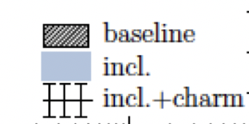
nPDFs before and after EIC
Ratio g(x,Q²)_{pb} /g(x,Q²)_{p}
√s < 45 GeV
√s < 90 GeV
LHC
RHIC
Measure different structure function in eA → constrain nPDF:
arXiv:1708.05654
quark+anti-quark
momentum distributions
gluon momentum distribution
or tag on charm → F₂^{C}
Gluon distribution ~ dσ(x,Q²)/dlnQ²

Slide 21

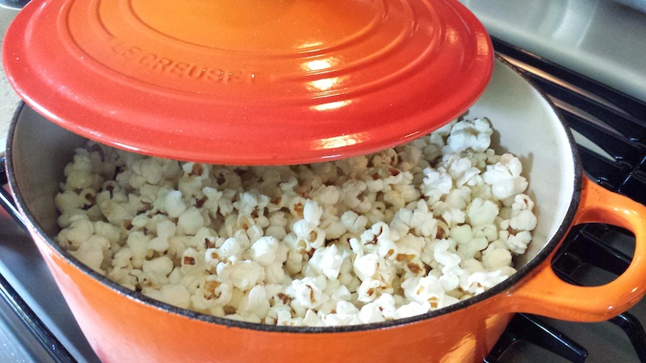
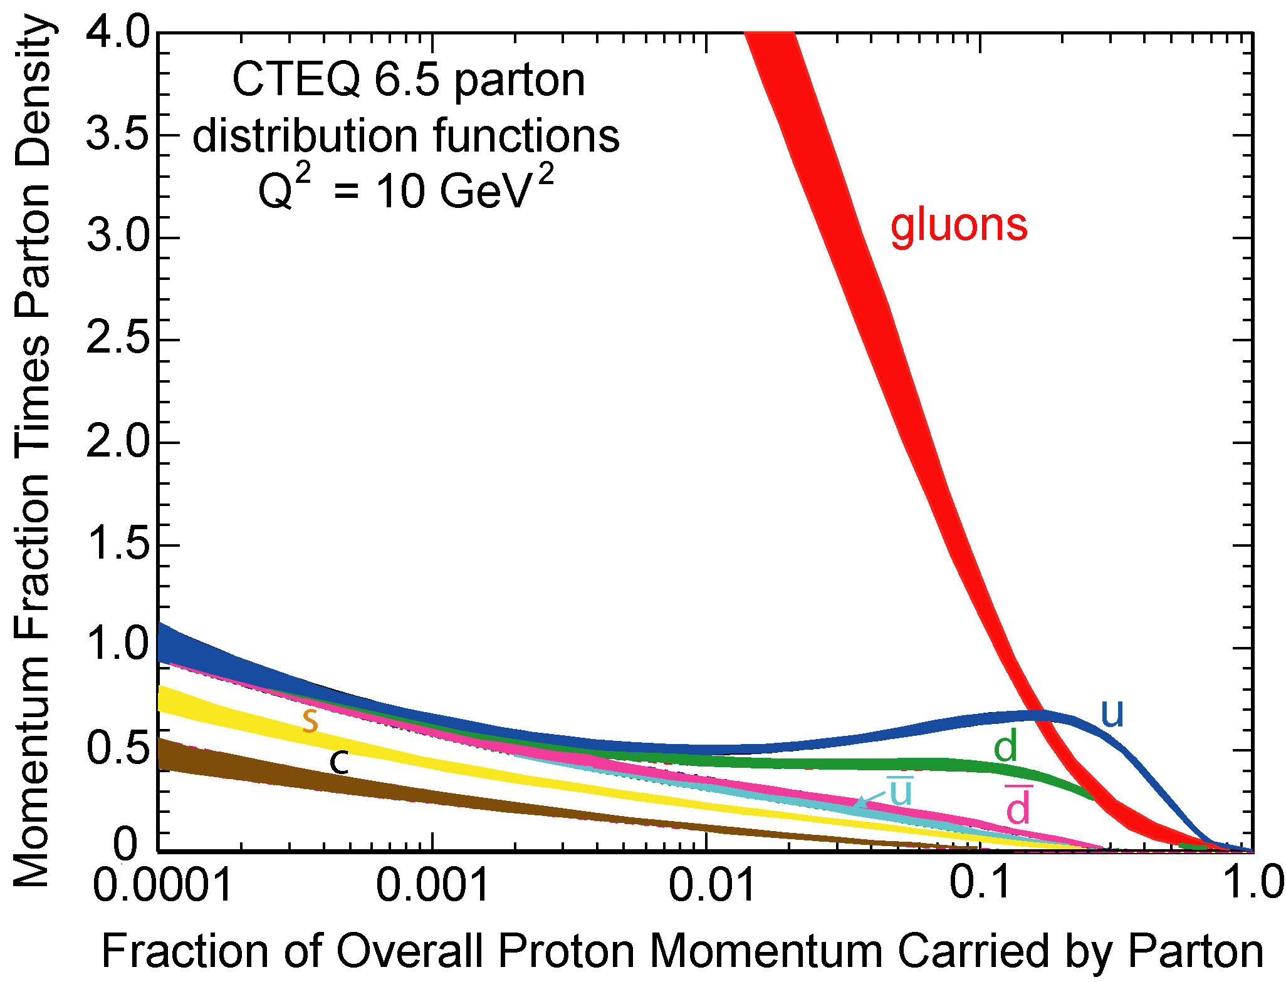
can EIC discover a new state of matter
Is the proton a runaway popcorn machine?
?
gluon
gluon
gluon
gluon
gluon
gluon
gluon
gluon
gluon
gluon
gluon
Does this rise get tamed ?
Important to understand the initial condition for heavy ion collisons
till today only ambiguous hints

Slide 22
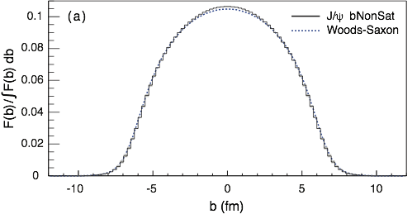
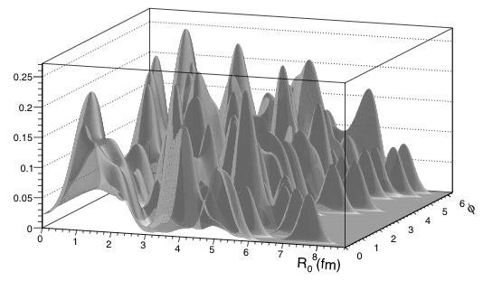
EIC: Spatial Gluon Distribution from dσ/dt
1950-60: Measurement of charge (proton) distribution in nuclei
Ongoing: Measurement of neutron distribution in nuclei
EIC ⇒ Gluon distribution in nuclei
Diffractive vector meson production:
e + Au → e′ + Au′ + J/ψ
Fourier Transform
Method:
Diffractive vector meson production:
e + Au → e′ + Au′ + J/ψ
Momentum transfer t = |pAu-pAu′|² conjugate to bT
PRC 87 (2013) 024913
  Hot topic:
      Lumpiness of source?
      Just Wood-Saxon+nucleon g(b_{T})
      coherent part probes “shape of black disc”
      incoherent part (large t) sensitive to “lumpiness of the source (= proton)
      (fluctuations, hot spots, ...)
possible Source distribution with b_{T}^{g} = 2 GeV⁻²
Notes:
spatial gluon distribution only done in eA / ep focus on lumpiness and source

Slide 23
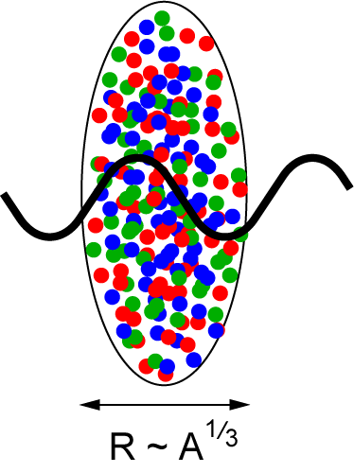
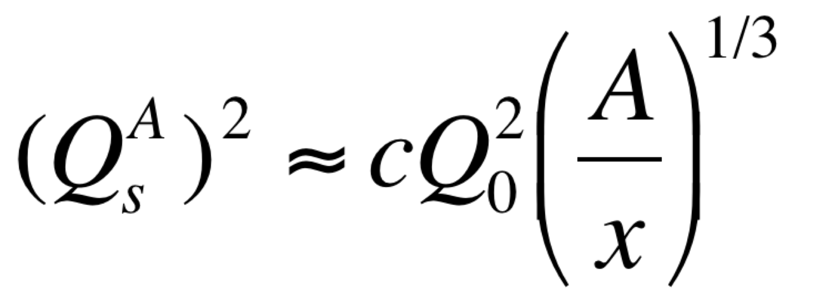
Studying non-linear effects
Does the rise of g(x,Q²) get tamed ?
Important to understand the initial condition for heavy ion collisions
Scattering of electrons off nuclei:
Probes interact over distances L ~ (2m_{N} x)⁻¹
For L > 2 R_{A} ~ A^{1/3} probe cannot distinguish between nucleons in front or back of nucleon
Probe interacts coherently with all nucleons
Nuclear “Oomph” Factor
Pocket Formula:
Enhancement of Q_{S} with A ⇒ non-linear QCD regime reached at significantly lower energy in nuclei than in proton

Slide 24
can EIC discover a new state of matter
EIC provides an absolutely unique opportunity
to have very high gluon densities
→ electron – lead collisions
combined with an unambiguous observable
counting experiment of
Di-jets in ep and eA
Saturation:
Disappearance of backward jet in eA
EIC will allow to unambiguously
map the transition from a non-saturated to saturated regime
e
p
e
A
#backward jets in eA / ep
increased √s → increased suppression

Slide 25
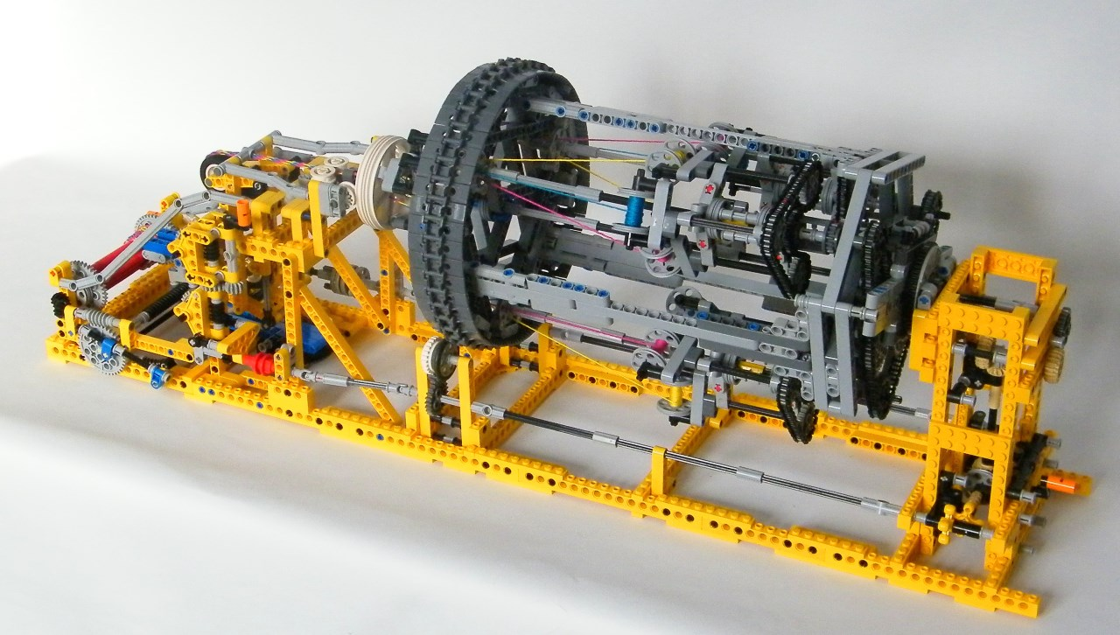
EIC Detector Concept

Slide 26
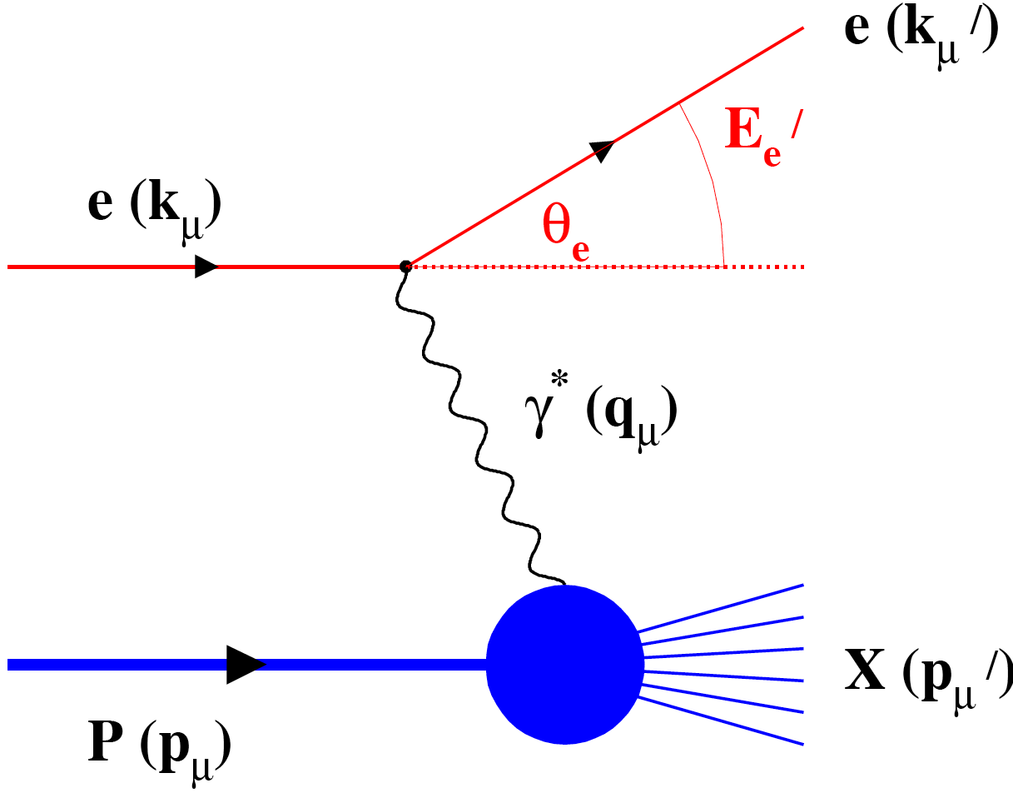
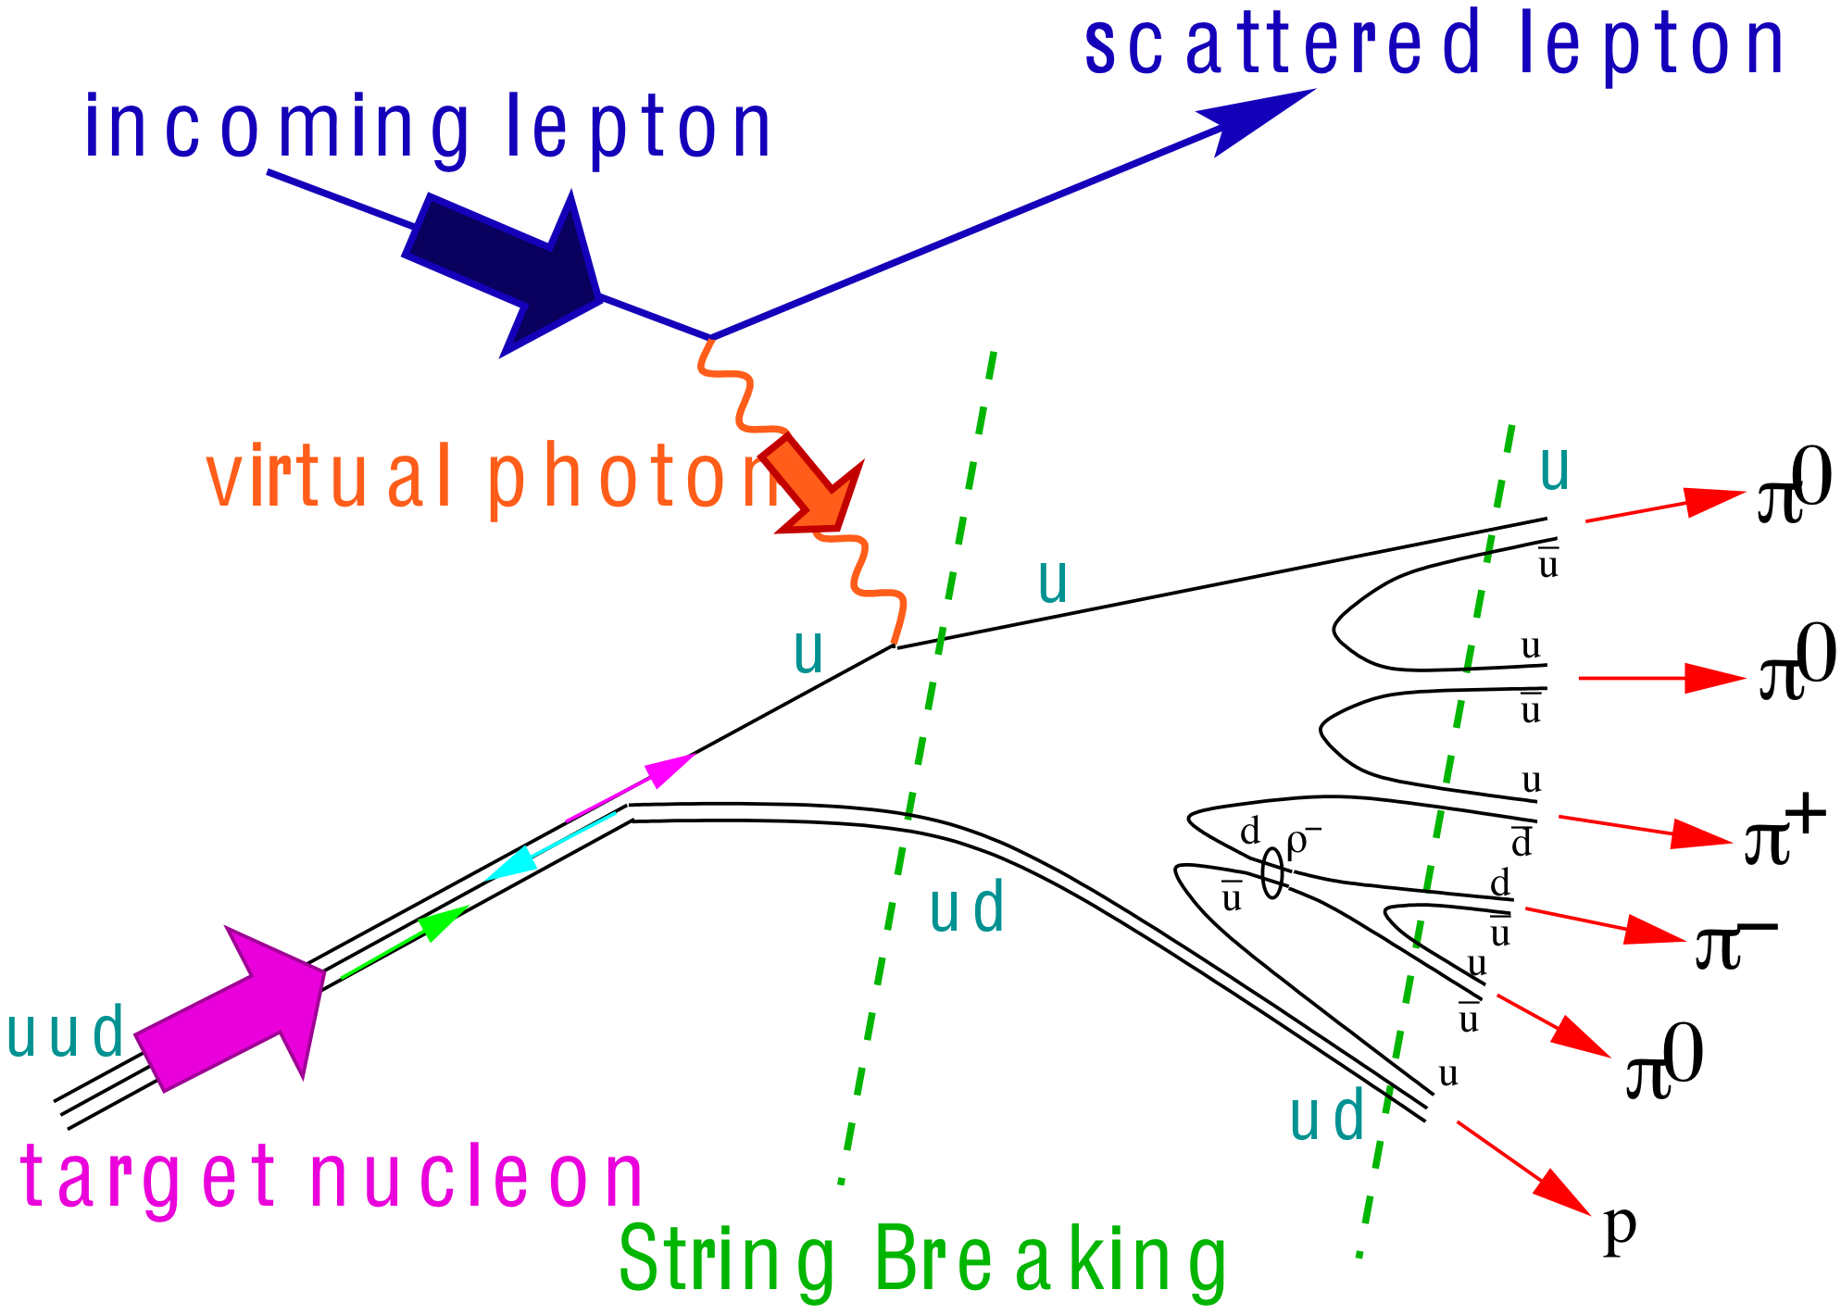
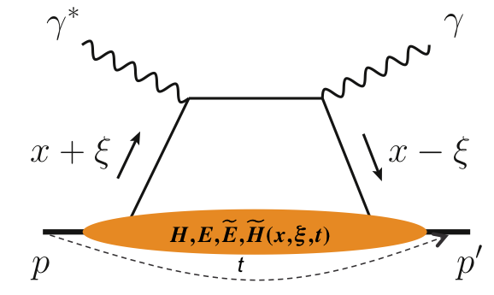
What is needed experimentally?
experimental measurements categories to address EIC physics:
Parton Distributions in nucleons and nuclei
Spin and
Flavor structure of nucleons and nuclei
Tomography Transverse Momentum Dist.
QCD at Extreme Parton Densities - Saturation
Tomography
Spatial Imaging
inclusive DIS
semi-inclusive DIS
exclusive processes
measure scattered lepton
multi-dimensional binning: x, Q²
reach to lowest x, Q² impacts
Interaction Region design
measure scattered lepton
and hadrons in coincidence
multi-dimensional binning:
x, Q², z, p_{T}, Θ
particle identification over entire region is critical
measure all particles in event
multi-dimensional binning:
x, Q², t, Θ
proton p_{t}: 0.2 - 1.3 GeV
  cannot be detected in main detector
  strong impact on Interaction Region design
∫Ldt:
1 fb⁻¹
10 fb⁻¹
10 - 100 fb⁻¹
machine & detector requirements

Slide 27

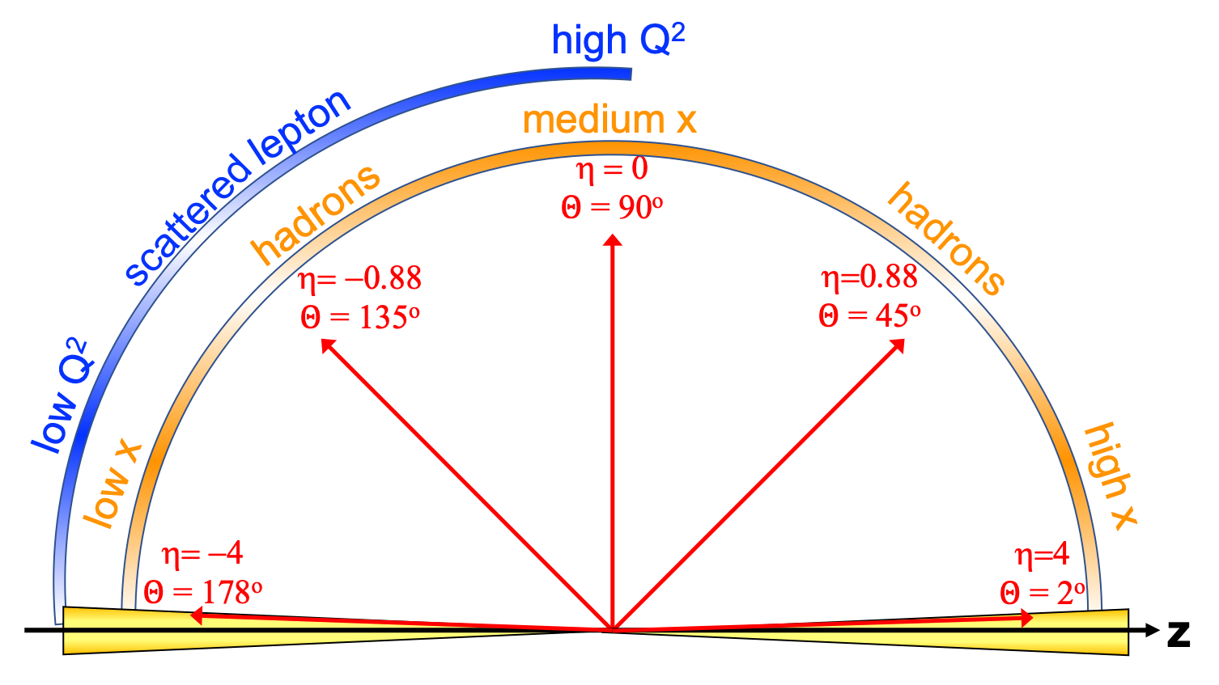
EIC General Purpose Detector: Concept
p/A beam
electron beam
inclusive DIS:
semi-inclusive DIS
Backward-η
Forward-η
Central
Detector
HCAL
Lepton
Endcap
Magnet
Hadron
Endcap
HCAL
ECAL
HCAL
ECAL
ECAL
Tracking
PID
PID
PID
Tracking
very low Q²
scattered lepton
Bethe-Heitler photons
for luminosity
Tracking
particles from nuclear
breakup and
from diffractive reactions
exclusive DIS
ZDC
Luminosity Detector
Forward Tracking
Low Q²-Tagger

Slide 28
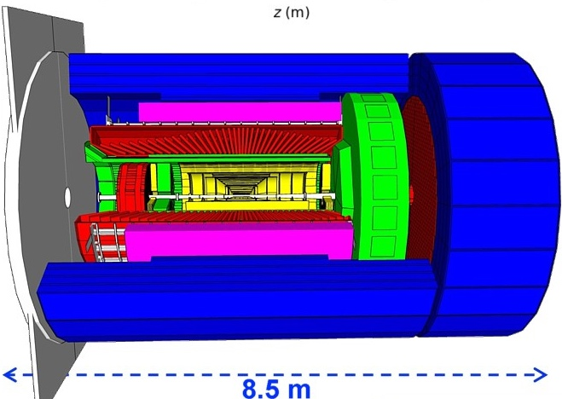
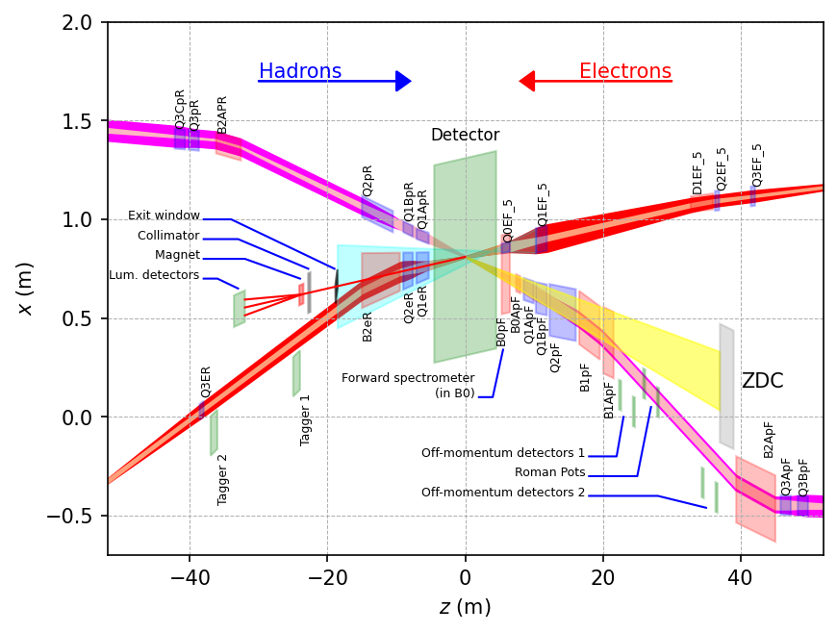
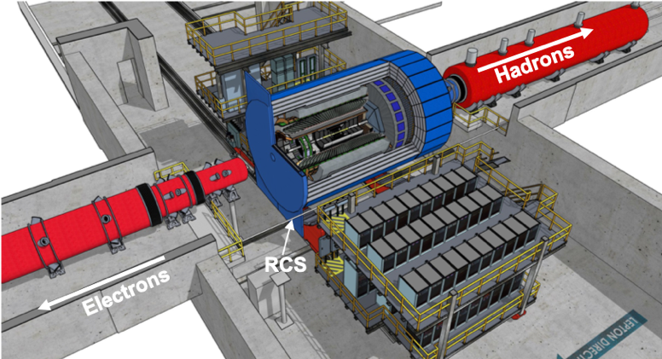
Experimental Equipment
hadronic calorimeters
solenoid coils
ToF, DIRC,
RICH detectors
e/m calorimeters
MPG & MAPS trackers
Overall detector requirements:
Large rapidity (-4 < η < 4) coverage; and far beyond especially in far-forward detector regions
  Large acceptance for diffraction, tagging, neutrons from nuclear breakup: critical for physics program
  Many ancillary detector along the beam lines:
  low-Q² tagger, Roman Pots, Zero-Degree
  Calorimeter, ….
High precision low mass tracking
  small (μ-vertex Silicon) and large radius (gaseous-based) tracking
Electromagnetic and Hadronic Calorimetry
  equal coverage of tracking and EM-calorimetry
High performance PID to separate e, π, K, p on track level
  good e/h separation critical for scattered electron identification
Maximum scientific flexibility
  Streaming DAQ → integrating AI/ML
High control of systematics
  luminosity monitor, electron & hadron Polarimetry
Integration Integration Integration → critical
  50 cm between detector and first IR magnets

Slide 29
What is new/special for a EIC GPD
Vertex detector → Identify primary and secondary vertices,
  Low material budget: 0.05% X/X₀ per layer;
  High spatial resolution: 10 μm pitch CMOS Monolithic Active Pixel Sensor (MAPS)
  → synergy with Alice ITS3
Central tracker → Measure charged track momenta
  MAPS – tracking layers in combination with micro pattern gas detectors
electron and hadron endcap tracker → Measure charged track momenta
  MAPS – disks in combination with micro pattern gas detectors
Particle Identification → pion, kaon, proton separation
  RICH detectors & Time-of-Flight
  high resolution timing detectors (, LAPPS, LGAD) 10 – 30 ps
  novel photon sensors: MCP-PMT / LAPPD
Electromagnetic calorimeter → Measure photons (E, angle), identify electrons
  Crystals (backward), W/SciFi Spacal (forward)
  Barrel: Pb/SciFi+imaging part or Scintillating glass → cost effective
Hadron calorimeter → Measure charged hadrons, neutrons and K_{L}⁰
  challenge achieve ~50%/√E + 10% for low E hadrons (<E> ~ 20 GeV)
  Fe/Sc sandwich with longitudinal segmentation
DAQ & Readout Electronics: trigger-less / streaming DAQ
  Integrate AI into DAQ → cognizant Detector
+ Beam pipe and very forward and backward detectors
Radius/Distance from IP

Slide 30
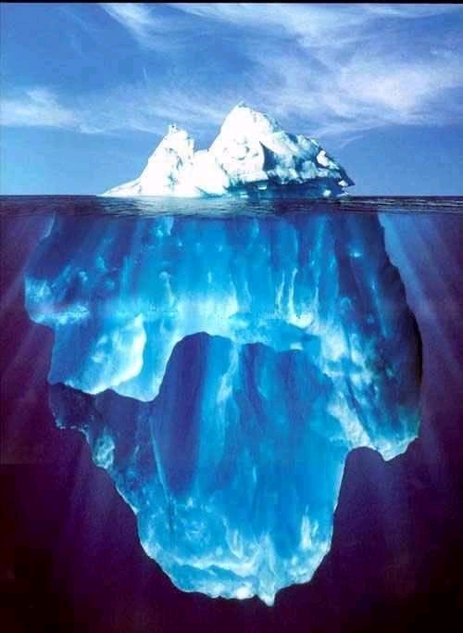
Take Away Message
Why EIC now?
“all stars align”:
theory developments will allow to obtain the answers to the big questions discussed
detector technologies allow for a collider detector with high resolution, wide acceptance and particle identification
BUT MOST IMPORTANTLY
accelerator technologies allow to built a collider with
  high luminosity
  highly polarized electron and light hadron beams
  a wide range in center of mass energies
  hadron beams with highest A
  demanding acceptance requirements can be realized in IR design
Current
knowledge about
nucleon structure
and the glue
EIC science program will profoundly impact
our understanding of the inner structure
of the world around us
uniquely tied to a future high energy, high luminosity,
polarized ep / eA collider
never been measured before & will never without
with EIC

Slide 31

Let’s get to work
and built the EIC
Please join us

Slide 32


Slide 33
The EIC: A Unique Collider
EIC
LHC
collide different beam species: ep & eA
consequences for beam backgrounds
  hadron beam backgrounds,
  i.e. beam gas events
  → synchrotron radiation
asymmetric beam energies
boosted kinematics
  high activity at high |η|
Small bunch spacing: >= 9ns
crossing angle: 25mrad
wide range in center of mass energies
factor 6
electron beam follows B-factory design
parameters but polarized
both beams are polarized
→ stat uncertainty: ~ 1/(P₁P₂ (∫L dt )^{1/2})
collide the same beam species: pp, pA, AA
→ beam backgrounds
  hadron beam backgrounds,
  i.e. beam gas events, high pile up
symmetric beam energies
kinematics is not boosted
  most activity at midrapidity
moderate bunch spacing: 25 ns
no significant crossing angle yet (150 μrad now)
LHC limited range in center of mass energies
factor 2
no beam polarization
→ stat uncertainty: ~1/(∫L dt )^{1/2}
Differences impact detector design, acceptance and possible technologies

Slide 34
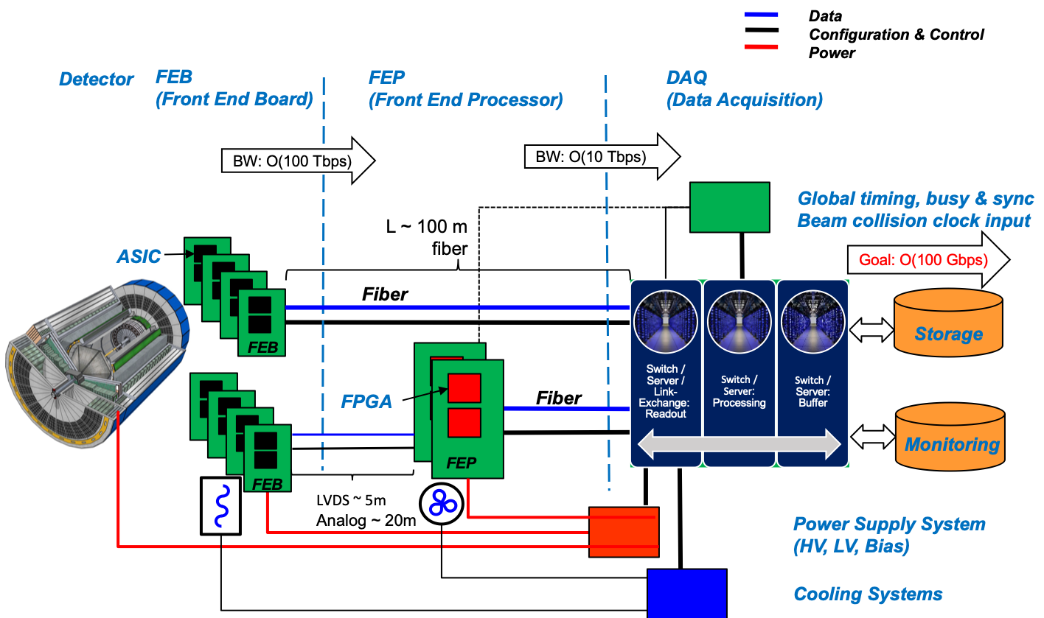
Streaming Readout Architecture
Possible at EIC as data rates manageable (500 kHz, O(100) Gbps)
Integrate AI into DAQ → cognizant Detector

Slide 35
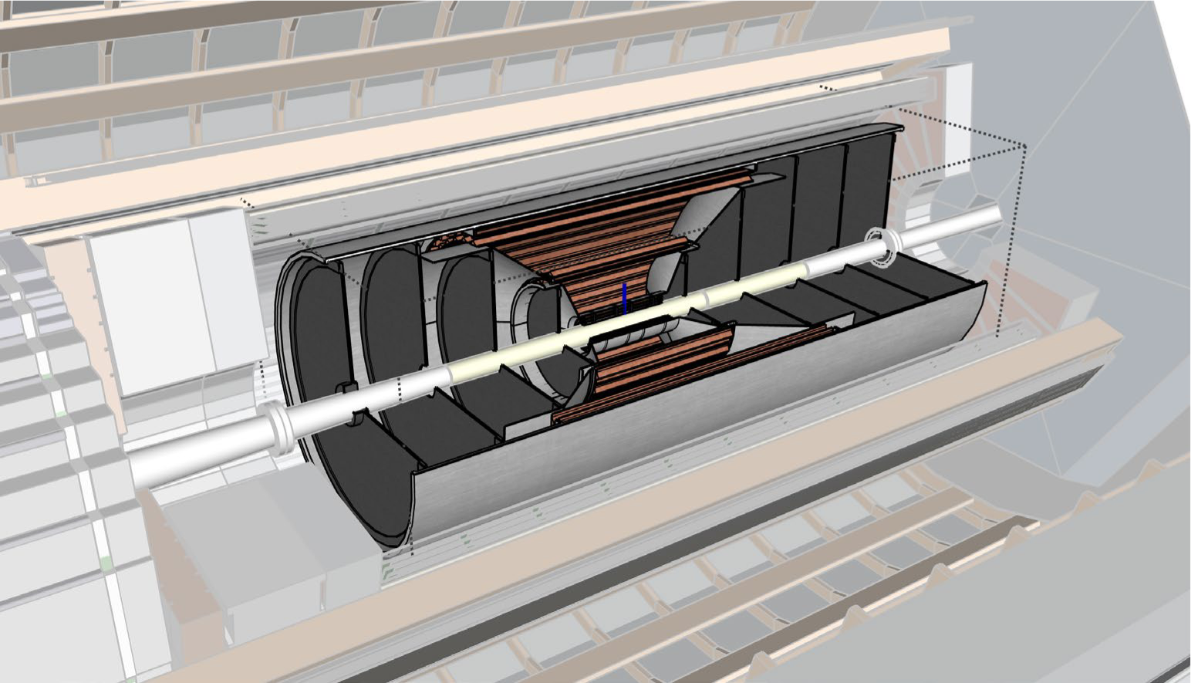
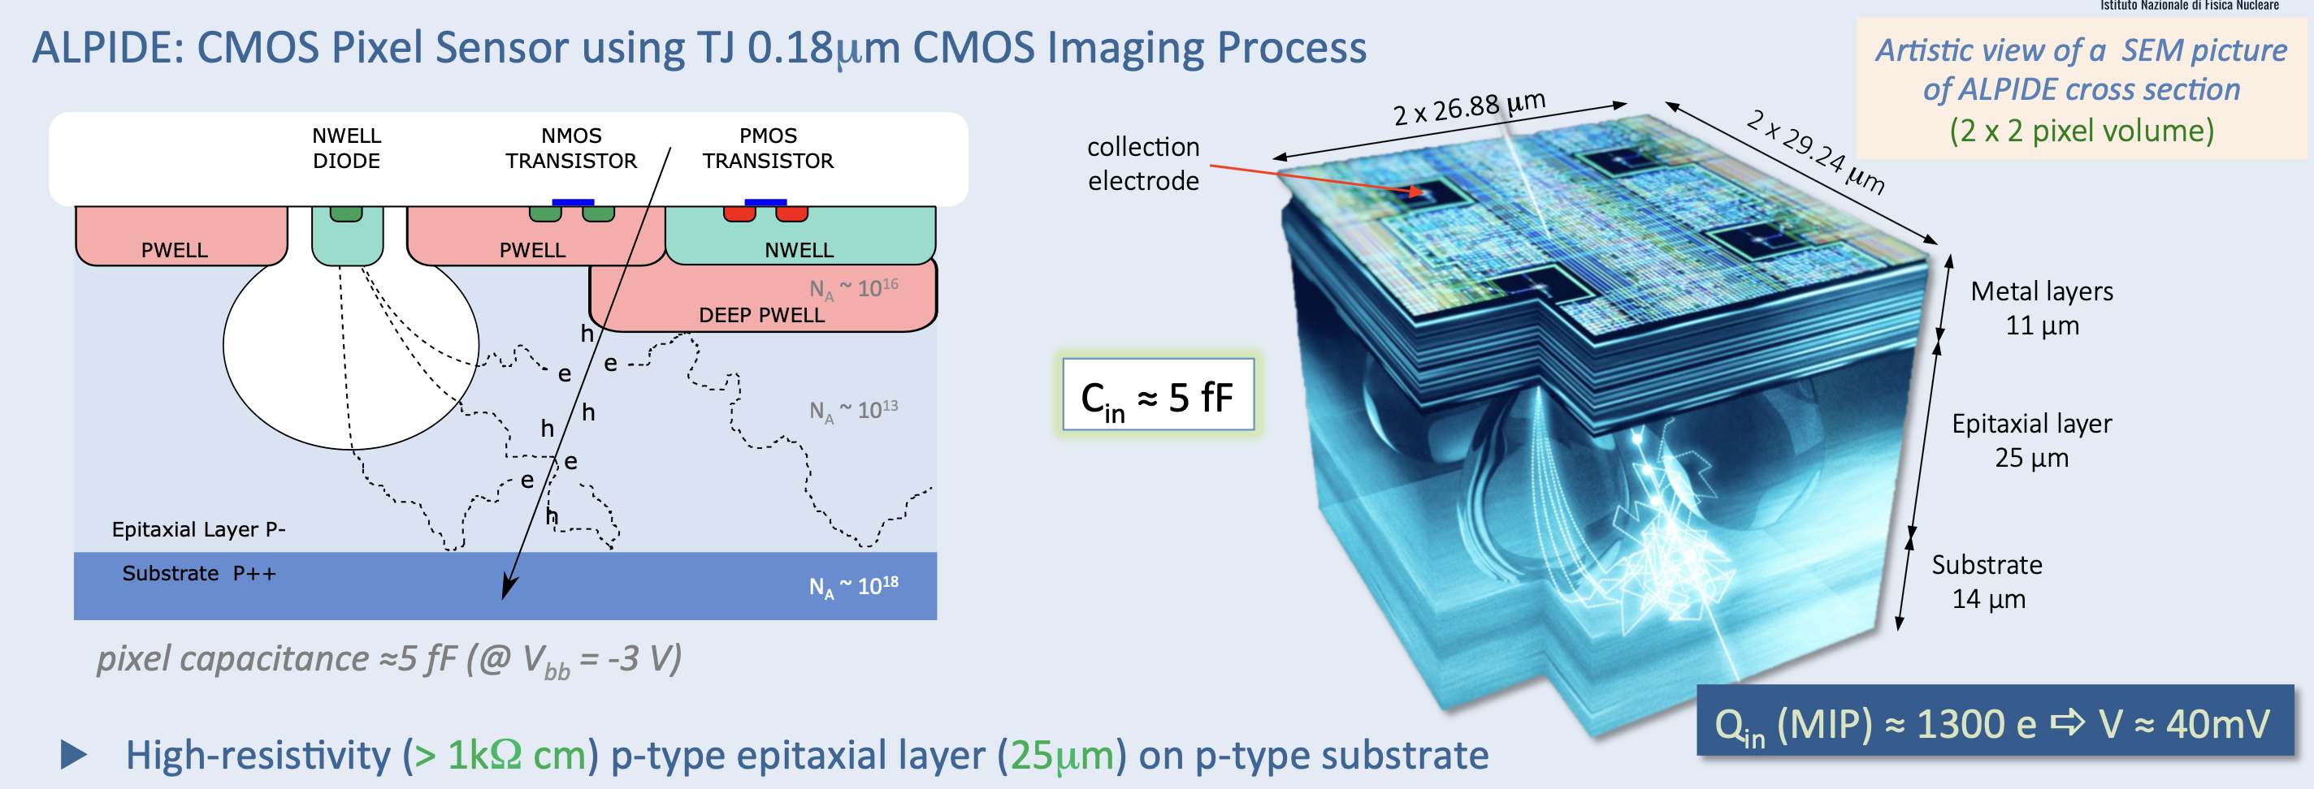
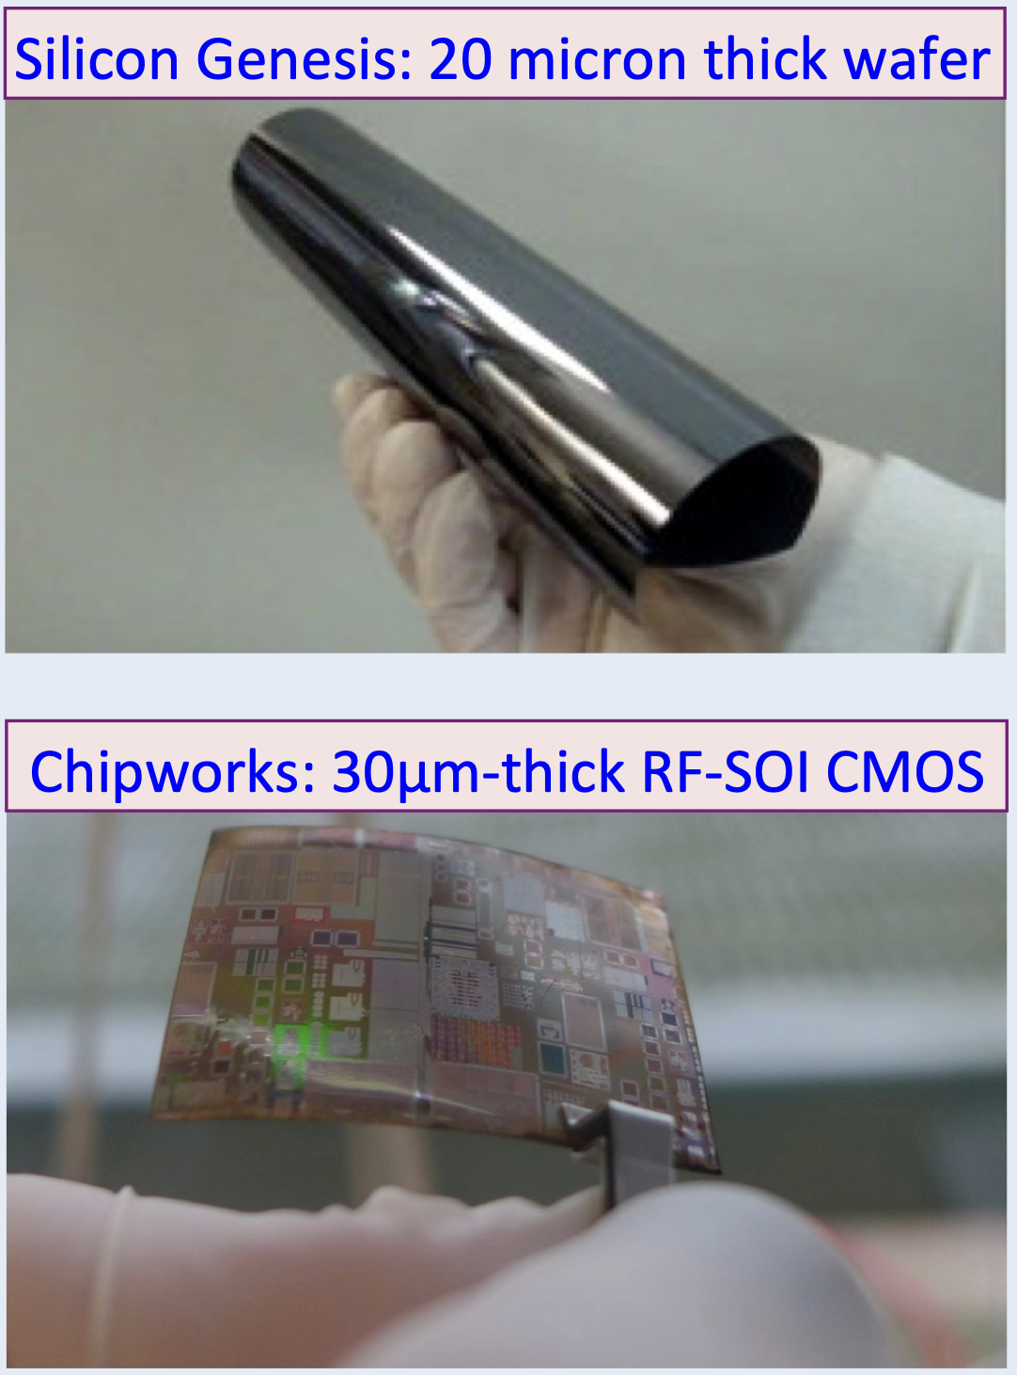
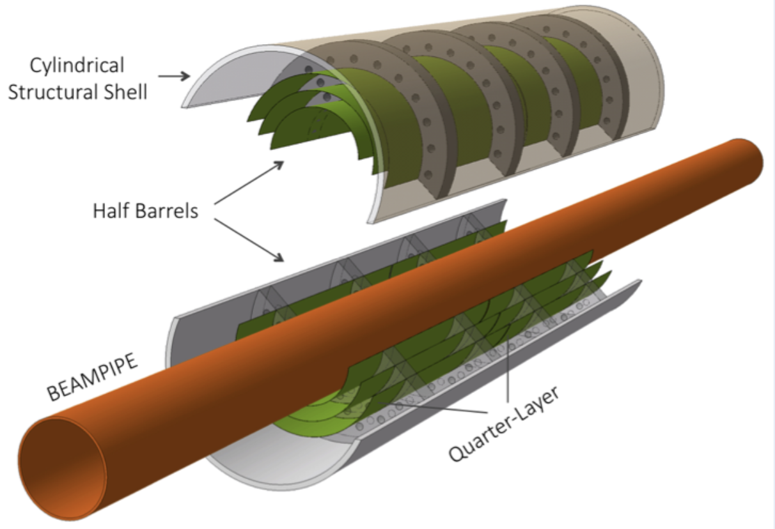
Sub-Detector Technologies
Tracking:
Silicon – MAPS
already ongoing R&D collaboration with CERN/ALICE ITS
development (0.05% X/X₀ per layer & 10 μm pitch )
  low mass EIC ITS-3 based forward disks
  new development
~900mm

Slide 36



Electro-Magnetic Calorimeter
Applications:
  Scattered electron kinematics measurement at large |η|
  in the e-endcap
  Photon detection and energy measurement
e/h separation (via E/p & cluster topology)
π⁰/γ separation
Anticipated stochastic term in energy resolution & π suppression
Other considerations:
  Fast timing
  Compactness (small X₀ and R_{M})
  Tower granularity
  Readout immune to the magnetic field
EIC Yellow Report

Slide 37



Barrel ECal ala ECCE
Homogeneous, projective calorimeter based on SciGlass, cost-effective alternative to crystals
→ Design follows PANDA
The geometry is optimized that ECCE barrel calorimeter can be made from 6 families of blocks (PANDA has 11 families)
With these families any gap is already reduced both angular and radially between glass blocks to <5mm
SC1 glass:
Feb 2020: 2cm x 2cm x 20cm (7 X0)
Dec 2020: 2cm x 2cm x 40cm ( 10-20 X0)

Slide 38




Barrel – ECal ala ATHENA
Hybrid concept:
6 imaging layer: AstroPix and Pb/SciFi
  AstroPix, monolithic Si sensor, developed (from ATLASPix)
  Pb/SciFi following KLOE, GlueX
Reconstruct scattered and secondary electrons
Separate e/π
Identify and reconstruct g (also radiated from e)
Identify π⁰ also at high momenta
Pb/SciFi
405 cm
Separate e/π at low p
206cm
also >1 λ_{I} contributing to bHCal
AstroPix
γ’s from 15 GeV/c π⁰ decay
expected performance

Slide 39

EIC PID
needs
are more demanding
then your
normal
collider detector
EIC
needs absolute
particle numbers at
high purity and low
contamination
E

Slide 40






Cerenkov Based Detectors
hadron separation
Dual radiator RICH for π, K, p
Aerogel; n=1.03
C₄F₁₀; n=1.0014
EIC Particle Momenta:
Pythia MC
P [GeV]
$$π/K±$$
π
Need more than one technology to cover the entire momentum ranges at different rapidities
K
$$η$$

Slide 41







Hadron PID
Barrel
REFERENCE
hpDIRC (High Performance DIRC)
Quartz bar radiator, light detection with MCP-PMTs
Fully focused
p/K 3s sep. at 6 GeV/c
Reuse of BABAR DIRC as alternative
Integration into a 4$π$ detector can be challenging
Forward Endcap
REFERENCE
dRICH (dual RICH)
Aerogel and C-F gas radiators
Full momentum range
Sensor: Si PMs(TBC)
p/K 3σ sep. at 50 GeV/c
dE/dx from gaseous tracker, i.e. TPC
complementary
STAR: ~ similar
resolution expected
Backward Endcap
windowless RICH
Gaseous sensors (MPGDs)
CF₄ as radiator and sensor gas
Low p complements required:
TOF ~ 2.5m lever arm / Aerogel (mRICH)
REFERENCE
mRICH (Modular RICH)
Aerogel Cherenkov Det.
Focused by Fresnel lens
e, pi, K, p
Sensor: SiPMs/ LAPPDs
Adaptable to includeTOF
π/K 3σ sep. at 10 GeV/c
HP-RICH (high pressure RICH)
Eco-friendly alternative for dRICH/windowless RICH
Ar @ 3. 5 bar ↔ C₄ F₁₀ @ 1 bar
Ar @ 2 bar ↔ C F₄ @ 1 bar
Everywhere
LGAD (Low Gain Avalanche Detector)
Silicon Avalanche
20-35 psec
Accurate space point for tracking
Relevant also to central barrel
R&D and PED by International consortium HEP & NP
LAPPD (Large Area psec Photon Detector)
MCP, Cherenkov in window
5-10 psec
→ supported by DOE SBIR program
TOF with short lever arm

Slide 42

Inclusive Cross-Sections in eA
arXiv:1708.05654
Direct Access to gluons at
medium to high x by tagging
photon-gluon fusion through
charm events
Gluon distribution ~ dσ(x,Q²)/dlnQ²

Slide 43
EIC: Impact on the Knowledge of 1D Nuclear PDFs
√s < 45 GeV
√s < 90 GeV
Ratio of PDF of Pb over Proton
Without EIC, large
uncertainties
→ With EIC significantly
reduced uncertainties
Complementary to RHIC
and LHC pA data.
Provides information on
initial state for heavy ion
collisions.
Does the nucleus behave
like a proton at low-x?
→ relevant to very
high-energy cosmic
ray studies
→ critical input to AA
arXiv:1708.05654

