Slide 1

Collectivity in relativistic nuclear collisions
Julia Velkovska
Jetscape summer school 2022

Slide 2
How does near-perfect fluid QGP form and evolve ?
The near-perfect fluid QGP is a key discovery in the field
How does this behavior emerge and what are its limits ?
I will give an (incomplete) overview of how our understanding evolved over the years

Slide 3
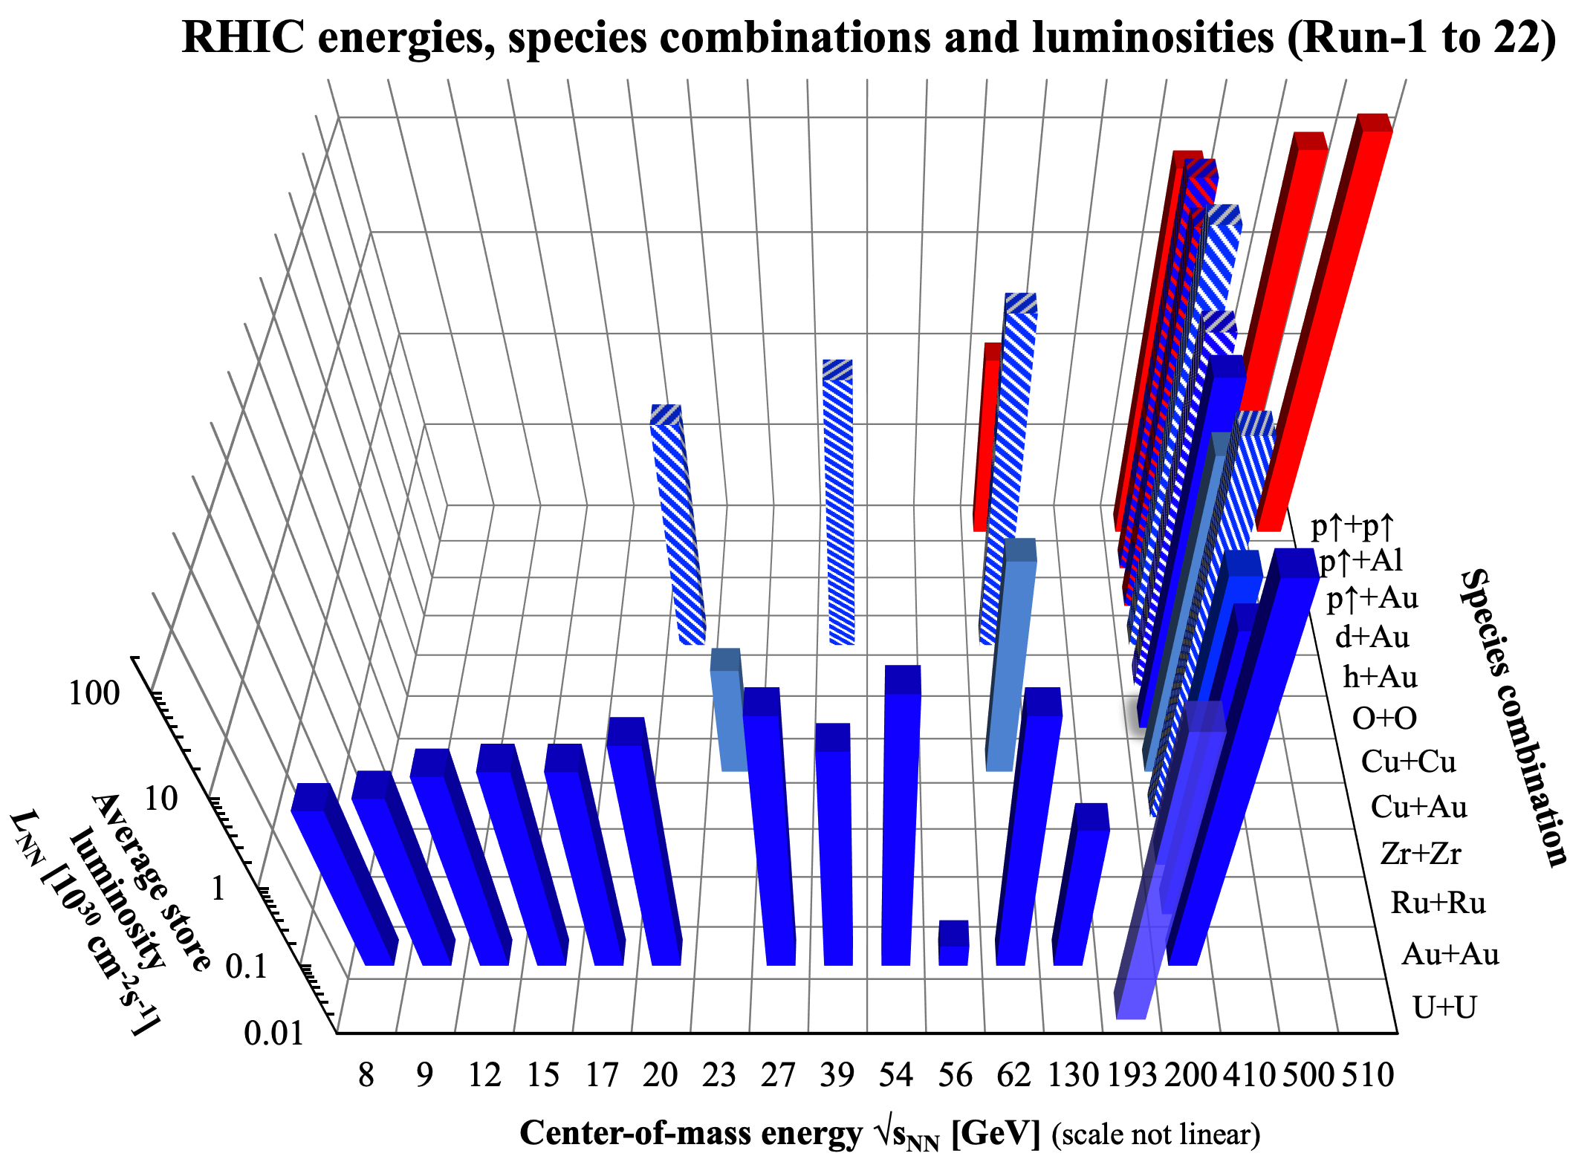
Heavy Ions at RHIC and LHC
Xe-Xe
Pb-Pb
pp
p-Pb
RHIC strength: a dedicated HI machine with incredible versatility
LHC strength: high luminosity, high energy, large acceptance, precision
pp (min bias)

Slide 4
The elliptic flow
z
y
x
b

Slide 5
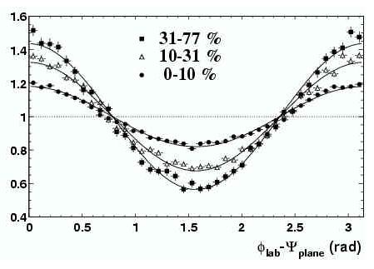
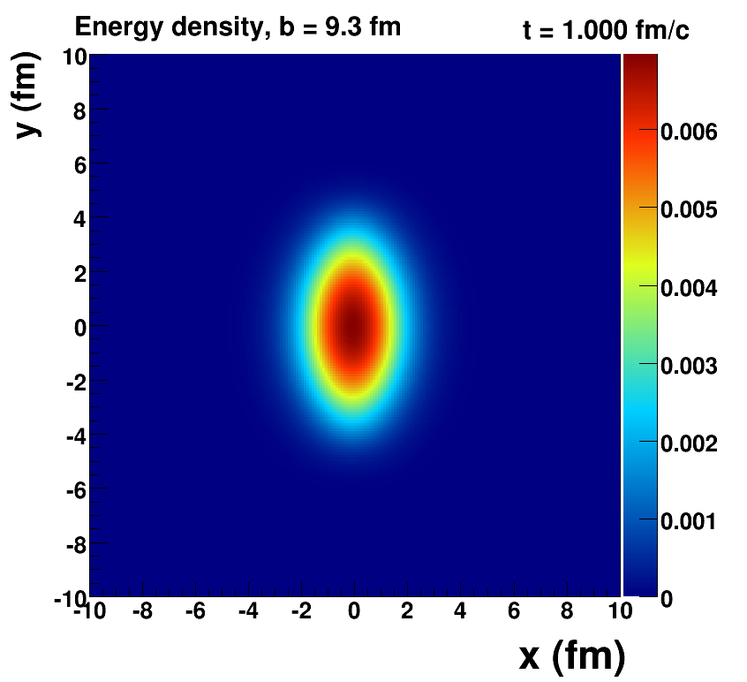

The elliptic flow
z
y
x
φ
2v₂
“elliptic flow”

Slide 6
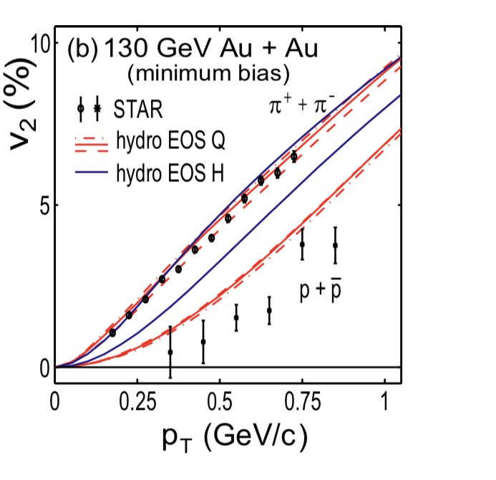
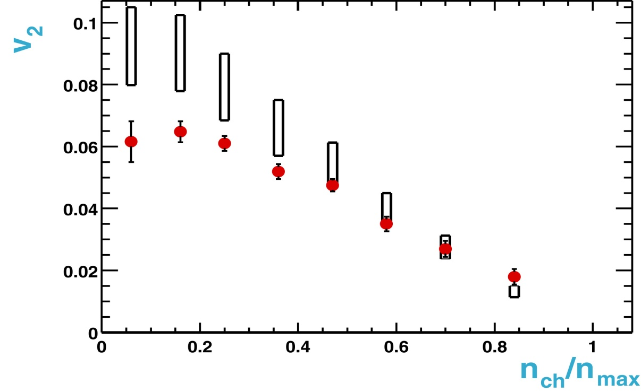
Ideal Hydrodynamics at RHIC: hydro works !
Run 1: Au+Au at 130 GeV
STAR white paper Nucl. Phys. A 757 (2005) 102
Hydro. Calculations
Huovinen,
P. Kolb,
U. Heinz
Phys. Rev. Lett. 86 (2001) 402
First STAR publication
Elliptic flow strength in semi-central collisions described by ideal hydro
Reproducing the correct mass dependence of v₂ requires QGP EOS
( lQCD-inspired, but had a 1st order phase transition)

Slide 7
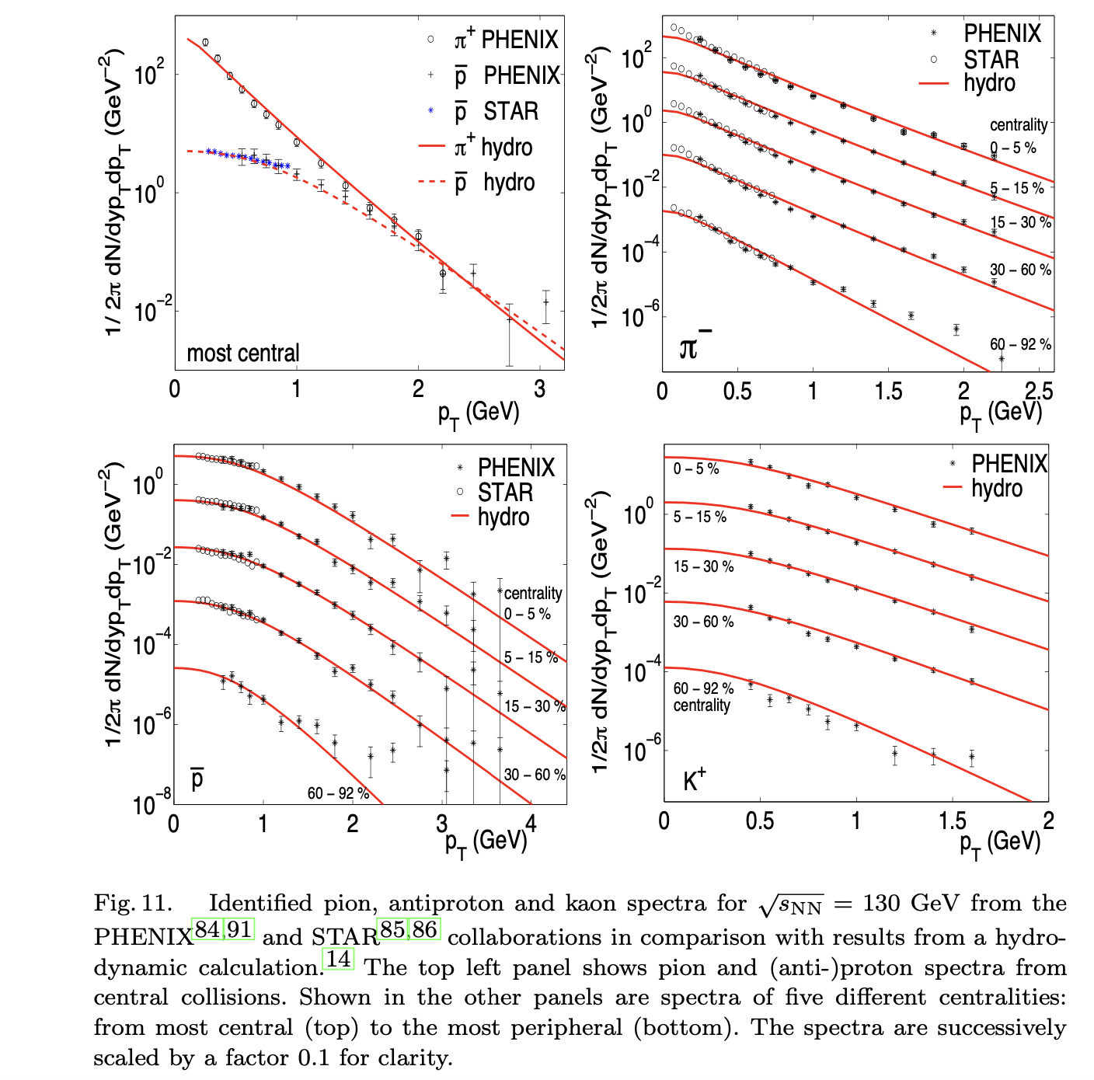
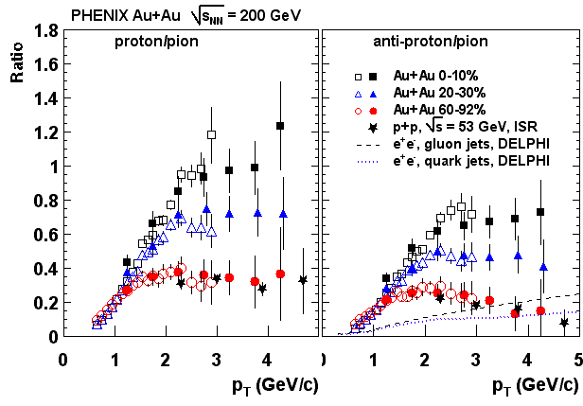
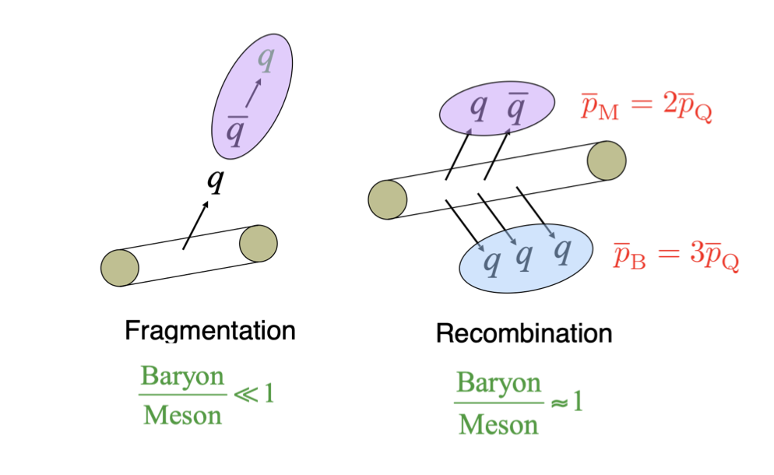
Identified particle spectra indicate collective expansion
Peter F. Kolb, Ulrich Heinz, Hydro review in 'Quark Gluon Plasma 3', Editors: R.C. Hwa and X.-N. Wang, World Scientific, Singapore
PHENIX Phys. Rev. Lett 91, 172301 (2003).
Large p/pi ratios at high-p_{T} in central collisions “baryon puzzle”
Later understood to be a combination of radial flow and
hadronization by quark recombination
J. Velkovska et al. (PHENIX Collaboration), Nucl. Phys. A 698 (2002) 507 ; (PHENIX., Phys. Rev. Lett. 88 (2002) 242301
STAR, Phys. Rev. Lett. 87 (2001) 262302. M. Calderon de la Barca Sanchez, Ph.D. Thesis, arXiv:nucl-ex/0111004.
R. J. Fries, B. Mu ̈ller, C. Nonaka and S. A. Bass, Phys. Rev. Lett. 90, 202303 (2003)

Slide 8
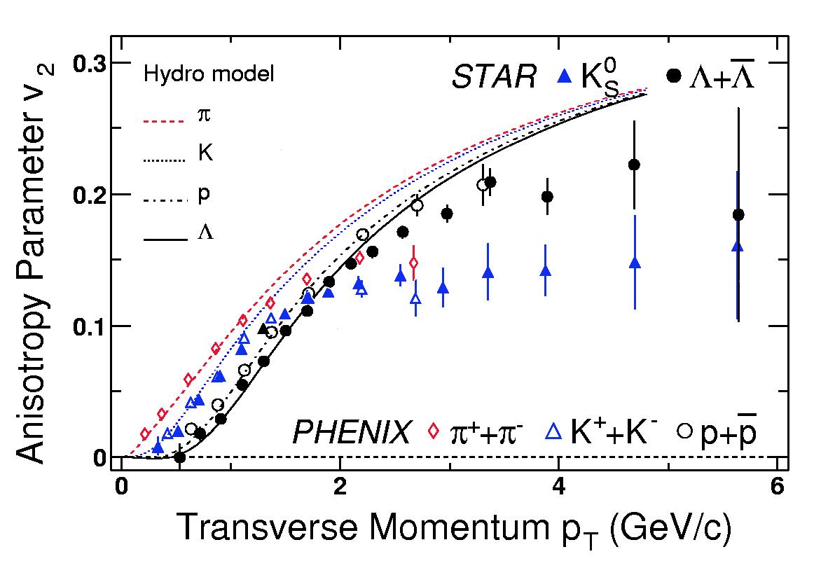
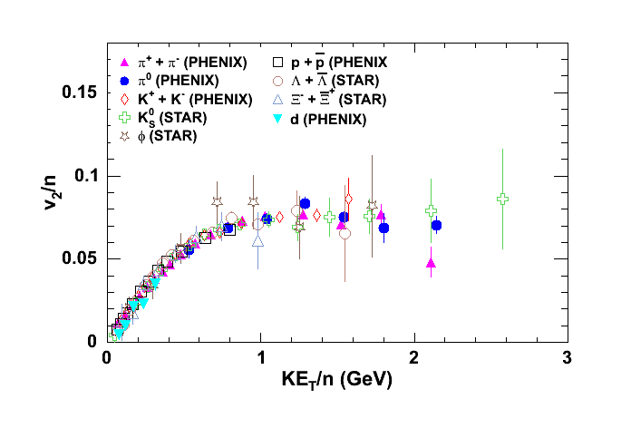
Common flow per quark: indications of partonic system
Run 2: Au+Au at 200 GeV
Mass-ordering of v₂(p_{T}) remarkably well described by ideal hydro
Empirical quark number scaling of v₂ – hadronization by recombination

Slide 9
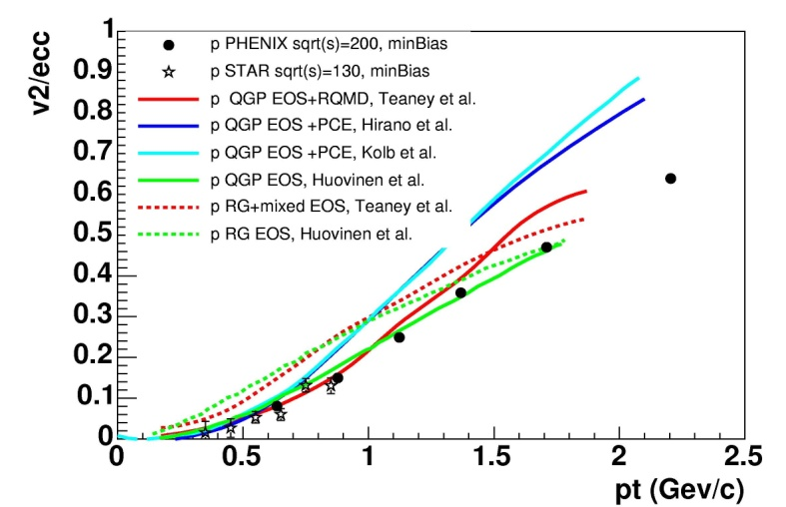
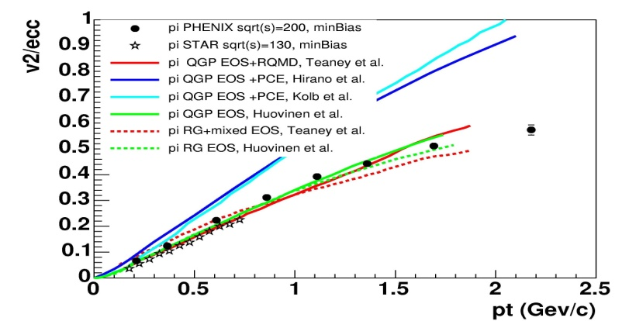
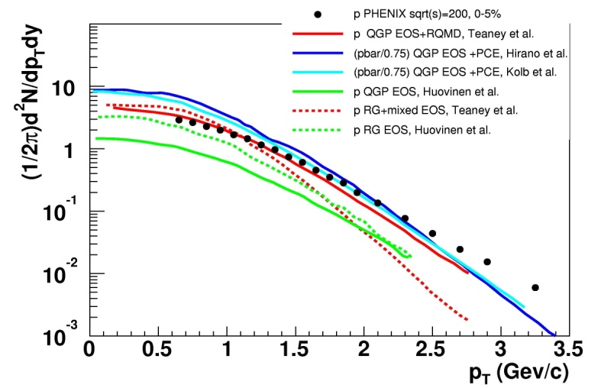
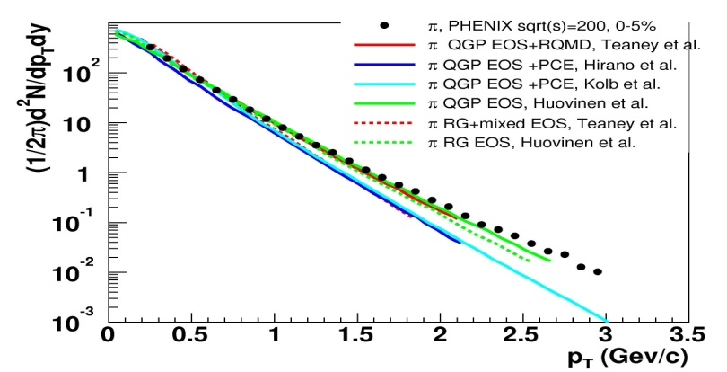
v₂ AND spectra
proton
PHENIX white paper: Nucl.Phys.A757:184-283,2005
pion
Not all hydro models describe all observables with the same set of parameters
Need to model the decoupling stage microscopically to achieve agreement with spectra and v2 simultaneously

Slide 10
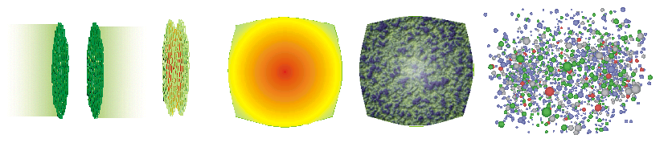
Modeling the near-perfect liquid in heavy-ion collisions
Pre-equillibrium
Hadronization
Initial state
Quark Gluon Plasma
thermally equilibrated ?
Hydrodynamic collective flow
Hadronic phase
and freezeout
Define the initial
energy density profile,
event-by-event fluctuations
Solve viscous hydrodynamic equations
need EoS and transport coefficients
(shear and bulk viscosity)
Decoupling from fluid to particles
Freezing hadron abundances
Switch to hadronic cascade
Modeling of all stages is important !
Notes:
perfect fluid paradigm.
Initial state is most likely saturated gluons and their quantum fluctuations;
local equilibrium efficiently on time scales smaller than 1 fm/c and that it maintains local equilibrium throughout an explosive expansion stage.
Hadronization at Tch hadron abundances are frozen in thermal equilibrium; quark coalescence affects momentum distributions; hadronc rescattering – kinetic freeze-out

Slide 11
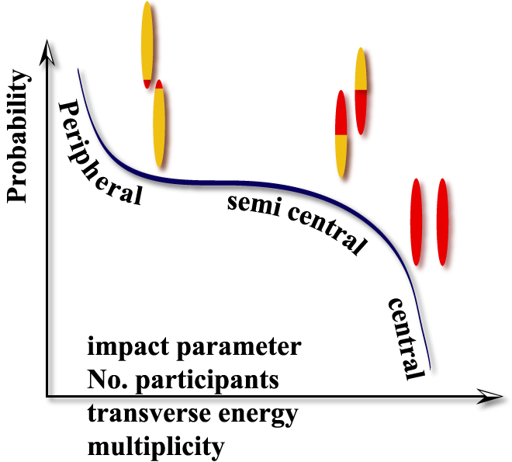
Nuclei are extended objects: defining nuclear geometry
Spectators
Participants
Spectators
  Impact parameter
  Number of participants
  Centrality
  ( % from total inelastic cross-section)

Slide 12
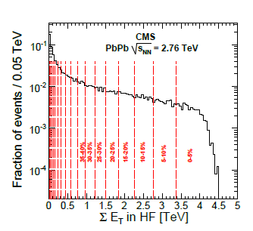
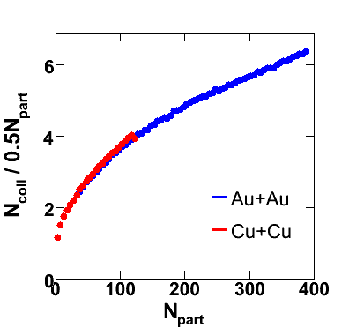
Nuclei are extended objects: defining nuclear geometry
Glauber model of nuclear collisions
Woods-Saxon nuclear
density distributions.
Put in the Lorentz boost
Put in the NN inelastic cross section
(as parameterized from data)
Straight line nucleon trajectories
Throw the dice:
see if the nucleon is a participant
see if the nucleon will collide with
another nucleon more than once
Variety of ways to make
correspondence with exp’t

Slide 13

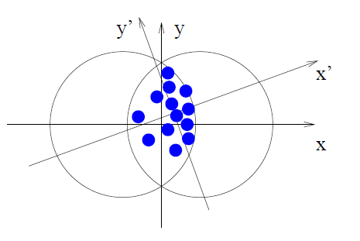
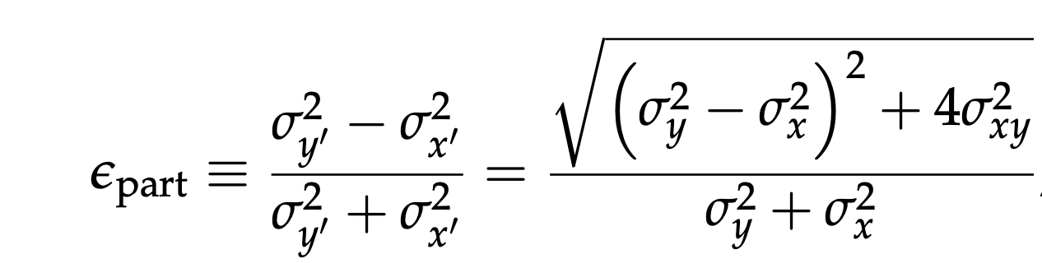
Participants, fluctuations, eccentricity
PHOBOS: Phys.Rev.Lett.98:242302,2007
Au+Au vs. Cu+Cu. → different v₂ for the same N_{part} (expected)
participant plane
Reaction plane
Au+Au vs. Cu+Cu. → similar v₂ /$<εpart>$for the same N_{part}

Slide 14
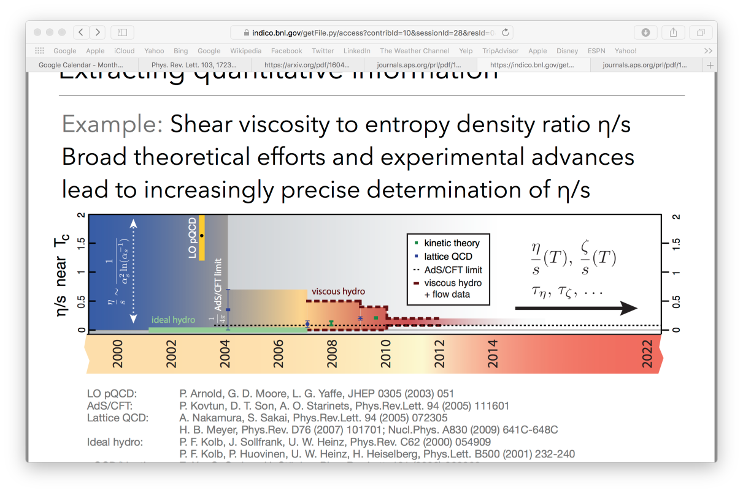
The history of refining perfection
B. Schenke, 2015 QCD town meeting
Hydrodynamic Modeling of Heavy-Ion Collisions
Charles Gale, Sangyong Jeon, Bjoern Schenke
Int. J. of Mod. Phys. A, Vol. 28, 1340011 (2013)
Two notable steps
  2007: development of viscous hydrodynamics
  2010: measurements of high-order harmonics, modeling of initial-state fluctuations event-by-event
Notes:
Lattice: http://journals.aps.org/prl/pdf/10.1103/PhysRevLett.94.072305
Transport coefficients of gluon plasma are calculated for an SU(3) pure gauge model by lattice QCD simulations on 163 8 and 243 8 lattices. Simulations are carried out at slightly above the deconfinement transition temperature Tc, where a new state of matter is currently being pursued in BNL RHIC experiments. Our results show that the ratio of the shear viscosity to the entropy is less than one and the bulk viscosity is consistent with zero in the region 1.4 T<Tc <1.8.

Slide 15
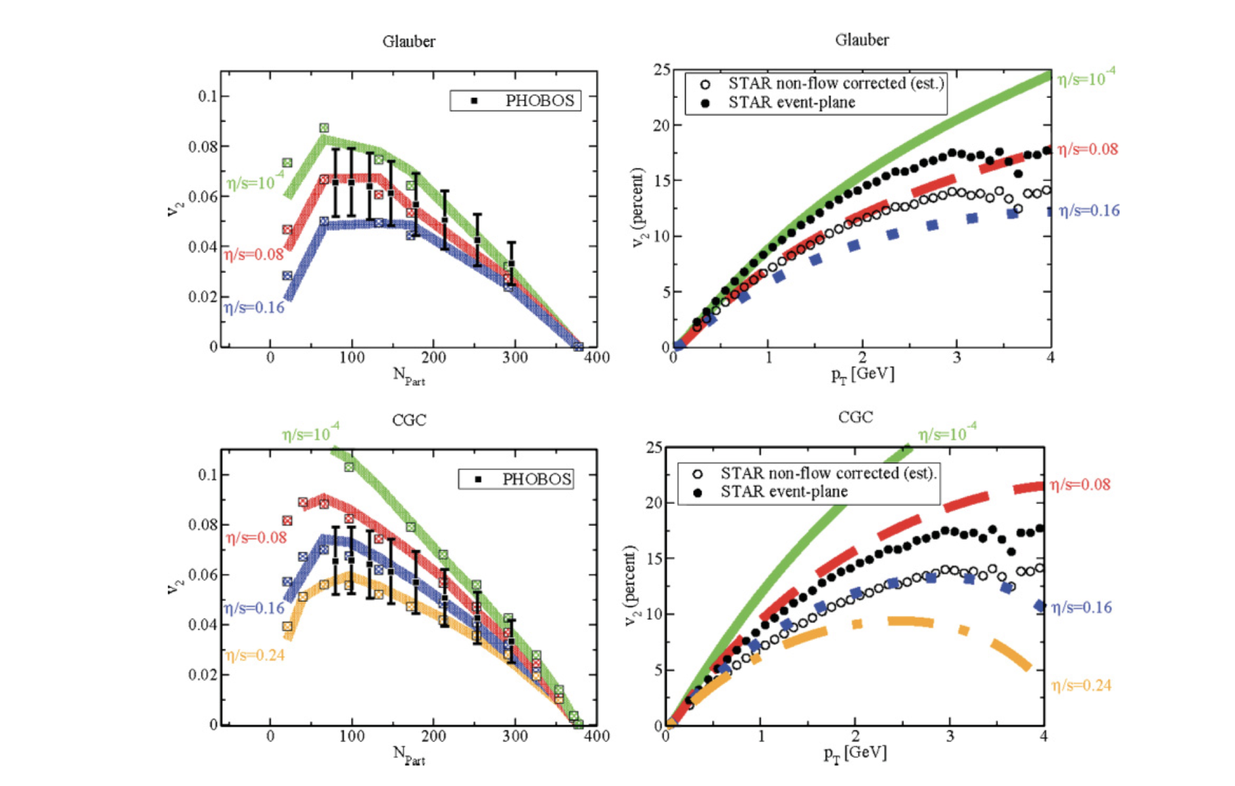
Viscous hydro compared to data: role of initial conditions
Luzum, Romatschke, Phys. Rev. C78, 034915 (2008)
Two different initial conditions give a factor of 2 difference in the extracted η/s - shear viscosity-to -entropy density
The uncertainties are both experimental (e. g. understanding the role of fluctuations) and theoretical

Slide 16
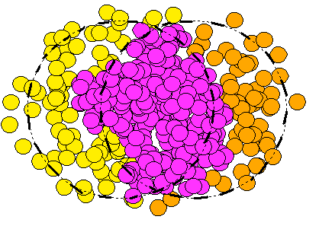
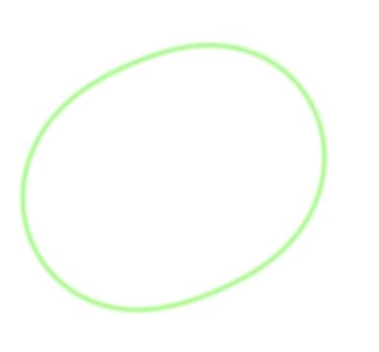
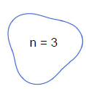
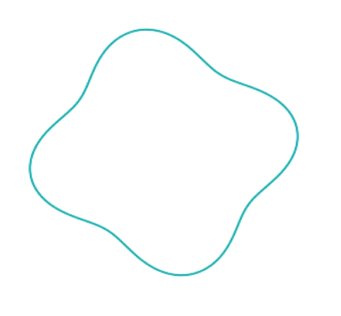

Fluctuations in the initial conditions: a new tool that drives precision
ψ₂
ψ₃
ψ₄
n = 2
n = 4
n = 5
n = 6
B. Alver and G. Roland, Phys. Rev. C81, 054905 (2010)
Notes:
Ridge-like long-range rapidity correlations in the anisotropic flow phenomena, which establish that the geometric features and fluctuations causing them and the system’s collective response to these fluctuations are both phenomena that, by causality, point back to the very beginning of the collision;

Slide 17
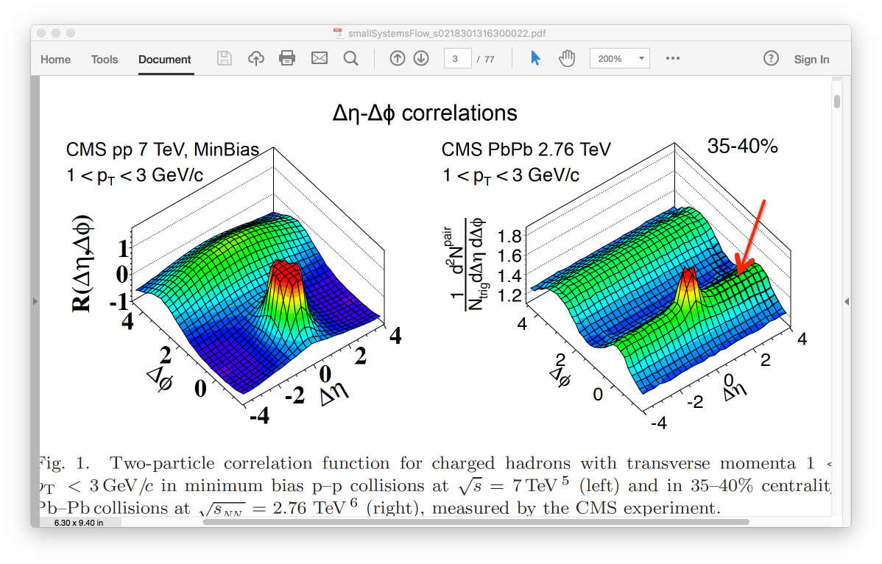
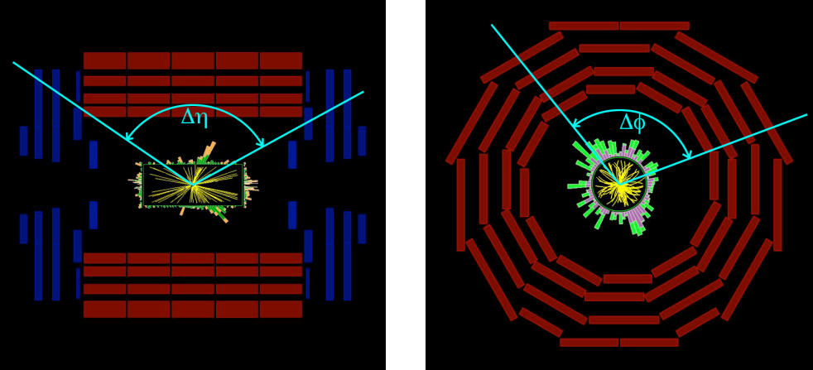
The “ridge”
Long-range structure in 𝚫η around 𝚫φ = 0 reflects the geometric fluctuations at the earliest time
They are propagated through the system with hydrodynamic flow

Slide 18
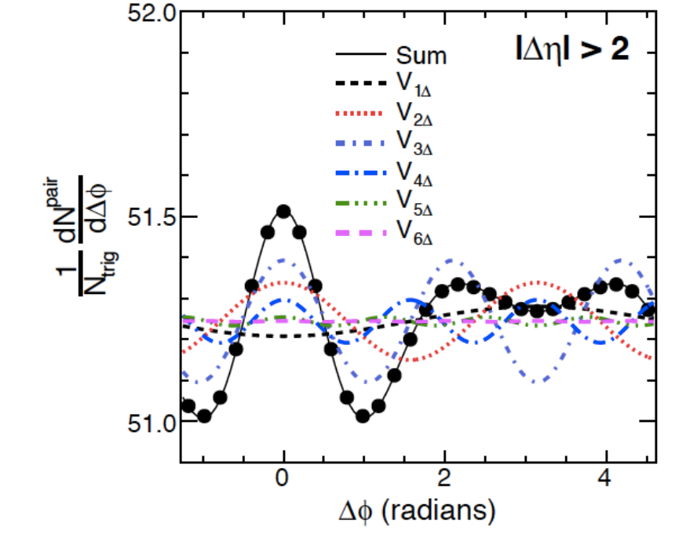
Fourier decomposition of the ridge
Significant 3rd harmonic
driven by initial-state fluctuations

Slide 19
The full harmonic spectrum
ATLAS PbPb 2.76 TeV
v₂ – strong centrality dependence driven by geometry
v₃ - driven by fluctuations

Slide 20
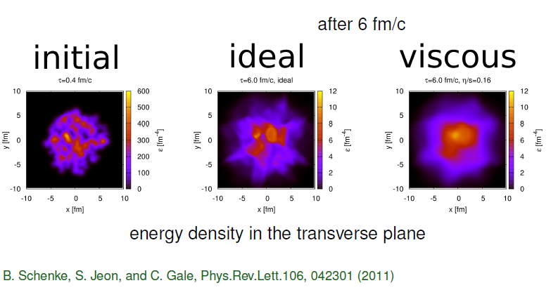
The effect of viscosity in event-by-event hydrodynamics

Slide 21
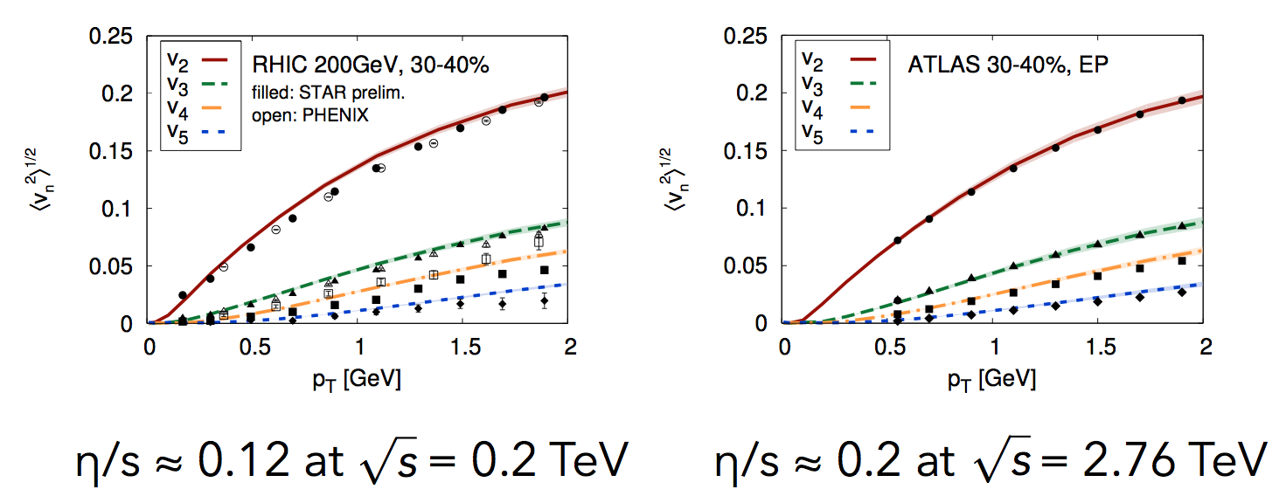
Higher Harmonics Used to Determine η/s
≈ 1.5 x string theory limit
≈ 2.5 x string theory limit
C. Gale, S. Jeon, B. Schenke, P. Tribedy, R. Venugopalan, Phys. Rev. Lett. 110, 012302 (2013)

Slide 22
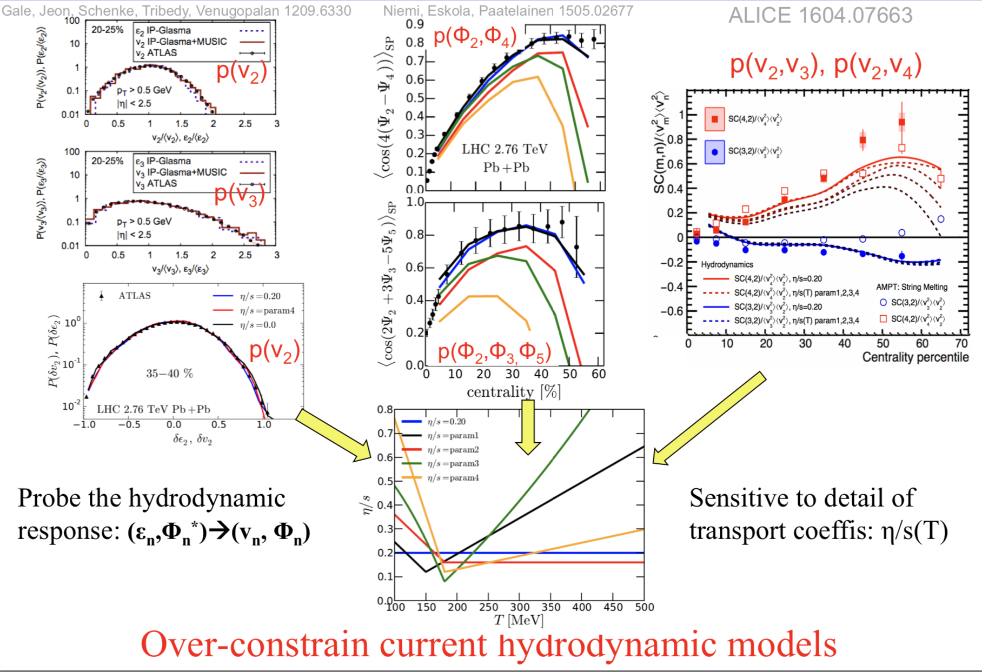
Many other sophisticated flow observables compared to hydro
Jiangyong Jia, QM18 student day

Slide 23
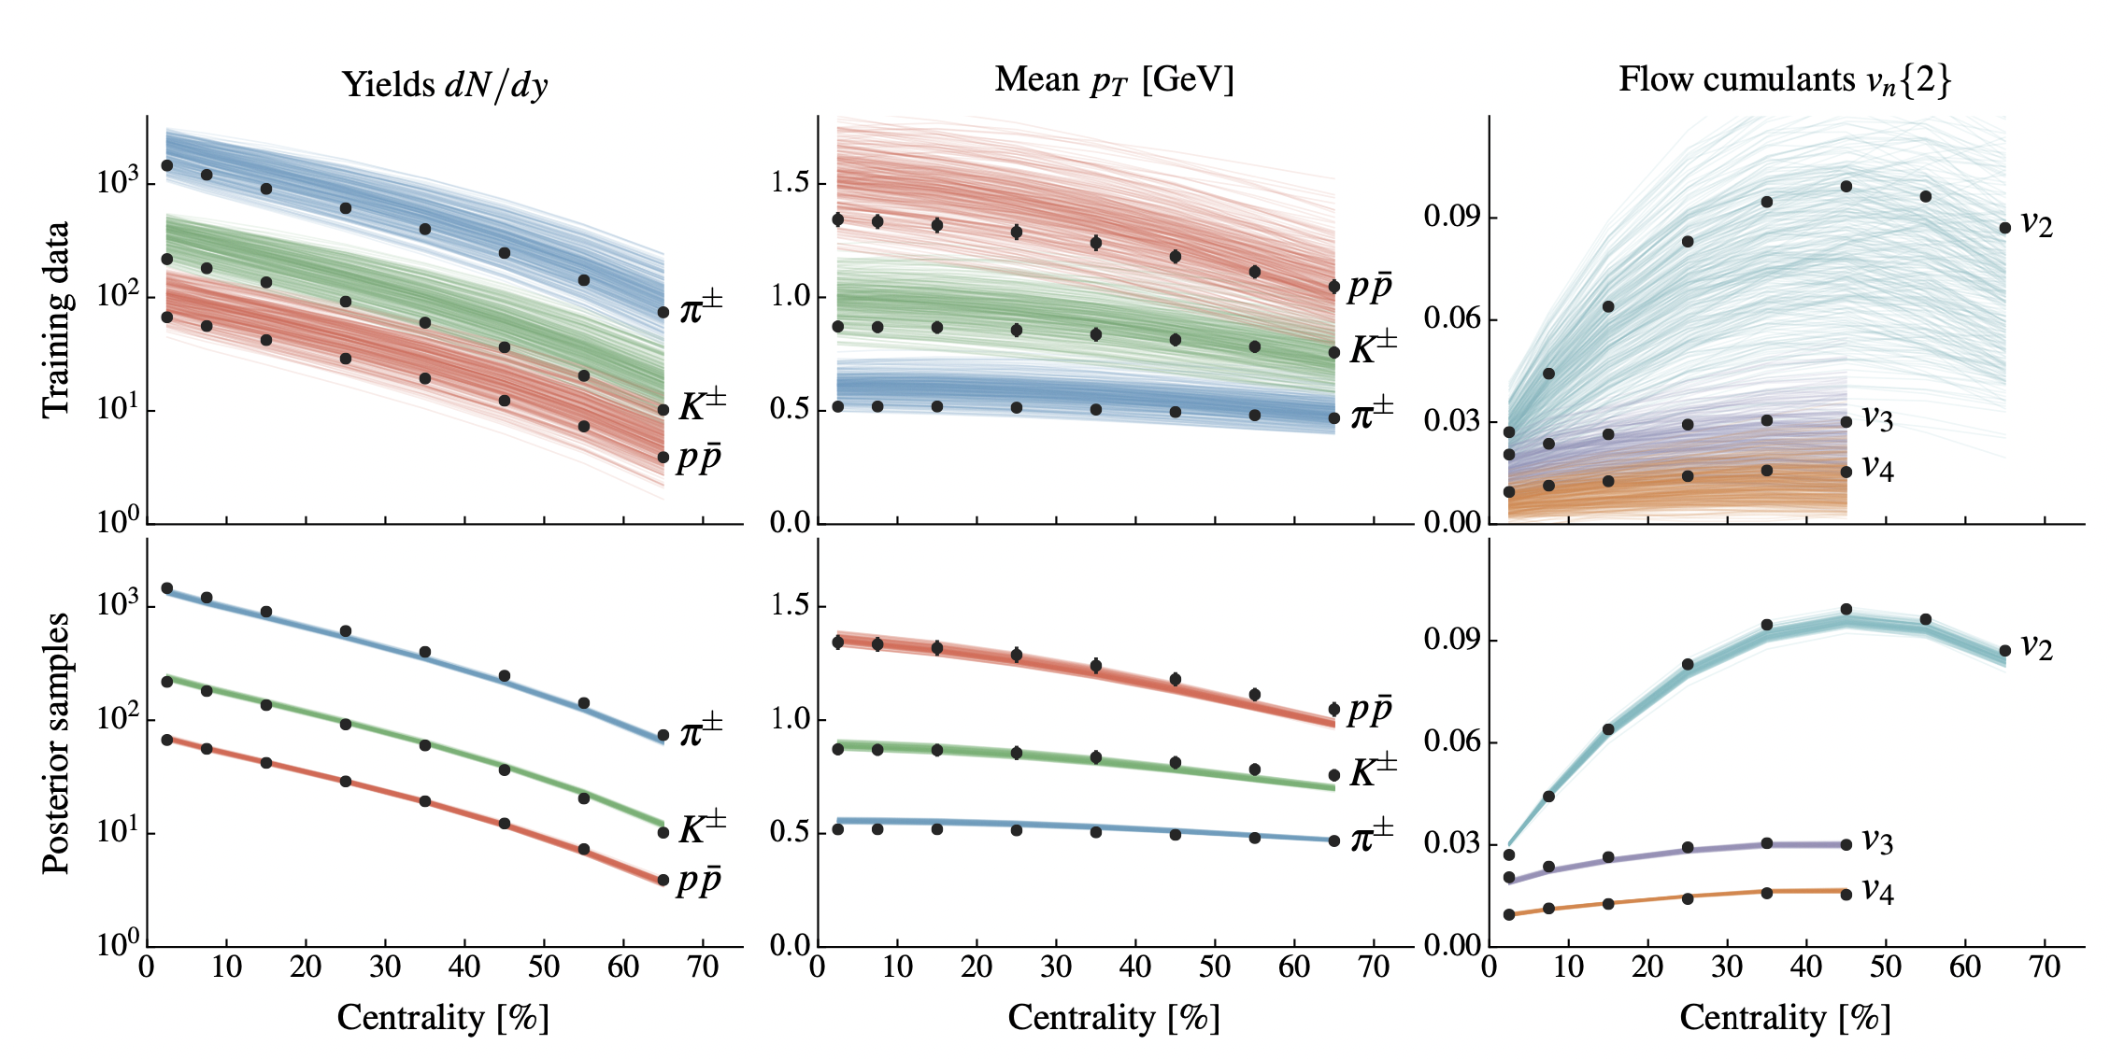
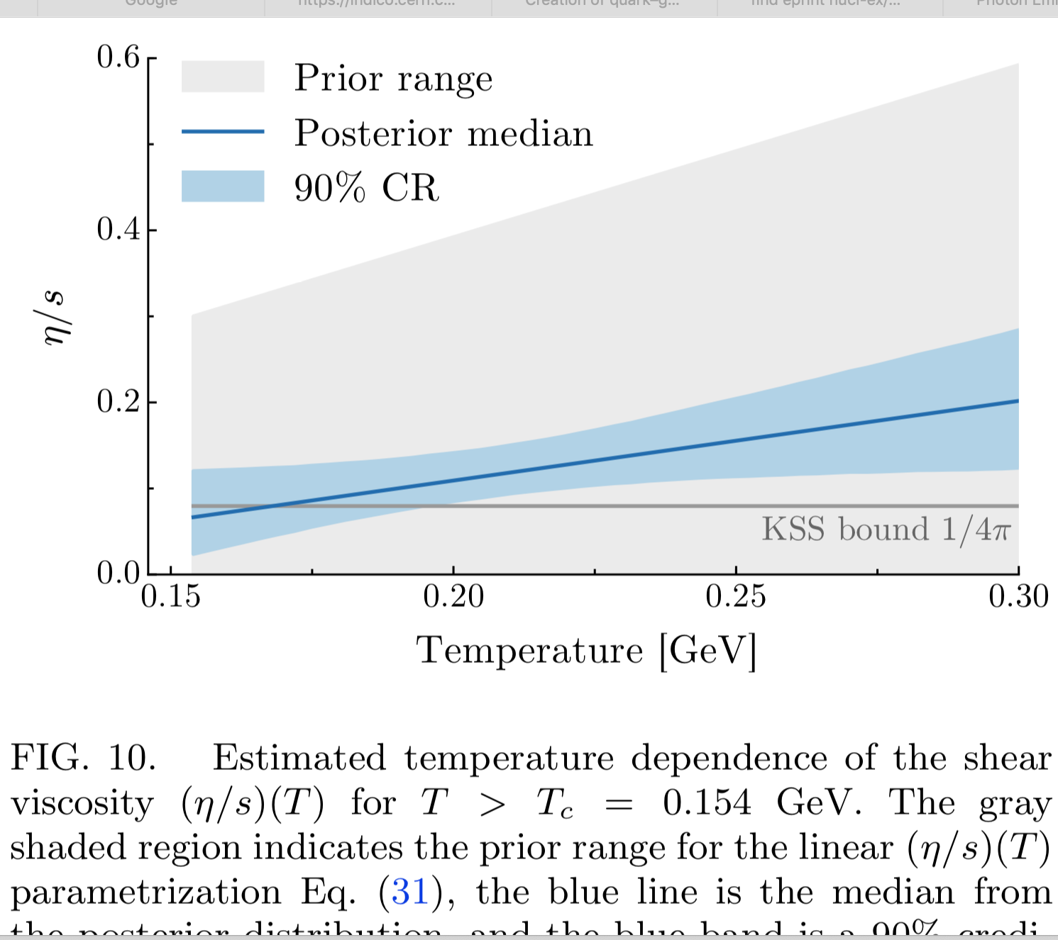
QGP properties from Bayesian model to data comparison
T dependence of η/s … and a lot more
Use data from identified particle yields, <p_{T}> and several flow harmonics to train parameters and perform a multi-parameter model-to-data comparison utilizing Bayesian statistics
training
posterior
Extract T dependence of η/s and constrain the initial conditions
PHYSICAL REVIEW C 94, 024907 (2016)

Slide 24
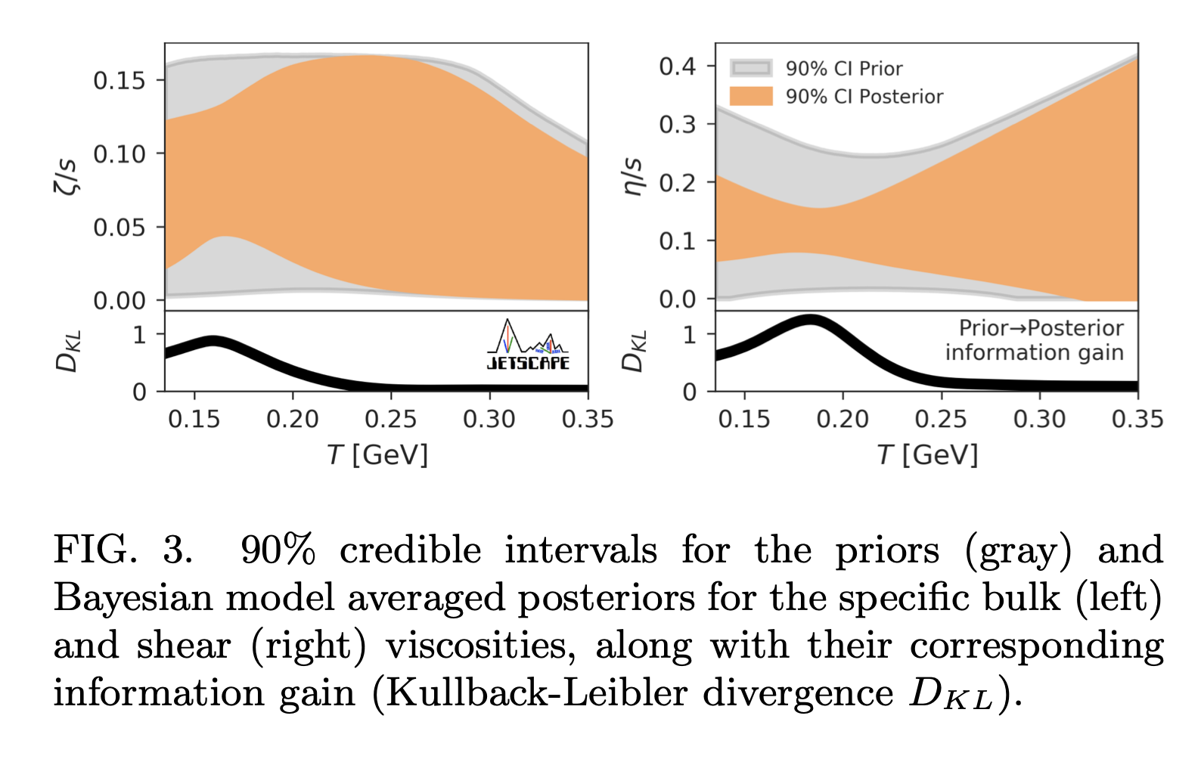
Detailed Bayesian parameter estimation from JETSCAPE
Phenomenological constraints on the transport properties of QCD matter with data-driven model averaging
Phys. Rev. Letter, vol. 126, pp. 242301, 2021, (Editors' Suggestion).
Multisystem Bayesian constraints on the transport coefficients of QCD matter
Phys. Rev. C, vol. 103, no. 5, pp. 054904, 2021.
“We improve on earlier such studies [14–20] by accounting for known theoretical ambiguities in our quantification of the uncertainties of the inferred viscosities. “

Slide 25
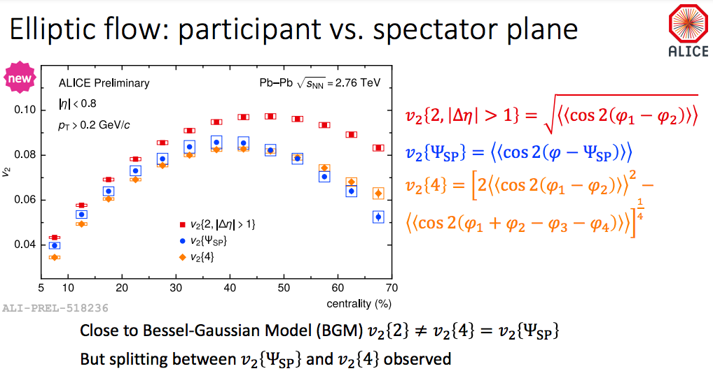
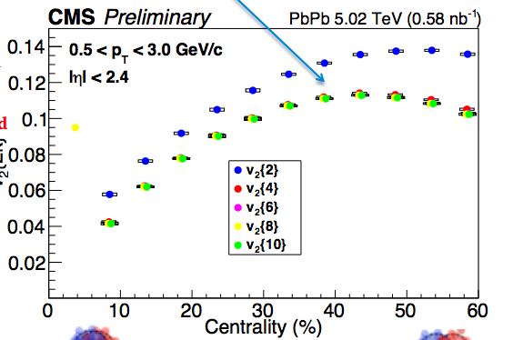
More detailed experimental studies at QM22
Further investigation in the nature of the flow fluctuations

Slide 26
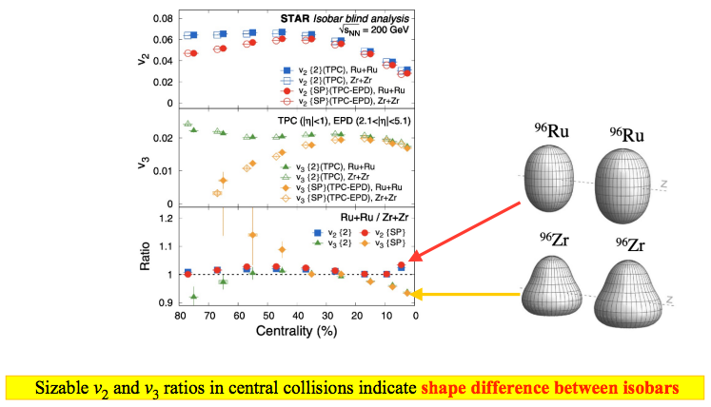
Nuclear structure from high-energy flow measurements?

Slide 27
Summary of large-system collectivity
A wealth of high-precision measurements establish the near-perfect fluidity of QGP
Significant progress in theoretical modeling
Modern theory-to-data comparisons account for experimental and model uncertainties → constraints on the QGP transport coefficients
Many new experimental observables yet to be included in global analyses
Upcoming high-luminosity LHC Run3 → rare probes
At RHIC → BES completed; a new state-of-the art detector sPHENIX; STAR forward upgrade provides larger coverage and precision for flow measurements

Slide 28
Small systems

Slide 29
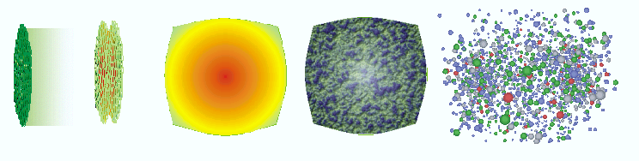


Long standing paradigm for small systems
Pre-equillibrium
Hadronization
COLD
Nuclear
Matter
Initial state
Quark Gluon Plasma
thermally equilibrated
Hydrodynamic collective flow
Hadronic phase
and freezeout
Not enough particles to achieve equilibration
No QGP
pp collisions serve as a reference baseline
pA or dA: reference for cold nuclear matter effects

Slide 30
Testing the small-systems paradigm

Slide 31
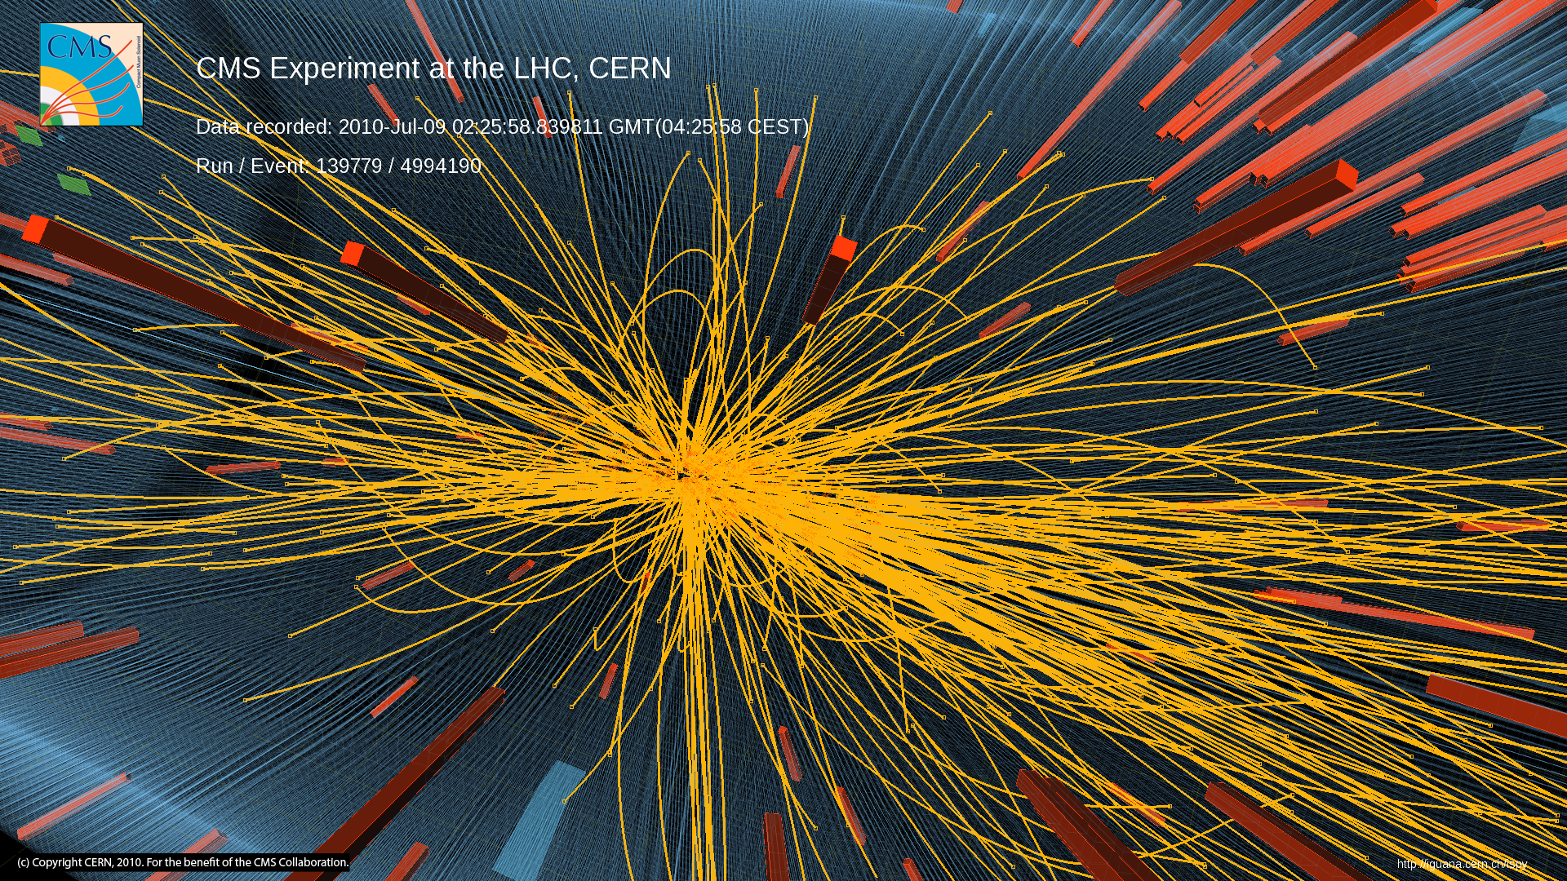
High-multiplicity pp collisions at √s = 7 TeV JHEP 1009 (2010) 091

Slide 32
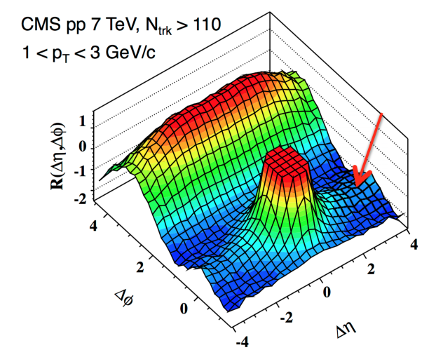
Ridge in pp ? Does it have the same origin as in AA ?
High-multiplicity pp collisions at √s = 7 TeV JHEP 1009 (2010) 091

Slide 33
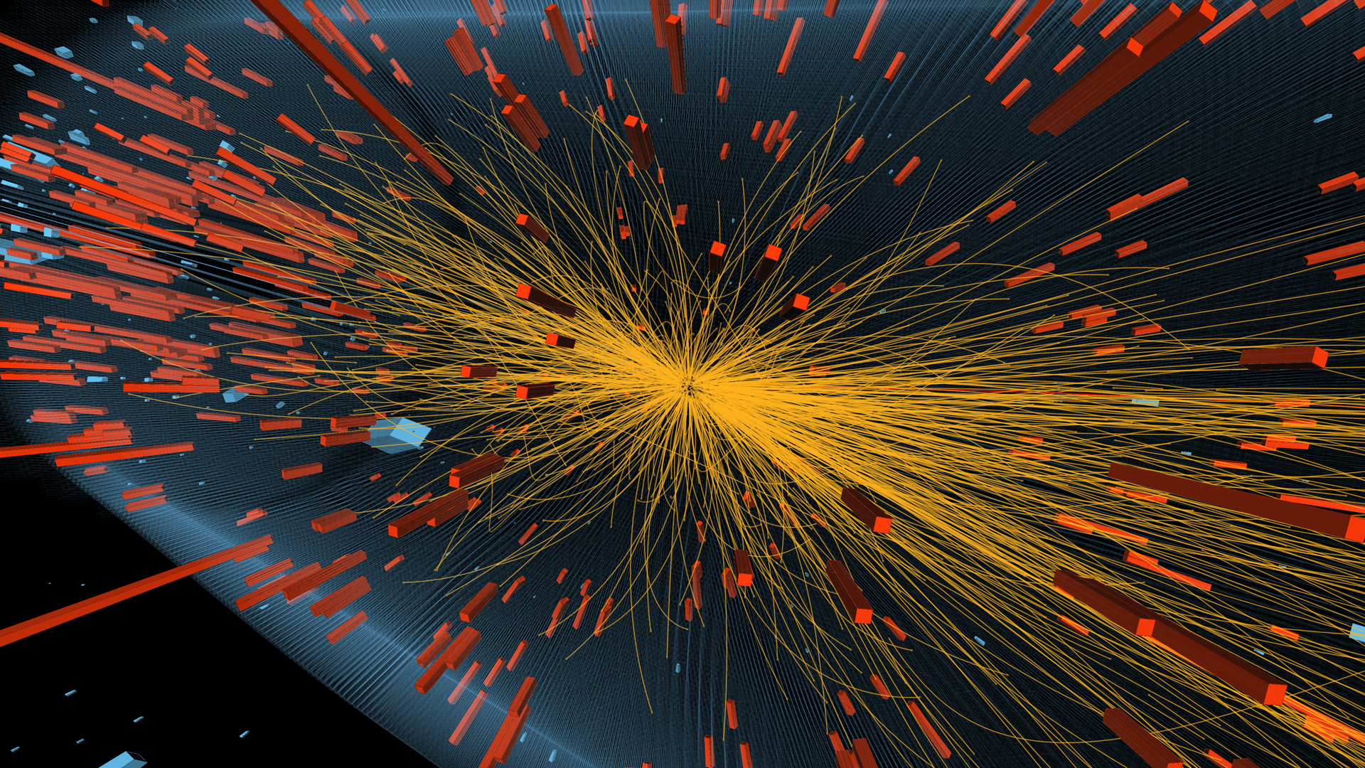
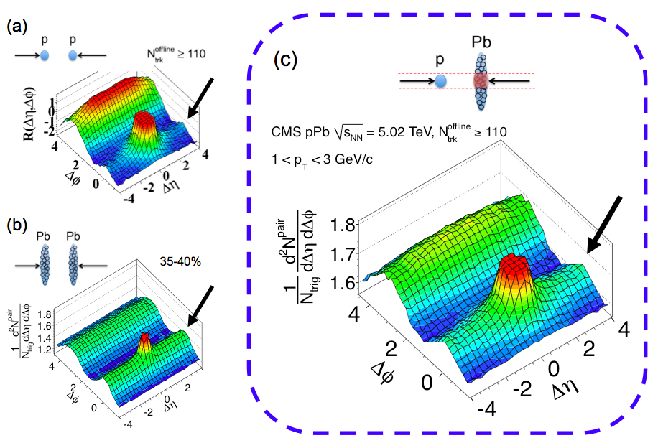
….ridges are everywhere

Slide 34

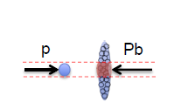

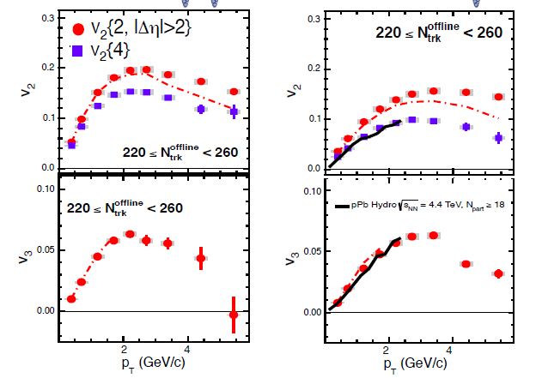

p_{T} dependence of v_{n} : PbPb vs pPb
Dashed-dotted curves
N<20 subtracted
Important for high-p_{T}
PLB 724 (2013) 213
n = 2
Remarkable similarity in PbPb and pPb for same multiplicity

Slide 35
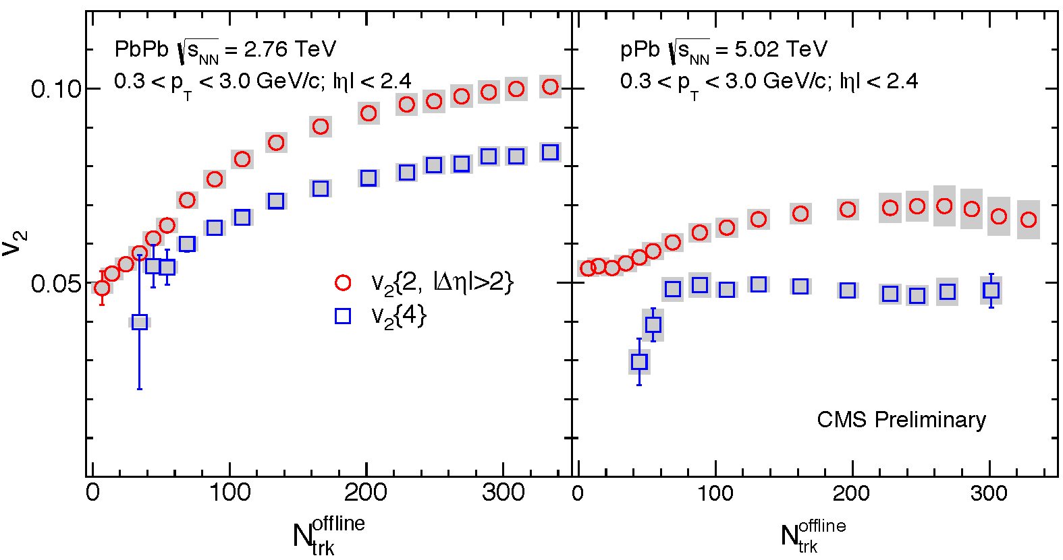
Beyond 2-particle correlations
v₂ from multi-particle cumulants remains large
  v₂(4)≠v₂(2)
  (non-flow, fluctuations…)
  PLB 724 (2013) 213
v₂
PbPb pPb
(event multiplicity)
Notes:
Snap from HIN-14-006-v7
Animated !

Slide 36
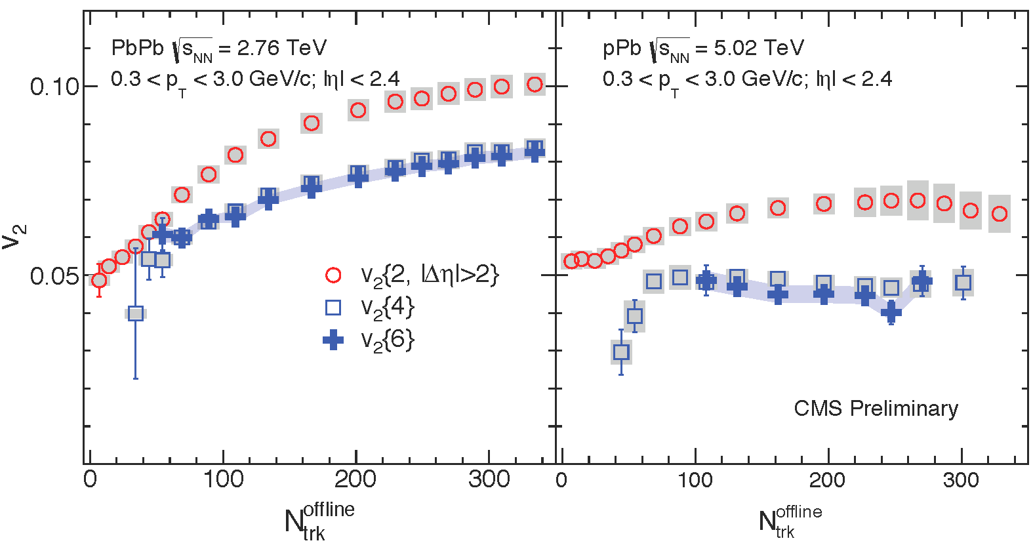
Multiparticle correlations
v₂ from multi-particle cumulants remains large
  v₂(4)=v₂(6)
  PRL 115 (2015) 0112301
v₂
PbPb pPb
(event multiplicity)
Notes:
Snap from HIN-14-006-v7
Animated !

Slide 37
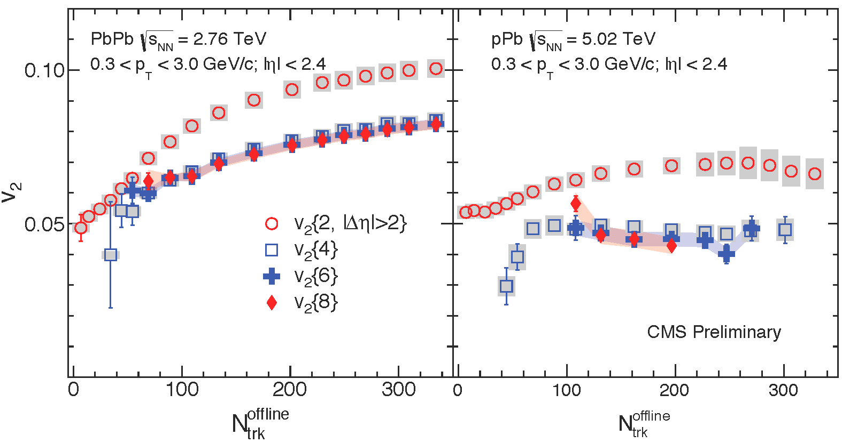
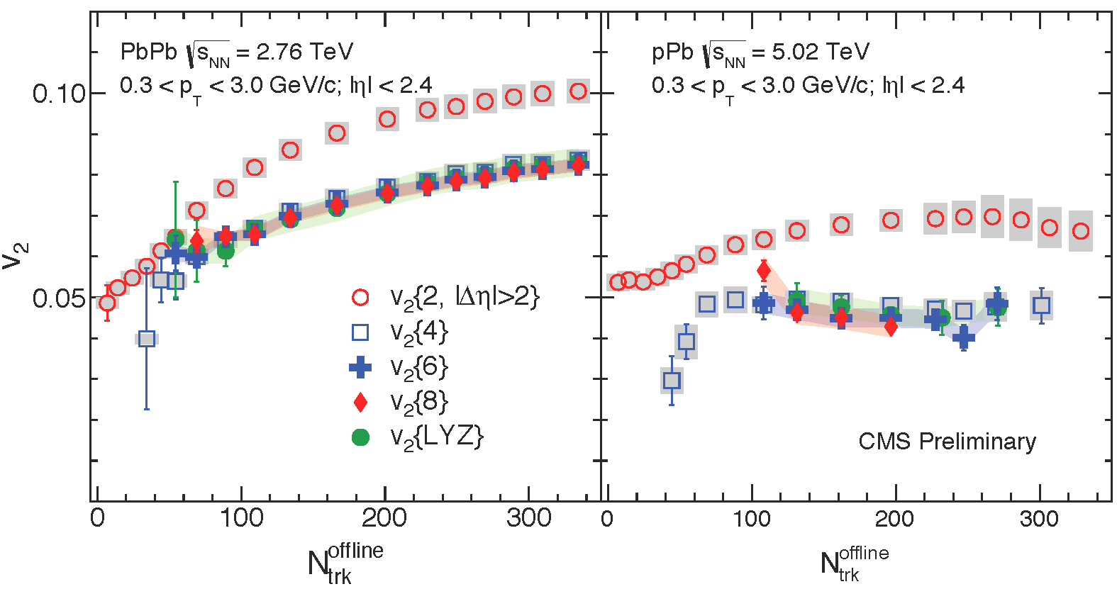
All-particle collectivity
v₂ from multi-particle cumulants remains large
  v₂(4)=v₂(6)=v₂(8)=v₂(LYZ) within 10%
  PRL 115 (2015) 0112301
v₂
PbPb pPb
(event multiplicity)
Notes:
Snap from HIN-14-006-v7
Animated !

Slide 38
Identified particle production and flow
Same fine splitting of v2 with mass
as in large systems
Smooth evolution in hadron chemistry

Slide 39
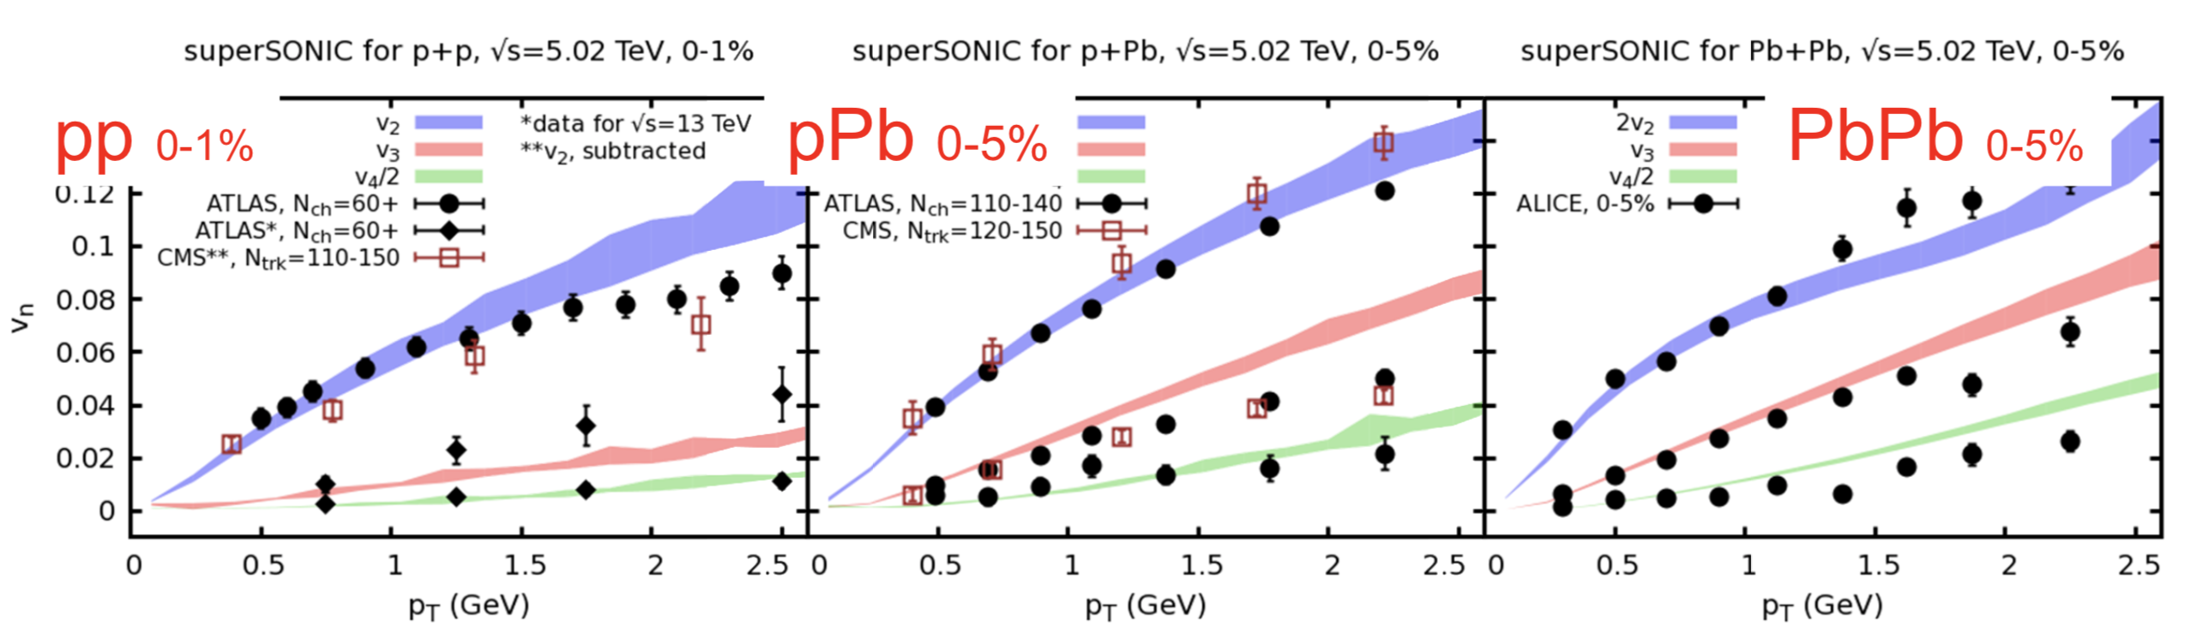
Everything flows
Weller & Romatschke, Phys. Lett. B 774, 351 (2017)
Hydrodynamics provides a simultaneous description of v₂, v₃, and v₄
in pp, pPb and PbPb with the same parameters!

Slide 40



Small systems paradigm shift ?
Pre-equillibrium
Hadronization
QGP?
Initial state
Quark Gluon Plasma
Hadronic phase
and freezeout
Unique RHIC measurements to answer key questions
How is the initial geometry transformed into final state momentum correlations? Use geometry engineering!
2014 2008, 2015
2016

Slide 41

Geometry engineering: what to expect if QGP ?
Ellipticity
  larger in d+Au and ³He+Au than in p+Au
Triangularity
  Larger in ³He+Au due to 3 initial hot spots
Perfect liquid preserves the ’memory’ of the beginning

Slide 42



Elliptic flow data
$$v_{2}^{p+Au}<v_{2}^{d+Au}≈v_{2}^{3He+Au}$$

Slide 43

Elliptic and Triangular flow data
Published in Nature Physics: doi.org/10/1038/s41567-018-0360-0
The v₂ and v₃ values follow the initial spatial eccentricity order
We have successfully engineered the shape of the droplets.

Slide 44
Comparison with viscous hydrodynamics
Hydrodynamics works!
  the same code with the same parameters as in Au+Au

Slide 45

Are all particles correlated ?
PRL, 120, 062302, (2018)
𝜂 separation reduces non-flow contributions
Note: different kinematics
v₂{2} is above v₂{2,|△𝜂 |>2}, v₂{4}, and v₂{6}
v₂{4} is consistent with v₂{6} and likely dominated by collective flow
v₂{2} is above v₂{2,| 𝜂 |>2}, v₂{4}, and v₂{6}

Slide 46

Is there a common velocity field ?
Phys. Rev. C 97, 064904 (2018)
Mass dependence at low p_{T} well described by viscous hydro
  no recombination in SONIC → No baryon/meson splitting for p_{T}> 2 GeV
  High-p_{T} baryon/meson splitting well described by AMPT (recombination)

Slide 47




Is there a common velocity field ?
PRC 97, 064904 (2018)
Quark number scaling observed similar to AA
holds better as the system size increases
Mass dependence well described by viscous hydro, and hadronic rescattering

Slide 48




Alternatives ?
$${expect: v}_{n}^{p+Au}>v_{n}^{d+Au}>v_{n}^{3He+Au}$$
$$v_{2}^{p+Au}<v_{2}^{d+Au}≈v_{2}^{3He+Au}$$
Measured:
$$v_{3}^{p+Au}≈v_{3}^{d+Au}<v_{3}^{3He+Au}$$
Initial state models do not reproduce the data. Phys. Rev. Lett. 123, 039901(E) (2019)

Slide 49
Summary
Perfect fluid QGP behavior is ubiquitous
Even short-lived systems far from equilibrium can behave hydrodynamically
A wealth of precise data still to be included in model comparisons
Progress in detailed account for model uncertainties and quantifying the QGP transport coefficients (shear and bulk viscosity)
New unified description for small and large systems, and lower energy (high baryon density) systems is under development XSCAPE

Slide 50
Back up

Slide 52
Initial + final state effects
B. Schenke et al, Phys. Lett. B 803, 135322 (2020)
Describing qualitative features of the experimental data require final state interactions; details of the initial state (CGC) also important, but not so much for the central collisions measured by PHENIX

Slide 53

Identified particle flow in AMPT
Phys. Rev. C 97, 064904 (2018)
In AMPT, late-stage hadronic rescattering results in pion/proton v₂ splitting for p_{T} < 2 GeV consistent with the data

Slide 54

Test of v₂ at the same multiplicity
PRC 96, 064905 (2017
PRC 95, 034910 (2017)
These are NOT the same

Slide 55

Test of v₂ at the same multiplicity
PRC 96, 064905 (2017
PRC 95, 034910 (2017)
Qualitative agreement with hydro

Slide 56

Test of v₂ at the same multiplicity
PRC 96, 064905 (2017
PRC 95, 034910 (2017)
MSTV misses
geometry dependence

Slide 57

The correlations carry information about the origin of the observed momentum anisotropy
No sign change at low multiplicity without initial v₂ from CGC
Phys. Rev. Lett. 125, 192301 (2020)

Slide 58



Results for the correlator
CMS-PAS-HIN-21-012
n=2
n=3
-0.75
-1.0
0.75
1.0
A
B
A
B
Apparent sign change for ρ(c₂{2}, [p_{T}]) in pPb -> agree with IP-Glasma+hydro
However, no sign change is observed when using |η|>1.0 for c₂{2}
After removing nonflow with larger η gap, no evidence of CGC in data
Data better described by the smaller initial fireball R_{RMS}=0.9 fm in hydro

