Slide 1

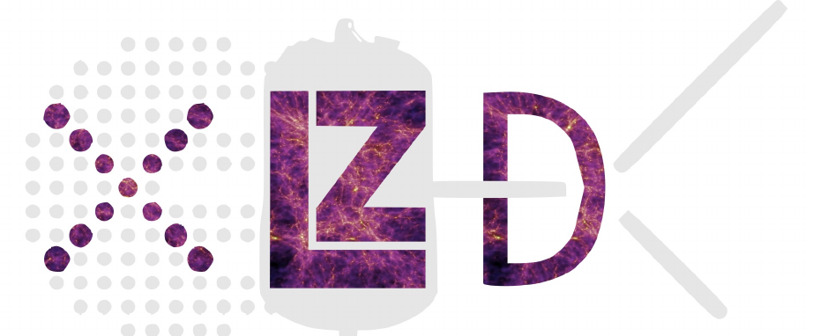

Dark matter detection in condensed systems
AIP Summer Meeting
Wollongong -- December 2025
Jayden Newstead
Based on arXiv:2510.06574
James Dent
Barry Friedman
Subir Sabharwal

Slide 2
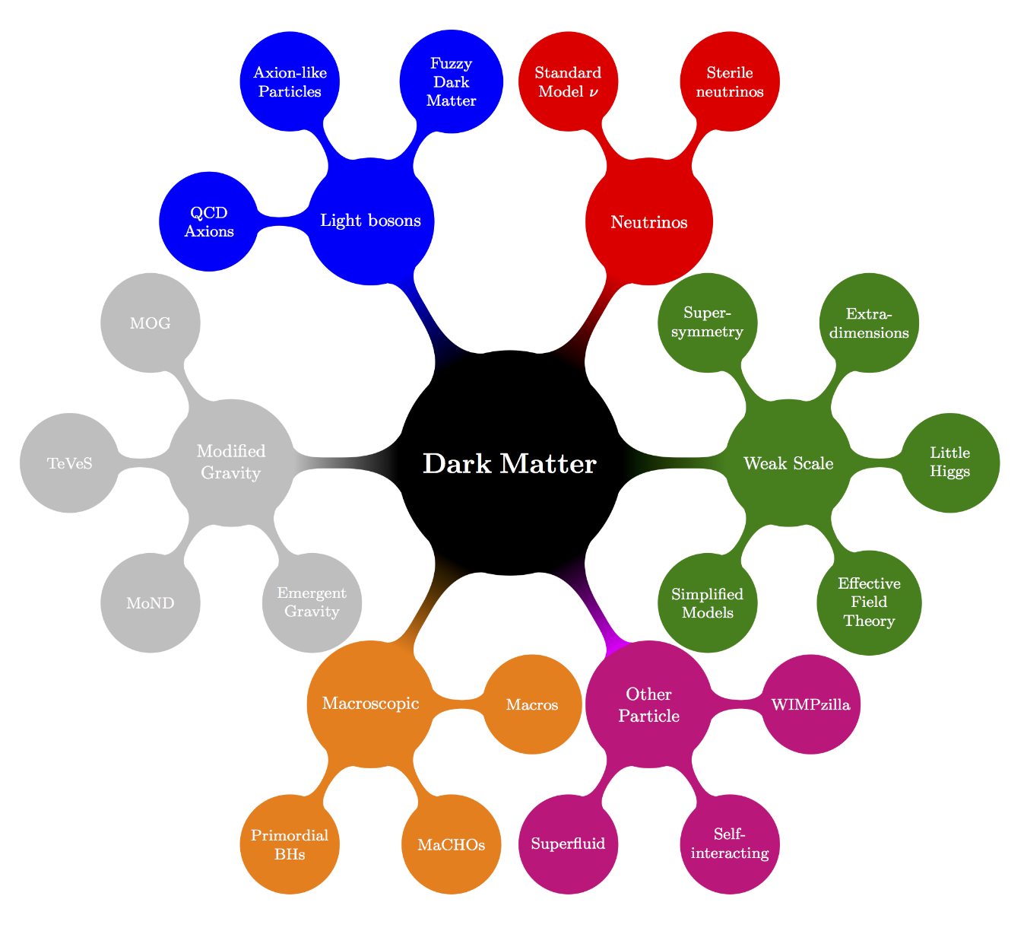
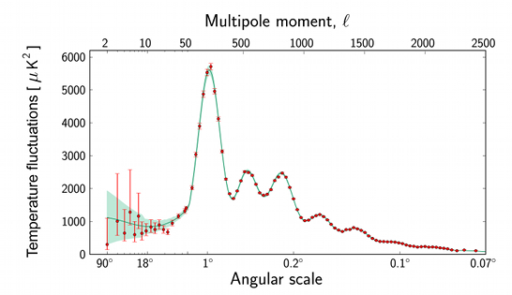
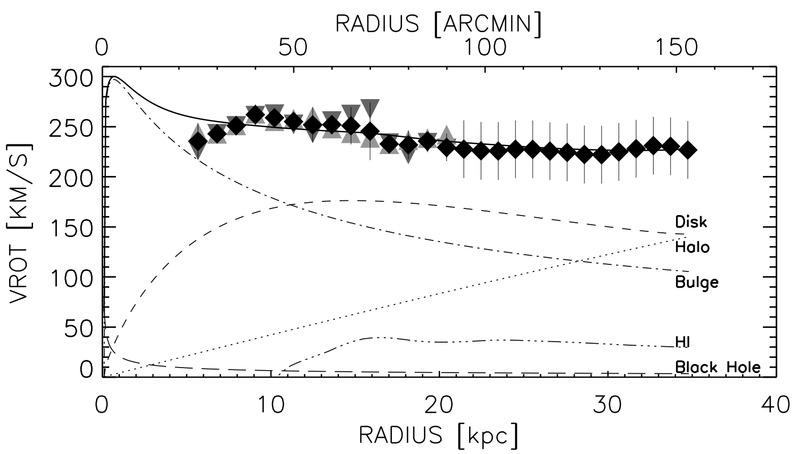
There is missing mass across large length scales
10²⁶ meters
The Universe
Ω_{b}/Ω_{M} ≈ 15%
~10²⁰ meters
Galaxies
Ω_{b}/Ω_{M} ≲ 10%
Planck Collaboration, Astron.Astrophys. 641 (2020)
C. Carignan et al. ApJ Lett. 641 (2006)
“Candidates” credit: T. Tait
24
Notes:
The standard model of cosmology, Lambda-CDM, fit the data extremely well (with just 5 free parameters),
The best fit parameters tell us the density of DM explain OMEGA
On the scale of galaxy clusters we have these wonderful examples of gravitational lensing, where the mass of the foreground galaxy cluster is warping space and acting as a lens for a background galaxy.
Baryons are ‘missing’ in galaxies due to feedback which blows baryons into the intergalactic medium
SO we have strong evidence for DM across many scales.. What about smaller scales? It’s tricky

Slide 3
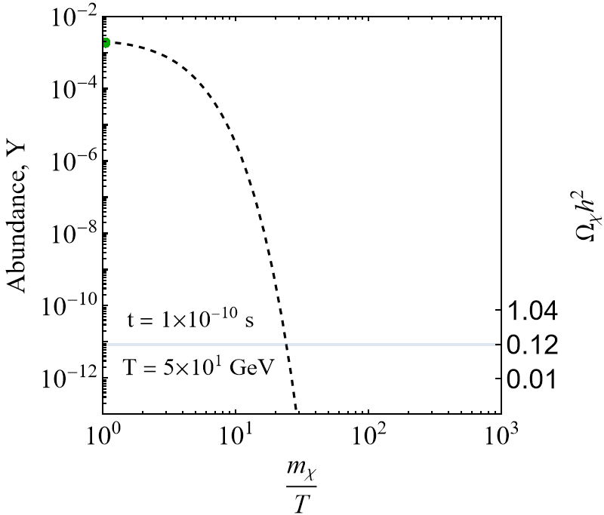
Dark matter production: thermal freeze out
WIMP
miracle
Example:
m_{𝜒}= 50 GeV
<𝜎v> = 0.21 x 10⁻²⁶ cm²
<𝜎v> = 2.1 x 10⁻²⁶ cm²
<𝜎v> = 21 x 10⁻²⁶ cm²
Ω_{DM}h² = 0.12
Planck Collaboration, Astron.Astrophys. 641 (2020)
Y.Zel’dovich Sov. Phys. JETP 21 (1965), H.Y.Chiu PRL 17 (1966)

Slide 4
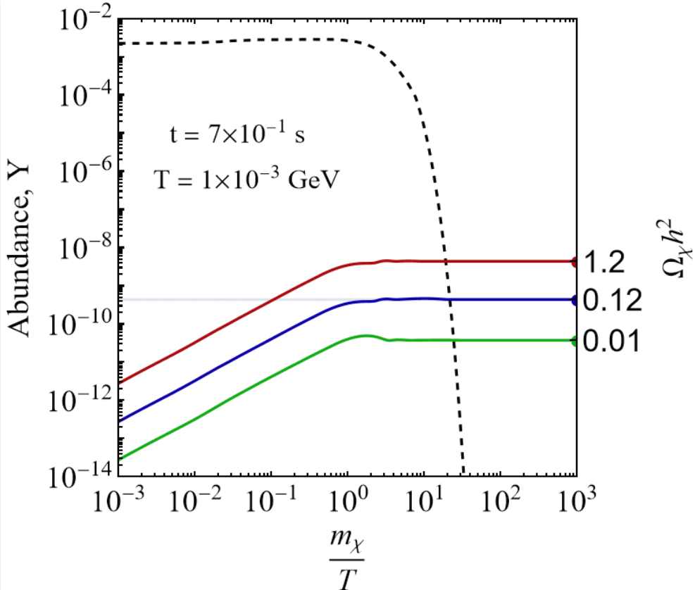
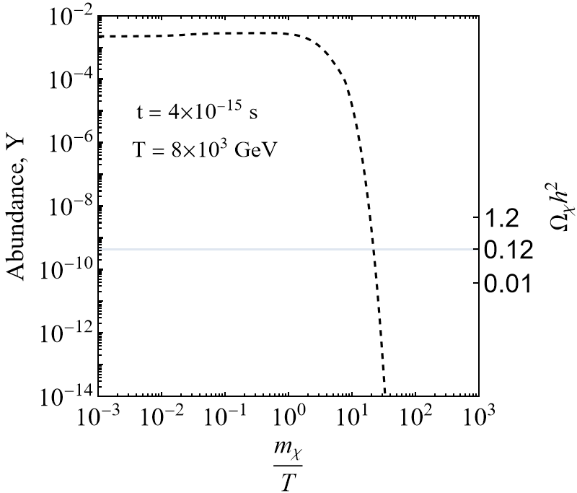
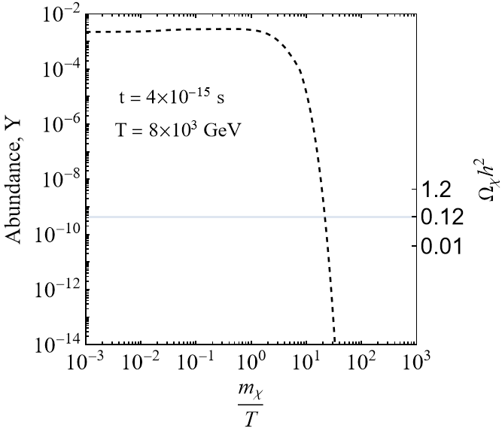

Dark matter production: freeze in
(i) No DM at t = 0,
but it is slowly created:
(ii) Creation stops when Temp. drops below the DM mass
→ DM never in equilibrium
Example:
m_{𝜒}= 1 GeV
<𝜎v> = 0.22 x 10⁻³⁹ cm²
<𝜎v> = 2.2 x 10⁻³⁹ cm²
<𝜎v> = 22 x 10⁻³⁹ cm²
(ii)
(i)
L. Hall et al. JHEP 80 (2010)
Notes:
Why was this invented?
This mechanism can allow you to produce DM down to ~10keV

Slide 5
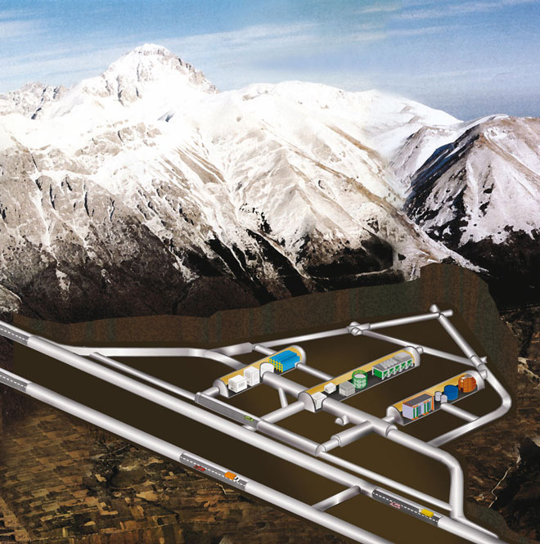
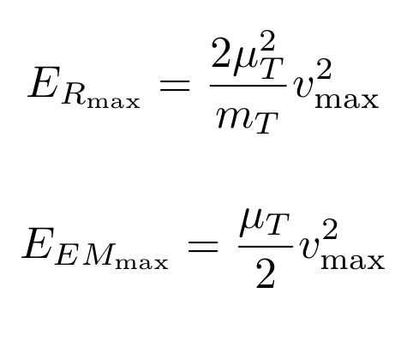
Finding the dark matter: direct detection
Experiments | Target | Readout
XENON/LZ /PandaX/DS | Liquid noble | PMTs
CDMS | Solid state: Si, Ge, CaOW | TES, charge
DAMIC | Si | CCD
PICO | C₃F₈ | Imaging
SABRE | NaI | PMT
Look for signals of dark matter from the galactic halo scattering off nuclei or electrons in a detector
Low-background, controlled experiment generally performed deep underground
Energy
deposit
Readout
Target
Credit: INFN
A.Drukier et al. Phys.Rev.D 33 (1985)

Slide 6
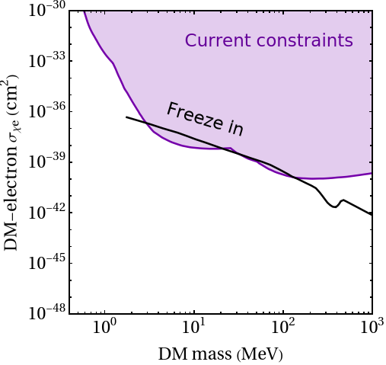
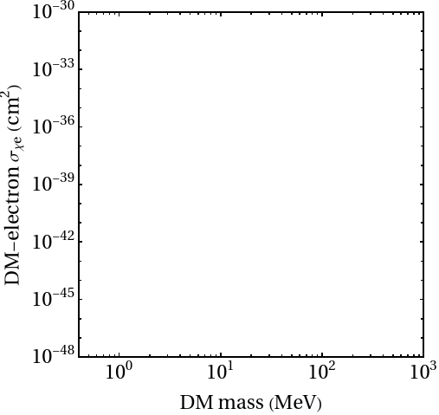
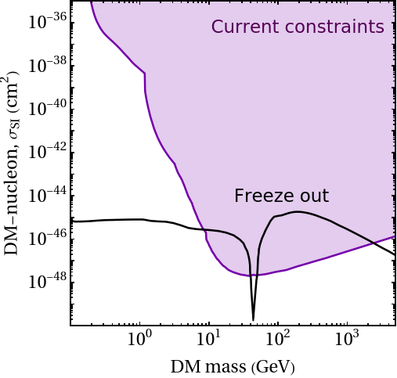
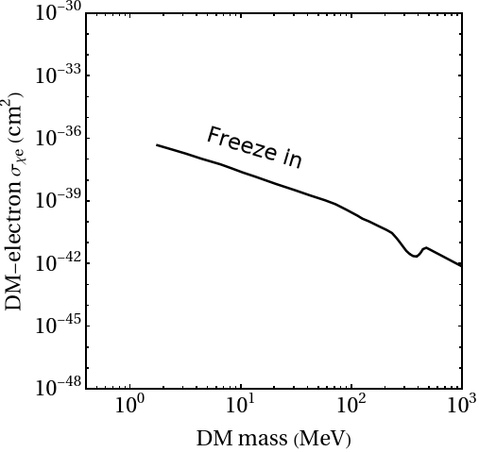
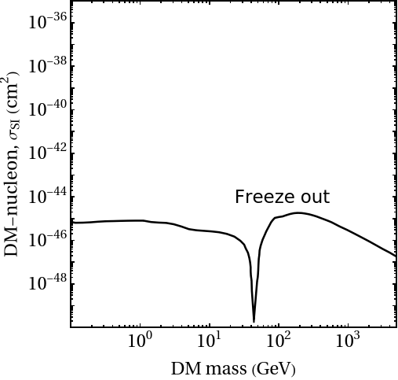
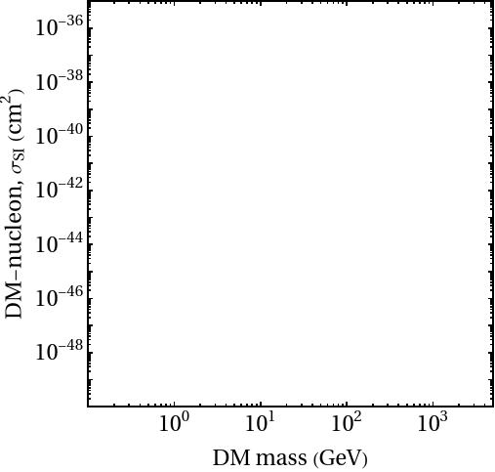
WIMP-nucleon scattering

Slide 7
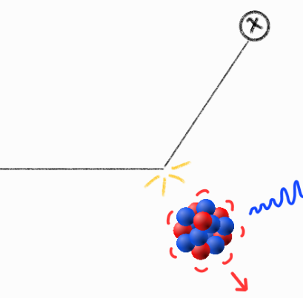
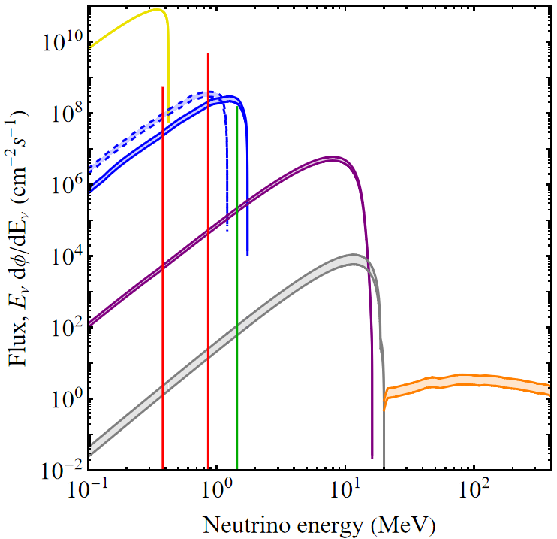
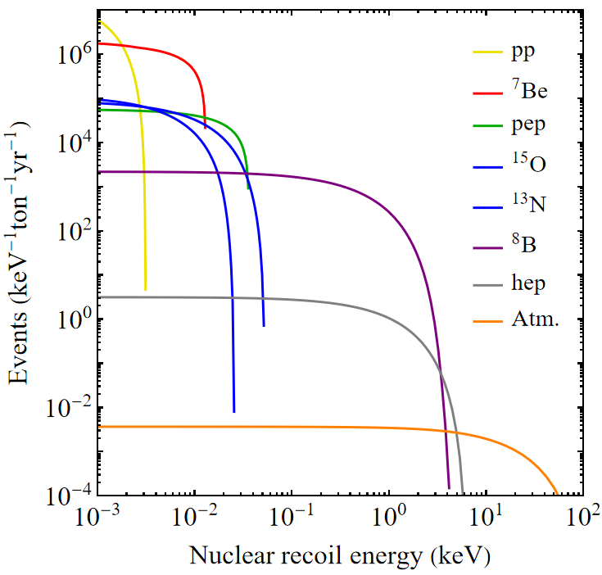
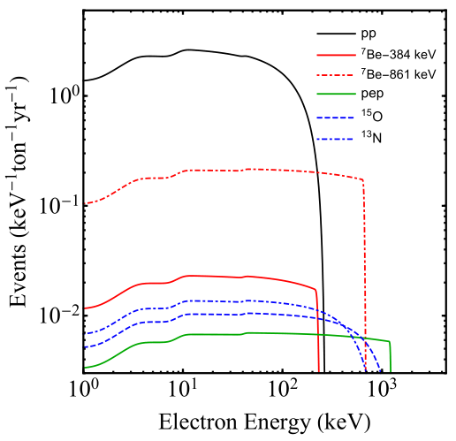
Neutrino backgrounds
Elastic nuclear scattering
(CEvNS)
𝜈
𝜈
Electron scattering
Neutrino fluxes
e
J. Monroe, P. Fisher, Phys.Rev.D 76 (2007) and L. Strigari New J.Phys. 11 (2009)

Slide 8
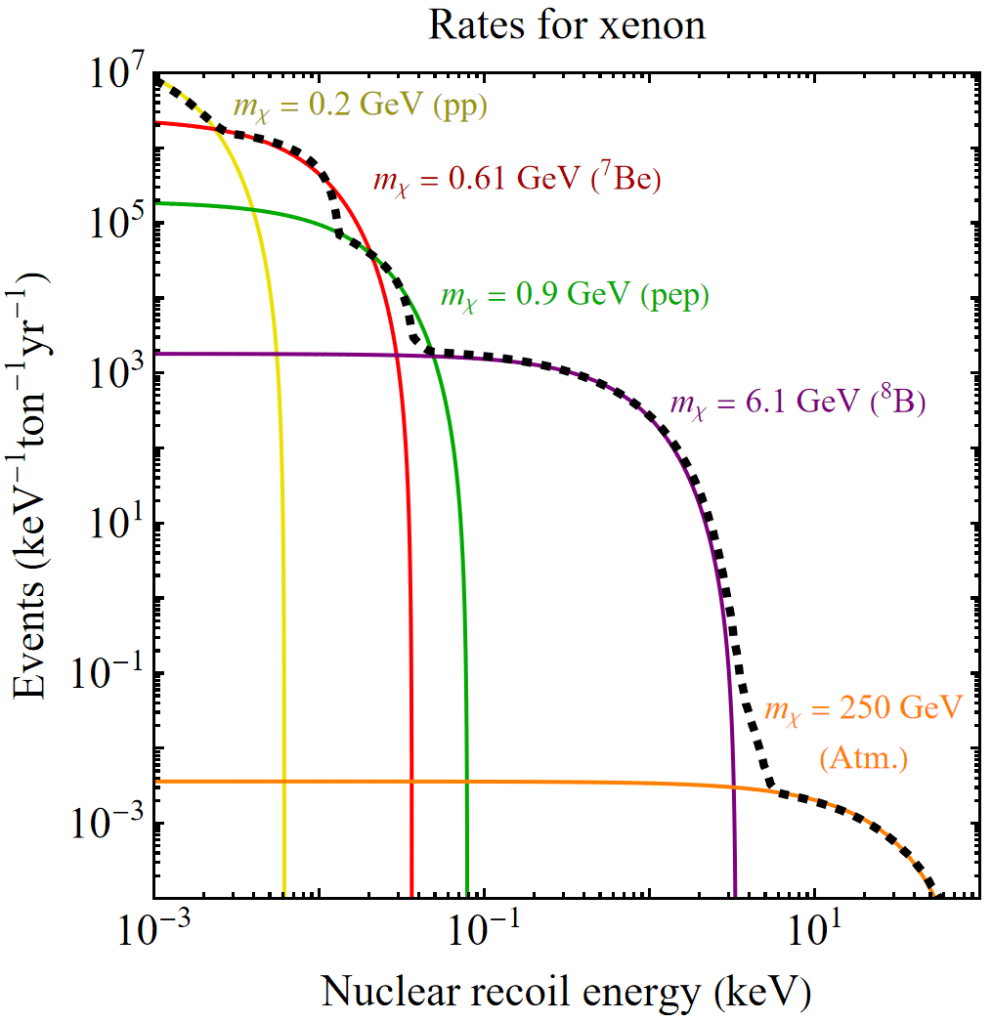
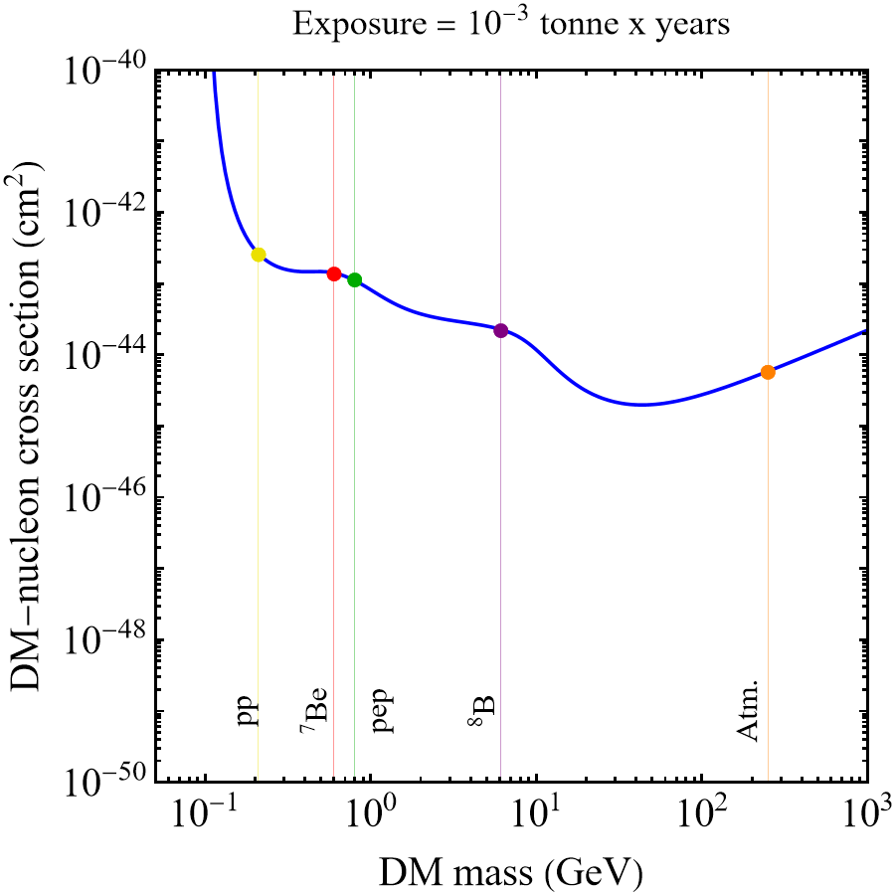
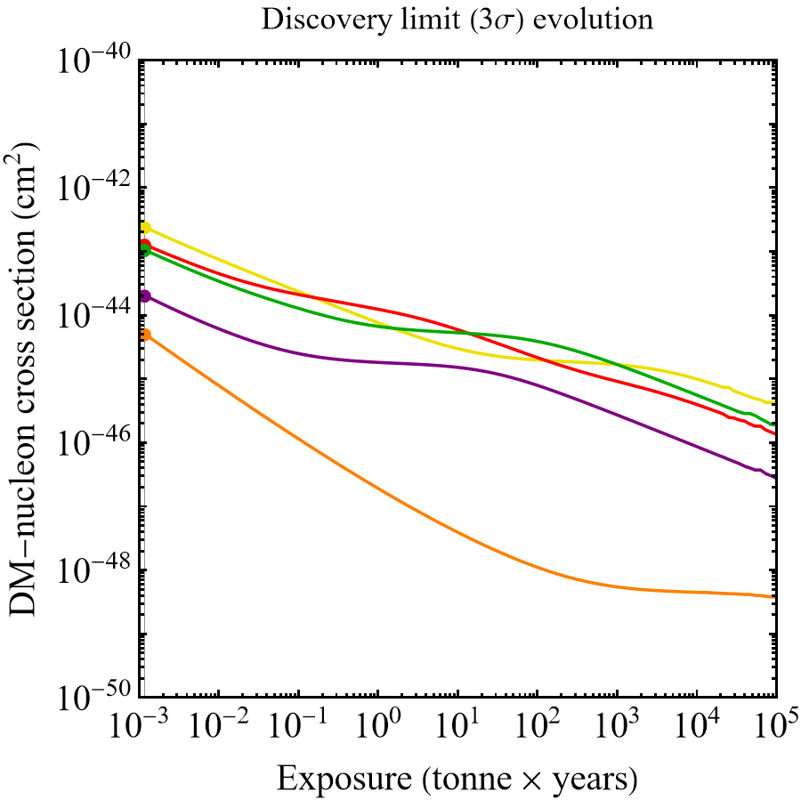
What is the neutrino floor?
→ Directional detection, annual modulation, target complementarity can be used to mitigate this effect
Notes:
Remind some basic statistics:
Bg free: 2x exposure (time or mass) = 2x sensitivity
etc

Slide 9
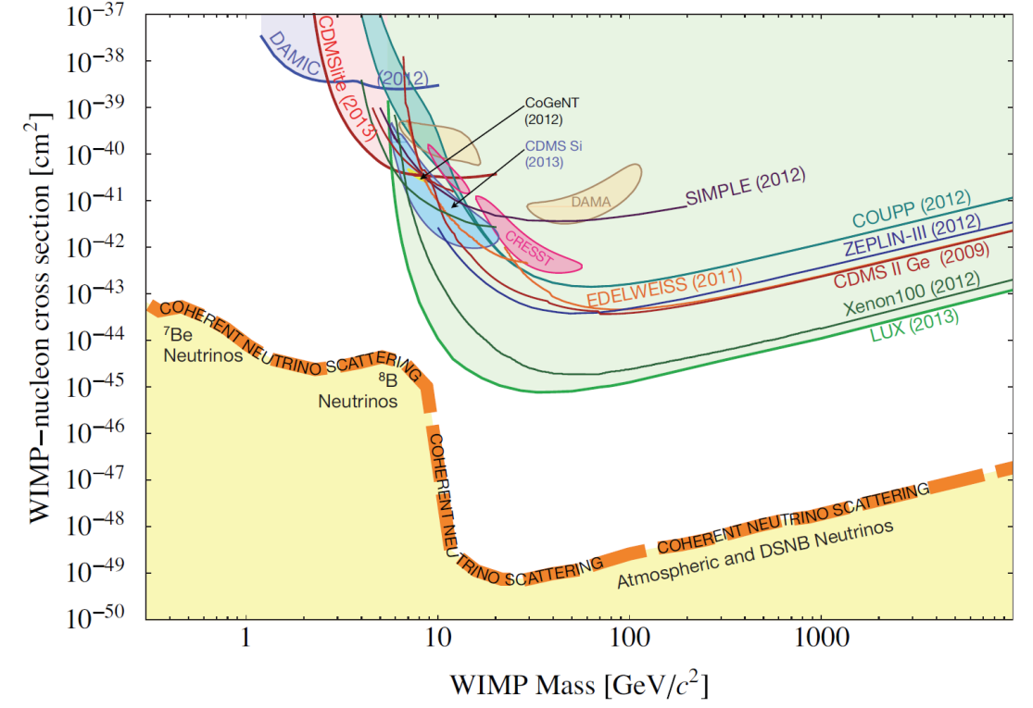
The neutrino floor for dark matter-nucleon searches
J. Billard et al. arXiv:1307.5458
Notes:
Remind some basic statistics:
Bg free: 2x exposure (time or mass) = 2x sensitivity
etc

Slide 10
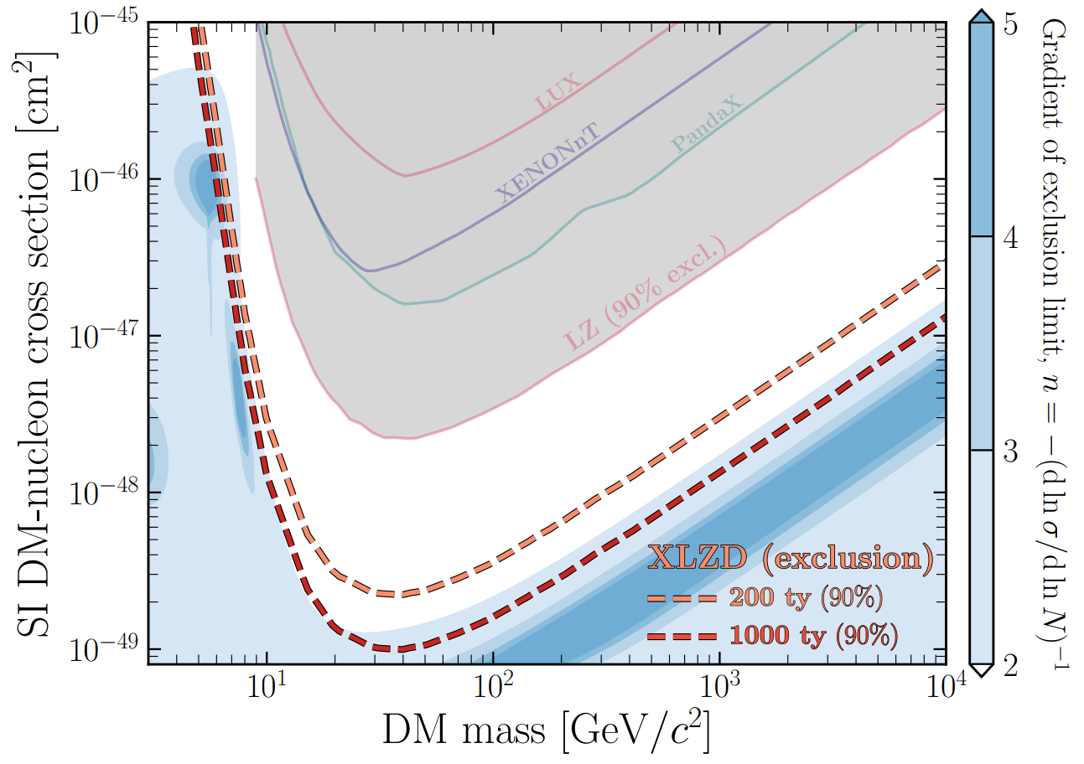
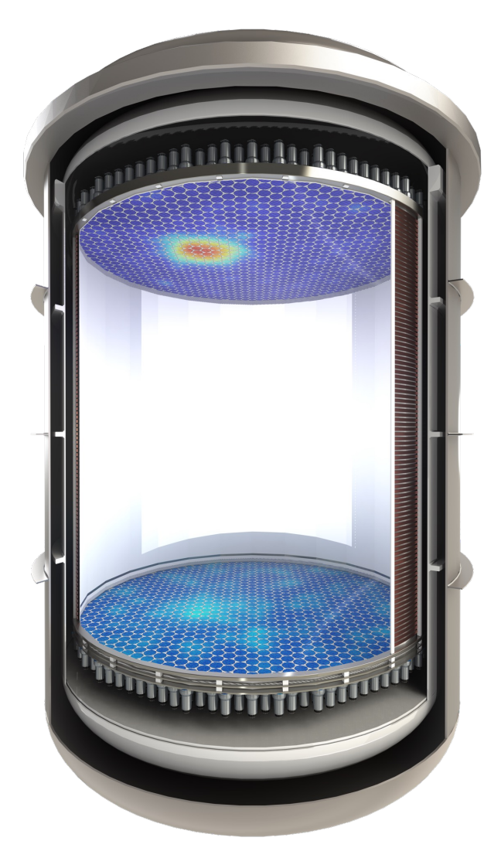
Future (heavy) dark matter-nucleon detection
XENON-LUX-ZEPLIN-DARWIN
60–80 tonne
(2035+)
XLZD design book, arXiv:2410.17137

Slide 11
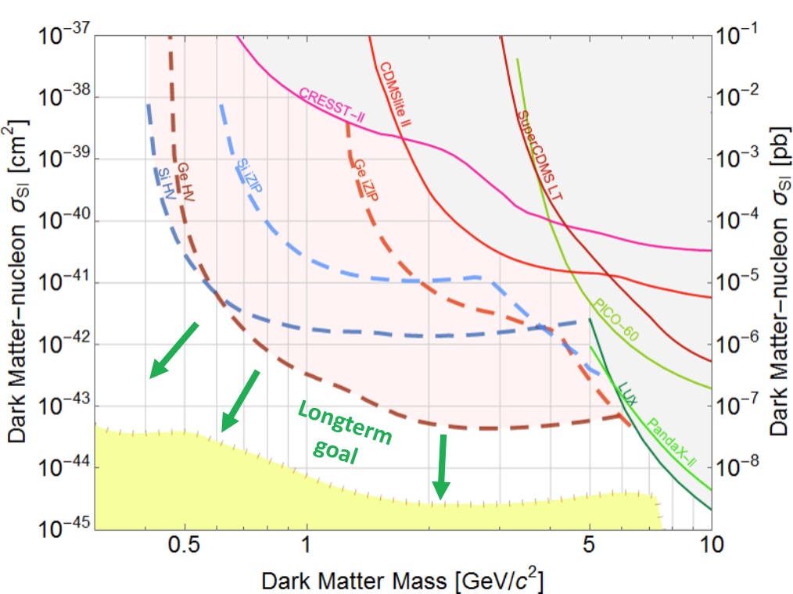
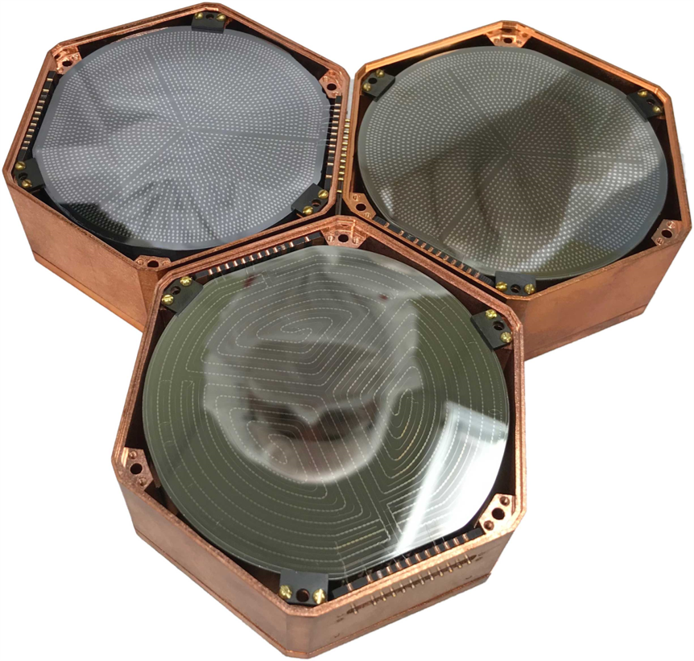
Future light dark matter-nucleon detection
SuperCDMS
~25 kg Ge / 3.6 kg Si
(Commissioning now)
R. Agnese et al. (SuperCDMS) PRD 85 (2017)

Slide 12
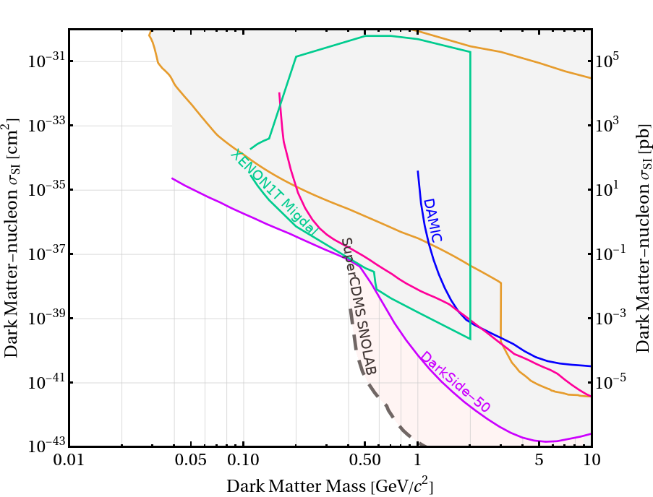
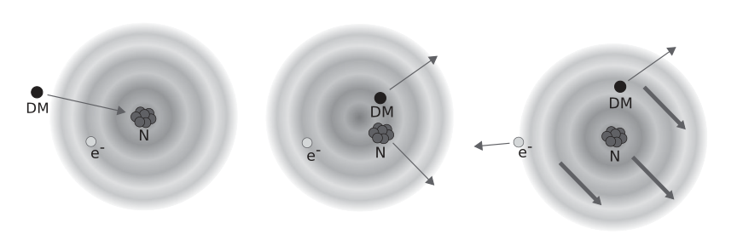
Future light dark matter-nucleon detection
-- via the Migdal effect
The Migdal effect may give large liquid detectors sensitivity at low masses
Credit: Dolan et al. PRL 2017
See Ananthakrishnan’s talk at 12:15pm today!

Slide 13
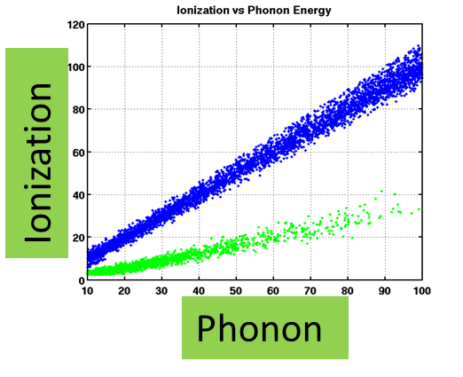
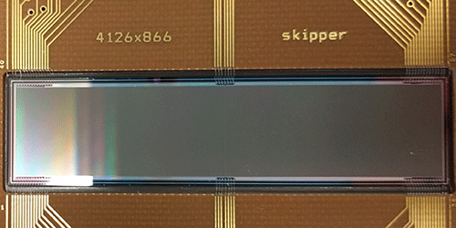
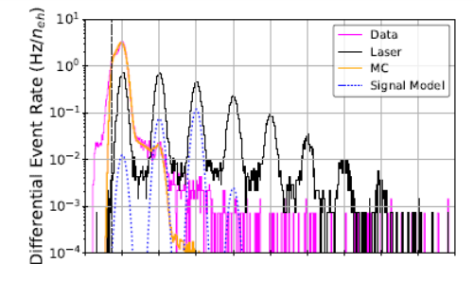
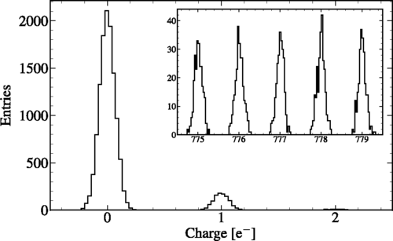
Solid-state detectors
Don’t scale as well as liquids, but are exquisitely sensitive:
CCDs:
Bolometers:
Single charge →
~eV scale
J. Tiffenberg et al. Phys.Rev.Lett. 119 (2017)
R. Agnese et al. Phys.Rev.Lett. 121 (2018)
Notes:
Skipper: 140K
iZIP: 50mK

Slide 14
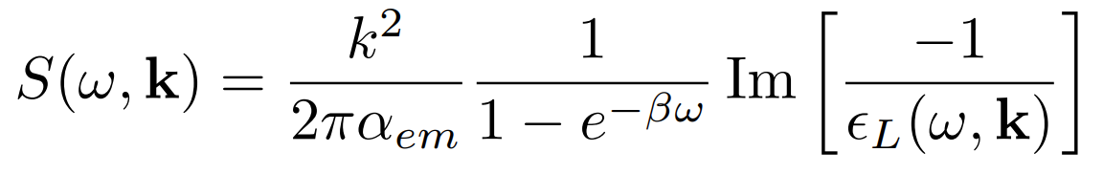
DM- and neutrino-electron scattering in dielectrics
DM, neutrino
Dynamic structure factor:
Energy loss function (ELF)
Encodes material’s electronic response to both electron and nuclear scattering (including screening and exciting collective plasmon modes)
Target
Electronic excitation with:
𝜔 -- energy
k -- momentum
S. Knapen et al. Phys. Rev. D 104 (2021)

Slide 15
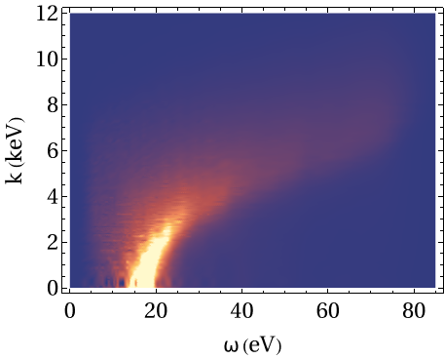
Calculating the electron energy-loss function
Analytic models (e.g. Mermin oscillators) not expected to be accurate in this regime
We computed the dielectric function using density-functional theory (DFT), using the package GPAW
Our computations compared well with previous results
Assuming T = 0 K

Slide 16
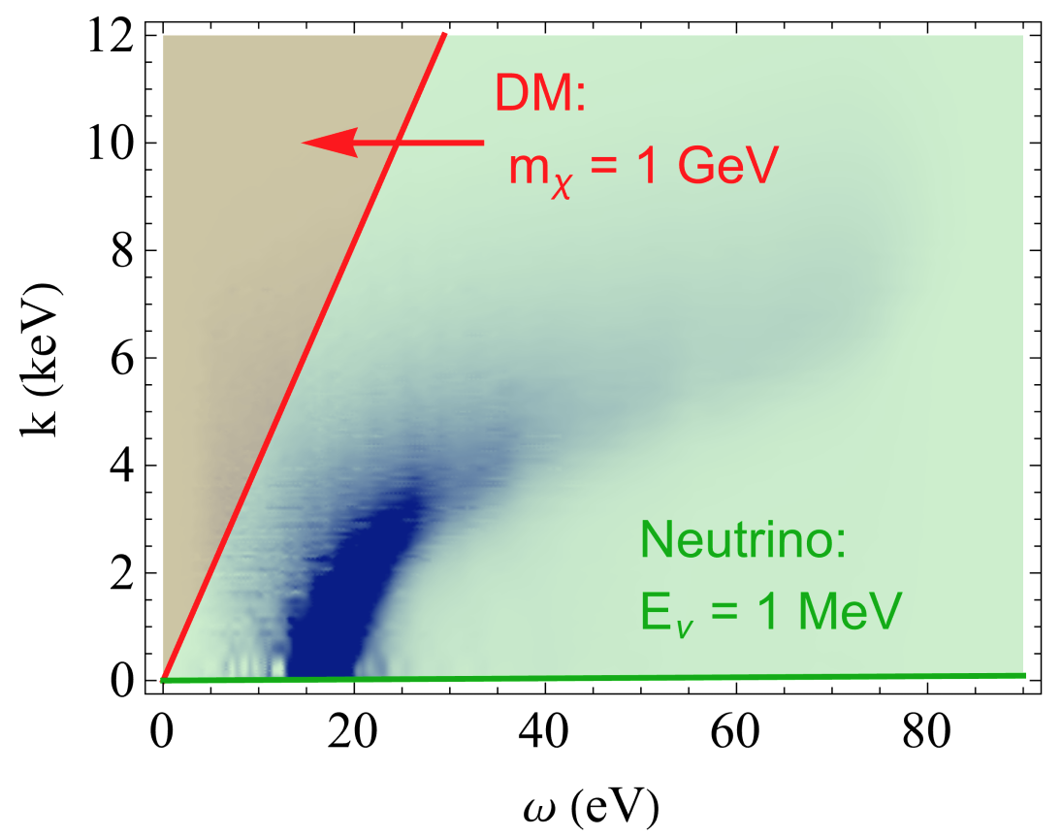

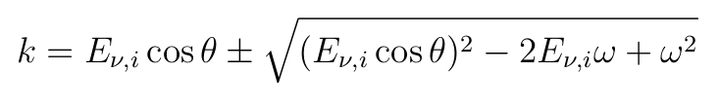
Modified kinematics of electronic scattering
Dark matter:
Neutrinos:
→ Neutrinos probe the plasmon resonance

Slide 17
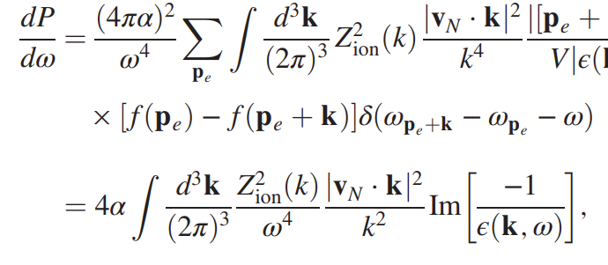
Dielectric function for the Migdal effect
We can use the same function to compute the Migdal probabilities for valence electrons
DM, neutrino
Energy loss function (ELF)
Target
Electronic excitation with:
𝜔 -- energy
k -- momentum
S. Knapen et al. Phys.Rev.L 127 (2021)

Slide 18
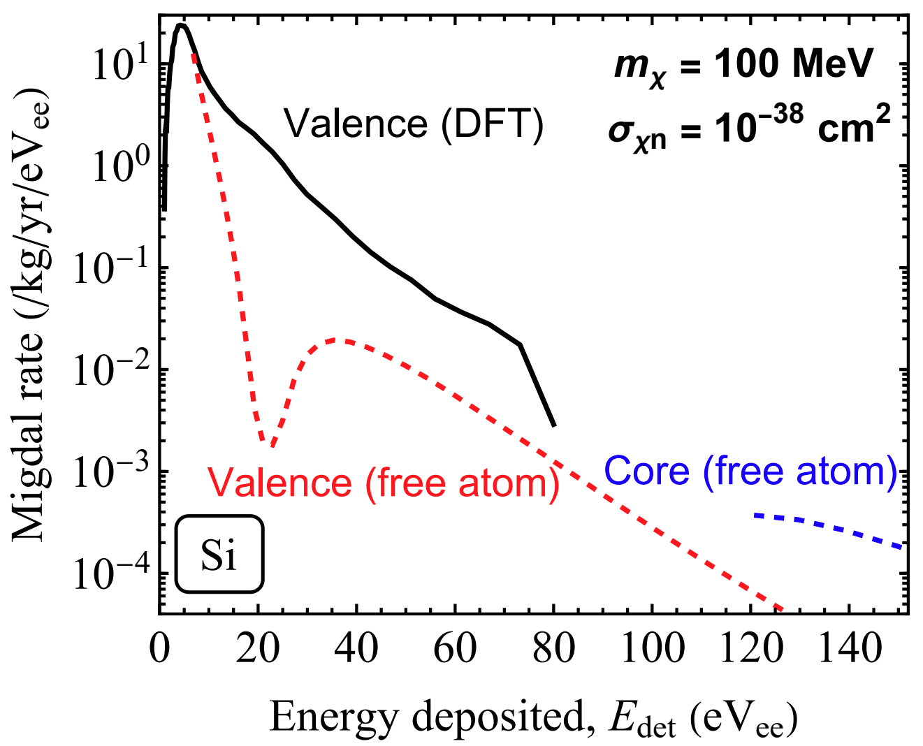
The Migdal effect in semiconductors
We compared the free atom rate (using Cox et al. probabilities) with the rate obtained from the energy-loss function
We find the rates obtained using DFT are much higher

Slide 19

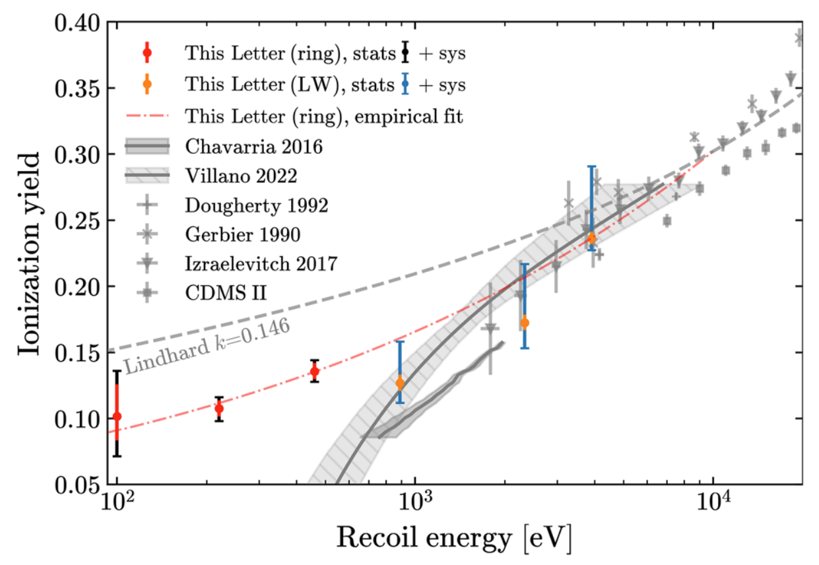
Nuclear recoil quenching
When considering nuclear recoils, not all energy is available for ionisation
The Lindhard model (used extensively in the literature) works well at higher energies
New data below 1 keV recoil is now available and shows that Lindhard is overly optimistic
M. F. Albakry et al. (SuperCDMS), PRL 131, (2023)

Slide 20
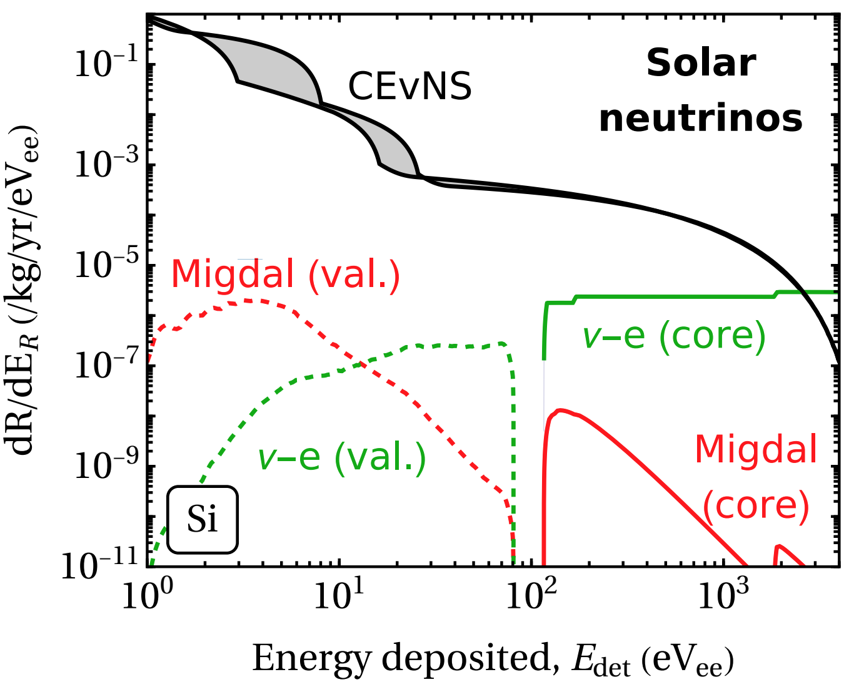
Results: solar neutrino backgrounds
As before, solar neutrinos backgrounds can be due to electron scattering and CEvNS
If there is no discrimination between electronic and nuclear recoils, CEvNS dominates
If there is discrimination, Migdal from CEvNS can become important at low energy

Slide 21
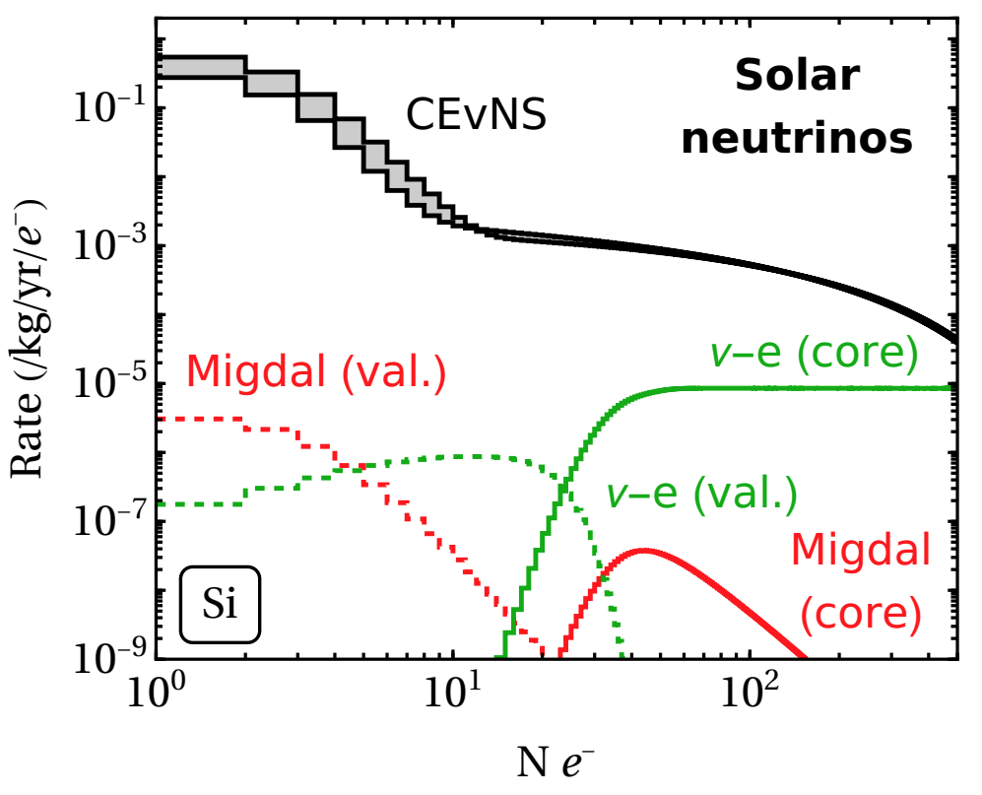
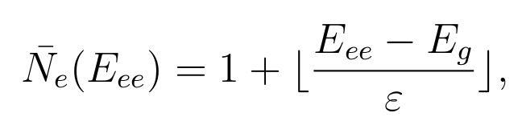
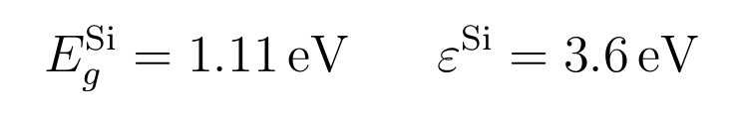
Results: solar neutrino ionisation signals
Here, I’m assuming all signals detected via ionisation
→ Current single-charge sensitive detectors cannot discriminate between nuclear/electron recoils

Slide 22
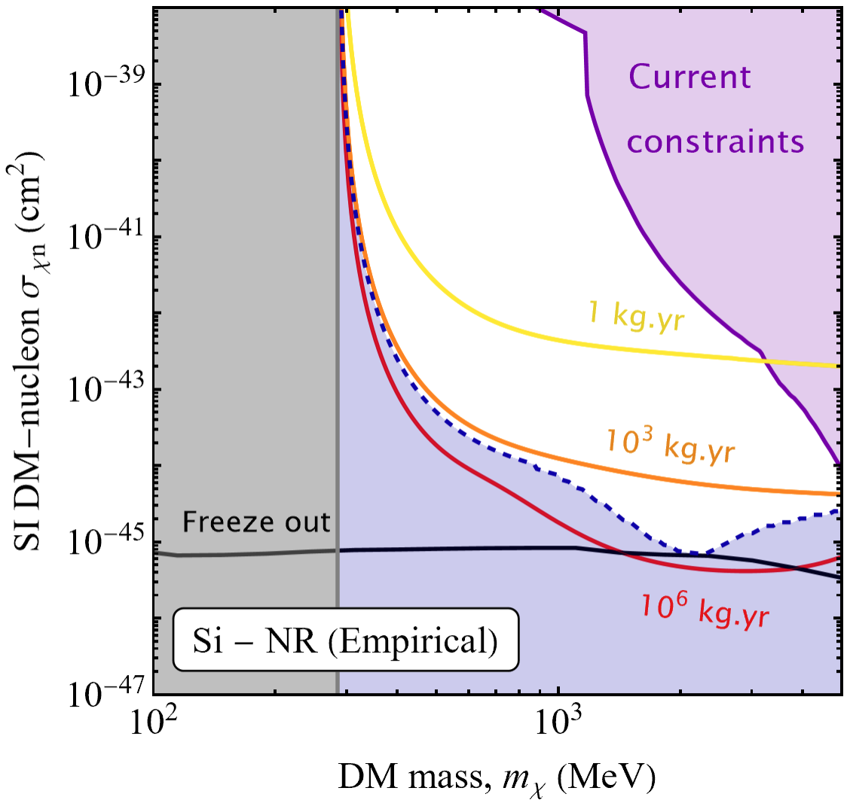
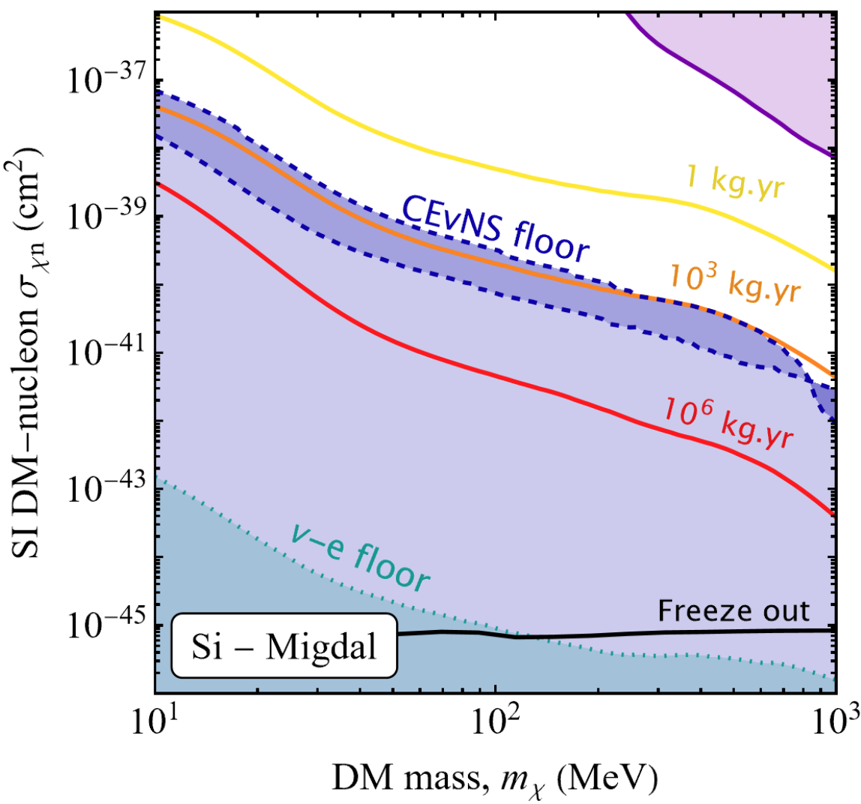
Results: projected sensitivity to DM-nucleus interactions

Slide 23
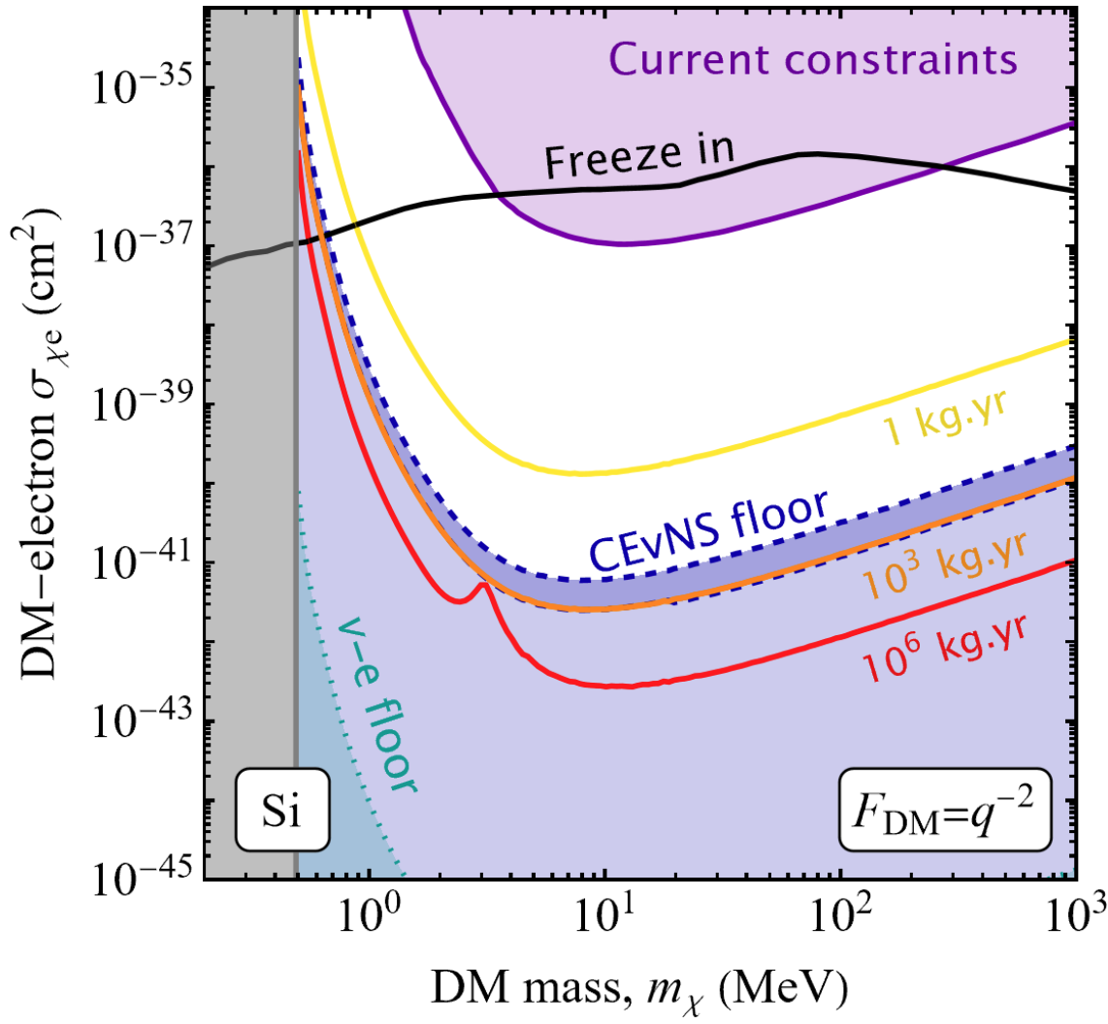
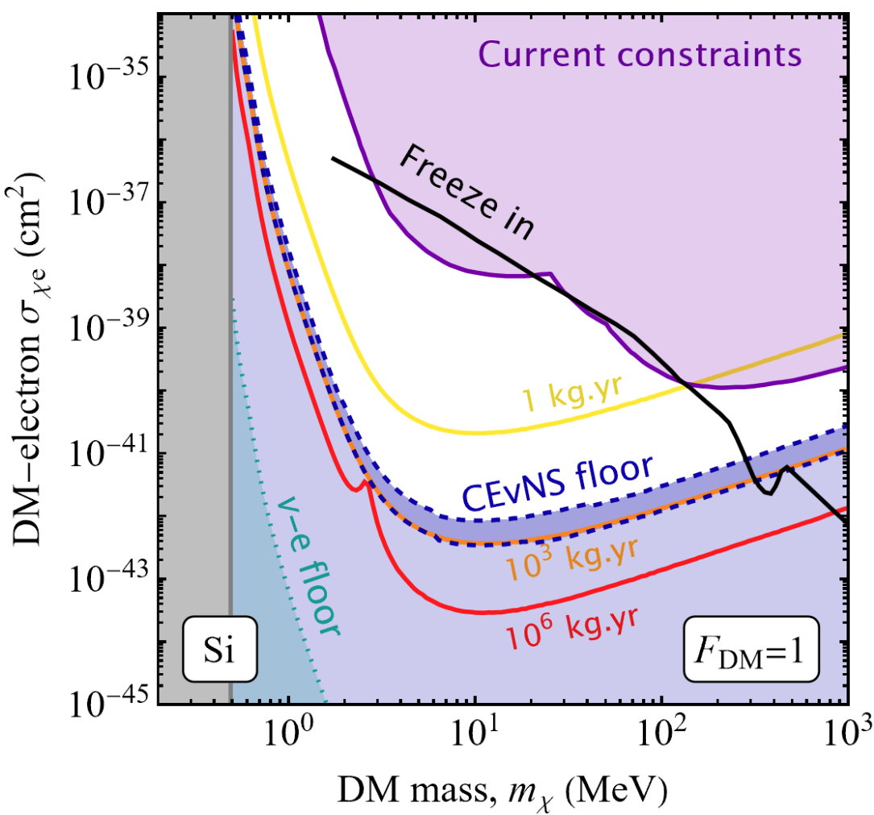
Results: projected sensitivity to DM-electron interactions
Light mediator
Heavy mediator

Slide 24
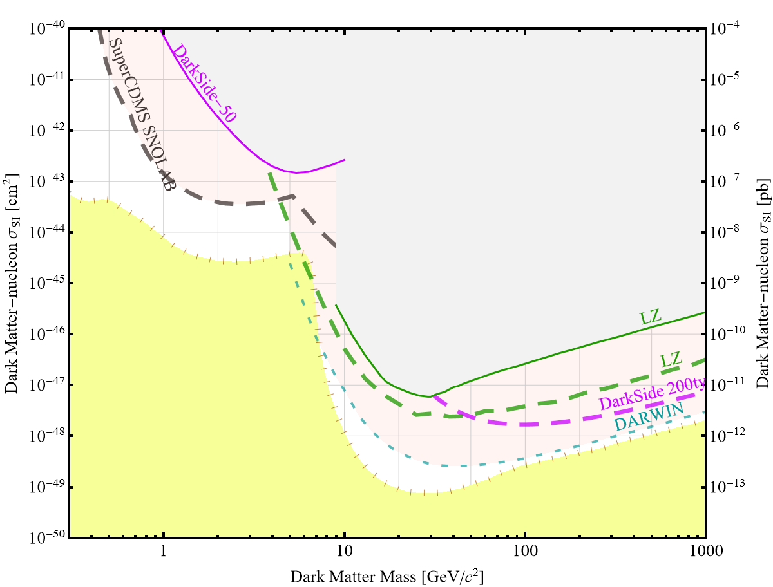
Summary
Future of direct detection
WIMP and FIMP dark matter is not dead -- many experiments will continue to probe it over the coming decade
We computed neutrino scattering in solids, which has important corrections at very low energies
Xenon detectors are still leading the sensitivity race at high masses, but solid-state detectors will be crucial for lower-mass dark matter
Collaborators:
James Dent (Sam Houston State University)
Barry Friedman (Sam Houston State University)
Subir Sabharwal (University of Rhode Island)

Slide 25
Backup slides

Slide 26



Dark matter elastic scattering, annual modulation:
Xenon target
𝜎_{𝜒p} = 10⁻⁴⁷ cm²
Threshold = 1 keV
This is the signal SABRE aims to measure
Direct detection of dark matter: theory & experiment
48

Slide 27




Example:
Xenon target
𝜎_{𝜒p} = 10⁻⁴⁷ cm²
Dark matter elastic nuclear scattering
m_{𝜒}
Differential rate (spin-independent)
(e.g. events/tonne/year/keV):
Nuclear physics
m_{T}
E_{R}
Where:
Particle physics
Astrophysics
*spin-independent only

Slide 28


Dark matter elastic nuclear scattering
How can we be sure a signal is DM?
Sun+Earth’s motion causes the rate to modulate throughout year and give DM a preferred direction
Credit: Pauline Gagnon

Slide 29




Dark matter elastic scattering, directional signals:
Earth’s motion in the Galaxy induces dark matter wind from the direction of Cygnus
The recoiling nuclei will also have a preferred direction
Currently, the technology for measuring the direction of keV scale recoils is in its infancy but under heavy R&D
CYGNUS-Oz is a group currently focused on R&D for a future directional DM experiment to be located in SUPL
F. Mayet Physics Reports 627 (2016)

Slide 30



Experiment: Anatomy of a TPC detector
Electronic
Nuclear
Credit: XENON1T collaboration
XENON1T Phys.Rev.Lett. 119 (2017)
48

Slide 31



WIMP-nucleon scattering
Simplified models:
Not-so-simple models:
XLZD design book, arXiv:2410.17137
GAMBIT collaboration, arXiv:2209.13266

Slide 32


Light-DM via the Migdal effect in xenon
Constraints:
N.Bell, JLN et al. Phys.Rev.D 101 (2020)
M. J. Dolan, F. Kahlhoefer, and C. McCabe, Phys.Rev.Lett. 121(2018)

Slide 33

Migdal effect for CEvNS
N.Bell, JLN et al. Phys.Rev.D 101 (2020)

