Slide 1
Constraining the scale of matter-radiation equality with peculiar velocities
Yan Xiang Lai
University of Queensland
Cosmic Flows 2025
Notes:
Hi everyone. I am Yan, a third-year PhD student from the University of Queensland. I am going to talk about constraining the matter-radiation equality with peculiar velocity.

Slide 2
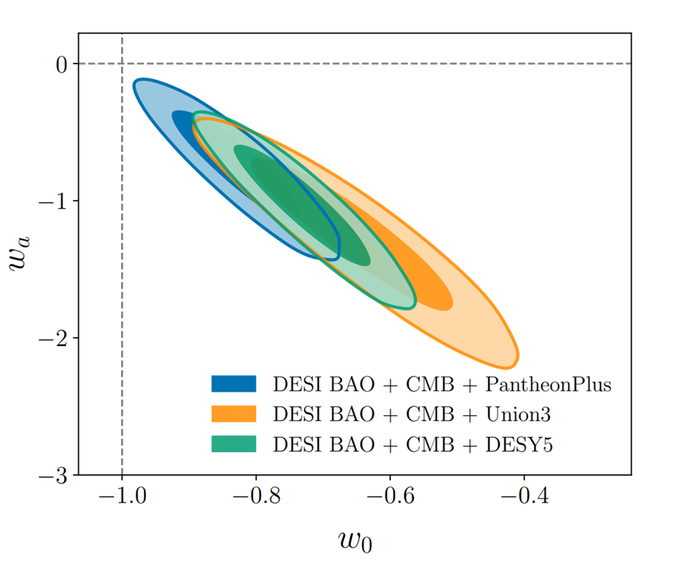
Scale of matter-radiation equality as a standard ruler
DESI Y1 analysis shows dark energy could evolve with time.
Size of the particle horizon at the matter-radiation equality is another standard ruler.
Combining the size of the particle horizon and other probes can constrain cosmological parameters.
Constraining the particle horizon size can provide complementary constraints on cosmological parameters (Bahr-Kalus et al., 2023) .
(DESI collaboration et al, 2024)
Notes:
Why do we want to do that? The plot on the right shows that DESI Y1 Baryon Acoustic Oscillation (BAO) data analysis shows that dark energy may not be a cosmological constant. In the BAO analysis, the sound horizon at the drag epoch can be used as a standard ruler. On the other hand, the size of the particle horizon at the matter-radiation equality is another standard ruler. Similar to the BAO, combining the size of the particle horizon with other probes can provide constraints on cosmological parameters. Previous work by Bahr-Kalus et al 2023 demonstrates that constraining the size of the particle horizon with the galaxy power spectrum can provide complementary constraints on the cosmological parameters. This talk will focus on whether adding the peculiar velocity data can improve the constraints.

Slide 3
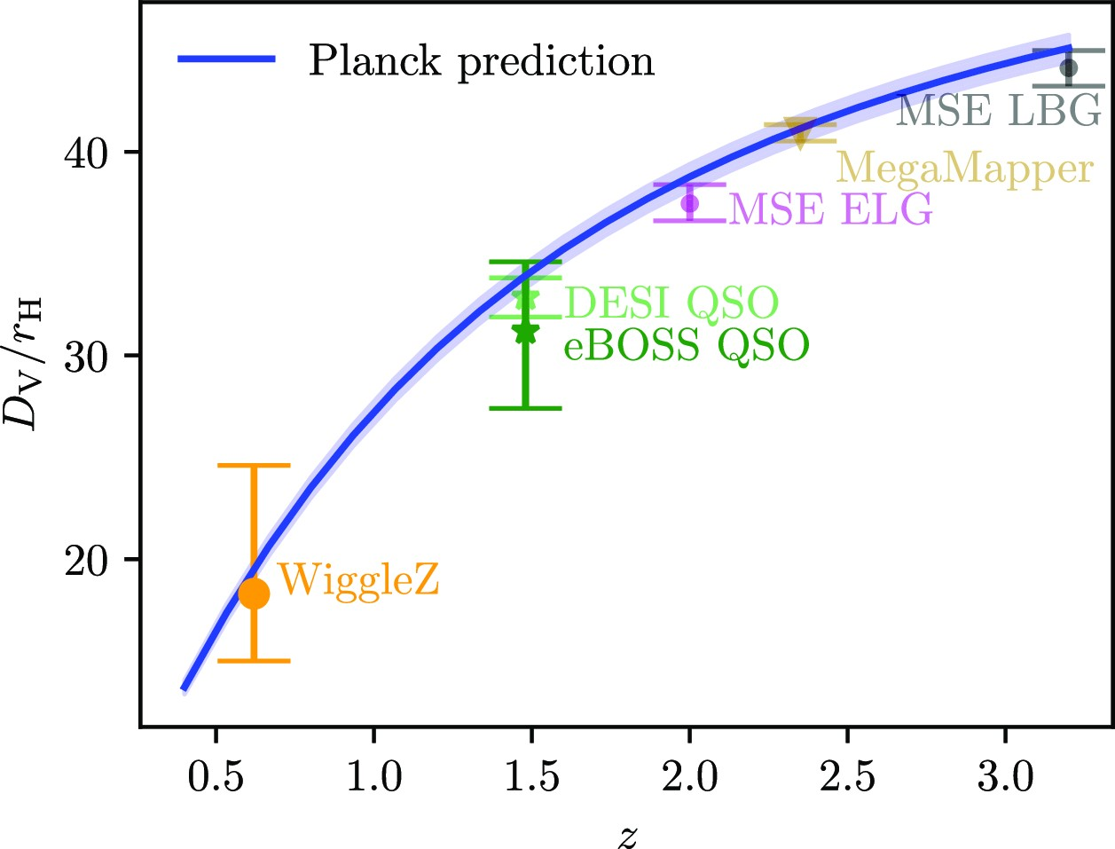

Previous approach with the galaxy power spectrum
$α_{eq}=\frac{k_{eq}}{k_{eq}^{fid}}=\frac{D_{v}}{D_{v}^{fid}}\frac{r_{H}^{fid}}{r_{H}}$.
Missing constraints below z=0.5, where peculiar velocity can improve constraints.
(Bahr-Kalus et al., 2023)
Notes:
The figure on the right here shows the constraints on the ratio of the volume average distance and the size of the particle horizon with WiggleZ and eBOSS QSO and the forecast constraints on DESI and other future surveys from Bahr-Kalus et al 2023. We can the formula on the left to calculate the ratio between Dv and rH by comparing our constraints on the scale of matter radiation equality with its fiducial value. The plot on the right also shows the constraints below redshift of 0.5 is missing. This redshift range will also contain lots of peculiar velocity measurements. Therefore, we want to see whether peculiar velocity can improve the constraints on the scale of matter-radiation equality below z=0.5.

Slide 4



Constraining the turnover of power spectrum.
The scale of matter-radiation equality ($k_{eq}$) is related to the turnover of the power spectrum ($k_{TO}$) by $k_{TO}=\frac{0.194}{ω_{b}^{0.321}}k_{eq}^{0.685−0.121\log_{10}\left(ω_{b}\right)}$ (Prada et al., 2011).
Modelling of the power spectrum is independent of cosmological models (Bahr-Kalus et al., 2023).
$$log⁡(P\left(k\right)k^{q})= \left\{\begin{aligned}−mx^{2}+\log\left(A\right)+1if k<k_{TO} \\ −nx^{2}+\log\left(A\right)+1if k≥k_{TO}\end{aligned}\right.$$
$x=\log_{k_{TO}}({k}) −1$.
Based on the linear theory, $q=0$ for galaxy power spectrum, $q=1$ for cross power spectrum, and $q=2$ for velocity power spectrum.
Down-weighting the scales affected by the BAO with mode-deprojection.
Notes:
The growth of the matter perturbation in the matter-dominated era is different from the radiation-dominated error. This difference in growth for different sizes of matter perturbation creates the turnover point of the power spectrum. However, the transition from the radiation-dominated era to the matter-dominated era is not instantaneous, so the turnover of the power spectrum does not correspond to the scale of matter radiation equality. However, Parda et al., 2011 found that this empirical formula relates the scale of matter-radiation equality and the turnover of the galaxy power spectrum. Omega_b here is the baryon density. We follow Bahr-Kalus et al to use a cosmological model-independent method to model the logarithmic power spectrum as a quadratic function with different slopes m, n at different side of the turnover. A here is the amplitude of the power spectrum, and parameter q depends on the type of the power spectrum. From the linear theory, q = 0 for the galaxy power spectrum, 1 for the cross power spectrum, and 2 for the velocity power spectrum. Based on the linear theory, q = 0 for galaxy power spectrum, q = 1 for the cross power spectrum, and q = 2 for the velocity power spectrum. Tthe model here will obviously fail at the small scale because it ignores other features of the power spectrum, such as the BAO wiggles. However, modelling the BAO will make this method model-dependent. Therefore, we choose to use the mode-deprojection to down-weight the scales affected by the BAO by inflating their error bar. .

Slide 5
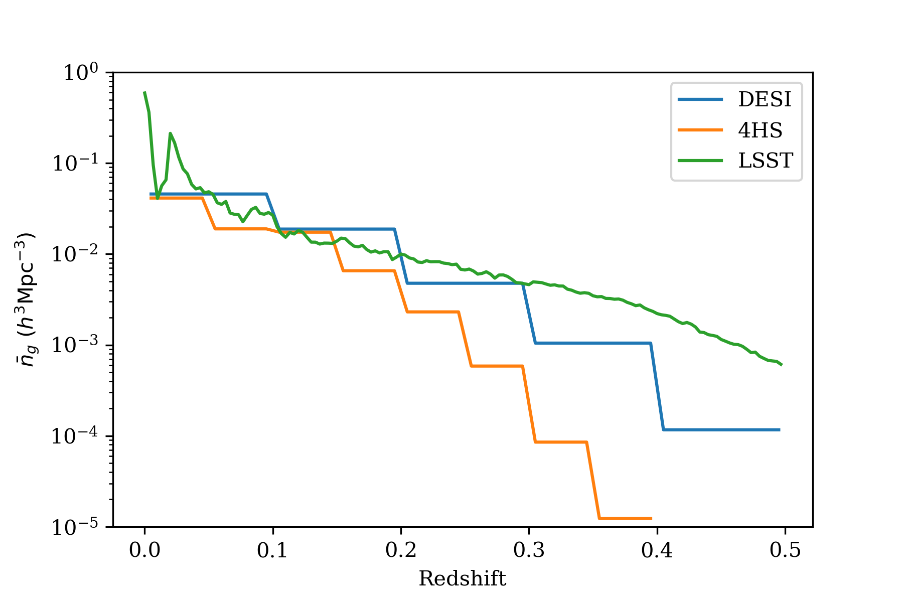
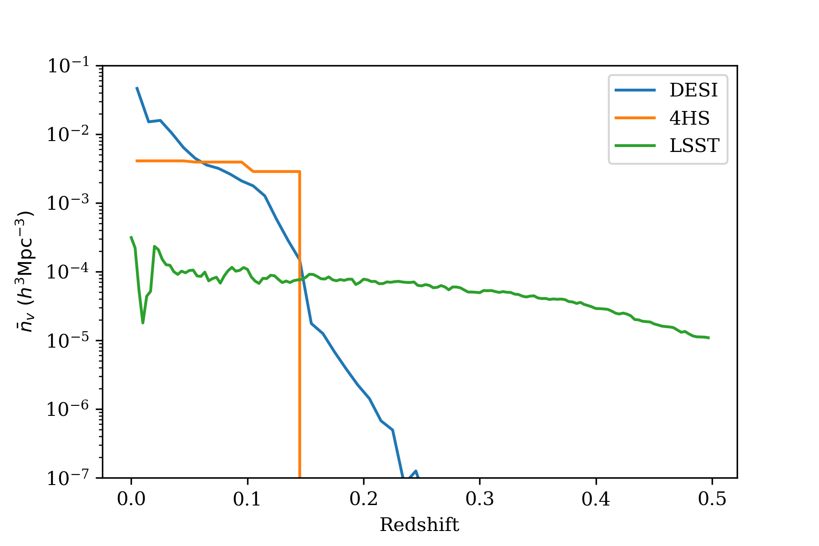



Data and covariance matrices
Analytical Gaussian covariance matrix
Number density of galaxies and peculiar velocities from Whitford et al. (2022).
Data power spectra are generated from linear theory with correction for small-scale FoG from Koda et al. (2014).
$$P_{gg}\left(k, μ\right)={\left(b+fμ^{2}\right)}^{2}P_{mm}\left(k\right)e^{{−\left(kμσ_{g}\right)}^{2}}$$
$$P_{gv}\left(k, μ\right)=\left(b+fμ^{2}\right)\left(\frac{aHfμ}{k}\right)P_{mθ}\left(k\right)e^{−\frac{{\left(kμσ_{g}\right)}^{2}}{2}}\left(\frac{\sin\left(kσ_{u}\right)}{kσ_{u}}\right)$$
$$P_{vv}\left(k, μ\right)={\left(\frac{aHfμ}{k}\right)}^{2}P_{θθ}\left(k\right){\left(\frac{\sin\left(kσ_{u}\right)}{kσ_{u}}\right)}^{2}$$
Notes:
We focus on three current and future surveys: the Dark Energy Spectroscopic Instrument (DESI), the 4Most Hemispheric Survey (4HS), and the Legacy Survey of Space and Time (LSST). We take the number density of galaxies and velocities from Whitford et al 2022, which are shown on the plots at the right. LSST measures the peculiar velocities from supernovae so it can reach higher redshift. We calculate the analytical Gaussian covariance matrices for each survey and generate the data power spectra from the linear theory with the koda et al 2014 empirical model for the small-scale finger of god effect. Here, b is the galaxy bias, f is the linear growth rate, mu is the line-of-sight angle, sigmag is the damping factor for the galaxy, sigmau is the damping factor for the peculiar velocity. The linear power spectra are generated with the Planck cosmology.

Slide 6
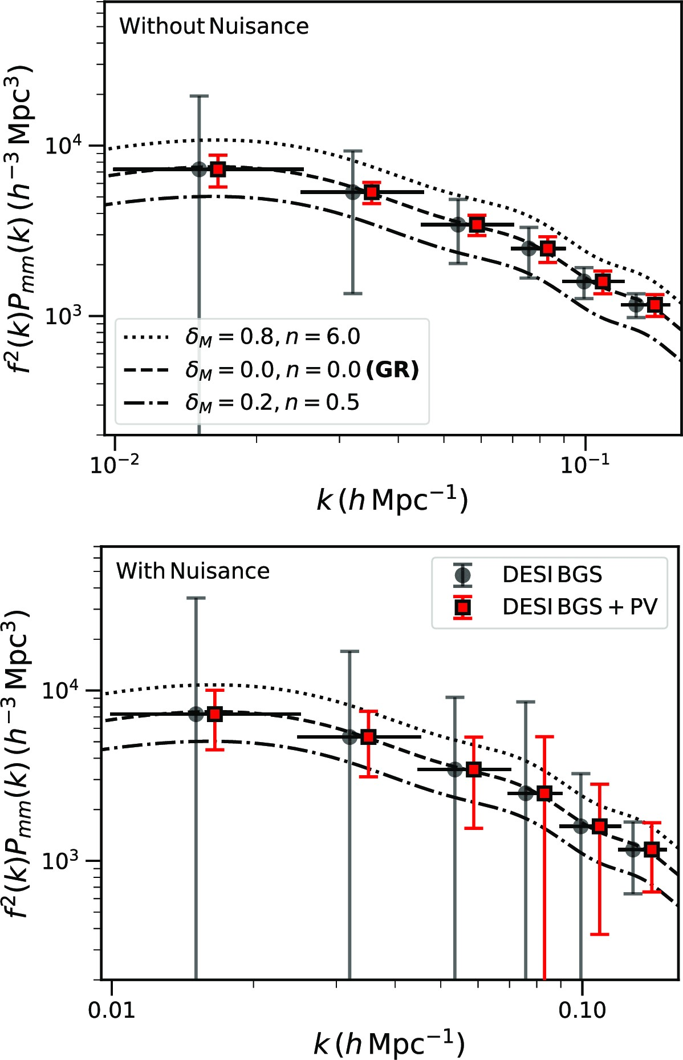

Can peculiar velocity constrain the turnover scale?
The volume of the survey determines the minimum scale.
For DESI and 4HS, $z_{max}^{pv}=0.1$. The minimum scale is $k_{min}≈0.015h/$Mpc $≈k_{TO}^{fid}$.
The minimum scale for the cross-power spectrum is $k_{min}≈0.005 h/$Mpc $≪k_{TO}^{fid}$.
Combining galaxy and cross-power spectra to improve constraints.
(Saulder et al., 2024)
Notes:
One thing we haven’t examined is whether peculiar velocity surveys are large enough to constrain the turnover scale. For DESI and 4HS, since they mainly use the Fundamental Plane and Tully-Fisher relation to measure the peculiar velocity, the redshift limit is around 0.1, which corresponds to kmin around 0.015 h/Mpc. This may not be small enough to detect the turnover scale. The plot on the right is the forecast for DESI's velocity power spectrum measurement and it confirms that using peculiar velocity alone, DESI may not be able to detect the turnover scale. However, the minimum scale for the cross-power spectrum from DESI will be much smaller than the turnover scale. Therefore, for DESI and 4HS, we can combine the galaxy and the cross-power spectra to improve constraints on the turnover scale. For LSST, we can combine all three power spectra because it can measure peculiar velocities out to redshift of 0.5.

Slide 7
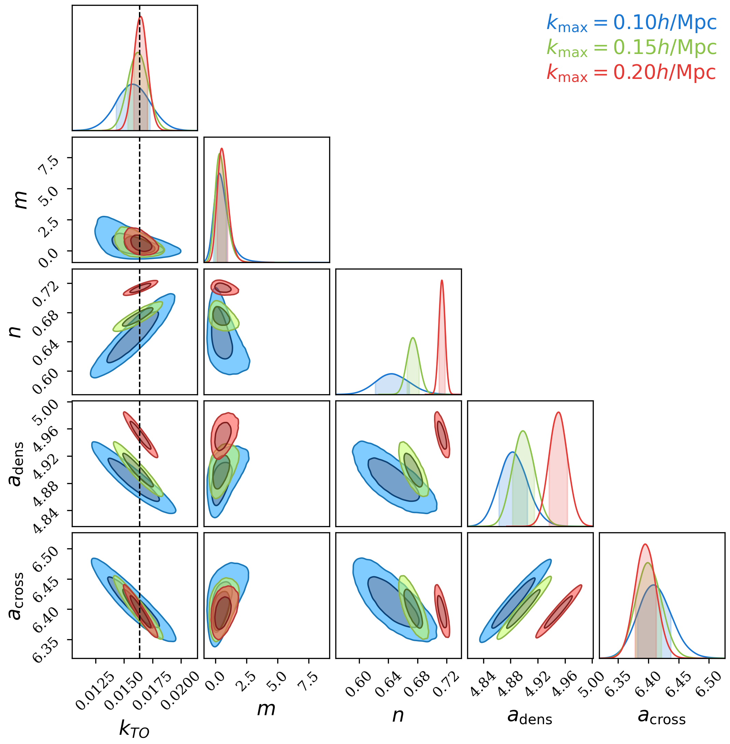
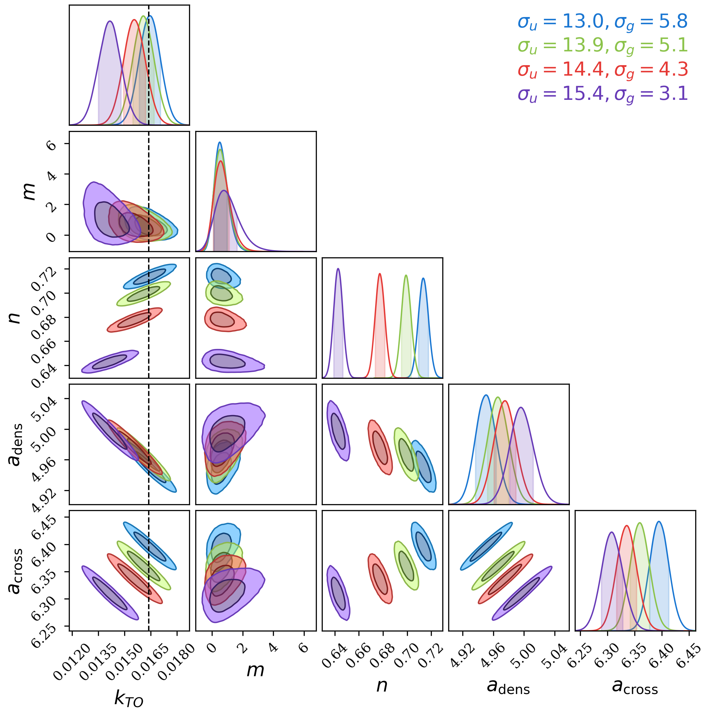
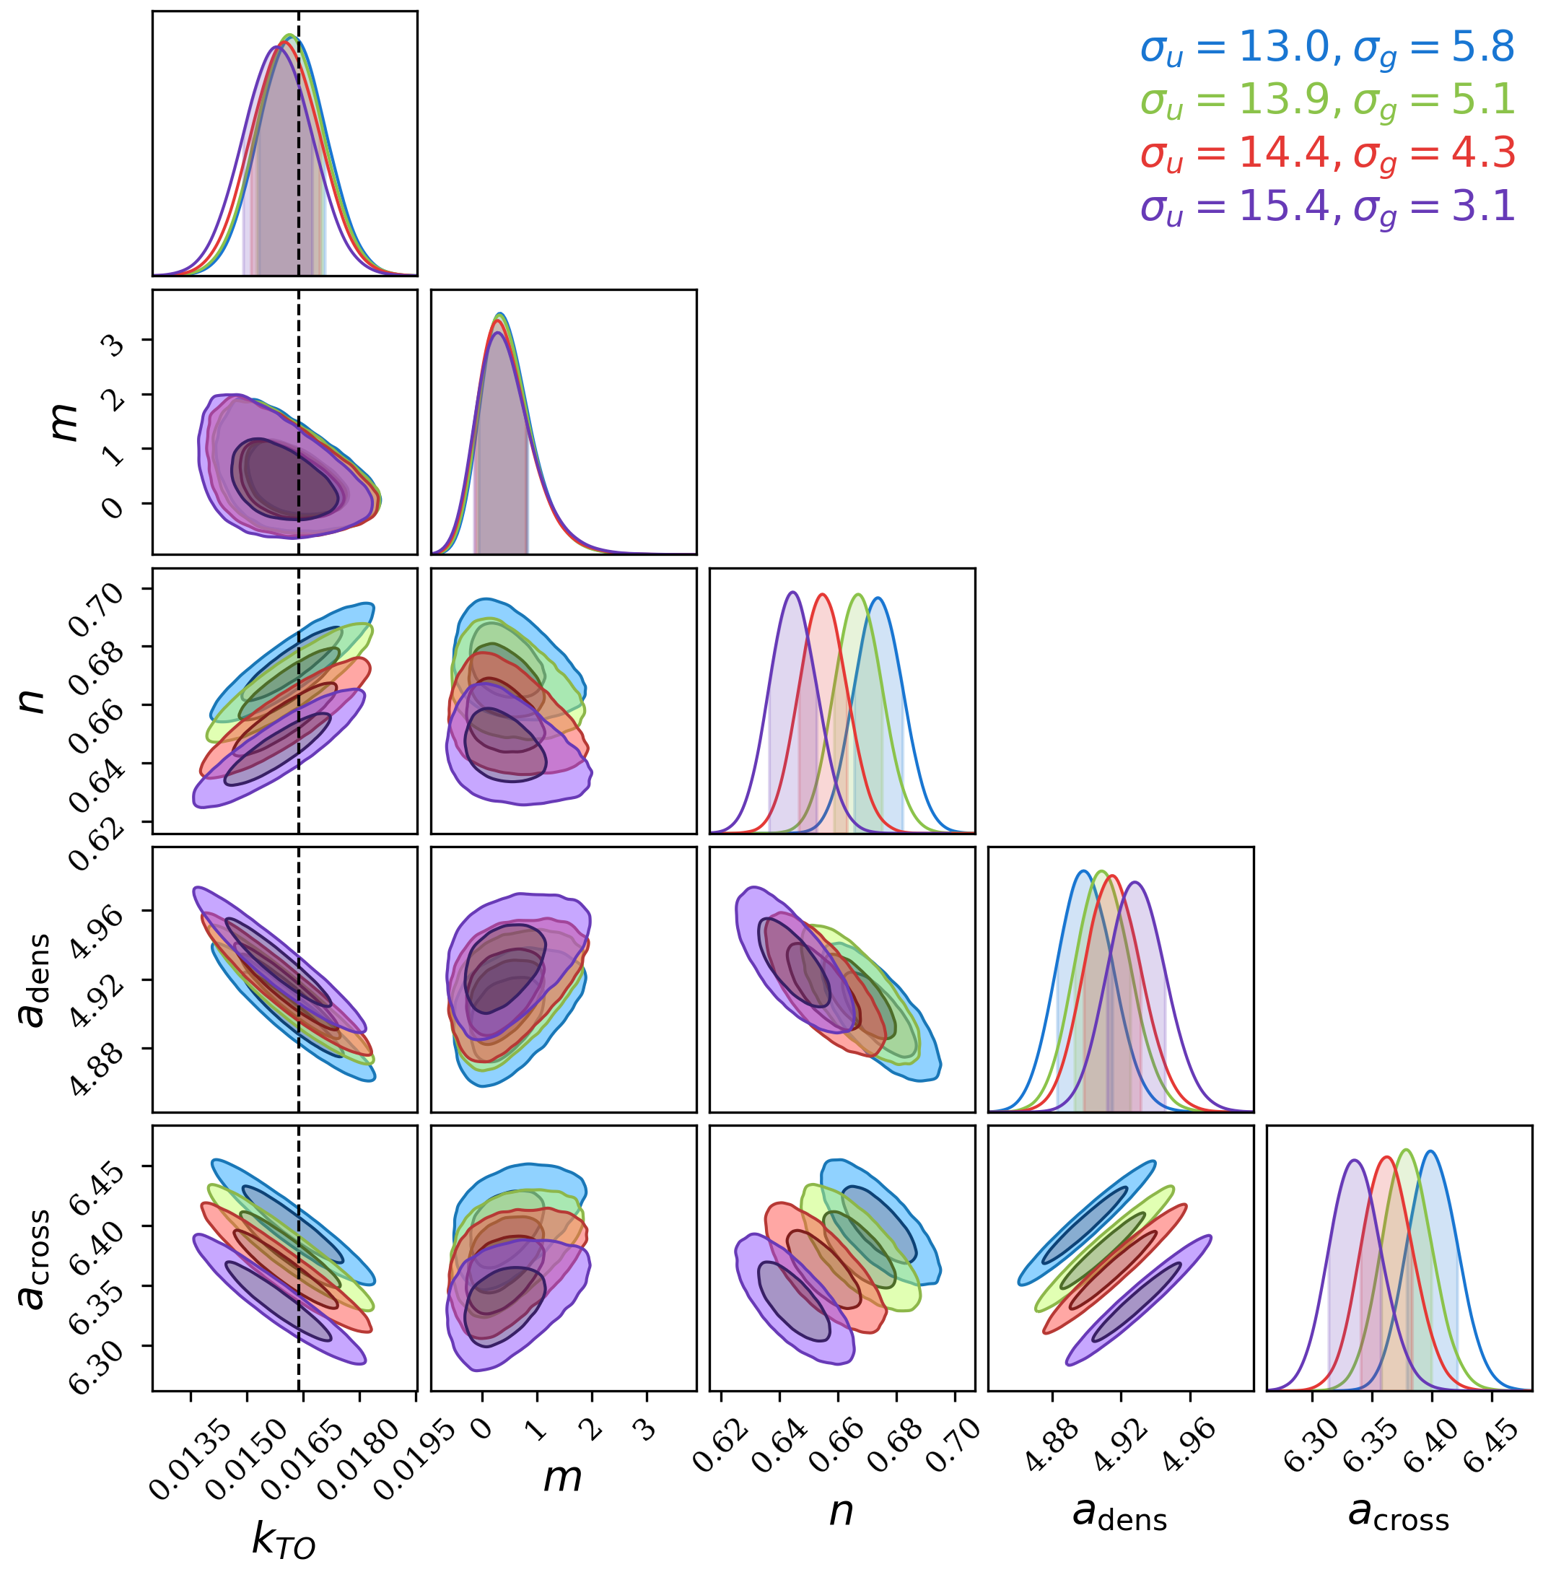



Effect of $k_{max}$ and the damping factor
$k_{max}=0.20 h/$Mpc
$k_{max}=0.15 h/$Mpc
Notes:
We fit our model to data. The left figure shows the effect of kmax on the constraints on the turnover scale. Theoretically, increasing kmax should not improve the constraint on the turnover scale because the turnover scale is much smaller than the kmax we used here. However, the left figure shows that the turnover scale is degenerate with the parameter n, which is the slope of the power spectrum at scales larger than the turnover. Therefore, increasing kmax can improve the constraint on n, which improves the constraints on the turnover scale because of their degeneracy. We also test how different damping factors may affect the constraints on the turnover scale. The four damping factors are chosen from Koda et al 2014 that are fitted to haloes with different masses. With kmax = 0.20 h/Mpc, the damping factors have a large impact on the turnover constraints, which is not expected. Additionally, despite a few of the constraints are consistent with the truth indicated by the black dashed line. They have high reduced chi-squared, which means our model is a bad fit to our data. This is not surprising since we don’t really expect a quadratic model to be a perfect fit to the power spectrum at kmax = 0.20h/Mpc even if we inflate the data error bars through mode deprojection. We reduced the kmax from 0.2 to 0.15 h/Mpc and the damping factors no longer impact the constraints on constraints on the turnover scale. Additionally, it also returns reasonable reduced chi-squared indicated our model is a good fit for the data. Therefore, we choose to set kmax = 0.15h/Mpc.

Slide 8
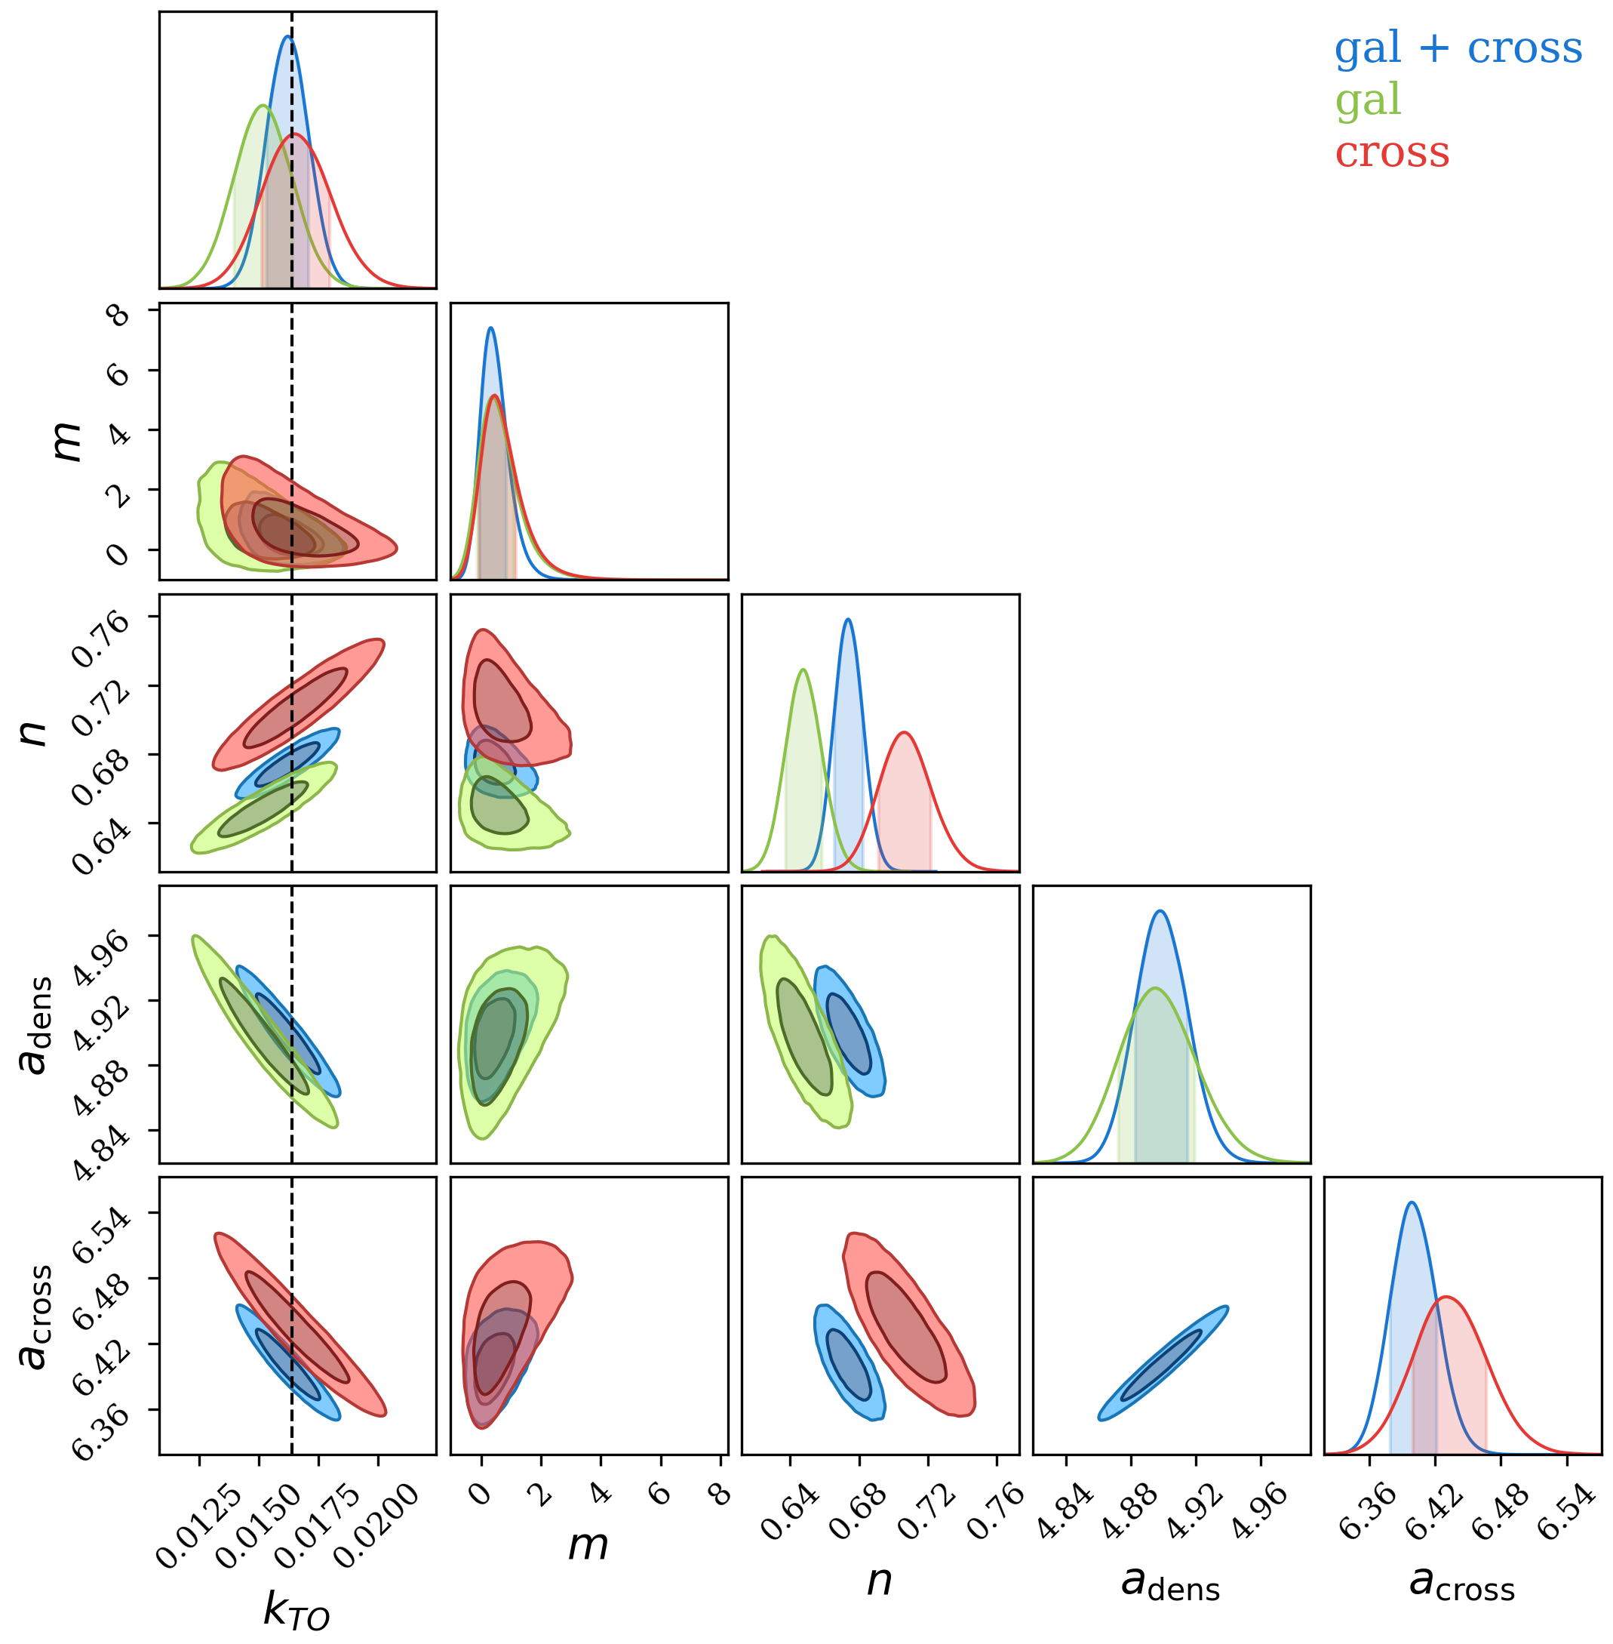
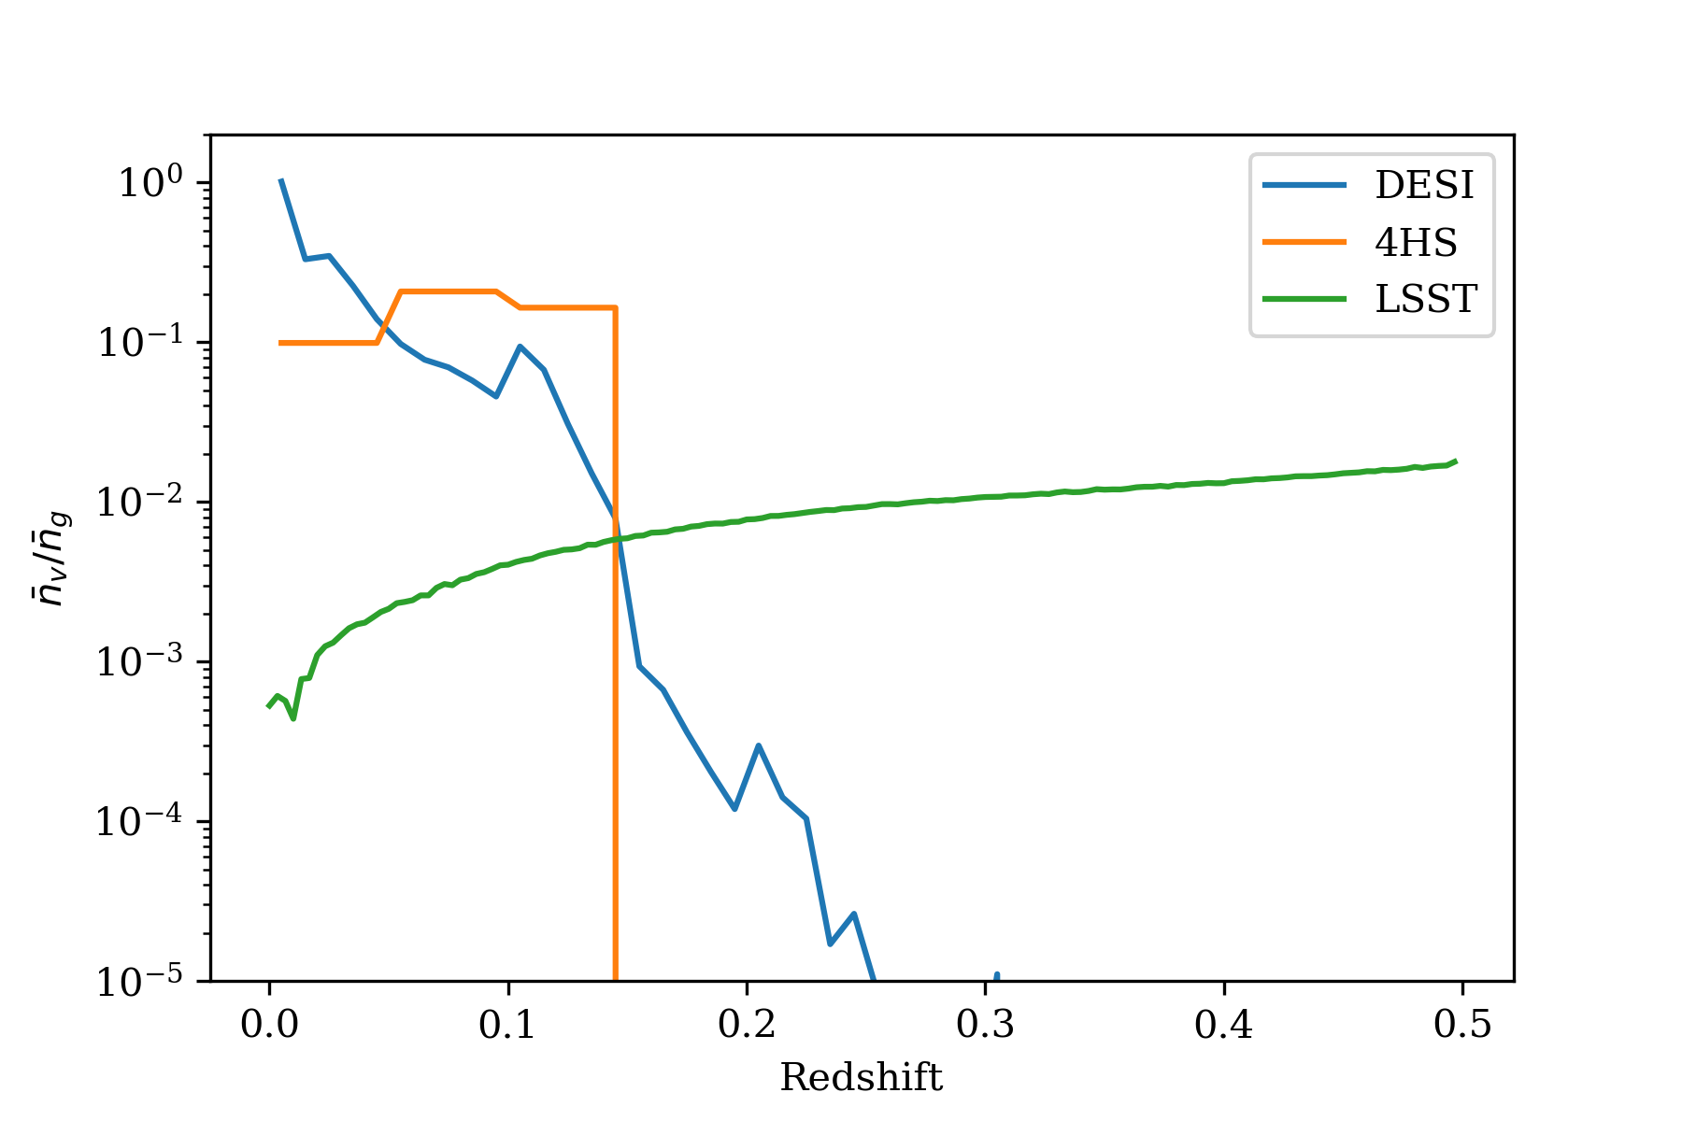
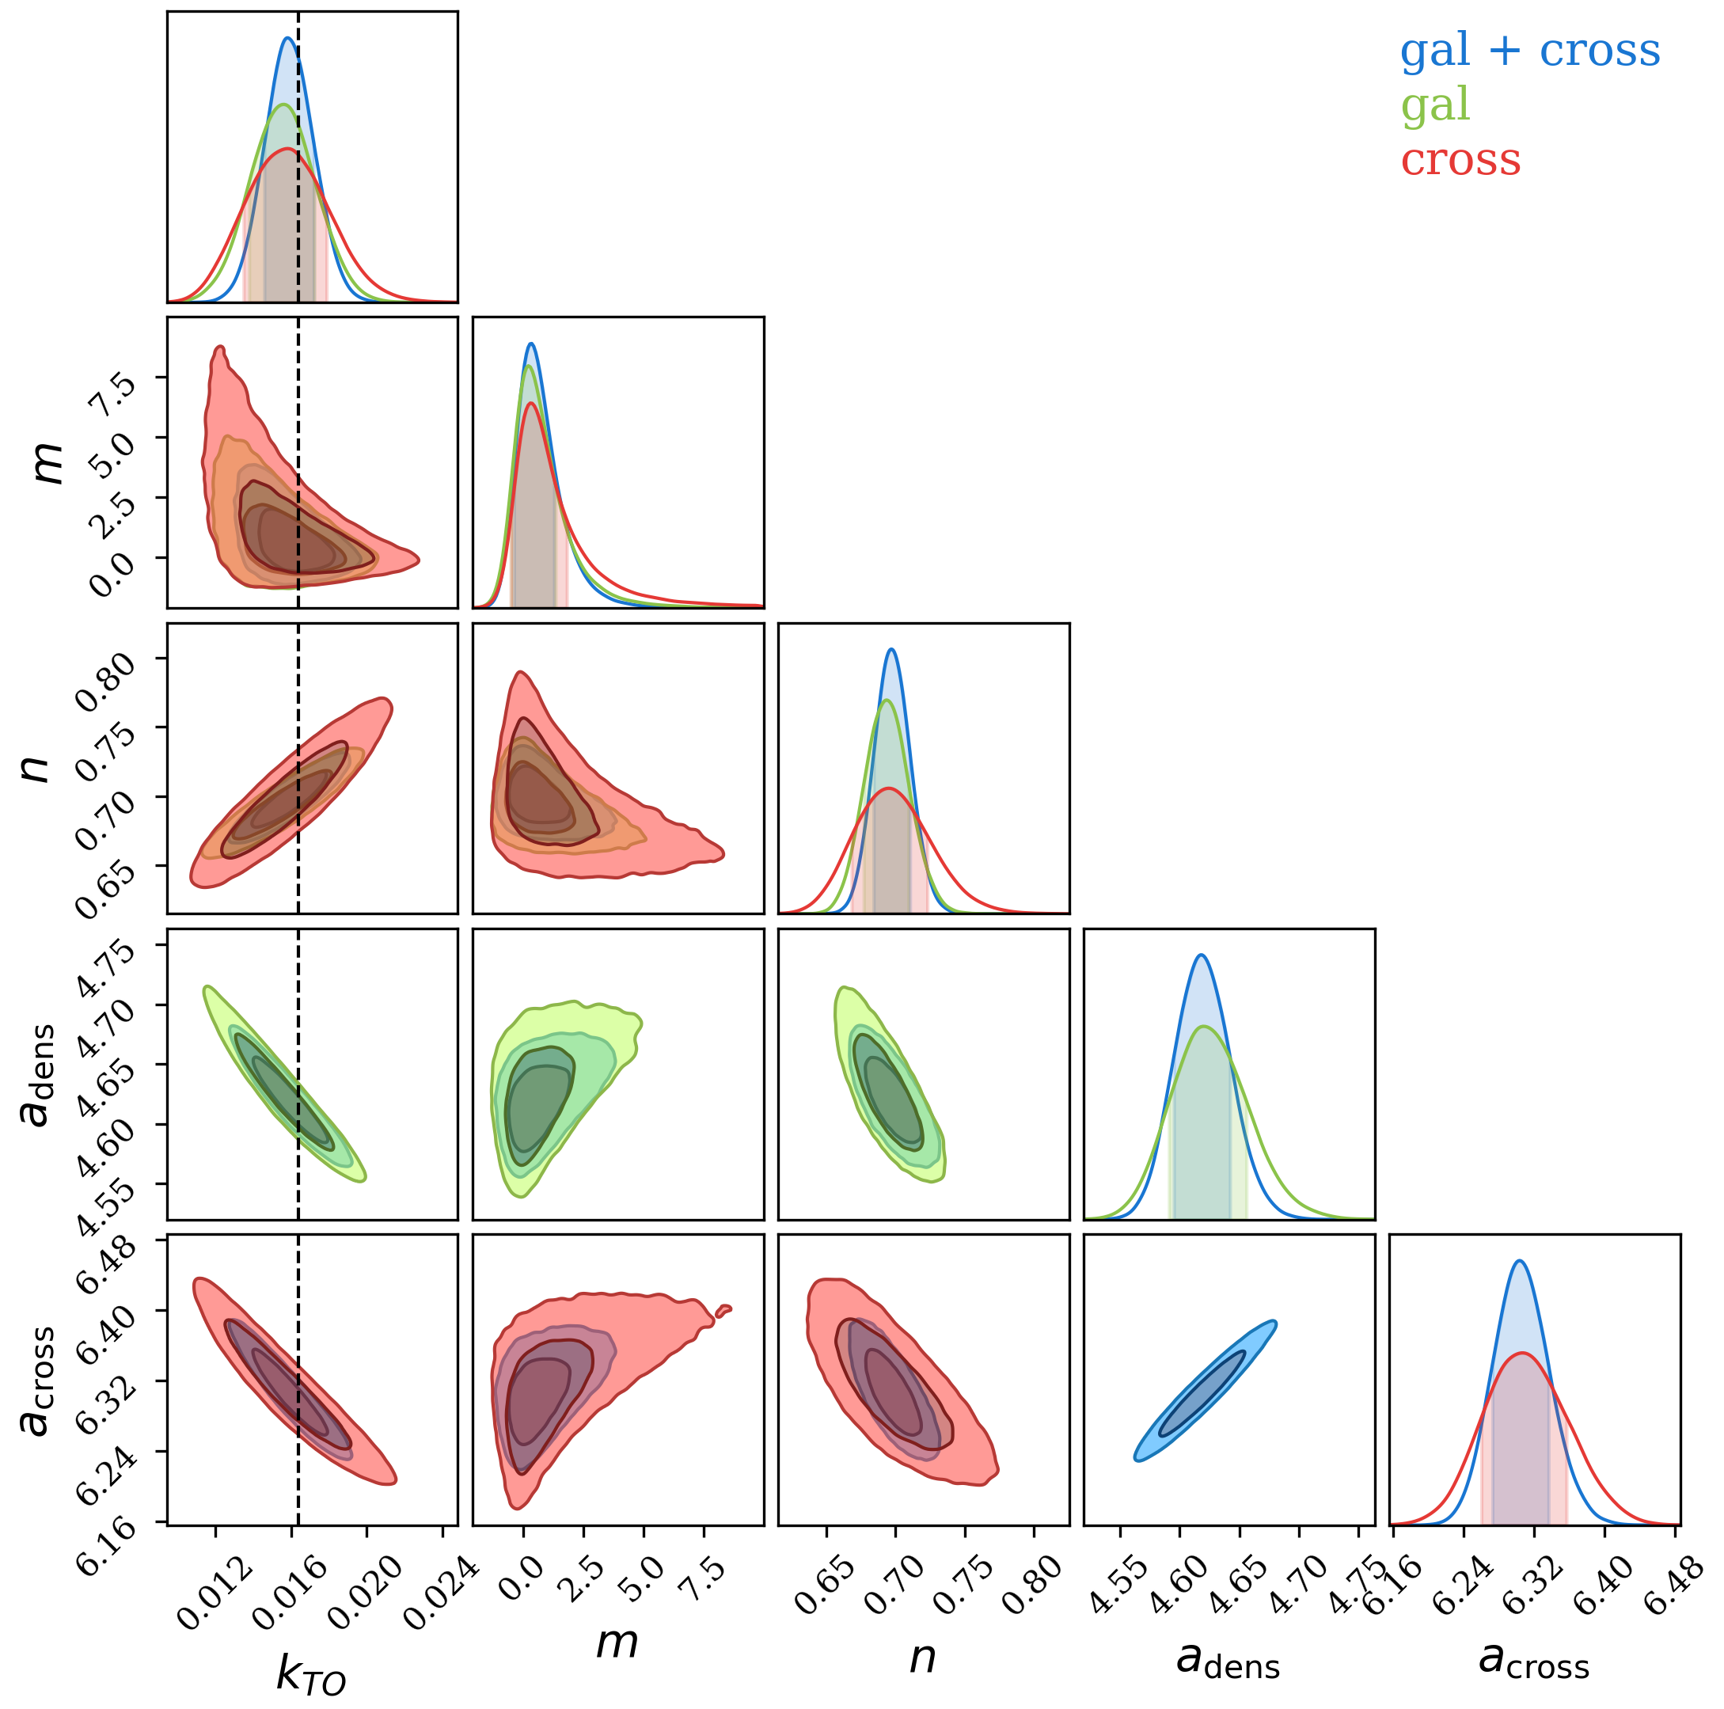
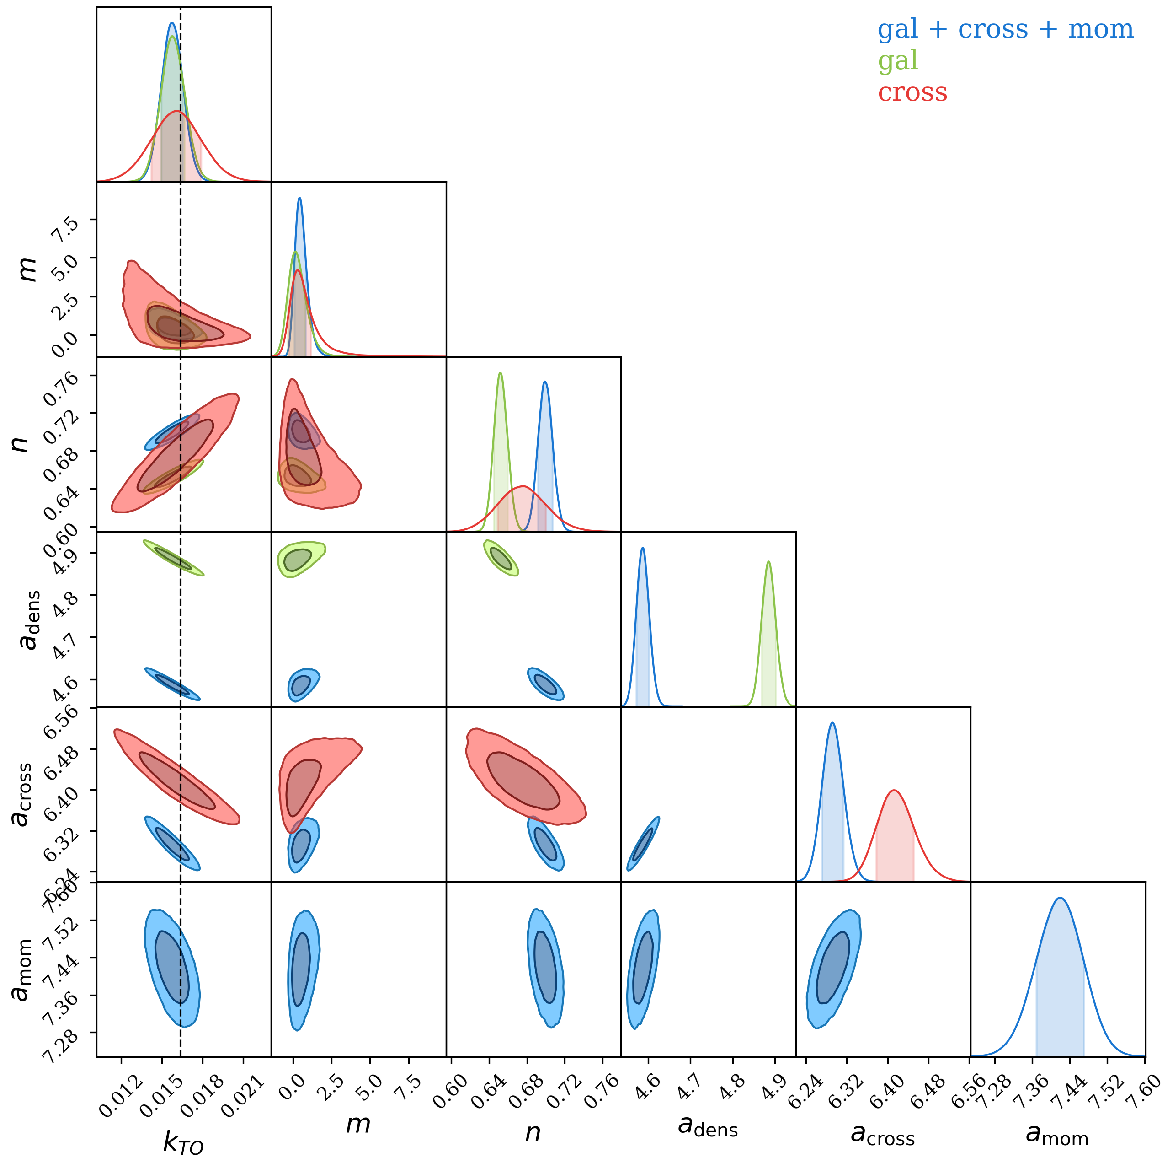



Preliminary forecast constraints on the turnover scale
DESI: $k_{TO}=0.0162±0.0009$
28% improvement
4HS: $k_{TO}=0.0158±0.0013$
25% improvement
LSST: $0.0157±0.0008$
9% improvement
Notes:
The plot on the left shows the constraint on the turnover scale from DESI. By combining the galaxy and cross-power spectra, DESI will be able to constrain the turnover scale to around 5% level. Adding the cross power spectrum also improve the constraints by 28% comparing to only using the galaxy power spectrum. In the middle, 4HS can constrain the turnover scale to around 8% level. Adding the cross power spectrum improves the turnover scale constraints by 25%. On the right, the LSST is able to constrain the turnover scale to around 5% level. However, adding the cross and momentum power spectra can only improve the constraint by 9%. The main constraining power of the cross-power spectrum also comes from low redshift because the error on the peculiar velocity measurement scale with distance. The number density of peculiar velocities for LSST is much lower than the galaxy number density, so adding the cross and momentum power spectra does not improve the constraints.

Slide 9
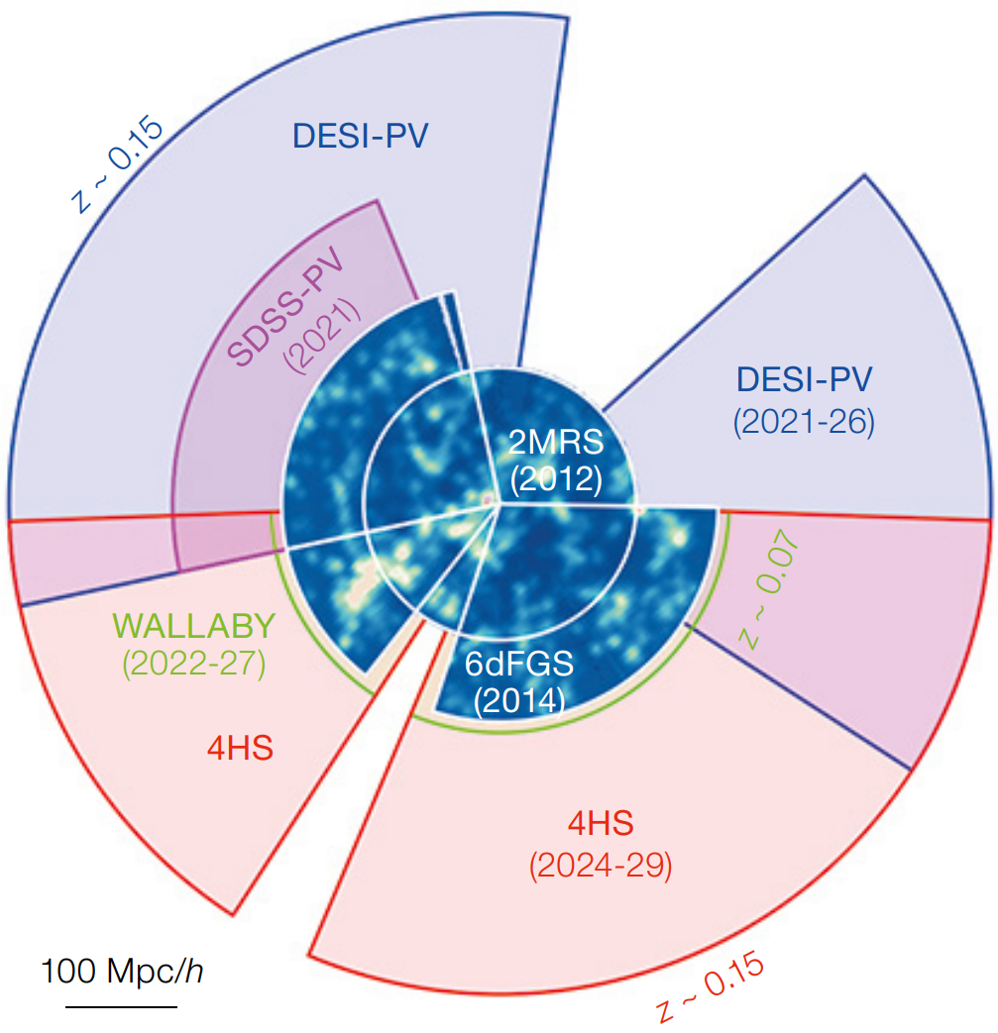

Future work
Combining our constraint at low redshift with other high redshift measurements.
Combining DESI and 4HS can potentially probe the turnover scale with the velocity power spectrum ($k_{min}≈0.01h/$Mpc).
Combining with other low-redshift probes to constrain the Hubble parameter.
(Taylor et al, 2023)
Notes:
Beyond the preliminary forecast for the three surveys, in the future, we will try to combine our constraint on the turnover scale with other higher redshift measurements to constrain Dv/rH. Although DESI and 4HS individually cannot constrain the turnover scale with the velocity power spectrum, the plot on the right shows combining these two surveys can significantly increase the volume because they cover different sky areas. Combining DESI and 4HS surveys will also allow us to probe the turnover scale with the velocity power spectrum, further improve the constraints. Finally, we can combine our constraints on the turnover scale with other low-redshift probes to constrain cosmological parameters such as the Hubble parameter.

Slide 10

Conclusion
Measuring the scale of matter-radiation equality can provide complementary constraints on cosmological parameters.
Cosmological model-independent method to constrain the turnover scale of the power spectrum.
$\sim 25\%$ improvement for DESI and 4HS when combining with the power spectrum.
$\sim 9\%$ improvement for LSST because velocity number density is much lower than the galaxy number density at low redshift.
Notes:
In conclusion, Measuring the scale of matter-radiation equality can provide complementary constraints on cosmological parameters. We show a cosmological model-independent way to constrain the turnover scale. However, for DESI and 4HS, the volume of their peculiar velocity sample is too small to constrain the turnover scale. Combining the galaxy and the cross power spectra provide around 25% improvement in constraints for both surveys. On the other hand, we only see around 9% improvement for the LSST because its velocity number density is significantly lower than the galaxy number density at low redshift.

Slide 11
Supplementary slides
Notes:
In conclusion, Measuring the scale of matter-radiation equality can provide complementary constraints on cosmological parameters. We show a cosmological model-independent way to constrain the turnover scale. Although for DESI and 4HS, the volume of their peculiar velocity sample is too small

Slide 12
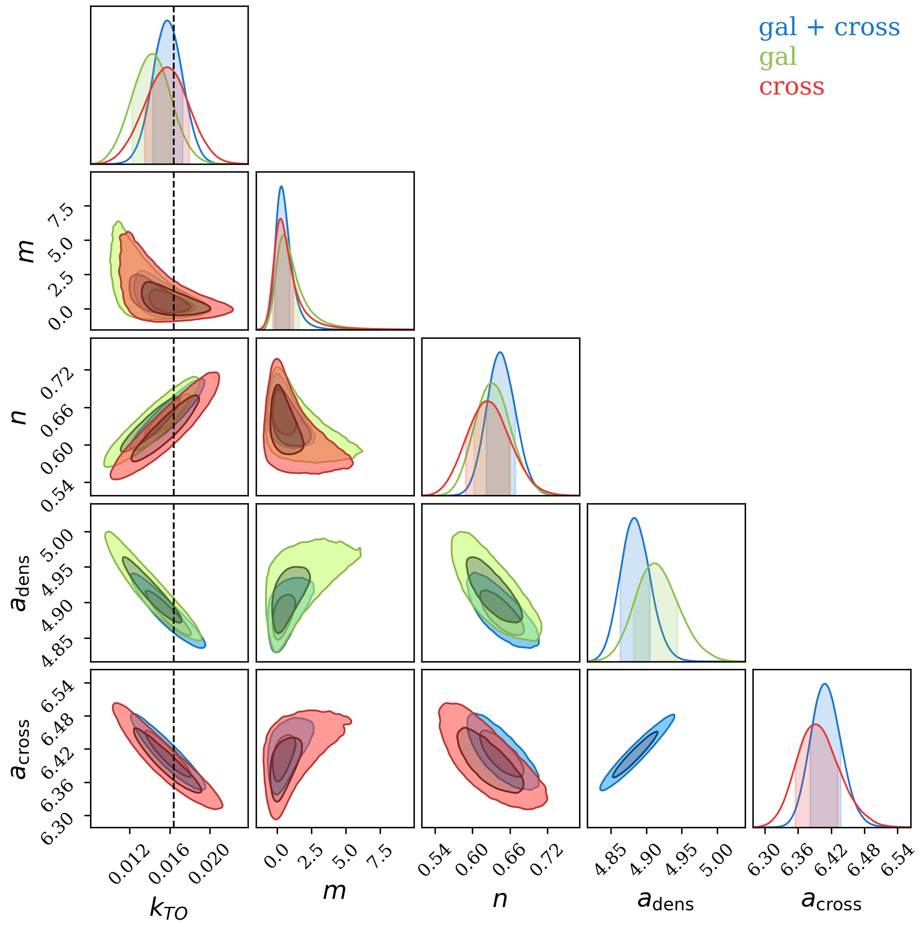
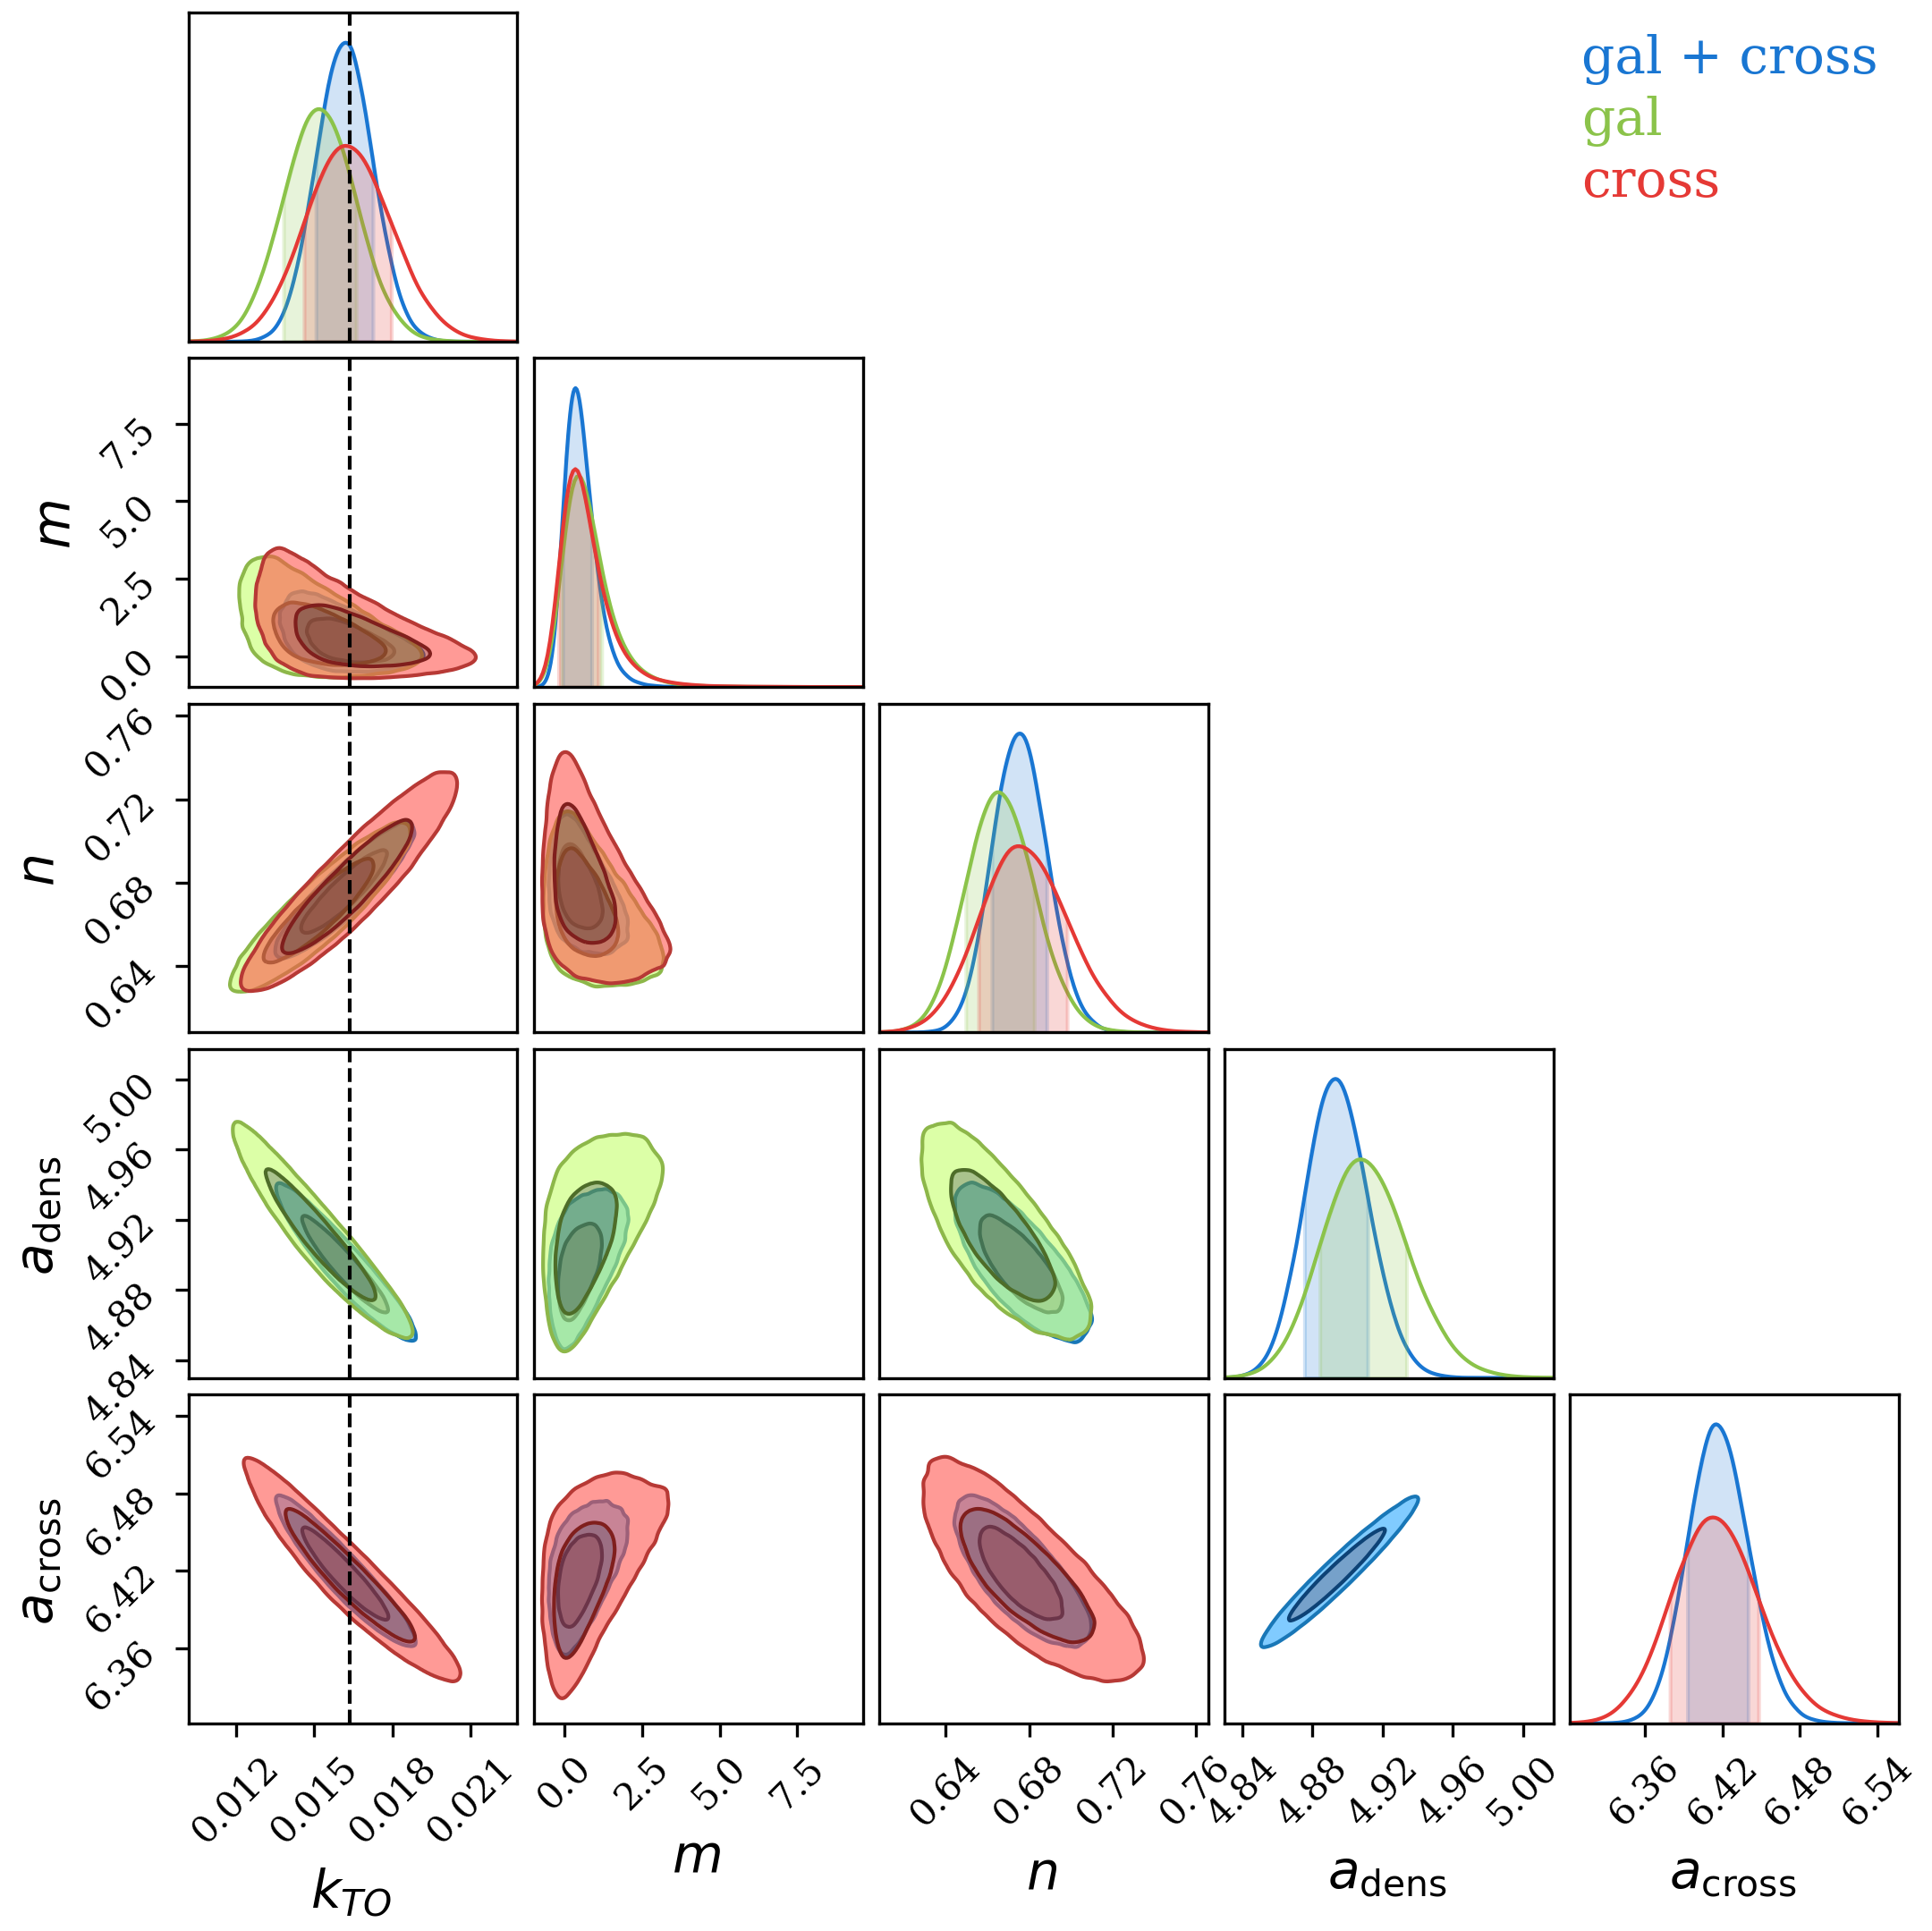


The effect of the tension in the constraints on n
$k_{max}=0.125h/$Mpc, 24% improvement
$k_{max}=0.125h/$Mpc, 22% improvement
Notes:
In conclusion, Measuring the scale of matter-radiation equality can provide complementary constraints on cosmological parameters. We show a cosmological model-independent way to constrain the turnover scale. Although for DESI and 4HS, the volume of their peculiar velocity sample is too small

Slide 13

Covariance matrix model
Wick’s theorem for Gaussian random field
Covariance matrix: $C_{abcd}∝\left\langle F_{a}F_{b}F_{c}F_{d}\right\rangle −\left\langle F_{a}F_{b}\right\rangle \left\langle F_{c}F_{d}\right\rangle =\left\langle F_{a}F_{c}\right\rangle \left\langle F_{b}F_{d}\right\rangle +\left\langle F_{a}F_{d}\right\rangle \left\langle F_{b}F_{c}\right\rangle$.
$F_{g}(\vec{r})=\frac{w_{g}\left(\vec{r}\right)[{\overline{n}}_{g}\left(\vec{r}\right)−α{\overline{n}}_{g}^{s}(\vec{r})}{\sqrt{∫d^{3}\vec{r} {\overline{n}}_{g}^{2}\left(\vec{r}\right)w_{g}^{2}(\vec{r})}}$ , $F_{v}\left(\vec{r}\right)=\frac{w_{v}\left(\vec{r}\right){\overline{n}}_{v}\left(\vec{r}\right)v\left(\vec{r}\right)}{\sqrt{∫d^{3}\vec{r} {\overline{n}}_{v}^{2}\left(\vec{r}\right)w_{v}^{2}\left(\vec{r}\right)}}.$
$C_{abcd}^{ll^{′}}={\left(2π\right)}^{3}\frac{(2l+1)(2l^{′}+1)}{2V_{k}}∫dμ\frac{∫dr r^{2}\left(q_{ac}q_{bd}W_{acbd}^{ll^{′}}+q_{ad}q_{bc}W_{adbc}^{ll^{′}}\right)}{G_{a}G_{b}G_{c}G_{d}}$, where $G_{δ}=\sqrt{∫dr r^{2}n_{g}^{2}w_{g}^{2}}$, $G_{v}=\sqrt{∫dr r^{2}n_{v}^{2}w_{v}^{2}}, q_{δδ}=P_{δδ}+\frac{1}{n_{g}}, q_{vv}=P_{vv}+\frac{\left\langle v^{2}\right\rangle }{n_{v}}, q_{δv}=P_{δv}, W_{abcd}^{{ll}^{′}}=n_{a}n_{b}n_{c}n_{d}w_{a}w_{b}w_{c}w_{d}L_{l}L_{l}^{′}, w_{g}= \frac{1}{1+P_{δδ}\left(k\right)n_{g}}, w_{v}= \frac{1}{\left\langle v^{2}\right\rangle +P_{vv}n_{v}}$.
Notes:
I am expected to finish my PhD by the 30th of June 2025. During my PhD, I mainly focus on observational cosmology, particularly in developing pipelines to analyse the peculiar velocity and galaxy power spectrum data from cosmological surveys such as the Solan Digital Sky Survey (SDSS) and the Dark Energy Spectroscopic Instrument (DESI). I will talk about more detail of my PhD research in the next slide. Beyond my research, I also participated in various outreach events, such as outreach talks or telescope viewing sessions with the general public. I organised the work experience student program for the astrophysics group at UQ this year. This program is similar to the school internship program you have at the AIP where talented high school students are invited to visit the institute and work on projects. I also supervised and designed the projects for the work experience students in 2022 and 2023.

