Slide 1
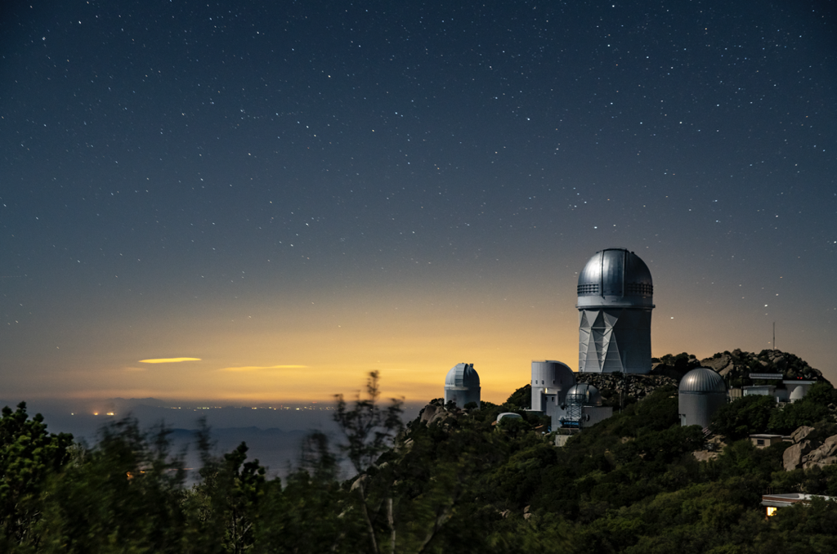
A High-Statistics Tully-Fisher Catalog using Fiber Spectroscopy with DESI
Segev BenZvi, University of Rochester
on behalf of Kelly Douglass, Alex Kim, Julia Largett, Anthony Carr, and many others in the DESI Collaboration
Cosmic Flows 2025
Brisbane, Australia
February 3, 2025

Slide 2
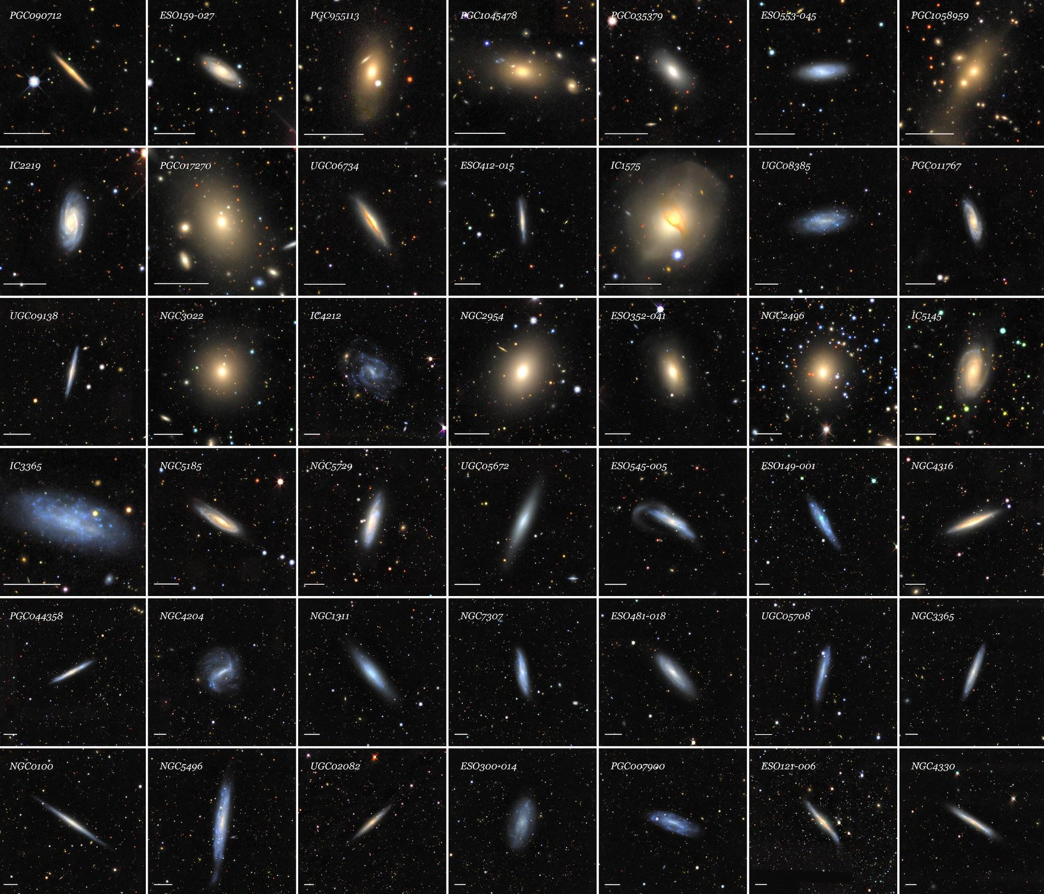
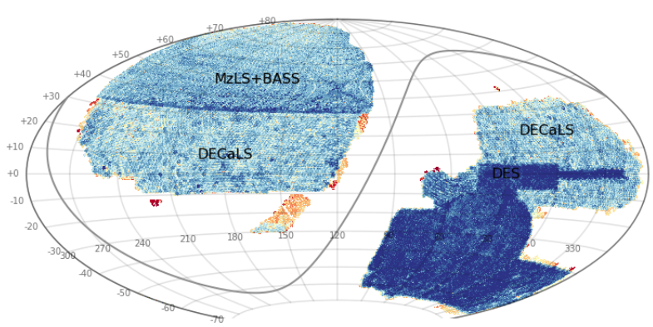
Siena Galaxy Atlas:
Large Objects in the Nearby Universe
Digital atlas in grz of 383,620 large galaxies in the DESI Legacy Surveys (Moustakas+ ApJS 269:3, 2023).
Credit: CTIO / NOIRLab / DOE / NSF / Aura / J. Moustakas
20,000 deg²
2 billion distinct objects
Credit: CTIO / NOIRLab / DOE / NSF / Aura / DECaLS

Slide 3
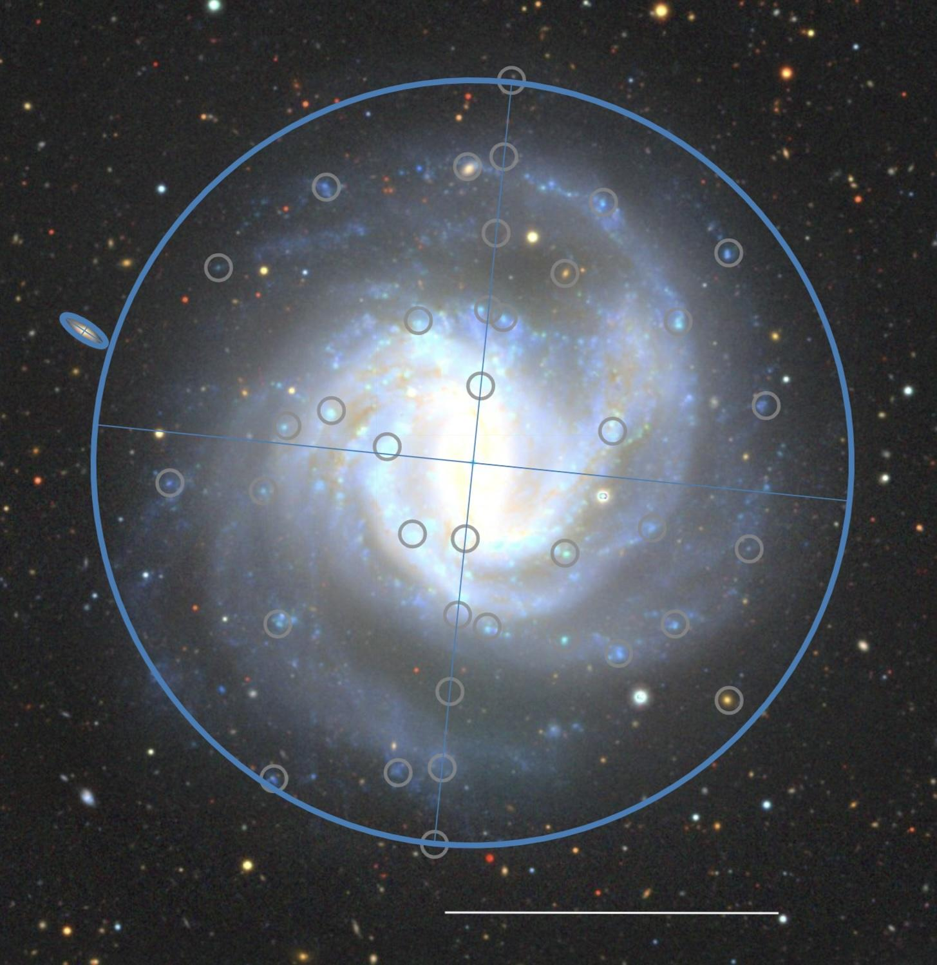
Large Galaxies in DESI: Fiber Placement
The purpose of DESI is to measure redshifts at the centers of galaxies and QSOs to z ≈ 4.5.
SGA galaxies are so large that we can/must independently target many different regions and obtain spectra.
This presents an opportunity for optical spectra and rotation curve measurements in spiral galaxies without an IFU.
Target using a secondary targeting program. Note: DESI fiber diameter: 107𝜇m ~ 1.5”.
Credit: legacysurvey.org
R₂₆
3’

Slide 4
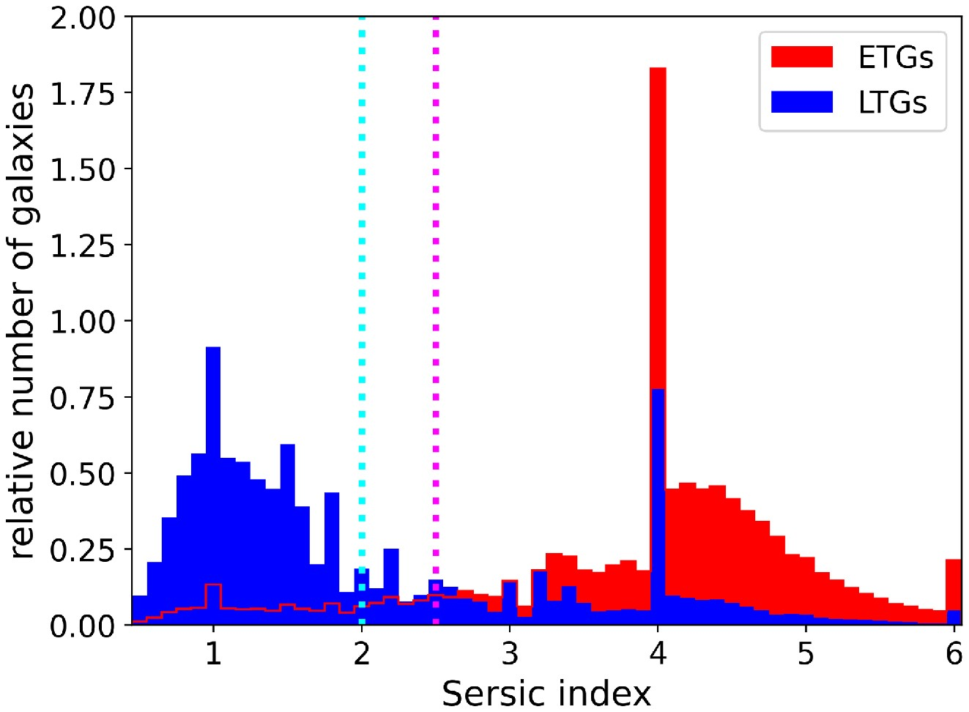
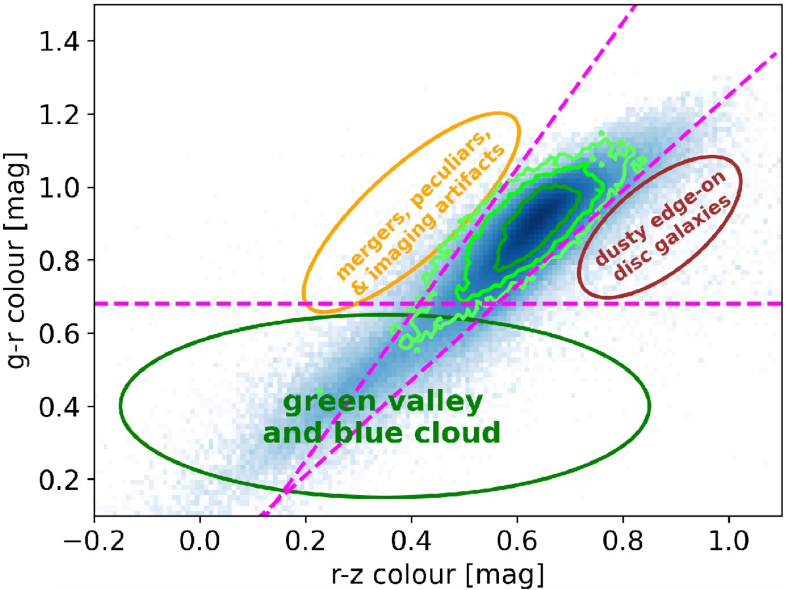
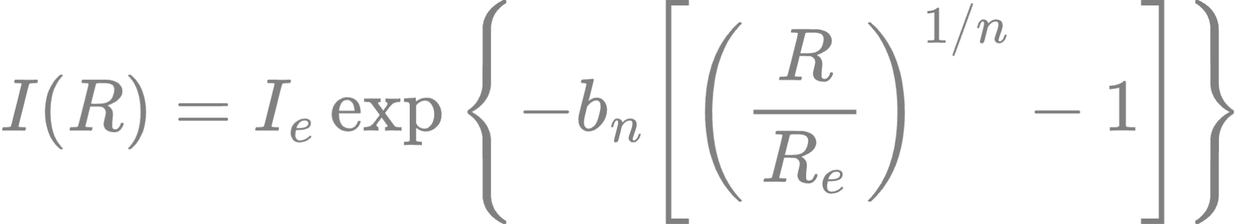
Target Selection
Using Sersic profile for galaxies:
Late-type galaxies selection:
Objects in SGA catalog
Non-ETG color cuts
EXP or SER with n ≤ 2
i ≥ 25° [b/a < cos(25°)]
D_{26,LEDA} > 20”
118,637 LTGs ⇒ 53k TF galaxies in 14k deg² DESI 5-year survey
Credit: C. Saulder+, MNRAS 525:1106, 2023

Slide 5
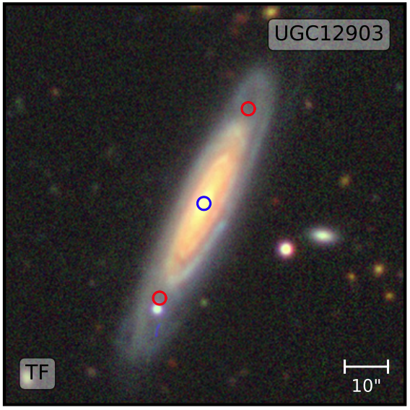
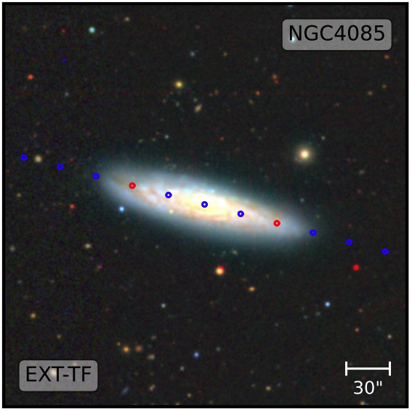
Tully Fisher Targets in DESI
R₂₆ < 1.4’
R₂₆ ≥ 1.4’
Credit: C. Saulder+,
MNRAS 525:1106, 2023
On most spiral galaxies, we record a spectrum on the galactic center and on one or more locations on the major axis of the R₂₆ isophotal ellipse.

Slide 6
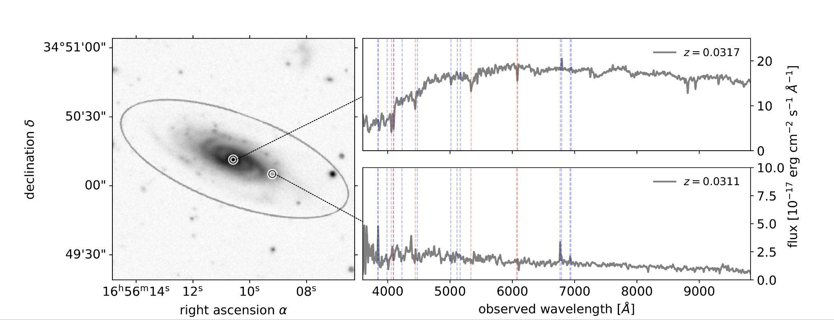
Measuring Rotational Velocities using Optical Spectra from DESI
Credit: C. Saulder+, MNRAS 525:1106, 2023

Slide 7
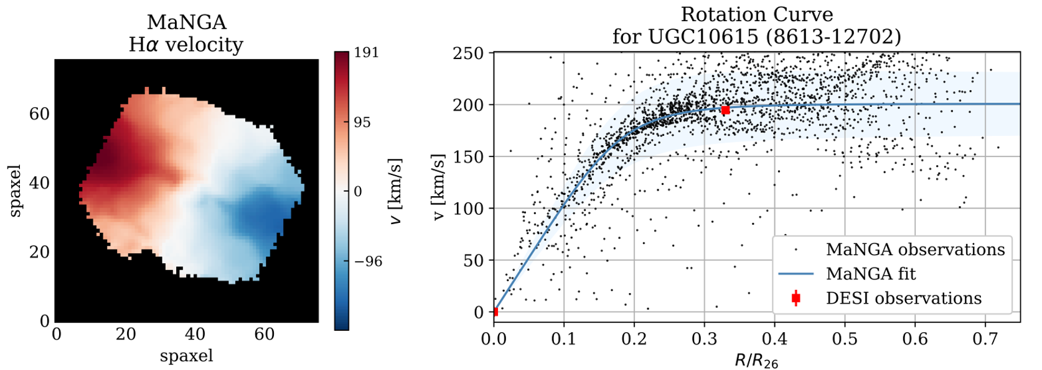
Rotation Curve Fits:
Comparison with SDSS MaNGA
Example comparison from DESI Survey Validation (measured at 0.33R₂₆):
Credit: C. Saulder+, MNRAS 525:1106, 2023

Slide 8
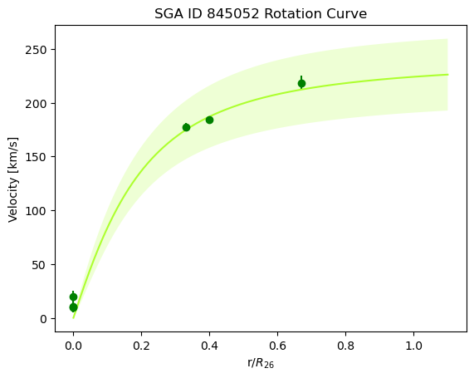
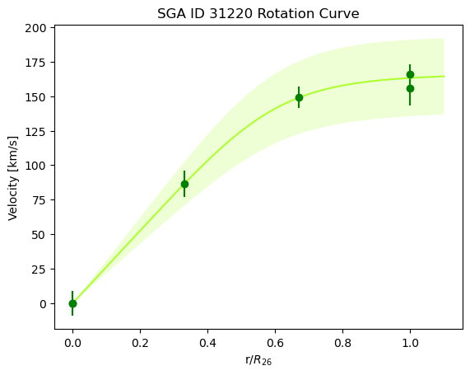
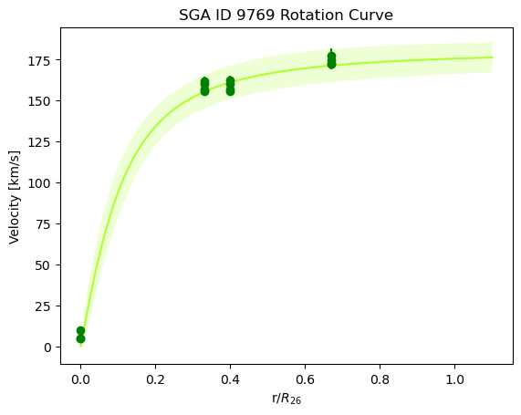
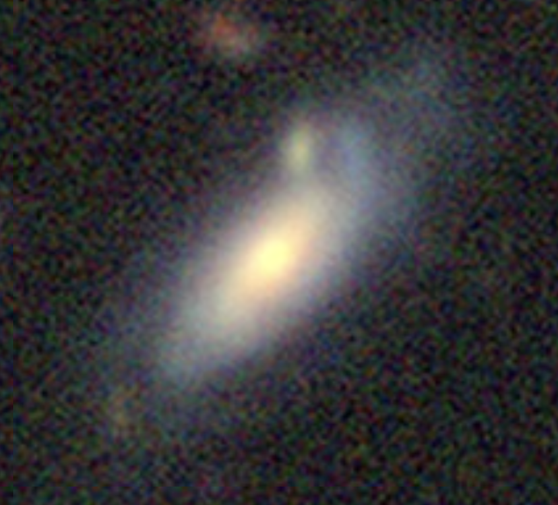
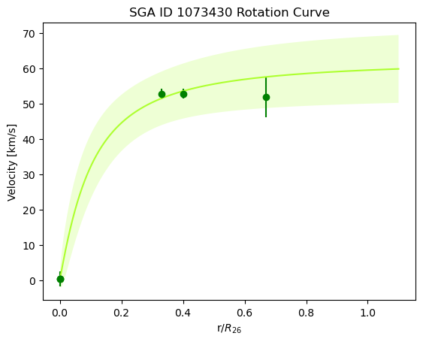
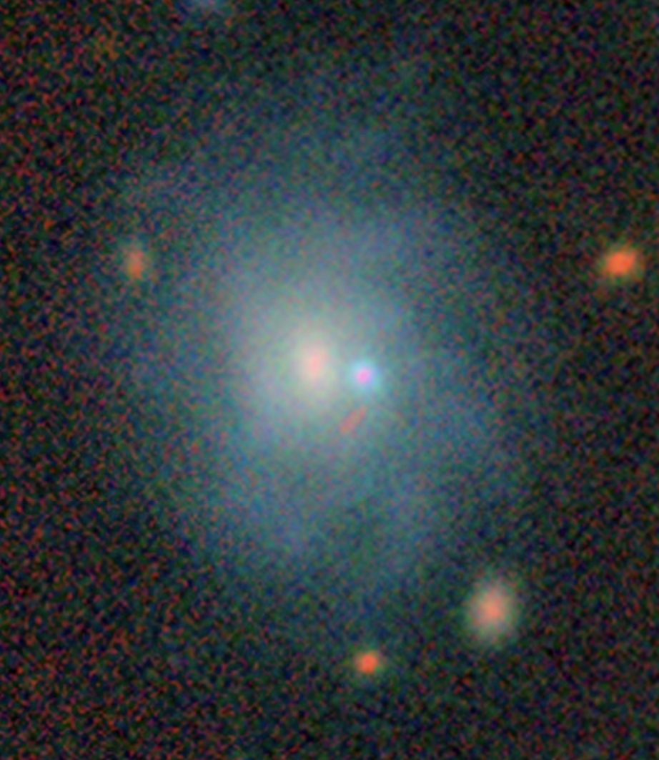
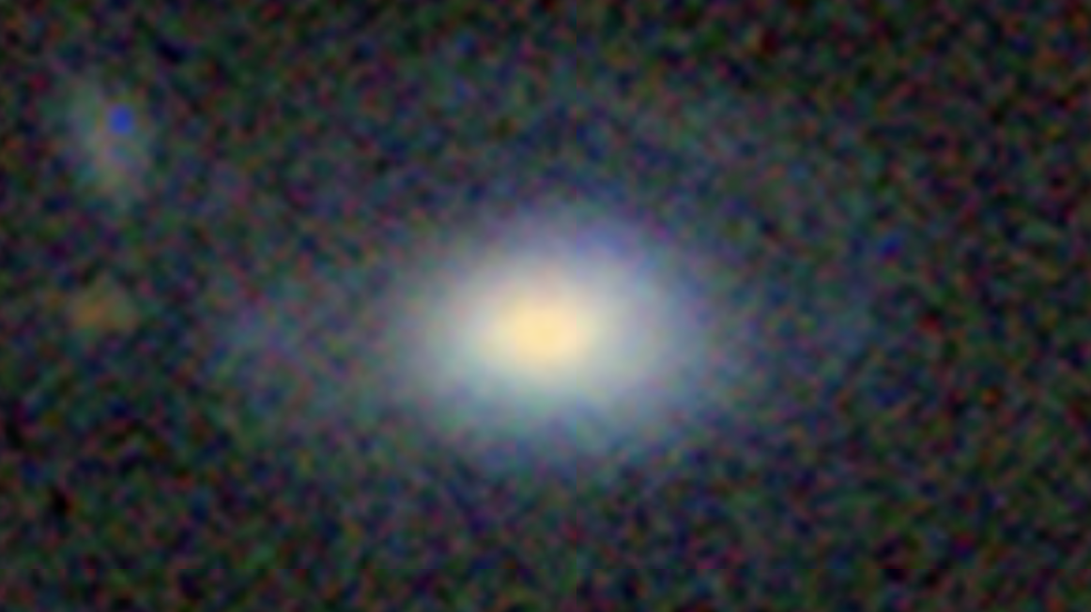
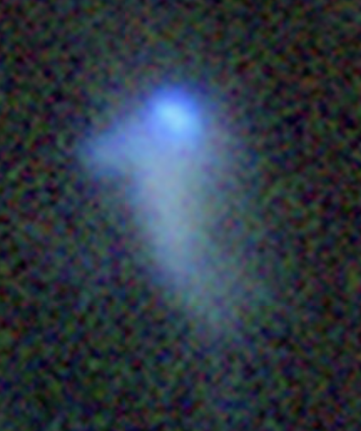
Rotation curves from EDR + DR1
Credit: J.J. Pimentel

Slide 9
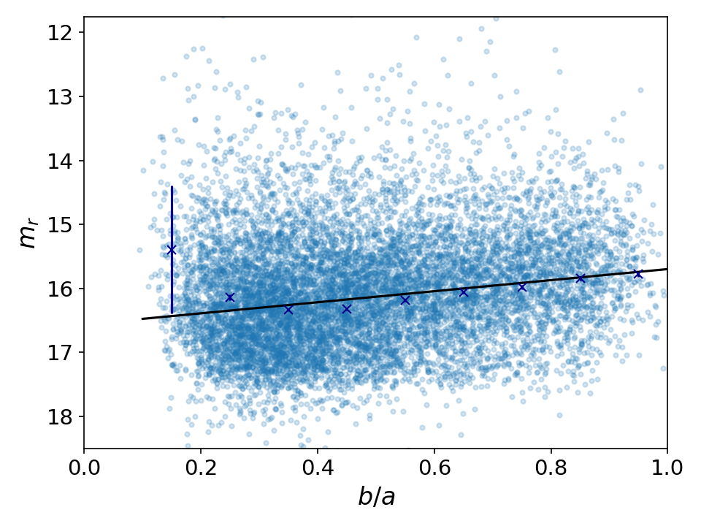
Photometric Corrections
Credit: K. Douglass+, in prep.
Corrections applied to all spiral galaxies in the final TFR sample:
Imaging survey systematic offset:
m_{BASS} - m_{DECaLS} = 0.0234
Milky Way dust extinction:
A_{MW} = R_{r} E(B-V)
K-corrections to z = 0.1:
Hogg+ 2002, Blanton+Rowles 2007
Internal dust extinction per galaxy:
A_{dust} = slope(b/a - 1)

Slide 10
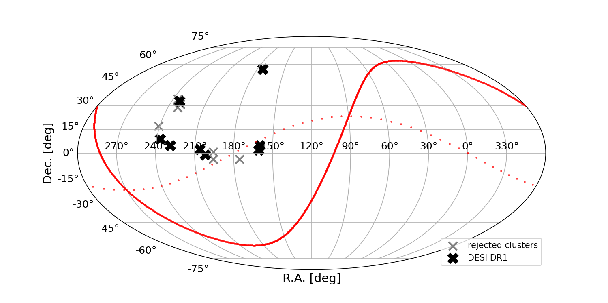
Calibration of the TFR Slope: DESI Y1
Credit: K. Douglass+, in prep.
We fit the slope of the relation
M_{r} = a log(V_{max} - V₀) + b
using galaxy clusters since all galaxies in each are roughly at the same distance.
Galaxies are matched to the Tully 2MASS group catalog using the criteria
(R_{p} < 1.5R_{2t} & v < v_{c} ± 3𝜎_{p}) | (1.5R_{2t} < R_{p} < 3R_{2t} & v < v_{c} ± 2𝜎_{p})
Preliminary
Clusters must have ≥ 15 galaxies, centered on each cluster in angle and z.
8 clusters survive all selections

Slide 11
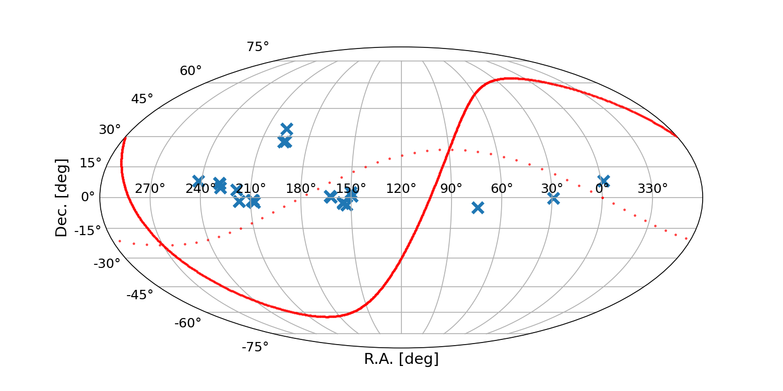
Calibration of TFR Zero Point: DESI Y1
Credit: K. Douglass+, in prep.
M_{r} = a log(V_{max} - V₀) + b
Galaxies with independent distance estimates are chosen to calibrate the zero point, b.
Cross-matched the Pantheon+ sample of SNe Ia (>2500) with DESI Y1 TFR galaxies (after cuts).
After all selections, 24 galaxies with zero-point calibrators are available.
Preliminary

Slide 12
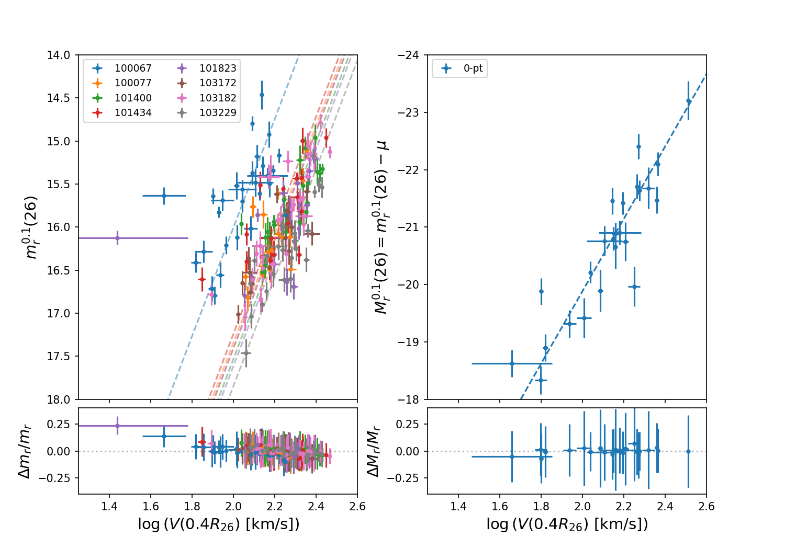
DESI Y1 Tully-Fisher Calibration
Joint fit of clusters + 0-point SN Ia calibrators.
11 parameters in total:
1: Slope a
2: SN Ia zero point b_{0-pt}
3: Mag variance 𝜎
4: Cluster intercepts b_{i}
Preliminary
Preliminary
Credit: K. Douglass+, in prep.

Slide 13
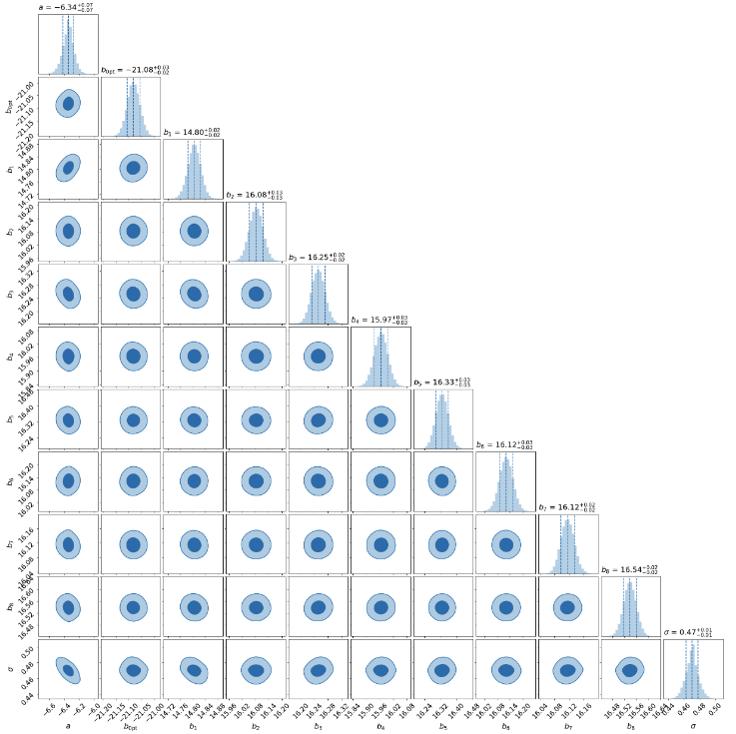
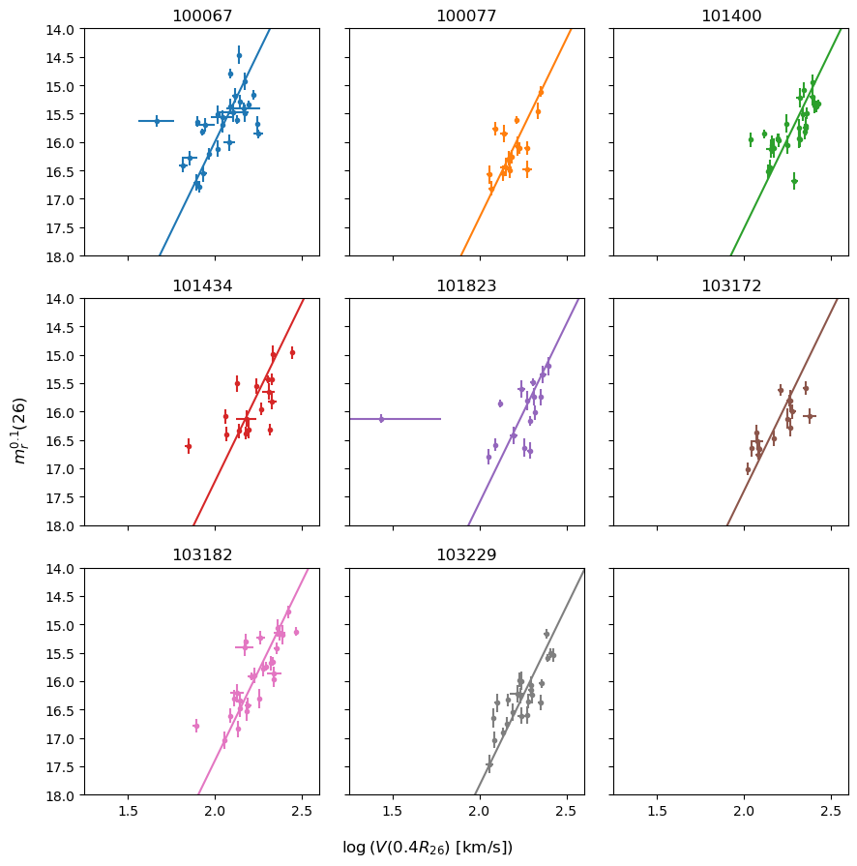
DESI Y1 Tully-Fisher Calibration
Preliminary
a = -6.34 ± 0.07
b_{0-pt} = -21.08 ± 0.03
𝜎 = 0.47 ± 0.01
Preliminary
Credit: K. Douglass+, in prep.

Slide 14
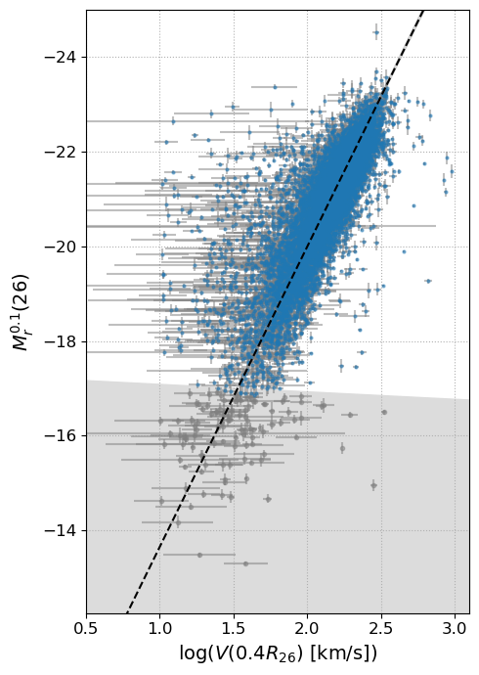
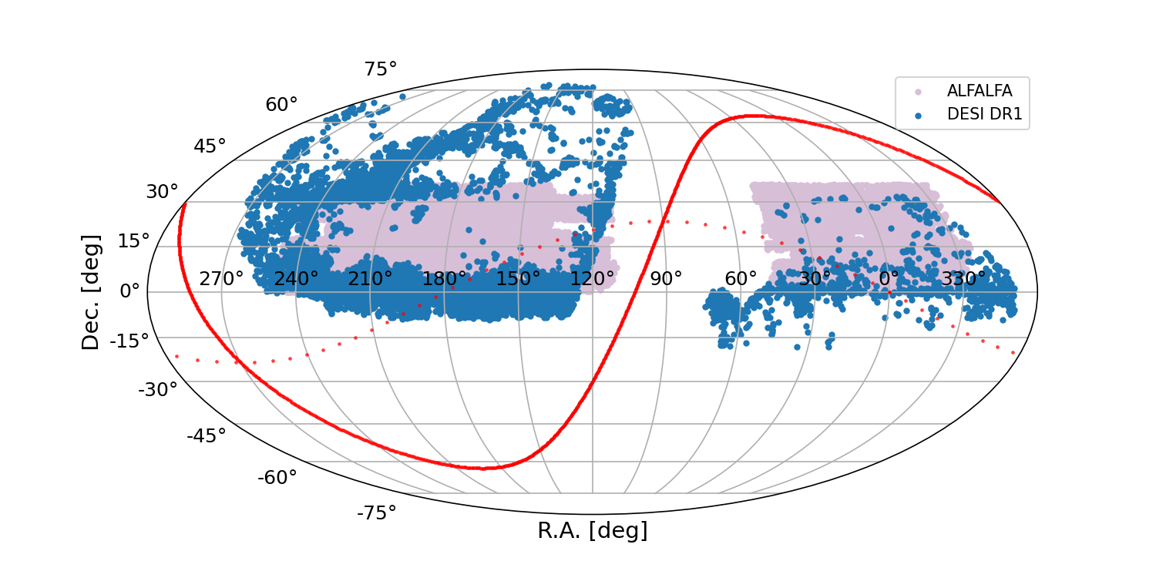
DESI Y1 Tully-Fisher Relation
Preliminary
10,263 spiral galaxies with TFR distances in DESI Y1.
Preliminary
Dwarf galaxies
Credit: K. Douglass+, in prep.

Slide 15
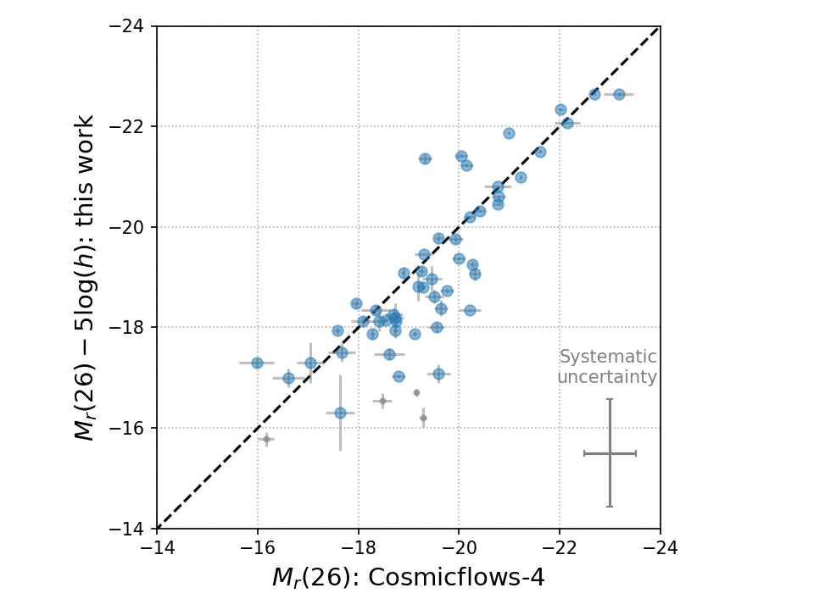
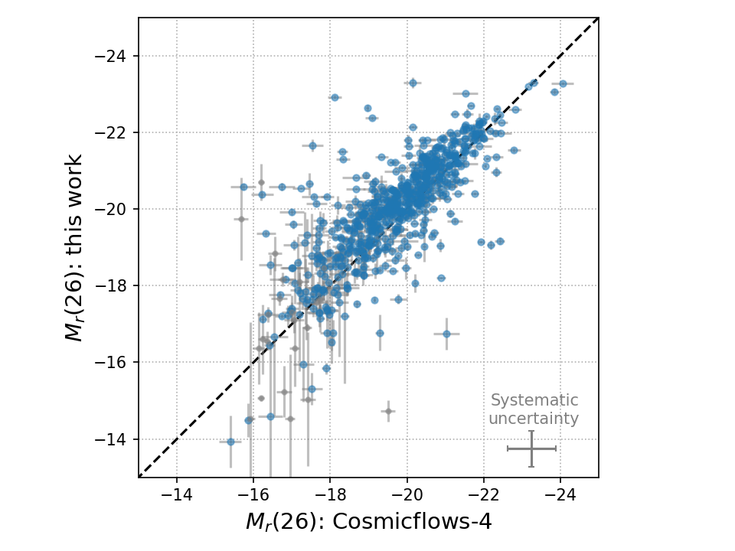
Comparison to Cosmicflows-4
Credit: K. Douglass+, in prep.
EDR
Year 1

Slide 16
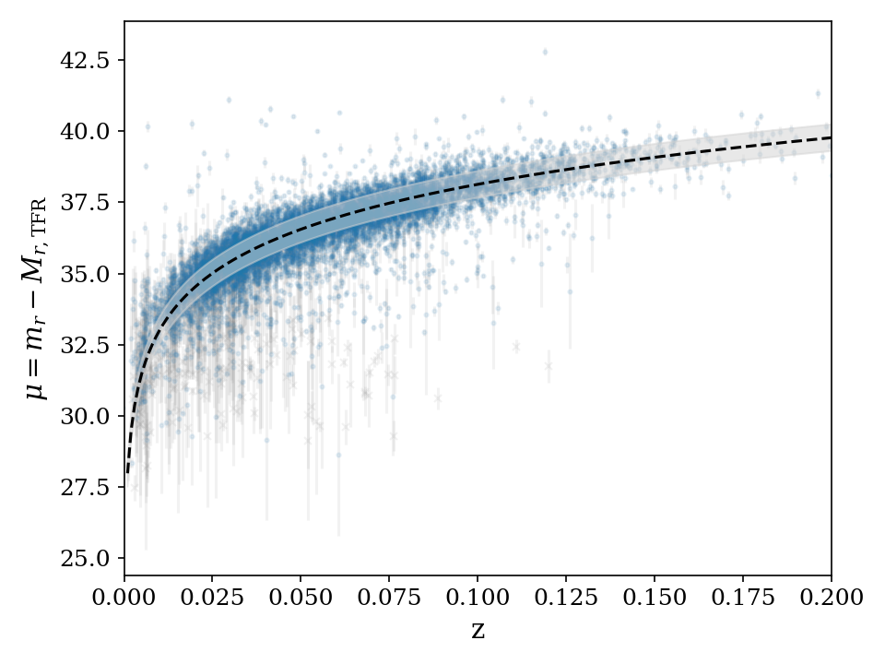
DESI Y1 TFR Hubble Diagram
Blue points: DESI Y1 TFR measurements.
Gray points: measurements removed after dwarf cuts.
H₀ = ~76 km s⁻¹ Mpc⁻¹ [no uncertainty reported; TFR scatter not included in fit].
Preliminary

Slide 17
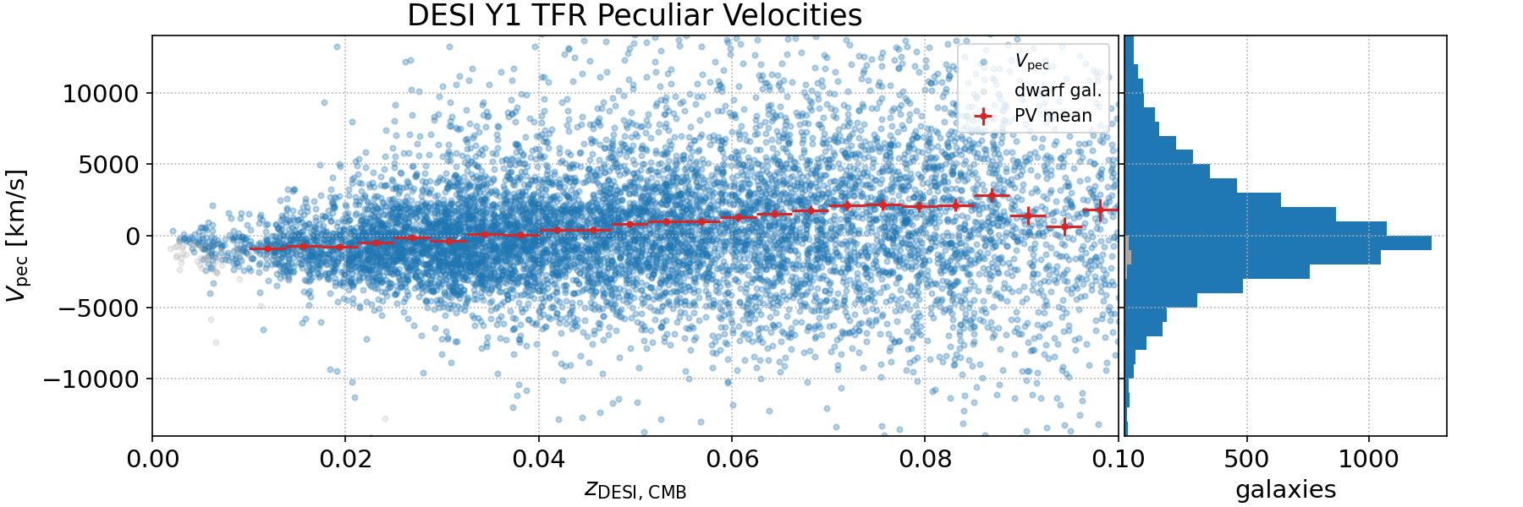
Peculiar Velocities
in the DESI Y1 Tully-Fisher Sample
Final steps: tracking down correlation in v_{p} in the sample as a function of redshift.
Preliminary

Slide 18
Summary
The DESI Tully-Fisher sample includes measurements of 10,263 spiral galaxies in Y1 of the survey.
The sample statistics will increase by a factor of 3 in DESI Y3, consistent with forecasts from the DESI Peculiar Velocity Survey secondary targeting program (Saulder+ 2023).
The TFR sample complements the much larger DESI Fundamental Plane sample with an independent selection function and systematic uncertainties.
The combined sample is expected to produce the tightest constraints to date on f𝜎₈ (talks next session by K. Said and C. Ross).

Slide 19
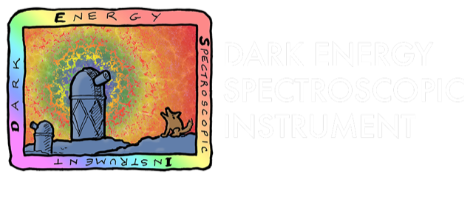
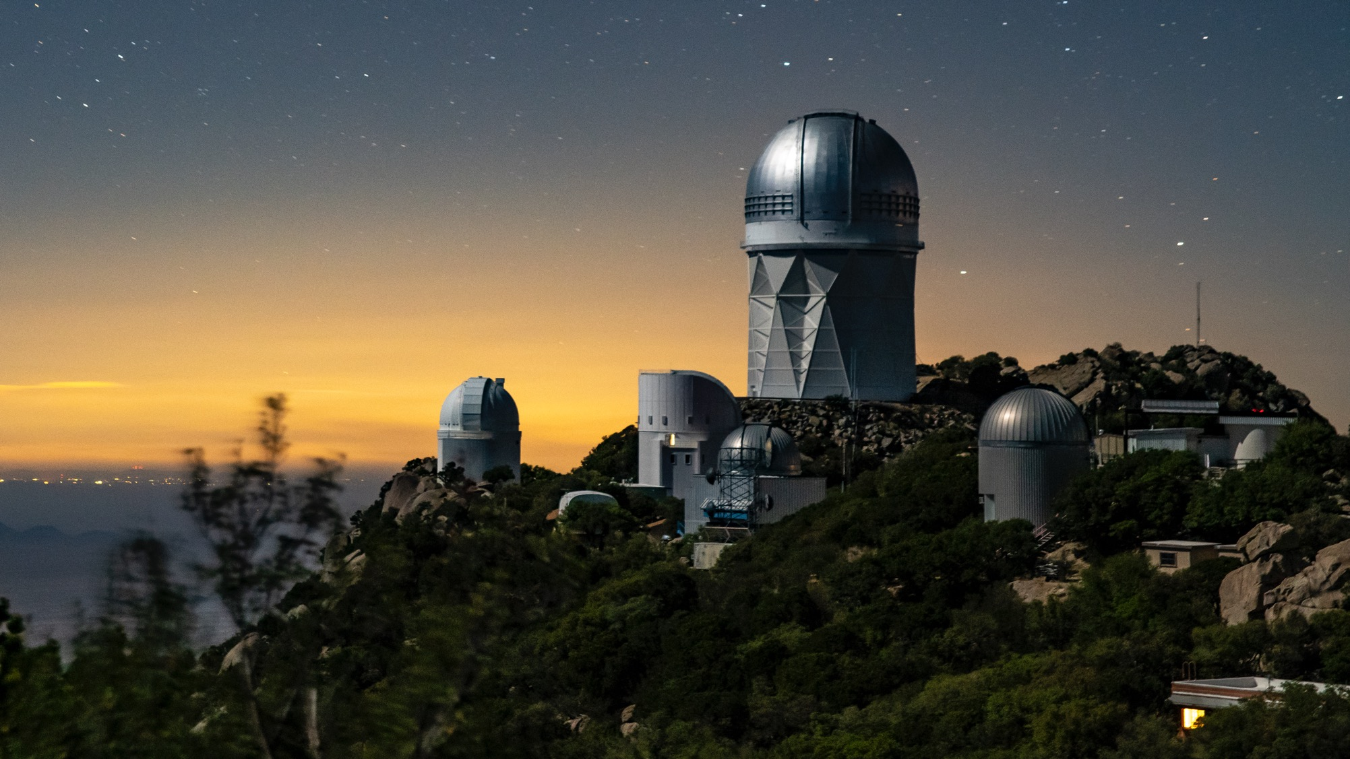

Thanks to our sponsors and
72 Participating Institutions!

