Slide 1
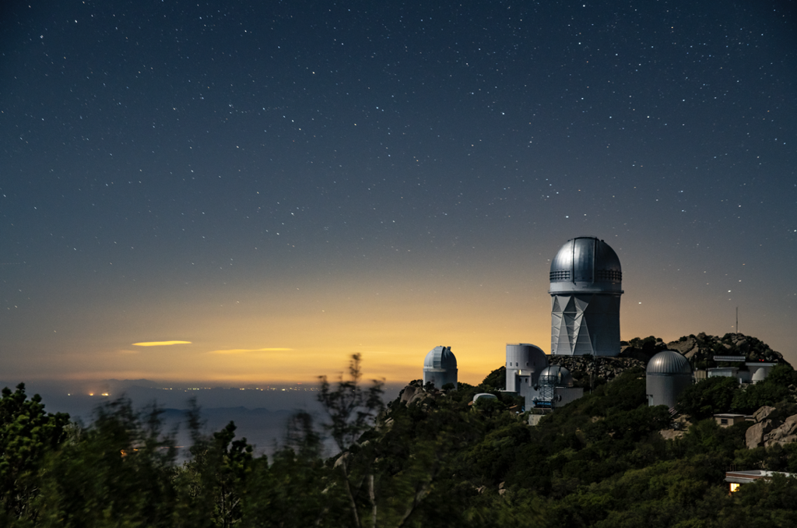
DESI Peculiar Velocity Survey
Year 1 Fundamental Plane
Caitlin Ross - University of Queensland
On behalf of the DESI Collaboration
Cosmic Flows 2025

Slide 2
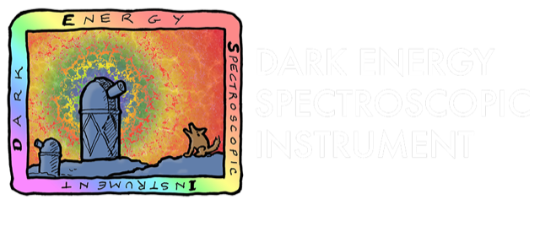
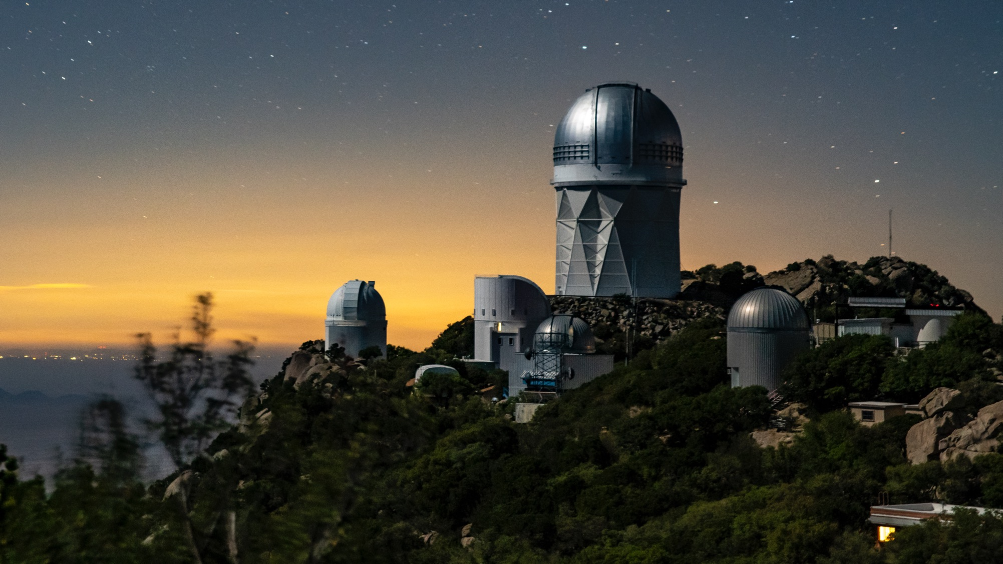









Thanks to our sponsors and
72 Participating Institutions!

Slide 3
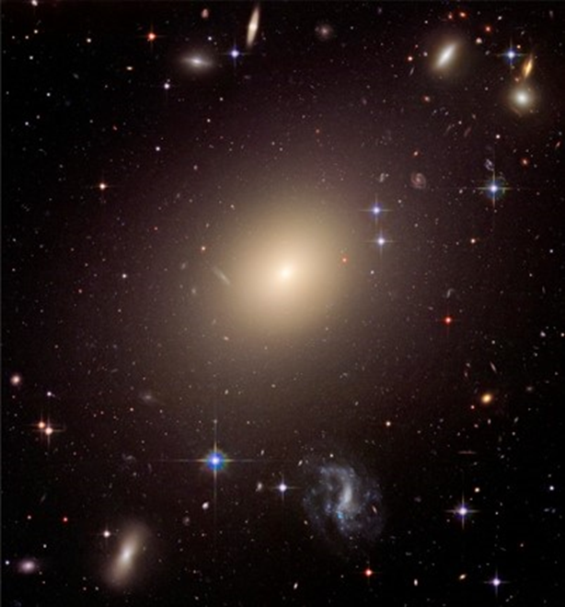
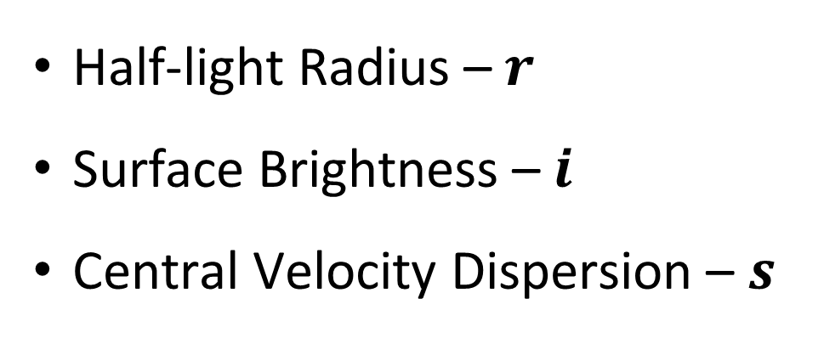
Fundamental Plane (Distance Relation)
Dispersion Supported
Non star forming
Ellipticals!
Half-light Radius – $r$
Surface Brightness – $i$
Central Velocity Dispersion – $s$

Slide 4
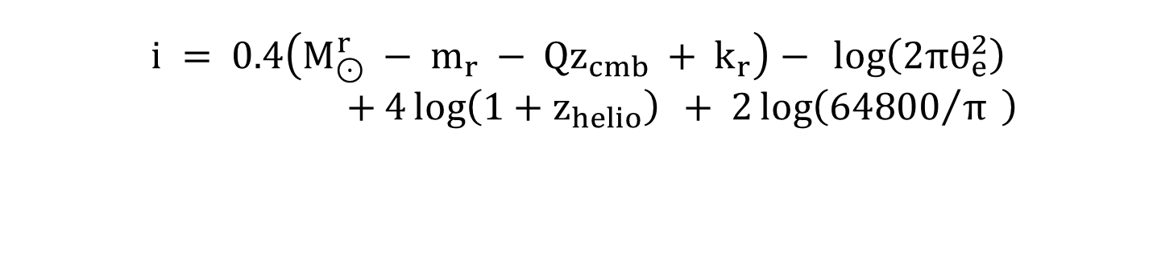

Parameters
Convert arcsec to Mpc
$$r_{z}=\log\left(θ_{e} \right)+\log\left(d\left(z_{cmb}\right)\right)−\log\left(1−z_{helio}\right)+\log\left(\frac{1000π}{180×3600}\right)$$
Circular “on sky” radius (arcsec)
angular diameter distance
Corrects for fixed size spectral fiber
$$s=σ_{vdisp}{\left(\frac{θ_{e}}{8θ_{ap}}\right)}^{α_{ap}}$$
Velocity dispersion
Solar magnitude
(for consistency between surveys)
r-band magnitude
Convert magnitude into surface brightness
Corrects for evolution in galaxy brightness
K-correction
$$i = 0.4\left(M_{⊙}^{r} − m_{r} − Qz_{cmb} + k_{r}\right)− \log\left(2πθ_{e}^{2}\right)$$
$+ 4\log\left(1+z_{helio}\right) + 2\log\left({64800}/π \right)$
Surface brightness dimming correction

Slide 5
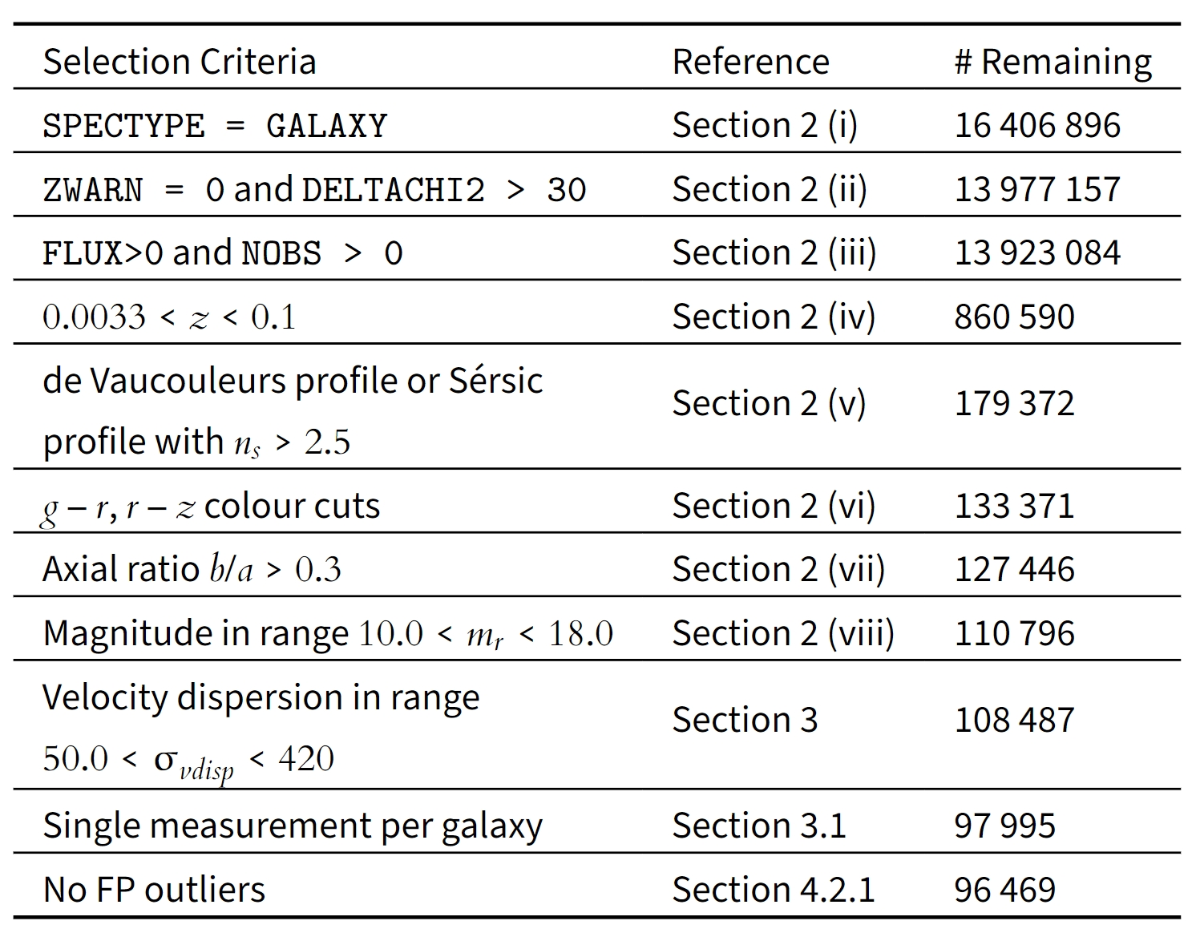
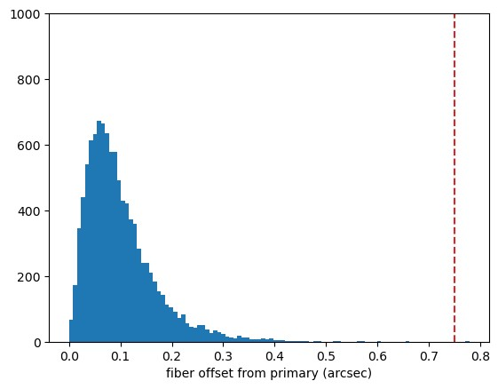
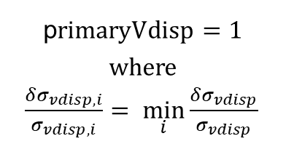
Selection Criteria
Quality Control
Isolation of Early Type Galaxies
Sigma Clipping (Calibration only)
p$rimaryVdisp=1$
where
$\frac{δσ_{vdisp,i}}{σ_{vdisp,i}}= \min_{i}{\frac{δσ_{vdisp}}{σ_{vdisp}}}⁡$

Slide 6
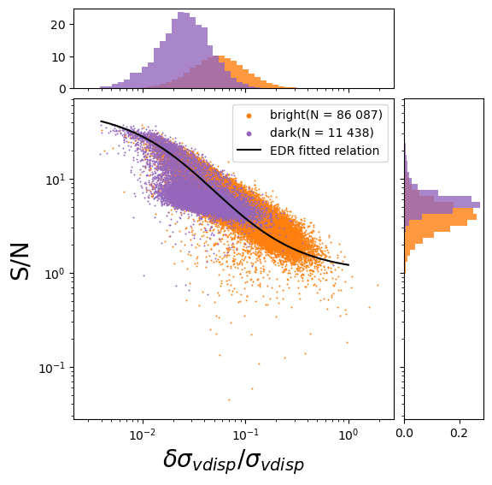
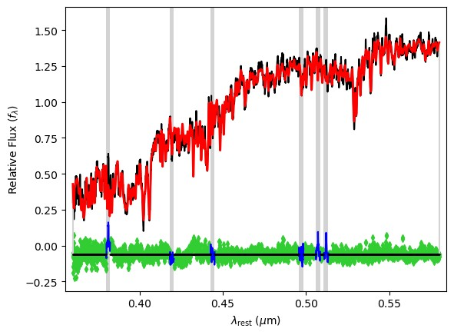
Velocity Dispersions
Indo-U.S. Coudé Feed
Spectral Library

Slide 7
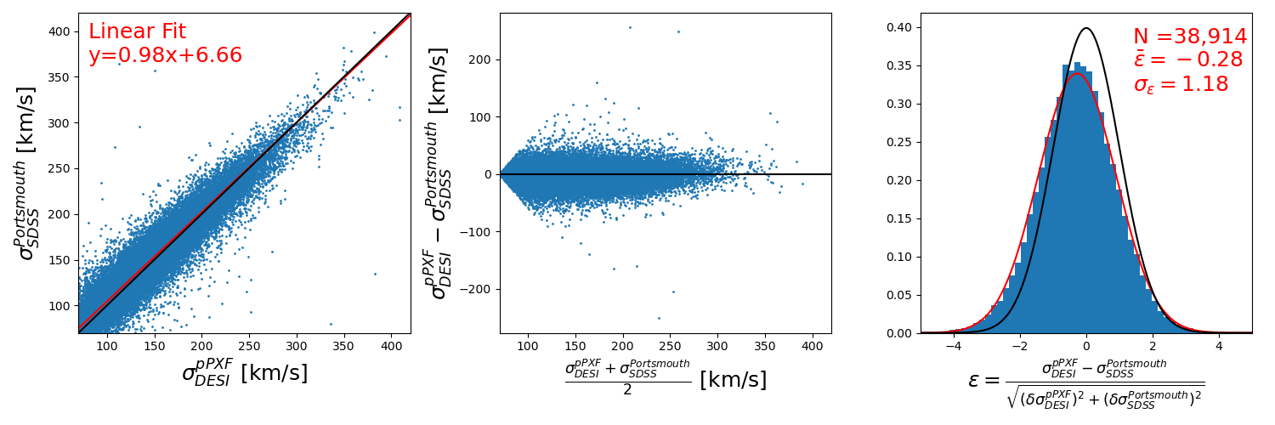
Velocity Dispersions - Comparison to SDSS

Slide 8
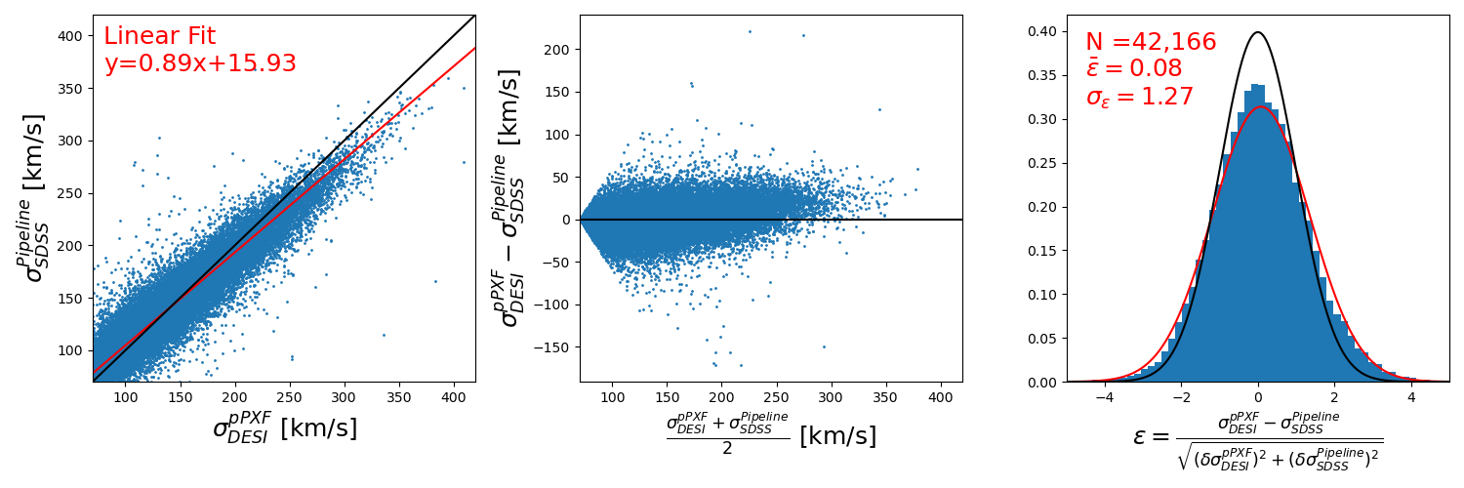
Velocity Dispersions - SDSS (Pipeline)

Slide 9
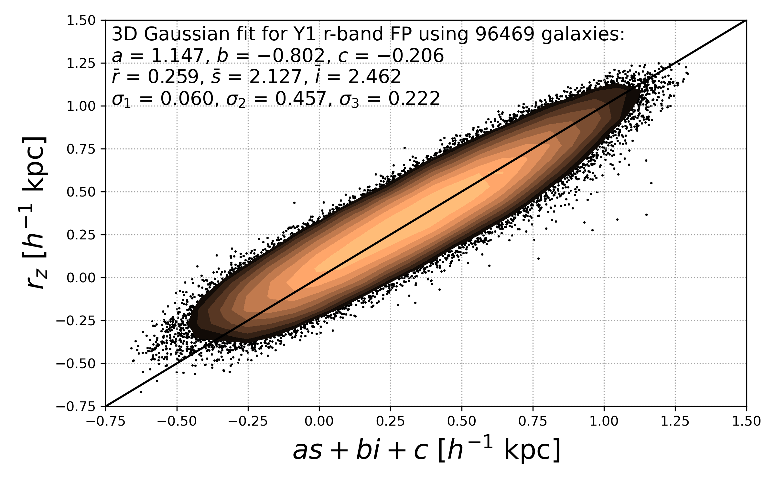
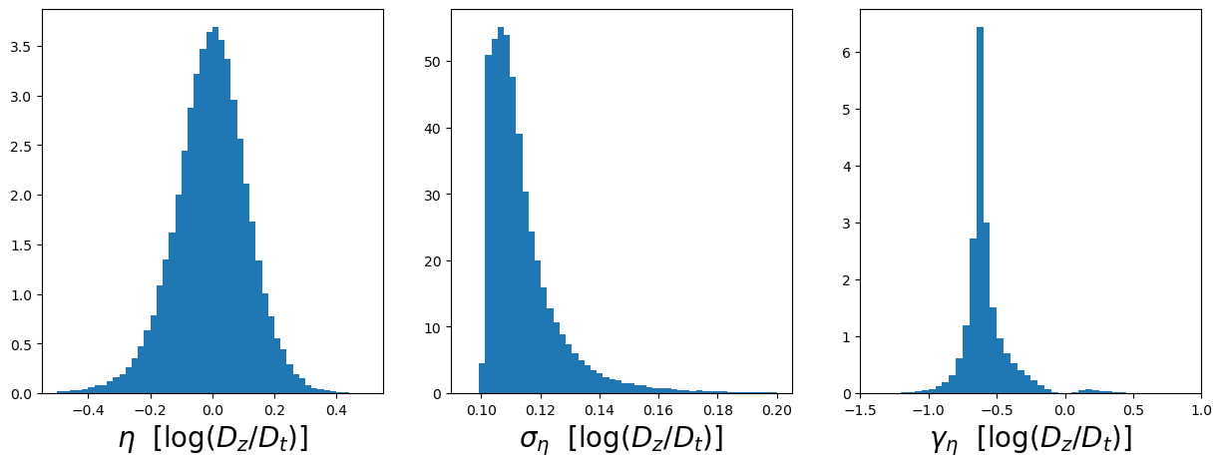
Fiducial Sample
Preliminary
Preliminary
Preliminary

Slide 10
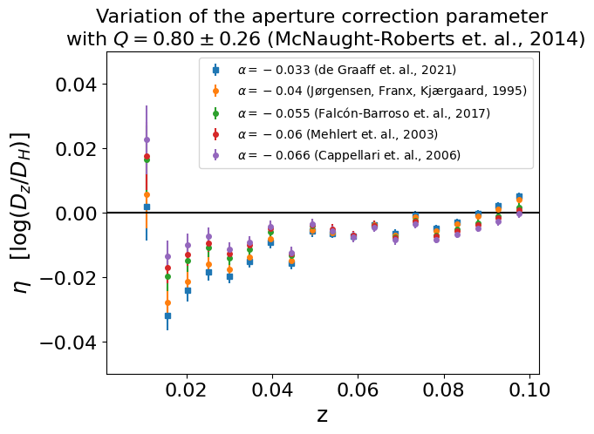
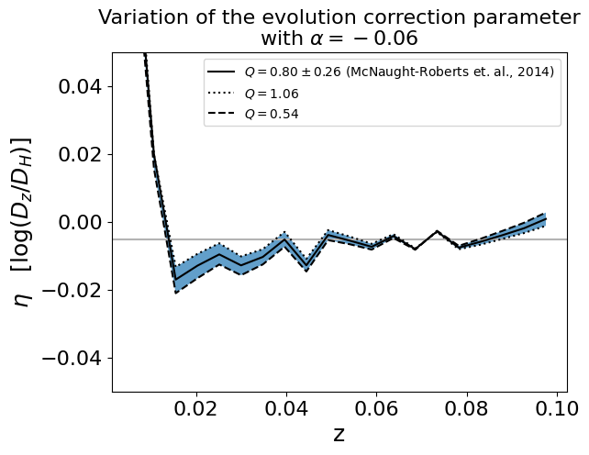
Validation
Preliminary
Preliminary

Slide 11
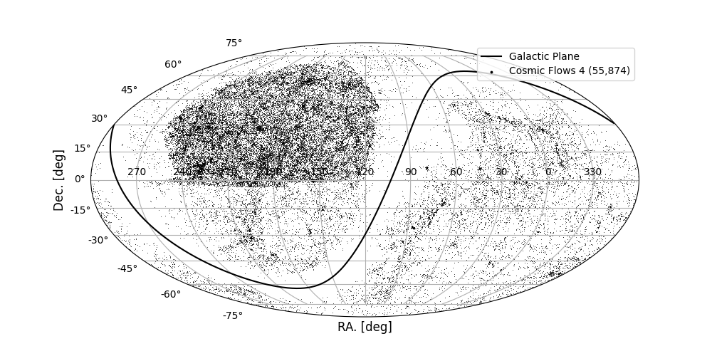
FP Catalogue

Slide 12
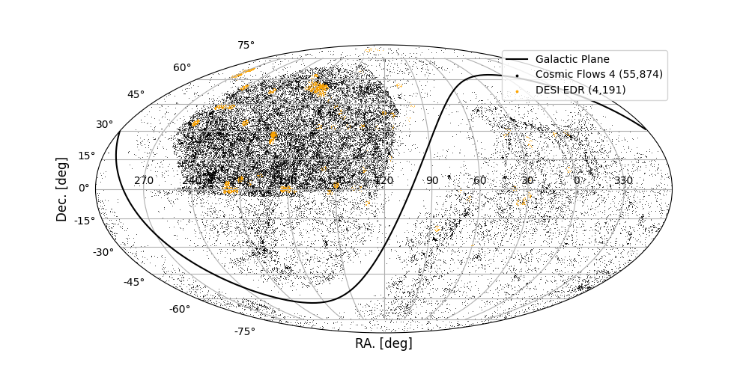
FP Catalogue

Slide 13
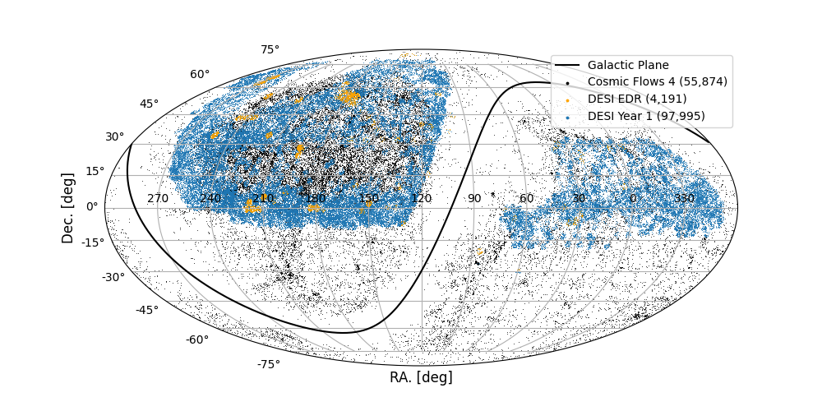
FP Catalogue

Slide 14
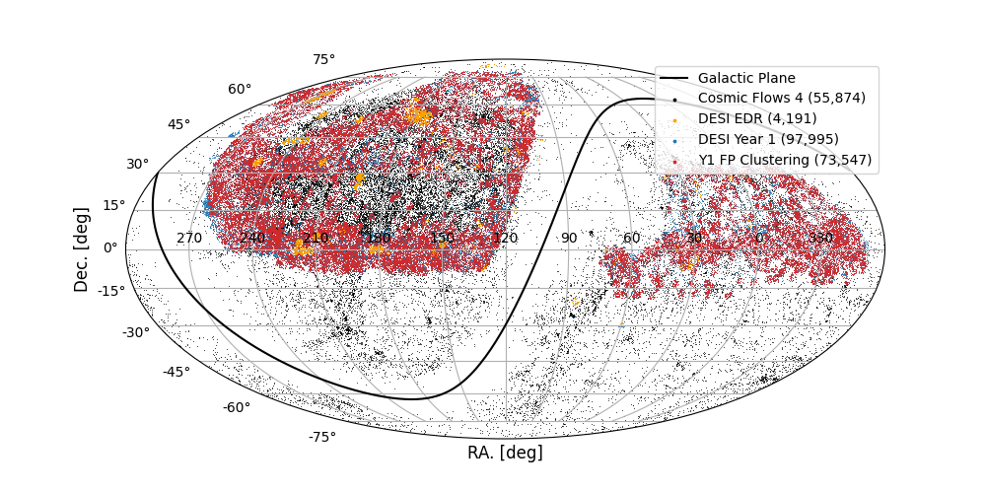
FP Catalogue

Slide 15
FP Catalogue
Catalogue Inclusions
ID parameters
DESI ID info + RA/DEC
Selection Parameters
FP inputs
r,s,i + errors
PV outputs
logdist + PV + errors
Subset Flags
primaryVdisp + Fpcalibrator + Pvclustering
Zero-Pointing
Tied to Y1 TF sample (Pantheon+)

Slide 16
What’s Next?
Y1 Tasks in-progress include:
  cross-correlations with Pantheon+
  mock catalogue generation
  density field reconstruction
  maximum likelihood field
  density-velocity correlation function & power spectrum
Y3 FP catalogue:
  Spiral Contamination
  Re-evaluate magnitude offsets found in EDR (external comparison)
  Log-distance calculation method

