Slide 1
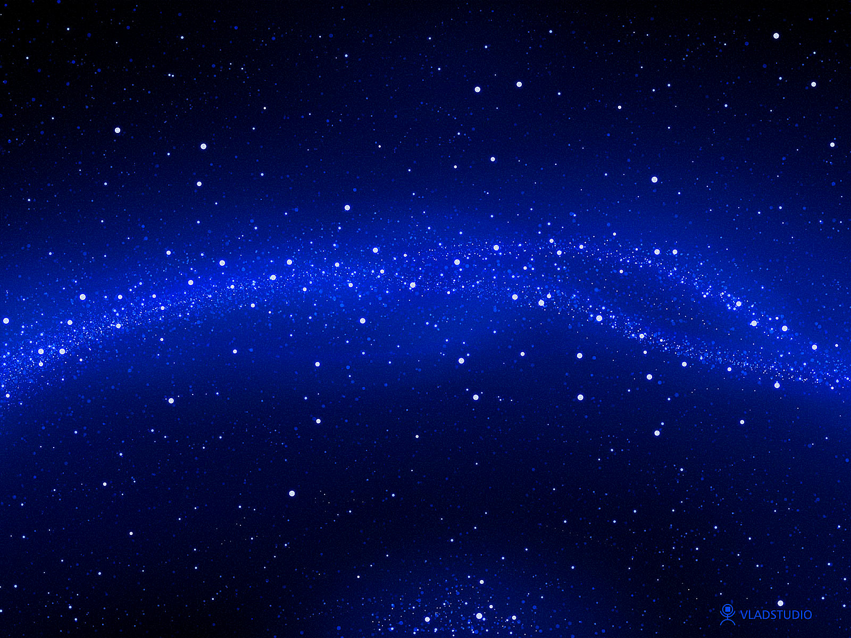



INVESTIGATING THE OBSCURED CORE OF THE VELA SUPERCLUSTER WITH MEERKAT
by Sambatriniaina Rajohnson
Collaborators: Renée Kraan-Korteweg, Bradley Frank, Paolo Serra, Lister Staveley-Smith, Sushma Kurapati, D. J. Pisano
Cosmic Flows 2025, Brisbane, Australia
February 5, 2024
E-mail: aychasam@gmail.com

Slide 2
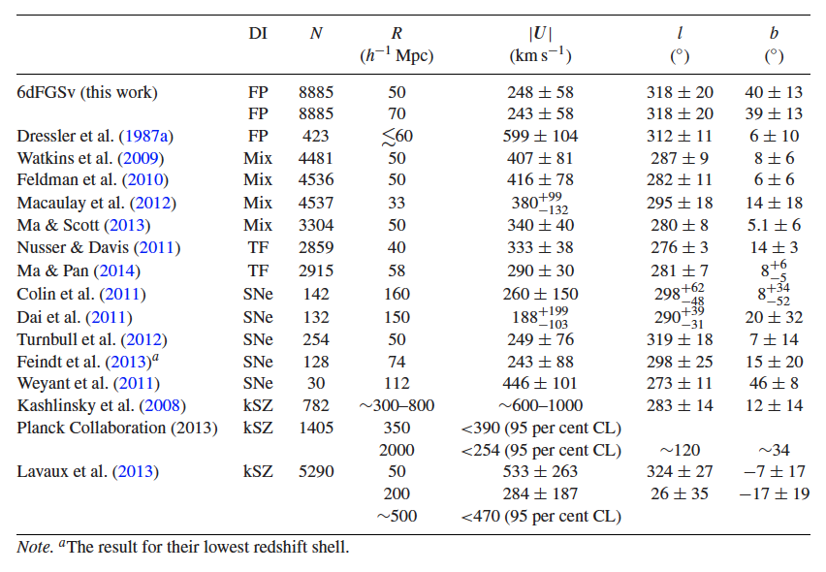
The ZOA: an obstacle to cosmological studies 2
A residual bulk flow of 273 km/s seems to arise in the ZoA region at l ~ 270 deg (VSCL region), v > 16000 km/s.
The Vela Supercluster (VSCL)
The 2MASS redshift survey (2MRS) – Macri+2019
Bulk flow discrepancies
Conforming of two possibly merging walls (Kraan-Korteweg+2017)
Inner part poorly sampled
Only HI systematic surveys can bridge the gap and map the inner ZoA
(so far shallow and affected by continuum at lowest latitudes)
Scrimgeour et al. 2016

Slide 3
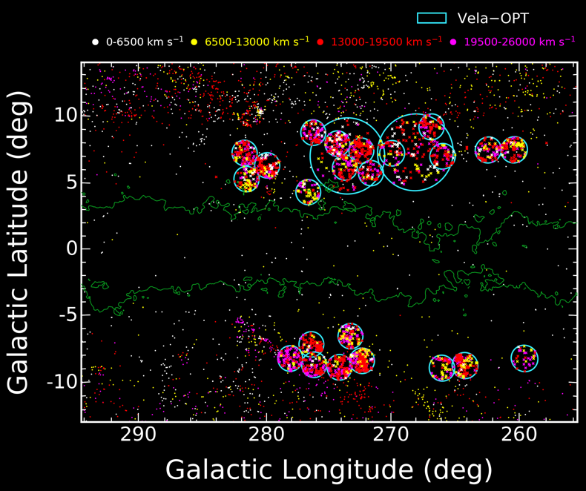
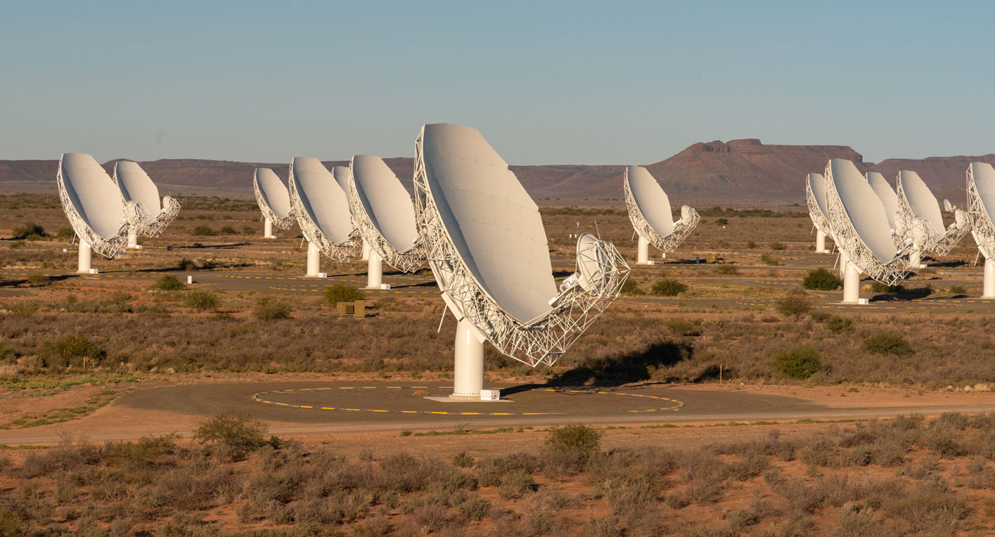
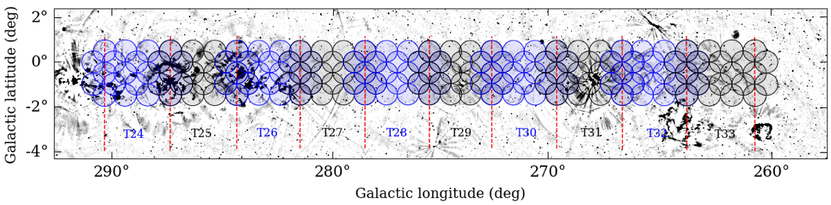
VELA-SMGPS & VELA-HI
3
Mapping the inner ZOA toward the Vela region
detect gas rich spirals (MHI > 4 +/- 0.5 x10⁹ M⊙) up to 25 000 km/s.
Study its effect on the cosmic flow field
Can we contribute to the understanding of the residual bulk flow?
Vela-SMGPS
Vela-SMGPS
Parameters | Vela-SMGPS (LSP)
Survey area | 3 x 30 deg²
Fields/Mosaics | 157 / 10
Total time | 211 hours (1h/pointing)
Mosaic rms (mJy/beam) | 0.35+/-0.07
The Vela spectroscopic survey region, magenta and red dots are galaxies at the Vela Supercluster distance (Kraan-Korteweg+2017)

Slide 4
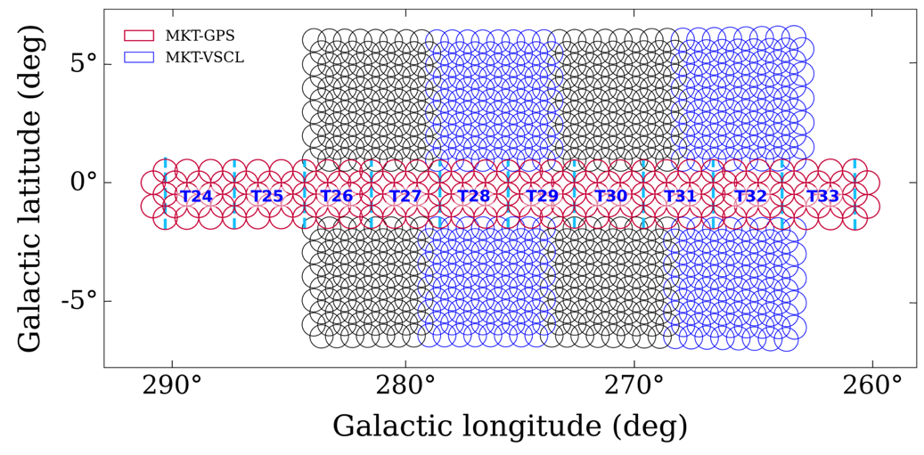
VELA-SMGPS & VELA-HI
4
Vela-HI
Vela-HI1
Vela-SMGPS
Vela-SMGPS
Vela-HI
Vela-HI2
The Vela spectroscopic survey region, magenta and red dots are galaxies at the Vela Supercluster distance (Kraan-Korteweg+2017)
Parameters | Vela-SMGPS (LSP) | Vela-HI (OTP)
Survey area | 3 x 30 deg² | 242 deg²
Fields/Mosaics | 157 / 10 | 667/ 32
Total time | 211 hours (1h/pointing) | 67 hours (5mn/pointing)
Mosaic rms (mJy/beam) | 0.35+/-0.07 | 0.74+/-0.13

Slide 5
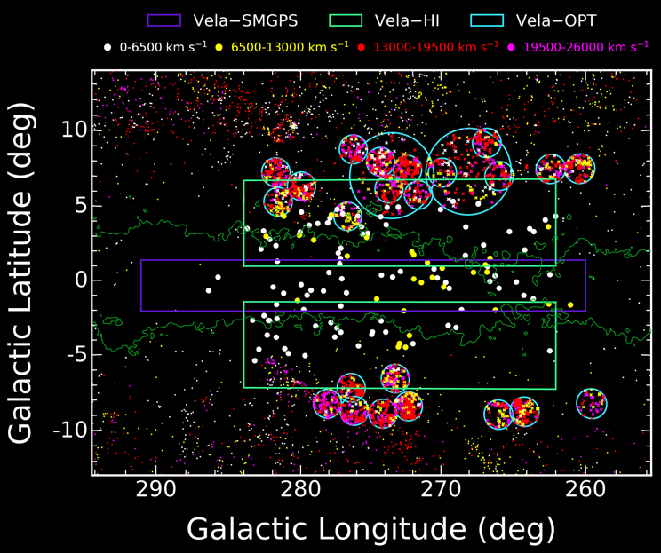
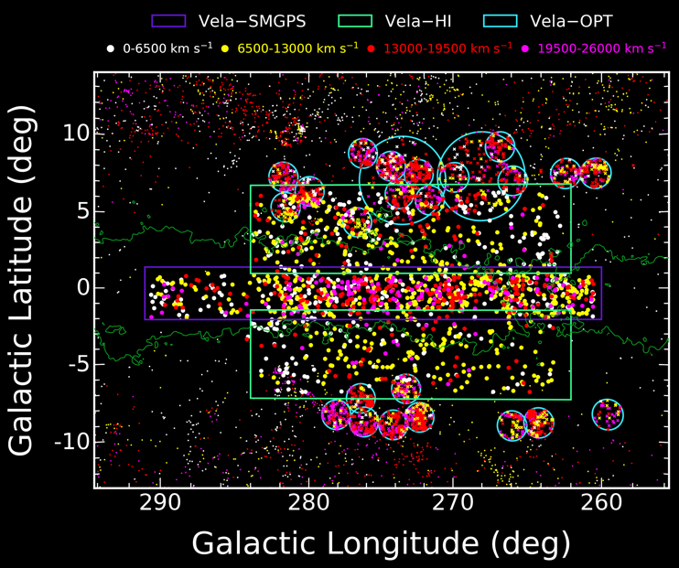
SURVEYS PERFORMANCE
5
HIZOA (Staveley-smith+16, Parkes Telescope)
This work (MeerKAT)
~6 mJy/beam, 15.5’ beam
(v < 12700 km/s), 131 galaxies in the area
~0.4-0.8 mJy/beam, ~35” beam
(v < 25000 km/s), +1500
Final source list
1562 detections out to 25000 km/s (843 in Vela-SMGPS +719 in Vela-HI)
313 detections possibly belonging to VSCL (v > 16000 km/s)

Slide 6
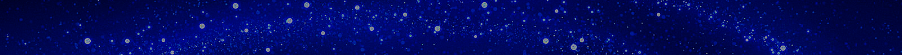
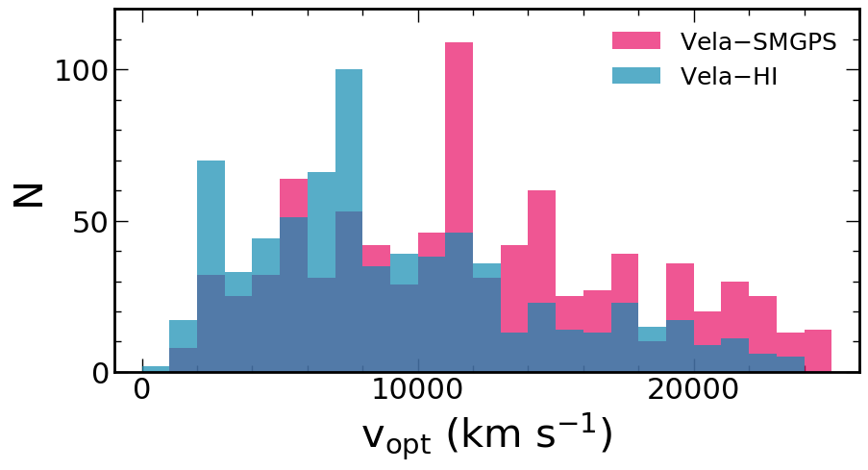
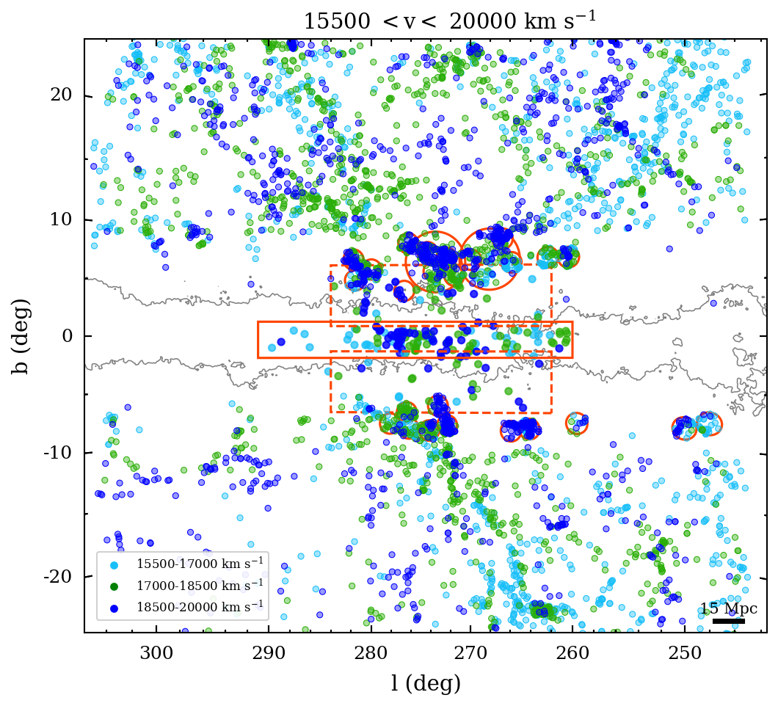
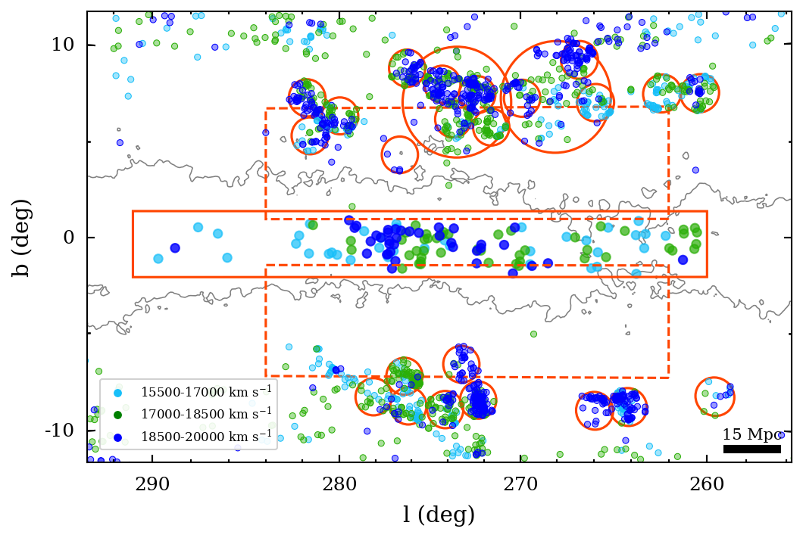
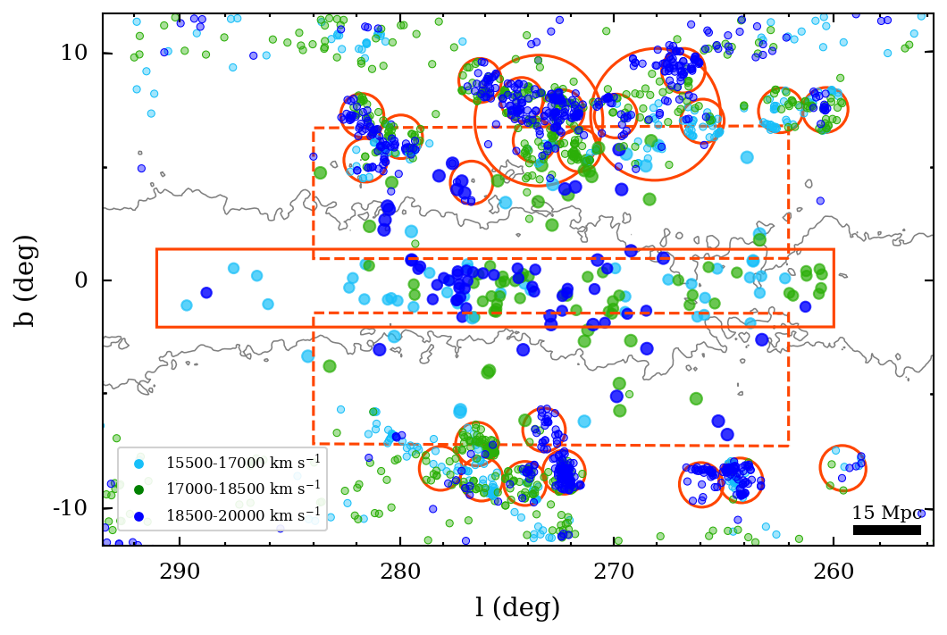
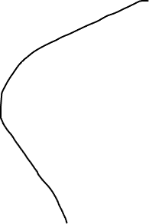
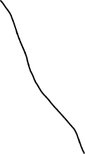
THE VELA SUPERCLUSTER 6
CIZA
A3391
18500-21500 crossing ~ 270-279 deg , > 15 Mpc (Wall not filament)
Rajohnson et al. 2024a,b

Slide 7
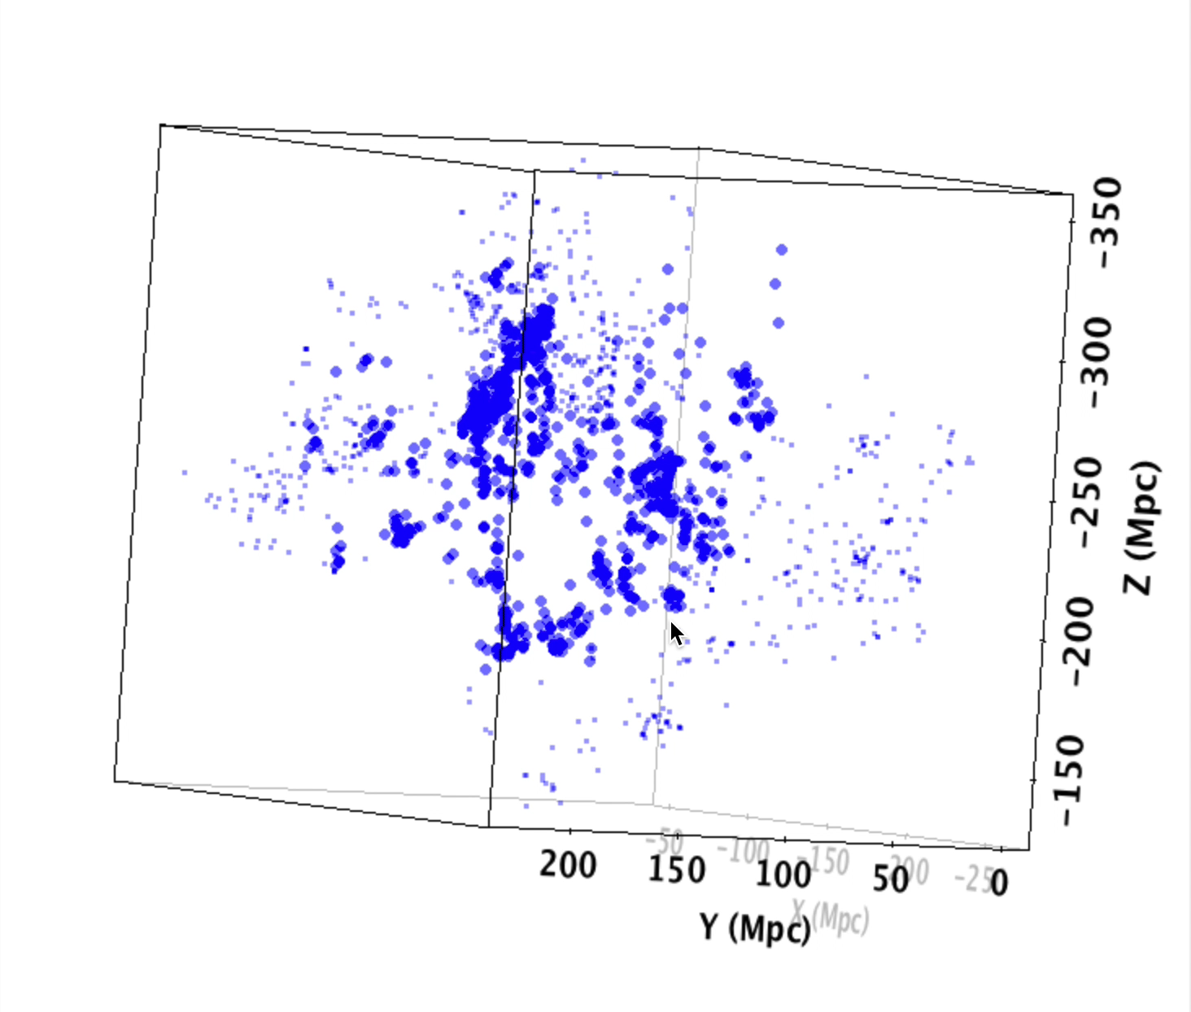
THE VELA SUPERCLUSTER
7
Above the GP
Mould+2024
(WALLABY-Vela)
Below the GP
Possible offset between HI and OPT/NIR Walls
Connection of the two walls at ~18500 – 21500 km/s
Aligned with independent reconstructions results (Mould+24, Courtois+19, Sorce+17)

Slide 8
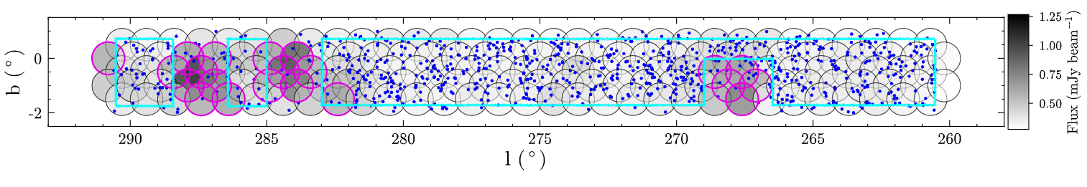
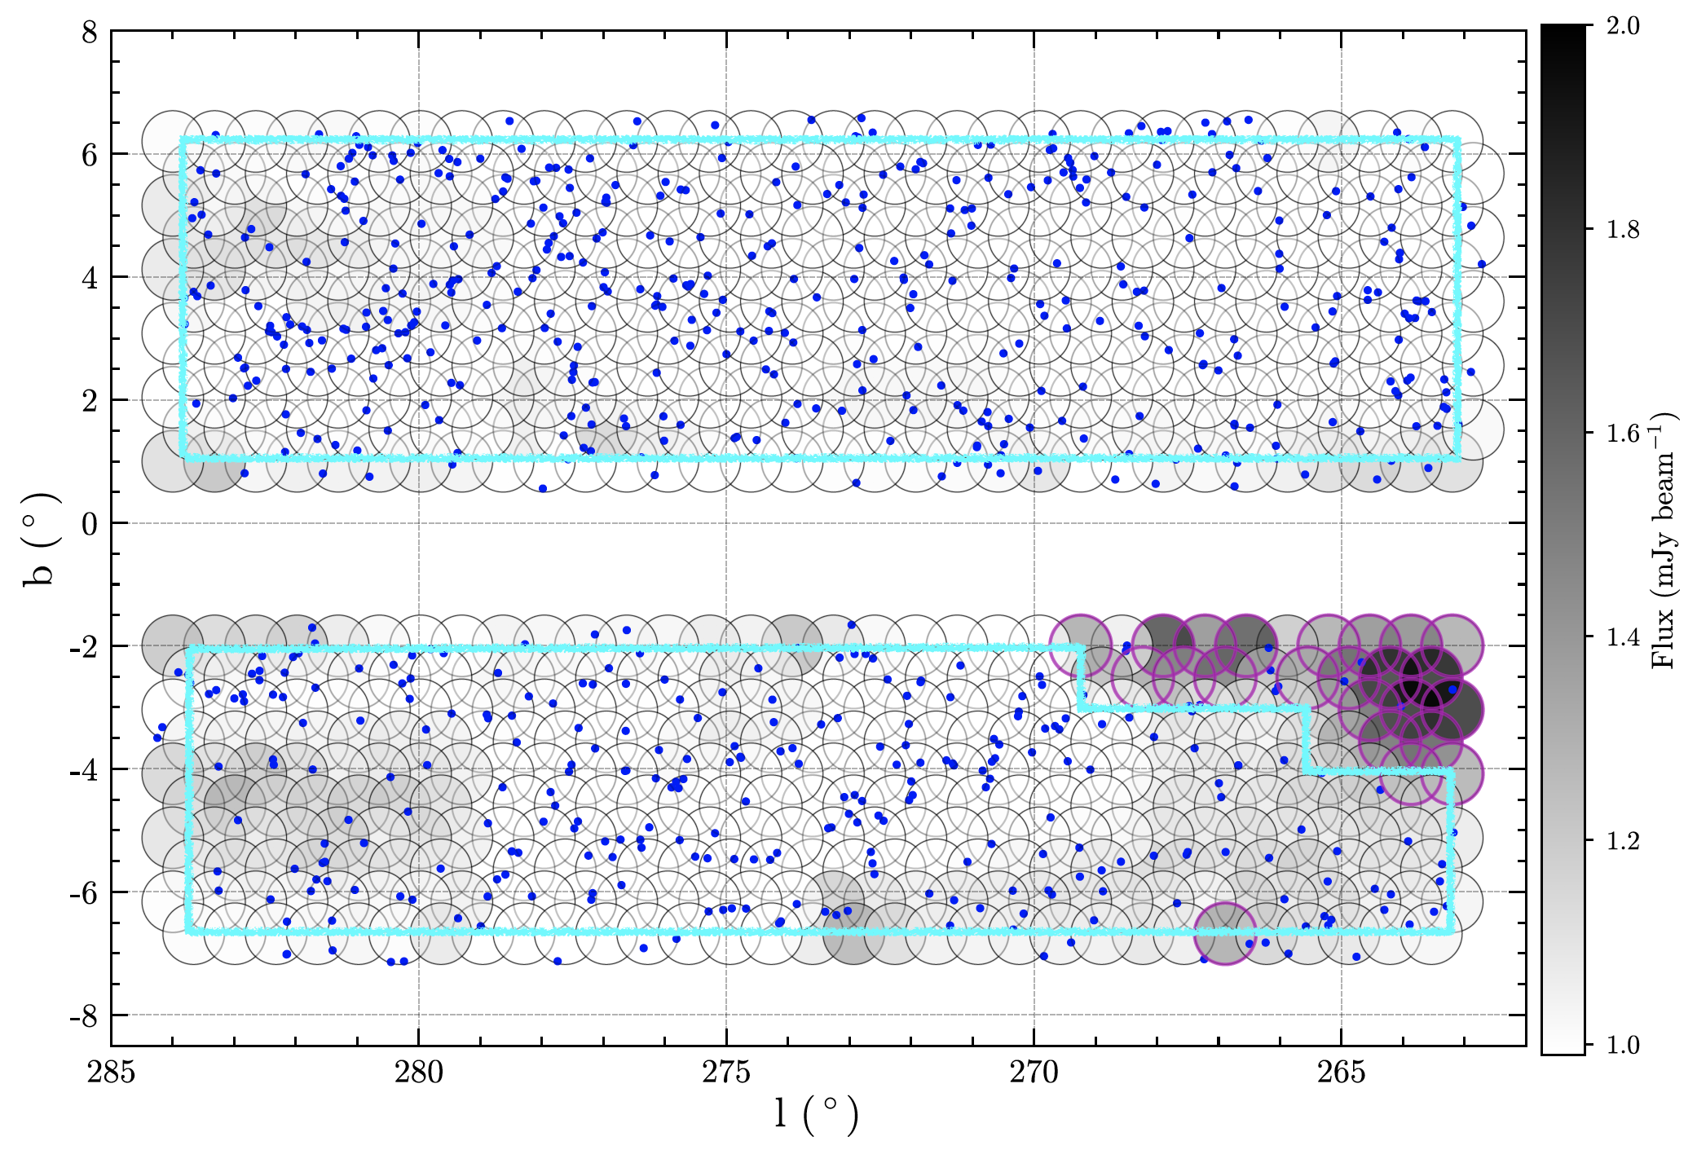
COMPLETENESS ESTIMATION
8
Sample selection
Exclude regions with rms > 2 sigmas (magenta fields, > 0.6 and 1.35 mJy/beam)
1322 selected galaxies

Slide 9
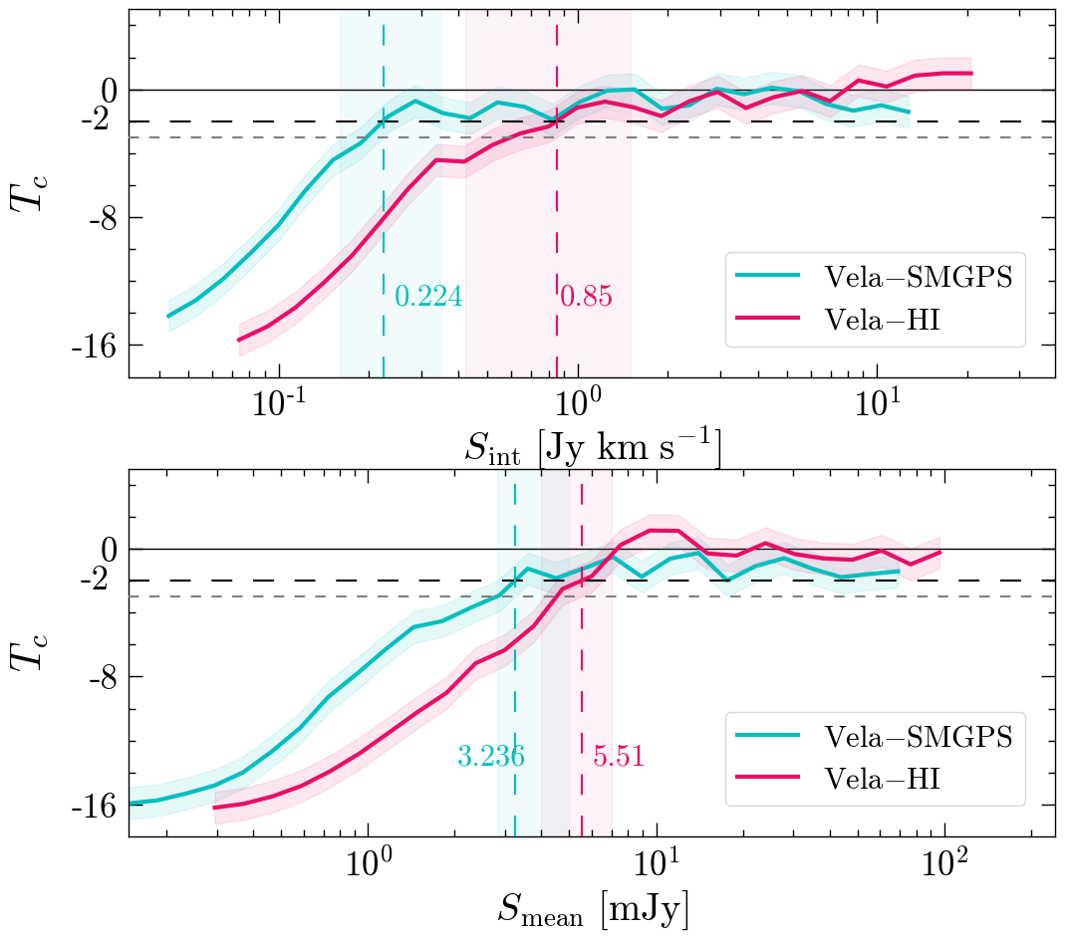
COMPLETENESS ESTIMATION
9
Rauzy completeness test (Rauzy 2001) measured at Tc = -2 (97.7%)
insensitive to LSS
Robust alternative of false-source injection
Integrated flux limit for Vela-SMGPS (77% of sample)
Mean flux density limit for Vela-HI (50% of sample)
Will be used in HIMF analysis

Slide 10
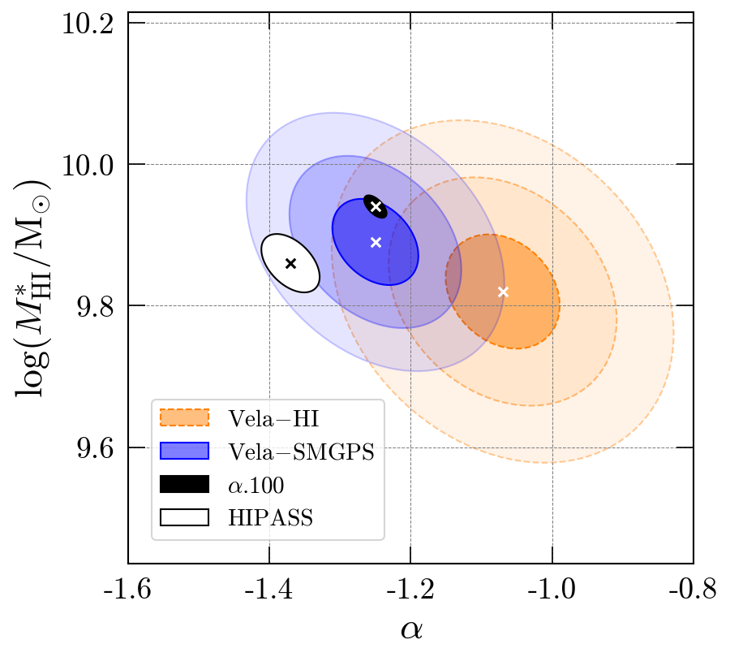
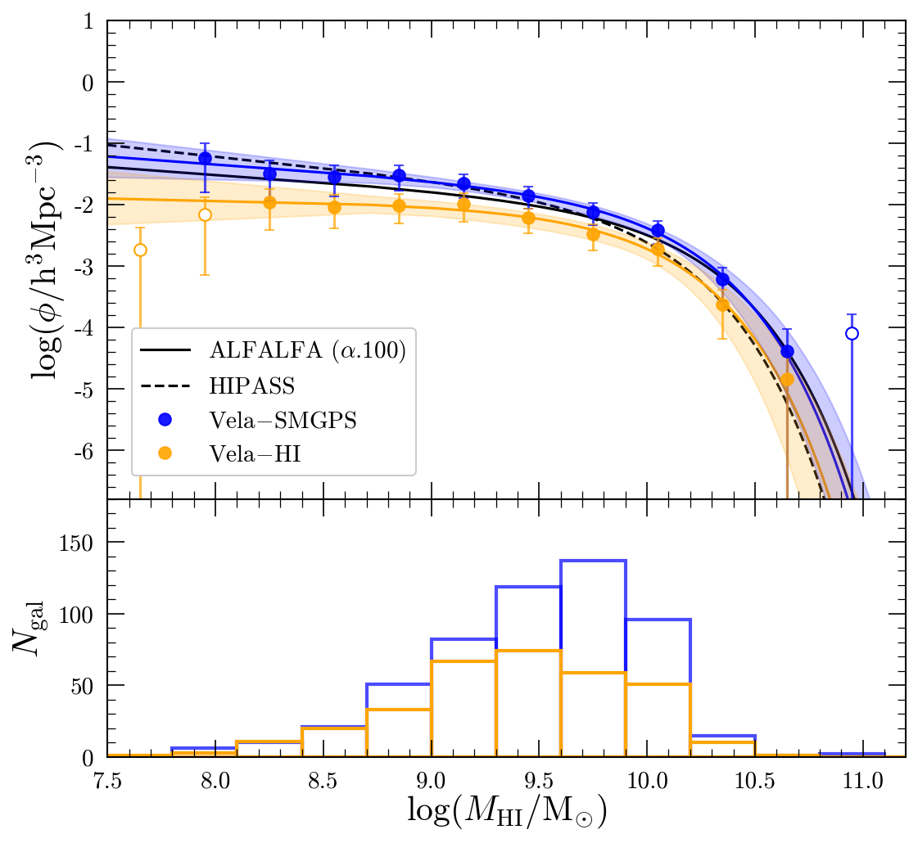
HI Mass functions
10
The HIMF can serve as an indicator of the galaxy’s environment → number of galaxies per Mpc³
HIMFs of the surveys: the overall fit aligns with the ALFALFA100 HIMF within 3𝜎
2D Stepwise Maximum Likelihood Method
No obvious overdensity seen here

Slide 11
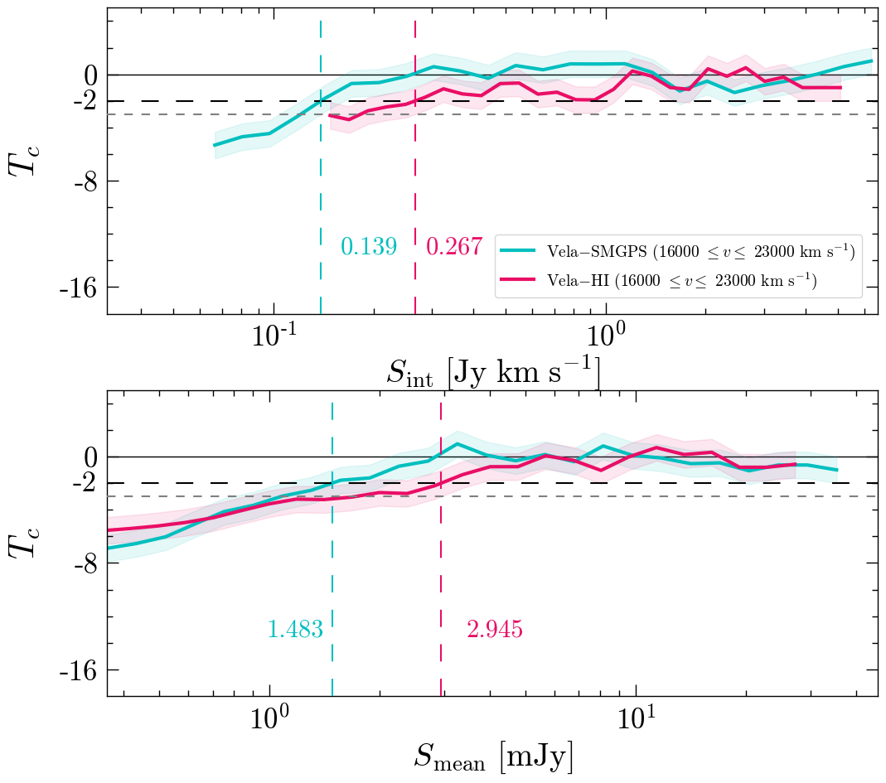
Completeness at the VSCL distance
11
Our samples are already almost complete at the VSCL distance
Select flux density-based completeness: 0.139 and 0.267 Jy km/s

Slide 12
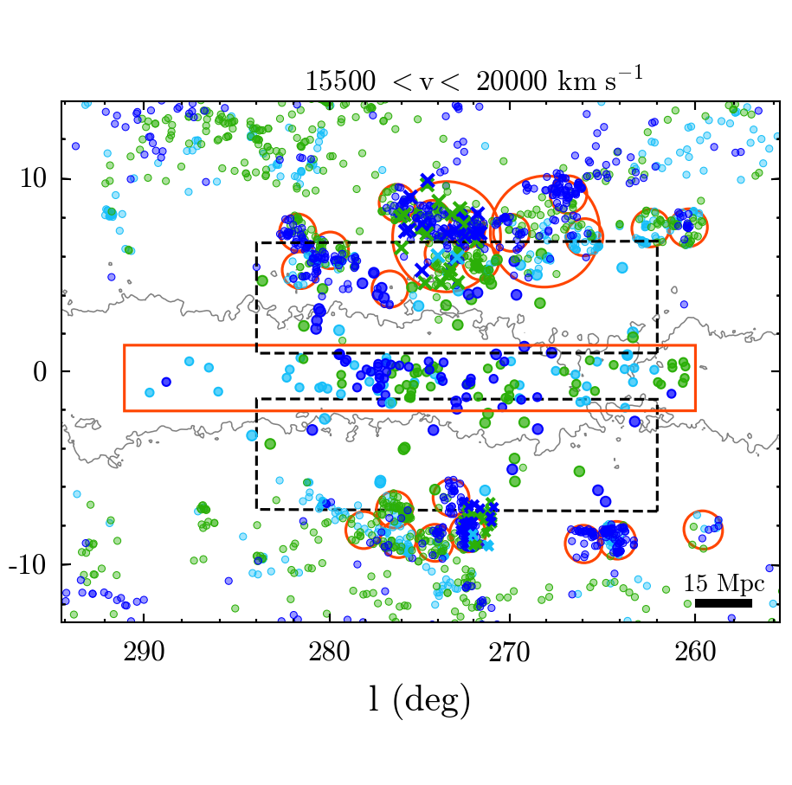
Overdensity at the core of VSCL
12
Ratio of mass densities compared to ALFALFA 16000-19000 km/s (W1) and 19000-23000 km/s (W2)
Galaxies at the VSCL distance (W1 example)
Total matter content:
2.5 x 10¹⁵ h³ M⊙ (W1)
8.3 x 10¹⁵ h³ M⊙ (W2)

Slide 13
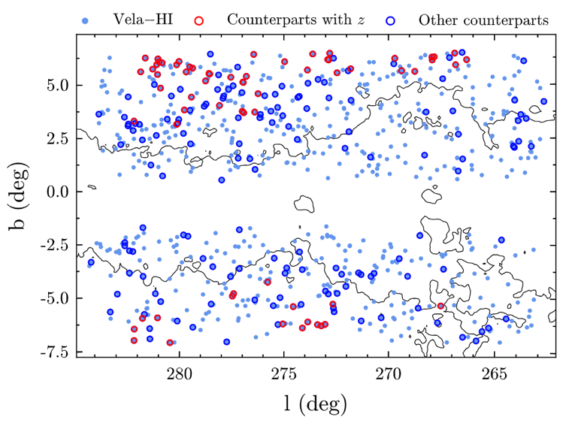
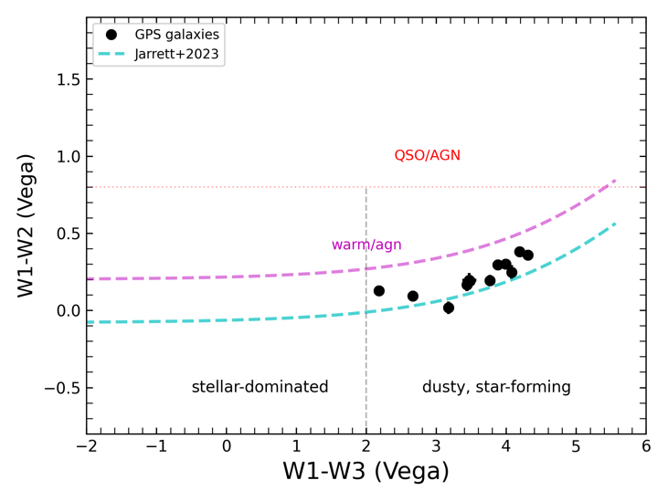
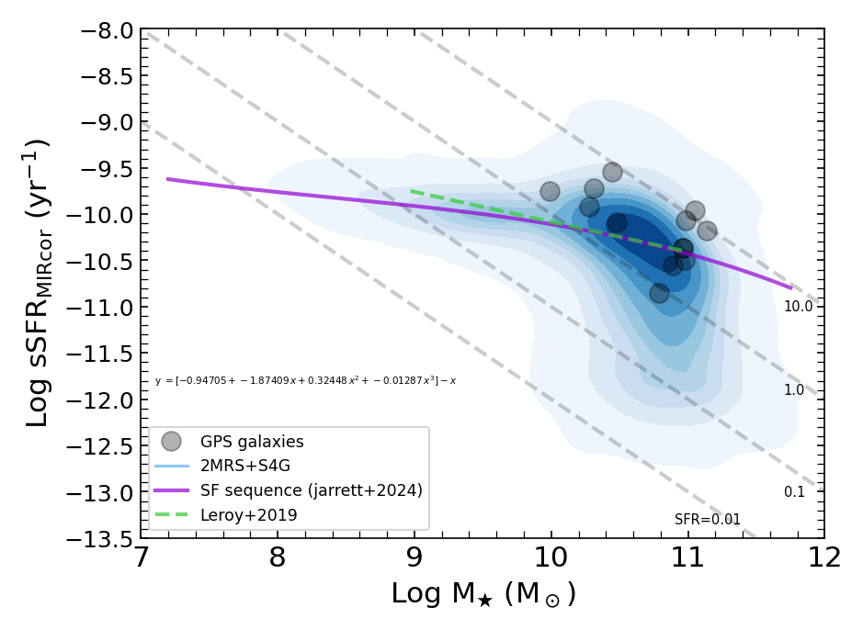
Exploring Peculiar Velocities in VSCL
13
29% (211) with OPT and NIR counterparts (with only 31% (65) of them with spectroscopic redshift) in Vela-HI.
190 potential WISE counterparts (140 in Vela-HI, 50 in Vela-SMGPS).
In the preliminary test of 12 WISE counterparts, they have been found to be dusty and star forming galaxies.
Possible construction of Tully-Fisher relation with adequate photometry.

Slide 14

Summary & Conclusions 14
Two blind systematic interferometry surveys that have been done across the thickest layer of the Milky Way (Over +800 MKT pointings, +300 deg² area processed thanks to IDIA facilities)
We detected +1560 heavily obscured galaxies and can detect gas-rich spirals (M(HI) > 10^{9.44} M⨀) which is in agreement with expectations beyond cz ~ 15 000 km/s in both surveys.
Offsets between the HI and OPT/NIR walls which indicate that galaxies are infalling toward the walls, those being near the edges still gas-rich.
Hints of two wall-like overdensities crossing at l~270 – 279°(at v ~ 18500 – 21500 km/s) seen on the multi-branching structure of the on-sky plots.
We found an overdensity of the potential crossing at 273◦ – 278.5◦ in the mass density estimations from the HIMFs.
With adequate photometry, we could determine peculiar velocities and estimate the potential contribution of VSCL on the cosmic flow fields.

