Slide 1

UTC and the role of primary and secondary frequency standards
P. Tavella
With the support of all
the BIPM Time Dept

Slide 2
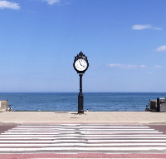
What time it is?

Slide 3
Time scale: the 4th coordinate of a space-time system
From the observation of a position, based on Newtonian dynamics
Dynamic Time Scale
to the time coordinate
From the integrated accumulation
of time units, defining an origin
Integrated Time Scale
to a proper time scale

Slide 4
Dynamic Time Scale
Time is the parameter of a mathematical equation describing the dynamics of an observable system
For any configuration of the dynamical system a unique (or distinguishable) time instant is associated
Example: Keplero law gives a relation between observed positions of the Earth and particular time instants
Measuring time means measuring position
A coordinating organisation is needed,
time unit is not directly accessible

Slide 5
Error of the Dynamic Time Scale
Observation errors
-
Decrease as technology improves
Definition errors
in the mathematical equations
in the knowledge of initial conditions
imperfect knowledge of influencing factors
+

Slide 6
Integrated Time Scale
Let’s take a physical system that presents repetitively two identifiable different states. If the time interval between the two states is constant
we can define a unit of time
Choosing arbitrarily an origin and summing up successive time units (without dead time)
we build up a time scale.
Any time interval is easily measured as difference between final and initial dates, the time unit is easily accessible

Slide 7
Error of the Integrated Time Scale
Definition errors
the origin has not a unique definition
-
Realisation errors
difficult to reproduce the time unit always in same conditions
if the time unit realisation differs from the definition, the error accumulates and the realised time scale diverges from the definition
+

Slide 8
For centuries
The time was given by the rotating Earth
on which we set the clock
From 1967
The time is given by atomic clock
used to study Earth rotation

Slide 9
Along centuries...
day and night are the “natural” time unit
it was observed that during the year the length of day changes but the “Mean Solar Day” was deemed constant and Universal
Universal Second = 1/86400 of rotational day (Mean Solar Time)
1884 Greenwich reference meridian
1925 International Astronomical Union fixes the beginning of the mean solar day at h. 00 and defines the Universal Time
Universal Time

Slide 10
the rotation rate is constant?
Universal Time

Slide 11
Polar motion
Suspected around 1850 from astronomers
That’s odd! The
Polar seems lower!
The Polar
is higher!
Polar motion can be measured but is not predictable

Slide 12
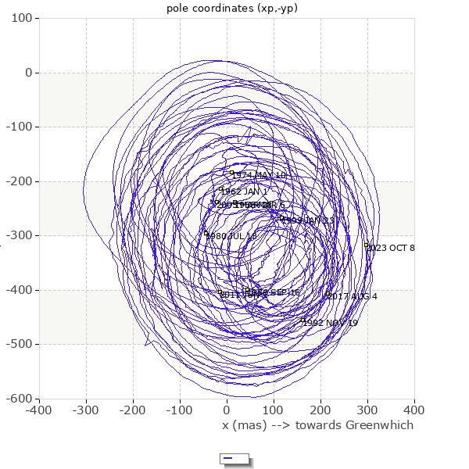

Polar motion
About 10 m
Units and conversion of units
1 astronomical unit | UA | 149 597 870.691(6) | km | 0.00004 | numerical IERS Standards
From milliarcseconds (mas) to radians |  |  | 1 mas =4.8481(1) 10⁻⁹ rad
What represents an arc of 1mas from the center of the Earth at distance equal to the polar radius (6 356 755 m)? |  |  | 3.1(1) cm
Conversion of arc units in hour, minute, second to arc units in degre, arcminute, arcsecond |  |  | 24 h = 360° 1 h = 15° 1 min = 15' 1 s = 15" 1 ms = 15 mas
https://eoc.obspm.fr/index.php?index=realtime&lang=en
http://www.iers.org International Earth Rotation and Reference Systems Service

Slide 13
Seasonal variation:
in summer we spin faster
A. Scheibe, 1936 in Berlin
N. Stoyko, 1936 in Paris (BIH)
with crystal clock the day was measured shorter of about 1.2 ms

Slide 14

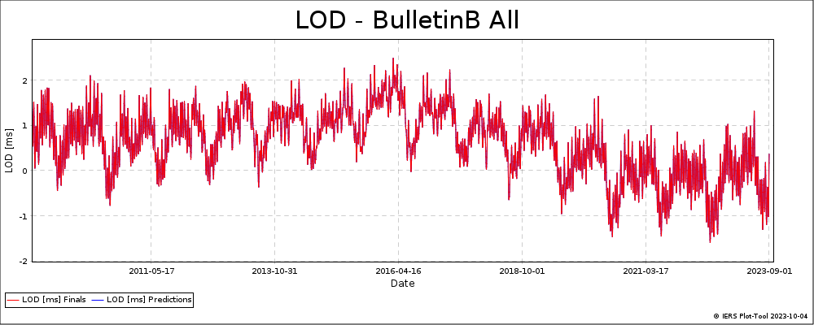
Variations
in the duration of the day
LENGTH OF DAY exceeding 86400 seconds
https://www.iers.org/IERS/EN/DataProducts/EarthOrientationData/eop.html

Slide 15
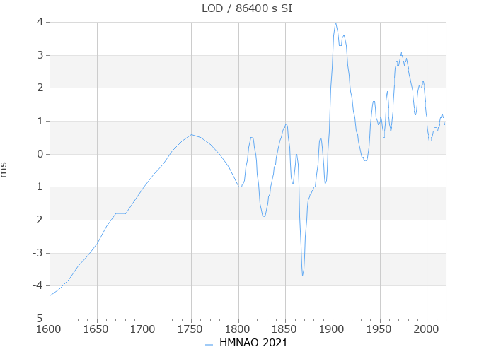
Secular slowing down
LENGTH OF DAY exceeding 86400 s

Slide 16
The Universal Time was improved
UT = Universal Time scale
UT1 = Universal Time corrected by polar motion
UT2 = Universal Time scale corrected by seasonal variations
…. (UT not GMT!)

Slide 17
…in 1960
the “revolution” of the Earth around the Sun is constant.
Measuring the longitude of the Sun and using the equation of the apparent Sun orbit
The new time scale: Ephemeris Time starts from h. 0 UT of January 1st, 1900.
Time unit is the Ephemeris Second =
1/31 556 925.9747 of the tropical year on day January 0, 1900
any new definition of the Second has to be in agreement with the previous one. For continuity with UT, this is the duration of the second in 1900
Ephemeris Time
that duration!
in 1960 this duration was already shorter than 1/86400 of the Mean Solar Day

Slide 18
…in 1967
Atomic Second = 9 192 631 770 periods of the radiation corresponding to the transition between the two hyperfine levels of the ground state of the Cs 133 atom
First comes the second, then the time scale: in 1971: Temps Atomique International TAI, International Atomic Time
TAI starts from h. 0 UT of January 1st, 1958.
The length of the atomic second is in agreement with the Ephemeris second
Atomic Time
therefore shorter than 1/86400 of the Mean Solar Day

Slide 19
So far we have learnt that the Atomic Second is, by definition,
shorter than the current Rotational Second (Universal Time)
because it was defined in agreement with
the duration of the Rotational Second in 1900 and
the Earth is (slowly!) slowing down

Slide 20
In a relativistic frame
Any clock realises a proper local time
The average of many different proper times may be a coordinate time
(as the International Atomic Time)

Slide 21
The International Astronomical Union recommends time scales and reference frames for the different applications in Geocentric or Solar System Barycentric frames. On the Earth or in the vicinity (50000 km) the reference time scale (1991 and update in 2000) is the
Terrestrial Time
The Terrestrial Time is a coordinate time scale defined in a geocentric reference frame (centered at the centre of the Earth), with scale unit the SI second as realized on the geoid
“on a conventional equipotential surface close to the geoid”.

Slide 22
The SI second as realised on the rotating geoid
The geoid is an empirical surface known with relative uncertainty of about 10⁻¹⁷ . In addition, the rotating velocity impacts at 10⁻¹⁹ level.
The definition of the Terrestrial Time was updated (IAU 2000) as:
The Terrestrial Time is a coordinate time scale defined in a geocentric reference frame (centered at the centre of the Earth), with scale unit the SI second differing by a constant rate L_{G}= 6.969290134 *10⁻¹⁰ with respect to a geocentric clock.
L_{G} equals U_{G}/c² where U_{G} is the geopotential at the geoid

Slide 23
The International Atomic Time
is one the best realisation of the Terrestrial Time
But which is now the angular position of the
EARTH?

Slide 24
In the ‘70s most of the navigation was based on traditional methods observing celestial bodies
It was considered necessary to have a civil time close enough to the Universal Time UT1 (rotational)
Coordinat
ed
in 1975
The Universal Coordinated Time (UTC) is a trade-off defined with the same time unit as TAI but with insertion of additional leap second
TAI-UTC = n seconds n = 0, ±1, ± 2, ...
|UT1-UTC| < 0.9 s
Universal Time UT0, UT1, UT2,….

Slide 25

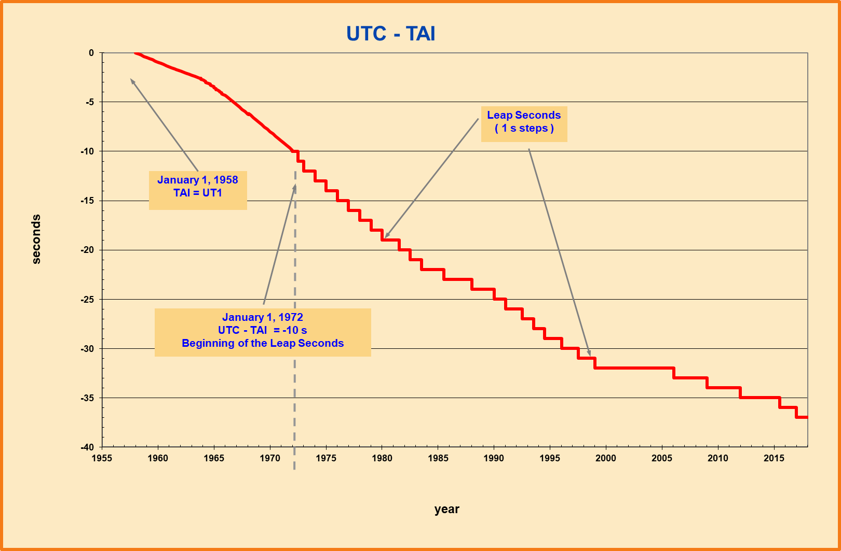

Coordinated Universal Time UTC is
in agreement with the rotational angle of the Earth UT1
Timekeeping is related to the rotation of the Earth.
The real time timekeeping is based on atomic clocks and, since 1972, UTC is obtained from the International Atomic Time (TAI) plus leap seconds.
When the difference between the Earth rotational angle UT1 time scale and UTC reaches 0.9 second, an integer second is inserted to UTC to keep it within 1 s of UT1.
Before 1972, UTC was corrected by small frequency steps
Last leap second
Dec 31, 2016
|UTC - UT1| < 1 second
Today
TAI - UTC = 37 s
UTC = TAI + n seconds
23:59:59
23:59:60
00:00:00
UTC = TAI + leap seconds
The process to insert the leap second and the code to transmit DUT1= UT1-UTC are described in Rec ITU-R TF 460-6

Slide 26
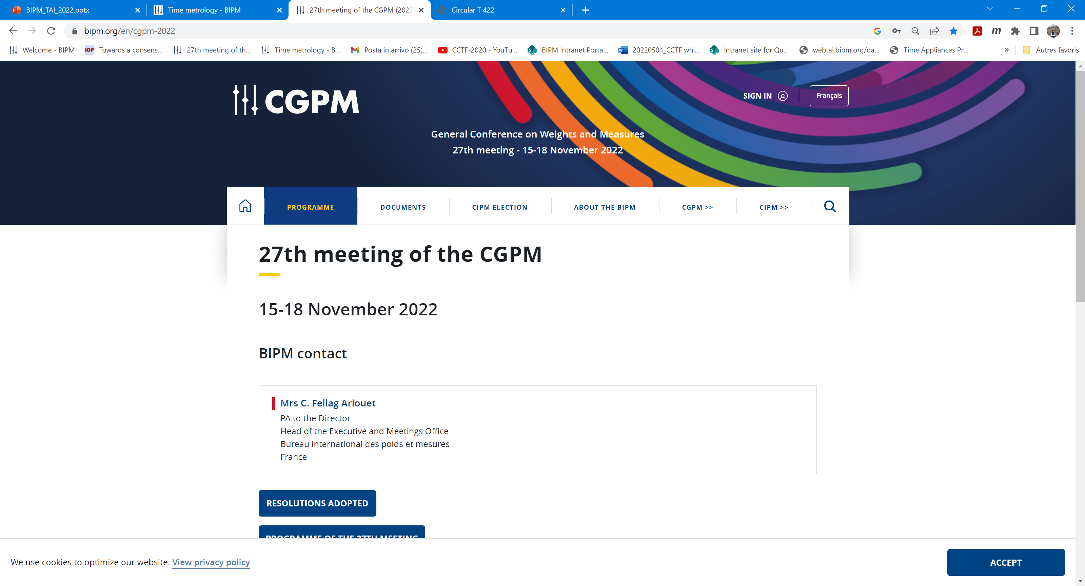
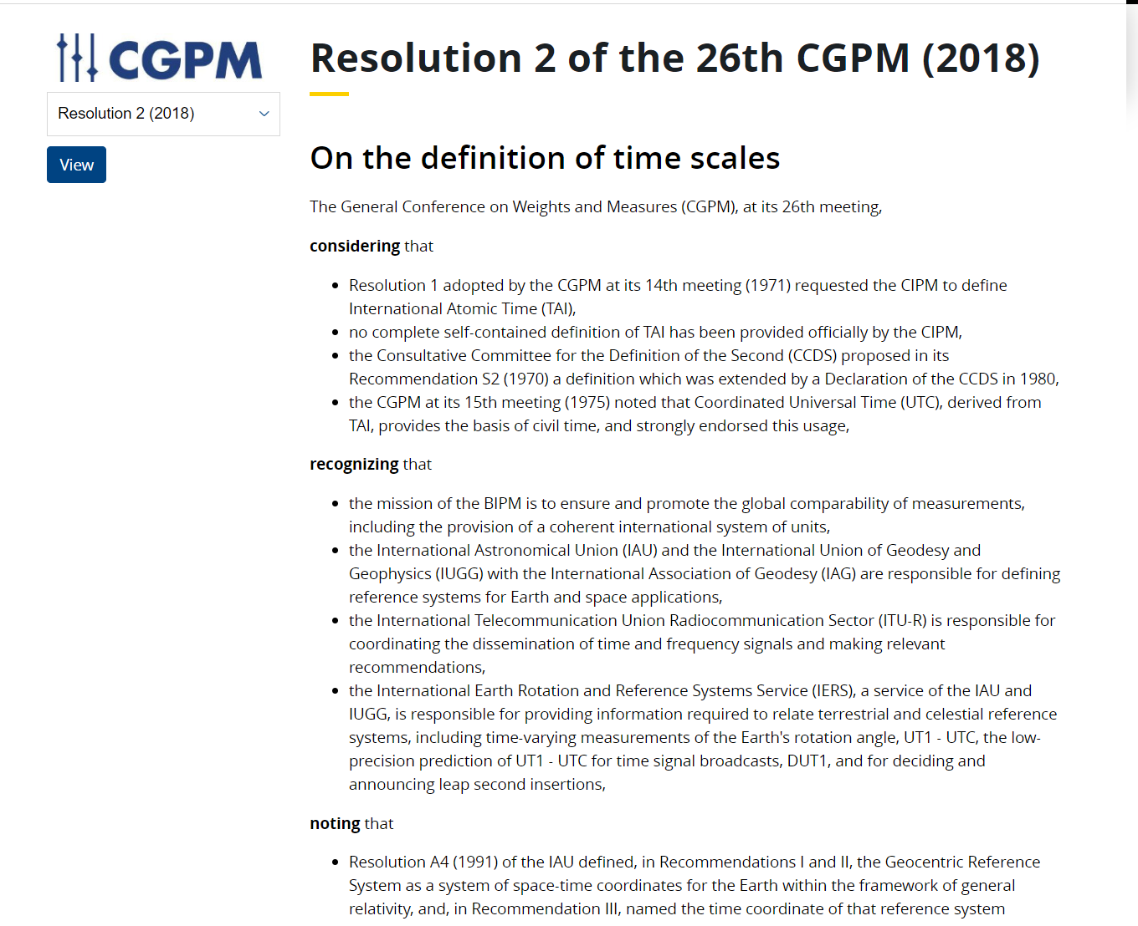
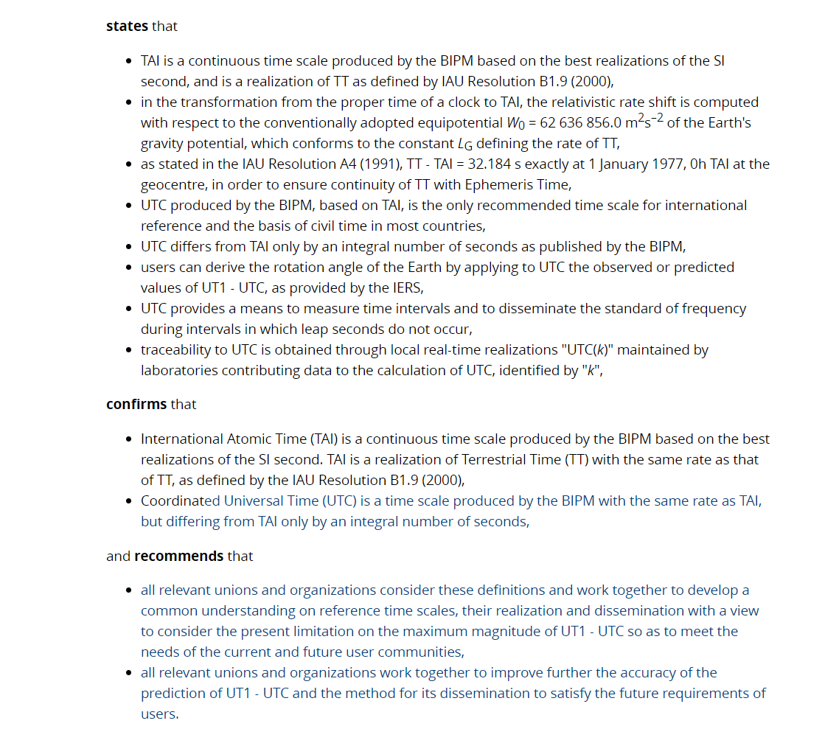

Slide 27
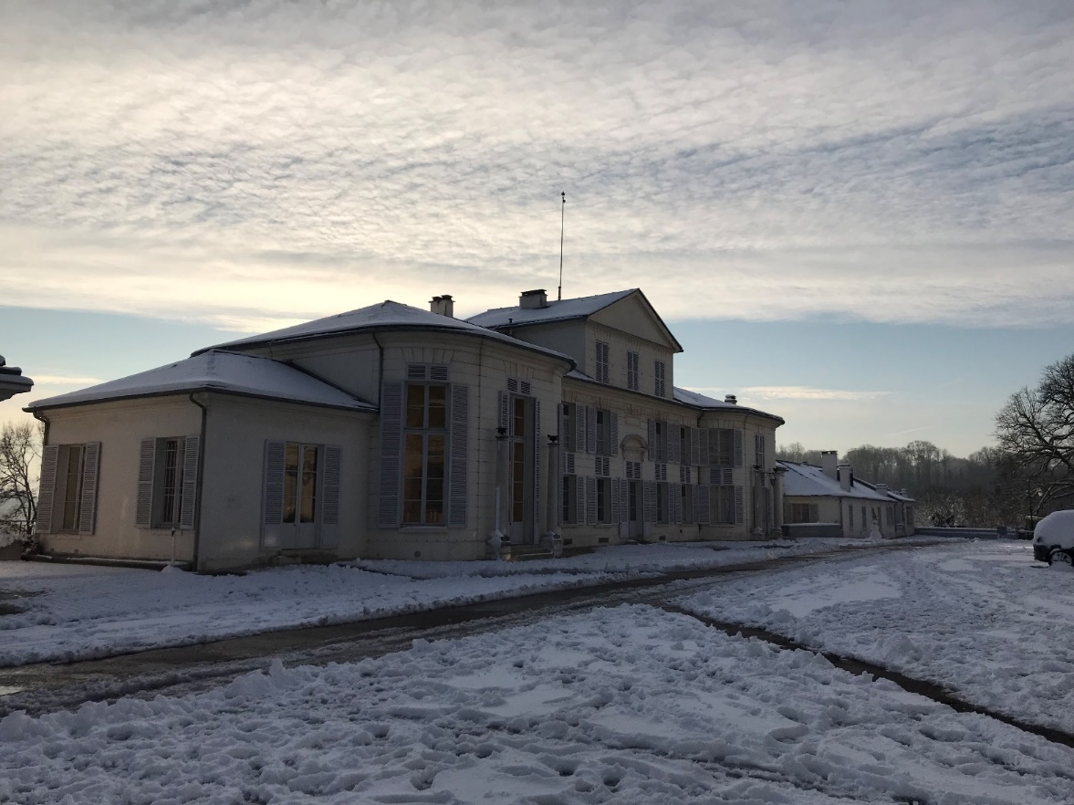
How UTC is computed?
The Bureau International des Poids et Mesures maintains and coordinates international measurement standards

Slide 28
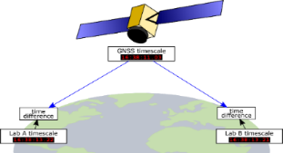
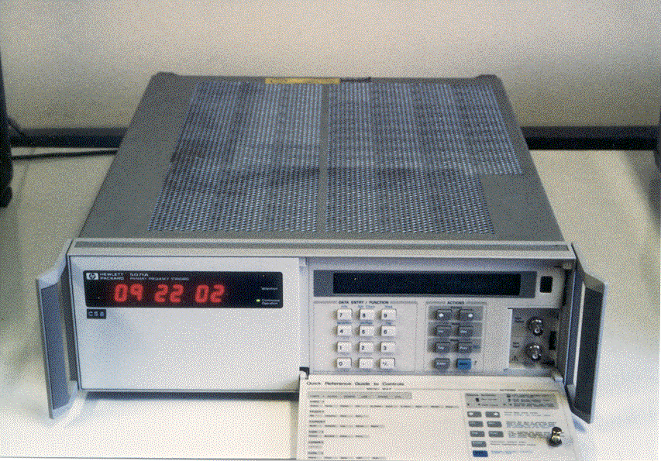

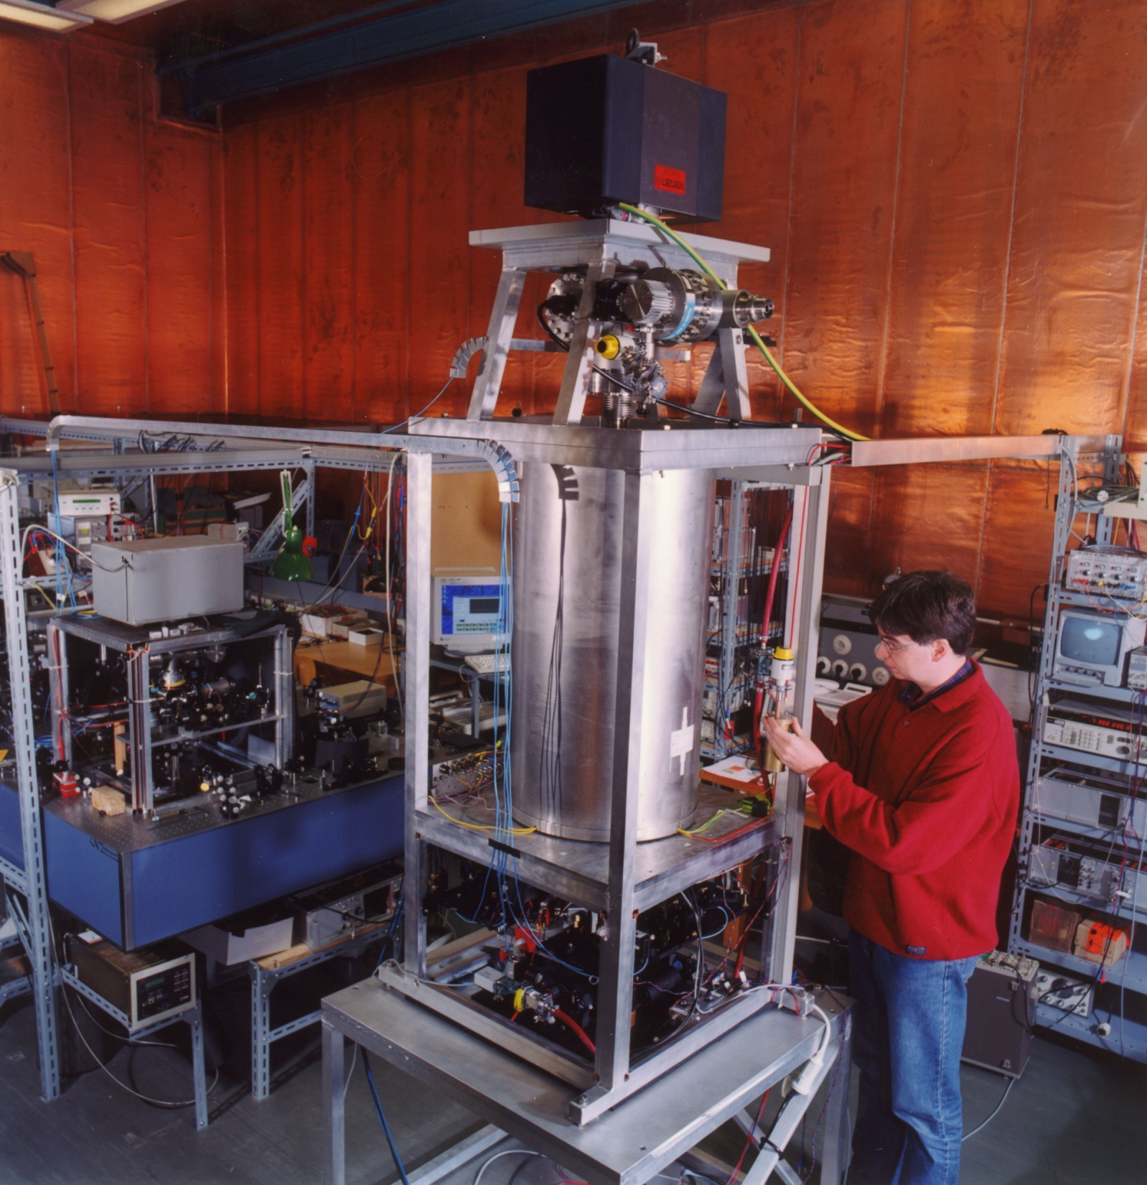

Construction of the Coordinated Universal Time
450 atomic clocks
15 primary frequency standards
in ∼ 85 laboratories
TAI
International
Atomic Time
National time laboratories realize real-time approximations UTC(k)
Measurement of Earth’s rotation UT1 (IERS)
leap seconds
UTC
Coordinated
Universal Time
|UT1 – UTC| < 1 s
The offset [UTC - UTC(k)] is published in
BIPM Circular T

Slide 29
The International Atomic Time and the Universal Time Coordinated are the ultimate time reference but available
in deferred time
Local time scale UTC(k) are realised by national laboratories
in real-time

Slide 30
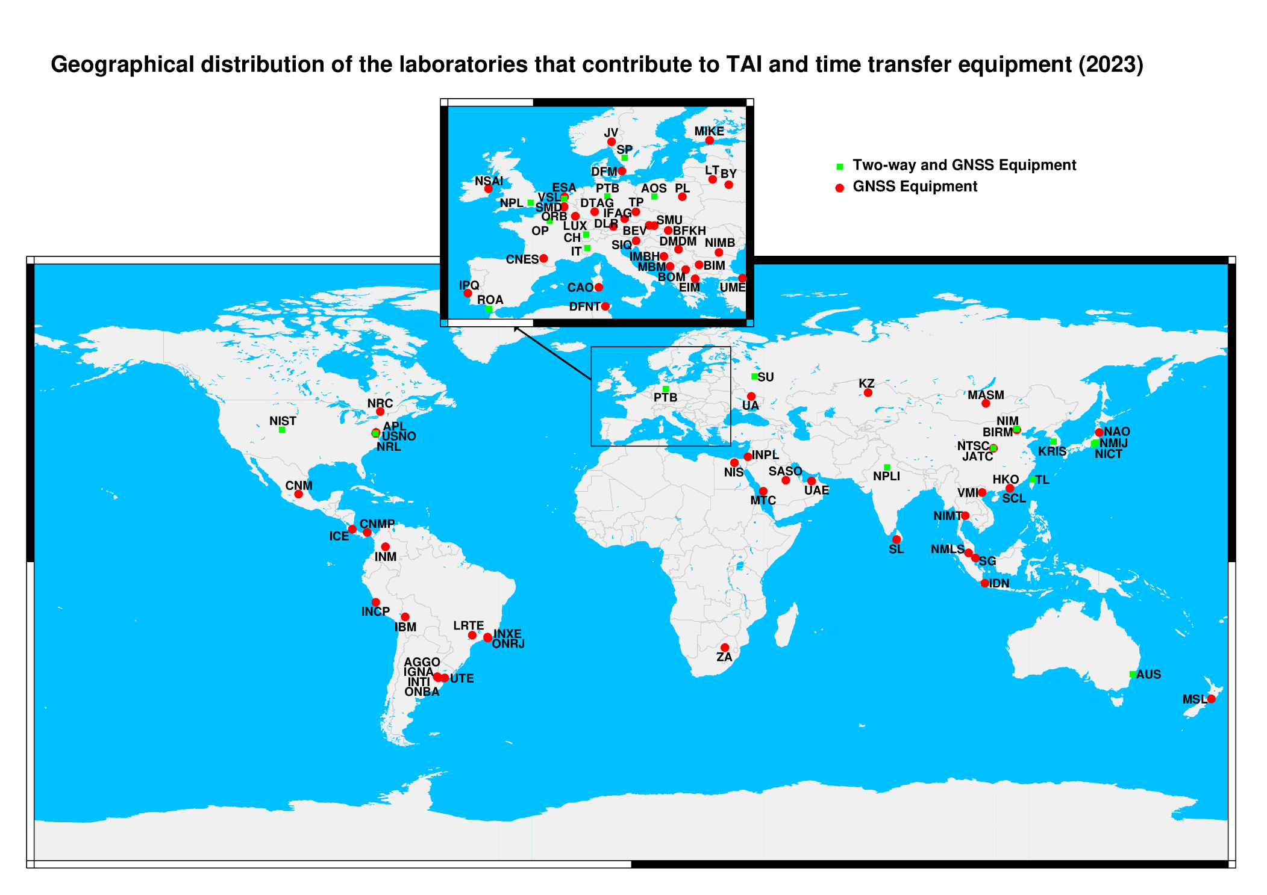
UTC is based on ≈ 450 atomic clocks kept in ≈ 85 laboratories in the world

Slide 31
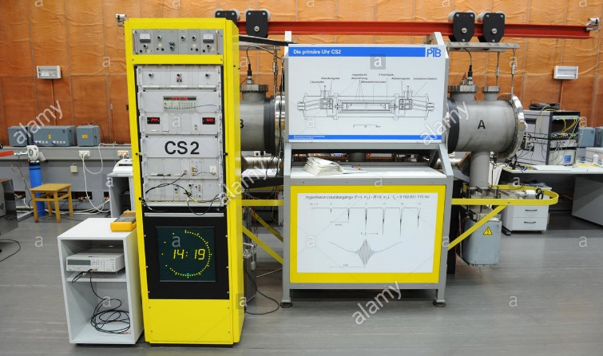
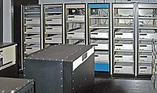
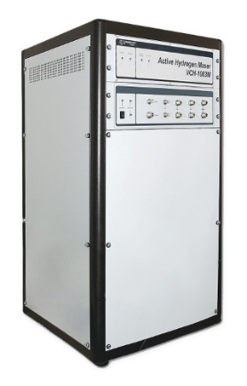
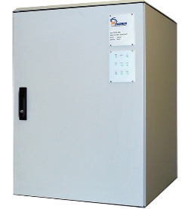
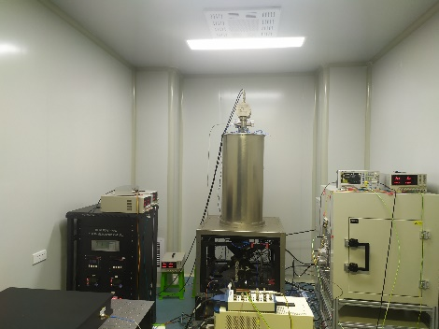
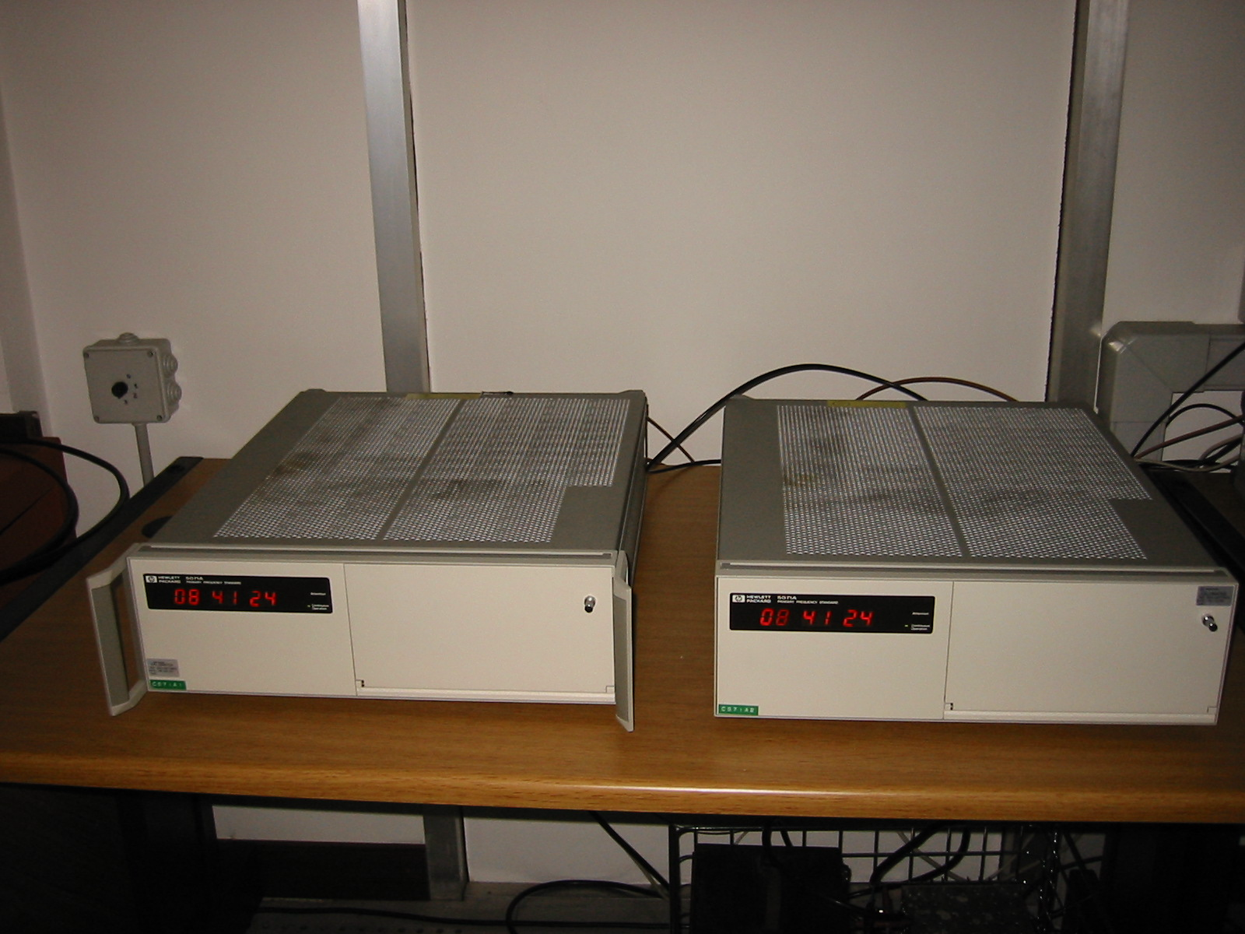
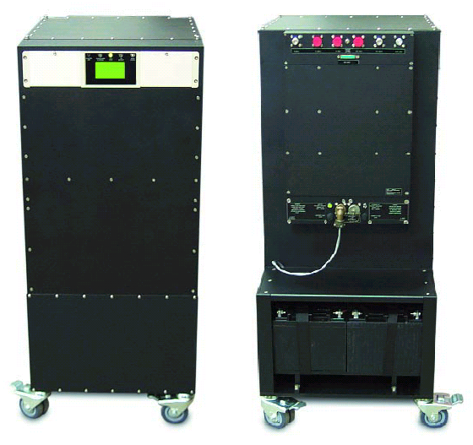
About 450 Clocks participating in TAI
Cesium clocks 55%
Hydrogen masers 35%
Others 10%
PTB-CS1
PTB-CS2
NTSC and USNO Rubidium Fountain

Slide 32
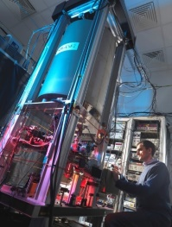
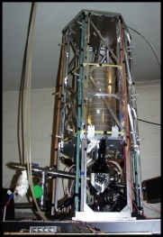
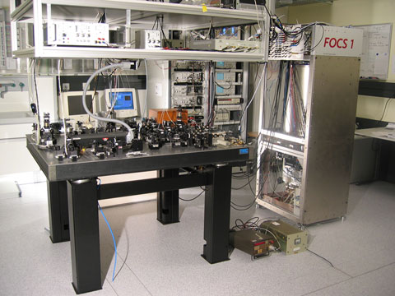
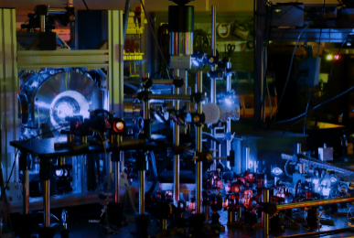
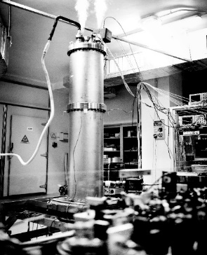
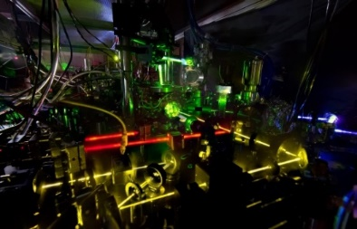
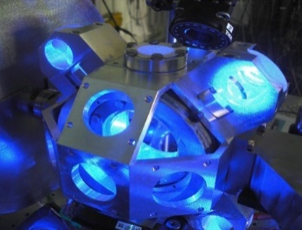
Primary frequency standards
The uncertainty of Caesium primary fountains can reach 10⁻¹⁶
3 nanoseconds accumulated in 1 year
About 15 laboratories operate primary frequency standards. Their uncertainty can be evaluated a priori by examining the different effects perturbing the Cesium atom
100
NPL
SYRTE
METAS
NIM
Sr lattice Clock (Photo: NICT)
NIM
Progress in the construction of optical clocks allows now 10^{–18} accuracy
PTB
INRIM
Yb Lattice Clock (Photo: NIST)
Will the definition of the SI second change?
The Consultative Committee for Time and Frequency is at work
Sr Clock (Photo: LNE–SYRTE)

Slide 33


Clocks need to be compared
The most used clock comparison techniques is based on GNSS

Slide 34
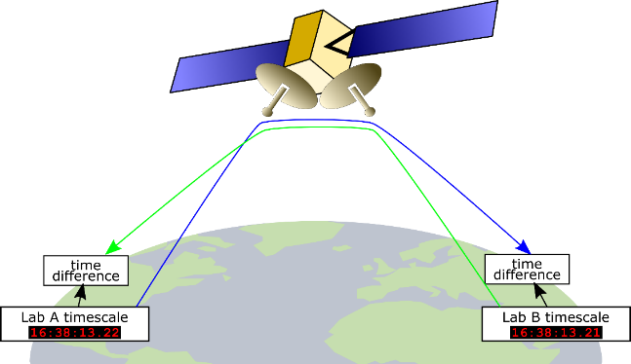

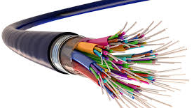
Clocks in different laboratories are compared by suitable time and frequency transfer techniques (see M. Wouters’s talk)
Global Navigation Satellite Systems (GNSS)
GNSS are based on time broadcasting from satellites to ground receivers (one-way time transfer). Distant labs equipped with GNSS receivers periodically compare their clocks to the broadcasted time and send the result to the BIPM.
Two-Way Satellite Time & Freq. Transfer (TWSTFT)
dedicated ground terminals simultaneously receive and transmit time transfer signals (two-way time transfer) on geostationary telecom satellites.
Two-way method cancels out (at first order) the propagation time of the signal.
Operational since ~2000
Number of links : 18
Typical freq. transfer accuracy @1d : a few 10-15
Typical time transfer accuracy : ≳ 1 ns
Operational since ~ 1980
Number of links : all contributing laboratories
Typical freq. transfer accuracy @1d : a few 10⁻¹⁵
Typical time transfer accuracy : a few ns
Progress in TWSTFT
Software Designed Radio and TWSTFT Carrier Phase
ACES MWL on the int space station
1x10-17 after one/several days, launched > 2023
Progress in GNSS measures
GPS+ GLONASS + Beidou + Galileo
IPPP : Precise Point Positioning with integer ambiguity resolution
In development : Optical Fiber links
A growing number of UTC laboratories are gaining access to fiber links dedicated to time and frequency. Although few of them are currently interconnected by operational, high-duty cycle links, this number is expected to grow quickly during the next decade.

Slide 35
Ensemble algorithms
H maser
Time error
Cesium average
Cesium clock
Steered H maser
Calibration by a frequency standard
time

Slide 36
Ensemble algorithms
H maser
Time error
Cesium average
Cesium clock
Steered H maser
Calibration by a frequency standard
time

Slide 37




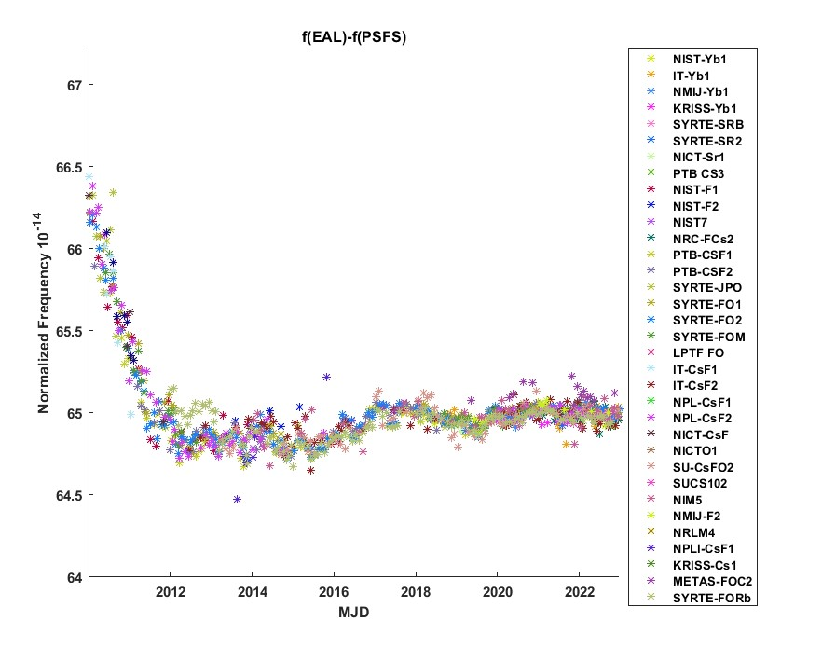
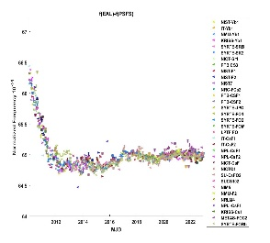




Computation of UTC (monthly) at the BIPM
≈ 450 atomic clocks
in 85 laboratories
weighted average
EAL
Echelle
Atomique Libre
freq stability
3 x 10⁻¹⁶
@ 30-40 days
≈ 15 primary and secondary frequency
standards
frequency steering
International
Atomic Time
TAI
freq accuracy ~10⁻¹⁶
leap seconds
Coordinated
Universal Time
Measurement of Earth’s rotation (IERS)
UTC
[UTC - UTC(k)]
BIPM Circular T

Slide 38
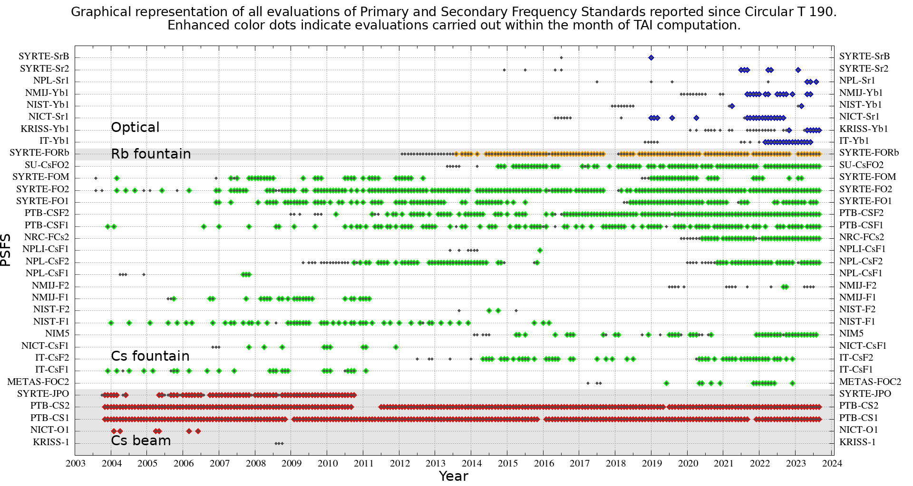
Contribution from Primary and Secondary Frequency Standards to UTC
https://webtai.bipm.org/database/show_psfs.html

Slide 39
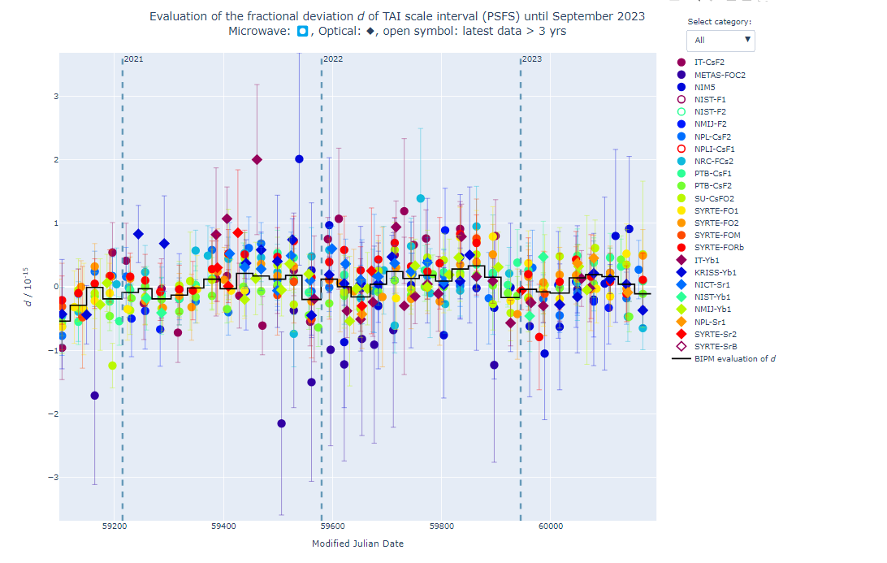
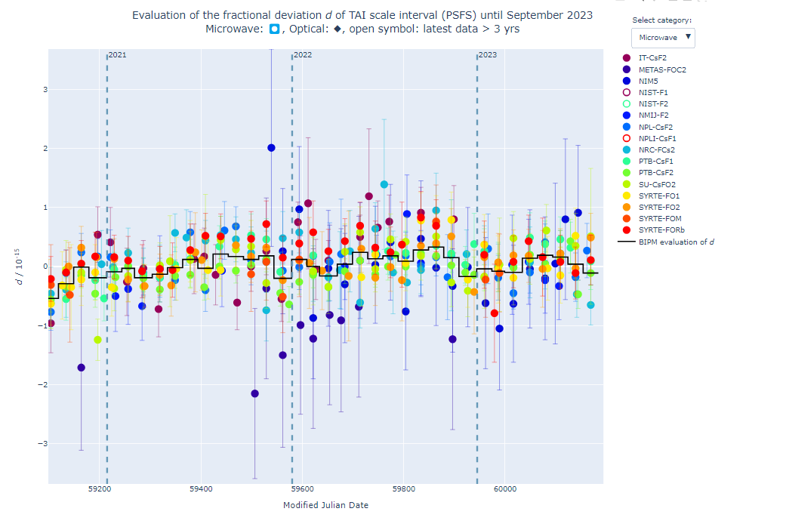
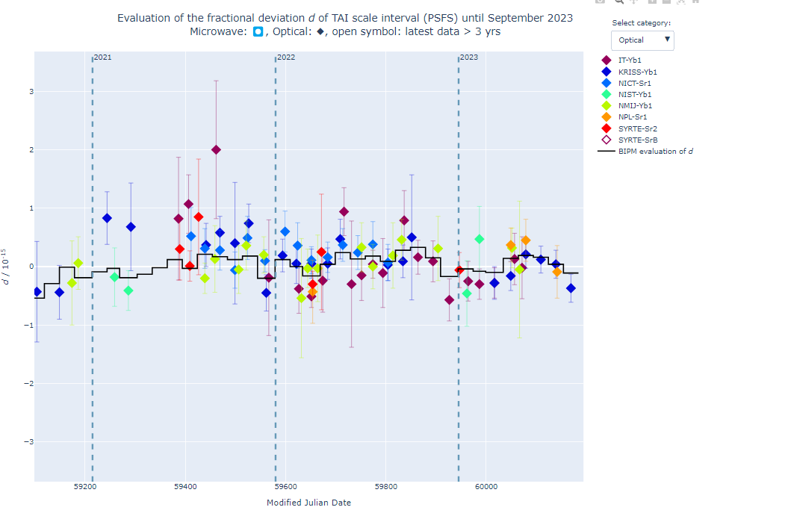
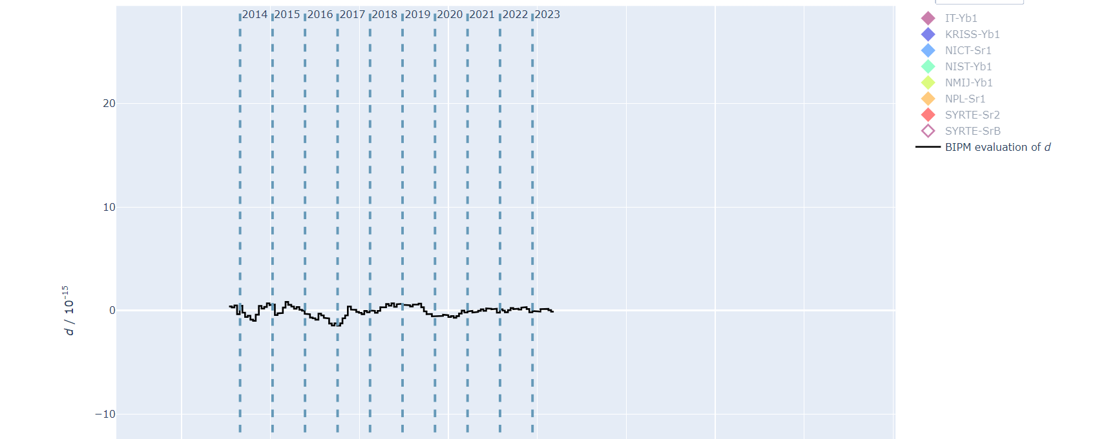
https://webtai.bipm.org/database/d_plot.html
Fractional deviation of the TAI scale unit versus PSFS
TAI Accuracy d ≈ 2 x 10⁻¹⁶ since 2012
Interactive plot
in collaboration with Nelida Diaz, secondee from CENAM

Slide 40
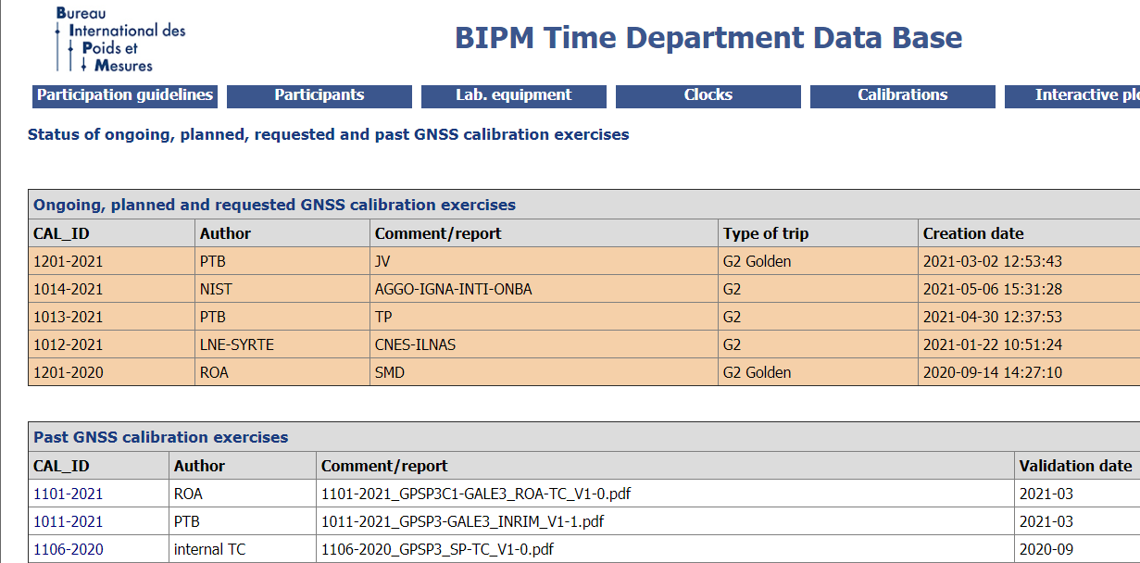
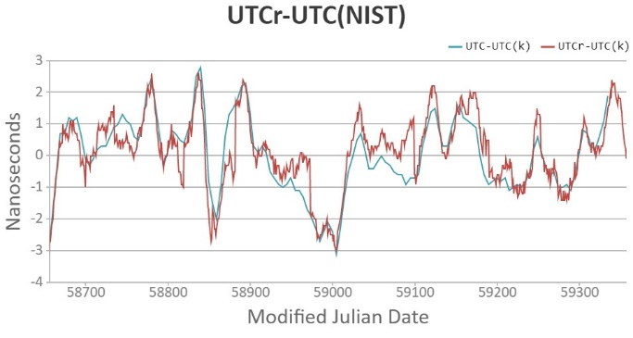
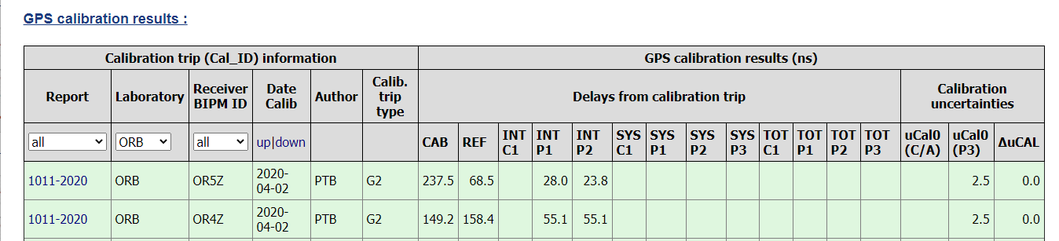
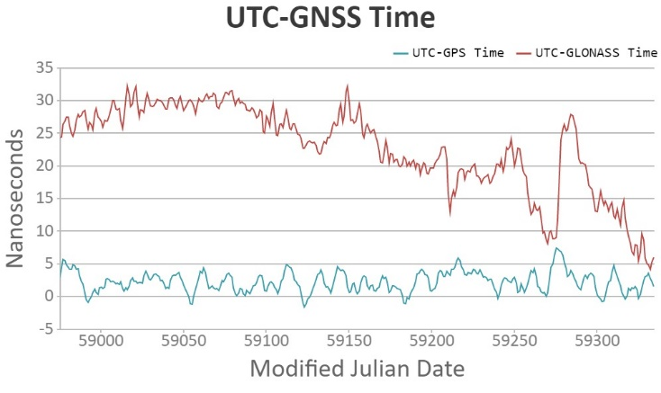
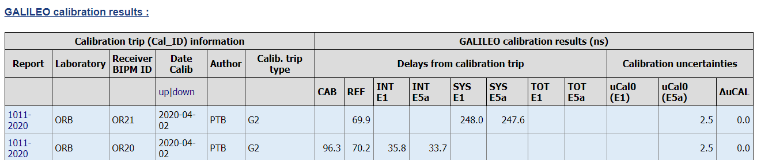
Results are available in the data base http://webtai.bipm.org/database/ and https://www.bipm.org/en/bipm-services/timescales/time-ftp
With API under test https://webtai.bipm.org/api
Available on-demand
dynamic plots:
Calibrations
on-going
Calibrations
listing
GPS
Calibrations results
Galileo

Slide 41
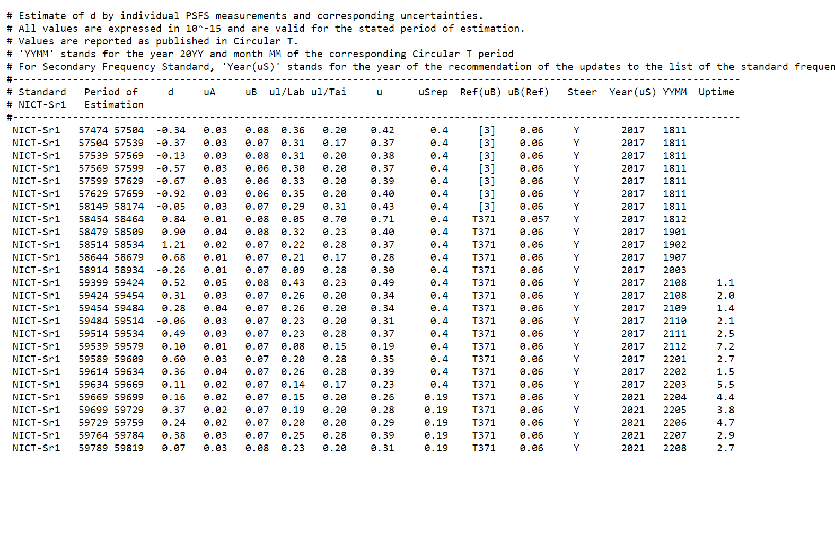
Estimate of individual PSFS
https://webtai.bipm.org/ftp/pub/tai/other-products/taipsfs/nict_sr1-ftai

Slide 42
every week, on Wednesdays the results are in the previous week (Monday-Sunday)
Since 2013 a rapid evaluation of UTC is available
UTCr - UTC (k)

Slide 43
How secondary frequency standard are recognized by the CCTF and CIPM?

Slide 44
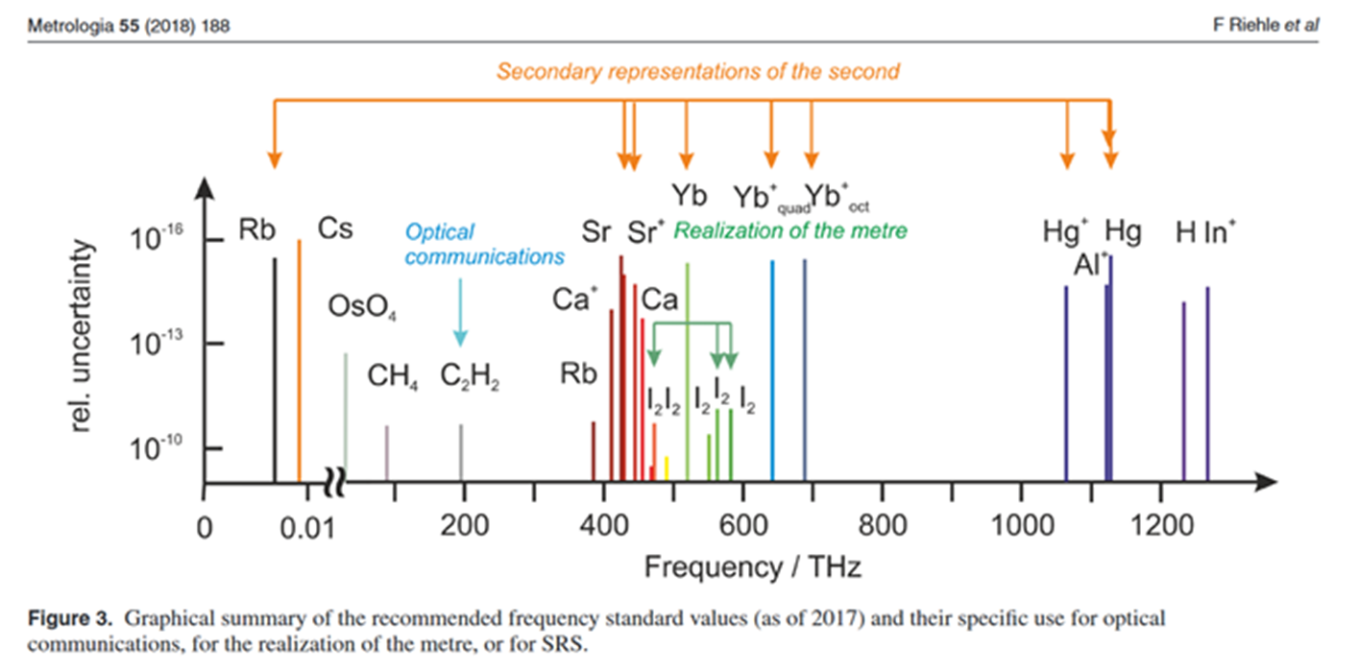
13th CGPM (1967)
Resolution 1
The second is the duration of 9 192 631 770 periods of the radiation corresponding to the transition between the two hyperfine levels of the ground state of the caesium 133 atom.
Resolution 2
Considering that the cesium frequency standard is still perfectible and current experiments allow the hope of producing other standards with even better qualities to define the second,
invites …. laboratories in the field of atomic frequency standards to actively pursue their studies.
Since 2001 CCL-CCTF working group on Frequency Standards:
produces and maintains a single list of Recommended frequency standard values for applications including the practical realization of the metre and secondary representations of the second.
See https://www.bipm.org/en/publications/mises-en-pratique/standard-frequencies.html

Slide 45
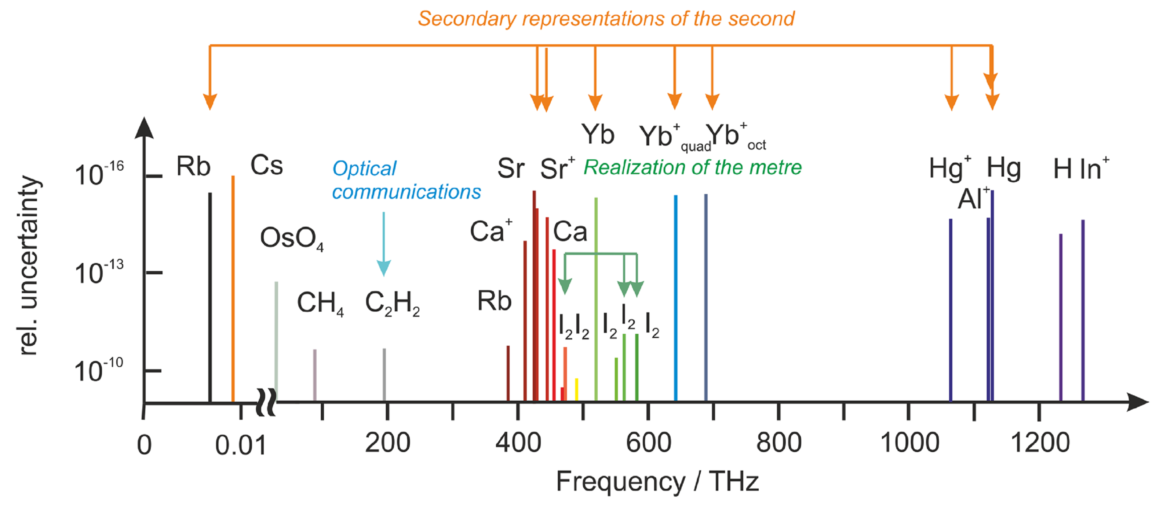
https://www.bipm.org/en/publications/mises-en-pratique/standard-frequencies-info
Secondary representations of the second
List of recommended standard frequencies (validated by CIPM, published on the BIPM website) recommended for applications including the practical realization of the metre and secondary representations of the second
Uncertainty limited by the Cesium primary realization

Slide 46
Values of the secondary representations of the second from a multisystem of frequency ratio measures
Estimation by independent methods and software
Take into account the correlation between measurements (e.g. due to their comparison to the same Cs standards
All the estimates are interrelated
Joint CCL-CCTF WG (2020-21)
Graphical representation of 105 frequency measures (33 optical frequency ratios and 72 absolute frequency measures vs Cesium) used for the calculation of 14 frequency values.
The new computational mode has been able to take into account 483 correlations
Metrologia paper in progress

Slide 47
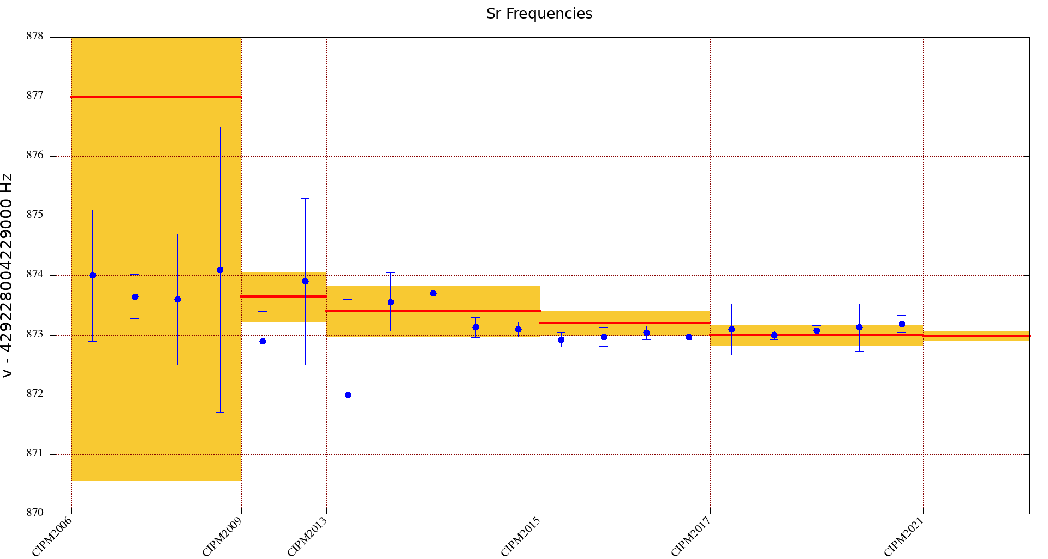
87Sr | 429228004229872.99 | 1.9 E-16
1 874.000000 1.1 [Boyd2007]
2 873.650000 0.37 [Campbell2008]
3 873.600000 1.1 [Baillard2008]
4 874.100000 2.4 [Hong2009]
5 872.900000 0.5 [Falke2011]
6 873.900000 1.4 [Yamaguchi2012]
7 872.000000 1.6 [Akamatsu2014b]
8 873.560000 0.49 [Tanabe2015]
9 873.700000 1.4 [Lin2015]
10 873.130000 0.17 [Falke2014]
11 873.100000 0.13 [LeTargat2013]
12 872.920000 0.12 [Lodewyck2016]
13 872.970000 0.16 [Grebing2016(Oct14)]
14 873.040000 0.11 [Grebing2016(Jun15)]
15 872.970000 0.4 [Hachisu2017]
16 873.100000 0.429 [Hobson2020]
17 873.000000 0.0708 [Schwarz2020]
18 873.082000 0.0773 [Nemitz2020]
19 873.130000 0.4 [Grotti2018]
20 873.190000 0.15 [Leopardi2020]

Slide 48
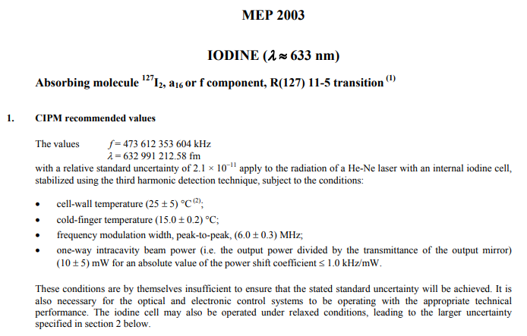
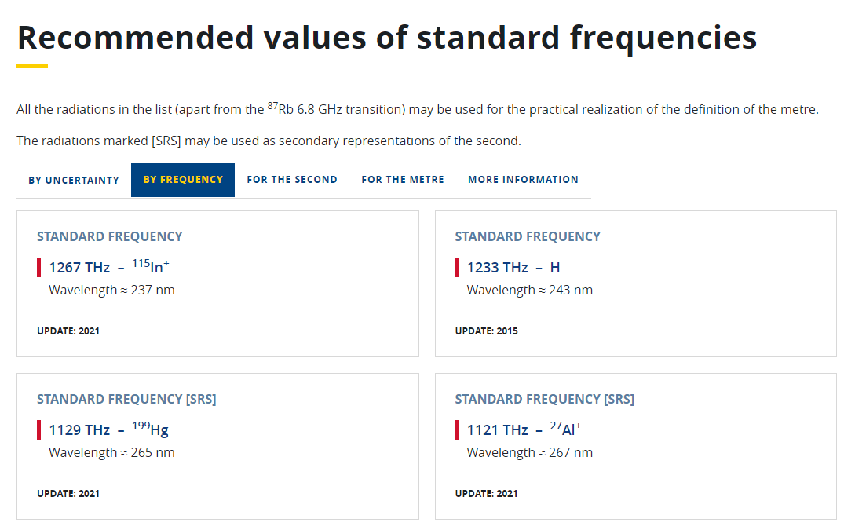
Need for digitalization
Now : access to « Recommended values of standard frequencies »
and « mises en pratique » PDF files via BIPM website
https://www.bipm.org/en/publications/mises-en-pratique/standard-frequencies
Traceability informations are required
to generate digital certificates …
Notes:
48

Slide 49
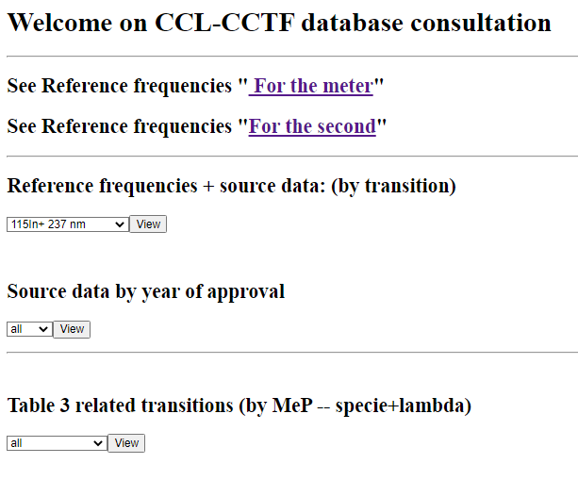
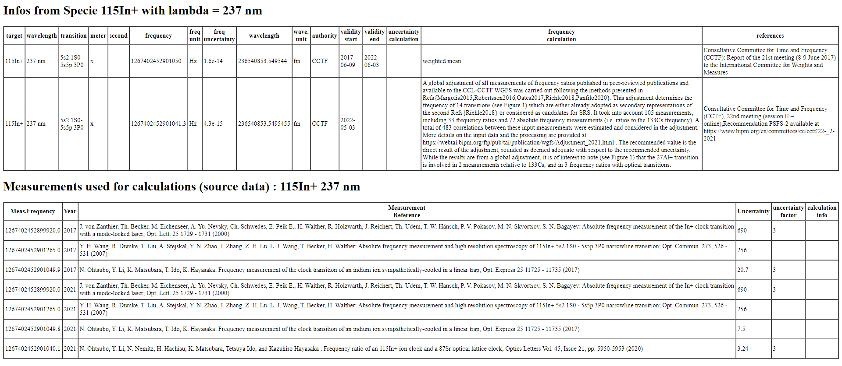
Database and API were developed
https://webtai.bipm.org/webdb/api/ccl-cctf/
Transitions
Values
Authority
Complement info
Calculation parameters
Notes:
49

Slide 50
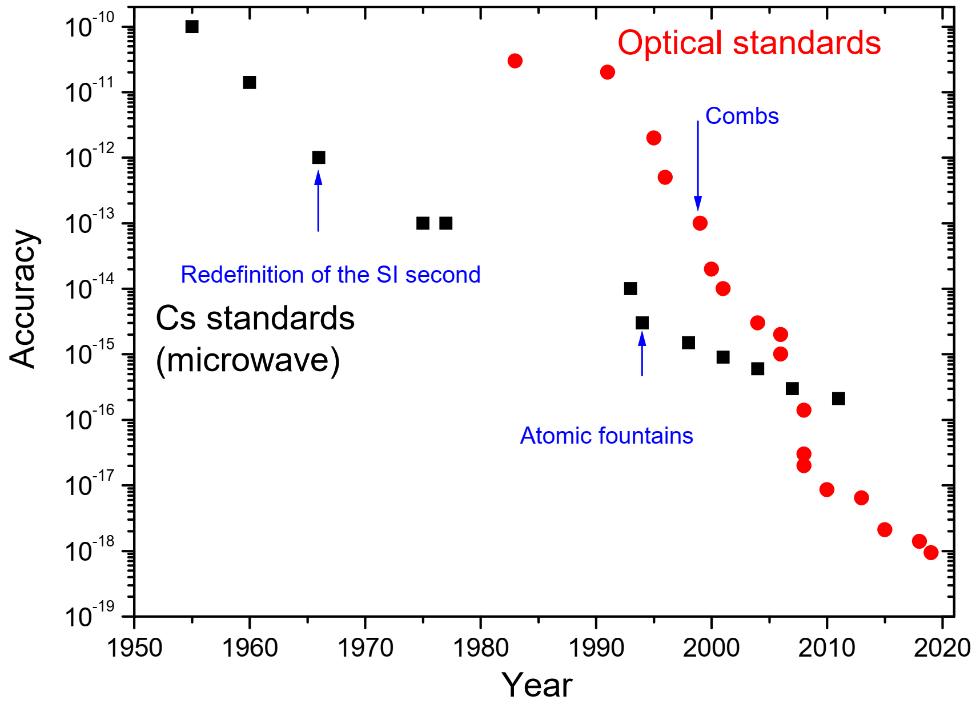

The era of optical frequency metrology
Optical Frequency Standards (Sr, Yb, Yb+, Al+, Ca+, …) at 10⁻¹⁸ level
→ Time to change the definition?

Slide 51
CGPM 2022 Resolution 5 - On the future redefinition of the second
encourages the International Committee for Weights and Measures (CIPM)
to promote the importance of achieving the objectives in the roadmap for the redefinition of the second,
to bring proposals to the 28th meeting of the CGPM (2026) for the choice of the preferred species, or ensemble of species for a new definition of the second, and for the further steps that must be taken for a new definition to be adopted at the 29th meeting of the CGPM (2030),
and invites Member States to support research activities, and the development of national and international infrastructures, to allow progress towards the adoption of a new definition of the second.

Slide 52
How primary and secondary frequency standard PSFS can better enter in UTC?

Slide 53
How a Secondary Frequency Standard can be evaluated with respect to the SI second?
By comparing against a primary freq standard, like a CS fountain, connected by a short cable or a long fibre
By measuring SFS with respect to a UTC(k) time scale or an individual clock entering in UTC
  Using Circular T monthly estimation of d_{TAI}
  Comparison to the best estimate of an ensemble of PFS ( a d_{TAI} estimation on demand)
If the SFS is in Lab, not producing a UTC(k) time scale and not part of UTC?
Any laboratory can be considered as a virtual “additional laboratory” that can be included in BIPM computation if it is equipped for example with a GNSS (Global Navigation Satellite System) receiver.
  This evaluation will be limited by frequency transfer uncertainty, the TAI deadtime (if the measurement is shorter than 1 month), and by the accuracy of PFS/SFS, as for a UTC laboratory.
See G.Petit, G.Panfilo, “Optimal traceability to the SI second through TAI” Proceedings of the EFTF 2018

Slide 54
How primary and secondary frequency standard PSFS can better enter in UTC?
UTC is a weighted average of clock reading based on clock time comparison
The PSFS are frequency calibrations usually of a « clock » participating to UTC
y_{TAI}-y_{PSFS} =
(y_{TAI}-y_{clock})+ (y_{clock} - y_{PSFS})
From UTC monthly computation
From PSFS calibration
Lasting one month?

Slide 55

How deadtime can affect the estimation?
Study case: a PSFS is used as reference to measure the frequency of a H maser, whose frequency deviation evolution can be modeled as a straight line affected by white frequency noise. PSFS measures are available only a few days during the month
True Frequency behavior of a Hydrogen maser
Available measures versus PFS

Slide 56



Deadtime on a Least Square linear fit
We estimate the effect of deadtime on the least square estimation of a straight line
For easy visualization we use a barycentre coordinate → the origin of the new time coordinate is placed in the center of the available measures epochs
$$y\left(t\right)=y_{tb} − d(t−t_{B})$$
$$t_{i}^{′}=t_{i}− t_{B}$$
$$\sum_{i=1}^{N}{t_{i}^{′}=0}$$
Notes:
uncertainty on the slope estimate
decreases if the measures are far from the barycentre
is larger if the measures are all concentrated closed to the barycentre
uncertainty on the slope estimate
decreases if the measures are far from the barycentre
is larger if the measures are all concentrated closed to the barycentre

Slide 57



Least Square approach
$$y\left(t\right)=y_{tb} − d(t−t_{B})$$
Estimate of the mean frequency
$$\hat{X}=\left|\begin{matrix}\hat{y_{b}} \\ \hat{d}\end{matrix}\right|= \left[\begin{matrix}\frac{\sum_{i=1}^{N}{y_{i}}}{N} \\ \frac{\left(\sum_{i=1}^{N}{{t_{i}}^{′}y_{i}}\right)}{\sum_{i=1}^{N}{{{t_{i}}^{′}}^{2}}}\end{matrix}\right]$$
$$Σ_{\hat{y_{b}}}= \frac{σ^{2}}{N}$$
$Σ_{\hat{d}}= \frac{σ^{2}}{\sum_{i=1}^{N}{{{t_{i}}^{′}}^{2}}}$
$$t_{i}^{′}=t_{i}− t_{B}$$
Estimate of the linear drift
$Σ_{\hat{y_{b}}}$depends only on the number of measures and the uncertainty of each of them
$Σ_{\hat{d}}$ depends on the uncertainty σ of the measures and on the sum of the distance between all measurement epoch t_{i} and the baricentre time t_{B}

Slide 58




Study case: H maser participating to UTC measured versus PSFS
We want to estimate the
mean frequency of the H Maser vs PSFS
in $t_{M}$the center of the previous month
In presence of dead time
the estimation time $t_{M}$could be
different from the barycentre $t_{M}≠ t_{B}$.
$$\begin{aligned}{\hat{y}}_{t_{M}}= \hat{y_{b}}+{\hat{d}(t}_{B}−t_{M}) \\ u_{{\hat{y}}_{t_{M}}}^{2}= u_{{\hat{y}}_{b}}^{2}+ {u_{d }^{2}(t}_{B}−t_{M}) \end{aligned}$$
Notes:
Usually, as in TAI steering case, the objective is to estimate the frequency deviation averaged on a certain period, typically a month [5], such mean value is then time tagged in correspondence of the centre of the considered period. Let’s suppose we have the availability of distributed measurements covering one month and that we want to estimate the mean value of the frequency deviation on that month. The centre of the month is tagged with but our analysis is valid for any epoch at which we want to estimate the frequency value.

Slide 59






$$\left\{\begin{aligned}y_{t_{M}}= \frac{\sum_{i=1}^{N}{y_{i}}}{N}+\frac{\sum_{i=1}^{N}{{t_{i}}^{′}}y_{i}}{\sum_{i=1}^{N}{{{t_{i}}^{′}}^{2}}}{(t}_{B}−t_{M}) \\ u_{y_{t_{M}}}^{2}= \frac{σ^{2}}{N}+\frac{σ^{2}}{\sum_{i=1}^{N}{{{t_{i}}^{′}}^{2}}}{{(t}_{B}−t_{M})}^{2} \end{aligned}\right.$$
H maser participating to UTC measured versus PSFS
Estimate of ${\hat{y}}_{t_{M}}$ is always good
the best case with lower uncertainty on the estimate of ${\hat{y}}_{t_{M}}$corresponds
to the case $t_{B}=t_{M}$,
the worst case is when $t_{B}$is very distant from $t_{M}$and the measures are very close to each other
Notes:
when the available measures or calibrations are “balanced” in the considered period and symmetrical around
the uncertainty on ${\hat{y}}_{t_{M}}$ increases when the measures are not balanced and for example all at the beginning or at the end of the time period.

Slide 60



H maser participating to UTC measured versus PSFS
When $t_{B}≠t_{M}$ the uncertainty depends on the distance among the measures and between $t_{B} \text{and} t_{M}$
CASE A
CASE B
Best case
Worst case

Slide 61
H maser participating to UTC measured versus PSFS
The estimate of the frequency offset does not depends on dead times and it is always correct (under these assumptions)
Minimum uncertainty is obtained when the measures are symmetric with respect to the center of the month
Measures not symmetric and very close to each other leads to the worst case

Slide 62
Which are the affecting noises and are them stationary?
How primary and secondary frequency standard PSFS can better enter in UTC?
Time and Frequency spectral analysis
is a useful tool
Not only estimating which frequencies existed
But also estimating when they existed

Slide 63

Time-frequency analysis
It describes how the frequencies of a signal change with time
Bowhead whale
L. Cohen, Time-frequency analysis, Prentice-Hall, 1995

Slide 64
A Dynamic Allan variance
sliding the Allan variance estimator on the data
t₁
t₂
...
Notes:
64

Slide 65
L. Galleani, P. Tavella, “Dynamic Allan variance” , IEEE Transactions on Ultrasonics, Ferroelectrics, and Frequency Control, UFFC, vol. 56, no. 3, March 2009, pp450-464
L. Galleani, P. Tavella, “The Dynamic Allan Variance V: Recent Advances in Dynamic Stability Analysis”, EEE Transactions on Ultrasonics, Ferroelectrics, and Frequency Control, Vol. 63, No. 4, Pag 624 - 635, April 2016
The Dynamic Allan variance
Discrete time formulation from the phase samples x[n]
where:
  Nw is the window length
  x_{N} is the phase signal in the window Nw
  τ₀ is the sampling time
the DAVAR estimator
has no expectation value E because we have one realization only
Notes:
65

Slide 66
Simulation results : Bump
t
τ
τ
t

Slide 67




CANVAS by NRL @ https://goby.nrl.navy.mil/canvas/download/
STABLE 32 version 1.5

Slide 68

Repeated measurements and the analysis of stationarity reveal always something
issues or new physics
LIGO Sees First Gravitational Waves

Slide 69
Towards a continuous UTC

Slide 70
Coordinated Universal Time UTC is
in agreement with the rotational angle of the Earth UT1
Timekeeping is related to the rotation of the Earth.
The real time timekeeping is based on atomic clocks and, since 1972, UTC is obtained from the International Atomic Time (TAI) plus leap seconds.
When the difference between the Earth rotational angle UT1 time scale and UTC reaches 0.9 second, an integer second is inserted to UTC to keep it within 1 s of UT1.
Before 1972, UTC was corrected by small frequency steps
Last leap second
Dec 31, 2016
|UTC - UT1| < 1 second
Today
TAI - UTC = 37 s
UTC = TAI + n seconds
23:59:59
23:59:60
00:00:00
UTC = TAI + leap seconds
The process to insert the leap second and the code to transmit DUT1= UT1-UTC are described in Rec ITU-R TF 460-6

Slide 71

Coordinated Universal Time UTC is the international time standard
UTC is supported by the work of:
BIPM and the 85 time laboratories providing data and realizing real-time traceability
  under the authority of the General Conference of Weights and Measures,
  where all states are represented
the International Earth Rotation and Reference Systems Service - IERS
  computing and publishing the difference versus the Earth rotation angle UT1-UTC, and announcing leap seconds
the International Telecommunication Union, ITU-R, to ensure it is used and correctly transmitted
  (ITU-R TF.460-6 (2002): Standard-frequency and time-signal emissions)
→ But, users underpinning critical infrastructures, need a continuous and unique timescale. Increasingly UTC is not being used by:
  most of the GNSSs,
  the digital network giants (eg GAFA and Alibaba),
  the most widely used Internet time synchronization protocols as NTP and PTP
The leap second process in UTC needs to be revised

Slide 72


Global Navigation Satellite System need a continuous time scale
Navigation using GNSS signals prefers a continuous time scale, and the GNSS system time does not use leap seconds (except GLONASS which applies leap seconds). These time scales are easily available all over the world, are commonly used as time and frequency references, and differ from each other and from UTC by several seconds
Notes:
72

Slide 73






The digital networks cannot cope with unpredictable leap seconds
Consultative Committee on Time and Frequency User Survey (2021)
> 200 answers
The large majority asks to get rid of discontinuities in UTC
GPS time and TAI are used, instead of UTC, as continuous time scales
https://3c.ltn.com.tw/news/18985/2
Time travels on the network
Computer operating systems are not easily able to handle a minute with 61 seconds
Notes:
73

Slide 74
Systems underpinning critical infrastructures, need a continuous timescale
Several “ah hoc” methods have been developed to avoid leap seconds
Ignore leap seconds after an initial synchronization
  GPS, Galileo, BeiDou system times.
  Most current versions of Windows (till next synchronization)
Stop clock for 2 seconds at 23:59:59 or 00:00:00
  Network Time Protocol, Posix time on many computers
  Two seconds have same name
  Problems with causality, time ordering, time intervals
  Leap second has no indicator
Reduce frequency of clock over some interval
  Google (24 h before), Microsoft, Facebook (18 h after), Alibaba (12 h before – 12 h after) …
All of these methods are not in agreement with UTC on the leap second day, and many disagree with each other
Users cannot tell which method is used by a time source, especially a posteriori
Leap second and the alternative methods threatens the resilience of the synchronization
The leap second process in UTC needs to be revised

Slide 75


Solution to progress towards a continuous UTC
Increase the tolerance in|UT1 - UTC| to a new limit (e.g. 1 min reached after 1 century or 1 hr reached after 5000 yrs) or to an unlimited value (= the difference UT1 – UTC will be let growing with no limit).
→ UTC remains linked to UT1, the Earth’s rotation angle, whose origin is the reference meridian of Greenwich.
In the daily life, there is no change for the general public since the evolution of |UT1 - UTC| will remain negligible compared to the +/- 15 min seasonal day variations, for centuries. The general perception of conformity to astronomical phenomena is not challenged.
Users needing the knowledge of UT1-UTC find accurate and real time estimations by the services of IERS, NASA, GNSS, ITU-R broadcast signals
In the ‘70s UTC was used as approximation to UT1 mostly for navigation with traditional optical instruments.
Approximation UTC ≈ UT1 corresponds to an uncertainty in the position up to 400 m (at the equator). It is used only in low accuracy applications (as amateurs telescope pointing).
But it is not adapted for high precision applications (as high accuracy astronomy and space applications) that are already using the IERS and NASA estimates with 10 microsecond uncertainty, corresponding to about 0.3 cm uncertainty in the position

Slide 76
CGPM 2022 Resolution 4 - On the use and future development of Universal Coordinated Time (UTC)
decides that the maximum value for the difference (UT1-UTC) will be increased in, or before, 2035,
requests that the CIPM consult with the ITU, and other organizations that may be impacted by
this decision in order to
propose a new maximum value for the difference (UT1-UTC) that will ensure the
continuity of UTC for at least a century,
prepare a plan to implement by, or before, 2035 the proposed new maximum value for the
difference (UT1-UTC),
propose a time period for the review by the CGPM of the new maximum value following
its implementation, so that it can maintain control on the applicability and acceptability of
the value implemented,
draft a resolution including these proposals for agreement at the 28th meeting of the
CGPM (2026),
encourages the BIPM to work with relevant organizations to identify the need for updates in the
different services that disseminate the value of the difference (UT1-UTC) and to ensure the correct
understanding and use of the new maximum value.

Slide 77
CGPM 2022 Resolution 4 - On the use and future development of Universal Coordinated Time (UTC)
Overall consensus on the technical need of enlarging the tolerance: CCTF, CIPM, ITU-T, ITU-R, IAU, IUGG, URSI, IGS, GAFA, GNSS providers, IT stakeholders, …
Process in two steps:
decision in CGPM 2022 to enlarge UT1-UTC tolerance in, or before 2035
details for the new tolerance, its implementation and periodic review process at CGPM in 2026
Trade-off on the implementation date between:
the need of updating systems (eg Glonass)
the important issues that
  discontinuities in UTC and different ad-hoc solutions currently implemented (Google / Facebook / Alibaba smears, NTP, Microsoft, …) cause confusion and put at risk the resilience of critical national infrastructures,
  the current Earth acceleration may lead to a possible negative leap seconds in the next decade,
  one of the GNSS time scales may be use de facto as the international standard

Slide 78

Is the Earth deciding for us?
https://eoc.obspm.fr/index.php?index=realtime&lang=en
Possibility for the first negative leap second ?
200 ms/3 years
Additional 600 ms in 10 years?
Oct 2023
2030-2035
Dec 2016 last leap second
June 2020

Slide 79



BIPM and ITU working together
develop a common way forward so that both organisations continue to address the needs for internationally-recognised timing and synchronisation by
ensuring a continuous UTC + efficient and used protocols for the transmission of UTC and (UT1- UTC)
https://www.itu.int/pub/R-REP-TF.2511
https://www.itu.int/en/itunews/Documents/2023/2023-02/2023_ITUNews02-en.pdf

Slide 80
THANK YOU
… optical clocks (secondary representations of the second) contribute regularly to UTC
We look forward to your evaluations of secondary standards
  to gain experience and promote their use
  to determine / check their reference frequency
  to prepare for future redefinition of the second
… UTC will undergo an important transformation
We look forward to your use and promotion of continuous UTC
  to serve the world countries with a good reference time scale
  to avoid misconceptions that are blocking the correct use and evolution of UTC

