Slide 1



Summer School on Frequency Standards, Precision and Quantum Measurement
Gold Coast, Queensland, Australia, 9-13 October 2023
Nuclear Clocks
(and a bit of nuclear physics for AMO physicists)
Ekkehard Peik
Ekkehard.Peik@ptb.de
Physikalisch-Technische Bundesanstalt
Time and Frequency Department
Braunschweig, Germany

Slide 2
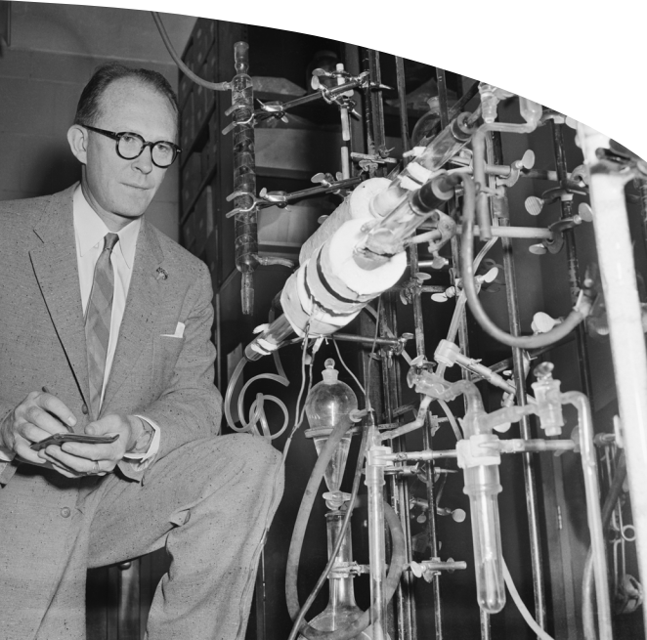
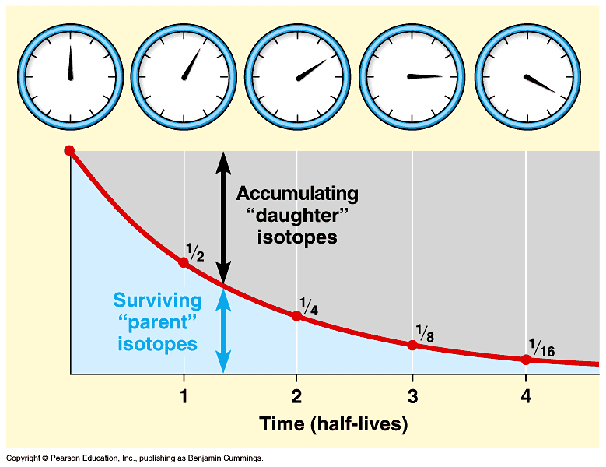
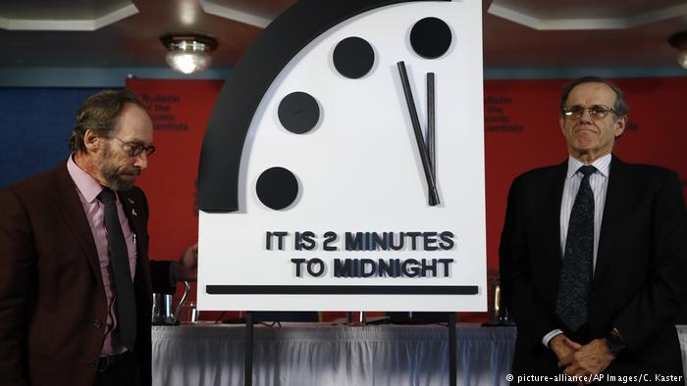
C-14 radiocarbon dating
„Nuclear Clock“
we do not mean:
radiometric dating
(W. Libby did not build an atomic clock in 1946)
the doomsday clock

Slide 3
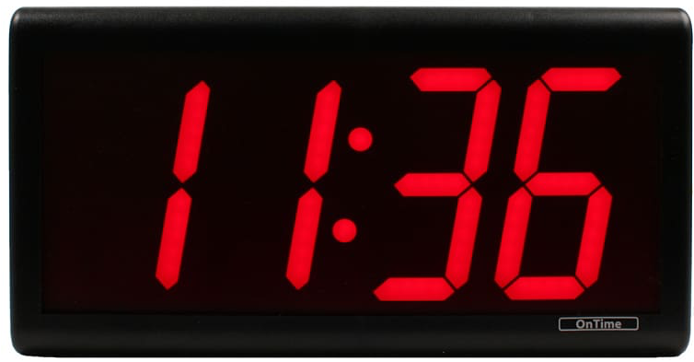
Scheme of an atomic clock
/ Scheme of a nuclear clock
frequency control
state detection
eV
servo
electronic
excited
states
1.0
stable laser
2-level system
0
ground
state
ΔE = hν
10⁻¹⁰ m
MeV
Optical clockwork:
femtosecond laser
nuclear
excited
states
1.0
10⁻¹⁴ m
0
ground
state
Notes:
The most precise measurement devices we currently have on this planet are optical atomic clocks.
These are highly stable lasers which are feedback-stabilized to narrow-band quantum transitions that take place in the electron shell of trapped atoms or ions.
Comparison measurements between different atomic clocks currently constrain variations of the fine structure constant, check Lorentz invariance, and are increasingly used in dark matter searches.
40 s → 0:55

Slide 4
Outline of the lecture:
Concept of a nuclear clock
Expected performance of a Th-229 nuclear clock (field-induced systematic frequency shifts)
Th-229 and its low-energy isomer: nuclear properties and experiments towards excitation of the isomer
Applications of a nuclear clock: Tests of fundamental physics

Slide 5

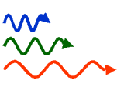
Nuclear Clock:
Based on an oscillator that is frequency-stabilized to a nuclear (γ-ray) transition
Motivation:
Higher accuracy: In most of the state-of-the-art optical clocks (trapped ion and optical lattice) field-induced shifts make a dominant contribution to the uncertainty budget. These can be reduced in a nuclear clock.
Higher stability: In a Mößbauer solid state nuclear clock, many absorbers may be interrogated (>10¹⁰ instead of ≈10⁰ (ion) or ≈10⁴ (lattice)).
Higher frequency: → higher stability. EUV or even X-ray transitions
may be used when suitable coherent radiation sources become available.
Different sensitivity for „new“ physics: Not predominantly electromagnetic, provides a precision probe of the strong interaction.

Slide 6
Nuclear Clock:
Based on an oscillator that is frequency-stabilized to a nuclear (γ-ray) transition
Review article:
E. Peik, M. Okhapkin, Comptes Rendus Physique 16, 536 (2015)
also available at: arXiv:1502.07322
Experimental starting point:
A nuclear clock is first expected in the domain of low-energy nuclear physics.
What is the lowest usable nuclear excitation energy?

Slide 7
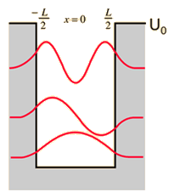
Nuclear transitions are not expected in the energy domain of visible light.
Energy scales:
Visible photon:
Atomic nucleus: bound nucleon
with
(proton rest mass: 938 MeV)
Atomic shell: bound electron
with
(electron rest mass: 0.51 MeV)

Slide 8

The nucleus is not a suitable source or absorber for visible light.
Emission rate for electric multipole radiation
of order l and wavelength λ from an antenna of dimension r :
(see for example J.D. Jackson, Classical Electrodynamics)
Additional suppression of E1 radiation: the nucleus contains only positive charge (not both signs, like the atom).
Low emission rate → Long-lived excited states: Isomers
e.g. Ta-180: naturally occuring isomer,
decays via E8 radiation (l=8) at 75.3 keV, (r/λ)¹⁶ ≈ 10⁻⁵⁸
half-life > 10¹⁵ yr
0.012% abundance in natural tantalum
Transmitting antenna for long-wave radio

Slide 9
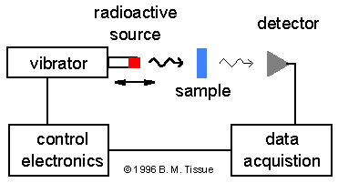
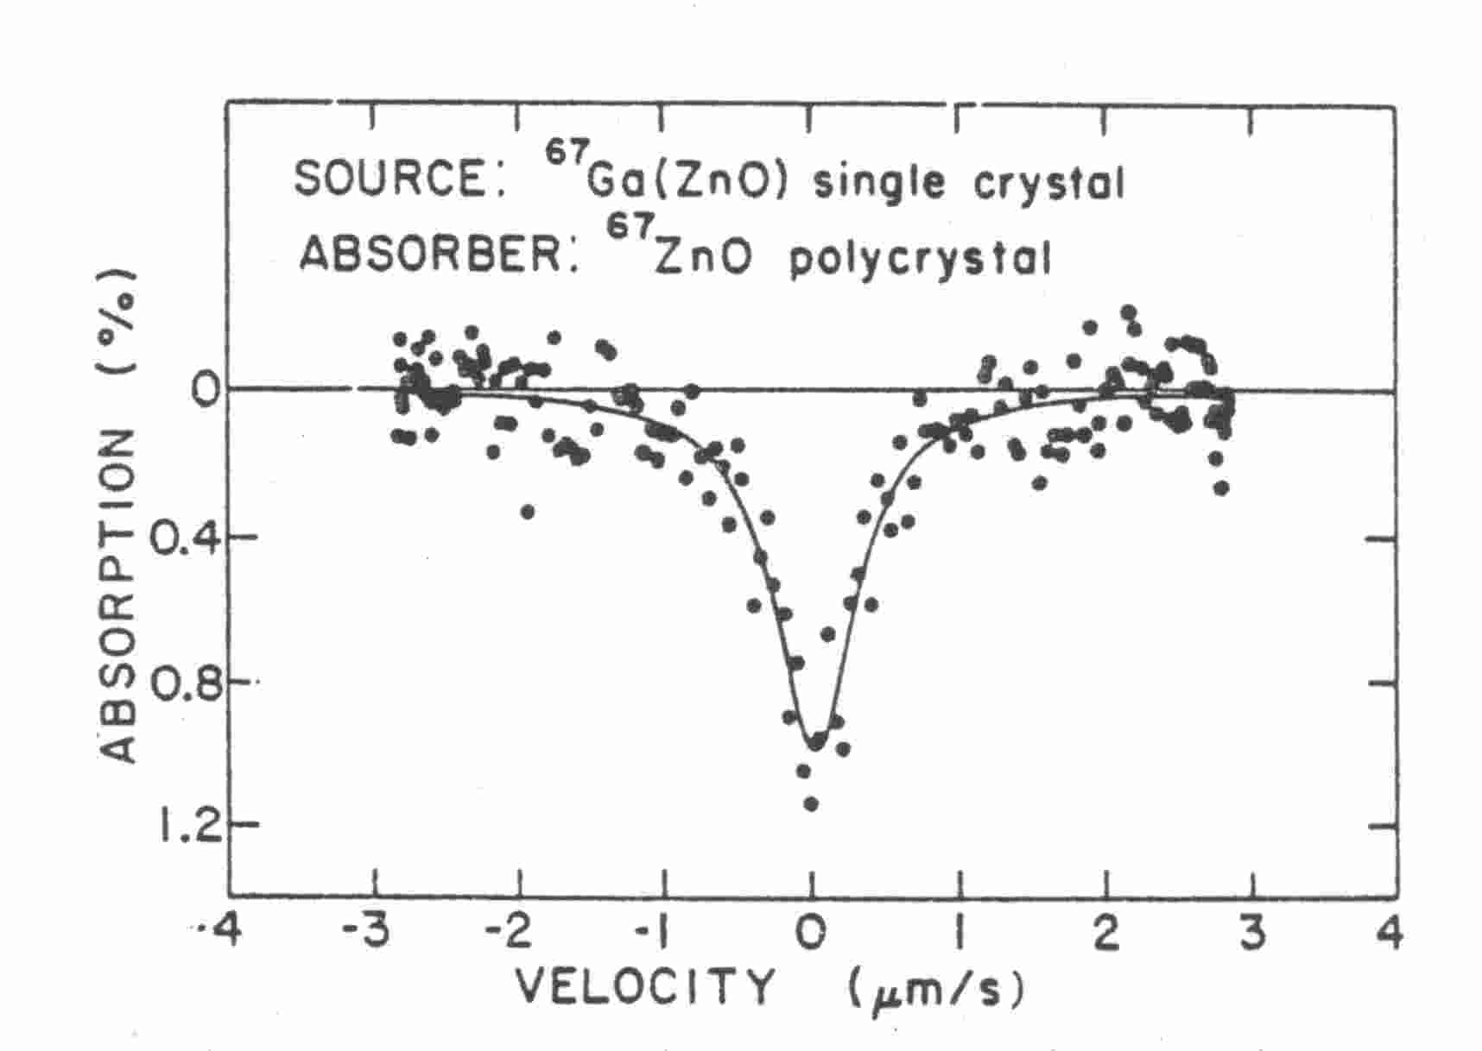
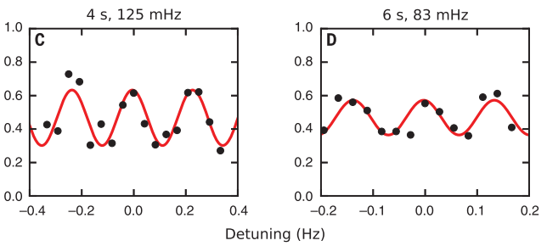
Nuclear spectroscopy provides very high resolution
Mößbauer spectrum of the
93.3 keV resonance of Zn-67
Atomic laser spectroscopy reached higher resolution
only in 2017: Sr optical lattice clock, S.L. Campbell,
Science 358 (2017)
Δν/ν=2.5∗10⁻¹⁵
G. Perlow et al., 1974
Δν/ν=1.9∗10⁻¹⁶

Slide 10
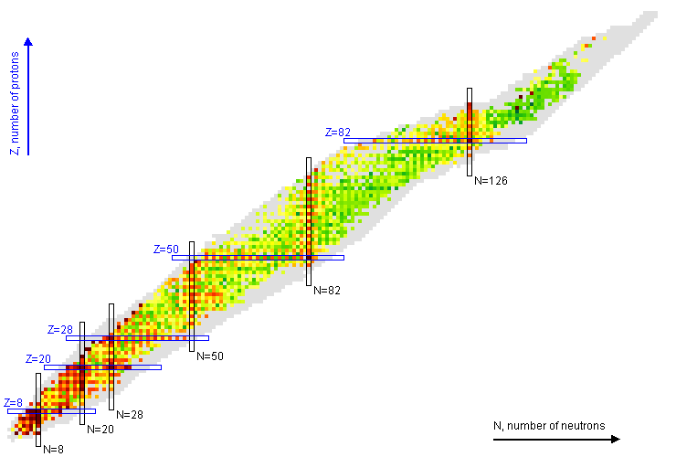
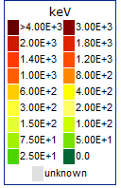
Chart of Nuclides: Energy of the first excited state
Region of deformed nuclei with collective
rotational and vibrational motion;
partly chaotic in excited states.
²²⁹Th
magic nucleon numbers
closed shell,
deeply bound ground state
From: National Nuclear Data Center, Brookhaven National Laboratory

Slide 11
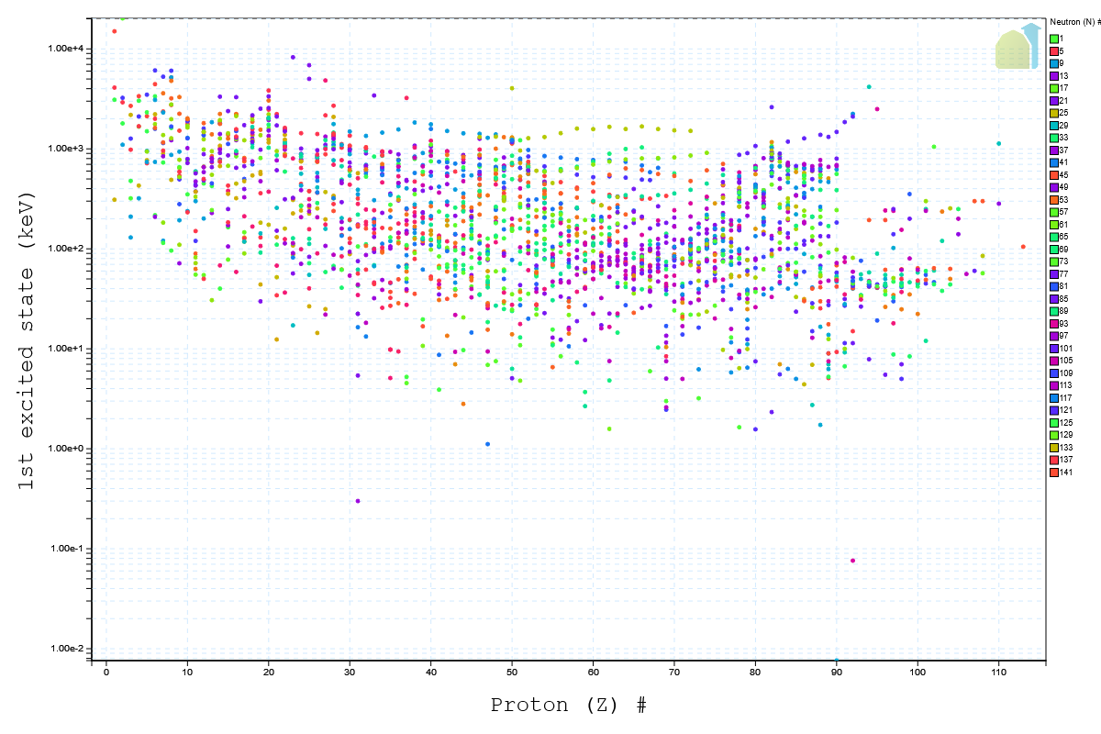
Sc-45
U-235
Th-229
https://www.nndc.bnl.gov/nudat3/

Slide 12
Energy of the rigid rotor
simple order of magnitude estimate for solid sphere:
The simple estimate is pretty good:
Nuclear matter has near constant density.
Quadrupole deformation is not huge
ε≈0.1…0.3
NB: quantum rotation is only observable for ε≠0,
not for spherical symmetry.

Slide 13
Nuclear structure: The deformed shell model or Nilsson model
← Collective motion of an elliptical core
combined with
single-particle motion of a valence nucleon →
(much faster than motion of the core)
S.G. Nilsson, "Binding states of individual nucleons in strongly deformed nuclei," doctoral thesis, 1955
Nilsson diagram:
Energy vs. quadrupole deformation
ε=0: spherical

Slide 14
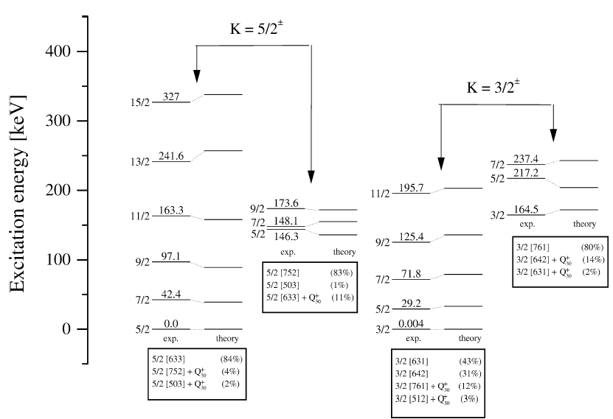
K. Gulda et al. / Nuclear Physics A 703 (2002) 45–69
The nuclear structure of ²²⁹Th
Very well classified into rotational bands. First explored by C.W. Reich et al.
since the mid 1970ies.
Two close-lying band-heads: ground state and isomer

Slide 15
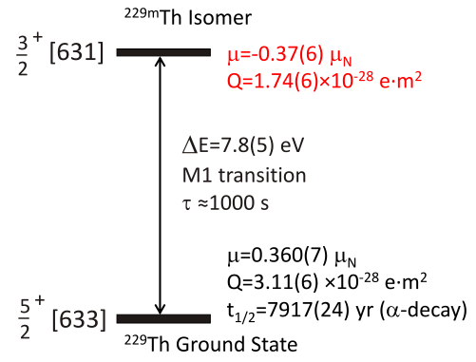
A high-precision nuclear clock
An atomic clock shall realize the unperturbed transition frequency. The uncertainty of
advanced optical clocks is often limited by field-induced shifts, e.g. from thermal radiation of the environment.
Nuclear moments are small. Field induced systematic frequency shifts can be smaller
than in an (electronic) atomic clock.
Magnetic dipole moment
Nuclear spin, parity
Nilsson classification
(leading configuration)
8.1(2) eV
Electric quadrupole moment

Slide 16
Outline of the lecture:
Concept of a nuclear clock
Expected performance of a Th-229 nuclear clock (field-induced systematic frequency shifts)
Th-229 and its low-energy isomer: nuclear properties and experiments towards excitation of the isomer
Applications of a nuclear clock: Tests of fundamental physics

Slide 17
How about interaction with the electrons?
Work with bare Th⁹⁰⁺ ? (Requires 110 keV ionisation energy; difficult to trap or cool)
Consider electric and magnetic hyperfine coupling.
Frequency shift from magnetic field: Zeeman-Effect
Electron: Bohr magneton: 14 MHz/mT
Nucleus: Nuclear magneton: 7.6 kHz/mT
One may do better in coupling of electronic and nuclear magnetic moments:
Integer angular momentum quantum numbers and m=0 components

Slide 18
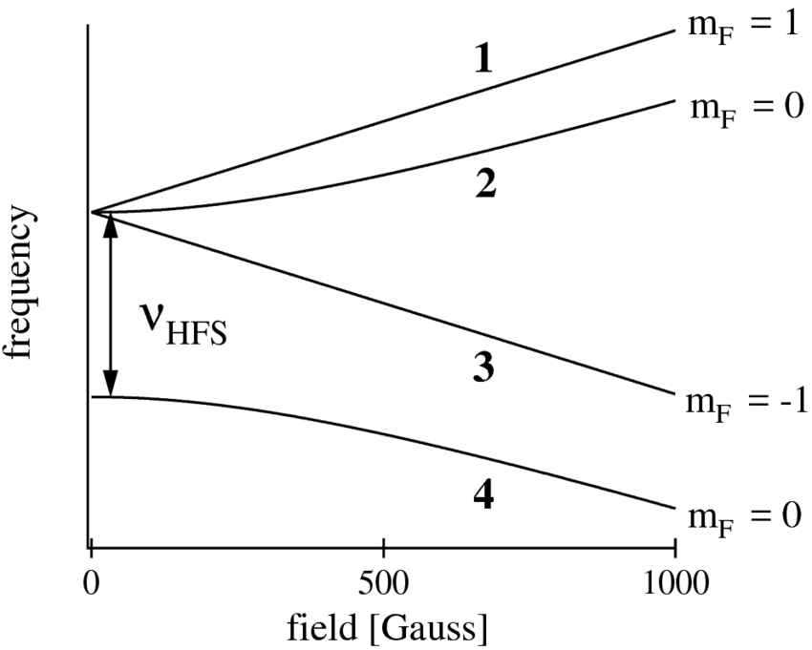
Zeeman diagram of the H ground state (proton + electron)
Linearly magnetic field independent frequency
between m_{F}=0 levels at low external field, because of coupling between p and e.
Zeeman regime:
Slope determined by quantum number m_{F}
Paschen-Back regime:
Electron and proton uncoupled
Slope essentially determined by electron spin orientation

Slide 19
Electric field shift: Stark effect
„shielding“: No linear Stark effect at the nucleus of an atom in the nonrelativistic limit
Schiff theorem (discussed in the context of parity violation, electric dipole moments)
NB: The electron shell is no „Faraday cage“ for the nucleus;
A non-degenerate state of the electron shell also does not show a linear Stark effect.
„anti-shielding“: an external electric field gradient may be enhanced at the nucleus.
Sternheimer antishielding (studied in NMR)
Predicted inversion and enhancement by factor -178 for Th⁴⁺
The field gradient interacts with the electric quadrupole moment.
Electron shell: Q≈e×10⁻²⁰ m²
Nucleus: Q≈e×10⁻²⁸ m²

Slide 20
Quadratic Stark shift:
Effects that lead to level mixing, light shifts, collisions,…
are predominatly common-mode for both levels of the nuclear clock transition
i.e. they do not produce a frequency shift.
Combined energy level diagram:
electronic and nuclear
Next nuclear level:
28 keV away
Perturbation
Isomer
Nuclear clock transition
Nuclear ground state

Slide 21
Advantage of the nuclear over the atomic clock: (nearly) free choice of a suitable
electronic state for the interrogation of the nuclear resonance.
Two options:
States of high symmetry: J=0 or J=1/2
E. Peik, Chr. Tamm, Europhys. Lett. 61, 181 (2003)
stretched states: nuclear and electronic moments are maximally aligned
C. J. Campbell et al., PRL 108, 120802 (2012)
Eliminates field induced shift to a level not achievable in (electronic) atomic clocks,
magnetic field shifts to first order, electric field shifts to second order.

Slide 22
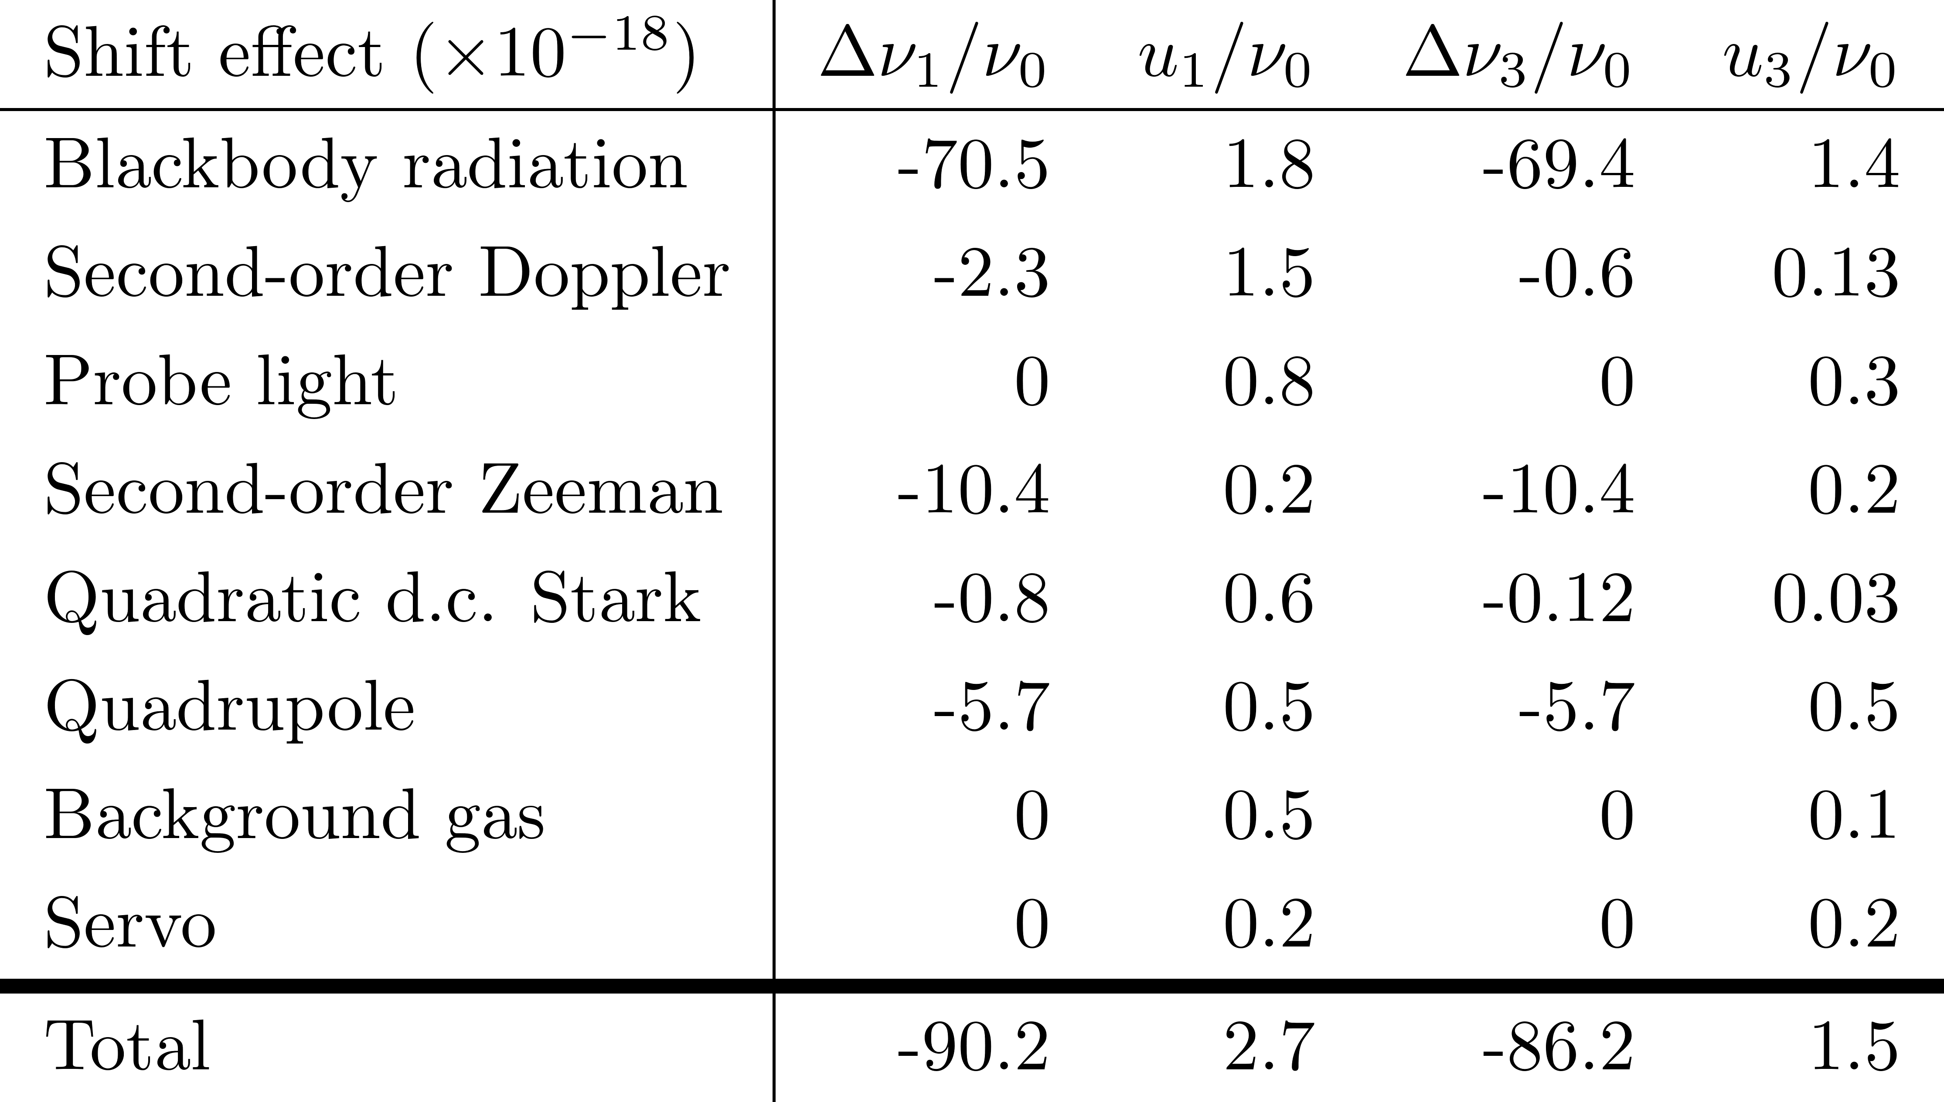
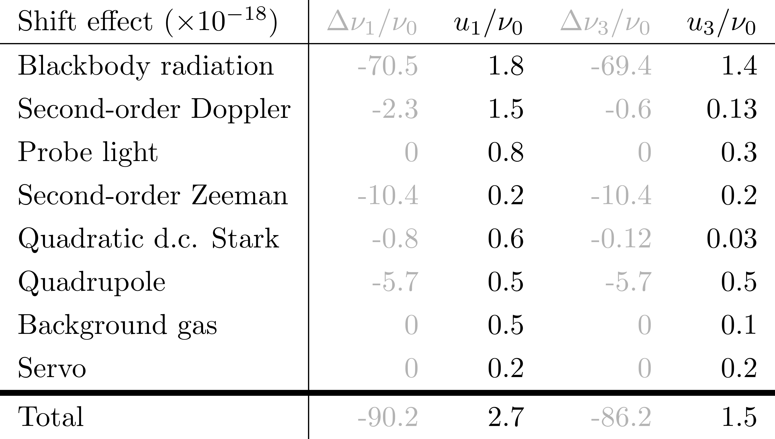


Yb3 uncertainty budget / projections for ²²⁹Th³⁺
Uncertainty budget for a single-ion clock Yb⁺
and projections for a nuclear clock ²²⁹Th³⁺
-
0.2
-
0.2
-
-
-
-
0.2
0.4
Yb⁺: C. Sanner, N. Huntemann, R. Lange, Chr. Tamm, E. Peik, M. Safronova, S. Porsev
Nature 567, 204 (2019)

Slide 23
Electronic Level Scheme of Th³⁺
Th³⁺ possesses a simple level scheme. It can be laser-cooled using
diode lasers and detected via resonance fluorescence at red or NIR wavelengths.
Electronic and nuclear resonances are separated in energy.
τ=0.51 s
6p⁶ 7s ²S_{1/2}
τ=0.34 μs
5d ²D_{5/2}
717 nm
690 nm
984 nm
τ=0.50 μs
5d ²D_{3/2}
6p⁶ 5f ²F_{7/2}
1087 nm
6p⁶ 5f ²F_{5/2}
Lifetime calculations:
Biémont et al., JPB 37, 4193 (2004)
Safronova et al. PRA 74, 042511 (2006)
Experiment:
Campbell et al., PRL 102, 233004 (2009)

Slide 24
Detection of the Nuclear Excitation in Nuclear-Electronic Double-Resonance
Nucleus in the ground state;
laser-induced fluorescence
from the shell.
Laser excitation of the nucleus;
change of hyperfine structure detected in
intensity or polarisation of fluorescence.
Analog of Dehmelt‘s „electron shelving“
Observation of „quantum jumps“ in the single-ion fluorescence

Slide 25
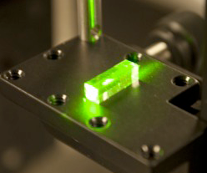
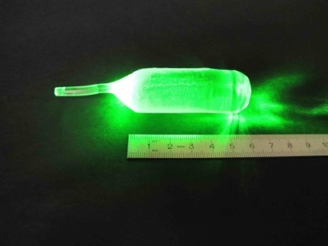
Optical Mössbauer Spectroscopy
Laser excitation of Th-ions in a solid
→ compact optical frequency standard
of very high stability
Crystal doped with 1 nucleus per λ³: 10¹¹ / mm³
Simple fluorescence detection is possible;
initial broadband excitation experiment with synchrotron light.
Host crystal should be: transparent, symmetric, diamagnetic.
Possible candidates: fluorides
UCLA, LiCAF
TU Vienna, CaF₂

Slide 26
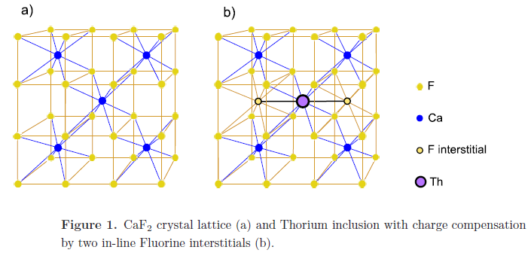
Dominant crystal field shift: Electric quadrupole shift
E.g. field gradient in ThB₄ (tetragonal): V_{zz}=5∙10²¹ V/m²
Resulting Th-229 nuclear quadrupole shift: ≈ GHz
→ Use suitable crystal symmetry (e.g. cubic).
Predictions for doped Th:CaF2
Th⁴⁺ replaces Ca²⁺; charge compensation from two F⁻ interstitials
Electric field gradient from F⁻ interstitials: V_{zz}=-5∙10²² V/m²
Magnetic dipole interaction with ¹⁹F nuclei: <B²> ≈ 5∙10⁻⁷ T²
→ decoherence rate for Th nucleus ≈ 10³/s G. A. Kazakov et al, NJP 14 (2012) 083019

Slide 27
Temperature dependence of linewidth and frequency shifts:
line shape depends on phonon frequencies and correlation times
relativistic Doppler shift: 10⁻¹⁵ / K
electric crystal field shifts may be >> 10⁻¹⁵ / K
→ For high precision beyond 10⁻¹⁵,
work at cryogenic temperature to freeze out lattice fluctuations
E. Peik, K. Zimmermann, M. Okhapkin, Chr. Tamm
Proc. 7th Symp. on Frequency Standards and Metrology (arXiv:0812.3458)
W. Rellergert et al., Phys. Rev. Lett. 104, 200802 (2010)
G. A. Kazakov et al, New J. Phys. 14 (2012) 083019

Slide 28
Outline of the lecture:
Concept of a nuclear clock
Expected performance of a Th-229 nuclear clock (field-induced systematic frequency shifts)
Th-229 and its low-energy isomer: nuclear properties and experiments towards excitation of the isomer
Applications of a nuclear clock: Tests of fundamental physics

Slide 29
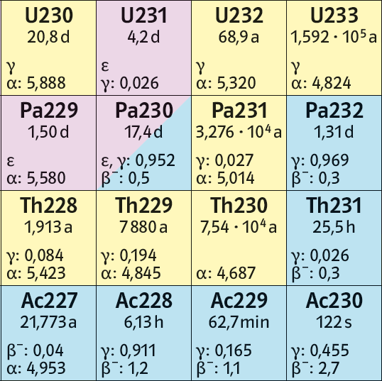
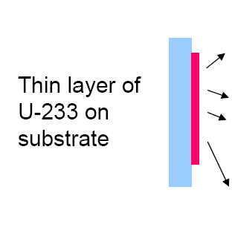
Production of ²²⁹Th
²²⁹Th is radioactive with ≈8000 years halflife. It can be produced in α-decay of ²³³U, which has been produced in large quantity in breeder reactors.
The α-decay (4.8 MeV)
Populates ²²⁹Th excited states (about 2% isomer)
Imparts 84 keV recoil energy on the freshly produced ²²⁹Th which may eject it from the solid source.
α
β⁻
β
Th-229 recoil
ion source

Slide 30
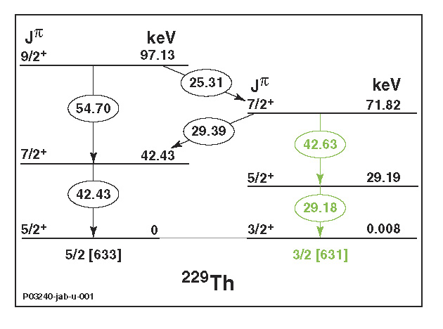
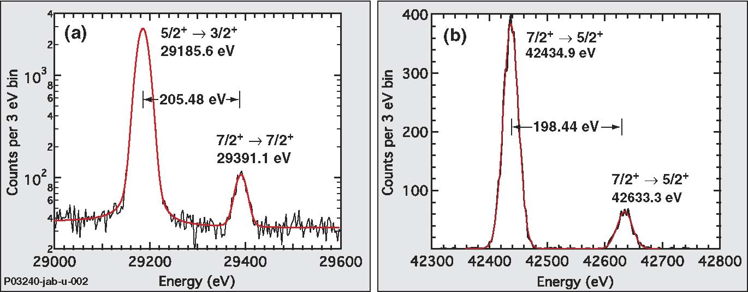
Motivation
Measurement of the energy of the Th-229 isomer
B. R. Beck et al. (LLNL), Phys. Rev. Lett. 98, 142501 (2007)
γ-spectroscopy of two decay cascades
from the 71.82-keV-level
Isomer energy:
Difference of the doublet splittings:
7.6 ± 0.5 eV
(corr.: 7.8 ± 0.5 eV, LLNL-Proc-415170)
29 KeV lines
42 KeV lines
Ground state → isomer: transition in the vacuum-ultraviolet at about 160 nm wavelength
Notes:
7,6 eV enthalten Korrektur für mögliche Verzweigungen zwischen den Kaskaden (sonst nur 7,1 eV)
Unsicherheitsabschätzung vermutlich konservativ

Slide 31
Improved γ-spectroscopy measurement (U Heidelberg, TU Wien, U Mainz)
T. Sikorsky et al., Phys. Rev. Lett. 125, 142503 (2020)
Magnetic microcalorimeter
Isomer energy: 8.10(17) eV, corresponding to 153(4) nm

Slide 32
Improved γ-spectroscopy measurement (U Heidelberg, TU Wien, U Mainz)
T. Sikorsky et al. arXiv:2005.13340, Phys. Rev. Lett. (in print)
Lineshape of the 29.2 keV doublet

Slide 33
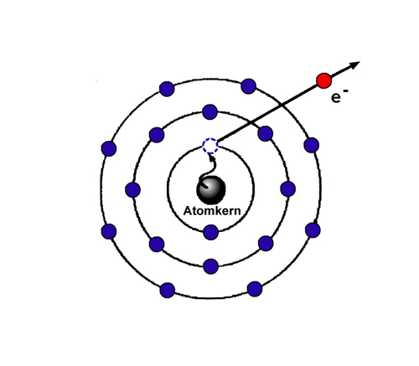
Low-energy γ-emission is often
in competition with decay via
internal conversion
(release of a free electron,
most likely from the 1s shell,
leads to ionization of the atom)
In Th-229 with only ≈ 8 eV isomer energy, IC is only possible for the neutral Th atom (ionization potential 6.3 eV)
but not for positive ions (ionization potential 12 eV in Th⁺ and higher in higher charge states).

Slide 34
Isomer energy measurement in internal conversion decay (LMU München, TU Wien, U Mainz)
B. Seiferle et al. Nature 573, 243 (2019)
Th-229 recoil nuclei are slowed down in buffer gas, …
…mass-filtered in a RF quadrupole, producing an isotopically pure ion beam, 2% in isomeric state
…ions are neutralized by passing through a graphene foil.
In neutral Th the isomer decays within a few μs. The energy of the emitted e⁻ is measured

Slide 35
Isomer energy measurement in internal conversion decay (LMU München, TU Wien, U Mainz)
B. Seiferle et al. Nature 573, 243 (2019)
The electron energy spectrum is not a single line – corresponding to the isomer energy – because after interaction with the graphene and after the IC decay, the Th atoms are distributed over several excited atomic states. This has been simulated in analysis of the spectrum.
Isomer energy: 8.28(17) eV

Slide 36
Optical observation of the isomer decay in Th-229 beta-recoils from Ac-229 (CERN ISOLDE)
S. Kraemer et al. Nature 617, 706 (2023)

Slide 37
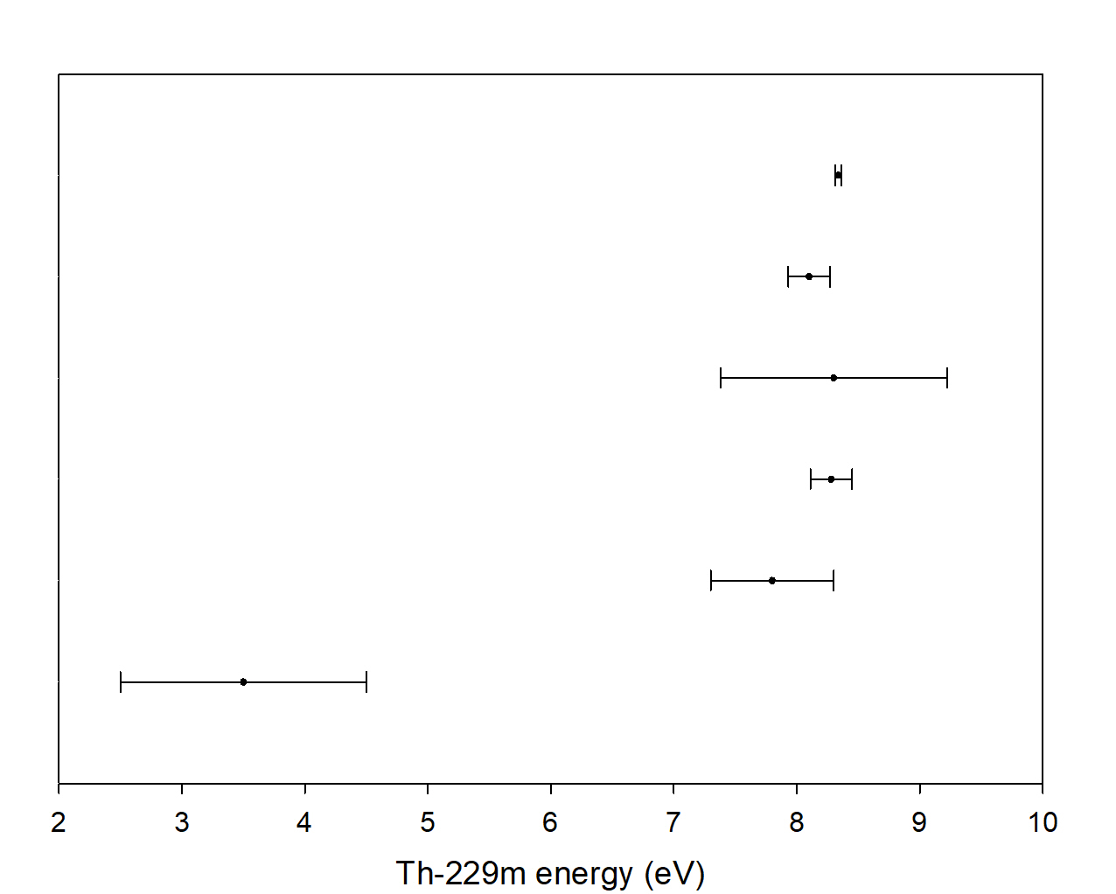
Results on the Th-229 isomer energy
≈11 THz ±1σ range
CERN ISOLDE 2023
KIP-U Heidelberg 2020
RIKEN 2019
LMU Munich 2019
LLNL 2009
INEL 1994

Slide 38
Isomer nuclear properties
Spectroscopy of electronic transitions is an important source of information on nuclear properties: Hyperfine structure
Interaction of nuclear and electronic magnetic moments leads to line splitting (e.g. microwave Cs clock transition in the 6s electronic ground state)
Nuclear mass leads to a line shift via different reduced mass of the electron (isotope shift)
Size of the nuclear charge distribution leads to line shift (isotope shift)
Interaction of the electron with a non-spherical nuclear charge distribution leads to line splitting (e.g. electric quadrupole moment of deuterium, first indication of non-central nuclear force)

Slide 39
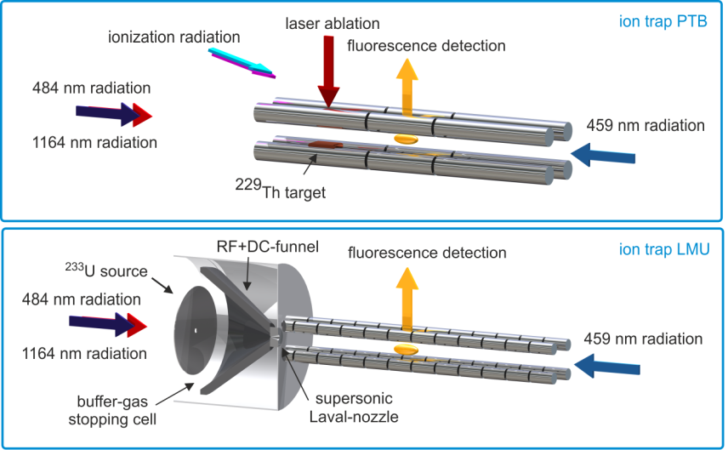
Hyperfine structure of ^{229m}Th²⁺ and isomer nuclear properties
Joint experiments of LMU and PTB, combining:
Production and storage of ^{229m}Th ions
High-resolution laser spectroscopy of Th²⁺
Development of the
laser spectroscopy scheme;
reference spectra with
^{229g}Th²⁺ and ²³²Th²⁺
Spectra of
^{229m}Th²⁺ and ^{229g}Th²⁺

Slide 40
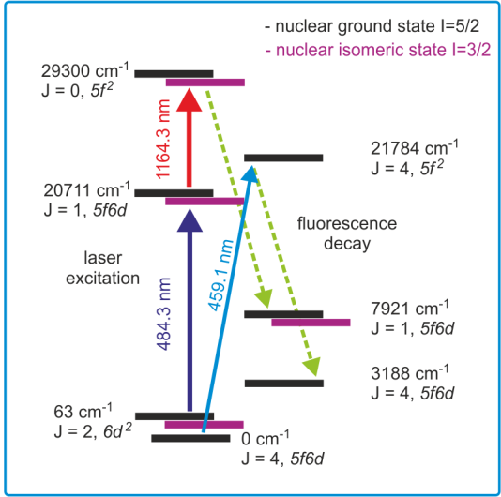
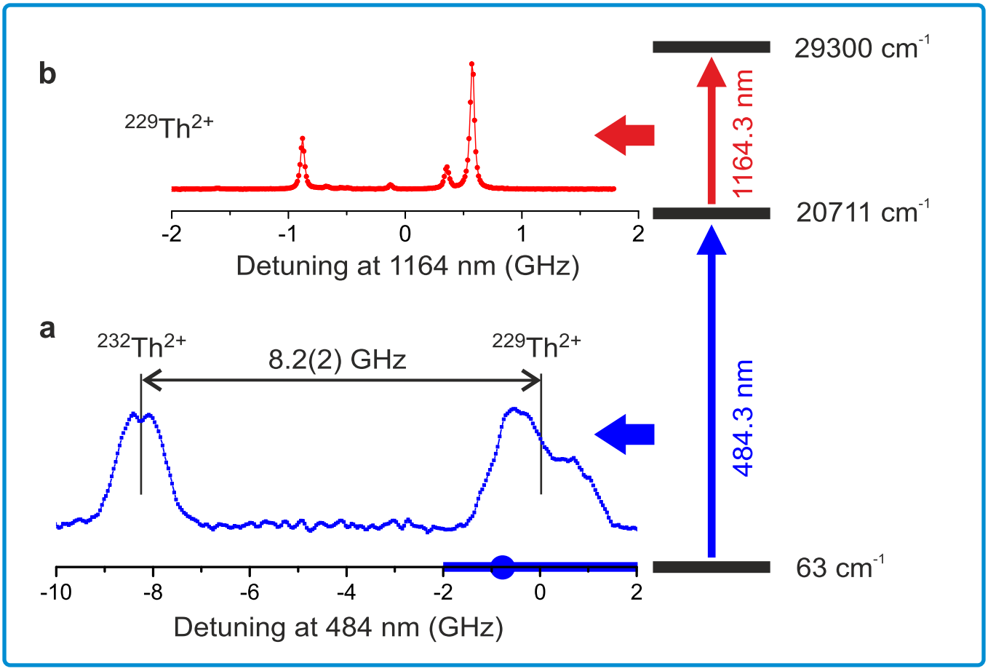
Hyperfine structure of ^{229m}Th²⁺ and isomer nuclear properties
Two-step laser excitation eliminates Doppler-broadening:
1st step: excitation of a narrow velocity class out of the 300 K thermal distribution
2nd step: high-resolution spectroscopy, free from Doppler-broadening
Spectra of step 2 for various detunings of laser 1 provide the resolved HFS of both transitions
Fluorescence detection free from laser straylight
Levels with J=2─1─0 simplify the analysis

Slide 41
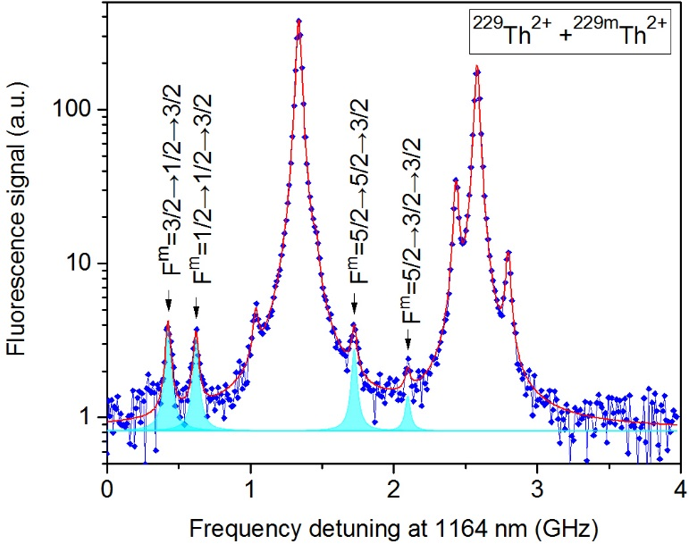
Hyperfine structure of ^{229m}Th²⁺ and isomer nuclear properties
Typical HFS resonances of nuclear isomeric and ground states in scan of the 2nd-step laser.
Nuclear ground state
resonances
(98% of all ions)
Cyan: isomer resonances with
F: total angular momentum

Slide 42
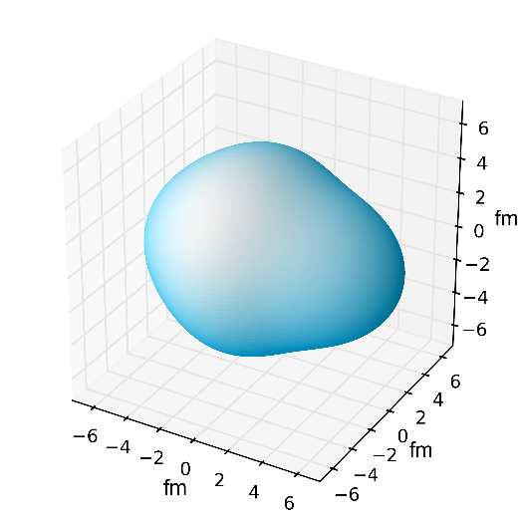
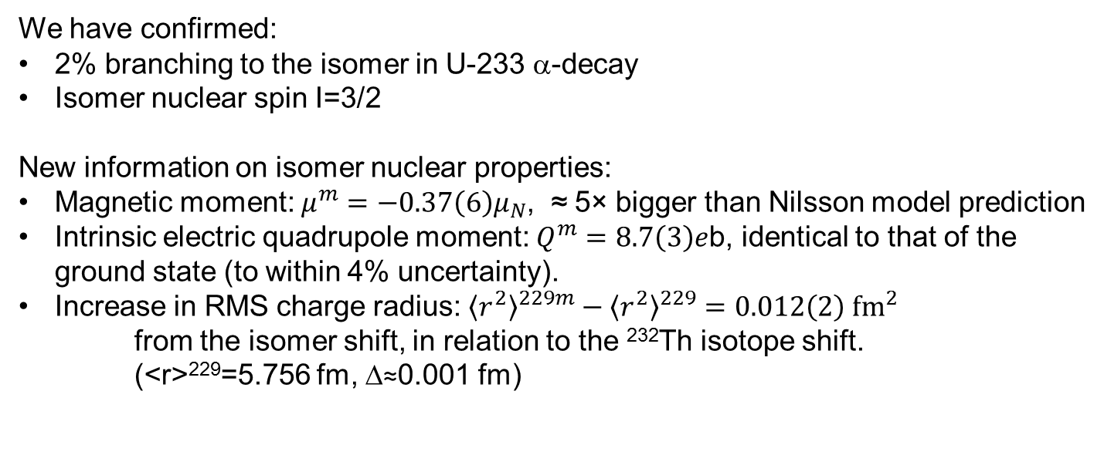
Hyperfine structure of ^{229m}Th²⁺ and isomer nuclear properties
We have confirmed:
2% branching to the isomer in U-233 α-decay
Isomer nuclear spin I=3/2
New information on isomer nuclear properties:
Magnetic moment: $μ^{m}=−0.37\left(6\right)μ_{N}$, ≈ 5× bigger than Nilsson model prediction
Intrinsic electric quadrupole moment: $Q^{m}=8.7\left(3\right)e$b, identical to that of the ground state (to within 4% uncertainty).
Increase in RMS charge radius: ${\left\langle r^{2}\right\rangle }^{229m}−{\left\langle r^{2}\right\rangle }^{229}=0.012\left(2\right) {fm}^{2}$
from the isomer shift, in relation to the ²³²Th isotope shift.
(<r>²²⁹=5.756 fm, Δ≈0.001 fm)
Proton distribution is similar in both states;
but must contribute some change to equalize
the energies to within a few eV.
J. Thielking, M. V. Okhapkin, P. Glowacki, D. M. Meier, L. v.d. Wense, B. Seiferle, C. E. Düllmann, P. G. Thirolf, E. Peik, Nature 556, 321 (2018)

Slide 43
Outline of the lecture:
Concept of a nuclear clock
Expected performance of a Th-229 nuclear clock (field-induced systematic frequency shifts)
Th-229 and its low-energy isomer: nuclear properties and experiments towards excitation of the isomer
Applications of a nuclear clock: Tests of fundamental physics

Slide 44
Search for new physics with clocks:
Search for violations of present theories, or experimental hints for new theories
Quantum
Theory
General
Relativity
Einstein Equivalence Principle
Local Position Invariance: The outcome of any local non-gravitational
test experiment is independent of where and when in the universe it is performed.
This makes gravitation “universal” and allows it to be described
as a geometrical phenomenon, but it also separates gravitation
from the other fundamental interactions.
We search for violations of the Equivalence Principle with different atomic clocks:
Search for a time dependence of fundamental constants
Test of the universality of the gravitational red shift
Clock comparison test of Lorentz invariance

Slide 45
High sensitivity of a Th-229 nuclear clock for violations of the equivalence principle
Transition frequency is sensitive to the strong interaction (in addition to electromagnetism)
Coulomb- and strong- contributions (MeV scale) cancel in the transition energy
Enhanced sensitivity to variations of fundamental constants: Phys. Rev. Lett. 97, 092502 (2006)
Bound system of massive particles (n, p) at high energies
Enhanced effect of LLI violation: Phys. Rev. Lett. 117, 072501 (2016)
Work of Victor Flambaum
ground state
isomer
8.3 eV
Coulomb contribution
total binding energy
Coulomb contribution
MeV scale

Slide 46


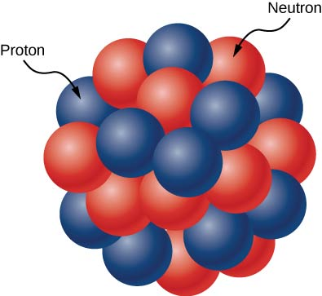
α- sensitivity of the Th-229 nuclear clock transition frequency
Depends on the difference in Coulomb energies:
Potentially very big: 10⁵
Total Coulomb energy (homogeneously charged sphere):
For Th-229: E_{C}=1.2 GeV (m₂₂₉c² = 215 GeV)
Nilsson model description of ^{229m}Th and ²²⁹Th: one unpaired neutron
in a static, deformed nuclear potential of all other nucleons.
How does the neutron interact
with the proton distribution?
This is not how a heavy nucleus looks like

Slide 47
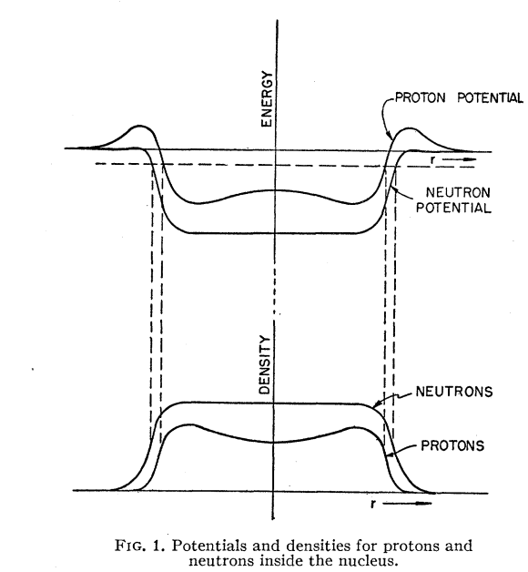
α- sensitivity of the Th-229 nuclear clock transition frequency
M. H. Johnson, E. Teller
Phys. Rev. 93, 357 (1953)
Fermi distributions of protons
and neutrons in a heavy nucleus:
β-stability requires filling up to a common
Fermi energy.
Neutrons form a „skin“ around the nucleus.
Question of ΔE_{C} in the Th-229 nuclear clock:
Predictions vary: ΔE_{C}≈ 0 excitation of the unpaired neutron does not influence the proton distribution
ΔE_{C}≈ 1 MeV required to obtain E_{is} ≈ 8 eV from a cancellation
involving Coulomb and strong interactions.

Slide 48
α- sensitivity of the Th-229 nuclear clock transition frequency
Hyperfine structure data based evaluation of ΔE_{C} using
a simple nuclear droplet model (uniform, hard-edged, prolate ellipsoid), proposed by J. Berengut et al., Phys. Rev. Lett. 102, 210801 (2009)
With updated ground state radius and quadrupole moment:
ΔE_{C}≈ - 485 MeV (Δ<r²>/<r²>) + 11.6 MeV (ΔQ/Q)
With our data on the isomer:
ΔE_{C}= - 0.18(3) MeV - 0.12(43) MeV = - 0.29(43) MeV
We plan to improve on this with a more precise measurement of the isomer quadrupole moment.

Slide 49
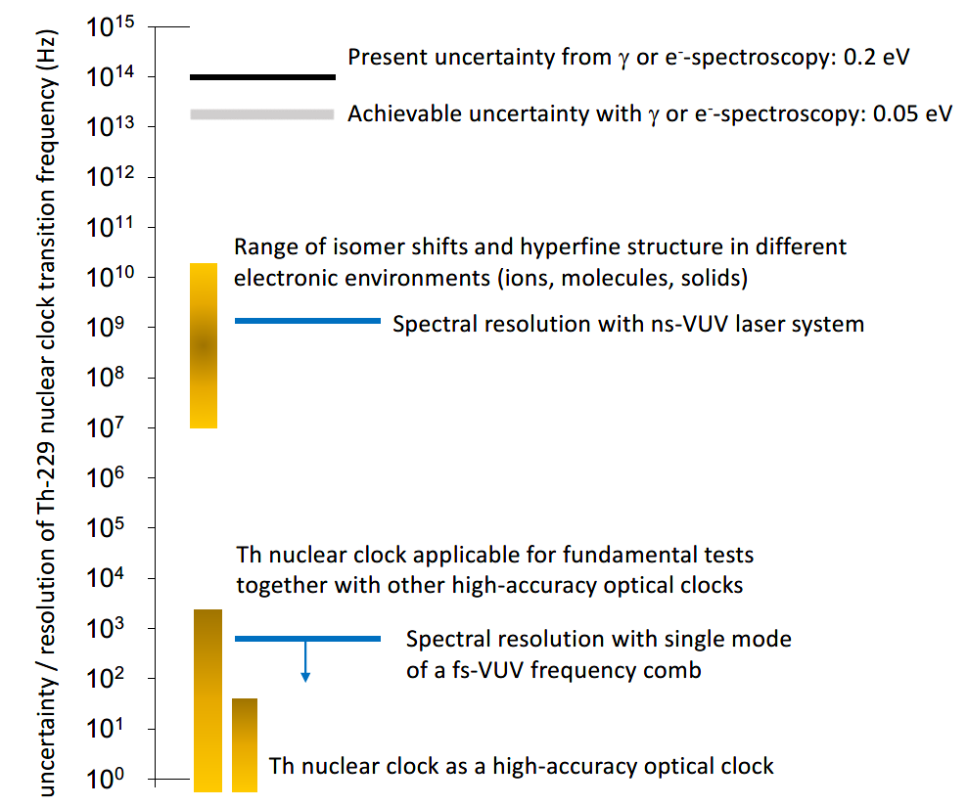
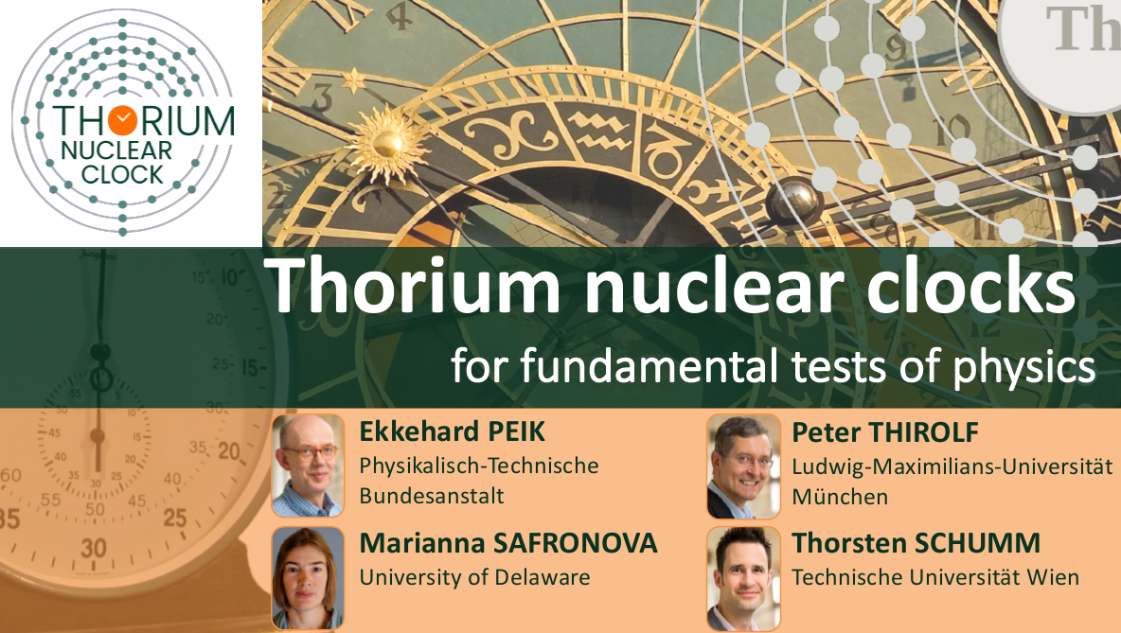

„Roadmap“ in frequency uncertainty for the Th-229 nuclear transition
ERC Synergy Project 2020

Slide 50
Review articles:
E. Peik, M. Okhapkin, Comptes Rendus Physique 16, 536 (2015)
also at: arXiv:1502.07322
L. von der Wense, B. Seiferle, and P. G. Thirolf,
Measurement Techniques 60, 1178 (2018)
The Thorium-229 low-energy isomer and the nuclear clock
K. Beeks, T. Sikorsky, T. Schumm, J. Thielking, M. V. Okhapkin, E. Peik
Nature Reviews Phys. 3, 238 (2021)
Nuclear clocks for testing fundamental physics
E. Peik, T. Schumm, M. Safronova, A. Palffy, J. Weitenberg, P.G. Thirolf
Quantum Sci. Technol. 6, 034002 (2021)
See also:
www.nuclock.eu
(for a Th-229 library up until 2019)
https://www.ptb.de/cms/en/ptb/fachabteilungen/abt4/fb-44/44-literatur.html
(for the work of the PTB group on Optical Clocks with Trapped Ions)

Slide 51
Physikalisch-Technische Bundesanstalt
Braunschweig und Berlin
Bundesallee 100
38116 Braunschweig
Dr. Ekkehard Peik
Telefon: 0531 592-4400
E-Mail: ekkehard.peik@ptb.de
www.ptb.de/time/

