Slide 1
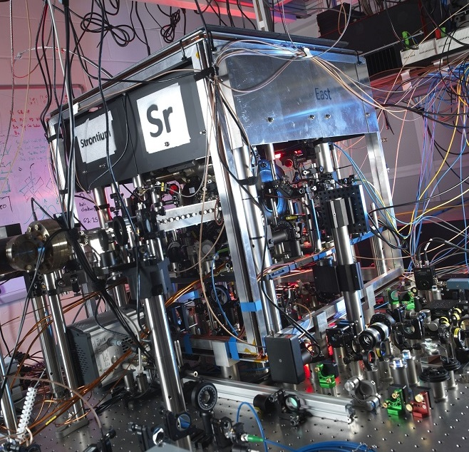
Optical clocks for international timekeeping
Helen Margolis
Summer School on Frequency Standards, Precision and Quantum Measurement
Gold Coast, Queensland, Australia, 11th October 2023

Slide 2
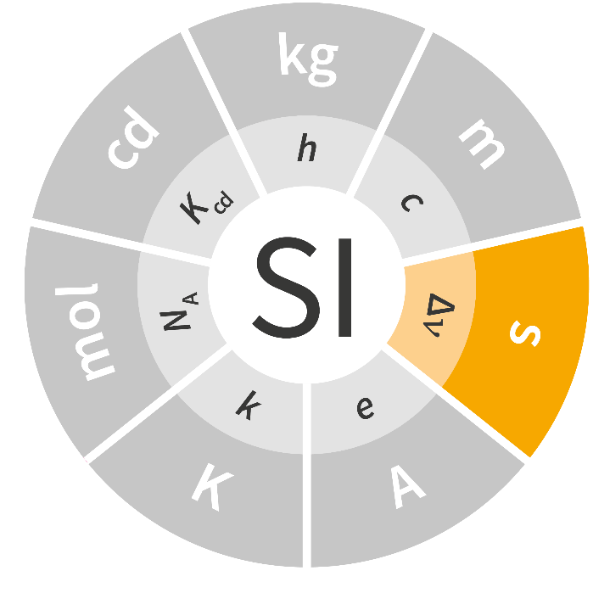
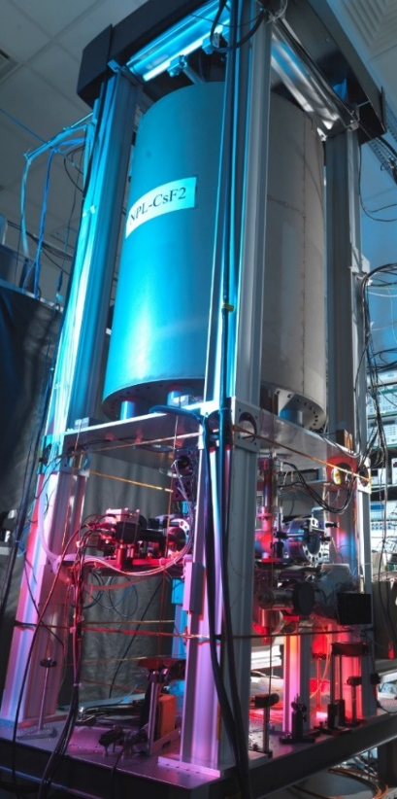
Timekeeping based on Cs atoms
The second, symbol s, is the SI unit of time. It is defined by taking the
fixed numerical value of the caesium frequency Δν_{Cs}, the unperturbed ground-state hyperfine transition frequency of the caesium 133 atom,
to be 9 192 631 770 when expressed in the unit Hz, which is equal to s⁻¹.
Definition is realised using a Cs fountain primary frequency standard
Used to contribute to the global time scales TAI and UTC
Used to steer the physical realisations of UTC maintained
by national timing laboratories, e.g. UTC(NPL)
NPL-CsF2 , accuracy 2.0 ×10⁻¹⁶

Slide 3
Coordinated Universal Time (UTC)
∼ 80 National
Timing Institutes
BIPM
Free Atomic Time
(EAL)
Local UTC(k)
time scales
IERS
Earth rotation
measurements
International
Atomic Time
(TAI)
~ 500 commercial
atomic clocks
leap seconds
Universal Time
(UT1)
~ 12 Cs primary
standards
Coordinated
Universal Time
(UTC)
UTC is a paper time scale, computed monthly
BIPM Circular T

Slide 4

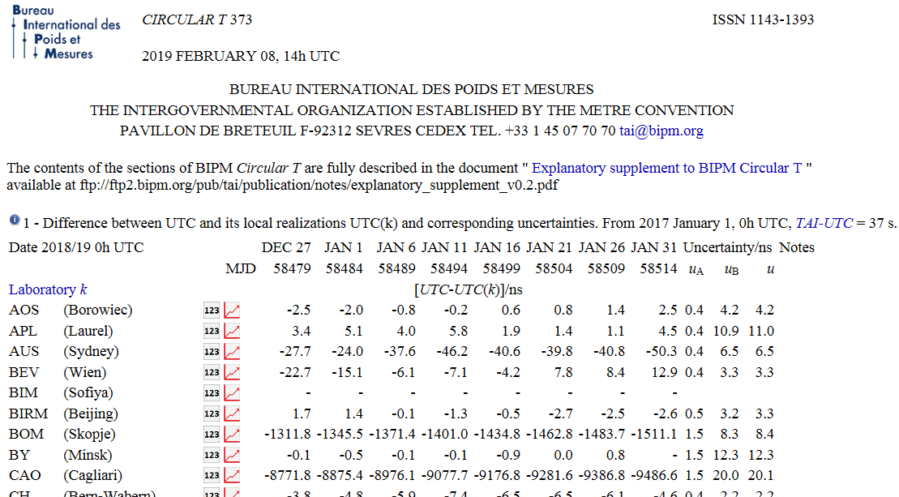
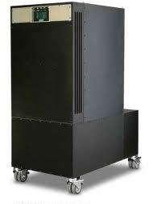
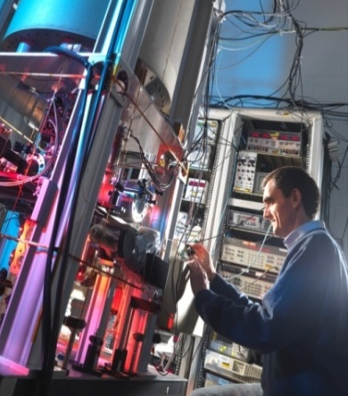
UTC(k) time scales
Satellite links to other UTC(k) laboratories
BIPM Circular T
UTC(NPL)
Time and frequency dissemination services
Cs fountain primary
frequency standard, NPL-CsF2
Accuracy 2.0 ×10⁻¹⁶
Cs beam clocks
Hydrogen masers

Slide 5
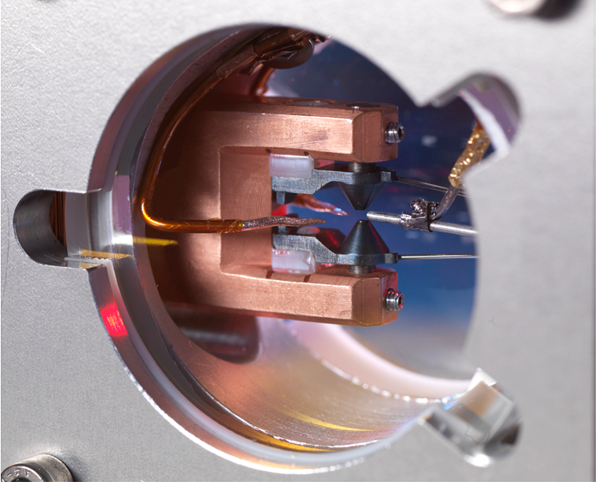
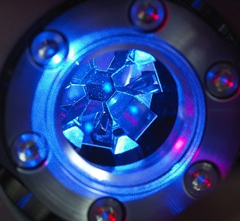
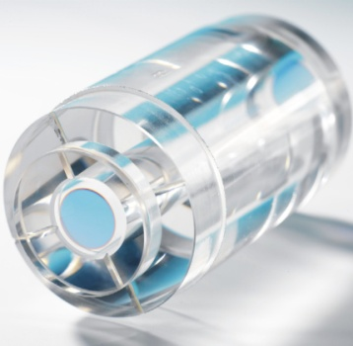
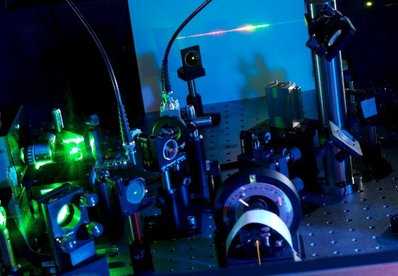
Optical atomic clocks
Frequency control
Theoretically achievable
fractional frequency instability ∝ Q ⁻¹
f₀
Q =
= line quality factor
Δf
Atomic reference
(narrow optical transition
in an ion or atom)
 | Microwave | Optical
f₀ | ~ 10¹⁰ Hz | ~ 10¹⁵ Hz
Δf | ~ 1 Hz | ~ 1 Hz
Ultrastable laser
5 orders of magnitude
improvement in stability
(in principle)
Femtosecond optical frequency comb

Slide 6
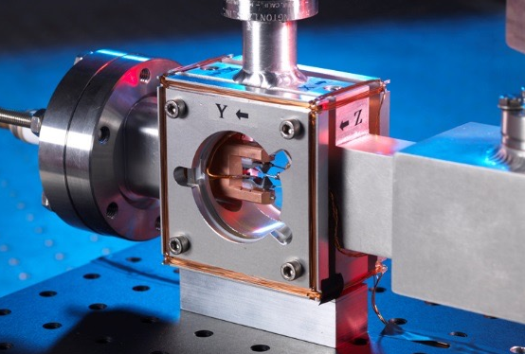
Optical atomic clock technology
Trapped ion optical clocks
Based on “forbidden” (e.g. E2) transitions
in single trapped ions (Q ~ 10¹⁵)
Long interrogation times possible
Rf ion trap provides a low perturbation environment
Neutral atom optical lattice clocks
¹S₀ – ³P₀ clock transitions (mHz natural linewidth)
Atoms confined in an optical lattice
N atoms, stability ∝ N^{1/2}
AC Stark shift eliminated by operating at
“magic” wavelength
¹P₁
τ ∼10 ns
³P₂
1st-stage
cooling
2nd-stage
cooling
³P₁
τ ∼1 s
³P₀
cooling
transition
clock transition
reference
(“clock”) transition
¹S₀
ground state
λ
1D lattice, site spacing λ/2

Slide 7
Candidates for the atomic reference
Neutral atom and single ion
H
1
He
2
Neutral atom
3
4
5
6
7
8
9
10
Li
Be
B
C
N
O
F
Ne
Single ion
Desirable features:
Narrow optical transitions
(for low instability)
Insensitive to
external perturbations
(for high accuracy)
Accessible clock
transition wavelengths
(practical to build)
11
12
13
14
15
16
17
18
Na
Mg
Al
Si
P
S
Cl
Ar
19
20
21
22
23
24
25
26
27
28
29
30
31
32
33
34
35
36
K
Ca
Sc
Ti
V
Cr
Mn
Fe
Co
Ni
Cu
Zn
Ga
Ge
As
Se
Br
Kr
37
38
39
40
41
42
43
44
45
46
47
48
49
50
51
52
53
54
Rb
Sr
Y
Zr
Nb
Mo
Tc
Ru
Rh
Pd
Ag
Cd
In
Sn
Sb
Te
I
Xe
55
56
57
72
73
74
75
76
77
78
79
80
81
82
83
84
85
86
Cs
Ba
La
Hf
Ta
W
Re
Os
Ir
Pt
Au
Hg
Tl
Pb
Bi
Po
At
Rn
87
88
89
104
105
106
107
108
109
110
Fr
Ra
Ac
Rf
Db
Sg
Bh
Hs
Mt
Ds
58
59
60
61
62
63
64
65
66
67
68
69
70
71
Ce
Pr
Nd
Pm
Sm
Eu
Gd
Tb
Dy
Ho
Er
Tm
Yb
Lu
90
91
92
93
94
95
96
97
98
99
100
101
102
103
Th
Pa
U
Np
Pu
Am
Cm
Bk
Cf
Es
Fm
Md
No
Lr

Slide 8
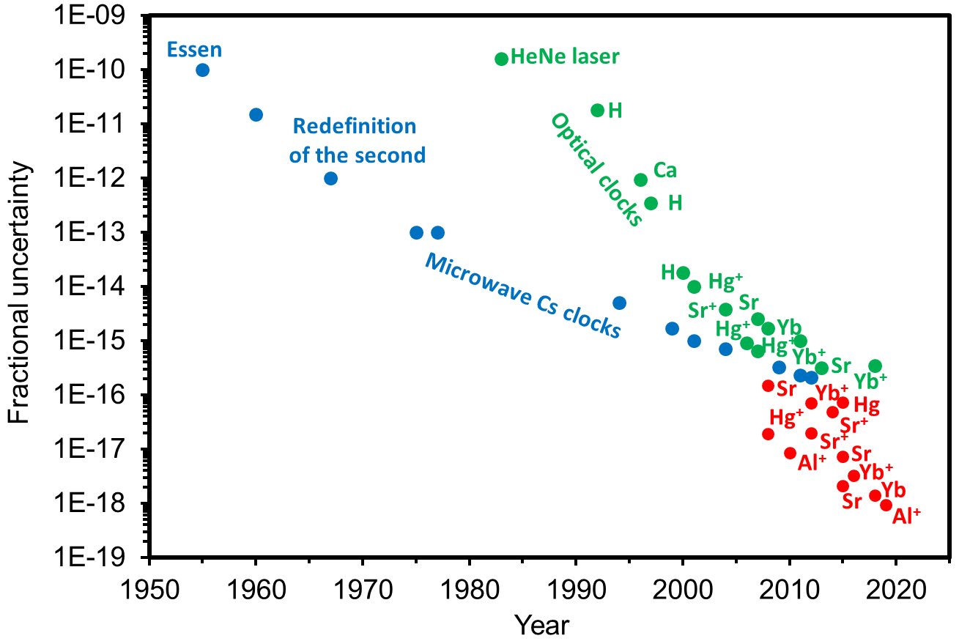
Improvements in clock performance
Optical atomic clocks:
absolute frequency measurements
Cs microwave
atomic clocks
Optical atomic clocks:
estimated systematic uncertainties
Optical redefinition of the SI second is anticipated

Slide 9
Secondary representations of the second
Frequency standards that can be used to realise the SI second, and to contribute to TAI
Uncertainty cannot be better than Cs primary standards
List contains 1 microwave transition (Rb) and 10 optical transitions
Atom or ion | Transition | Wavelength | Recommended fractional uncertainty (2017)
¹⁹⁹Hg | ¹S₀ – ³P₀ | 266 nm | 2.4 x 10^{–16}
²⁷Al⁺ | ¹S₀ – ³P₀ | 267 nm | 1.9 x 10^{–16}
¹⁹⁹Hg⁺ | ²S_{1/2} – ²D_{5/2} | 282 nm | 2.2 x 10^{–16}
⁴⁰Ca⁺ | ²S_{1/2} – ²D_{5/2} | 411 nm | 1.8 x 10^{–15}
¹⁷¹Yb⁺ | ²S_{1/2} – ²D_{3/2} | 436 nm | 2.0 x 10^{–16}
¹⁷¹Yb⁺ | ²S_{1/2} – ²F_{7/2} | 467 nm | 1.9 x 10^{–16}
¹⁷¹Yb | ¹S₀ – ³P₀ | 578 nm | 1.9 x 10^{–16}
⁸⁸Sr⁺ | ²S_{1/2} – ²D_{5/2} | 674 nm | 1.3 x 10^{–15}
⁸⁷Sr | ¹S₀ – ³P₀ | 698 nm | 1.9 x 10^{–16}
⁸⁸Sr | ¹S₀ – ³P₀ | 698 nm | 2.0 x 10^{–16}
https://www.bipm.org/en/publications/mises-en-pratique/standard-frequencies

Slide 10
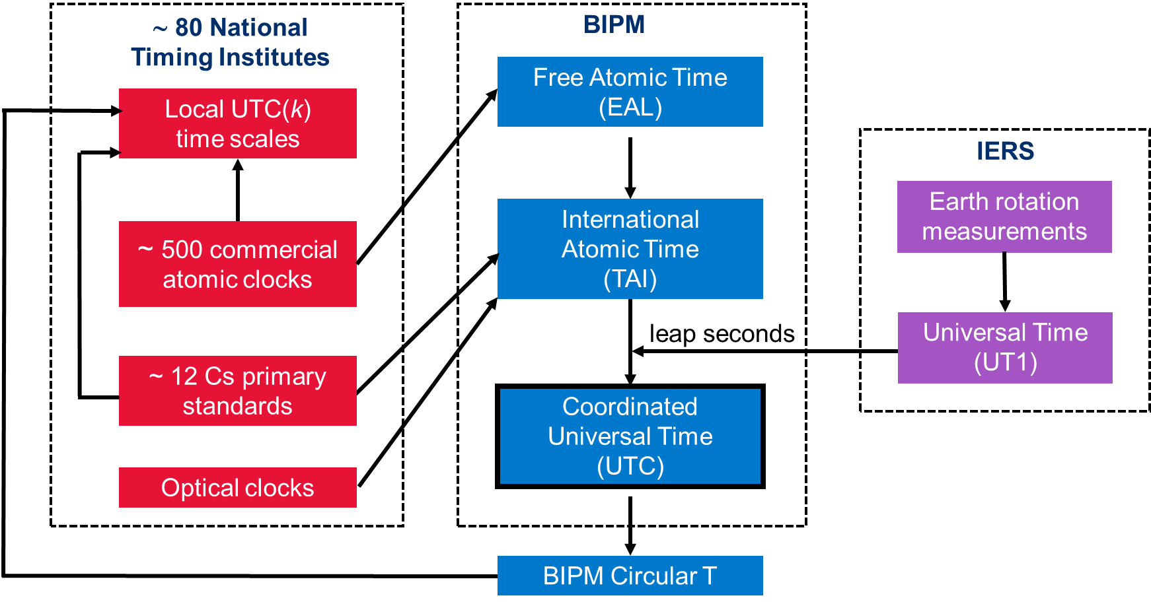
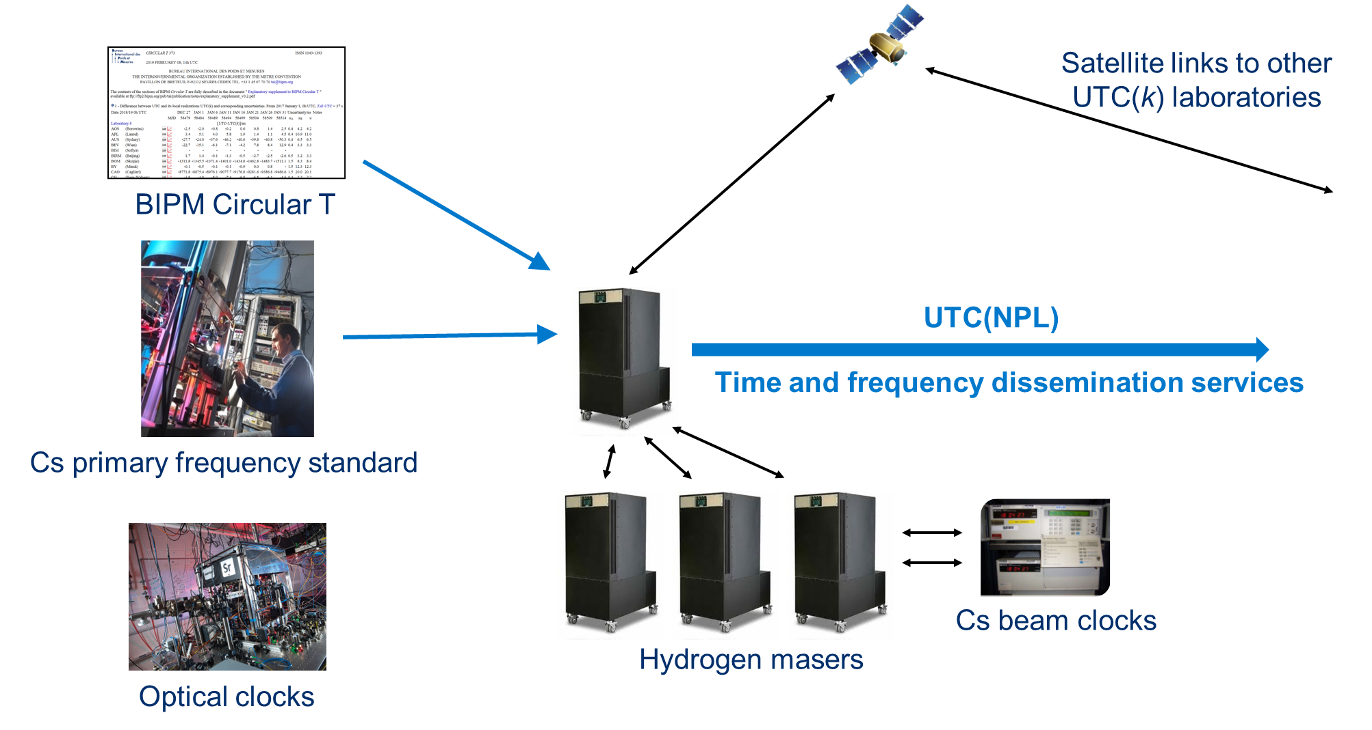
Integration of optical clocks into UTC and UTC(k)
Secondary representations of the second can be used for:
Steering International Atomic Time (TAI)
Steering hydrogen masers in UTC(k) time scales

Slide 11

Roadmap towards the redefinition
Dedicated CCTF task force established June 2020,
chaired by Noel Dimarcq and Patrizia Tavella
3 sub-groups bringing together 40 worldwide contributors to prepare
a detailed roadmap towards the redefinition of the second
Paper submitted to Metrologia, available at https://arxiv.org/abs/2307.14141
CGPM 2022:
Validated roadmap
Different options for redefinition
CGPM 2030:
Redefinition
2020:
CCTF task group formed
CGPM 2026:
Redefinition option proposed
Mandatory criteria achievable by 2029
CGPM 2034:
(backup scenario)

Slide 12
Mandatory criteria and ancillary conditions
https://arxiv.org/abs/2307.14141
Validation that optical frequency standards (OFS) are at a level 100 times better than Cs
Continuity with the definition based on Cs
Regular contributions of OFS to TAI as secondary representations of the second
Availability of sustainable techniques for OFS comparisons
Knowledge of the local geopotential with a sufficient uncertainty level
Definition allowing future more accurate realisations
Access to the realisation of the new definition
Achieved
Mandatory criteria
Must be achieved before changing the definition
Ancillary conditions
High reliability of optical frequency standards
High reliability of ultra high stability T/F links
Continuous improvement of the realization and time scales after redefinition
Regular contributions of optical clocks to UTC(k)
Availability of commercial optical clocks
Improved quality of the dissemination towards users
In progress
Status should be advanced,
even if not completely
achieved at the
time of redefinition

Slide 13
Mandatory criteria and ancillary conditions
https://arxiv.org/abs/2307.14141
Validation that optical frequency standards (OFS) are at a level 100 times better than Cs
Continuity with the definition based on Cs
Regular contributions of OFS to TAI as secondary representations of the second
Availability of sustainable techniques for OFS comparisons
Knowledge of the local geopotential with a sufficient uncertainty level
Definition allowing future more accurate realisations
Access to the realisation of the new definition
Achieved
Mandatory criteria
Must be achieved before changing the definition
Ancillary conditions
High reliability of optical frequency standards
High reliability of ultra high stability T/F links
Continuous improvement of the realization and time scales after redefinition
Regular contributions of optical clocks to UTC(k)
Availability of commercial optical clocks
Improved quality of the dissemination towards users
In progress
Status should be advanced,
even if not completely
achieved at the
time of redefinition

Slide 14
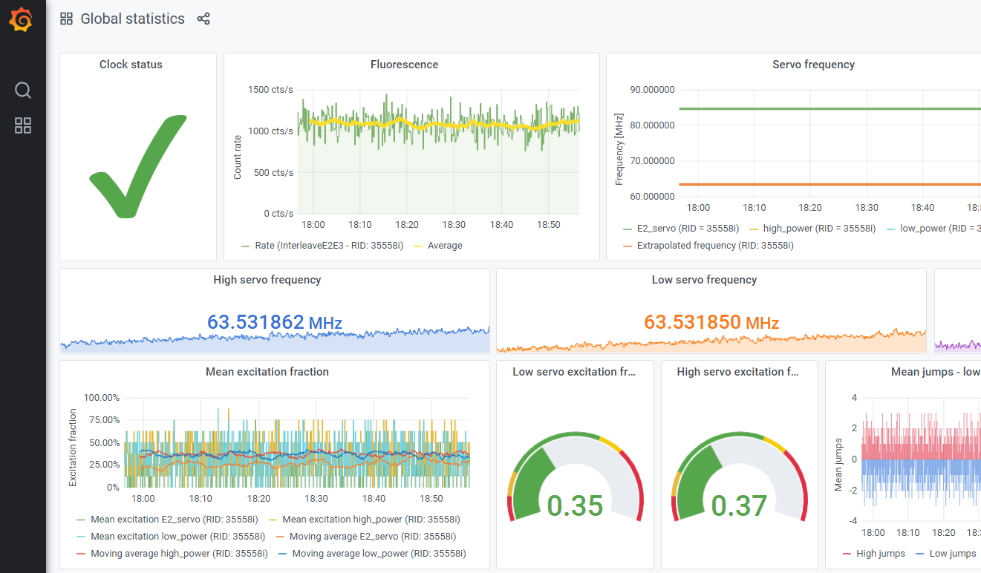
Robust optical clocks
Monitoring and automatic control systems
Robust & autonomous frequency stabilisation
of laser systems
Automated optical alignment
Remote monitoring and control
Software to schedule and perform operational checks,
e.g. minimisation of micromotion in trapped ion clocks,
magic wavelength calibration in lattice clocks
Tools for on-the-fly correction of systematic frequency shifts
With sufficiently low latency for UTC(k) steering
Also useful for timely contributions to TAI and faster data analysis in international comparisons
e.g. uptimes exceeding 80 % over several weeks demonstrated for NPL-Sr1

Slide 15
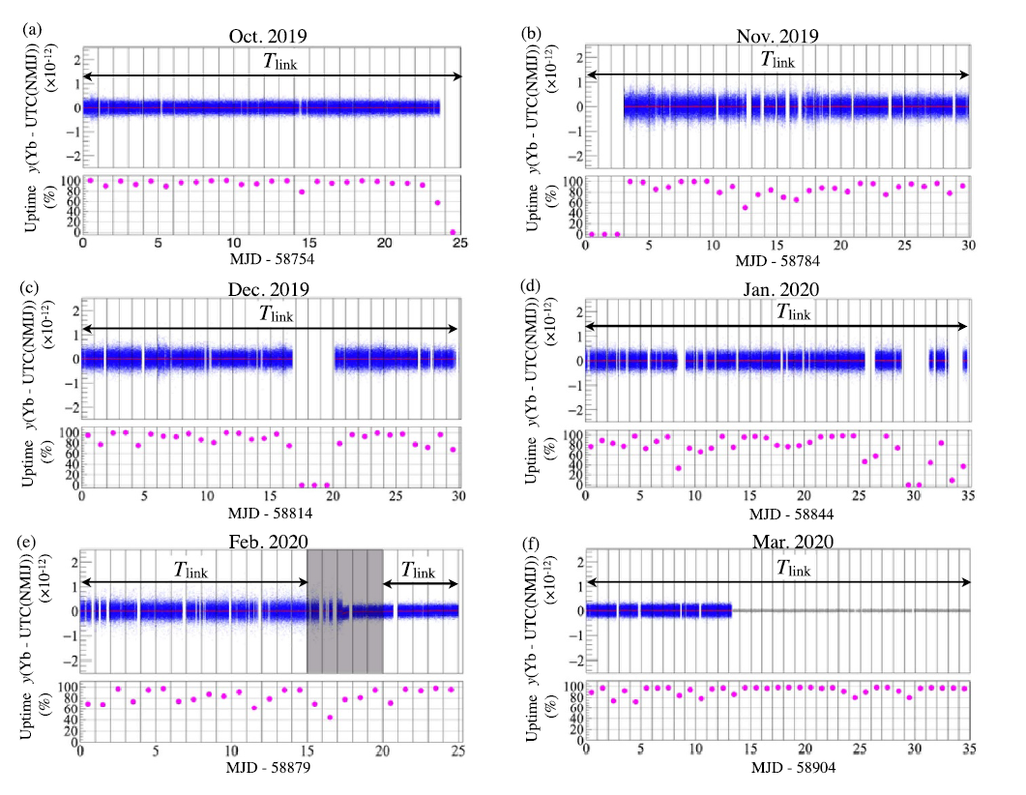
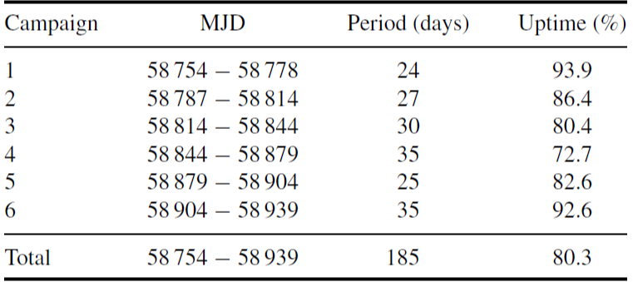
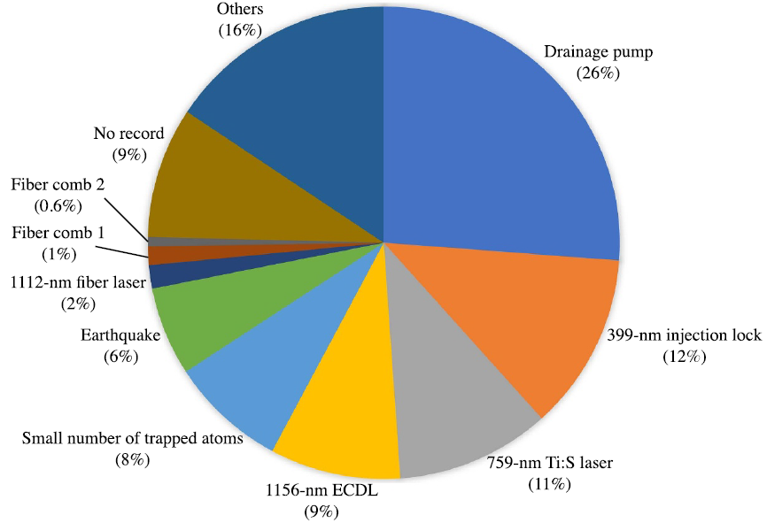
Uptime of the NMIJ optical lattice clock over 6 months
T. Kobayashi et al., Metrologia 57, 065021 (2020)

Slide 16
Mandatory criteria and ancillary conditions
https://arxiv.org/abs/2307.14141
Validation that optical frequency standards (OFS) are at a level 100 times better than Cs
Continuity with the definition based on Cs
Regular contributions of OFS to TAI as secondary representations of the second
Availability of sustainable techniques for OFS comparisons
Knowledge of the local geopotential with a sufficient uncertainty level
Definition allowing future more accurate realisations
Access to the realisation of the new definition
Achieved
Mandatory criteria
Must be achieved before changing the definition
Ancillary conditions
High reliability of optical frequency standards
High reliability of ultra high stability T/F links
Continuous improvement of the realization and time scales after redefinition
Regular contributions of optical clocks to UTC(k)
Availability of commercial optical clocks
Improved quality of the dissemination towards users
In progress
Status should be advanced,
even if not completely
achieved at the
time of redefinition

Slide 17
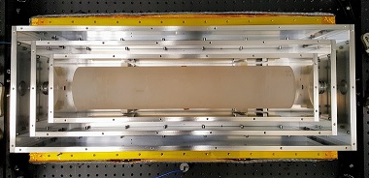
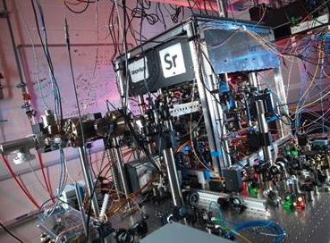
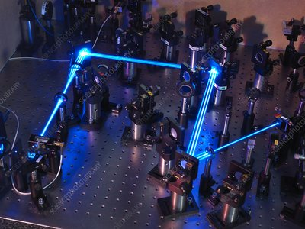
Frequency combs for local optical clock comparisons
Cs fountains
Hydrogen masers
Ultrastable lasers
Sr lattice clock
Yb⁺ optical clock
Femtosecond optical frequency combs can be used for
Absolute frequency measurements (referenced to the SI unit of frequency)
Optical frequency ratio measurements
Frequency combs themselves contribute negligible uncertainty to either type of measurement

Slide 18
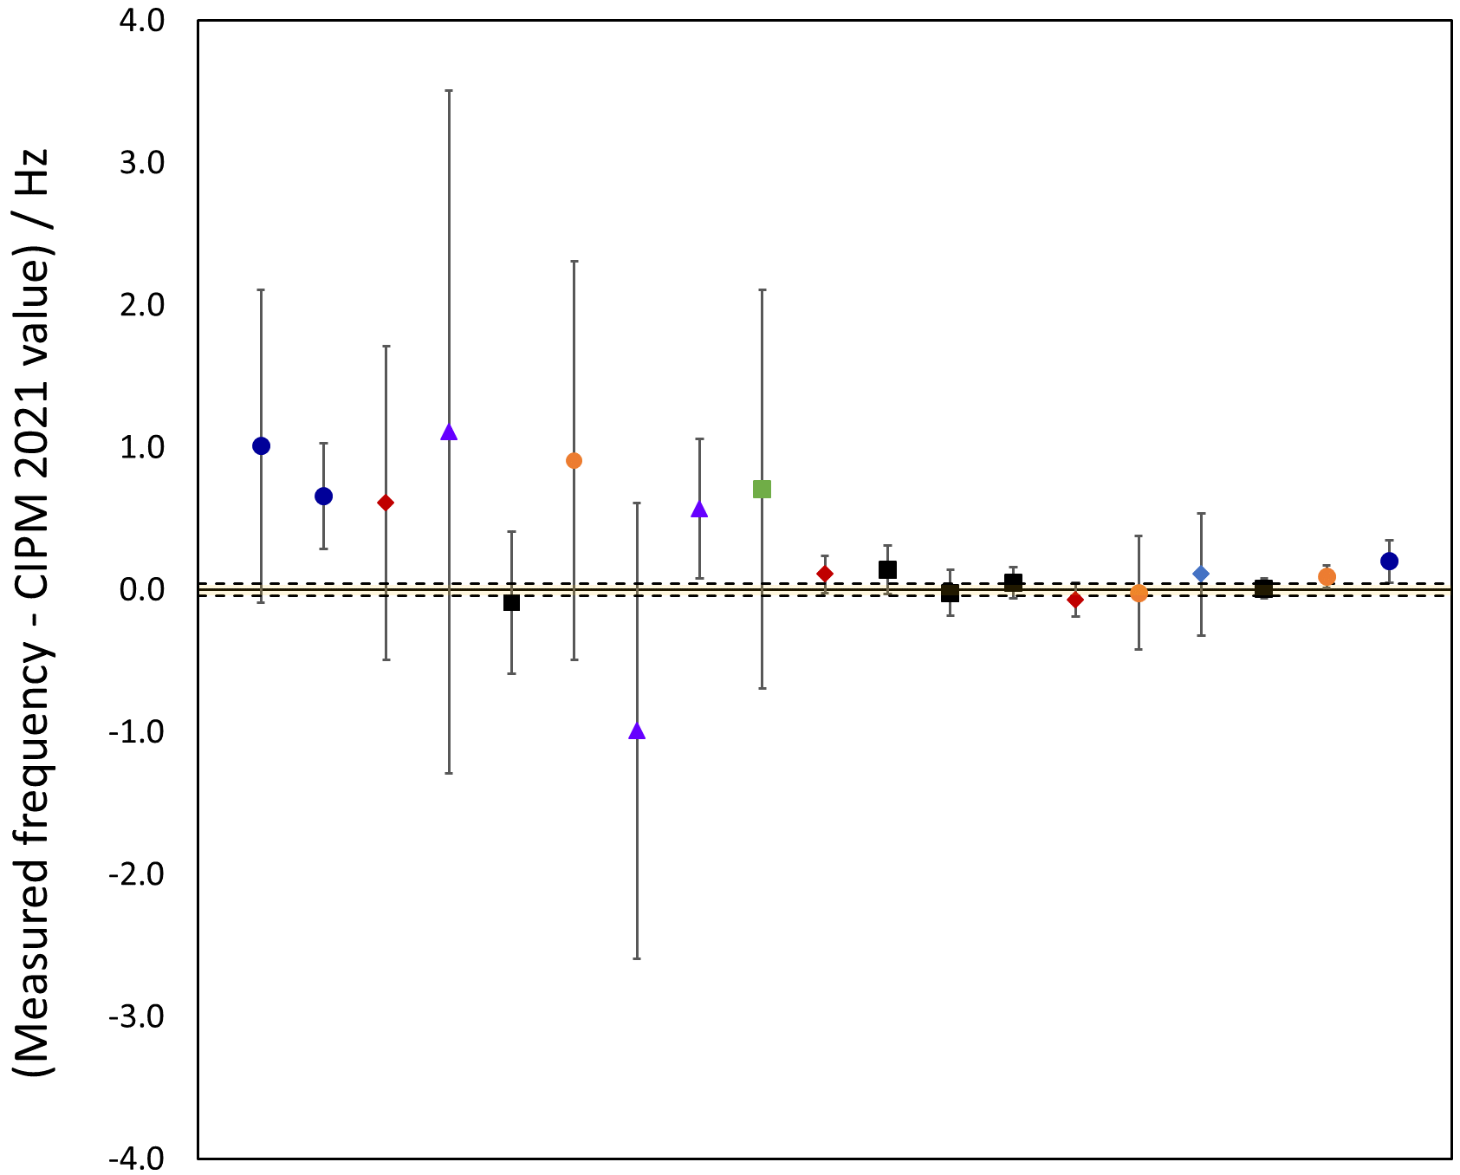
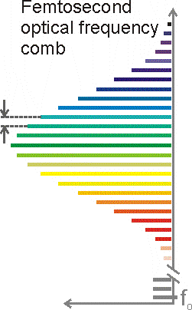

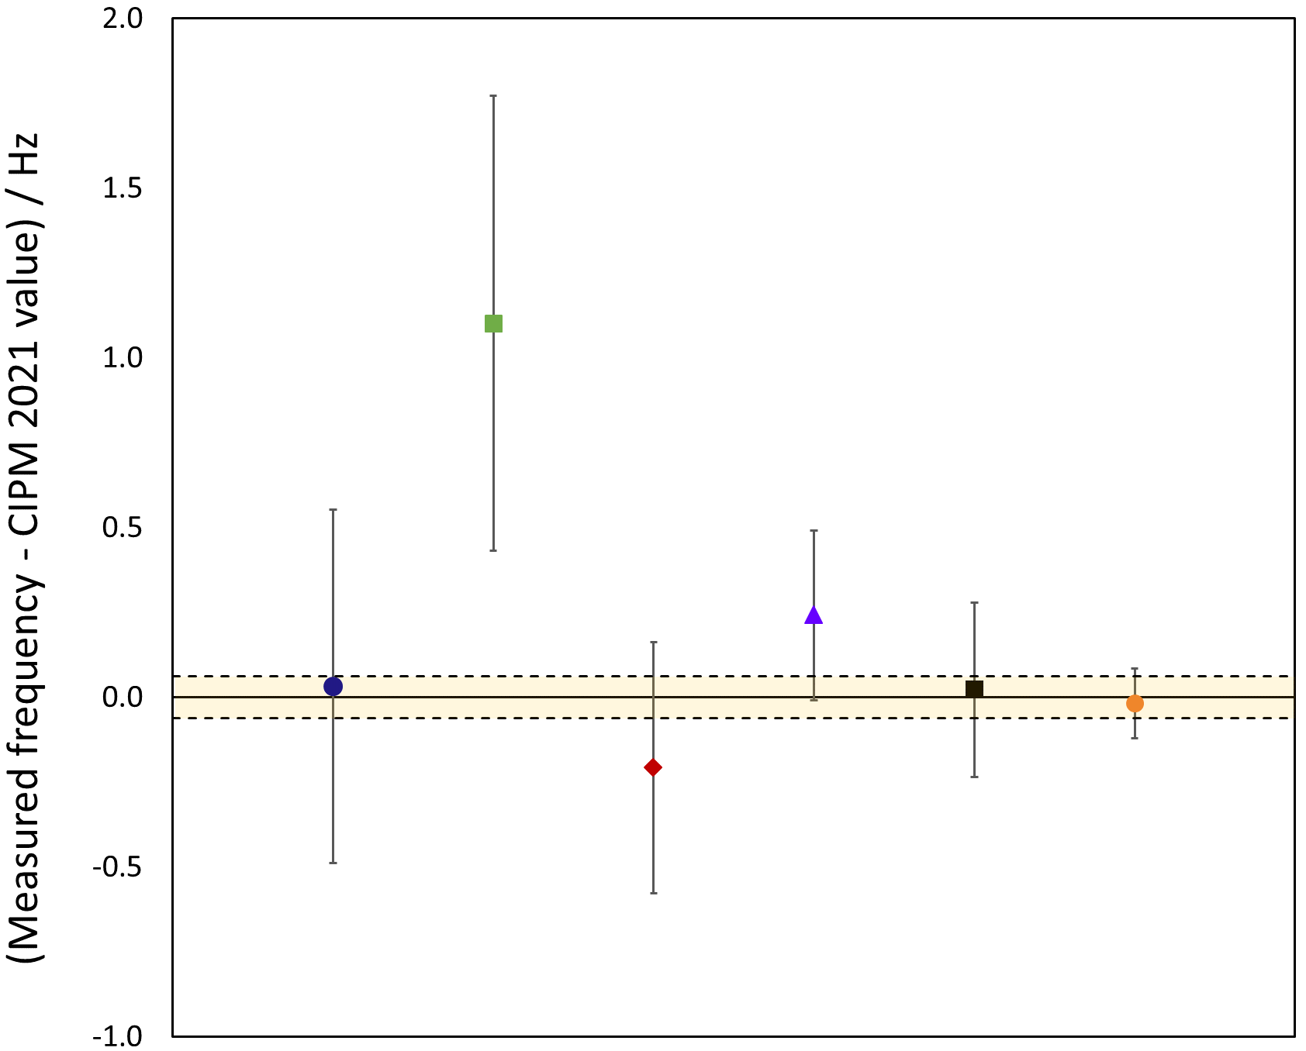
Absolute frequency measurements
NMIJ 2009
⁸⁷Sr
Femtosecond
comb
JILA 2007
NICT 2012
NIM 2015
f_{rep}
JILA 2008
NMIJ 2015
H-maser
NICT 2017
JILA 2020
PTB 2014
PTB 2015
PTB 2020
Caesium fountain
SYRTE 2013
SYRTE 2016
NICT 2020
SYRTE 2008
PTB 2011
PTB 2014
NPL 2020
Optical clock
f₀
¹⁷¹Yb⁺ E3
NMIJ 2014
NPL 2012
PTB 2014
PTB 2021
Independent measurements made relative to
local Cs fountain primary frequency standards or TAI
Limited by uncertainty of the best Cs primary standards (low parts in 10¹⁶ after 20 – 30 days)
PTB 2012
NPL
2014
NPL 2018

Slide 19
Optical frequency ratio measurements
Femtosecond
comb
Optical clock 1
f_{rep}
f₂
m₂ f_{rep} + f₀ + f_{b2}
m₂
1 + Δ₂
=
=
f₁
m₁ f_{rep} + f₀ + f_{b1}
m₁
1 + Δ₁
Optical clock 2
f₀ + f_{bi}
where Δ_{i}
10⁻⁶ – 10⁻⁷
f₀
=
~
m_{i} f_{rep}
i.e. f_{rep} cancels to first order
Optical frequency ratio measurements can have better
stability and accuracy than absolute frequency measurements

Slide 20

Local optical frequency ratio measurements
ν_{Yb+}/ ν_{Sr}
NPL
LNE-SYRTE
PTB
NIST/JILA
INRIM/PTB
RIKEN
RIKEN
ν_{Yb}/ ν_{Sr}
ν_{Yb}/ ν_{Sr}
Limited only by the stability and accuracy of the optical clocks themselves
  Low parts in 10¹⁸ achievable in a few hours
  Can demonstrate reproducibility to an accuracy beyond that of the realisation of the SI second
Clock comparisons without a direct link!

Slide 21

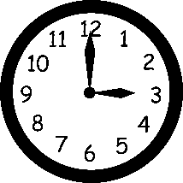
Remote clock comparisons
Transportable
optical clocks
Clock A
Clock B

Slide 22
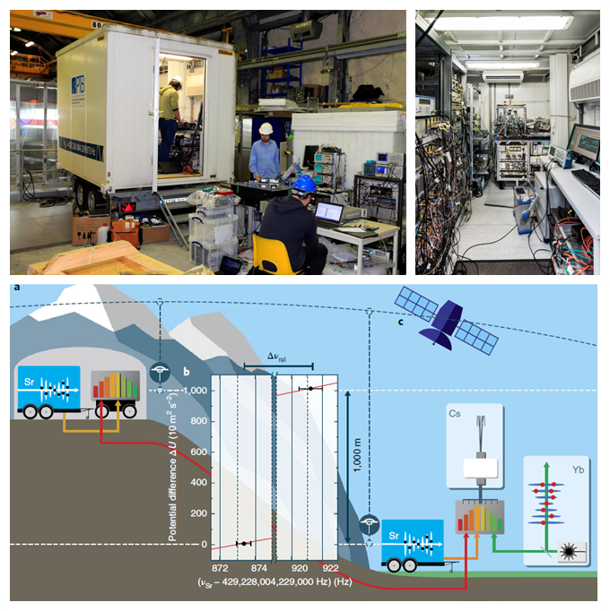
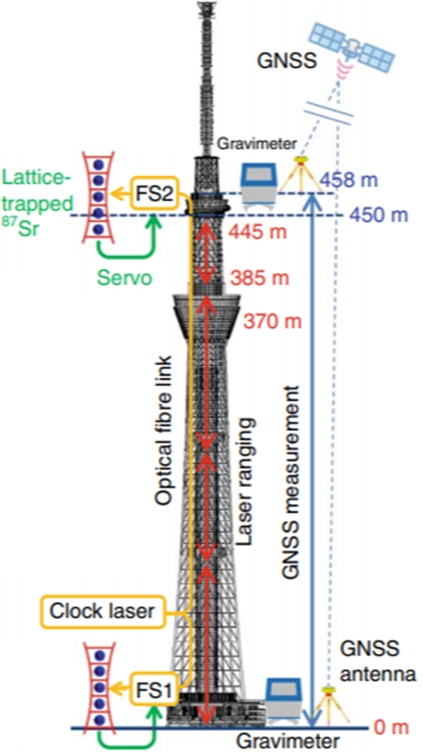
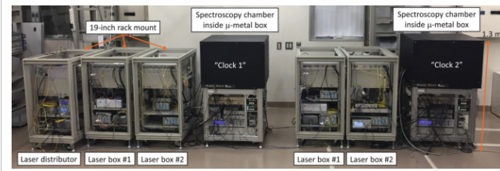
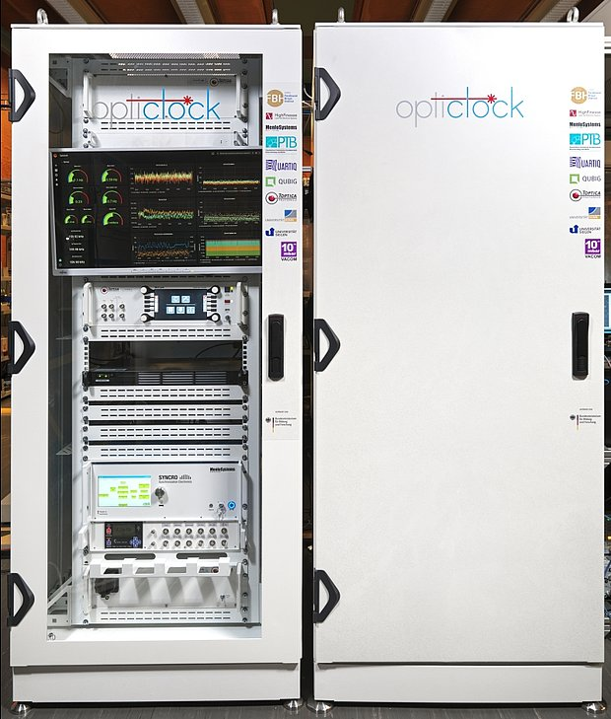
Transportable optical clocks
RIKEN transportable Sr optical lattice clock
M. Takamoto et al., Nature Photonics 14, 411 (2020)
PTB transportable Sr optical lattice clock
J. Grotti et al., Nature Physics 14, 437 (2018)
Opticlock: transportable Yb⁺ (E2) optical clock
J. Stuhler et al., Measurement: Sensors 18, 100264 (2021)

Slide 23
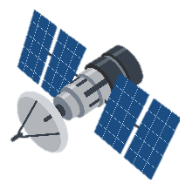
Remote clock comparisons
Two-way satellite time and frequency transfer (TWSTFT)
GEO
GNSS links
MEO
Transportable
optical clocks
Clock A
Clock B

Slide 24


Optical clock comparisons via satellite
NPL – SYRTE – PTB
Broadband two-way satellite time
and frequency transfer (TWSTFT)
Dedicated transponder (expensive!)
Remote comparison of 5 optical
clocks in 3 European laboratories
Comparison uncertainties at the
low parts in 10¹⁶ level
F. Riedel et al., Metrologia 57, 045005 (2020)
Yb⁺
Yb⁺
Sr
Sr
Sr
Sr
NICT – PTB
Carrier-phase-based two-way satellite
time and frequency transfer (TWCP)
Remote comparison of
⁸⁷Sr lattice clocks separated
by a baseline of 9000 km
Fractional difference
(1.1±1.6)×10⁻¹⁵
Hachisu et al, Opt. Lett. 39, 4072 (2014)
PTB – NPL
GPS Precise Point Positioning (PPP)
Remote comparison of ¹⁷¹Yb⁺ (E2)
optical clocks
Fractional difference (−1.3 ± 1.2)×10⁻¹⁵
J. Leute et al., IEEE Trans. UFFC 63, 891 (2016)
Long averaging times required
Uncertainty achieved does not match clock performance

Slide 25
Remote clock comparisons
Two-way satellite time and frequency transfer (TWSTFT)
GEO
GNSS links
MEO
LEO
Optical or microwave links to satellites in low Earth orbit
Transportable
optical clocks
Clock A
Clock B

Slide 26
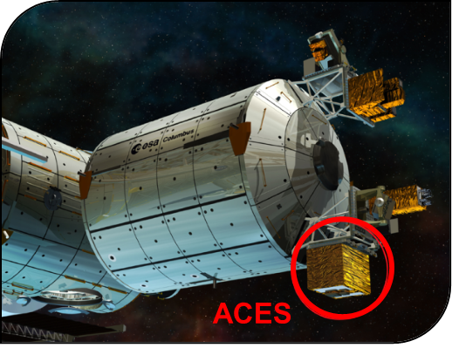
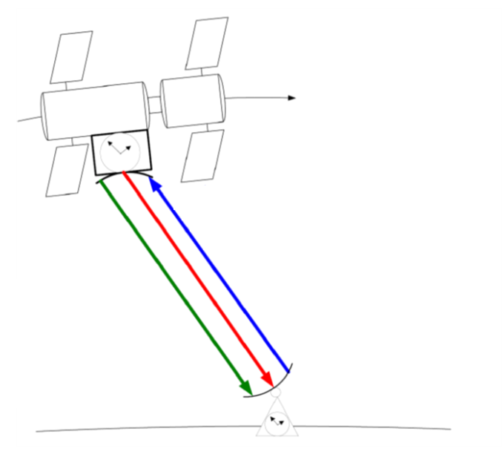
ACES microwave link
Part of the Atomic Clock Ensemble in Space (ACES) payload
to be installed on the International Space Station
Bidirectional Ku-band link with high modulation rate of 100 Mchips/s
Additional S-band downlink allows ionospheric delay
to be determined and cancelled
Specified performance ADEV ≤ 1.6×10⁻¹⁶ @ 1 day,
but intercontinental frequency comparison accuracies
at the 10⁻¹⁷ level achievable with one week of averaging
if no cycle slips
Image: ESA–D. Ducros
Free-space optical links also
being investigated, e.g. at NIST
Image: W. Schäfer, T. Feldmann,
J. Phys.: Conf. Ser., 723 012038, 2016, CC BY 3.0.

Slide 27
Remote clock comparisons
Two-way satellite time and frequency transfer (TWSTFT)
GEO
GNSS links
MEO
LEO
Optical or microwave links to satellites in low Earth orbit
Transportable
optical clocks
Clock A
Clock B
Optical fibre links

Slide 28
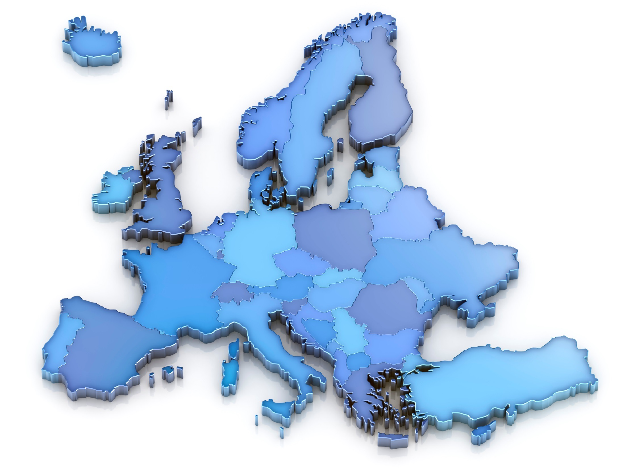
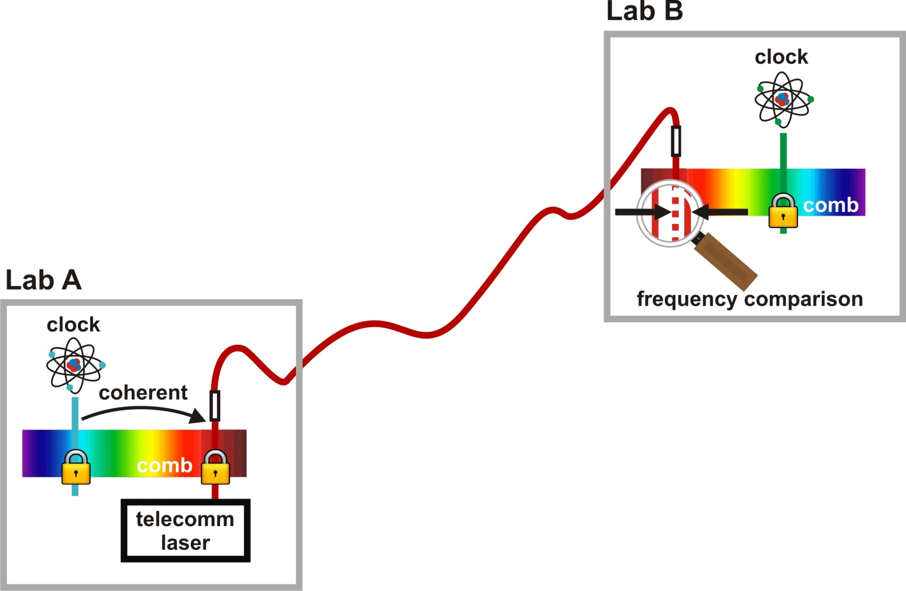





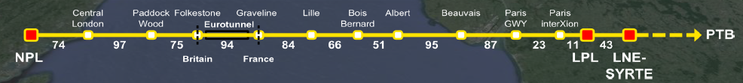
European optical fibre network for clock comparisons
Uses the 1.5 µm transmission band
of standard telecommunications fibre
Environmentally induced phase fluctuations must be measured and corrected
NPL
PTB
Yb⁺
Sr
Sr
Hg
Yb⁺
Sr
LPL
LNE-SYRTE
Sources of noise:
Vibrations
Temperature changes
INRIM
Yb
Frequency comparison uncertainties currently reaching the low part in 10¹⁷ level
< 1 part in 10¹⁸ possible

Slide 29
Tests of fundamental physics using the network
Test of Lorentz invariance
Comparison of Sr optical lattice clocks in 3 laboratories
Search for daily variations in clock frequency differences tests the assumption that there is no preferred frame of reference in the universe
Factor of 2 improvement on previous tests
P. Delva et al., Phys. Rev. Lett. 118, 221102 (2017)
NPL
PTB
Yb⁺
Sr
Sr
Hg
Yb⁺
Sr
LPL
LNE-SYRTE
INRIM
Search for transient variations of the fine structure constant and dark matter
Comparison of Sr, Hg and Yb⁺ optical clocks in 3 laboratories
Search for variations in optical frequency ratios that are coherent across the entire network
Improved constraints on transient variations of α, especially for timescales > 100 s
B. M. Roberts et al., New J. Phys. 22, 093010 (2020)

Slide 30
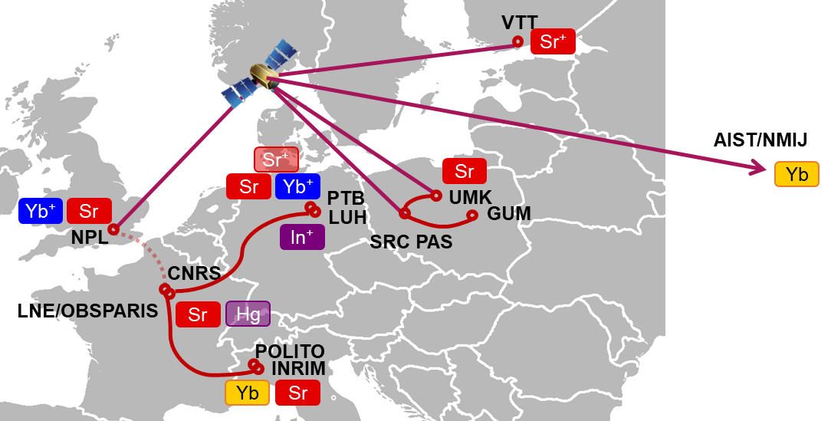
March 2022 comparison campaign
Optical fibre links
between INRIM,
LNE-SYRTE & PTB
Local links with
ultrastable lasers
Optical clocks
11 optical clocks in 7 different countries
Used satellite links as well as fibre links, so more optical clocks could participate

Slide 31
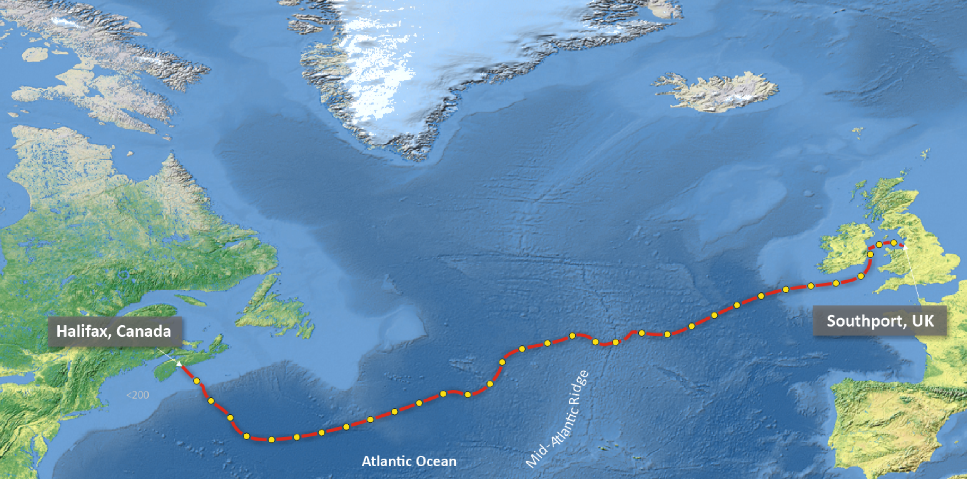
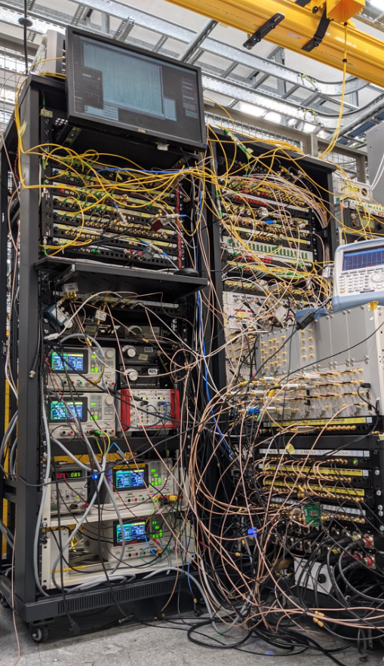
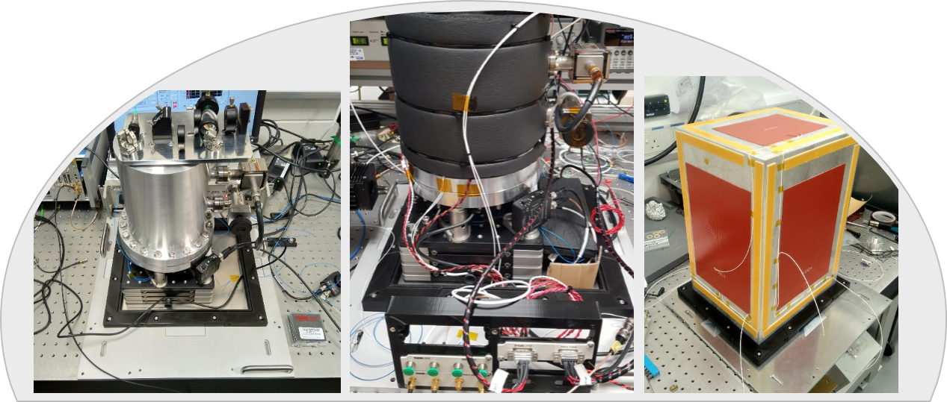
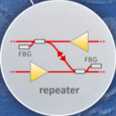
Towards intercontinental clock comparisons via fibre?
Transatlantic fibre linking Halifax and Southport (5860 km long)
So far mainly used for environmental sensing
  Initial demonstration: G. Marra et al., Science 361, 486 (2018)
  Isolation of signals from individual spans between optical repeaters: G. Marra et al., Science 376, 874 (2022)
Also offers prospects for intercontinental clock comparisons
  Environmentally induced noise lower than for terrestrial fibres
  Encouraging predictions of stability achievable using two adjacent fibres for noise cancellation
Actual number of repeaters (128)
reduced for illustrative purposes

Slide 32
Mandatory criteria and ancillary conditions
https://arxiv.org/abs/2307.14141
Validation that optical frequency standards (OFS) are at a level 100 times better than Cs
Continuity with the definition based on Cs
Regular contributions of OFS to TAI as secondary representations of the second
Availability of sustainable techniques for OFS comparisons
Knowledge of the local geopotential with a sufficient uncertainty level
Definition allowing future more accurate realisations
Access to the realisation of the new definition
Achieved
Mandatory criteria
Must be achieved before changing the definition
Ancillary conditions
High reliability of optical frequency standards
High reliability of ultra high stability T/F links
Continuous improvement of the realization and time scales after redefinition
Regular contributions of optical clocks to UTC(k)
Availability of commercial optical clocks
Improved quality of the dissemination towards users
In progress
Status should be advanced,
even if not completely
achieved at the
time of redefinition

Slide 33

Clocks and gravity
Relativistic redshift between two Earth-bound clocks at rest is
Δf = f ΔW / c²
ΔW = gravity potential difference (gravitational + centrifugal components)
f = clock frequency
c = speed of light
Correction terms < 10⁻¹⁸ as long as time-variable effects are considered
Potential differences ΔW sufficient for clock comparisons
Absolute potentials needed for contributions to international time scales (relative to conventional W₀)
Frequency shift ∼ 1 part in 10¹⁶ per metre difference in height
at the Earth’s surface

Slide 34
Definition of International Atomic Time (TAI)
Proper quantities are the direct results
of observations, e.g. measurement of local time τ by an ideal clock
Coordinate quantities are dependent on conventional choices, e.g. International Atomic Time (TAI)
Recommendation CCTF 3 (2017)
TAI is a continuous time scale produced by the BIPM based on the best realizations
of the SI second …
In the transformation from the proper time of a clock to TAI, the relativistic rate shift
is computed with respect to the conventionally adopted equipotential W₀ = 62 636 856.0 m²s⁻²
of the Earth’s gravity potential …
UTC … is the only recommended time scale for international reference and the basis of
civil time in most countries
UTC differs from TAI only by an integral number of seconds …

Slide 35
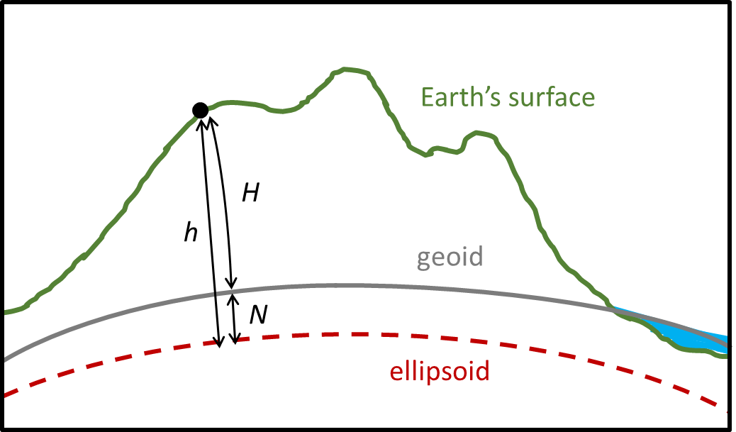
Physical geodesy
Determination of W(r) is one of the primary goals of geodesy
  Cannot be computed directly
  Has to be determined indirectly through
  measurements taken at or near the Earth’s surface
A complicated problem, closely related to the
definition of heights, equipotential surfaces,
and the geoid
Required uncertainty for optical clock comparisons
~ 0.1 m²s⁻²
h = ellipsoidal height (purely geometric)
e.g. from GNSS
H = orthometric height (physical height),
measured along the curved plumb line
N = geoid height or geoid undulation
H. Denker et al.,
Journal of Geodesy 92, 487 – 516 (2018)

Slide 36
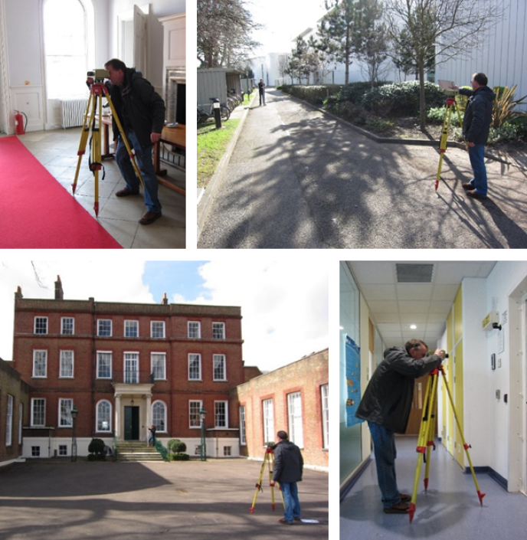
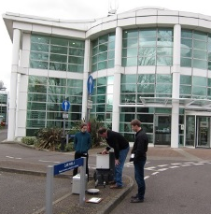
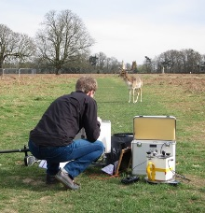
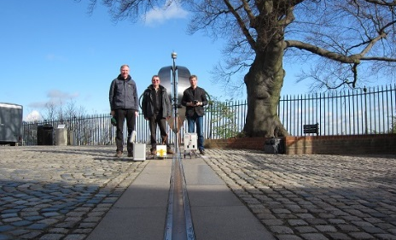










Gravity potential for optical clock comparisons
Geometric levelling approach
Based on geometrical levelling and gravity observations
A differential technique – gives only potential differences
Used for local clock comparisons at INRIM, LNE-SYRTE, NPL and PTB
Sub-mm accuracy over short distances,
but systematic errors accumulate over larger distances
Usually connected to a national tide gauge,
leading to inconsistencies of > 0.5 m across Europe
GNSS/geoid approach
Combines results from gravity field modelling with GNSS position measurements
Can deliver absolute potential values
ITOC project

Slide 37


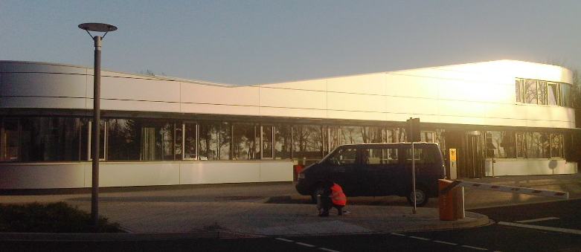
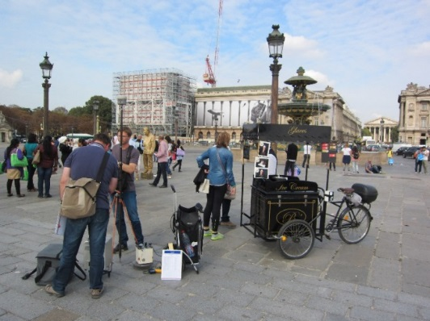
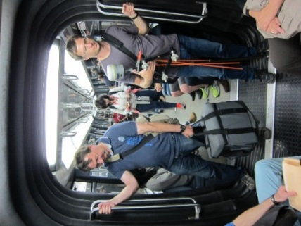
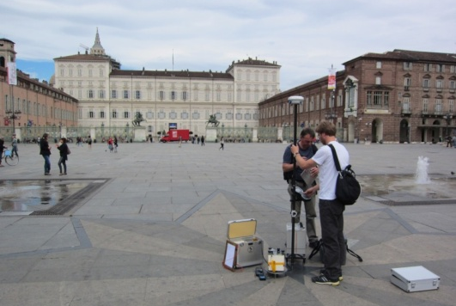
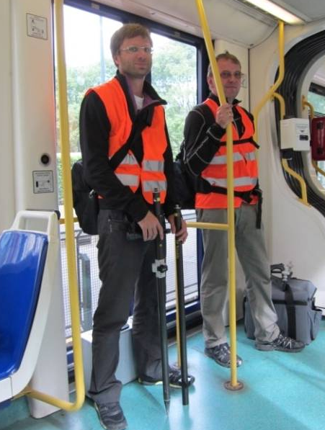
Gravity measurement campaigns
NPL (Mar 2014)
Consistency checks of historical gravity data
Filled gaps in coverage
PTB (Mar and Oct 2014)
2 absolute gravity measurements
64 relative gravity measurements
1 absolute gravity measurement
83 relative gravity measurements
LNE-SYRTE (Oct 2014)
INRIM (Sept 2013)
3 absolute gravity measurements
99 relative gravity measurements
1 absolute gravity measurement
35 relative gravity measurements
Map ©iStock.com/scibak

Slide 38
New European Gravimetric (Quasi)Geoid Model (EGG2015)
Long wavelength components computed
from a global geopotential model (GOCO05S)
Short wavelength components computed from high resolution digital elevation models (topographic data)
Medium wavelength structures recovered from
terrestrial gravity data
Accuracy ~ 0.2 m²s⁻²
Equivalent to 2 cm or 2×10⁻¹⁸ in fractional accuracy
H. Denker et al., Journal of Geodesy 92, 487 – 516 (2018)

Slide 39


Time-variable components of the gravity potential
Largest effect is Solid Earth tides:
Peak-to-peak range ~ 5 m²/s²
Differences increase as East-West separation increases
Gravity potential differences between NPL and PTB
1.3 m²/s²
(1.3×10⁻¹⁷)
7 hours
C. Voigt et al., Metrologia 53, 1365 – 1383 (2016)

Slide 40
Mandatory criteria and ancillary conditions
https://arxiv.org/abs/2307.14141
Validation that optical frequency standards (OFS) are at a level 100 times better than Cs
Continuity with the definition based on Cs
Regular contributions of OFS to TAI as secondary representations of the second
Availability of sustainable techniques for OFS comparisons
Knowledge of the local geopotential with a sufficient uncertainty level
Definition allowing future more accurate realisations
Access to the realisation of the new definition
Achieved
Mandatory criteria
Must be achieved before changing the definition
Ancillary conditions
High reliability of optical frequency standards
High reliability of ultra high stability T/F links
Continuous improvement of the realization and time scales after redefinition
Regular contributions of optical clocks to UTC(k)
Availability of commercial optical clocks
Improved quality of the dissemination towards users
In progress
Status should be advanced,
even if not completely
achieved at the
time of redefinition

Slide 41
Optical clock contributions to TAI
Calibrate a commercial clock for which phase comparison data is submitted
on a continuous basis to the BIPM
Use the frequency of the optical clock as listed in the “Recommended values of standard frequencies” http://www.bipm.org/en/publications/mises-en-pratique/standard-frequencies-second
Femtosecond
comb
For first submission of a new standard
  Several calibration values must be provided
  (do not need to be contiguous)
  Operation of the frequency standard and its
  uncertainty evaluation must be described
  in a peer-reviewed publication
Material must be reviewed and approved by
the CCTF WGPSFS before the clock can be used
for steering of TAI
f_{rep}
H-maser
f₀
Sr lattice clock

Slide 42




List of recommended frequency values
Recommended frequencies and uncertainties are assigned by the CCL-CCTF Frequency Standards Working Group (WGFS)
Values are periodically updated and published at
https://www.bipm.org/en/publications/mises-en-pratique/standard-frequencies.html
Straightforward with only absolute frequency measurements
2015
2017
2021
Direct optical frequency ratio measurements make the situation more complicated
No longer possible to treat each optical clock in isolation when considering the available data

Slide 43

Handling over-determined sets of clock comparison data
Methods have been developed for analysing
over-determined sets of clock comparison data
  To check the level of internal self-consistency
  To derive a self-consistent set of optimal values
  for the ratios between their operating frequencies
H. S. Margolis and P. Gill, Metrologia 52, 628 (2015)
Use a least-squares adjustment procedure, based on the approach used by CODATA to provide a self-consistent set of recommended values of the fundamental physical constants
First used to update the list of recommended frequency values in September 2015
  By 2017 a second independent technique was also available
L. Robertsson, Metrologia 53, 1272 (2016)
All data stored as frequency ratios
(optical frequency ratios, microwave frequency ratios or optical-microwave frequency ratios)
Correlations between measured quantities can be included (where known)

Slide 44
Importance of correlations
Neglecting correlations can lead to biased frequency values and underestimated uncertainties
Correlations can arise from both statistical and systematic uncertainties
Consider
  Correlations between clocks based on the same atomic species
    E.g. due to common theoretical or experimental values of atomic coefficients
  Correlations between different clocks in the same institution
    E.g. due to common gravitational redshift correction
  Correlations arising from common data
    Several ratio measurements involving the same clock, performed at the same time
    Absolute frequency measurements performed using TAI as a reference,
    even if several months apart
H. S. Margolis and M. Pizzocaro,
Guidelines on the evaluation and reporting of correlation coefficients between frequency ratio measurements (2020)
http://empir.npl.co.uk/rocit/project-outputs/

Slide 45

2021 update to the list of recommended frequency values
105 input data points
(72 absolute frequencies, 33 ratios)
Correlations included for the first time
(483 correlation coefficients)
6 secondary representations of the second
now have uncertainties ≤ 2 × 10⁻¹⁶

Slide 46

Optical clock contributions to TAI
https://webtai.bipm.org/database/show_psfs.html

Slide 47
Mandatory criteria and ancillary conditions
https://arxiv.org/abs/2307.14141
Validation that optical frequency standards (OFS) are at a level 100 times better than Cs
Continuity with the definition based on Cs
Regular contributions of OFS to TAI as secondary representations of the second
Availability of sustainable techniques for OFS comparisons
Knowledge of the local geopotential with a sufficient uncertainty level
Definition allowing future more accurate realisations
Access to the realisation of the new definition
Achieved
Mandatory criteria
Must be achieved before changing the definition
Ancillary conditions
High reliability of optical frequency standards
High reliability of ultra high stability T/F links
Continuous improvement of the realization and time scales after redefinition
Regular contributions of optical clocks to UTC(k)
Availability of commercial optical clocks
Improved quality of the dissemination towards users
In progress
Status should be advanced,
even if not completely
achieved at the
time of redefinition

Slide 48
Optical steering of UTC(k) time scale
UK time scale
Frequency offset generator
Frequency steers applied 3 times a week,
based on data from NPL-CsF2 and Circular T
UTC(NPL)
HM4
Phase comparator
Experimental prototype
Frequency offset generator
UTCx(NPL)
Frequency steers applied hourly,
based on data from Sr and Yb⁺ optical clocks
HM6

Slide 49

Automated data validation and steering
Automated validation of hour-long
chunks of data
Maser frequency deviation from 10 MHz computed using the recommended
frequency values for each optical clock,
and corrected using the external
frequency offset generator
Optical clock deadtimes bridged with
predicted values based on previous
maser behaviour.

Slide 50

Stability of the optically steered time scale
Phase step in output of frequency offset generator
Incorrect steers applied due to improperly flagged optical clock uptimes
Manual correction
Maximum 0.64 ns deviation
from UTC, despite gaps
in optical clock data (32.3%)
Similar tests performed
at LNE-SYRTE
Direct comparison between
the two prototype time scales
Agreement better than between the corresponding
operational time scales

Slide 51
Mandatory criteria and ancillary conditions
https://arxiv.org/abs/2307.14141
Validation that optical frequency standards (OFS) are at a level 100 times better than Cs
Continuity with the definition based on Cs
Regular contributions of OFS to TAI as secondary representations of the second
Availability of sustainable techniques for OFS comparisons
Knowledge of the local geopotential with a sufficient uncertainty level
Definition allowing future more accurate realisations
Access to the realisation of the new definition
Achieved
Mandatory criteria
Significant progress is being made towards fulfilment of the mandatory criteria…
… but need to reach consensus on best option for the redefinition
Must be achieved before changing the definition
Ancillary conditions
High reliability of optical frequency standards
High reliability of ultra high stability T/F links
Continuous improvement of the realization and time scales after redefinition
Regular contributions of optical clocks to UTC(k)
Availability of commercial optical clocks
Improved quality of the dissemination towards users
In progress
Status should be advanced,
even if not completely
achieved at the
time of redefinition

Slide 52


NPL e-learning (free)
https://elearning.npl.co.uk
~ 1 day
Provides an introduction to the measurement of time and frequency, time dissemination methods and time scales.
~ 1 day
Provides an introduction to measurement and data analysis methods
used to quantify clock performance.

Slide 53



Time and Frequency department at NPL
∼ 70 staff across 3 groups:
National time scale
Optical frequency metrology
Atomic clocks and sensors
https://jobs.npl.co.uk/vacancies/

