Slide 1
Time and frequency transfer techniques
Michael Wouters
Measurement for a fair, safe, healthy and competitive Australia | measurement.gov.au
Notes:
Good morning, my name is Michael Wouters.
I am the leader of Standards for Time and Frequency at the National Measurement Institute in Sydney, where I am responsible for Australia’s realization of Coordinated Universal Time.
Over the past 25 years or so that I’ve worked at NMI, time-transfer has been a theme of my work, with a particular emphasis on GNSS time-transfer, and I’ve also worked on two-way satellite time-transfer and optical fibre time-transfer.

Slide 2
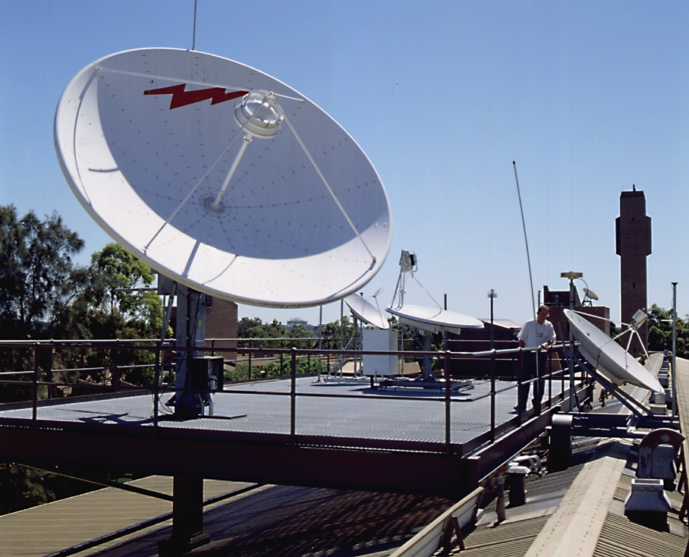
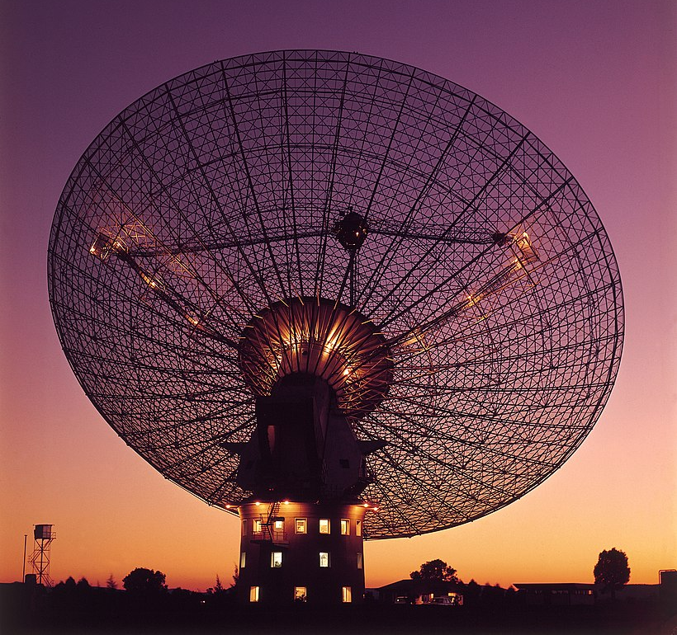
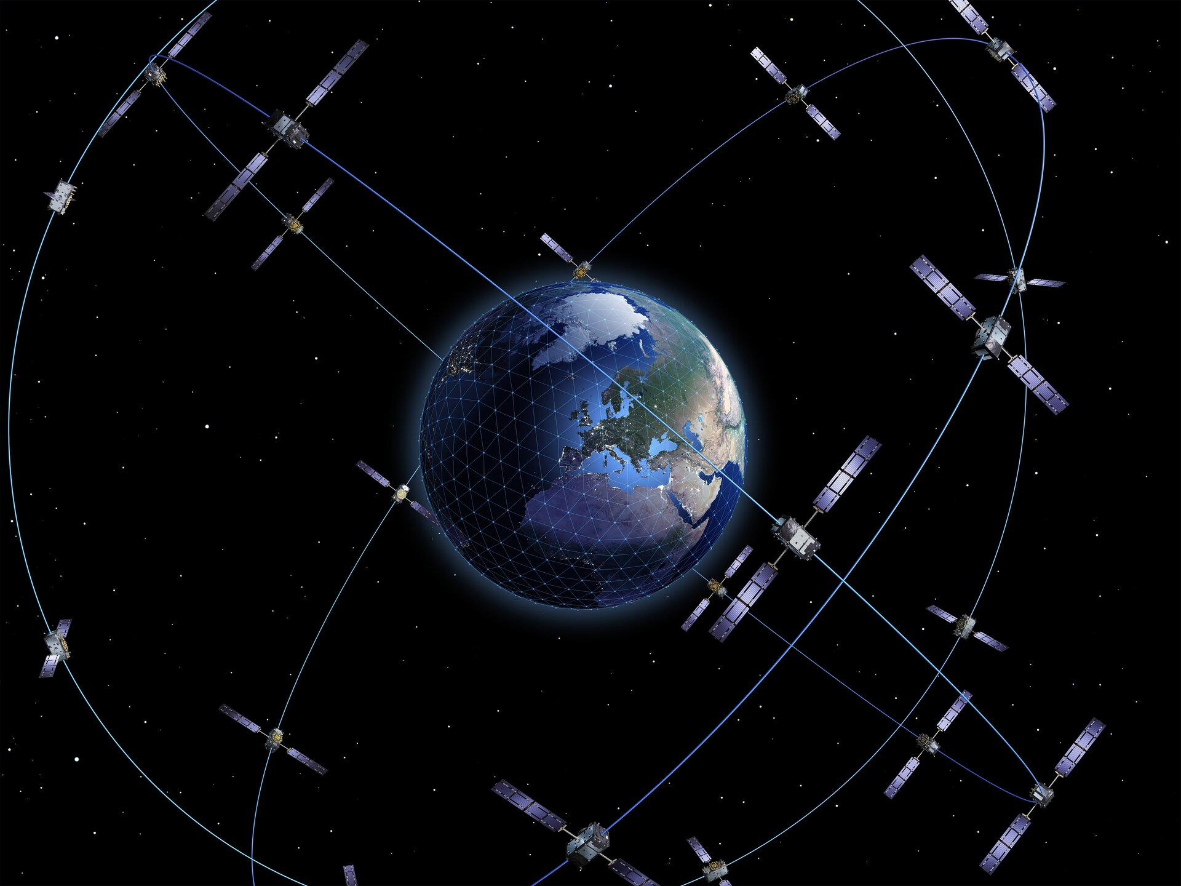

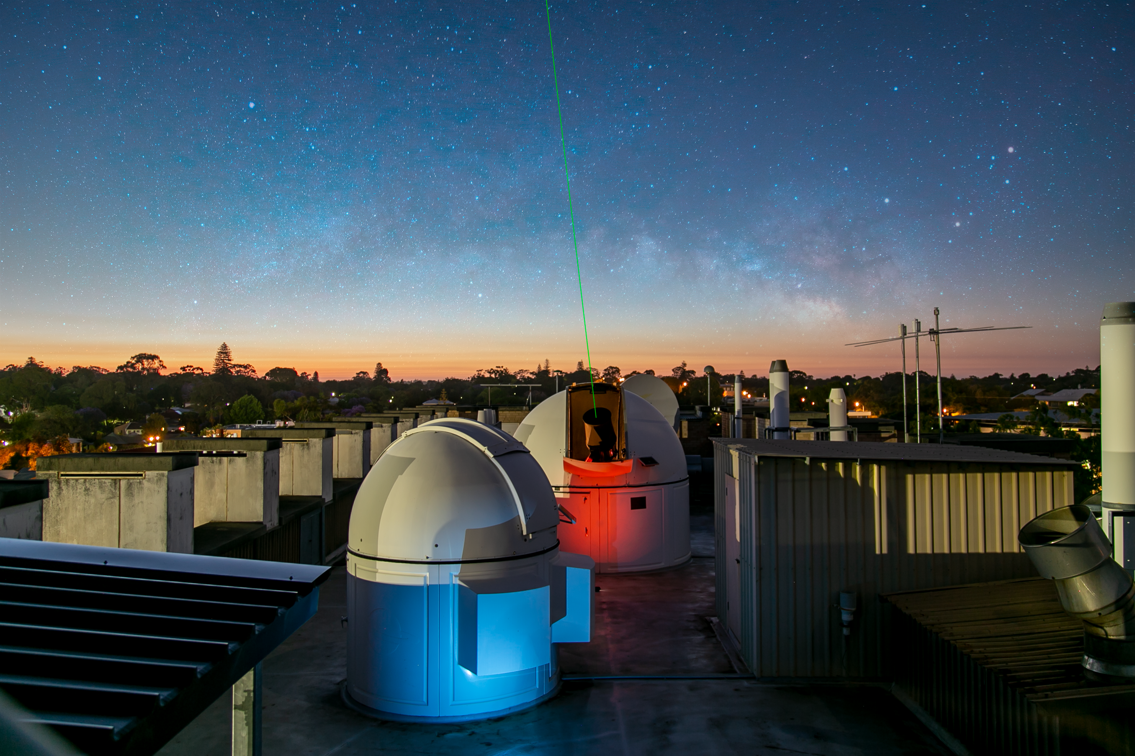
Introduction
GNSS TT
Two way satellite TT
VLBI TT
optical fibre
free space optical
Notes:
Whether you’re running a national timescale or developing a state of the art frequency standard, being able to compare your standards with others around the world can be essential.
In this lecture, I’m going to talk about some of the ways you can do this and show you what the state of the art is.
The five techniques I’m going to cover are GNSS, two way satellite time-transfer, VLBI, optical fibre and free space optical links.
I won’t be talking about ethernet-based methods like Precise Time Protocol.

Slide 3
Taxonomy of time transfer methods
1. One way methods
2. Two way methods
3. Common view methods
See Levine Metrologia 45 S162 2008 for a good general introduction
Notes:
You can classify time-transfer methods into three broad classes, according to the relationships between the receivers and sources of time.
These are one way methods, two-way methods and common-view methods.
I will now describe these in a little more detail.

Slide 4
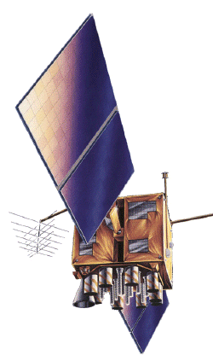
One way methods
communication channel
delay δ_{BA}
clock difference Τ_{AB} = A - B
source B
receiver A
TIC
A
B
TIC_{AB} = Τ_{AB} + δ_{BA}
Synchronization of a
GNSS receiver
geometric delay
ionosphere
troposphere
Rx
GNSS satellite
GNSS receiver
GNSS = Global Navigation Satellite System (GPS, GLONASS, BeiDou, Galileo)
Notes:
In one way methods, there is a source of time information B which is used to synchronize a receiver A over some one-way communication channel.
[1] Supposing the difference between the two clocks is T_AB then a time interval counter at A
[2]measures this difference plus the one way delay deltaBA.
To set the time on the receiver, we need to estimate this delay by some means.
Even if we are only interested in frequency, it may still be desirable to have a means of compensating for the delay when the delay is varying.
[3] An example of one way time transfer is the operation of a GNSS receiver.
The communication channel is a microwave signal propagating from space to the ground.
Timing information in the signal from the satellite is used to synchronize the receiver.
The satellite broadcasts a model of its orbit so that the varying geometric delay can be estimated once the receiver position is calculated.
Other varying delays that need to be estimated are those due to the troposphere and ionosphere.

Slide 5
Two way methods
δ_{AB}
δ_{BA}
receiver/source A
receiver/source B
clock difference Τ_{AB} = A - B
clock difference Τ_{BA} = B - A = - Τ_{AB}
TIC
A
B
TIC
B
A
Two-way satellite time and frequency transfer
TIC_{AB} = Τ_{AB} + δ_{BA}
TIC_{BA} = Τ_{BA} + δ_{AB}= - Τ_{AB}+ δ_{AB}
TIC_{AB} - TIC_{BA} = 2 Τ_{AB} + δ_{BA} – δ_{AB}
Τ_{AB} = (TIC_{AB} – TIC_{BA} )/2
Notes:
In two way methods, both stations are source and receiver, each making measurements against the other.
We have two delays, which are not necessarily the same.
[1] First suppose that the time difference between the two stations A – B is T_AB, measured with respect to A’s clock, so a positive value means that A leads B.
Station B would say the difference is T_BA which is just the negative of T_AB.
[2] Suppose station B sends a signal to station A. Let’s suppose it’s a one pulse per second tick.
The signal is delayed by delta_BA and measured by the station A against its own pulse per second tick
[3] It measures a time interval that is the offset plus the delay
Suppose now that the process is repeated, but with A and B interchanged.
[4] Station B measures something similar
[5] If Station A and B now send each other their measurements, they can compute the time difference between their clocks.
The difference of the two time interval measurements is just this …
If the delays are symmetric, the two delays cancel and the clock offset T_AB is just half of the difference of the two counter readings.
[6] Two way satellite time and frequency transfer is an example of this method. Here, signals are exchanged via a communications satellite in geostationary orbit.

Slide 6
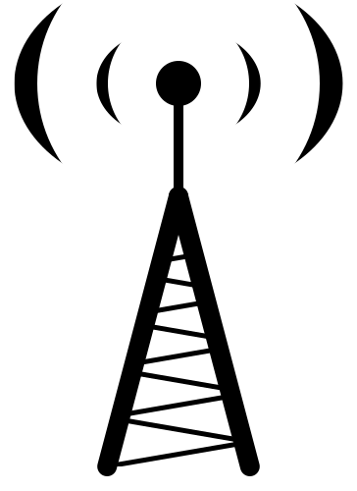
Common view methods
δ_{CA}
δ_{CB}
receiver A
source C
receiver B
clock difference Τ_{AC} = A - C
clock difference Τ_{BC} = B - C
A
TIC
B
TIC
C
C
TIC_{AC} = Τ_{AC} + δ_{CA}
TIC_{BC} = Τ_{BC} + δ_{CB}
TIC_{AC} - TIC_{BC} = Τ_{AC} – Τ_{BC} + δ_{CA} – δ_{CB}
= Τ_{AB} + δ_{CA} – δ_{CB}
Τ_{AB} = (TIC_{AC} - TIC_{BC} ) – (δ_{CA} – δ_{CB})
radio transmitter
eg WWW-B
Notes:
In the common-view method, the two stations measure their clock with respect to a common clock, here the source ‘C’.
[1] At station A, the clock difference is T_AC and the time interval counter measures this difference plus a delay
[2] Station B measures something similar
[3] If we combine the two time interval measurements, we get a term T_AC – T_BC, which reduces to T_AB, the difference of the two stations, plus a term involving the two one-way delays.
[4] An example of common view is the use of the timing signal broadcast by a radio station.
One significant advantage of the common view method is that an arbitrary number of stations can participate, unlike two way methods, which do not scale as easily.

Slide 7
GNSS time transfer
Credit: Galileo
Common View/All in View/Precise Point Positioning
Notes:
GNSS time transfer has been used for comparing remote clocks pretty much since the beginning of the first GNSS system, GPS.
Most of the national metrology institutes that participate in Co-ordinated Universal Time use GPS for their main link to UTC.
It was initially implemented as a common-view method because the timing receivers of the day could only track one satellite at a time.
As the capabilities of receivers improved, other methods of using GNSS came into use, including the All in View method and Precise Point Positioning
I’m going to go into a little bit more of the nuts and bolts on this topic because for most people, GNSS time-transfer is the most practical method at present.

Slide 8


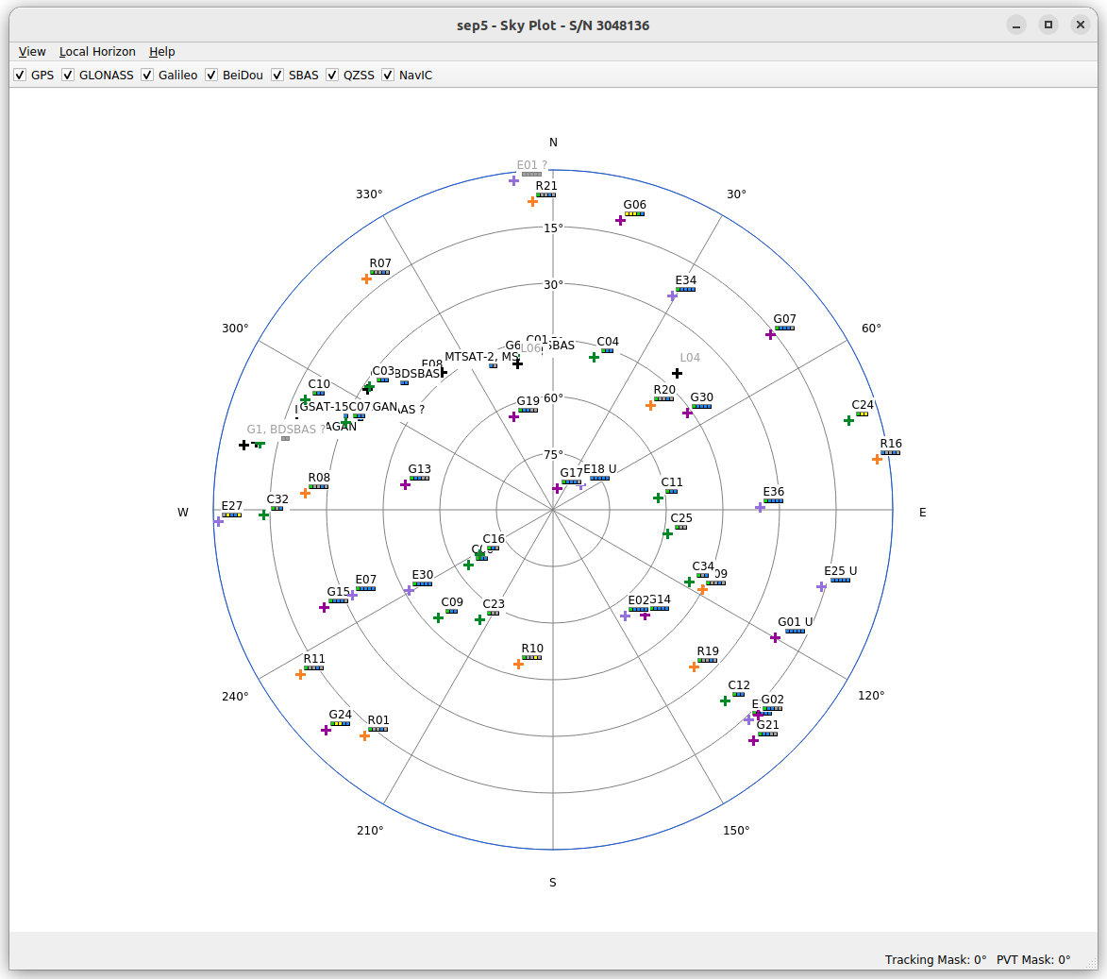


Global Navigation Satellite Systems (GNSS)
GPS (USA)
- operational since 1993
GLONASS (Russia)
- operational since 2011
BeiDou (China)
- operational since 2012
Galileo (EU)
- 23 satellites
- full service 2023?
63 SV tracked
44 in PVT solution
Notes:
There are four GNSS constellations that can be used for time transfer, at least in principle.
GPS was the first of these, with the first launch in 1978 and with full operation in 1993.
GPS is the system most commonly used for time-transfer today.
The Russian system GLONASS also became operational in 1993 but went through a long period where it was not well –maintained, but was brought back into full operation again in 2011.
The Chinese system BeiDou has been operational for 11 years, and the European system Galileo is now almost complete.
Galileo is now officially in use in for UTC time-transfer links and can give better performance than GPS in some modes, but this advantage may change with upgrades to the GPS system that are in progress.
There is work ongoing to incorporate BeiDou in UTC links.
There are some technical difficulties with using GLONASS that have slowed its use in time-transfer.
[1] The sky plot at the right shows satellites being tracked by one of our timing receivers.
It’s tracking 63 space vehicles, of which 44 are being used to generate a Position Velocity Time solution.
If you have sharp eyes, you’ll see a few other constellations that I didn’t mention – SBAS, QZSS and NavIC – these are regional systems intended to improved and augmented positioning services over a particular geographic region.
QZSS for example, is a Japanese system.

Slide 9
Principle of GNSS common-view time transfer
SV (Space Vehicle)
ionosphere
troposphere
δ_{A}
δ_{B}
A
B
Rx
Rx
T_{A} = A – (SV + δ_{A})
T_{B} = B – (SV + δ_{B})
A – B = Τ_{A} + (SV + δ_{A}) – [Τ_{B} + (SV + δ_{B})]
= Τ_{A} – Τ_{B} + (δ_{A} – δ_{B})
Notes:
Let’s look at common-view time-transfer again, but this time using GPS in the role of time source.
Each GPS satellite has an atomic clock on board that generates timing signals that are transmitted from Medium Earth Orbit, about 20000 km or 70 ms away, down to a receiver on the ground.
[1] Apart from the motion of the satellite, there are continuously varying delays due to the ionosphere and troposphere.
The receiver on the ground converts these timing signals into something that can be compared with the local clock and we get a difference with respect to the satellite’s clock, with delays and offsets.
In common view, some of the delays in this term here (deltaA – deltaB) will cancel out substantially.
For example, on a 100 km baseline, the difference in the estimated ionospheric delay is just a few tenths of a nanosecond.

Slide 10
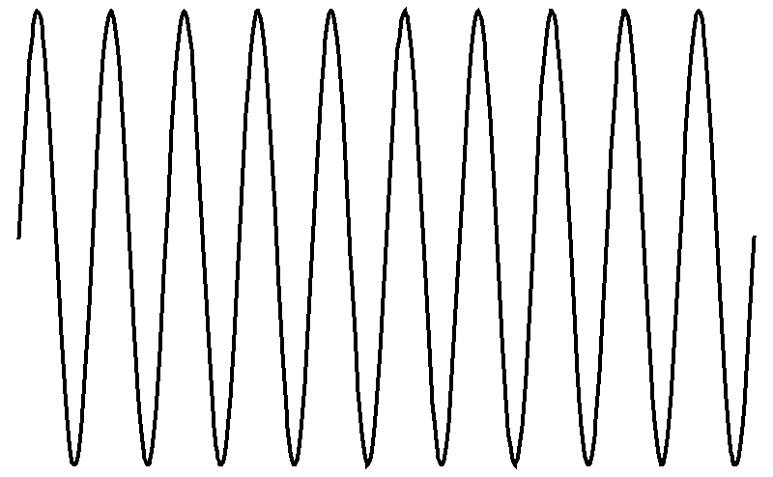
GPS timing signals
L1 carrier: 1.575 GHz
modulated by
C/A code: 1 MHz pseudo-random noise (PRN) sequence, repeating every 1 ms
L1: 1.575 GHz
L2: 1.227 GHz
L5: 1.176 GHz
modulated by
GPS data: 50 bits/second
Notes:
To understand the timing capabilities of a GNSS receiver ikt’s useful to know something about the timing signals that are available.
I’ll use GPS as an example.
The first generation of satellites transmitted on two frequencies, L1 and L2.
The purpose of this is to make a measurement of the ionospheric delay, by taking advantage of the dispersion in the ionosphere.
There’s a newer signal at L5 too.
[1] The first timing signal we have is from the microwave carrier; we can measure its phase but of course there’s an N-cycle ambiguity in this measurement.
[2] The carrier is modulated by a pseudo random noise sequence.
For the C/A code, this is clocked at 1 MHz and repeats every 1 millisecond.
This is the so-called ranging code.
Each satellite has a unique PRN sequence or code, and these have the mathematical property that their correlation with each other is low and bounded.
This allows a particular satellite’s signal to be extracted by performing a correlation with a locally generated copy of the code.
The time shift of the generated copy with respect to the incoming code gives a delay between the receiver’s clock and the satellite clock.
This gives a lower resolution timing signal than the carrier phase, but the N millisecond ambiguity can be resolved relatively easily.
[3] Finally, the GPS data stream is modulated on top of this.
The data stream provides information to the receiver about satellite orbits and clocks.

Slide 11
GNSS timing receivers and measurements
comm port
RINEX* OBS
Rx
code measurements
resolution 500 ps
1 pps
10 MHz
1 pps
1 pps
Rx
code measurements
resolution 500 ps
RINEX* OBS
pps sawtooth
phase measurements
TIC
resolution 20 ps
*RINEX = Receiver Independent Navigation Exchange
Notes:
So, as we saw in the last slide, there are two kinds of measurements that the GNSS receiver can report: carrier phase and the PRN code delay.
These measurements are reported by the receiver with respect to its own, internal clock.
Depending on the capabilities of the GNSS receiver, there are two ways the measurements can be used for time-transfer.
Low end timing receivers will have a one pulse per second timing output that can be measured against the 1 pps of your clock using a counter.
Provided that the relationship between the receiver 1 pps and the raw measurements of individual satellites is known, the offset between the local clock
and each SV clock can then be obtained.
The measurements can be recorded in a RINEX observation file, a standard file format used in the geodesy community.
It only makes sense to use the PPS for the code measurements, which have a resolution of about half a nanosecond.
This is because the receiver’s physical clock, which is used to generate the 1 pps, is a crystal oscillator with a frequency of say 50 MHz or a period of 20 ns.
Typical receivers are designed to place the 1 pps with the resolution of this clock, or about 20 ns.
[1] What you then see if you compare the receiver 1 pps with a stable reference is a sawtooth, as the receiver clock drifts and then periodically steps the 1 pps to keep it approximately aligned.
Now, the receiver knows what the difference is between the output 1 pps and the true time, so it can output this information continuously, and you can process this information to correct the
measurements made by the counter. This is the red line in the plot. However this is still noisy at the level of a nanosecond which is why the carrier phase measurements are not useful: their high resolution is washed out in the noise in the 1 pps.
This method was used in the first GPS time-transfer systems, but has been superseded by more capable GNSS receivers.
[2] The principle improvement in these receivers is to have inputs for 1 pps and 10 MHz and to use these as the reference for making measurements, rather than the internal crystal oscillator.
This means that the higher resolution of the carrier phase measurements is now useable and this is at least an order of magnitude better than that available from the code measurements.
[The availability of carrier phase measurements also means that the antenna position can be determined to a few cm by the receiver, for accurate determination of the geometric delay.]

Slide 12

RINEX data processing
broadcast clock & orbit products
ionosphere model
troposphere model
CGGTTS
CGGTTS processing
code
eg r2cggtts
CGGTTS = Common GNSS Generic Time Transfer Standard
RINEX OBS
eg Bernese, GipsyX (JPL), CSRS PPP online service
PPP processing
code + phase
RINEX CLK
IGS clock & orbit products
troposphere model
meteorological data
PPP = Precise Point Positioning
antenna model
Notes:
Once you have a RINEX observation file, it needs further processing to generate a file with useful timing information.
Remember, all we have is raw time offsets from the receiver and these need to be corrected for various delays and offsets.
One processing method results in a so-called CGGTTS time-transfer file.
CGGTTS processing uses the code measurements only.
The CGGTTS standard specifies how the various corrections such as for the ionosphere and troposphere delays, must be made.
In particular, it specifies the use of the broadcast clock and orbit products for GNSS satellites.
The broadcast products are predictions that are transmitted by each GNSS satellite and are limited in their accuracy.
For example, broadcast orbits have an accuracy of about 1 metre.
The software typically used is a program called r2cggtts, which unfortunately is not openly available.
Some manufacturers of timing receivers also provide software with their receivers for generating CGGTTS files.
[1] The currently favoured method for processing is PPP.
PPP stands for Precise Point Positioning and has been adapted from a technique used in the geodesy community.
PPP principally uses the carrier phase measurements.
Crucially though, it can be used with very accurate post-processed orbit and clock products, which are based on measurements made on the satellites by a network of ground stations.
The downside is latency, which is two weeks for the final products.
The software to do this is complicated and requires quite a bit of effort to set up.
One commonly used program is Bernese, available from the University of Bern.
An easier alternative is the Canadian CSRS online PPP service.
All you need to do with this is to upload your RINEX observation files.
It’s free.

Slide 13
CGGTTS analysis – CV and AIV
Common View
SAT CL MJD STTIME TRKL ELV AZTH REFSV SRSV REFSYS SRSYS DSG IOE MDTR SMDT MDIO SMDI MSIO SMSI ISG FR HC FRC CK
hhmmss s .1dg .1dg .1ns .1ps/s .1ns .1ps/s .1ns .1ns.1ps/s.1ns.1ps/s.1ns.1ps/s.1ns
G07 FF 60164 000200 780 631 1636 -1017529 +101 4390 -8 24 38 91 +0 162 +12 162 12 18 0 0 L3P 1F
SAT CL MJD STTIME TRKL ELV AZTH REFSV SRSV REFSYS SRSYS DSG IOE MDTR SMDT MDIO SMDI MSIO SMSI ISG FR HC FRC CK
hhmmss s .1dg .1dg .1ns .1ps/s .1ns .1ps/s .1ns .1ns.1ps/s.1ns.1ps/s.1ns.1ps/s.1ns
G07 FF 60164 000200 780 631 1636 -1017518 +96 4401 -13 24 38 91 +0 157 +21 157 21 23 0 0 L3P 23
All in View
SAT CL MJD STTIME TRKL ELV AZTH REFSV SRSV REFSYS SRSYS DSG IOE MDTR SMDT MDIO SMDI MSIO SMSI ISG FR HC FRC CK
hhmmss s .1dg .1dg .1ns .1ps/s .1ns .1ps/s .1ns .1ns.1ps/s.1ns.1ps/s.1ns.1ps/s.1ns
G04 FF 60164 000200 780 251 395 -1184972 -86 4438 +27 26 123 190 +47 298 +23 298 23 17 0 0 L3P 71
G05 FF 60164 000200 780 111 2282 +1383890 -60 4476 -74 62 99 412 -71 269 +77 269 77 54 0 0 L3P 7D
G07 FF 60164 000200 780 631 1636 -1017518 +96 4401 -13 24 38 91 +0 157 +21 157 21 23 0 0 L3P 23
G08 FF 60164 000200 780 401 1030 +1365152 +24 4458 +6 23 31 126 +2 209 -12 209 -12 18 0 0 L3P 1C
G09 FF 60164 000200 780 557 305 +927918 -99 4454 -2 17 52 98 +9 168 +31 168 31 16 0 0 L3P 20
G14 FF 60164 000200 780 425 3052 -1466981 -167 4431 -50 24 161 120 -15 194 +26 194 26 22 0 0 L3P 76
G20 FF 60164 000200 780 182 2579 -4179819 -82 4452 -103 42 4 256 +18 268 +133 268 133 38 0 0 L3P 92
G27 FF 60164 000200 780 176 1342 +184311 +182 4439 +113 60 45 265 +56 336 -26 336 -26 49 0 0 L3P 7D
Notes:
To perform time-transfer using CGGTTS, we can either do common-view or all in view.
For common view, what we need to do is make a time series, matching satellites at each track time between two files.
We can then either use REFSV or REFSYS to calculate a clock difference.
[REFSV is the difference between the lab clock and the satellite clock.
REFSYS is the difference between the lab clock and the GNSS system time]
It may be necessary to match on ephemeris too [ephemeris contains orbit and clock models], `since different software may make different choices about use of ephemeris.
We can then make an average of the clock differences at each track time. This could be weighted, for example, by elevation.
Measurements at low elevation tend to be noisier.
[1] All-in-view is used on long baselines, say greater than 5000 km, where the number of satellites in common view is starting to drop.
For all-in-view, we make an average at each track time and then take the difference of the two averages.
In order to average the measurements, they need to be referred to a common time scale so we have to use REFSYS in this case.

Slide 14
Stability of GNSS time-transfer on 5800 km baseline
Time history
Frequency stability
Time stability
Notes:
This is probably a good time to compare the processing methods we’ve been discussing.
I’ve used UTC data on the BIPM ftp server from NPLI in India and NICT in Japan, a baseline of about 5800 km.
Both NPLI and NICT have steered time scales derived from a hydrogen maser.
You can see in the time series data that the code-based methods (in red and blue) are very noisy compared with the PPP data (in yellow).
[Even noisier than they appear – PPP is averaged over 5 minutes, CGGTTS over 13 minutes]
The performance comparison is a bit clearer if you look at ADEV and TDEV.
There’s actually not a lot to pick still between all in view and common view, even on this very long east-west baseline.
The PPP though is clearly the winner though at averaging times of less than a few days.
[The bump in ADEV may be due to steering of the local UTC(k).]

Slide 15
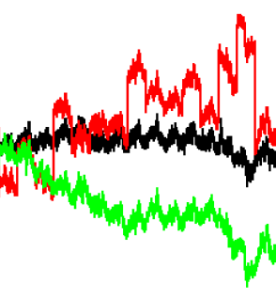
Current research – improved PPP
Common clock comparison
Frequency stability
-0.4
IPPP*
0.2
time difference (ns)
0
-0.2
__ PPP
__ aligned PPP
__ Integer PPP (IPPP)
-0.4
0
5
10
15
t (days)
Adapted from Huang et al Sensors 19 p4389 2019
* from Petit et al Metrologia 52 p301 2015
Notes:
There’s a well known problem with PPP.
If you calculate PPP solutions in daily batches say, you will see jumps at the day boundaries.
You can see this in the plot here, in the data in red.
This is common clock data, ie two co-located receivers referenced to the same clock.
If everything was working perfectly, the difference between the two PPP solutions should be a straight line.
Instead, we see jumps of a few hundred ps at each day boundary.
You might think of estimating the step at each jump and joining up the data sets.
But this doesn’t quite work.
The data in green shows the result of trying this – there is drift in the time difference, corresponding to a frequency offset of a few parts in 10^16.
The source of the boundary jumps is not completely understood, but is generally thought to be due to accumulation of errors in the clock solution.
This also suggests that you don’t win by extending the duration of the processing run.
One solution to mitigate the boundary jumps recognizes a problem with standard PPP.
The carrier phase is ambiguous by N cycles of the carrier frequency and this ambiguity has to be solved for.
Standard PPP allows N to float, rather than be constrained to an integer.
This tends to feed in noise from other corrections that are made, such as the troposphere delay.
If you modify the PPP processing to constrain N to be an integer, you get something like the data in black.
The daily jumps are significantly reduced.
[1] Looking at our ADEV plot again, we can see a significant improvement.

Slide 16
A challenge
Frequency stability
Cs beam
IPPP
cold Rb
CSO
active H-maser
NIST Al⁺
Notes:
GNSS is the workhorse time-transfer method for UTC.
For the common clocks in UTC, like a Cs beam standard, or active H-masers, IPPP is good enough with a day’s averaging.
But, it just doesn’t cut it for optical clocks.
If we look at the ADEV of the NIST aluminium ion clock, there is still two orders of magnitude too much noise, even after two weeks of averaging.
Something better is needed if we want to compare remote optical clocks.

Slide 17
Two-way satellite time transfer
4.6 m C-band antenna at NMI, Sydney
Notes:
Currently, two kinds of time links used in the construction of UTC.
GNSS links are the most common but there is also another kind of link that I’ll talk about now: two-way satellite time transfer.

Slide 18
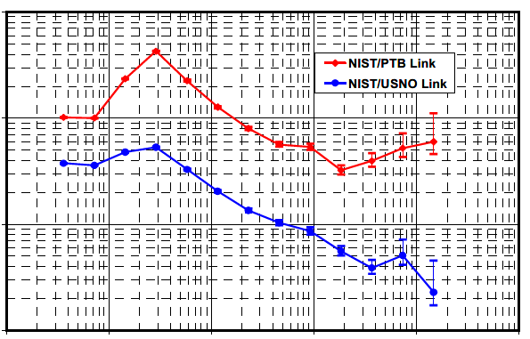
Principle of TWSTT
Asymmetries - ionosphere
uplink 14.2 GHz
downlink 11.4 GHz
geostationary
comms satellite
Modelled ionospheric delay asymmetry
δ_{BA}
100
NIST/PTB
NIST/USNO
δ_{AB}
10
TDEV (ps)
A
B
1
modem
modem
0.1
10³
10⁴
10⁵
10⁶
10⁷
10⁸
averaging time (s)
TIC_{AB} - TIC_{BA} = 2 Τ_{AB} + δ_{BA} – δ_{AB}
Τ_{AB} = (TIC_{AB} – TIC_{BA} )/2
Adapted from Parker et al Proc. IFCS 2005 p745
Notes:
Two way satellite time-transfer requires the use of a communications satellite in geostationary orbit to transmit signals between the two stations.
The timing signals from the station clock are converted into something suitable for transmission and reception by a special modem.
As usual with two way methods, we hope for cancellation of the one-way delays deltaBA and deltaAB.
It’s not perfect of course.
For example, one source of asymmetry results from the uplink and downlink frequencies being different.
Typical links operate in the Ku band, woth uplink at 14.2 GHz and downlink at 11.4 GHz.
Differences in the ionosphere seen by A and B mean that the one way delays are not quite the same.
If you model the asymmetry, you can see diurnal variations of up to 40 ps on very long links like the NIST/PTB link.
[Others: barometric pressure, sensitivity of equipment to temperature variations …]
The advantages over GNSS time-transfer are better short term stability, data are available near real time and the uncertainty of the calibrated delay can be smaller.

Slide 19
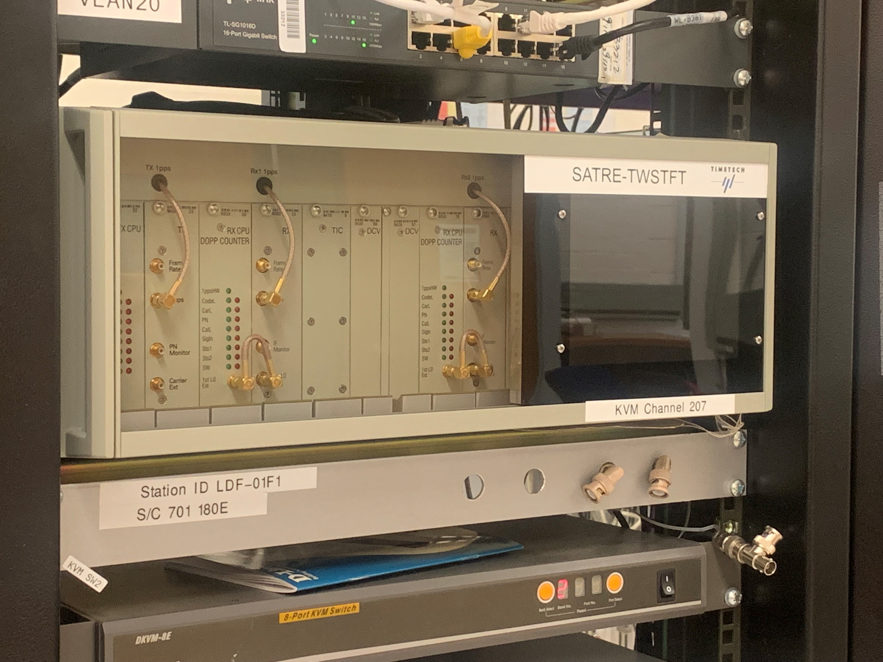
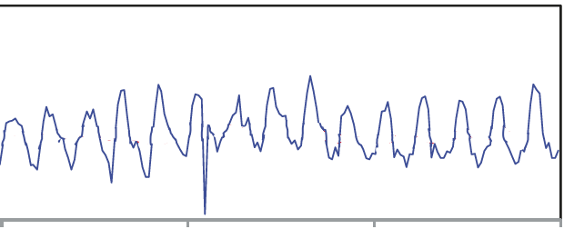
TWSTFT modem and performance
AOS-PTB TWSTT link
6
3
Τ (ns)
0
-3
57800
57805
57810
57815
MJD
Adapted from Jiang et al Metrologia 55 p685 2018
Notes:
For a long time, there has really been only one modem available for TWSTT, the SATRE modem.
As a technical aside, the modem works by transmitting a PRN signal, just like GPS.
TWSTT with this modem can show diurnal variations of up to a few ns, as shown in the data here for the relatively short link between PTB and AOS (in Poland).

Slide 20
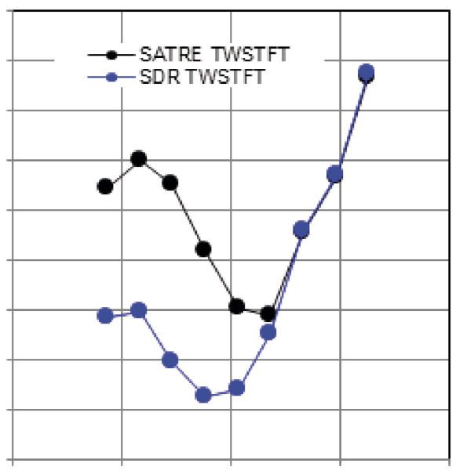
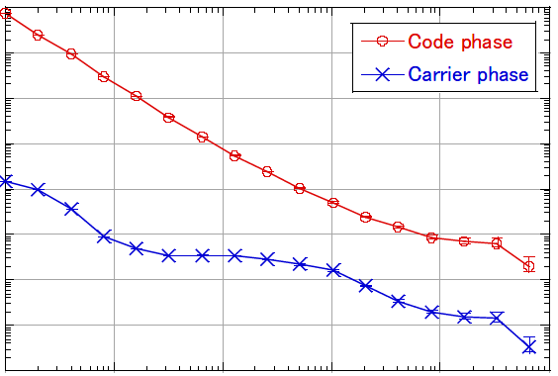
Current research
TL (Chinese Taipei) – SDR modem
OP-PTB link
NICT (Japan) – carrier phase modem in common clock
10⁻⁹
1
10⁻¹¹
0.4
TDEV (ns)
Frac. MDEV (Hz/Hz)
10⁻¹³
0.1
10⁻¹⁵
NIST Al⁺
0.04
10⁻¹⁷
10³
10⁴
10⁵
10⁶
10⁷
1
10
100
10³
10⁴
10⁵
averaging time (s)
averaging time (s)
Adapted from Jiang et al Metrologia 55 p685 2018
Adapted from Fujieda et al Proc IFCS EFTF 2019
Notes:
One possible source of the diurnal variations that has been identified is in the electronics in the receive side of the modem.
This has been investigated using a software defined radio (SDR).
The incoming signal is digitized and then all subsequent processing is in software.
Processing in software allows easy changes to algorithms and easy optimization.
The data shown here for the link between OP in Paris and PTB show a reduction in the diurnal of about a factor of 3.
The improvement on much longer links (Europe-USA) is not so large; only about 30%.
There is also ongoing research into improving the resolution of TWSTT.
The simplest thing you could do is increase the chip rate of the ranging signal, but this requires proportionately more bandwidth,
and the cost of the satellite link is also proportional to bandwidth.
[1] Another thing you can do is to use the carrier phase for a timing signal, just like in GNSS time-transfer.
NICT have been developing a modem that uses the carrier phase for timing measurements.
In common-clock, the improvement over code-based time-transfer is a factor of 10000 at short averaging times.
It’s still an order of magnitude from where we’d like to be with respect to optical clock stability though.
[nb for NIST Al+ clock, MDEV is scaled from ADEV – white FM]

Slide 21
Very Long Baseline Interferometer (VLBI) time-transfer
Parkes radio telescope, Australia
Notes:
Very Long Baseline Interferometry (VLBI) is used in radio astronomy to improve the angular resolution of radio astronomical observations.
As a byproduct, these measurements can also be used to compare clocks, as we will see.

Slide 22
Principle of VLBI
extragalactic radio source
geometric delay
ionosphere
troposphere
equipment
radio source structure
D
digitizer
digitizer
correlation processor
Notes:
Here the two stations are observing some very distant radio source like a pulsar.
The incoming (multichannel) signal is digitized, stored and then sent off to the correlation processor.
This correlation process results in the time offset between the two signals.
This all requires good clocks at each station, typically a H-maser.
Similarly to GNSS time-transfer, if you then make corrections for the ionosphere, geometric delay, equipment delays and so on, you can get the offset between the two clocks.
One advantage of VLBI is that uses a universally accessible signal, unlike GNSS and TWSTFT, where you are at the whim of the respective satellite operators.

Slide 23
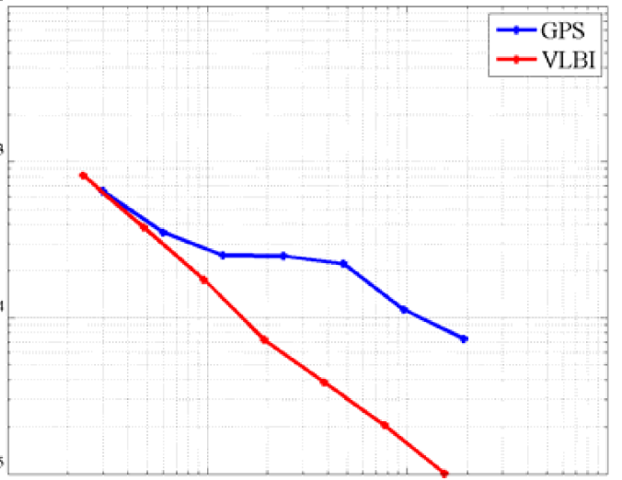
Stability
10⁻¹²
GPS PPP
VLBI
Onsala –Wettzell (920 km)
10⁻¹³
frac. MDEV (Hz/Hz)
Same data show GPS/VLBI time difference of +/- 200 ps
10⁻¹⁴
10⁻¹⁵
10²
10³
10⁴
10⁵
averaging time (s)
Adapted from Takiguchi et al Proc EFTF 2008
Notes:
I’ve reproduced here some comparative data here for GPS PPP and VLBI time-transfer on a 920 km link between stations in Onsala, Sweden and Wetzell in Germany.
It shows the VLBI link outperforming GPS at longer averaging times by a factor of 5 or so but you should probably take this with a grain of salt.
The performance obtained varied a lot between data sets, and depended on the receiver in use and so on.
It’s probably fair to say that VLBI as used at the time of this study in 2008 and GPS have about the same performance, on average.
There are some prospects for improvement though, as we’ll see in the next slide.

Slide 24
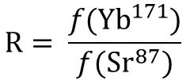
Current research
fixed hub
portable node
portable node
B
C
A
A - B
B - C
INRIM
Yb¹⁷¹ lattice
NICT
Sr⁸⁷ lattice
 | R/R₀ - 1 | u total / method
VLBI | +2.5E-16 | 2.8E-16 / 0.9E-16
IPPP | -3.2E-16 | 4.0E-16 / 2.6E-16
$$\text{R}= \frac{f({\text{Yb}}^{171})}{f({\text{Sr}}^{87})}$$
Pizzocaro et al Nat. Phys 2020
Notes:
NICT in Japan has been working on an improved and more flexible VLBI system, based on small, portable stations and a rather larger hub.
One improvement is increased bandwidth in the receiving system, which increases the precision of the delay measurement by a factor of 10.
Flexibility is achieved by the use of small portable stations, so that they can be readily co-located with the clocks being compared.
The purpose of the large hub is to bump up the SNR (1)
Roughly speaking, the scheme involves forming the baselines AB and BC, which then allows determination of the clock difference AC.
[1] The setup has been used to measure the ratio of two optical frequencies.
Transportable nodes were located in Italy and Japan, a baseline of 9000 km.
The hub was in Japan.
[The VLBI node in Italy was connected to a Yb lattice clock operated at INRiM by an 535 km long stabilised optical fibre link.
There appears to have been some practical reason why a VLBI node could not be directly located at INRIM.
The VLBI node in Japan was connected to a Sr lattice clock.]
[2] The VLBI measurements were compared with IPPP time-transfer.
[R0 is the accepted value of the frequency ratio]
The base uncertainty for the VLBI time-transfer is estimated to be a bit lower than for IPPP (extra uncertainty component is uncertainty in R0)
Paper suggests that technique has potential to reach a few parts in 10E17 at 10 days averaging time.
(1) Effective aperture is the geometric mean

Slide 25
Time-transfer over optical fibre (TTOF)
Notes:
So to summarise, we’ve looked at three techniques that involve the transmission of radio frequency signals: GNSS, TWSTFT and VLBI.
These have roughly the same level of performance currently, at least in their most advanced incarnations.
We now move on to methods based on transmission of an optical signal and the first of these utilises an optical fibre as the medium for the signal.

Slide 26


TTOF – one way methods
transmitter
optical fibre
photo-detector
phase detector
φ
10 MHz
1 pps
10 MHz
1 pps
$$τ=Ln/c$$
feedback
$Δτ=\frac{L}{c} \frac{∂n}{∂T} ΔT+Lα\frac{n}{c} ΔT+\frac{L}{c}\frac{∂n}{∂λ} Δλ$
thermal dependence of refractive index
chromatic dispersion
thermal expansion
40 ps K⁻¹ km⁻¹
0.2 ps K⁻¹ km⁻¹
Adapted from Sliwczynski J. Meas Sci Tech 21 p75302 2010
Notes:
Let’s first consider one-way time-transfer of a timing signal via an optical signal over a fibre.
The 1 pps or 10 MHz signal from the reference clock is used to modulate the intensity of a laser.
This could be directly, via the laser current, or by an electrooptic device.
The signal is transmitted over the fibre, received and converted back to an electrical signal by a photodetector.
The electrical signal is then compared with the output of the remote clock and used to synchronize it.
There is a delay in the optical fibre proportional to the fibre length L and the refractive index n.
This is about 4 microseconds per km.
This delay is not constant.
The refractive index changes with temperature as will the physical length of the fibre.
If the wavelength of the laser is changing, there will also be a delay variation due to chromatic dispersion in the fibre.
If you look at the relative size of the these effects, the thermal effects dominate.
(to estimate the chromatic dispersion, delta lambda = 0.1 nm was assumed, which is very modest).
It’s not too hard to see that once you get beyond a few km or so, you’re not doing too well.
GNSS time-transfer has a stability of a few hundred ps at an averaging time of a day and this is exceeded in a few km of fibre with just a couple of degrees of diurnal temperature variation.
So for long fibre runs, something needs to be done.

Slide 27
TTOF – two way – unstabilized link
circulator
φ
φ
Adapted from Sliwczynski J. Meas Sci Tech 21 p75302 2010
One implementation used SATRE modems to
modulate the laser and make the timing measurement
Piester et Proc 41st. PTTI 2009
Notes:
We can just measure the varying delays using a two-way method.
The idea is just the same as in the satellite-based two-way: each station transmits a signal to the other, which is measured against the local reference.
[Here, we’re presuming an RF signal modulated onto the laser.]
Combining the measurements allows cancellation of the delay and any variation in this delay, assuming symmetry.
[1] This kind of scheme has been implemented with TWSTT modems by using the modulated RF signal output by the modem to modulate a laser.

Slide 28
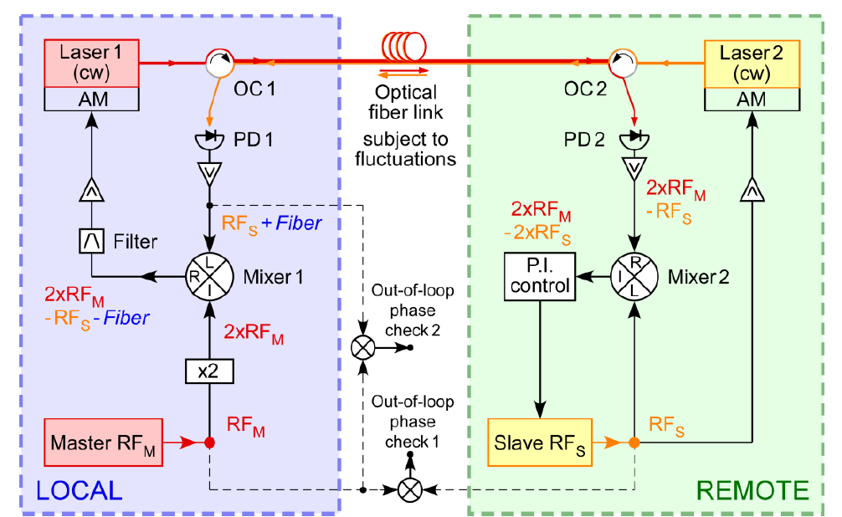
Principles of TTOF – two way – electronic stabilization
circulator
Φ_{Ν}
REMOTE
Φ_{Ν}
−Φ_{Ν}
feedback
feedback bandwidth ~ 1/round trip time
He Optics Express 21 p18754 2013
Notes:
To provide a stabilized RF signal to a remote user we can electronically stabilize the phase of the transmitted signal.
This signal accumulates noise PHI_N outbound and PHI_N on the way back.
The idea is that with some suitable scheme, the phase noise PHI_N can be extracted and subtracted from the outgoing signal, so that it arrives at the remote end with the noise compensated.
As ever, we depend on symmetry of the link for this to work.
This method is also called the phase conjugation method.
[1] Note that the bandwidth of the feedback we can apply is limited by the round trip time of the signal in the fibre.
For a 100 km run, the round trip time is about 1 ms, so the feedback bandwidth is limited to a few hundred Hz.
Notice that I’ve indicated the two lasers as having different wavelengths.
Ideally you would like the lasers to have the same wavelength to avoid chromatic dispersion but Rayleigh scattering of the red beam back into the detector
at A (or simply from joins in the fibre) can be a significant source of noise,
due to both beating of the backscattered light with itself and with the received signal.
This can be mitigated by separating the two lasers in frequency by a few tens of GHz.
[2] Here’s an example of a practical implementation, where an 80 MHz RF signal is transmitted from the LOCAL end and used to stabilize the frequency of an oscillator at the REMOTE end.
Extraction of the required phase correction requires no more than a suitable choice of frequencies, and RF mixers, multipliers and filters.
In practice, leakage in the mixers can cause problems, so you end up doing something a bit more elaborate to separate the various RF frequencies, but this is just more RF electronics
Rather nicely, you can also take a SDR approach, and do all of the signal processing in an FPGA.

Slide 29
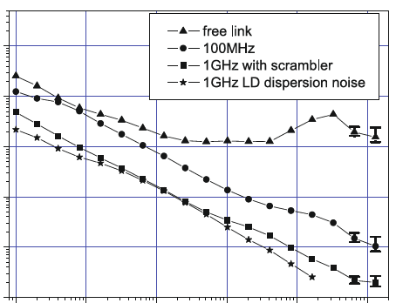
Principles of TTOF – two way – optical delay stabilization
adjustable
optical delay
φ
feedback
Adapted from Sliwczynski J. Meas Sci Tech 21 p75302 2010
86 km link between LPL and LNE-SYRTE in Paris
Optical delay line has two elements:
Fast feedback via a PZT stretched fibre (15 ps range)
Slow feedback via a heated fibre spool (6 ns range)
“scrambler” = polarization scrambler inserted after laser
10⁻¹⁴
frac. ADEV (Hz/Hz)
10⁻¹⁶
10⁻¹⁸
1
10
100
1000
10⁴
10⁵
averaging time (s)
Adapted from Lopez Eur. Phys J. D. 48 p35 2008
Notes:
Alternatively, the fibre link can be stabilized with respect to the optical carrier.
In this case, feedback is applied to stabilize the optical path length, rather than to the phase of the RF signal.
The phase detector provides a suitably conditioned error signal to the adjustable optical delay here.
[1] Here is some data from an 86 km link between LPL and SYRTE in Paris.
On the unstabilized link (orange), the fibre noise kicks in and limits the stability beyond an averaging time of about 100 s.
To stabilize the link, fast feedback is applied by stretching a fibre wound around a PZT tube.
Slow feedback is applied by heating a fibre spool.
Long term stability is then improved by a factor of 1000.
The data also show the benefit of running at a higher RF frequency.
The 1 GHz data are about 10 times better than at 100 MHz.
This is because at the higher frequency, the phase sensitivity is proportionately higher but the detection noise is about the same, so the SNR is then proportionately higher.
[LD dispersion noise is chromatic dispersion resulting from laser frequency fluctuations and is uncorrelated in the forward and return directions]

Slide 30
Transmission of a CW optical reference
Faraday mirror
Φ_{Ν}
REMOTE
AOM
Φ_{Ν}
−Φ_{Ν}
ultrastable cavity
feedback
φ
Notes:
So far, we’ve been considering transmission and stabilization of an RF signal modulated onto the optical carrier.
We can use the same phase conjugation idea as used in the RF domain to stabilize the frequency of the optical carrier.
[1] We have an extra requirement now though.
The laser needs to be stabilized to an ultrastable cavity because the link-delayed homodyne phase noise of the laser has to be negligible compared with the free-running fibre noise.
Light is returned to the local photodetector via a Faraday mirror. This forms the reference for detection of the phase of the returned light.
Essentially it’s an interferometer, with one short arm and one very long arm.
Feedback in this case is applied via an acoustooptic modulator, which shifts the frequency of the light.

Slide 31
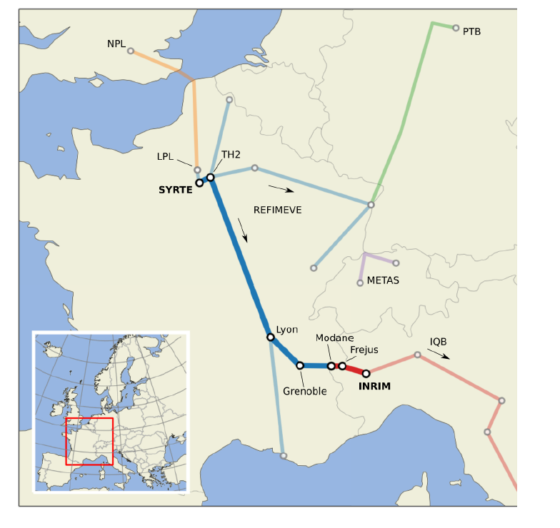
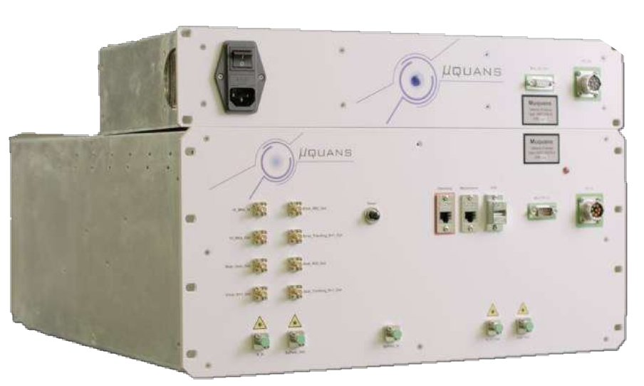
Current R&D: fibre networks
SYRTE
TH2
Lyon
Grenoble
Modane
Frejus
INRIM
11 km
597 km
RLS
118 km
RLS
143 km
RLS
7 km
RLS
147 km
MLS
MLS
MLS
RLS
RLS
φ
φ
φ
MLS = Multipoint Laser Station
Clivati et al Phys Rev Appl 18 054009 2022
REFIMEVE
Réseau Fibré Métrologique à Vocation Européenne
RLS = Repeater Laser Station
5 kHz linewidth diode laser
Notes:
There has been a significant effort over the past decade to establish permanent fibre networks,
both to facilitate comparisons of state of the art optical standards and to support applications of precise time and frequency signals like VLBI.
The map shows some of the fibre links that exist in Europe, in particular the French network REFIMEVE.
The first practical issue that has to be solved is the fibre itself. Sometimes unused ‘dark’ fibre is available,
but generally it is necessary to share fibres with data traffic on telecomms networks. Working in the standard telecomms
Band around1550 nm means that there is plenty of reliable, commercial hardware available but also mean that frequency combs will generally be needed for bridging to an
local optical clock.
Fibre noise cancellation methods require path symmetry so it is necessary to bypass
telecomms equipment that is installed along the fibre run.
This can be done with standard telecomms hardware.
The next technical issue that has to be addressed is attenuation loss in the fibre.
These losses amount to about 0.3 dB per km, so the power loss is a factor of 1000 every 100 km.
In the 1000 km link between SYRTE and INRIM, there is about 280 dB of loss.
Custom-built, bi-directional fibre amplifiers can be used, but these are limited in gain due to self oscillation that can occur because of scattering in the fibre.
Other methods that have been used for injecting power include via Stimulated Raman Scattering (SRS) and Stimulated Brillouin Scattering.
[1] Another solution is to regenerate the signal using a laser repeater station, using a link stabilization scheme like we saw a few slides back.
The link between SYRTE NRIM has four of these repeater stations.
There’s another advantage to doing this. The noise scales as L^3/2, so by breaking the link into N sections, the overall noise is reduced by sqrt(N).
There are also fibre amplifiers.
In the network diagram, there’s a secondary link that is used to verify the operation of the primary link.
When you lease fibre, you generally get a pair: one for receive and one for transmit, so the spare fibre is used for a secondary link.
There are some presentations next week on the REFIMEVE network.

Slide 32
Stability of optical frequency transfer
Cs beam
IPPP
cold Rb
CSO
active H-maser
Data from REFIMEVE – 540 km link
REFIMEVE
NIST Al⁺

Slide 33
Free space optical time-transfer
Credit: ICRAR, Perth Australia
Notes:
In numerous situations it may not be practical to operate a fibre link.
Free space, point to point links offer an option here.

Slide 34
Atmospheric turbulence
Beam wander
Scintillation
intensity
intensity
t
t
Optics/beam smaller than scale length of turbulence
Optics/beam larger than scale length of turbulence
Tip/tilt feedback to optics
(see UWA talk next week)
Notes:
Reception of and locking to a CW optical signal is disrupted by atmospheric turbulence.
There are two effects here:
[1] Beam wander occurs when the beam and optics are smaller than the scale length of the turbulence. This can result in complete loss of signal.
[2] Scintillation occurs when the beam is larger than the scale length of the turbulence. The beam can then interfere with itself, causing
rapid intensity fluctuations.
Beam wander can be addressed by simple tilt/tip feedback to the optics, to keep the beam stably pointed.
There’s a talk next week about this from UWA so I won’t say any more about this.
Another approach to the turbulence problem is to use pulsed signals, where a phase lock is much more robust against cycle slips because a cycle is now in the nanosecond regime, rather than in the femtosecond regime for a CW optical signal.
Or looking at it another way, if you want to estimate mean frequency offset from a sequence of time-interval measurements, it doesn’t matter if you miss a few.

Slide 35
Time Transfer via Laser Link (T2L2)
Jason 2 launched 2008
retroreflector array
+ onboard USO
+ detector
In CV, limited to about a 6000 km baseline
Estimated uncertainty of TT is < 0.1 ns (cf 1.5 ns for GNSS)
telescope
Samain et al Metrologia 52 423 2015
mode-locked Nd:YAG
100 ps
start
stop
Notes:
The setup here shows one scheme using pulsed signals that has been experimentally tested on the Jason 2 satellite, beginning in 2008.
A repetitively pulsed laser, in this case a frequency doubled, mode-locked Nd:YAG laser, produces a sequence of pulses that are transmitted up to a satellite.
The outgoing pulse is detected and time-tagged against the local clock.
The pulse is detected at the satellite and time-tagged against an onboard ultra-stable quartz oscillator.
A retroreflector on the satellite returns the pulse to the ground station where it is time-tagged against the local clock.
The difference between the START and STOP measurements at the ground station then gives the round trip time and the difference between the local clock and the satellite clock can be determined, making the usual assumption about path reciprocity.
You can do this is common view between two ground stations but like GNSS, you are limited by satellite visibility to a baseline of about 6000 km.
The baseline can be extended, with observations made by the ground stations at different times, with the practical limit of this depending on the stability of the satellite clock.
A detailed uncertainty budget for CV time-transfer indicates a practical uncertainty of about 0.1 ns which is significantly better than the 1.5 ns claimed for GNSS.
One disadvantage of this scheme is that it uses direct timing of the pulses, so it’s limited by such things as the photodetector rise time.
In particular, this results in at least picosecond level jitter, which means that the short term stability of an optical frequency standard cannot be accessed.
Accessing the short term stability of an optical clock demands achieving timing jitter at the femtosecond or better level and this can be done using optical frequency combs, as we will see in the next slide.

Slide 36

Optical TWTT with frequency combs
A
300 km round trip
B
retroreflector
Hawaii
Adapted from Caldwell et al Nature 618 721 2023
Maui
linear optical sampling*
time programmable fibre comb
f_{rep}
1/f_{rep}
1/δf
signal
signal
t
t
t
t
t
f_{rep} + δf
$\text{p}\text{ower} \text{penal}ty \sim \frac{\text{pulse} \text{width}}{\text{comb} \text{period}}= \frac{\text{400 }\text{fs}}{\text{4 }\text{ns}}=0.0001$
[*Invited talk: Q. Shen et al “Time and Frequency dissemination over 113 km free-space”]
Notes:
This is a recent experiment using combs for time-transfer, reported in Nature in June this year.
It’s an optical implementation of two way time transfer over a 300 km long round trip between the islands of Hawaii and Maui.
There are two stations A and B, each transmitting and receiving the other stations’ signal.
Additionally though, site B laser’s timing is locked to the site A laser through the two way link.
Co-locating the two stations enables an out of loop test of the quality of locking of B to A.
[1] One way to measure the time offset of two combs is to measure the incoming comb against another comb running at a slightly different repetition rate
so that the two combs slowly sweep in time with respect to each other. This technique is called “linear optical sampling”.
The resulting signal can be digitized and processed to determine the peak very precisely.
You get a reference for the measurement by doing the same thing with the outgoing comb.
There is lots of dead time in this.
During the slow sweep, you throw away the light from many pulses, until the two comb pulses are aligned in time briefly.
[2] The power penalty is given by the ratio of the pulse width to the period of the comb.
Plugging in some numbers for a typical Er fibre comb, we can see that we’re throwing away a lot of photons.
[There’s a talk next week on Thursday where this technique was used]
[3] An improved way to do this is to have a second comb that is used to track the incoming comb, so that all of the pulses are detected
rather than sampled at low duty cycle.
This requires a special comb, a so-called time programmable fibre comb.
Feedback is applied to this comb in such a way that timing of the comb pulses can be controlled to +/- two attoseconds.

Slide 37
Optical TWTT with frequency combs
A
300 km round trip
B
retroreflector
Hawaii
Maui
Site A measurements
B
optical timing discriminator
I
Kalman filter
100 mm aperture beam expander
tracking lock
Q
tracking TPFC
DCF
PBS
Two way
ultrastable laser
sync lock
signal processing
beacon laser
TPFC = time programmable fibre comb
Temporal placement of comb pulses is controllable to 2 attoseconds
Caldwell et al Nature 610 677 2022
clock TPFC
clock comb
out of loop verification
A
Adapted from Caldwell et al Nature 618 721 2023
Notes:
Station B looks like this; Station A is identical except that it doesn’t have the extra electronics that are used to lock the site B clock comb to site A.
A laser locked to an ultrastable cavity provides the optical reference for the two combs
The clock comb is transmitted to the remote site through a telescope.
Light from the remote site is collected by the telescope and passed to the optical timing discriminator, where it is combined with light from the tracking comb,
detected in balanced photo detectors and then filtered to produce an error signal to feed back to the tracking comb.
The Dispersion Compensating Fibre is necessary because the calibration of the optical timing calibrator depends on the laser pulse shape,
and the calibration is done on a zero length link. It then becomes necessary to compensate for the atmospheric dispersion to maintain the pulse shape.
Site B receives the one-way measurements made by Site A and feeds these into a lock that synchronizes the clock comb.
The synchronized clock comb can then be compared directly with the site A clock comb for an out of loop test.

Slide 38
Optical TWTT stability
Time stability
Frequency stability
10⁻¹²
10 fs
300 km
10⁻¹⁴
1 fs
300 km
TDEV
frac. MDEV
2 km
2 km
10⁻¹⁶
100 as
shorted fibre
shorted fibre
10⁻¹⁸
10 as
quantum limit
0.01
0.1
1
10
100
1000
0.01
0.1
1
10
100
1000
averaging time (s)
averaging time (s)
Adapted from Caldwell et al Nature 618 721 2023

Slide 39
Conclusion
Frequency stability
VLBI⁽¹⁾
GNSS IPP
GNSS
TWSTT
VLBI
Microwave
carrier
TWSTT CP
NIST Al⁺
Optical
carrier
optical fibre
free space
fibre ⁽²⁾
free space optical⁽³⁾
(1) assuming white phase noise
(2) REFIMEVE Paris-CERN link (920 km)
(3) Caldwell et al
Notes:
To summarize, we’ve looked at a number of time transfer methods that are in practical use or under development.
Broadly speaking we could group these by the carrier frequency in use.
[1] In the microwave domain, we talked about GNSS time transfer, two way satellite time-transfer and very long baseline interferometry.
[2] In the optical domain, we looked at time transfer over optical fibre and free space links.
[3] If we look at the stability of these methods, the microwave methods are unable to match the stability needed to take full advantage of the performance of optical clocks.
Only optical methods can really take best advantage of optical clocks.
All of the microwave methods can work over very long baselines.
Extending these optical methods to intercontinental baselines presents some practical challenges but progress is being made.
There have been some tentative steps towards testing long, undersea fibre links and the free space optical methods are keeping in eye the possibility of flying a station on a satellite.

Slide 40
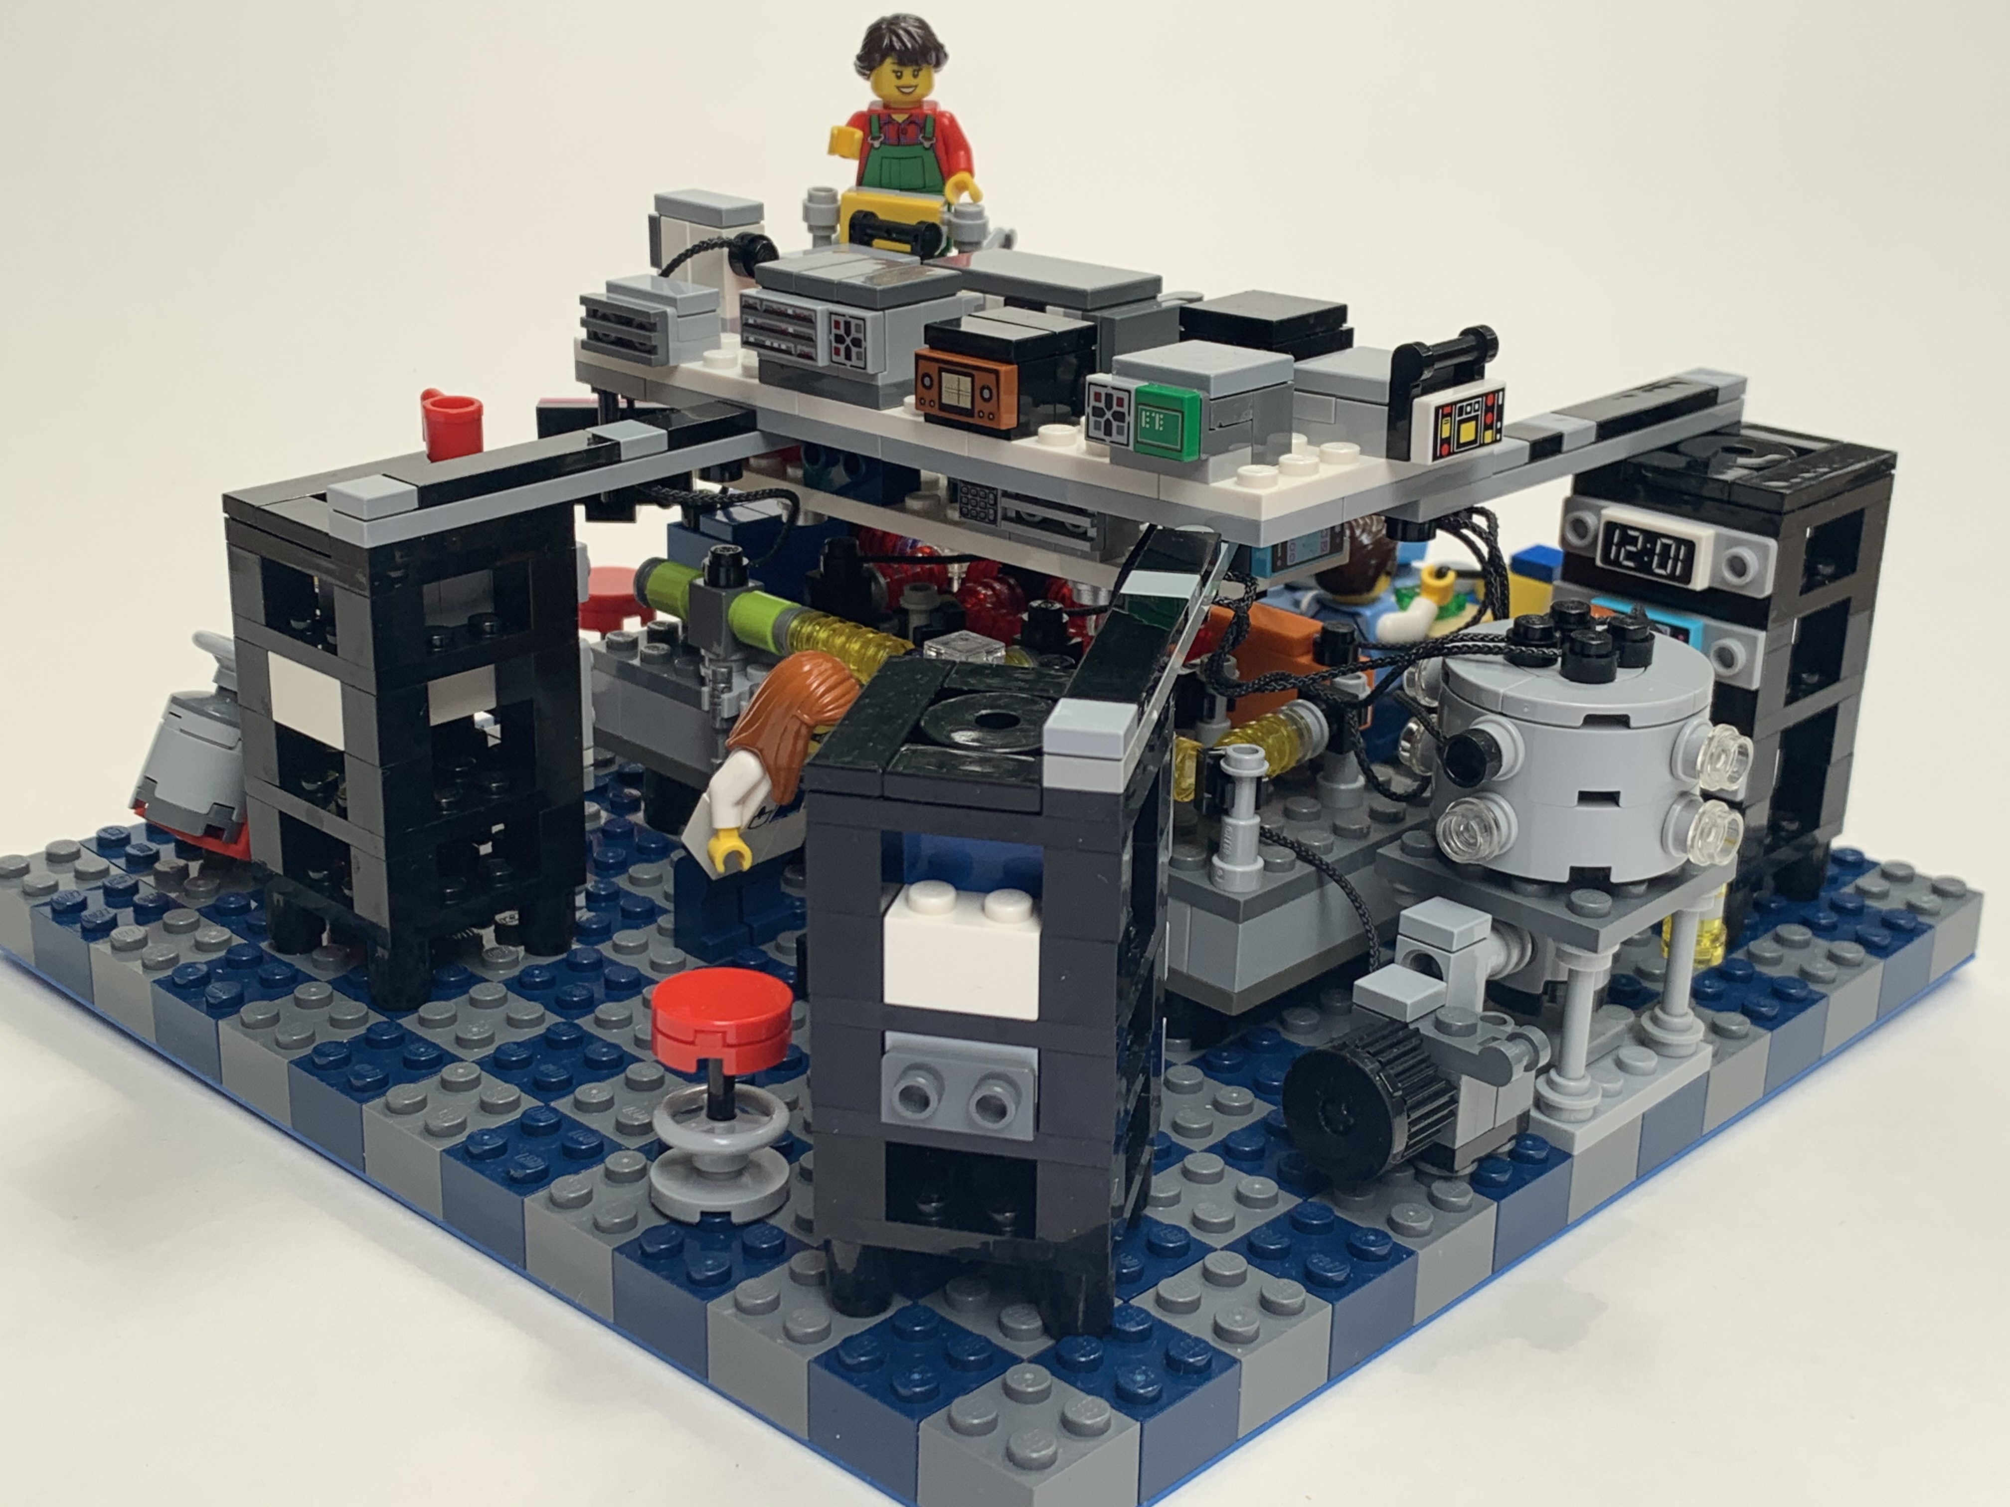

Slide 41
CGGTTS file
CGGTTS specification
http://dx.doi.org/10.1088/0026‐1394/52/6/G1
CGGTTS GENERIC DATA FORMAT VERSION = 2E
REV DATE = 2023-02-01
RCVR = Septentrio PolaRx2 S/N 3252 R2CGGTTS v8.3
CH = 20
IMS = Septentrio PolaRx2 S/N 3252
LAB = NMI Australia
X = -4648241.00 m
Y = +2560636.48 m
Z = -3526317.74 m
FRAME = ITRF
COMMENTS = IGS antenna SYDN
INT DLY = 211.7 ns (GPS P1), 213.3 ns (GPS P2) CAL_ID = 1015-2021
CAB DLY = 2484.6 ns
REF DLY = 337.2 ns
REF = UTC(AUS)
CKSUM = 75
SAT CL MJD STTIME TRKL ELV AZTH REFSV SRSV REFSYS SRSYS DSG IOE MDTR SMDT MDIO SMDI MSIO SMSI ISG FR HC FRC CK
hhmmss s .1dg .1dg .1ns .1ps/s .1ns .1ps/s .1ns .1ns.1ps/s.1ns.1ps/s.1ns.1ps/s.1ns
G07 FF 60164 000200 780 631 1636 -1017529 +101 4390 -8 24 38 91 +0 162 +12 162 12 18 0 0 L3P 1F
…
satellite track
Notes:
A CGGTTS file looks like this.
The header contains some of the information used in the calculations, including the equipment delays.
[1] The time transfer data consists of a track for each satellite visible to the receiver.
Each track is a linear fit to 13 minutes of data.
Tracks are 16 minutes apart so there’s a bit of dead time.
[The reason for this is historical. Early receivers could only track one satellite at a time and this was done to a schedule. The three minute gap was to allow the receiver to acquire the next satellite in the schedule.]

Slide 42
RINEX CLK file
3.00 CLOCK DATA G RINEX VERSION / TYPE
SPARK 3.49.0 CSRS-PPP 20210309 045336 UTC PGM / RUN BY / DATE
GPS TIME SYSTEM ID
1 AR # / TYPES OF DATA
EMR Natural Resources Canada ANALYSIS CENTER
G SPARK igs14_2136_nrcan.atx SYS / PCVS APPLIED
1 IGb14 # OF SOLN STA / TRF
SEP1 -4648240922 2560636452 -3526317756SOLN STA NAME / NUM
END OF HEADER
AR SEP1 2021 02 01 00 00 30.000000 2 2.777382759502e-06 1.743022524273e-10
AR SEP1 2021 02 01 00 01 0.000000 2 2.777384620946e-06 1.741553427481e-10
…
Notes:
PPP processing tools will output a solution for the receiver clock in a RINEX CLK file.
Note that there is just one measurement reported at each time.
The PPP method is an All in View method.
The reference time scale is some kind of average of the clocks of each satellite in view at each epoch.
This is something to be careful of when comparing RINEX CLK files generated by different software – the reference time scales may not be the same.
RINEX clock files are not designed for time-transfer so they don’t contain information like equipment delays.

Slide 43
Delay calibration
BIPM Time and Frequency Dept
BIPM
G1
TL
u = 1.5 ns
BIPM
APMP
NICT, NIM, TL, KRISS
UTC(TL)
TL
u = 2.5 ns
G2
TL
NMIA
APMP
NMIA, ...
UTC(AUS)
Notes:
If you want a calibrated connection to UTC you need to know the delays. Cable delays are easy, but others like the delay in the antenna electronics and the receiver, are much harder to measure. For an antenna, the delay might be 20 to 70 ns. For the receiver, it could be up to 100 ns. So if you need to know your offset to UTC to better than 100 ns or so, calibration is necessary.
The calibration scheme in use for UTC is hierarchical. The BIPM Time and Frequency Dept sits at the top, and sends out calibrated receivers to the so-called Group 1 laboratories of which there three or so in each regional metrology organization. In the Asia –Pacific These receivers then sit by the receivers to be calibrated, connected to the local clock. A direct comparison of time-transfer data allows transfer of the calibration.
These calibrated Group 1 receivers then travel out to Group 2 laboratories to calibrate their receivers.
A Group 1 receiver calibration receives a minimum uncertainty of 1.5 ns and a Group 2 receiver an uncertainty of 2.5 ns.
Of course, if all you want to do is frequency transfer, then you don’t need to worry about any of this.

Slide 44
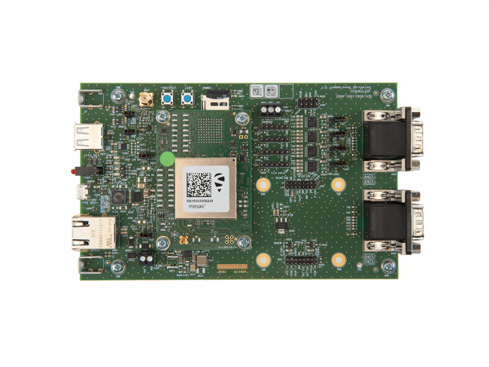
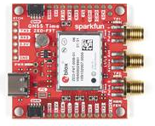
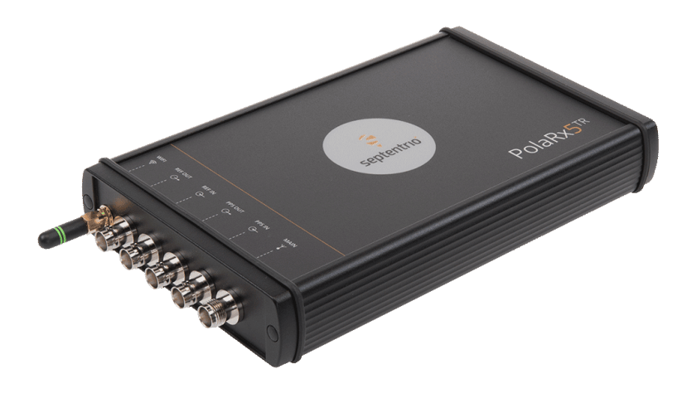
Summary of options
$500
$2000
$25000 - $50000
DIY with OEM receiver
Need external C/T
CGGTTS only
See www.openttp.org
DIY with OEM receiver
Uses external clock
CGGTTS + PPP
Only one receiver in this class
(Septentrio mosaicT)
Ready to go
Uses external clock
CGGTTS + PPP
Several fully integrated commercial solutions available

