Slide 1
Optical and microwave metrology with frequency combs
Tara Fortier
NIST Time and Frequency Division
Oct 10, 2023

Slide 2
Outline
Introduction to atomic clocks.
What is a frequency comb and how does it work?
Combs for optical and microwave metrology.
Time & frequency applications with combs.

Slide 3
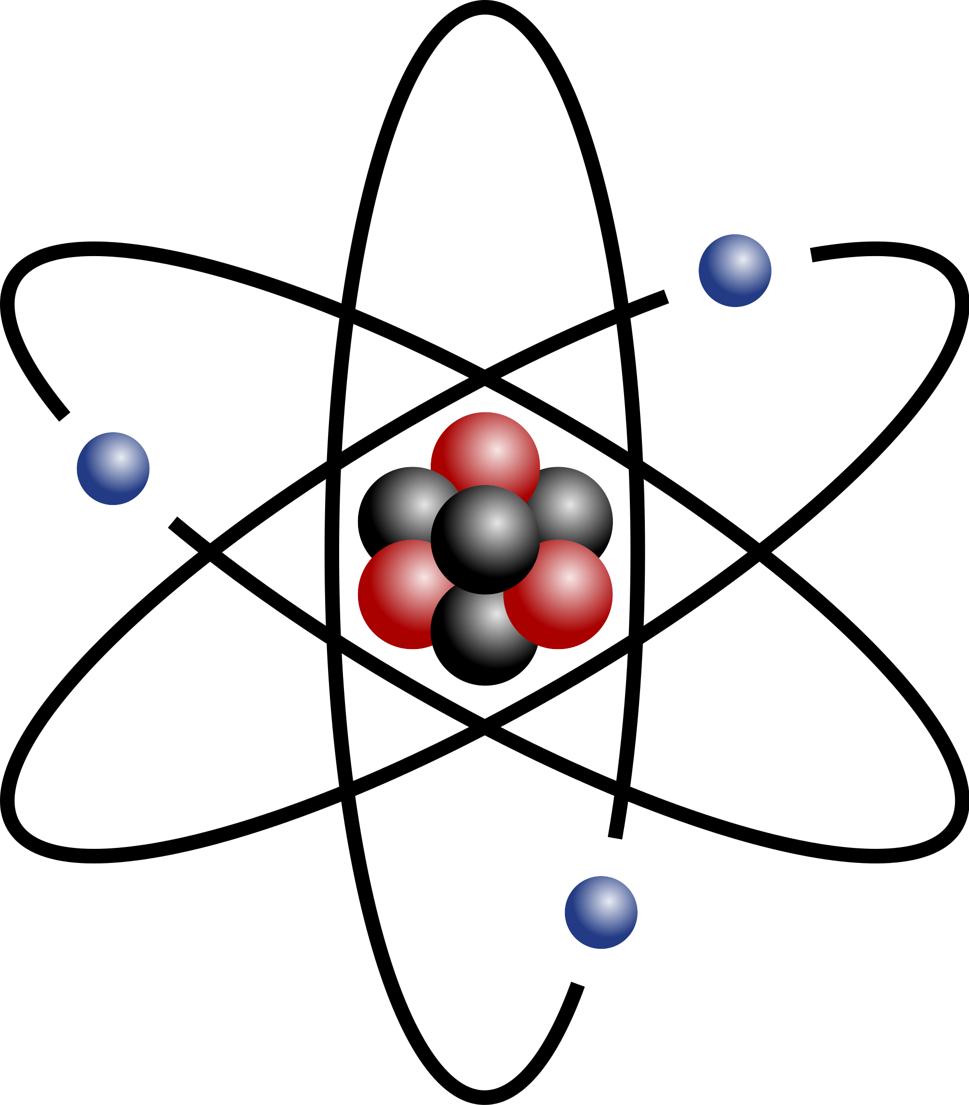
How atomic clocks define time
How the atomic clock works
1. Cycles of microwave EM radiation are stabilized to a hyperfine transition in ¹³³Cs
Atomic clocks are frequency references, not time references!
To calibrate the passage of time accurately you need to accumulate cycles of a phase continuous signal since t₀ = 0s.…. Due to their complexity most atomic clocks are only run intermittently.
SI second
2. The second is then defined as a fixed number of cycles of radiation of the atomic transition.
The second is currently defined as 9,192,631,770 oscillations of an electronic hyperfine transition in ¹³³Cs

Slide 4
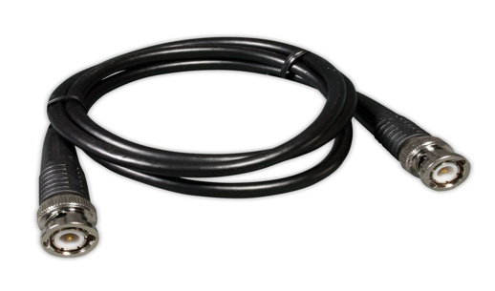
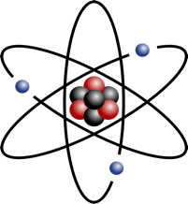
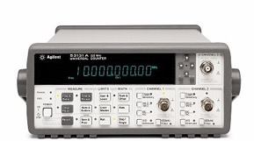
How atomic clocks define time
How the atomic clock works
Frequency is determined by counting # zero crossings in 1s
1. Cycles of microwave EM radiation are stabilized to a hyperfine transition in ¹³³Cs
1 s
Voltage
Time
SI second
2. The second is then defined as a fixed number of cycles of radiation of the atomic transition.
¹³³Cs
The second is currently defined as 9,192,631,770 oscillations of an electronic hyperfine transition in ¹³³Cs
Unknown frequency in

Slide 5
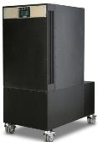
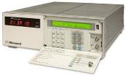
How atomic clocks define time
The microwave timescale
¹³³ Cs
¹³³Cs corrects the frequency drift of a weighted ensemble of microwave oscillators (usually H-masers and commercial atomic clocks) that act as a continuously running flywheel for local time.
Frequency steering
The microwave flywheel creates continuous timing “ticks”
The local Cs clock, however, can only provide frequency steering of the maser ensemble…. ¹³³Cs cannot tell if the ensemble is “on time”
The steered u-wave ensemble signal is used by the NMI to provide stable local signals for synchronization of oscillators in mobile devices, GPS, etc.

Slide 6
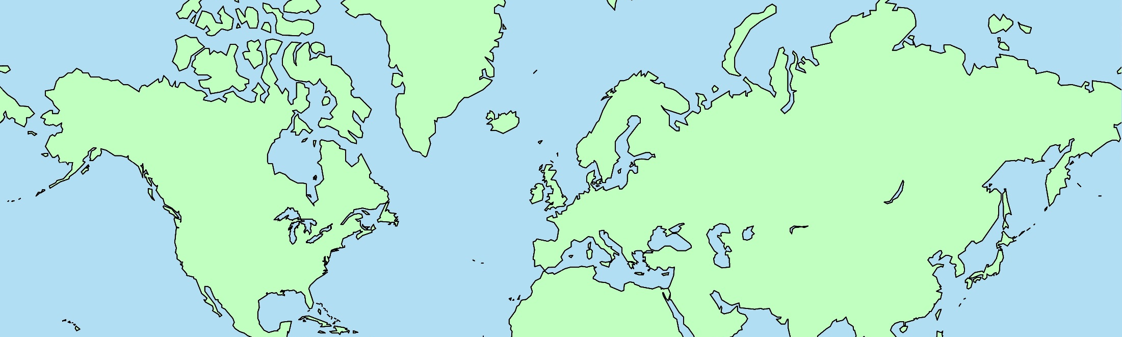
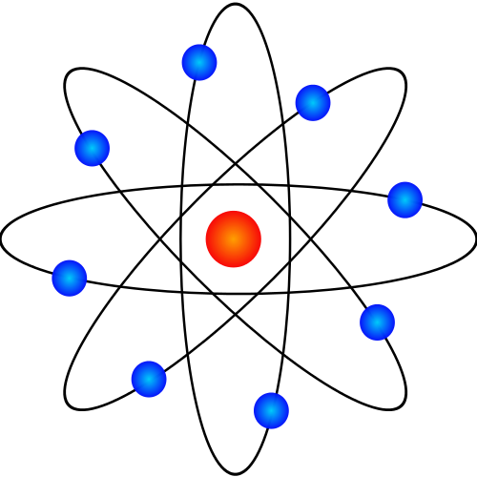

How atomic clocks define time
NIST’s microwave timescale information is broadcast via satellite to the BIPM to compare against the international ensemble of primary and secondary standards (PSFS)
PSFS
The BIPM sends a document to NIST, once a month, to tell it how many nanoseconds off UTC(NIST) is with respect to PSFS.
NIST uses the information from BIPM to steer UTC(NIST) on time with PSFS.
PSFS
400 atomic clocks
50 NMIs
Fun fact: the NIST time server receive 10 time more combined hits per day than the Google Search engine!

Slide 7
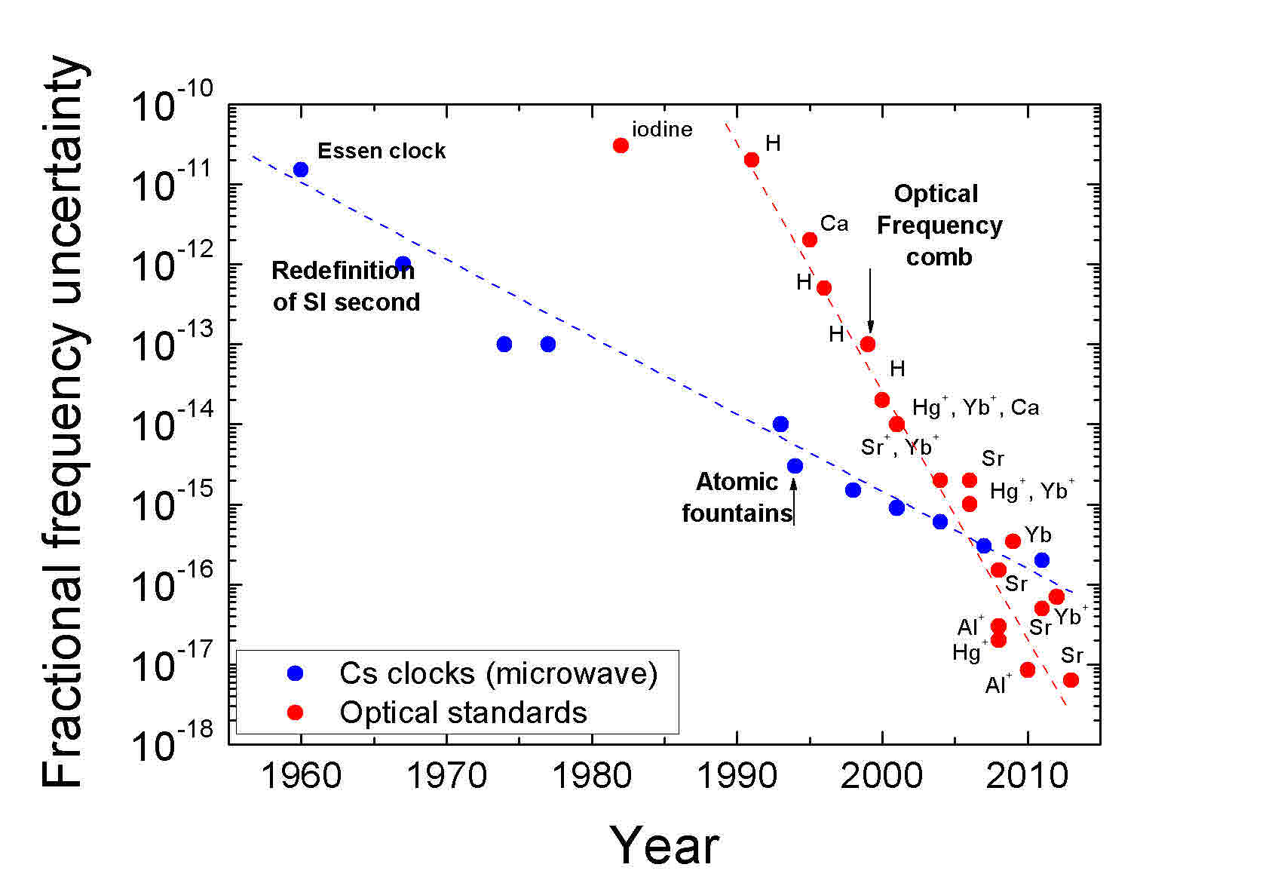
Historical performance of atomic clocks
Clocks accuracy Δν/ν
… operating at a higher transition frequency naturally increases the precision and accuracy.
Optical clocks
Microwave clocks
Fractional Accuracy
1 part/million control of u-wave a cycle!
Accuracy Limit 10⁻¹⁶
Al⁺
1 part/1000 control of an optical cycle
Sr
Yb
Sr
Accuracy limit
10⁻¹⁸
Al⁺
Year
N. Poli et al, Rivista del Nuovo Cimento, 36 (2013)
Ludlow Rev. Mod. Phys. 87 (2015)
Notes:
Steeper slope for optical clocks
Reason: microwave clocks require much better control over their systematics.
Accuracy and potential of optical clocks…. Redefinition of second.
If we look at the performance of clocks over time we see a steeper slope associated with improvements in the accuracy of optical as opposed to microwave clocks. There is a reason for this. As I mentioned before, the higher the frequency of your clock the better the accuracy and stability. Said differently, the lower your clock frequency, the higher the constraint on the your systematics.
To achieve parts in 10-18 requires knowledge of an optical transition to 1 mHz. On a microwave transition 10-18 requires that you know your transition frequency to a fraction of a micro-Hz. Because the difference in constraints, microwave clocks are not likely to make significant gains in accuracy over their current performance, but optical clocks which have been demonstrated to be 100 more accurate are still improving.
The question that must be on everyone’s minds is…. Given the higher accuracy and potential for optical clocks…. Is it the time right for optical redefinition of the SI second?

Slide 8

The big challenge of optical clocks
The big obstacle to optical clock development: light waves are too fast to count!
3 GHz processor
Up to 10 GHz
200 Tera-oscillations/s
~10,000 to 100,000 x faster
than a state-of the-art
counter!

Slide 9
Difference frequency measurement
The carrier frequency of a light wave is too fast for a photodiode to resolve….
Wave 1
(ν_{opt1})
V
Photodector signal
PD will produce a voltage proportional to the light’s intensity
t

Slide 10
Difference frequency measurement
Wave 1
(ν_{opt1})
Interference of two optical waves close in frequency results in an amplitude modulated optical carrier
+
+
Wave 2
(ν_{opt2})
=
V
Photodector signal
Beat frequency
Δf =(ν₂ - ν₁)
t
T. Udem et al., "Phase-coherent measurement of the hydrogen 1S-2S frequency with an optical frequency interval divider chain," in IEEE Transactions on Instrumentation and Measurement, 46 (1997)

Slide 11
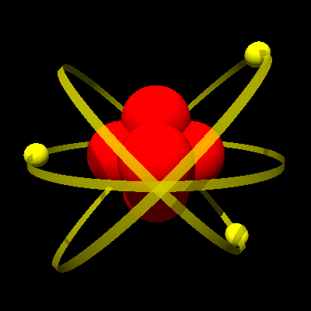
A brief history of optical frequency measurement
To measure the frequency of the optical transition we need to measure it against the definition of the Hz.
Atomic transition
~ 300 THz
Problem!
Cs clock
9.192 GHz
5 orders of magnitude
different in frequency!
Counter
Conversely, to define the second to Optical atomic time we need to count the cycles of the clock transition.

Slide 12
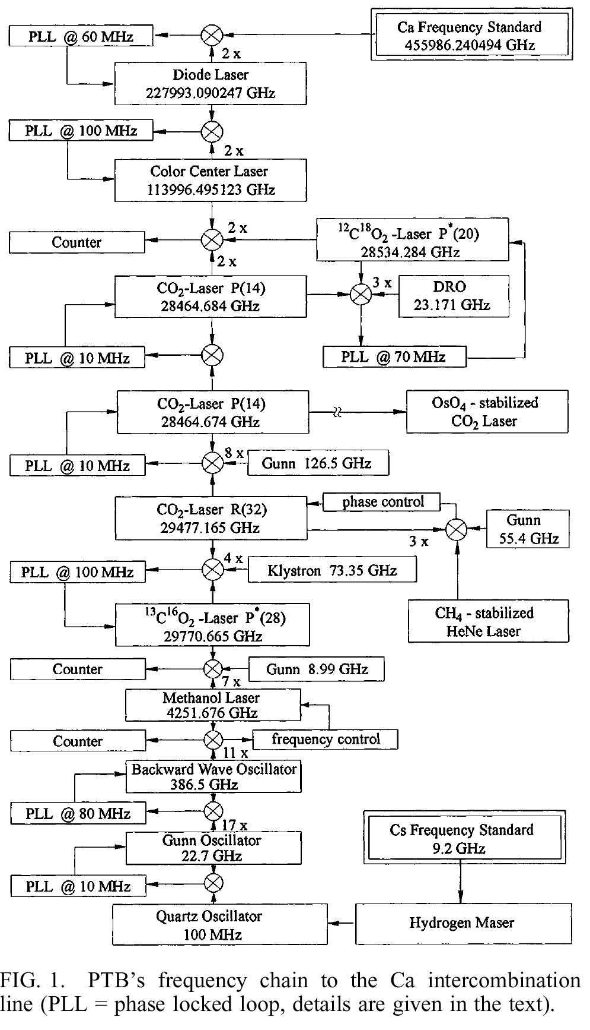
A brief history of optical frequency measurement
Frequency multiplication chains: prior to 2000
Atomic transition
~ 300 THz
Cs clock
9.192 GHz
Counter
Frequency chain enables multiplication of the 133Cs microwave reference to the optical domain via a series of 20 intermediate and 50 phase locked oscillators.
Schnatz, et al., Phys. Rev. Lett. 76, 19 (1996)
Schnatz, et al., Phys. Rev. Lett. 76, 19 (1996)
Schnatz, et al., Phys. Rev. Lett. 76, 19 (1996)
Schnatz, et al., Phys. Rev. Lett. 76, 19 (1996)

Slide 13
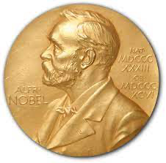
A brief history of optical frequency measurement
2005 Nobel Prize: Jan Hall and Ted Haensch
OFC
Atomic transition
~ 300 THz
Cs clock
9.192 GHz
In 2000, the first optical frequency comb was demonstrated:
direct optical-to-microwave conversion with a single oscillator!
Counter

Slide 14
The frequency comb: a photonic pulsed synthesizer
Ultrabroad frequency synthesis:
Wideband optical & microwave synthesis
Direct optical-to-microwave conversion
Near perfect frequency multipliers/dividers
  High precision frequency counter
Ultra-short optical pulse synthesis
fs-level pulse-to-pulse timing jitter
Control/shaping of pulse electric field
Arbitrary waveform synthesis
Reference
Photonic Synthesizer
Microwave OUT
DC – 100 GHz
Optical OUT
150 – 280 THz
ΔT < 1fs
Optical IN
250-500 THz
μ-wave
optical

Slide 15
What is a frequency comb and how does it work?

Slide 16
Modelocked lasers: Time/frequency representations
L – cavity length
f_{r}
2 f_{r}
3 f_{r}
4 f_{r}
Artist rendition -oscillations should be 10⁵ times faster
Spectrum of lasing light
resonant modes are equally spaced by the laser repetition rate:
ν_{n} = n (c/ 2L)= n f_{r}
ν

Slide 17
Modelocked lasers: Time/frequency representations
Coherent addition of longitudinal cavity modes
Pulse formation
Spectrum of lasing light
resonant modes are equally spaced by the laser repetition rate:
ν_{n} = n (c/ 2L)= n f_{r}
ν

Slide 18
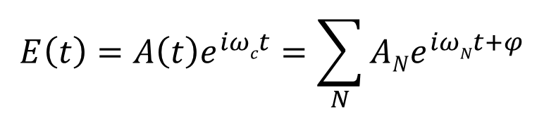
Modelocked lasers: Time/frequency representations
$$E\left(t\right)=A\left(t\right)e^{iωct}=\sum_{N}{ANe^{iωNt+φ}}$$
Spectrum of lasing light
resonant modes are equally spaced by the laser repetition rate:
ν_{n} = n (c/ 2L)= n f_{r}
ν

Slide 19
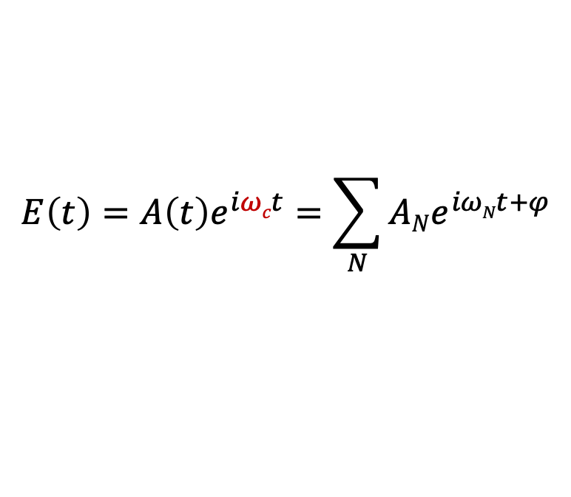
Modelocked lasers: Time/frequency representations
$$E\left(t\right)=A\left(t\right)e^{iωct}=\sum_{N}{ANe^{iωNt+φ}}$$
Spectrum of lasing light
resonant modes are equally spaced by the laser repetition rate:
ν_{n} = n (c/ 2L)= n f_{rep}
ν

Slide 20
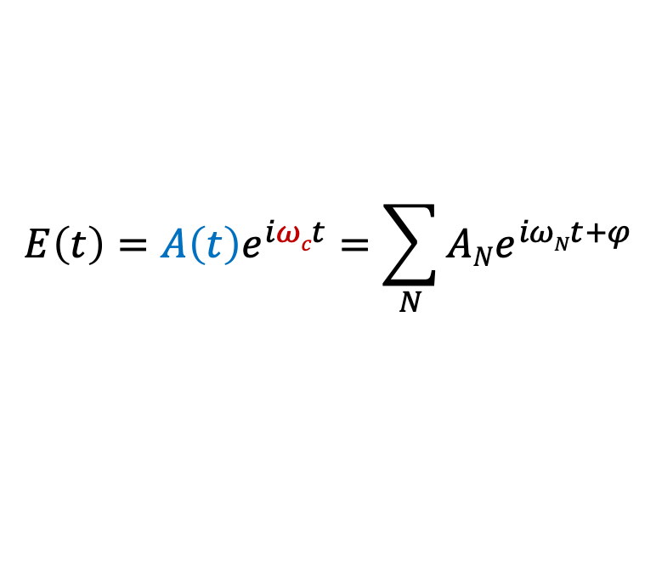
Modelocked lasers: Time/frequency representations
$$E\left(t\right)=A\left(t\right)e^{iωct}=\sum_{N}{ANe^{iωNt+φ}}$$
Spectrum of lasing light
resonant modes are equally spaced by the laser repetition rate:
ν_{n} = n (c/ 2L)= n f_{r}
ν

Slide 21
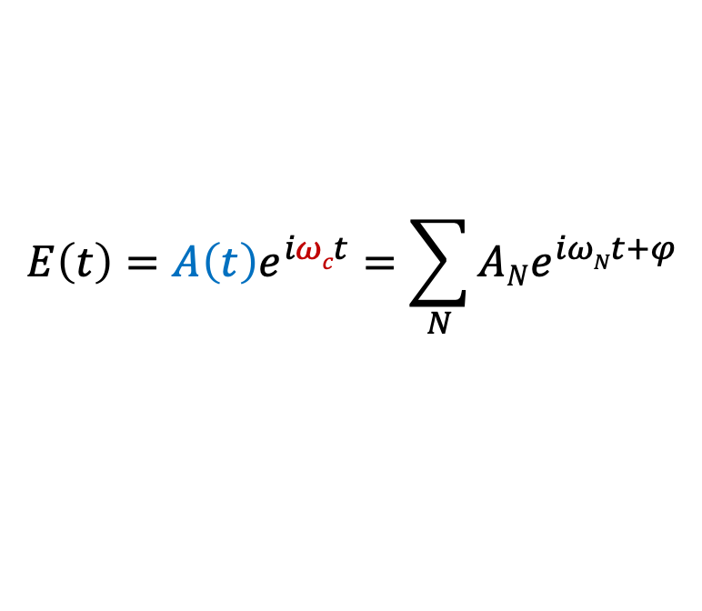
Modelocked laser-based frequency comb
T_{r}
Pulse envelope
Optical carrier
$$E\left(t\right)=A\left(t\right)e^{iωct}=\sum_{N}{ANe^{iωNt+φ}}$$

Slide 22
Modelocked laser-based frequency comb
T_{r}
Pulse envelope
Optical carrier
$$E\left(t\right)=A\left(t\right)e^{iωct}=\sum_{N}{ANe^{iωNt+φ}}$$

Slide 23
Modelocked laser-based frequency comb
T_{r}
Pulse envelope
Optical carrier
$$E\left(t\right)=A\left(t\right)e^{iωct}=\sum_{N}{ANe^{iωNt+φ}}$$

Slide 24
Modelocked laser-based frequency comb
0
Δφ_{CE}
2 Δφ_{CE}
3 Δφ_{CE}
4 Δφ_{CE}
T_{r}
Pulse envelope
Optical carrier
$$E\left(t\right)=A\left(t\right)e^{iωct}=\sum_{N}{ANe^{iωNt+φ}}$$
The CE phase slip results from a difference in dispersion: the group and phase velocities are different as the pulse travels through a dispersive medium, such as the laser crystal or optical fiber.
2023 Nobel Prize: Ultrafast studies of electron dynamics in atomic and molecular systems.

Slide 25
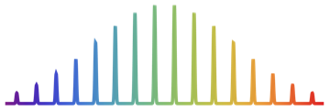
Modelocked laser-based frequency comb
0
Δφ_{CE}
2 Δφ_{CE}
3 Δφ_{CE}
4 Δφ_{CE}
T_{r}
Δφ_{CE} = 2π (f_{CE} / f_{r} )
L
T_{r} = 1 / f_{r} = 2L/c
f_{CE} < f_{r}
f_{r}
frequency
Microwave
Optical

Slide 26
Modelocked laser-based frequency comb
0
Δφ_{CE}
2 Δφ_{CE}
3 Δφ_{CE}
4 Δφ_{CE}
T_{r}
Δφ_{CE} = 2π (f_{CE} / f_{r} )
L
The comb equation
T_{r} = 1 / f_{r} = 2L/c
ν_{N}= N x f_{r}+ f_{CE}
f_{CE} < f_{r}
f_{r}
frequency
Microwave
Optical

Slide 27
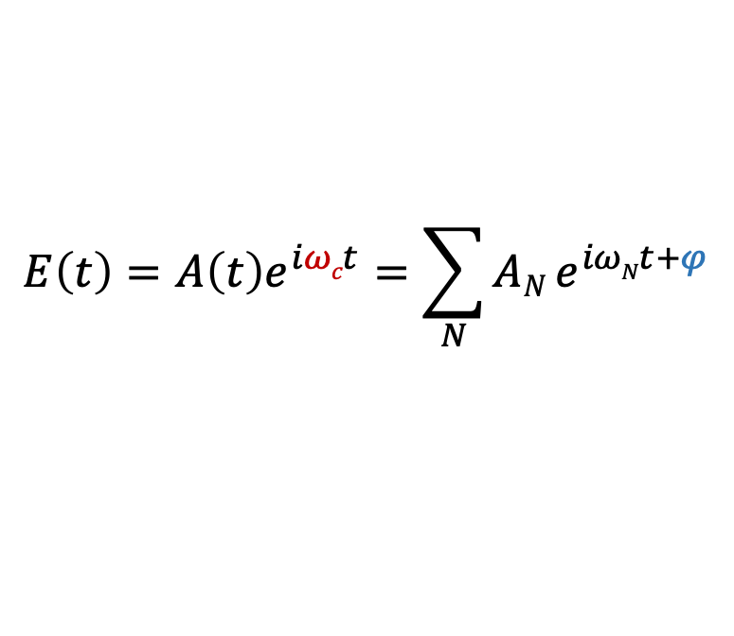
The comb equation
The comb equation:
Directly connects optical and microwave frequencies.
Optical modes are related in a deterministic fashion (coherently related spectral components, or every optical mode shares the same phase)
$$E\left(t\right)=A\left(t\right)e^{iωct}=\sum_{N}{AN}e^{iωNt+φ}$$
f_{CE} connects the optical spectrum to DC (0 Hz).
It is dependent on dispersion in the laser cavity
air currents
material dispersion
changes in gain
Control: modulation in pump power (gain modulation)
Optical frequency (500 THz)
ν_{N}= N x f_{r} + f_{CE}
f_{r} is inversely to the pulse round trip time:
cavity length (temp changes)
Control: PZT actuated mirror

Slide 28
The comb equation: f_{r} measurement
T_{r} =1/f_{r}
T_{r} =1/f_{r}= 2L/c
Optical frequency (500 THz)
ν_{N}= N x f_{r} + f_{CE}
N takes f_{r} to the optical domain (can be determined using a wavemeter Δν/ν ~ 10⁻⁷)

Slide 29
The comb equation: f_{r} measurement
T_{r} =1/f_{r}= 2L/c
f_{r}
Optical frequency (500 THz)
ν_{N}= N x f_{r} + f_{CE}
Frequency counter
N takes f_{r} to the optical domain (can be determined using a wavemeter Δν/ν ~ 10⁻⁷)

Slide 30
The comb equation: f_{CE} measurement
0
Δφ_{CE}
2 Δφ_{CE}
3 Δφ_{CE}
4 Δφ_{CE}
Δφ_{CE} /(2π T_{r}) = f_{CE}
T_{r}
Optical frequency (500 THz)
ν_{N}= N x f_{r} + f_{CE}
Hard to measure!
Is related to the phase of the optical carrier)
If you can’t measure the optical carrier, so how do you measure its phase?
Without access to f_{CE…….} Δν_{atom}/ν_{atom} = 1 part per million = 10^{9/}10¹⁵ !

Slide 31
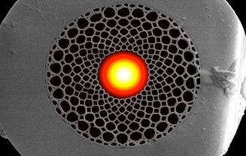
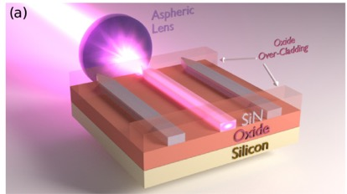
The comb equation: f_{CE} measurement
Optical frequency combs
ν_{n} = n f_{rep} + f_{CE}
ν_{2n} = 2n f_{rep} + f_{CE}
f_{CE}
Measuring f₀ requires an optical octave of bandwidth!... Poses significant challenges to systems with low pulse energies (high f_{r} systems).
x 2
2n_{n} = 2n f_{rep} + 2f_{CE}
_
ν_{2n} = 2n f_{rep} + f_{CE}
f_{CE}
Continuum generation
High confinement
Small mode volume = high intensities
Long interaction lengths
dispersion is managed by balancing material and geometrical dispersions.
J.Bethe (2009)
Cores =2 - 5 μm
Carlson et al. Optics Letters Vol. 42, 2314 (2017)

Slide 32
Optical setup: f_{CE} measurement
Optical amp.
bandpass
ν_{2n,} 2ν_{n}
When detecting f₀, the photodetector detects a pulse train with slow additional amplitude modulation, with modulation frequency, f₀
ν_{n}
MLL
+
x2
Nonlinear fiber
ν_{2n}
f_{CE}
f_{CE} conjugate beats
RF spectrum
Power (dBm)
f
fr
2 fr
3 fr
4 fr

Slide 33
The comb equation
ν_{N}= N x f_{r} + f_{CE}
Important note: The comb equation holds for any coherently modelocked laser spectrum!
Question: What is a frequency comb?
Answer: A modelocked optical spectrum that is
Deterministic (coherent) and
Accessible or controllable in frequency and phase.

Slide 34
Modelocked sources and clocks vs wavelength
Preferential gain for pulsed operation
Any modelocked laser can be turned into a frequency comb as long as you can measure f_{CE}:
usually requires optical amplification + non-linear broadening
High-reflector
Partial reflector
Gain
χ³
SA
n(I) = n₀+ I n₂
Pump
Cr:LiSaF
Yb:KYW
Yb:fiber
Cr+:ZnSe
Cr+:ZnS
ErYb:glass
Er:fiber
Tu:fiber
Ti:sapphire
VISIBLE
2-3 μm
2 μm
1550 nm
1000 nm
700 - 400 nm
200 nm
100 nm
Wavelength

Slide 35
Modelocked sources and clocks vs wavelength
https://www.bipm.org/en/publications/mises-en-pratique/standard-frequencies
¹⁷¹Yb+ (436nm/ 467 nm)
²⁸⁸Th nuclear
(~149 nm)
⁸⁷Sr (698 nm)
⁸⁸Sr+ (674 nm)
⁴⁰Ca (657 nm)
¹⁷¹Yb
(578 nm)
²⁷Al+ (267 nm)
¹¹⁵In+ (237 nm)
¹⁹⁹Hg+ (282 nm)
Cr:LiSaF
Yb:KYW
Yb:fiber
Cr+:ZnSe
Cr+:ZnS
ErYb:glass
Er:fiber
Tu:fiber
Ti:sapphire
VISIBLE
2-3 μm
2 μm
1550 nm
1000 nm
700 - 400 nm
200 nm
100 nm
Wavelength

Slide 36
Chip-based combs: Kerr-resonators
Smaller: Optical frequency combs
Micro-resonators:
Compact nonlinear optical filters/cavities
CMOS compatible
Chip-scale
  Inexpensive to manufacture
Credit: Image by Jiangang Zhu and Jingyang Gan/WUSTL
Vahalla et al
Maleki et al
Gaeta et al
200 um
Silica
CaF2
SiN
High-Q resonator
Pump
Comb modes formed via degenerate and non-degenerate 4 wave mixing
Pump
χ³
SA
n(I) = n₀+ I n₂

Slide 37
Chip-based combs: Kerr-resonators
Smaller: Optical frequency combs
Micro-resonators:
Compact nonlinear optical filters/cavities
CMOS compatible
Chip-scale
  Inexpensive to manufacture
Current limitations:
Low optical coupling < 5%
Narrow optical bandwidth ~ 10 nm
Optical loss due to Brownian noise limits stability
Difficult to broaden-> low energy/pulse
Credit: Image by Jiangang Zhu and Jingyang Gan/WUSTL
Vahalla et al
Maleki et al
Gaeta et al
200 um
Silica
CaF2
SiN
High-Q resonator
Pump
Comb modes formed via degenerate and non-degenerate 4 wave mixing
Pump
χ³
SA
n(I) = n₀+ I n₂

Slide 38

Electro-optic comb generators
A. J. Metcalf, V. T-. Campany, D. E. Leaird, and A. M. Weiner, JSTQE 19(6) (2013).
f_{synth} (< 40 GHz)
+
+
+
+
Tunable
CW laser (f_{c})
EDFA
PM
PM
PM
IM
Comb output
Optical spectrum IN
Optical spectrum OUT
f_{c}
f_{c}
f_{synth}
frequency
frequency

Slide 39
3. Combs for optical and microwave metrology

Slide 40
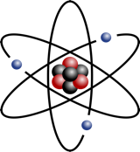
Combs for measuring optical frequencies
Wavemeter
~ 500,000
ν_{atom} (Hz)= N x f_{r} +f_{CE}+ Δf
< 1 GHz
ν_{N}= N x f_{r}+ f_{CE}
f_{CE}
f_{r}
Δf
frequency
Microwave
Optical

Slide 41

Combs for measuring optical frequencies
Wavemeter
~ 500,000
¹³³Cs
ν_{atom} (Hz)= N x f_{r} +f_{CE}+ Δf
¹³³Cs
ν_{N}= N x f_{r}+ f_{CE}
¹³³Cs
Frequency counter
f_{CE}
f_{r}
Δf
frequency
Microwave
Optical

Slide 42
Accuracy in microwave frequency counting
1/Δf
δν_{Cs}/ν_{Cs} ~ 10⁻¹⁶
Counter accuracy is only as good as its reference (”Hz”)
Counted frequency
Δf * δν_{Cs} /ν_{Cs}
Δf
=
1 x 10⁻¹⁶
Normalization frequency

Slide 43
Accuracy in optical difference frequency counting
1/Δf
1/Δf
δν_{Cs}/ν_{Cs} ~ 10⁻¹⁶
Counter accuracy is only as good as its reference (”Hz”)
Δf * δν_{Cs}/ν_{Cs}
=
100 MHz * 10⁻¹⁶
=
=
ν_{opt}
10⁻⁷ x 10⁻¹⁶
1 x 10⁻²³ !
1 PHz
Because of the large normalization frequency, optical difference frequencies can be counted with extremely high resolution (10⁻¹⁹ τ⁻¹) and accuracy using a microwave reference and standard frequency counter.
Normalization frequency

Slide 44
Combs for measuring optical frequencies
Optical amp.
Dichroic beamsplitter
bandpass
ν_{2n,} 2ν_{n}
Mode-locked laser
ν_{n}
+
x2
f_{CE}
Nonlinear fiber
ν_{2n}
Optical beat signal measurement requires the following:
Spectral overlap
Spatial overlap
Polarization overlap
With 1 mW of CW light + 100 nW in a single comb mode Δf ~ 40 dB SNR
f_{r}
Pol.
Δf
λ/2
Optical band pass filter:
λ_{opt} ± 5 nm ~ 800 GHz @ 1550 nm
Unknown optical frequency, λ_{opt}
> 1 mW

Slide 45
Stabilizing combs with optical clocks
δT_{r}/T_{r} < 10⁻¹⁵
Pump
f_{r} ∝ ν_{opt}/N
δf_{r}/f_{r} < 10⁻¹⁵
L
ν_{N}= N x f_{r}+ f_{CE}
Pump current
f_{CE}
Δf
frequency
By stabilizing the comb at frequencies ν_{N} and at f_{CE}, you are pinning the spectrum at two extremes: 1) in the optical domain and 2) near 0 Hz. This rigidly stabilizes the entire optical spectrum, transferring the fractional clock stability to all modes.
Fortier et al. “Generation of ultrastable microwaves via optical frequency division,” Nat. Photon. 5 (2011)

Slide 46
Summary: Frequency combs
Transfer phase and frequency information across the optical domain and down to μ-wave frequencies.
Optical reference
Review: T.M. Fortier & E. Baumann, “20 years of developments in optical frequency comb technology and applications,” Communications Physics 2 (2019)
DFG
Harmonic generation
Photomixing
μ-wave
THz /Mid IR
MID IR/ Near IR/optical
UV/ XUV
Optical frequency combs (OFCs)
Ultra-broad spectral coverage (optical octave)
High-precision optical frequency counters (perfect frequency multipliers/dividers)
Provide fs-level pulse-to-pulse timing
Sub-radian phase control of the carrier-envelope phase for deterministic evolution/control of field sensitive experiments

Slide 47
4. Time & frequency applications with combs

Slide 48

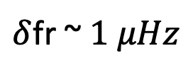
Low noise microwaves via optical division
Optical cavity
Length reference
ΔL/L = 10⁻¹⁵
CW laser
Frequency reference
Δf/f = 10⁻¹⁵
Timing stability
Δt/t = 10⁻¹⁵
S_{μ-wave}(f) = S_{φ_opt}(f)/N²
f_{r}
$δ$fr ~ $1 μHz$
1000 x narrower linewidth than a H-maser
Fortier et al Nat. Photonics (2011)
Fortier et al Laser and Photonic Reviews (2016)

Slide 49
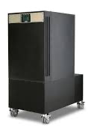
Microwave timescale calibration
ν_{Yb}(SI) = 518,295,836,590,863.6 Hz
A constant of nature
Δf
Time base
f_{r}
Δf_{r}/f_{r} < 10⁻¹⁵
H-maser (local time), tells the counter what it thinks 1-s is for gating the counters.
From the counters, we calculate:
ν_{Yb} (local time)= N x f_{r} +Δf
“Local time” is calibrated to Yb atomic time by assessing the difference:
ν_{Yb} (local time) - ν_{Yb}(SI)

Slide 50
2-way time transfer: Clock synchronization/comparison
Clock timing difference = interference between the red and blue pulse trains.
remote clock synchronization
relative measurement of remote clocks
Turbulence is common to both pulse trains.
Enables free-space comparison of clocks in the absence of fiber networks.
Requires line of sight and good weather
F. Giorgetta Nature Photonics (2013), I. Khadar Optica (2018)

Slide 51
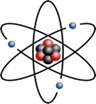
Comparing atomic clocks
Comparing clocks:
To perform measurements beyond the accuracy defined by the Hz (10⁻¹⁶)
Regular clock comparisons, local and international, are necessary for redefinition of the SI second.
Tests of fundamental physics.
⁸⁷Sr
359 THz
2 x10⁻¹⁸
¹⁷¹Yb
518 THz
2 x10⁻¹⁸
²⁷Al+
1.1 PHz
9 x10⁻¹⁹
ν_{Yb}
ν_{Al}
100’s THz
Modes act like tick marks to measure frequency differences.
Optical mode spacing can be split by parts in 10¹⁴!
resolution, σ(τ) ~ 10⁻¹⁸/τ-^{1/2}
Notes:
And so, with our photonic synthesizer, we can span all of our favorite clock transition frequencies. And, we all say optical frequency comb but a better name might be optical frequency ruler because, much the same as a ruler has ticks to mark distance, the comb has lines to mark frequency, and these ticks span the entire spectrum and allow us to measure the difference in frequency between two or more optical clocks but with readily available microwave electronics. And much the same as the tick marks of a ruler can be split to measure millimeters, the spacing between modes in a frequency comb can be split by 10^14 to measure as small as micro-Hz!

Slide 52




Boulder Atomic Clock Optical Network
>5 frequency combs
1) Optical frequency measurement/comparisons
2) Frequency conversion
  Optical synthesis
  Optical-to-microwave conversion
3) Time/frequency distribution over free-space
JILA
laser
Sr lab
BRAN fiber link
Er comb
Free-space link
NIST
Er comb
TiS comb
laser
laser
BACON “Frequency ratio measurements at 18-digit accuracy using an optical clock network,” Nature 591 (2021).
Yb lab
Al⁺ lab

Slide 53
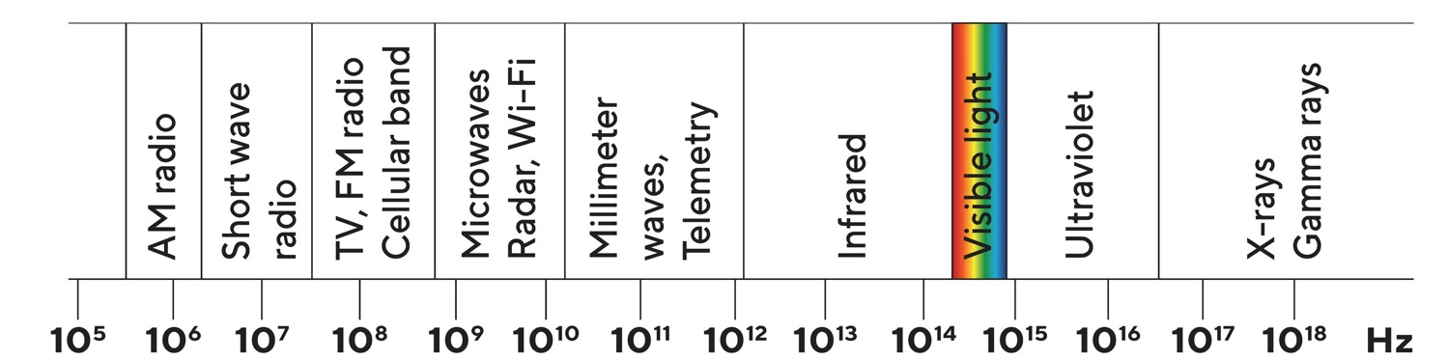
Comb applications across the E-M spectrum
Review: T.M. Fortier & E. Baumann, “20 years of developments in optical frequency comb technology and applications,” Communications Physics 2 (2019)
Optical free-space communications
Coherent Lidar
AOWFG
Ranging
Astronomical
spectrographs
Microwave
Atomic Clocks
Optical & nuclear
atomic clocks & spectroscopy
Low-noise
Microwave generation
Molecular spectroscopy
Attosecond Science
Photo-electronic spec.
Frequency

Slide 54
Summary
Reference
OFCs are mode-locked optical systems with a deterministic (coherent) relationship between optical and microwave modes.
Optical harmonics: ν_{N} = N f_{r}+ f_{CE}
Microwave harmonics: f_{N} = N f_{r}
Photonic Synthesizer
Microwave OUT
DC – 10 GHz
Optical OUT
150 – 280 THz
Optical IN
250-500 THz
ΔT < 1fs
μ-wave
optical
1) OFCS enable down-conversion of optical frequencies to the electronic domain where signals can be counted, conditioned and synthesized for definition of the SI second, test & measurement, calibration services and GPS.
Microwave signals derived from optical reference are ultra-low noise and carry the stability and accuracy of the reference.
2) OFCs enable synthesis of harmonically related optical modes/optical pulses that carry the stability and accuracy of the reference.
The optical spectrum can be used as a high-precision frequency ruler for optical measurement of unknown signals and for comparison of optical clocks.
The stable optical pulse train can be used for free-space time transfer.

Slide 55

Thank you for your attention!
Have additional questions, please feel free to email me:
Tara.Fortier@nist.gov
T.M. Fortier & E. Baumann, “20 years of developments in optical frequency comb technology and applications,” Communications Physics 2 (2019)
N. Newbury, “Searching for applications with a fine-tooth comb,” Science 5 (2011)
S.A Diddams, K. Vahal & T. Udem “Optical frequency combs: Coherently uniting the electromagnetic spectrum,” Science (2020)

