Slide 1

Distributed quantum sensing with networks of entangled atomic ensembles
Mark Kasevich, Stanford University

Slide 2
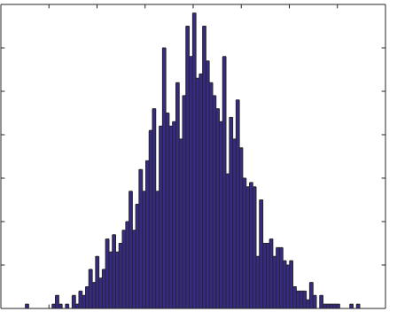
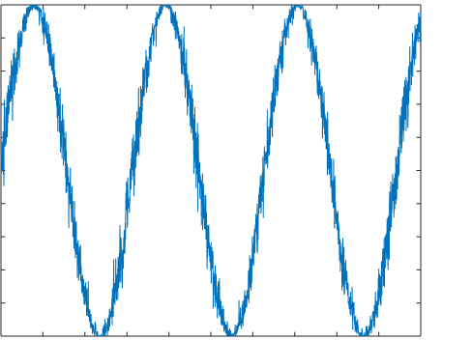
Noise in interferometric sensors
Probability P(N )
Number of atoms N in exit port
N
For uncorrelated particles:
“Shot noise” – physical origin is randomness of wavefunction collapse.
Phase (rad)

Slide 3
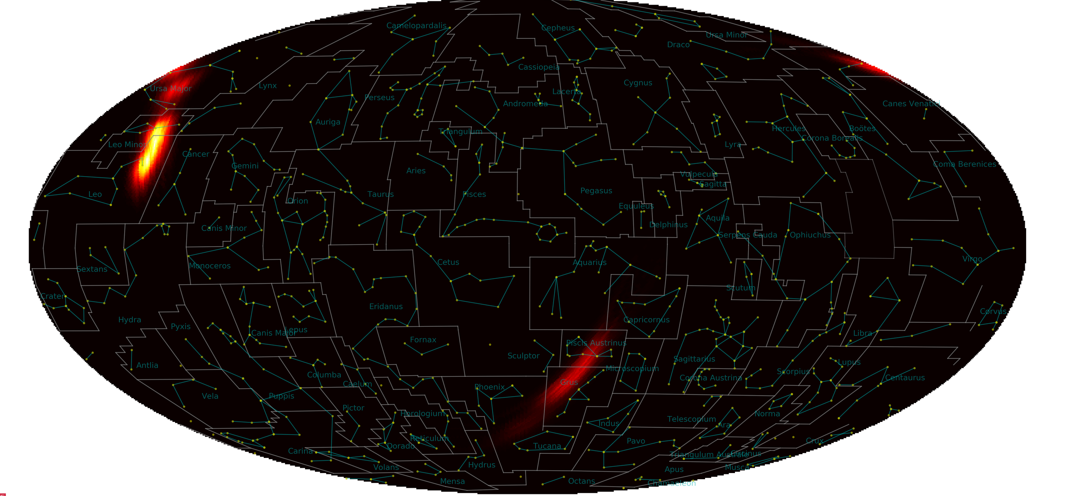
LIGO runs with squeezed light
https://www.ligo.caltech.edu/news/ligo20190812

Slide 4
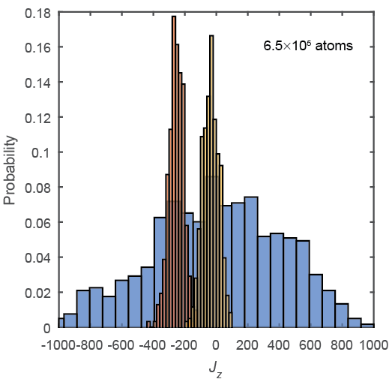
Spin-sqeezed (entangled) single node metrology
Entangled atoms
Reduced
read-out noise
This data: 20 dB variance reduction
Consider N ~ 1e6 atoms, each in a quantum superposition of two ground state energy levels.
Measure probability of finding atoms in one of these states
Uncorrelated atoms
“Shot-noise”
Coin-toss statistics
ΔN
O. Hosten, et al., Nature (2016).

Slide 5
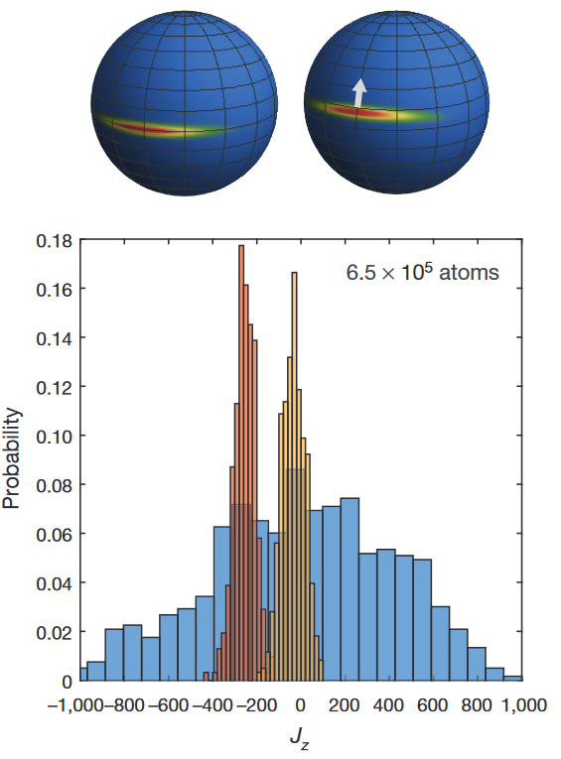
Metrology requires coherence
Noise is reduced via squeezing.
Coherent response is preserved.

Slide 6
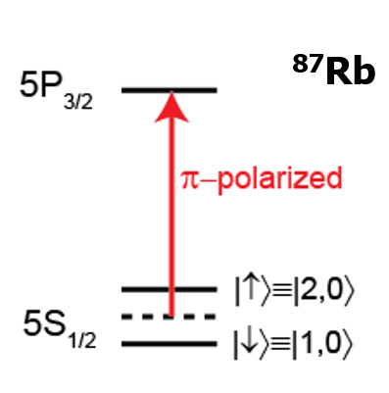
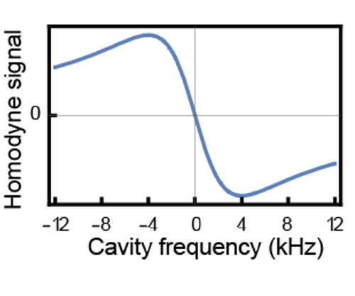
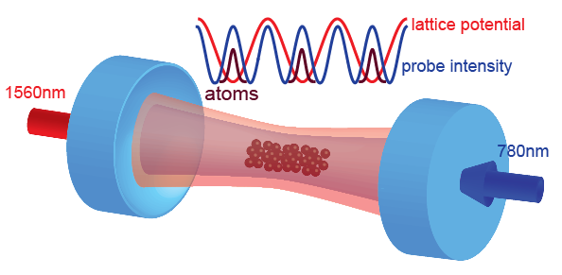
Our method: cavity assisted entanglement
Dispersive atom-cavity interactions are used to realize a quantum non-demolition measurement of atom number.
Measurement results in a metrologically useful many-atom entangled state.
Resonance frequency (kHz)

Slide 7
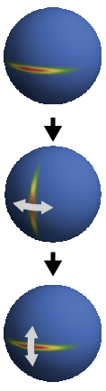
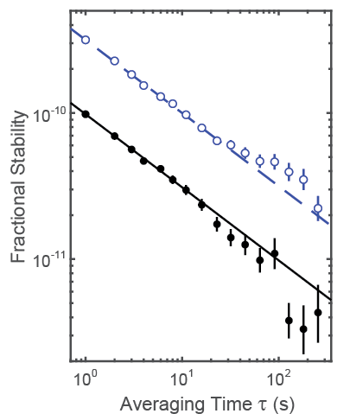
Atomic clock implementation
Quantum projection noise
1×10⁵ atoms
220μs interrogation
time
10.5 dB below quantum projection noise
1 s update rate
Limited by μ-wave LO
phase noise. Hosten, et al., Nature (2016)

Slide 8

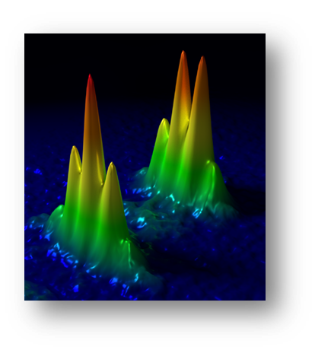
Two node quantum sensing
Many precision metrology protocols require comparison between two sensor outputs.
  differential clock measurements
  differential atom interferometry
Distance
Atom interferometer outputs
How can entanglement be exploited to improve the noise performance of the sensor network?
Atom interferometer trajectories
Time
Asenbaum, et al. , PRL 2017

Slide 9
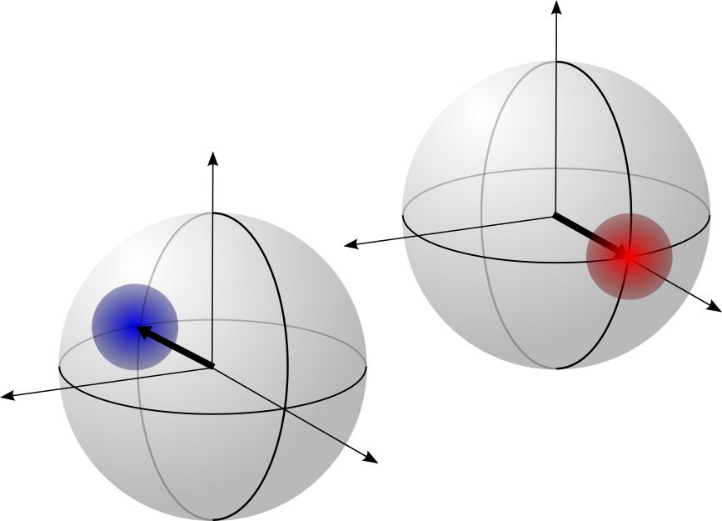
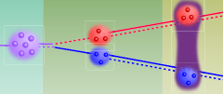
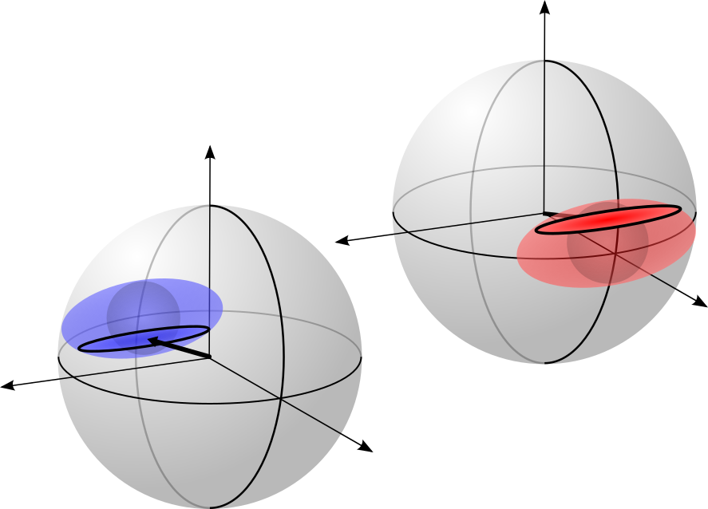
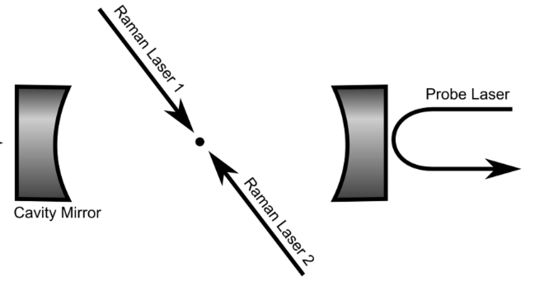
Two node entanglement
Experimental protocol:
Two spatially separated nodes
Initial ensemble, coherent spin state
Two nodes (via Doppler sensitive Raman transitions)
Cavity-assisted entanglement
Node entanglement via projective cavity measurement
Apparatus schematic:
Entanglement interaction leads to broadening of the marginal distribution and number correlation of the conditional distribution.
Malia, et al., Nature 2022

Slide 10
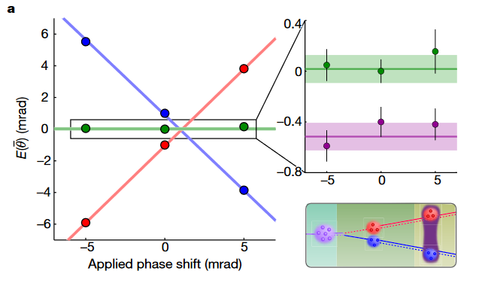

Two node network phase observable
Network (collective) phase observable for M network nodes:
Node 1
Network phase
Network phase
Node 1 - Node 2 (offset)
Observable suppresses local oscillator phase noise.
Node 2
Applied local oscillator phase shift (mrad)

Slide 11
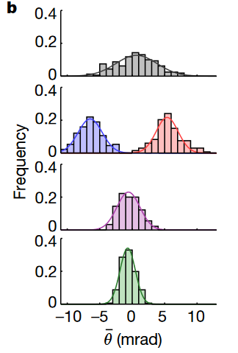
Two node noise
Coherent spin state, 2 node response
Single node coherent spin state response
Node separable (each node independently squeezed)
Noise inferred from a second cavity interrogation.
Both nodes share the common cavity mode.
Node entangled
Malia, et al., Nature 2022

Slide 12
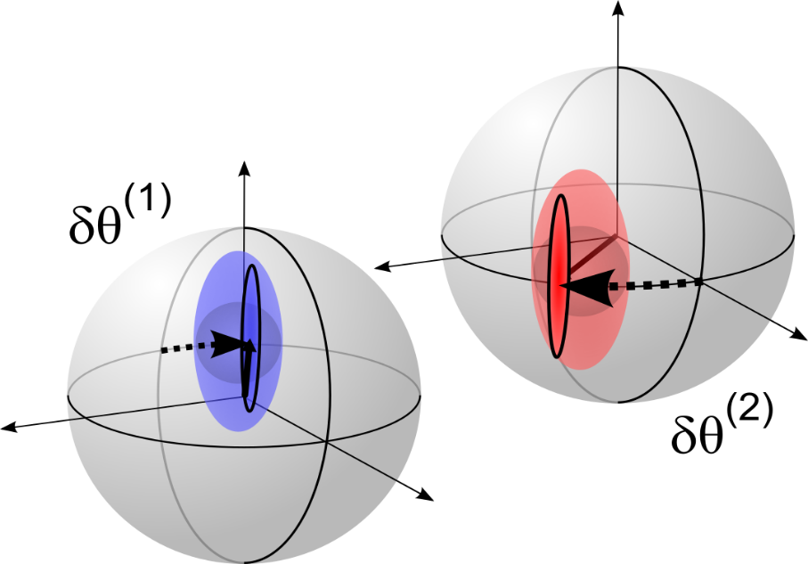
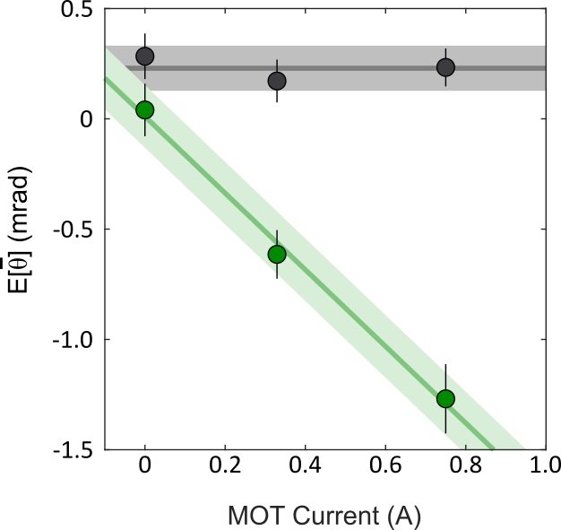
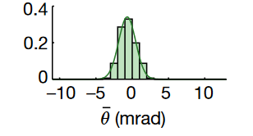
Two node metrology
Measured differential phase shift due to magnetic field gradient (green).
Prepare 2 node entangled state (non-destructive measurement of J_{z})
Microwave Ramsey sequence
Detection (second measurement of J_{z})
No change in width of detection noise histogram vs. applied phase shift.

Slide 13
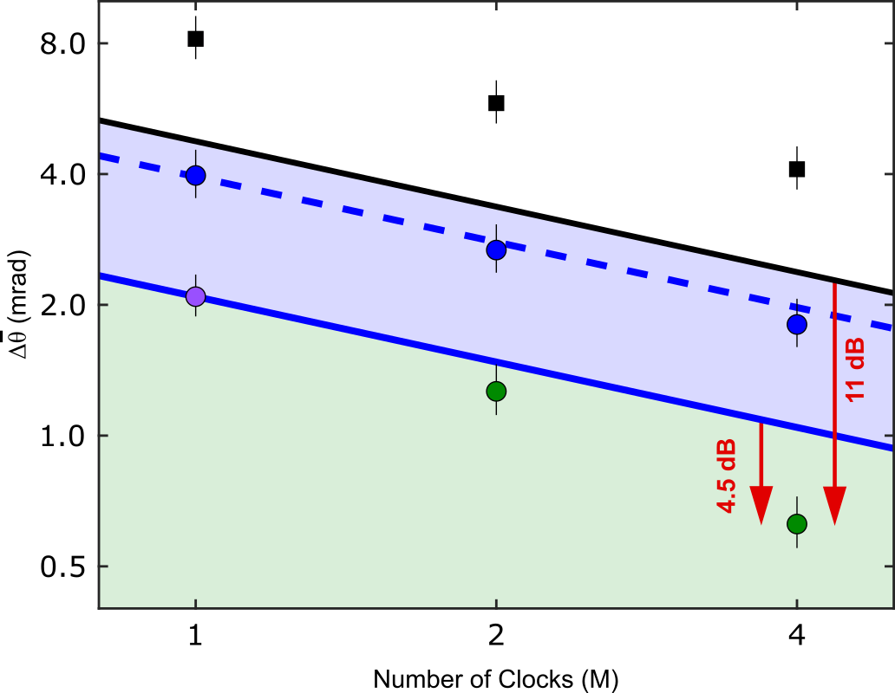
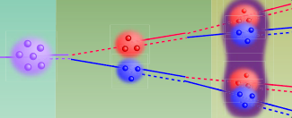
Two and four node metrological noise improvement
Network phase noise vs. number of nodes
Coherent state + local oscillator noise (black squares)
Projection noise (black line)
Node separable + local oscillator noise (blue circles)
4 node entangled state preparation
Node entangled noise (green)
Number of nodes

Slide 14
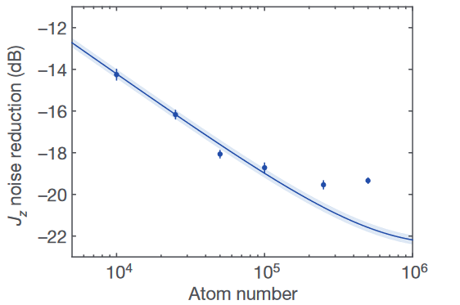
Why?
Squeezing efficacy for projective, cavity-assisted, squeezing improves with atom number.
More nodes = more atoms.
Hosten, et al., Natue 2016

Slide 15
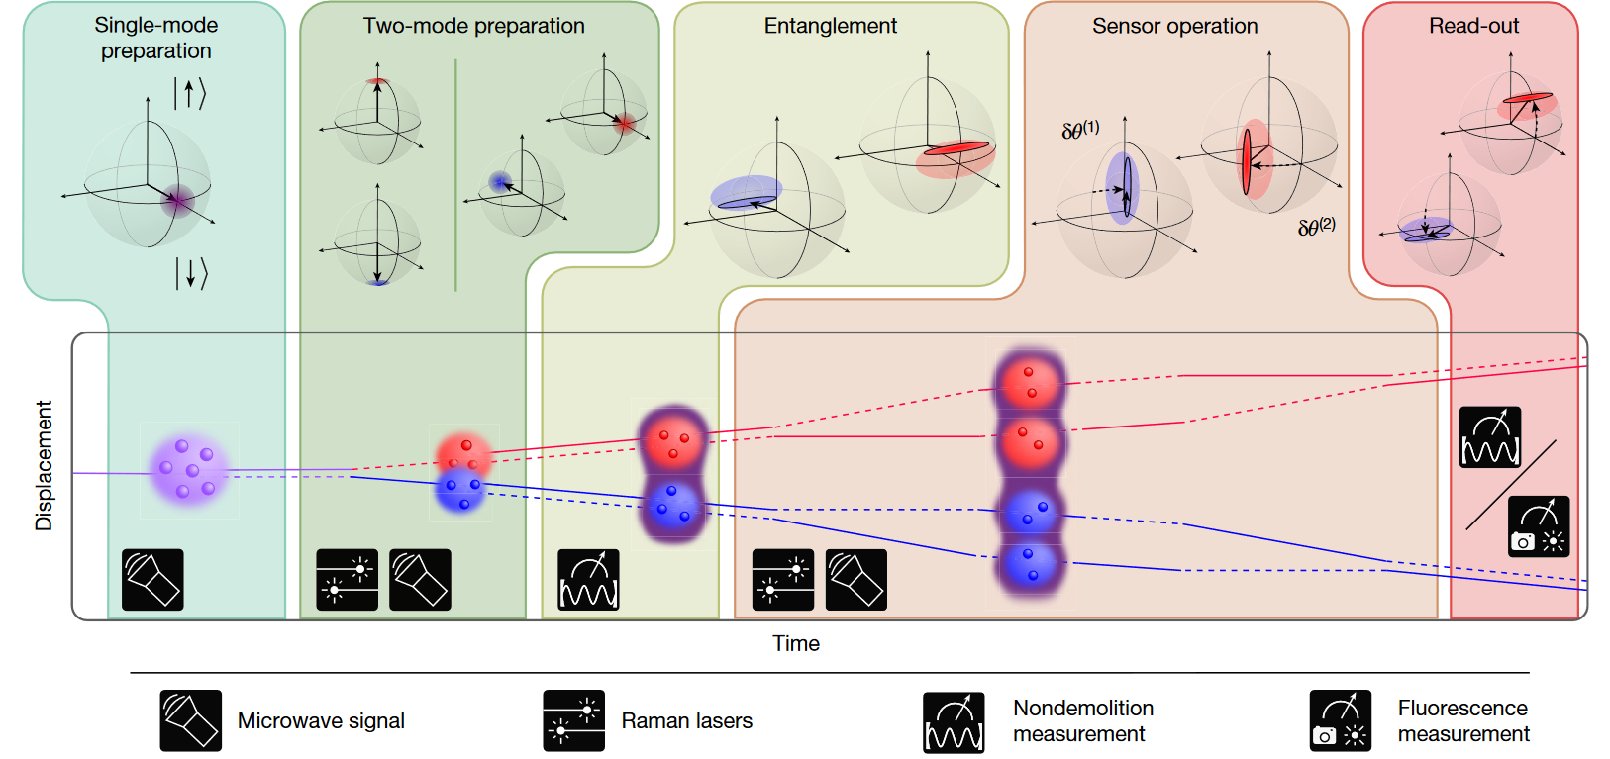
Application to 2 node atom interferometry

Slide 16
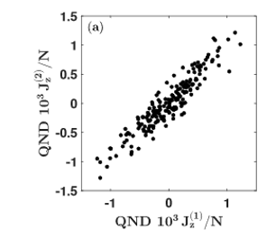
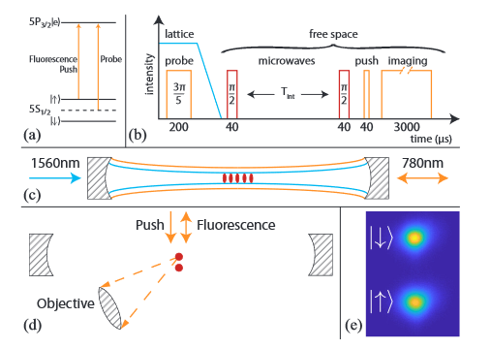
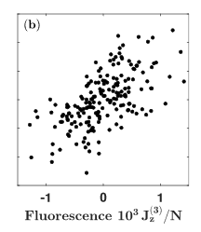

Fluorescence detection
Malia, et al., PRL 2020

Slide 17
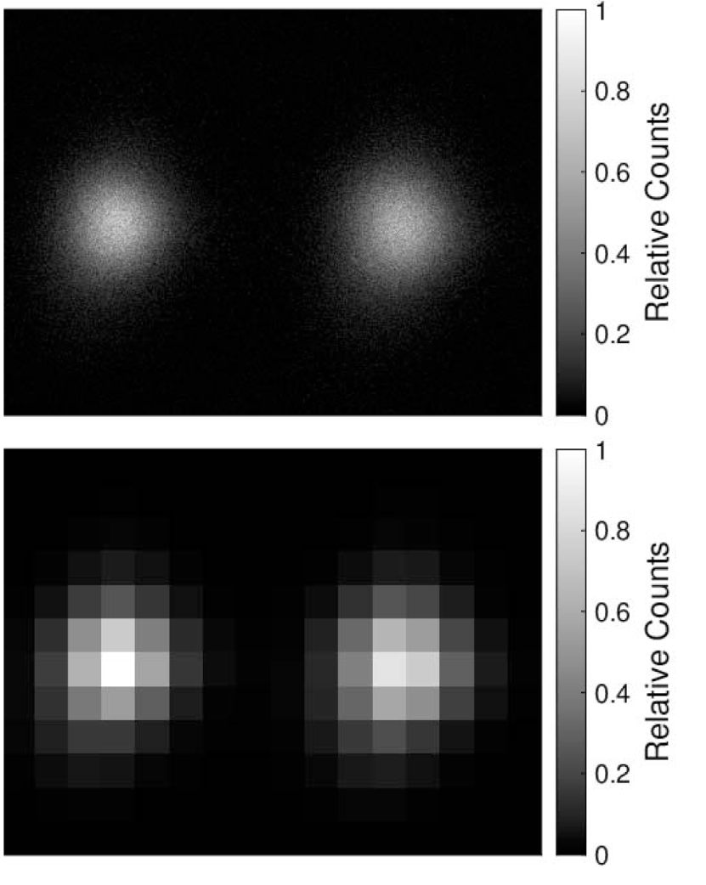
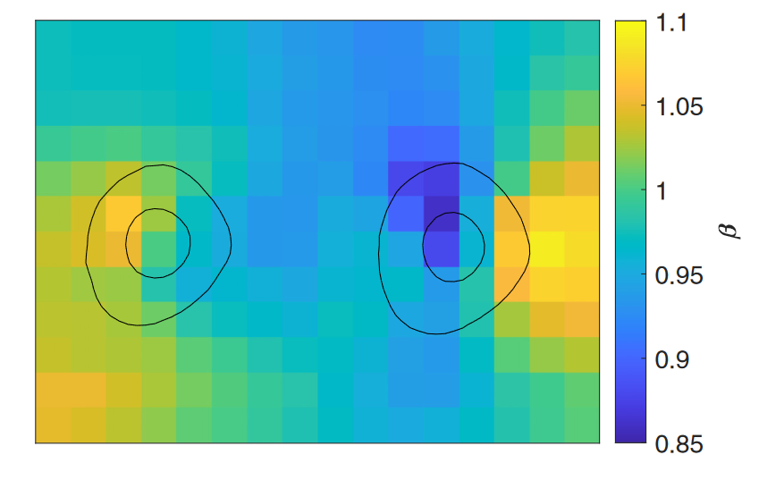
Machine learning to train detection system
Use machine learning to correct detection inhomogeneities associated with fluorescence imaging.
Train fluorescent images with truth from cavity output.
27% reduction in measurement noise (7.2 dB squeezing).
Raw and pixelated images used for training.
Malia, et al., PRA 2022

Slide 18
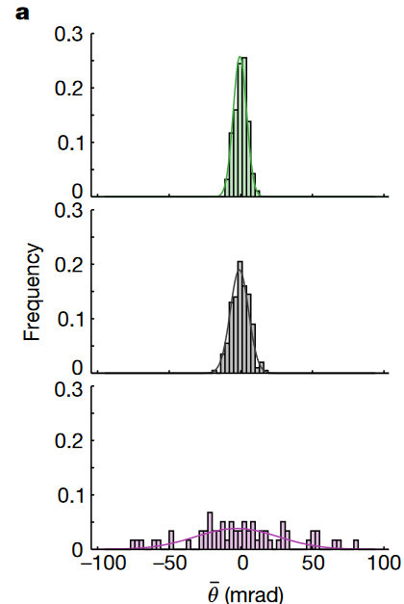
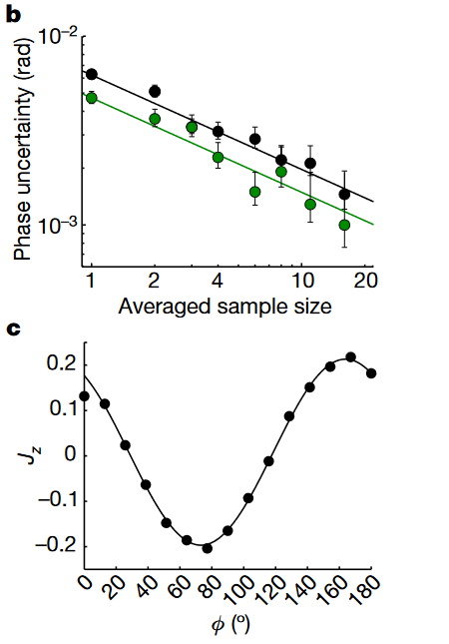
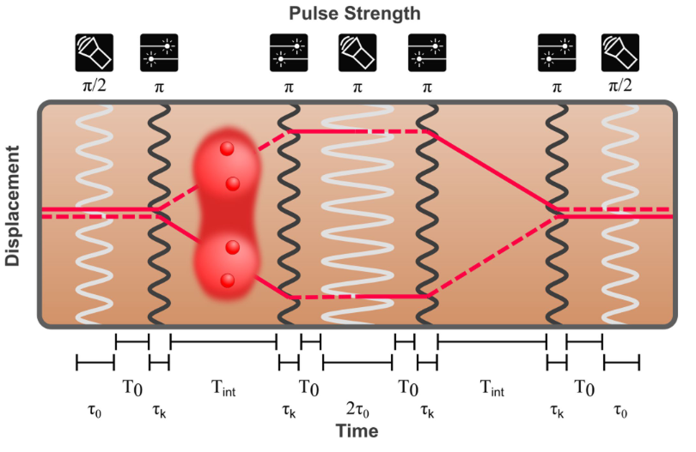
Two node atom interferometry demonstration
Node entangled
Coherent state
Node entangled
Coherent state, 2 nodes (rejects local oscillator noise)
Single node interferometer sequence.
Microwave interaction (white); Raman interaction (black).
Nodes are separated by 0.16 mm.
Singe node + local oscillator noise
Contrast

Slide 19
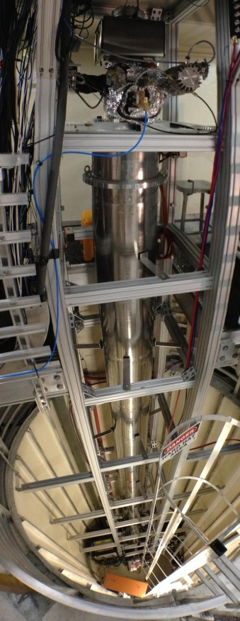
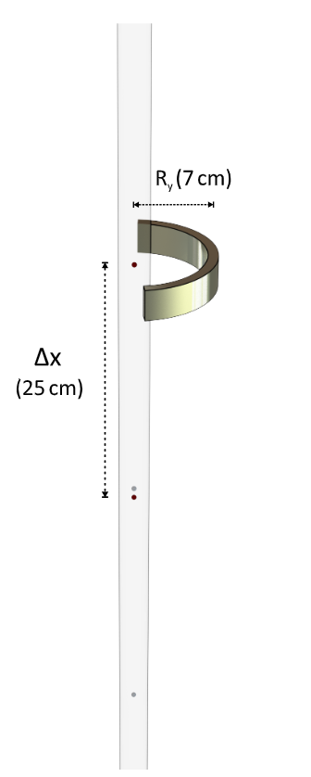
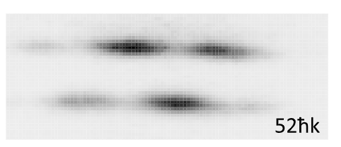
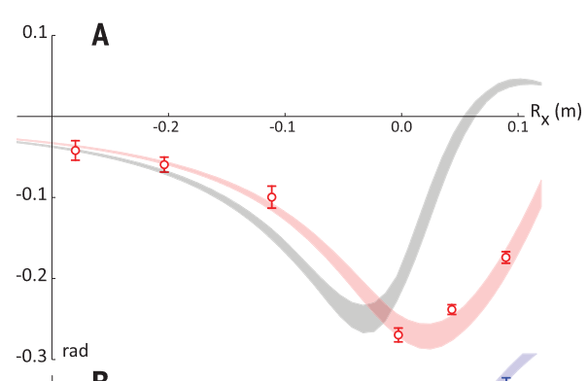
Future application to long baseline atom interferometers
Apparatus
Experiment
Raw data
1e-12 g accelerometer resolution using atom interferometry.
Applications in foundation of QM, DM searches, gravitational wave detection, tests of the equivalence principle and geodesy.
Results
Semi-classical theory
Gravitational Aharonov-Bohm phase shift
Overstreet, et al., Science 2022

Slide 20
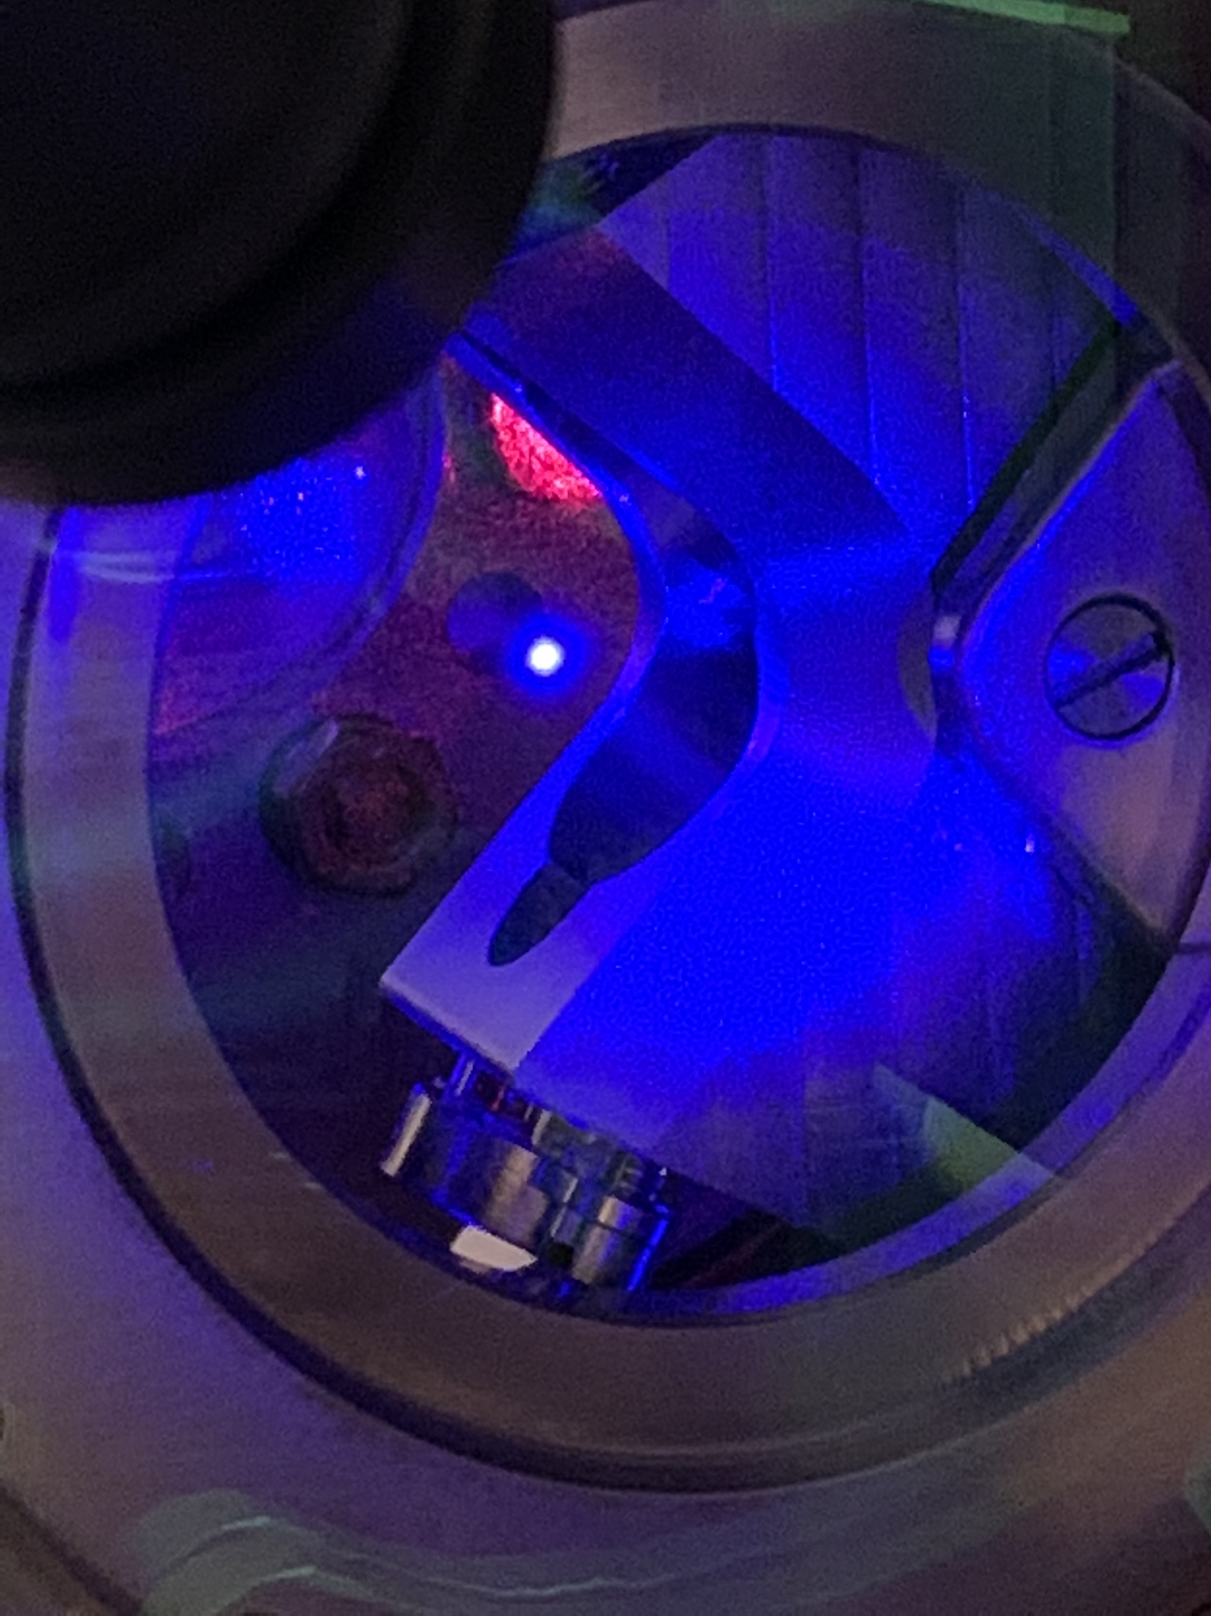
Future
Currently working to implement this protocol with Sr optical clocks:
- gravitational redshift between entangled clock ensembles
- gravitational Aharonov-Bohm effect with entangled ensembles
- large distance scale for network using multiple cavities and low-loss photonic link.

Slide 21


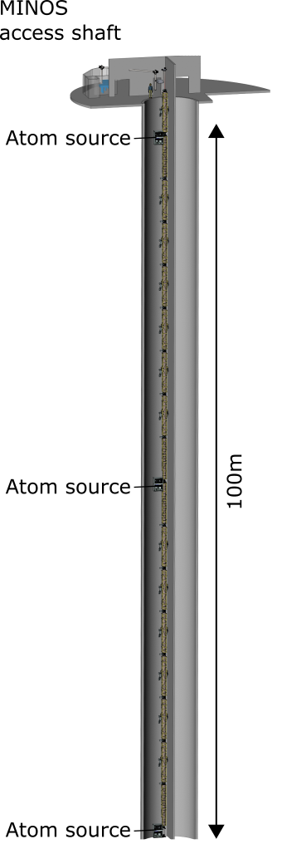
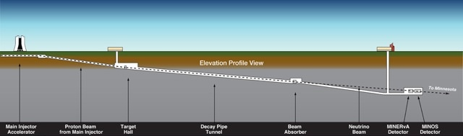









Incorporate into the MAGIS-100 detector
100 m separation between atom interferometers
Prototype 0.3 – 3 Hz gravitational wave detector

Slide 22
Thanks
Onur Hosten (IST Austria)
Nils Engelsen (Chalmers)
Rajiv Krishnakumar (start-up)
Julian Martinez (Brookhaven)
Ben Malia (Cornell)
Yunfan Wu (start-up)
Guglielmo Panelli (PhD student)
Erik Porter (PhD student)
Shuan Burd (post-doc)

