Slide 1


Roadmap towards a redefinition of the SI second
Noel Dimarcq CIPM Member, CCTF President
Patrizia Tavella BIPM, CCTF Executive secretary
with the
CCTF Strategic WG extended to co-chairs of dedicated CCTF task groups
CCTF Task Force on the Roadmap towards the redefinition of the second

Slide 2
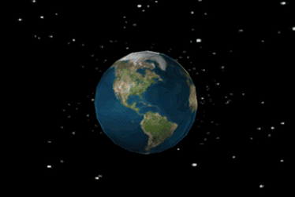

Definitions of the SI unit of time
The SI unit of time – the second – is defined as:
→ until 1960 : the fraction 1/86 400 of the mean solar day
→ 1960 to 1967 : the fraction 1/31,556,925.9747 of the tropical year 1900
1 tropical year = 365,2422 solar days = 366,2422 sideral days
1967 : the duration of 9 192 631 770 periods of the radiation corresponding to the transition between the two hyperfine levels of the ground state of the cesium 133 atom Added in 1999: This definition refers to a cesium atom at rest at a temperature of 0 K
New formulation in 2018:
The second, symbol s, is the SI unit of time. It is defined by taking the fixed numerical value of the caesium frequency Δν_{Cs}, the unperturbed ground-state hyperfine transition frequency of the caesium-133 atom, to be 9 192 631 770 when expressed in the unit Hz, which is equal to s^{–1}.
any
Astronomy
(from the configurations of a dynamical system)
This specific one
Quantum physics
(frequency of a periodic process)

Slide 3
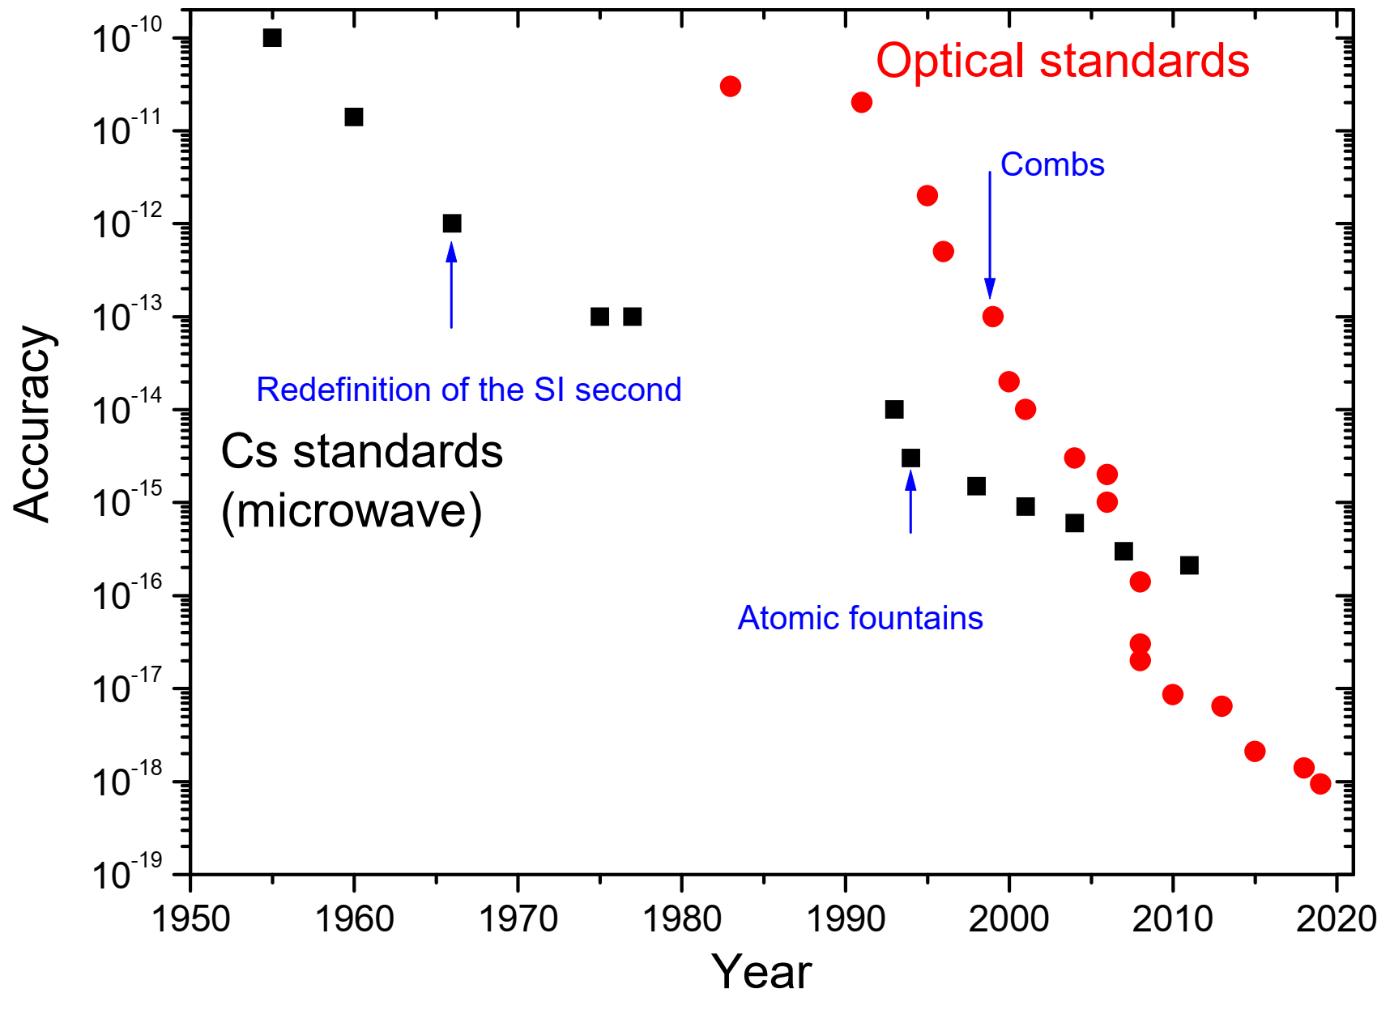

Realization of the SI second with primary Cs frequency standards
Cs fountain accuracy ∼ 10⁻¹⁶

Slide 4
13th General Conference on Weights and Measures CGPM (1967)
Resolution 1
The second is the duration of 9 192 631 770 periods of the radiation corresponding to the transition between the two hyperfine levels of the ground state of the caesium 133 atom.
Resolution 2
Considering that the cesium frequency standard is still perfectible and current experiments allow the hope of producing other standards with even better qualities to define the second,
invites …. laboratories in the field of atomic frequency standards to actively pursue their studies.
Since 2001 CCL-CCTF working group on Frequency Standards:
produces and maintains a single list of Recommended frequency standard values for applications including the practical realization of the metre and secondary representations of the second.

Slide 5
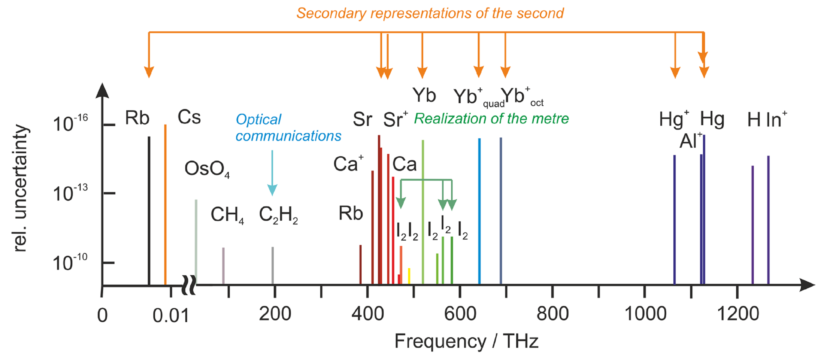
Secondary representations of the second
https://www.bipm.org/en/publications/mises-en-pratique/standard-frequencies-info
List of recommended standard frequencies (validated by CIPM, published on the BIPM website) recommended for applications including the practical realization of the metre and secondary representations of the second
Uncertainty limited by the Cesium primary realization

Slide 6
Values of the secondary representations of the second from a multisystem of frequency ratio measures
Estimation by 3 independent methods and software
Take into account the correlation between measurements (e.g. due to their comparison to the same Cs standards
All the estimates are interrelated
Joint CCL-CCTF WG (2020-21)
Graphical representation of 105 frequency measures (33 optical frequency ratios and 72 absolute frequency measures vs Cesium) used for the calculation of 14 frequency values.
The new computational mode has been able to take into account 483 correlations
Metrologia paper in progress

Slide 7
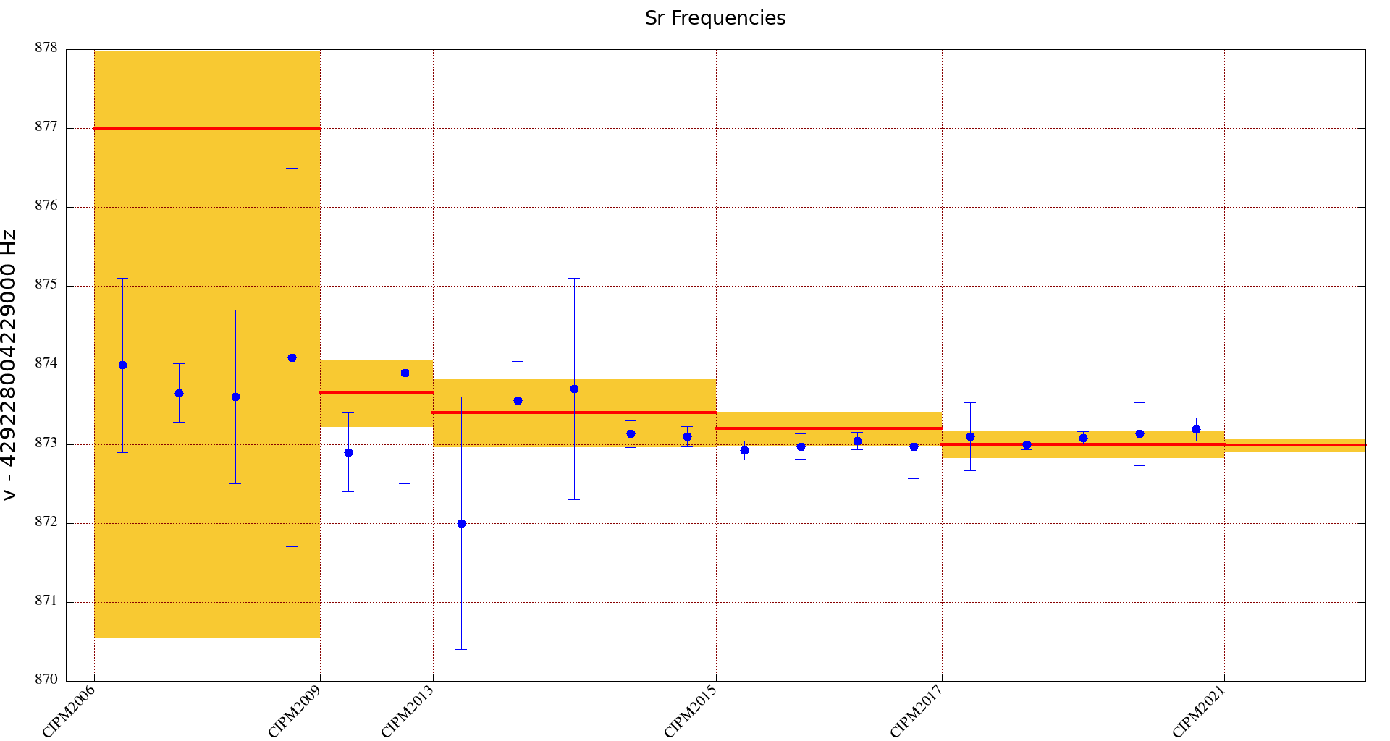
87Sr | 429228004229872.99 | 1.9 E-16
1 874.000000 1.1 [Boyd2007]
2 873.650000 0.37 [Campbell2008]
3 873.600000 1.1 [Baillard2008]
4 874.100000 2.4 [Hong2009]
5 872.900000 0.5 [Falke2011]
6 873.900000 1.4 [Yamaguchi2012]
7 872.000000 1.6 [Akamatsu2014b]
8 873.560000 0.49 [Tanabe2015]
9 873.700000 1.4 [Lin2015]
10 873.130000 0.17 [Falke2014]
11 873.100000 0.13 [LeTargat2013]
12 872.920000 0.12 [Lodewyck2016]
13 872.970000 0.16 [Grebing2016(Oct14)]
14 873.040000 0.11 [Grebing2016(Jun15)]
15 872.970000 0.4 [Hachisu2017]
16 873.100000 0.429 [Hobson2020]
17 873.000000 0.0708 [Schwarz2020]
18 873.082000 0.0773 [Nemitz2020]
19 873.130000 0.4 [Grotti2018]
20 873.190000 0.15 [Leopardi2020]

Slide 8
The era of optical frequency metrology
Optical Frequency Standards (Sr, Yb, Yb+, Al+, Ca+, …) at 10⁻¹⁸ level
→ Time to change the definition?

Slide 9
Goals for a new definition
Offer an improvement by 10 to 100 of the realization of the new definition on short term after the redefinition (reaching 10⁻¹⁷ to 10^{‑18} relative frequency accuracy) and a larger improvement on longer term
Ensure continuity with the current definition
Ensure continuity and sustainability of the availability of the new SI second through TAI, and a significant improvement of the quality of TAI as soon as the definition is changed (at least no degradation !)
Enable the dissemination of the unit towards wide categories of users
Be acceptable by all NMIs and stakeholders

Slide 10
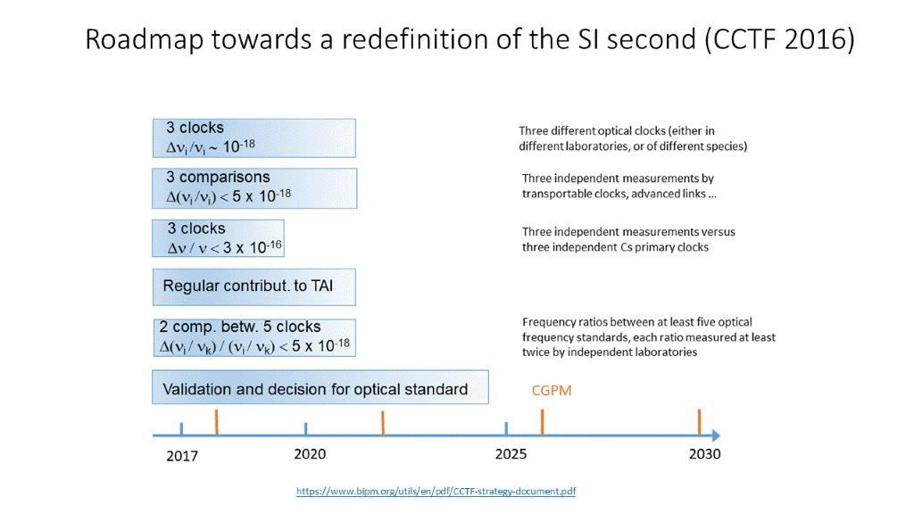
Criteria fixed in 2016 for a change of the definition

Slide 11

CCTF Task Force
Updating the roadmap towards the redefinition of the SI second
Roadmap and mandatory criteria (N. Dimarcq CIPM, P. Tavella BIPM)
Request from user communities, NMIs and Liaisons (M. Gertsvolf, NRC; G. Mileti, Uni Neuchatel)
Atomic frequency standards, and redefinition approaches (S. Bize, SYRTE; E. Peik, PTB; C. Oates, NIST)
TF Dissemination and time scales (D Calonico, INRIM; T. Ido NICT)
=> Started in 2020, presented the objectives to the CCTF 22-1 in October 2020, updates on the work to the CCTF 22-2 in March 2021, and CCTF 23rd in June 2022,
  Launched a questionnaire online and stimulated > 200 answers
  Defined the mandatory criteria and the ancillary conditions for the redefinition readiness
  Evaluated the status of criteria fulfilment in 2021 and 2022
  Evaluated the impact on the user communities
  Proposed 3 possible options for the redefinitions and organized two related workshops online
  Published a Metrologia paper (accepted, under revision, http://arxiv.org/abs/2307.14141),
  and several posters/papers in international fora
More than 40 people from all the RMOs, all CCTF members at work

Slide 12
Priority setting of criteria / conditions to change definition
Validation that Optical Frequency Standards are at a level 100 times better than Cs
Continuity with the definition based on Cs
Regular contributions of OFS to TAI as secondary representations of the second
Availability of sustainable techniques for OFS comparisons
Knowledge of the local geopotential with a sufficient uncertainty level
Definition allowing future more accurate realizations
Access for NMIs to primary or secondary realizations of the new definition
Mandatory criteria
To be achieved
before changing the definition
Achieved
Mandatory achievements frontier
Ancillary conditions corresponding to essential Work still in progress when the definition is changed
High reliability of optical frequency standards
High reliability of ultra high stability T/F links
Continuous improvement of the realization and time scales after redefinition
Regular contributions of optical clocks to UTC(k)
Availability of commercial optical clocks
Improved quality of the dissemination towards users
In progress

Slide 13
Priority setting of criteria / conditions to change definition
Frequency standards & contribution to atomic time scales
Validation that Optical Frequency Standards are at a level 100 times better than Cs
Continuity with the definition based on Cs
Regular contributions of OFS to TAI as secondary representations of the second
Availability of sustainable techniques for OFS comparisons
Knowledge of the local geopotential at the proper level
Definition allowing future more accurate realizations
Access for NMIs to primary or secondary realizations of the new definition
Mandatory criteria
To be achieved
before changing the definition
Achieved
Mandatory achievements frontier
Ancillary conditions corresponding to essential Work still in progress when the definition is changed
High reliability of optical frequency standards
High reliability of ultra high stability T/F links
Continuous improvement of the realization and time scales after redefinition
Regular contributions of optical clocks to UTC(k)
Availability of commercial optical clocks (III.4)
Improved quality of the dissemination towards users (III.5)
In progress

Slide 14
Priority setting of criteria / conditions to change definition
TF comparison and dissemination
Validation that Optical Frequency Standards are at a level 100 times better than Cs
Continuity with the definition based on Cs
Regular contributions of OFS to TAI as secondary representations of the second
Availability of sustainable techniques for OFS comparisons
Knowledge of the local geopotential at the proper level
Definition allowing future more accurate realizations
Access for NMIs to primary or secondary realizations of the new definition
Mandatory criteria
To be achieved
before changing the definition
Achieved
Mandatory achievements frontier
Ancillary conditions corresponding to essential Work still in progress when the definition is changed
High reliability of optical frequency standards
High reliability of ultra high stability T/F links
Continuous improvement of the realization and time scales after redefinition
Regular contributions of optical clocks to UTC(k)
Availability of commercial optical clocks
Improved quality of the dissemination towards users
In progress

Slide 15
Priority setting of criteria / conditions to change definition
Acceptability of the new definition
Validation that Optical Frequency Standards are at a level 100 times better than Cs
Continuity with the definition based on Cs
Regular contributions of OFS to TAI as secondary representations of the second
Availability of sustainable techniques for OFS comparisons
Knowledge of the local geopotential at the proper level
Definition allowing future more accurate realizations
Access for NMIs to primary or secondary realizations of the new definition
Mandatory criteria
To be achieved
before changing the definition
Achieved
Mandatory achievements frontier
Ancillary conditions corresponding to essential Work still in progress when the definition is changed
High reliability of optical frequency standards
High reliability of ultra high stability T/F links
Continuous improvement of the realization and time scales after redefinition
Regular contributions of optical clocks to UTC(k)
Availability of commercial optical clocks
Improved quality of the dissemination towards users
In progress

Slide 16
Fulfilment level of mandatory criteria (2022)
Mandatory criteria
I.1 - OFS accuracy budgets ( < 2x10⁻¹⁸ )
2022
I.2 - Validation of OFS accuracy budgets
– Frequency ratios ( < 5x10⁻¹⁸ )
2022
I.3 - Continuity with the definition based on Cs ( < 3x10⁻¹⁶ )
2022
I.4 - Regular contributions of OFS to TAI
( 5 OFS contributing @ 2x10⁻¹⁶ )
2022
II.1 - Availability of sustainable techniques for OFS comparisons ( @ 5x10⁻¹⁸ )
2022
II.2 - Knowledge of the local geopotential at the proper level
2022
III.1 - Definition allowing future more accurate realizations
To be confirmed, based on the chosen redefinition option
III.2 - Access to the realization of the new definition
2022
< 30 %
30-50 %
50-70 %
70-90 %
90-100 %
> 100 %
Achievement level

Slide 17
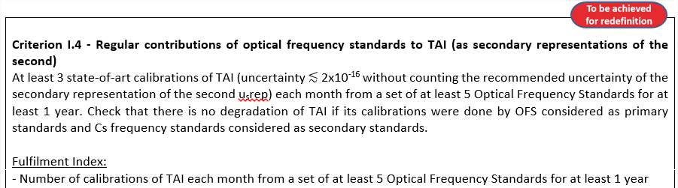
Criteria and conditions related to frequency standards and their contribution to time scales

Slide 18
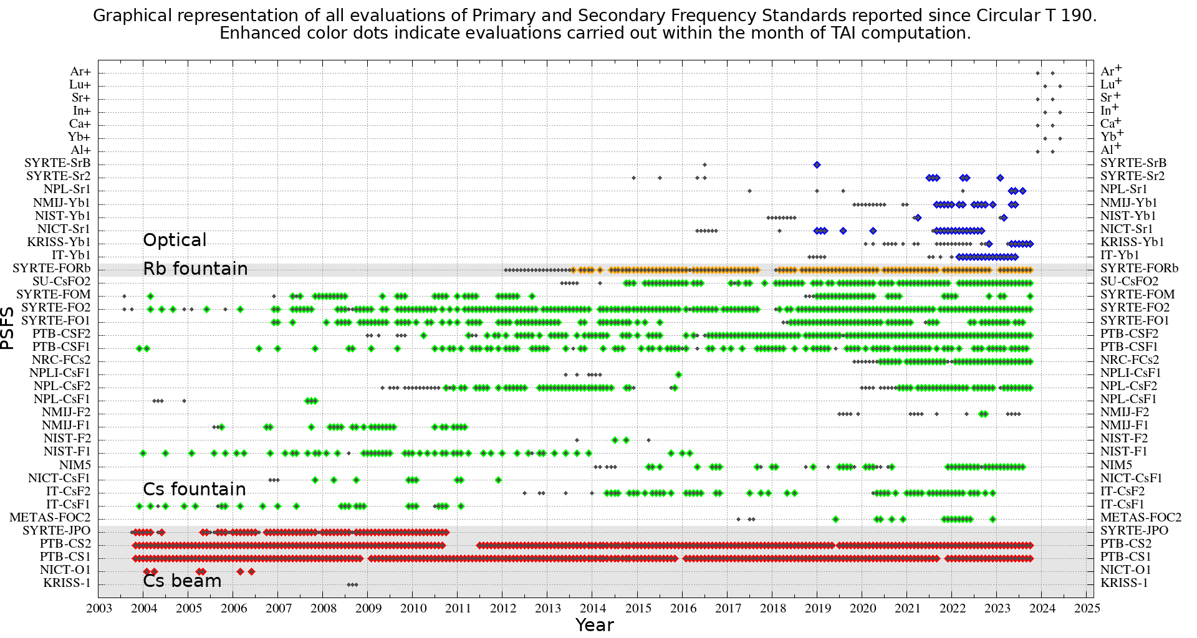
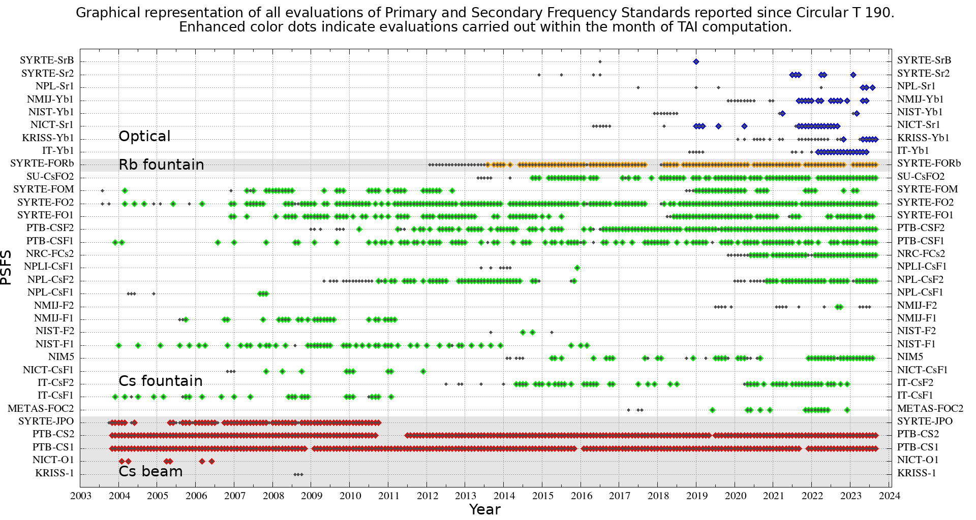
Contribution from Primary and Secondary Frequency Standards to UTC
https://webtai.bipm.org/database/show_psfs.html
Next ion standard contribuons

Slide 19
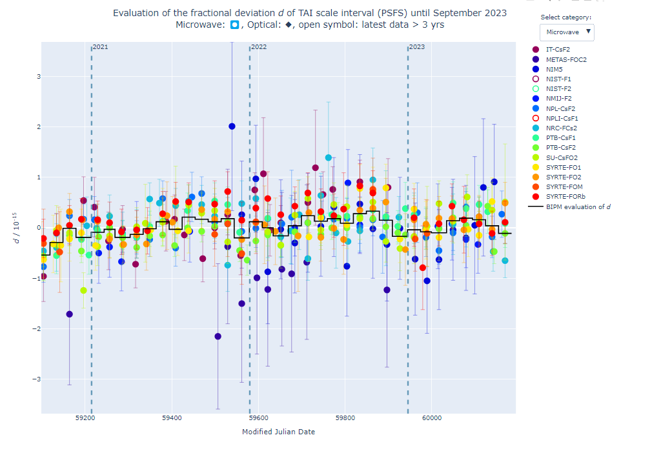
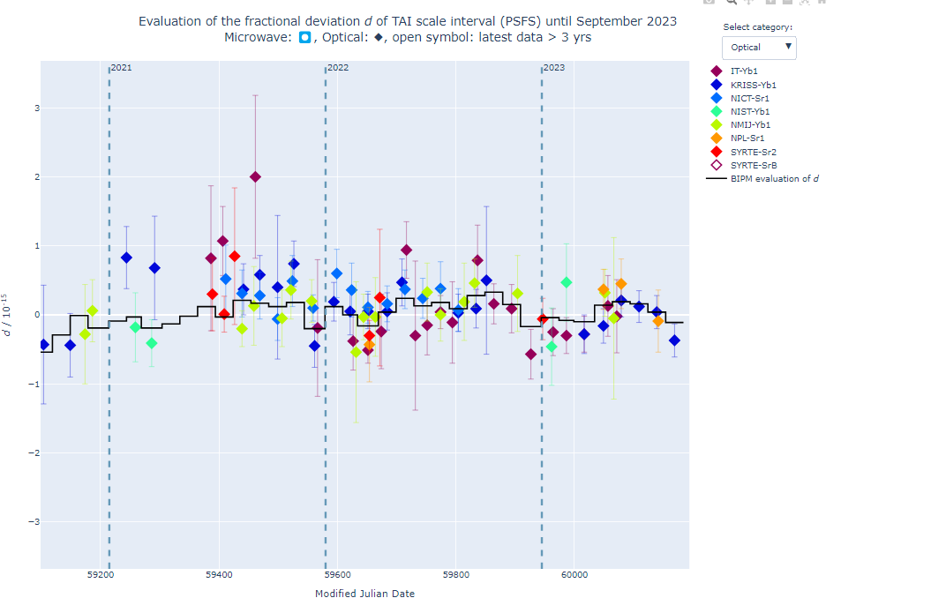
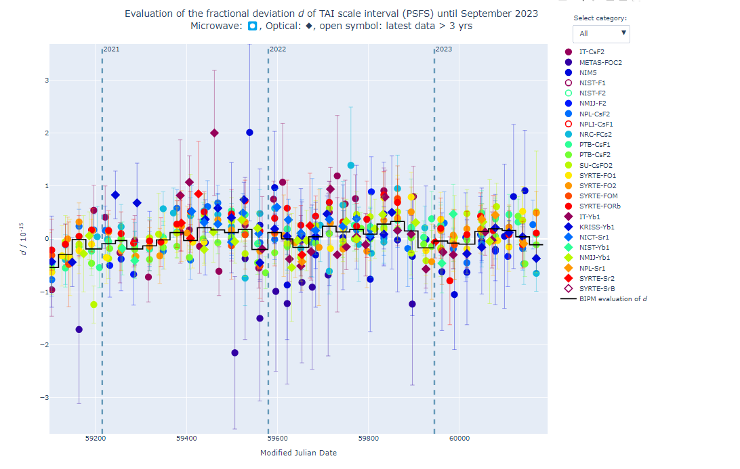
https://webtai.bipm.org/database/d_plot.html

Slide 20
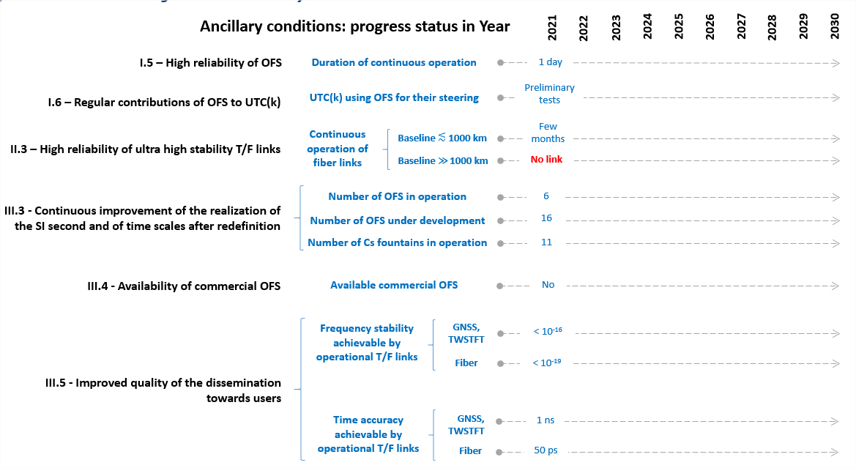
Progress level of ancillary conditions

Slide 21

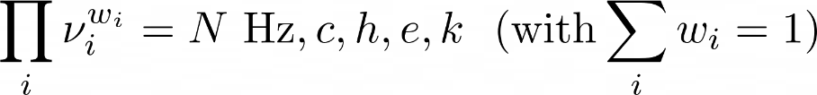
Summary of options for the redefinition
Option 1:
  Example
Option 2.1:
  Example
Option 2.2:
  CIPM can update w_{i}, N and the ensemble of chosen transitions following a set of predefined rules
  Opt 2.2 is initially identical to opt 2.1, and include opt 1 as special case
Option 3:
  Example:
static definition
dynamic definition

Slide 22
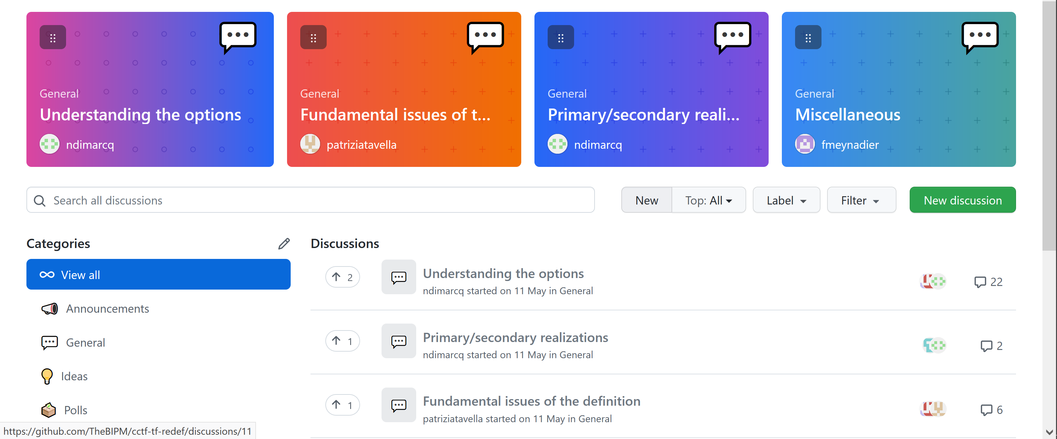
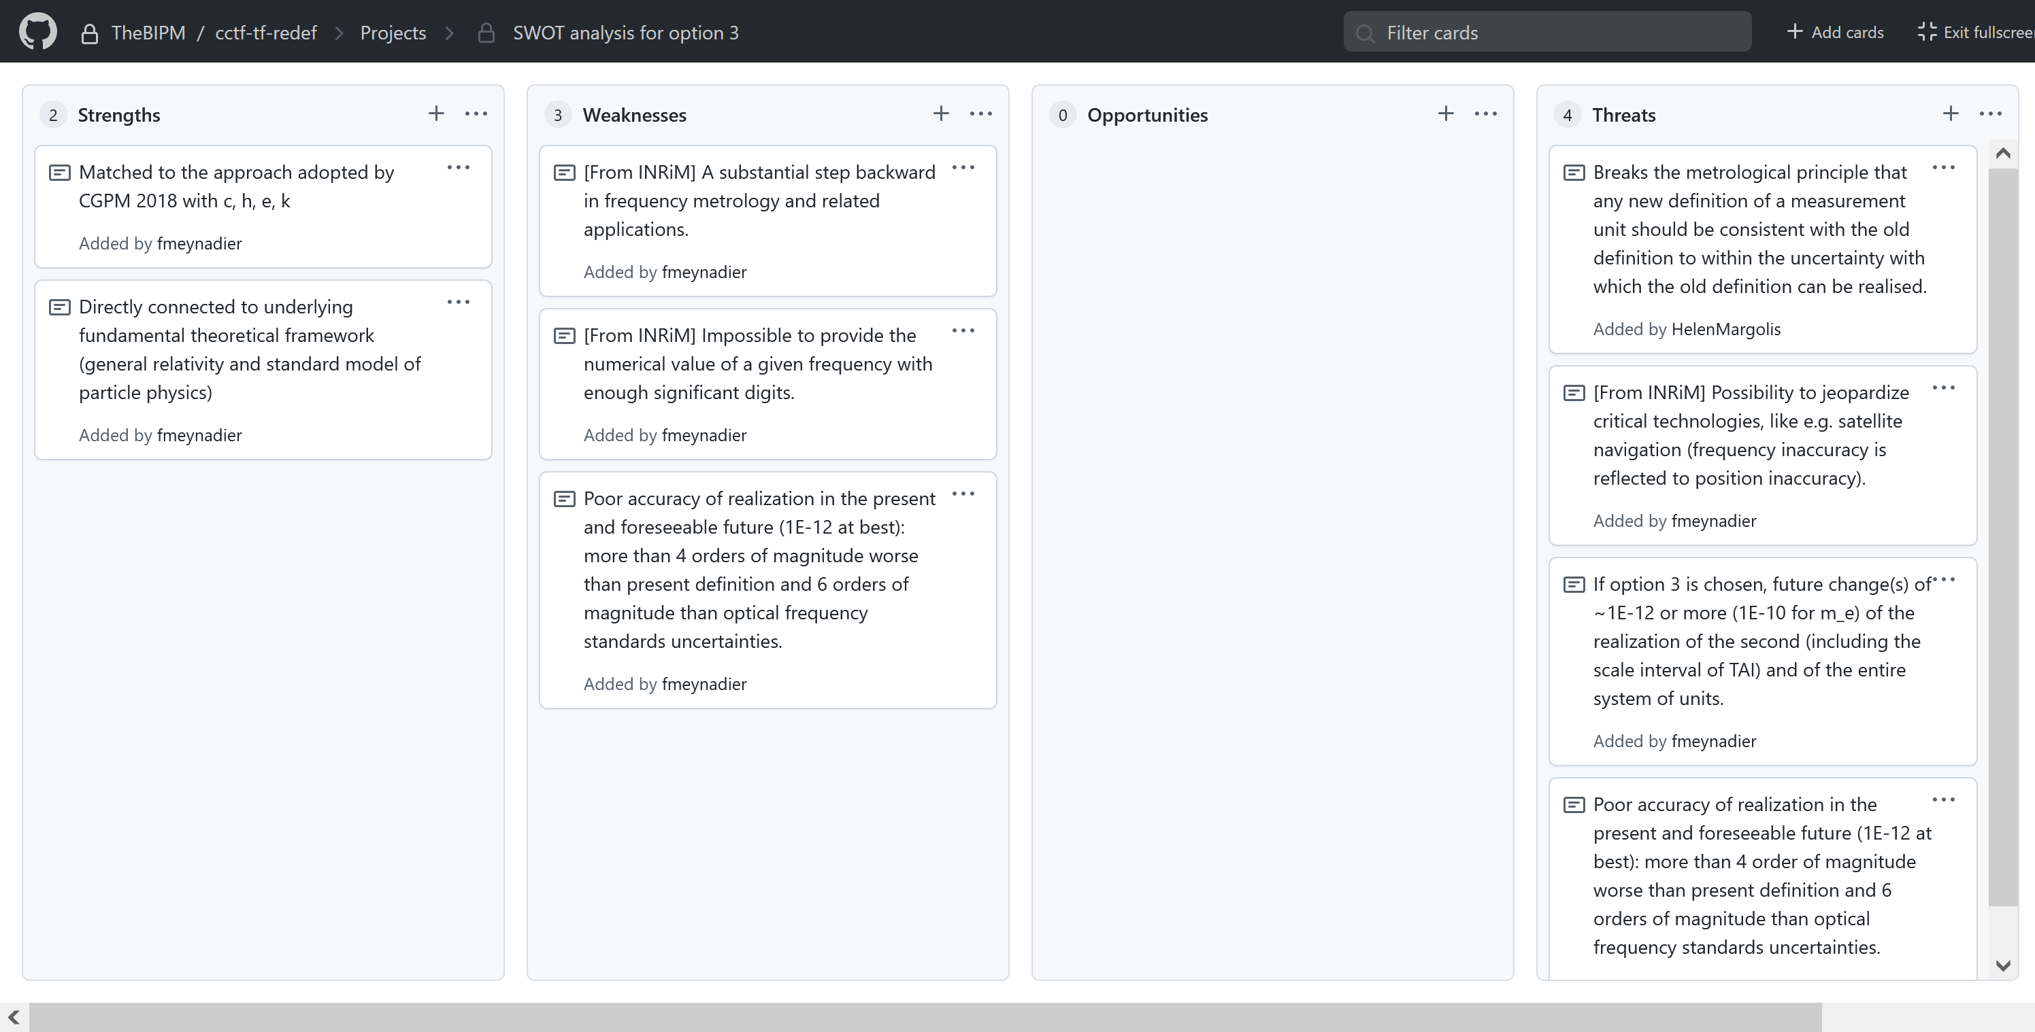
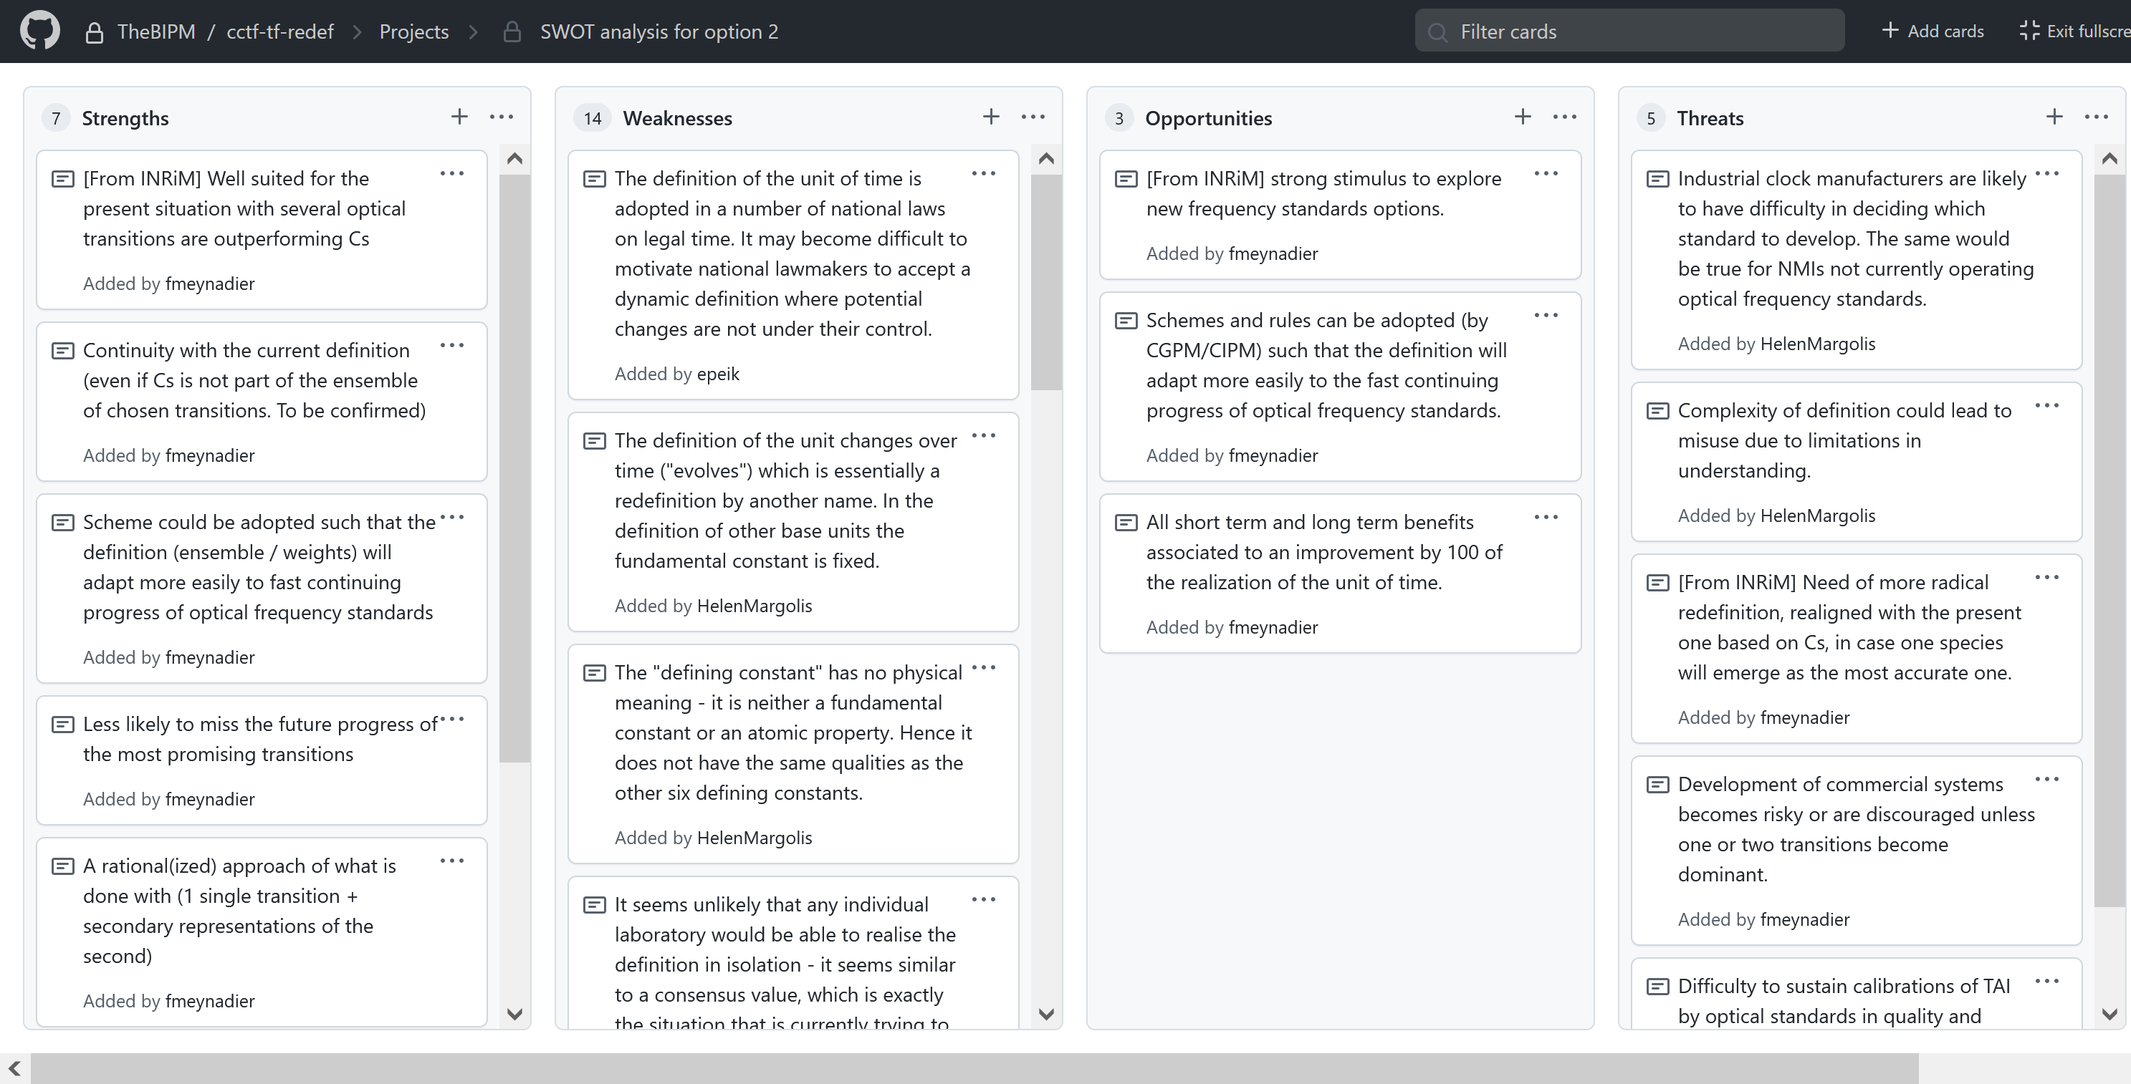
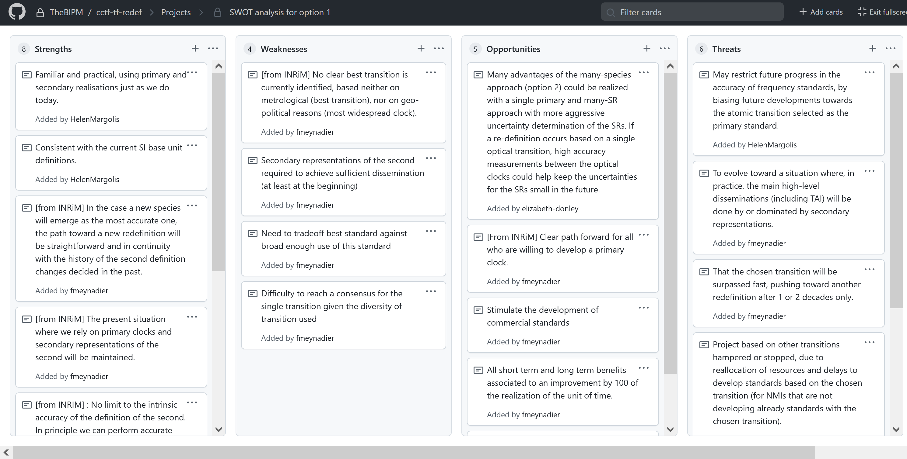
Strengths, Weaknesses, Opportunities and Threats
Based on the many inputs from CCTF workshop participants
  A Git page was used
  One SWOT analysis for each option 1, 2 & 3.
  3 discussion tracks: “understanding the options”, “Fundamental issues of the definition” and “Primary/secondary realizations”
see presentation by Jerome Lodewyck

Slide 23
Scenarios for the redefinition of the second
CGPM
2022
2026
2030
2034
….
A redefinition at CGPM 2026 is unrealistic since in 2022 there was no consensus on the preferred option and still some important work to fulfil all mandatory criteria.

Slide 24
Scenarios for the redefinition of the second
CGPM
2022
2026
2030
2034
….
A redefinition at CGPM 2026 is unrealistic since in 2022 there was no consensus on the preferred option and still some important work to fulfil all mandatory criteria.
CGPM 2026 could validate a roadmap towards a redefinition in 2030 if, in 2026, there is a consensus on the redefinition option to be chosen and if the work to fulfil mandatory criteria is likely to be achievable by 2030.

Slide 25
Scenarios for the redefinition of the second
CGPM
2022
2026
2030
2034
….
A redefinition at CGPM 2026 is unrealistic since in 2022 there was no consensus on the preferred option and still some important work to fulfil all mandatory criteria.
CGPM 2026 could validate a roadmap towards a redefinition in 2030 if, in 2026, there is a consensus on the redefinition option to be chosen and if the work to fulfil mandatory criteria is likely to be achievable by 2030.
If it is not possible in 2030, the redefinition will be postponed, to CGPM 2034 or the following one… But what about maintaining until 2040 and later the operation of Cs fountains that have been built in the 1990s - 2000s?

Slide 26
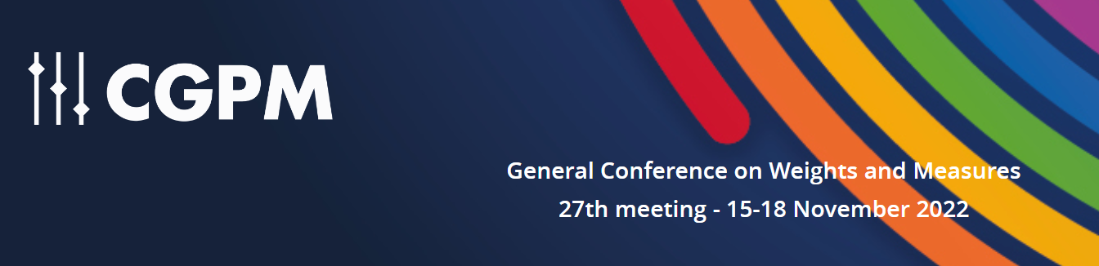
Updating the Roadmap for the redefinition of second
https://www.bipm.org/documents/20126/64811223/Resolutions-2022.pdf
CGPM 2022 Resolution 5 - On the future redefinition of the second
encourages the International Committee for Weights and Measures (CIPM)
to promote the importance of achieving the objectives in the roadmap for the redefinition of the second,
to bring proposals to the 28th meeting of the CGPM (2026) for the choice of the preferred species, or ensemble of species for a new definition of the second, and for the further steps that must be taken for a new definition to be adopted at the 29th meeting of the CGPM (2030),
and invites Member States to support research activities, and the development of national and international infrastructures, to allow progress towards the adoption of a new definition of the second.

Slide 27
Working towards CGPM 2026
in preparation to CGPM 2026, we need a consensus on
which definition option, which radiation(s) (or a few possibilities)
have a good confidence in the capacity to fulfil the mandatory criteria before 2030
Re-organization of the Task Force for the redefinition of the second
Coordination: Dimarcq, Tavella
SG 1 - Redef options (Bize, Peik, Fang, Panfilo with members to ensure an international/all countries point of view)
Provide analysis of concrete proposals focused on options 1 and 2
SG 2 - Criteria (Calonico, Ido, Weyers, Tagliaferro with Chairs CCTF WG FS, PSFS, ATFT, TAI, ALGO, GNSS, TWSTFT )
Monitor fulfilment index and promotion of progress and achievements
SG 3 - Education (Gertsvolf and Mileti, Meynadier with dedicated members )
Educational activities and communication

Slide 28
TF Actions and deliverables
 |  | KO all TF members Sept 26, 2023 | CCTF Information meeting, Nov 16, 2023 | 24th CCTF Session 1 Nov 2024 | 24th CCTF Session 2 Sept. 2025 | CGPM 2026
TF | Action Plan | Almost finalized | Finalized
 | Updated roadmap towards the redefinition of the second, criteria, conditions, and Indicators to discriminate among redef possibilities |  |  | Draft Preliminary redef possibilities | Updated roadmap with chosen redefinition option and species (or a few possibilities) and planned fulfilment of mandatory criteria by 2029
 | Draft resolution to the CGPM |  |  | draft | Submitted to CGPM
SG1 | Option documents Description of options describing opt 1, opt 2 (a and b), (opt 3), practical implementation of opt 1 and 2 (comparative table?) Pros/cons | ToC and draft version | First version | Final version
 | Factsheets on most promising atomic species | Template/ Preliminary version | First version | Updated version - Categorize candidates (mostly ready, intermediate, not ready) | Final version
SG2 | Factsheet for each criterion fulfilment status | Template/ Preliminary version | First version | Updated version – Pointing out criticalities and achievements | Updated version
SG2 | On CCTF web page: criteria fulfilment presentation | Announce | 2023 version | 2024 version | 2025 version | 2026 version
 | Ideas for recognition of the activities in NMIs and for valorisation of achievements and progress. Monitor projects and possible delay in achievements with the Sg3 and all sg Chairs | Preliminary list of ideas | Proposed list of ideas | Updated status | Updated status
SG3 | Shared repository for educational, reference and supporting material (including attribution and copyright rules) | Announce | Draft plan | Updated status | Updated status
 | FAQ page on the CCTF web page (with possibility to raise additional questions) | Announce | Template | First update | Updated status
SG3 | Develop tools for recognizing and acknowledging achievements at NMIs and progress status of the criteria fulfilment (with SG2) | Announce | Draft plan | Updated status | Updated status
 | Develop long-term plan for education and communication to wider audience (with SG1 and SG2) | Announce | Draft plan | Updated status | Updated status

Slide 29
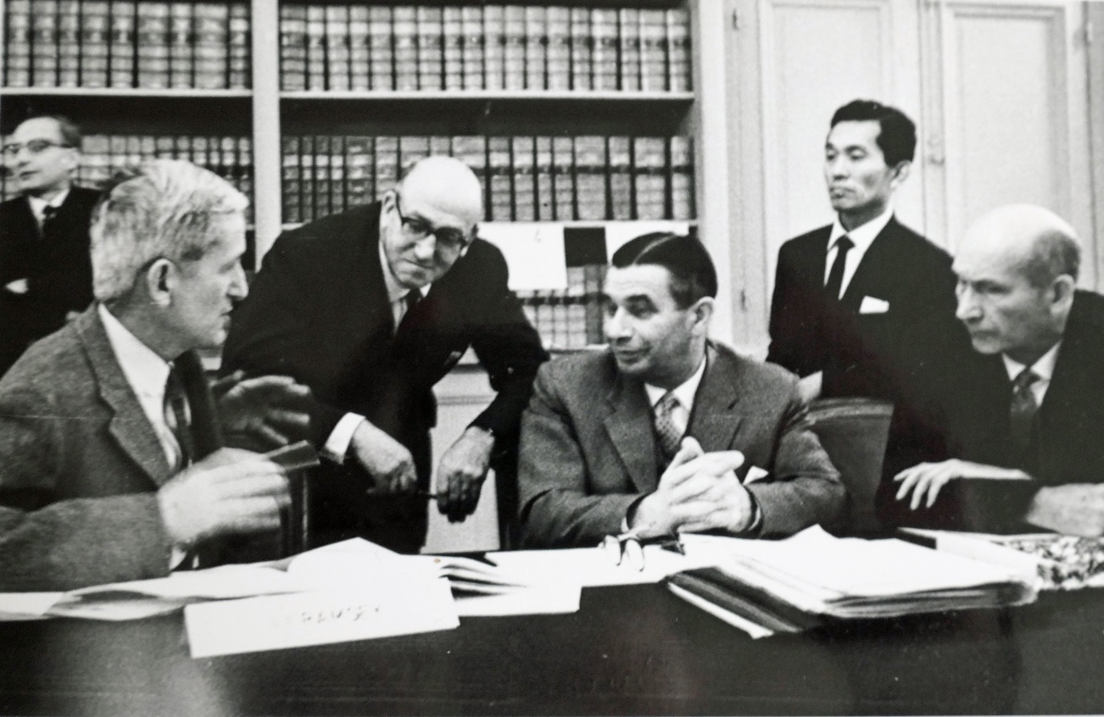
Discussion on the redefinition of the second at Consultative Committee for the Definition of the Second (now CCTF) (1963)
Topics discussed:
- Conditions for a change of the definition
- Choice of the atom (Cs, H) or molecule ?
- Radio techniques for comparisons
R. Essen, “The birth of atomic time”, Upfront Publishing, 2015
RECOMMANDATIONS
1) the SI second be defined as the duration of a specified number of periods of a specified transition between two energy levels of an atom or a molecule
2) the definition of the second (when it will be time to choose the transition) be in accordance with the value of 9 192 631 770 Hz attributed to the radiation corresponding to the transition between the two hyperfine levels of the unperturbed ground state of the ¹³³Cs atom.
To review the long process to measure the Cs frequency in terms of Ephemerids second see
Metrologia 42 (2005) S10–S19 "The definition of the ‘atomic’ second" by S. Leschiutta

Slide 30


Thanks to CCTF, its WGs, the Task Force for the “roadmap to redefinition of the second”, National Metrology Institutes, academic experts, and concerned bodies for their constructive contribution and dedication
Thanks for your attention

