Slide 1
Applications of time and frequency signals on optical fiber
Davide Calonico, Cecilia Clivati, Simone Donadello, Alberto Mura, Maroc Pizzocaro, and Filippo Levi
Quantum Metrology and Nanotechnologies Division
Istituto Nazionale di Ricerca Metrologica
d.calonico@inrim.it

Slide 2

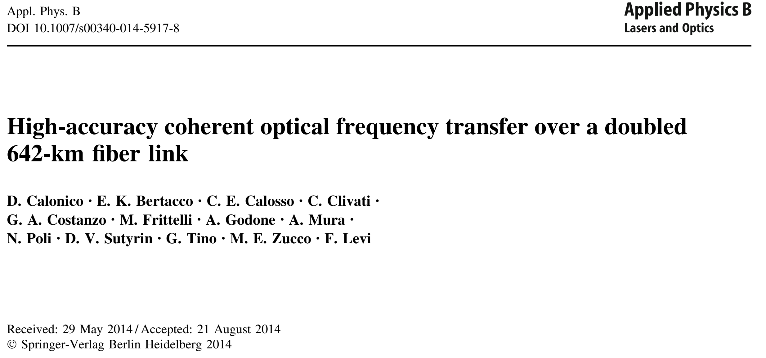
Italian Quantum Backbone was born with the Project LIFT (Link in Italy for Frequency and Time).
First Signals Turin-Florence:
February 2013
Published the year after

Slide 3

Italian Quantum Backbone steps
2014 650 km Link
2015 8th Symposium on Frequency Metrology
2016 Remote SI traceability for spectroscopy
// Remotely enabling quantum simulation
2018 Chronometric Levelling (Relativistic Geodesy)
// Submarine Cables and Earthquake sensing
2017- 2020 1850 km optical link // Radioastronomy
2021 1000 km White Rabbit Timing
2022 Atlantic cable - seabottom sensing
//Clock comparisons
//Quantum Communication
2023 Seismic permanent Observatory

Slide 4

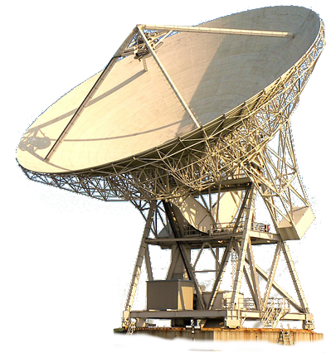
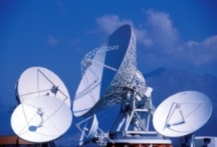
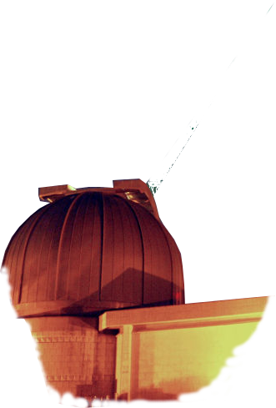
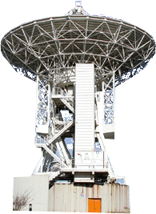
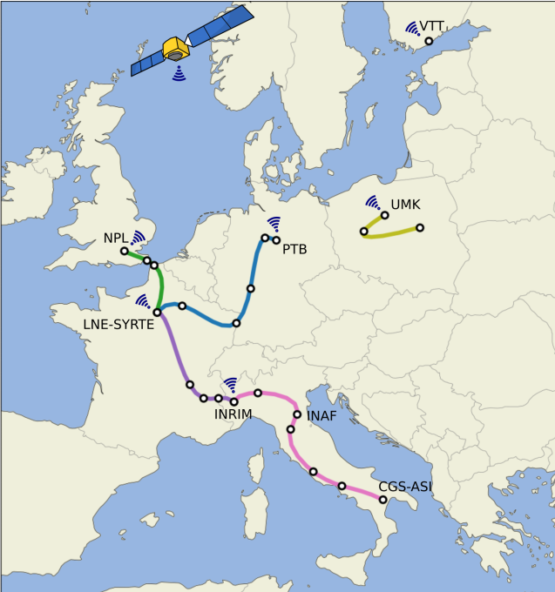
Italian Quantum Backbone: exploring applications
INRIM IQB: 1850 km fibre research infrastructure
7 public research laboratories/institutes, 3 industrial companies connected
Primary frequency metrology (comparison and dissemination)
Certified atomic time and frequency
Platform for quantum metrology and communication
Coherent Fibre Sensing
MILANO
←FRANCE
TORINO
INRIM
Medicina Radiotelescope
BOLOGNA
Absolute frequency reference dissemination and comparisons
C. Clivati et al., Opt. Express 24, 11865 (2016)
L. Livi, et al. Phys Rev Lett 117, 220401 (2016)
S. Borri et al, Sci. Rep. 7, 12780 (2017)
C. Clivati et al, Phys. Rev. Applied 18, 054009 (2022)
Relativistic geodesy
J. Grotti et al., Nature Physics (2018)
Radioastronomy (Very Long Baseline Interferometry)
C. Clivati et al., Sci. Rep. 7, 40992 (2017)
C. Clivati, et al. Optica 7, 1031-1037 (2020)
M. Pizzocaro, et al. Nature Physics, 17, 2, (2020)
Seismology/Geophysics
G. Marra et al., Science 361 (2018)
C. Clivati et al. Optica (2018)
G. Marra, et al. Science, 376, 6595 (2022)
Quantum Communication
S. Wengerowsky, et al., PNAS 116, .6684-6688 (2019)
D. Bacco, et al. EPJ Quantum Technology, 6, 1(2019)
S. Wengerowsky, et al. 6, 1 Nature PJ Quantum Information (2020)
D. Bacco, et al. Advanced Quantum Technologies 4, 7 (2021)
C. Clivati, et al. Nature Communnications, 13, 1 (2022)
FIRENZE
ROMA
FUCINO
MATERA
NAPOLI
Space Geodesy Centre

Slide 5
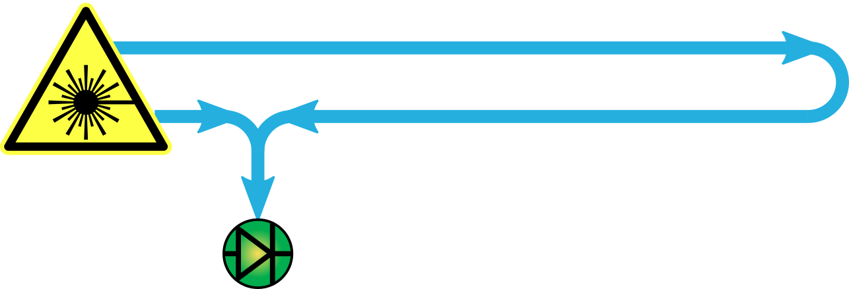
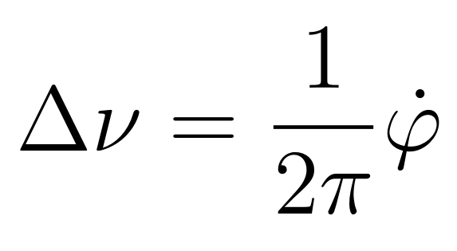
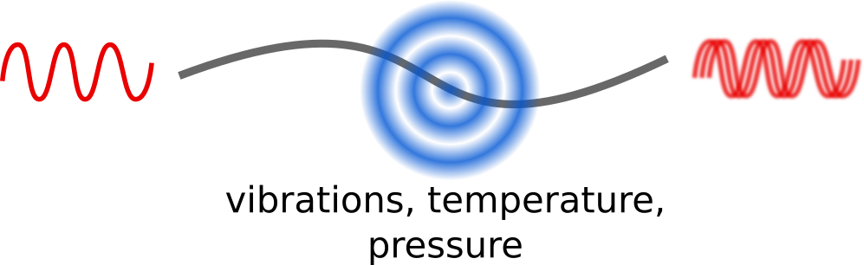
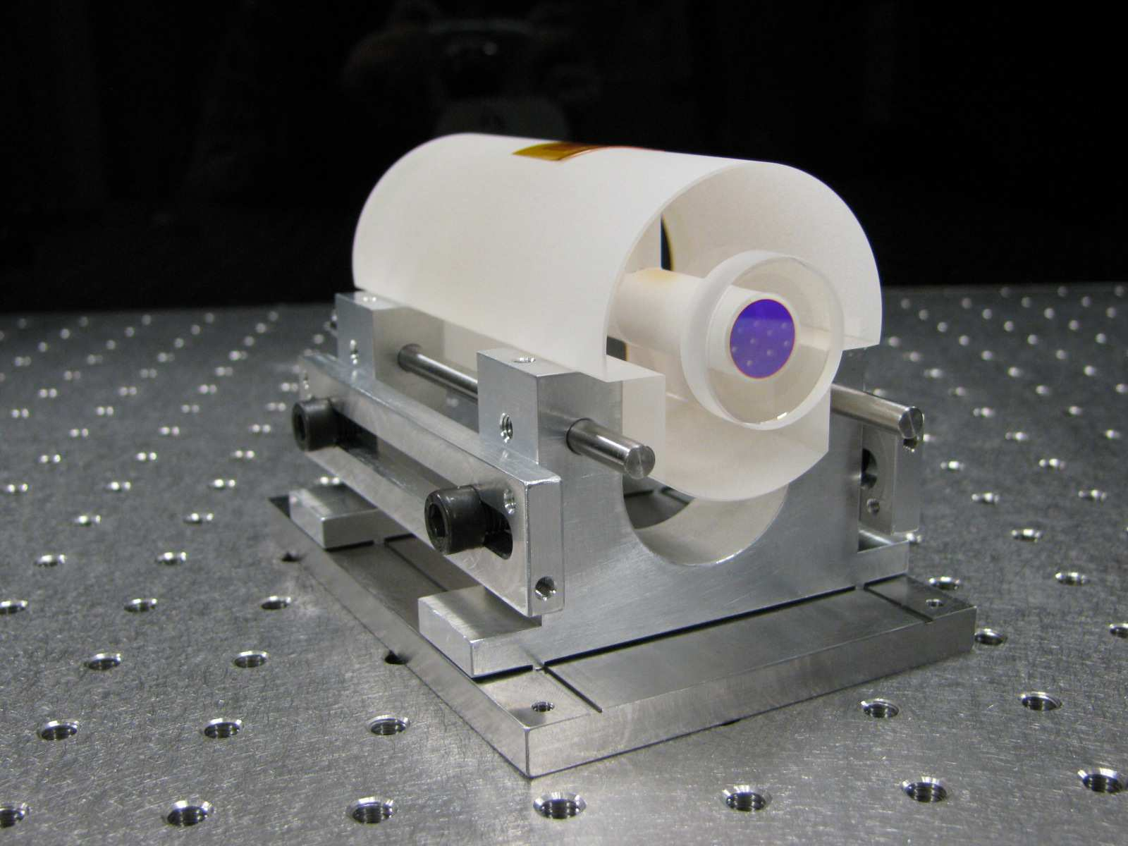
Coherent laser interferometry
Basic principles:
interference between coherent light
optical phase measurement
Ultrastable lasers – laser noise < fiber noise
Doppler noise cancellation
Interferometry over the fiber network:
compatible with telecom infrastructure
coexistence with internet data traffic
high sensitivity and linearity
long range, can be amplified + high coherence

Slide 6
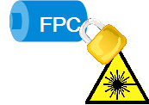
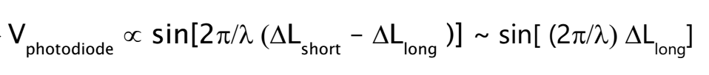
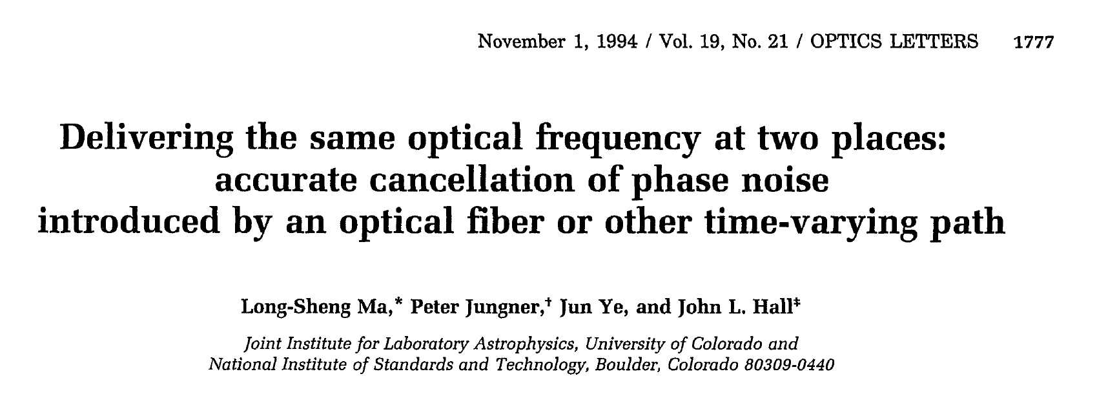
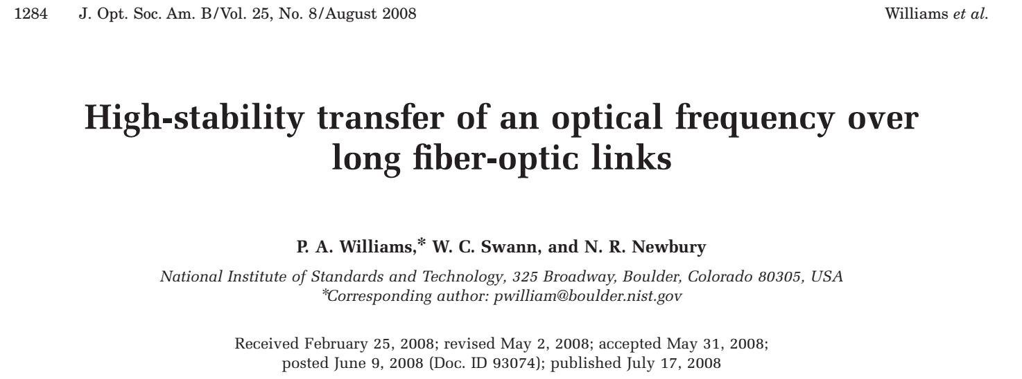
Coherent laser interferometry
Interferometer
Faraday
Mirror
Ultrastable
Laser
Real Fibre
(with data
Detection

Slide 7
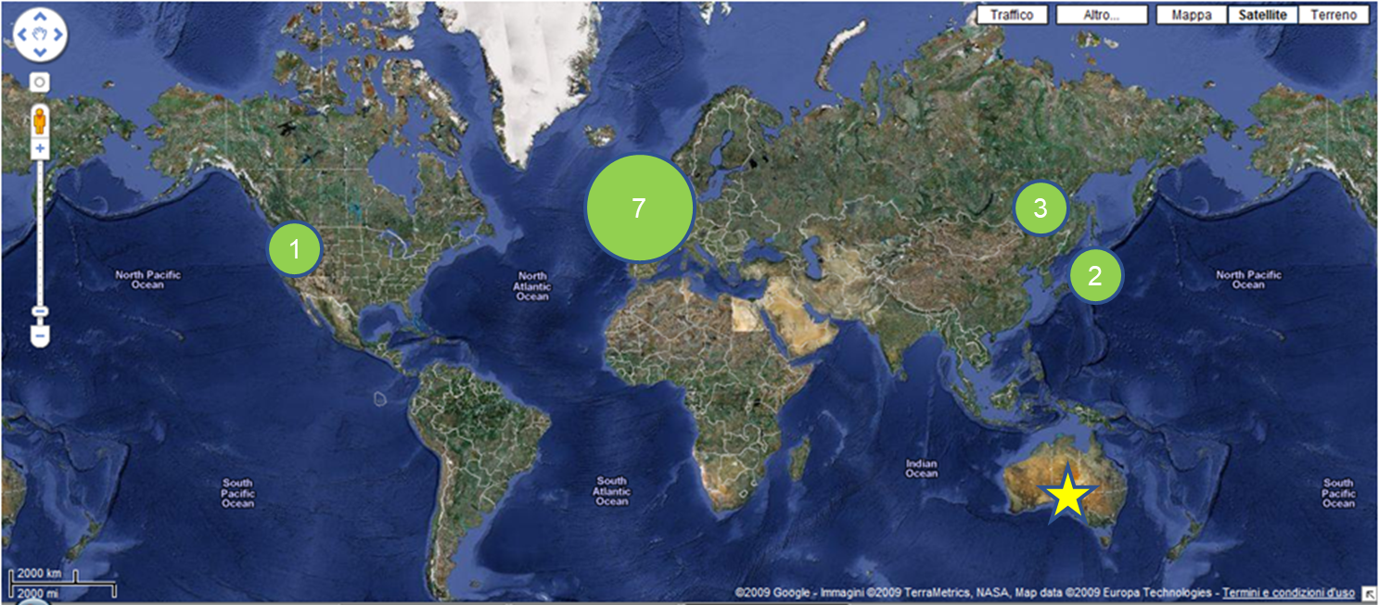
Optical Fiber Links: a worldwide snapshot
1
Fiber Link in use

Slide 8
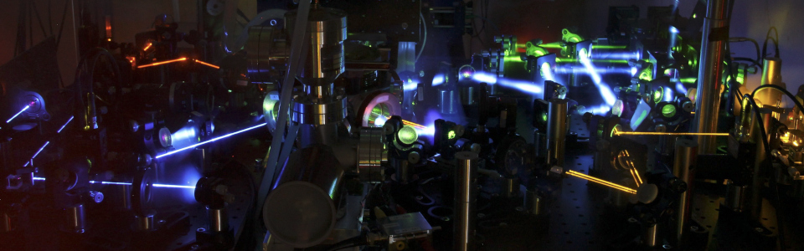
Remote frequency measurements

Slide 9
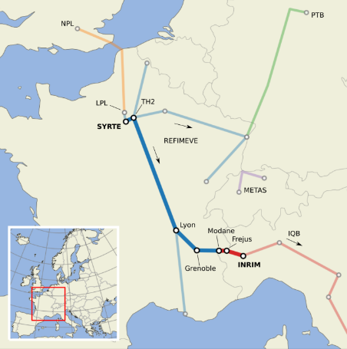



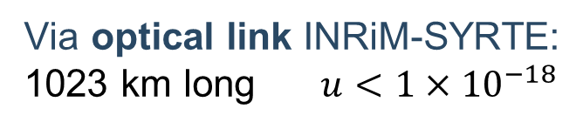
Remote frequency measurement
Yb vs fountains at SYRTE (Paris)
Via optical link INRiM-SYRTE:
1023 km long $u<1×{10}^{−18}$
Optical comparison between INRIM and
SYRTE (Systèmes de Référence Temps-Espace)
+ LPL (Laboratorie de Physique des Lasers)
C. Clivati et al., 2022 Phys. Rev. Applied 18, 054009

Slide 10
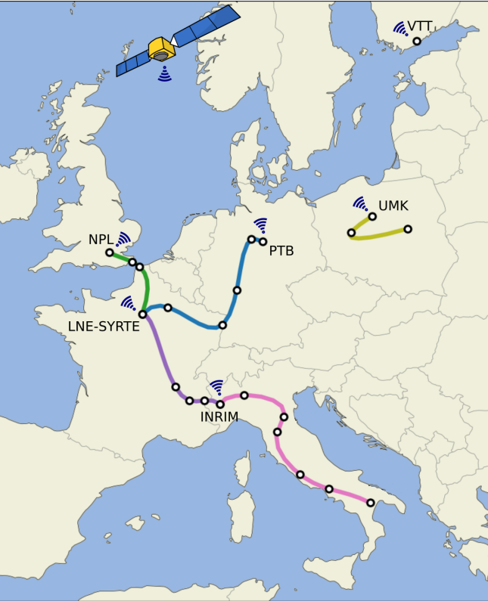
Ongoing optical clocks comparisons
Two European optical clock comparisons
ROCIT campaign (March 2022):
- 11 optical clocks involved
- 7 different countries linked via GPS
- INRiM, SYRTE and PTB connected via
fiber link
- NPL, VTT, UMK and NMIJ connected via GPS
2023 campaign (March and April 2023):
- INRiM, SYRTE, PTB and NPL connected
via fiber link
- 6 optical clocks involved
- 2 transportable clocks developed at PTB and
RIKEN hosted at NPL
Data under analysis

Slide 11
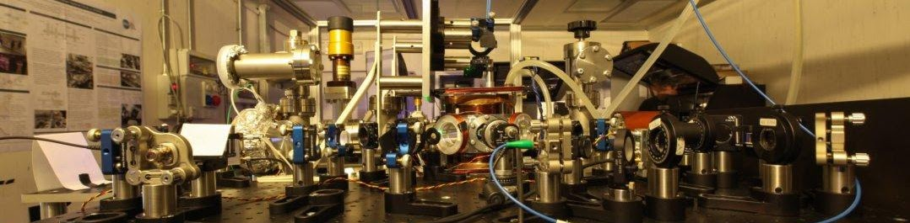
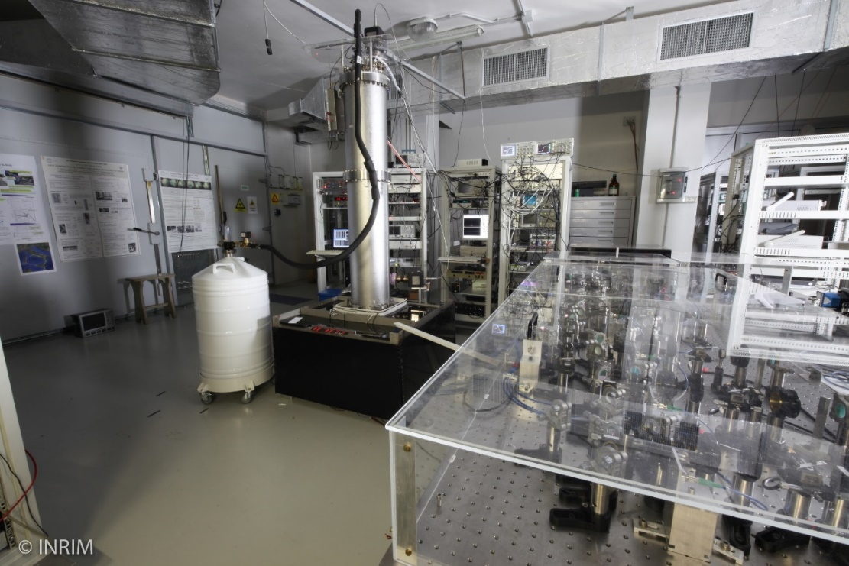
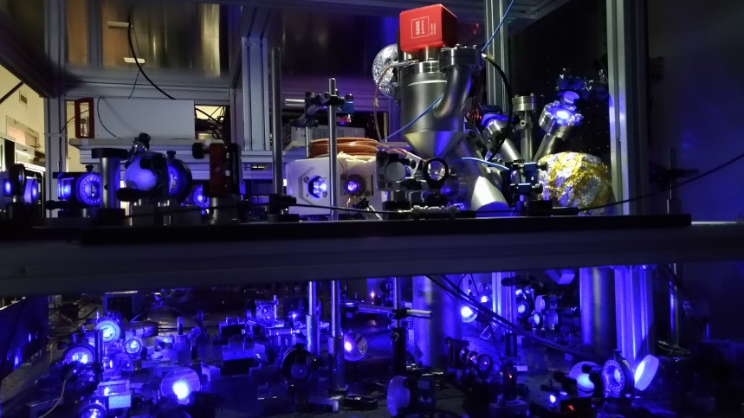
INRIM AFS
INRiM – Yb clock
Accuracy: 2·10⁻¹⁷
Stability: 2·10⁻¹⁵ @ 1 s
M. Pizzocaro, et al., Nature Phys 17, 2 (2021)
INRiM – Cs fountain
Accuracy: 1.7·10⁻¹⁶
Stability: 1.5·10⁻¹³ @ 1 s
F. Levi, et al., Metrologia, 51, 270 (2014);
INRiM – Sr clock
Accuracy: 1·10⁻¹⁴
Stability: 8·10⁻¹⁴ @ 1 s
Barbiero, M et al. , IEEE Trans I&M, 71, 1501509 (2022)

Slide 12
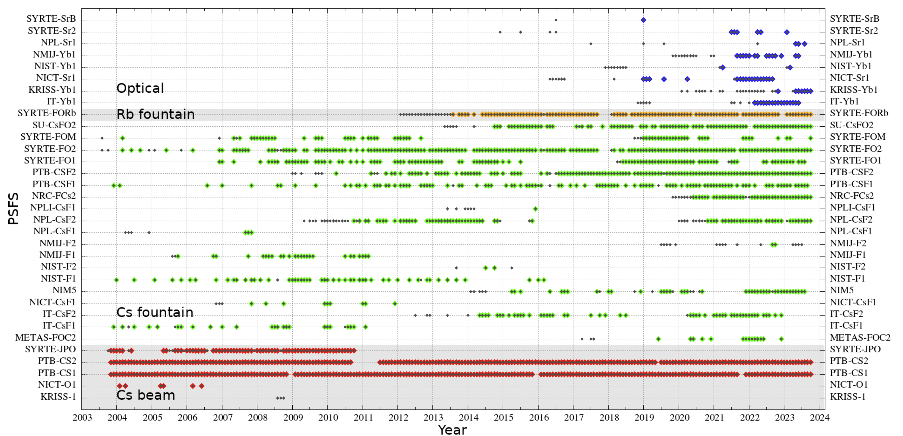
INRIM AFS
INRiM – Yb clock ITYb1
Accuracy: 2·10⁻¹⁷
Stability: 2·10⁻¹⁵ @ 1 s
IT-Yb1 contributed to TAI real-time for 16 months
I. Goti et al., Metrologia 60, 035002 (2023)
M. Pizzocaro, et al., Nature Phys 17, 2 (2021)

Slide 13
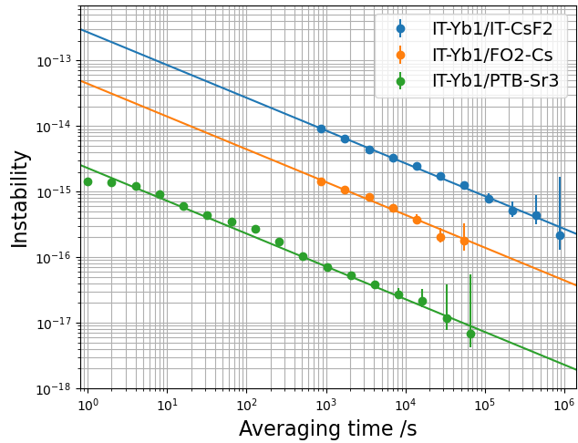
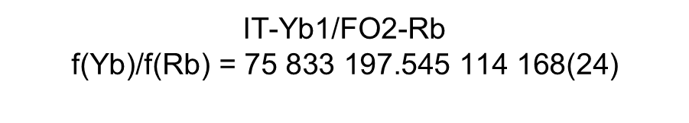
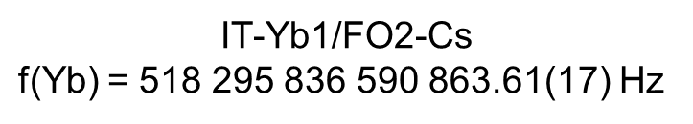
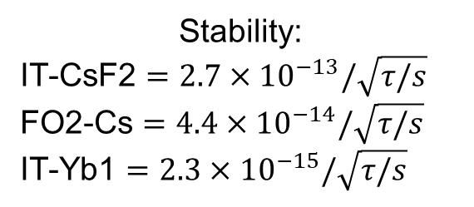
Instability of clocks comparisons
Stability:
IT-CsF2 $=2.7×{10}^{−13}/\sqrt{τ/s}$
FO2-Cs $=4.4×{10}^{−14}/\sqrt{τ/s}$
IT-Yb1 $=2.3×{10}^{−15}/\sqrt{τ/s}$
IT-Yb1/FO2-Cs
$\text{f}\text{(}\text{Yb}\text{)}$= 518 295 836 590 863.61(17) $\text{Hz}$
IT-Yb1/FO2-Rb
$$\text{f}\text{(}\text{Yb}\text{)/}\text{f}\text{(}\text{Rb}\text{) = 75 833 197.545 114 168(24)}$$
Results in agreement
with value recommended
by CIPM
I. Goti et al., 2023 Metrologia 60 035002
C. Clivati et al., 2022 Phys. Rev. Applied 18, 054009

Slide 14
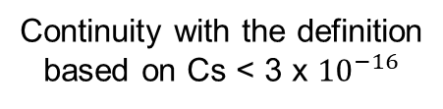
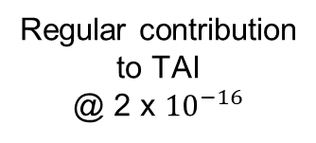
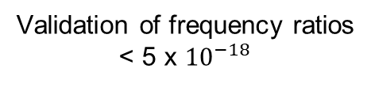
Towards the redefinition of the second
Uncertainty
< 2x10⁻¹⁸
In 2022 the CCTF proposed a roadmap toward a redefinition
with clear criteria and quantitative conditions
Regular contribution
to TAI
@ 2 x ${10}^{−16}$
GOAL: Redefinition by 2030
Continuity with the definition
based on Cs < 3 x ${10}^{−16}$
1.The 2022 and 2023 campaigns in Europe demonstrated the maturity of the comparison process
2. In 2023, first involvement of a transportable optical clock in intercontinenal comparisons
3. Given 6 years 2024-2030: 2 campaigns/yr means 12 campaigns
4. This should a very good pace for demonstrating solid numbers (i.e. consistency)
Validation of frequency ratios
< 5 x ${10}^{−18}$
Access to the realization
of the new definition
N. Dimarcq et al., arXiv preprint arXiv:2307.14141 (2023)

Slide 15
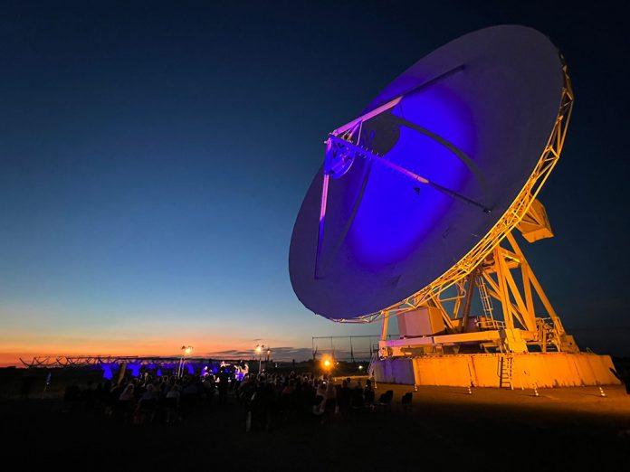
Radioastronomy
Geodesy

Slide 16
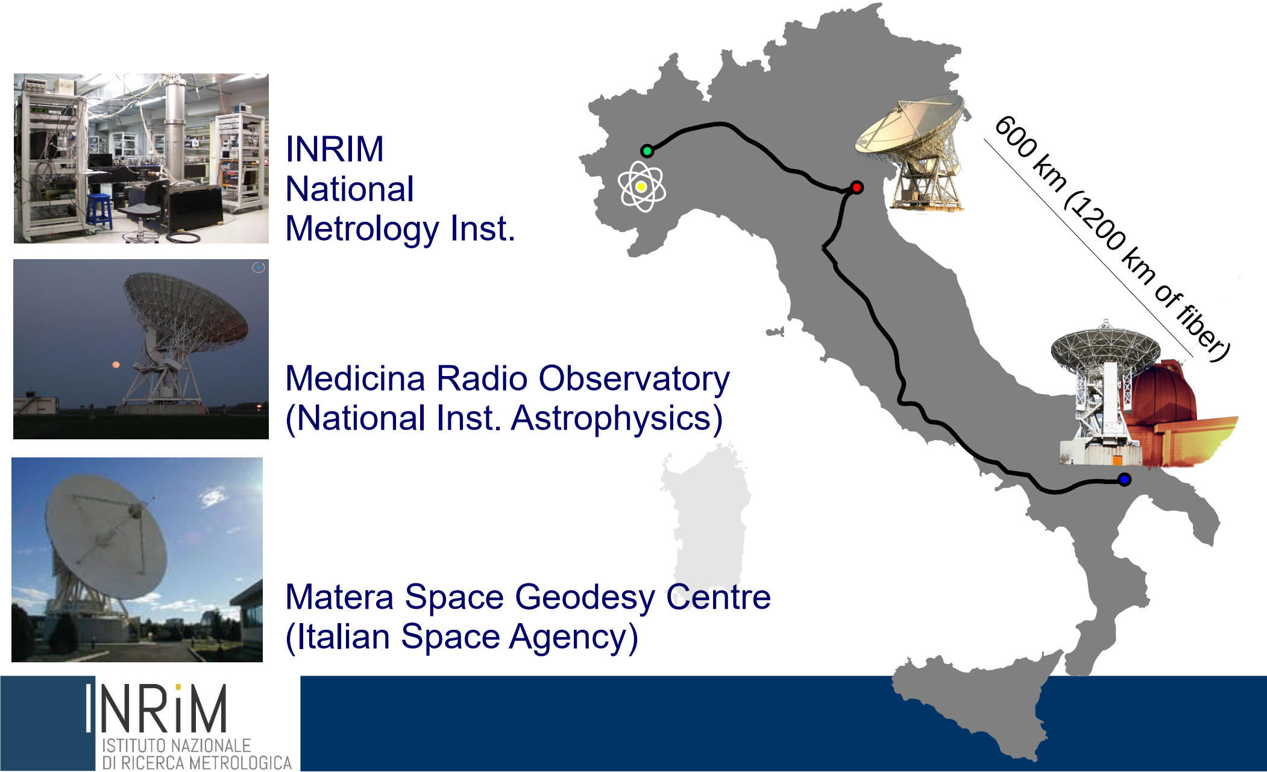


VLBI Common clock via optical fibre
C. Clivati, et al. Optica 7, 1031-1037 (2020)

Slide 17
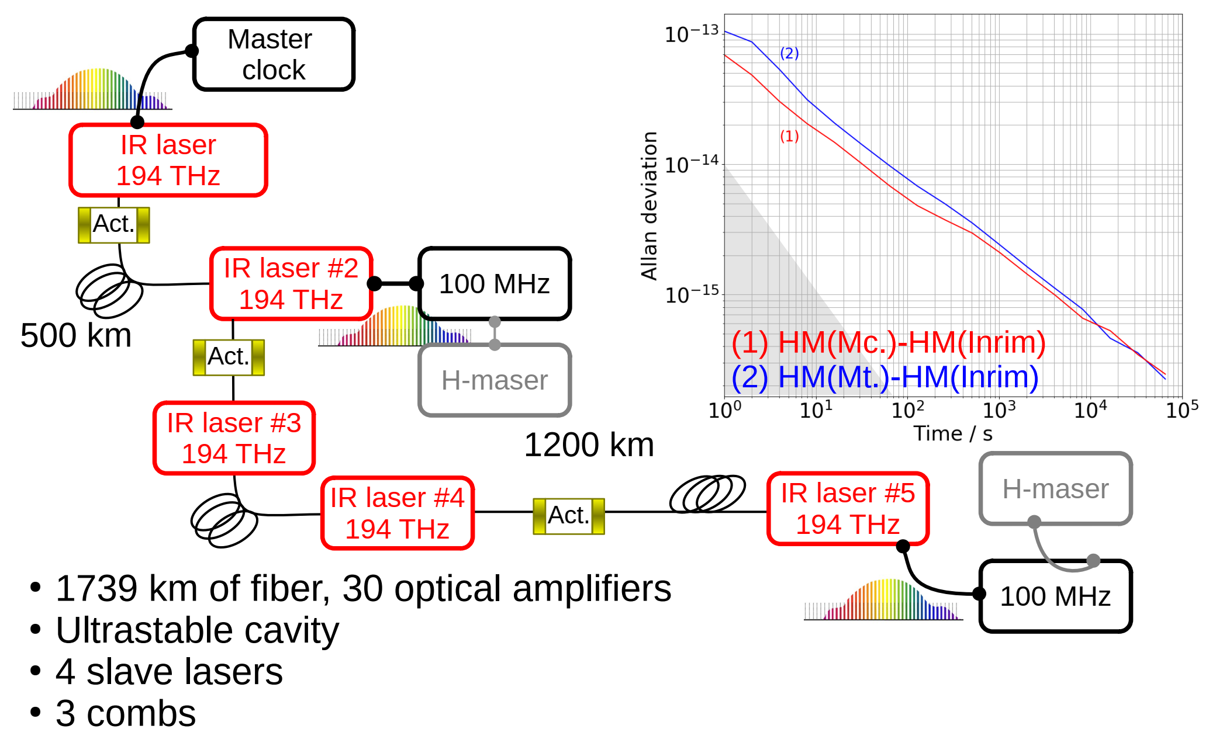
VLBI Common clock via optical fibre
Dissemination of better clocks for
Better mm-VLBI: above 80 GHz, H-Masers are the main limit to resolution
M. Rioja, et al. Astron. J., vol. 144, no. 4, art. no. 121, 2012.
B. Nikolic, et al. Astron. Astrophys., vl. 552, art. no. A104, Apr. 2013.
M. Rioja and R. Dodson, Astron. J., vol. 141, no. 4, art. no. 114, 2011
In Geodesy VLBI, accuracy is relevant and 1-mm positioning accuracy requires clocks uncertainties at 1e-16.
A. Neill, et al. Report of Working Group 3 to the IVS Sep. 2005.Directing Board
Study of compact radio sources (better angular resolution) and interstellar molecular clouds
Studying Pulsar through absolute accurate time (1E-15 stability @years)
Improve atmospheric models
C. Clivati, et al. Optica 7, 1031-1037 (2020)

Slide 18
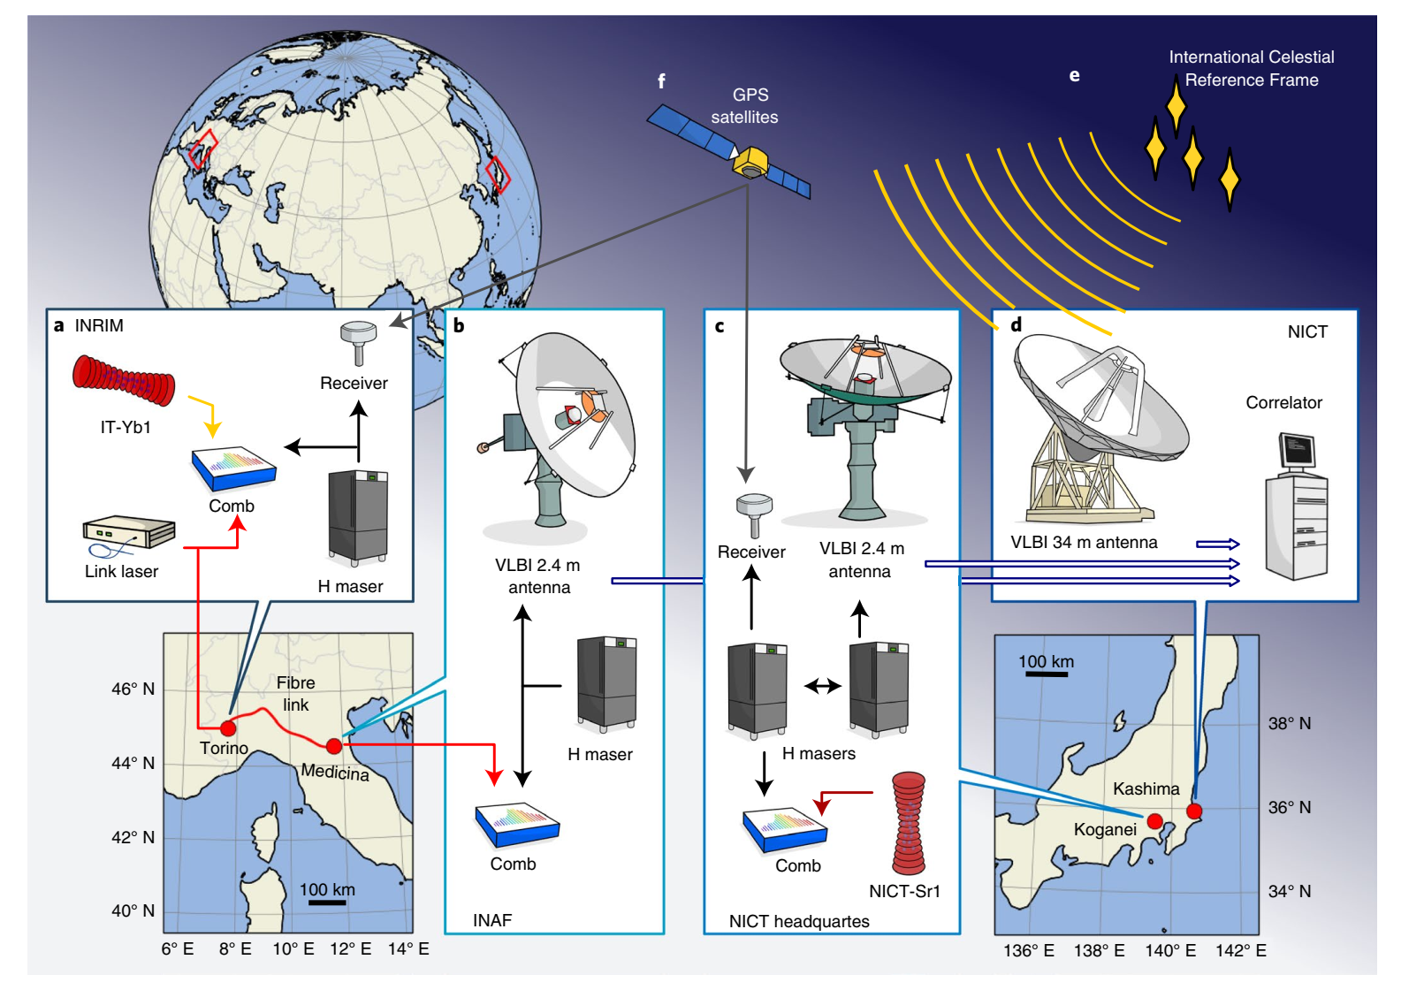
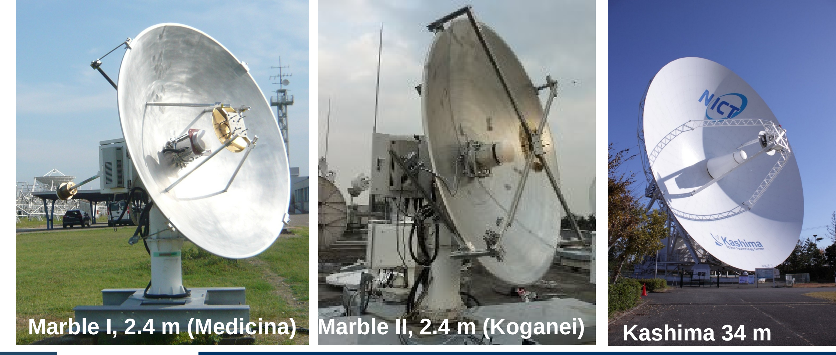
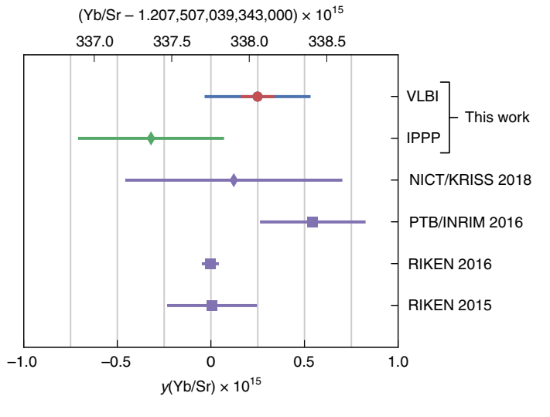


VLBI for intercontinental OFS comparisons
M. Pizzocaro, et al. Nature Physics, 17, 2, (2020)

Slide 19
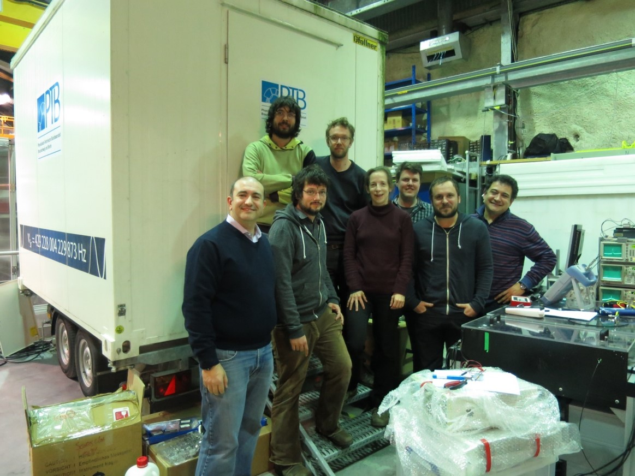



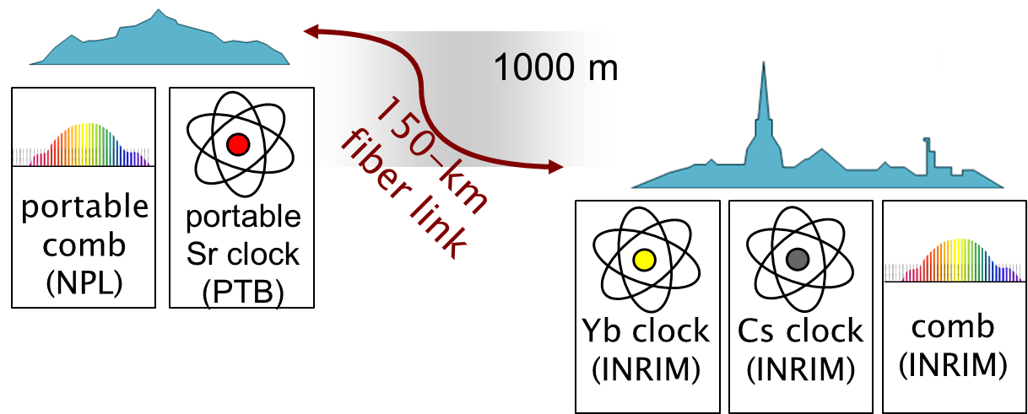
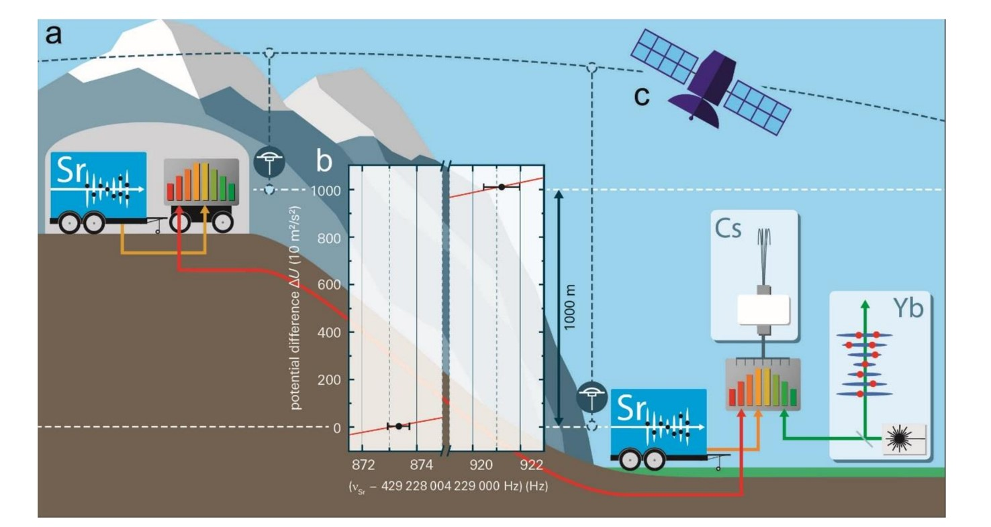

Chronometric levelling
How to translate this into a “real instrument”?
→ Transportable optical clocks + fibre link
A proof-of-principle geodesy experiment on the Alps
J. Grotti et al., Nature Phys. 14, 2018

Slide 20
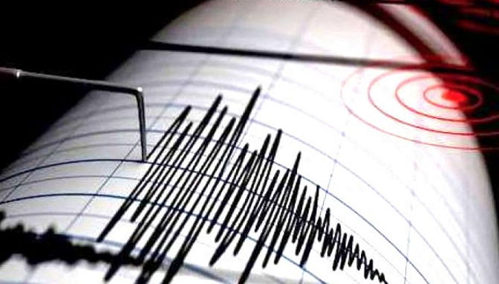
Earthquakes

Slide 21
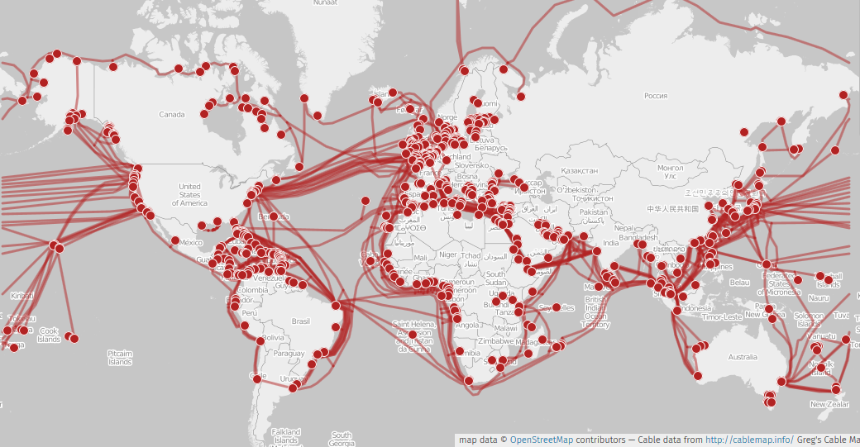
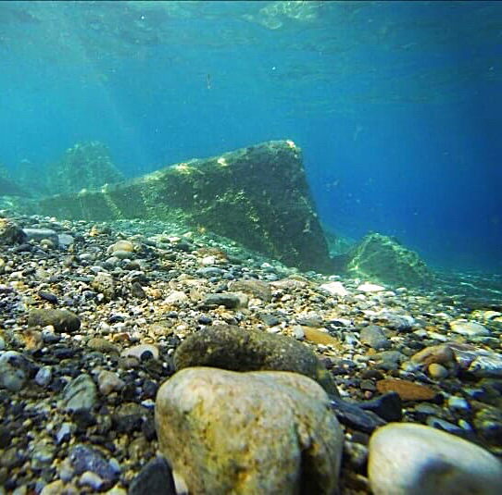
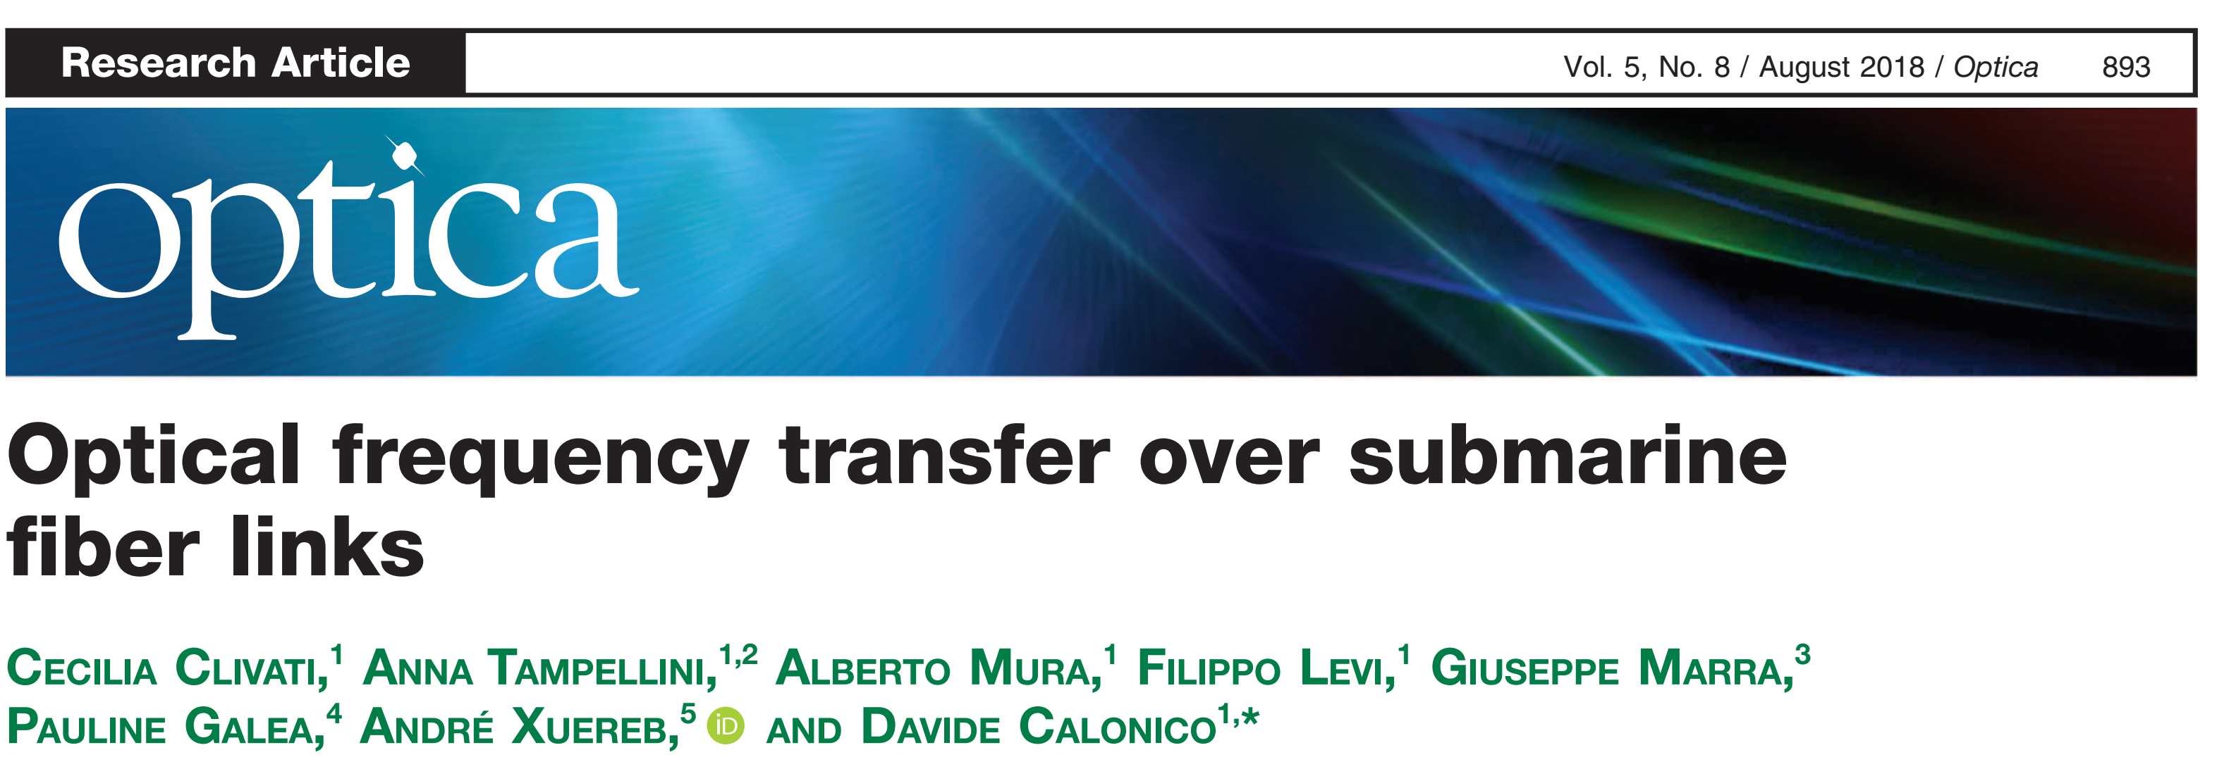
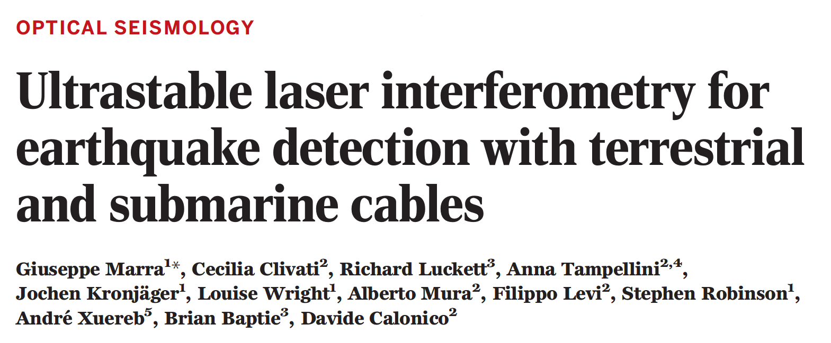
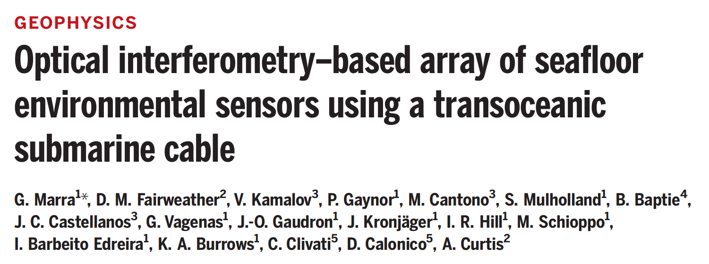
Earthquake monitoring with subsea fibers
Underwater cables:
unmonitored seafloors
important for early warning
deep seas are
quiet environments
ideal for sensing
(earthquakes, waves, tides...)
9SFM - Kingscliff AUS - October 20th, 2023

Slide 22
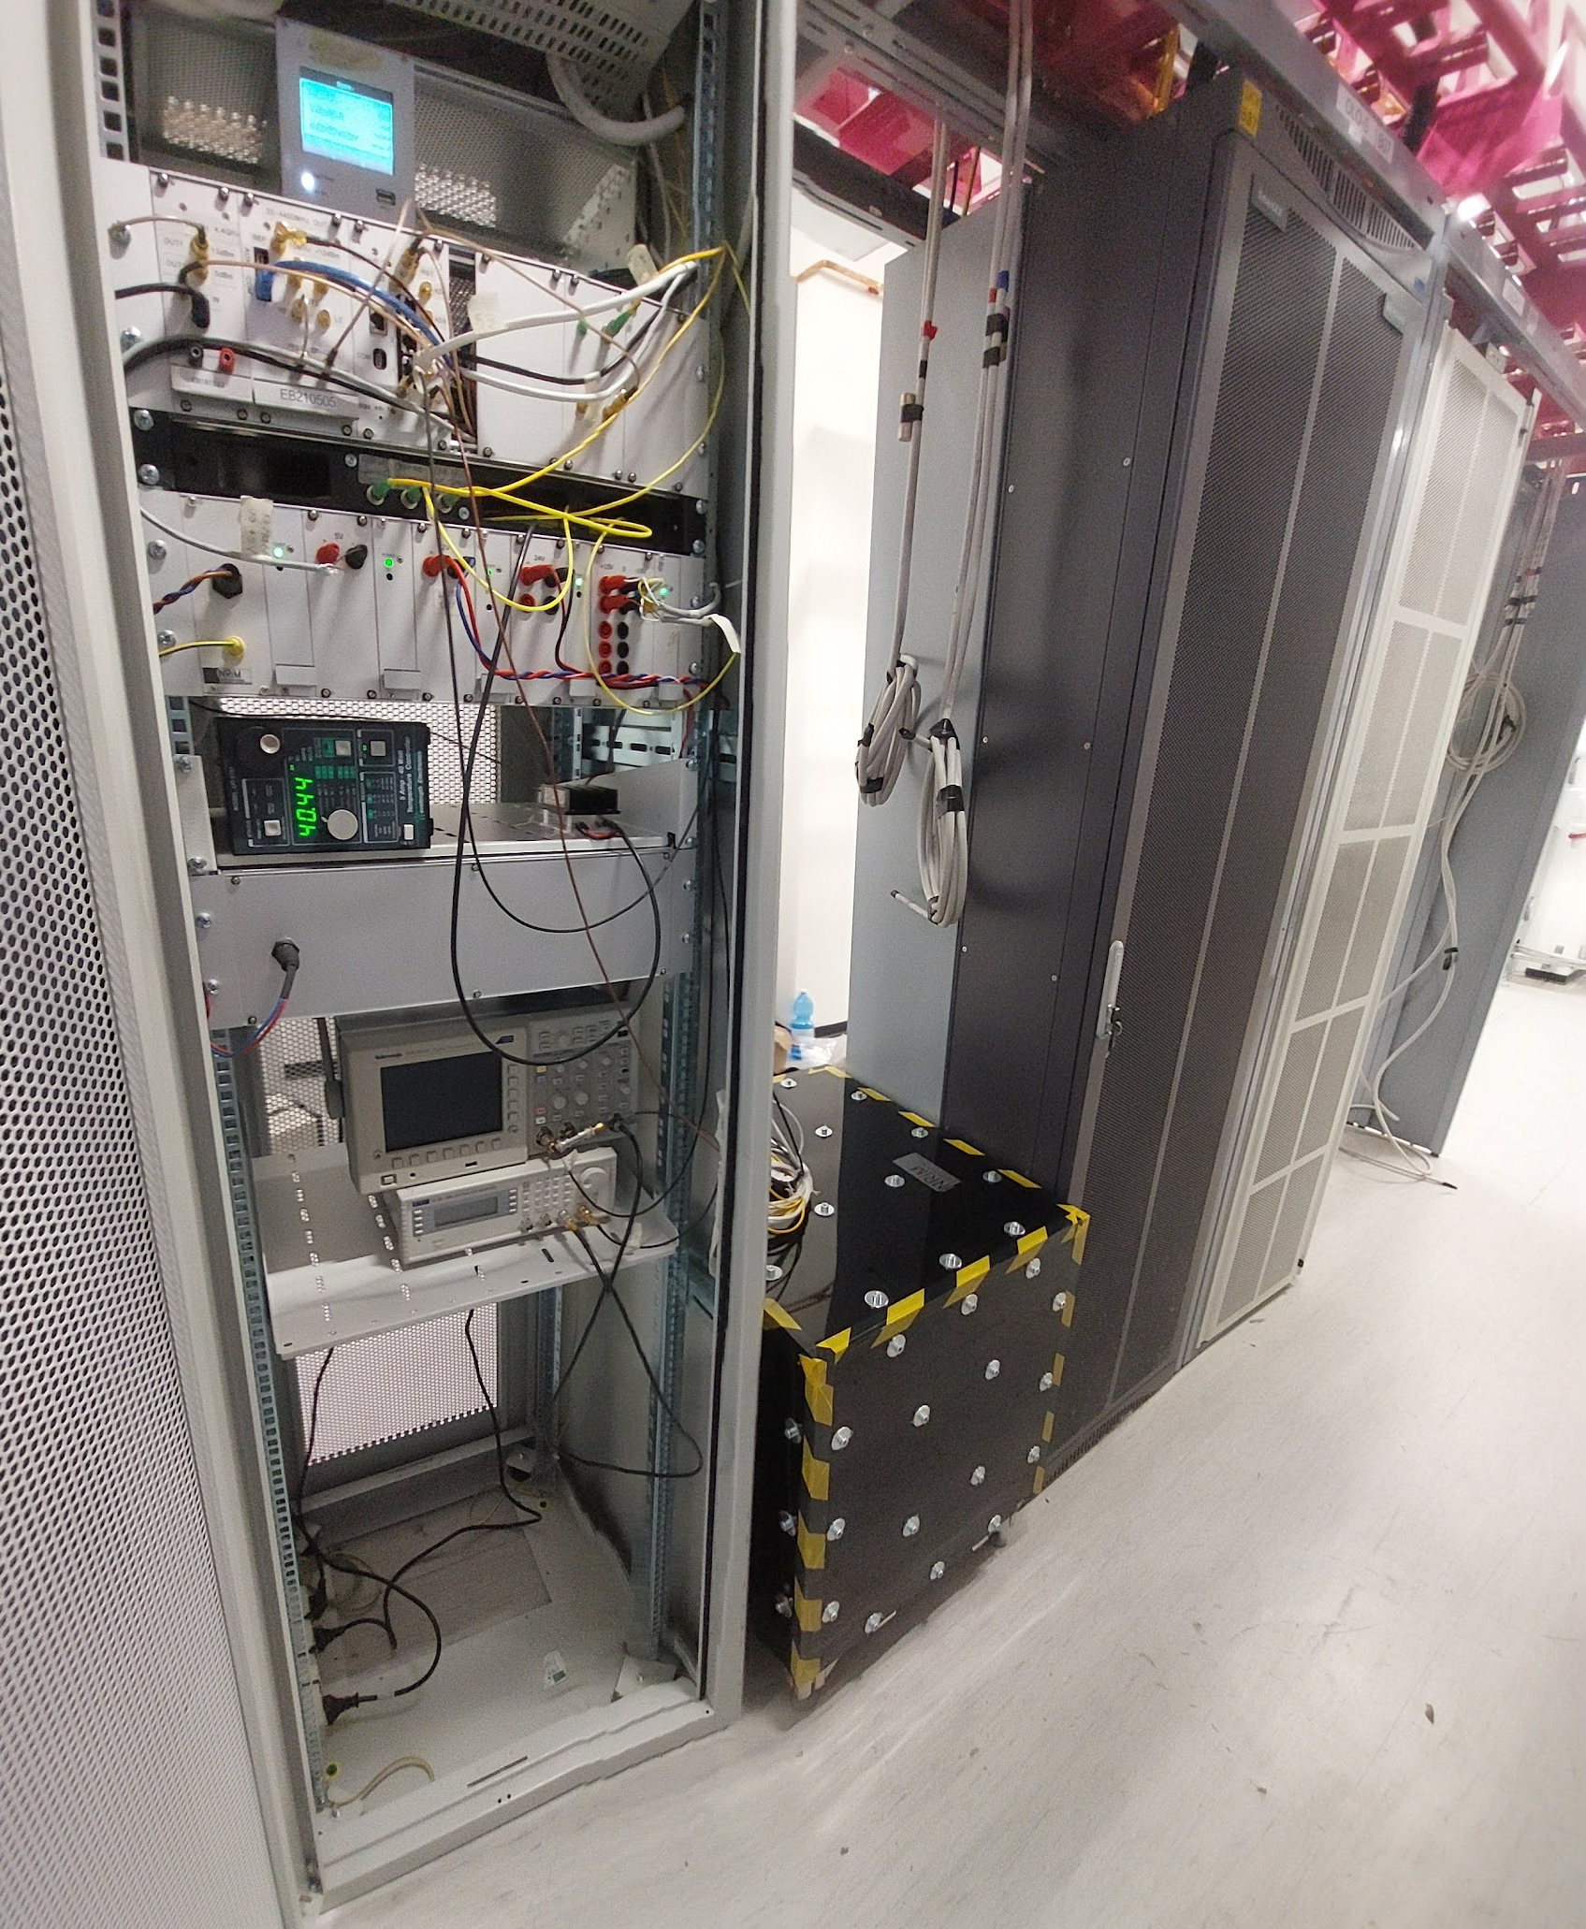
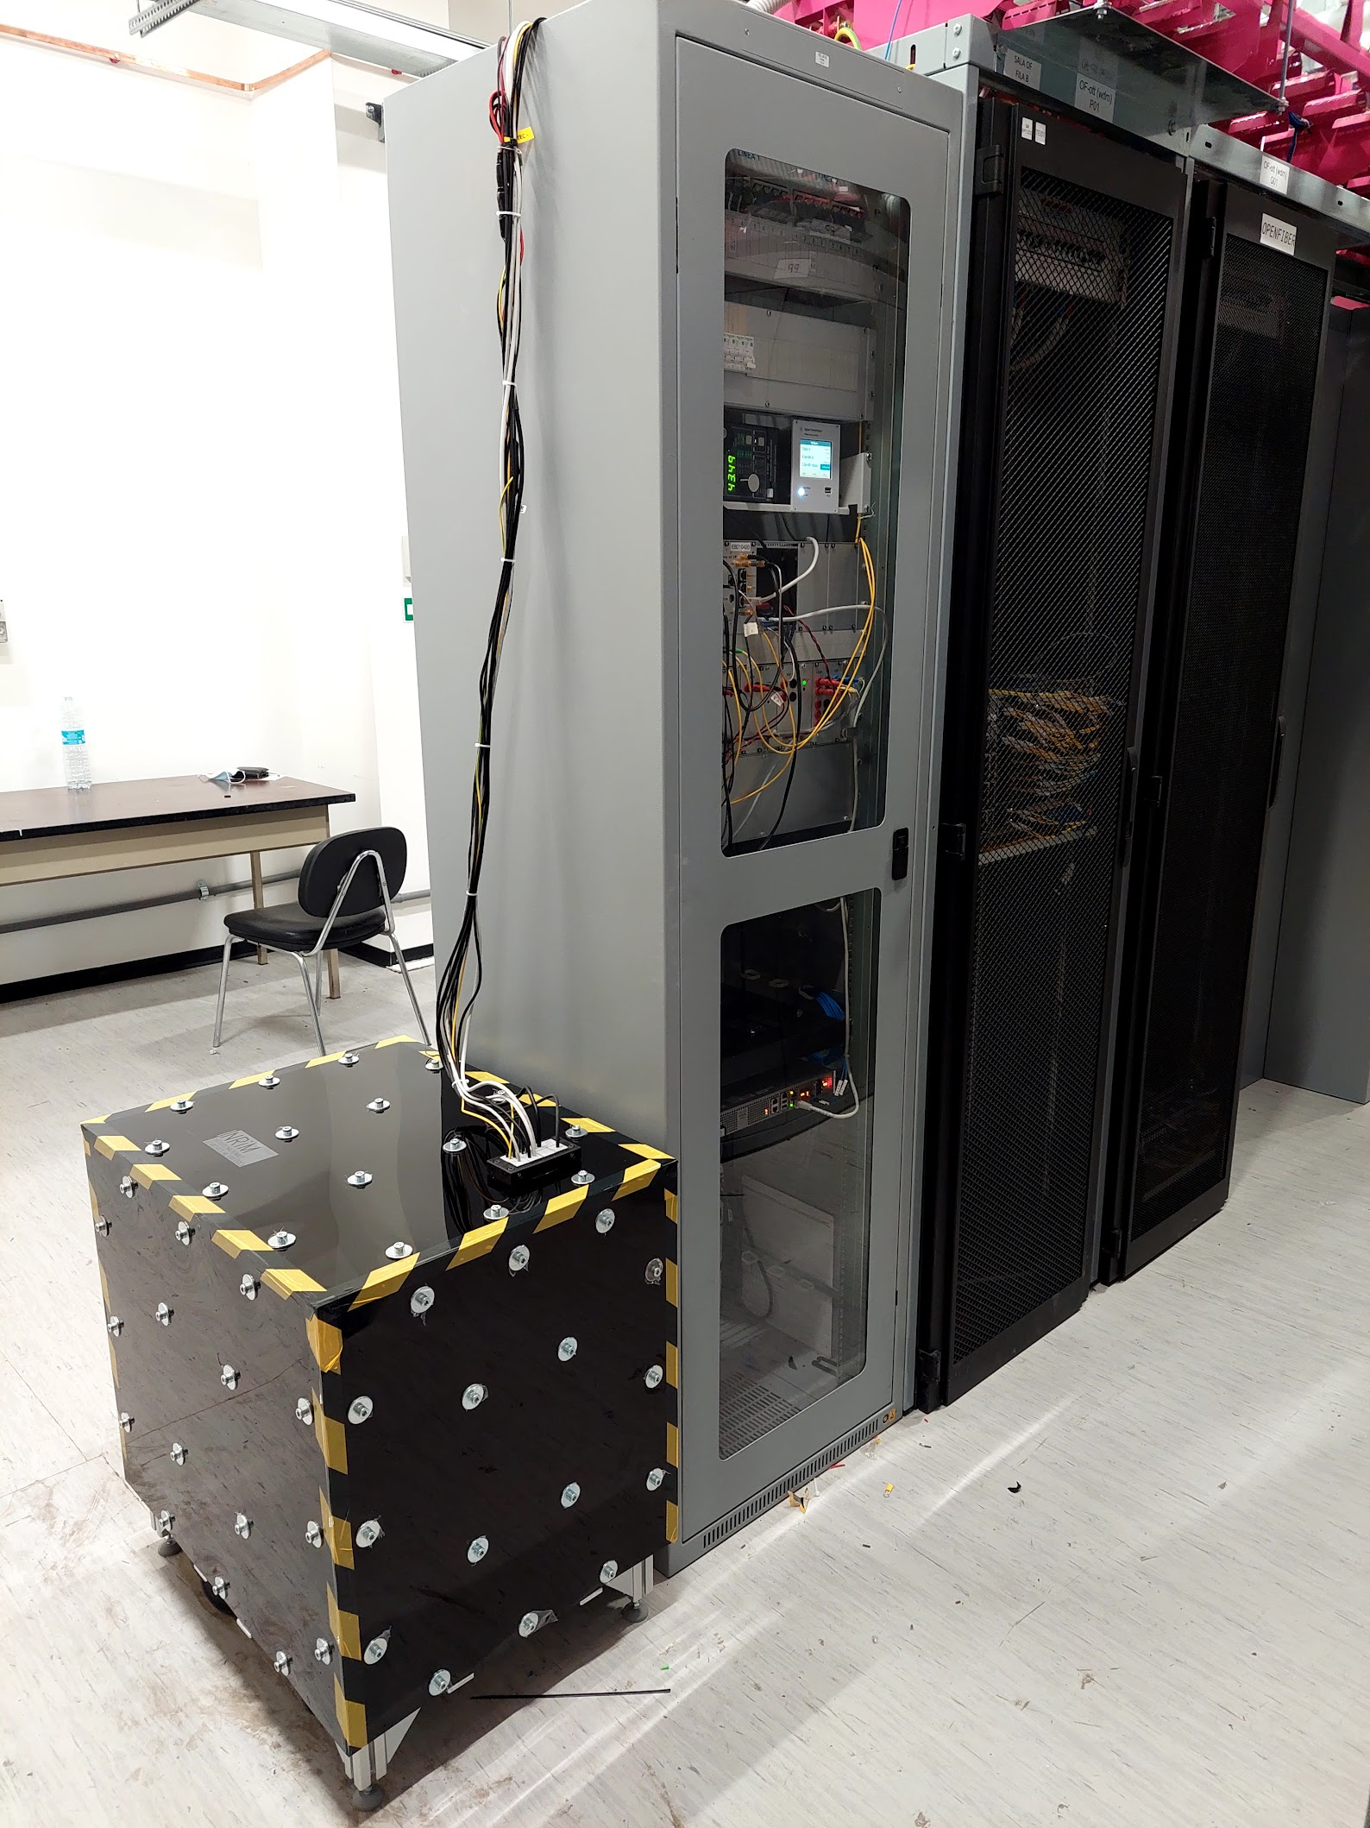
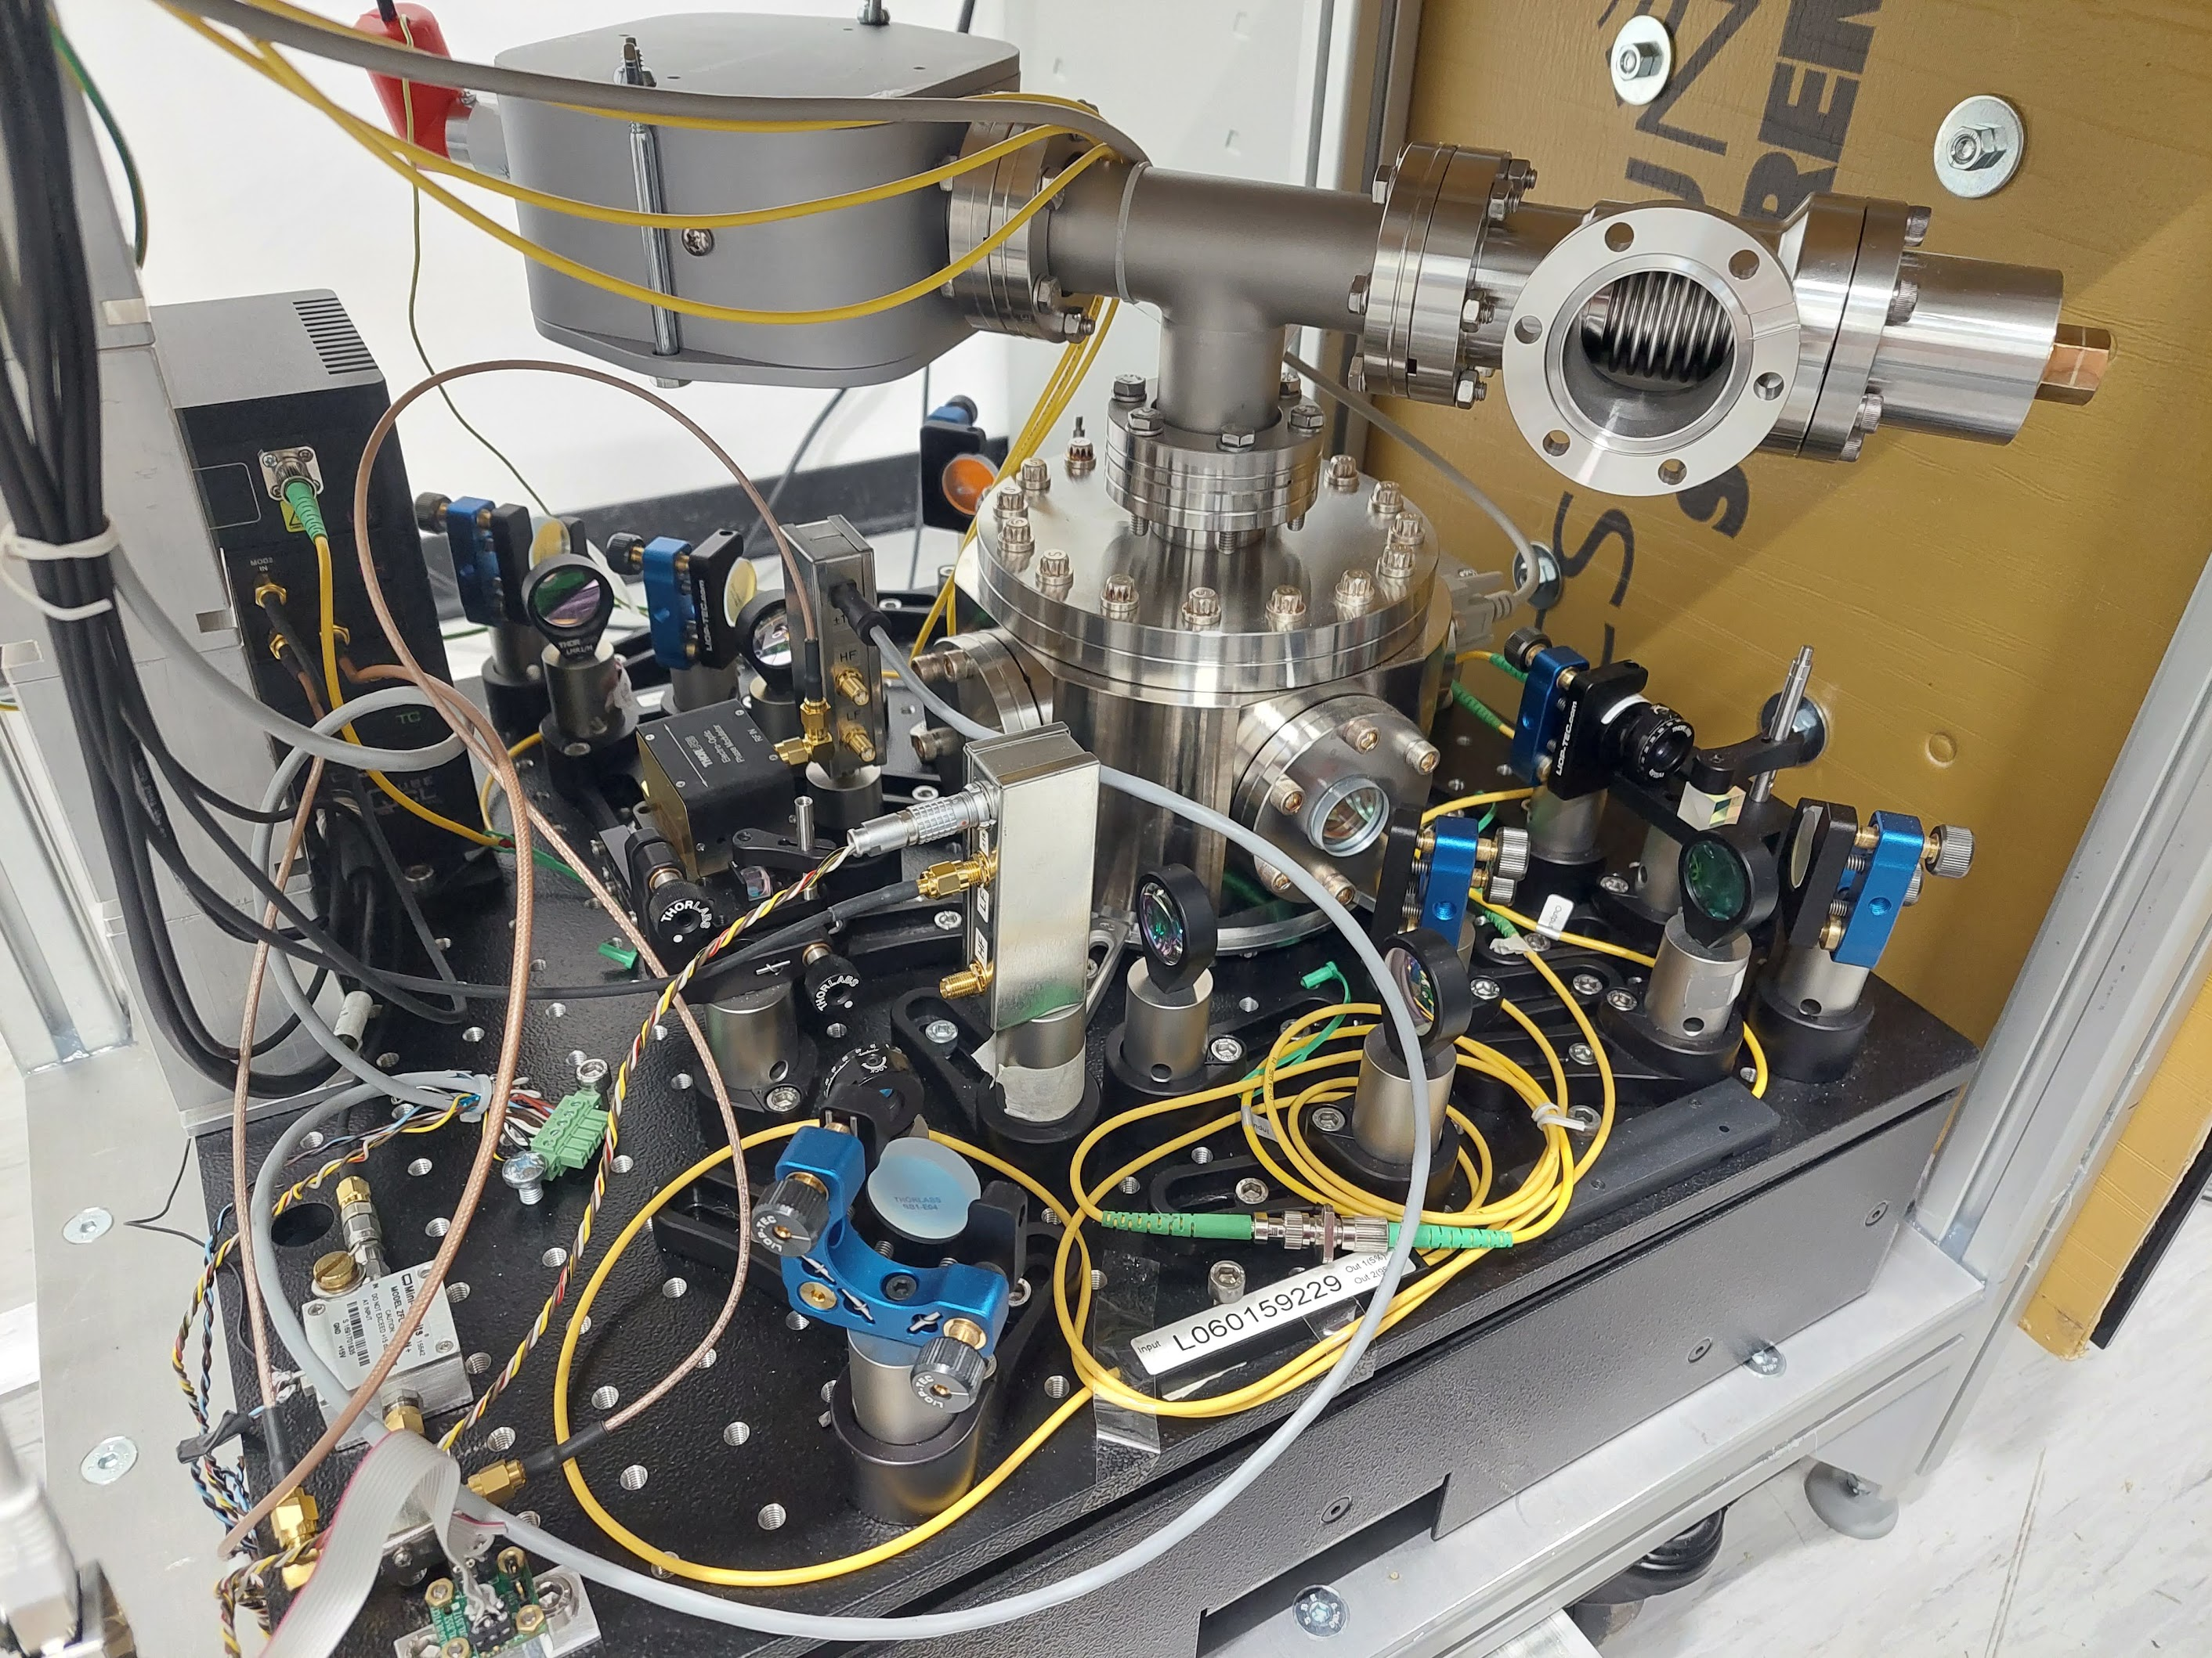
The experimental setup (today)
control and electronics
internet operator data rack
In-field installation:
transportable ultrastable lasers
at data centers
standard fiber with internet traffic
vacuum
pump
laser diode
cavity
9SFM - Kingscliff AUS - October 20th, 2023

Slide 23
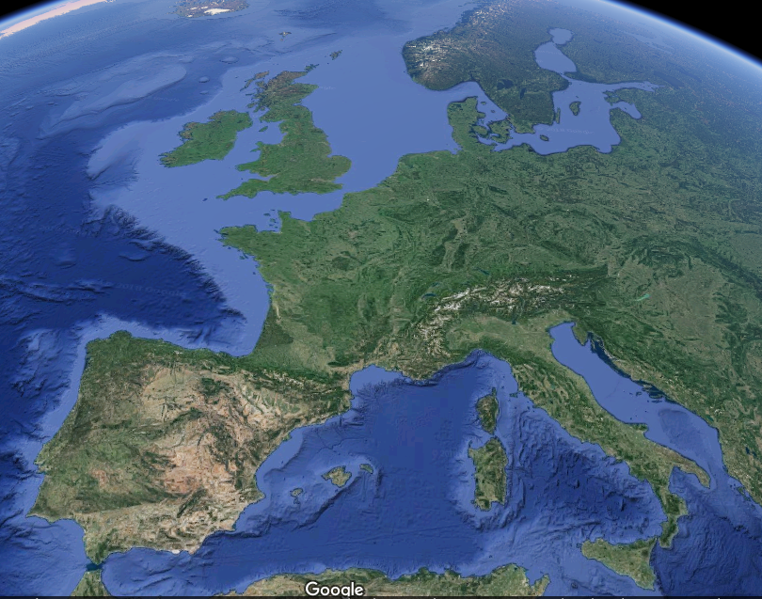

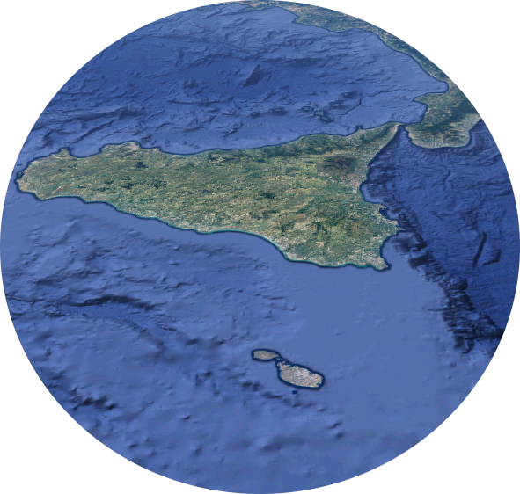



Submarine Earthquakes detection
Two testbeds in the Mediterranean Sea,
Sicily to Malta:
A 96.4 km telecom cable
(fiber only, buried 1 m below sand)
A 117 km cable along electrical interconnection
(fiber + HV power, 1 m below sand)
Ragusa
Pozzallo
L2
UniMalta
L1
C. Clivati et al., Optica 14 (2018)
G. Marra et al., Science 361 (2018)
9SFM - Kingscliff AUS - October 20th, 2023

Slide 24


Submarine Earthquakes detection
G. Marra et al., Science 361 (2018)
9SFM - Kingscliff AUS - October 20th, 2023

Slide 25



Submarine Earthquakes detection
40 dB
C. Clivati et al., Optica 14 (2018)
Submarine fibers have up to 20 dB lower noise than terrestrial fibers
High SNR achievable even on transoceanic links
C. Clivati et al., Optica 14 (2018)
9SFM - Kingscliff AUS - October 20th, 2023

Slide 26



Geo-sensing: sea-bottom seismic noise
Generated by wind-sea interaction,
propagates down to seabed
Characteristic peaks at 0.1 Hz< f < 0.2 Hz
(twice the wave's frequency)
Affected by wind, coasts, water depth...
C. Clivati et al., Optica 14 (2018)
9SFM - Kingscliff AUS - October 20th, 2023

Slide 27




Submarine cables: from 200 km to 2x6000 km
9SFM - Kingscliff AUS - October 20th, 2023

Slide 28


Submarine cables over the Atlantic: geophysics and earthquakes
9SFM - Kingscliff AUS - October 20th, 2023
G. Marra et al., Science (2022

Slide 29

Intercontinental clock comparisons expectations:
7000 km fibre
7000 km over two separated submarine fibres, extrapolated from 100 km meaured noise
In this region: exploitation of separated fibre noise correlations
7000 km over single submarine fibre, extrapolated from 100 km measured noise
C. Clivati et al., Optica 14 (2018)

Slide 30






Sensing with terrestrial fibers: the permanent observatory MEGLIO in central Italy
36 km commercial link pair
(Ascoli Piceno - Teramo)
highly seismic area
populated towns and road traffic
1 sensing DWDM channel
coexistence with data traffic
comparison with local seismometers

Slide 31




Detection of weak, local, earthquakes... ... and strong, distant, earthquakes
Civitella (Italy),
Feb. 19th, 2022
magnitude 2.0
distance 18 km
Turkey,
Feb. 6th, 2023
magnitude 7.9
distance 2100 km
9SFM - Kingscliff AUS - October 20th, 2023

Slide 32


Two years of observations: the sensitivity curve
Analysis over ~ 570 events:
(June 2021 to September 2022)
detection of ~ 70 events
good sensitivity
down to M ~ 1
detection probability:
distance ⇔ magnitude
Donadello et al., (2023), arXiv:2307.06203

Slide 33




Fourier analysis and earthquake magnitude estimation
Brune’s model:
ground acceleration spectrum
corner-frequency ⇔ magnitude
Donadello et al., (2023), arXiv:2307.06203

Slide 34


EuroQCI: European Quantum Communication Infrastructure

Slide 35


European Quantum Communication Infrastructure
An integrated satellite and terrestrial system spanning the whole EU for ultra-secure exchange of cryptographic keys (Quantum Key Distribution)
Quantum communication infrastructure (QCI) is part of the European Cybersecurity Strategy and is to be integrated in the new Secure Space Connectivity initiative ‘IRIS²’
EuroQCI space segment
Distribution of quantum-secured encryption keys on a global scale
EuroQCI terrestrial segment
Federation of national terrestrial QCI networks with cross borders connections
Source: European Commission

Slide 36



QUID: EuroQCI Italy
Deploy EuroQCI in Italy, advanced national quantum systems and networks for testing quantum communication technologies and for integrating them with existing communication networks
Quantum Metropolitan Area Networks (QMAN), >14 points in 9 towns: Turin, Milan, Bologna, Padua, Trieste, Florence, Rome, Naples, Matera.
Use these quantum systems and networks for developing and testing use cases in support of national QCI initiatives
Initial Connection of QMANS by Italian Quantum Backbone (IQB), from North to South Italy.
Coordination: INRIM
18 Partners: 9 Public + 9 Private
Large companies and SME
Budget: 9.45 Meuro
Duration 30 months
Acknowledgements – This presentation has been developed in the project The Project QUID (QUantum Italy Deployment) which is funded by the European Commission in the Digital Europe Programme under the grant agreement No 101091408

Slide 37

ITALY DEPLOY NATIONAL: Extensions
Today: INRIM Italian Quantum Backbone
Time Distribution, VLBI Geodesy, Aerospace-Galileo
Metropolitan Q-comm tests,
Several collaborations (Pubblic and Private)
QUID: extension and operation
Long range QKD / 7 Q-MAN / 9 Use Case / 18 partners
Time and Frequency distribution from IQB
MILANO
←FRANCE
TORINO
INRIM
Medicina Radiotelescope
BOLOGNA
FIRENZE
ROMA
FUCINO
MATERA
NAPOLI
Space Geodesy Centre

Slide 38
Quantum Key Distribution
In classical information, bits (0, 1) are encoded in power, phase, or polarization of a laser beam
In quantum information, qubits are encoded in phase or polarization of single photons
Quantum Key Eavesdropping implies measuring, hence destroying the quantum state
10010110
10010100
Photon
source
Photon
detector
φ = 0→ qubit 0
φ = π→ qubit 1
10010110
10010100
Alice
Bob
φ = 0→ qubit 0
φ = π→ qubit 1
eavesdropper

Slide 39





QKD in Real-World limits: losses
PLOB bound
OPTICAL AMPLIFIERS
QUANTUM REPEATERS
TRUSTED NODES

Slide 40




Twin-field QKD
DOUBLING THE DISTANCE between trusted nodes

Slide 41



Frequency Metrology and TF- QKD: technological convergence
Alternative solution derived from atomic clocks comparison technology
The transmission of coherent laser radiation over thousand-kilometer-long fibers is exploited for the comparison of distant atomic clocks at the highest accuracy
Ultrastable lasers + the active cancellation of the noise introduced by connecting fibers → clock comparison

Slide 42


Twin-field QKD setup
Ideal TF-QKD: Alice and Bob encode quantum states on local lasers with equal frequencies ν_{A} = ν_{B}
tight control of the fiber noise
simultaneous key streaming
Our approach: a reference laser frequency ν_{R} to Alice and Bob + an additional sensing laser frequency ν_{S} over the service fiber with the reference laser, and the QKD fibers together with the QKD lasers

Slide 43


Twin-field QKD on IQB (real world)
IQB
1800 km
TESTBED
206 km
65 dB
ν_{R} = 1542.14
ν_{s} = 1543.33
Notes:
The incoming and returning sensing laser is let to interfere here and the phase difference between each close path is evaluated here. The result drive an AOM that adjust the phase difference of the sensing laser of the two arms. Since also QKD lasers travel through the same AOM, the fiber noise is suppressed also for their signals.

Slide 44

Results /1
Unstabilized condition: an instantaneous phase drift by 30 rad/ms is observed
Stabilized condition: the phase remains stable over the whole acquisition frame
G. Bertaina et al., arXiv:2310.08621v1 (2023)
C. Clivati, et al. Nature Communnications, 13, 1 (2022)

Slide 45

Results /2: QBER and duty cycle
w/o INRIM TECHNIQUES
with INRIM TECHNIQUES
Secret key rate SKR of 4.942 kb/s is achievable
C. Clivati, et al. Nature Communnications, 13, 1 (2022)

Slide 46
Conclusions
After 10 years, T/F over fibre links is more and more exciting
Comparisons for the redefinition of the second: mature and sustainable
Interesting results demonstrated in different applications
Areas interested / yet to be fully explored: Radioastronomy, Geodesy, Sensing, Q-Comm
Paradigm: T/F knowledge enables new measurements possibilities and insights, then a convergent technological platform is possible

Slide 47




Acknowledgements
This work was supported by:
European Metrology Program for Innovation and Research
(projects 18SIB05 ROCIT, 20FUN08 NextLasers; 19NET02 EMN Quantum)
Horizon2020 (project Clonets-DS)
This presentation has been developed in the project The Project QUID (QUantum Italy Deployment) , which is funded by the European Commission in the Digital Europe Programme under the grant agreement No 101091408

Slide 48

Fibre Team at INRIM
Ytterbium Clock
M. Pizzocaro
I. Goti
S. Condio
F. Levi
D. Calonico
Cesium Fountain
F. Levi
G. Costanzo
M. Gozzellino
Quantum Optics
I.P. Degiovanni
A. Meda
M. Gramegna
S. Virzi
G. Bertaina
M. Genovese
THANK YOU.
We are hiring!
d.calonico@inrim.it

Slide 50


Optical fibre link in Australia

Slide 51

Sensing with terrestrial fibers
G. Marra et al., Science 361 (2018)

Slide 52


WR-PTP over 1200 km (Turin to Rome and Fucino)

Slide 53




Coherent + WR-PTP Architecture
1233 km, single fibre, 18 regeneration stations, 1 end receiver
FIBRE
FIBRE
STARTING POINT (INRIM)
X16
FIBRE
10 MHz,
1PPS
REMOTE END (FUCINO)
Euramet TC-TF March 24th, 2022

Slide 54



Coherent link needs ultrastable lasers
Optical clock techniques:
laser locked to ultrastable cavity
ultra-low-noise narrow-linewidth lasers
laser noise < fiber noise
high coherence ⇔ very long range (> 1000 km)

Slide 55



Remote frequency measurement vs FO2 (SYRTE)
IT-Yb1/FO2-Cs
$\text{f}\text{(}\text{Yb}\text{)}$= 518 295 836 590 863.61(17) $\text{Hz}$
IT-Yb1/FO2-Rb
$$\text{f}\text{(}\text{Yb}\text{)/}\text{f}\text{(}\text{Rb}\text{) = 75 833 197.545 114 168(24)}$$
Results in agreement
with value recommended
by CIPM
C. Clivati et al., 2022 Phys. Rev. Applied 18, 054009

