Slide 1
Micro mercury ion clock with frequency stability performance comparable to that of rack-mount Cs beam frequency standards
Nan Yu
Quantum Sciences and Technology Group
Jet Proportion Laboratory
California Institute of Technology
The views, opinions and/or findings expressed are those of the author and should not be interpreted as representing the official views or policies of the Department of Defense or the U.S. Government.
Copyright © 2023 California Institute of Technology. Government sponsorship acknowledged.

Slide 2
Compact Atomic Frequency Reference Standards
– State of Practice
(1e-11)
(1e-14)
DSAC
DSAC
(1e-16)
Micro Mercury Trapped Ion Clock (M2TIC)
Marlow, B. L. S. & Scherer, D. R. A review of commercial and emerging atomic frequency standards. IEEE Trans. Ultrason. Ferroelectr. Freq. Control 68, 2007–2022 (2021).

Slide 3
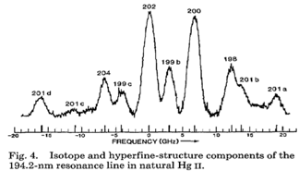
Basic Mercury Ion Clock Scheme
¹⁹⁹Hg⁺
²⁰²Hg⁺
Electron source
194 nm
Advantages of using Hg ions as atomic reference
No lasers
No microwave cavity
No oven
Low g sensitivity
Low B field sensitivity
Cutler, L. S., Giffard, R. P. & McGuire, M. D. A trapped mercury 199 ion frequency standard. In Proceedings of the 13th Annual Precise Time and Time Interval Systems and Applications Meeting 563–578 (1981).
“Integrated physics package of micromercury trapped ion clock with -10^-14 level frequency Stability,” T. Hoang et al., Appl. Phys. Lett. 119, 044001 (2021); https://doi.org/10.1063/5.0049734.

Slide 4
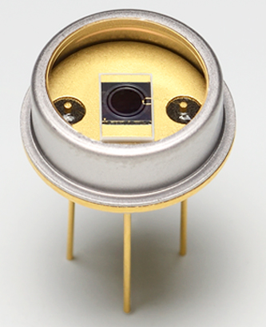
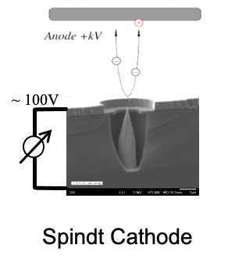
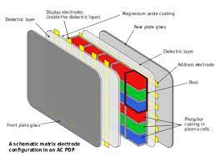
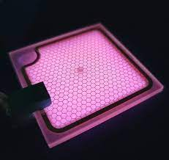
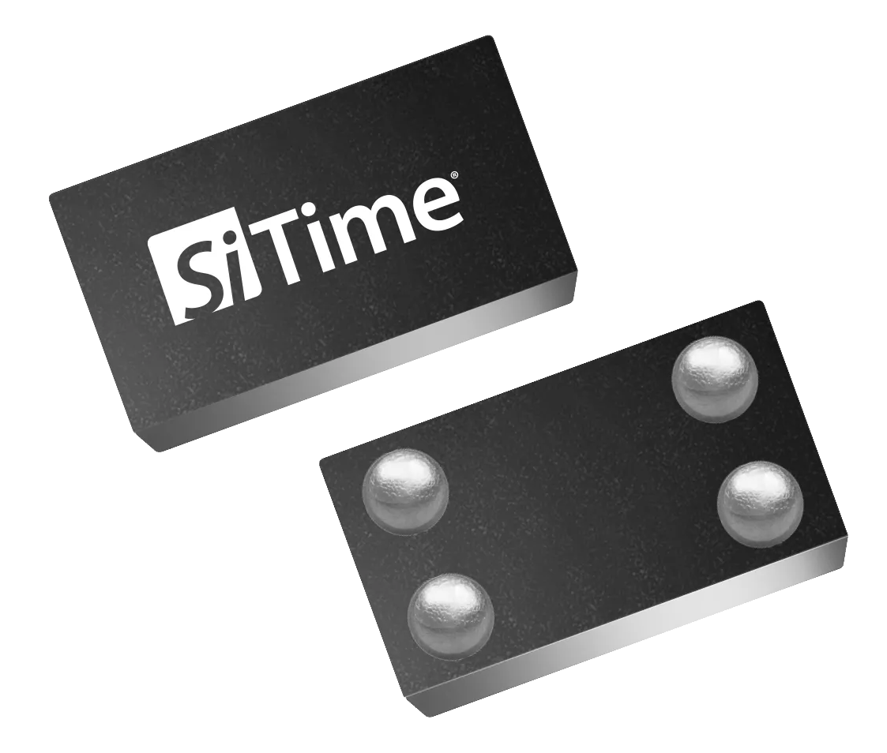
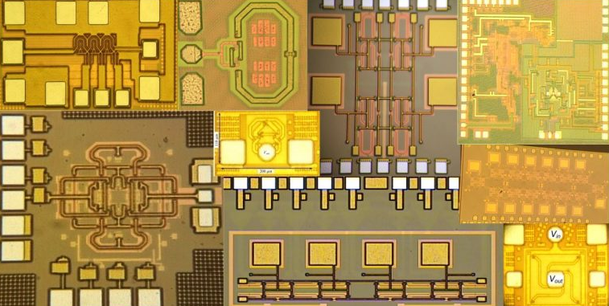

SWaP Reduction Approaches in Hg+ Clock
UV single photon APD??
Electron source
Plasma TV
(Wikipedia)
Lighting industry
Ultra-low power oscillator??
Micro discharge lamp??
DARPA IMPACT Trap PKG: 3 cc
O. Momeni, UCD
High speed CMOS Electronics?
Yb+ micro tube

Slide 5
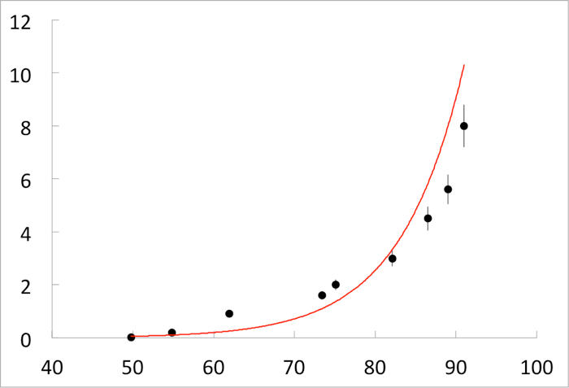
Micro Mercury Ion Trap Tube
Trap vacuum tube fabricated using the glass-metal seal approach.
Sapphire windows, DUV transmission, impermeable to helium.
Constructed from materials to withstand bake-out to 400 ˚C.
Use of field emission electron (FEA) source.
Non-evaporative getter to maintain high vacuum.
Helium buffer gas
U3.1 sealed tube has been working over 4 years without any sign of degradation
FEA I-V curve
Operating here
Current (μA)
A fitted lifetime is 260 days
The actual lifetime may be well > 260 days.
Voltage (V)
<10 mW DC power, normally operate infrequently.
“Integrated physics package of micro mercury trapped ion clock with -10^-14 level frequency Stability,” T. Hoang et al., Appl. Phys. Lett. 119, 044001 (2021); https://doi.org/10.1063/5.0049734.

Slide 6

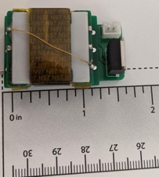
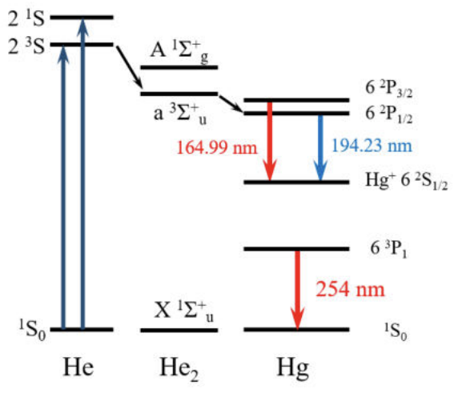
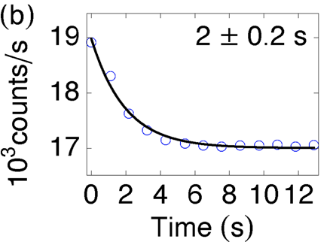
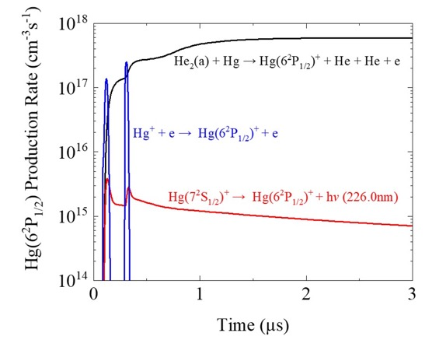
194 nm DUV Micro Plasma Discharge Lamp
The dielectric barrier micro cavity plasma discharge lamp design.
Helium carrier gas provides transient excited He dimers for efficient one-step Hg ion excitation and 194 nm generation.
Pulsed high voltage plasma excitation for intense efficient light production.
Mercury micro discharge lamp
Micro plasma discharge concept
Lamp driver
S.-J Park, et al. 2016 IEEE International Conference on Plasma Science (ICOPS) 1–1 (IEEE, 2016).
Efficient 194 nm generation mechanism
Optical pumping time
S. Park, et al. Plasma Sourc. Sci. Technol. 31, 045007 (2022).
Sub-second pumping time has been demonstrated with 300 mW DC power

Slide 7
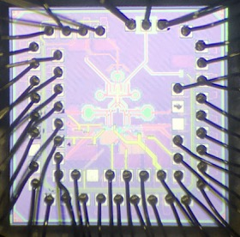
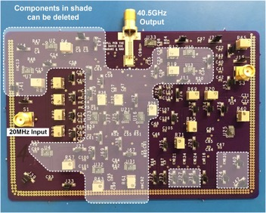
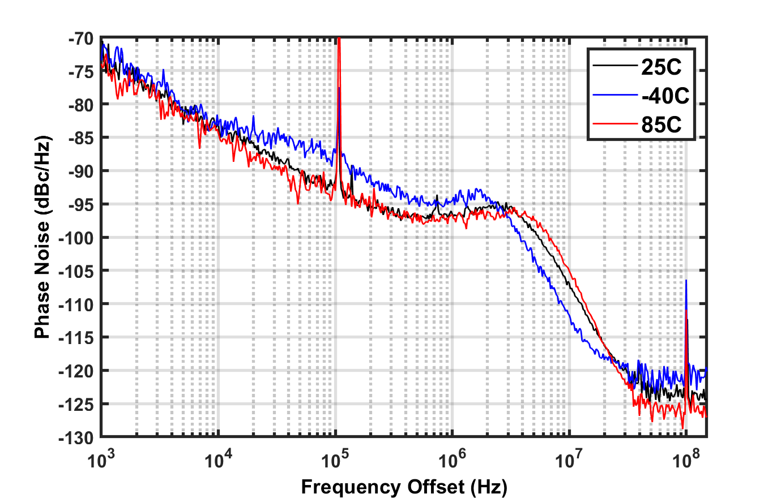
Lower Power Low Noise 40 GHz Synthesizer
High-speed CMOS circuitry for overall low power consumption
Sub-sampling phase detector for dividerless loop resulting low power and low noise
Dual PLL architecture for robust locking operation with minimum power consumption.
Temperature compensation and wide tuning range for wide operating temperature range
~ 40 mW power consumption
8 mW on the chip
Chip temperature locking range
The second generation CMOS synthesizer board (40.5 GHz output phase locked to 20 MHz input)
Wang, H. & Momeni, O.. In 2019 IEEE Radio Frequency Integrated Circuits Symposium (RFIC) 171–174 (IEEE, 2019).
Wang, H. & Momeni, O. IEEE Trans. Microw. Theory Tech. 69, 469–481 (2021).

Slide 8
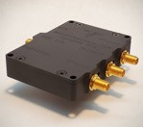

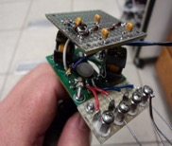

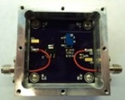
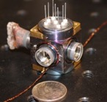
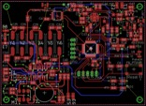

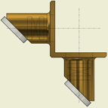
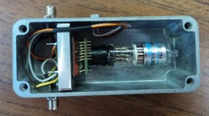
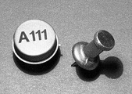
Micro Mercury Ion Clock Components
Clock system diagram
RF driver
40 GHz CMOS synthesizer PLL
C field
Off chip DDS
Low power oscillator
Trap RF drive
lamp driver
FEA driver
FEA supplies
Trap vacuum tube
Lamp
Lamp driver
Microprocessor
FEA
Lamp optics
PMT and driver
Preamp
detector optics
PMT HV
PMT
Signal conditioner

Slide 9
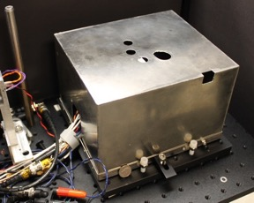
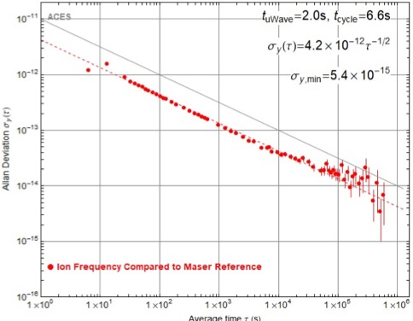
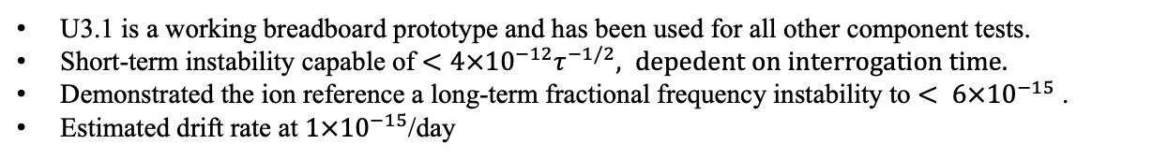
Evaluation of Integrated Clock Stability Performance
Measurements of the trapped ion stabilities against a hydrogen maser.
M2TIC U3.1
COTS processor controller
U3.1 is a working breadboard prototype and has been used for all other component tests.
Short-term instability capable of $<{4×10}^{−12}τ^{−1/2}, depedent on interrogation time.$
Demonstrated the ion reference a long-term fractional frequency instability to $< 6×{10}^{−15}$ .
Estimated drift rate at $1×{10}^{−15}$/day

Slide 10
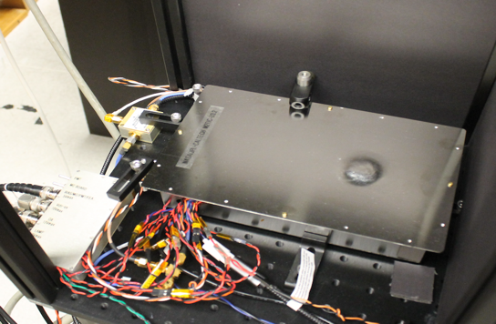
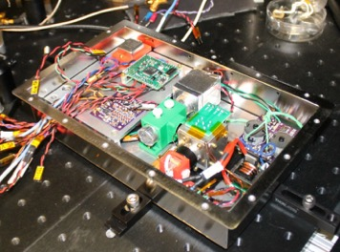
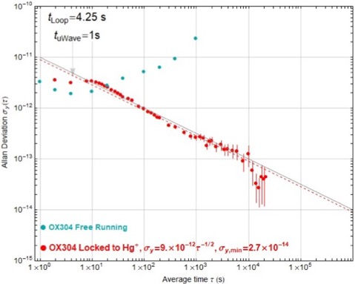
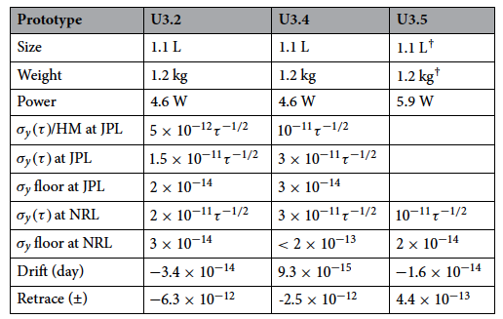
Integrated Clock Packages
M2TIC U3.2
A total of three standalone prototypes are built.
SWaPs and Performances at JPL
Frequency stability performance measured at JPL.
Thai M. Hoang, et al., Sci Rep 13, 10629 (2023). https://doi.org/10.1038/s41598-023-36411-x.

Slide 11
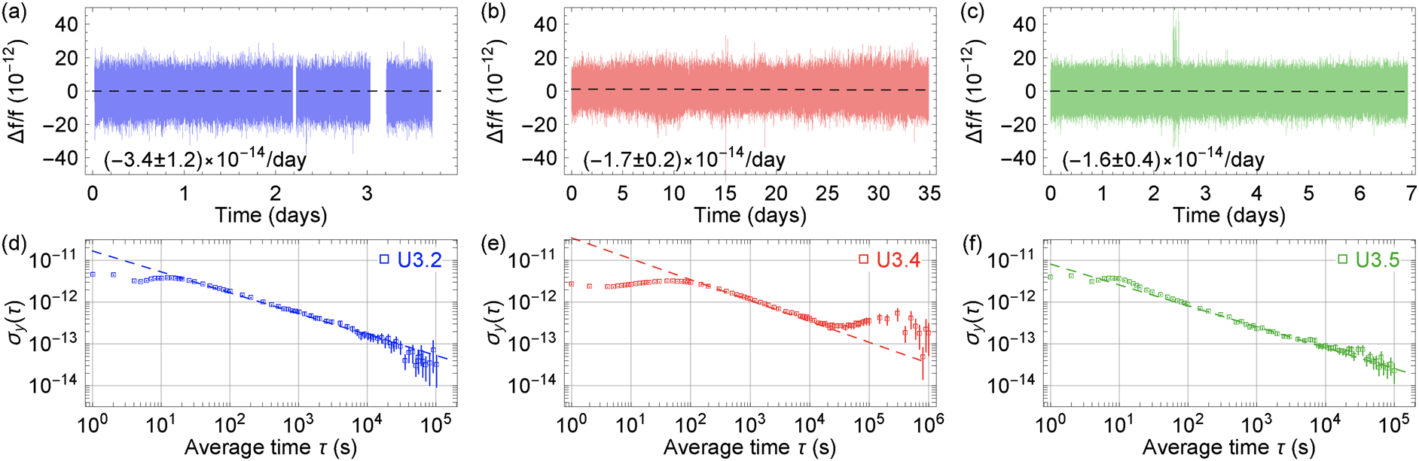
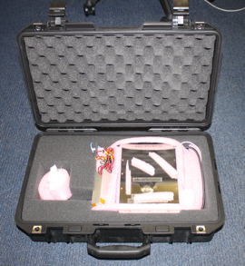
Independently Evaluated at US NRL
Shipping were done by commercial carriers and the clock packages arrived in working order.
Thai M. Hoang, et al., Sci Rep 13, 10629 (2023). https://doi.org/10.1038/s41598-023-36411-x.

Slide 12
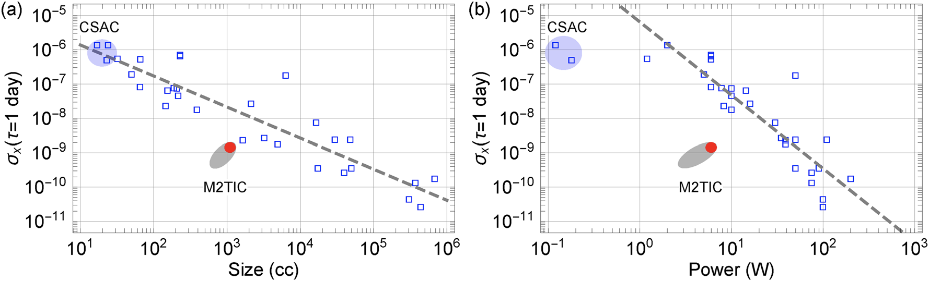
Summary and Outlook
Summary: we have been able to demonstrate M2TIC capable of providing the performance of the rack-mount 5071A Cs beam tube clocks in a much lower SWaP package.
What’s next?
SWaP – There are paths to further SWaP reduction without loss of performances with adoption and use of new component technologies available.
Performance – The dominating instability sources are mainly from Second-order Zeeman shifts from various magnetic field sources and the second-order Doppler shifts from ion number variations. Both can be improved significantly within the current design architecture.

Slide 13



Acknowledgement
Dr. Nan Yu
JET PROPULSION LABORATORY (JPL)
California Institute of Technology
Pasadena, California 91109
Prof. Gary Eden
Electrical and Computer Engineering
University of Illinois, Urbana-Champaign (UIUC)
306 North Wright Street
Urbana Illinois 61801
Prof. Omeed Momeni
Electrical & Computer Engineering
University of California, Davis
3167 Kemper Hall
Davis, CA 95616
Dr. Chris Holland
SRI International
333 Ravenswood Ave,
Menlo Park, CA 94025
Dr. Sung-Jin Park
Eden Park Illumination
903 N Country Fair Drive
Champaign, IL 61822
JPL team key members:
John Prestage, Sang Chung, Thanh Le, Thai Hoang, Lin Yi, Blake Tucker, Jacob Gorelik, and Robert Tjoelker
Team: Sung-Jin Park, Sehyun Park
Team: Hao Wang et al.
Micro lamp
and driver
LO
Optics and detector
Atomic reference
CMOS
Synthesizer
Electronics and Firmware

Slide 14
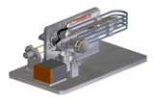


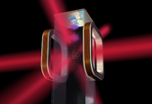
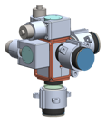






Quantum Sciences and Technology Group
Nan Yu (818)-354-4093 nan.yu@jpl.nasa.gov; http://quantum.jpl.nasa.gov
Actively looking for new postdoc and staff members
Study quantum systems and exploit quantum properties, and develop new technology for advanced clocks, sensors and precision measurement tools, and apply them to space science exploration and fundamental physics measurements
Frequency Standards and Clocks
Small and micro atomic clock
Trapped ion optical clocks
Neutral lattice clocks
Atomic Quantum Sensors
Quantum gravity gradiometer
Atomic quantum accelerometers
Atomic quantum magnetometer
Quantum enhanced sensors
Science and Experiments in Space
Fundamental Physics
Ultra-cold atoms in space
Planetary and Earth Sciences
Space Comm and Navigation
Light and Microwave Photonics
Micro resonator research and devices
Nonlinear and quantum optics
Frequency comb and applications
Optical links at quantum limit
Trapped Hg ion Space clock
(DSAC genesis)
Micro Mercury Trapped Ion Clock
Sr lattice clock
Miniature singly trapped Yb⁺ optical clock
Cold Atom Laboratory
Atom interferometer and quantum sensors
BEC-CAL
QGG
EP and GR
Whispering Gallery mode resonators and quantum optics
Dark energy
Cold atom
Gravity, fundamental physics, and space science through precision measurements in space
Laser frequency and phase controls
Q.C.

