Slide 1
Scalable infrastructure for Sr optical clocks with integrated photonics
9th FSM, Kingscliff, Australia, October 2023
Scott Papp
Quantum and Nonlinear Nanophotonic Systems (QNS)
Funding: DARPA (QuASAR, PULSE, DODOS, ACES, DRINQS, PIPES, A-PhI, LUMOS, QuICC, NaPSAC), AFOSR, AFRL, NASA, JPL, ARPA-e, NSF, NIST

Slide 2
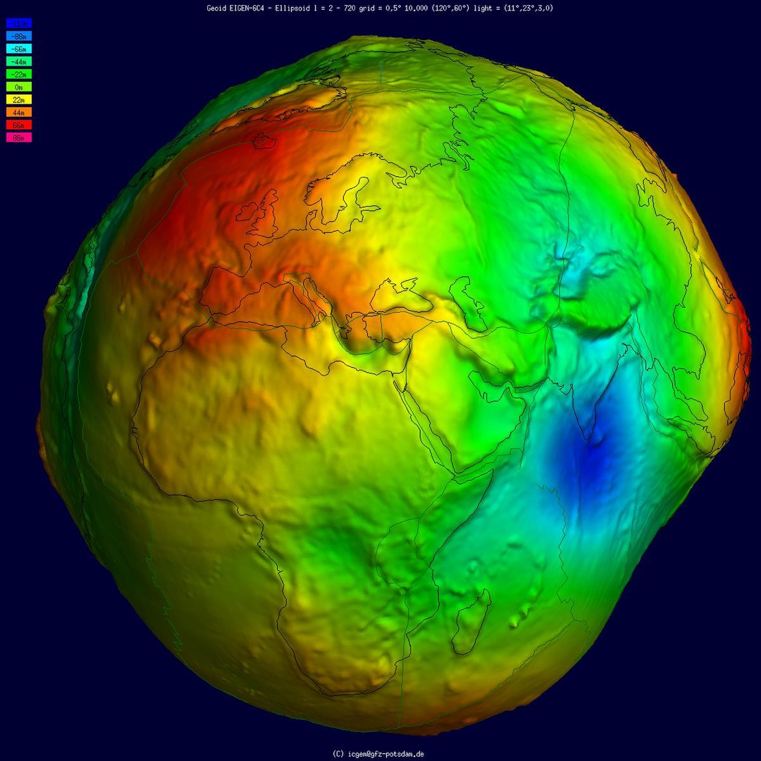
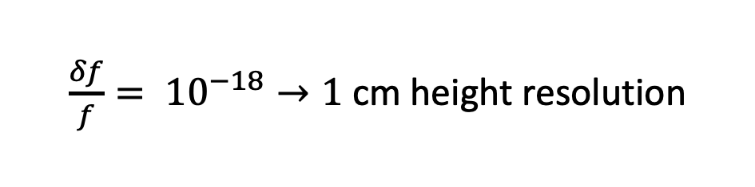
Geodesy
$\frac{δf}{f}= {10}^{−18}→1$ cm height resolution
Barthelmes et al International Centre for Global Earth Models (ICGEM)
Notes:
Geodesy is the science of accurately measuring and understanding the Earth's geometric shape, orientation in space, and gravity field.
Climate science,
ground water levels
Hurricane evacuation route planning
Building infrastructure, roads and bridges.

Slide 3
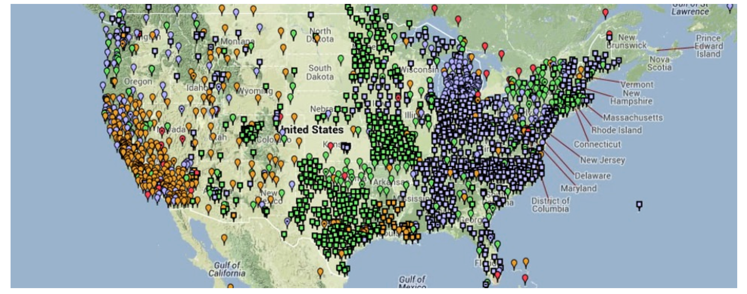
Geodesy stations
https://oceanservice.noaa.gov/education/tutorial_geodesy/geo08_spatref.html
Notes:
The way geodesy is used for practical application is often large network of reference station, which allows the user to achieve the several centimeter precision.
For our community to truly break through and significantly influence geodesy, we need to disrupt the current clock technology in a way to enable us to build 10’s or 100’s of optical clocks.
(This is how geodesy is used in the real world)

Slide 4
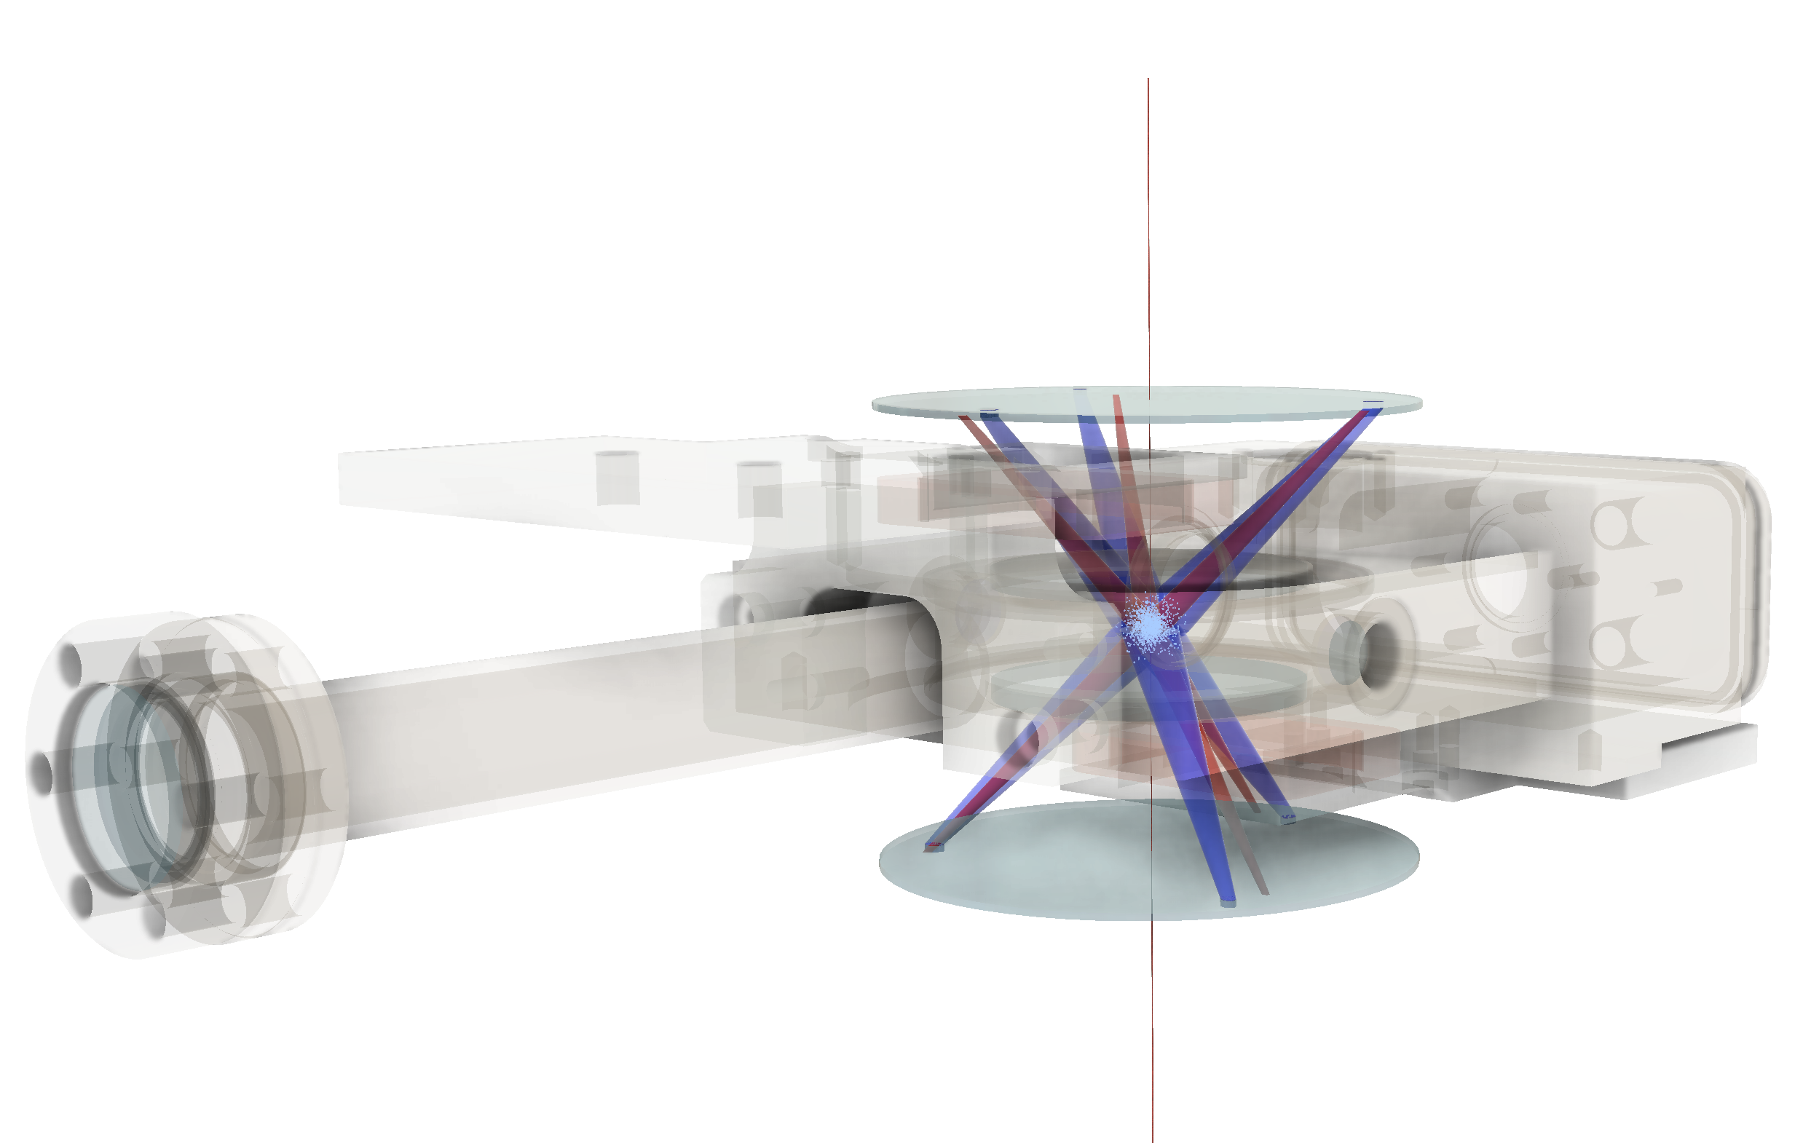
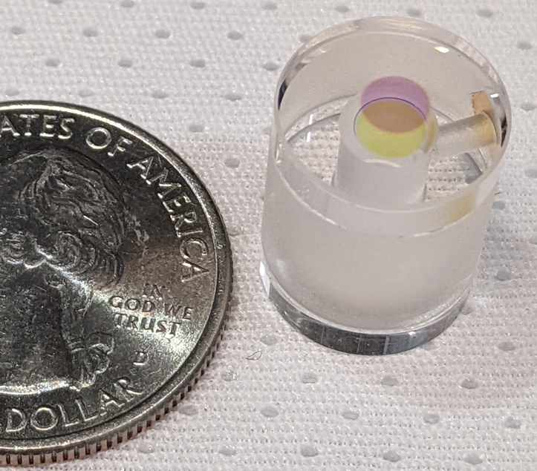
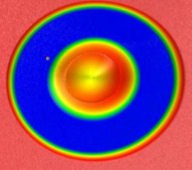
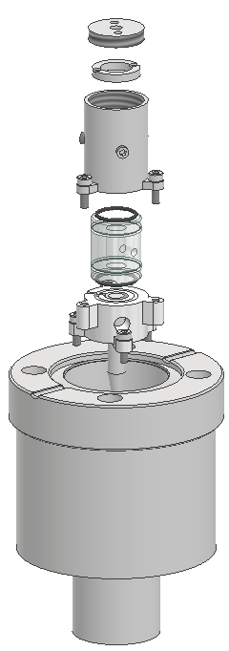
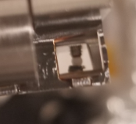
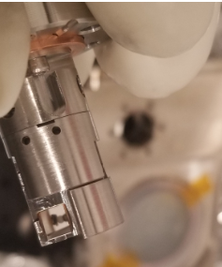

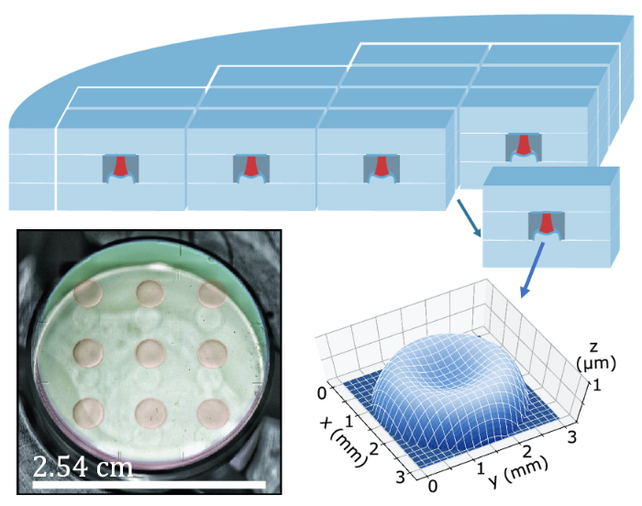
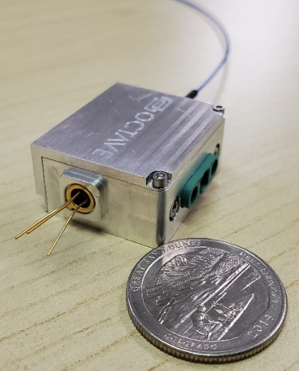
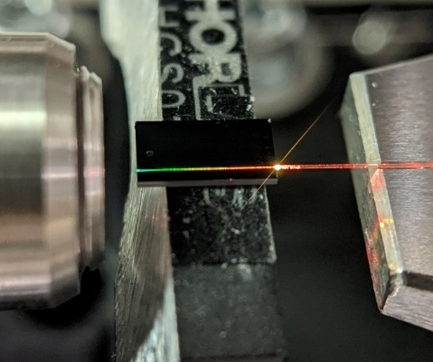
Scalable infrastructure for Sr clocks
atom-photonic Interface
Micro Fabry-Perot Cavity (Quinlan)
compact strontium vapor source (Vector Atomic)
Solid Sr
3 mm
Clamp
Clock Laser
To Atoms
f_{ceo}
Broad-line Cooling Laser
To Atoms
Narrow-line Cooling Laser
integrated photonics frequency comb
(Octave Photonics)
Frequency Comb
To Atoms
Notes:
We will probe our atoms with a clock laser stabilized to a micro fabry perot cavity developed by frank and his team.
The micromirrors of these cavities are made in Peter Rackiche’s lab using a photoresist and reflow technique that create dimples in ULE, which are then coated with a reflective dielectric material.
Amenable to mass manufacturing
Finesse > 400k, and fractional frequency stability 10-14 level at 1s in 2mL cavity
The cavities they have made reach their thermal noise limit

Slide 5
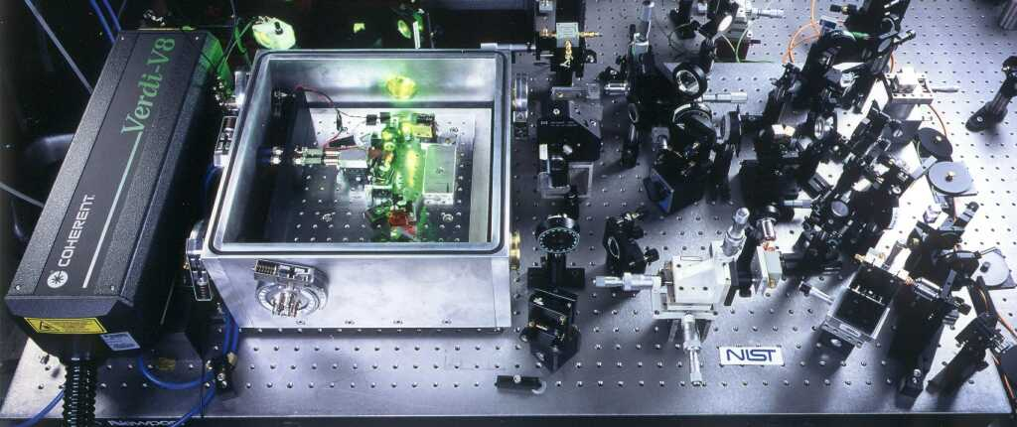
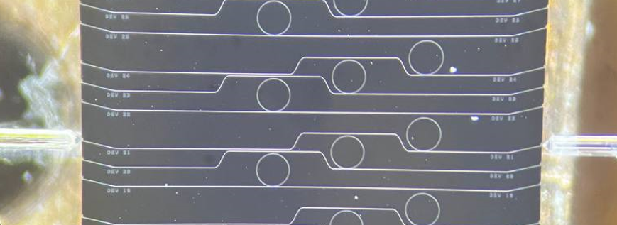
Integrating frequency combs
NIST tabletop frequency comb
NIST microcombs

Slide 6
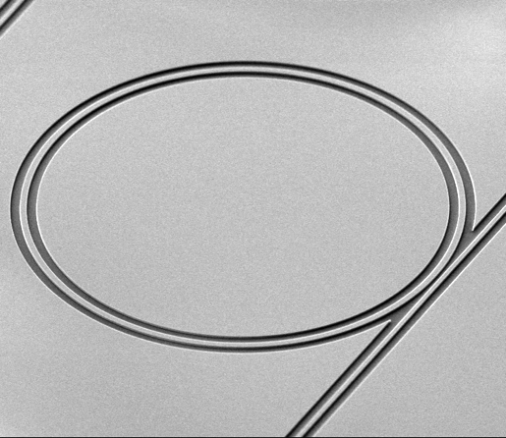
Soliton microcombs
$$\frac{∂ψ}{∂τ} = −\left(1+iα\right)ψ + i{\left|ψ\right|}^{2}ψ − i\frac{β}{2}\frac{∂^{2}ψ}{∂θ^{2}} + F$$
Size
Dissipation and detuning
Kerr nonlinearity
Dispersion
Pump
Octave span
Kartik Srinivasan
Spencer et al. Nature 2018; Briles et al. Opt. Lett. 2018; Stone et al. PRL 2018

Slide 7
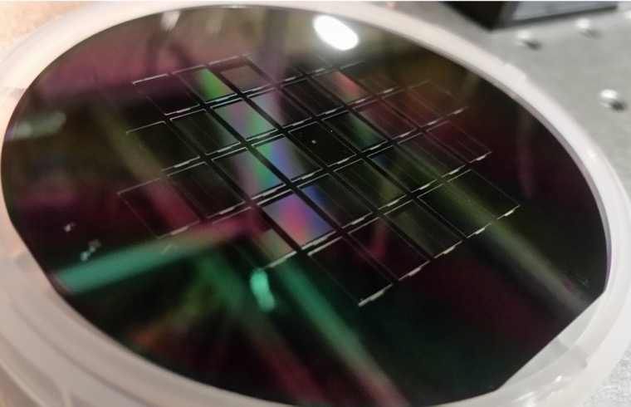
Tantala (Ta₂O₅) integrated photonics
High Q
Full wafer process
Visible to SWIR wavelength range
Versatile integrated nonlinear photonics
Spin-off: Octave Photonics
H. Jung et al. Optica 2020; J. Black et al. Opt Lett 2020; D. Carlson et al. AVFOP 2019

Slide 8
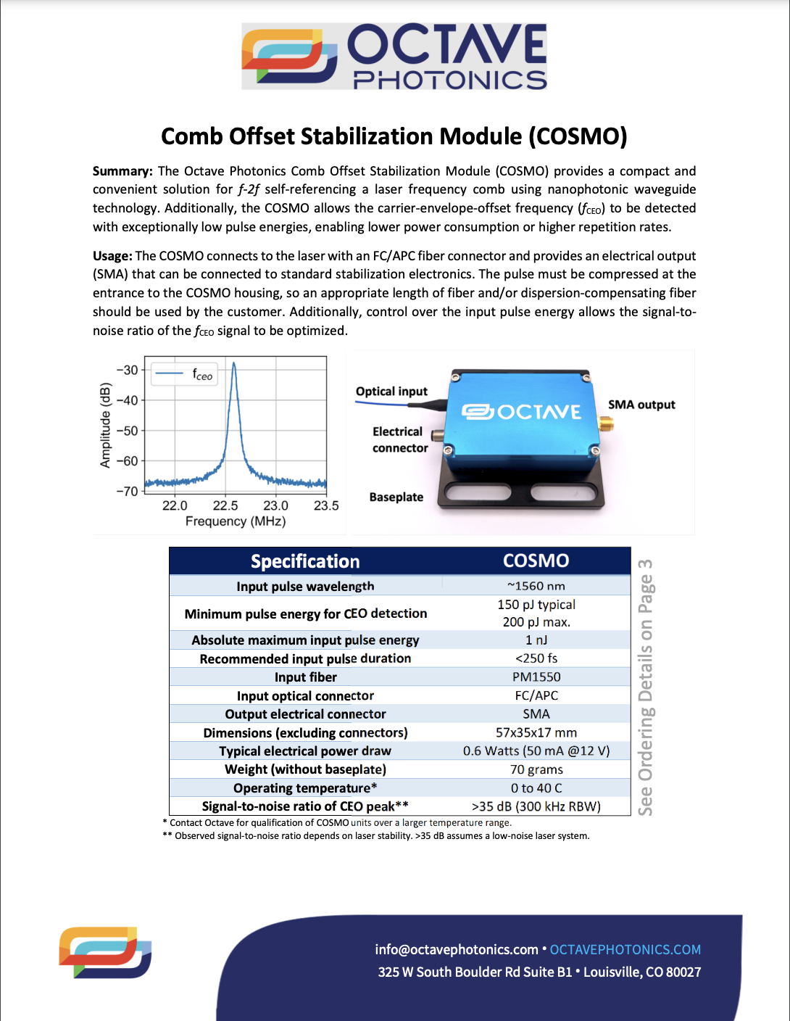
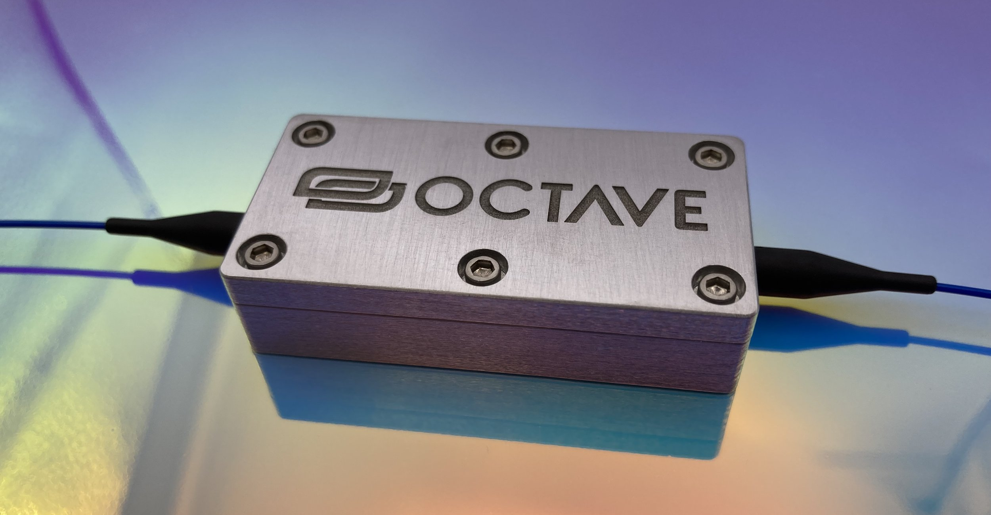
Integrated photonics modules

Slide 9
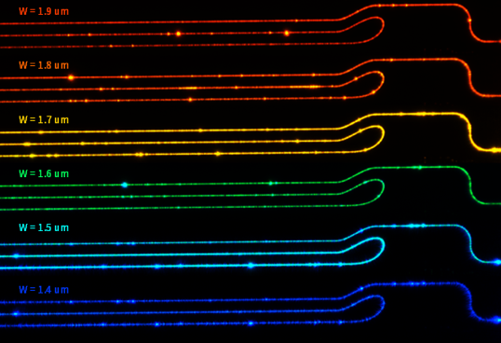
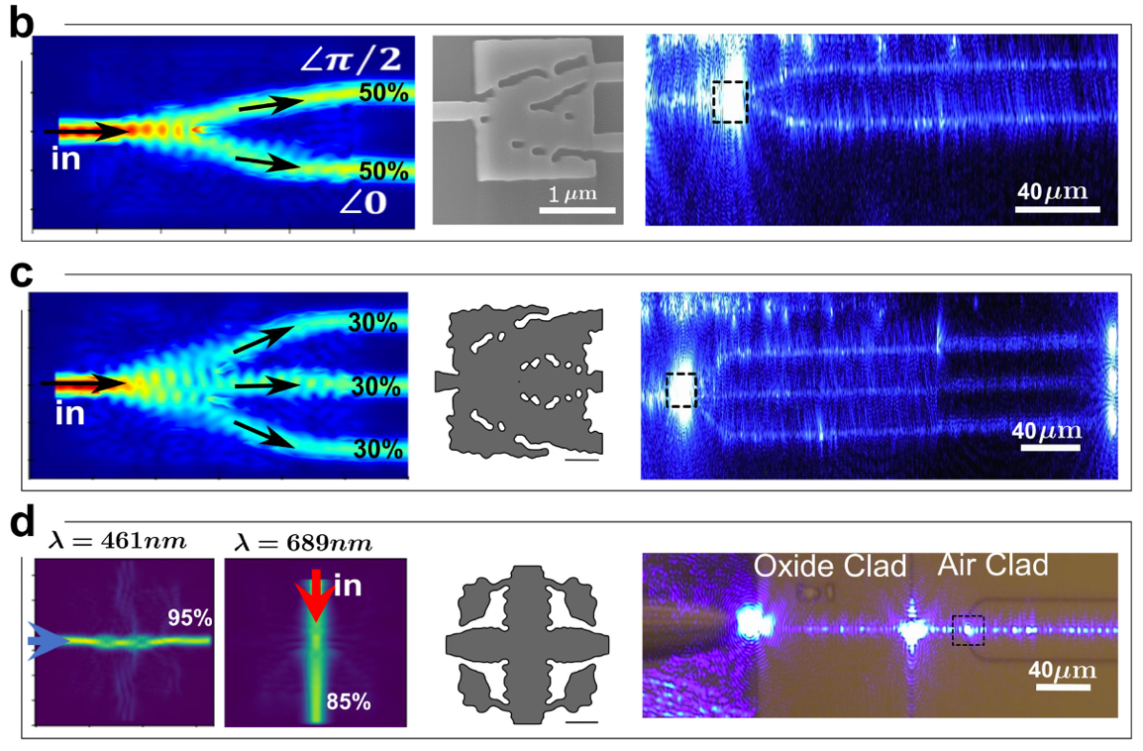
Visible integrated photonics with tantala
Loss < 2 dB/cm from blue to SWIR
Spektor et al. Optica 2023

Slide 10
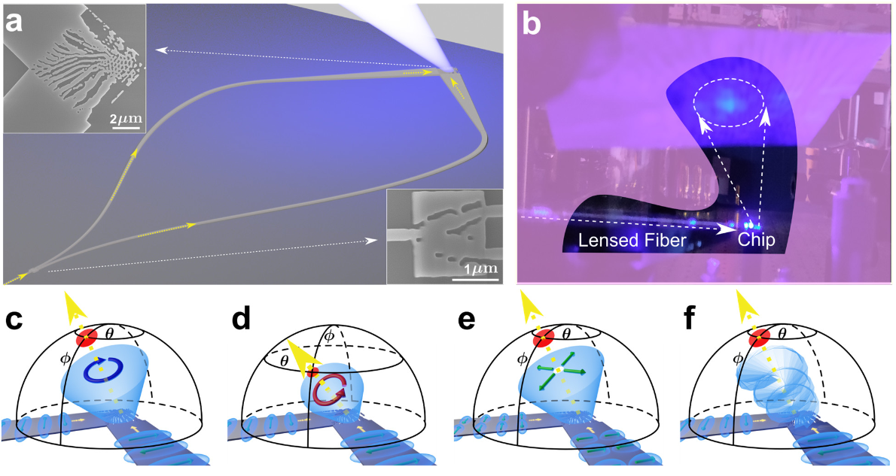
Circular polarization grating coupler
Spektor et al. Optica 2023

Slide 11
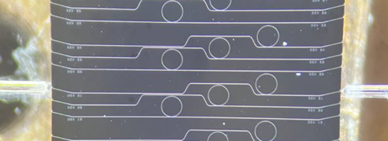
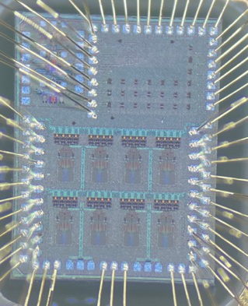
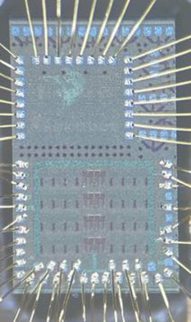
Microcombs & Si photonics/electronics
NIST-B fab
GlobalFoundries 45CLO
Microcomb
32channel transceiver
32channel receiver
DFB laser
22m of SMF
10 Tb/s data link
Needed for data centers and next-gen computing
Collaboration: UPenn, NIST, Stanford, UCF

Slide 12

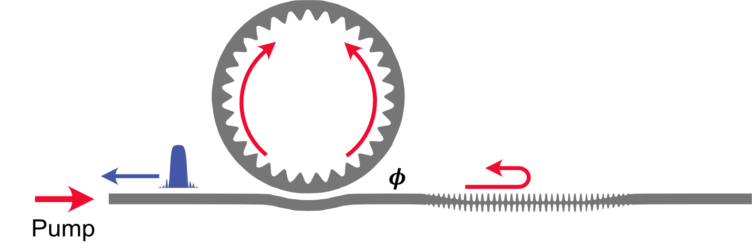
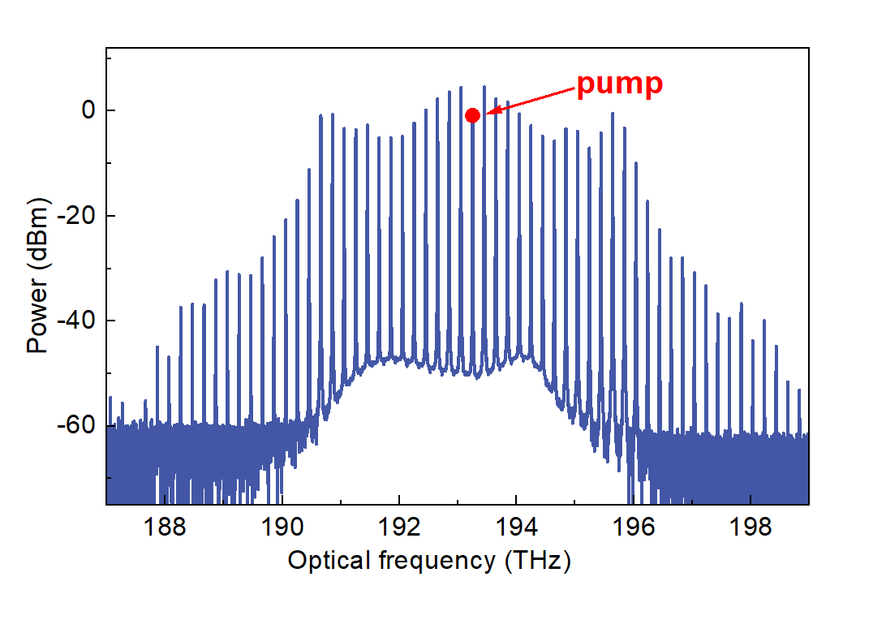


Nanophotonic microcombs
A photonic crystal reflector for “pump recycling”
Pump
$$1 μm$$
$$10 μm$$
S. P. Yu et al. Nature Photonics 2021
S. P. Yu et al. Nature Communication 2022
E. Lucas et al. Nature Photonics 2023

Slide 13
Scalable infrastructure for Sr clocks
metasurface optics: atom-photonic interface
Notes:
This is the aim of our research. We are creating a scalable infrastructure for optical clocks using integrated photonic technologies. Our infrastructure helps scale the production of clocks and fit all clock components into a package.
A-PhI based on MSO at the heart of our system. Tailor light from commercial fibers for atom trapping. Both colors.
ZERO FREE SPACE OPTICS
Replaces a myriad of freespace optics. Alignment by design.
message: we are developing the best integrated photonics available to build an optical clock
All components will fit in a package.
We can reduce the production complexity
Message: (everything will fit into the package) Reduce production complexity (Can be produced at scale)

Slide 14
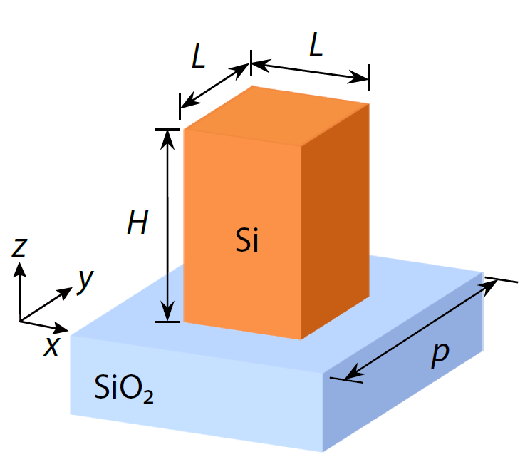
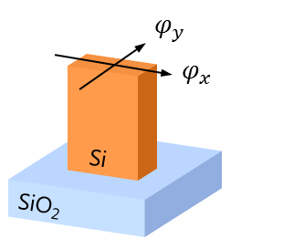




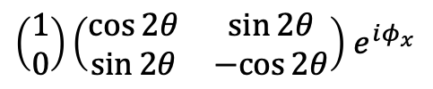


Metasurface optics
Propagation phase
Input = $\left(\begin{matrix}1 \\ 0\end{matrix}\right)$
$φ_{x}=φ_{y}$+$π/2$ (QWP)
$φ_{x}=φ_{y}$+$π$ (HWP)
Output :
$$\left(\begin{matrix}1 \\ 0\end{matrix}\right)e^{iφ}$$
$$\left(\begin{matrix}1 \\ i\end{matrix}\right)e^{iφ_{x}}$$
$\left(\begin{matrix}1 \\ 0\end{matrix}\right)\left(\begin{matrix}\cos{2θ} & \sin{2θ} \\ \sin{2θ} & −cos{2θ}\end{matrix}\right)$ $e^{iφ_{x}}$
$$\left(\begin{matrix}1 \\ 0\end{matrix}\right)e^{iφ_{x}}\cos{2θ}$$
Control of :
Phase
Ellipticity and phase
Polarization and phase
Amplitude and phase

Slide 15
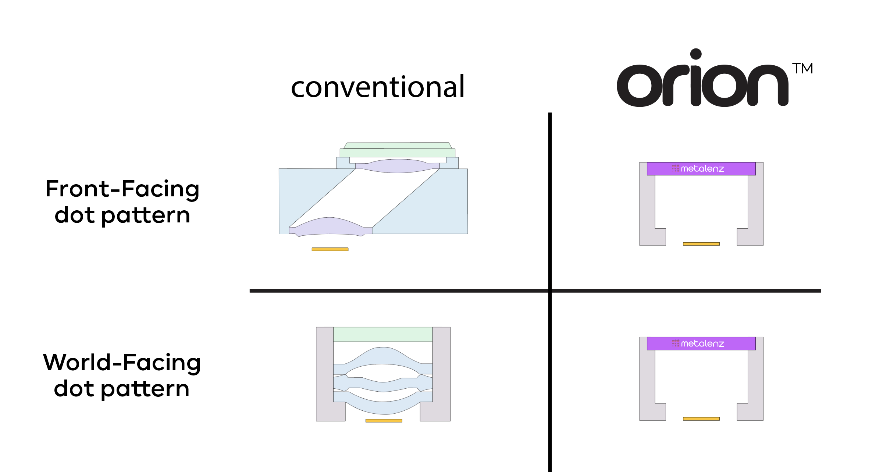
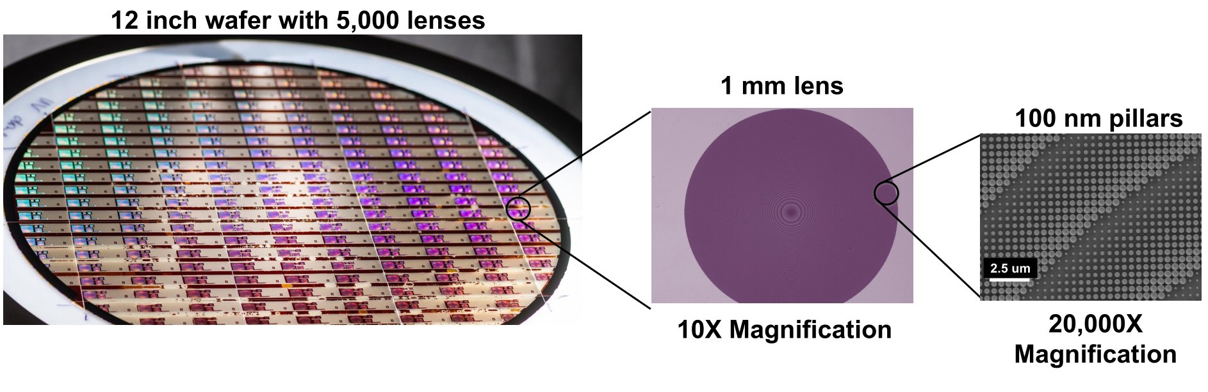
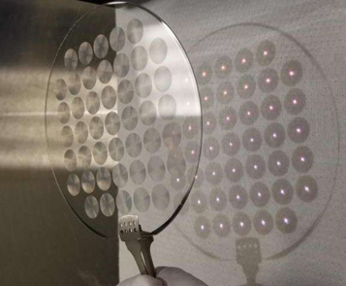
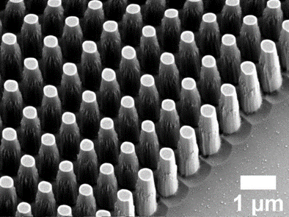
Metasurface optics
Image Courtesy: Metalenz
Nano Lett. 19, 8673 (2019)

Slide 16
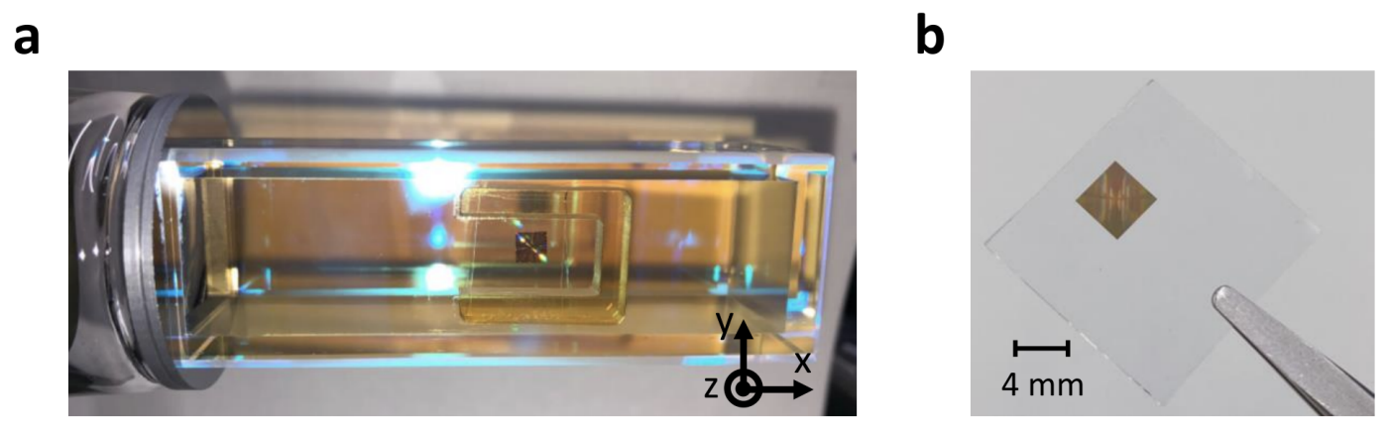
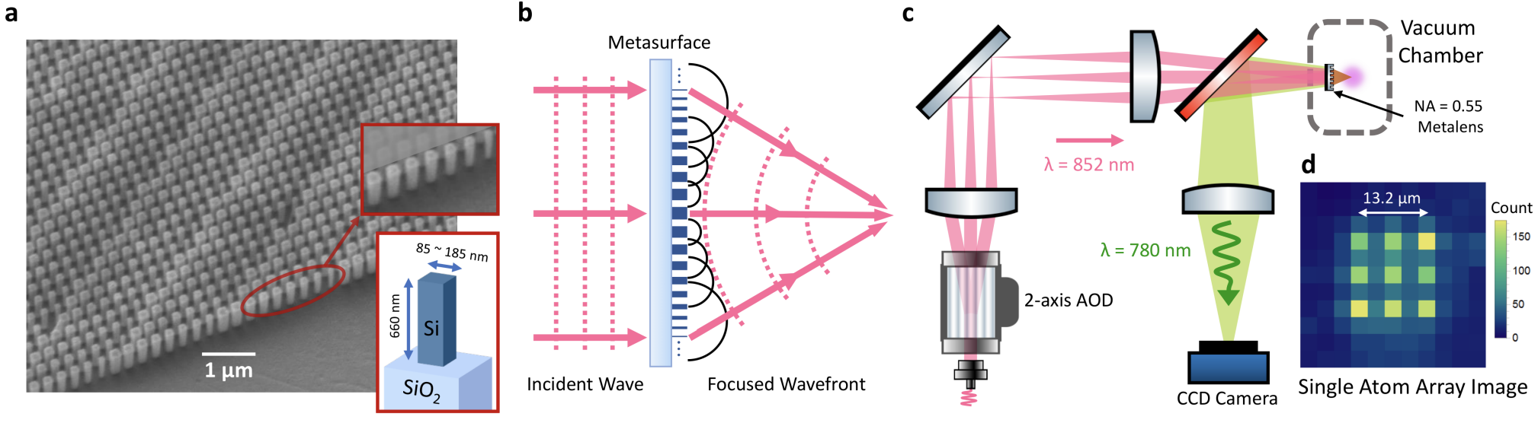
Pilot experiment: Rb single-atom trapping
Atom trapping configuration for
single-atom array creation and imaging
metasurface
amorphous silicon on fused silica
metasurface lens
concept
T. W. Hsu et al. PRX Quantum 2022

Slide 17
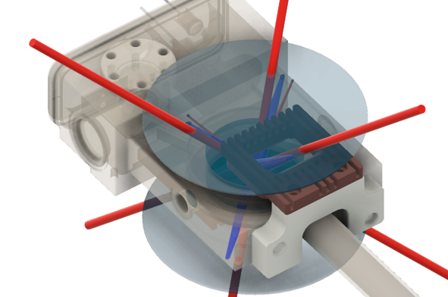
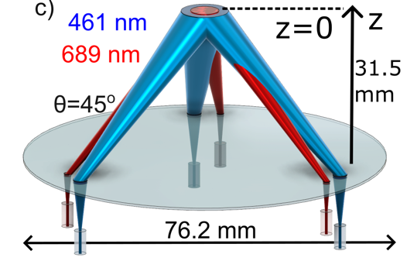
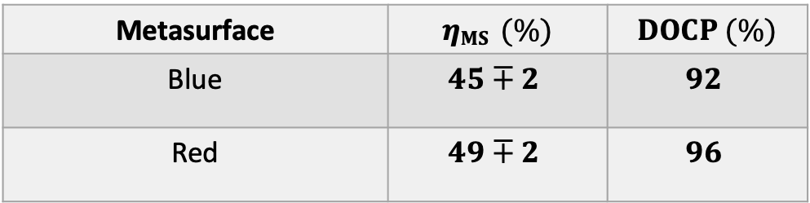
MS optics system for Sr
3 in
Metasurface | $ηMS$ $(\%)$ | $DOCP$ $(\%)$
Blue | $$45∓2$$ | $$92$$
Red | $$49∓2$$ | $$96$$

Slide 18
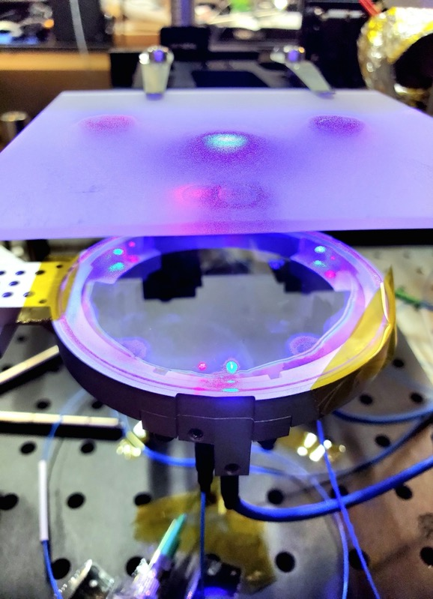
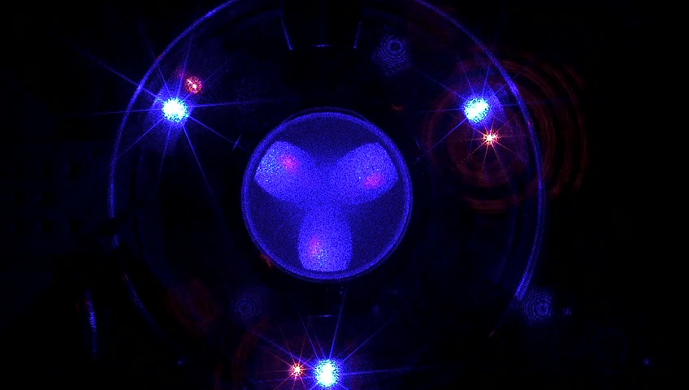
Sr MS system: Optical assembly and test
461 nm and
689 nm beams
Field of view: 101.6 mm
Custom designed Photonics holder
55.9 mm
Notes:
The video shown here is a z stack of the beam images showing the dual color beams expanding and intersecting at a certain height. This describes one of the key aspects of our integrated photonics framework – to have six individual beams from input fibers manipulated by Metasurfaces and meet at a designed height. To characterize the beams, we image them at various heights and extract the beam positions and sizes to compare to the designed values as shown previously. This allows for the use of a complete fiber system at the wavelengths and reducing complexity.

Slide 19
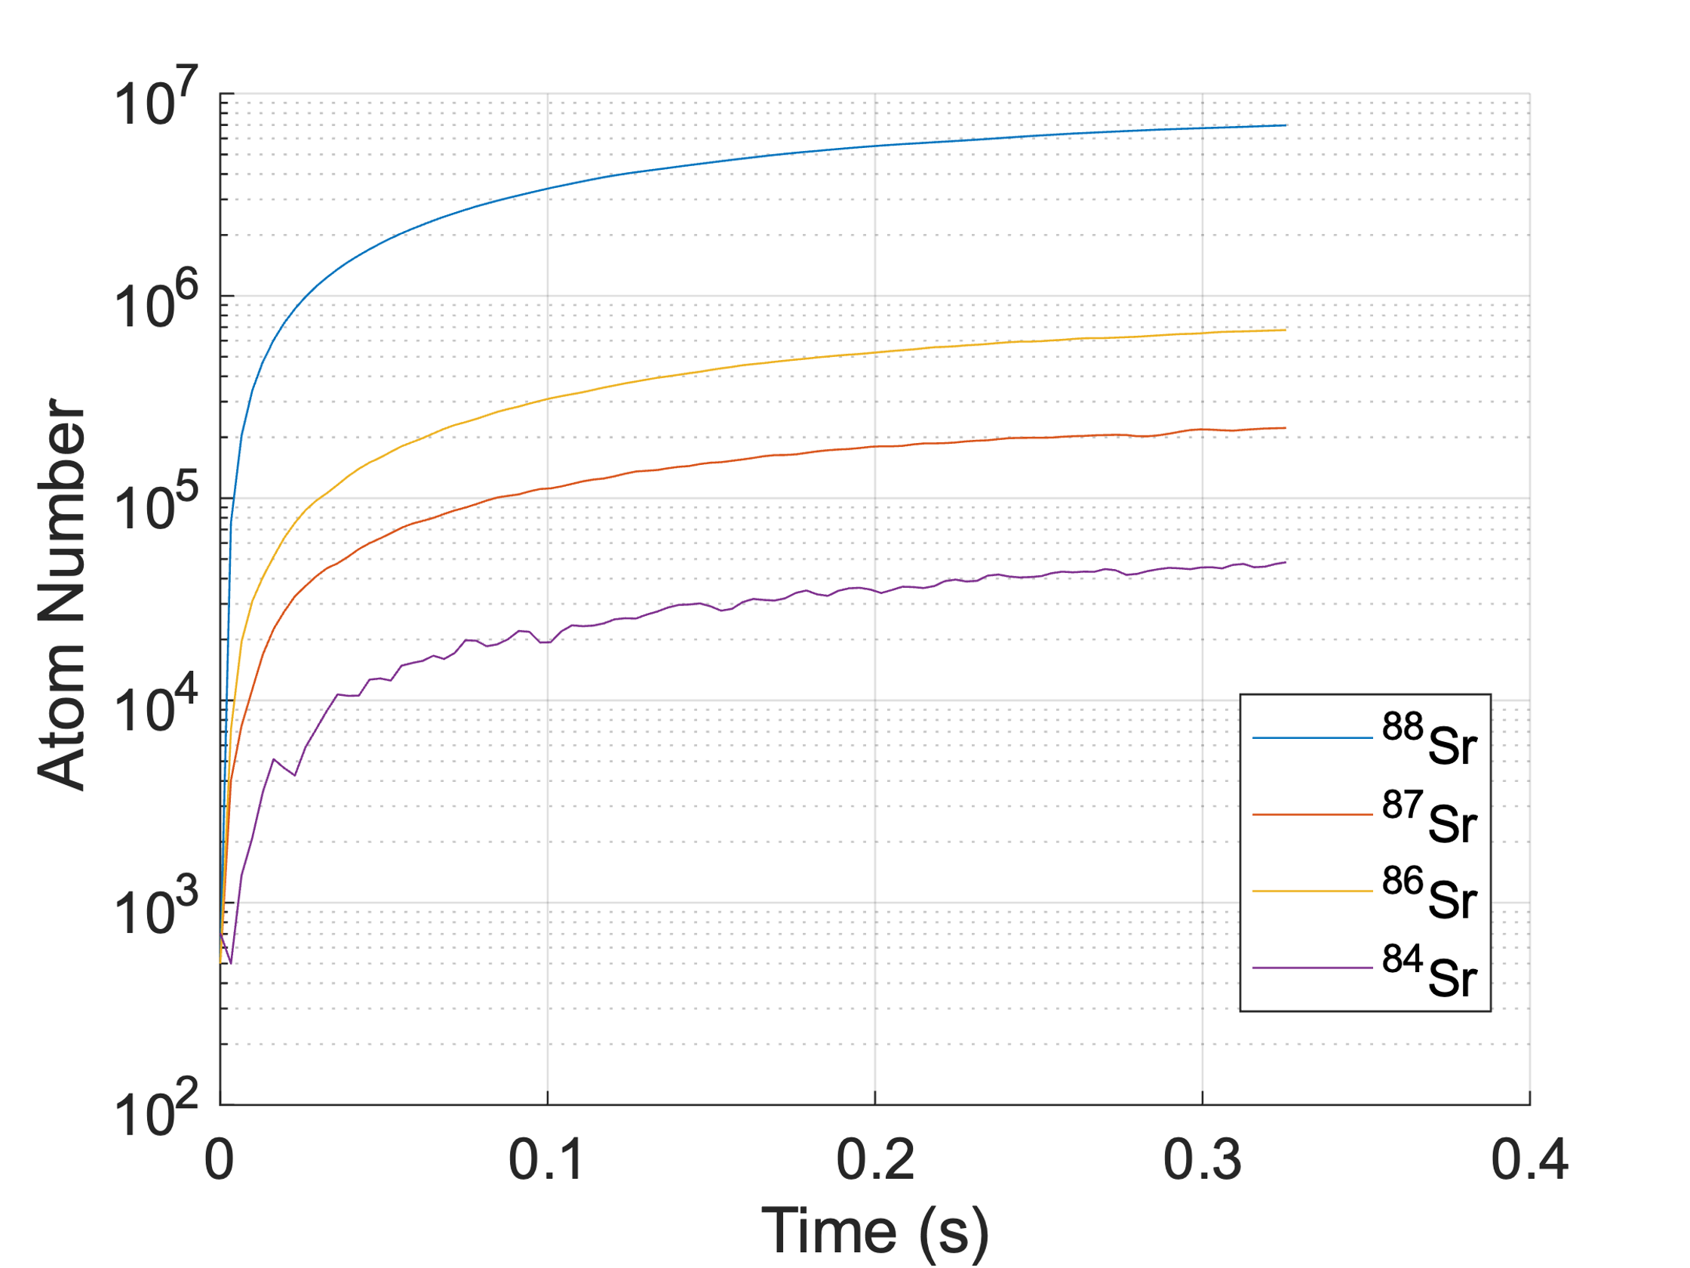
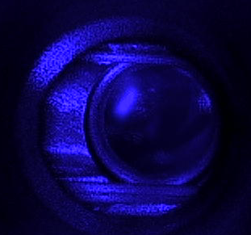
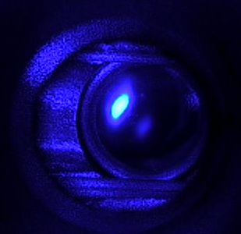
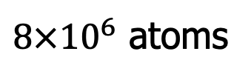
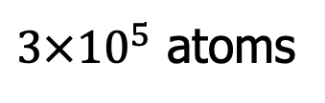
Breakthrough #1: Broad line trapping
⁸⁷Sr
⁸⁸Sr
$3×{10}^{5}$ atoms
$8×{10}^{6}$ atoms
Notes:
With this platform of integrated photonics, we demonstrate for the first time a Sr mot with Metasurfaces with pre set beam parameters and all alignment by machining. The trapping of all species at 461 nm, especially strontium 87 to be used for optical clock measurements shows the system is robust and with precise control of the parameters, especially the polarization control for trapping sr 87 that will be used in next steps, to cool at 689 nm, trap atoms in an optical lattice and perform clock measurements.

Slide 20
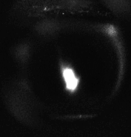
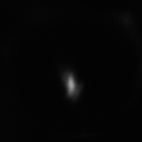
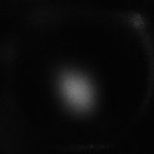
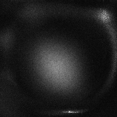
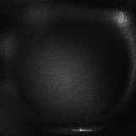


Time of Flight – MOT Temperature
Load
Expansion
ON
MOT Light
OFF
T = 1.7 mK
ON
Camera
OFF
100 μs
0 ms 1 ms 2 ms 3 ms 4 ms 5 ms

Slide 21
Scalable infrastructure for Sr clocks
atom-photonic Interface
Micro Fabry-Perot Cavity (Quinlan)
3 mm
Clock Laser
To Atoms
f_{ceo}
Broad-line Cooling Laser
To Atoms
Narrow-line Cooling Laser
integrated photonics frequency comb
(Octave Photonics)
Frequency Comb
To Atoms
Notes:
We will probe our atoms with a clock laser stabilized to a micro fabry perot cavity developed by frank and his team.
The micromirrors of these cavities are made in Peter Rackiche’s lab using a photoresist and reflow technique that create dimples in ULE, which are then coated with a reflective dielectric material.
Amenable to mass manufacturing
Finesse > 400k, and fractional frequency stability 10-14 level at 1s in 2mL cavity
The cavities they have made reach their thermal noise limit

Slide 22





Laser stabilization with waveguides
^{10 μm}

Slide 23



Chip-scale clock lasers
Frank Quinlan
Compact vacuum Can
Heat shield/rigid holder
Phase I
Phase II
½” diameter cavity
Macor base
Fixed pigtailed collimator
Custom vacuum can

Slide 24





Chip-scale clock lasers
Scott Papp group, NIST
Q = 5 billion
Thermal-noise limited performance
~30 Hz linewidth & ~1 kHz/s drift
Dan Blumenthal (UCSB) / SP collaboration
Q = 720 million
Thermal-noise limited performance
~30 Hz linewidth & ~1 kHz/s drift
25 mm
HR Coating
(Curved Surface)
HR Coating
(Flat Surface)

Slide 25




Heterogeneously integrated clock laser
UCSB III/V-Si tunable laser + NIST photonic resonator
Silicon chip w/ 30 lasers
Packaging for lab experiment
25 mm
HR Coating
(Curved Surface)
T_{c}
T_{p}
HR Coating
(Flat Surface)
T_{a}
L. Stern et al. Opt. Lett. 2020

Slide 26



Ultralow drift at low temperature
NIST (+ JILA for measurement support)
Linear fit 4 mHz/s
Collaboration: Wei Zhang, Andrey Matsko JPL

Slide 27
Narrow Line MOT Sequence
300 μs
t_{lg}
t_{ramp}
t_{sf}
1 ms
Variables:
t_{lg} – time low gradient
t_{ramp} – time B gradient ramp
t_{sf} – time single frequency cooling
I_{sf} – 689 nm intensity single frequency cooling
Δ_{sf} – 689 nm single frequency detuning
FM – 689 nm frequency modulation during broadband cooling
Δ_{sf} – 689 nm single frequency detuning
Δ_{bb} – 689 nm center frequency detuning during broadband cooling
∇B_{lg} – magnetic field gradient low point
∇B_{sf} – magnetic field gradient at single frequency cooling
689 nm Intensity
ON
I_{sf}
OFF
689 nm Frequency
Max
Δ_{bb}
Δ_{sf}
FM
Min
461 nm
Power
ON
OFF
ON
Camera
OFF
B field
(Gauss / cm)
50
Controlled with Argent
Ludlow group, NIST
10
∇B_{sf}
5
∇B_{lg}
Notes:
Challenges of a red MOT. Demands of laser and experimental experimental sequence
Physics of why we need this complicated of a sequence.
First we optimize the broadband red cooling, we turn to singe frequency narrowline cooling which is where we are able to achieve the uK level temperatures needed to load the lattice and probe the clock transition.

Slide 28


Breakthrough #2: Narrow line trapping
t = 0 ms
t = 2 ms
t = 4 ms
t = 6 ms
t = 8 ms
t = 10 ms
t = 12 ms
s_{final} = 57
Δ = 670 kHz
T = 4 μK

Slide 29










MOT dependence on Δ and s
0.1 Imax
689 nm intensity
0.8 Imax
$$∆ =−0. 75 MHz$$
$$∆ =−0.88 MHz$$
689 nm detuning
$$∆ =−1.00 MHz$$
$$∆ =−1.12 MHz$$
$$∆ =−1.25 MHz$$
Notes:
We can optimize the MOT temperature, shape, and density with the parameters of single frequency
WHY?? Optimizing for cold dense atom sample -> LOAD LATTICE

Slide 30


In progress: lattice trapping
Frank’s clock laser
Clock transition search
B
Bothwell et al Metrologia 2019

Slide 31


Further metasurface integration
B –field gif: zbias_x_0_15

Slide 32




DARPA A-PhI program
Peter Rakich
Micro FP cavity design/fab/test
Boulder, CO
Scott Papp (PI)
Frank Quinlan
Scott Diddams
Cindy Regal
Sr experiments with photonics
Optical frequency divider combs
Optical reference cavity
Gaithersburg, MD
Amit Agrawal
Vladimir Aksyuk
(Kartik Srinivasan)
Photonic system for atomic interface: Design, fabrication, testing
Photonic interface for reference cavity: Design, fabrication
Marty Boyd
Jamil Abo-Shaeer
Atomic source: Design, fabrication, and testing
System integration
  Phase 1 laser cooling
  Phase 2 deliverable construction and testing.
Kerry Vahala
10 GHz photonic oscillator
John Bowers
SHG for clock laser

Slide 33



Heterogeneous laser integration for visible
SOA and WG-facet laser-mirror
III/V-tantala integrated laser + nonlinear optics platform
(NIST-Boulder)
Design Angled facets for 570 nm TaO at 980 nm wavelength
Chip 1
LM+PhCRR laser cavity
oxide
LN
tantala
oxide
Chip 2
full wafer laser epi layer
Si
50 mm² LN chip areas
Notes:
One of the remaining siginifant hurdles in scaling optical clock technologies are the lasers.
We can’t talk about a scalable or compact optical clock without considering all the lasers necessary to make these types of systems work.
Laser integration is being actively address by many in the integrated photonics community, including us, our collaborators, all sizes of companies, and government like DARPA.
We can get an idea of what future laser technology may look like from our group and collaborators work in the DARPA Lumos program, where we have integrated III/V gain material with our tantala platform with additional nonlinear optical matials.
This program has demonstrated the ability to scale laser technologies, where you can envision having hundreds or thousands of lasers produce on a single wafer.
These lasers have not reached the point where they are ready to be incorporated into an experiment such as our optical clock. There is a lot of work to do to improve the performance of the lasers, but the technologies are there.

Slide 34






Heterogeneous laser integration for visible
Waveguide PPLN (Stanford)
III/V tantala laser (NIST)
Tantala OPO (NIST and Octave)
Waveguide PPLN (Colorado)
Laser active region, 500 μm

Slide 35

Visible OPO lasers
K. Srinivasan, 2022

Slide 36



Visible OPO lasers
Wavelength by design.
J. Black and S. Papp, 2023

Slide 37




DARPA LUMOS program
Boulder, CO
Scott Papp (PI)
Jennifer Black
Rich Mirin
Nima Nader
Scott Diddams
nonlinear wavelength converter
integrated pump laser
Lithium niobate poling in Boulder
Jelena Vuckovic
Amir Safavi-Naeini
inverse design of photonics
nonlinear wavelength converter
optical isolation
lithium niobate for modulation and SHG
Gaithersburg, MD
Kartik Srinivasan
nonlinear wavelength converter
Phase 3 application: heterogeneous quantum network
Louisville, CO
David Carlson
Zach Newman
Preliminary PDK on tantala platform
Tantala passives and nonlinear fabrication
Lithium niobate bonding and fab

Slide 38



Integrated photonics for quantum
SOA and WG-facet laser-mirror
NIST integrated photonics
Design Angled facets for 570 nm TaO at 980 nm wavelength
Chip 1
LM+PhCRR laser cavity
Chip 2
Advanced physics packaging
(Vector Atomic)

Slide 39
























QNS Group at NIST-B
Staff, Postdocs, Students: Jennifer Black, Katja Beha, Travis Briles, David Carlson, Dan Cole, Tara Drake, Ivan Dickson, Andy Ferdinand, Connor Fredrick, Dan Hickstein, Sindhu Jammi, Yan Jin, Hojoong Jung, Erin Lamb, Haixin Liu, Erwan Lucas, Zheng Luo, Zach Newman, Grisha Spektor, Jordan Stone, Liron Stern, Su-Peng Yu, Lindell Williams, Jizhao Zang, Wei Zhang
NIST Collaborators: Agrawal, Aksyuk, Diddams, Kitching, Hummon, Mirin, Nader, Stanton, Newbury, Srinivasan, Westly, …

