Slide 1

Differential Spectroscopy of Atomic Clocks
Tara Fortier….. and many others!
Time and Frequency Division
National Institute of Standards and Technology
That’s me holding a koala!
9FSM: Oct 16 2023
Notes:
Atomic clocks are amazing:
Optical clock comparisons
Optical to microwave clock comparisons
Accessibility limitations

Slide 2

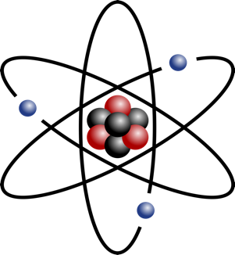
Atomic clock basics
Isolate, trap, cool, control, probe….
oscillator
Atomic energy levels
Fields/constants:
B, E, T, U….
c,m_{p}/m_{e},α...
Energy
Lifetime >> 1s

Slide 3
Atomic clock basics
Isolate, trap, cool, control, probe….
oscillator
Atomic energy levels
Resonant frequency
Energy
Power
Lifetime >> 1s
frequency

Slide 4
Atomic clock basics
Cycles of an electromagnetic field are stabilized to an atomic transition
Isolate, trap, cool, control, probe….
oscillator
Resonant frequency
Power
feedback to oscillator
frequency

Slide 5
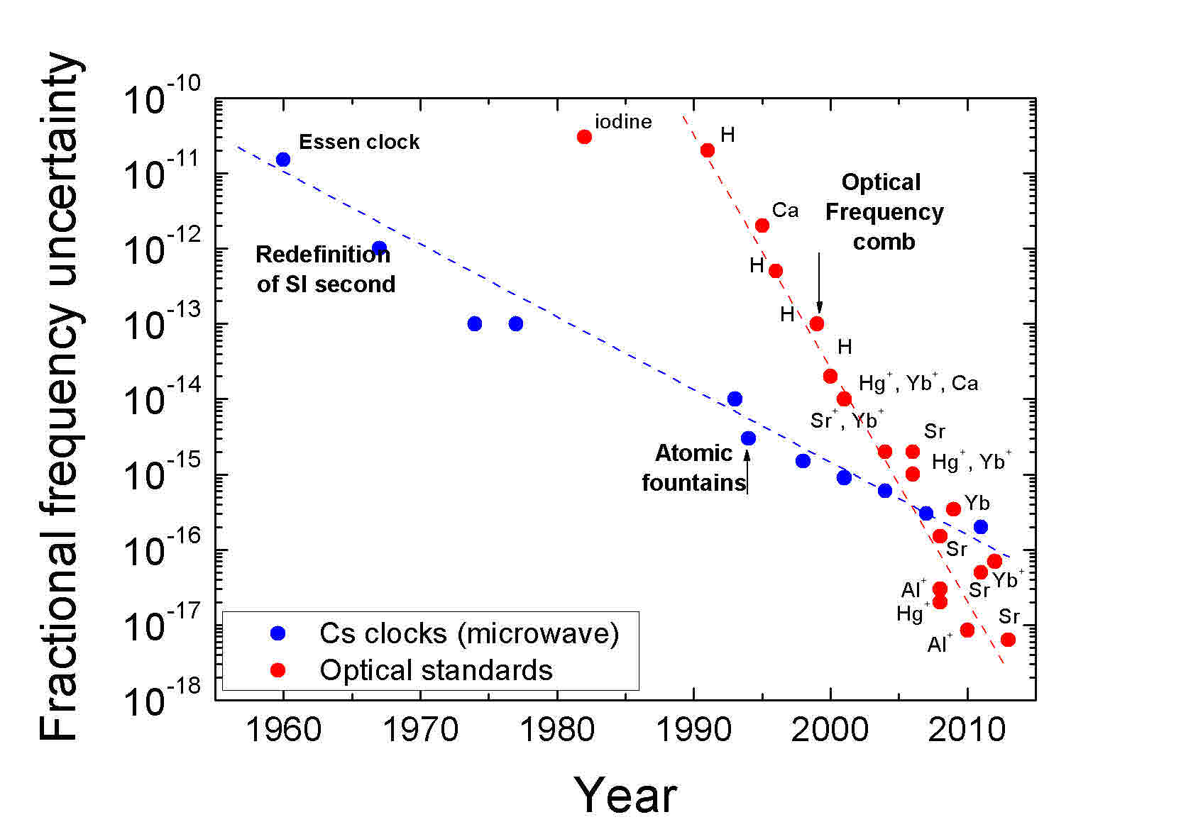
Historical Performance of Atomic Clocks
N. Poli et al, Rivista del Nuovo Cimento, 36 (2013)
A. Ludlow et al. Rev. Mod. Phys. 87, 637 (2015)
Clock accuracy: Δν/ν₀
10⁵ time higher constraint on microwave transitions to achieve the same accuracy
Optical clocks
Microwave clocks
Fractional Accuracy
Δν = 10 μHz on 10 GHz
Accuracy ¹³³Cs
~10⁻¹⁶
Δν = 1 mHz on 1 PHz
Al⁺
Sr
Yb
Sr
Optical ~10⁻¹⁸
Al⁺
Year
Is it time to redefine the SI second?
Notes:
Steeper slope for optical clocks
Reason: microwave clocks require much better control over their systematics.
Accuracy and potential of optical clocks…. Redefinition of second.
If we look at the performance of clocks over time we see a steeper slope associated with improvements in the accuracy of optical as opposed to microwave clocks. There is a reason for this. As I mentioned before, the higher the frequency of your clock the better the accuracy and stability. Said differently, the lower your clock frequency, the higher the constraint on the your systematics.
To achieve parts in 10-18 requires knowledge of an optical transition to 1 mHz. On a microwave transition 10-18 requires that you know your transition frequency to a fraction of a micro-Hz. Because the difference in constraints, microwave clocks are not likely to make significant gains in accuracy over their current performance, but optical clocks which have been demonstrated to be 100 more accurate are still improving.
The question that must be on everyone’s minds is…. Given the higher accuracy and potential for optical clocks…. Is it the time right for optical redefinition of the SI second?

Slide 6
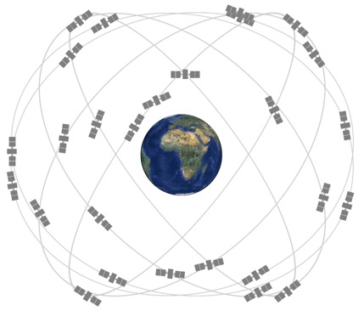
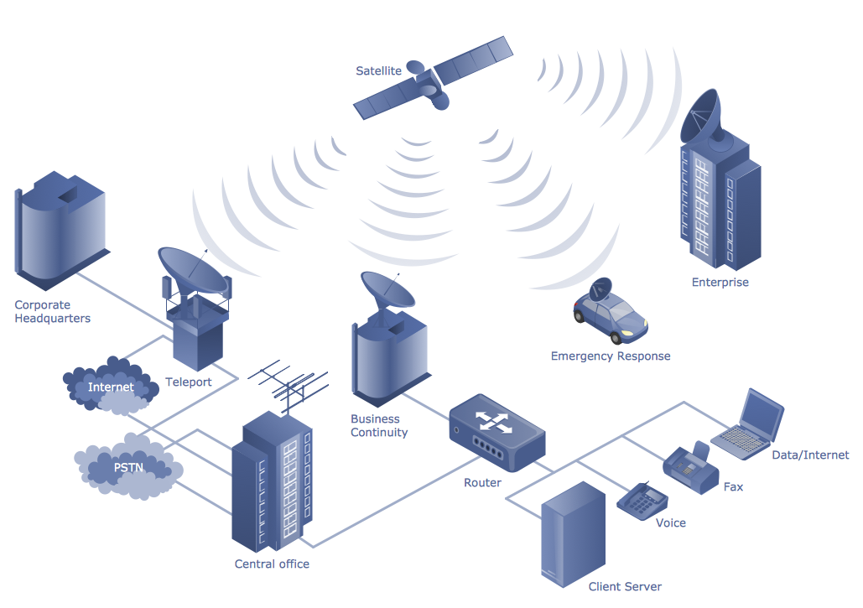
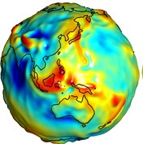
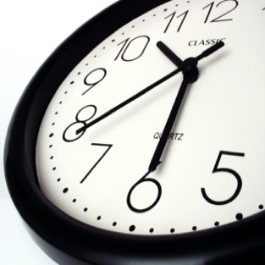

Atomic Clock Applications
GPS and Navigation
Defining the SI second
Synchronization in communications networks
F. Riehle, et. al., Metrologia 55.2 188 (2018).
T. E. Mehlstäubler et. al., Rep. Prog. Phys. 81 (2018)
C. Grebing, et. al.,, Optica, 3(6) (2016).
v_{g}
Difference in clock readings
α
Improve local geodesic measurements
l/v_{g}
Time
Variation of
fundamental constants
Credit: A. Derevianko
Dark matter detection

Slide 7
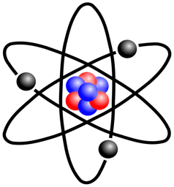
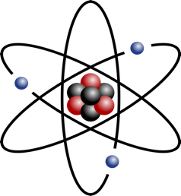
Applications requiring comparison of two dissimilar clocks
Fundamental physics
Atomic Clock | Resolution ✕ 10⁻¹⁸ | Accuracy ✕ 10⁻¹⁸ | α− Sensitivity
¹⁷¹Yb | 1 | 1 | +0.06
⁸⁷Sr | 1 | 1 | +0.31
¹⁹⁹Hg⁺ | 40 | 30 | -3.0
²⁷Al⁺ | 4 | 1 | +0.0079
Hees et al, Phys. Rev. D. (2018)
T.Rosenband et al. Science (2008)
Roadmap for redefining the SI second
Demonstrate robustness of optical systems, consistency between the new and current SI, and 100 improved accuracy
Demonstrating comparison between different atomic clock species at 5 x 10⁻¹⁸

Slide 8
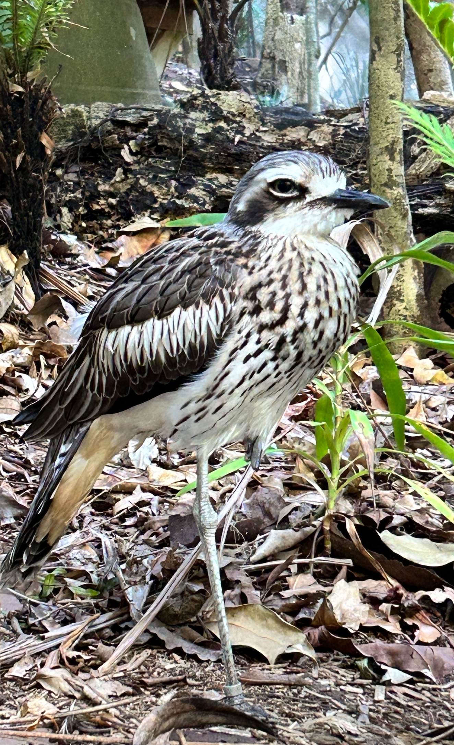
How do you compare optical clocks when they operate at different optical frequencies?
Skeptical bush stone-curlew: Currumbin Wildlife Sanctuary

Slide 9
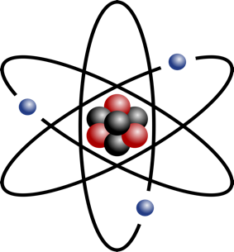

Frequency comb: a pulsed harmonic synthesizer
The OFC is referenced using an atomic clock.
It synthesizes a stable optical pulse train comprised of coherently and harmonically related optical modes.
ν_{opt}
Reference
Photonic Synthesizer
Microwave OUT
DC – 100 GHz
Optical OUT
150 – 280 THz
ΔT = 1/f_{r} < 1fs
Optical IN
250-500 THz
μ-wave
f_{N} = N * f_{r}
optical
ν_{N} = N * f_{r} + f_{CE}
f_{r} ~ ν_{opt ➗} C
C ~ 500,000 (non-integer)
Review: Fortier and Baumann, Communications Physics (2019)

Slide 10
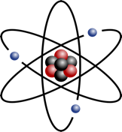


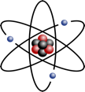
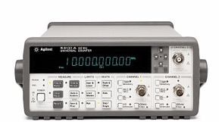
Combs for clock comparisons
Frequency ratios are unitless: relative measurement of optical atomic clocks allow for measurements independent of the 10⁻¹⁶ accuracy limitations of PSFS (Hz).
ν_{opt1}
ν_{opt2}
100’s THz
f_{r} ~ ν_{opt ➗} C
Optical ruler
Cs¹³³
f_{r} ~ 1GHz
Comb optical synthesis performance:
Additive instability ~ 10⁻¹⁸ τ⁻¹
Fractional accuracy ~ 10⁻²¹

Slide 11
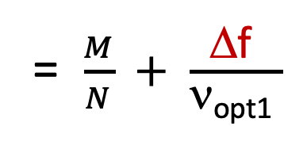
Optical-to-optical clock comparisons
Frequency ratios are unitless: relative measurement of optical atomic clocks allow for measurements independent of the 10⁻¹⁶ accuracy limitations of PSFS (Hz).
ν_{opt1}
ν_{opt2}
100’s THz
f_{r} ~ ν_{opt ➗} C
Δf
N
M
ν_{opt2}
(“Hz”)
= $\frac{M}{N} + \frac{\text{D}\text{f} }{\text{n}\text{opt}\text{1} }$
fractional offset < 1e-9
ν_{opt1}
(“Hz”)
Dominant term

Slide 12




Boulder Atomic Clock Optical Network (2018)
JILA
Frequency combs used for: 1) ratio and absolute clock measurements, 2) free-space time/frequency dissemination, 3) optical synthesis and 4) microwave generation for absolute frequency measurements.
Record measurement of 3 optical atomic clocks ratios, all near 10⁻¹⁸ using an inter-city optical fiber network (BRAN).
First comparison of optical atomic clocks across a free-space optical link, with measurement accuracy near 10⁻¹⁸
New constraints on the coupling of ultralight dark matter to normal matter via the fine structure constant.
laser
Sr lab
BRAN fiber link
Er comb
Free-space link
NIST
Er comb
TiS comb
laser
laser
BACON “Frequency ratio measurements at 18-digit accuracy using an optical clock network,” Nature 591 (2021).
Yb lab
Al⁺ lab

Slide 13
Ratios Day by Day

Slide 14
Comparison with world and past results
Clocks will be competitive with LIGO : 10⁻²¹
Relativistic Sensitivity
10⁻¹⁵
Gravitational redshift
m²/s²
(altitude)
Sr
10⁻¹⁶
Ratios of 1
Hg
Yb
Sr
Al+
10⁻¹⁷
Hg+
Accuracy Δν/ν
Al+
Sr
BACON
10 cm
Sr
Sr
Yb
10⁻¹⁸
1cm
Al+
10⁻¹⁹
1 mm
2005
2010
2015
2020
Year
Comparisons at 10⁻¹⁹ will require knowledge of relative clock
height difference at the mm-level…..

Slide 15
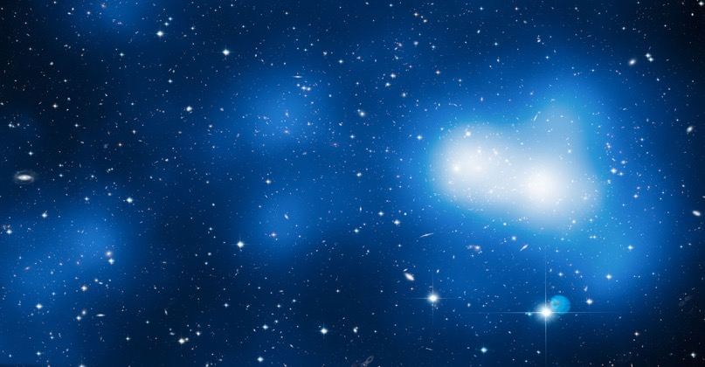
Clocks and tests of fundamental physics
One theory of dark matter (DM) suggests that our galaxy is pervaded by a DM halo composed of Bosonic, ultralight particles.
DM is predicted to couple transitions will couple to a DM field via α−fine structure constant
Coupling will result in a periodic time-variation in α,
¹⁷¹Yb
¹⁹⁹ Hg⁺
⁸⁷Sr
²⁷Al⁺
α (t) ∝ d_{e}* cos (ω_{DM} t)
ω_{DM}
Atomic Clock | Resolution ✕ 10⁻¹⁸ | Accuracy ✕ 10⁻¹⁸ | α− Sensitivity
¹⁷¹Yb | 1 | 1 | +0.06
⁸⁷Sr | 1 | 1 | +0.31
¹⁹⁹Hg⁺ | 40 | 30 | -3.0
²⁷Al⁺ | 4 | 1 | +0.0079
DM coupling strength
Compton frequency
∝ DM mass
A. Arvanataki et al.,Phys. Rev. D 91, 015015 (2015)
Y. V. Stadnik and V. V. Flambaum, Phys. Rev. Lett. 115, 201301 (2015)
A. Derevianko and M. Pospelov., Nature Phys. 10, 933 (2014)
Y. V. Stadnik and V. V. Flambaum, PRA 93, 063630 (2016)

Slide 16
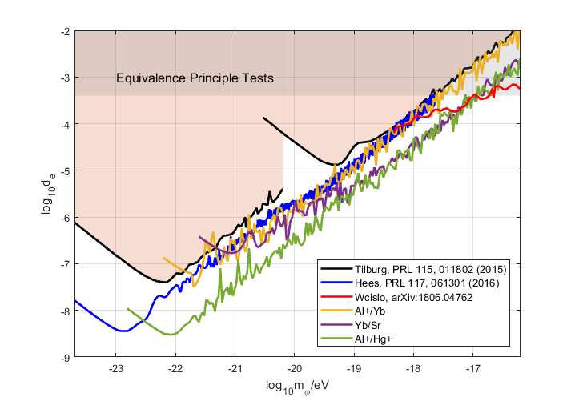
Clocks and tests of fundamental physics
Improve coupling constraint over 6 decades in DM mass.
Hees et al PRD 98 (2018)
DM coupling/mass excluded in shaded regions
Equivalence Principle Tests
Tilburg et al., PRL 115, 011802 (2015)
Coupling strength, d_{e} (log)
Decreasing DM Coupling
Hees et al., PRL 117, 061301 (2016)
Compton frequency, ω_{DM} (log)
BACON Nature 591 (2021)
Decreasing DM Mass
Notes:
We did this analysis on the ratio data I showed earlier in this talk as well as data from a clock comparison done at nist in 2007 with al/hg
From this analysis we are able to improve constraints on dm coupling from earlier measurements searching for ultra light dm coupling thru alpha osillations, black curve, by an order of magnitude, over 6 decades of DM mass. Explain plot

Slide 17
Clocks and tests of fundamental physics
Improve coupling constraint over 6 decades in DM mass.
Hees et al, arXiv:1807.04512v3 (2018)
DM coupling/mass excluded in shaded regions
Equivalence Principle Tests
Tilburg et al., PRL 115, 011802 (2015)
Improved measurement resolution
Coupling strength, d_{e} (log)
Better Constraints
Higher α sensitivity
Higher stability
Hees et al., PRL 117, 061301 (2016)
Compton frequency, ω_{DM} (log)
Longer time interval
Notes:
We did this analysis on the ratio data I showed earlier in this talk as well as data from a clock comparison done at nist in 2007 with al/hg
From this analysis we are able to improve constraints on dm coupling from earlier measurements searching for ultra light dm coupling thru alpha osillations, black curve, by an order of magnitude, over 6 decades of DM mass. Explain plot

Slide 18

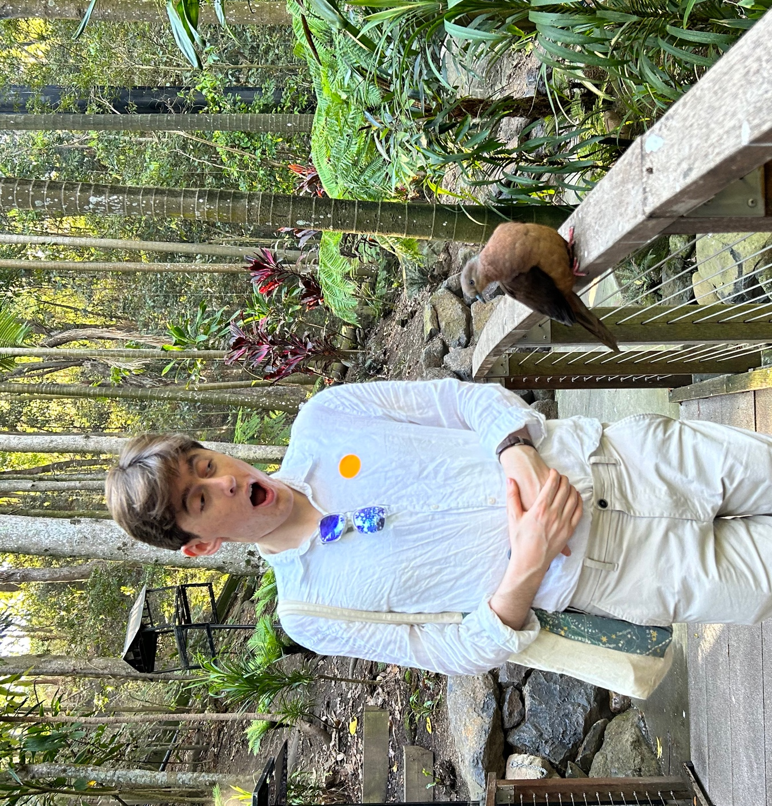
Best tree(s) ever!....... Antarctic beech trees in Springbrook National Park
Quick aside…..
Enthusiastic scientist at Currumbin Wildlife Sanctuary

Slide 19
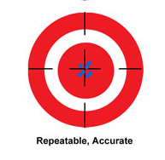
Stability vs accuracy in clocks
Resonant frequency
Voltage
Δf + SNR -> precision
frequency
Accurate and precise!
Δf_{c} -> accuracy
For atomic clocks, which are dominated by Gaussian (white frequency) noise, the longer you average, the better you can define the center frequency.
10⁻¹⁵
15
1/t^{1/2}
10⁻¹⁶
16
Adev (frac. instability)
Digits of resolution
10⁻¹⁷
17
10⁻¹⁸
18
1s
1 hour
1 month
Averaging time

Slide 20
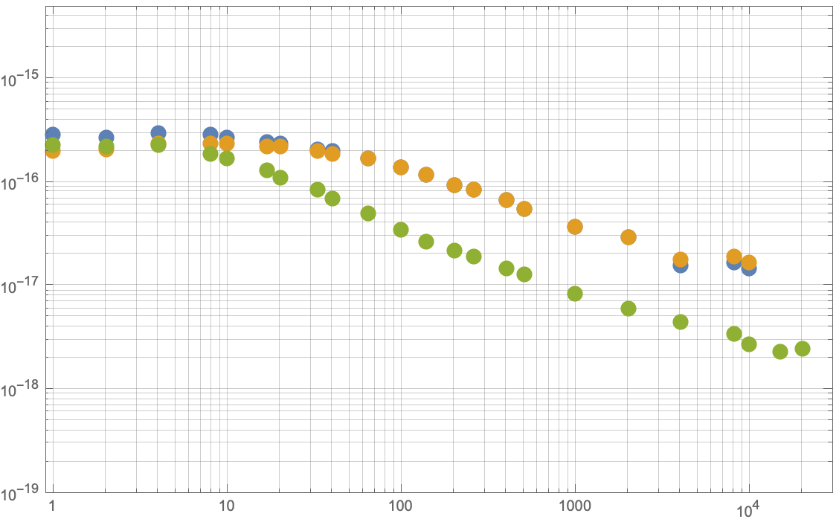
Clock stability impact on applications
Clock ratio offset from BIPM
Ratios with Al+
Time record of ratio data
Ratio with lattice clocks
15
Al⁺/Yb
Al⁺/Sr
16
Yb/Sr
Most applications of atomic clocks have impractically long measurement times!
17
Improving digits of resolution
18
geodesy at the mm level
19
10⁰
10¹
10²
10³
10⁴
10⁵
10⁶
10⁷
10⁸
20
Averaging Time (s)
10 months
21
gravitational waves
10 years
3000 years/ 100,000 years!

Slide 21
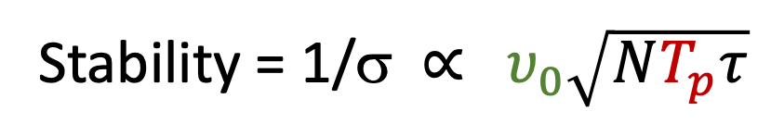
NIST Boulder Atomic Clocks
²⁷Al+ quantum logic clock
¹⁷¹Yb & ⁸⁷Sr lattice clocks
S. Brewer et al. PRL 123 (2019)
W. McGrew et. al. Nature 564 (2018)
T. Bothwell et al Metrologia 56 (2019)
Al⁺
Mg⁺
Accuracies ~ 10⁻¹⁸
ν_{o} = 1.12 PHz
N = 1
σ = 1.5 x 10⁻¹⁵ τ^{-1/2}
ν_{o} = 0.518 PHz
N ~ 10⁴
σ = 2-3 x 10⁻¹⁶ τ^{-1/2}
T_{p} = 150 ms
T_{p} = 500 ms
Stability = 1/σ ∝ $υ_{0}\sqrt{NT_{p}τ}$
Averaging time
Atomic probe time
Transition frequency
# Atoms
Notes:
While optical atomic clocks have been under development for nearly 30 years, it is still unclear which species might be most suitable as the reference when the SI is redefined to optical atomic times. As a result, research groups around the work have invested into many atomic species.
At NIST, we current have have 3 operational clocks, the Al single quantum logic clock, and two optical lattice clocks.
Briefly, ion and neutral atom clocks exhibit different advantages and disadvantages. The lattice clocks can operated with up to 10^5 atoms permitting high SNR. The Al+ clock transition frequency is near 1 PHz which is advantageous to its QPN. A serious drawback of the ion clock is that it relies on a single ion for detection, which results in low SNR and relatively high short term instability as compared with the lattice clocks.
The focus of my today will be on how phase coherent comparison between the Al ion clock and a lattice clock can be used to improve measurement resolution beyond what is current possible if the Al ion clock is operated independently.

Slide 22
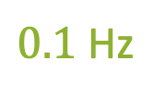
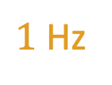

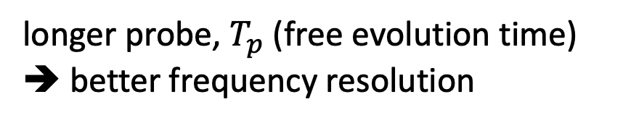
Probe time and frequency resolution
longer probe, $T_{p}$ (free evolution time)
➔ better frequency resolution
Resolvable clock transition
$10$ Hz
$1$ Hz
$0.1$ Hz
$$ν−ν_{clock}$$
Stability = 1/σ ∝ $υ_{0}\sqrt{NT_{p}τ}$
Averaging time
Atomic probe time
Transition frequency
# Atoms

Slide 23
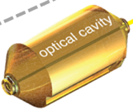



Atomic clocks and laser atom decoherence
Technical limitations of the clock laser:
Dick effect (noise aliasing) < 100% uptime.
Probe time limitations… drift in phase between the laser and the atomic sample.
10⁻¹⁶ @ 1s
Atom corrected signal
LASER
Freq. shifter
Clock stability limitations: 1) laser noise and 2) atom-laser phase drift
One clock cycle
$$π/2$$
$$∅_{clock}$$
T_{p}
$$−π/2$$
Prep. atoms
Prep. atoms
Prep. atoms
Notes:
From the equation that relates the QPN to measurement instability we see that the longer the measurement time, or the atom probe time, the higher the achievable measurement resolution.
While the upper state lifetime of the excited state limits both the Al and Yb clocks to measurement times less than 20 s, drift in the relative phase of the laser with respect to the atoms results in laser-atom decoherence that limits the probe time to less than 1 s.
So why is decoherence and measurement time important?
The longer I can allow the atomic system to oscillate the higher the Q of the system, and the better the short term measurement resolution and stability. More importantly, the better the stability, the less averaging I have to do to reach a specific level of frequency resolution.

Slide 24
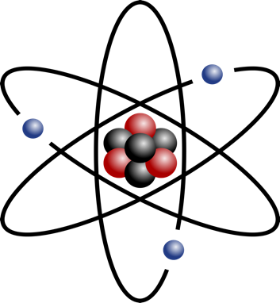
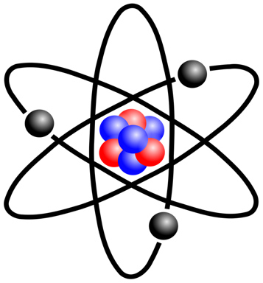
Traditional clock comparison
0.15 s
Al clock cycles
Atom stabilized light from each clock is sent to the frequency comb…. clocks are operated independently and asynchronously.
1
2
3
4
5
6
7
8
1
2
3
0.5 s
Yb clock cycles
¹⁷¹Yb
N = 10⁴
N= 1
²⁷Al⁺
T_{p} = 0.5 s
T_{p} = 0.15 s
\
LASER
LASER
Δf_{Yb}
Δf_{Al}
Modelocked
laser
M
N
Notes:
To extend correlated spectroscopy to unlike atoms, the LO oscillator of the Yb system at 1157 nm, needs to be phase coherently transferred via the OFC to 1070 nm and quadrupoled to probe the Al+ clock transition frequency. More specifically, the reduce the drift of the Yb laser oscillator with respect to the Al+ ion, the Yb laser is phase corrected by the atomic sample on each Yb measurement cycle. As a result, the Al+ clock recieves atom corrected light from the Yb system.
Unfortunately, the Yb atom probe time itself is limited by laser atom decoherence due to drfit in the Yb optical cavity. This drift when transferred to the Al frequency is twice a large since the Al clock transition frequency is more than double the Yb transition frequency. As a result to Yb probe time is limited to less than 500 ms, albeit almost 5 times longer thatn the probe time of Al+ when it is operated independently.
To ensure faithful transfer from one atomic system, through the comb to the other atomic system, we performed a measurement of the network instability to ensure that the optical link noise was well below the expected performance of the atomic systems.

Slide 25

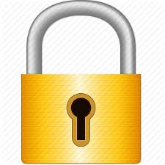
Differential Spectroscopy
The comb is stabilized to the Yb clock
Al+ laser is locked to the com
Clocks are operated synchronously
Al and Yb clocks share phase information and are synchronous.
Al clock cycles
1
2
3
1
2
3
0.5 s
But… the Al+ probe time is still limited by the drift between the Yb cavity!
Yb clock cycles
¹⁷¹Yb
N = 10⁴
N= 1
²⁷Al⁺
T_{p} = 0.5 s
T_{p} = 0.5 s
\
LASER
AOM
LASER
Δf_{Yb}
Δf_{Al}
Modelocked
laser
M
N
D. Hume and D. Leibrandt, Phys. Rev. A, 93, 032138 (2016)
Notes:
To extend correlated spectroscopy to unlike atoms, the LO oscillator of the Yb system at 1157 nm, needs to be phase coherently transferred via the OFC to 1070 nm and quadrupoled to probe the Al+ clock transition frequency. More specifically, the reduce the drift of the Yb laser oscillator with respect to the Al+ ion, the Yb laser is phase corrected by the atomic sample on each Yb measurement cycle. As a result, the Al+ clock recieves atom corrected light from the Yb system.
Unfortunately, the Yb atom probe time itself is limited by laser atom decoherence due to drfit in the Yb optical cavity. This drift when transferred to the Al frequency is twice a large since the Al clock transition frequency is more than double the Yb transition frequency. As a result to Yb probe time is limited to less than 500 ms, albeit almost 5 times longer thatn the probe time of Al+ when it is operated independently.
To ensure faithful transfer from one atomic system, through the comb to the other atomic system, we performed a measurement of the network instability to ensure that the optical link noise was well below the expected performance of the atomic systems.

Slide 26
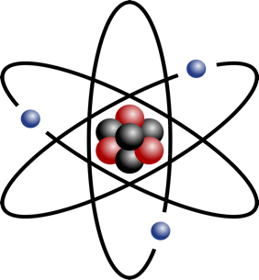

Zero-Dead Time Differential Spectroscopy
The comb is stabilized to interleaved Yb clocks
Al+ laser is locked to the comb
The Al clock is probed synchronously over multiple Yb/Yb clock cycles.
We can extend the Al probe time to multiple seconds!
Al clock cycles
1
2 s
1
2
3
4
0.5 s
Yb clock cycles
¹⁷¹Yb₁
¹⁷¹Yb₂
N= 1
N = 10⁴
N = 10⁴
²⁷Al⁺
T_{p} = 2 s
T_{p} = 0.5 s
T_{p} = 0.5 s
\
LASER
LASER
Δf_{Yb}
Δf_{Al}
Modelocked
laser
M
f_{r}
N
Notes:
To extend correlated spectroscopy to unlike atoms, the LO oscillator of the Yb system at 1157 nm, needs to be phase coherently transferred via the OFC to 1070 nm and quadrupoled to probe the Al+ clock transition frequency. More specifically, the reduce the drift of the Yb laser oscillator with respect to the Al+ ion, the Yb laser is phase corrected by the atomic sample on each Yb measurement cycle. As a result, the Al+ clock recieves atom corrected light from the Yb system.
Unfortunately, the Yb atom probe time itself is limited by laser atom decoherence due to drfit in the Yb optical cavity. This drift when transferred to the Al frequency is twice a large since the Al clock transition frequency is more than double the Yb transition frequency. As a result to Yb probe time is limited to less than 500 ms, albeit almost 5 times longer thatn the probe time of Al+ when it is operated independently.
To ensure faithful transfer from one atomic system, through the comb to the other atomic system, we performed a measurement of the network instability to ensure that the optical link noise was well below the expected performance of the atomic systems.

Slide 27
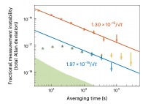
Improved clock measurement resolution
Al⁺ probe time 150 ms
Diff. spec. Al⁺ probe time 1.7 s
Clocks were not run in high accuracy mode.

Slide 28
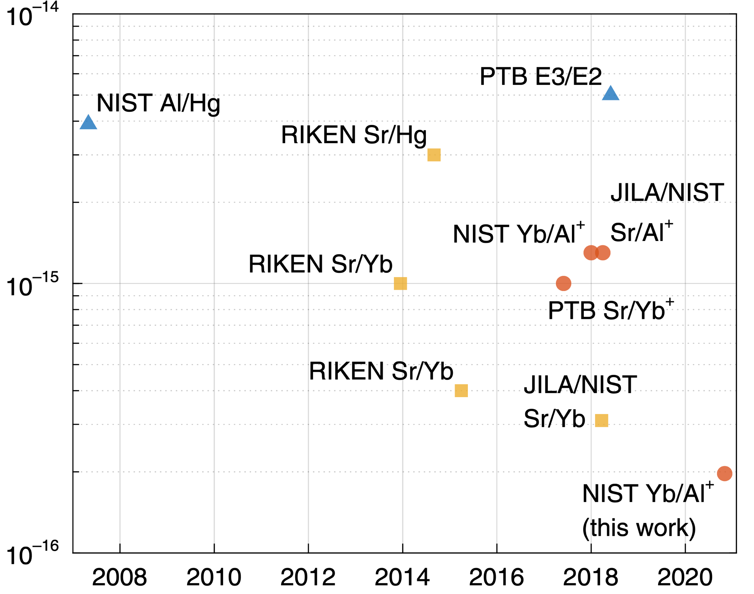
Comparison with previous results
Inter-species clock comparisons
10⁻¹⁴
1-s precision
10⁻¹⁵
Record inter-species precision!
10⁻¹⁶
2008
2010
2012
2014
2016
2018
2020
year

Slide 29
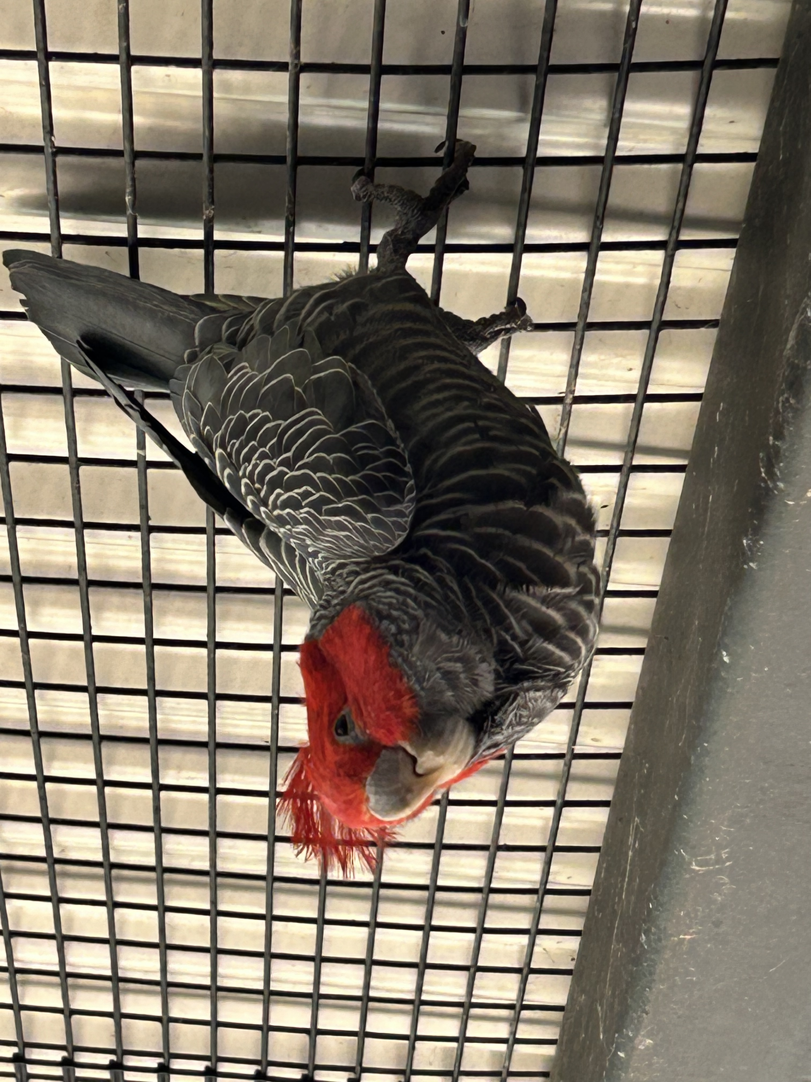
What does this have to do with time?

Slide 30
Improved clock measurement resolution
Highest measurement for any interspecies clock comparison
Factor of 10 improvement in measurement resolution.
Factor of 100 speed up in measurement time.
15
Al⁺/Yb
Al⁺/Sr
16
Yb/Sr
17
Al⁺ T_{p} = 20 s
digits of resolution
18
Al⁺ T_{p} = 2 s
Al⁺ T_{p} = 0.15 s
geodesy at the mm level
19
10⁰
10¹
10²
10³
10⁴
10⁵
10⁶
10⁷
10⁸
Averaging Time (s)
Synchronously and phase coherently linking clocks with via frequency combs can permit significant improvements in measurement resolution… bringing next generation applications closer to reality.
10 months
10⁻¹⁹ in < 15 hours!
10 years

Slide 31
Boulder Atomic Clock Optical Network 2.0 (2024...?)
JILA
BRAN fiber link
laser
Sr lab
Distribute the Sr clock LO (Si cavity) to the Al and Yb clocks:
Probe all 3 clocks synchronously
reduce measurement induced laser noise and
improve the QPN of the Al and Yb clocks, whose probe time is limited by atom-laser decoherence.
Er comb
NIST
Er comb
TiS comb
laser
laser
Yb lab
Al⁺ lab

Slide 32

Boulder Atomic Clock Network Collaboration
Thank you for your attention!
Al Ion Clock
May Kim
Ethan Clements
David Hume
Sam Brewer
Jwo-Sy Chen
David Leibrandt
Yb Lattice Clock
Xiaogang Zhang
Will McGrew
Robbie Fasano
Stefan Schäffer
Daniele Nicolodi
Kyle Beloy
Andrew Ludlow
Sr Lattice Clock
Dhruv Kedar
Colin Kennedy
Toby Bothwell
John Robinson
Eric Oelker
Sarah Bromley
Jun Ye
Optical Frequency
Measurement Group
Scott Diddams
Holly Leopardi
Nick Nardelli
Tara Fortier
Free-Space Time Transfer
Martha Bodine
Issac Khader
Laura Sinclair
JD Deschenes
Nate Newbury

Slide 33
FIN

Slide 34
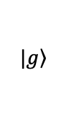
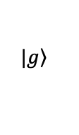
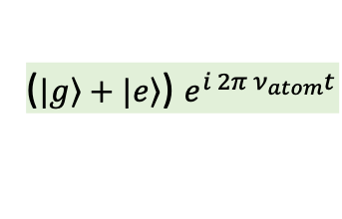
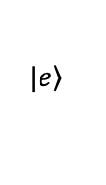
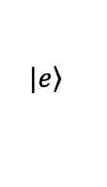


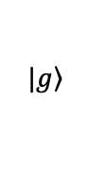
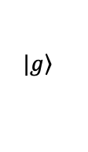
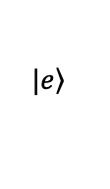

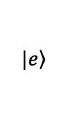

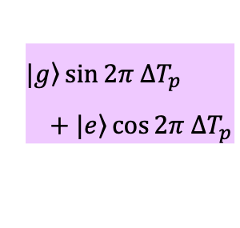
Ramsey Spectroscopy
$\frac{π}{2}$ pulse
$\frac{π}{2}$ pulse
$\left.|g\right\rangle \sin{2π ∆T_{p}}$
$+ \left.|e\right\rangle \cos{2π ∆T_{p}}$
($\left.|g\right\rangle +\left.|e\right\rangle$) $e^{i 2π ν_{atom}t}$
$$\left.|e\right\rangle$$
$$\left.|e\right\rangle$$
$$\left.|e\right\rangle$$
$$\left.|e\right\rangle$$
$$∆ =ν_{atom}−ν_{laser}$$
$$\left.|g\right\rangle$$
$$\left.|g\right\rangle$$
$$\left.|g\right\rangle$$
$$\left.|g\right\rangle$$
Probe Time (T_{p})
Optical Cavity
$$e^{i{ 2π ν}_{laser} t}$$

Slide 35
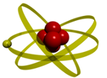
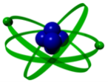


The Er/Yb:glass Frequency Comb
Er/Yb:glass (500 MHz)
pulse
amplification
HNLF (2 ps/km/nm)
HNLF (5.6 ps/km/nm)
FPGA feedback
supercontinuum
generation
$$f_{0}$$
f – 2f
$$f_{b}$$
Yb (1157 nm)
FPGA-based feedback
made by Marco Pomponio
Al⁺ (1070 nm)

Slide 36
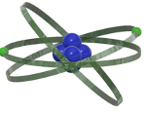



The Er/Yb:glass Frequency Comb
N. V. Nardelli et al., Optical and microwave metrology at the 10⁻¹⁸ level with an Er/Yb:glass frequency comb, Laser & Photonics Reviews (2023).
Al⁺ clock (NIST)
1070 nm
Yb clock (NIST)
1157 nm
Sr clock (JILA)
1542 nm
$$2f$$
$$2f$$
$$f$$
$$f$$
input pulse
1.0 $μm$
1.2
1.4
1.6
1.8
2.0
2.2

Slide 37
Comparison against previous results
Clocks will be competitive with LIGO : 10⁻²¹
Relativistic Sensitivity
10⁻¹⁵
Gravitational redshift
m²/s²
(altitude)
Sr
10⁻¹⁶
Hg
Yb
Sr
Al+
10⁻¹⁷
Hg+
Accuracy Δν/ν
Al+
Sr
10 cm
Sr
Sr
Yb
10⁻¹⁸
1cm
Al+
10⁻¹⁹
1 mm
2005
2010
2015
2020
Year
Comparisons at 10⁻¹⁹ will require knowledge of a relative
height difference at the mm-level!
Notes:
French recognized the
metric system was first introduced in France in 1799

Slide 38
Ratios Day by Day
?
?
Measurement uncertainty:
Statistical uncertainties averaged below 5x10⁻¹⁸
Systematic uncertainties evaluated below 5x10⁻¹⁸
Network agreement:
Combs agreed to < 1x10⁻¹⁹ (overlapping data)
Links agreed to 1x10⁻¹⁸ (statistically limited)
Analysis:
Independent analyses agree to below 5x10⁻¹⁹
When the dust settles: 3 most accurate frequency ratio measurements
?

Slide 39
Comparison with previous results

Slide 40
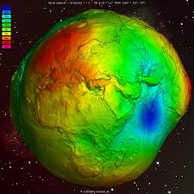

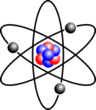
Clocks as Sensors!
Atomic clock transitions are sensitive to relativistic time-dilation shifts:
Relativistic geodesy
gravitational wave detection
Violation of LPI
J. Grotti et al. Nature (2018)
N. Ashby Nat. Physics 14 (2018)
P. Delva PRL 118 (2017),
Review: T. Mehlstäubler, Reports on Scientific Progress (2018)
An extremely fine tool for probing the laws of Physics
Atomic transitions are defined by fundamental constants (m_{e}, m_{p}, α)
Time variation of fundamental constants
  T.Rosenband et al. Science 2008
  N. Huntemann et al PRL (2014)
  R. M. Godun et al PRL (2014)
Searches for dark matter
Notes:
What limits you in terms of sensitivity makes you a great sensor!

Slide 41
Clocks and tests of fundamental physics
One theory of dark matter (DM) suggests that our galaxy is pervaded by a DM halo composed of Bosonic, ultralight particles.
DM is predicted to couple transitions will couple to a DM field via α−fine structure constant
Coupling will result in a periodic time-variation in α,
¹⁷¹Yb
¹⁹⁹ Hg⁺
⁸⁷Sr
²⁷Al⁺
α (t) ∝ d_{e}* cos (ω_{DM} t)
ω_{DM}
Atomic Clock | Resolution ✕ 10⁻¹⁸ | Accuracy ✕ 10⁻¹⁸ | α− Sensitivity
¹⁷¹Yb | 1 | 1 | +0.06
⁸⁷Sr | 1 | 1 | +0.31
¹⁹⁹Hg⁺ | 40 | 30 | -3.0
²⁷Al⁺ | 4 | 1 | +0.0079
DM coupling strength
Compton frequency
∝ DM mass
A. Arvanataki et al.,Phys. Rev. D 91, 015015 (2015)
Y. V. Stadnik and V. V. Flambaum, Phys. Rev. Lett. 115, 201301 (2015)
A. Derevianko and M. Pospelov., Nature Phys. 10, 933 (2014)
Y. V. Stadnik and V. V. Flambaum, PRA 93, 063630 (2016)

Slide 42
Exclusion plot for dark matter coupling
Improve coupling constraint over 6 decades in DM mass.
Hees et al PRD 98 (2018)
DM coupling/mass excluded in shaded regions
Equivalence Principle Tests
Tilburg et al., PRL 115, 011802 (2015)
Coupling strength, d_{e} (log)
Decreasing DM Coupling
Hees et al., PRL 117, 061301 (2016)
Compton frequency, ω_{DM} (log)
BACON Nature 591 (2021)
Decreasing DM Mass

Slide 43
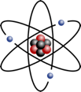
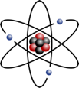
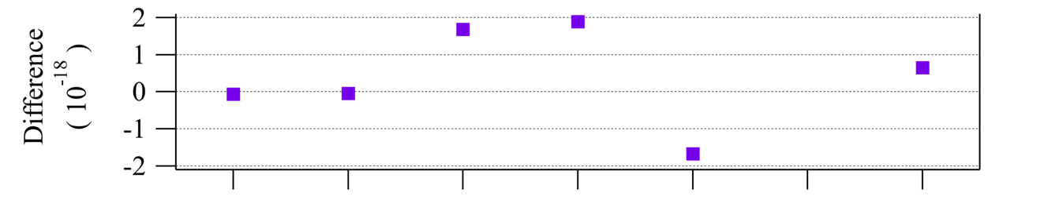
JILA
Free-space optical link
Fidelity of free-space link
10⁻¹³
Sr
Yb
Before IMS
10⁻¹⁵
Fractional Instability
FY2018
Residual link noise at 10⁻¹⁷ @1s
Free-space and BRAN link agreement near 10⁻¹⁸ (consistent with statistics)
10⁻¹⁷
10⁻¹⁷ @1s
10⁻¹⁹
0.001
0.01
0.1
1
10
100
1000
Averaging time(s)
Link agreement in optical clock ratio measurement
2/28
3/01
3/05
3/06
3/09
3/23
4/03
Date (2018)

Slide 44




Counting optical frequencies for comparisons
Counter data is recorded on a computer as multiple columns of microwave frequencies, averaged over a 1s gate time.
Data is filtered at 5-sigma + uptime data from clock labs.
Optical frequencies/ratios are calculated using the comb data + shifts provided by each clock lab that correct for time-dependent perturbations to the ideal transition frequency (temperature, E + B fields, collisional shifts)
¹⁷¹Yb
⁸⁷Sr
²⁷Al+
Comb
Comb frequencies
Δf_{Yb}
Δf_{Al}
Δf_{Sr}
UTC(NIST)
Time base for counters

Slide 45








Ratios for loop closures
Loop Closure:
$1−\frac{υAl}{υYb}×\frac{υSr}{υAl}×\frac{υYb}{υSr}$
$$=0.06±2×{10}^{−17}$$
$$δAl/Sr=8×{10}^{−18}$$
2.611 701 431 781 463 025(21)
Al clock
1.7 x10⁻¹⁸
Sr clock
4.8 x10⁻¹⁸
2.162 887 127 516 663 703(13)
1.207 507 039 343 337 848 2(82)
$$δAl/Yb=6×{10}^{−18}$$
$$δYb/Sr=7×{10}^{−18}$$
Measurements of
3 clocks or more permit
evaluation of a loop closure,
which assesses consistency in the measurements of clocks against one another & against ¹³³Cs.
Yb clock
1.4x10⁻¹⁸

Slide 46





Ratios for loop closures
Loop Closure:
$1−\frac{υAl}{υYb}×\frac{υSr}{υAl}×\frac{υYb}{υSr}$
$$=0.06±2×{10}^{−17}$$
1121015393207859.5(36) Hz
$$δAl/Sr=8×{10}^{−18}$$
429228004229873.19(15)
2.611 701 431 781 463 025(21)
Al clock
1.7 x10⁻¹⁸
Sr clock
4.8 x10⁻¹⁸
3.2e-16
3.6e-16
¹³³Cs
The Hz
2.162 887 127 516 663 703(13)
1.207 507 039 343 337 848 2(82)
$$δAl/Yb=6×{10}^{−18}$$
$$δYb/Sr=7×{10}^{−18}$$
2.1e-16
Measurements of
3 clocks or more permits
evaluation of a loop closure,
which assesses consistency in the measurements of clocks against one another & against ¹³³Cs.
Yb clock
1.4x10⁻¹⁸
518 295 836 590 863.71(11)

Slide 47



Ratios for loop closures
Loop Closure:
$1−\frac{υAl}{υYb}×\frac{υSr}{υAl}×\frac{υYb}{υSr}$
$$=0.06±2×{10}^{−17}$$
1121015393207859.5(36) Hz
$$δAl/Sr=8×{10}^{−18}$$
429228004229873.19(15)
2.611 701 431 781 463 025(21)
Al clock
1.7 x10⁻¹⁸
$$−1.6±4.8×{10}^{−16}$$
3.2e-16
3.6e-16
Sr clock
4.8 x10⁻¹⁸
¹³³Cs
The Hz
$$1.5±3.8×{10}^{−16}$$
$$−3.1±4.2×{10}^{−16}$$
2.162 887 127 516 663 703(13)
1.207 507 039 343 337 848 2(82)
$$δAl/Yb=6×{10}^{−18}$$
$$δYb/Sr=7×{10}^{−18}$$
2.1e-16
Measurements of
3 clocks or more permits
evaluation of a loop closure,
which assesses consistency in the measurements of clocks against one another & against ¹³³Cs.
Yb clock
1.4x10⁻¹⁸
518 295 836 590 863.71(11)

Slide 48
2018 Clock ratio data
3
1 good day of data
2
Ratio frac. offset from BIPM
1
0
4x10⁻¹⁵
-1
14 hours
10⁻¹⁵
Al⁺/Yb
Al⁺/Sr
Optical network performance better than clocks so does not add measurement errors/instability
Yb/Sr
10⁻¹⁶
Fractional Frequency Stability
Improved resolution
10⁻¹⁷
Free-space link
10⁻¹⁸
Combs
Fiber link
10⁻¹⁹
10⁰
10¹
10²
10³
10⁴
BACON collaboration Nature 591 (2021)
Averaging Time

