Slide 1
Low Phase Noise Microwave Sapphire Oscillators
Eugene Ivanov and Michael Tobar
School of Physics, The University of Western Australia
Talk Outline
Phase noise in Oscillators:
Characterization & Measurements & Suppression
Sapphire Oscillators with Improved Frequency Stability
Cryogenic Sapphire Resonators and Oscillators
This work is supported by the Australian Research Council

Slide 2
Characterization of Phase Fluctuations in Frequency Domain: Continuous Time
A fraction of α random process
Fourier transform of δφ_{T}(t)
(rad/Hz)
Power Spectral Density (PSD) of δφ(t)
(rad²/Hz)
Single-sideband (SSB) phase noise
(dB/Hz)

Slide 3
Characterization of Phase Fluctuations in Frequency Domain: Discrete Time
Sampled phase fluctuations
(rad)
- measurements time
Discrete Fourier Transform (DFT) of periodically extended function δφ^{(S)} at frequency Ω_{n} = 2 π n/T
(rad)
Phase noise Power Spectral Density (PSD)
(rad²/Hz)
Phase noise PSD estimate after M consecutive measurements
(rad²/Hz)
* *

Slide 4
Spectrum of a Signal with Random Walk of Phase
Power Spectral Density of δφ(t)
Power Spectral Density of u(t) at σ << 1
Shape of signal spectrum
Schawlow-Townes formula

Slide 5
Phase Noise in Microwave Oscillators
2 Δf_{0.5}
Microwave Loop Oscillator & Expressions for the power spectral densities of the phase fluctuations
Fit to SSB phase noise spectrum of a 10 GHz loop oscillator:
Resonator loaded Q-factor ~ 100 000

Slide 6
Oscillator Phase Noise Reduction: 1
Loop Oscillator Expected Phase Noise Spectra:
Signal frequency 10 GHz, resonator Q-factor 100 000

Slide 7
Oscillator Phase Noise Reduction: 2
Frequency discriminator noise floor
Power incident on resonator
Resonator loaded half-linewidth
LNA effective noise temperature
Resonator coupling coefficient
“Low Phase Noise Sapphire Crystal Microwave Oscillators: Current Status”, IEEE Trans. on UFFC, v. 56, no.2 , pp.263-269 , 2009.
*

Slide 8
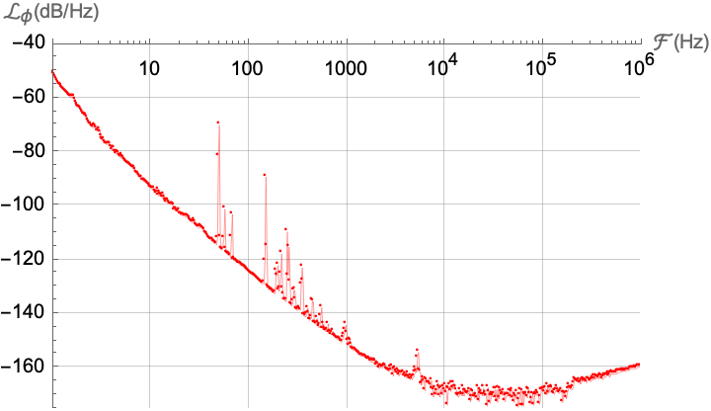
Oscillator Phase Noise Reduction: 3
SSB phase noise of an individual 9 GHz oscillator with automatic carrier suppression (UWA & QuantX Labs collaboration)
Photonic microwave signals with zepto-second-level absolute timing noise, Nature Photonics, v. 11, January 2017, pp. 44-47.

Slide 9
Frequency Stable Microwave Sapphire Oscillator
E. Ivanov and M. Tobar, Frequency Stable Microwave Sapphire Oscillators, Microwave and Wireless Technology Letters, Online ISSN: 2771-9588, Digital Object Identifier: 10.1109/LMWT.2023.3318530.

Slide 10
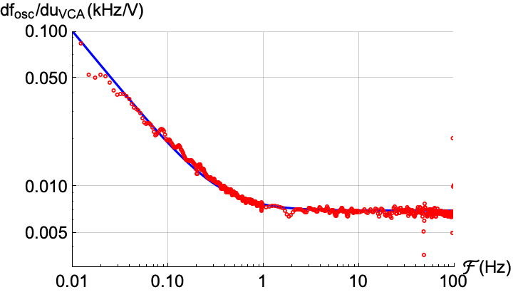
Frequency Stable Microwave Sapphire Oscillator: PLL Design
Fig. 2. Sapphire oscillator frequency tuning coefficient
Fig. 1. Experimental setup
Sapphire oscillator frequency tuning coefficient is derived from the transfer function measured by the VNA in Fig. 1:
Fig. 3. Phase-locked Loop filter

Slide 11
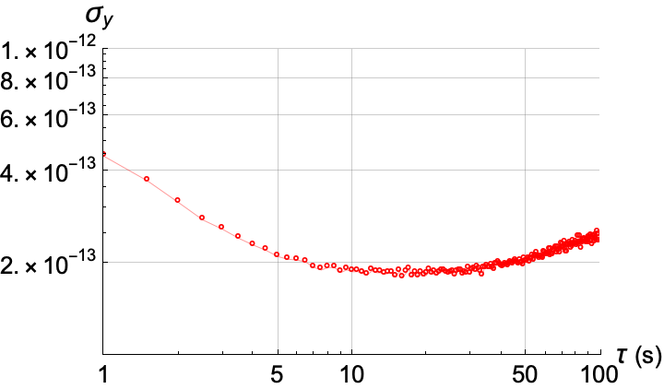
Phase Noise & Frequency Stability Measurements
Phase noise measurements system:
Frequency stability measurements
Fractional frequency stability of the phase-referenced sapphire oscillator
SSB phase noise spectra

Slide 12
Cryogenic Sapphire Oscillators
Phase noise spectra of the beat notes between two cryogenic loop oscillators
Resonant frequency ~ 11.2 GHz
Beat note frequency ~ 2 MHz
Resonator linewidth ~ 50 Hz
Transmission peak contrast ~ 50 dB
*

Slide 13
Cryogenic Sapphire Resonators: 1
10 kHz span
8 MHz span
Transmission coefficients of the 11.2 GHz cryogenic resonator:
The height of the copper shield varies

Slide 14
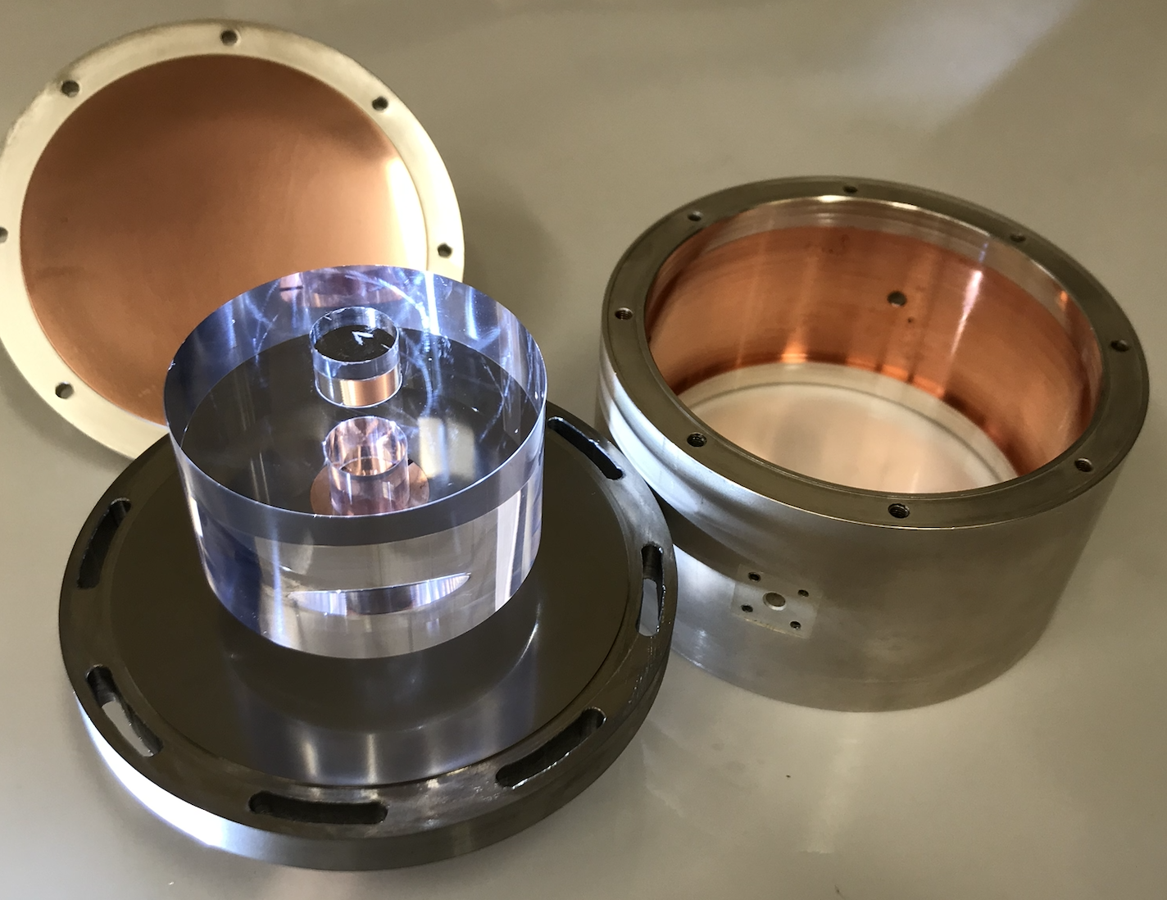
Cryogenic Sapphire Resonators: 2
Δφ ~ - 4 deg
Δφ ~ - 2 deg
Δφ ~ - 1 deg
Transmission coefficients of the 11.2 GHz cryogenic resonator:
Sapphire spindle is rotated relative to coupling probes
(d)

Slide 15
Resonator Noise Suppression Factor & Its Measurements
For the noiseless resonator with Lorentzian lineshape tuned to signal frequency
T₁(F) - VNA-measured transfer function
T₂(F) - VNA-measured transfer function

Slide 16
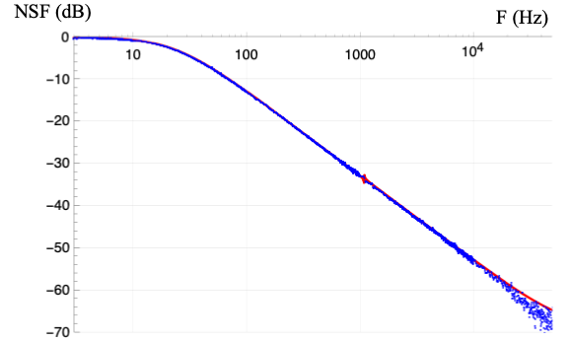
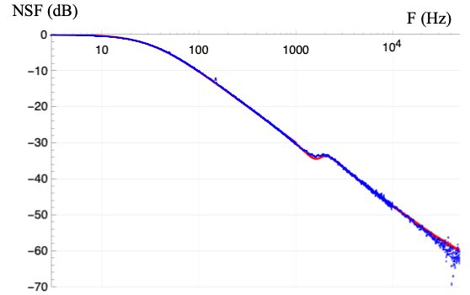
Resonator Noise Suppression Factor: 2
Transmission coefficients (insets) and Noise Suppression Factors of various cryogenic resonators
E. Ivanov and M. Tobar, Noise Suppression with Cryogenic Resonators, Microwave and Wireless Components Letters, vol. 31, Issue 4, pp. 405-408, April 2021

Slide 17
Power-to-Frequency Conversion in Cryogenic Sapphire Resonators
Experimental setup for measuring the power-to-frequency conversion of the cryogenic sapphire resonator
Set of equations needed for the data processing

Slide 18
Power-to-Frequency Conversion in Cryogenic Sapphire Resonators
Voltage noise spectra at the mixer output due to:
1 - Synthesizer phase fluctuations (measured spectrum);
2 - Combined effect of all noise sources (measured spectrum);
3 – Power-induced resonator frequency fluctuations;
4 - Combined effect of all noise sources (calculations);
5 - VCA-induced spurious phase modulation (dφ/du ~ 0.01 rad/V);
6 - Residual amplitude sensitivity of the frequency discriminator (δΦ ~ 1 deg).
Power-to-frequency conversion fit inferred from the above noise spectra

Slide 19
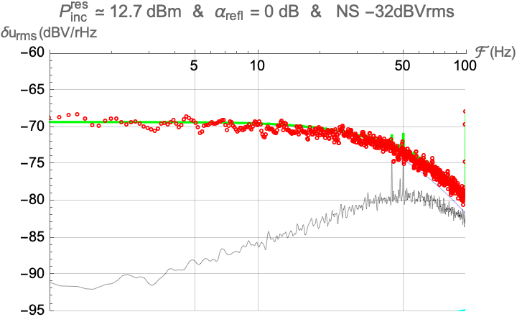


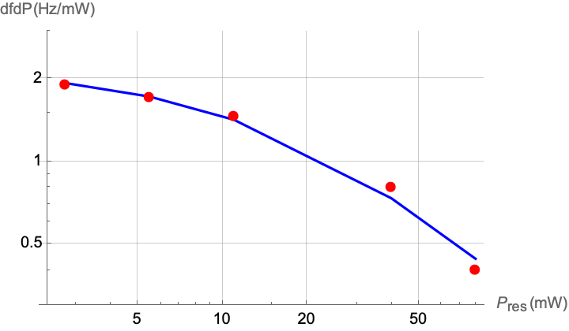
Effect of Paramagnetic Impurities on the df_{res}/dP
P_{inc} ~ 12.5 dBm & df/dP ~ 1.1 Hz/mW
P_{inc} ~ 15.7 dBm & df/dP ~ 0.6 Hz/mW
P_{inc} ~ 18.5 dBm & df/dP ~ 0.32 Hz/mW
Voltage noise spectra at the mixer output at different levels of incident power
df/dP (Hz/mW)
P_{inc} (mW)
Power-to-frequency conversion vs incident power
E. Ivanov and M. Tobar, “Power-to-Frequency Conversion in Cryogenic Sapphire Resonators,” Microwave and Wireless Technology Letters, vol. 33, issue 7, pp. 1090-1093, July 2023

Slide 20
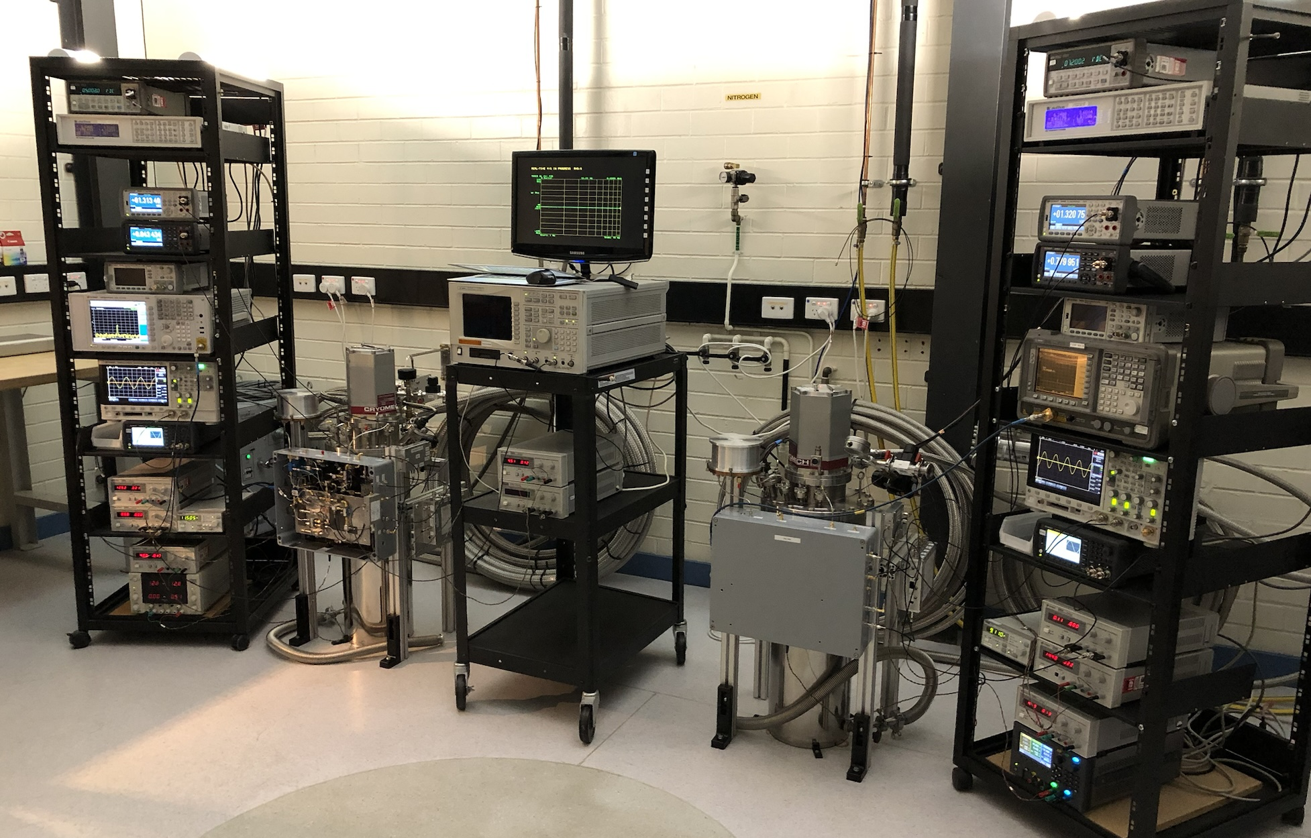
Cryogenic Sapphire Oscillators

Slide 21
Phase Noise Performance of the Cryogenic Sapphire Oscillators
SSB phase noise of an individual 11. 2 GHz oscillator

Slide 22
Conclusions
We proved that fractional frequency instability of the low phase noise sapphire oscillators could be reduced to the level of the best RF signal sources, i.e.,
σ_{y} (5…50 s) ~ 2 10⁻¹³
We found that the transmission peak contrasts of the cryogenic sapphire resonators could be as high as 60 dB, allowing strong suppression of technical fluctuations of the incoming signal with a modest loss of power
We measured the power-to-frequency conversion of in the cryogenic sapphire resonators as a function of Fourier frequency.
We showed that the power of technical fluctuations of the cryogenic sapphire oscillator could be reduced by 18 orders of magnitude relative to carrier at offset frequencies above a few kHz.
Serious attention must be paid to vibration isolation of the cryogenic resonators to enable further progress in oscillator noise reduction

