Slide 1


A computable Hydrogen optical Lattice Clock
O.Amitª, V.Wirthlª, D.Taray, V.Weisª, D.Yost^{b}, T.W.Hänsch^{a,c}
and Th.Udem^{a,c}
Max-Planck Institute of Quantum Optics, Garching, German
Department of Physics, Colorado State University, Fort Collins, Colorado, USA
c) Ludwig-Maximilians-Universität, München, Germany

Slide 2

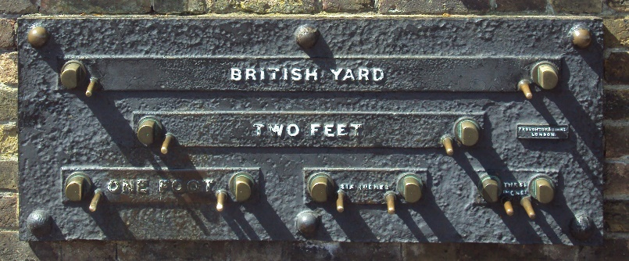
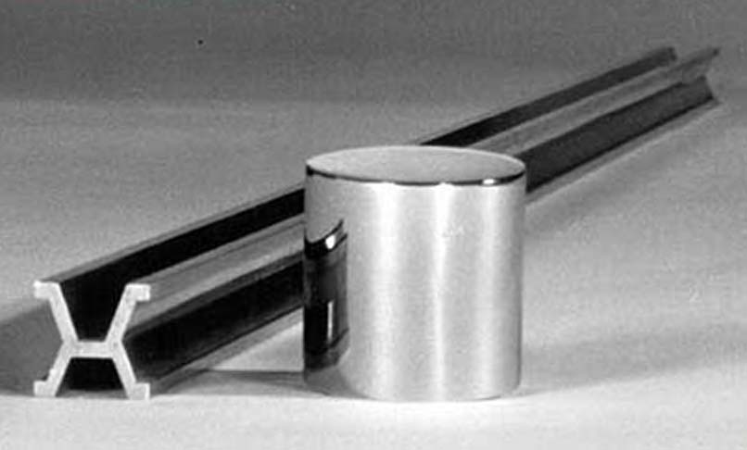


Units
Notes:
Artifact can get lost

Slide 3
Fixing the dimensional Constants

Slide 4


Example #1: Speed of Light

Slide 5
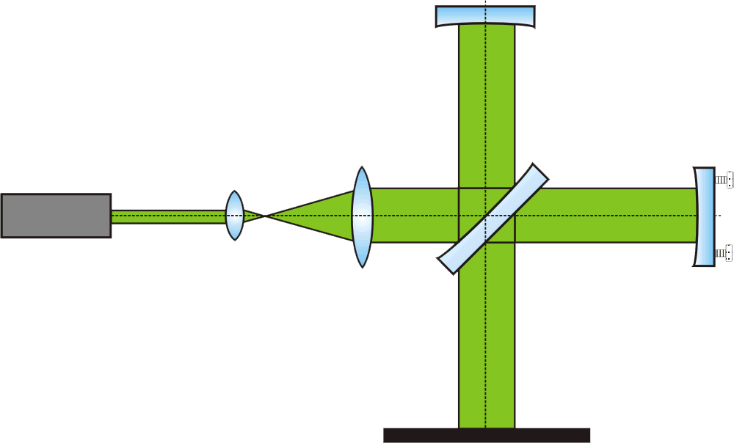
Example #1: Speed of Light

Slide 6
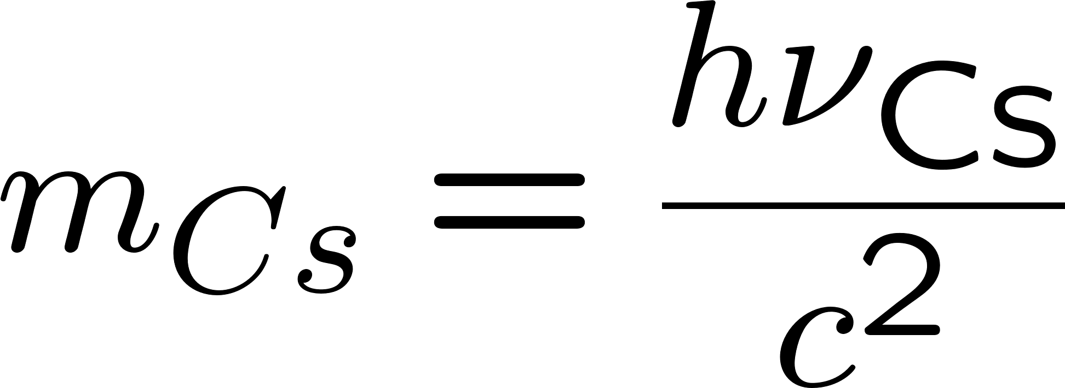
Example #2: Planck’s Constant

Slide 7


Example #2: Planck’s Constant
Notes:
Famous examples: Michelson-Morley, black body, maximum parity violation in weak interaction.
Proton decay, free fall of antimatter, edm…

Slide 8
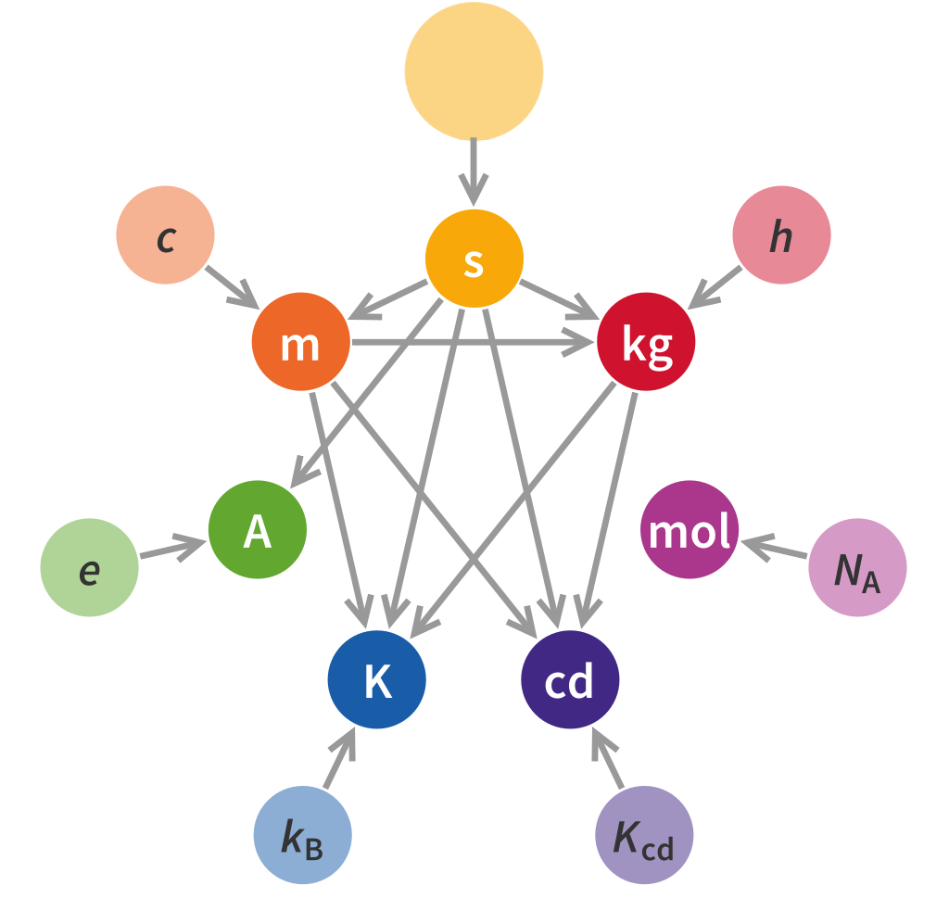
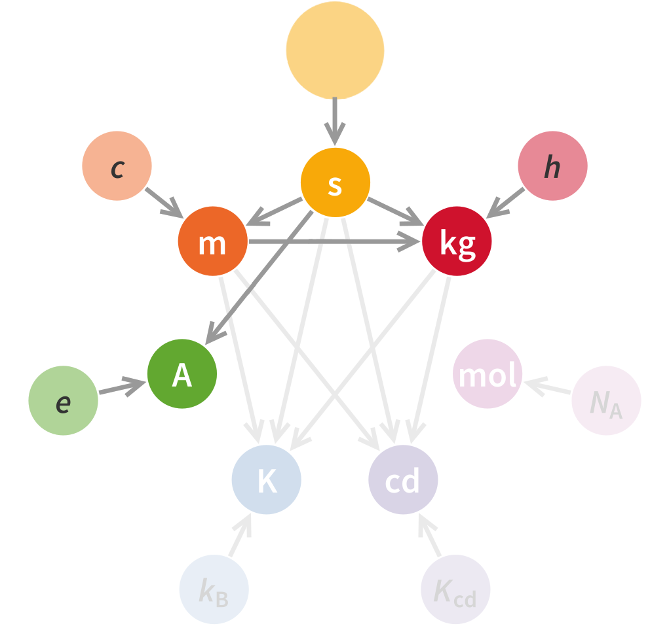

Everything tied to the Second

Slide 9






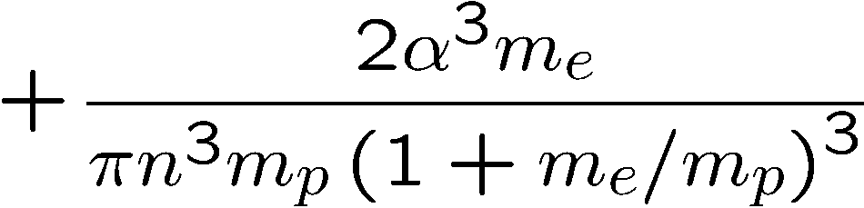
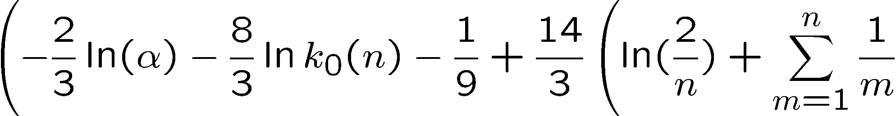
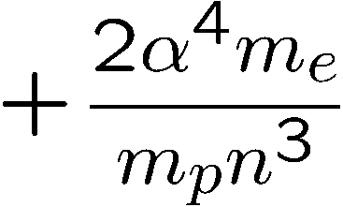
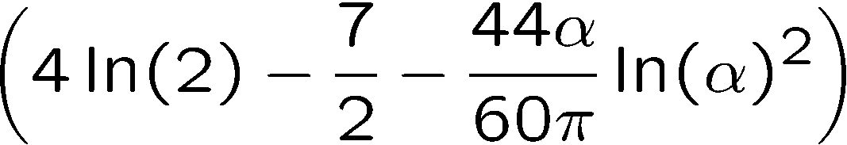
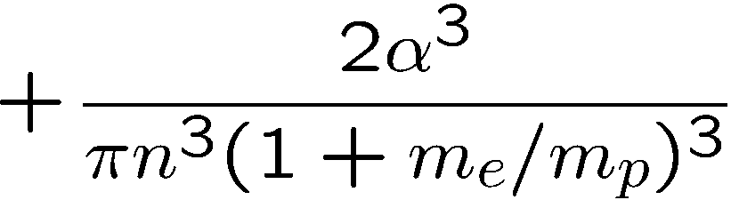
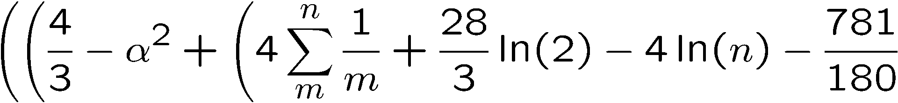
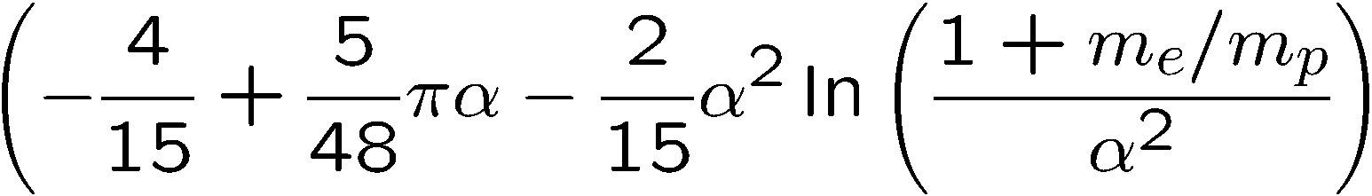
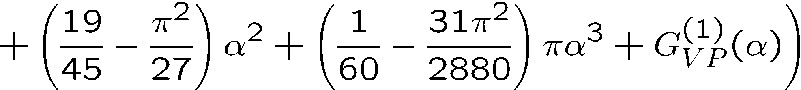
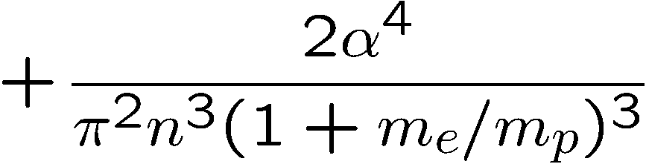
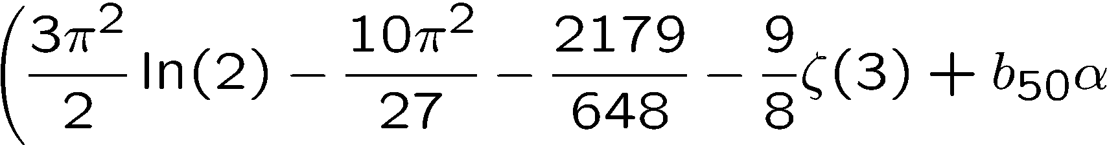
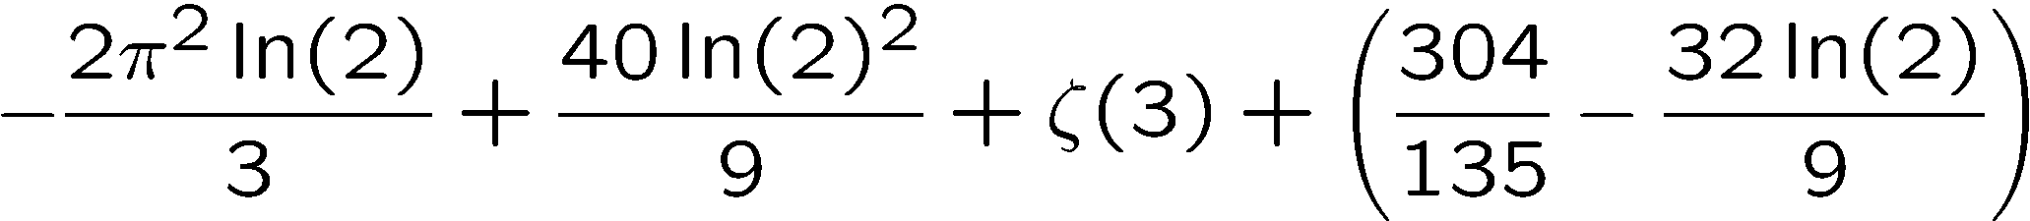
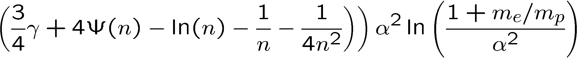
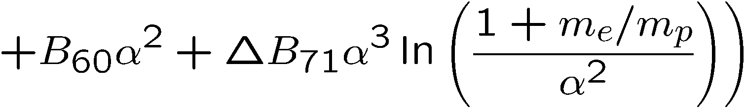

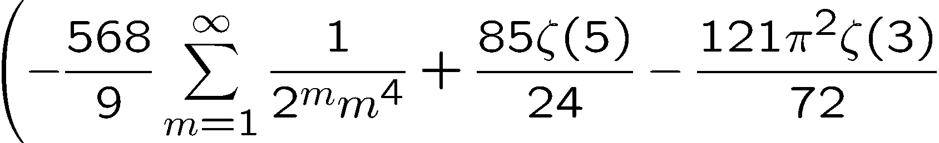
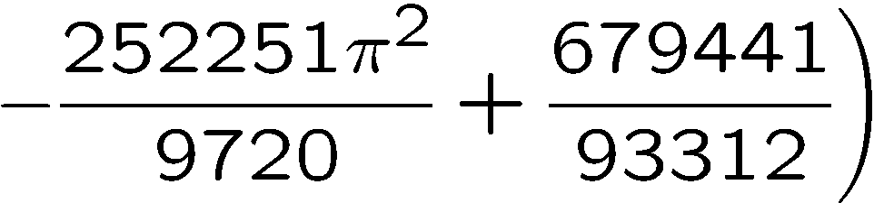
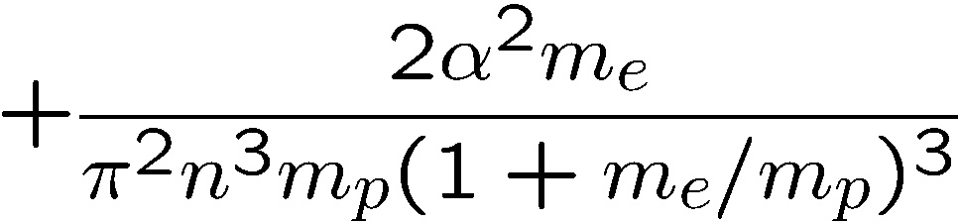
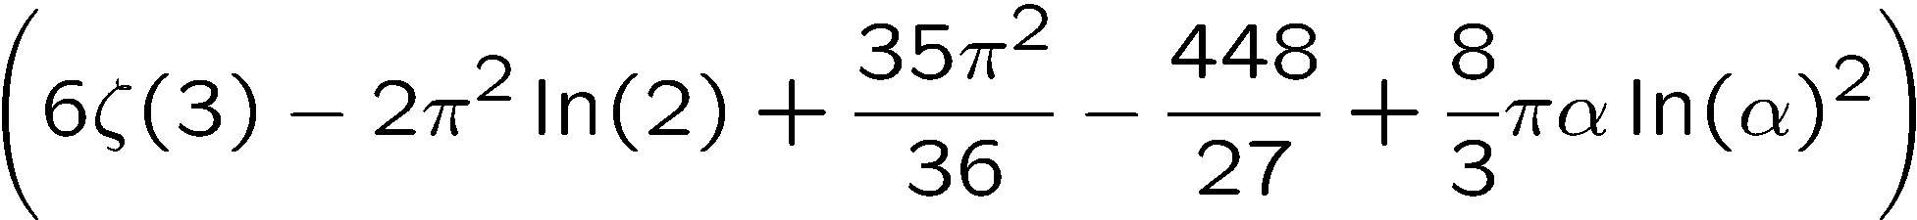
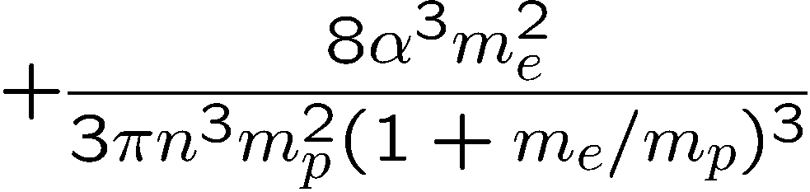
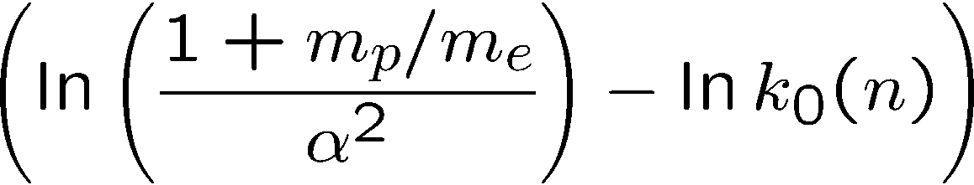
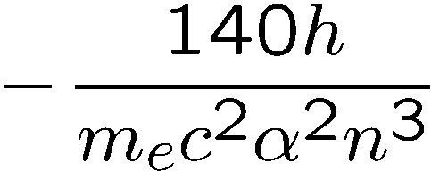
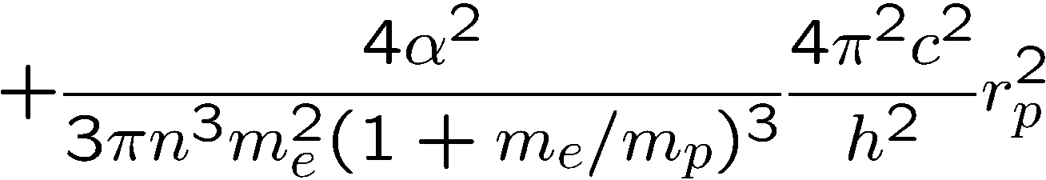
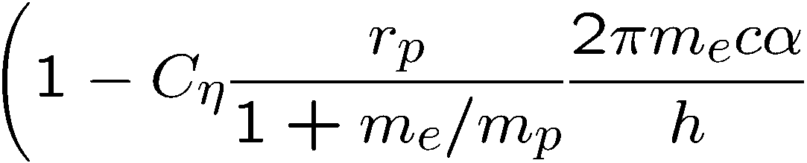
Energy Levels of atomic Hydrogen
Dirac +recoil
Relativistic and higher order recoil
Selbstenergie
Vakuumpolarisation
Zweiphotonenkorrekturen
Dreiphotonenkorrekturen
StrahlendeRückstoßkorrekturen
Kernselbstenergie und Polarisierbarkeit
Kerngröße

Slide 10
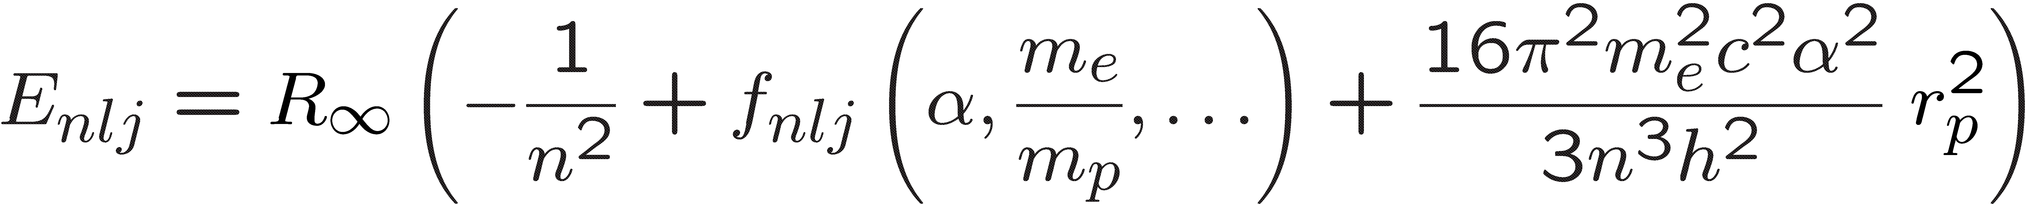
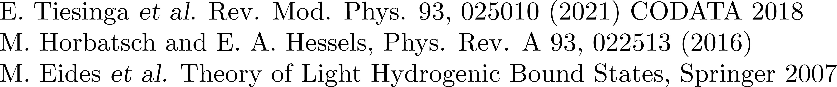
Energy Levels of atomic Hydrogen

Slide 11


Everything tied to the Second

Slide 12






Laser cooling atomic Hydrogen ?

Slide 13
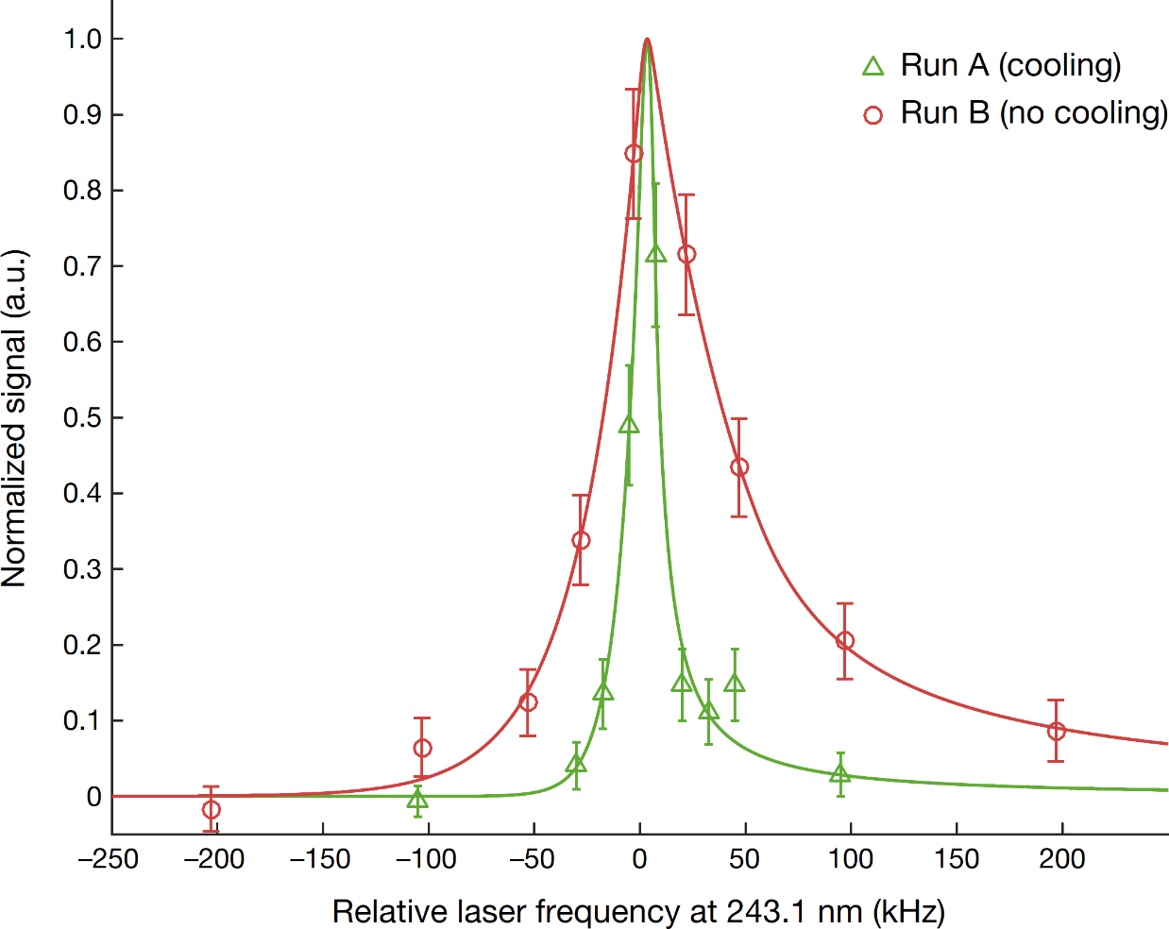
Laser cooling Antihydrogen !
- Normally cooling to trap, H: trap to cool (antihydrogen)
- Magnetic trapping possible (H and anti-H) but complicated and B~T not a good clock environment

Slide 14

Laser cooling atomic Hydrogen ?

Slide 15

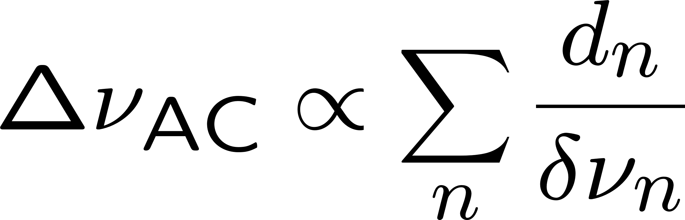


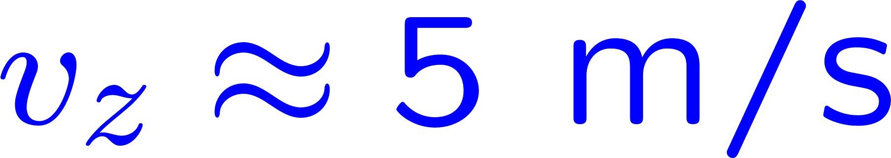

Optical Dipole Trap
- Magic wavelength convenient 514.6nm (SHG(Yag))
- but large slope (magic wavelength can act as standard)
- Planned setup not more complex than a common lattice clock

Slide 16





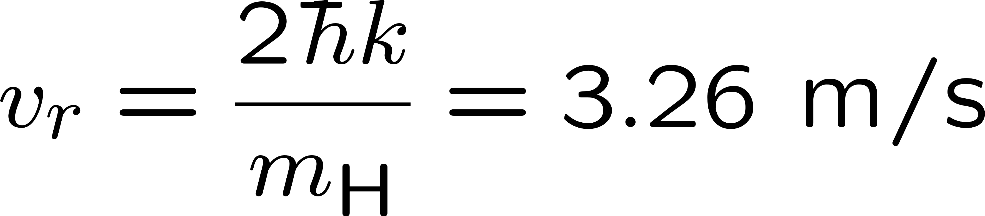

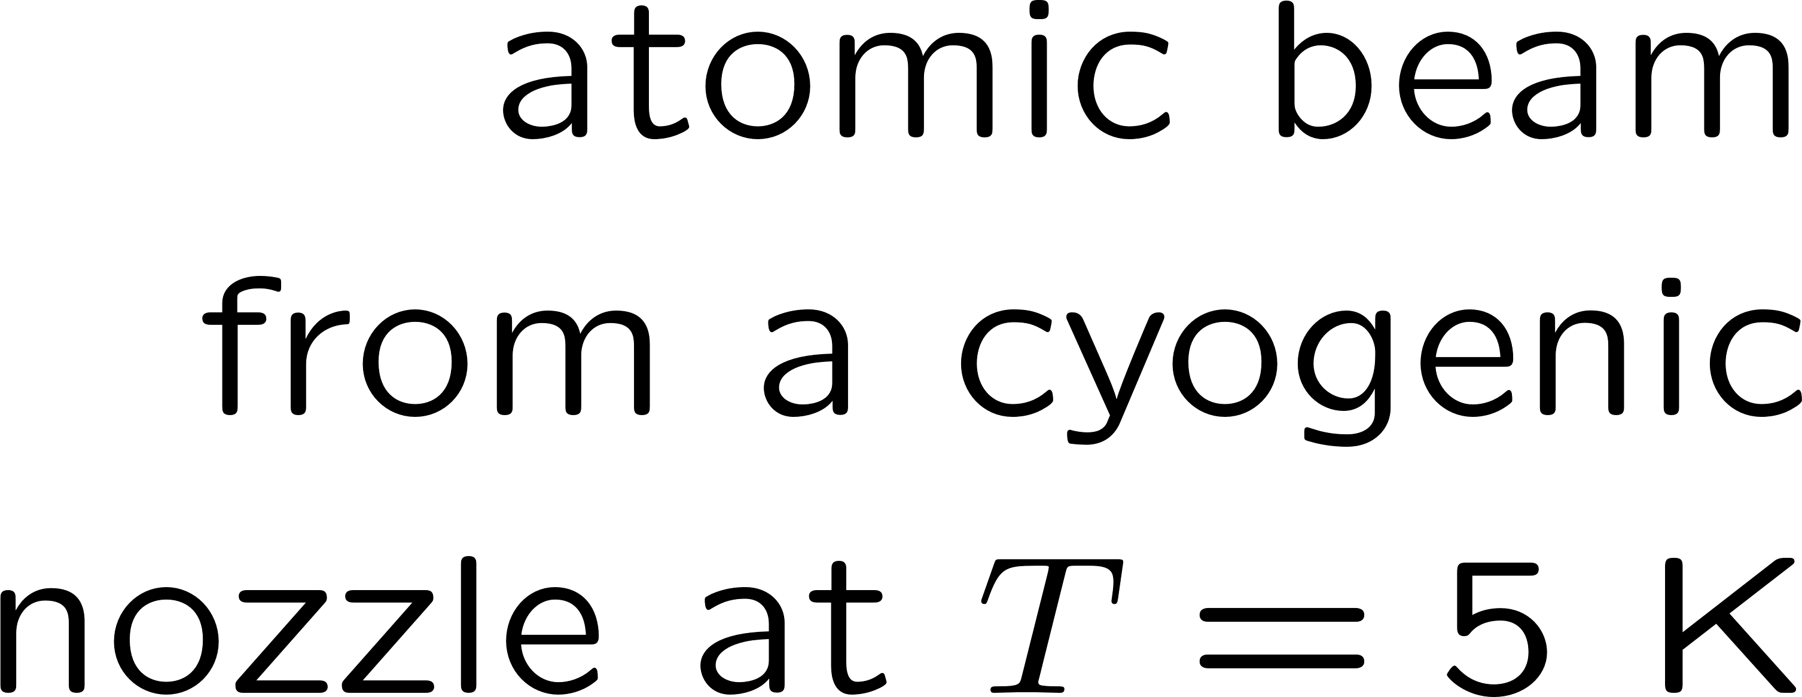
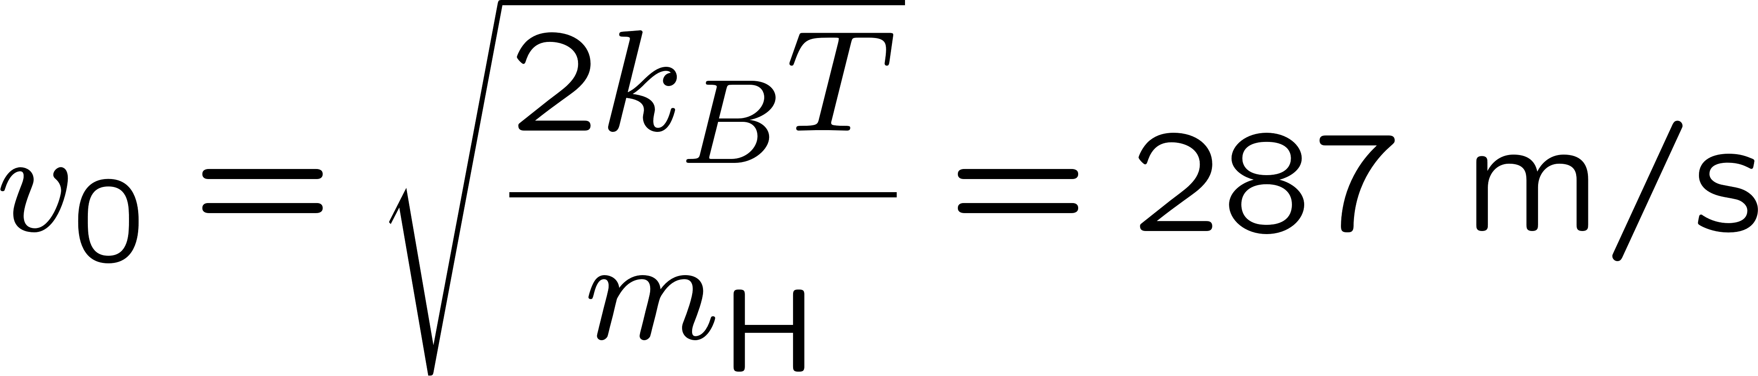
Velocity Selection

Slide 17
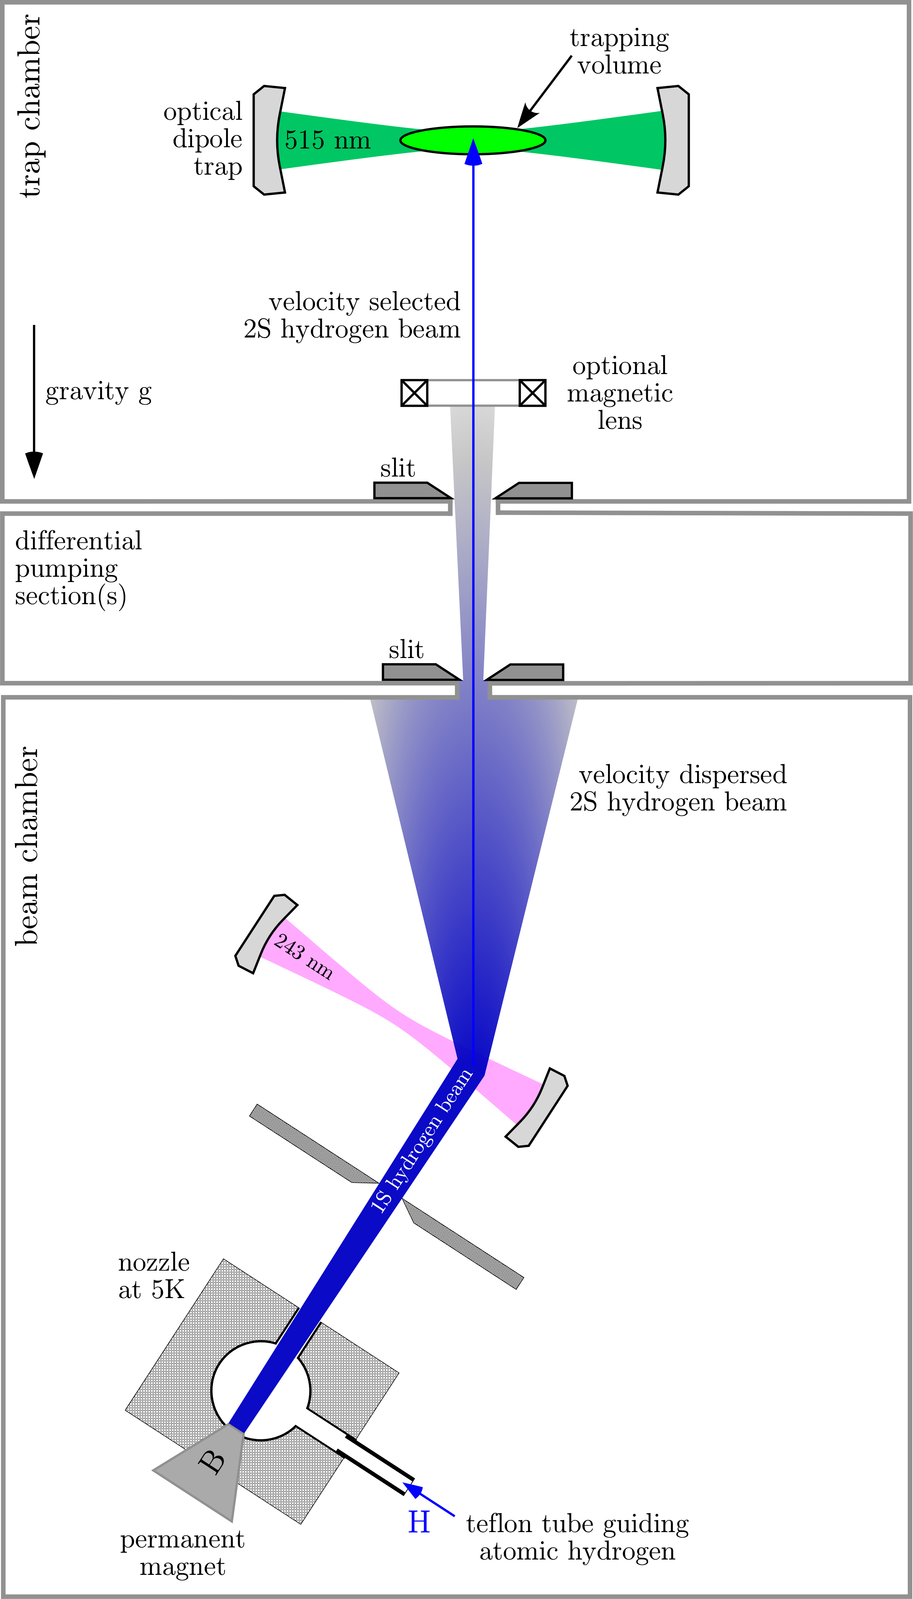

Trapping Atomic Hydrogen

Slide 18
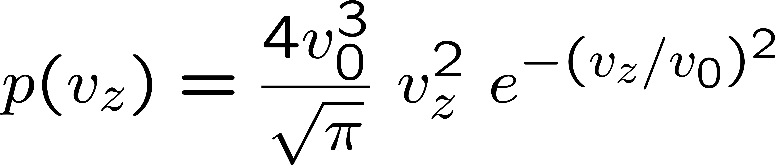

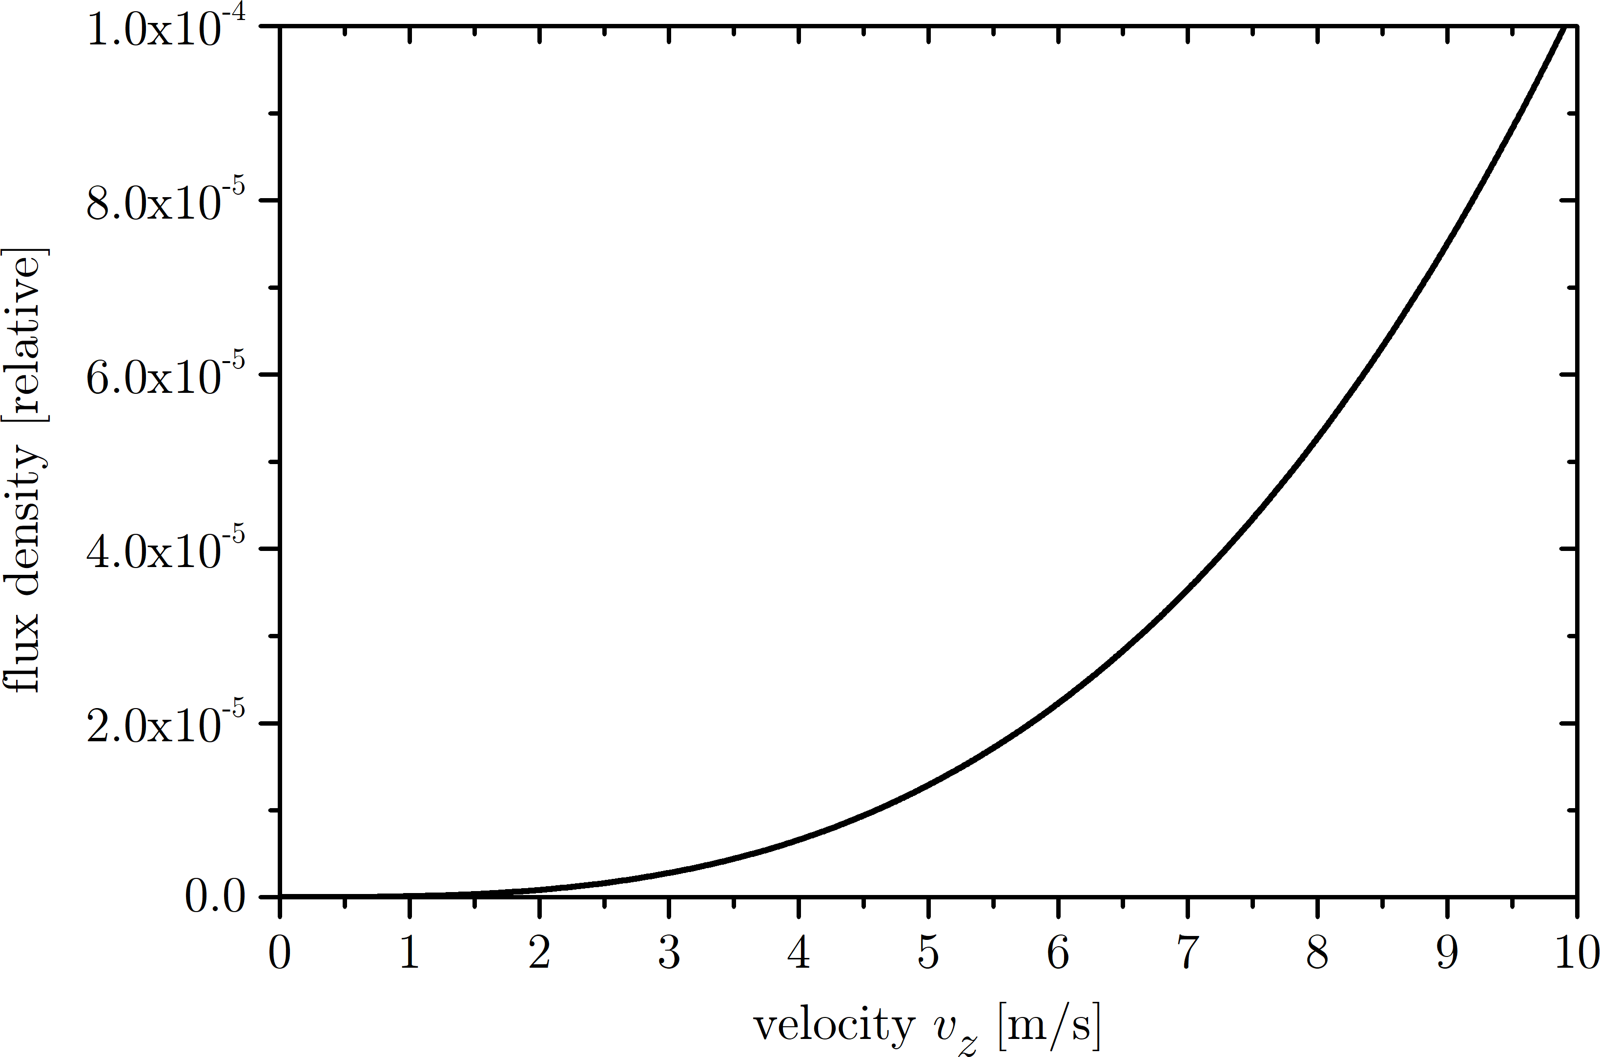
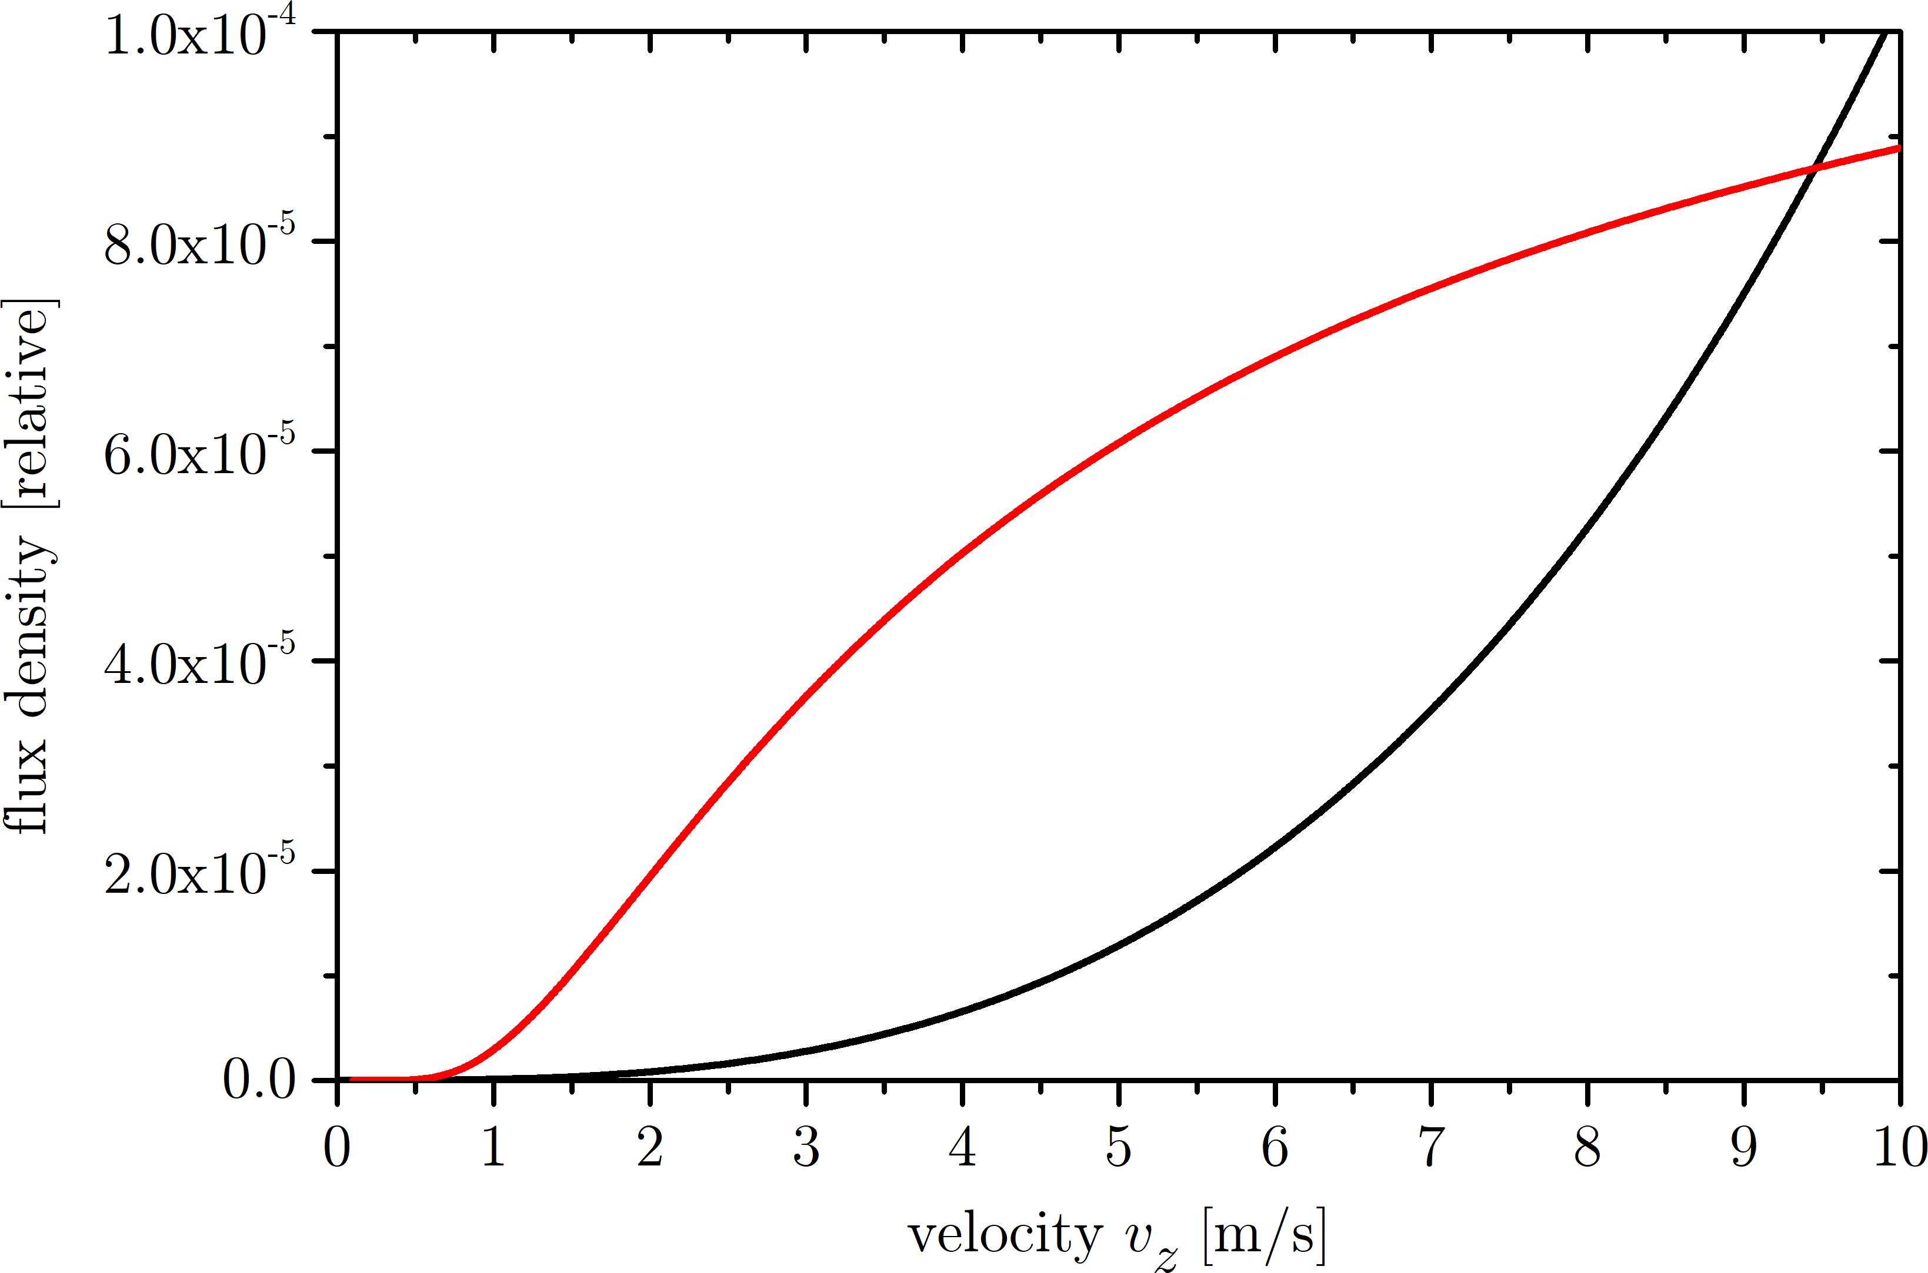
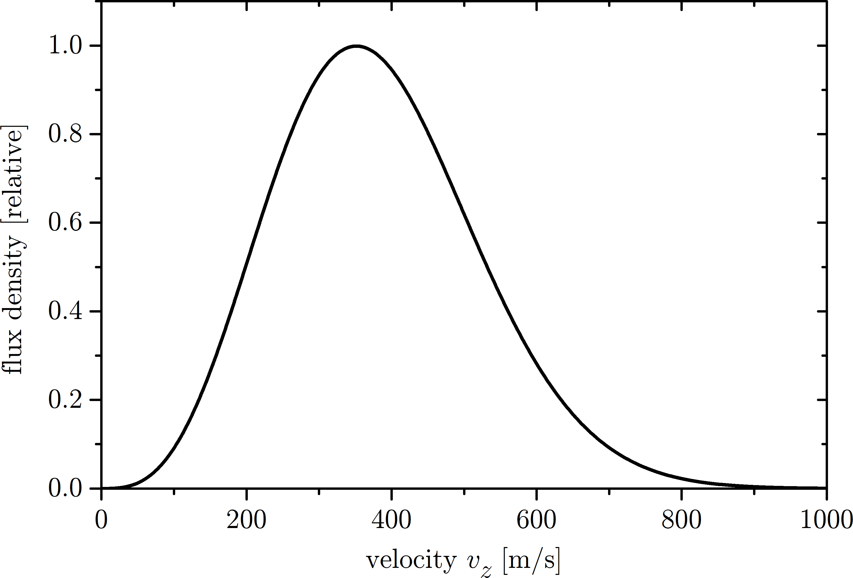
Velocity Distributions

Slide 19
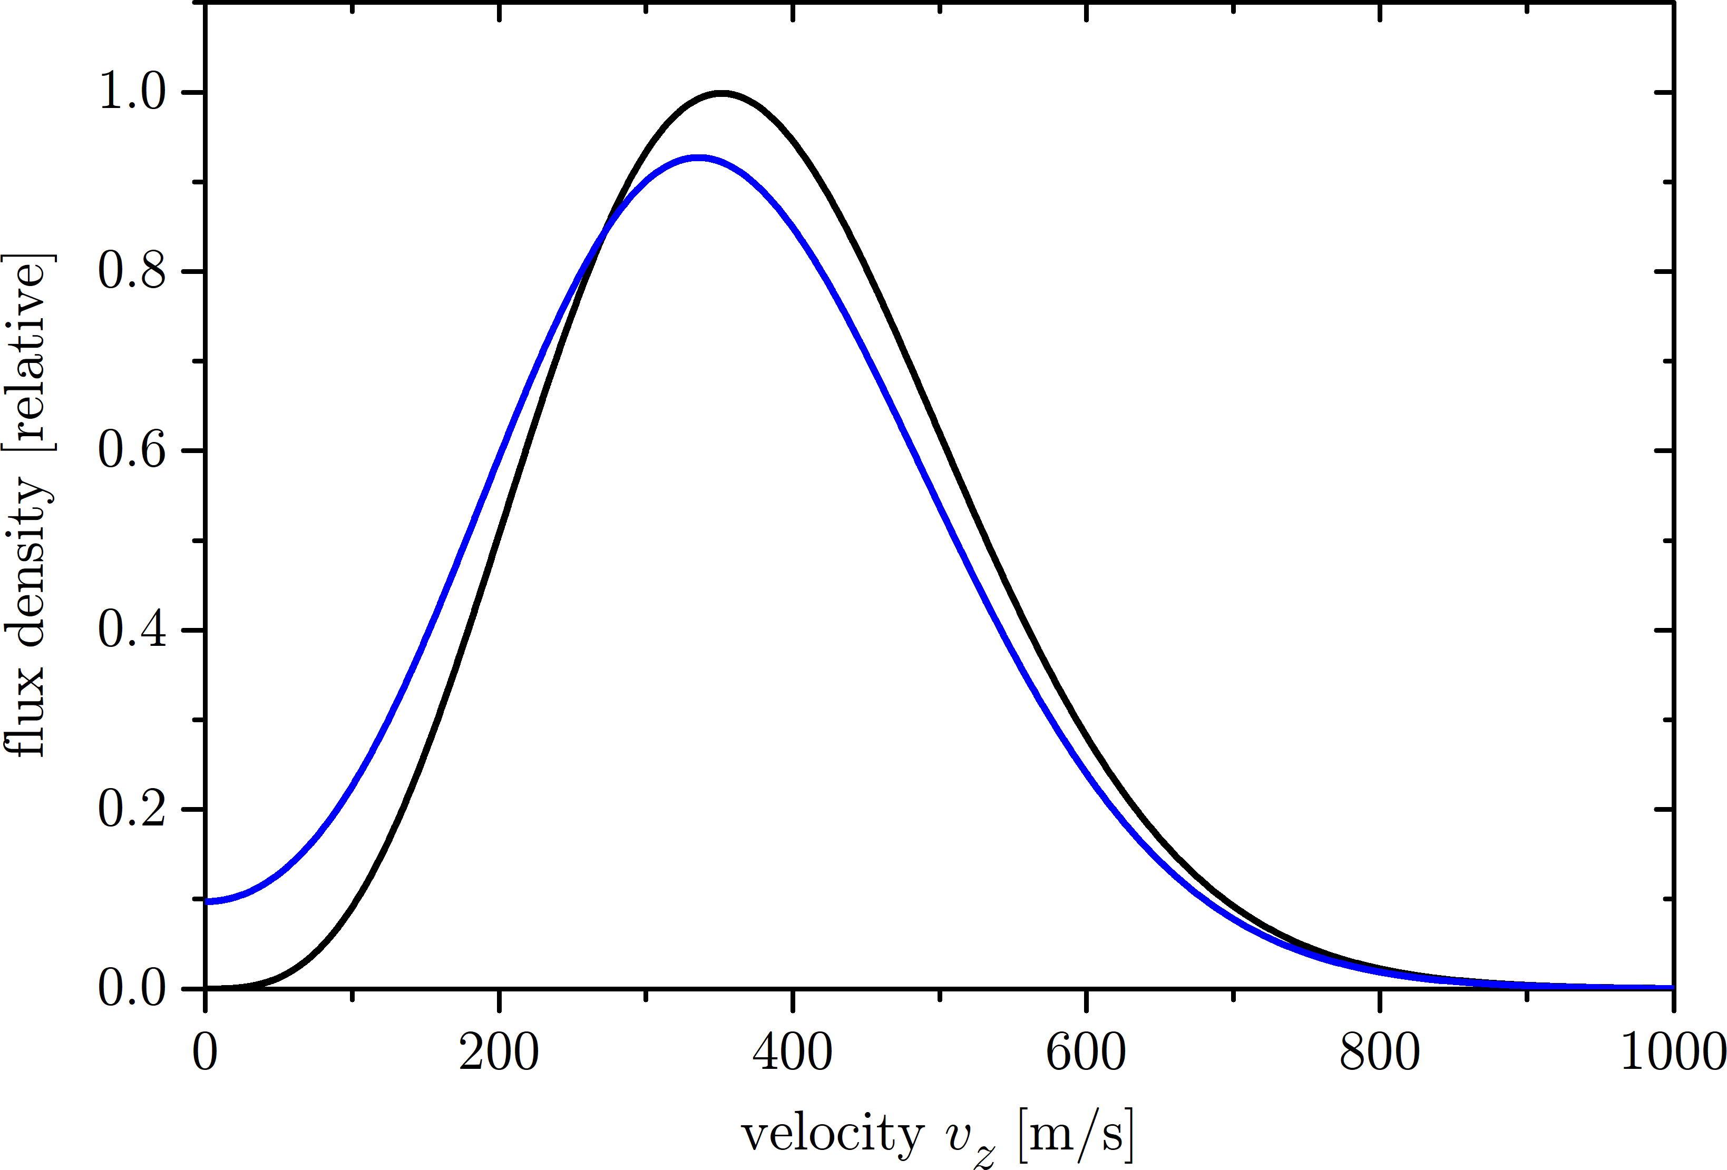

Velocity Distributions

Slide 20
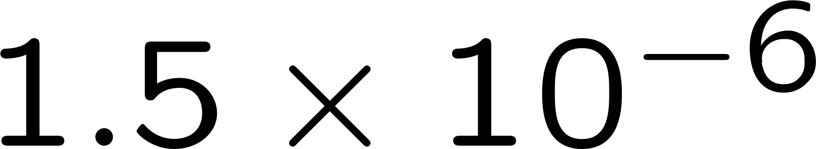


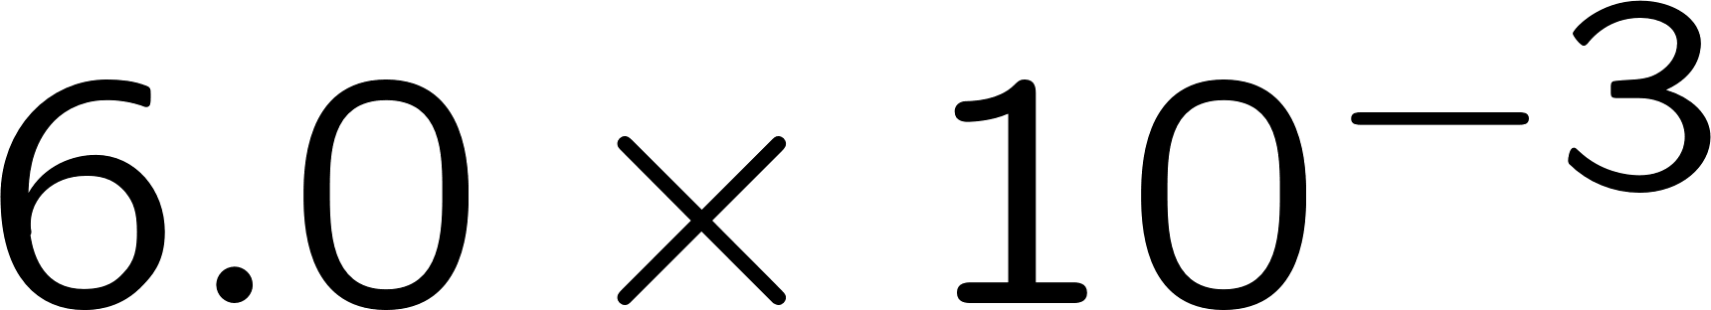









Expected Trap loading

Slide 21
Ion Detection

Slide 22
Outlook/Prospects

Slide 23


Sisyphus loading
- Magic wavelength convenient 514.6nm (SHG(Yag))
- but large slope (magic wavelength can act as standard)
- Planned setup not more complex than a common lattice clock
Notes:
tune-out wavelength for the 2S is 515.572 nm
Magic wavelength for the 1S-2S is 514.646 nm

Slide 24
Outlook/Prospects

Slide 25
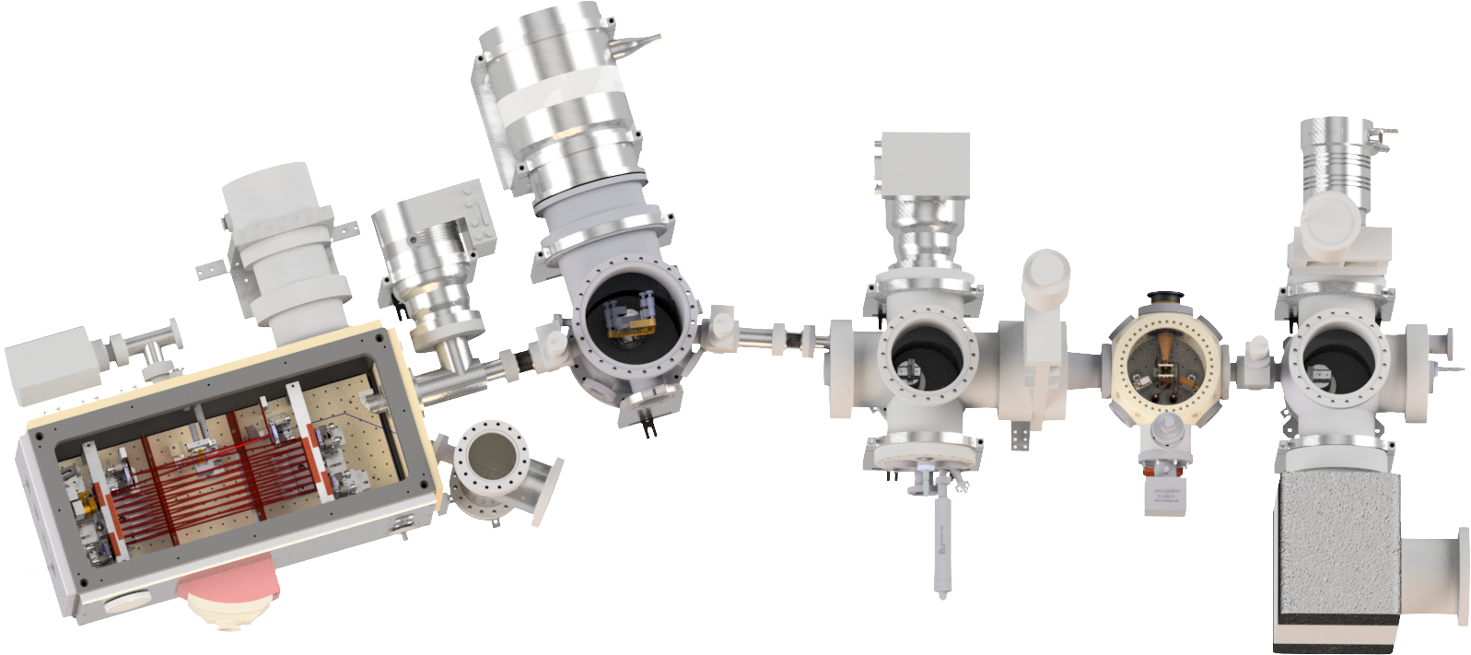


1S-2S in hydrogen like helium

Slide 26
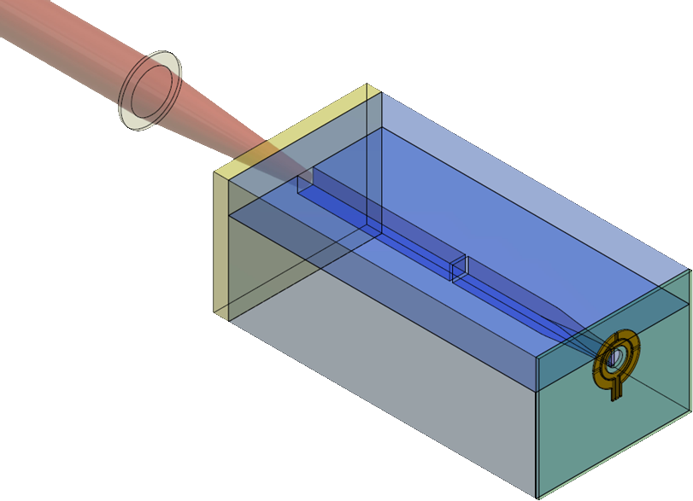





Miniaturization
Notes:
HHG target: some fluorides (Li, Ba…) because of XUV transparencies. Not good comparisons yet.

Slide 27

Outlook/Prospects

Slide 28
Thank you for your Attention

Slide 29
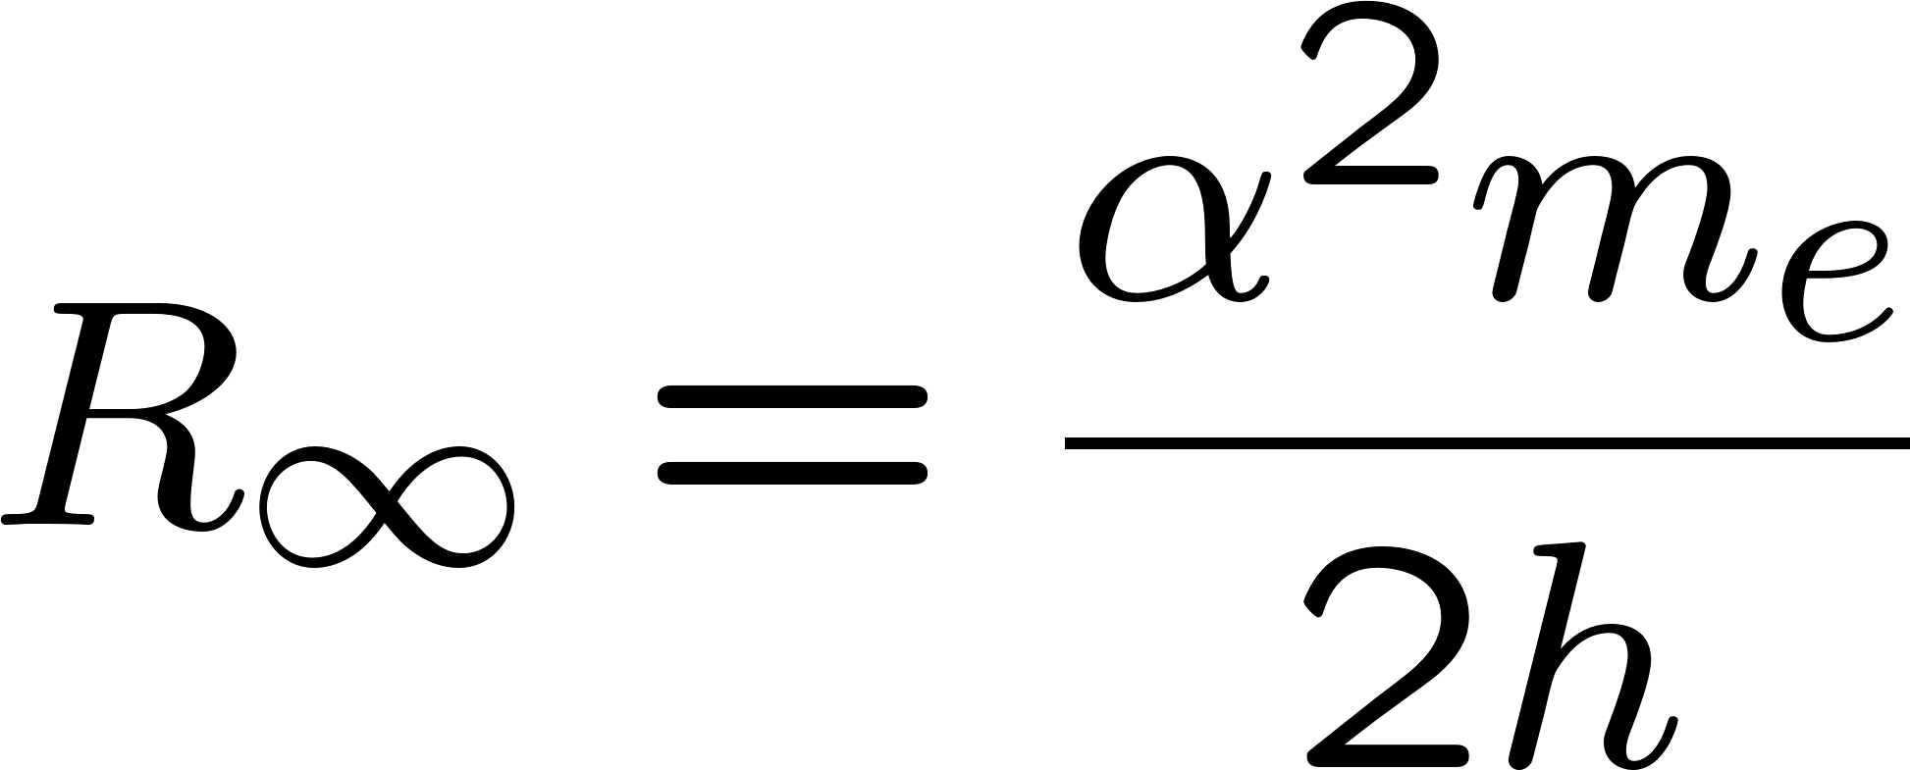
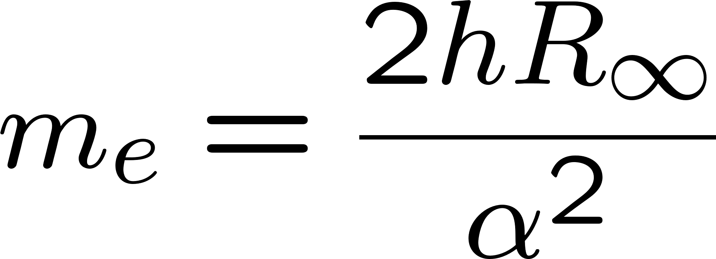
Fixing the Rydberg Constant

Slide 30
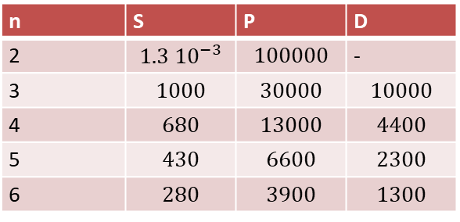
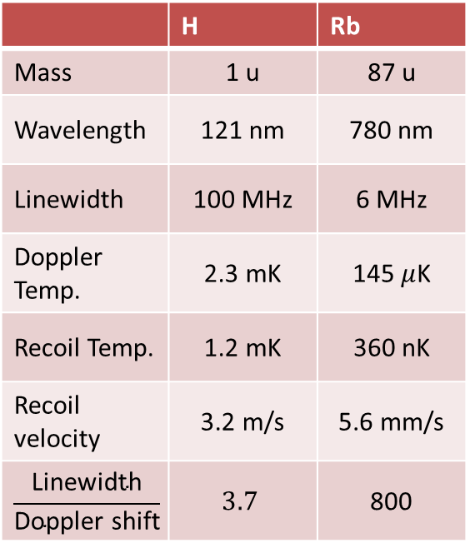
Atomic Properties
Natural width / kHz
n | S | P | D
2 | $$1.3 {10}^{−3}$$ | $$100000$$ | -
3 | $$1000$$ | $$30000$$ | $$10000$$
4 | $$680$$ | $$13000$$ | $$4400$$
5 | $$430$$ | $$6600$$ | $$2300$$
6 | $$280$$ | $$3900$$ | $$1300$$
 | H | Rb
Mass | 1 u | 87 u
Wavelength | 121 nm | 780 nm
Linewidth | 100 MHz | 6 MHz
Doppler Temp. | 2.3 mK | 145 $μ$K
Recoil Temp. | 1.2 mK | 360 nK
Recoil velocity | 3.2 m/s | 5.6 mm/s
$$\frac{\text{Linewidth}}{\text{Doppler} \text{shift}}$$ | $$3.7$$ | 800

Slide 31

Quenching Decay Paths

Slide 32
Laser Sources
ECDL 1030 nm
Fiber Amplifier
SHG PP-Mg:SLT
ECDL 972 nm
TA
SHG PP-Mg:SLT
Resonant SHG

Slide 33
„Zacharias“ Effect
Slow atoms are being pushed out of the atomic beam by fast moving atoms.
H
H
H

Slide 34
Thank you for your Attention

