Slide 1

The 9th Symposium on Frequency Standards and Metrology @ Kingscliff, NSW, Australia
Time and frequency dissemination over 113 km free-space
Haifeng JIANG, Jianwei PAN
University of Science and Technology of China (USTC)
Oct 19, 2023

Slide 2
Outline
Background & Motivation
Experimental Setup
Measurement Results
Summary and Outlook

Slide 3
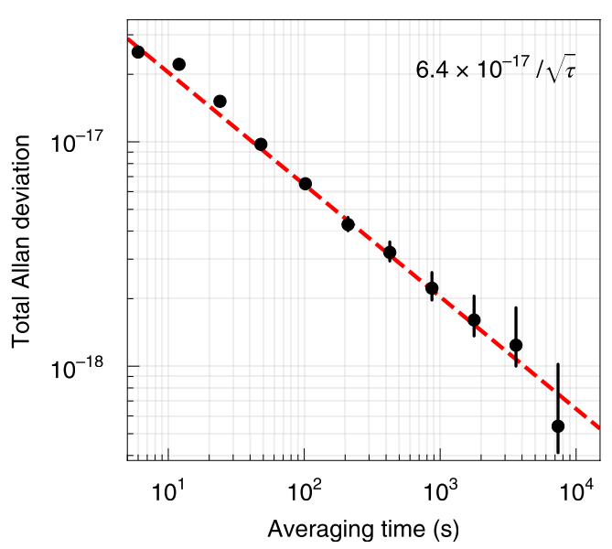
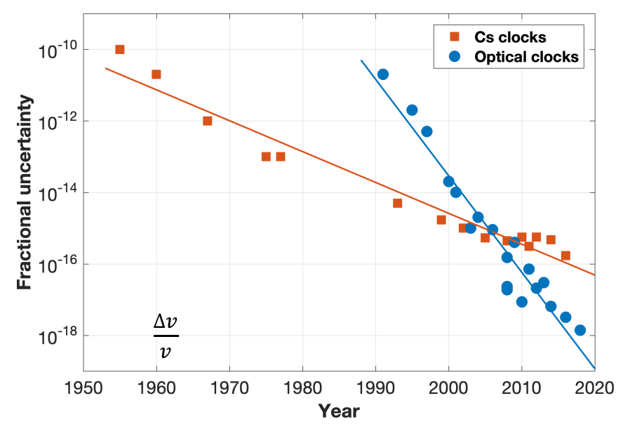
Background
Frequency uncertainty around 1E-18，2 orders better than the primary frequency standards
Frequency instability reaches E-19@10000s
Lu+,Al+,Yb, Sr Clocks
Oelker, E., et al. (2019).." Nature Photonics 13(10): 714

Slide 4
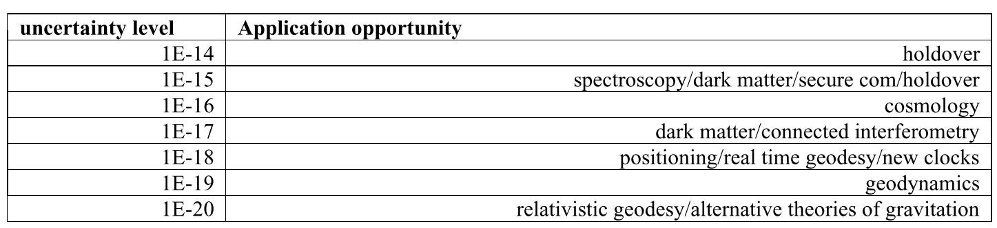
Background
Many research opportunities will arise with better access to optical clocks and better dissemination methods,
METROLOGIA - Roadmap towards the redefinition of the second 2023

Slide 5
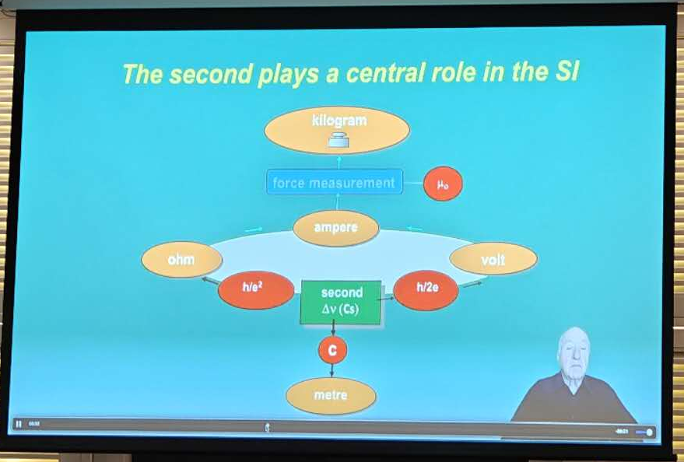
Background
Better optical clocks and better dissemination methods are important for metrology.
Jacques Vanier
On Monday
Redefinition of second may happens around 10 years, so better comparison link is required..
METROLOGIA - Roadmap towards the redefinition of the second 2023

Slide 6
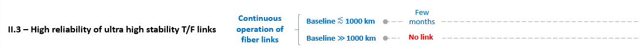
Background
Fiber-based T/F dissemination: Europe, Australia, Japan, China
Complex
Expensive
Talk of “Roadmap towards a redefinition of the SI second”
Global scale link: free space, double length (6dB)

Slide 7
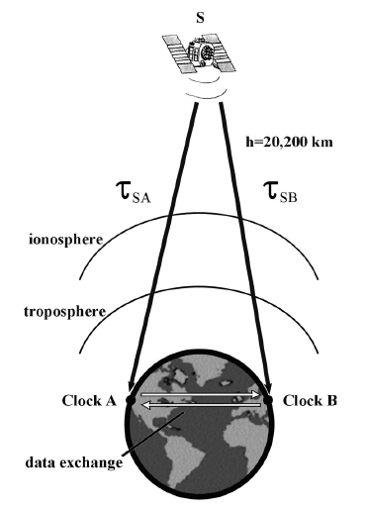
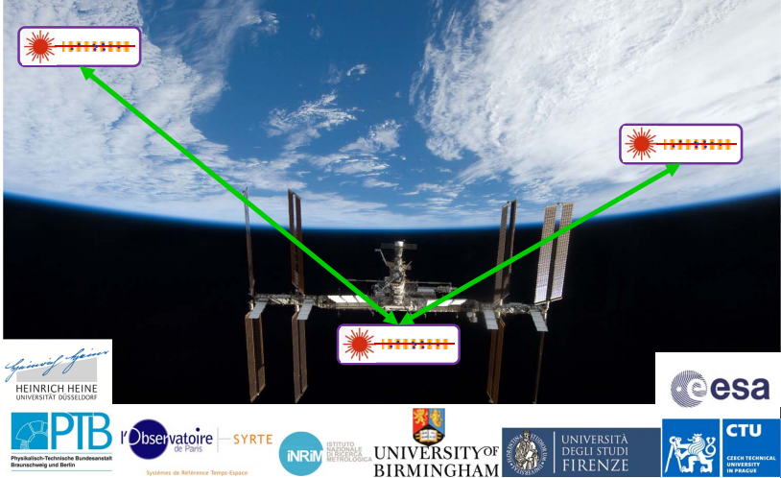
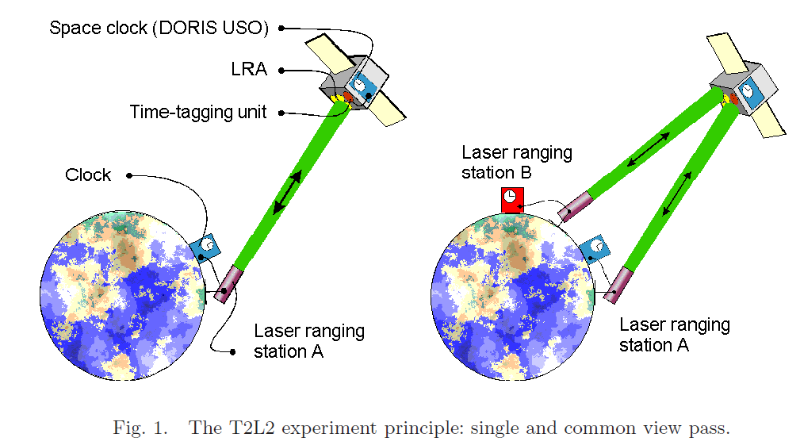
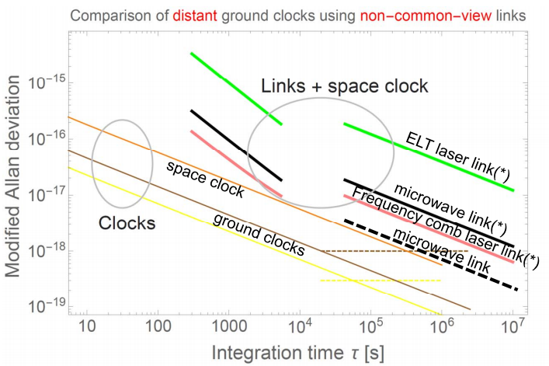
Satellite-based time-frequency transfer link
The existing satellite-based T/F transfer link cannot meet the requirements of optical clock comparison.
I-SOC
Satellite CV
T2L2
T/F link | Intability
GPS（CV) | 1×10⁻¹⁵@1 day
Time to laser link（T2L2） | 1×10⁻¹⁶@1 day (2013)
I-SOC（planning） | 10⁻¹⁷@10,000s，10⁻¹⁸@10day

Slide 8
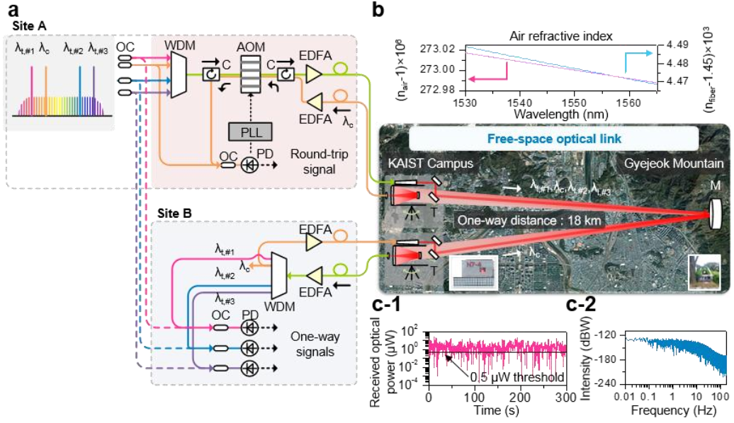
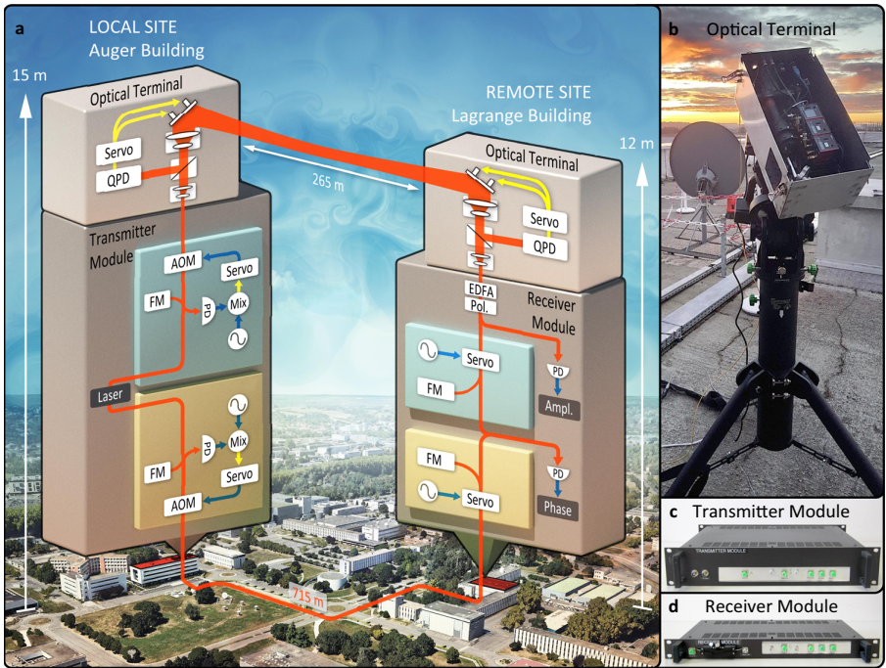
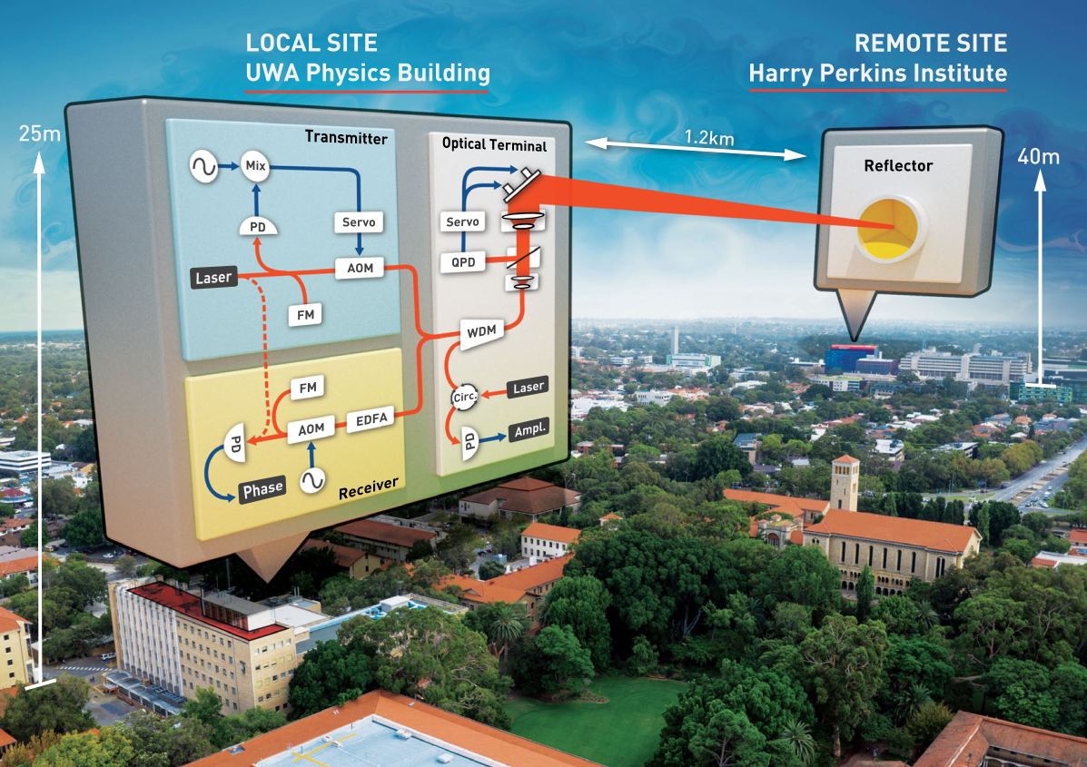
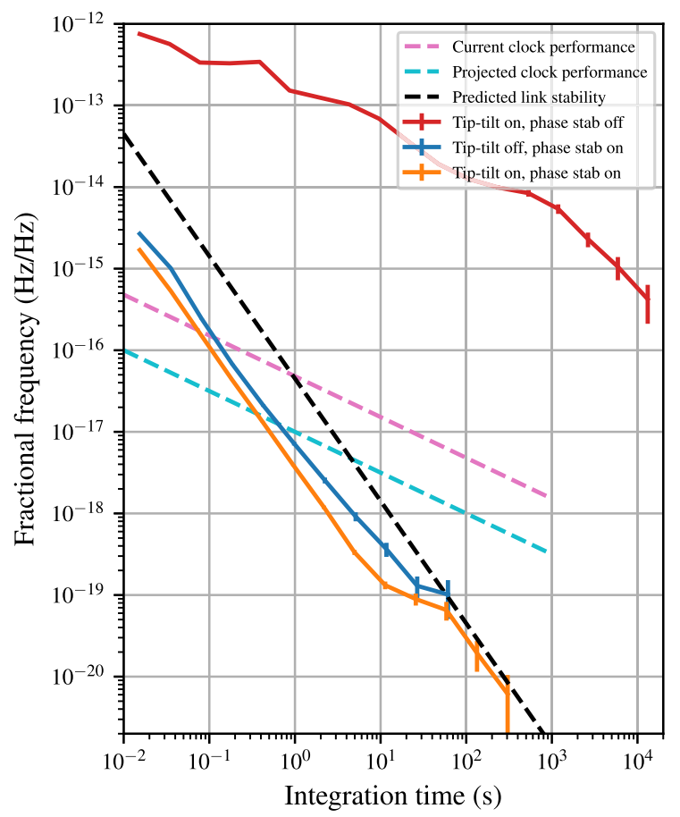
Research progress of high-precision T/F link on the ground
Ultra-stable laser frequency transfer
2019，South Korea KAIST, multi-wavelength ultra-stable optical frequency and microwave transfer locked by optical comb, 18km, 4E-15@0.1s; no long-term stability limited by link influence
2021, Joint team of Australia and France achieved 265m freespace ultra-stable optical frequency transfer，1.6E-19@40s。 2022，increased to 2.4km，6.1E-21@300s。
Low ambiguous range (drawback)
Nat Commun. 10:4438 (2019)
Nat. Commun. 12:515 (2021)
PRL 128, 020801 (2022)

Slide 9
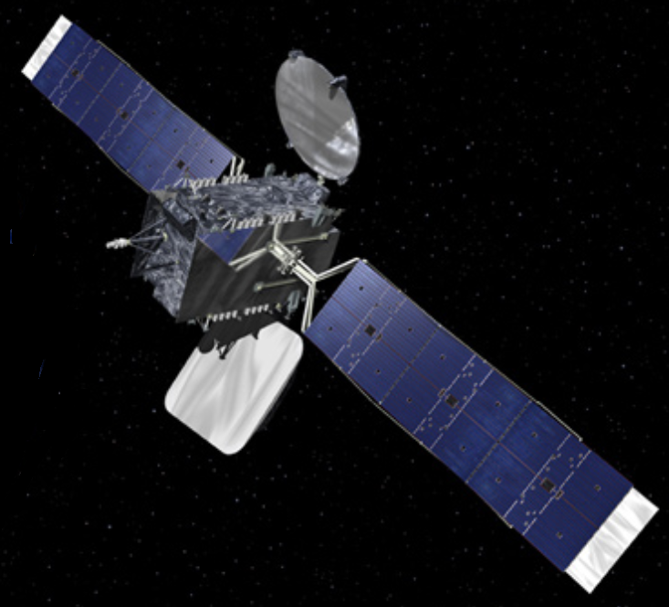


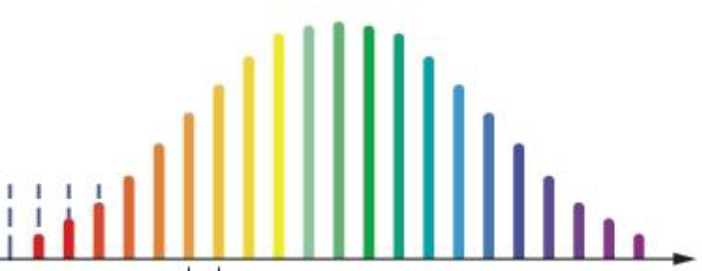
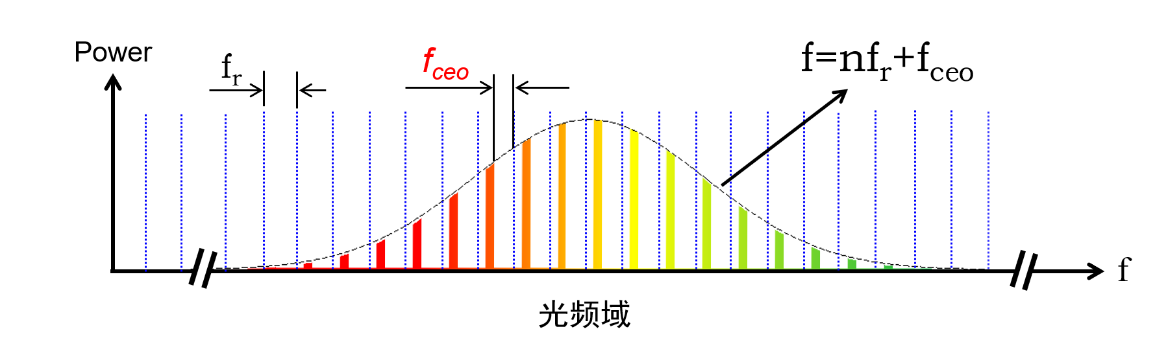

Optical comb-based T/F link
Comb-based T/F link scheme：
Broad-band optical signal
Highly coherent
GEO/MEO
Clock
Comb
LOS
LOS
Two-way link
LOS
Comb
LOS
Clock
Earth
Enlarge ambiguous range

Slide 10
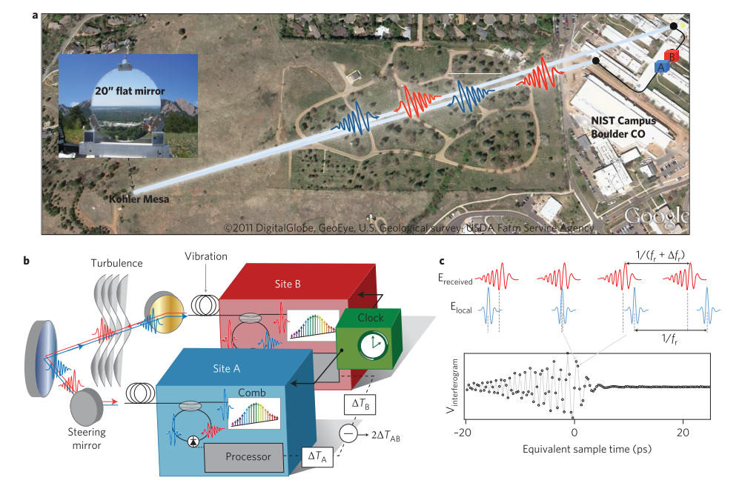
Optical comb-based T/F link
Comb-based T/F link scheme
Local comb locked to clock, which stability is transformed to comb
Linear optical sampling(LOS) to extract the arrival time of the signal comb
Drawback: low photon efficiency
Local comb
interference
RF spectrum
fr
Received comb
fr¹
0
fr/2
fr0
[Nat. Photonics 7, 434–438 (2013)]
Frequency

Slide 11
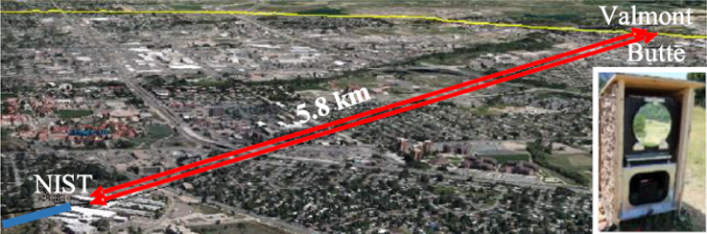
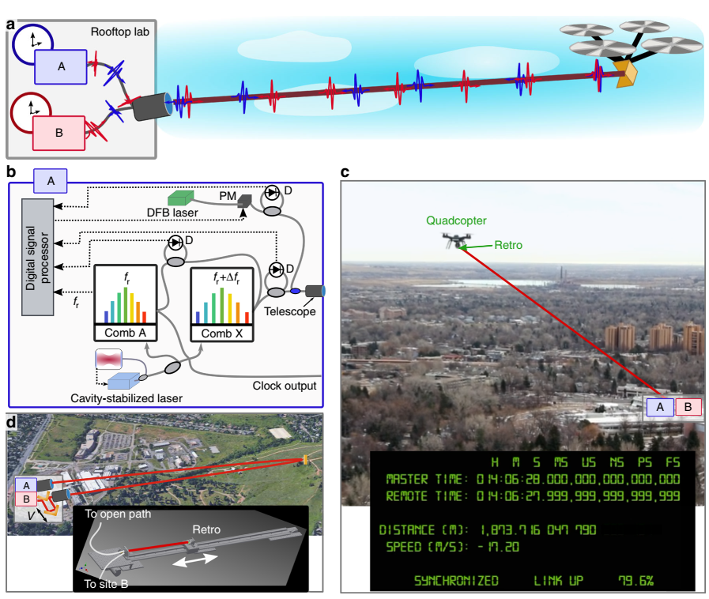
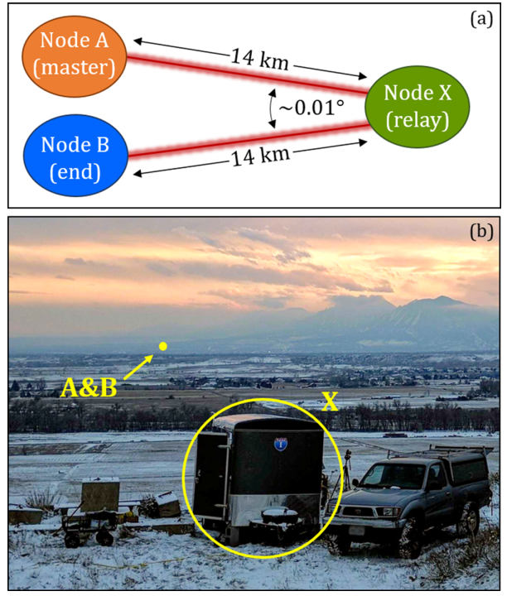
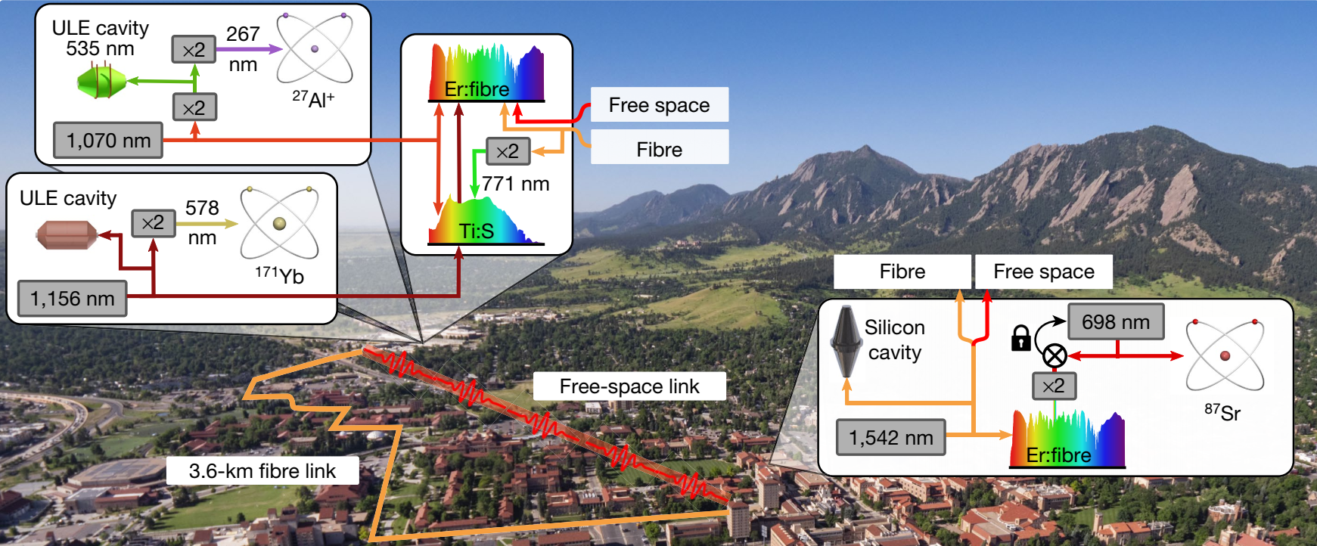
Research progress of high-precision T/F link on the ground
NIST group pioneering works based on optical comb：
2013, scheme first proposed [Nat. Photonics 7, 434–438 (2013).]
2016，round-trip 12km atmosphere，5E-19@1000s
2019，flying quadcopter，24m/s, E-18@100s
2020, 14 km freespace， three-node network，6E-19@200s
2021，BACON，free space and fiber optical comparison network，5E-18@10000s
Appl. Phys. Lett. 109, 151104 (2016)
Nat. Commun. 10, 1–7 (2019).
APL Photon. 5, 076113 (2020)
Nature. 591:564-569 (2021)

Slide 12
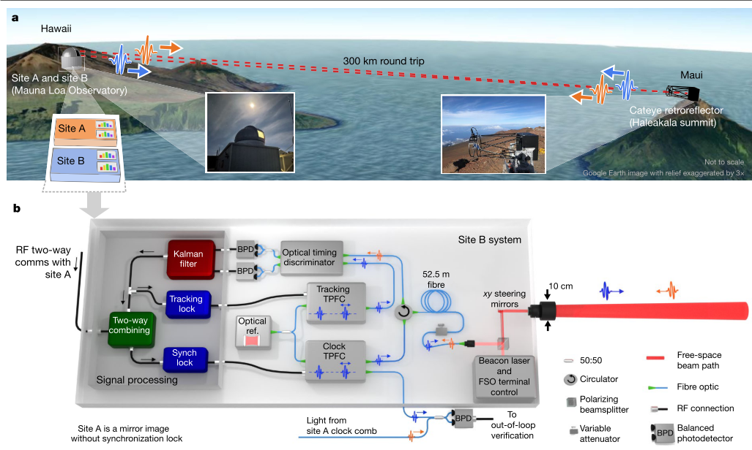
Research progress of high-precision T/F link on the ground
Below 1 p W

Slide 13
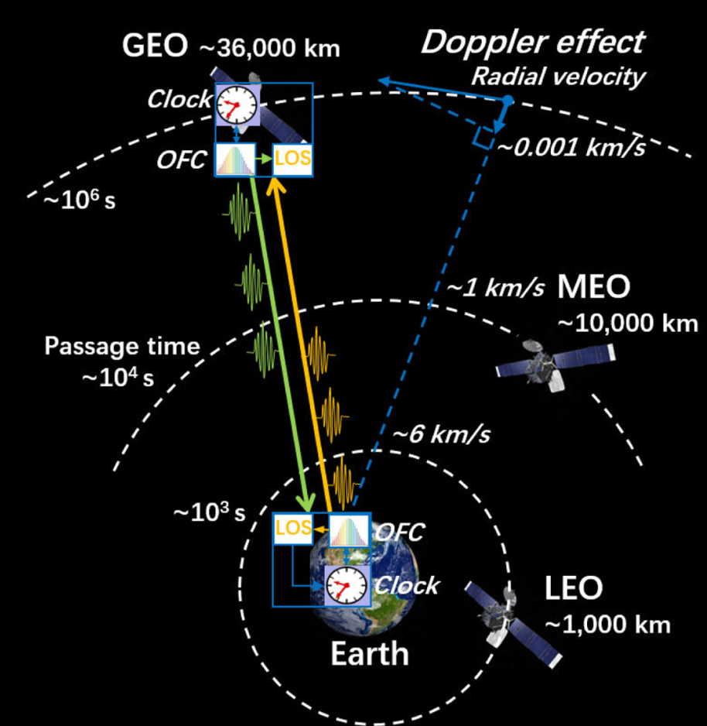
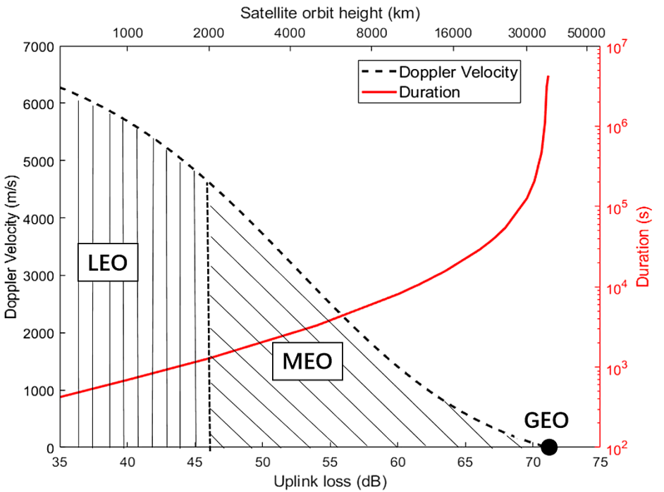
Different satellite orbit types consideration
MEO/GEO is better than LEO for longer duration, larger common view range, and lower relativistic effects.
The most challenges are large link loss, atmospheric noise.
Qi. Shen Optica 8, 471(2021)

Slide 14
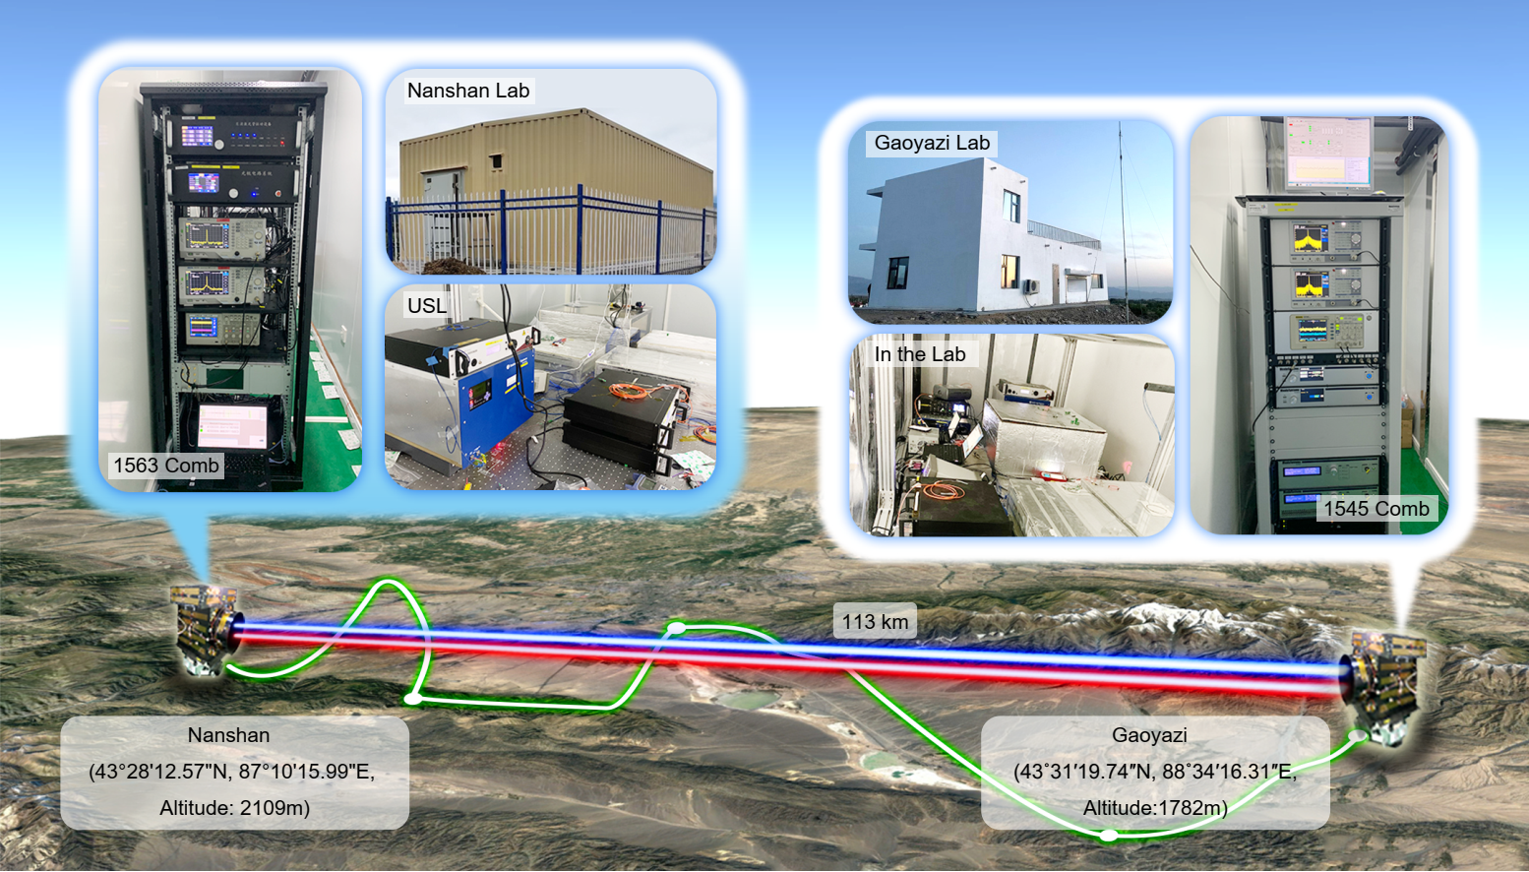
Experimental Setup
113 km point-to-point straight line free-space link
Qi. Shen et. al.. Nature, 610: 661–666 (2022)
Notes:
Here, to further verify the feasibility of satellite-ground T/F link at high orbit, we designed a 100 km point-to-point straight line freespace link. Compared to previous work, the distance is longer, the link loss is higher. This is our experimental setup picture, which is in Xingjiang Province of China, one terminal is called Nanshan，another called Gaoyazi. The lab is built specifically for this experiment. The work can be found in this paper.

Slide 15
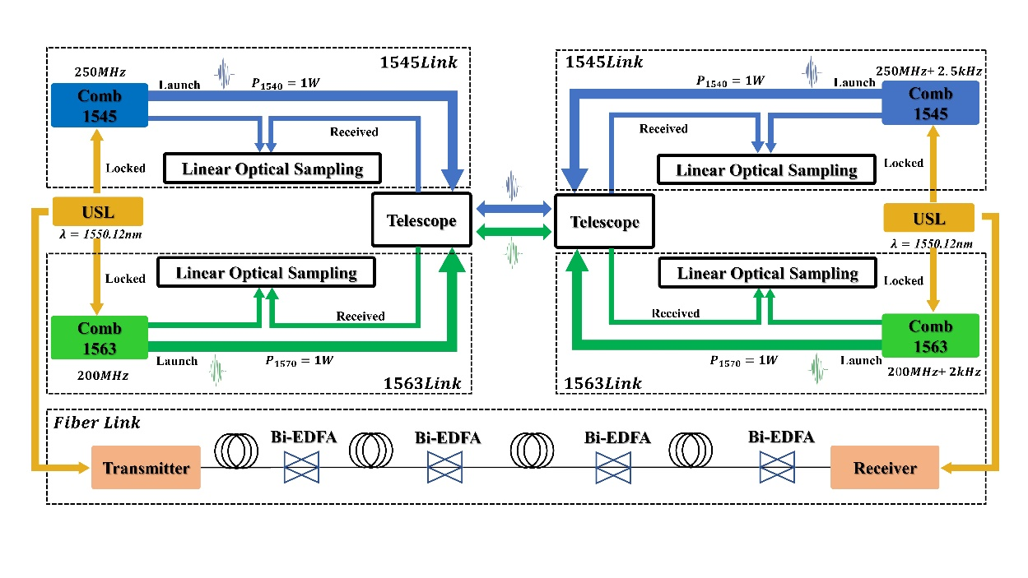
113 km point-to-point straight line free-space link
System setup：
Ultra stable laser、1545/1563 comb、Linear optical sampling (LOS) optics and electronics
Telescope
Fiber optical transfer terminal
Two independent two-way comb links:
1545nm link： comb repetition rate/diff. 250 MHz/ 2.5kHz
1563nm link： comb repetition rate/diff. 200 MHz/ 2kHz
An independent optical fiber frequency transfer link:
Fully verify and evaluate the performance of space transfer links

Slide 16
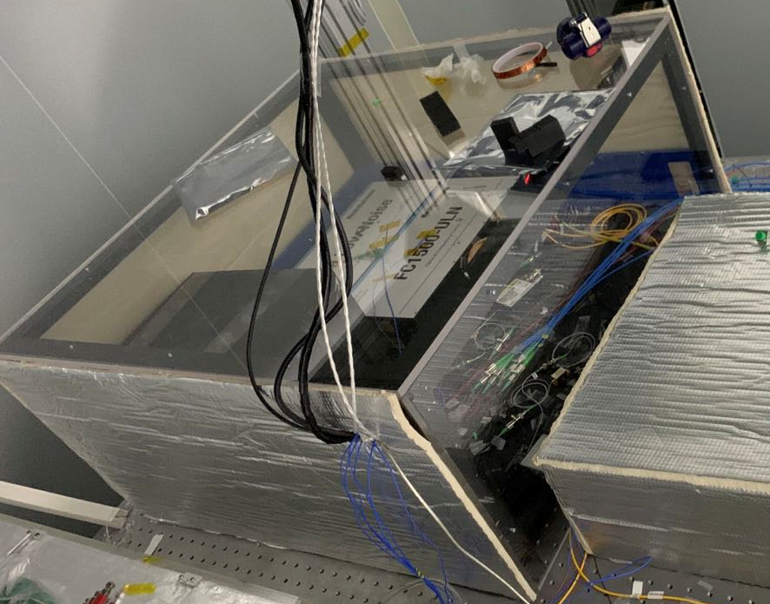
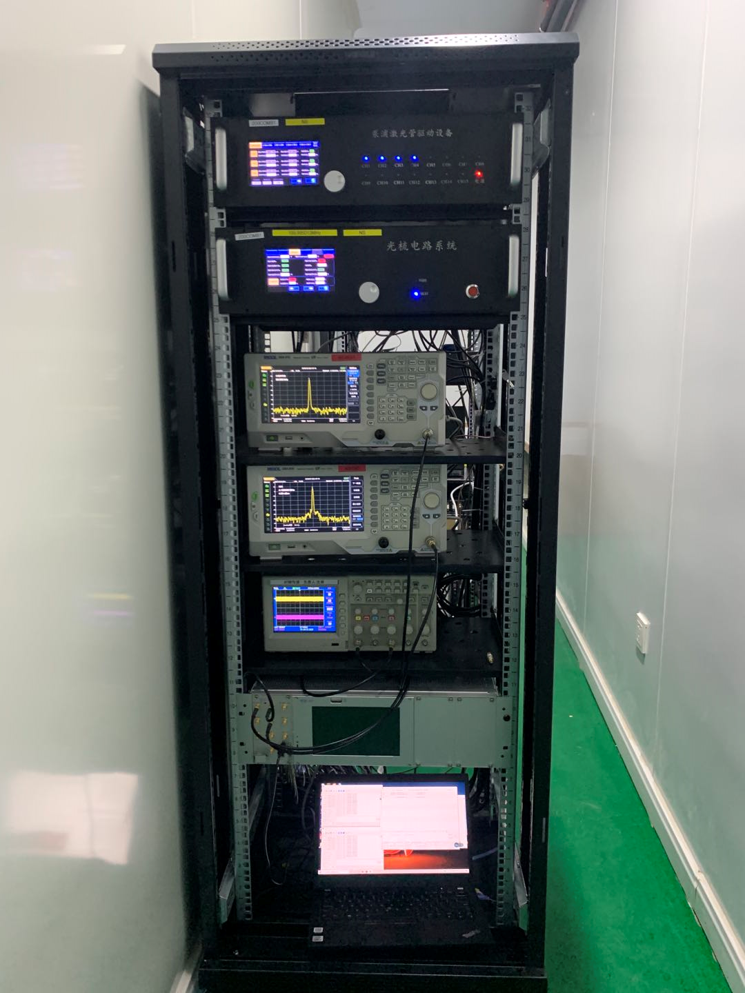
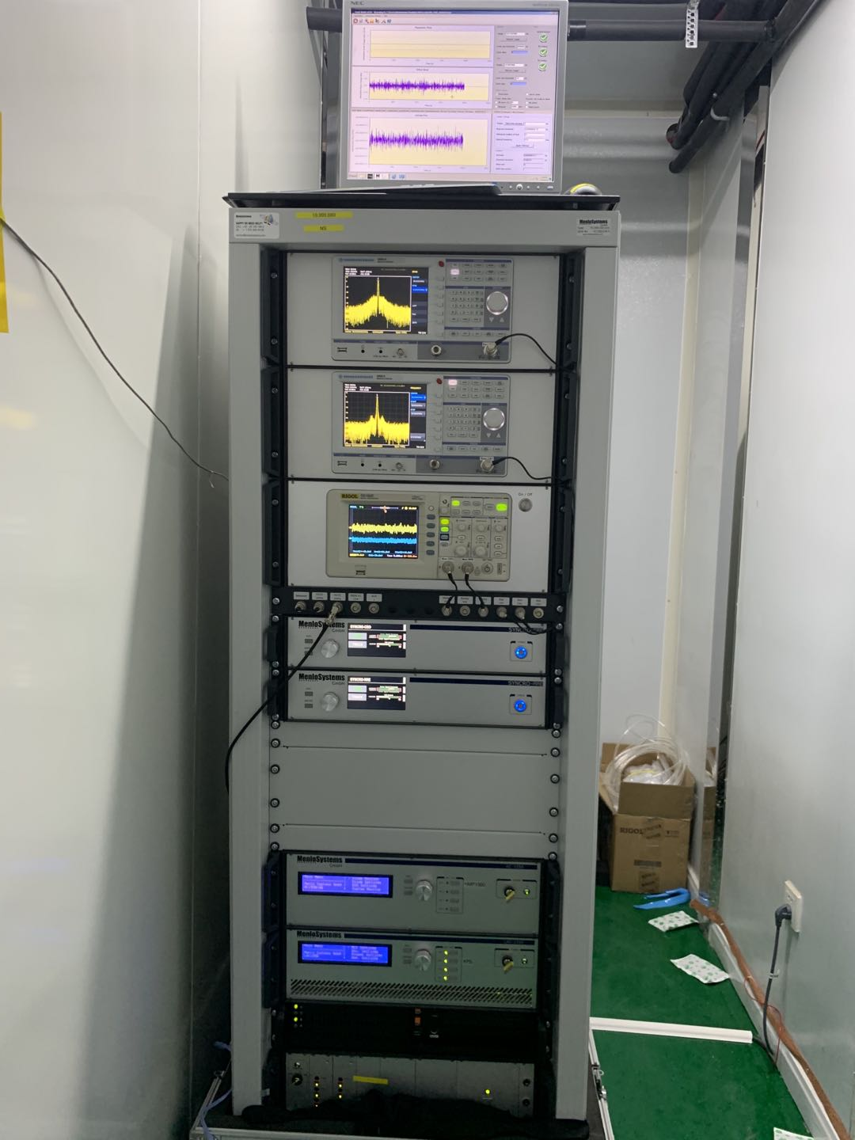
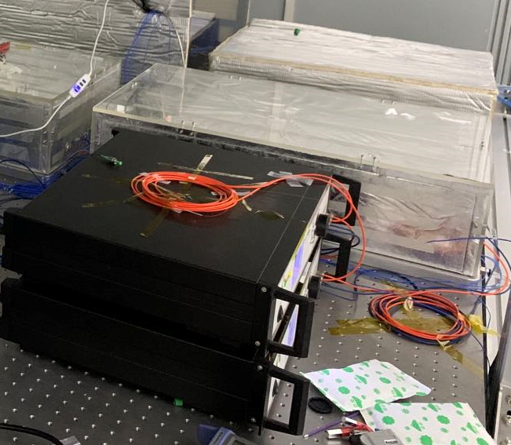
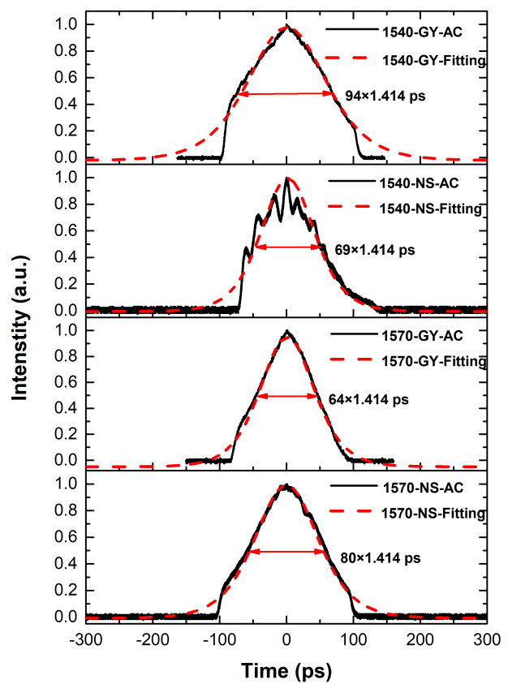
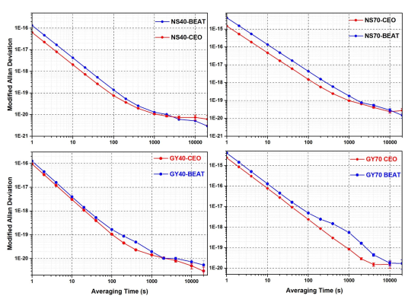
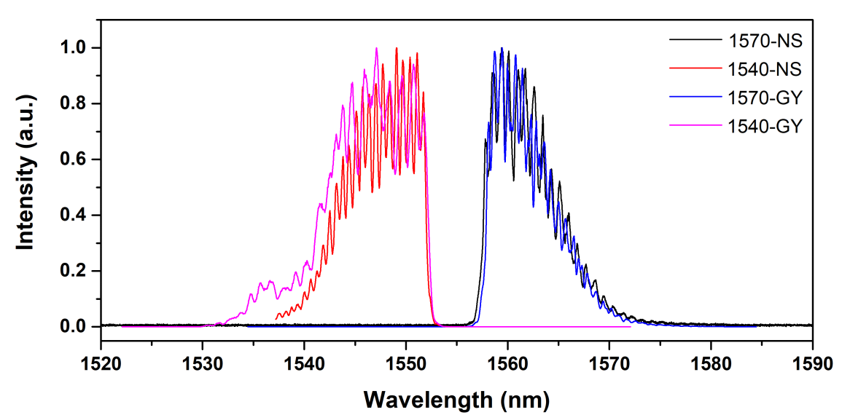
113 km point-to-point straight line free-space link
1545 comb :
Commercial product from Menlo. System Inc.
Homemade amplifier to 1W output power
MDEV: 1E-16@1s；6E-21@10000s
3dB wavelength：10 nm；70/90 ps pulse width
1563 comb :
Homemade：1W output power
MDEV: 2E-15@1s；1E-20@10000s
3dB bandwidth：7 nm；60/80 ps pulse width

Slide 17
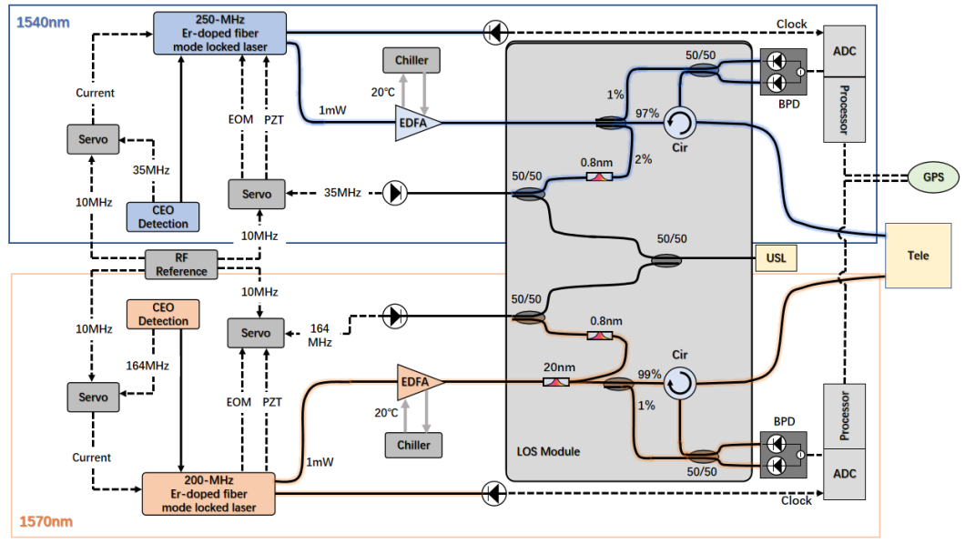
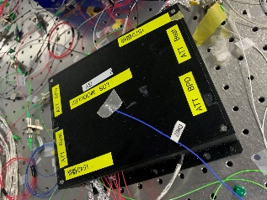
113 km point-to-point straight line free-space link
LOS optics:
Integrated fiber optical module design with circulator
Temperature control: 7 mK std
LOS optics module

Slide 18
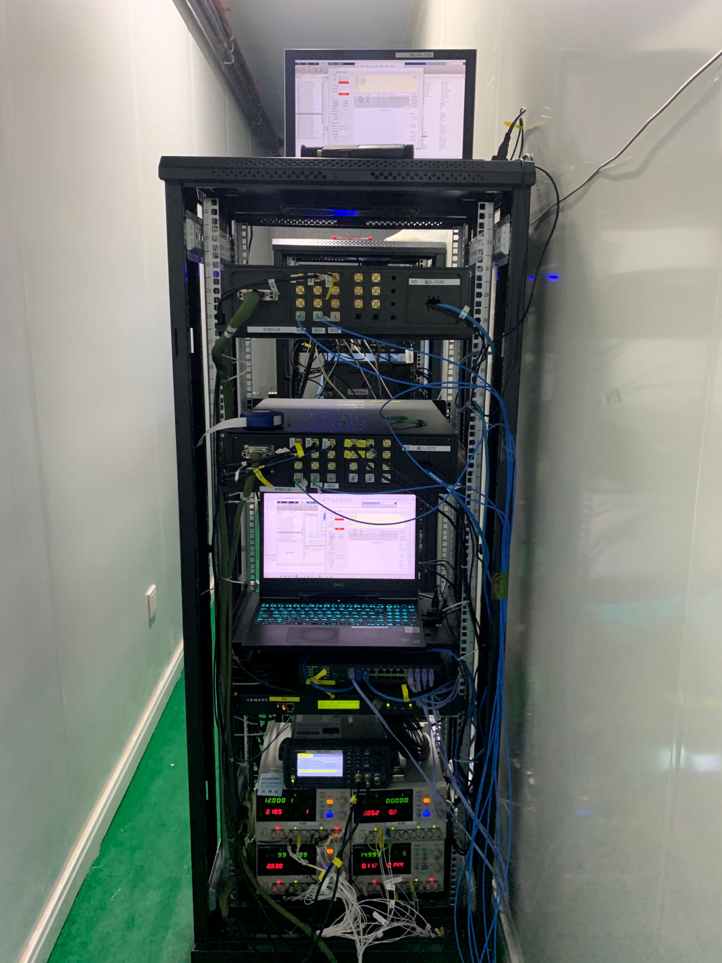
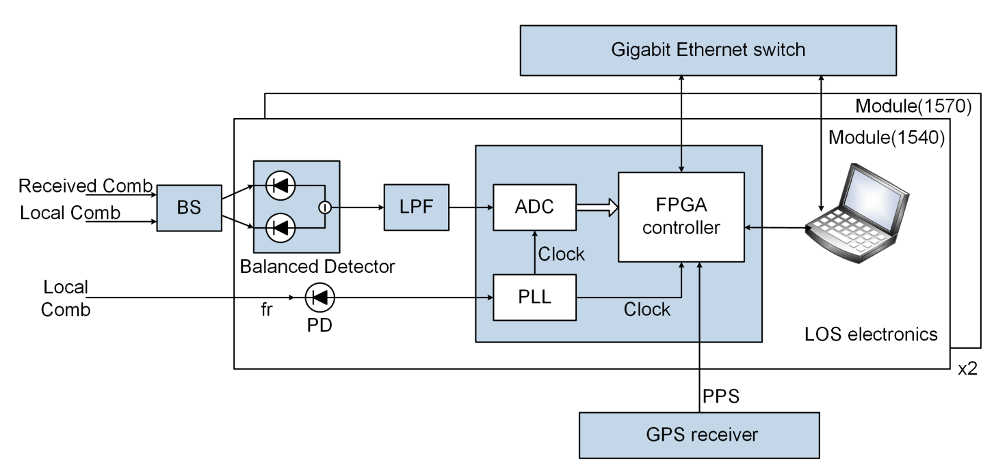
113 km point-to-point straight line free-space link
LOS electronics :
Balanced detector: NEP < 10 pW/sqrtHz，Gain: 40kV/W
ADC: 14 bits; FPGA controller
One data frame includes 1024 sampling points
Remote start synchronize by GPS pps with 30 ns jitter
LOS electronics
Notes:
.

Slide 19
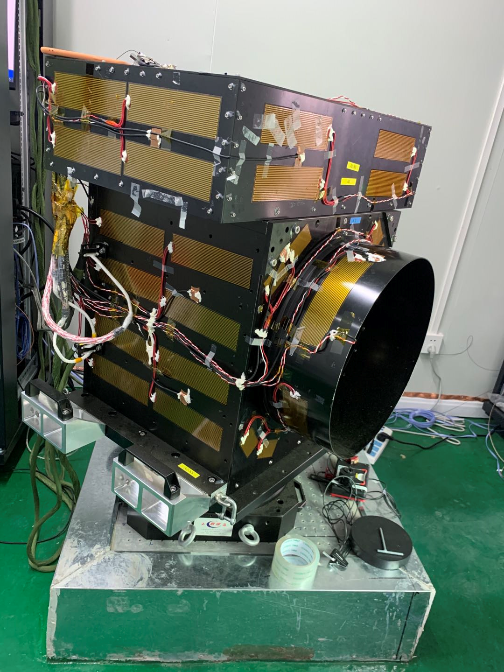
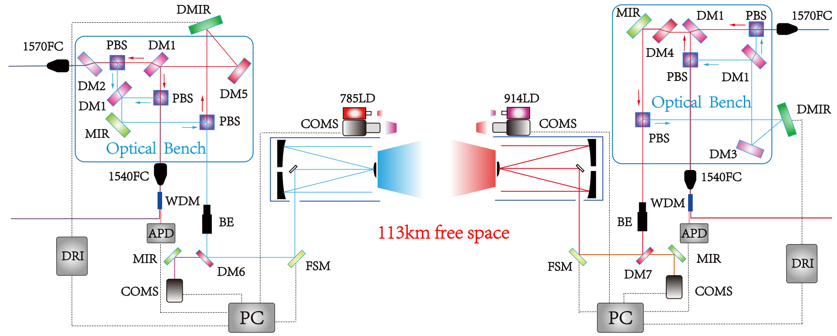
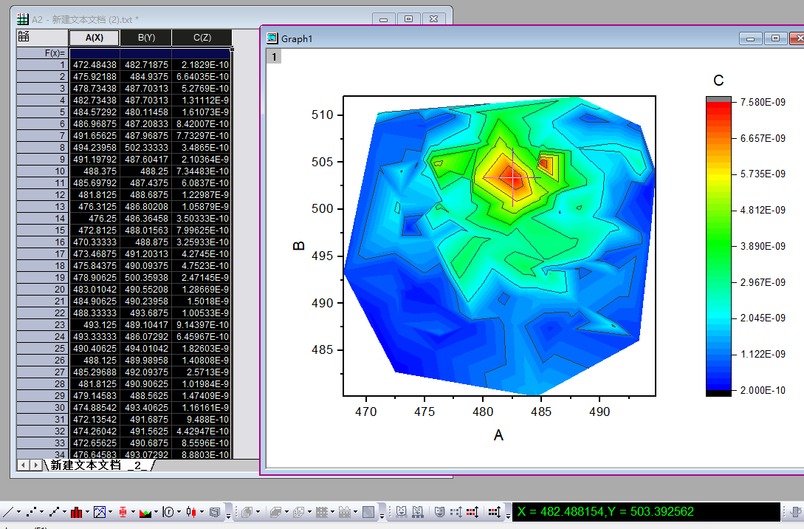
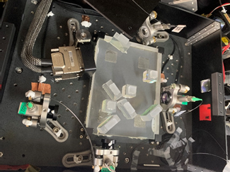
113 km point-to-point straight line free-space link
Optical transceiver telescope :
400 mm diameter, focal length of 1600 mm
Full-angle divergence: 12 urad indoor; 30-50 urad after 113 km free space link
Orthogonal polarization scheme to separate two directional signals, to simulate the nonreciprocal situation due to satellite point-ahead angle
Adaptive optics with deformable mirror: increase single-mode coupling efficiency
Optical bench technique employed with temperature control
Divergence test result
Optical bench

Slide 20
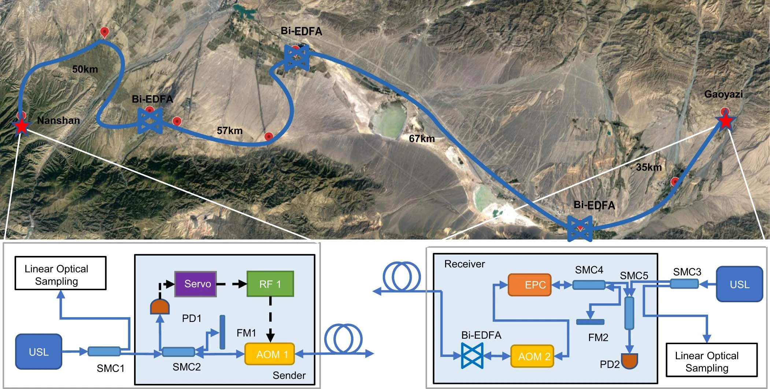
209 km fiber optical frequency transfer link
Fiber optical frequency transfer link:
Total length 209km, which transmits the Nanshan ultra-stable laser frequency to Gaoya
Link loss is 65dB, add 4 bidirectional amplifier to suppress the link loss: 3 in the link, 1 in the Gaoya
Sharing the same ultra-stable laser clock with free space T/F links
The in-loop instability of frequency transfer is better than 1E-20@10,000s

Slide 21

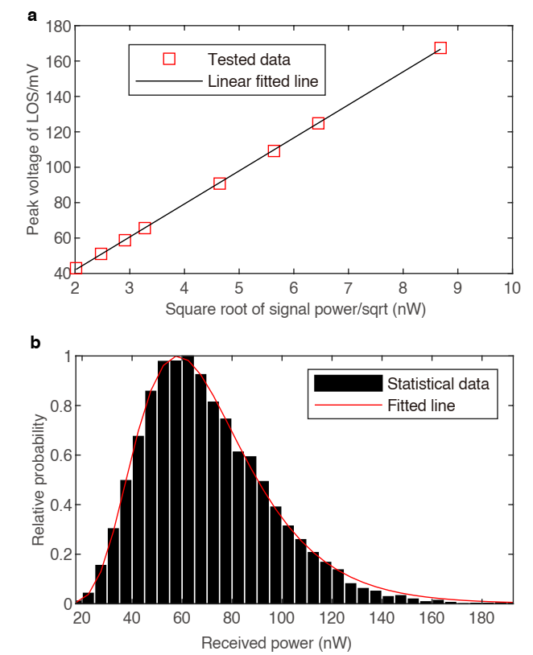
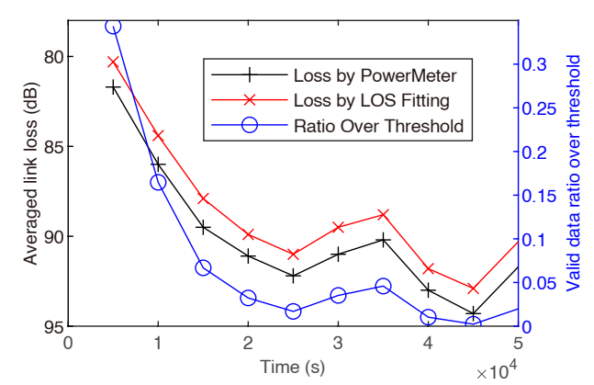
Measurement results
Received signal power and link loss estimation and calibration:
Received power (nW) much less than reflected Local power, cannot be measured real time by powermeter. A power estimation method is proposed.
Calibration:
Indoor calibrate: linear relation between peak voltage and sqrt Signal Power
Outdoor estimation: log-normal distribution; the average power can be estimated by this distribution and the valid data ratio
Verification: With sending comb power reduced, both power meter and this estimation method are compared to be consistent.
Notes:
,

Slide 22
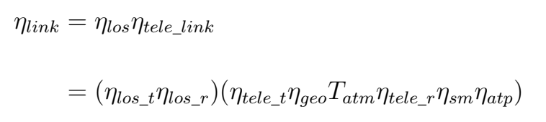
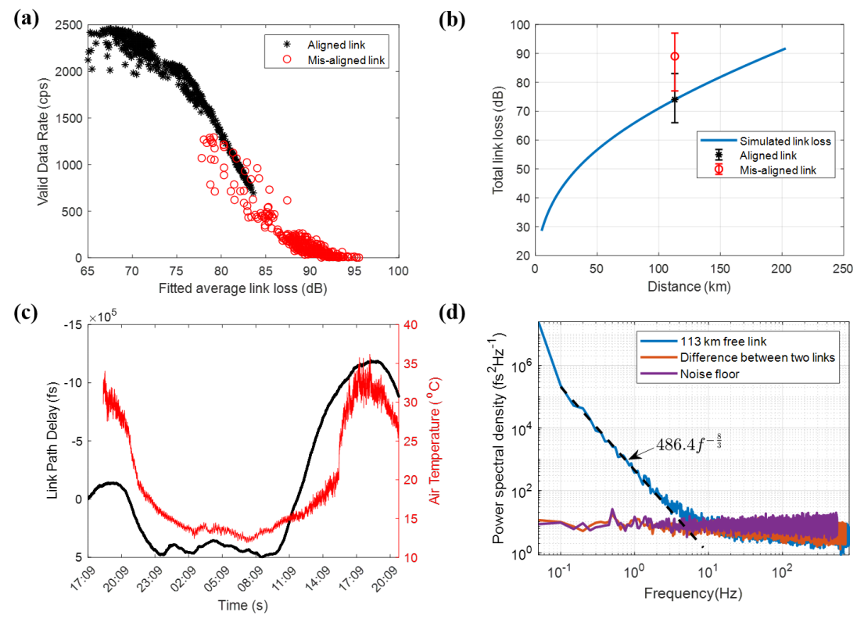
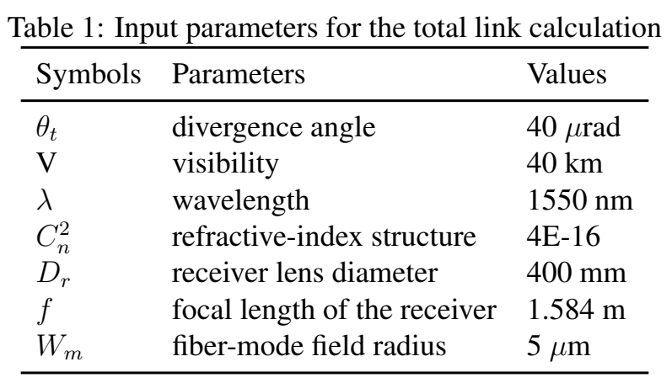
113 km point-to-point straight line free-space link
Characteristic of the 113 km link loss :
Typical average loss 74 dB, consistent with the theoretical calculation
the LOS optics loss of 4 dB
the telescope optical efficiency of 4.8 dB
the geometric attenuation of 21.8 dB
the atmospheric attenuation of 12.5 dB
the single-mode coupling attenuation of 27.9 dB
the ATP loss of 3 dB

Slide 23
113 km point-to-point straight line free-space link
Characteristic of the 113 km link :
Valid data rate reduce with loss increase;
Received signal data rate can be 100 cps with 90 dB (1 nW)
Notes:
.

Slide 24
113 km point-to-point straight line free-space link
Link delay drift and PSD :
Link delay drift: >1ns in 24 hours, mainly caused by air temperature
Noise power spectra density (PSD) of the free link exhibits a single power-law decay at a curve consistent with proposed atmospheric model
Residual noise of the two-way link is same as the system floor with indoor shorted-fiber

Slide 25
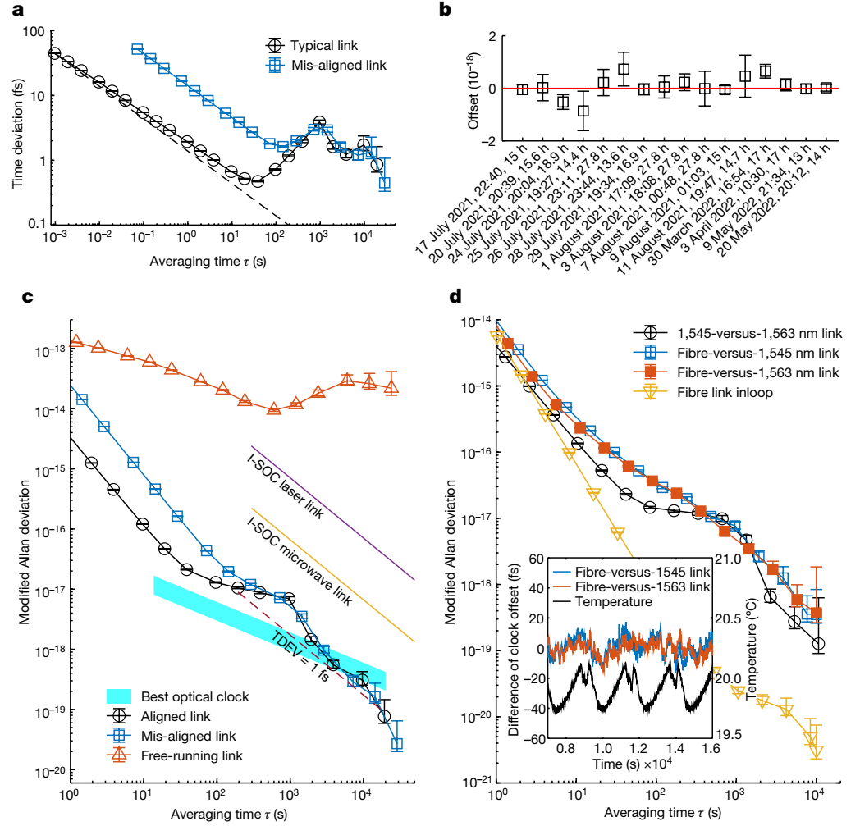
113 km point-to-point straight line free-space link
Time transfer:
TDEV: down to 0.5 fs at 40s from 40 fs at start
Thermal drift limits TDEV to 1 fs, bumps around 1000 s due to air conditioner
Mis-aligned link 89 dB; Typical link 74 dB

Slide 26
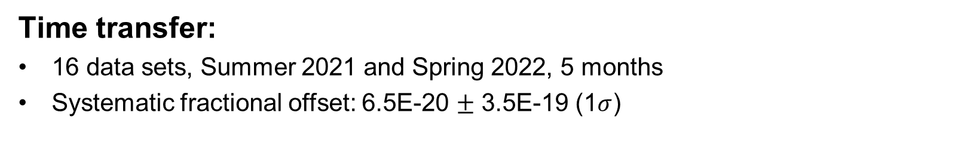
113 km point-to-point straight line free-space link
Time transfer:
16 data sets, Summer 2021 and Spring 2022, 5 months
Systematic fractional offset: 6.5E-20 $±$ 3.5E-19 (1$σ$)

Slide 27
113 km point-to-point straight line free-space link
Frequency transfer:
MDEV: 2E-14~3E-15@1s;
3E-19@10,000s;
One way link: E-14@10,000s
Better than optical clock after one hour
Mis-aligned link 89 dB;
Typical link 74 dB

Slide 28
113 km point-to-point straight line free-space link
Frequency transfer:
Free-space link and fiber link results are consistent: < 4E-19@10,000s
Thermal drift effects limit the link performance for long averaging times

Slide 29
Summary
A time–frequency dissemination over a 113 km free-space link have been implemented. The relative instability is below 4 × 10⁻¹⁹ at 10,000 s, whereas the link loss is up to 89 dB.
Several key techniques have been used and verified:
  High power low noise comb
  High sensitive and high precision time measurement
  High stable and high efficiency optical transceiver

Slide 30






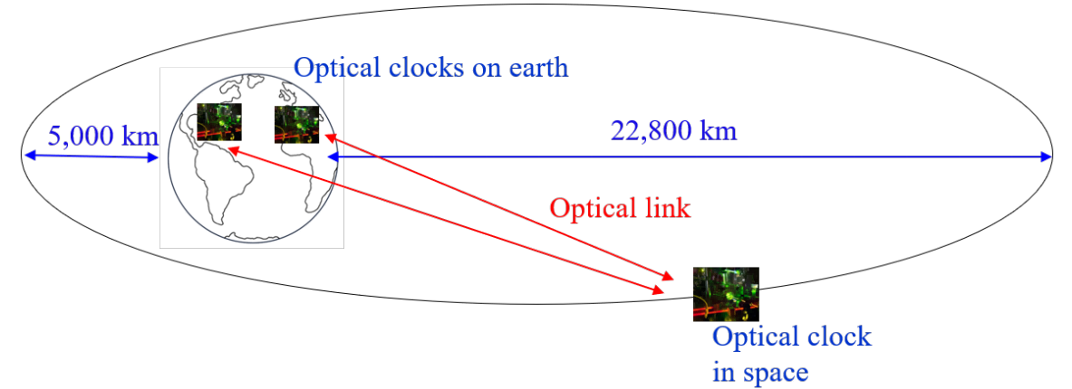

Perspective
NIST/JPL（FOCOS）
Quantum Sci. Technol. 7 (2022) 044002

Slide 31

Perspective
Satellite with Sr clock (<1E-17 uncertainty), OFC and two telescopes.
Launch time : 2026-2027
Ultra-stable laser
Optical clock
Optical clock
Optical clock
Optical clock
Satellite-ground and satellite common view optical clock comparisons at global scale

Slide 32

Perspective
Looking for collaboration!
NIM (Beijing)
USTC(Hefei)
IATMST(Wuhan)
NTSC(Xian)
Tokyo University
SYRTE
PTB
NPL
……
Australia
Singapore
Hawaii
NIM（China）
Email: hjiang1@ustc.edu.cn

Slide 33


Acknowledgements
113 km
NanShan
Gaoyazi
Jian-Yu Guan, Ji-Gang Ren, Ting Zeng, Lei Hou, Min Li, Yuan Cao, Jin-Jian Han, Meng-Zhe Lian, Yan-Wei Chen, Xin-Xin Peng, Shao-Mao Wang, Dan-Yang Zhu, Xi-Ping Shi, Zheng-Guo Wang, Ye Li, Wei-Yue Liu, Ge-Sheng Pan, Yong Wang, Zhao-Hui Li, Jin-Cai Wu, Yan-Yan Zhang, Fa-Xi Chen, Chao-Yang Lu, Sheng-Kai Liao, Juan Yin, Jian-Jun Jia, Cheng-Zhi Peng, Hai-Feng Jiang, Qiang Zhang, Jian-Wei Pan
Email: hjiang1@ustc.edu.cn

Slide 34
The end,
Thank you for your attention!

