Slide 1





Precision Penning-Trap Mass Measurements
on Light Nuclei and Highly Charged Heavy Ions
Basics of Penning-trap mass spectrometry
Masses of the building blocks of matter
Tests of fundamental symmetries
Atomic binding and excitation energies
Klaus Blaum
Max-Planck-Institute for Nuclear Physics, Heidelberg
9th SFSM, Oct 17th, 2023

Slide 2
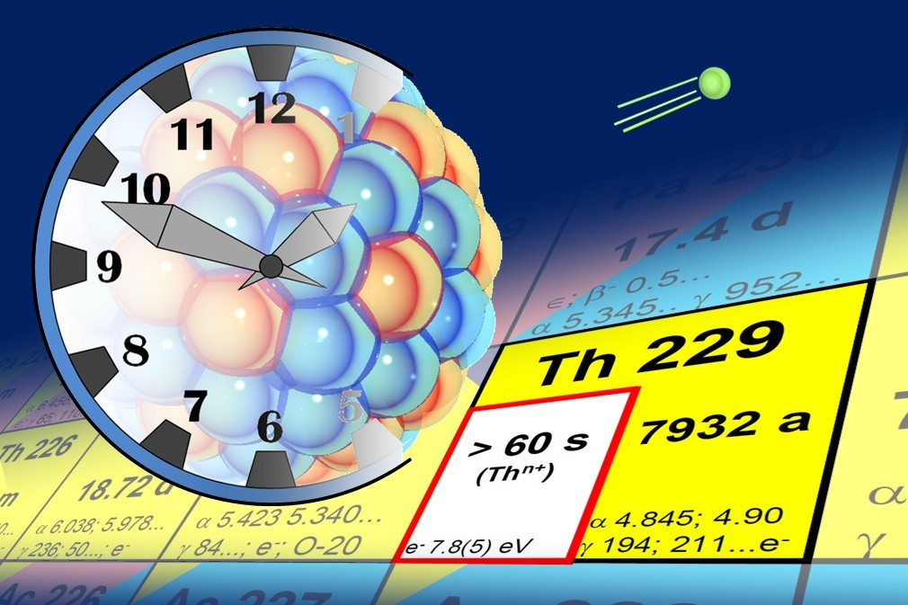
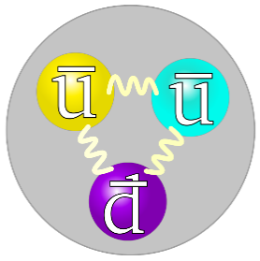
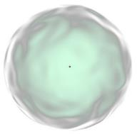

Atomic/nuclear mass spectrometry …
… probes fundamental physics!
How heavy are the building blocks of matter?
What is the mass of a neutrino?
Why is there more matter than anti-matter?
Does QED fail in the strong field regime?
radionuclides
antimatter
highly charged ions

Slide 3
The mass of an atom
Einstein E = mc²
m_{Atom} = N•m_{neutron} + Z•m_{proton} + Z•m_{electron}
- (B_{atom} + B_{nucleus})/c²
δm/m < 10⁻¹⁰
δm/m = 10⁻⁶ – 10⁻⁸

Slide 4
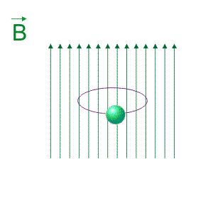
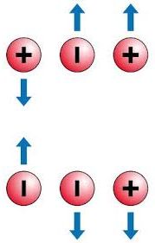
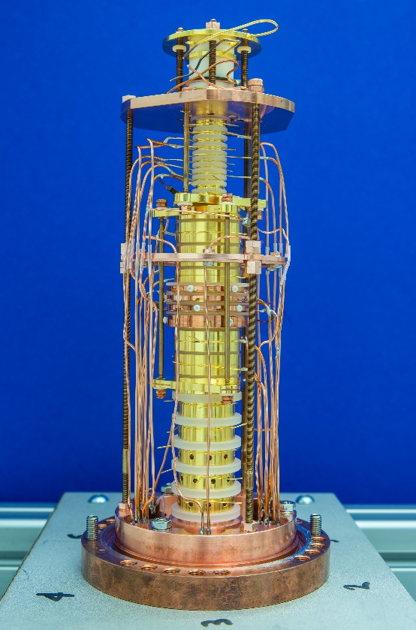
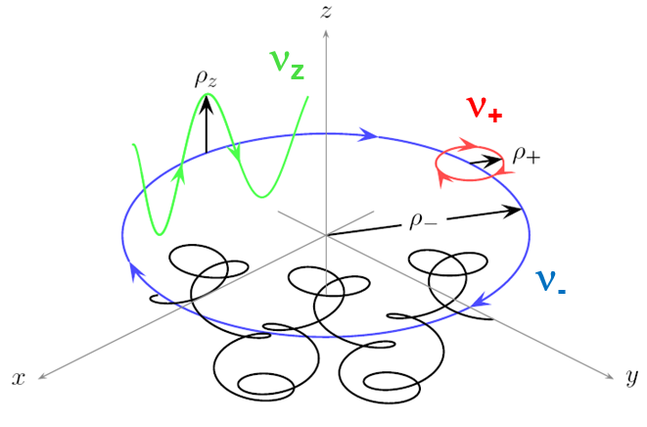
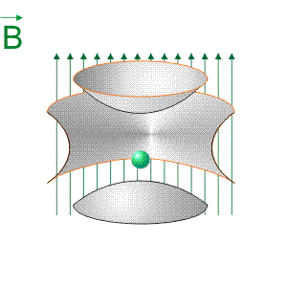
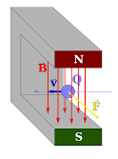
Storage of ions in a Penning trap
20 cm
Ion q/m_{ion}
U
Charge q
Mass m_{ion}
The free cyclotron frequency is inverse
proportional to the mass of the ion!
Non-destructive FT-ICR detection technique
L.S. Brown, G. Gabrielse, Rev. Mod. Phys. 58 (1986) 233

Slide 5
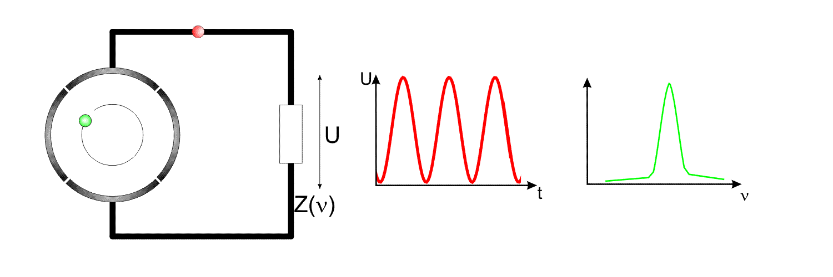
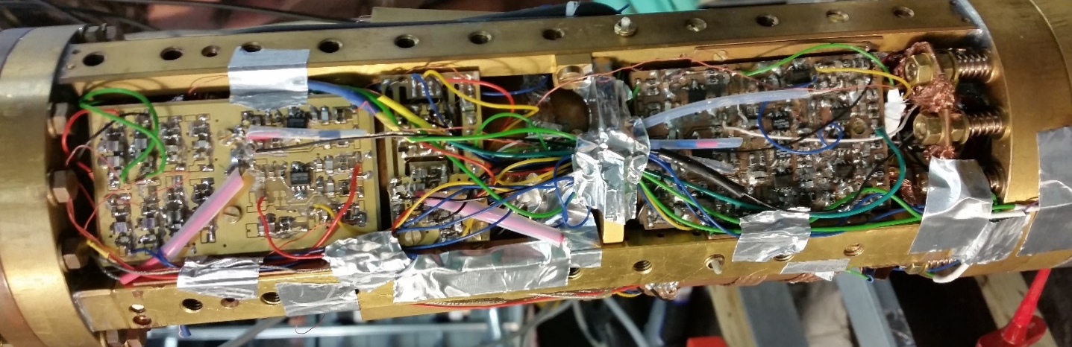
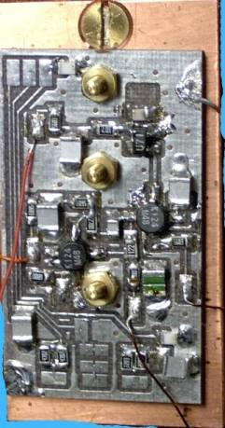
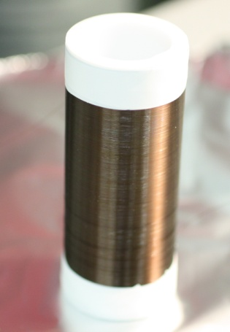
Non-destructive detection technique
ion signal
mass/frequency spectrum
Amplitude
very small
signal ~fA
Fourier transformation
S. Sturm et al., Phys. Rev. Lett. 107, 143003 (2011)
30 cm

Slide 6
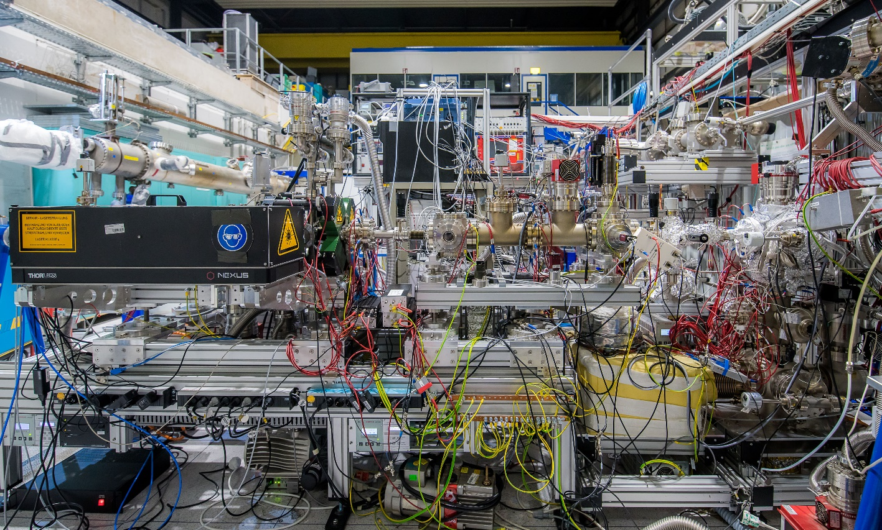
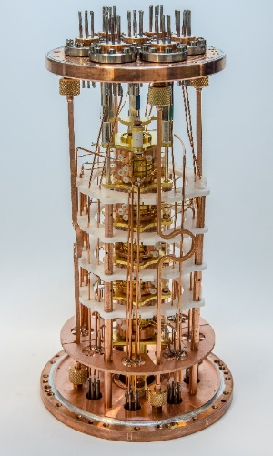
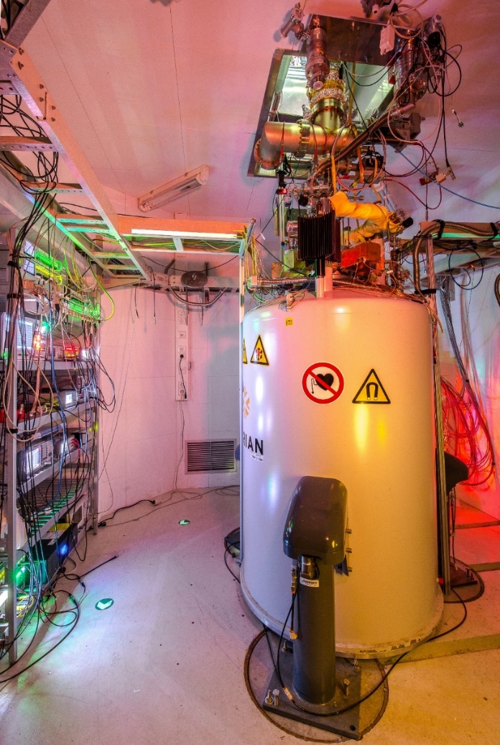
PENTATRAP – A Penning-trap setup at MPIK
A balance for highly charged ions.
Penning Traps
Laser Ion Source
EBIT
Transfer Beamline
Electronics
Superconducting Magnet

Slide 7
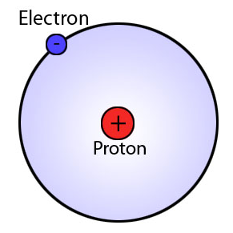
The building blocks of matter
The atomic mass of the proton and electron
Hydrogen
Electron: previous best value
improved by a factor of 13
Proton: previous best value
improved by a factor of 3
m_{e} = 0.000 548 579 909 067 (17) u
m_{p} = 1.007 276 466 583 (33) u
Nature 506 (2014) 467
Phys. Rev. Lett. 119 (2017) 033001

Slide 8
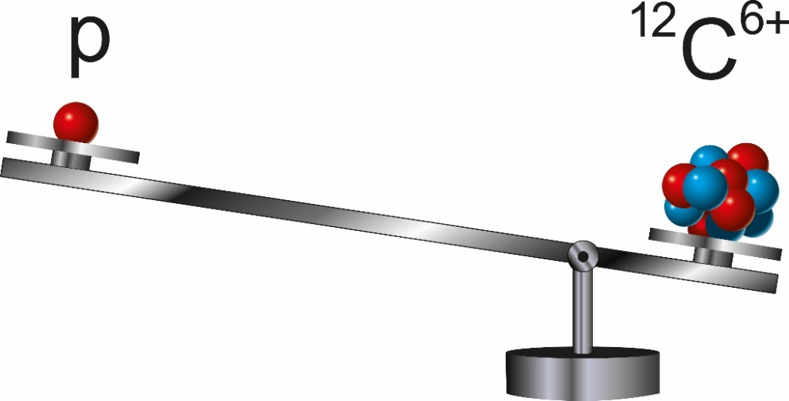
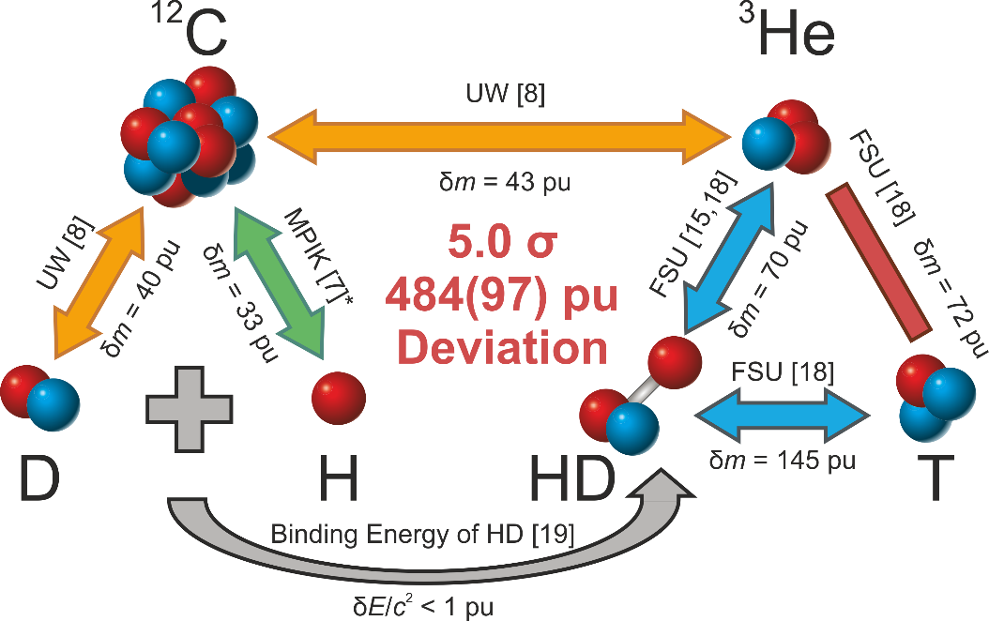


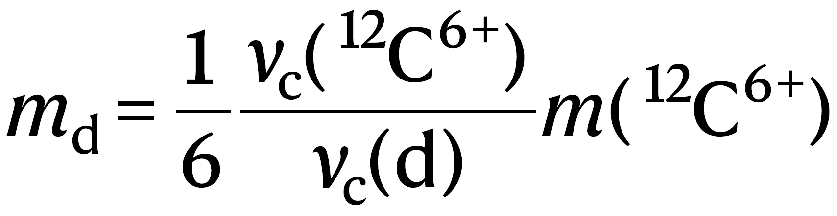
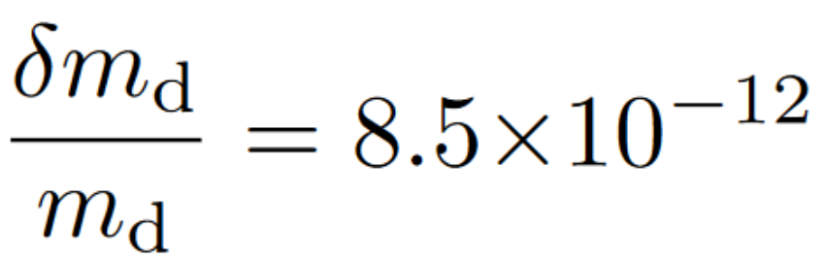
The atomic mass of the deuteron and HD⁺
Deuterium
d
Neutron
0
A factor of ~3 improved value and 6.6 sigma deviation!
→ Provides access to the mass of the neutron
S. Rau et al., Nature 585 (2020) 43

Slide 9
The building blocks of matter
The atomic mass of the proton and electron
and neutron ☺
Hydrogen
Deuterium
Neutron
0
Electron: previous best value
improved by a factor of 13
Proton: previous best value
improved by a factor of 3
deuteron: previous best value
improved by a factor of ~3
m_{e} = 0.000 548 579 909 067 (17) u
m_{p} = 1.007 276 466 583 (33) u
m_{d} = 2.013 553 212 535 (17) u
Nature 506 (2014) 467
Phys. Rev. Lett. 119 (2017) 033001
Nature 585 (2020) 43

Slide 10
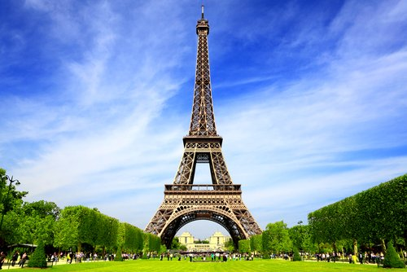

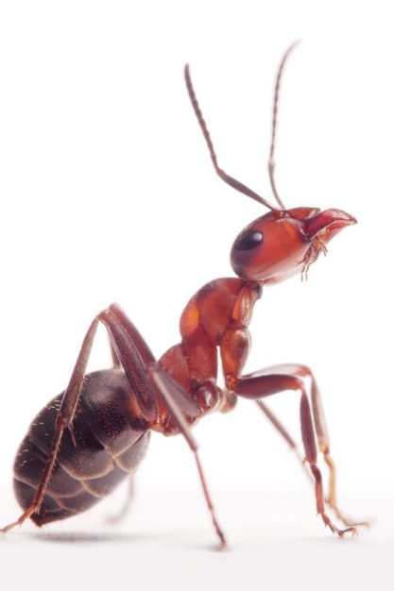
An easy image of our precision regime
60 mg
m_{bee} ≈ 60 mg
m_{bee}
m_{Eiffel}
≈ 810⁻¹²
m_{Eiffel} = 7300 T = 7.300.000.000.000 mg = 7.3·10¹² mg
BUT: Precision
achieved on the
atomic scale!
recently achieved
210⁻¹²

Slide 11
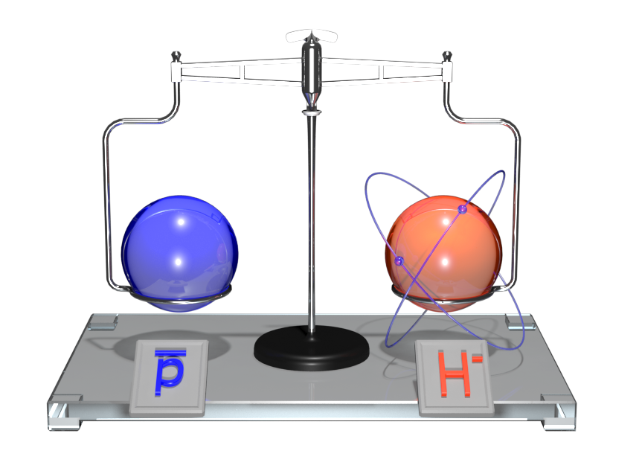
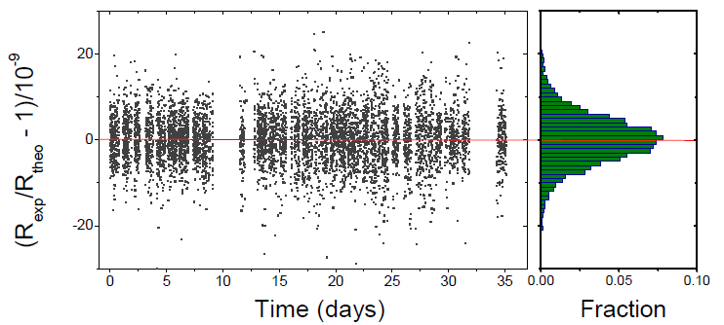
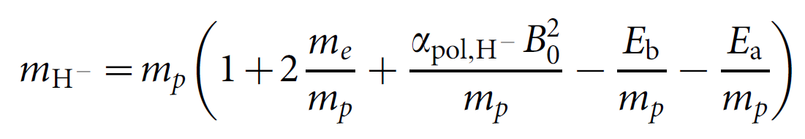
Comparison of the proton and antiproton
ν_{c,1}
ν_{c,2}
Compare charge-to-mass ratios R
of p and p:
(q/m)_{p} / (q/m)_{p} = -1.000 000 000 003 (16)
ν_{c,1}
R =
ν_{c,2}
M.J. Borchert et al., Nature 601 (2022) 53
Remarkable:
Temperature: T = -270°C
Pressure: p < 4∙10⁻¹⁹ mbar
Storage time: years
Experiment: BASE @ AD/CERN
It is not that easy!
Most stringent test of CPT symmetry in the baryon sector!

Slide 12
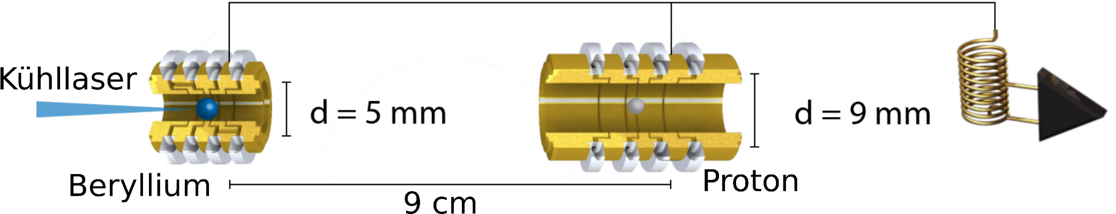
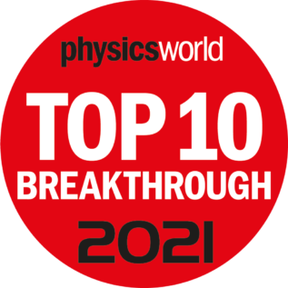
Sympathetic laser cooling of a proton
Cooling laser
M.Bohman et al., Nature 596 (2021) 514
B. Tu et al., AQT 210009 (2021) 1
Proton axial temperature of
~ 100 mK
demonstrated!

Slide 13
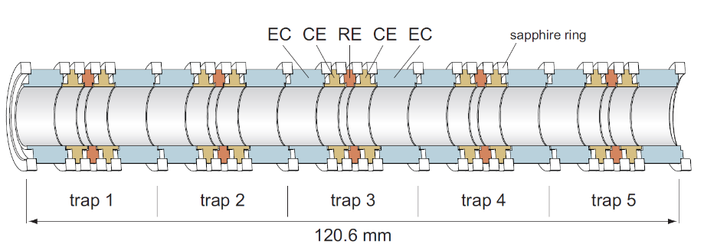
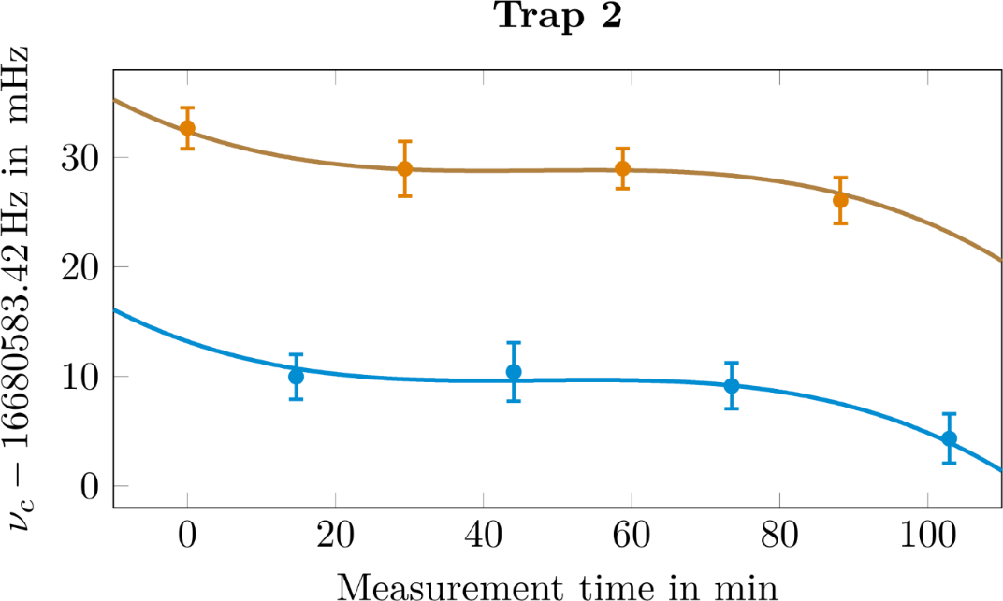
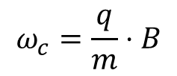



Measurement principle at PENTATRAP
Mass Ratio determination – Polynomial Method
$$ω_{c}=\frac{q}{m}⋅B$$
Magnetic field not known!
Second ion:
$$R=\frac{ω_{1}}{ω_{2}}=\frac{q_{1}⋅m_{2}}{q_{2}⋅m_{1}}\frac{{ B}_{1}\left(t\right)}{{ B}_{2}(t)}$$
meas. trap
$$f_{1}\left(t\right)=R⋅\left(a+b⋅t+c{⋅t}^{2}+d⋅t^{3}\right)$$
$$f_{2}\left(t\right)=\left(a+b⋅t+c{⋅t}^{2}+d⋅t^{3}\right)$$
Future: Monitoring trap
A. Rischka et al., Phys. Rev. Lett. 124 (2020) 113001

Slide 14
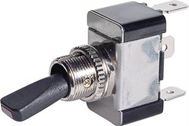
Q-value of ¹⁸⁷Re-¹⁸⁷Os for neutrino physics
pos 1
Re
Os
Re
Change position every 30 min
Measurement of ν₊, ν_{z}, ν₋
Phase detection method
Storage time of days
1
2
3
4
5
pos 2
Re
Os
Re
1
2
3
4
5
P. Filianin et al., Phys. Rev. Lett. 127 (2021) 072502
relative nuclear mass precision achieved: 610⁻¹²
BUT
For Re²⁹⁺ (Z = 75) vs. Os²⁹⁺ (Z = 76) we measure two ratios with a 50/50 probability:
R₁ = 1.000000013886(15)
R₂ = 1.000000015024(12)

Slide 15
Weighing of different electron config.
Ground-state configuration of Re²⁹⁺ and Os³⁰⁺: [₃₆Kr] 4d¹⁰
Metastable state [₃₆Kr] 4d⁹ 4f¹ with E_{exc} ≈ 200 eV in Re²⁹⁺
Similar state in Os³⁰⁺ expected!
Re²⁹⁺
Os³⁰⁺
metastable state
metastable state
Β _{PENTATRAP} = 202.2(17) eV
Β _{PENTATRAP} = 207(3) eV
Β _{Harman} = 202.2(5) eV
Β _{Haverkort} = 209(2) eV
Β _{Indelicato} = 202.1 (27) eV
Β _{Indelicato} = 207(3) eV
Β _{Haverkort} = 202.8(4) eV
ground state
ground state
R. Schüssler et al., Nature 581 (2020) 42
Possible application: search for suitable clock transitions

Slide 16
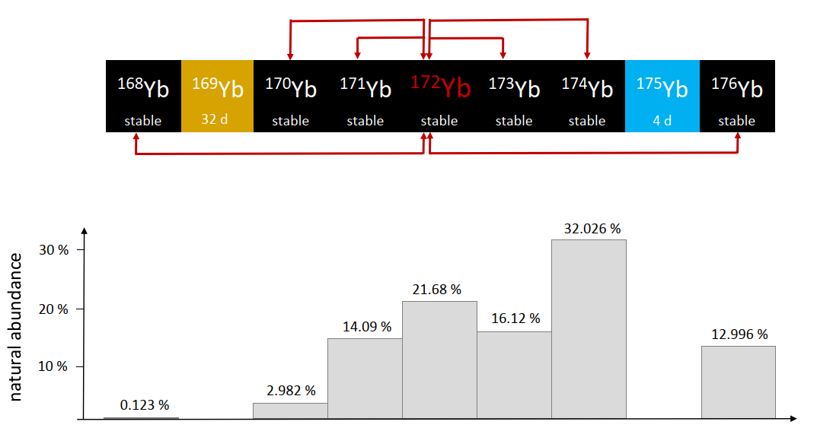
Yb mass-ratio measurements
Motivation: 5th force search using King-plot analysis in Ca, Sr, Yb
Mass-ratio uncertainties of 10⁻¹¹ and below required!
All even-even mass ratios measured. ☺
Relative mass uncertainty: ~4·10⁻¹², improvement factor: typically >50

Slide 17
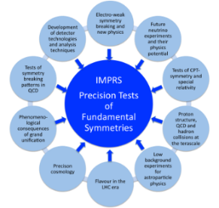


Summary
Precision Penning-trap mass spectrometry
has reached an amazing precision
even on exotic systems and has opened up
many new fields of research!
Max Planck Society
IMPRS-PTFS
IMPRS-QD
ERC AdG 832848 - FunI
DFG

Slide 18

Thanks …
to all my Division members and
you for the invitation and your attention!

Slide 19
Spare slides

Slide 20
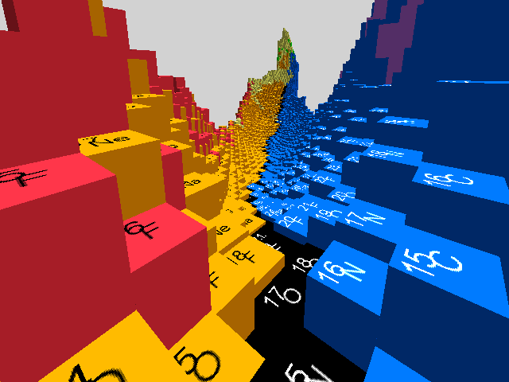
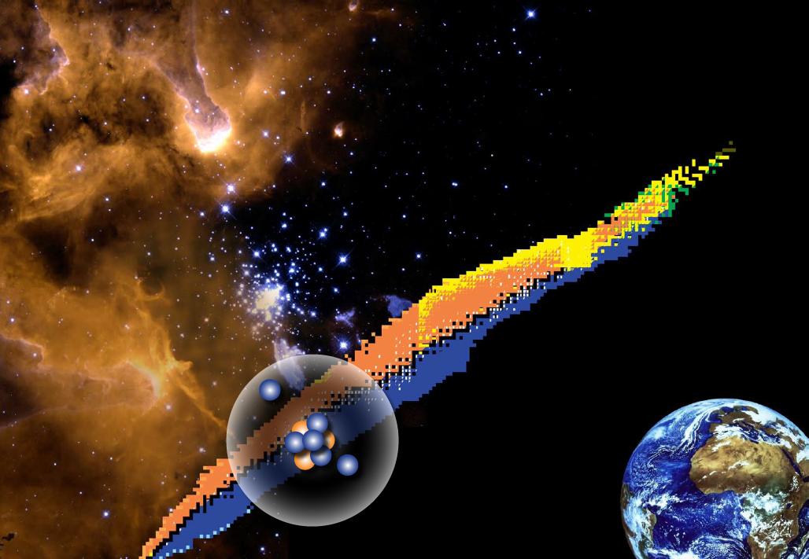
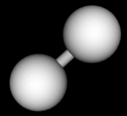
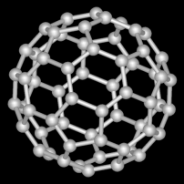


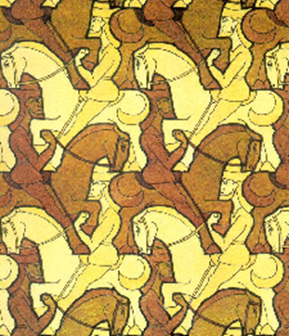


Motivation – Fields of applications
Test of nuclear mass models
and nuclear structure studies
Astrophysics, neutrino physics
and atomic binding energies
H₂
fundamental interactions, symmetries
and fundamental constants
C₆₀
particle
antiparticle
P
C
T
Adapted from H. Wilschut

Slide 21
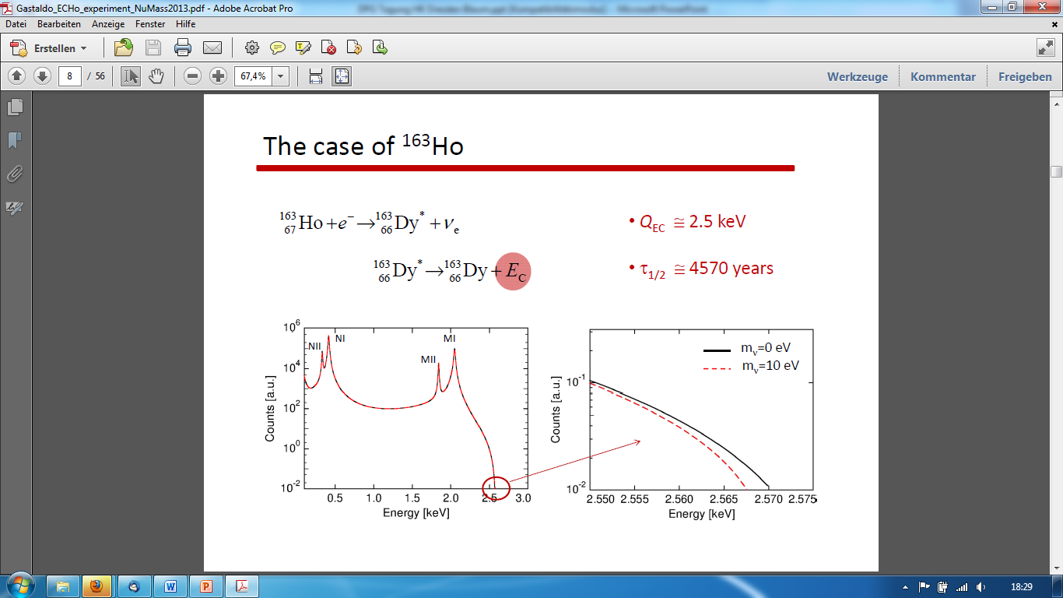
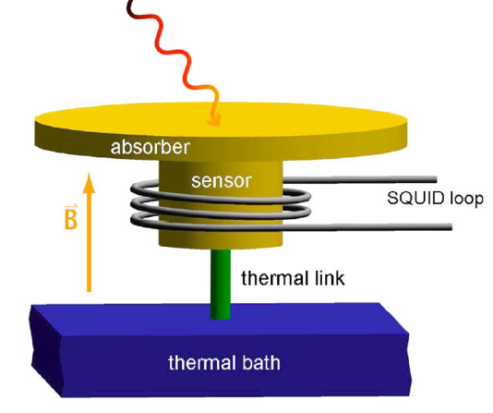

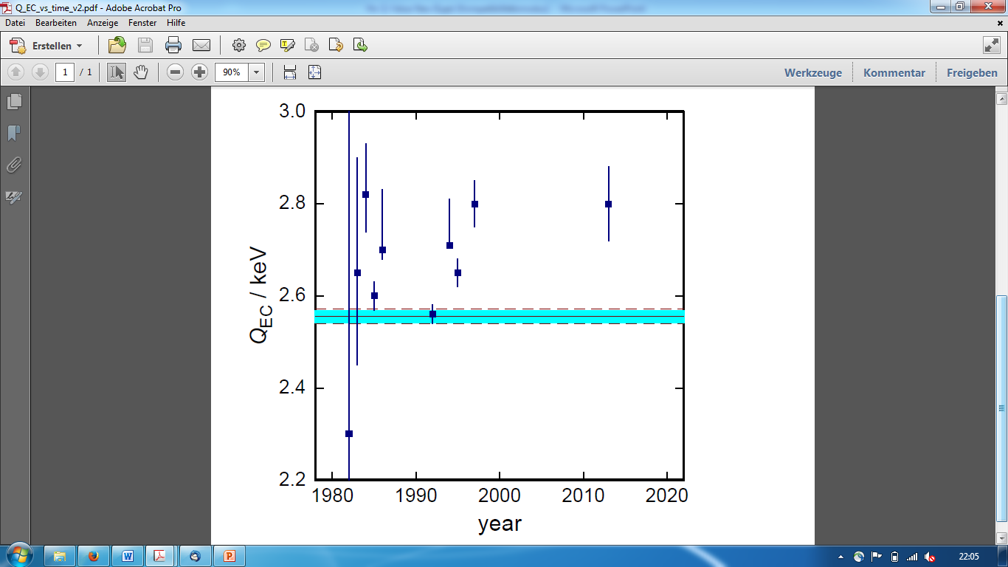

The ECHo (¹⁶³Ho) project
Metallic Magnetic Calorimetry
Q-value of EC in ¹⁶³Ho
ECHo-Collaboration:
Loredana Gastaldo
Christian Enss
δQ=0.6 eV
∙
Q-value with
δQ<3 eV
Status in 2014
S. Eliseev et al., PRL 115 (2015) 062501
P. Ranitzsch et al., PRL 119 (2017) 122501
Notes:
N-rich

Slide 22
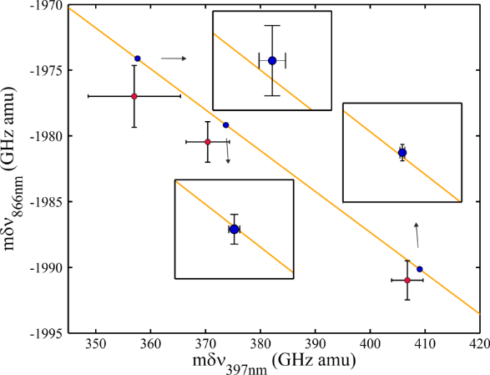
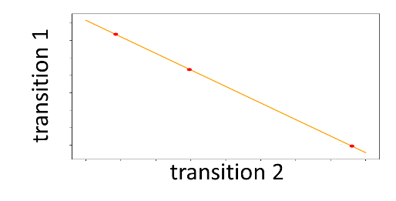
Probe for new force carriers
Isotope shift spectroscopy: 5th force?
$δν_{i}^{A,A^{′}}=F_{i}δ{〈r_{}^{2}〉}_{A,A′}+k_{i}\frac{A−A′}{AA′}$
use 2 transitions $i,j$
➔ eliminate $δ{〈r_{}^{2}〉}_{A,A′}$
new force mediated through scalar field with mass $m_{φ}→X_{i}$
coupling to neutrons: $y_{n}$
coupling to electrons: $y_{e}$
nonlinearity in King’s plot:
$$δν_{i}^{A,A^{′}}=F_{i}δ{〈r_{}^{2}〉}_{A,A′}+k_{i}\frac{A−A′}{AA′}+$$
+$α_{NP}X_{i}(A−A^{′})$
High-precision atomic and nuclear
spectroscopy measurements needed!
Berengut et al., PRL 120, 091801 (2018); Ozeri et al. (2020)

Slide 23
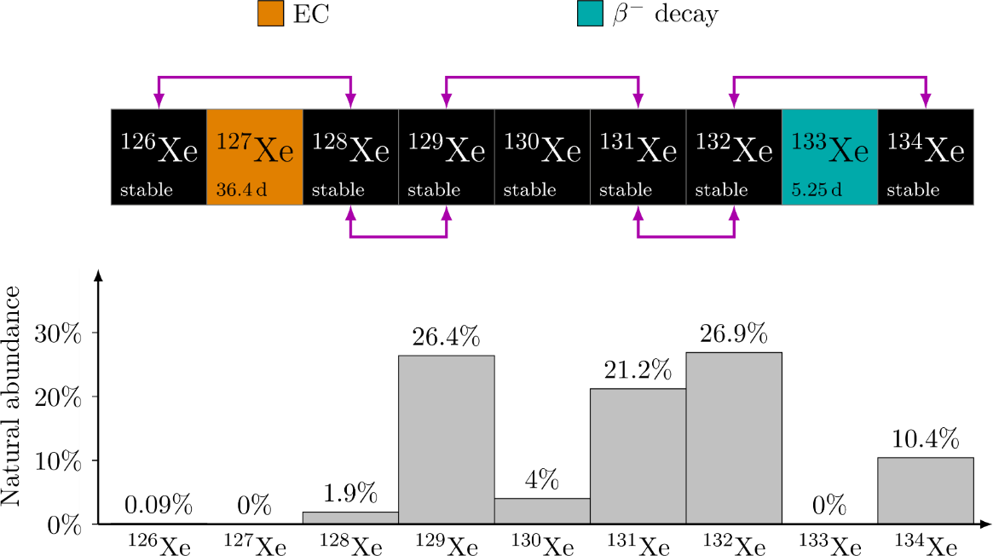
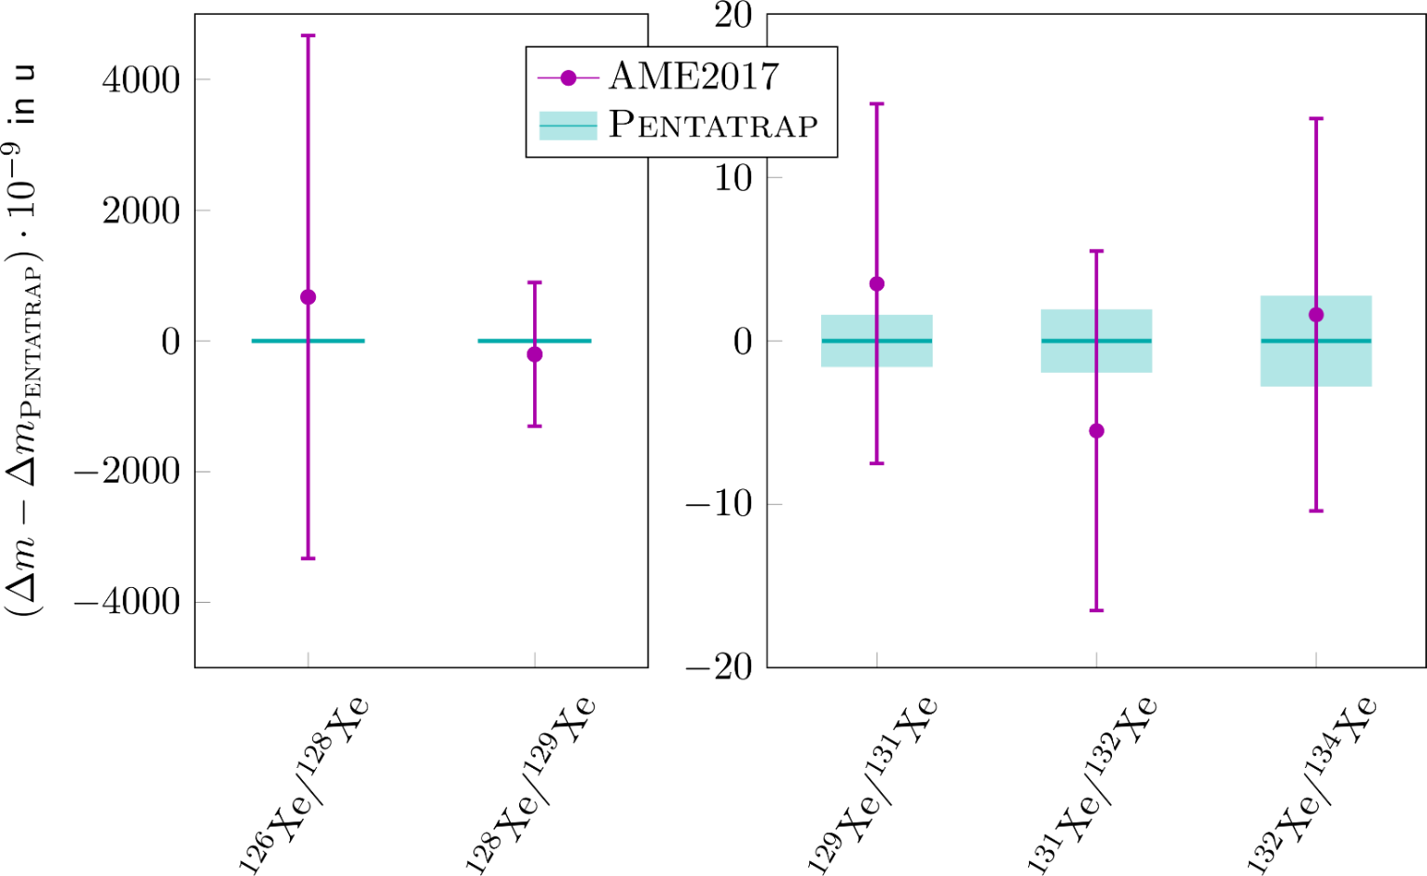
Xe mass-ratio measurements
Motivation: 5th force search using King-plot analysis in Ca, Sr, Yb
Mass-ratio uncertainties of 10⁻¹¹ and below required!
Rischka et al., PRL 124, 111301 (2020)
Improvement factor: 1700 740 7 6 4

