Slide 1

UTC(k) steered by intermittent operation of an optical clock
Tetsuya Ido
H. Hachisu, N. Nemitz, H. Ito, N. Ohtsubo, Y. Miyauchi, M. Morikawa,
M. Tonnes, T. Gotoh, Y. Hanado, K. Matsubara
Space-Time Standards Laboratory,
National Institute of Information and Communications Technology (NICT)

Slide 2
Outline
UTC(k) generation using an optical clock
UTC(k) : real signal generated in laboratory k
Optically steered timescale (1):
Source oscillator + Frequency reference
Optically steered timescale (2):
Source oscillator + MW clock ensemble + Frequency reference
  Optically steered UTC(NICT) for 2 years
Recent improvements
Option 2 in the redefinition of the SI second
Graphical picture of the option 2a and 2b for the redefinition of the SI second

Slide 3
UTC(k) generation using an optical clock

Slide 4
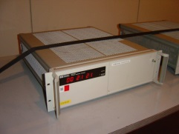
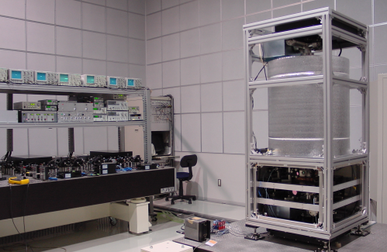
How is UTC maintained?
NICT
institute k
BIPM
H-Maser
EAL
(ensemble)
UTC(k)
>400 clocks
Local Ensemble
adjustment
TAI
International Atomic Time
Cs (or Rb) fountains
18 clocks
PMS
adjustment
adjustment
leap second
Generating a real signal in institute k
UTC
UT1
UTC(NICT)
+ 9h
Generating a paper clock “UTC”
Japan Standard Time (JST)

Slide 5
JST generation
Synthesis
Atomic clocks
18 Cs
3 HM
JST
Time, frequency adjustment
Ｈメーザ
Phase micro stepper
1PPS generation
Ｈメーザ
HM
3 to 1 multiplexer
Source oscillator
-
Cs clock
Paper clocks as ensemble of 18 clocks
+
HM frequency was steered to ensemble of 18 Cs clock

Slide 6

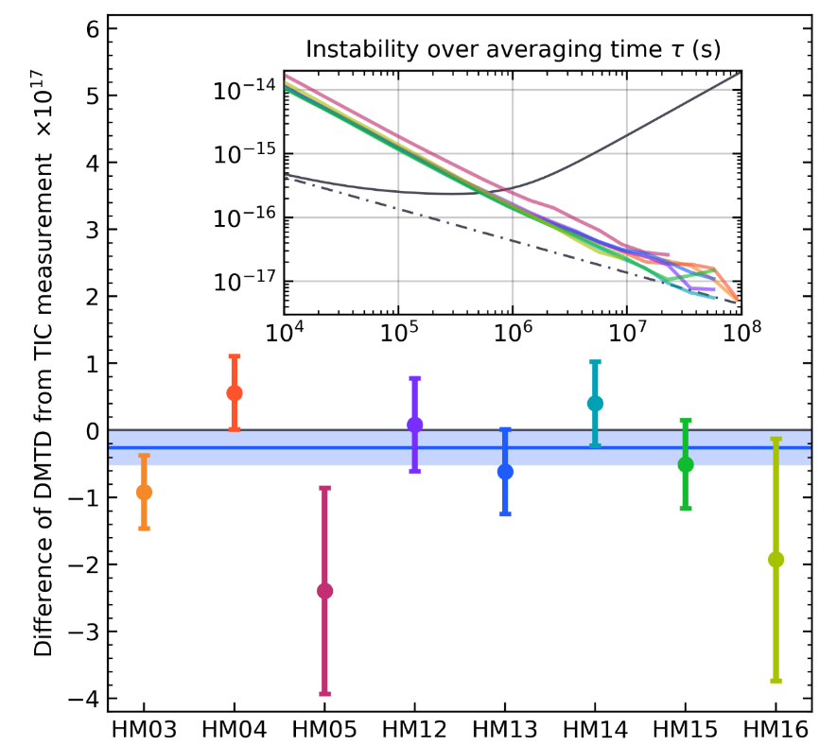
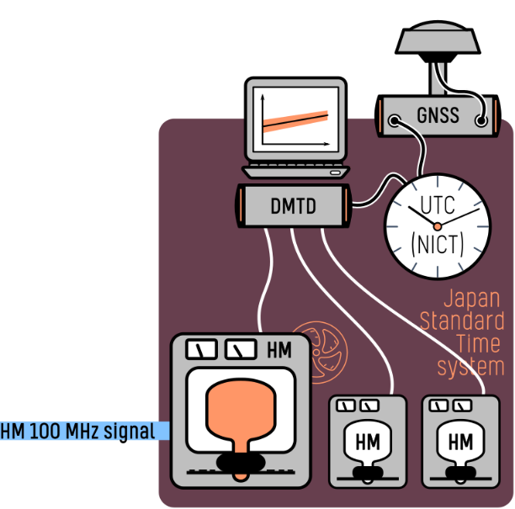
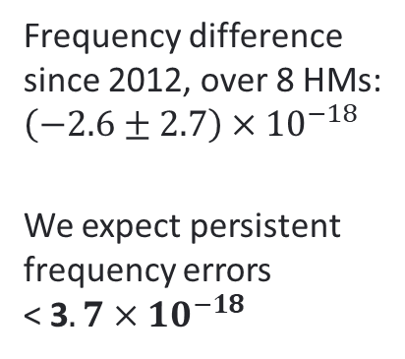
DMTD system performance
Flywheel HM – UTC(NICT)
HM rf signal transfer
comb up-conversion
We similarly examine the performance of the Japan Standard Time system dual-mixer time-difference system.
Constant errors are bounded by comparing DMTD measurement against a time interval counter (TIC).
Agreement of TIC and DMTD
Instability over averaging time τ (s)
HM instability
Frequency difference
since 2012, over 8 HMs:
$\left(−2.6±2.7\right)×{10}^{−18}$
We expect persistent frequency errors
< 3$.7×{10}^{−18}$

Slide 7
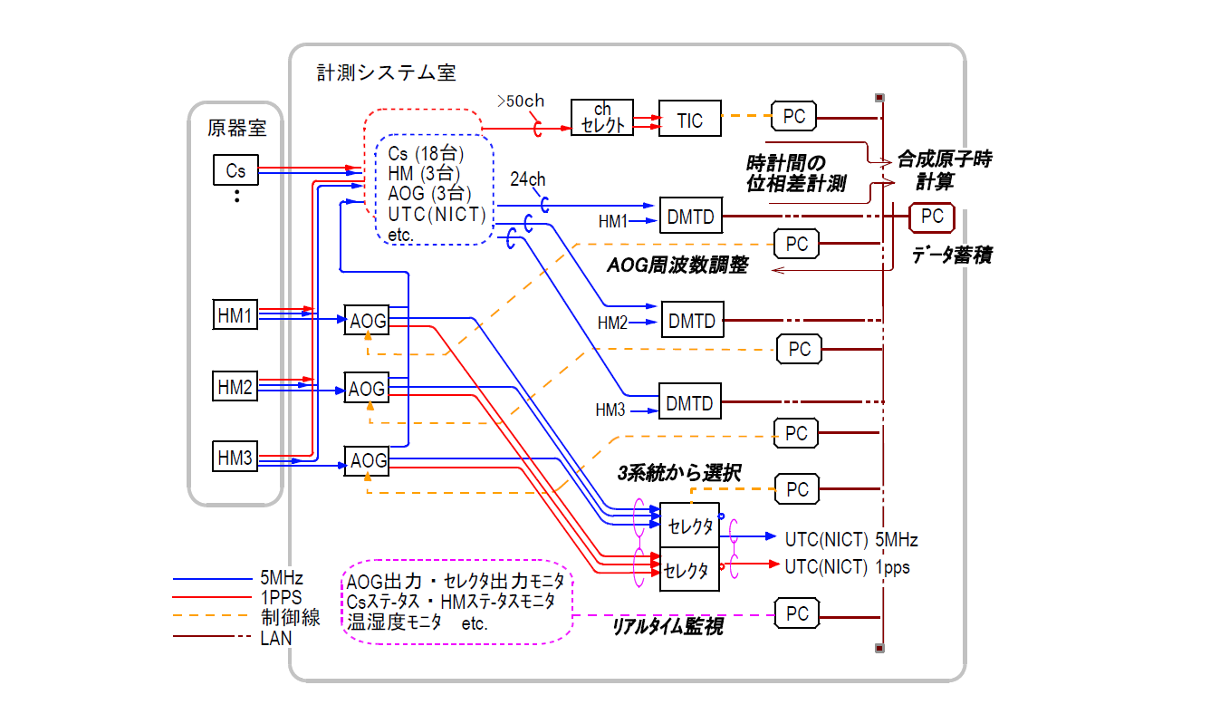
Reliability (Power & Signals)
Measurement, steering, and choosing signals
Atomic
Clocks
Phase difference measurement
between clocks
RTA
calculation
3 signals for redundancy
AOG frequency steering
Data storage
& steering algorithm
Opt one of signals
Manual change of signal selection
Multi
-plexer
5MHz
1PPS
Control
LAN
Multi
-plexer
UPS & Two backup power generators
Status monitor
(Cs, HM, AOG, multiplexer, room temp. humidity)
Real-time monitoring

Slide 8
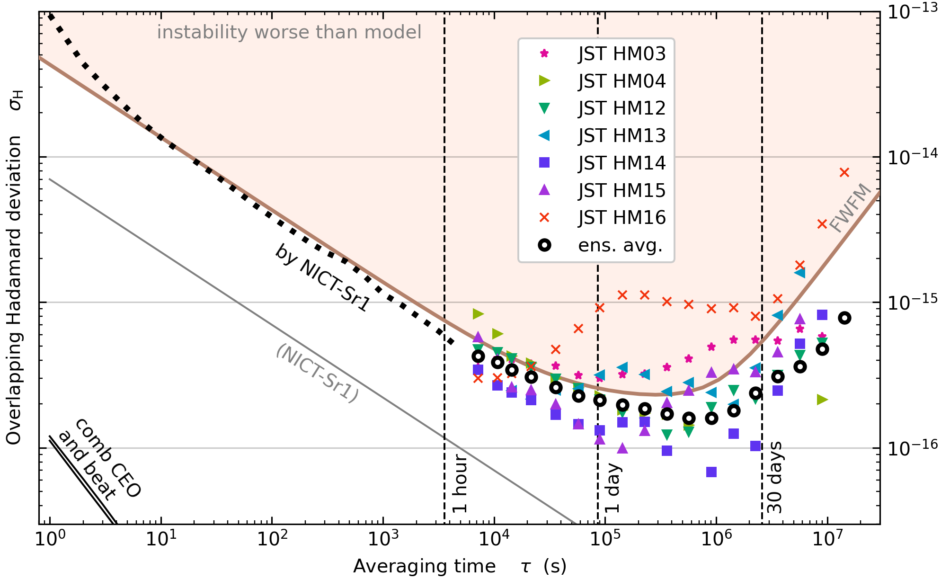
Hydrogen masers at NICT
NICT operates multiple HMs that has Hadamard deviations at the 10⁻¹⁶ level.
Mid 10⁻¹⁶ level of Hadamard deviation extends to 10 days or more.
Mote than half of HMs reach less than 2×10⁻¹⁶ at the bottom.

Slide 9
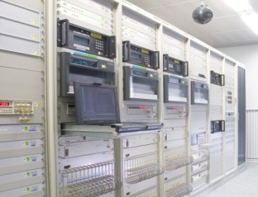
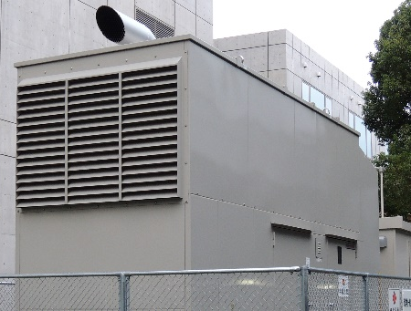
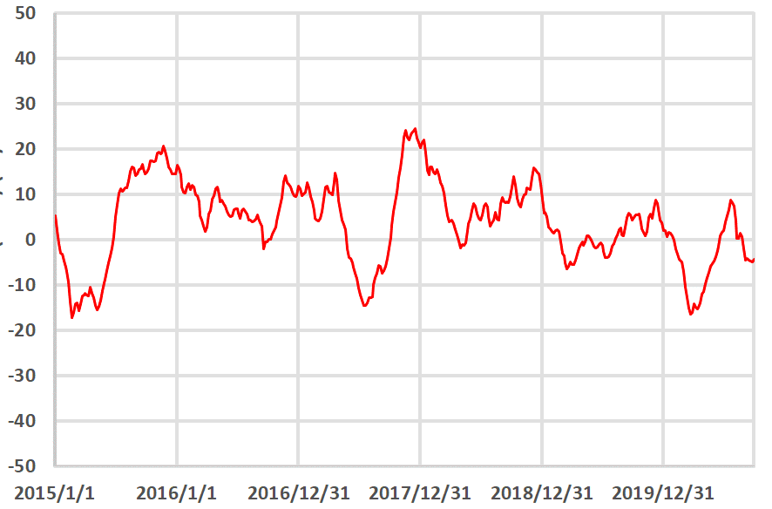
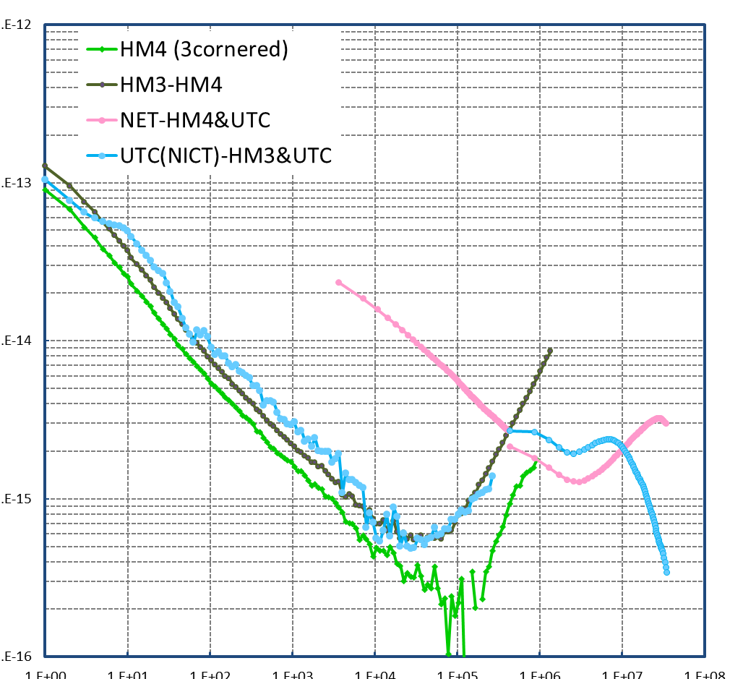
Japan Standard Time before 2020
Timescale generation
JST system
backup generator
One hydrogen maser is source oscillator for UTC(NICT)
Two more masers serve as backup.
An ensemble of 18 cesium 5071A clocks steers the timescale.
Behavior of UTC(NICT)
The deviation from UTC is typically less than 20 ns.
Instability is 2×10⁻¹⁵ over 10 to 30 days.
Allan deviation
10⁻¹²
10⁻¹³
10⁻¹⁴
10⁻¹⁵
10⁻¹⁶
20 ns
NICT Cs ensemble
20 ns
timescale
UTC – UTC(NICT) [ns]
HM3-HM4
UTC(NICT)-HM3
Source oscillator HM4
(3-corner hat)
10⁰ 10¹ 10² 10³ 10⁴ 10⁵ 10⁶ 10⁷ 10⁸
Date
Averaging time [s]
5 years
UTC(NICT) = HM4+AOG

Slide 10
Optically steered timescale in 2016:
Source oscillator + Frequency reference
10⁴ s measurement
Source osc.
(HM)
Phase micro stepper (PMS)
TA(Sr)
f(HM)
based on Sr
1×10⁻¹³
TA(Sr): Frequency and drift rate of HM signal is adjusted with reference to Sr
Adjustment of PMS offset frequency every 4 hours
No servo to reduce the time offset UTC ─ TA(Sr)
6 months

Slide 11
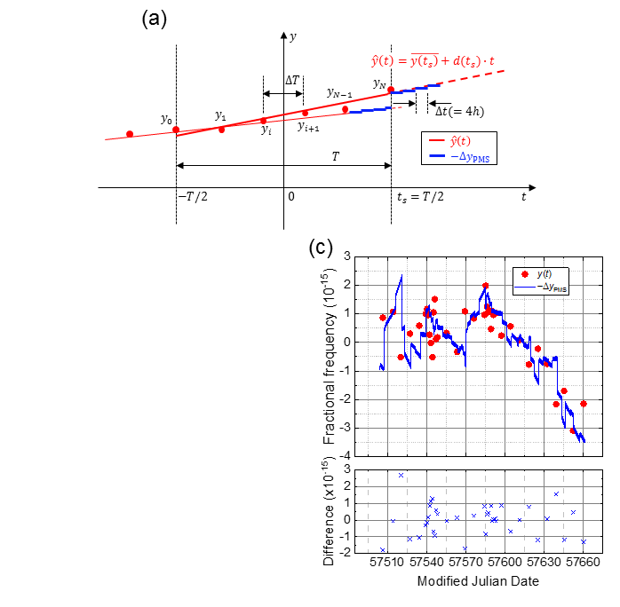
Steering
Interval for the drift estimation: T=25days
Number of Optical frequency standard (OFS) operation in T : N+1 >4
(once per week or more frequently)
One HM free evolution time: ΔT = T/N

Slide 12
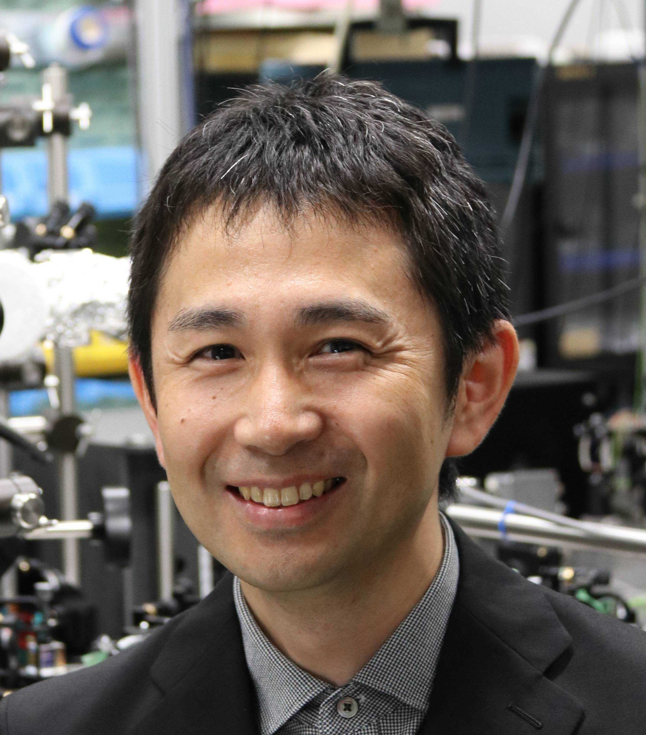
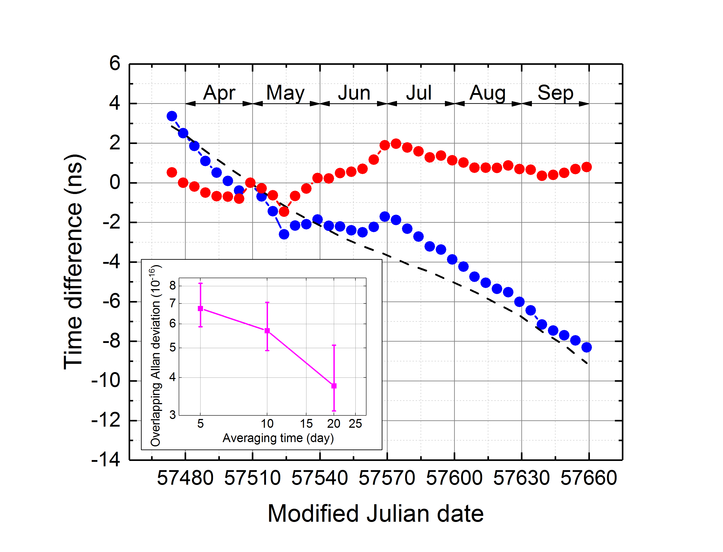
Comparison against UTC & TT(BIPM16)
the frequency offset of UTC is clearly identified.
Phase difference against TT(BIPM16)
< 1ns after 5months
Stability 4e-16 @ 20 days
H. Hachisu
TA(Sr)-TT(BIPM16)
TA(Sr)-UTC
TT(BIPM16)-UTC
H. Hachisu et al., Sci. Rep. 8, 4243 (2018)

Slide 13
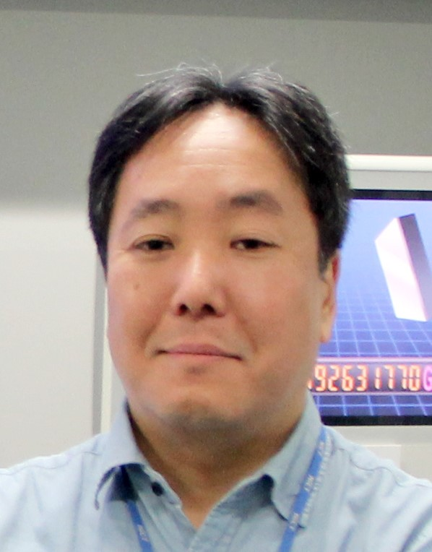
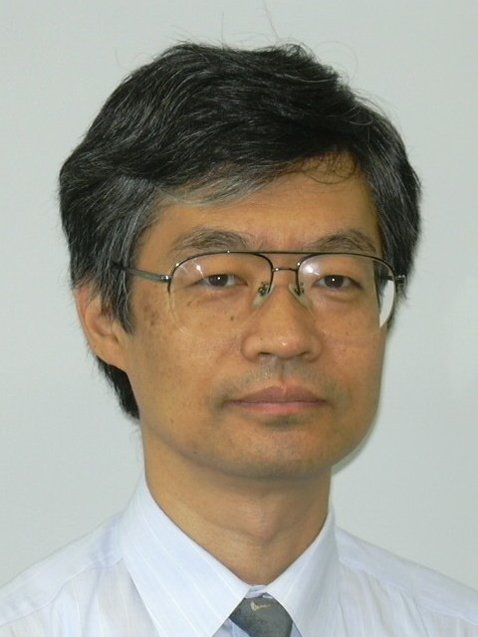
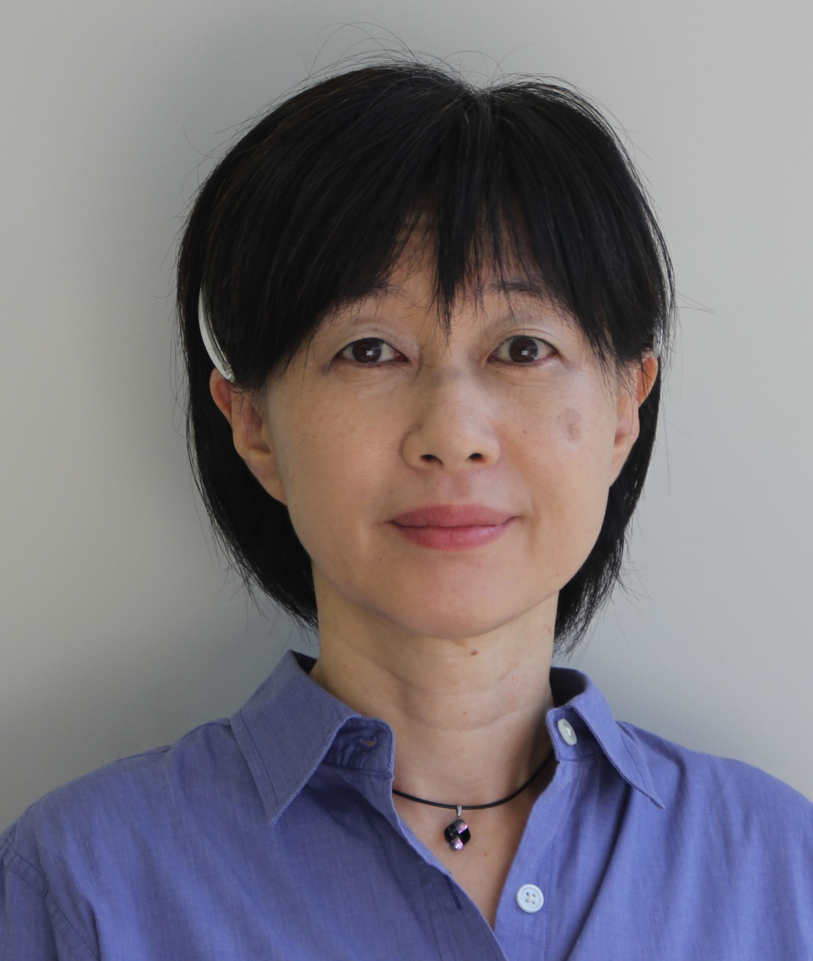

Upgrade of UTC(NICT) in 2021
2006
JST system built in 2006 with rich redundancies for reliability.
  Three independent HMs signals are steered to ensemble clocks made of 18 Cs
  3 DMTD & 1 TIC for reliable measurement of clock phase differences
F. Nakagawa
K. Imamura
Y. Hanado
2016
Test operation of a Sr-steered timescale (1HM + Sr) showed great potential in accuracy.
2020
Reliability of Opt.-> MW conversion improved. Monitor, control, and evaluation have become systematic. Redundancy in various parts established.
→ Reliable operation of a Sr lattice clock once per week now feasible.
H. Hachisu
N. Nemitz
2021 ─ UTC(NICT) is finally steered by NICT-Sr1

Slide 14
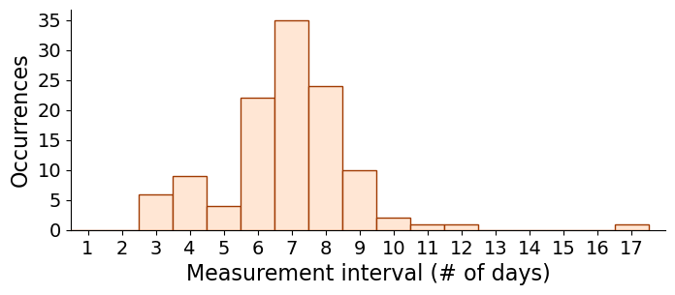
Strategy
Operations once per week or more has continued since September 2021, and is still ongoing.
To keep the benefit of reliability in legacy system…
  Keep the steering of 3 HM signals to Cs ensemble
  →Occasional adjustment of the parameter of frequency offset with respect to Cs ensemble timescale
  To keep the intermittent operation of the strontium lattice clock (once per week)
    →Leaves four (or more) working days for any necessary. Reduced operation time to extend the durability
120 operations
Measurement Interval
mostly ≤ 1 week for 2 years

Slide 15
Recipe of steering
Frequency adjustment of UTC(NICT) twice per week to remove y(UTC(NICT)-TA(Sr)) in the one past day
The instability of Cs ensemble often requires >3e-15 adjustment
Time difference ΔT=UTC(NICT)-TA(Sr) gradually removed by additional fractional frequency adjustment of
ΔT/(60 days)

Slide 16
Steering using optical clocks: before & after
Measurement Interval
mostly ≤ 1 week for 2 years
Standard deviation: 8.5ns
2 years
Standard deviation: 2.3ns
Incorporation of Sr reduced the fluctuation to 1/4.
The magnitude of the reduced fluctuation reflects the stability of mean timescale composed of commercial Cs clocks
(Poster No. 110)

Slide 17
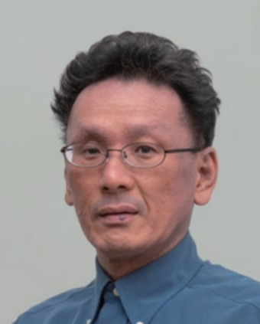
Incorporation of HMs to TA
HMs have been used only as source oscillators.
But predictions of the frequency drift in HMs allow us to incorporate HMs to the ensemble clocks.
BIPM did similar improvement in early 2010s*. EAL incorporate the 2nd-order term (frequency drift) of atomic clocks
  → Cs clocks have lost the weight, but HM gained the weight
  Similar strategy possible by adding HMs to ensemble clocks as well as changing the dedrifting process in mean free time scale.
H. Ito
Note that NICT prefers to depend on our own clocks as much as possible for resilience against the GNSS non-availability
*G. Panfilo, et al., Metrologia 49, 49 (2012)
G. Panfilo et al., Metrologia 51, 285 (2014)

Slide 18

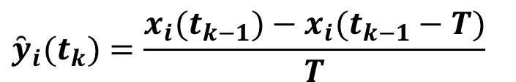
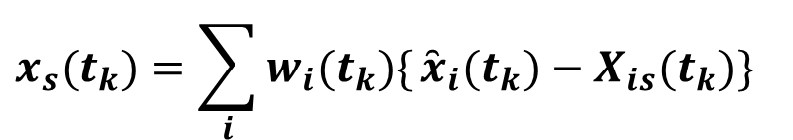
Actual calculation (an example)
Detrend term
y (rate) and w (weight) define $TA$’s character
$${\overset{̑}{x}}_{i}(t_{k})=x_{i}(t_{k−1})+{\overset{̑}{y}}_{i}(t_{k})⋅(t_{k}−t_{k−1})$$
Clock rate
…(8)
$${\overset{̑}{y}}_{i}(t_{k})=\frac{x_{i}(t_{k−1})−x_{i}(t_{k−1}−T)}{T}$$
$$x_{s}(t_{k})=\sum_{i}{w_{i}(t_{k})\{}{\overset{̑}{x}}_{i}(t_{k})−X_{is}(t_{k})\}$$
…(6)
$$x_{i}(t_{k})=x_{s}(t_{k})+X_{is}(t_{k})$$
…(9)
Linear prediction
based on the past duration T
with respect to TA itself
Could be self divergent
:Measured :Predicted :Output
:Calculated from x_{i}
Suited method and value for the purpose are important.
From Y. Hanado, IFCS-EFTF 2023 tutorial (2023)

Slide 19
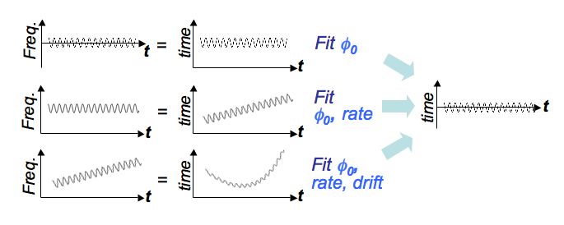
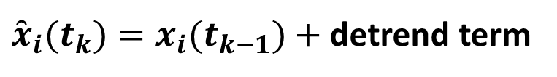
Actual calculation (an example)
Variation of de-trending
The optimal way to detrend depends on the clock’s behavior.
${\overset{̑}{x}}_{i}(t_{k})=x_{i}(t_{k−1})+$ detrend term
…(8)
(A)
No trend
Cs clocks
(B)
Linear fit
H-maser
(C)
Quadratic fit
From Y. Hanado, IFCS-EFTF 2023 tutorial (2023)

Slide 20
Consideration for independent timescale UTC(k)
Reference for detrending
  BIPM uses not EAL itself, but TT(BIPM) as the prediction reference
  Local source is ideal for UTC(k), considering the resiliency
  Independent signal, TA(Sr)? Or the ensemble timescale itself?
  Weighting
    Allan deviation → Hadamard deviation
 | BIPM (-2011) | BIPM (2011-) | UTC(NICT) (-2022) | UTC(NICT) (2023-)
Detrend (in phase) | linear | quadratic | linear | quadratic
Reference for prediction | EAL | TT | RTA | RTA@NICT
weight | Allan variance | predictability | Allan deviation | Hadamard deviation

Slide 21
We need to provide (or adjust) three parameters.
Phase offset, frequency offset, frequency drift offset
Algorithm to incorporate Sr data will be explored.
Similar level of stability with TA(Sr) up to one month
→ Steering using Circular T becomes an option

Slide 22
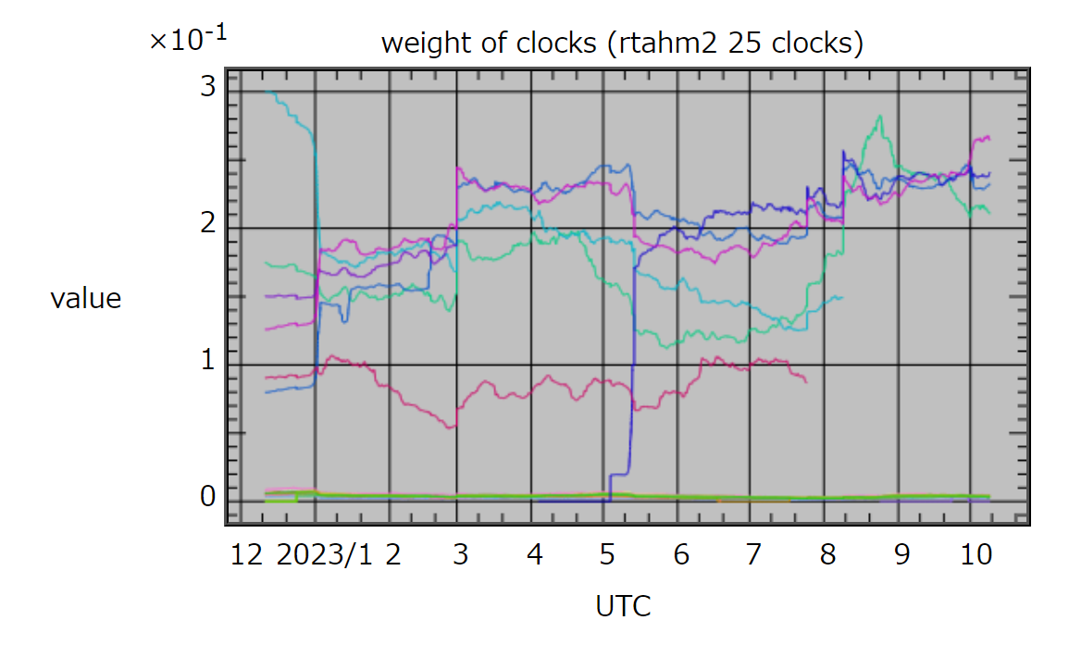
Improvement after quadratic detrending
(with Sr steering)
4 or 5 stable HM has weight in similar level.

Slide 23
Next step & outlook
Optimization of TA(HM)
  Reference for dedrifting
  weight
Adjusting three parameters (phase, frequency, frequency drift) based on intermittent operation of the optical clock and Circular T for phase alignment
  Kalman filter which can manage both frequency and phase data?
  Second or possibly commercial lattice clocks
  Redundancy for public service could be achieved by commercial system
  (For instance, Poster No. 82 by Shimadzu)
(Poster No. 112)

Slide 24
Graphical picture of the option 1, 2a and 2b in the redefinition of the SI second

Slide 25
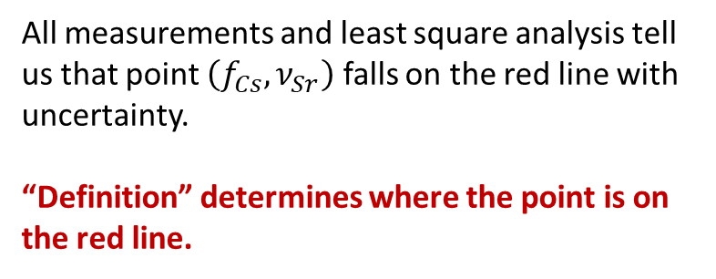

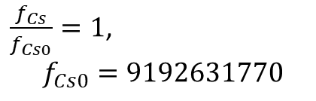
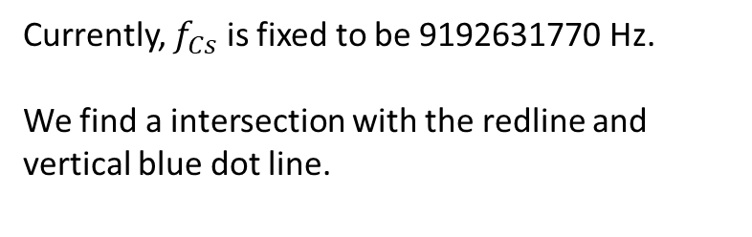
Choosing multiple transitions as primary transitions?
Constraint
by definition ( = definition line)
All measurements and least square analysis tell us that point $\left(f_{Cs},ν_{Sr}\right)$ falls on the red line with uncertainty.
“Definition” determines where the point is on the red line.
Current situation
ν_{Sr} /Hz
Constraint by LSA
(least square analysis)
$$ν_{Sr0}$$
u_{Sr}
$\frac{f_{Cs}}{f_{Cs0}}=1$,
$$f_{Cs0}=9192631770$$
Currently, $f_{Cs}$ is fixed to be 9192631770 Hz.
We find a intersection with the redline and vertical blue dot line.
9 192 631 770
f_{Cs} /Hz
The definition is an ARTIFICIAL constraint to determine values.
This constraint does not need to be vertical line, as long as it provides intersection with the red (LSA) line.

Slide 26


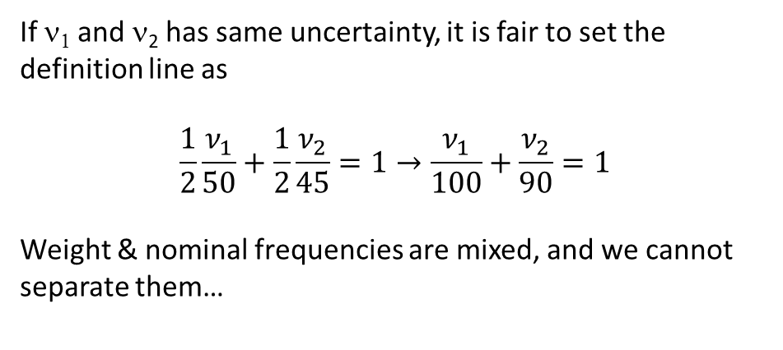

Further simplified picture
Option 1 (ν₁=50)
$\frac{ν_{2}}{ν_{1}}=45/50$=0.9(1)
Option 1:
Definition LINE : ν₁=50
→Uncertainty only occurs in ν_{2,} ν_{3, …}
(uncertainty of the ratio 0.1)
Another possibility: using arithmetic mean of two transitions
$$\frac{ν_{1}}{50}+\frac{ν_{2}}{45}=2$$
Definition LINE:
$$K\frac{ν_{1}}{50}+\left(1−K\right)\frac{ν_{2}}{45}=1$$
（1）
If ν₁ and ν₂ has same uncertainty, it is fair to set the definition line as
$$\frac{1}{2}\frac{ν_{1}}{50}+\frac{1}{2}\frac{ν_{2}}{45}=1→\frac{ν_{1}}{100}+\frac{ν_{2}}{90}=1$$
Weight & nominal frequencies are mixed, and we cannot separate them…
（note that $K=1$ →$ν_{1}=50 (i.e.$Definition1))

Slide 27
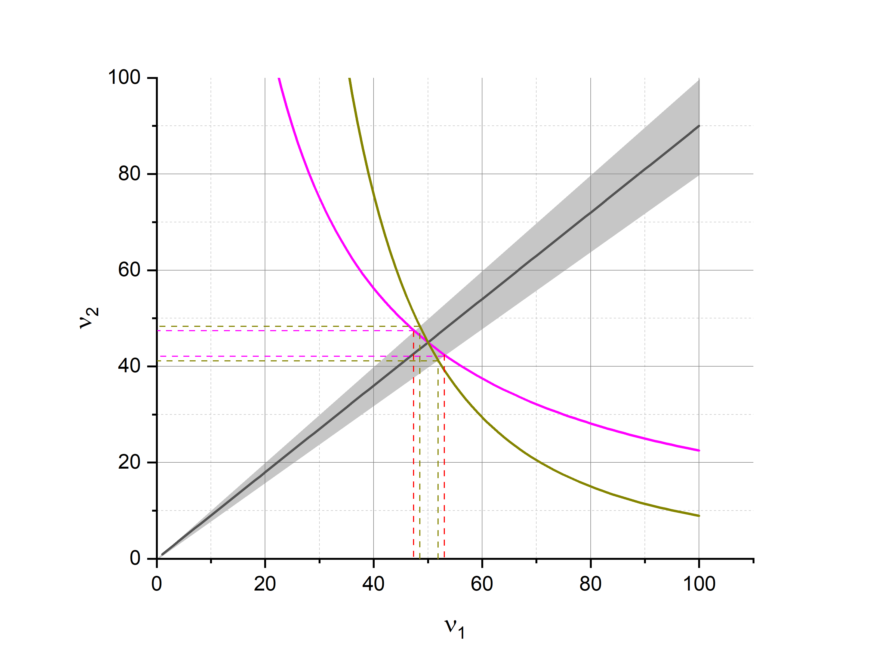

Definition line can also be a curve.
Indeed, curves that “Geometric mean = constant” is curve
$$ν_{1}^{k}ν_{2}^{1−k}={50}^{k}{45}^{1−k}\left(=N\right)$$
This formula holds weights and nominal frequencies separately !
k=0.5
k=0.6
If weight is inversely proportional to the square of uncertainty, the projection of the confidence band to each axis determines the uncertainty of each transition frequency.
Revision process
New experiments shift black line and confidence band.
Option 2.a: the definition curve is not renewed.
(point stays on the original curve)
Option 2.b: the definition curve is renewed after (possibly choosing transitions), fix the intersection point, and finally setting weights

Slide 28
Summary
Intermittent operation of an optical clock (once in a week) realized an optically steered timescale for two years.
Ensemble of HMs with quadratic de-drifting has good stability. We need a recipe to determine the offset parematers in phase, frequency, and frequency drift.
Option 2 in the redefinition of the SI second does not bring you to a totally different regime. Option 1 could have been just a special case of option 2.

Slide 29
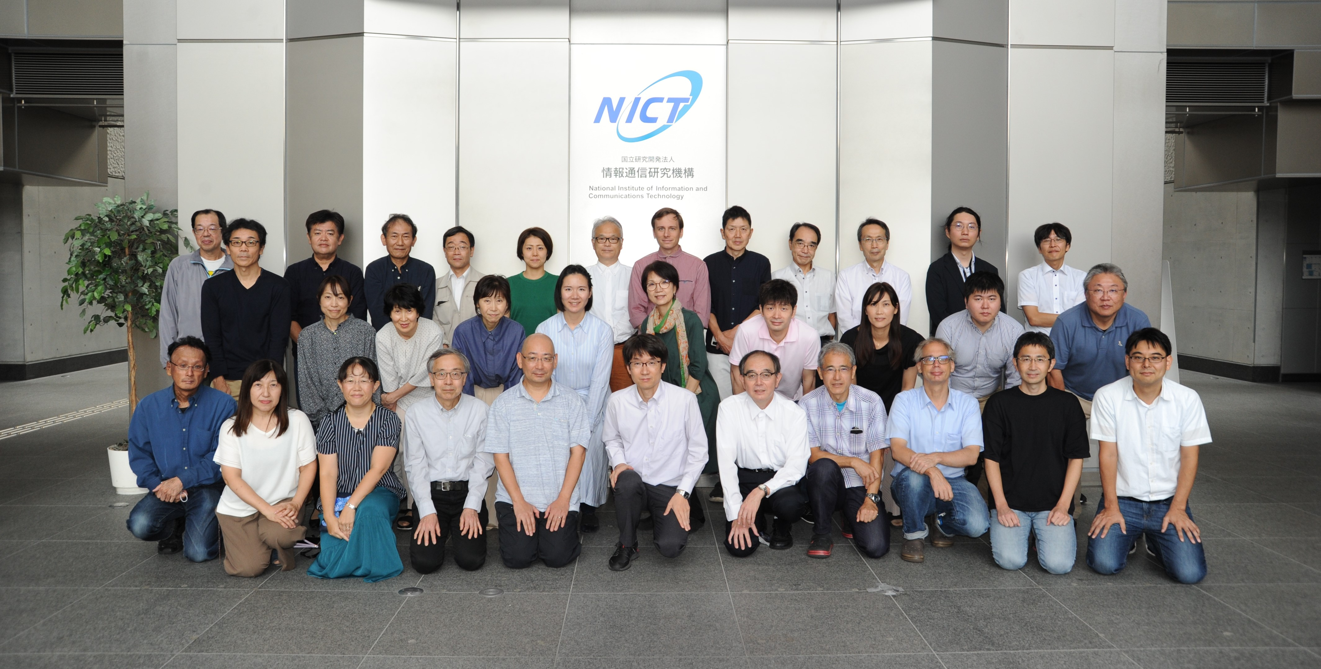
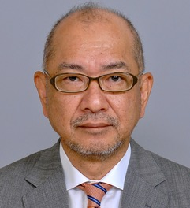
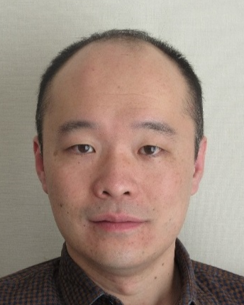
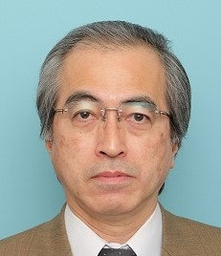
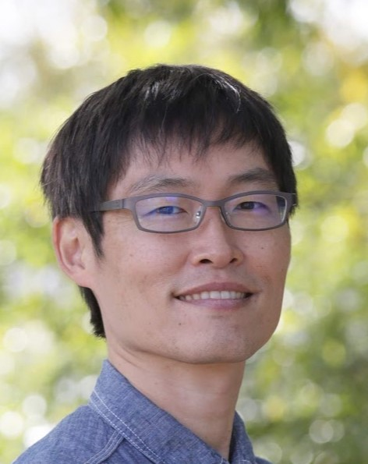
Teams
Members of the space-time standards laboratory, including those for telecom-related T&F research, public service, and technical & administrative support

Slide 30
In the audience
Lattice clock
M. Tonnes
N. Nemitz
H. Hachisu
T&F comparison
T. Gotoh
Y. Kozuki
R. Ichikawa
H. Ito
K. Matsubara
N. Ohtsubo
Y. Miyauchi
M. Morikawa
Generation of Japan Standard Time

