Slide 1
Next Generation Chip-Scale Atomic Clocks
John Kitching
Time and Frequency Division
National Institute of Standards and Technology
Boulder, CO USA

Slide 2
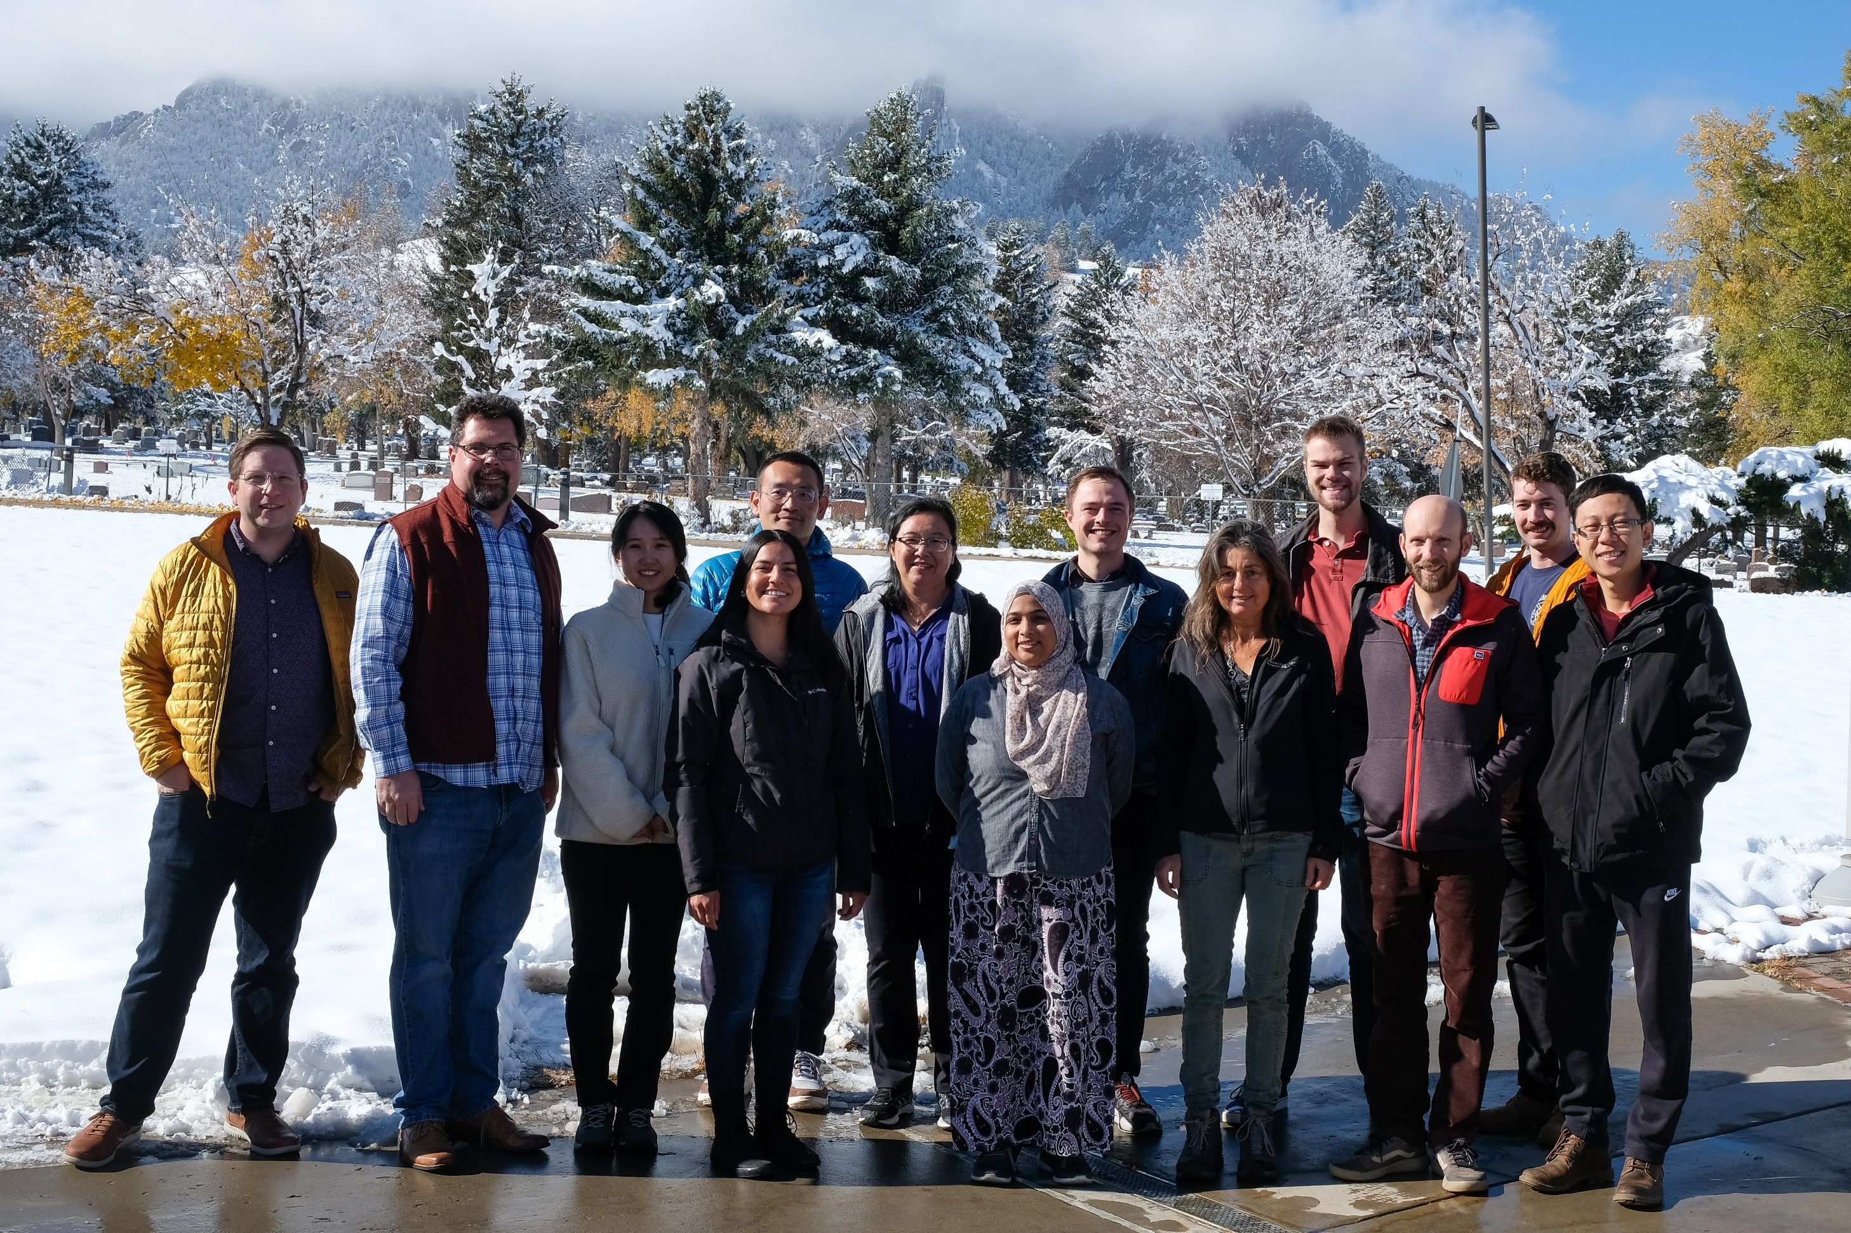
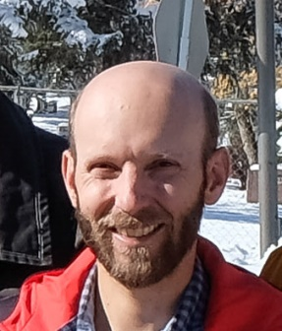
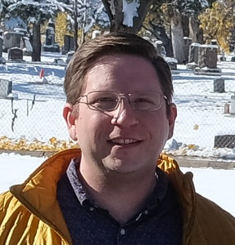
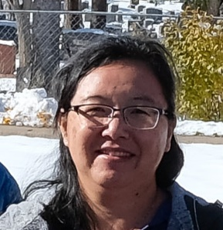
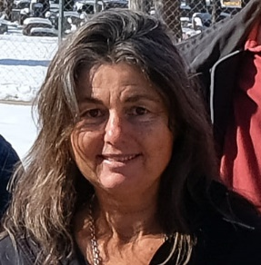
Atomic Devices and Instrumentation Group
Matt Hummon
Rb 2-hv clock
Sr vapor cells
Vapor cell cQED
Yorick Andeweg
Isaac Fan
Alex Staron
Peter Riley
William McGehee
Seji Kang
Gaby Martinez
Safra Niyaz
Yang Li
Atom interferometer
Chip-scale beam clock
Ying-Ju Wang
Atomic magnetometers
Rydberg sensors
Susan Schima
Silicon fab
Process development
2
Post-doc positions available!

Slide 3
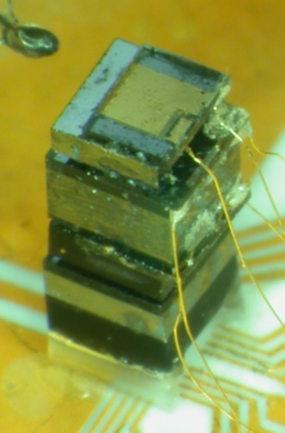
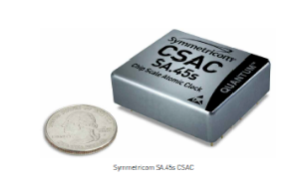
Chip-Scale Atomic Clocks
Precision spectroscopy + MEMS + photonics
Holds 100 μs over 1 day on 120 mW
  1 μs with environmental control
Commercial product – 2011
  120,000 sold as of 2020, > $100M in economic impact
30 X
J. Kitching, Applied Physics Reviews 5, 031302 (2018).
From Microsemi CSAC Datasheet

Slide 4
Chip-Scale Atomic Clocks
Precision spectroscopy + MEMS + photonics
Holds 100 μs over 1 day on 120 mW
  1 μs with environmental control
Commercial product – 2011
  120,000 sold as of 2020, > $100M in economic impact
US Army BAA, 2020
J. Kitching, Applied Physics Reviews 5, 031302 (2018).
From Microsemi CSAC Datasheet

Slide 5


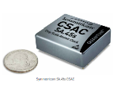
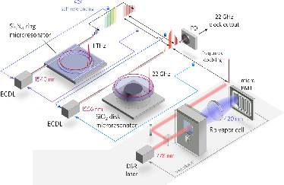
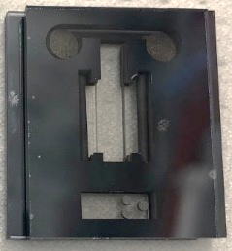
Chip-Scale Atomic Clocks
DARPA/NIST: V ~ 1 cm³, P ~ 30 mW, Δf/f ~ 10⁻¹¹ @ 1 hr
Chip-scale magnetometers
DARPA IMPACT (laser cooling)
CSAC workshop (NIST)
European CSAC begins
DARPA CSAC Program
Army MANTECH
NIST on a Chip
DARPA ACES (optical)
Army LC-CSAC
DARPA A-Phi
DARPA H6
Westinghouse/
DARPA
2001|2002|2003|2004|2005|2006|2007|2008|2009|2010|2011|2012|2013|2014|2015|2016|2017|2018|2019|2020|2021|2022|2023
Feasibility
MEMS
Cells
Physics
Packages
Thermal
suspensions
1cc, 30 mW
Instruments
Commercial
CSAC
100,000 CSACs sold
2nd Com. CSAC
Chip-scale optical clocks
Chip-scale beam clocks
VCSELs
NIST
NIST
NIST
Draper Labs
Microsemi
Microsemi
Microsemi
Teledyne
NIST/Draper
NIST/Ga Tech
Government, academia and industry all played a significant role: lots of information exchange
Large (100 X) potential improvement over existing approaches; high-risk, innovative
Early wins: MEMS cell demonstration 1 year after program start, physics package 1.5 years
Substantial, sustained funding (~ $100M over 10 years)
Multidisciplinary teams
Simple, manufacturable technical approach: VW Beetle, not Ferrari
5

Slide 6
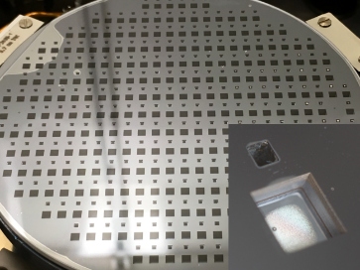
Portable Atomic Clocks
Next Generation CSACs
Better long-term stability
Beam microwave clocks
Overall better stability
Optical clocks, but at cost of needing a frequency comb
Lower cost
Wafer-level fabrication processes
D. G. Bopp et al., J. Phys: Photonics 3, 015002 (2020).

Slide 7
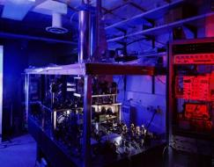
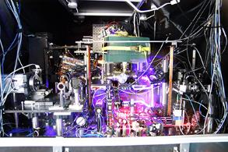
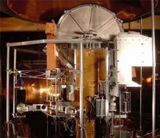
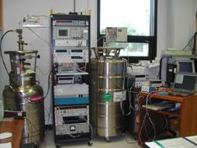
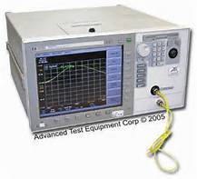
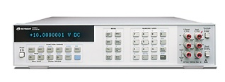
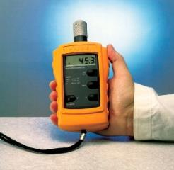
NIST on a Chip
Measurement standards in chip format
Embedded, SI-traceable calibration built into instruments
Goals: flexible, useful, manufacturable, deployable
Get rid of the middle-man (us!)
Temp
Time [s]
Current [A]
Force
Length [m]
Volt [V]
Temp [K]
Force [N]
J. Kitching, et al., Journal of Physics: Conference Series 723: 012056 (2016).

Slide 8
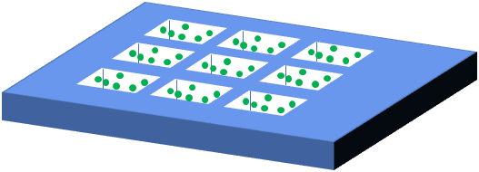
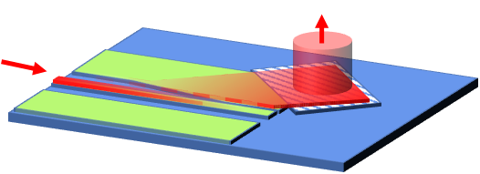
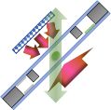
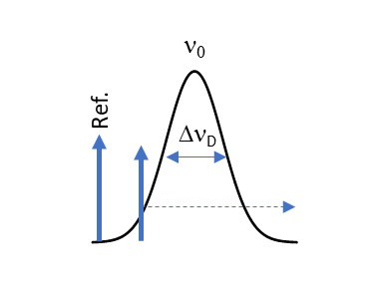
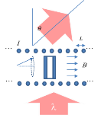
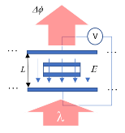
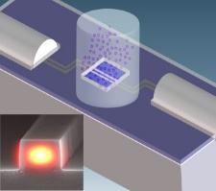
Integrated Photonics for Quantum Sensing
Matt Hummon
Temp
Atomic Cell Layer:
Quantum Standard
Time [s]
Current [A]
Force
Length [m]
Volt [V]
Temp [K]
Force [N]
Laser/Photonics
Layer
Time Length Temperature Current Voltage
5 base SI units!
Stability ~ 10⁻¹¹ @ 1 hour
Accuracy ~ 10⁻⁹
8

Slide 9
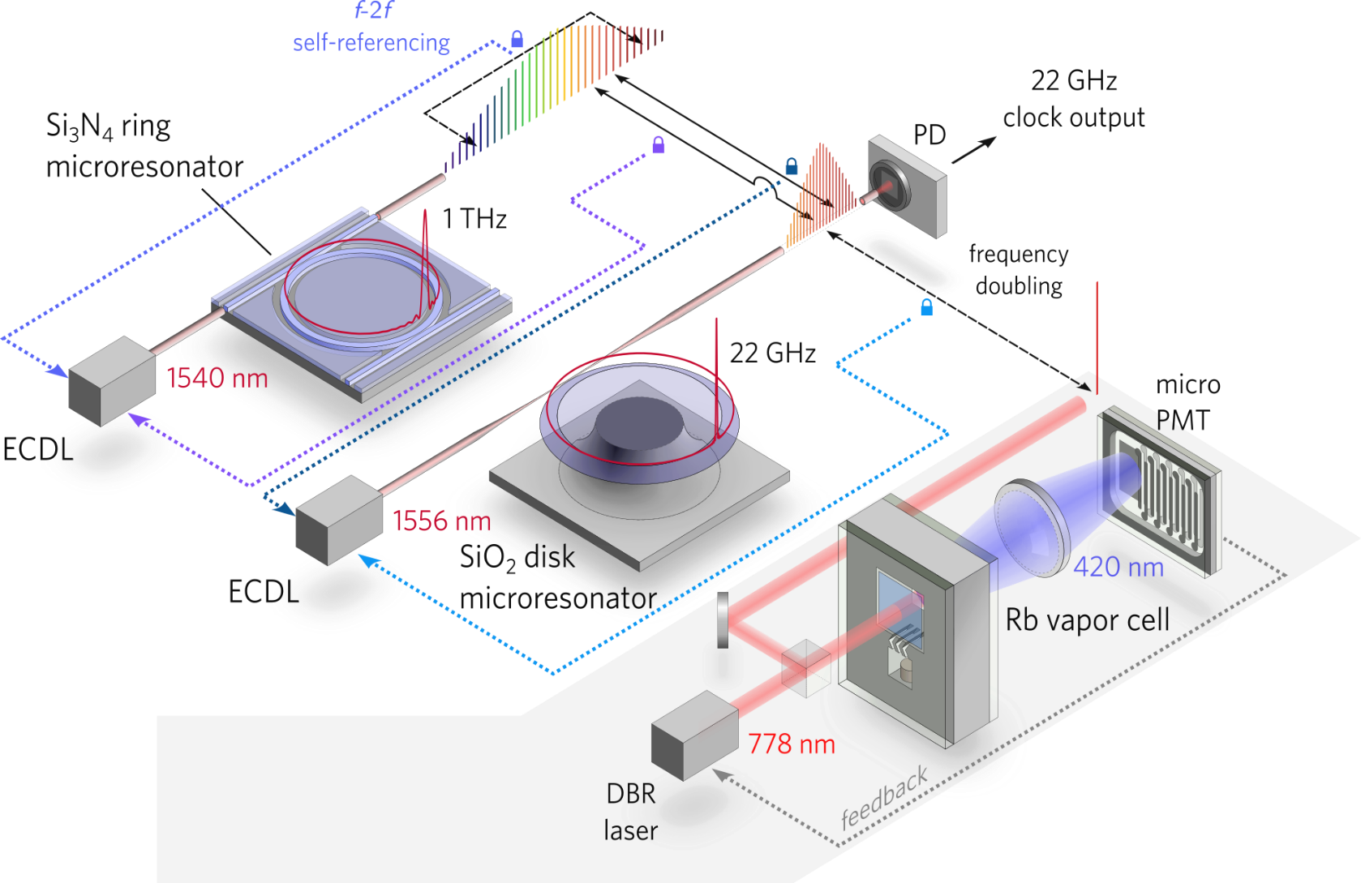
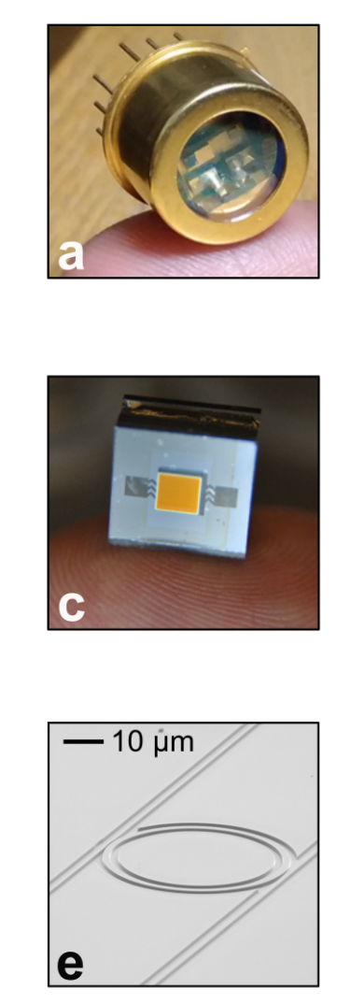
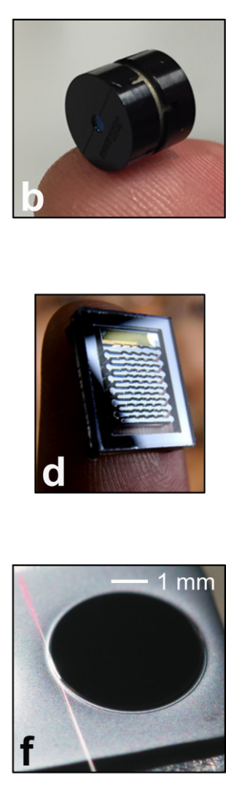
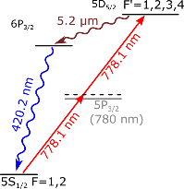
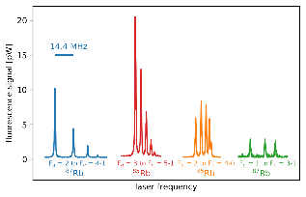
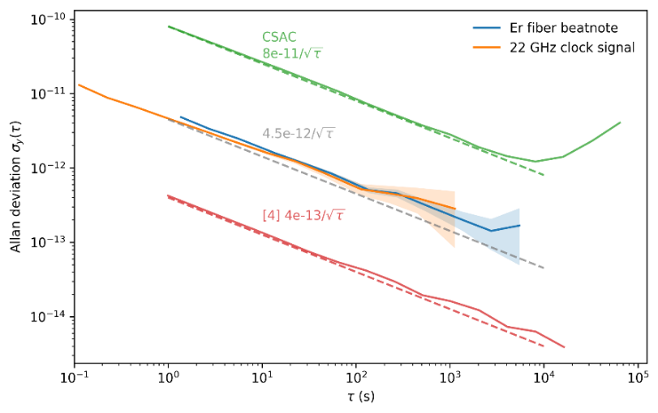
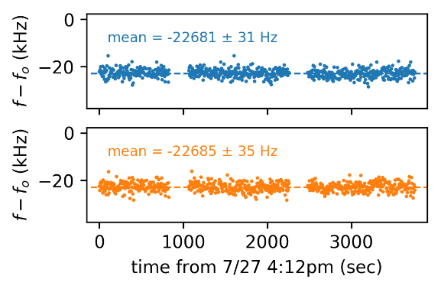
Two-Photon Chip-Scale Optical Standard
Rb 2-hv: Secondary representation of s
On-chip optical frequency division
Two-photon Rb
optical standard
10⁻¹⁰
10⁻¹¹
10⁻¹²
10⁻¹³
10⁻¹⁴
CSAC
This work
Collaborators:
Scott Papp
Scott Diddams
Kerry Vahala
Kartik Srinivasan
…
Allan Deviation
Best 2-hv clock
10⁻¹ 10⁰ 10¹ 10² 10³ 10⁴ 10⁵
Z. Newman, et al., Optica 6, 680 (2019).
Integration Time (s)

Slide 10
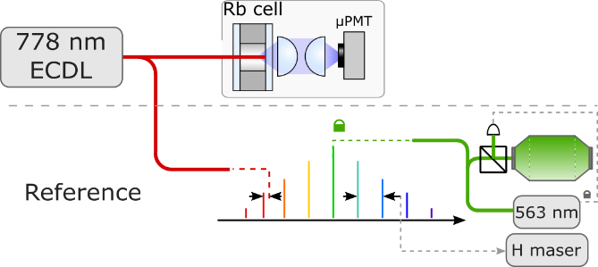
Performance with a low-noise ECDL
Lower frequency noise
→ reduced intermodulation effect
Short-term: 1.9 x 10⁻¹³ τ^{-1/2}
Frequency flicker floor at 2 x 10⁻¹⁴
Typical drift around 5 x 10⁻¹⁴ /day
Z. Newman, et al., Opt. Lett. 2021

Slide 11
Stability Limits – Long Term
Main Systematics: collision shift and light shift
11
Z. Newman, et al., Opt. Lett. 2021

Slide 12




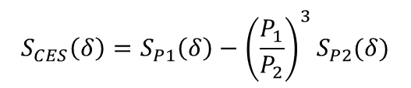
CW Light Shift Suppression
Modulate power and use “combined” error signal
Can go to higher laser power
  Better short-term stability ⇒ intermodulation noise
?
$$S_{CES}\left(δ\right)=S_{P1}\left(δ\right)−{\left(\frac{P_{1}}{P_{2}}\right)}^{3}S_{P2}(δ)$$
?
Technology transfer:
2 Hz²/Hz!
V. I. Yudin, et al., Phys. Rev. Appl., 14, 024001, 2020.
12
M. Abdel Hafiz, et al., Phys. Rev. Appl., 14, 034015, 2020.

Slide 13
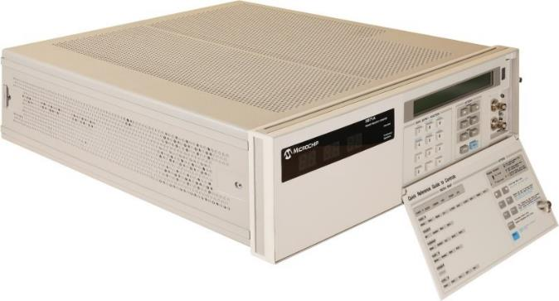
Chip-Scale Atomic Beam Clocks
Stern, Gerlach, Rabi, etc.
Most accurate realization of SI second for ~ 1968 -2000s
Workhorse in atomic timing for 70 years
Microchip website
J. Vanier and C. Audoin, Metrologia 42, S31-S42 (2005).
13
Distribution Statement `A' (Approved for Public Release, Distribution Unlimited)

Slide 14

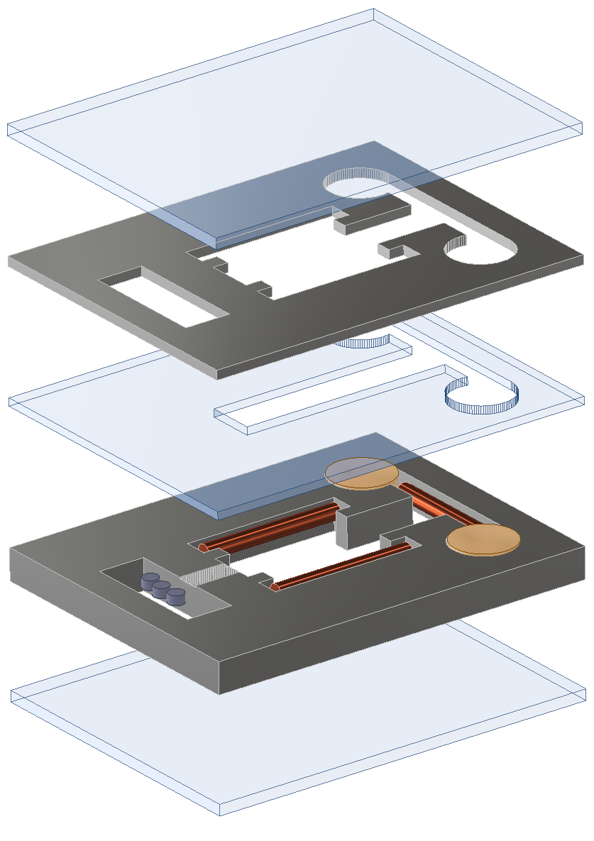

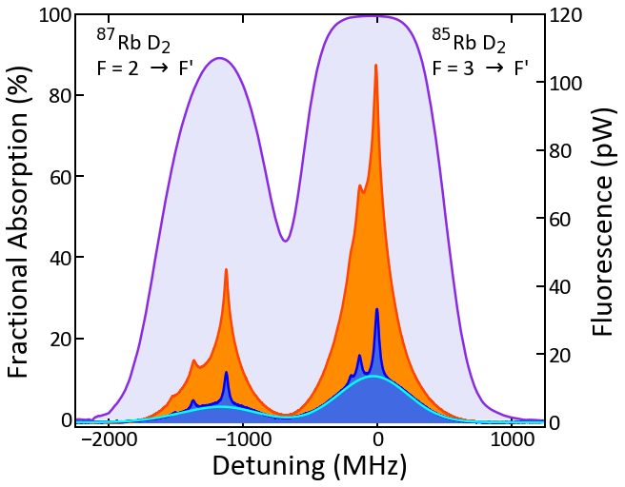
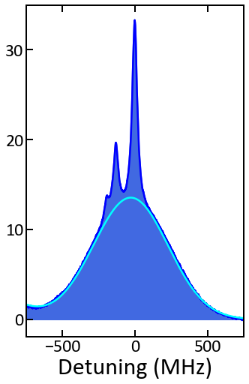
Chip-Scale Atomic Beam Physics Package
Microfabricated channels: C. Li et al., Nat. Commun. 10, 1831 (2019).
William McGehee
Anodically bonded Si/glass stack
Laser-activated Rb₂MoO₄/AlZr pills
  Douahi, et al., 2007
Source region
Drift region
Signal ≈ 1cm
downstream
Atomic beam signal at 90ºC
Glass (0.7mm)
Si spacer wafer (0.6mm)
Machined glass (1mm)
Si channel wafer (2mm)
Glass (0.7mm)
Rb₂MoO₄/AlZr pills
Graphite
Getters
14
G. D. Martinez et al., Nat. Commun. 14, 3501 (2023).
Distribution Statement `A' (Approved for Public Release, Distribution Unlimited)

Slide 15
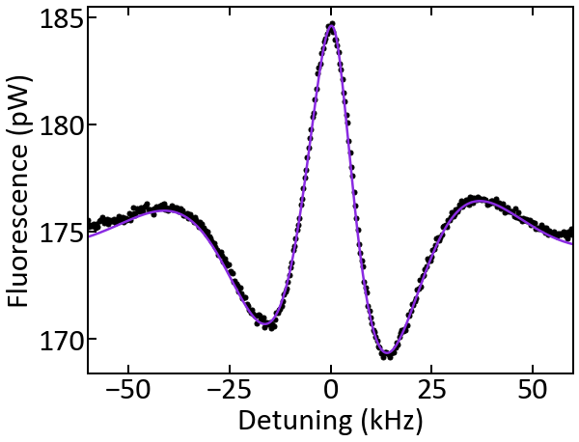
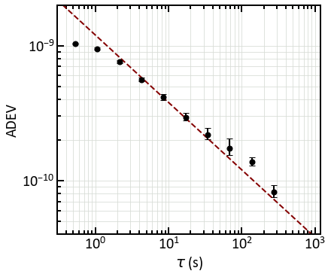
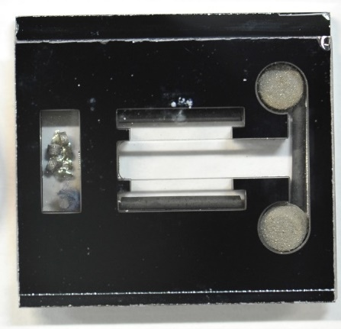
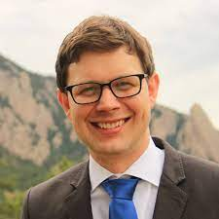

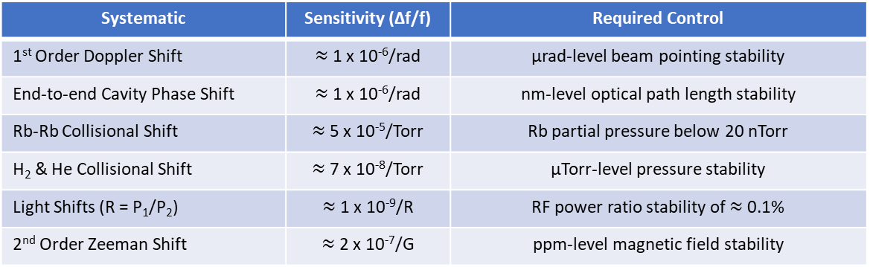
CPT Beam Clock Stability
Ramsey CPT spectroscopy
  J. E. Thomas et al., Phys. Rev. Lett. 48, 867-870 (1982).
1 cm Ramsey zone
Contrast: ≈ 16%
FWHM: ≈ 12kHz
5p_{1/2}
Ramsey
zones
F=2
F=1
5s_{1/2}
Projected systematics and accuracy budget (not measured yet) for $\frac{Δf}{f}=10^{−12}$
G. D. Martinez et al., Nat. Commun. 14, 3501 (2023).
Systematic | Sensitivity (Δf/f) | Required Control
1st Order Doppler Shift | $≈$ 1 x 10⁻⁶/rad | μrad-level beam pointing stability
End-to-end Cavity Phase Shift | $≈$ 1 x 10⁻⁶/rad | nm-level optical path length stability
Rb-Rb Collisional Shift | $≈$ 5 x 10⁻⁵/Torr | Rb partial pressure below 20 nTorr
H₂ & He Collisional Shift | $≈$ 7 x 10⁻⁸/Torr | μTorr-level pressure stability
Light Shifts (R = P₁/P₂) | $≈$ 1 x 10⁻⁹/R | RF power ratio stability of $≈$ 0.1%
2nd Order Zeeman Shift | $≈$ 2 x 10⁻⁷/G | ppm-level magnetic field stability
Technology transfer:
Travis Autry, PI
DARPA H6 (Jonathan Hoffman, PM):
1 μs @ 1 week in 1 cm³, 150 mW
15
Distribution Statement `A' (Approved for Public Release, Distribution Unlimited)

Slide 16



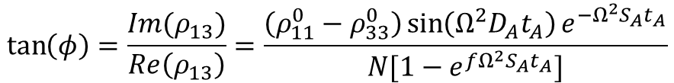


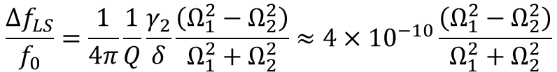



Light Shifts in CPT Beam Clocks
Off-resonant level
$$δ$$
$$γ_{2}$$
$$Ω_{1}$$
$$Ω_{2}$$
Resonant light shift → 0 for large $Ω^{2}$, $t_{A}$
$$\tan\left(φ\right)=\frac{Im(ρ_{13})}{Re\left(ρ_{13}\right)}=\frac{\left(ρ_{11}^{0}−ρ_{33}^{0}\right)\sin\left(Ω^{2}D_{A}t_{A}\right)e^{−Ω^{2}S_{A}t_{A}}}{N[1−e^{fΩ^{2}S_{A}t_{A}}]}$$
$$t_{A}$$
$$T_{R}$$
Off-resonant light shift:
$$\frac{Δf_{LS}}{f_{0}}=\frac{1}{4π}\frac{1}{Q}\frac{γ_{2}}{δ}\frac{\left(Ω_{1}^{2}−Ω_{2}^{2}\right)}{Ω_{1}^{2}+Ω_{2}^{2}}≈4×{10}^{−10}\frac{\left(Ω_{1}^{2}−Ω_{2}^{2}\right)}{Ω_{1}^{2}+Ω_{2}^{2}}$$
for Cs, $T_{R}=100 μs$
Atoms
Control of light shifts at 10⁻¹² level requires ~ 1% relative power control for CPT fields
Distribution Statement `A' (Approved for Public Release, Distribution Unlimited)

Slide 17
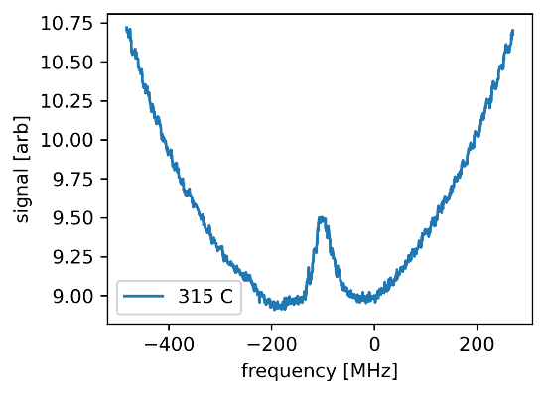
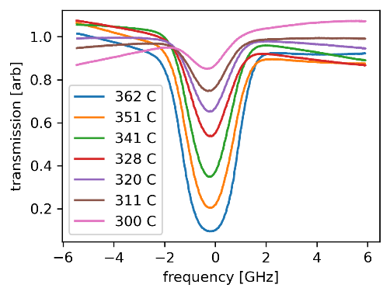
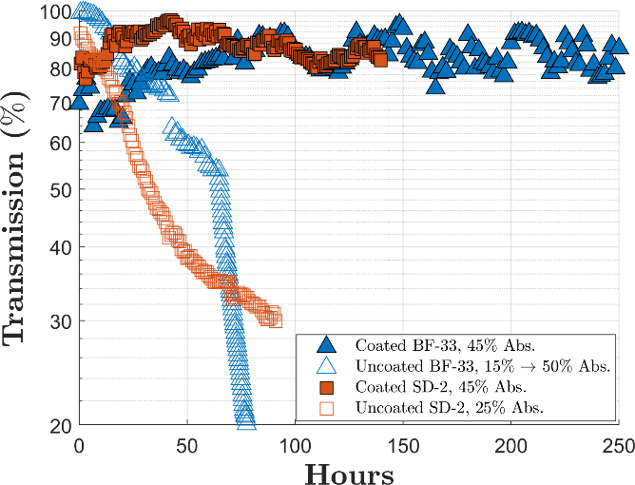
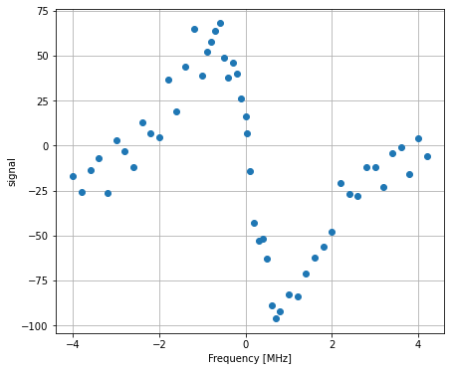
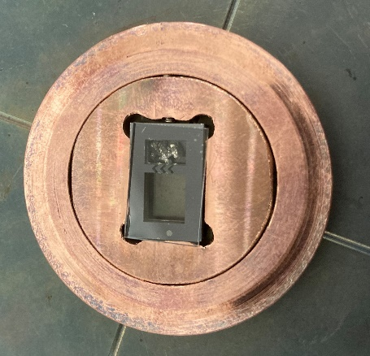
Microfabricated Sr Vapor Cells
461 nm Spectroscopy
Matt Hummon
Alkaline earths have range of transition linewidths
  461 nm -> 31 MHz
  689 nm -> 7 kHz
  698 nm -> mHz
Al₂O₃ coatings protect windows
  Woetzel, et al., 2013; Karlen, et al., 2017
461 nm laser
Strontium Levels
¹P₁
Det
461 nm,
31 MHz
³P₁
689 nm
7 kHz
Sr Cell
¹S₀
689 nm Spectroscopy
461 nm laser
698 nm laser
Sr Cell
Det
17
J. M. Pate, et al., Opt. Lett., 48, 383, 2023.

Slide 18


The Future?
+
Beam clock
Sr cells
+
Ca beam clock, 9 cm Ramsey zone -> 10⁻¹⁶ stability
Microresonator
combs
On-chip SBS lasers
Chip-scale clocks with 10⁻¹⁵ level stability?
18

Slide 19
Conclusions
CSACs now a successful commercial product: ~ $0.25B
  Underwater timing for oil and gas
Photonically-integrated wavelength references
Compact Rb 2-hv optical clocks
  Microresonator frequency combs
  10⁻¹⁴ stability @ 1 hr
Chip-scale atomic beam clocks
  CPT excitation
  Goal: 1 μs timing error at one day
Sr vapor cells

