Slide 1


Towards laser excitation of
the low-energy nuclear transition in ²²⁹Th
Ekkehard Peik
Time and Frequency Department
PTB, Braunschweig, Germany
9th Symposium on Frequency Standards and Metrology,
Kingscliff, NSW, Australia. 16-20 October 2023

Slide 2
From the atomic to the nuclear clock

Slide 3
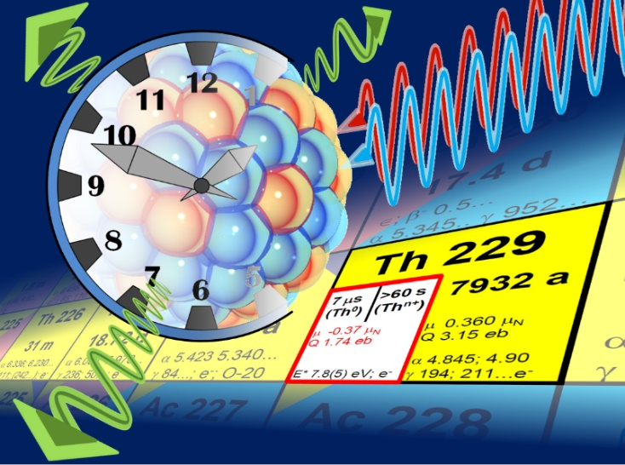
Nuclear Clock:
Oscillator that is frequency-stabilized
to a nuclear (γ-ray) transition
Motivation:
Higher precision: In many of the advanced optical clocks (trapped ion and optical lattice) field-induced shifts make a dominant contribution to the uncertainty budget. These can be reduced in a nuclear clock.
Higher stability: In a Mößbauer solid state nuclear clock, many absorbers may be interrogated (>10¹⁰ instead of ≈10⁰ (ion) or ≈10⁴ (lattice)).
Higher frequency: → higher stability. EUV or even X-ray transitions
may be used when suitable radiation sources become available.
High sensitivity in fundamental tests (strong and electromagnetic interactions)

Slide 4
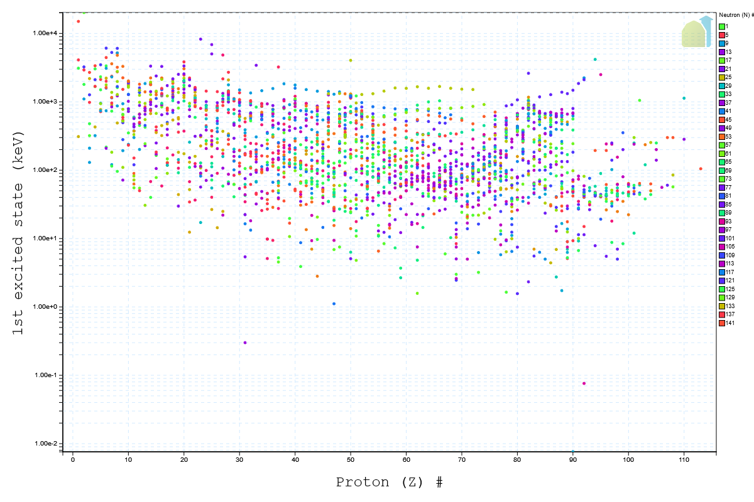
Energy of the 1st excited nuclear state
Sc-45:
12389.59 eV, M2
Sc-45
U-235:
76.737 eV, E3
U-235
Th-229
Th-229:
8.338 eV, M1
https://www.nndc.bnl.gov/nudat3/

Slide 5
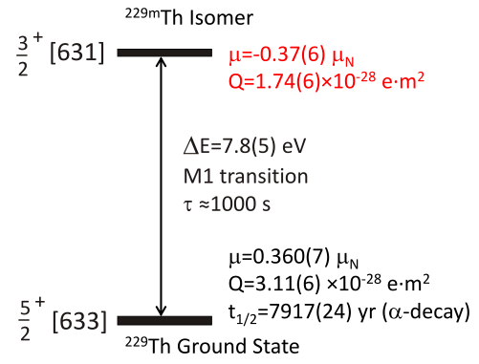

Low-energy transition in Th-229 as a reference for a nuclear clock
accessible for laser excitation at ≈ 150 nm
Magnetic dipole moment
Electric quadrupole moment
J. Thielking et al. (PTB, LMU)
Nature 556, 321 (2018)
Nuclear spin, parity
Nilsson classification
(leading configuration)
ΔE= 8.338(24) eV
S. Kraemer et al. (KU Leuven)
Nature 617, 706 (2023)
www.nuclock.eu
Advantage of the nuclear over the atomic clock: (nearly) free choice of a suitable
electronic state for the interrogation of the nuclear resonance.
E. Peik, Chr. Tamm, Europhys. Lett. 61, 181 (2003)
K. Beeks et al., Nat. Rev. Phys. 3, 238 (2021)

Slide 6
High sensitivity of a Th-229 nuclear clock for violations of the equivalence principle
Transition frequency is sensitive to the strong interaction (in addition to electromagnetism)
Coulomb- and strong- contributions (MeV scale) cancel in the transition energy
Enhanced sensitivity to variations of fundamental constants:
V. Flambaum, Phys. Rev. Lett. 97, 092502 (2006)
Bound system of massive particles (n, p) at high energies
Enhanced effect of LLI violation:
V. Flambaum, Phys. Rev. Lett. 117, 072501 (2016)
ground state
isomer
8.3 eV
Coulomb contribution
total binding energy
Coulomb contribution
MeV scale
E. Peik, T. Schumm, M. Safronova, A. Pálffy, J. Weitenberg, P.G. Thirolf, Quant. Sci. Tech. 6, 034002 (2021)

Slide 7
News from other labs
Production of ^{229m}Th through β-decay of ²²⁹Ac
First optical observation of the isomer decay
First optical wavelength measurement
First observation of Th-229 nuclear photon emission from solids (MgF₂, CaF₂)
Online experiment at CERN ISOLDE
Lead: KU Leuven, Piet van Duppen
S. Kraemer et al., arXiv:2209.1027
Nature 617, 706 (2023)
Wavelength 148.71(42) nm
excitation energy 8.338(24) eV
The half-life of ^{229m}Th embedded in MgF₂ is determined to be 670(102) s.
At LMU, PTB, LANL et al.
At CERN

Slide 8
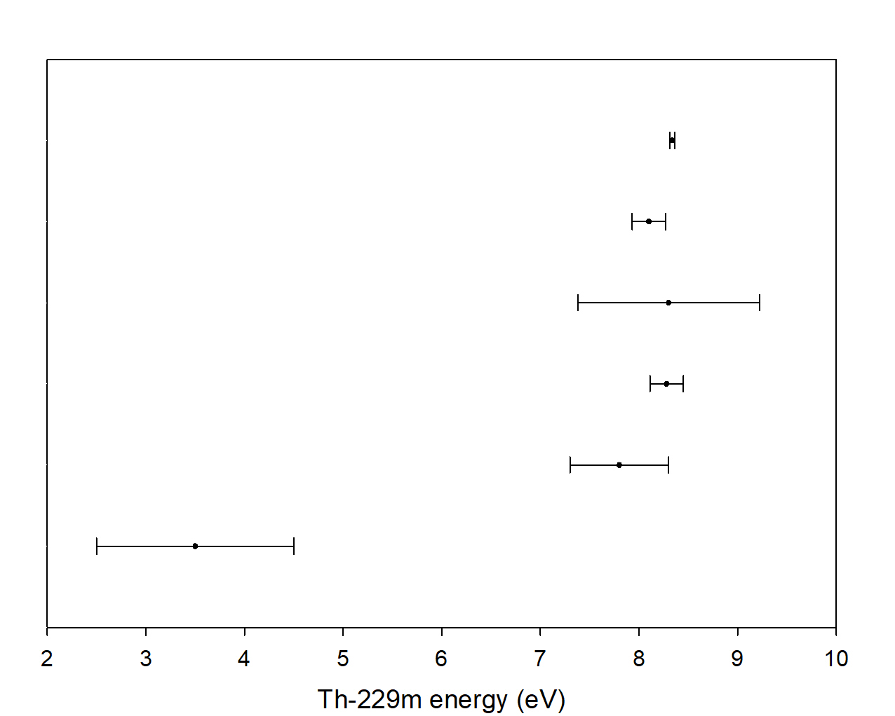
Measurements of the Th-229 isomer energy
≈11 THz ±1σ range
CERN ISOLDE 2023
KIP-U Heidelberg 2020
RIKEN 2019
LMU Munich 2019
LLNL 2009
INEL 1994

Slide 9
8-eV VUV generation: Four wave (difference) mixing principle
Near-resonantly driving of 2-photon transition in noble gas.
Supplying one photon with ν_{IR} yields fourth photon with ν_{VUV} = 2ν_{UV} – ν_{IR}.
Two-photon transition in Xe at 2 x 250 nm is suitable for VUV tunability from 167 nm to 148 nm, i.e. 7.42 eV to 8.38 eV.
noble gas
ν_{IR}
ν_{IR}
ν_{UV}
ν_{VUV}
ν_{UV}
ν_{UV}
ν_{VUV}
ν_{VUV} = 2ν_{UV} - ν_{IR}
9

Slide 10
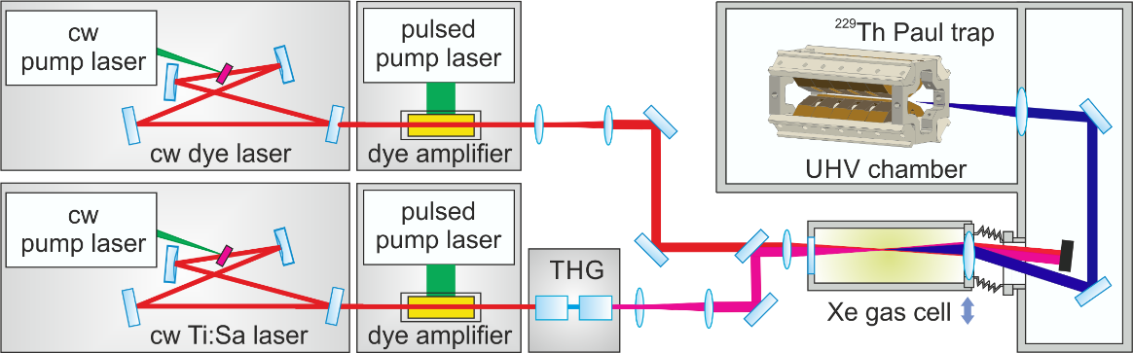
8-eV VUV generation: Four wave (difference) mixing principle
Tuning over the range 7.9 eV to 8.3 eV requires laser beams at 250 nm and 610-759 nm.
Third order process needs high intensity to achieve suitable efficiency.
Pulsed lasers (~10 ns, 30 Hz repetition rate) best compromise between VUV pulse energy (>10¹³ photons/pulse) and Fourier transform limited bandwidth (<1 GHz).
Our setup:
  Two cw ring lasers as seed: 750 nm Ti:Sa laser, 610-759 nm tunable dye laser.
  Pulsed dye amplifiers (~60 mJ/pulse, 30 Hz repetition rate).
  Third harmonic generation to achieve 250 nm for two-photon transition.
Xe
ν_{IR}
ν_{UV}
ν_{VUV}
ν_{UV}
ν_{VUV} = 2ν_{UV} - ν_{IR}
10

Slide 11
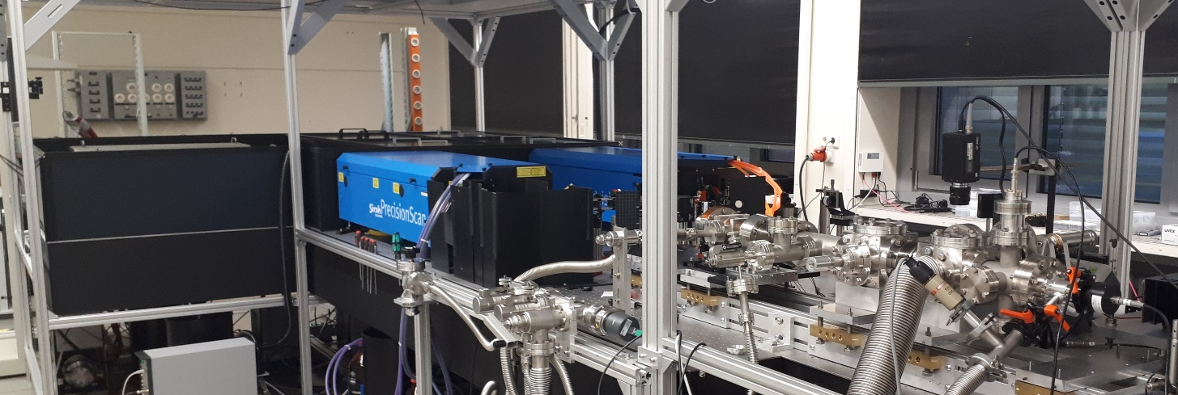
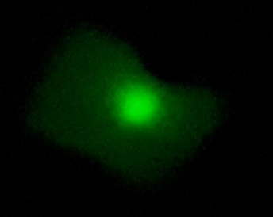
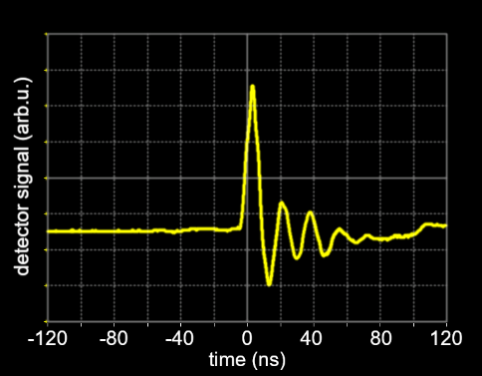
FWM laser system at PTB
cw ring lasers as seed (dye and Ti:Sa)
VUV gas cell and beam line
pulsed dye amplifiers
Relative power measurements with Cu-based photo-electron detector.
Absolute measurements with pyro-electric power meter show E_{pulse} > 5 µJ.
VUV beam visualization
on Ce:YAG phosphor
11

Slide 12
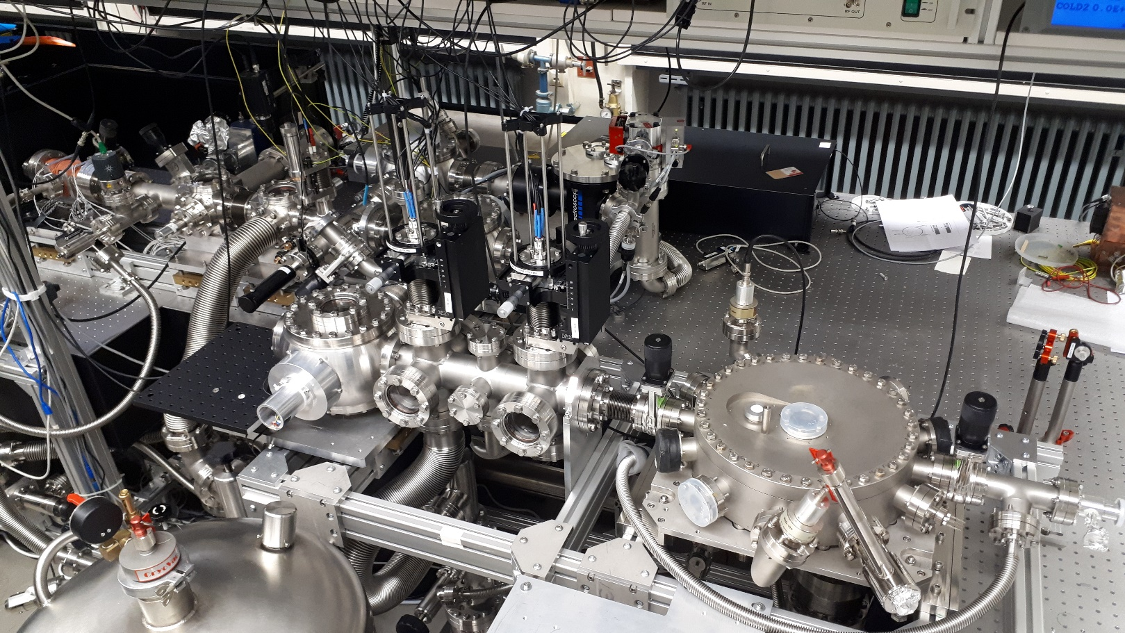
VUV Beam Line
Xe-cell
RF ion trap
Motorized VUV-mirrors

Slide 13
First VUV laser excitation of trapped Th⁺ ions
(electronic resonance lines)
Detection:
in Th⁺ : provides laser spectral profile
in Th²⁺ : sensitive to the integrated excitation rate
J. Thielking, K. Zhang, J. Tiedau, J. Zander, G. Zitzer, M. V. Okhapkin, E. Peik, New J. Phys. 25, 083026 (2023)

Slide 14
Linewidth of the VUV source: ≤6 GHz
(phase noise from the amplifiers gets upconverted in THG and FWM processes)
J. Thielking, K. Zhang, J. Tiedau, J. Zander, G. Zitzer, M. V. Okhapkin, E. Peik, New J. Phys. 25, 083026 (2023)

Slide 15
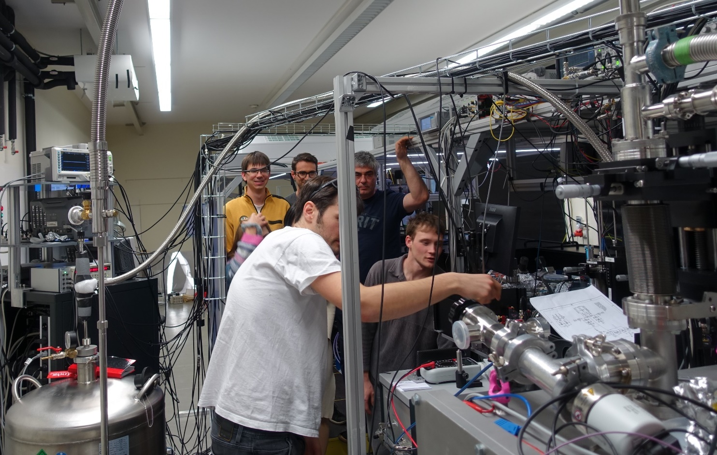

In cooperation with TU Vienna, group of Thorsten Schumm:
Study of ²²⁹Th-doped calcium fluoride crystals
Kjeld Beeks, PhD thesis TU Wien, 2022
Radiation damage to crystals (loss of F)
VUV-absorbing „ices“ at cryogenic temperature

Slide 16
Trapping and cooling of ²²⁹Th³⁺
U-233 recoil ion source with He buffer gas cell,
coupled to a linear ion trap for sympathetic laser cooling of ²²⁹Th³⁺ in UHV.

Slide 17
Sympathetic laser cooling of ²²⁹Th³⁺ with ⁸⁸Sr⁺
Both species have similar q/m and form closely coupled two-species Coulomb crystals in a linear RF ion trap.
Simulations
1000 Sr⁺ (blue) and 9 Th³⁺ (red)
500 Sr⁺ (blue) and 500 Th³⁺ (red)
First laser cooling of ²²⁹Th³⁺: Georgia Tech
C. J. Campbell, A. G. Radnaev, and A. Kuzmich, Phys. Rev. Lett. 106, 223001 (2011).

Slide 18
Sympathetic laser cooling of ²²⁹Th³⁺ with ⁸⁸Sr⁺
Experiment: fluorescence image from Sr⁺, Th³⁺ appear dark
Sr⁺ only
with 2 Th³⁺
Sr⁺ only
with ≈12 Th³⁺
with >20 Th³⁺

Slide 19
Laser spectroscopy of sympathetically cooled ²³⁰Th³⁺ ions
(without hyperfine structure, produced as recoil ions from ²³⁴U)
Prospects: precision HFS spectroscopy of ²²⁹Th and ^{229m}Th:
→ more precise nuclear moments, determining the α-sensitivity from the Coulomb energy
G. Zitzer, J. Tiedau, M. V. Okhapkin, K. Zhang, C. Mokry, J. Runke, C. E. Düllmann, E. Peik, to be published

Slide 20
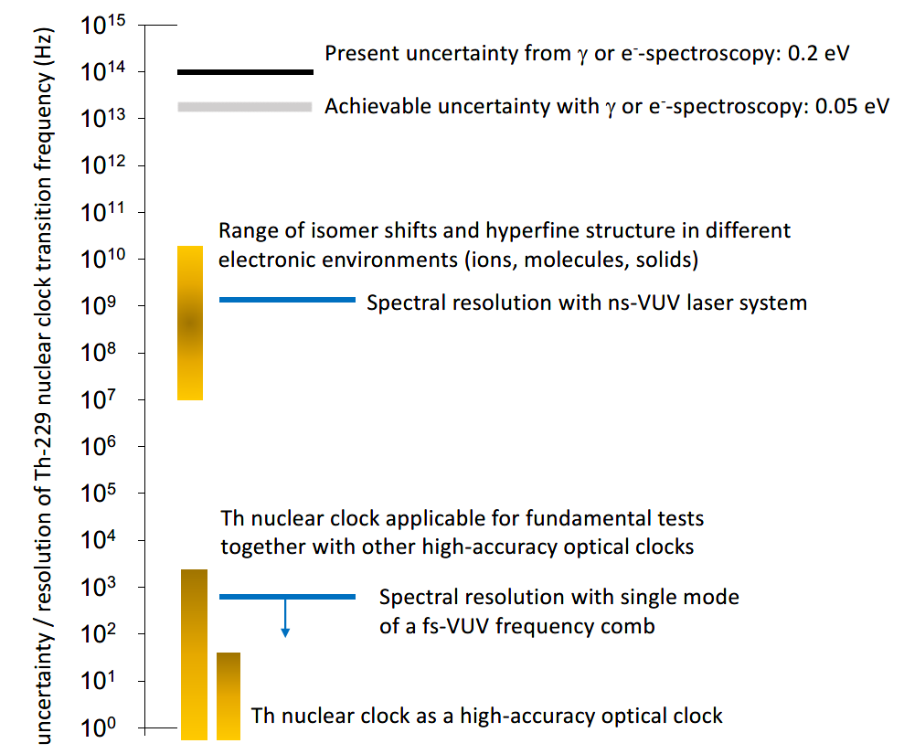
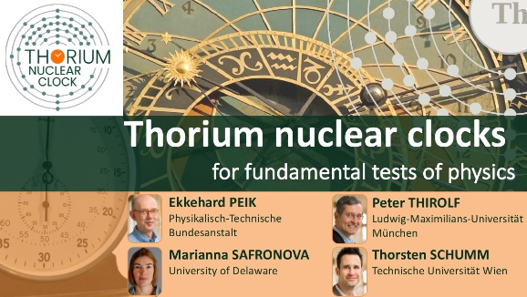

„Roadmap“ in frequency uncertainty for the Th-229 nuclear transition
ERC Synergy Project 2020

Slide 21
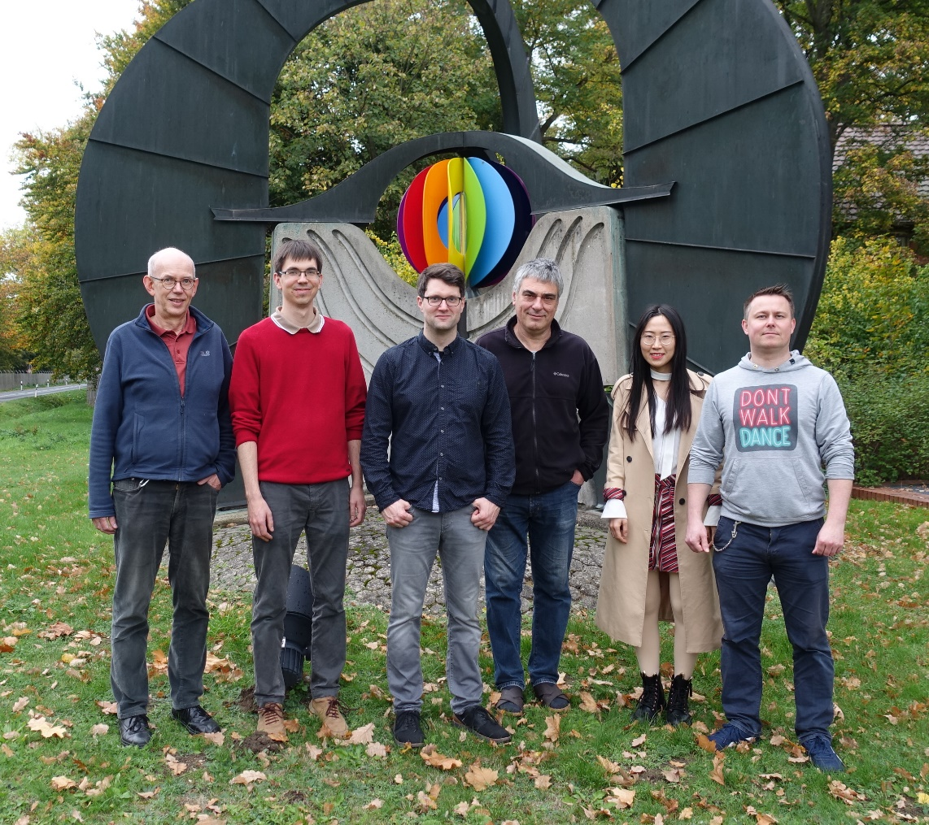




PTB Working Group
Laser Nuclear Spectroscopy
J. Tiedau
J. Thielking
M. Okhapkin
Ke Zhang
G. Zitzer
Positions available !
Funding:
DFG, EURAMET, EU H2020

