Slide 1
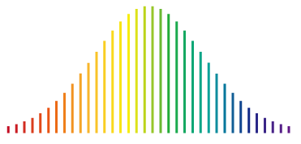
Compact and Manufacturable Ultrastable Optical Reference Cavities:
10⁻¹⁴ Stability in Less Than 10 mL Volume
Franklyn Quinlan
NIST Time and Frequency Division
fquinlan@nist.gov
9th Symposium on Frequency Standards and Metrology
October 2023

Slide 2
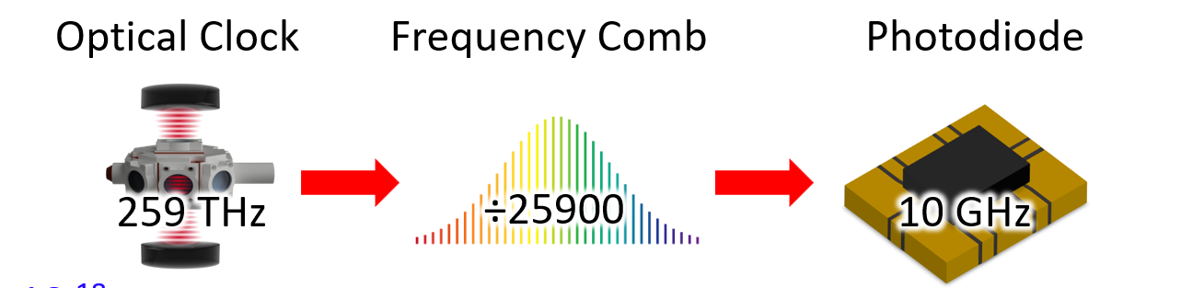
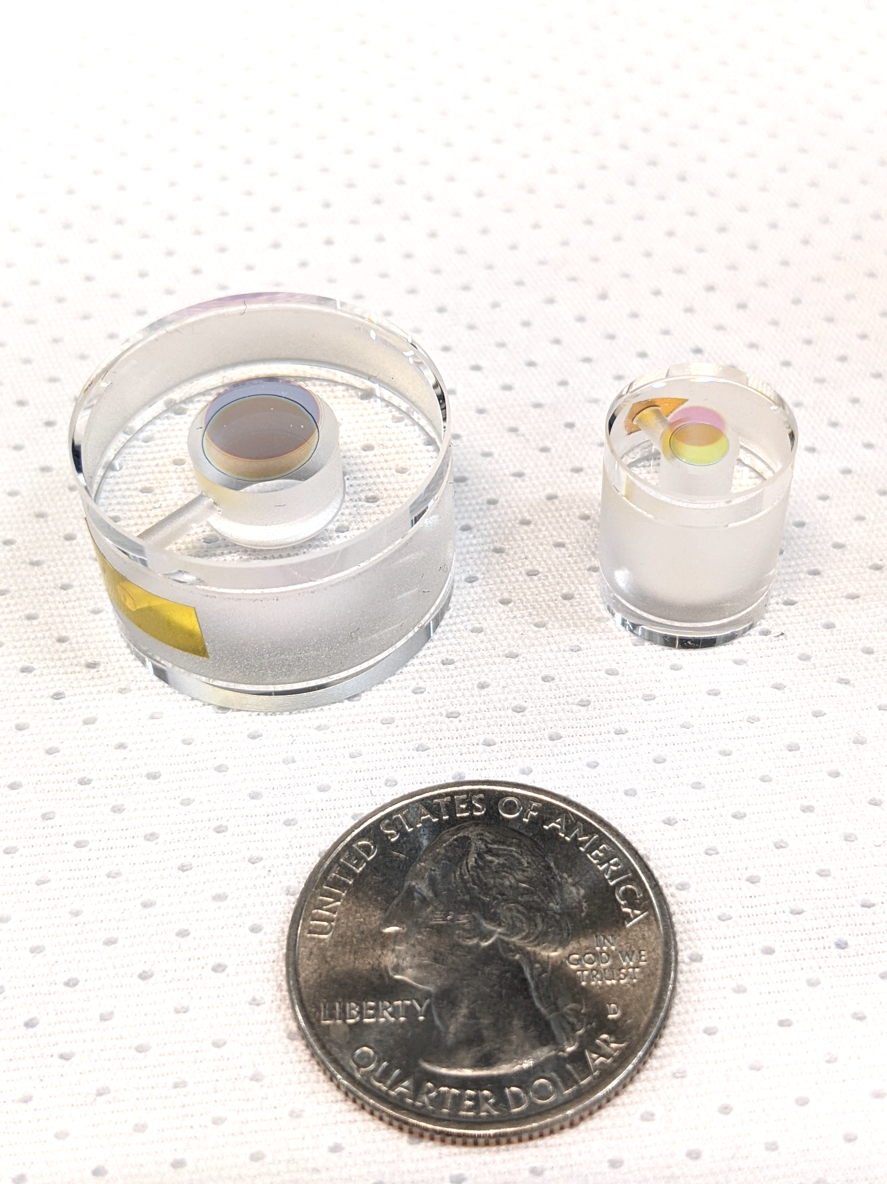
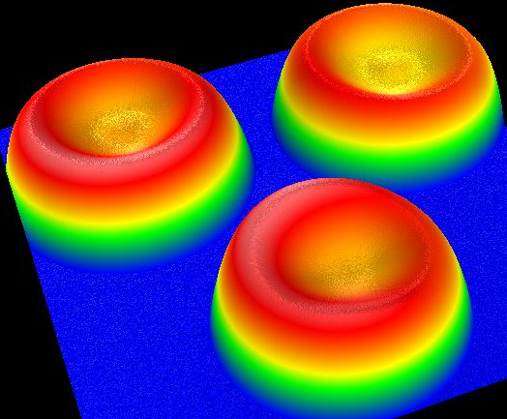
Preview
Microwave signals with optical clock stability
Compact optical reference cavities
2.54 cm

Slide 3
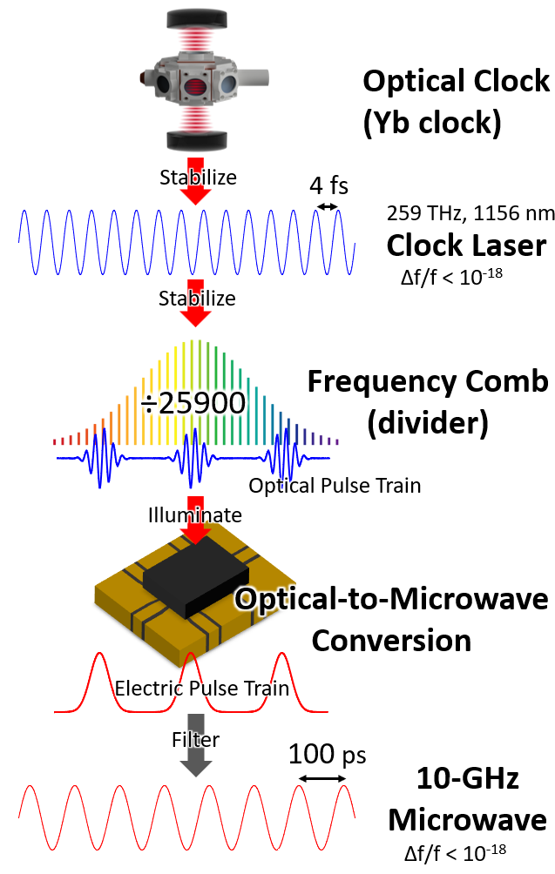
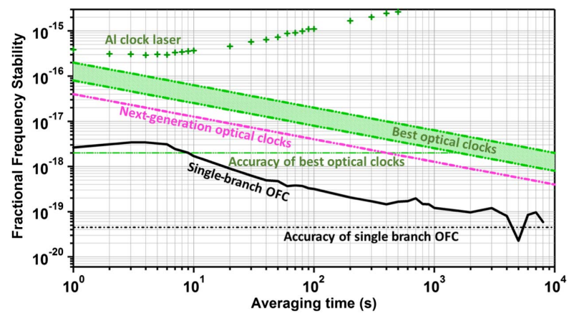
Optical clock frequency down conversion
Goal: establish that an optical frequency comb and high-speed photodetector can support optical clock stability (10⁻¹⁸) stability on a 10 GHz carrier
Leopardi et al, Optica 4 p. 879 (2017)

Slide 4
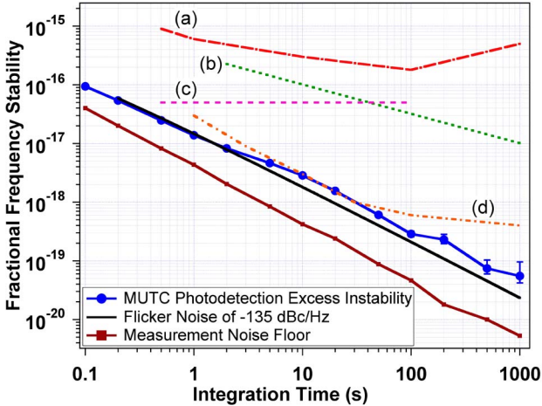
Optical clock frequency down conversion
Goal: establish that an optical frequency comb and high-speed photodetector can support optical clock stability (10⁻¹⁸) stability on a 10 GHz carrier
10 GHz carrier
Baynes et al, Optica 2 p. 141 (2015)

Slide 5
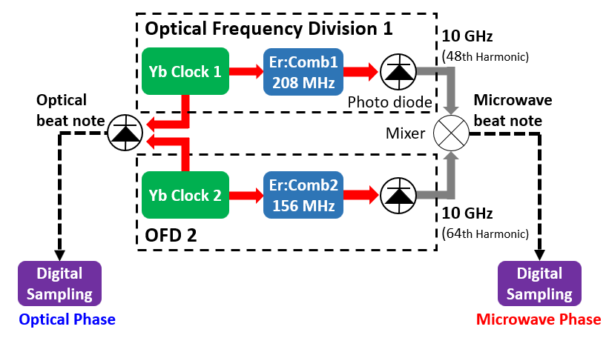
Phase coherent down-conversion
Optical clock signals provided by A. Ludlow & team
Highly correlated phase records
Scaling should be given by (259 THz/10 GHz)
T. Nakamura et al, Science 368, p. 889 (2020)

Slide 6
Phase coherent down-conversion
rms timing error: 900 attoseconds
Correlation coefficient= 0.998
Highly correlated phase records
Scaling should be given by (259 THz/10 GHz)
T. Nakamura et al, Science 368, p. 889 (2020)

Slide 7
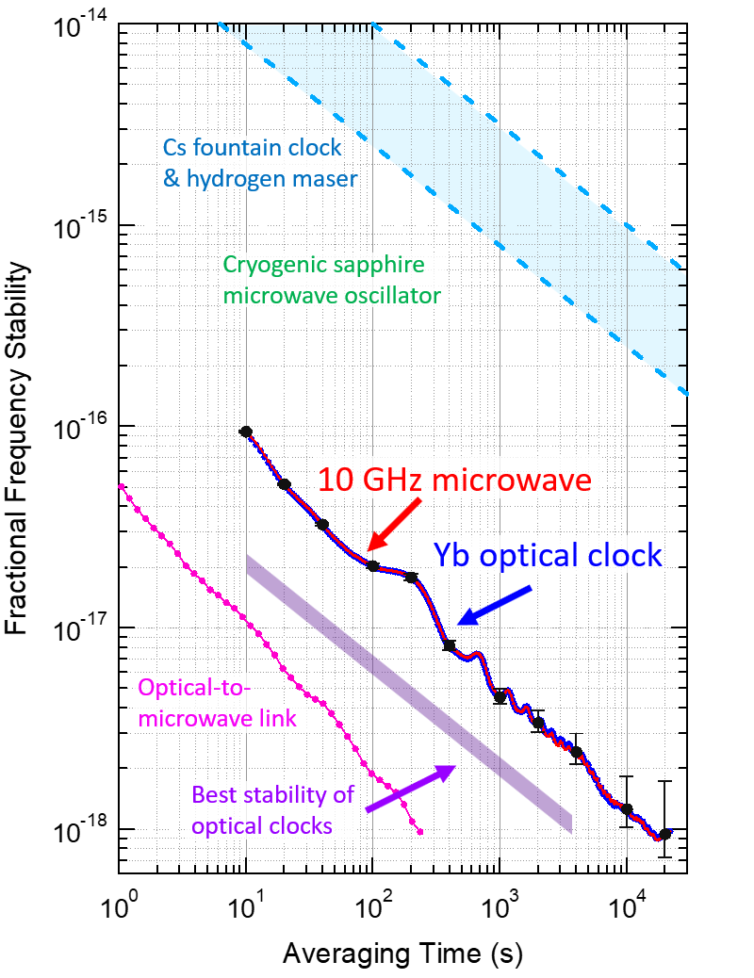
Frequency down-conversion
Optical-to-microwave frequency ratio:
OFD1: 25912.2626487667098(25)
OFD2: 25915.8720255287493985(25)
State-of-the-art optical clocks
T. Nakamura et al, Science 368, p. 889 (2020)

Slide 8
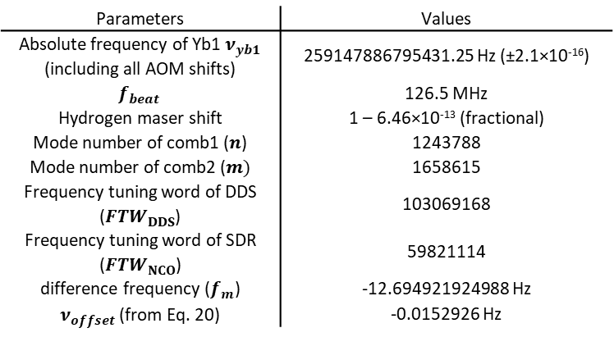
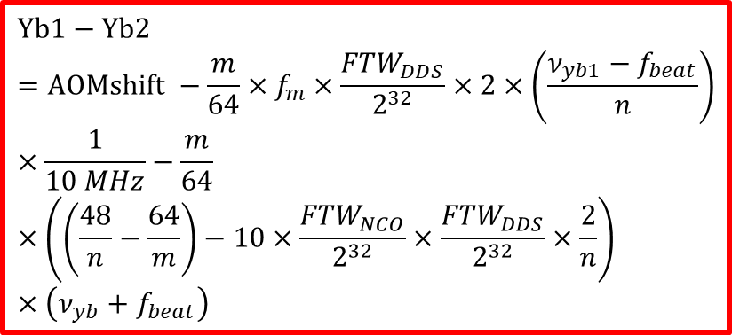
Accuracy of optical-to-microwave conversion
Parameters | Values
Absolute frequency of Yb1 $ν_{yb1}$ (including all AOM shifts) | 259147886795431.25 Hz (±2.1×10⁻¹⁶)
$$f_{beat}$$ | 126.5 MHz
Hydrogen maser shift | 1 – 6.46×10⁻¹³ (fractional)
Mode number of comb1 ($n$) | 1243788
Mode number of comb2 ($m)$ | 1658615
Frequency tuning word of DDS (${FTW}_{DDS}$) | 103069168
Frequency tuning word of SDR (${FTW}_{NCO}$) | 59821114
difference frequency ($f_{m}$) | -12.694921924988 Hz
$ν_{offset}$ (from Eq. 20) | -0.0152926 Hz
$$Yb1−Yb2=AOMshift −\frac{m}{64}×f_{m}×\frac{{FTW}_{DDS}}{2^{32}}×2×\left(\frac{ν_{yb1}−f_{beat}}{n}\right)×\frac{1}{10 MHz}−\frac{m}{64}×\left(\left(\frac{48}{n}−\frac{64}{m}\right)−10×\frac{{FTW}_{NCO}}{2^{32}}×\frac{{FTW}_{DDS}}{2^{32}}×\frac{2}{n}\right)×\left(ν_{yb}+f_{beat}\right)$$
 | Optical Frequency (Yb1-Yb2) | fractional
Optical beat note | -0.0152862 Hz | (-5.8986±0.095)×10⁻¹⁷
Microwave + calculation | -0.0152926 Hz | (-5.9011±0.096)×10⁻¹⁷

Slide 9
Preview
Microwave signals with optical clock stability
Compact optical reference cavities
2.54 cm

Slide 10
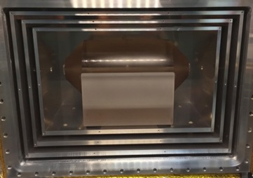
Compact optical reference cavities
NIST Yb clock laser cavity
(to scale)
30 cm
Stability ~1-2x10⁻¹⁶ at 1 second

Slide 11
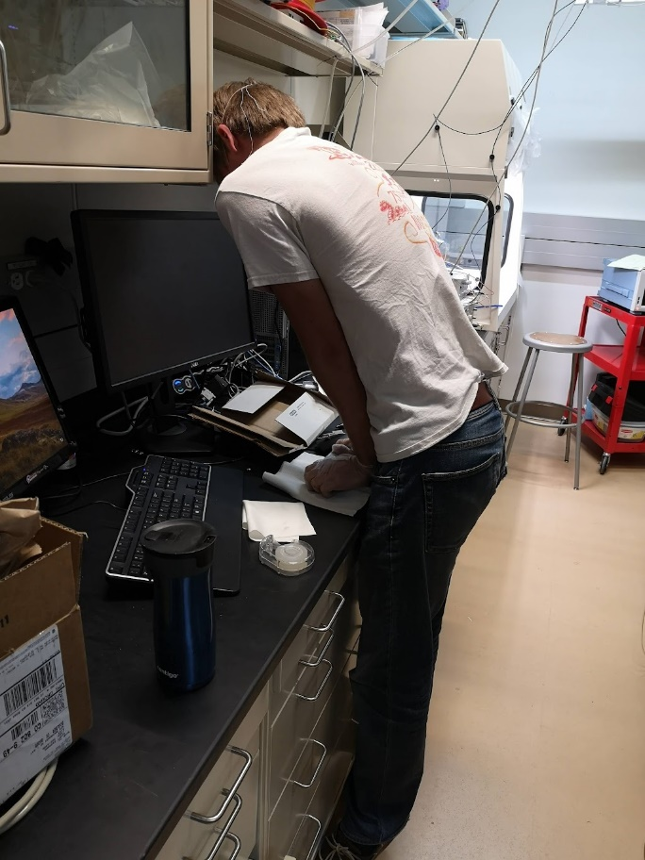
Compact optical reference cavities
NIST Yb clock laser cavity
Charles McLemore performing an optical contact bond
16 mm
30 cm
Wish list
High finesse
Mirrors with large radius of curvature
Manufacturable – no more individual hand assembly
Passive vacuum pumping – no more ion pumps
Fractional frequency stability at 10⁻¹⁴ or better

Slide 12
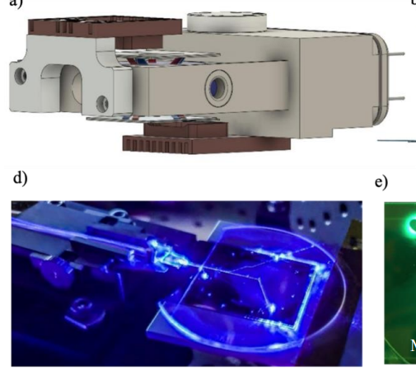
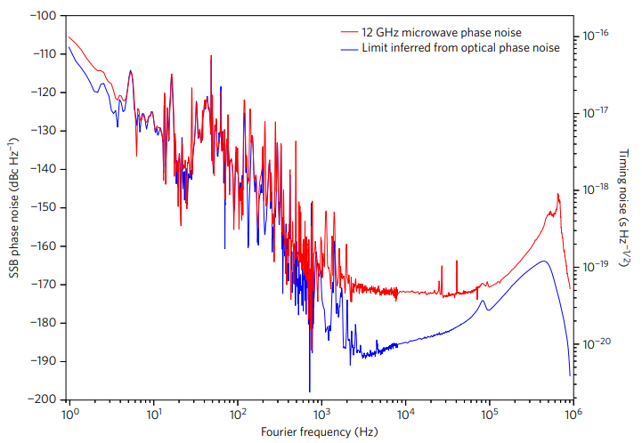
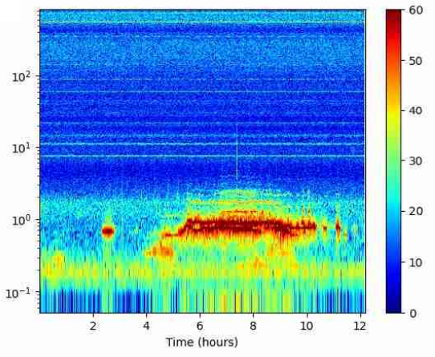
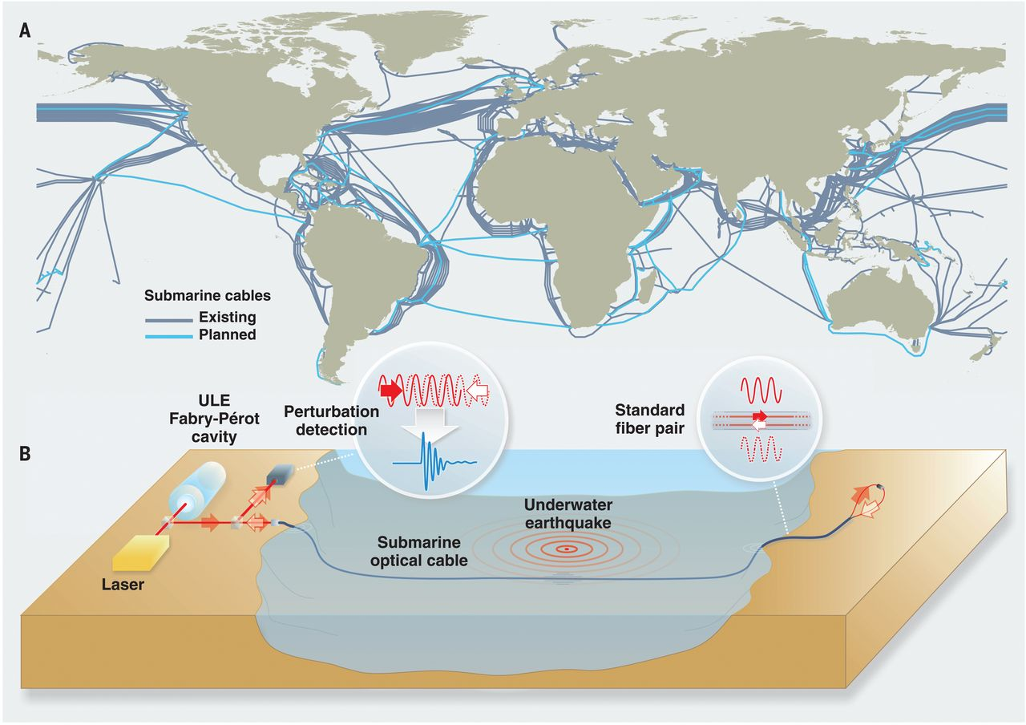
Applications of compact ultrastable cavities
Mobile optical clocks
Low noise microwave generation
Environmental sensing
Frequency PSD (dBHz²/Hz)
Frequency (Hz)
Jammi et al, CLEO 2022
Fortier et al, Nat. Photon. 5 (2011)
Xie et al, Nat. Photon. 11 (2017)
Marra, et al. Science 361, 6401 (2018)
Marra, et al. Science 376, 6595 (2022)
Mazur, et al. arXiv:2303.06528 (2023)

Slide 13
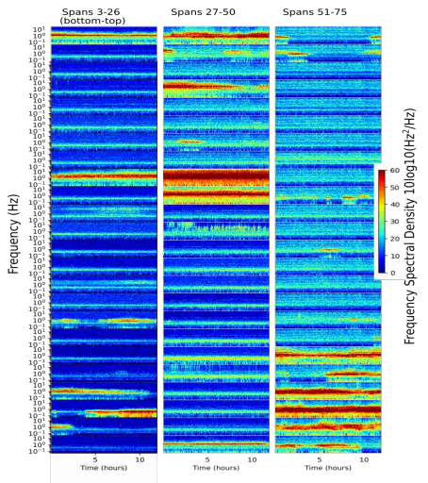
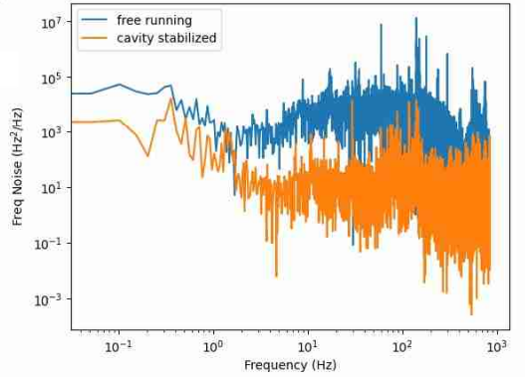
Applications of compact ultrastable cavities
Mobile optical clocks
Low noise microwave generation
Environmental sensing
400 km span
Jammi et al, CLEO 2022
Fortier et al, Nat. Photon. 5 (2011)
Xie et al, Nat. Photon. 11 (2017)
Marra, et al. Science 361, 6401 (2018)
Marra, et al. Science 376, 6595 (2022)
Mazur, et al. arXiv:2303.06528 (2023)

Slide 14
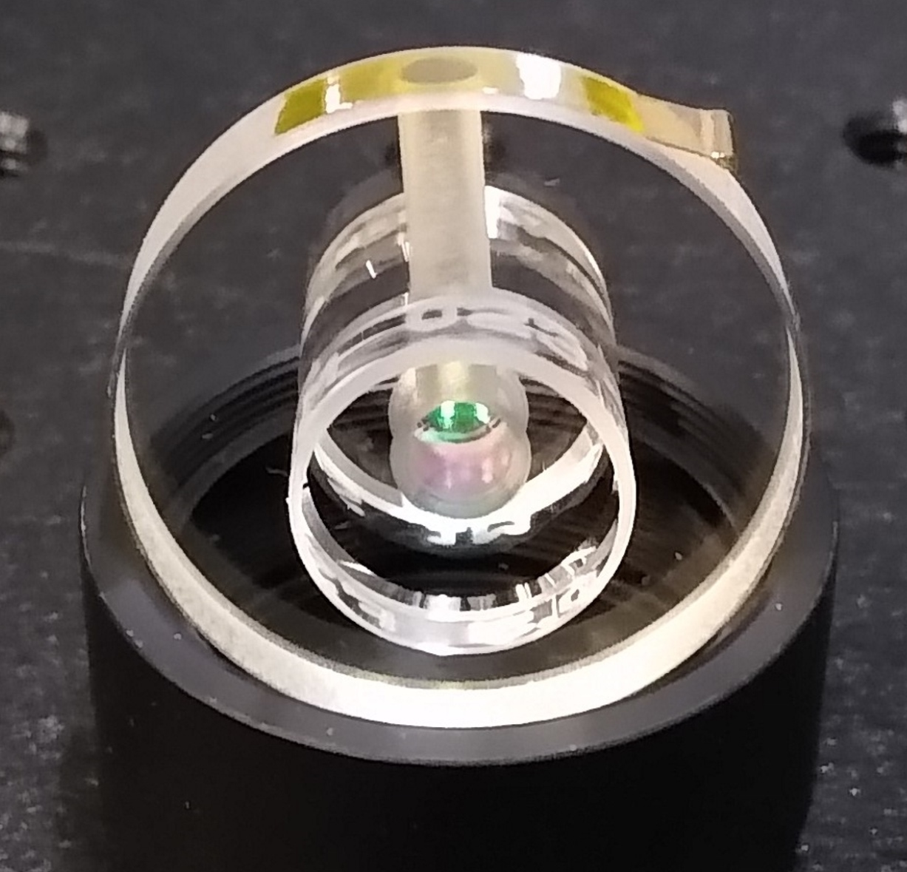
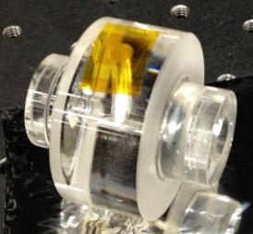
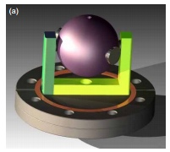
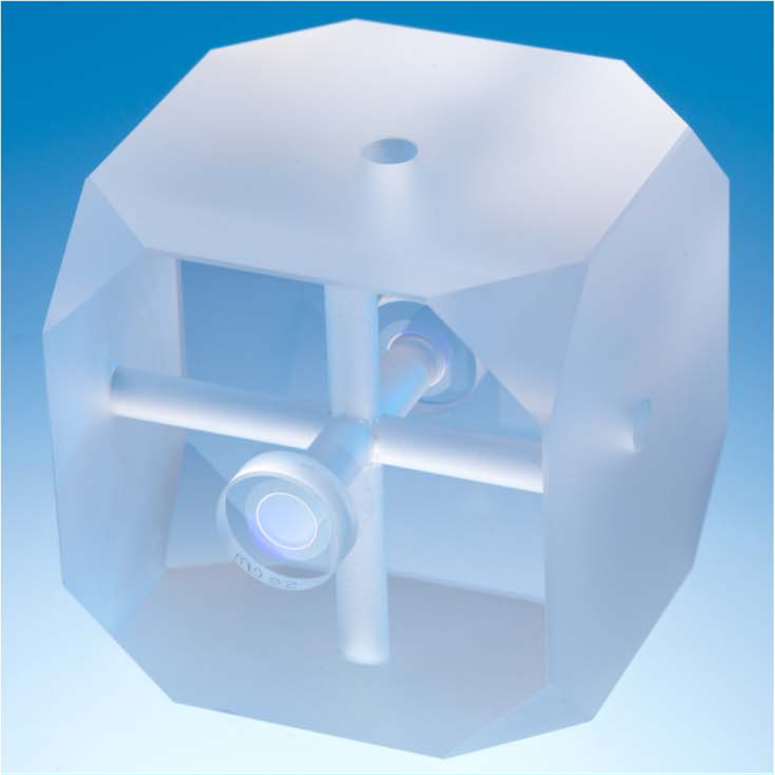
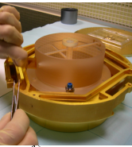
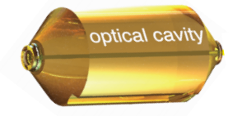
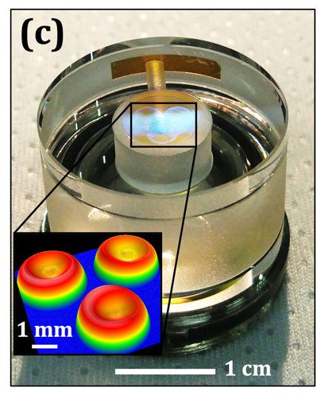
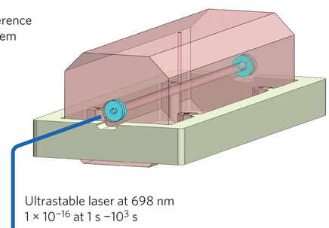
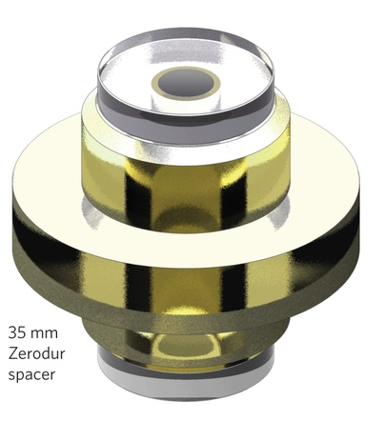
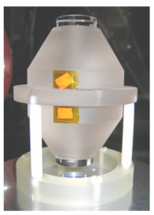
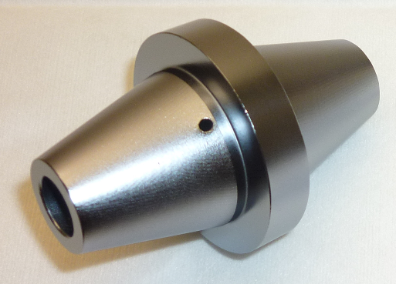
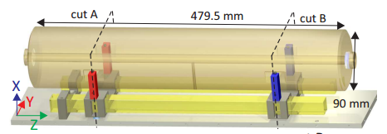

Survey of the state-of-the-art in FP stabilized lasers
M. Kelleher et al, arXiv:2301.08822 (2023)
C. McLemore, et al. PRA 18 054054 (2022)
J. Davila-Rodriguez, et al., Opt. Lett. 42, 1277 (2017)
G.D. Cole, et al., Nat. Photon. 7, 644 (2013)
S. Webster & P. Gill, Opt. Lett. 36, 3572 (2011)
D. Leibrandt, et al., Opt. Exp. 19, 3471 (2011)
D. Leibrandt, et al., Phys. Rev. A 87, 023829 (2013)
A. D. Ludlow, et al. Opt. Lett. 32, 641 (2007)
B. Argence, et al., Opt. Exp. 20, 25409 (2012)
D. Świerad, et al. Sci. Reports 6 33973 (2016)
$$∝\frac{1}{L}$$
T. Kessler, et al. Nat. Photon. 6, 687 (2012)
D. G. Matei, et al., arxiv: 1702.04669 (2017)
B. C. Young, et al. Phys. Rev. Lett. 82, 3799 (1999)
Y. Yiang, et al. Nat. Photon. 5, 158 (2011)
M. Schioppo, et al., Nat. Photon. 11, 48 (2017)
Jun Ye’s group at JILA
cryogenic cavity
S. Häfner, et al. Opt. Lett. 9, 2112 (2015)
Original plot credit: J. Davila-Rodriguez

Slide 15
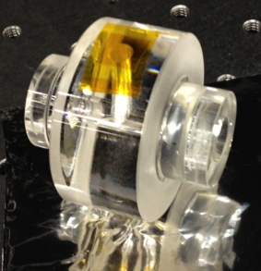
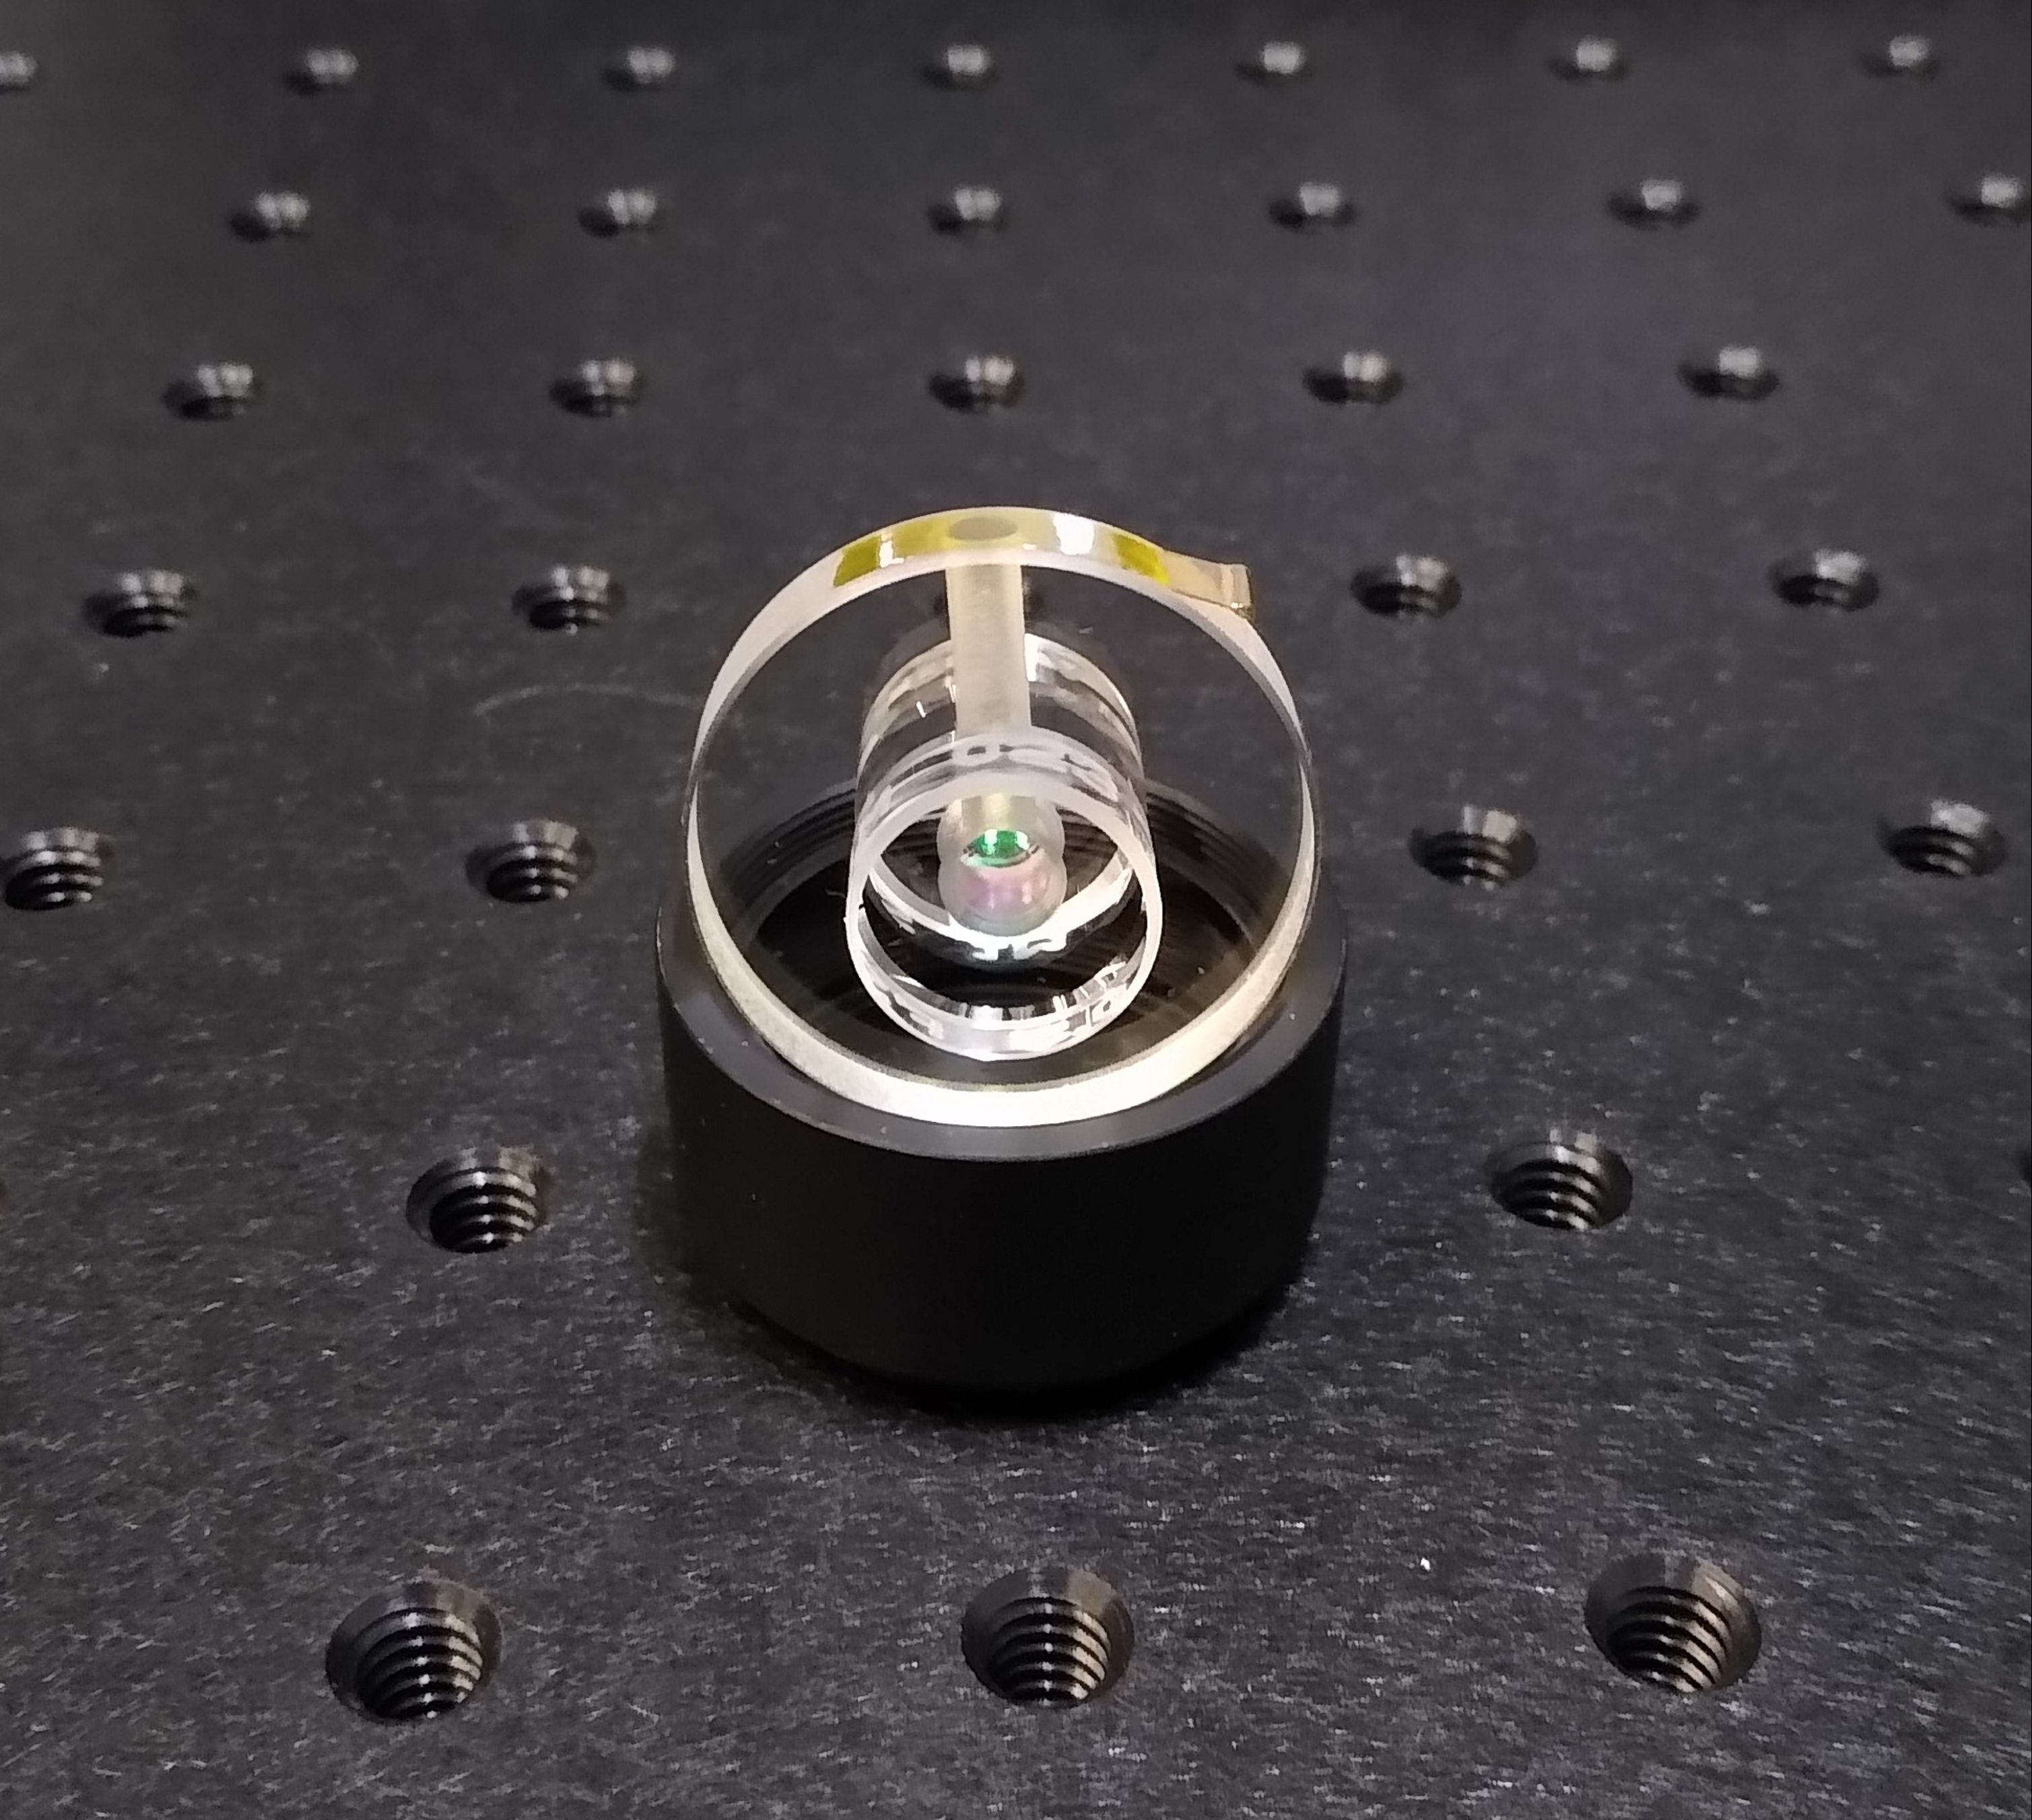
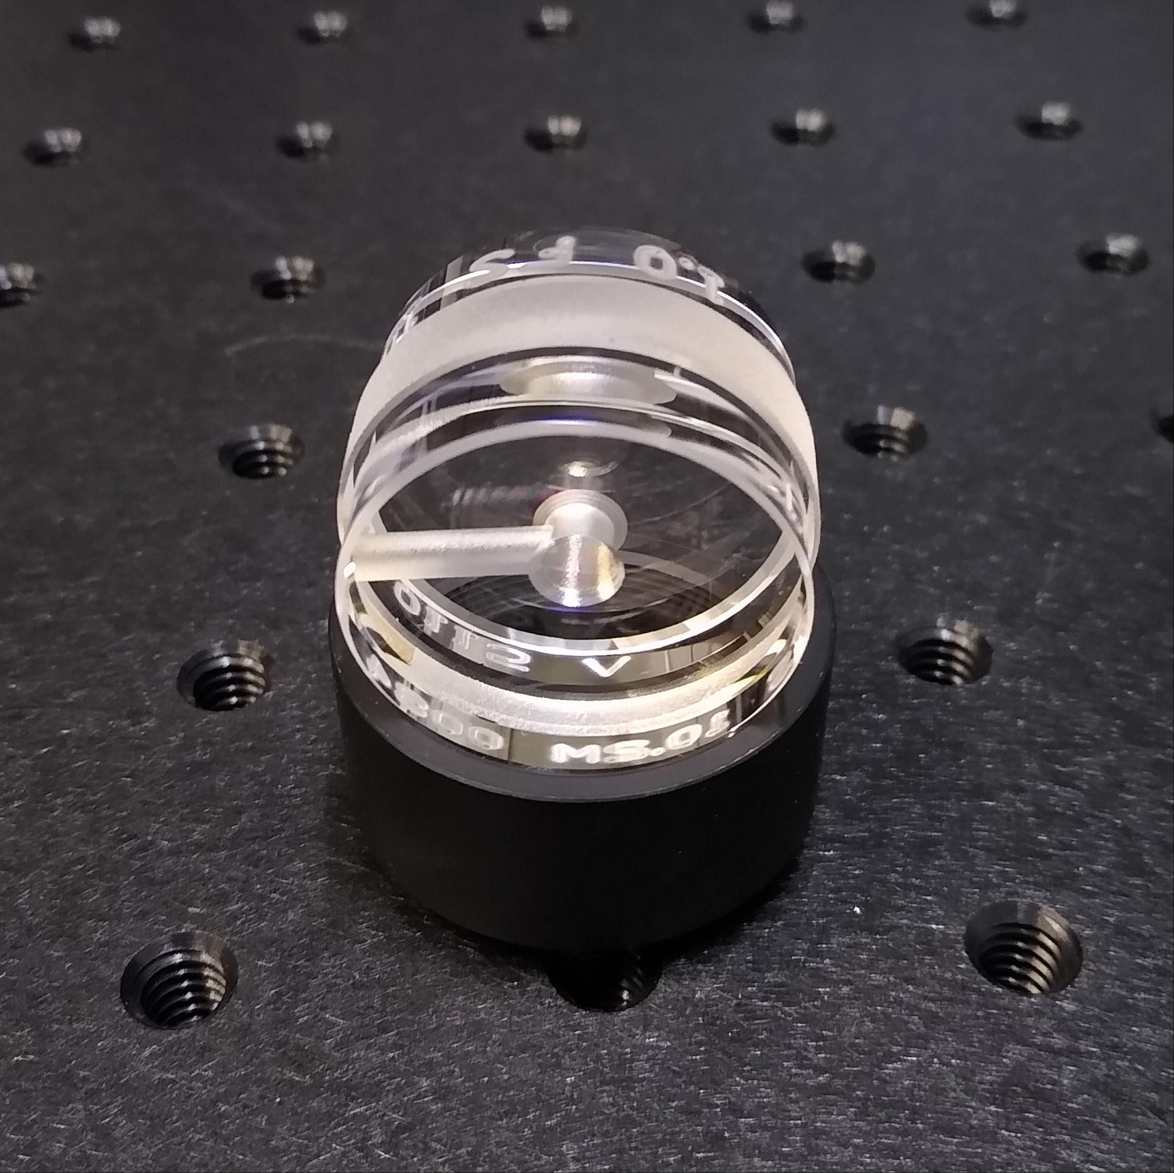
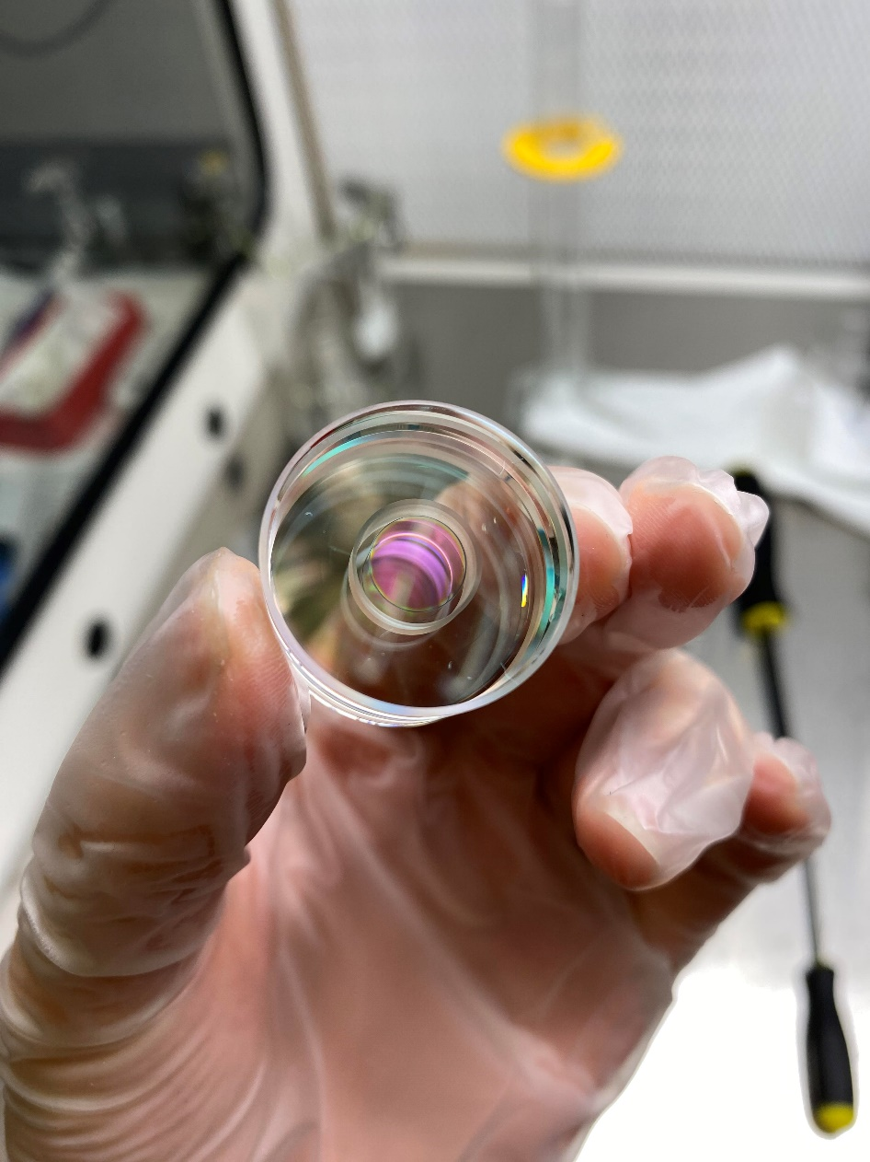
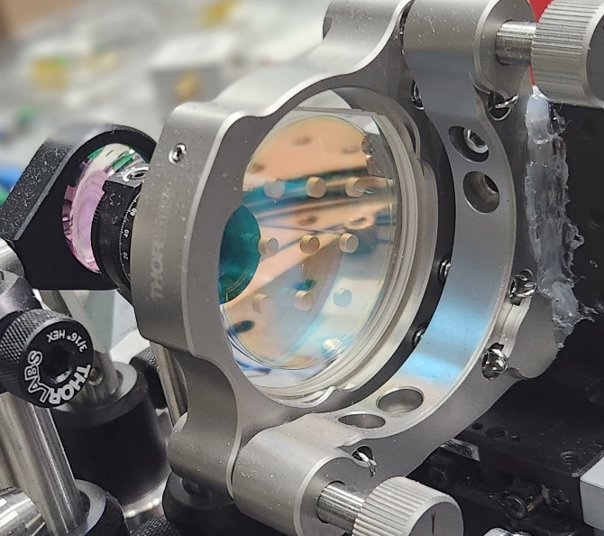
A glass menagerie
Microfabricated mirror-based cavities
In-vacuum bonded cavities

Slide 16
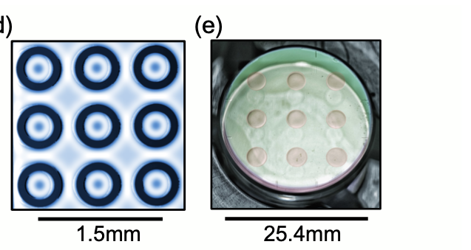
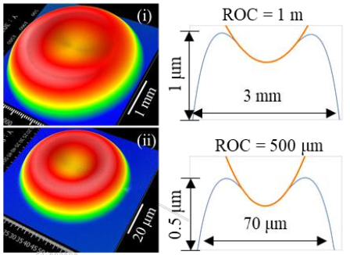
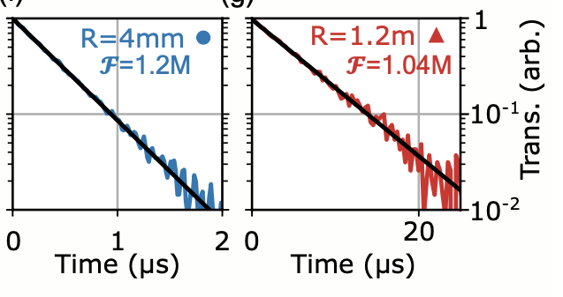

Microfabricating high finesse mirrors
Mirror layout
Small ROC
Large ROC
Mirror Fabrication
Mirror profiles
Increasing Reflow
Photoresist disk
FS or ULE
Stop reflow
Cavity ringdown & finesse
ROC
ROC
Reactive Ion Etch
Photoresist pattern is transferred to substrate via RIE
Tailorable mirror ROC and size
Mirror reflectivity > 99.9996%
Kharel, et al., APL Photonics, 3, 066101 (2018).
N. Jin, et al., Optica 9, 965-970 (2022)

Slide 17
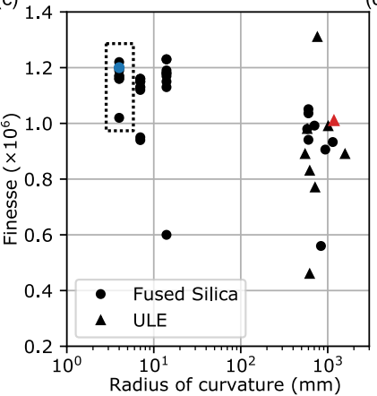
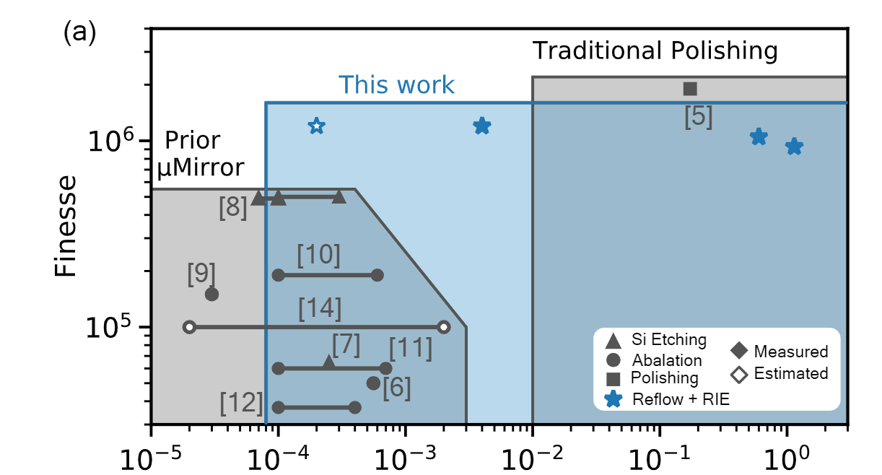

Million finesse micromirrors
Finesse compendium
Survey of state-of-the-art mirror finesse
Demonstrated ROC covers ~4 orders of magnitude
Applications range from cavity QED (small ROC) to optical clocks (large ROC)
1 million-level finesse produced with high yield
Naijun Jin, et al., Optica 9, 965-970 (2022)

Slide 18
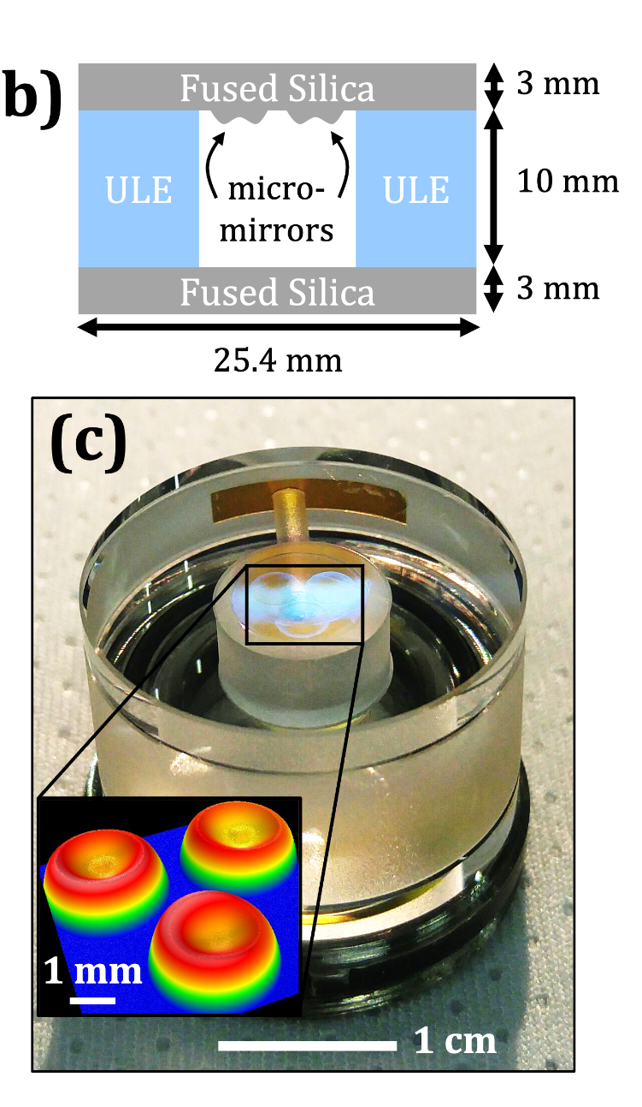
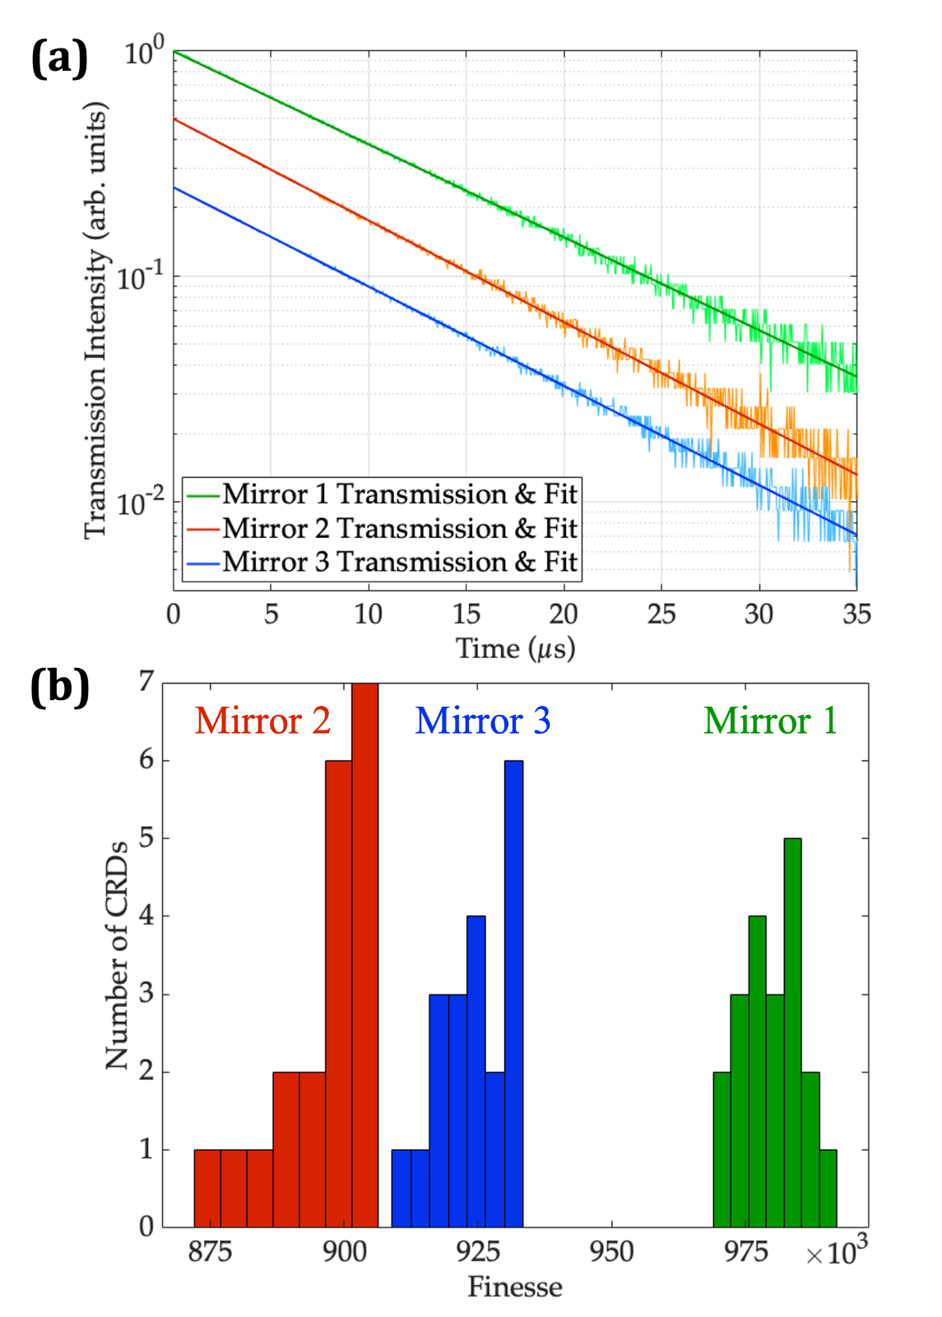
Micromirror cavities
Micromirrors are paired with a single flat mirror
Three independent cavities in a single 8 mL volume structure
Each cavity has a finesse ≥ 0.9 million
C. A. McLemore, et al., Phys. Rev. Appl. 18, 1 (2022)

Slide 19
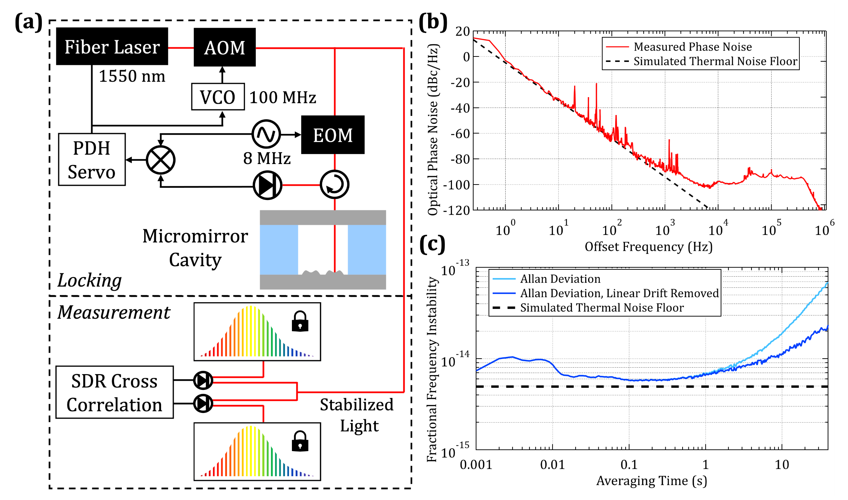
Micromirror cavity phase noise and stability
measurement
setup
Thermal noise limited performance

Slide 20
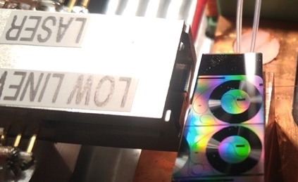
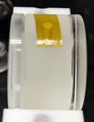
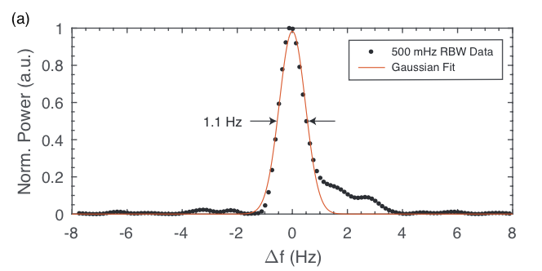
Micromirror cavity + chip-scale laser
Diode laser injection-locked to SiN ring
J. Guo et al, Sci. Adv. 8 (2022)
SOA
Stabilized laser output
SIL Laser
AOM
μFP cavity
1 Hz integrated linewidth laser
Cavity thermal noise limited to ~4 kHz
10⁻¹⁴ fractional frequency stability at 1 s
EOM
To AOM frequency
Q > 12 billion
Phase noise
PDH Servo
Linewidth
RBW = 10 Hz

Slide 21
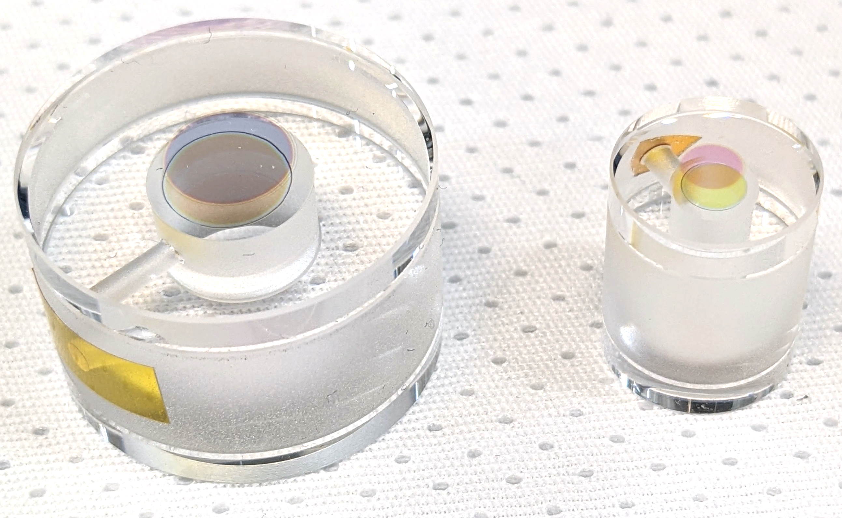
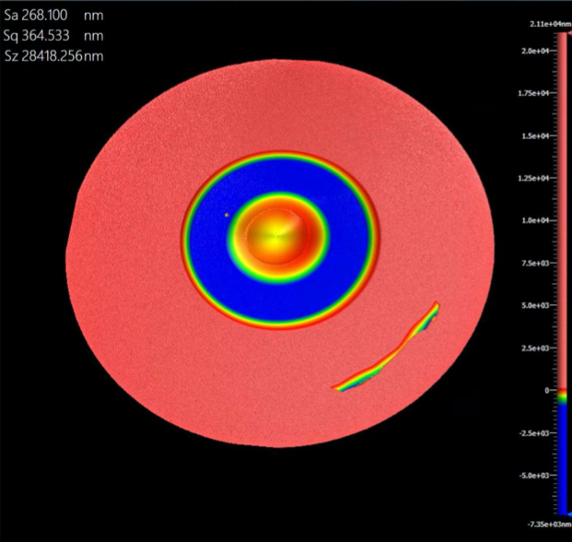



Micromirror cavities – reduction in size
Mirror profile
Mirror fab steps
3 μ-mirrors
1550 nm
1 μ-mirror
1396 nm
Sim. scattering loss: 0.6 ppm
ROC: 0.8 m
contact annulus
½”
μ-mirror
1”
Example cavity ringdown
Cavity ringdown statistics
Half-inch diameter decreases volume from 8 mL to 2 mL
Protected annulus on micromirror substrate guarantees reliable bond
Finesse is sufficient to reach thermal noise limit
Finesse = 462,000

Slide 22



Cavity in a custom can
Heat shield/rigid holder
External Alignment Jig
Assembled Vacuum System
½” diameter cavity
Macor base
Fixed pigtailed collimator
epoxy
fiber input
Custom vacuum can
Performance currently under evaluation

Slide 23
A glass menagerie
In-vacuum bonded cavities

Slide 24

Phase noise vs. air pressure
Test cavity
Optical Phase Noise
0.23
Spacer length: 6.3 mm
Spacer diameter: 27 mm
Mirror thickness: 6.35 mm
Meas. limit
Cavity is placed within a vacuum chamber with pressure monitoring
Optical phase noise is measured at different pressure settings
Tests indicate only modest vacuum ~1 torr is required to reach thermal noise limit

Slide 25




In-vacuum cavity bonding
Excess noise
500 Pa (3.75 torr)
Residual gas noise
Gas molecules perturb the optical phase as they transit the beam
25.4 mm
19.05 mm
Thermal noise limited phase noise
Still holding vacuum and going strong!
Noise model*:
$$S_{φ}\left(f\right)=\frac{4ρ{\left(2πα\right)}^{2}f_{c}^{2}}{v_{0}L^{2}f^{2}}\int_{0}^{L}{\frac{\exp\left[−2πfw\left(z\right)/v_{0}\right]}{w\left(z\right)}dz}$$
*Zucker & Whitcomb, LIGO (1994)

Slide 26



“Bake n’ bond” cavity
Thermal noise limited phase noise out to 10 kHz offset without a vacuum enclosure!

Slide 27

“Bake n’ bond” cavity
Thermal noise limited phase noise out to 10 kHz offset without a vacuum enclosure!

Slide 28



What’s next?
Vacuum bonding
micromirrors
+
In-vacuum bond cavity arrays
Dice into individual cavities

Slide 29


“minicube” cavity – preliminary results
In-vacuum micro-FP: bonded and diced at Yale
Preliminary phase noise
Cavity with micro-fabricated mirror
10 mm
7 mm
7 mm
Cavity in NIST-made holder
Noise matches thermal noise limit from ~10 Hz to ~200 Hz
Bake n’ bond could improve noise from 200 Hz to 10 kHz

Slide 30

Summary
Microwave signals with optical clock stability
High finesse micro-mirror cavities
Low phase noise with in-vacuum bonding
“minicube” cavities

Slide 31







Lots of contributors!
Peter Rakich
Naijun Jin
Andrey Matsko
Vladimir Iltchenko
Wei Zhang
John Bowers
Joel Guo
Joe Campbell
Steven Bowers
Scott Diddams
Andrew Ludlow
Scott Papp
Tara Fortier
Kerry Vahala
Funding

Slide 33

Optical clock diagram

Slide 34

OFD frequency

Slide 35

OFD noise
Two independent OFD systems
Phase fluctuation
48th harmonic
Common
optical reference
10 GHz
Er:Comb
208MHz
Digital sampling
Sampling rate: 100 Hz
(ADC)
1.5 mrad
Optical cavity
@1070 nm
MHz
10 GHz +1.5MHz
SDR
Er:Comb
156MHz
64th harmonic
PC
Phase deviation
Phase noise
Allan deviation, etc..
No cycle slip for 12 hours
Noise of reference was cancelled out
Estimate OFD system noise

Slide 36
Linewidth
Optical Clock
Microwave

Slide 37
Linewidth
Optical Clock
Microwave

Slide 38
Linewidth
Optical Clock
Microwave

Slide 39
Linewidth
Microwave is still transform-limited after 44000 seconds
Difference between measured sinewave and “perfect” sinewave not visible on a linear scale

