Slide 1

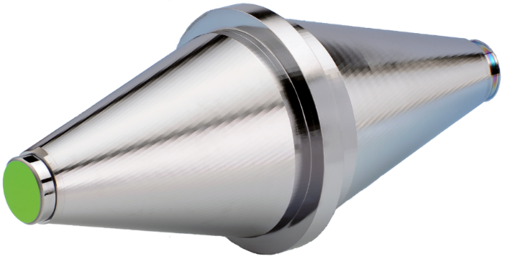
Ultrastable Lasers
New Developments and Challenges
Uwe Sterr, Jialiang Yu, Thomas Legero, Sofia Herbers,
Daniele Nicolodi, Mona Kempkes, Chun Yu Ma, Fritz Riehle
Physikalisch-Technische Bundesanstalt, Braunschweig Germany
Dhruv Kedar, John M. Robinson, Jun Ye
JILA, NIST and University of Colorado, Boulder, CO, USA
The 9th Symposium on Frequency Standards and Metrology
Kingscliff, Australia , 16-20 October 2023

Slide 2
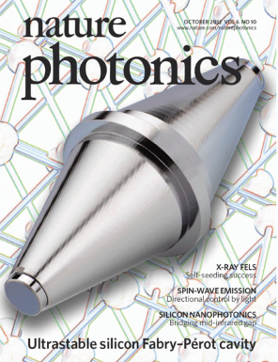
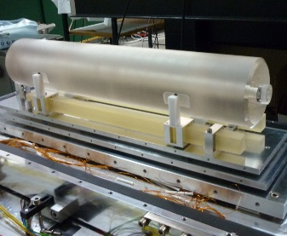
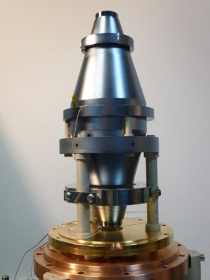
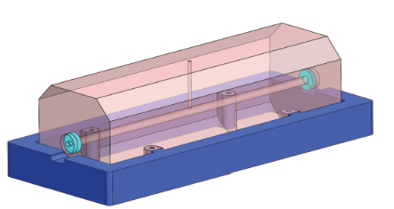
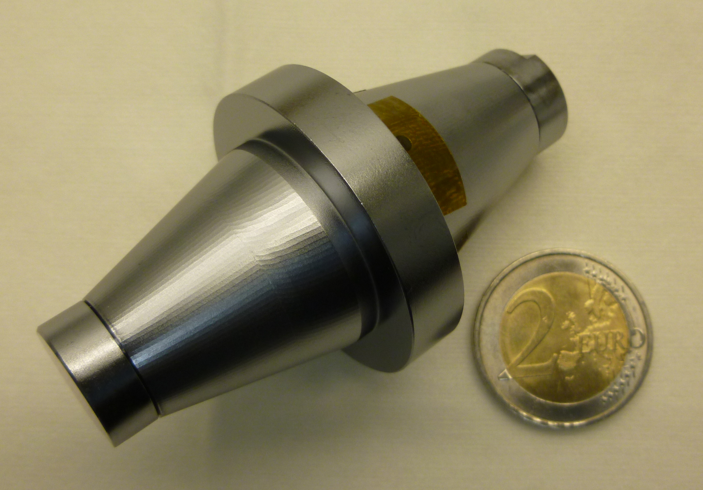
Progress of cavity-stabilized lasers
48 cm
ULE
21 cm
silicon
@ 124 K
21 cm silicon
@ 124 K
JILA/
NIST
6 cm
silicon
@ 4 K
10⁻¹⁶
PTB/
JILA
PTB
JILA/
PTB
40 cm ULE
PTB/
JILA
1 × 10⁻¹⁷ ?
S. Häfner,
PhD thesis (2015)
Notes:
Long history both room temperature and cryogenic cavities. Now with silicon 4 times 10-17. I want to show the next step towards the 1 times 10-17 range.

Slide 3
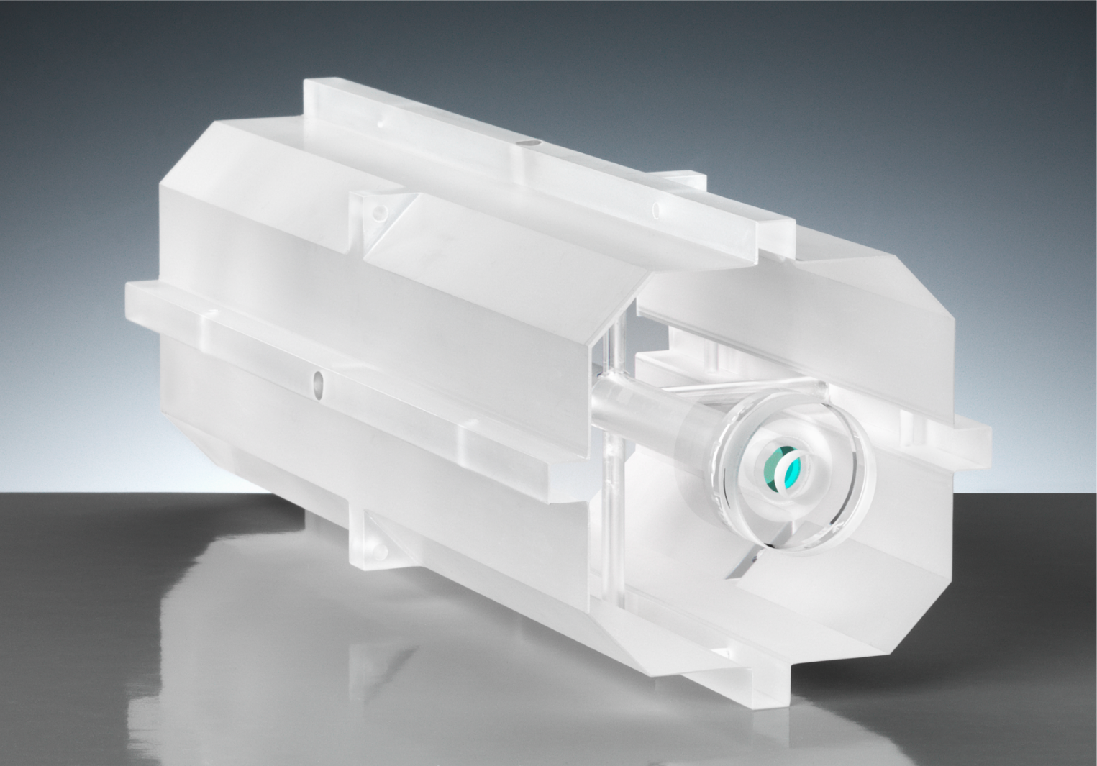
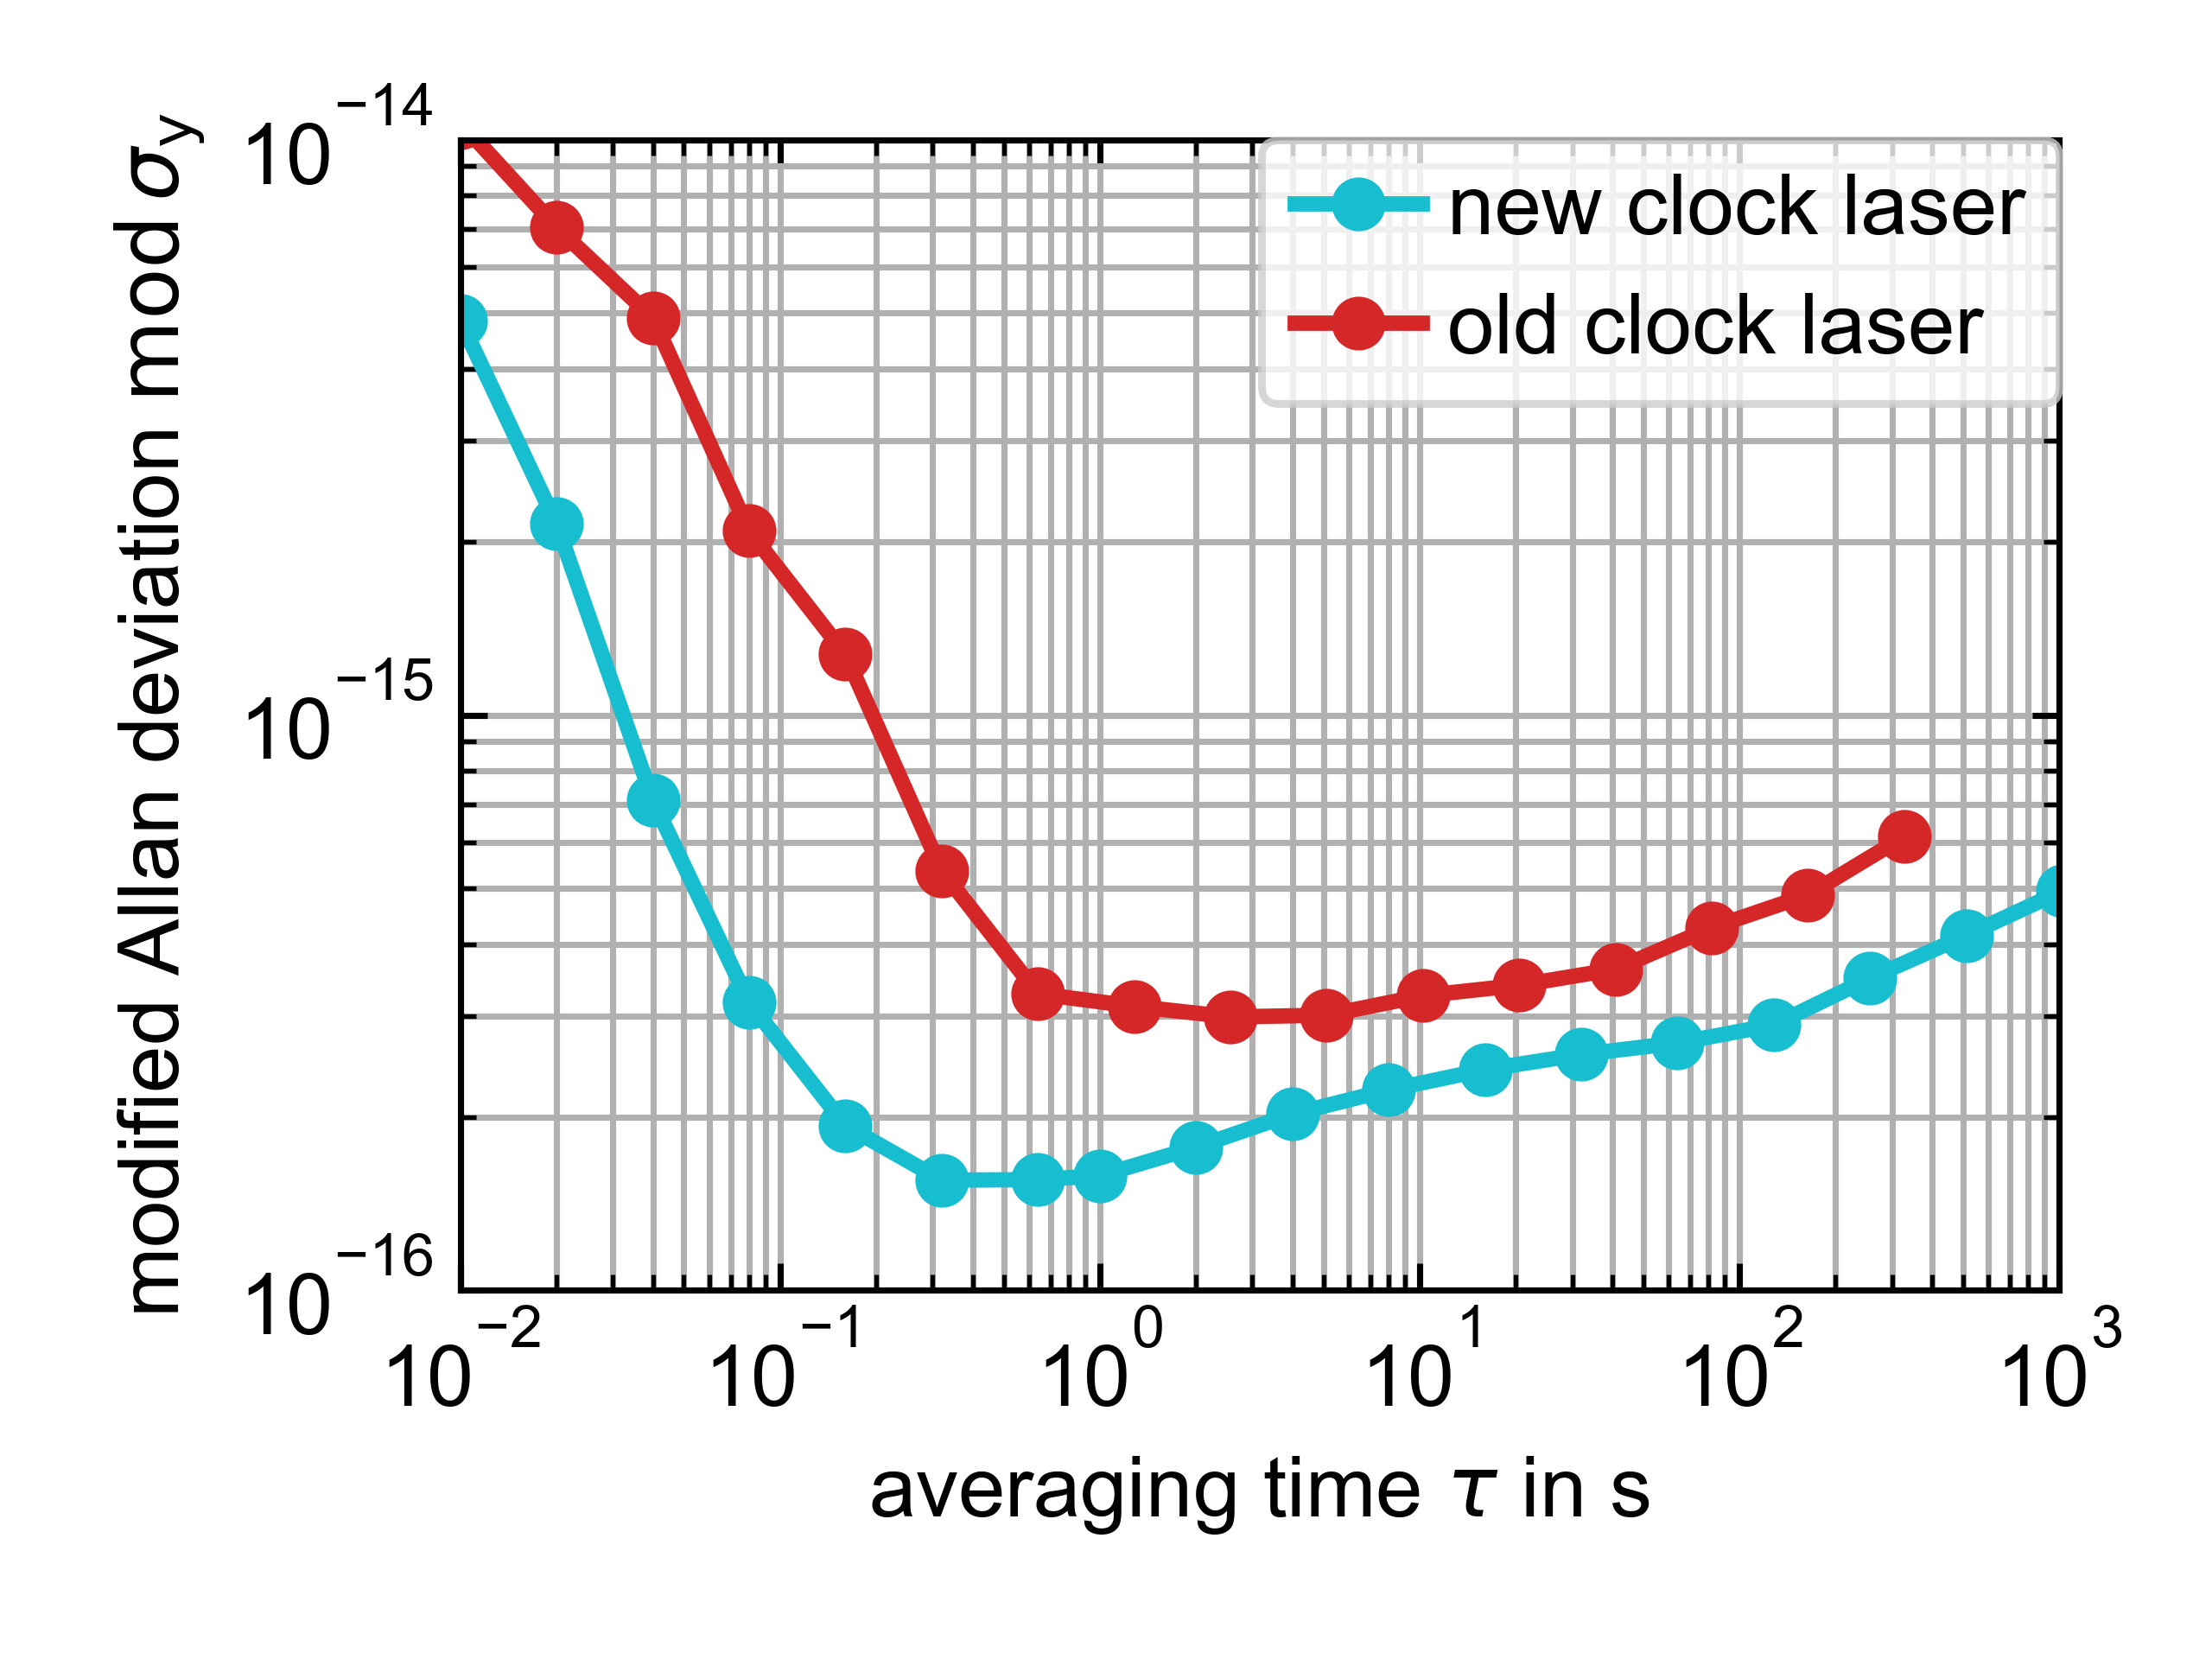
Transportable 1400 nm Sr clock laser
acceleration sensitivity: 3(3)×10⁻¹¹/g
fused-silica mirror substrates
20 cm ULE glass spacer
crystalline AlGaAs/GaAs
mirror coatings
S. Herbers, S. Häfner, S. Dörscher, T. Lücke, U. Sterr and C. Lisdat
Opt. Lett. 47, 5441-5444 (2022)

Slide 4
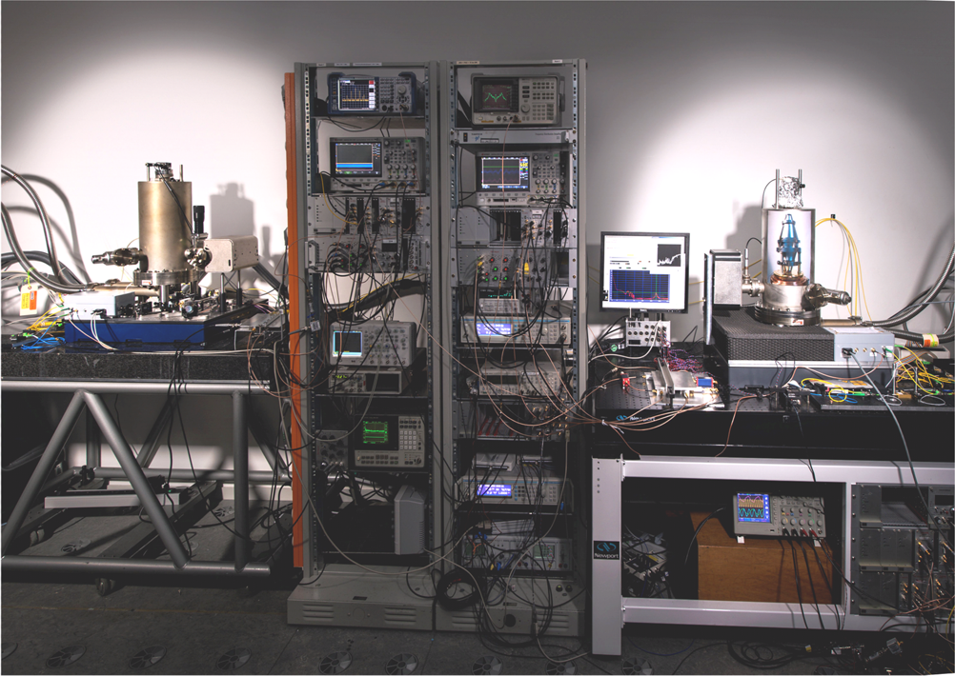
Cryogenic silicon optical resonator
Si3
Si2
Silicon spacer
dielectric mirror coatings
L = 212 mm
T = 124 K
zero thermal expansion

Slide 5
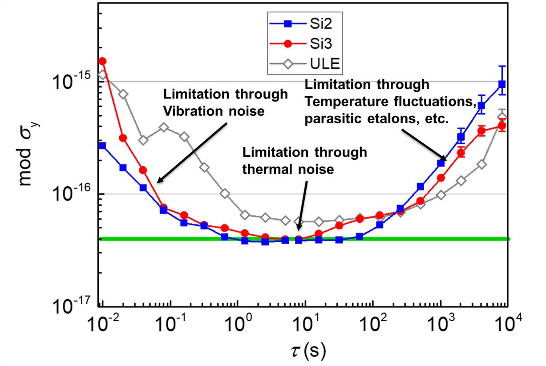
Cryogenic silicon optical resonator
Two systems with dielectric coatings
L = 212 mm
T = 124 K
Stability limited by thermal noise to 4×10⁻¹⁷
Si3 moved to JILA in 2017
next steps - reduce
thermal noise
D. Matei et al., Phys. Rev. Lett. 118, 263202 (2017)

Slide 6
Flywheel for an optical timescale
daily measurements to Sr-lattice clock
with 25 % uptime
estimated error < 150 ps over one month
cavity drift in June 2023:
-48 µHz/s
-4.1 Hz/day
at 1542 nm
(about 1000 times less than ULE)

Slide 7
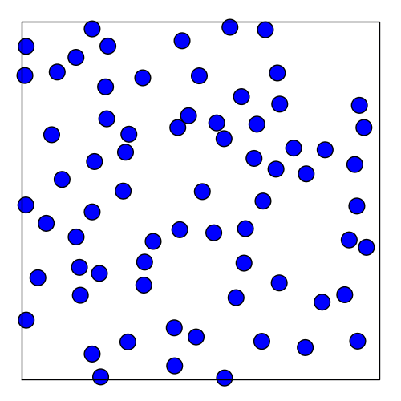
Brownian Noise in Fabry-Perot Cavities
High-finesse optical cavity
Fluctuation-dissipation theorem relates length fluctuations to mechanical loss ϕ_{x}
L
thermal noise for a 20 cm long cavity:
thermal noise reduction:
go to low temperatures T
enlarge cavity length L
T =124 K
enlarge mode diameter
choose low loss material
K. Numata, A. Kemery, J. Camp, Phys. Rev. Lett. 93, 250602 (2004)

Slide 8
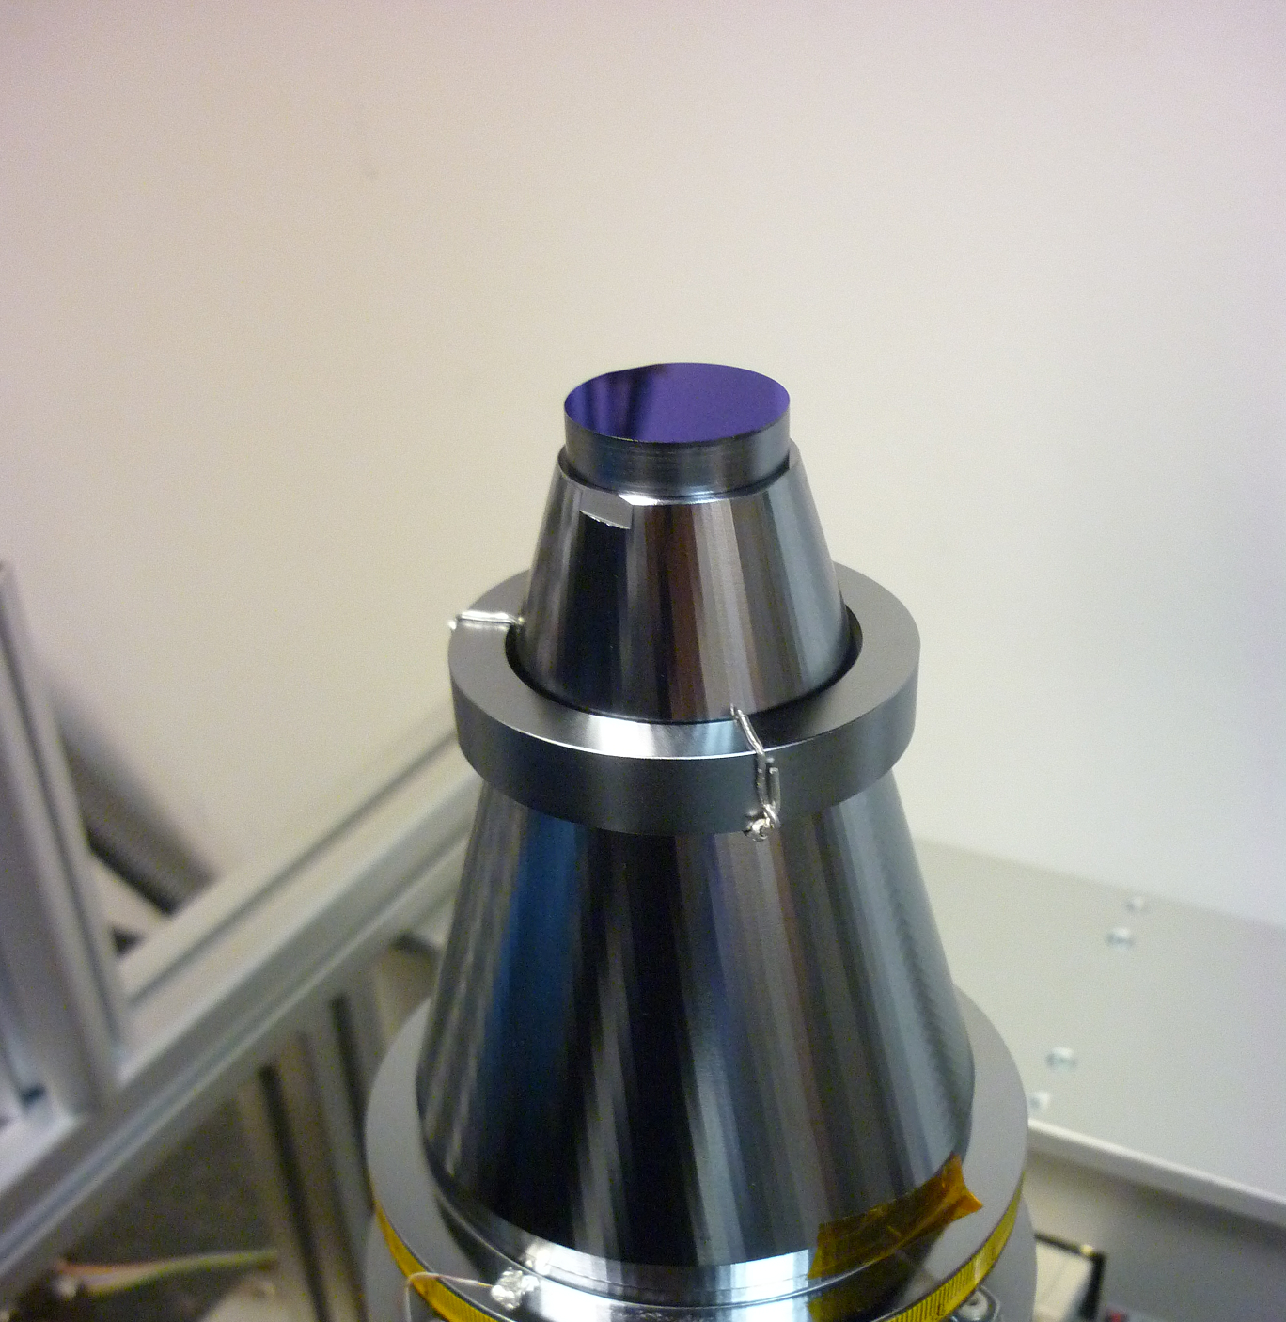
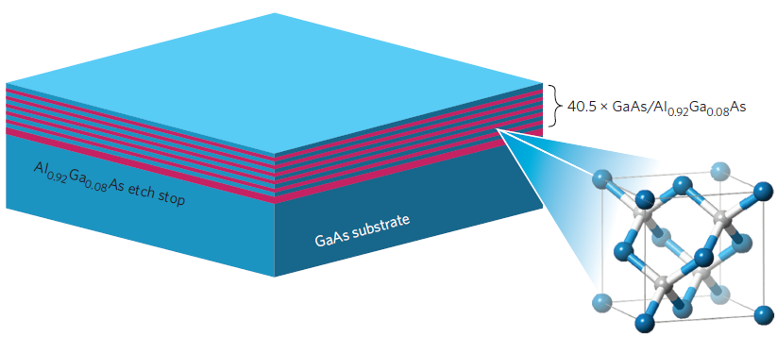
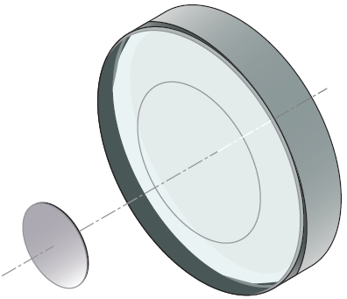
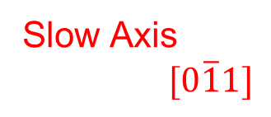

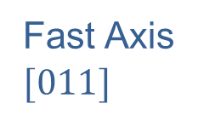
AlGaAs crystalline mirror coatings
GaAs/
AIGaAs
DBR disc
silicon
substrate
GaAs
$$[\overline{1}00]$$
Fast Axis
$$[011]$$
Slow Axis
$$[0\overline{1}1]$$
σ_{y}(τ) = 4×10⁻¹⁷
Cole et al., Nat. Phot. 7 (2013) 644
σ_{y}(τ) = 1×10⁻¹⁷
Cavity length | L = 212 mm
Mirrors | 2x plano-concave (2 m ROC)
Finesse | 380 000 at 124 K
Free Spectral Range | 707 MHz
Birefringent mode splitting | 200 kHz
Thermal noise | mod σ_{y}(τ) = 1×10⁻¹⁷
ϕ = 5×10⁻⁴
ϕ = 2.5×10⁻⁵
coating: n_{slow} > n_{fast}

Slide 9
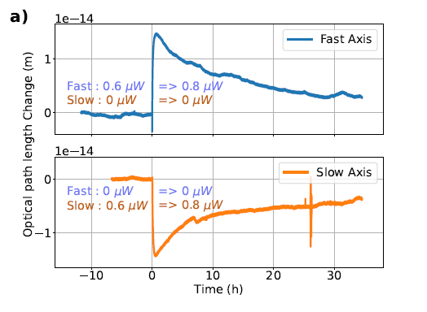
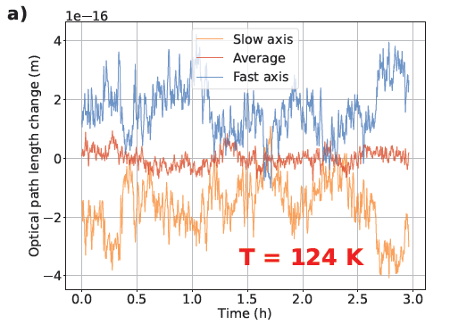
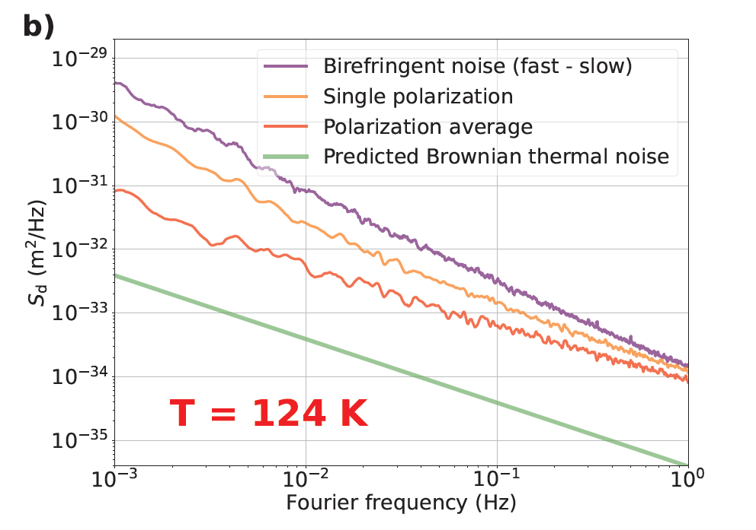
Novel noise contributions at low temperatures
light-modified birefringence
birefringent noise
global excess noise
non-thermal, light-induced change
of cavity resonance
different sign for fast and slow axis
time constant of many hours !
even with stabilized laser power
anticorrelated in fast and slow axis
correlation length < mode diameter
so far only observed at 4K, 16K, 124K
remaining noise when averaging
birefringent noise
exceeds Brownian thermal noise
correlation length > mode diameter
Δn_{stat} ≈ 10⁻⁴
Δn_{photo} ≈ 10⁻⁸
Δn_{noise} ≈ 10⁻¹⁰

Slide 10
Novel noise contributions at low temperatures
light-modified birefringence
Possible explanation:
Light is exciting carriers in the AlGaAs / GaAs
semiconductor building up electric field along
the coating ?
non-thermal, light-induced change
of cavity resonance
different sign for fast and slow axis
time constant of many hours !
linear electro-optic effect ?
Δn ≈ r₄₁ n₀³ E
electro-optic tensor component r₄₁ = 1.5 pm/V
refractive index GaAs n₀ ≈ 3.48
E ≈ 3 kV/m
small compared to electric field strengths in heterojunctions
Δn_{stat} ≈ 10⁻⁴
Δn_{photo} ≈ 10⁻⁸
S. Namba, J. Opt. Soc. Am. 51, (1961) 76 L. Ho, C. Buhrer, Appl. Opt. 2, 647 (1963)

Slide 11
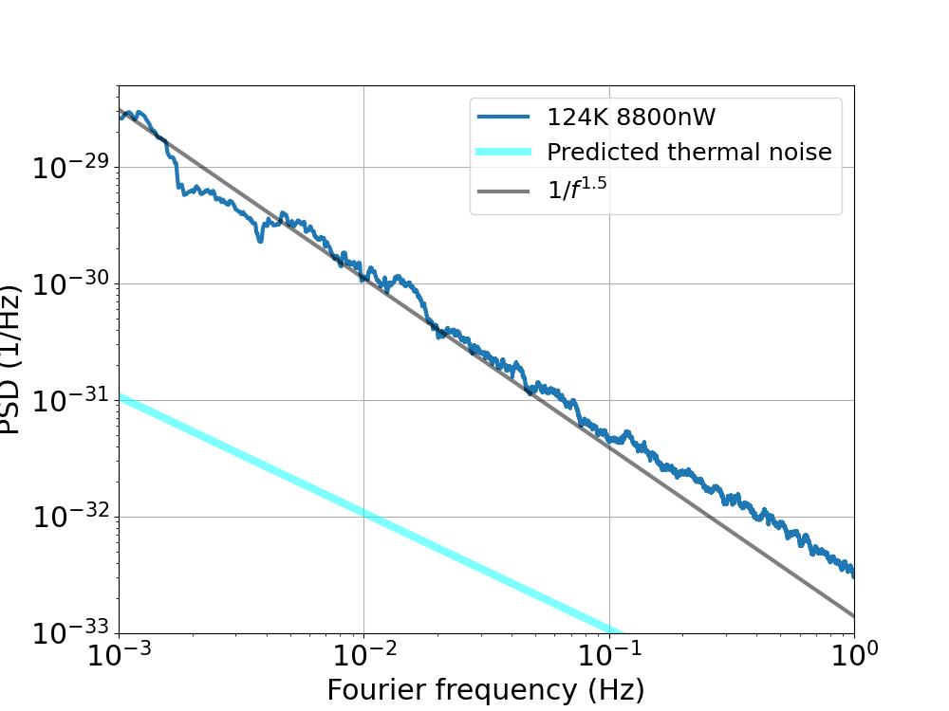
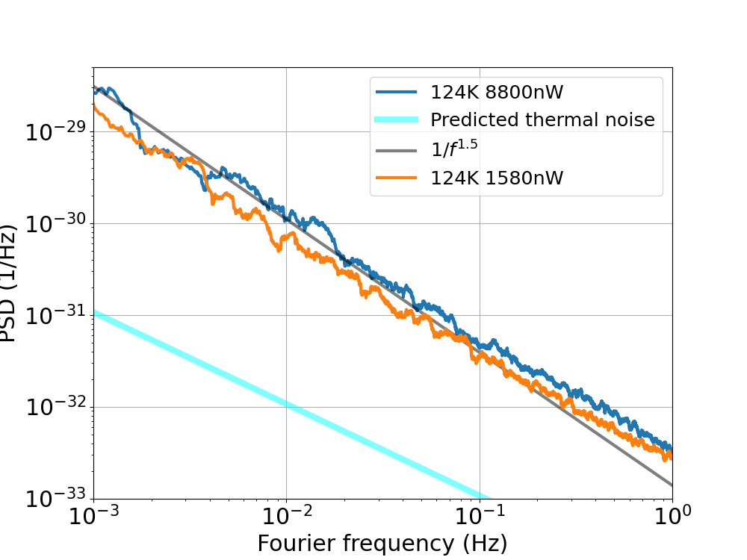
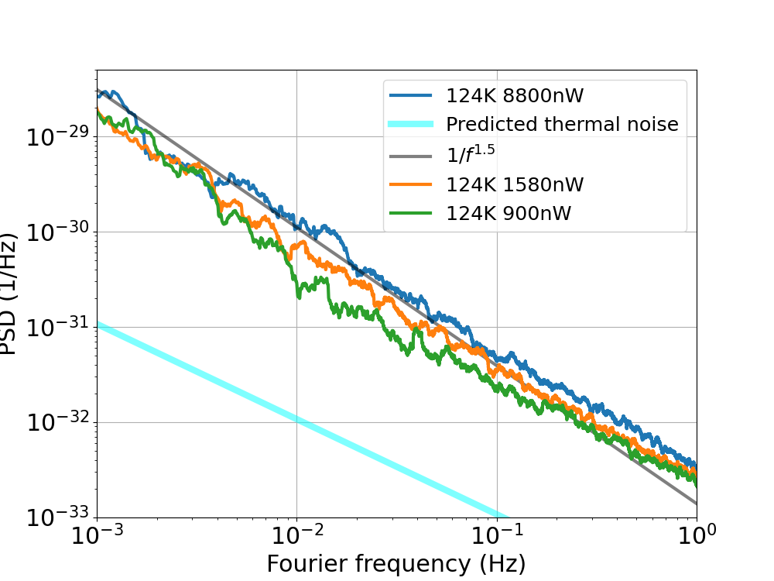
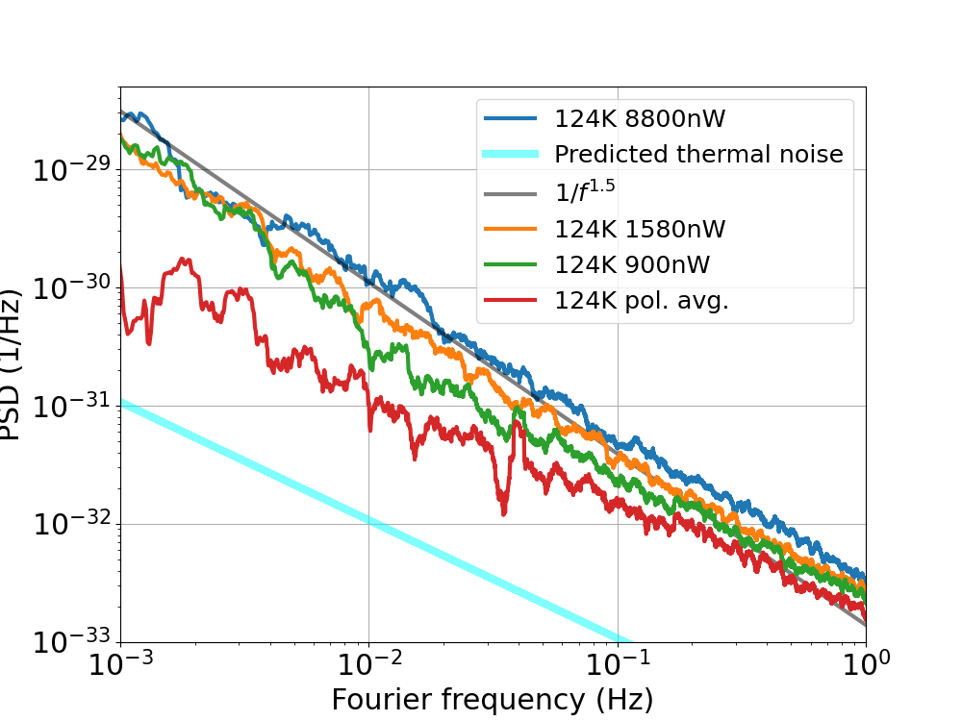
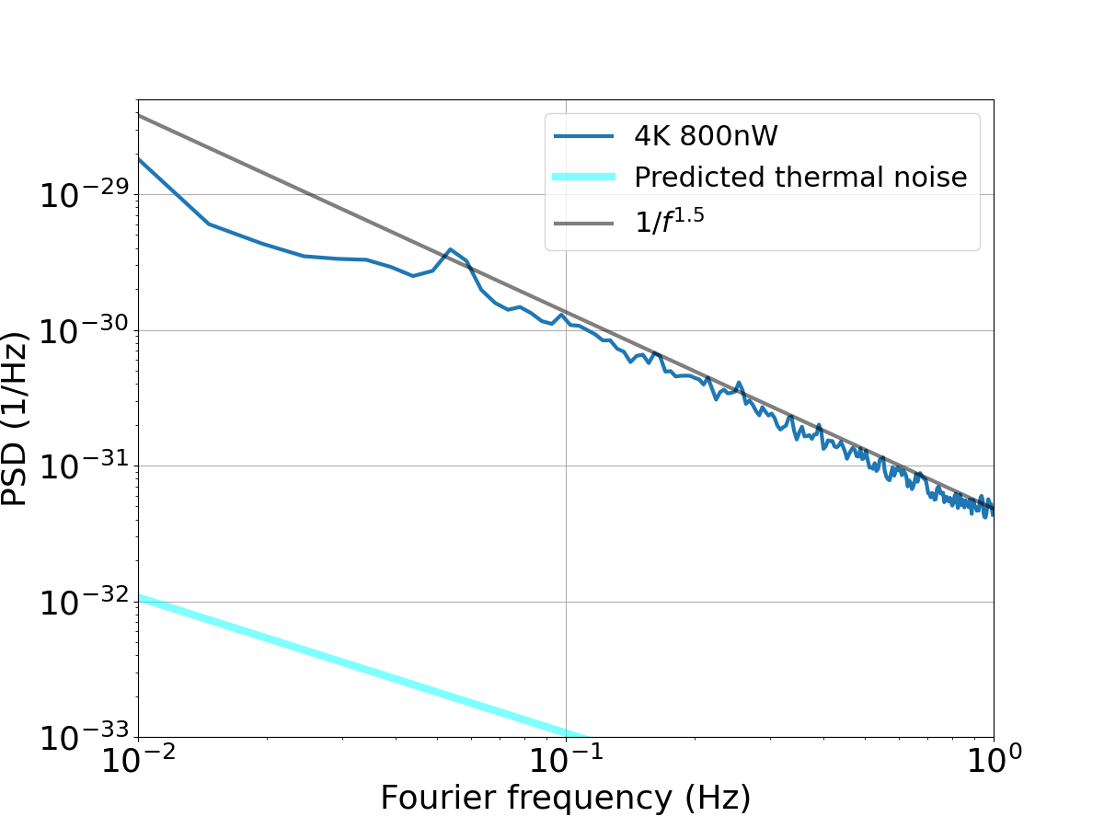

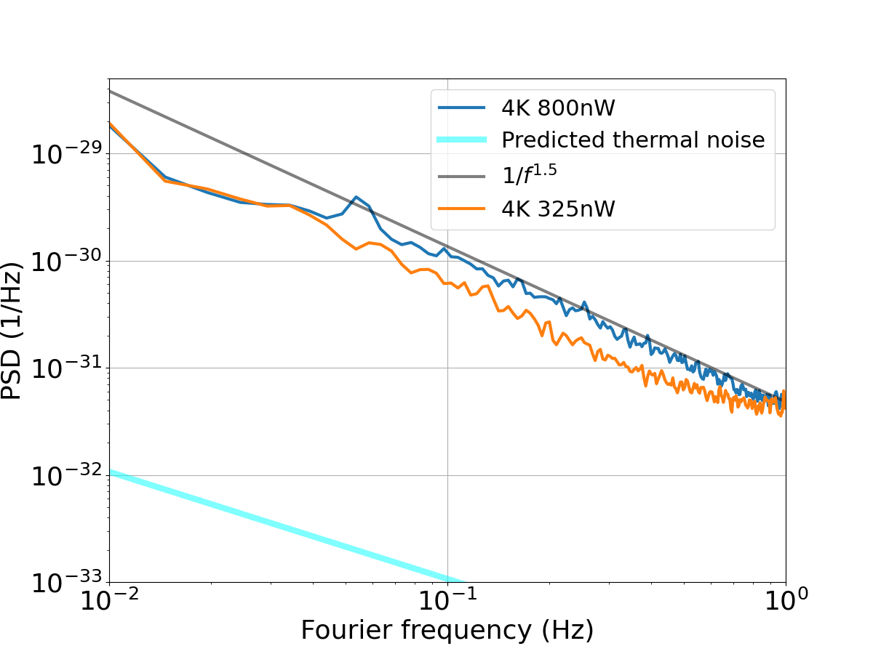
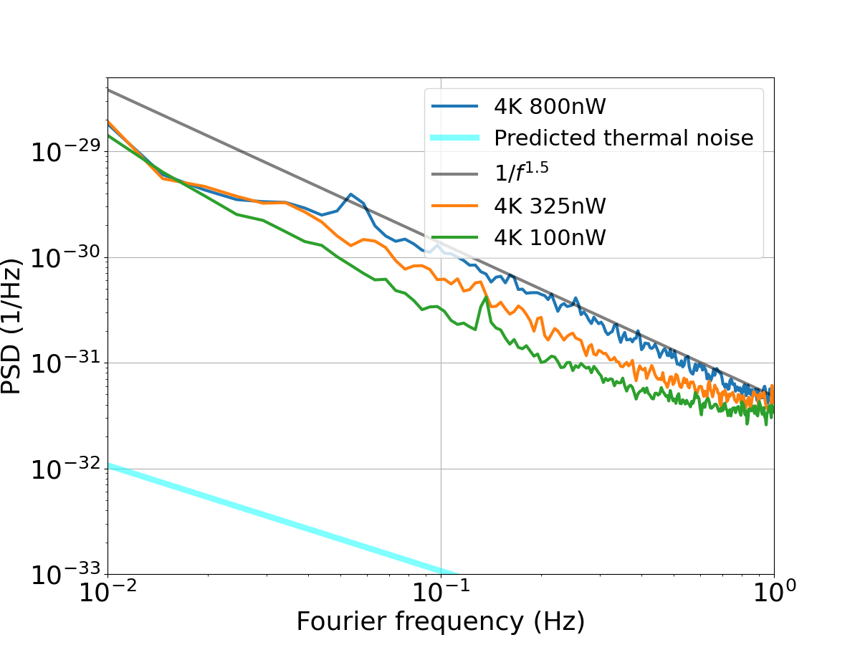
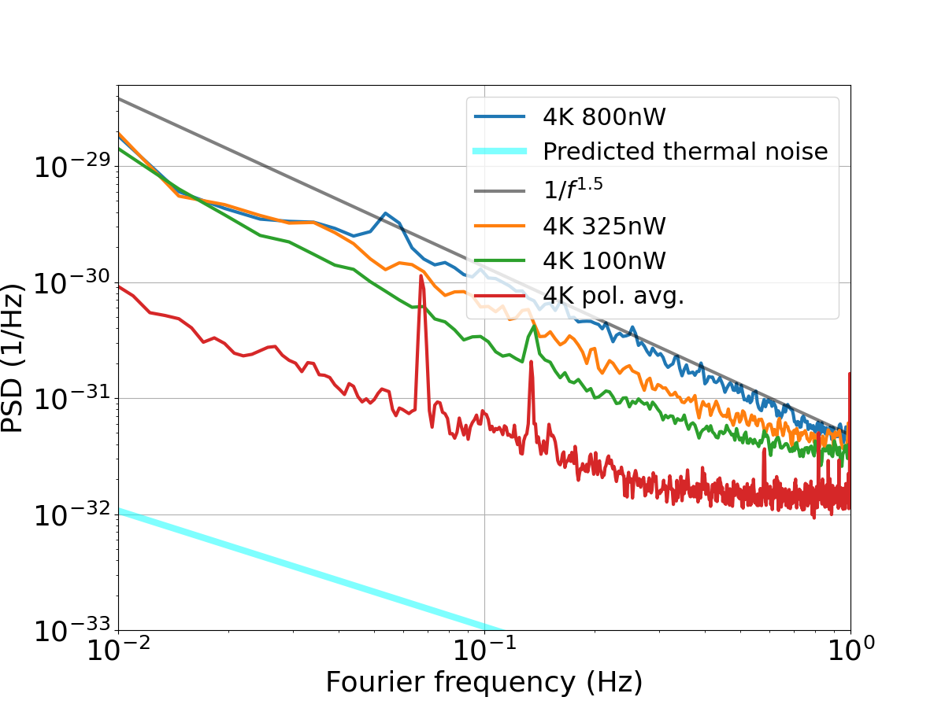
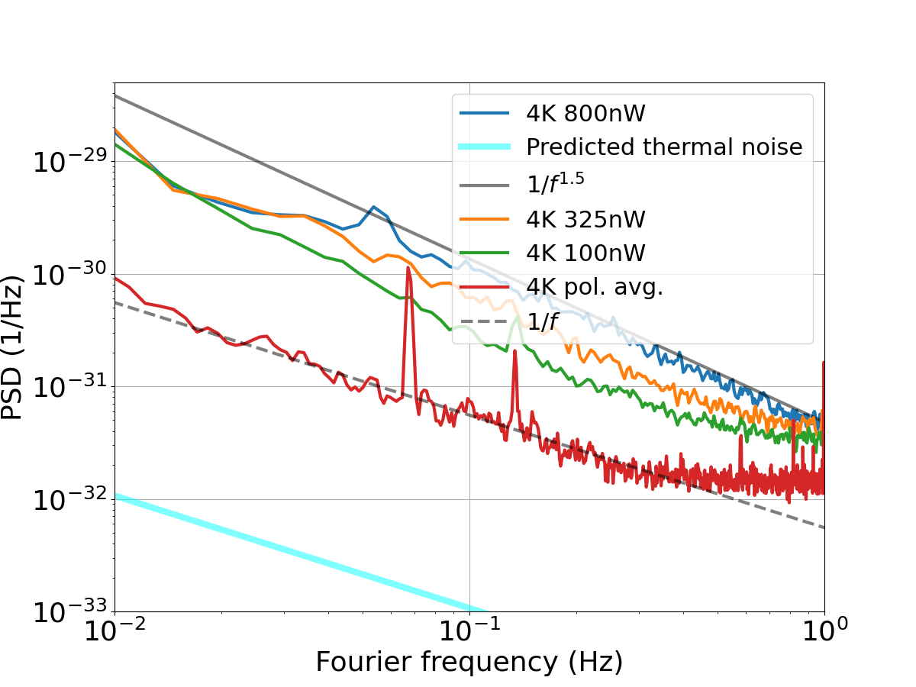
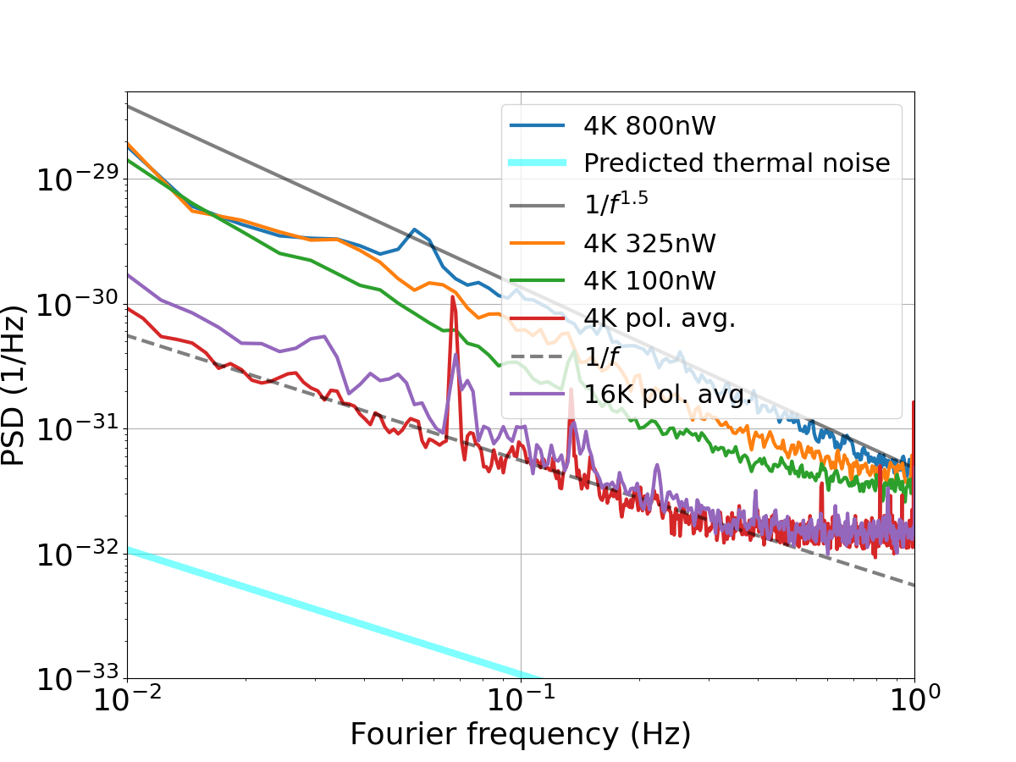
Measurements at 124 K and 4 K
JILA 6 cm Si cavity at 4 K
PTB 21 cm Si cavity at 124 K
Birefringent noise
1/f excess noise
Non-thermal

Slide 12
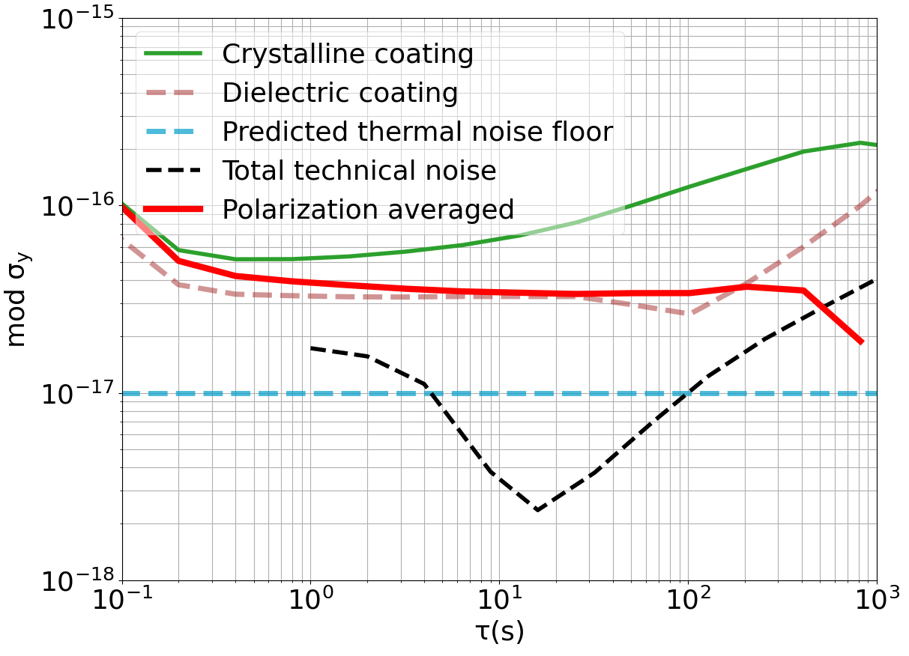
Stability at 124 K
AlGaAs single polarization
AlGaAs polarization averaged
dielectric coating
expected Brownian noise
technical noise
Birefringent noise can be removed with polarization averaging
The remaining frequency stability
σ_{y} ≈ 4×10⁻¹⁷
is still higher than predicted thermal noise
Origin of remaining noise:
Brownian thermal noise?
ϕ(124 K) ≫ ϕ(300 K) ?
Other unidentified noise?

Slide 13
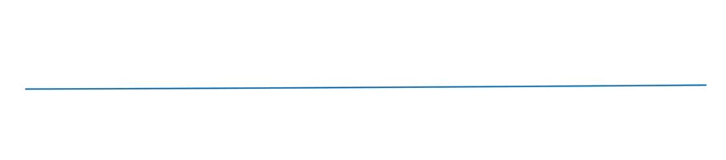
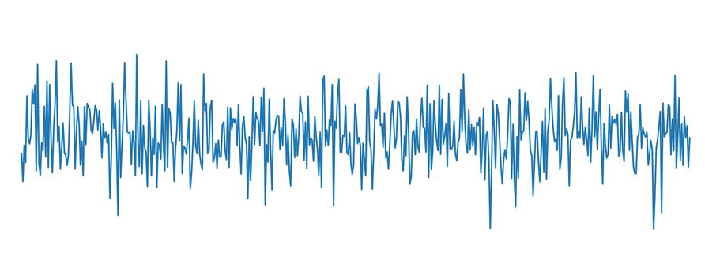
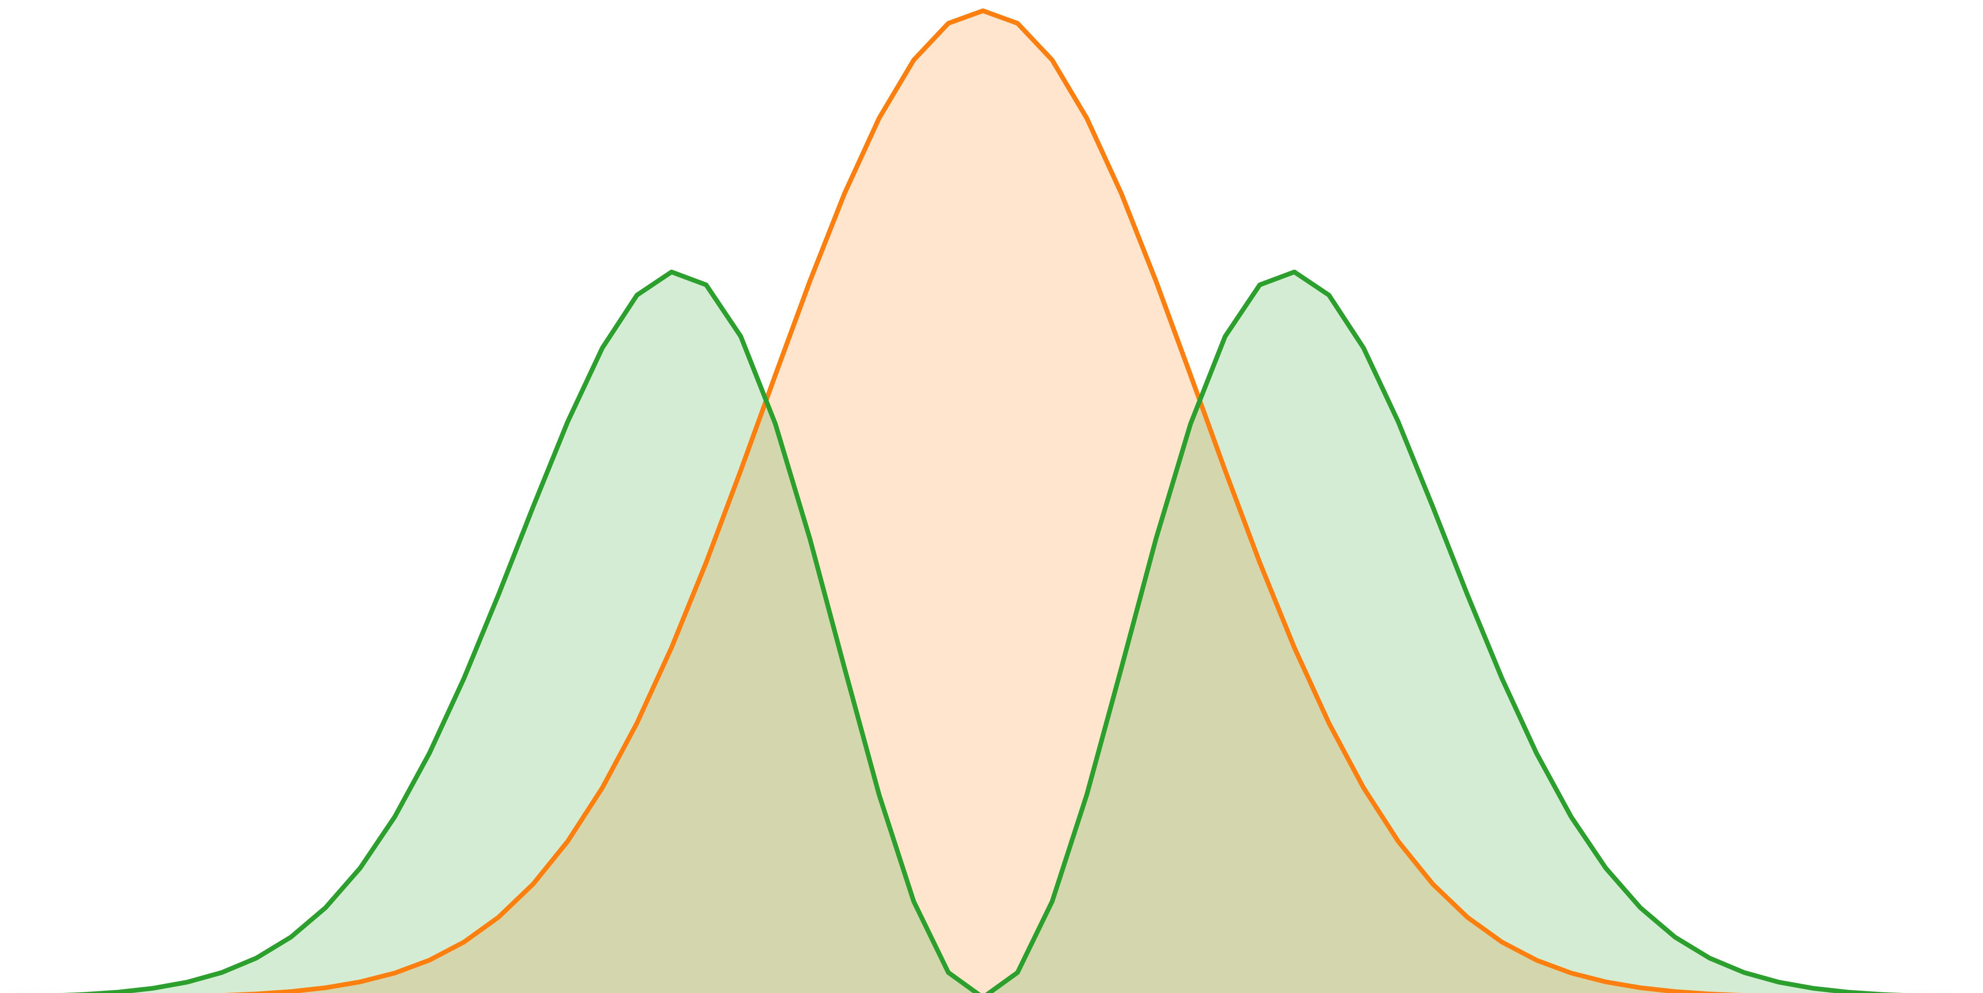

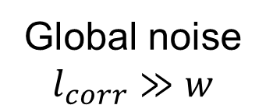

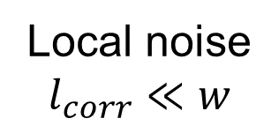
Spatial noise correlation on mirror
Global noise
$$l_{corr}≫w$$
Local noise
$$l_{corr}≪w$$
$$δx$$
$$δx$$
Cavity temperature fluctuation
Vibrations
Thermo-optic noise (т > 1 s)
etc.
Coating Brownian thermal noise
Birefringent noise
Notes:
For local noise, the freq. fluc. Of the two HG modes are partially uncorrelated.
We used the method described in the following slides to determine the spatial correlation of birefringent noise, it turned out that birefringent noise is also a local noise

Slide 14
Measurement of Brownian thermal noise

Slide 15
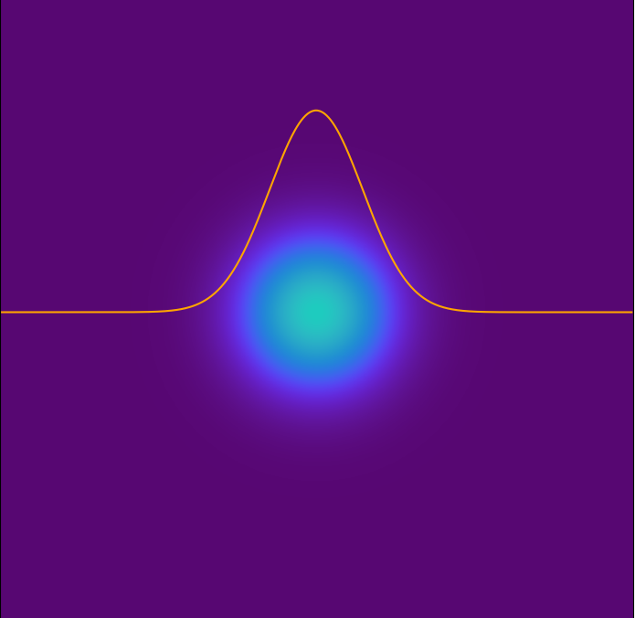
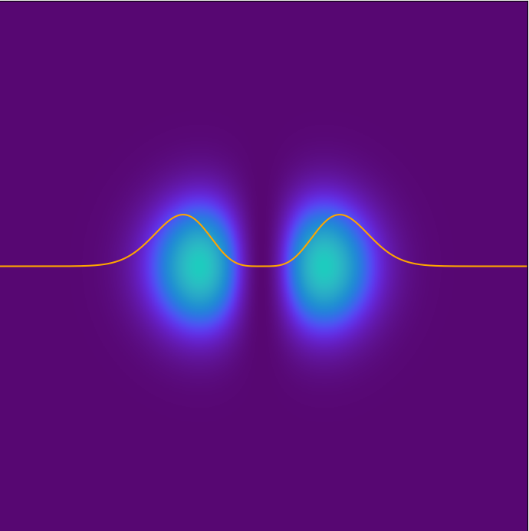
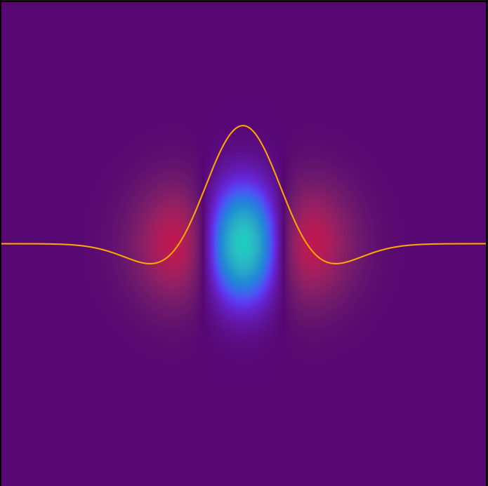

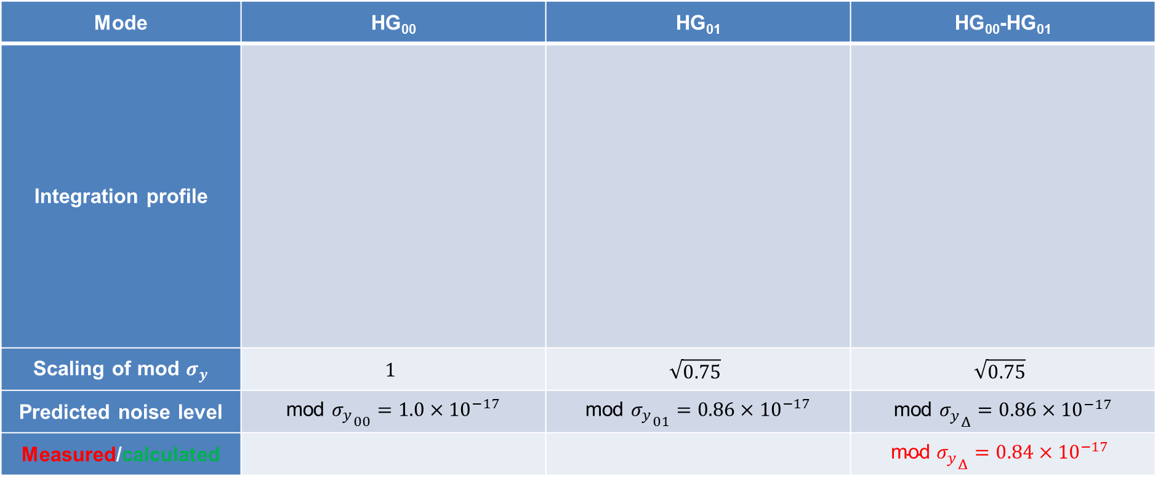

Brownian thermal noise
Determine upper limit of coating Brownian thermal noise
Mode | HG₀₀ | HG₀₁ | HG₀₀-HG₀₁
Integration profile
Scaling of mod $σ_{y}$ | $$1$$ | $$\sqrt{0.75}$$ | $$\sqrt{0.75}$$
Predicted noise level | mod ${σ_{y}}_{00}=1.0×{10}^{−17}$ | mod ${σ_{y}}_{01}=0.86×{10}^{−17}$ | mod ${σ_{y}}_{Δ}=0.86×{10}^{−17}$
Measured/calculated |  |  | $$\text{mod} {σ_{y}}_{Δ}=0.84×{10}^{−17}$$
φ(124 K) ≈ φ(300 K)
mod ${σ_{y}}_{00}=0.97×{10}^{−17}$
mod ${σ_{y}}_{01}=0.84×{10}^{−17}$

Slide 16
Further investigations at room temperature

Slide 17
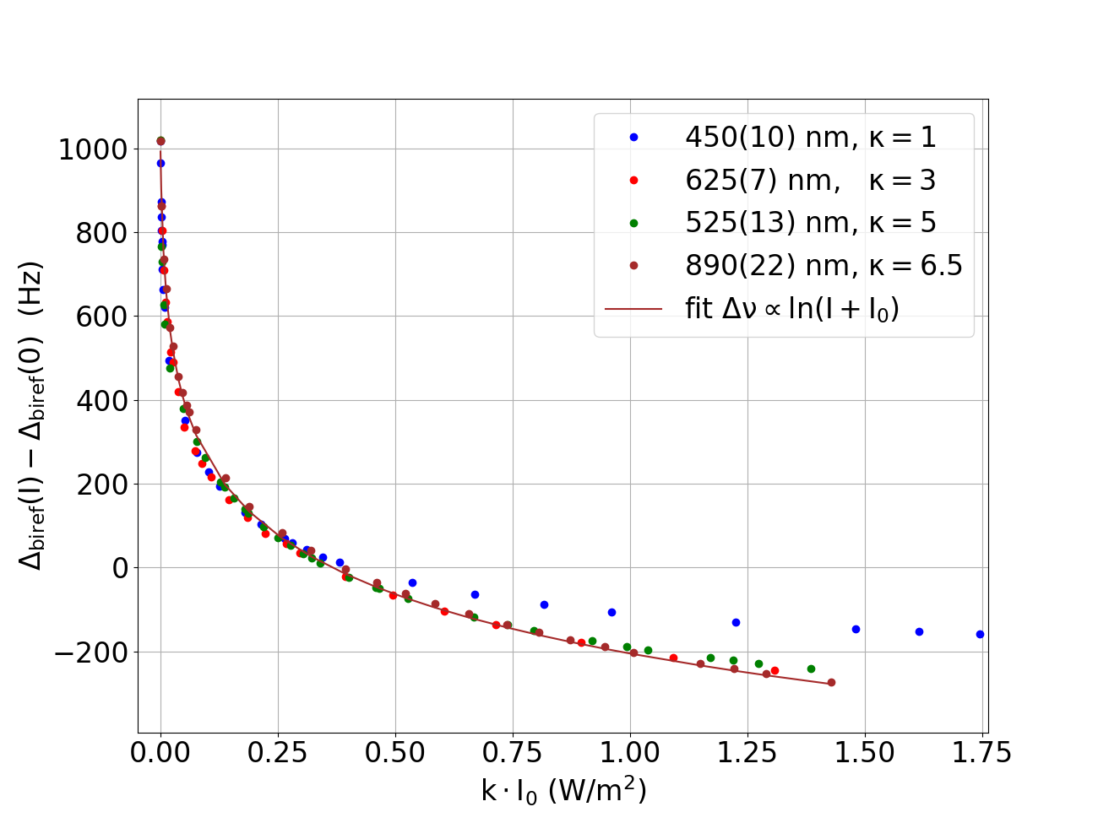
Sensitivity to external light
Fused Silica
LED
Δn (I_{ext})
38.5 layer pairs
GaAs (115.6 nm)
Al_{0.92}Ga_{0.08}As (133.2 nm)

Slide 18
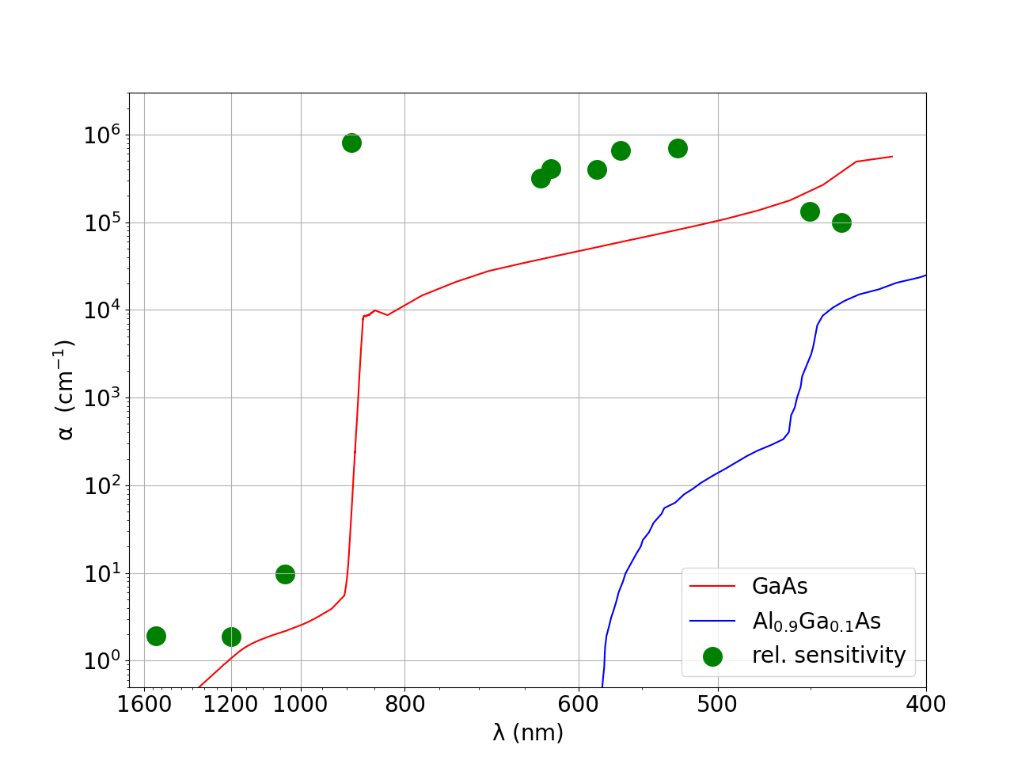
Wavelength-dependent sensitivity
Fused Silica
LED
Δn (I_{exr})
38.5 layer pairs
GaAs (115.6 nm)
Al_{0.92}Ga_{0.08}As (133.2 nm)
fractional sensitivity (arb. u.)

Slide 19

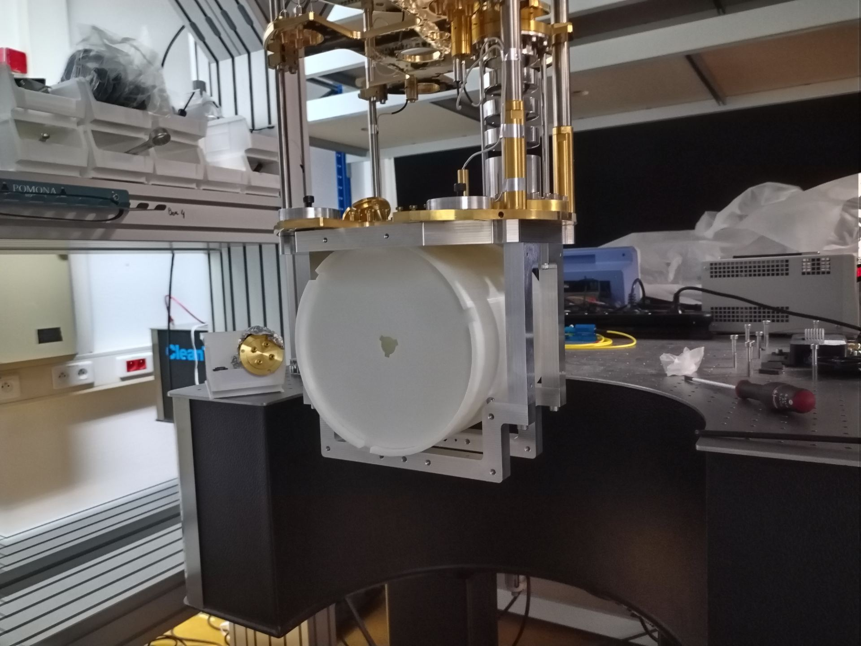





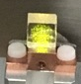






Outlook
EMPIR – European Metrology Programme
cryogenic cavities,
e.g.
10 mK closed-cycle dilution cryostat
12 kg silicon spacer
@ FEMTO-ST
spectral holes
vibration isolation
nanostructured mirrors
large modes

Slide 20
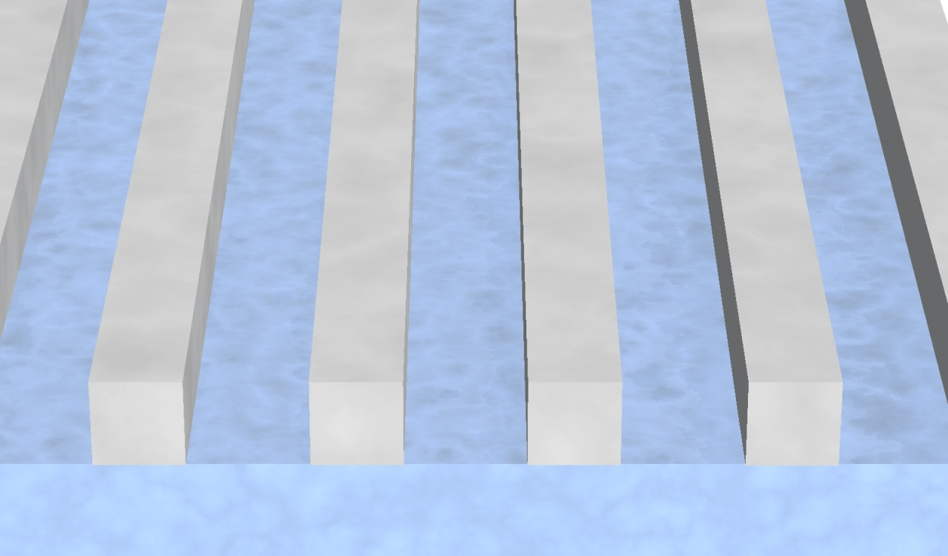
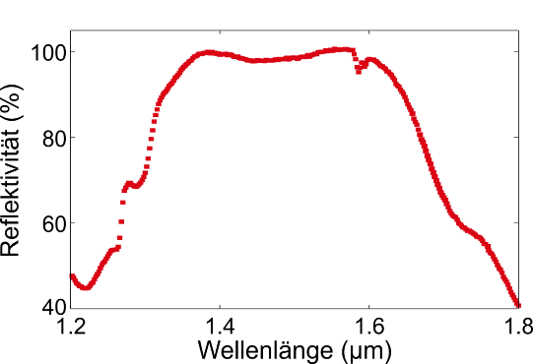
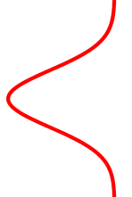

Nanostructured mirrors
Stefanie Kroker’s group at TU Braunschweig:
silicon nano-grating on low index fused silica substrate
- low thermal noise
Meta-Etalon mirror
combine grating R₁ ≈ 99.9 %
with rear dielectric mirror
R₂ ≈ 99.9 %
thermal noise is mostly determined by silicon grating
σ_{y} = 4×10⁻¹⁸ @ 124 K possible
R ≈100%
First results of cavity with
one meta-etalon:
Finesse 12 000
R ≈ 99.95%
reflectance (%)
silicon
fused silica
S. Dickmann et al.
Commun. Phys. 6, 16 (2023)
dielectric coating
wavelength (µm)
J. Dickmann and S. Kroker,
Phys. Rev. D 98, 082003 (2018)

Slide 21
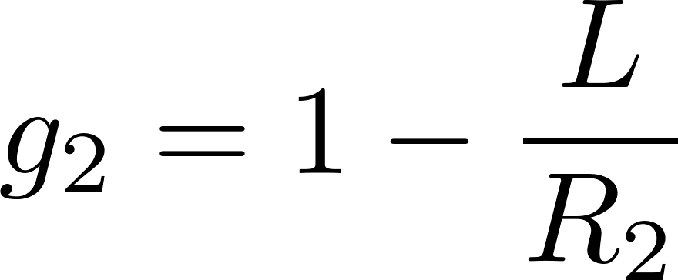
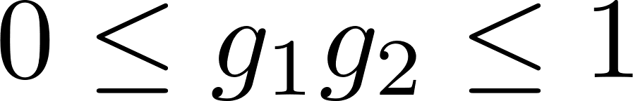
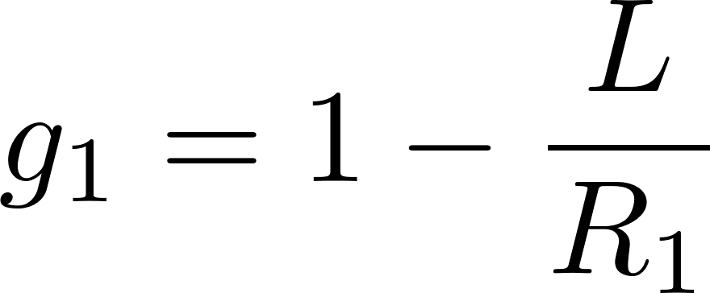
Large mode area cavities
Larger mode size:
smaller averaged thermal coating noise
plane parallel
R₁ | R₂ | rel. σ_{y}
1 m | plane | 1.00
2 m | plane | 0.84
5 m | plane | 0.67
10 m | plane | 0.56
20 m | plane | 0.47
50 m | plane | 0.37
Large modes
at the edge of stability
1
-1
1
1
-1
Problems:
mirror manufacturing
cavity assembly, tolerances:
mode shifts 1 mm for 10 arcsec deviation
concentric
21

Slide 22
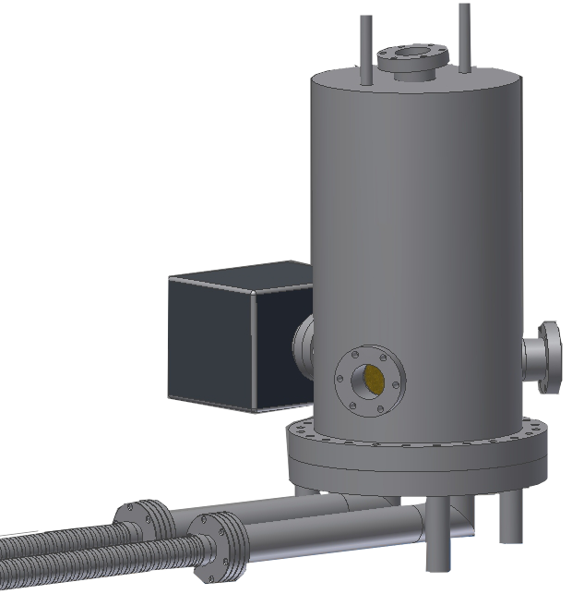



Transportable 124 K Si system
Cool cavity to 124 K by circulating cold gas between pulse tube cooler and cavity environment
Lock cavity during transport
resonator
with locking mechanism
pulse tube cold head
+ heat exchanger
heat
exchanger
compressor
CryoFan

Slide 23







Summary
  Summary
  silicon cavities at 124 K with dielectric coating reach thermal noise limit
  instability of 4×10⁻¹⁷
  crystalline coatings so far do not provide lower instability
  Outlook
  low-noise nanostructured meta-etalons F ≈ 12 000
  operation at 4 K
  transportable systems
  Funding
EXC2123
QuantumFrontier
SFB 1227
Max Planck-RIKEN-PTB Center for
Time, Constants and Fundamental Symmetries

Slide 25

LN2-based 124K cooling system
about 10 W cooling power needed
drawbacks:
LN2 infrastructure needed
about 400 liters
LN2/ week needed
two refills per week (holidays, X-mas …)
Replace the open loop LN2 system by a He-gas cooled, closed-cycle cooling to get a stand-alone and low-maintenance system.

Slide 26

124 K Cryostat
temperature fluctuations
α_{Si} (T₀ - 50 mK) < 1·10⁻⁹ K⁻¹
4 · 10⁻⁸ K
vertical vibration noise
~ 5 · 10⁻⁶ ms⁻²/Hz^{1/2}
required vibration sensitivity
∆L/L < 10⁻¹⁰ / ms⁻²
T. Kessler et al., Nature Phot. 6, 687-692 (2012)

Slide 27

Long-term drift
Cavity frequencies vs. H-Maser
Long-term frequency drift
~ 4 Hz/day - 2.4×10⁻¹⁹/s
about 10³ times smaller than ultralow expansion materials at room temperature
less than Hubble constant
H₀ = 2.27×10⁻¹⁸/s
June 2023:
-48 µHz/s
-4.1 Hz/day

Slide 28







Parasitic Etalons
light is fed back to cavity mode
with parasitic reflectivity
Periodic frequency fluctuation
related to air pressure
field changes mirror reflectivity
(as seen from inside the cavity):
to
Parastic etalons
Model: ∆p → ∆n → ∆φ → δν
MJD
Optics
Cavity front
Cavity rear
R_{p} = 1.2 × 10⁻⁶, L = 0.41 m
optimized: R_{p} < 5 × 10⁻⁸
R
L

Slide 29
Thermal-noise Zoo
k_{B}T
Brownian (thermal) noise:
internal friction
in coating, mirror, spacer
Thermo-elastic:
thermal expansion from
temperature fluctuations
Thermo-refractive:
refractive index change from temperature fluctuations
many more ...
Thermal noise S_{x}(f) for fused silica mirror with SiO₂ / Ta₂O₅ coating at 300 K
λ = 1542 nm, w = 400 µm
M. L. Gorodetsky
Thermal noises and noise compensation in high-reflection multilayer coating,
Phys. Lett. A 372, 6813-6822 (2008)

Slide 30

Evaluation of technical noise
All technical noise sources are suppressed to below 10⁻¹⁷
residual amplitude modulation (RAM)
vibrations with additional low frequency servo loop
….

Slide 31
AlGaAs coating - transient response
All thermal noise contributions are proportional to mechanical loss factor φ:

Slide 32


Transient response – power dependence
So far no simple explanation
semiconductor properties?
electric fields from internal photoeffect?
electrooptic/photorefractive effect?
Further investigations necessary:
temperature
spatial correlations
relation to noise
298 K
124 K

Slide 33
Compound Mirror Performance
Ultrahigh reflectivity: combine grating R₁≈ 99.9 % + rear dielectric mirror R₂ ≈ 99.9 %
Thermal noise mostly determined by silicon grating - σ_{y} = 4×10⁻¹⁸ @ 124 K possible
dielectric coatings
R₁ = 0.993
R₁ = 0.999
R₁ = 0.9999
J. Dickmann and S. Kroker,
Phys. Rev. D 98, 082003 (2018)

Slide 34

Improvements on Silicon Systems
Goals:
Stand-alone system
(towards field use)
Reduce impact of by vibrations by
additional feedback on AVI and feedforward technique (WP2)

Slide 35


He-based closed cycle cryostat
Cryo system from TransMIT arrived at PTB
Check cooling performance and vibration level on test system.
Replace LN2-based cooling system of Si5 (124 K, 21 cm silicon, AlGaAs coatings)

Slide 36




Crystaline AlGaAs / GaAs multilayer
epitaxially grown crystaline multilayer (1064 nm, 1156 nm, 1397 nm, 1550 nm)
Low optical absorption and scatter (A+S < 16 ppm)
PTB (21 cm)
124 K
lower mechanical loss than dielectric coatings
high refractive index GaAS
low refractive index Al_{x}Ga_{1-x}As
reduced Brownian Thermal Noise
JILA (6 cm)
4 K
$$φ ≈5×{10}^{−4}$$
SiO₂ /Ta₂O₅
transferred to arbitrary optical substrates
$$φ_{AlGaAs}≈2.5×{10}^{−5}$$
typ. Silicon or
Fused Silica
F = 400 000
δν = 1.8 kHz
F = 290 000
δν = 8.6 kHz
GaAs/
AIGaAs
DBR disc
G. Cole et al., Nat. Phot. 7 (2013) 644, Winkler et al., Optica, 8 (2021) 686, G. Cole, Proc. SPIE, (2012) 8458, 845807

Slide 37







Birefringent noise – power dependence
D. Kedar et al.
Optica 10, 464 (2023)
https://doi.org/10.1364/OPTICA.479462
J. Yu, et. al,,
arXiv:2210.15671 [physics.optics]
https://doi.org/10.48550/ARXIV.2210.15671
Notes:
We see power dependence, but don’t understand the effect

Slide 38




Excess noise
The excess noise:
Global noise
$$l_{corr}≫w$$
$$δx$$
Long correlation length
1/f slope in PSD
Independent of optical power
Notes:
we observed an excess noise which is possibly related to the semiconductor property of the coatings.
On a level comparable to the thermal noise level of dielectric coatings.

Slide 39


Change of splitting by intracavity power
Fused Silica
Δn (I_{cavity})
w₀ = 0.5 mm
38.5 layer pairs
GaAs (115.6 nm)
Al_{0.92}Ga_{0.08}As (133.2 nm)

