Slide 1
Low-noise optical frequency divider for precision measurement
9th Symposium on Frequency Standards and Metrology
Yanyi Jiang, Yuan Yao, Haosen Shi, Hongfu Yu, and Longsheng Ma
State Key Laboratory of Precision Spectroscopy
East China Normal University, Shanghai, China
Kingscliff, NSW, Australia, 20 October 2023

Slide 2
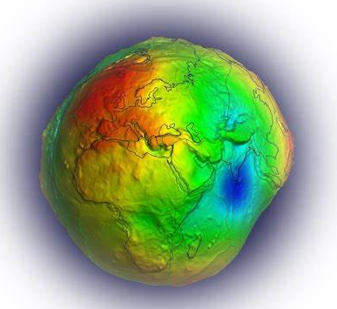
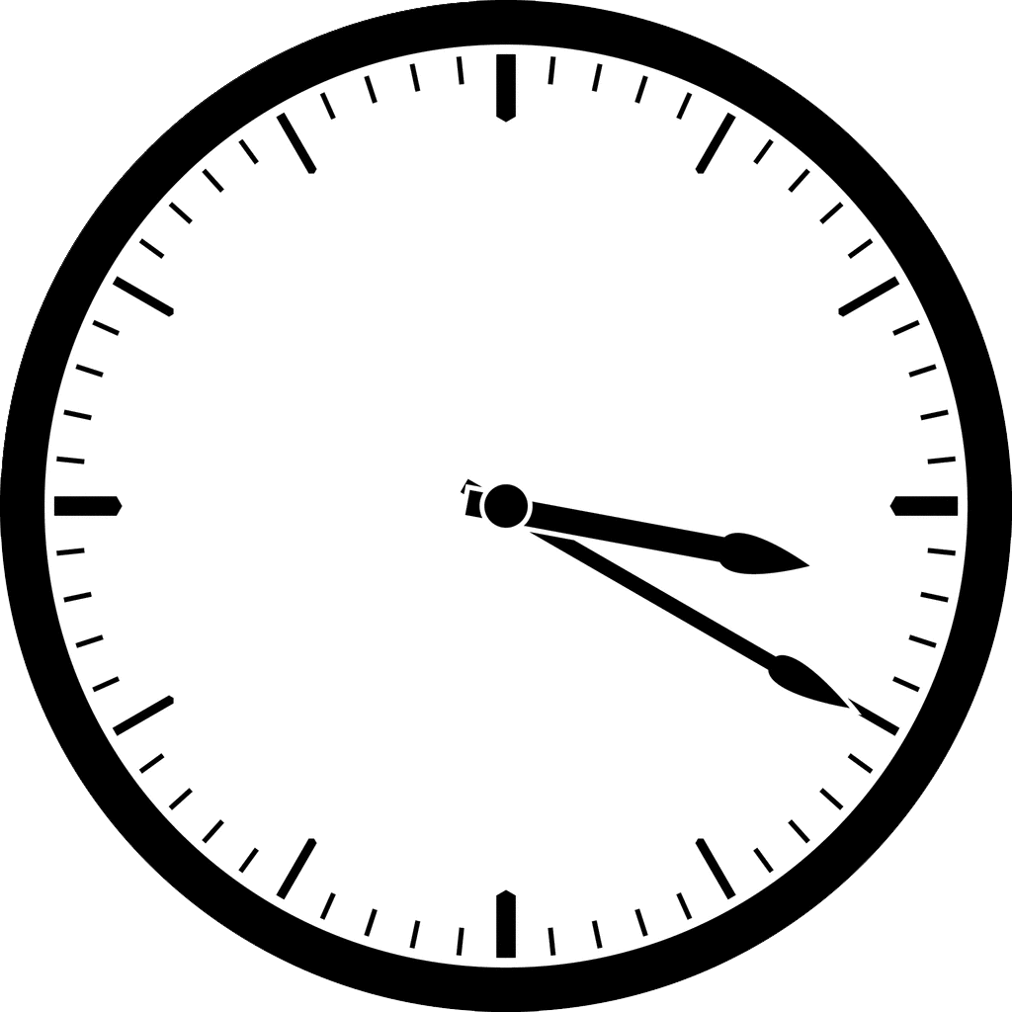
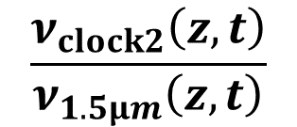
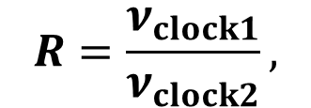

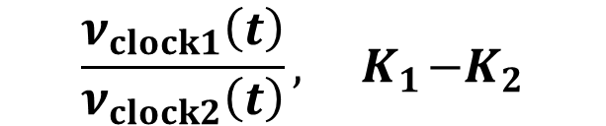
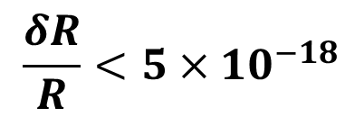

Motivation
Redefinition of the second
Precision measurement
$$R=\frac{ν_{clock1}}{ν_{clock2}},$$
$$\frac{δR}{R}<5×{10}^{−18}$$
Test the constancy of α
Dark matter detection
Geodesy
$$\frac{ν_{clock2}\left(z,t\right)}{ν_{1.5μm}\left(z,t\right)}$$
$$\frac{ν_{clock1}\left(t\right)}{ν_{clock2}\left(t\right)}, { K}_{1}−K_{2}$$
$$\frac{ν_{clock1}\left(z,t\right)}{ν_{1.5μm}\left(z,t\right)}$$
Precision spectroscopy (CaH⁺, ²²⁹Th…)
$$R= \frac{ν_{probe}}{ν_{clock1}}$$
An accurate ratio measurement relies on optical clocks and measurement device!

Slide 3
Precision ratio measurement supports applications of optical atomic clocks
δν /ν : 10⁻²¹
δν /ν : 10⁻²⁰
δν /ν : 10⁻¹⁹
δν /ν : 10⁻¹⁸
Optical atomic clocks
8th FSM (2015)
δR / R : 10⁻²²
Optical frequency ratio measurement
δR / R : 10⁻²⁰
Comb frequency noise
Noise from RF time base
Noise due to light path fluctuation
8th FSM
(2015)

Slide 4
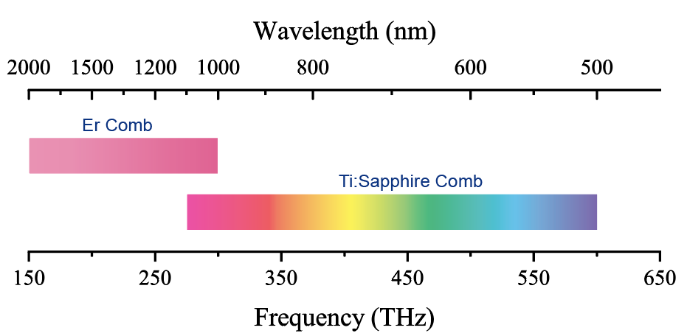
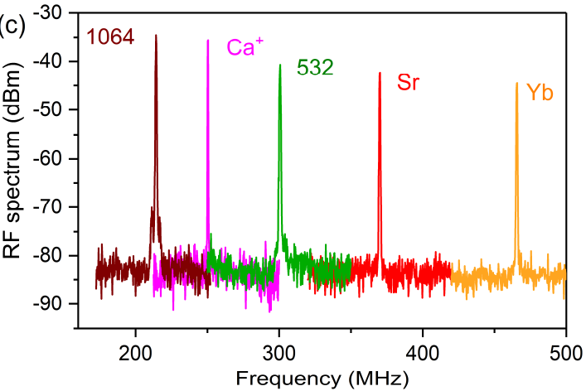
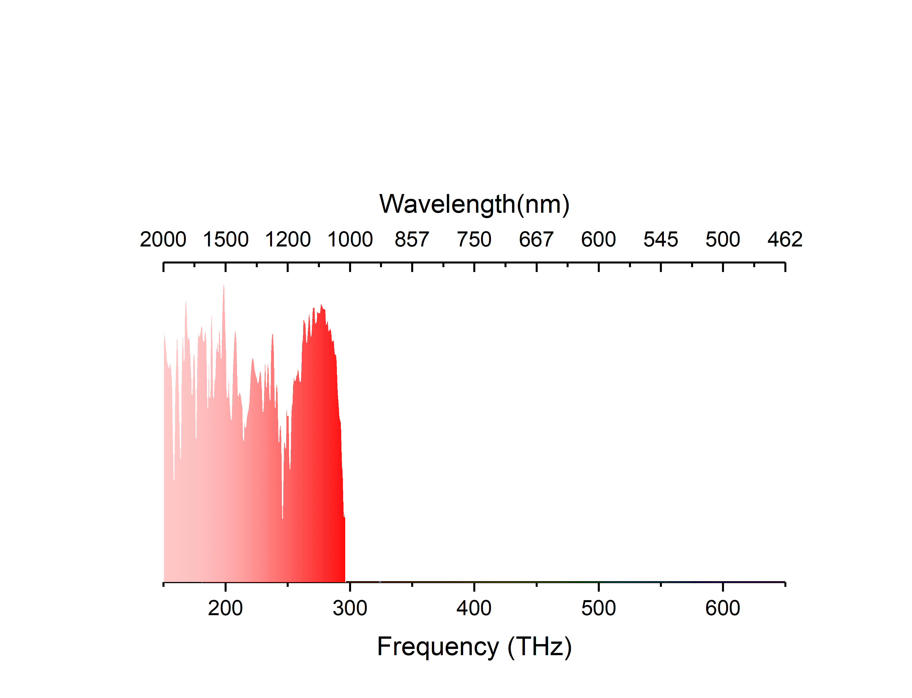

Ti:Sapphire optical frequency comb
Beat notes between a Ti:S comb and optical clocks or lasers (RBW=300 kHz)
Er comb
Ti:S comb
30 dB
Al⁺/4
Hg/4
Yb⁺/2
Ca⁺
Sr
Sr⁺
Yb
Low frequency noise (mm-scale solid state gain medium)
Broadened spectrum covers most of optical clocks
(no amplifiers, less frequency doublers…)

Slide 5
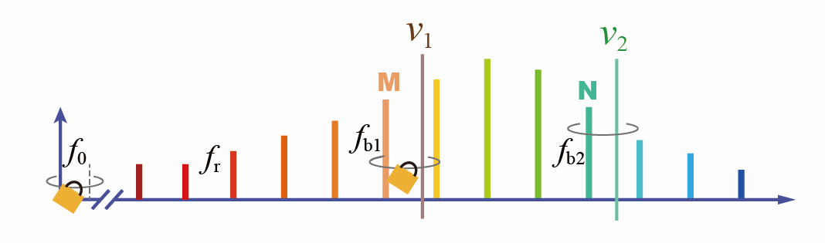
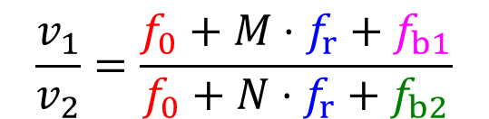
Reduce comb & RF time-base frequency noise
Comb phase-locked to an ultra-stable laser or an optical clock
Synchronous counting
~Hz
A×f_{time}
B×f_{time}
D×f_{time}
$$\frac{v_{1}}{v_{2}}=\frac{f_{0}+M⋅f_{r}+f_{b1}}{f_{0}+N⋅f_{r}+f_{b2}}$$
 | 1 s instability | uncertainty
BIPM, ECNU, NIST | 2.3 × 10⁻¹⁷ | 1.4 × 10⁻¹⁹ | Science, 303, 5665 (2004)
RIKEN | 5 × 10⁻¹⁸ | / | Appl. Phys. Exp., 10, 6 (2017)
NIST | 3 × 10⁻¹⁸ | 1.7 × 10⁻²⁰ | Optica, 4, 879-855 (2017)
Menlo | 5 × 10⁻¹⁸ | 5.3 × 10⁻²¹ | Nat. Photonics 14, 44–49 (2020)
A×f_{time}
B×f_{time}
C×f_{time}
× High servo bandwidth
× Easily lose lock

Slide 6
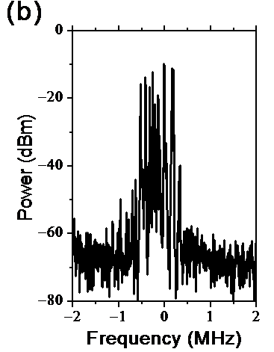
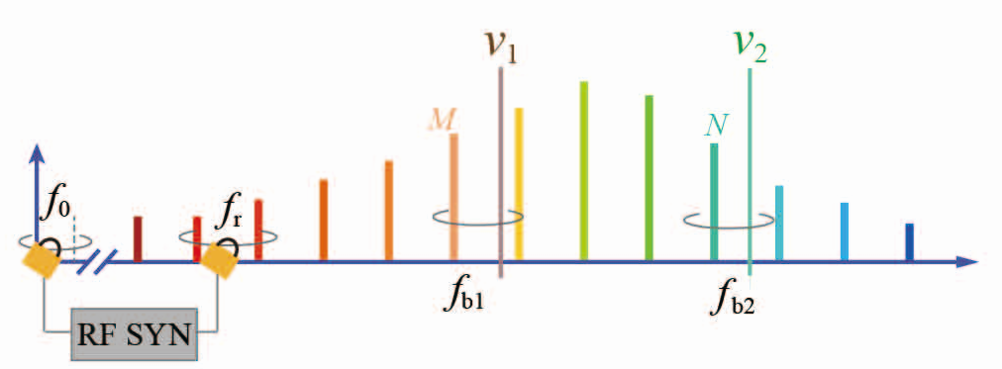
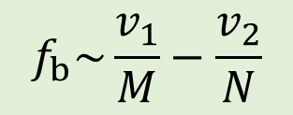
Immune to comb frequency noise
comb stabilized to a H maser or a Rb clock
(extend continuous operation time, less cycle slips)
~ kHz-MHz
f_{b1} =ν₁− (M×f_{r} + f₀)
f_{b2} =ν₂ − (N×f_{r} + f₀)
Comb noise free
$$f_{b}\sim \frac{v_{1}}{M}−\frac{v_{2}}{N}$$
Transfer oscillator scheme [1]
Extra RF time base induces noise
Count f_{b} → ν₁/ν₂
Lock f_{b} → PLL ν₂ to ν₁
[1] Telle, et. al. Appl. Phys. B 74, 1 (2002)

Slide 7
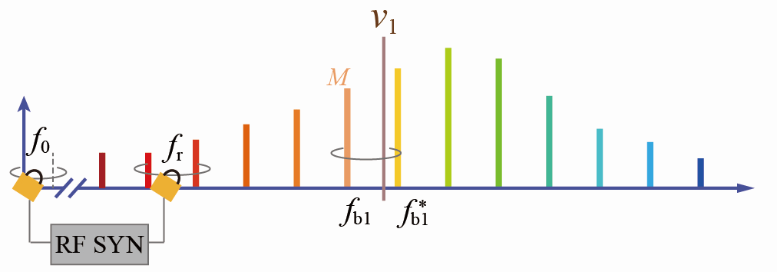
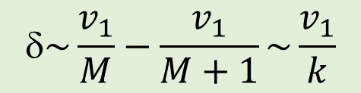
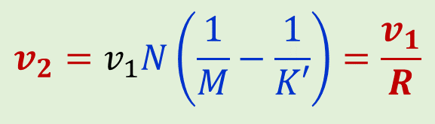
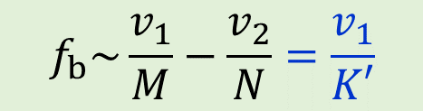
Optically-referenced RF time base
comb stabilized to a H maser or a Rb clock
(extend continuous operation time, less cycle slips)
$$f_{b}\sim \frac{v_{1}}{M}−\frac{v_{2}}{N}=\frac{v_{1}}{K′}$$
M+1
$$v_{2}=v_{1}N\left(\frac{1}{M}−\frac{1}{K′}\right)=\frac{v_{1}}{R}$$
R can be preset & sweep
f_{b1} =ν₁ − (M×f_{r} + f₀)
f_{b1}* = (M + 1)×f_{r} + f₀ − ν₂
Comb noise free
$$\sim \frac{v_{1}}{M}−\frac{v_{1}}{M+1}\sim \frac{v_{1}}{k}$$
Transfer oscillator scheme
Only related to ν₁
Yao et. al. Nat. Sci. Rev. 3, 463 (2016)

Slide 8
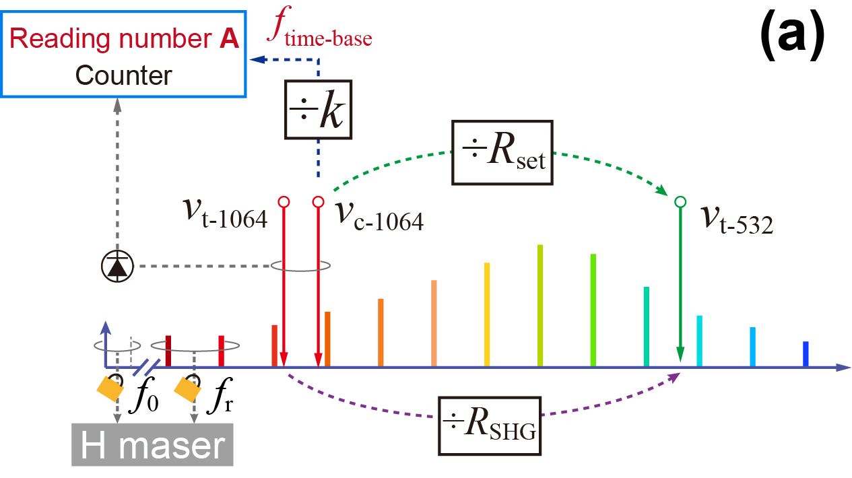
Division noise characterization
R_{set} = 0.499 999 219 876 815 223 597 90
0.500 000 106 518 137 671 678 87
R_{SHG} = 0.5
Noise due to light path fluctuation: common path, air sealed box

Slide 9
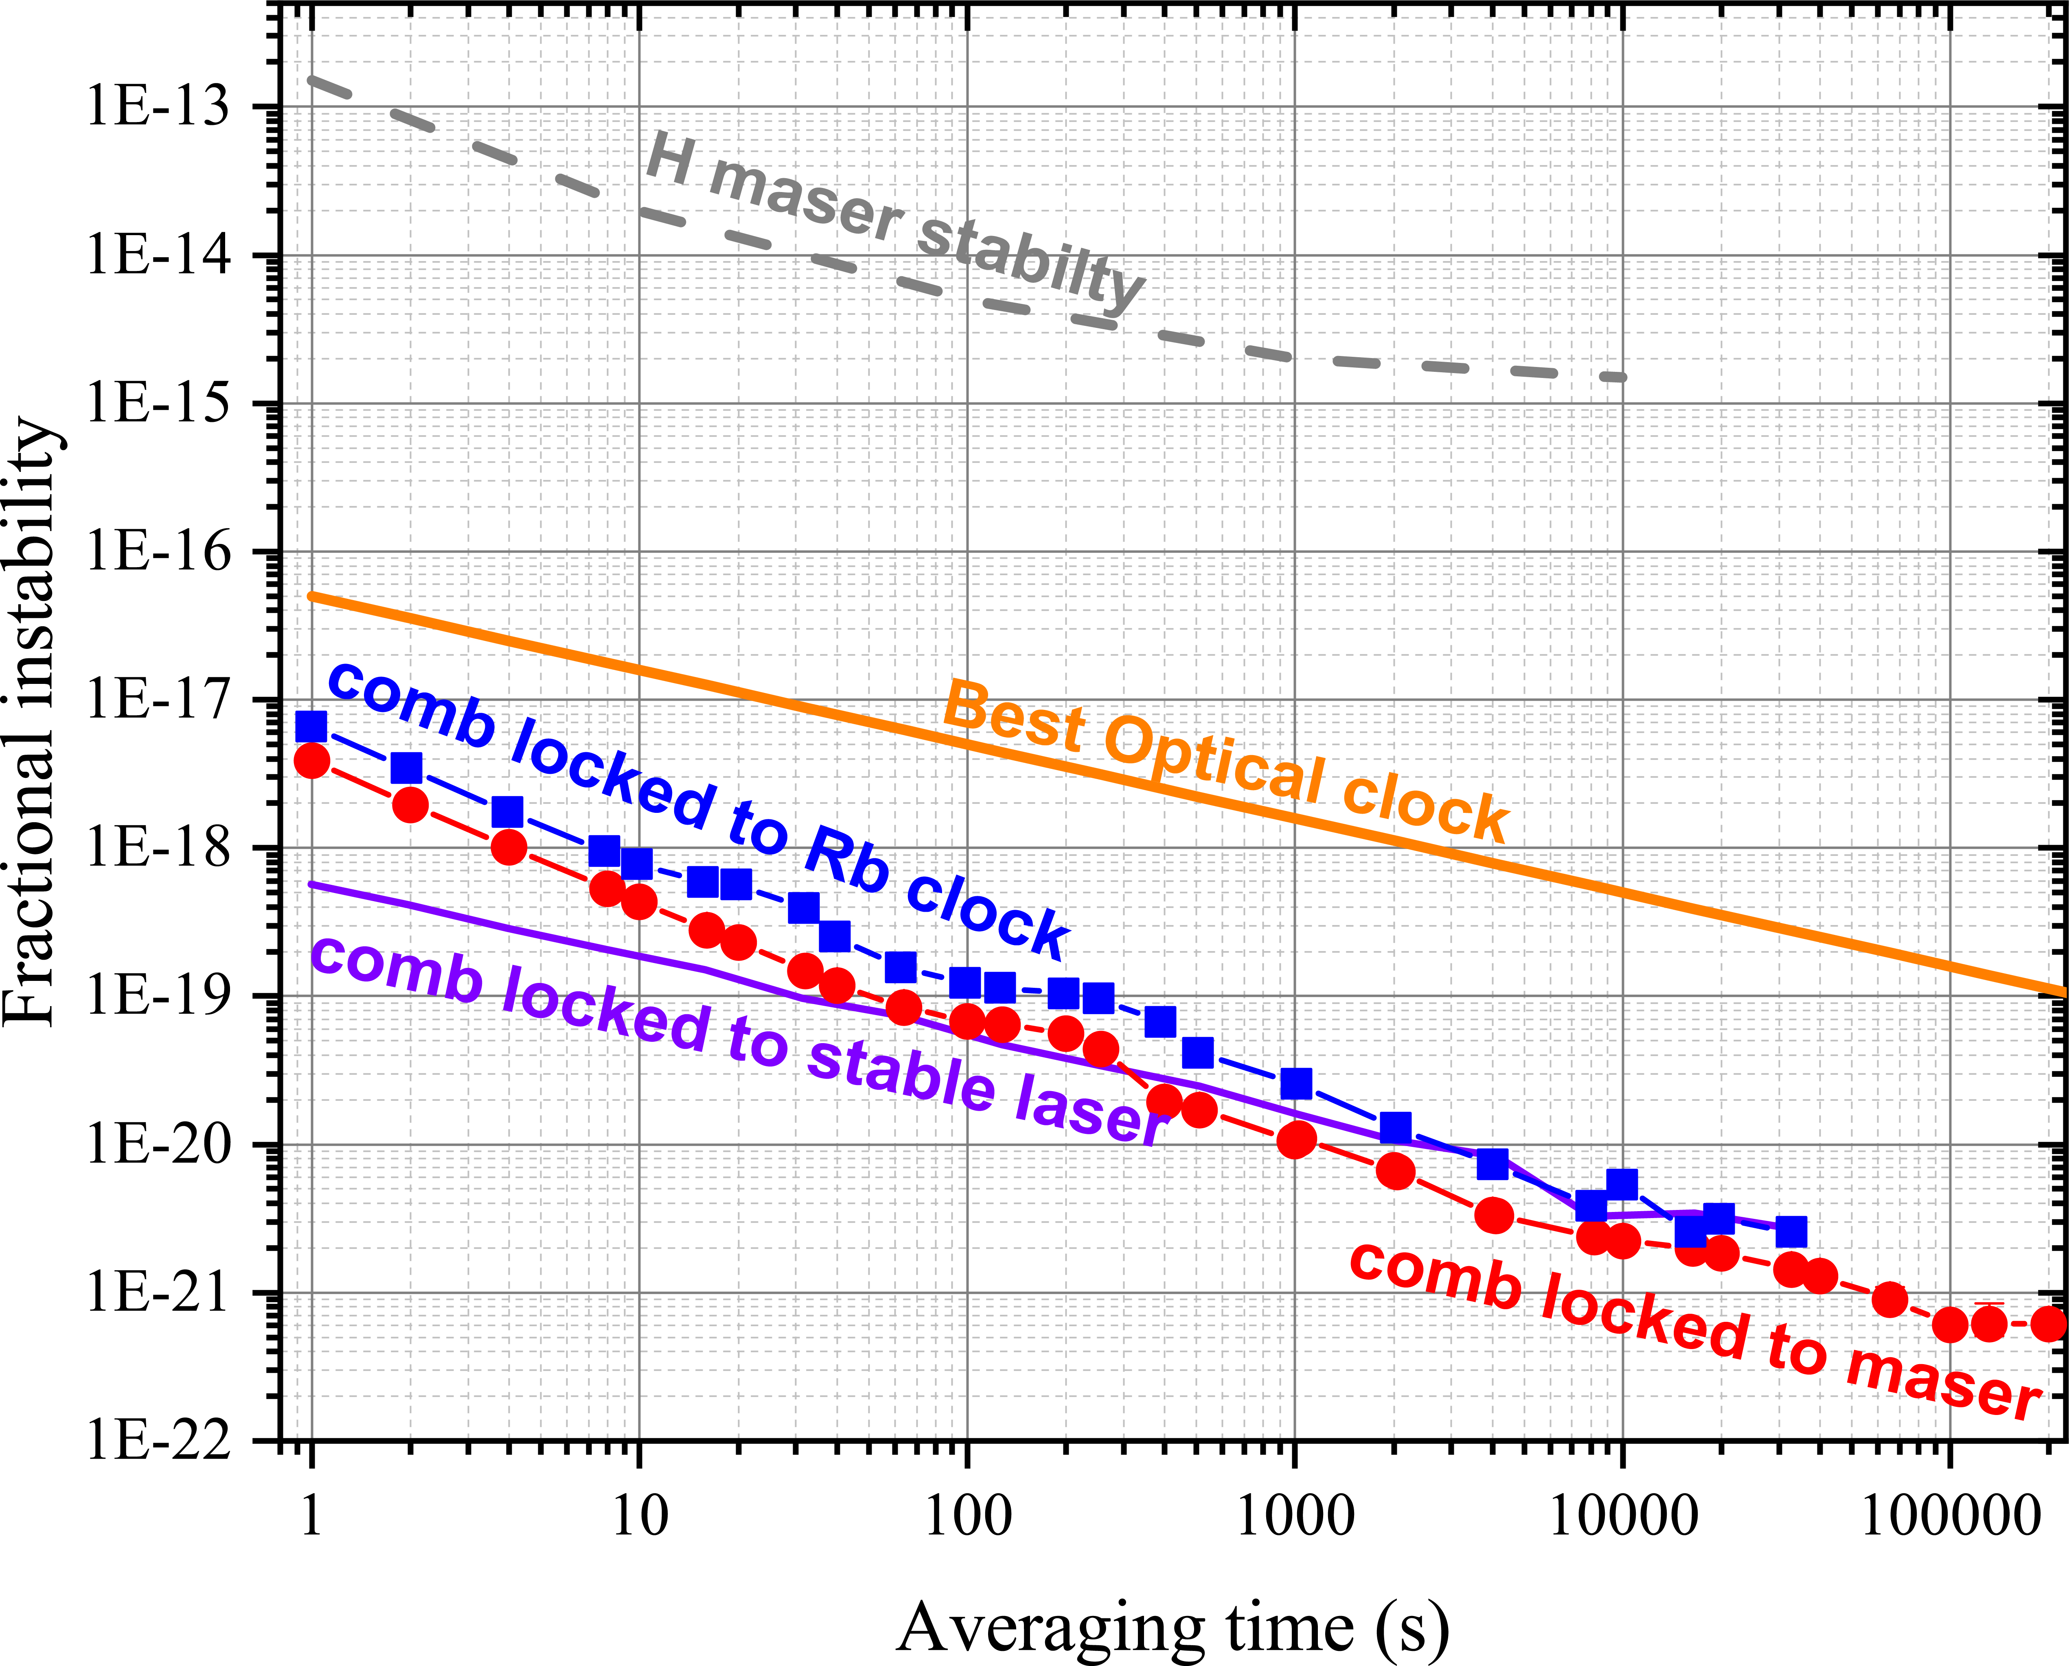
Division noise characterization
Comb frequency noise immunity factor: 10³− 10⁶
 | Instability of comb line @ 1 s | Instability of R @1 s
Rb^{[1]} | 1×10⁻¹¹ | 8×10⁻¹⁸
H^{[2]} | 1×10⁻¹³ | 4×10⁻¹⁸
Laser^{[3]} | 1×10⁻¹⁵ | 6×10⁻¹⁹
Applicable to chip-based combs
independent on comb f stability
multi-channel division (f₀, f_{b} )
[1] Yao et. al. Photon. Res. 9, 98 (2021)
[2] Shi et. al. APL Photonics (2023)
[3] Yao et. al. Nat. Sci. Rev. 3, 463 (2016)

Slide 10
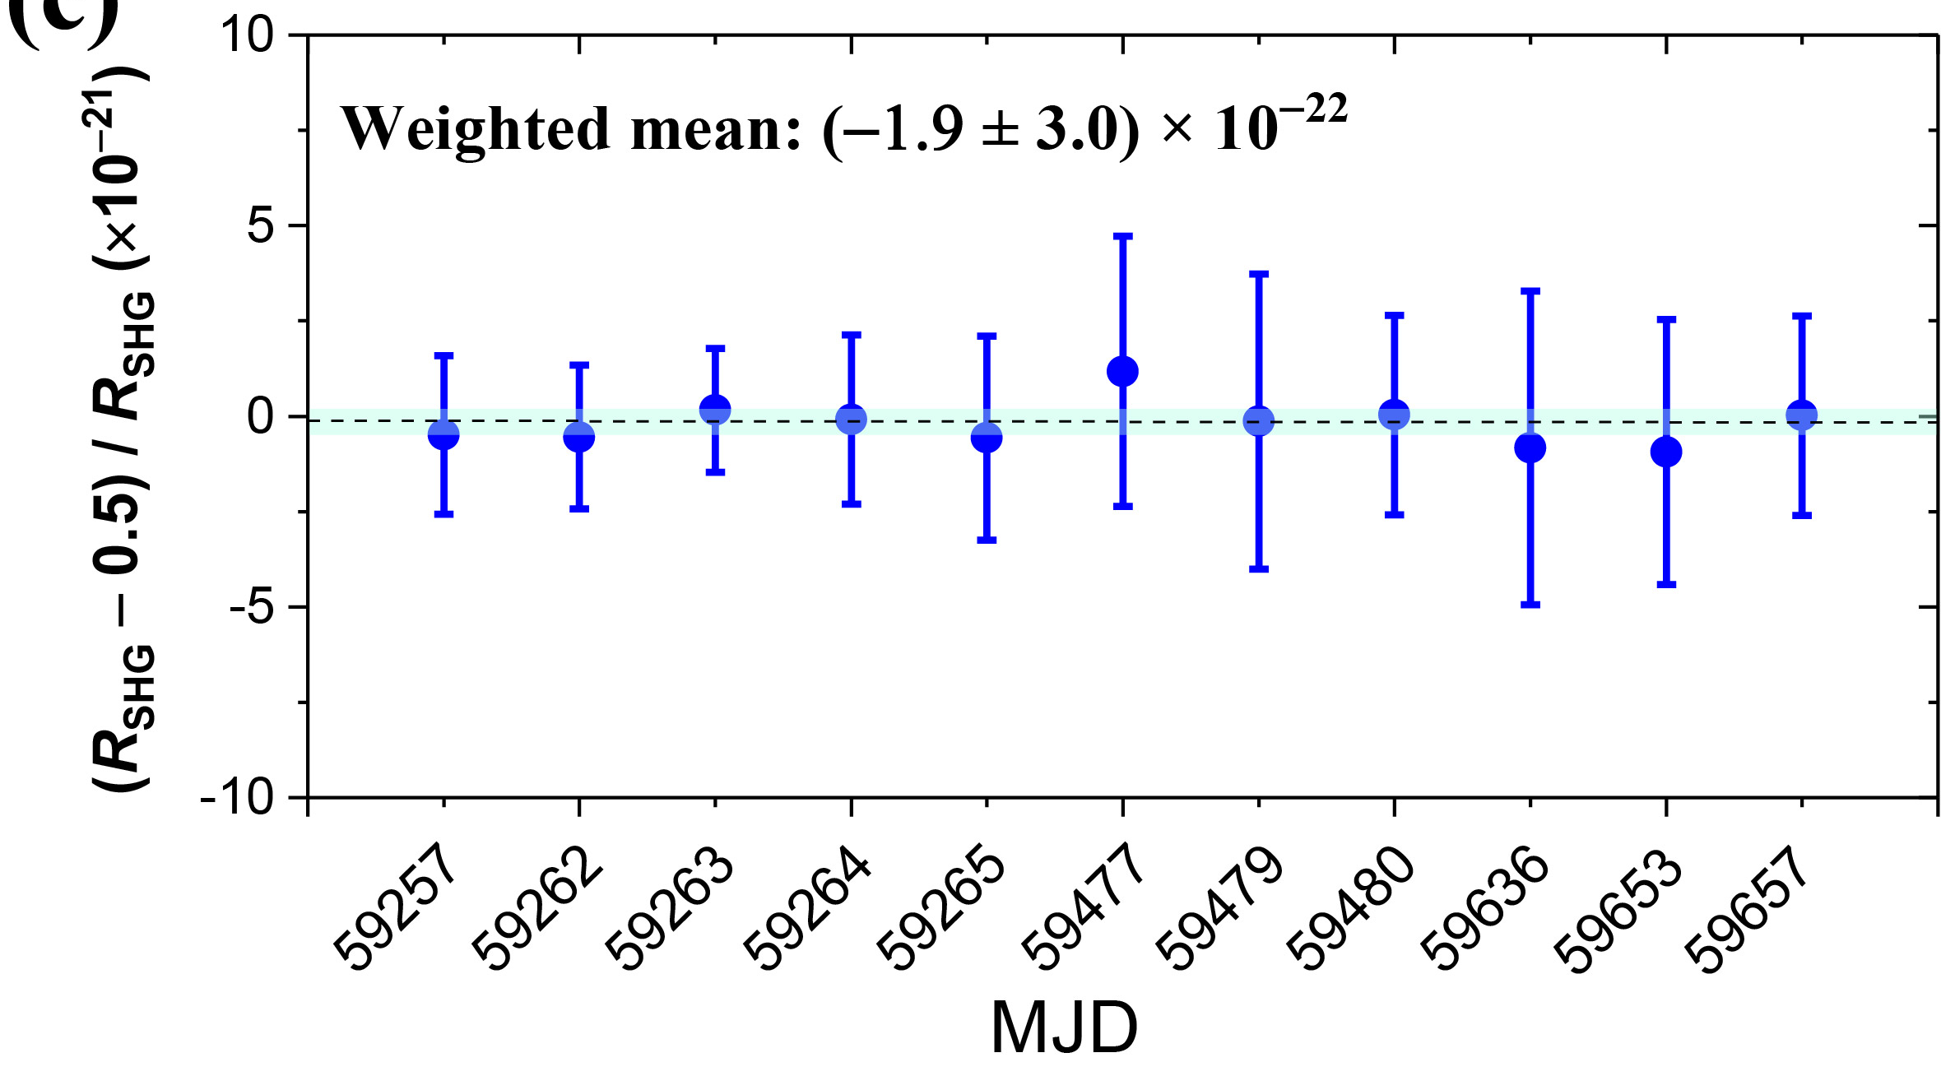
10⁻²² uncertainty in frequency division
when comb is stabilized to a H maser
Dataset with effective time >20 h in a day:
→ eliminate daily T and P variation-induced offset

Slide 11
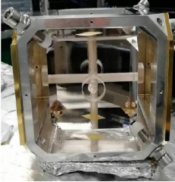
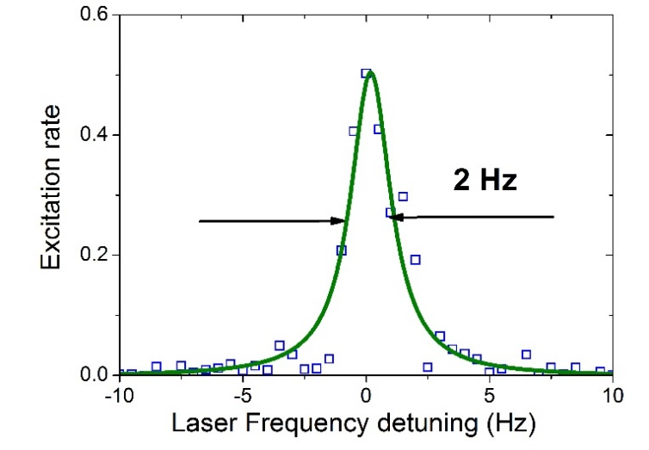
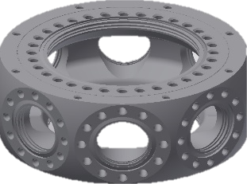
Coherence transfer
Portable ultra-stable laser
Servo bandwidth: MHz
(without pre-stabilization)
L=10 cm
ν_{ref}
OFD
÷R_{x}
Target laser
578 nm
Ref. laser
1064 nm
f₀
f_{r}
=ν_{ref} /R_{x}
σ(1 s): ~ 6 × 10⁻¹⁶
Rb
clock
PLL
PLL
Probe time
400 ms
Yb atoms
~MHz
¹S₀ ↔ ³P₀ clock transition
D
Comb frequency jitter
Yao et. al. Photon. Res. 9, 98 (2021)

Slide 12
Synthesizer referenced to Yb optical clock
OFD
Yb optical lattice clock
Ref. in
Output
ν _{out}=ν_{Yb} ÷ R_{x}
÷R_{x}
Effect | Shift ×10⁻¹⁷ | Uncertainty ×10⁻¹⁷
BBR | −244.87 | 1.10
Density shift | −0.52 | 0.33
Lattice shift | 1.81 | 0.56
Zeeman shift | −19.11 | 0.15
background gas | −0.25 | 0.02
Probe light | −0.02 | 0.01
DC Stark | 0.04 | 0.02
Servo error | 0 | <0.10
Total | −262.92 | 1.3
Tunable Ti:S c.w. laser
700—990 nm
c.w. lasers
@ designed frequency
RF/microwave
Yao et. al. Appl. Phys. Lett. 3, 463 (2016)

Slide 13

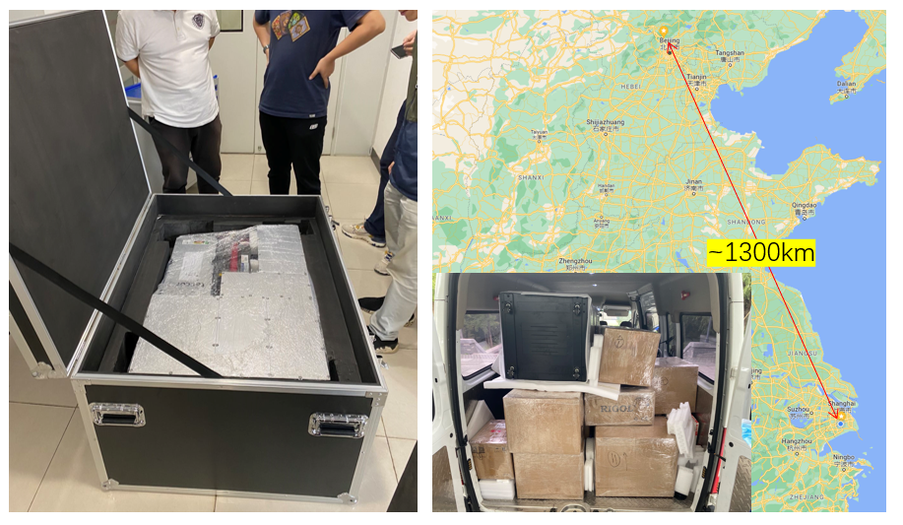
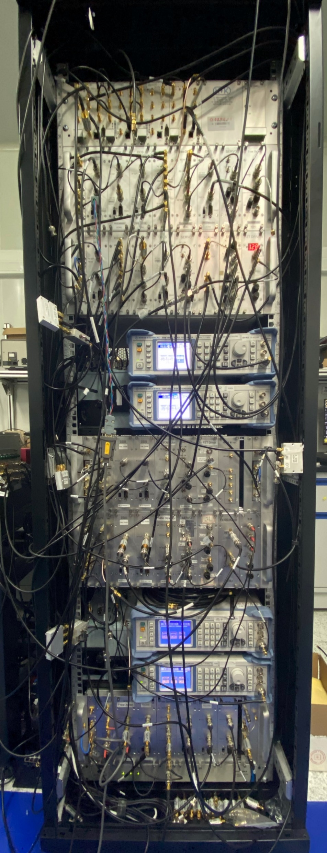

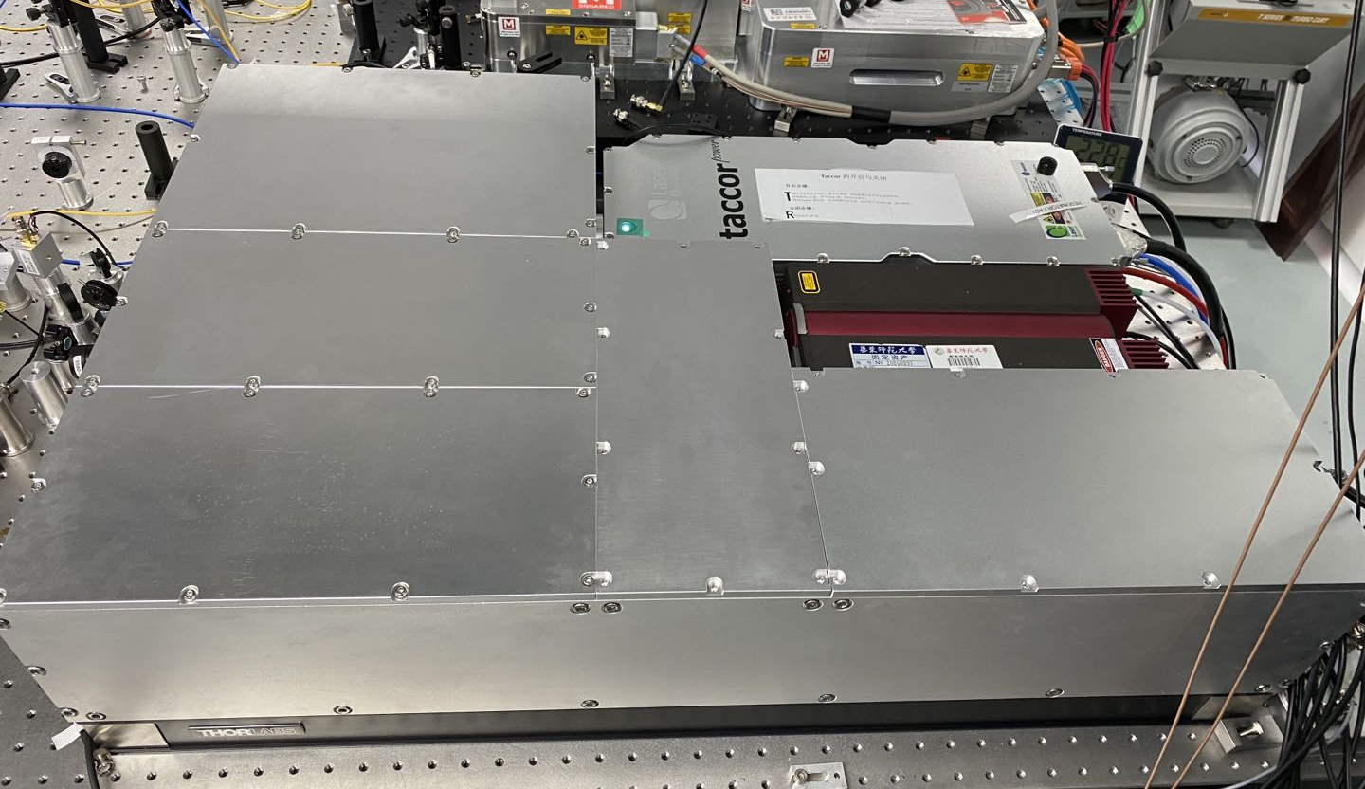
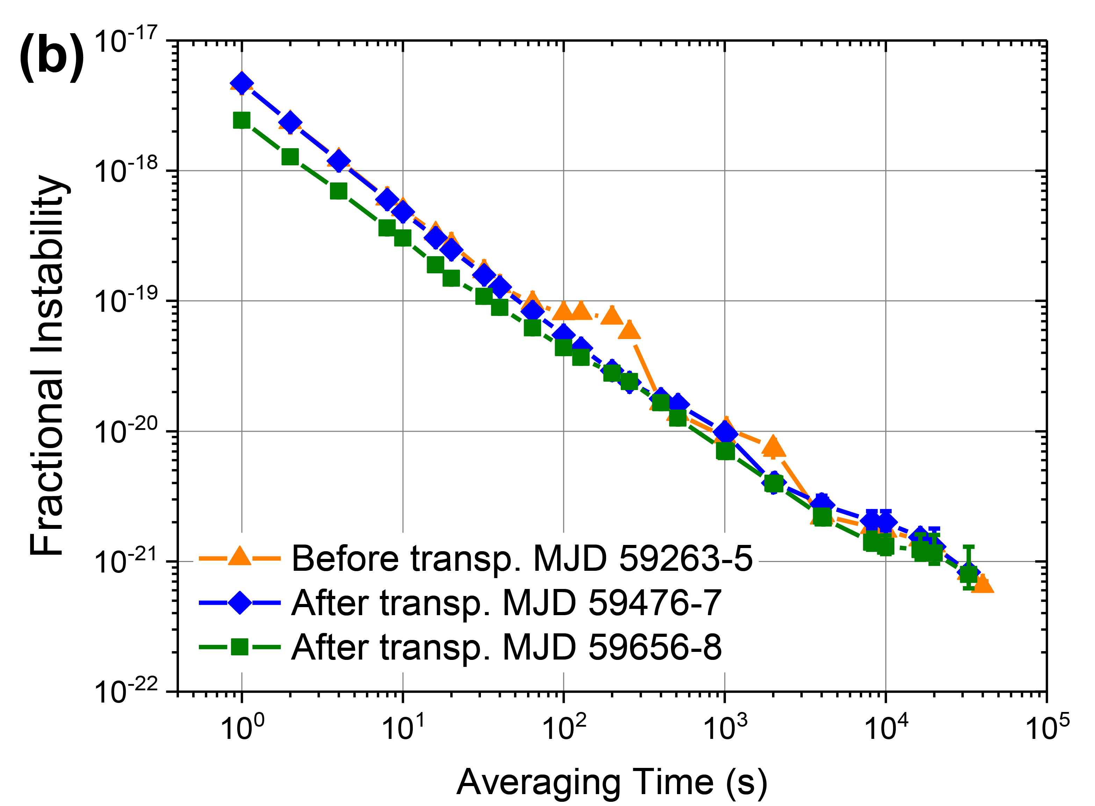
OFD for clock comparison
NIM
@Beijing
ν_{Sr} (NIM)
R ?
Differential spectroscopy
ν_{Ca+} (APM)
1.8 m
0.6 m
0.2 m
0.9 m
0.6 m
ECNU
@Shanghai
Optics
Input: 698 nm, 578nm, 729 nm…
Electronics for 4-channel OFD

Slide 14
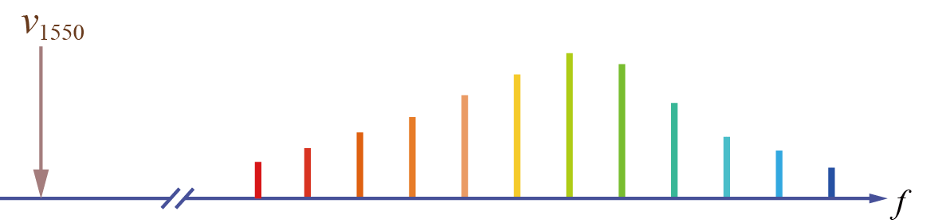



Beat note between Ti:S comb & 1.5 μm light
Nonlinear fiber
Nonlinear Fiber
Ti:S mode-locked laser
Ti:S mode-locked laser
1.5 μm
c.w. laser
1.5 μm
c.w. laser
SHG
$$N_{i}×f_{r}+f_{0}$$
SHG
$$v_{1550}$$
$$v_{\text{FWM}}$$
Conventional method
Four wave mixing-assisted method

Slide 15
Beat note between Ti:S comb & 1.5 μm light
Detected
@ 590 nm
Detected
@ 1.5 μm
Four wave mixing-assisted detection method
Detected
@ 780 nm
No SHG to double 1.5 μm laser frequency
Low 1.5 μm laser power: ~10 mW → 45 dB SNR f_{b}
Detection at convenient wavelength and bandwidth
30 dB

Slide 16
Division from Yb optical clock to 1.5 um
Four wave mixing-assisted detection method
OFD
ν₁₅₅₀₋₁
÷ R_{set-1}
ν_{Yb} ÷ R_{set-1} =ν₁₅₅₀₋₁
Yb optical clock ν_{Yb}
Frequency counter
Reading number A
Conventional detection method
ν_{Yb} ÷ R_{set-2} ÷ 2 =ν₁₅₅₀₋₂
OFD
ν₇₇₅₋₂
SHG
÷ 2
÷ R_{set-2}
ν₁₅₅₀₋₂
÷ K’
f_{time-base}= ν_{Yb} /K’

Slide 17
Division from Yb optical clock to 1.5 um
Instability: 5×10⁻¹⁸@1s，
1×10⁻¹⁹@1000s
Uncertainty：2.2 × 10⁻¹⁹
Limited by 30 cm-long uncompensated light path fluctuation
Typical instability of optical clocks
Yao et. al. submitted

Slide 18
Summary & outlook
Low-noise optical frequency divider
  Division noise: (0.6−8)×10⁻¹⁸@1s, 6×10⁻²²@10⁵ s
  Division uncertainty: 3×10⁻²²
  Coherence transfer: resolve Hz-linewidth spectrum of Yb clock transition even when comb frequency jitter is 1 MHz
  Coherent linking Ti:S comb with 1.5 μm laser using FWM-assisted detection
  Outlook:
  Frequency comparison between optical clocks
  Precision measurement & precision spectroscopy
  Optical frequency synthesis with chip-based combs

Slide 19
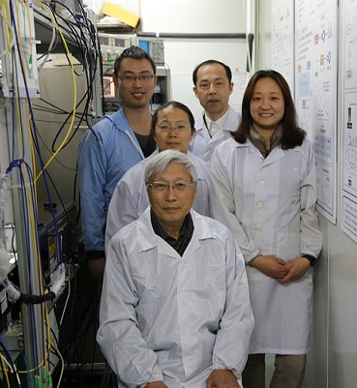
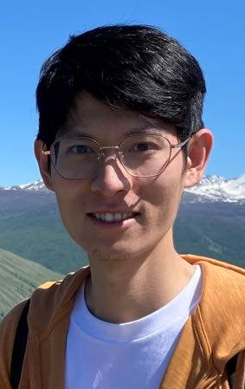
Acknowledgement
Group members:
Longsheng Ma, Yuan Yao, Haosen Shi, Hongfu Yu, Zhiyi Bi
Collaborators:
NIM: Yige Lin, Zhanjun Fang, Fang Fang…
APM: Kelin Gao, Hua Guan, Yao Huang, Baolong Lv, Linxiang He…
Special thanks to
Andrew Ludlow, Chris Oates, Jun Ye, Scot Diddams, Tara Fortier, Chin-wen Chou, Albrecht Bartels…

Slide 20
Thank you for your attention!

Slide 21
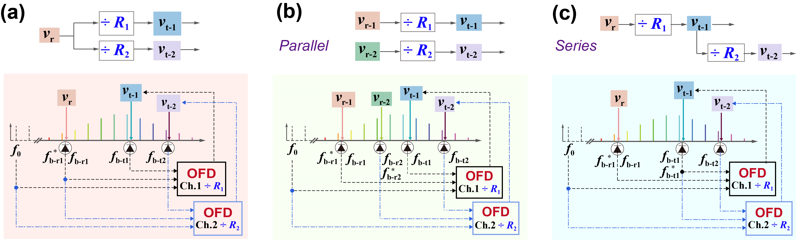
Multi-channel division
Single reference
Independent references

