Slide 1
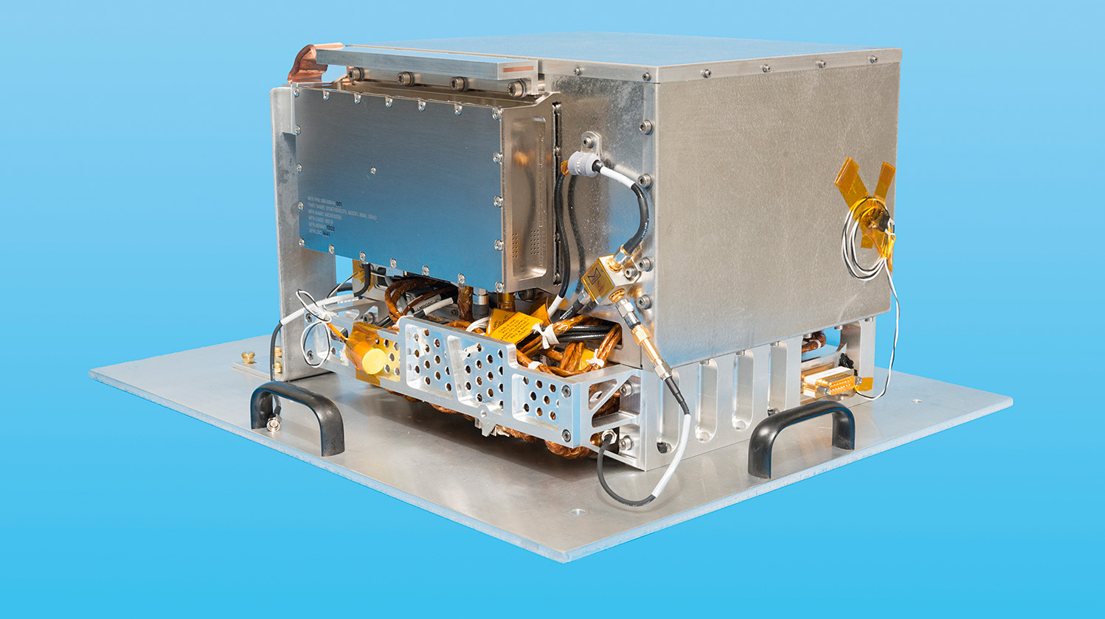

The Deep Space Atomic Clock and Potential Scientific Applications
Eric Burt, John Prestage, Robert Tjoelker, Eric Tardiff, Daphna Enzer, Da Kuang, Dave Murphy, David Robison, Jill Seubert, Rabi Wang, James McKelvey, Vladimir Iltchenko, Andrey Matsko, and Todd Ely
Jet Propulsion Laboratory, California Institute of Technology
9th Symposium on Frequency Standards and Metrology
Joint funding for the DSAC project provided by the NASA offices of Space Technology Mission Directorate (STMD) and Space Communications and Navigation (SCaN)

Slide 2

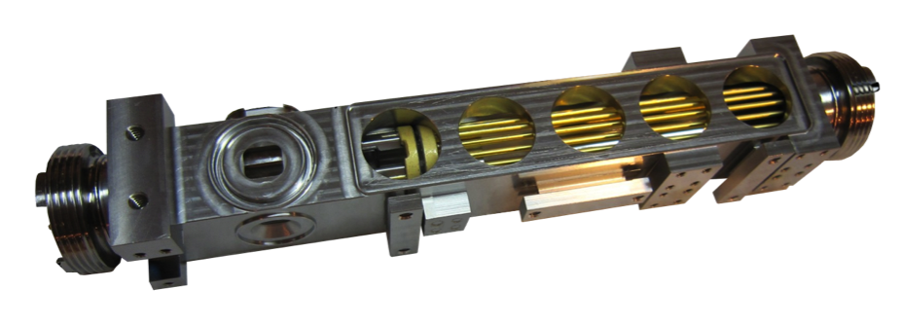
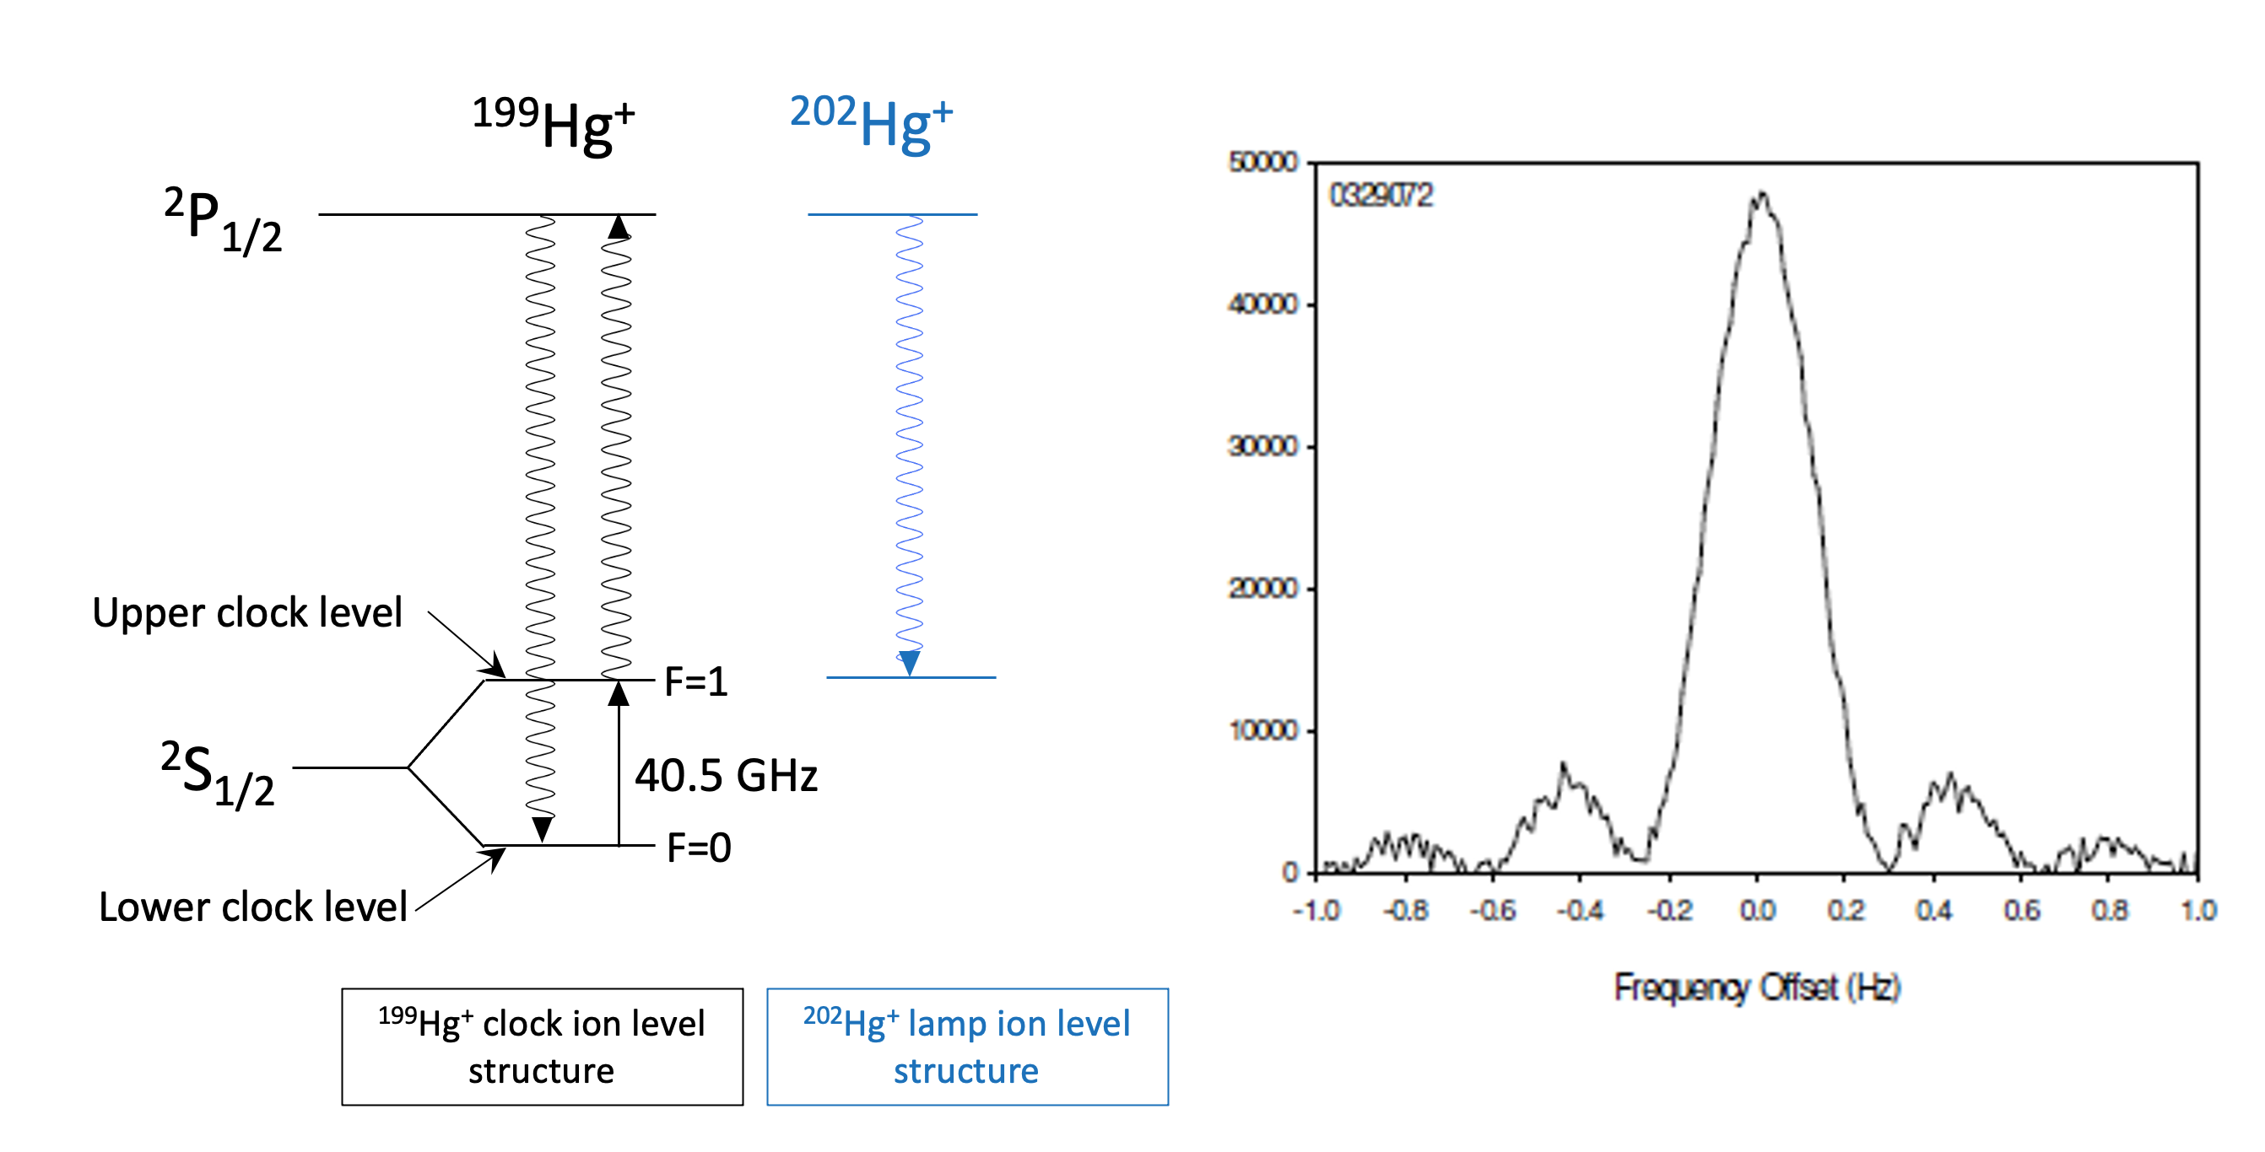
JPL Trapped Ion Clock Overview
Key Performance Features:
10⁶-10⁷ ¹⁹⁹Hg⁺ trapped ions
  No wall collisions, high Q microwave line
  Buffer gas cooled to ~300K
  Multi-pole ion trap – lower systematics
State selection/detection:
  Optical Pumping from ²⁰²Hg⁺ lamp
  1-2 UV photons per ion per second scattered
High Clock Transition:
  40,507,347,996.8 Hz – low magnetic sensitivity
Adapts to variety of Local Oscillators - flexible
Local Oscillator
Controller
Detection light system
QP
shuttle
MP
Input light system
Microwave Input
Key Reliability Features: - practical
No Lasers
No Cryogenics
No Microwave cavity
No Light Shift
Low Consumables

Slide 3
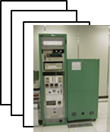
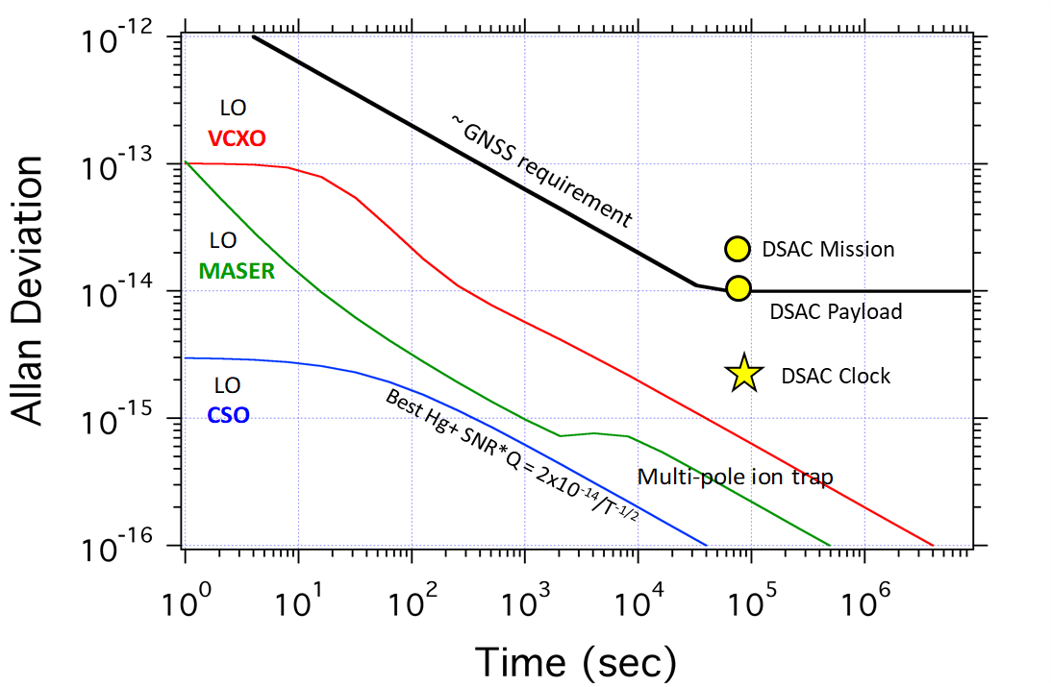
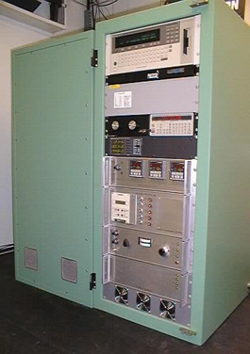
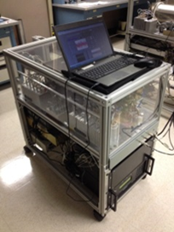
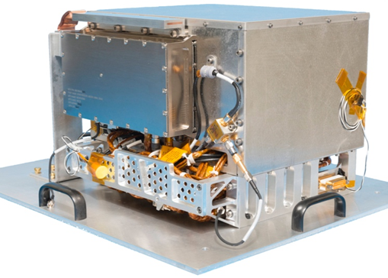
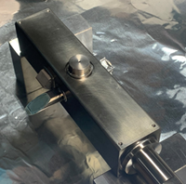
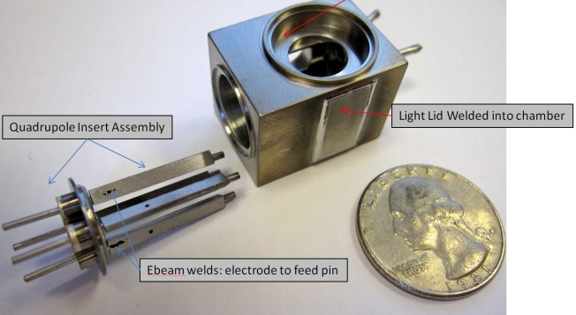
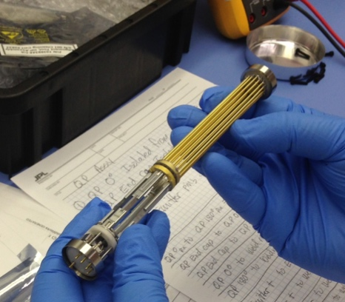
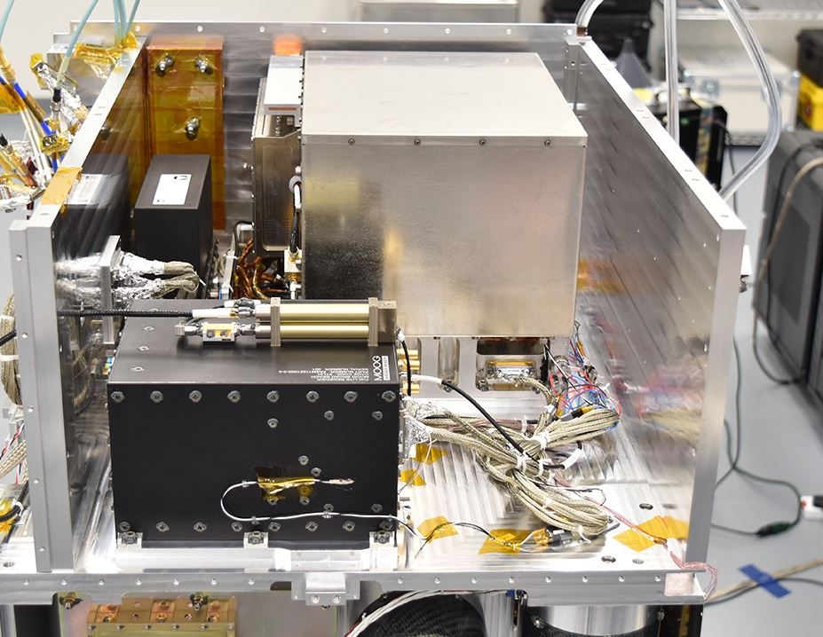
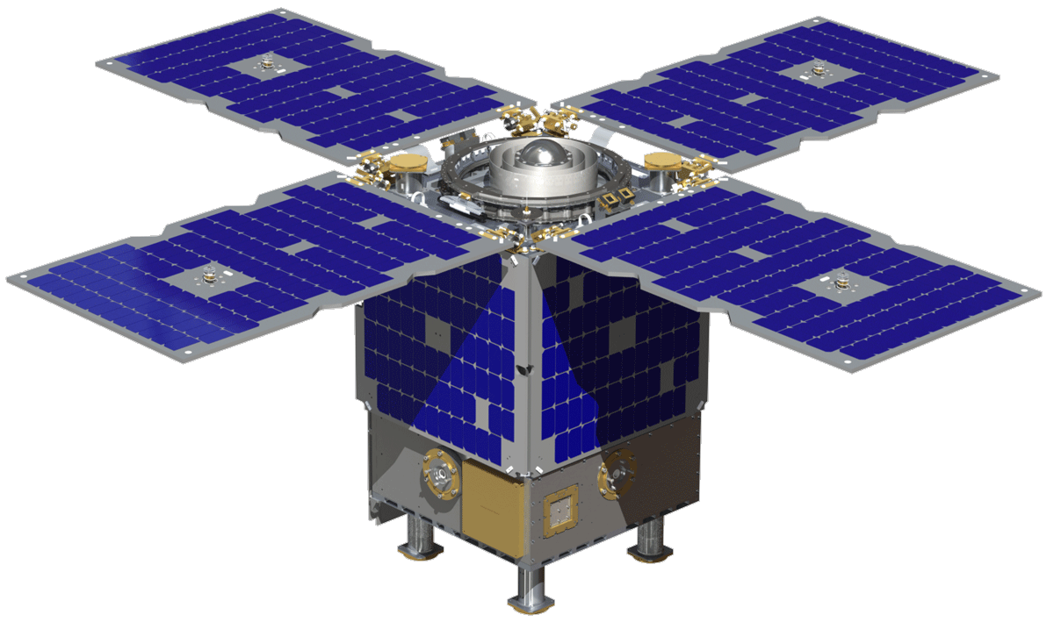
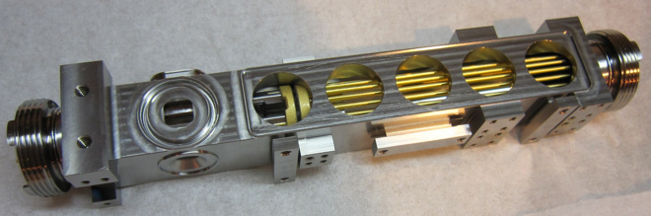
199Hg Ion Clock Development Timeline
40.5 GHz transition in 199Hg+, optically pumped with 202Hg+ discharge lamp, buffer gas cooled
5th FSM
1993 7x10⁻¹⁴/T^{1/2} , long term drifts < 2x10⁻¹⁶/day.
1996 2 x 10⁻¹⁴/T^{1/2} advanced LOs: CSO, H-masers
1999 Multi-pole ion trap reduction of 2nd Order Doppler Shift
2006 High temp bake-out -> sealed getter pump
Compensated Multi-pole: UTC quality timekeeping with a single clock
- long term variations below < 3x10⁻¹⁷/day.
GPSIII MAFS: 50W total power demonstrated.
high bake sealed operation demonstrated
2010-16 Ultra-stable multipole ion trap reference clock
2016-present - Miniature clock development: 1 liter (next talk)
2019-2021 DSAC operates in LEO
2022 DSAC-2 – Low 30W, long-life concept for NASA & DoD
low SWaP ion tube
2022, low TRL & SWaP ACES breadboard demo
7th FSM
8th FSM
/PLO
9th FSM
Notes:
- DSAC uniqueness: EM trap (no wall collisions) and 40 GHz (lower environmental sensitivies)
- Over 30 years experience with technology at JPL
- Best short term: 2e-14/sqrt(tau)
Best long term: < 3e-17/day drift - UTC quality in a single clock
Trapped Hg+: no wall collisions, highest clock frequency
- 50W, 19 kg DSAC operated in space for 2 years
- 30W, 10 kg DSAC-2 proposed

Slide 4
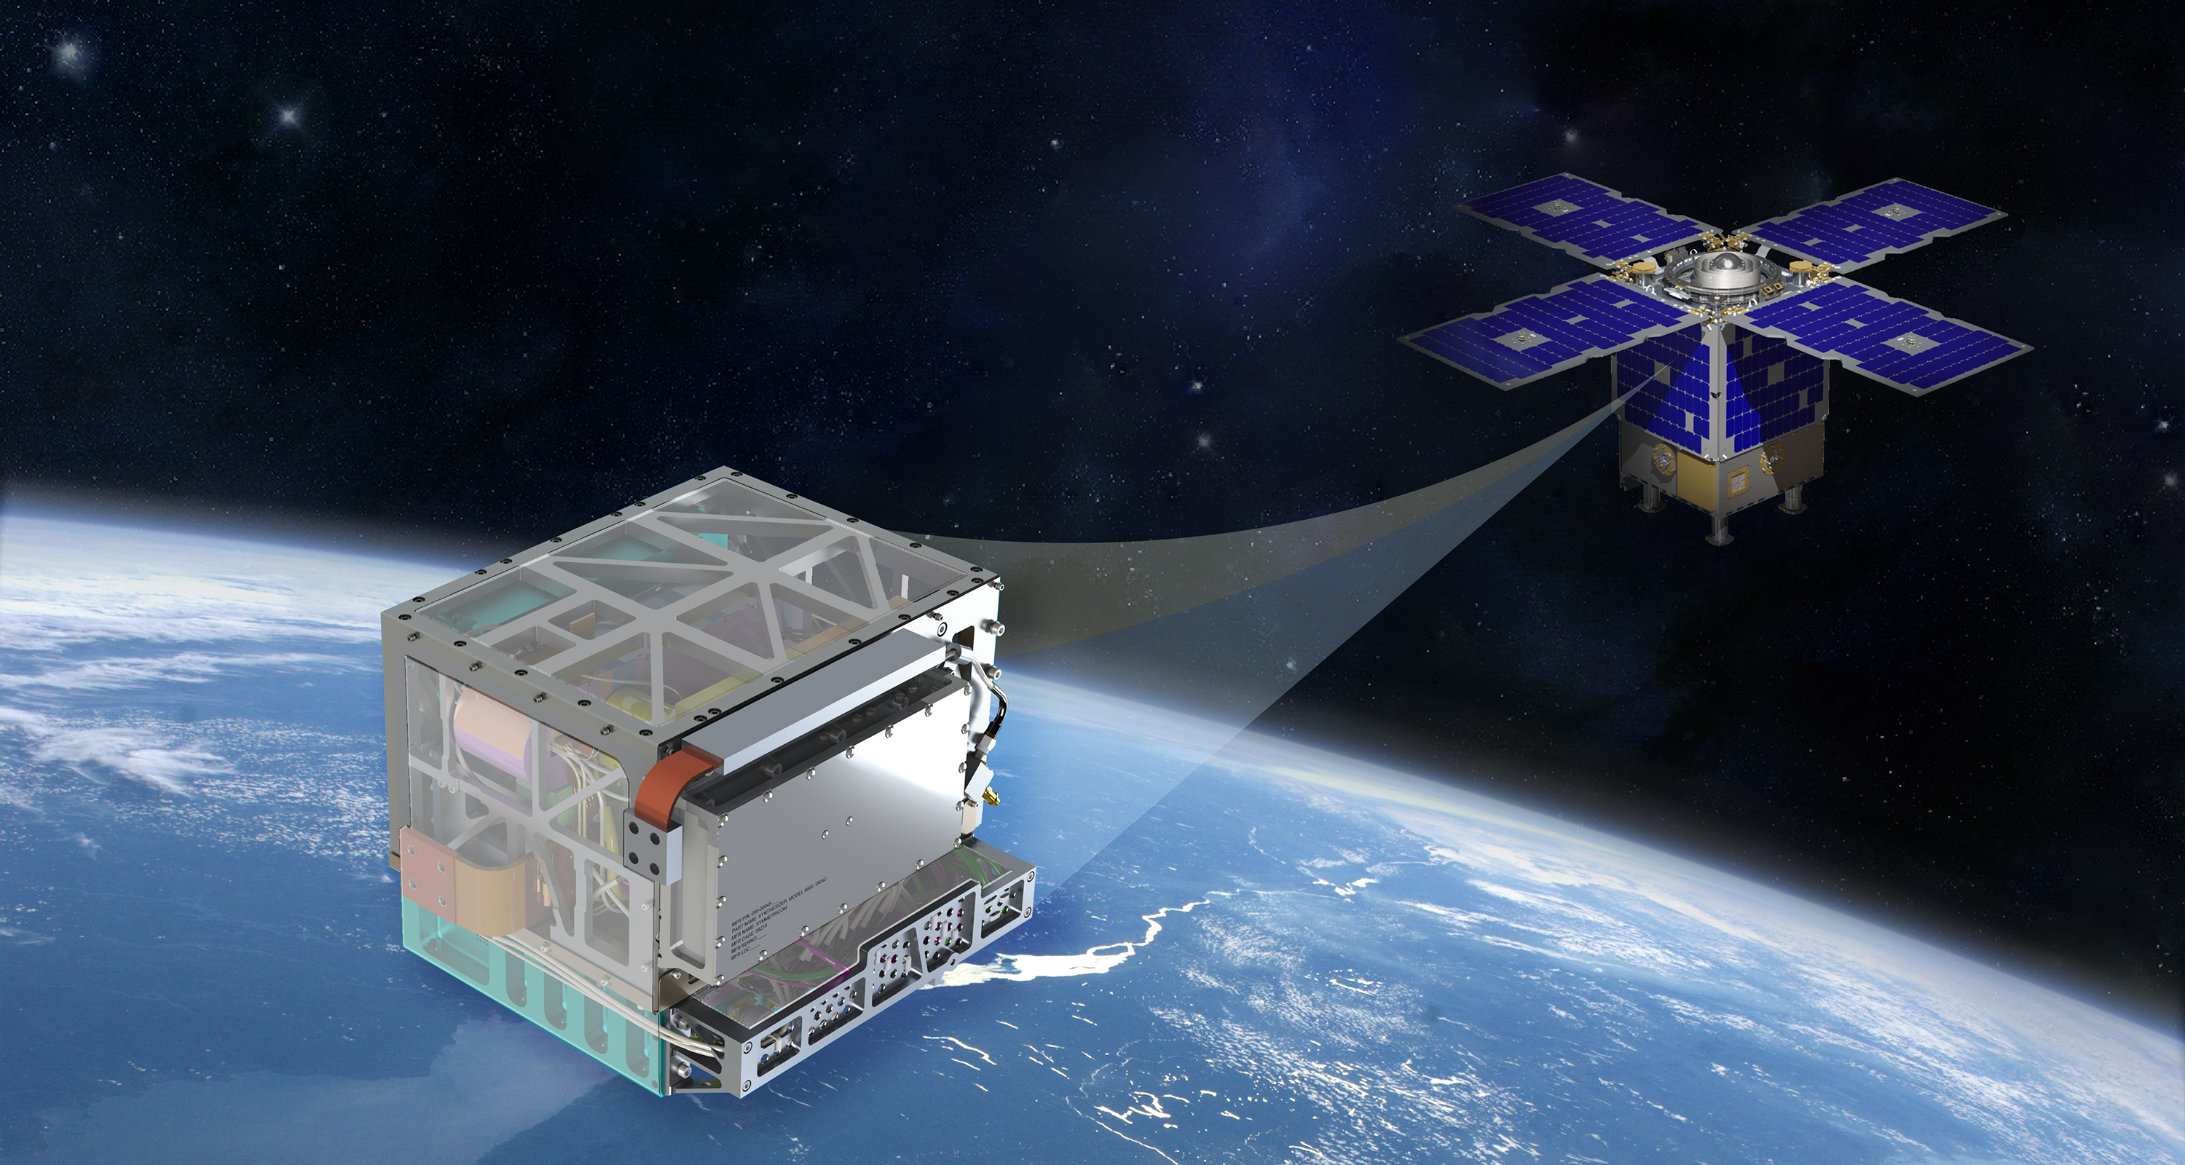
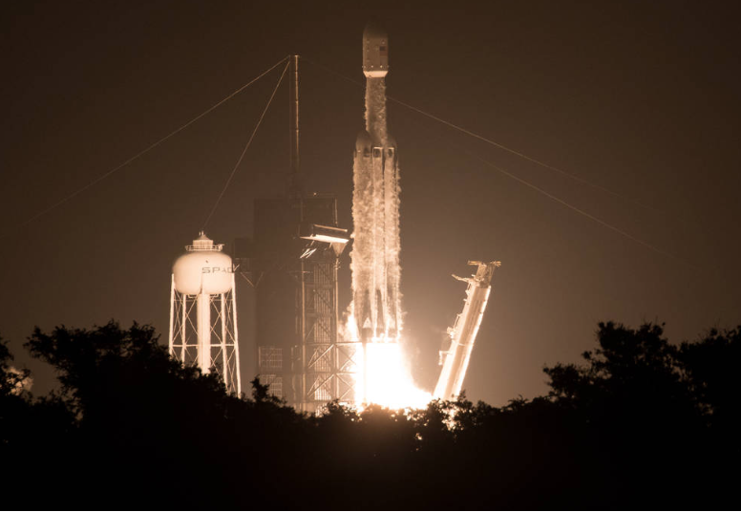

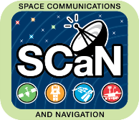

Deep Space Atomic Clock
A Technology Demonstration Mission
Successful launch, June 25, 2019
Notes:
STMD: Space Technology Mission Directorate
SCaN: Space Communications and Navigation
SST: Surrey Satelite Technologies

Slide 5

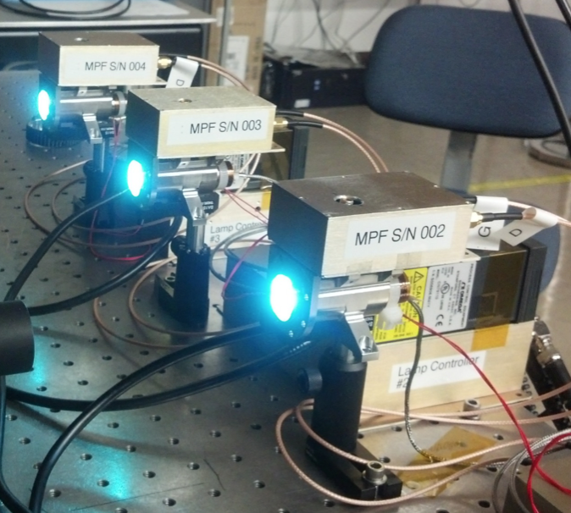
Some Primary Physics Package Subsystems
Titanium Vacuum Tube
DSAC Demonstration Unit
Mercury UV Lamp Testing
Quadrupole Trap Electrodes
Electron Emitter
Multi-pole Trap Electrodes

Slide 6
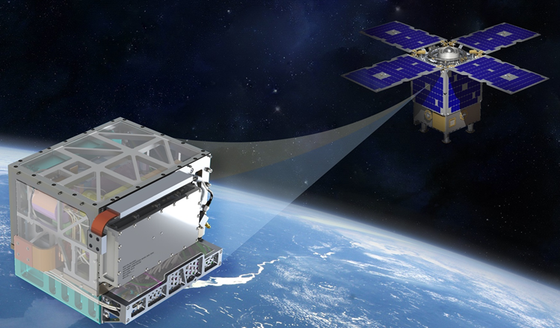
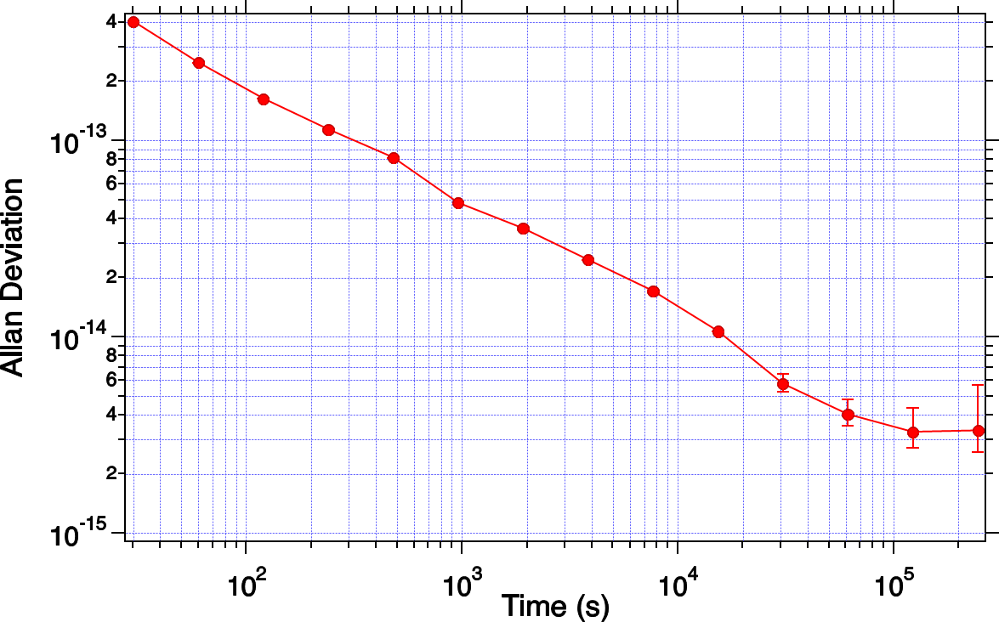
DSAC Frequency Stability Measurements vs UTC via GPS
Challenges of measurements in space: Noise Sources
Clock noise
GPS
Satellites
DSAC Payload in LEO
GPS noise
GPS
Rcv.
GPS
Rcv.
UTC(k)
Require precise orbit determination to remove relativistic effects – need J2 corrections
Final result: measure all three
OD
Hg+ stability vs UTC (> ~20,000 s) via GPS time transfer:
Adev(y(t))

Slide 7
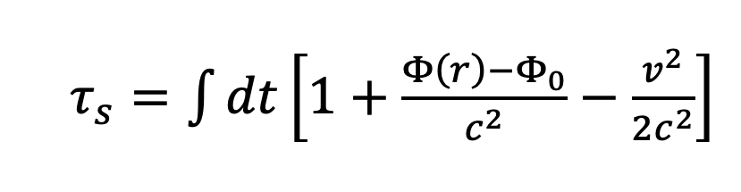
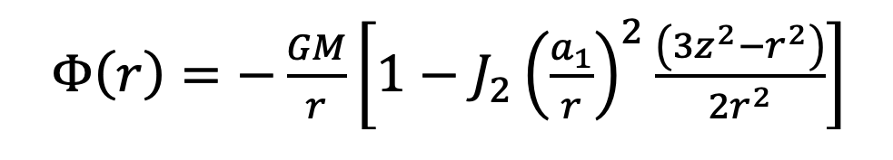
DSAC Results: Calibrating GPS Receiver and Relativistic Effects
GPS phase dynamically corrected for gravitational effects (red shift)
Must include higher order terms (J2) in the gravitational potential
No corrections
Relativity corrections, but no GPSR temperature corrections
Measurement floor after relativity and GPSR temp correction
Estimated clock noise
Notes:
Must correct for GRS
Must correct for GPS rcvr tempco
Still just an upper bound for actual clock
Includes residual OD noise, measurement system noise, and clock noise

Slide 8
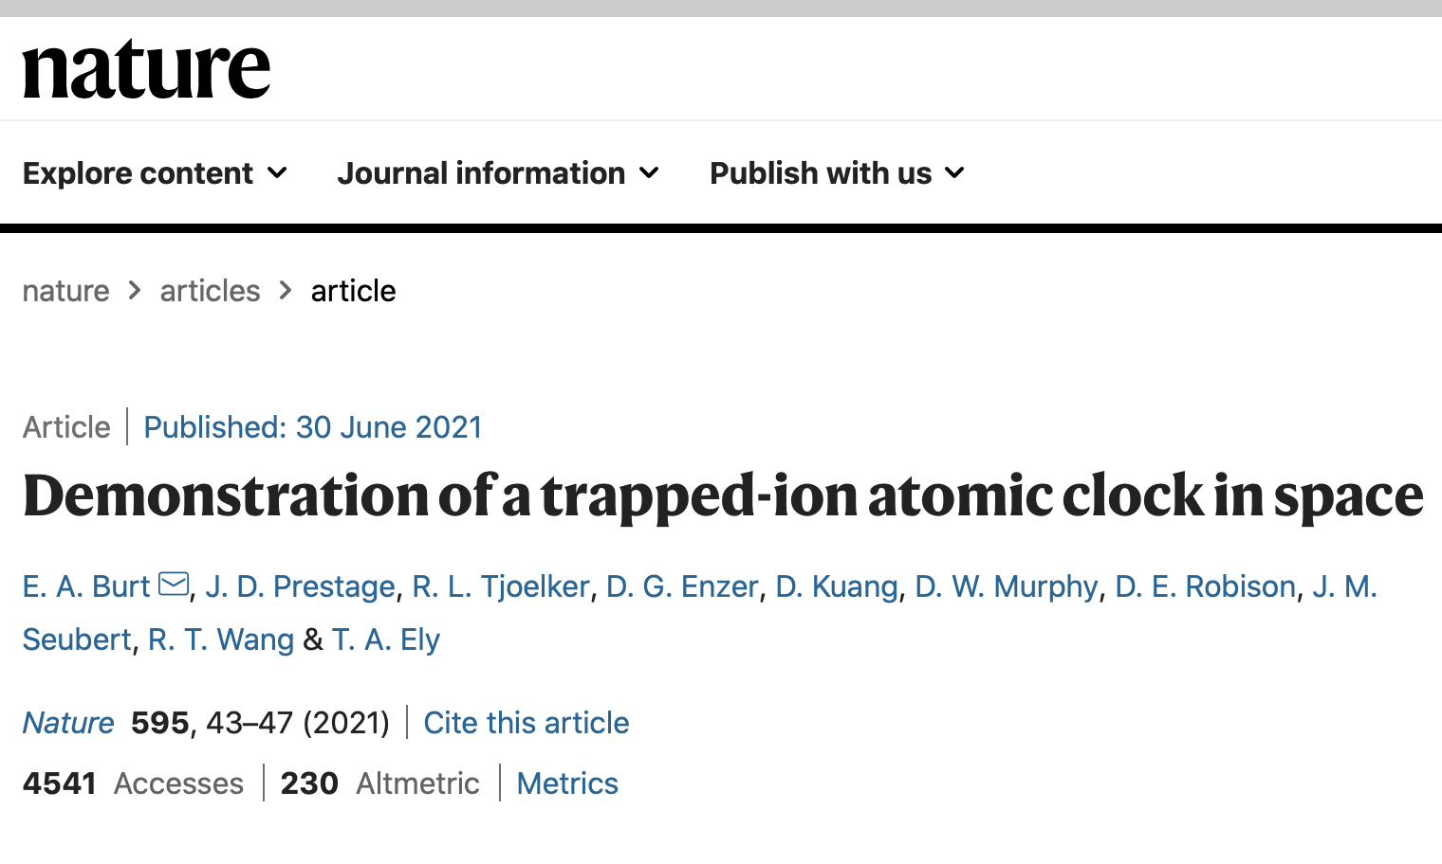
DSAC Results
DSAC requirement
GPS + OD + DSAC
DSAC
Optimized DSAC
DSAC measured on the ground &
w/ a Maser LO
Stability at one-day of 3e-15
significantly better than required 2e-14
Drift of 3.0e-16/day
establishes space clock record
Two subsequent long runs had similar long term stability
Run #1 (late 2020):
+3.0(0.6)e-16/day
Notes:
3e-15 at one day
3e-16/day drift – record in space

Slide 9
DSAC Environmental Sensitivities
Radiation: SAA-induced USO drift variations taken out by clock control loop
Notes:
Radiation on USO controlled
Magnetic 100x lab below noise
Ion number understood
Collision and light shifts at noise level
Temperature at 1e-14/C WITH NO THERMAL REGULATION – no other space clock can do this
Path to 2e-15/C known

Slide 10
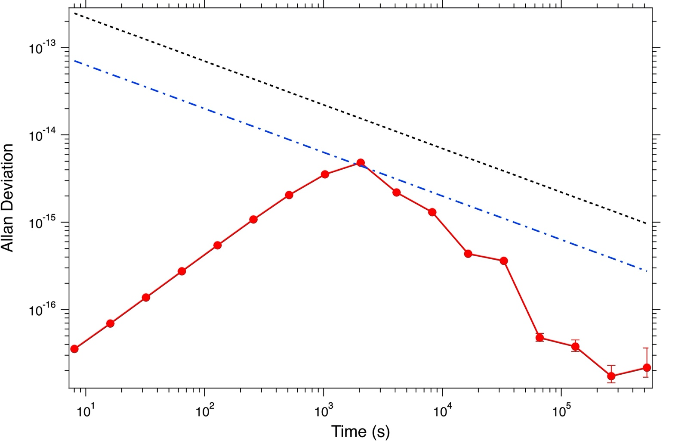
DSAC Environmental Sensitivities
Radiation
Magnetic Shifts: below measurement noise floor
250 mG/orbit - 100x lab!
Strength of Hg+ technology
Notes:
Radiation on USO controlled
Magnetic 100x lab below noise
Ion number understood
Collision and light shifts at noise level
Temperature at 1e-14/C WITH NO THERMAL REGULATION – no other space clock can do this
Path to 2e-15/C known

Slide 11
DSAC Environmental Sensitivities
Radiation
Magnetic Shifts
Ion number variations:
Second order Doppler shifts
Actual = model: well understood
Actual freq offsets
Modeled
Notes:
Radiation on USO controlled
Magnetic 100x lab below noise
Ion number understood
Collision and light shifts at noise level
Temperature at 1e-14/C WITH NO THERMAL REGULATION – no other space clock can do this
Path to 2e-15/C known

Slide 12
DSAC Environmental Sensitivities
Radiation
Magnetic Shifts
Ion number variations
Actual freq offsets
Modeled
Collision shifts
Residual frequency offsets with other effects removed
Stable at 4e-16/day level
Notes:
Radiation on USO controlled
Magnetic 100x lab below noise
Ion number understood
Collision and light shifts at noise level
Temperature at 1e-14/C WITH NO THERMAL REGULATION – no other space clock can do this
Path to 2e-15/C known

Slide 13
DSAC Environmental Sensitivities
Radiation
Magnetic Shifts
Temperature sensitivity:
Not fundamental
T-sensitivity of these
Overall: 1e-14/C with NO thermal regulation
Path to unregulated 2e-15/C is known
Ion number variations (second order Doppler)
Actual freq offsets
Modeled
Collision shifts (Background gas)
Light shifts: Not measured, but estimated at <3e-15 measurement noise floor
Fundamental systematic effects are well-understood and below the measurement noise floor
Notes:
Radiation on USO controlled
Magnetic 100x lab below noise
Ion number understood
Collision and light shifts at noise level
Temperature at 1e-14/C WITH NO THERMAL REGULATION – no other space clock can do this
Path to 2e-15/C known

Slide 14

DSAC Clock lifetime: > 7 years
Trap load time variations
Vacuum Tube
Mercury vapor evolution
Extrapolate current trap load time: 7-year life
Likely explanation: Hg/Au amalgamation – gold will be removed in future versions
Notes:
All three aging processes extrapolated to > 7 years
Hg and neon understood – path to longer life known
Working on lamp

Slide 15
DSAC Clock lifetime: > 7 years
Trap load time variations
Vacuum Tube
Mercury vapor evolution
Extrapolate current trap load time: 7-year life
Neon evolution
Shuttle decay measurements calibrated to neon pressure
Extrapolate to > 8-year life
Method to extend understood
Trap “shuttling” decay
Nov, 2016:
P = 4.7e-6 torr
May, 2020:
P = 2.6e-6 torr
June, 2021:
P = 1.3e-6 torr
Notes:
All three aging processes extrapolated to > 7 years
Hg and neon understood – path to longer life known
Working on lamp

Slide 16
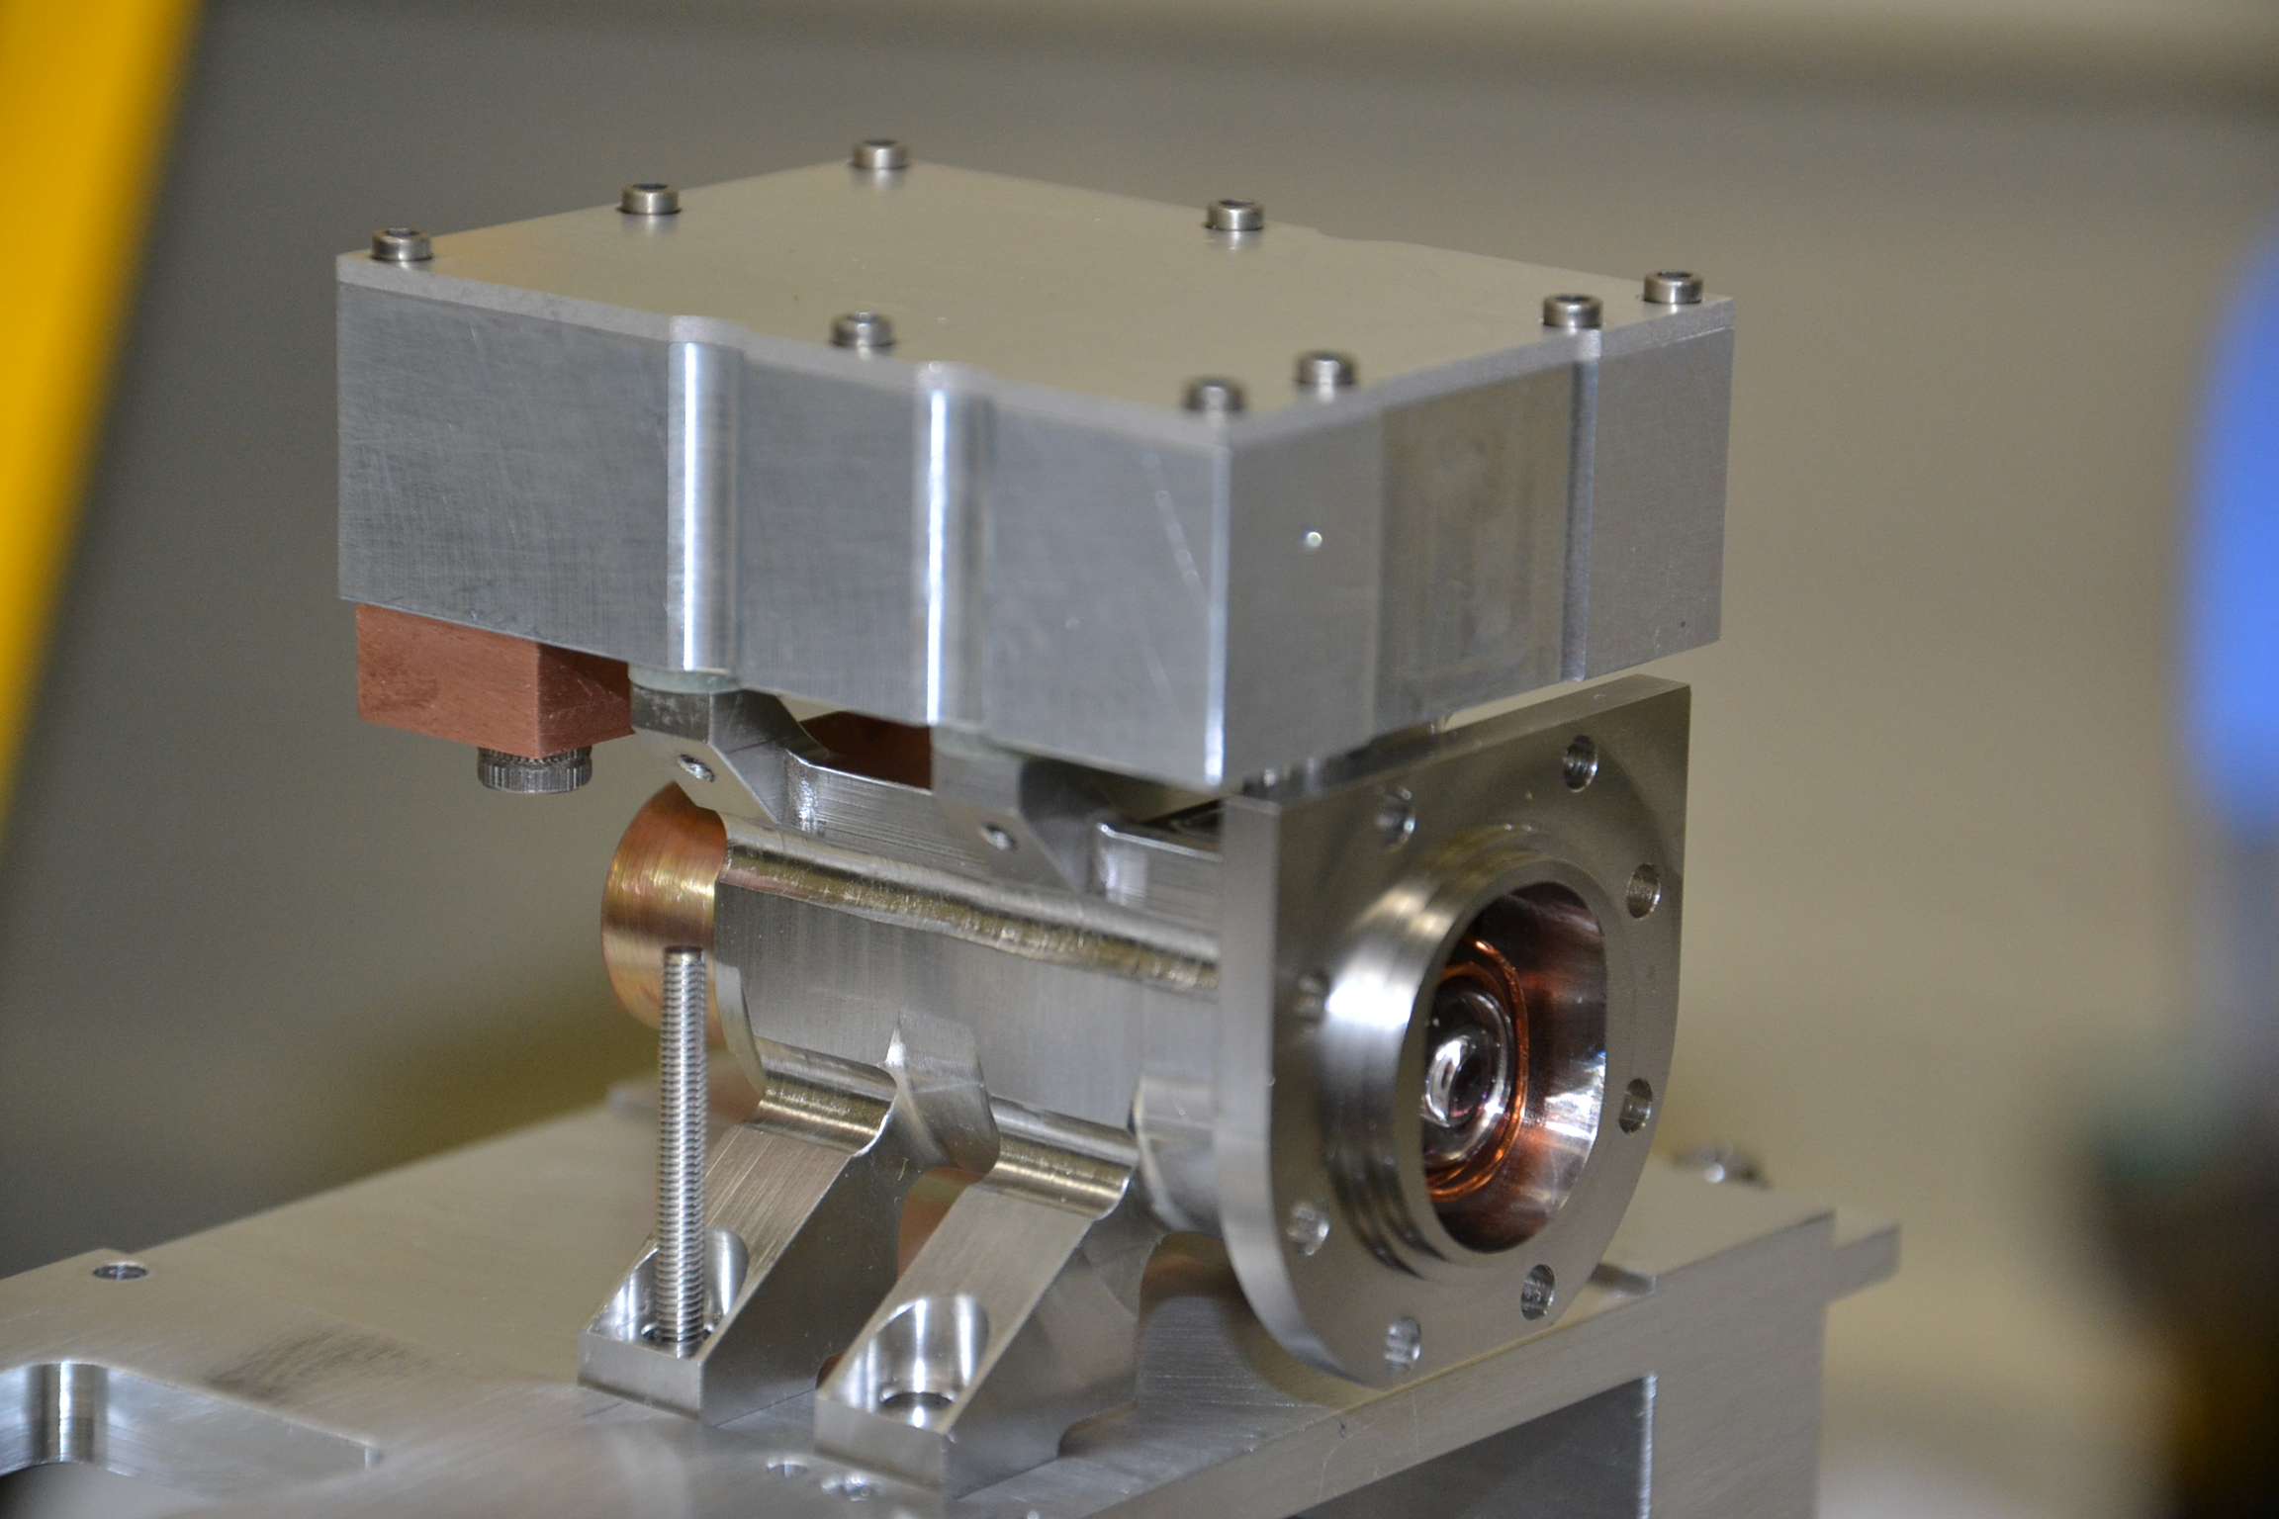
DSAC Clock lifetime: > 7 years
Trap load time variations
Vacuum Tube
Mercury vapor evolution
Extrapolate current trap load time: 7-year life
Neon evolution
Shuttle decay measurements calibrated to neon pressure
Extrapolate to > 8-year life
Trap “shuttling” decay
Nov, 2016:
P = 4.7e-6 torr
May, 2020:
P = 2.6e-6 torr
June, 2021:
P = 1.3e-6 torr
Lamp Assy.
September 2020
October 2021
Optics aging
13.7% change in 13 months
=> > 7 years total life
Most likely lamp
220169 counts
190062 counts
Clock lifetime > 7 years with known methods to extend this
Notes:
All three aging processes extrapolated to > 7 years
Hg and neon understood – path to longer life known
Working on lamp

Slide 17
Future Position, Navigation and Timing Clocks

Slide 18
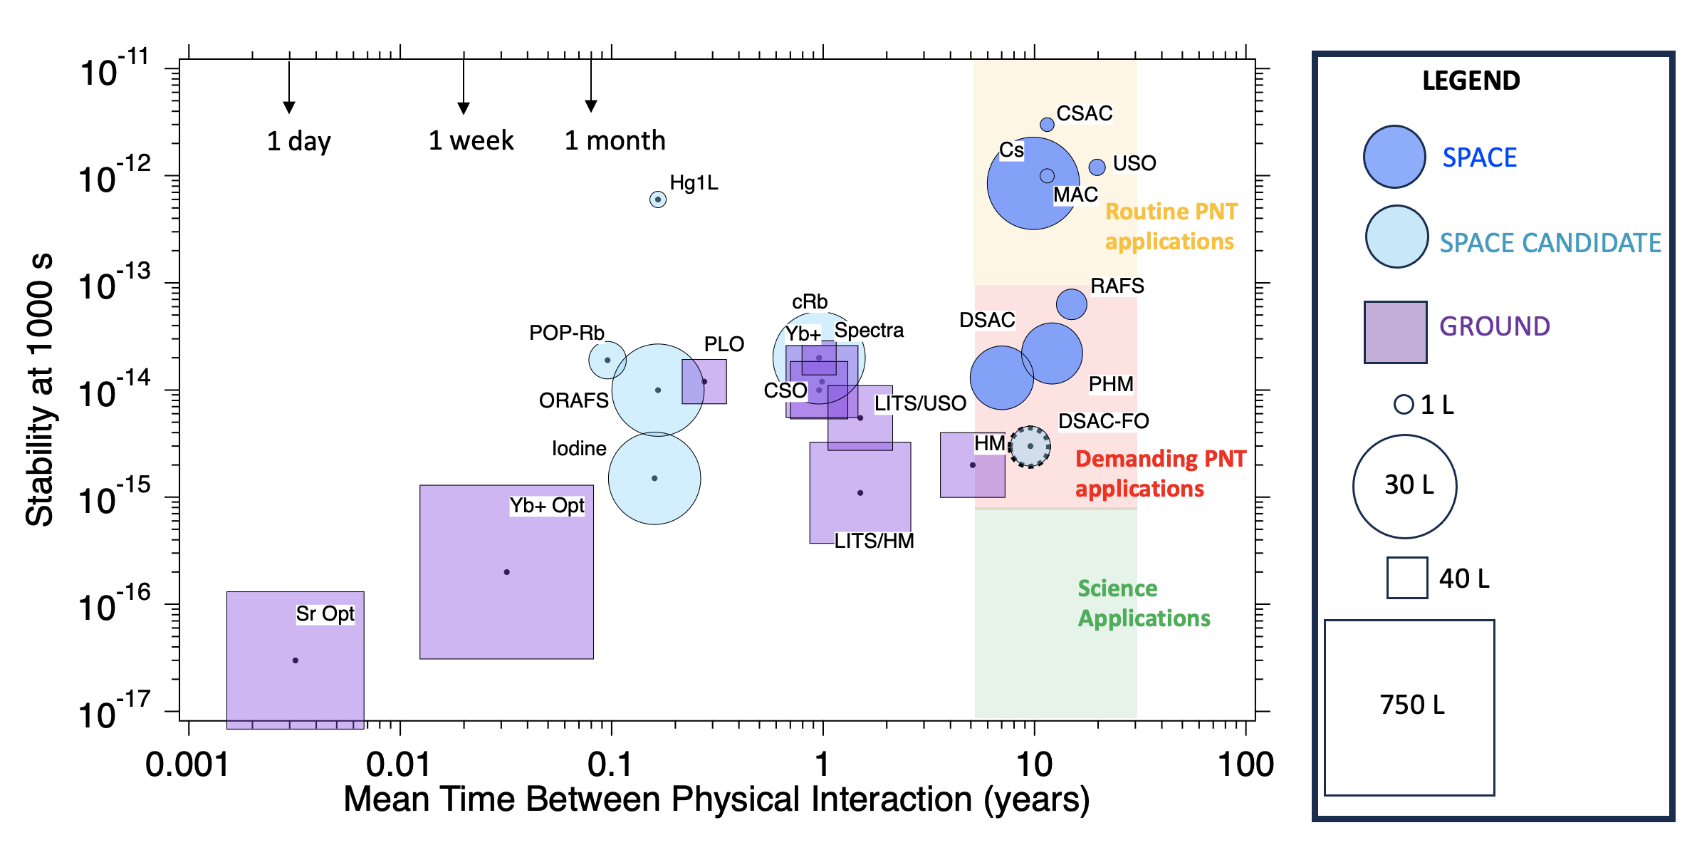
Position, Navigation and Timing (PNT) Clock Metrics
*Mean time between physical interaction is only estimated for these standards because this data was not reported
Takeaway: for PNT, need more than performance: SWaP and operability equally important

Slide 19
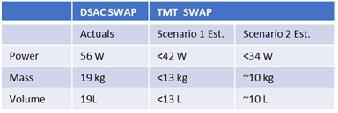
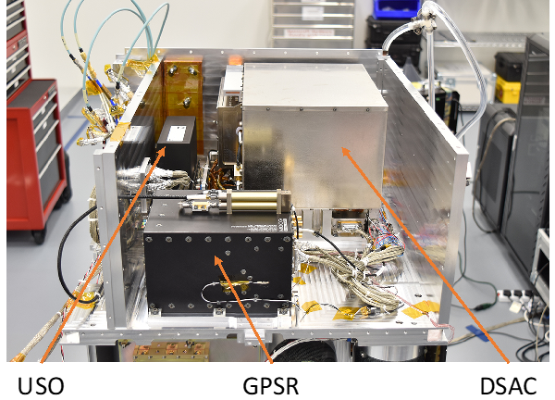

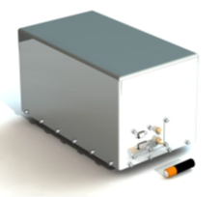

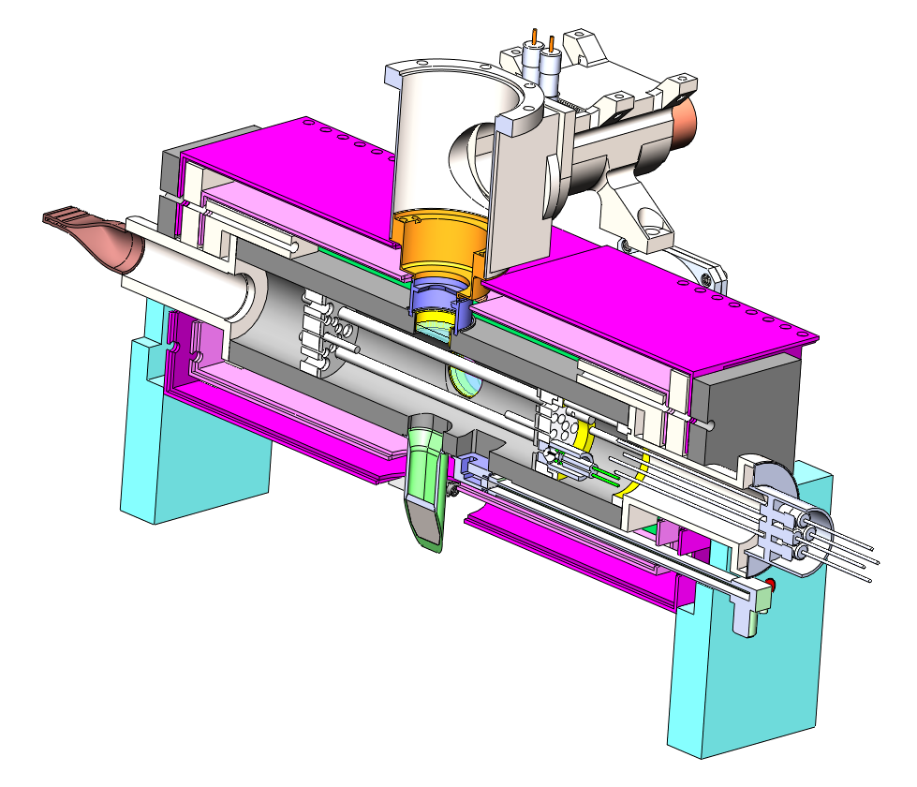
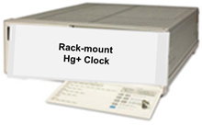
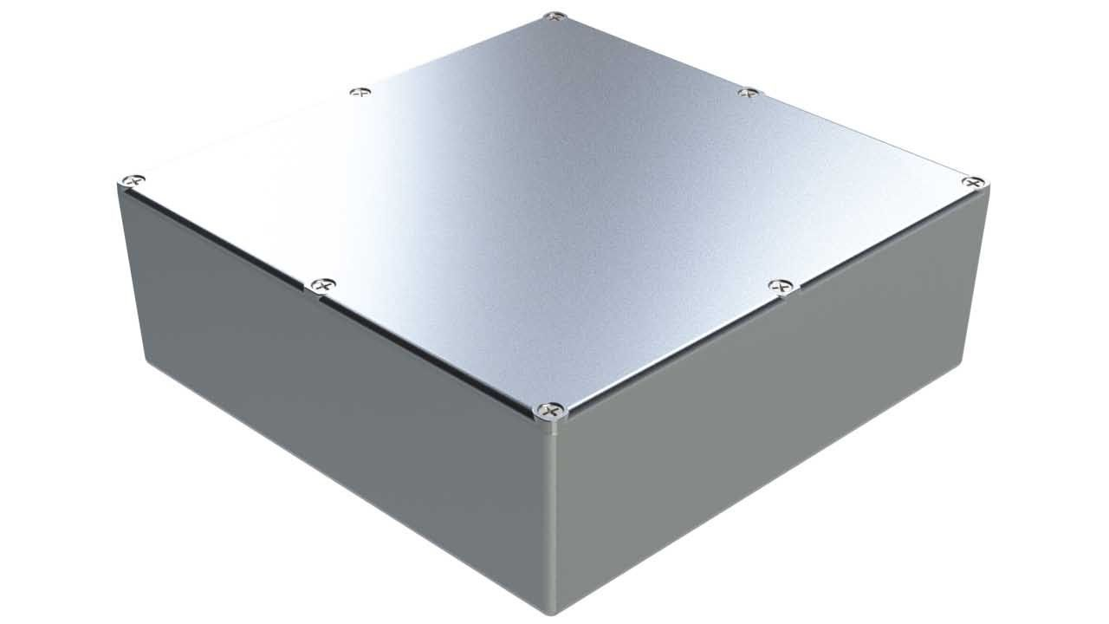
Technology Maturation Task (TMT)
Space and Ground Clocks – common performance properties
How much can we reduce SWaP and increase Life while maintaining maser-like performance?
Frequency stability with Quartz USO as the LO
Common requirements with broader market and commercial interest:
  Ground Clocks: H-maser (e.g. DSN, VLBI), Cs beam replacement (e.g. telecom)
  Space Clocks: DSAC2, GPS & GNSS
Operability, reliability, and manufacturability paramount.
Instrument Life: 5-10 years
Frequency stability class:
  Local Oscillator = 1E-13 class USO
  1E-13 at 1 second, 2E-13/τ½ , 1E-15 at 1 day. Long term drift <5E-16/day
SWaP class volume driver:
  Space < GPS clock footprint
  Ground < 5071 Cs chassis height (5.25”).
Free running USO
DSAC-1 in space
DSAC-2 expected
DSAC (STMD, SCaN)
TMT (SCaN)
Flight Prototype
DARPA/ONR development
miniature, tactical
(1E-11/root tau)
Ground Prototype

Slide 20
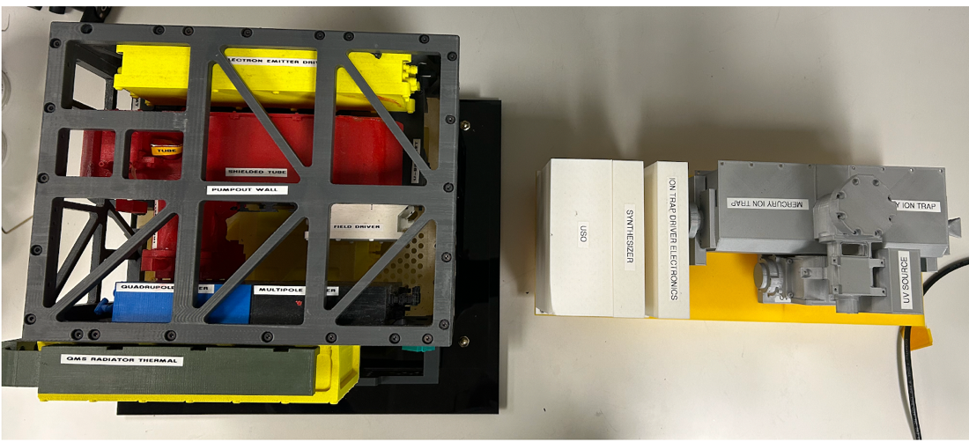
TMT
TMT approach
Simplified trap architecture: QP-only
Eliminate 1 trap driver
Simplify controller architecture
Integrate electronics
Eliminate empty space
Improve optics efficiency
3D-models
DSAC (+ USO and controller)
TMT (all-inclusive)

Slide 21
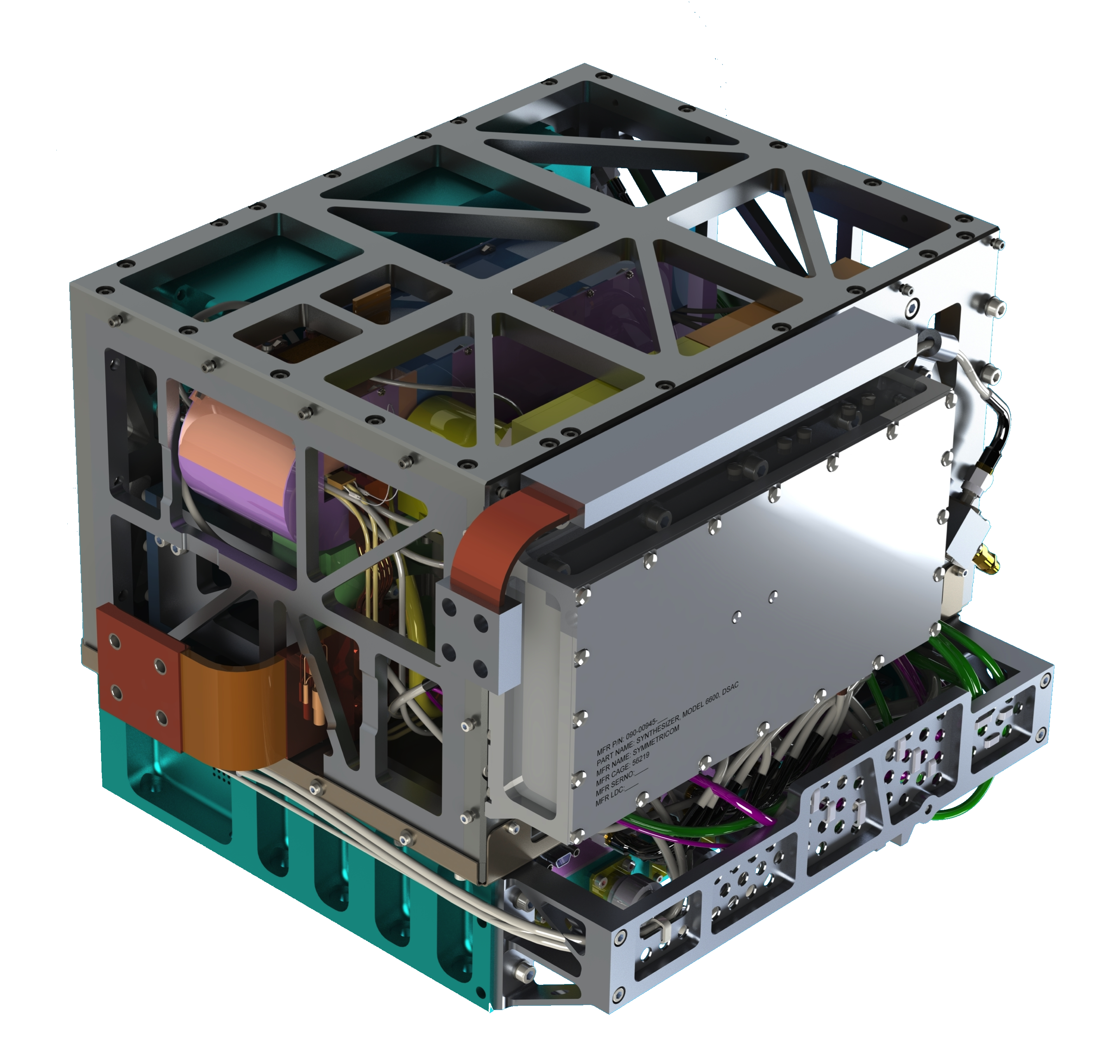
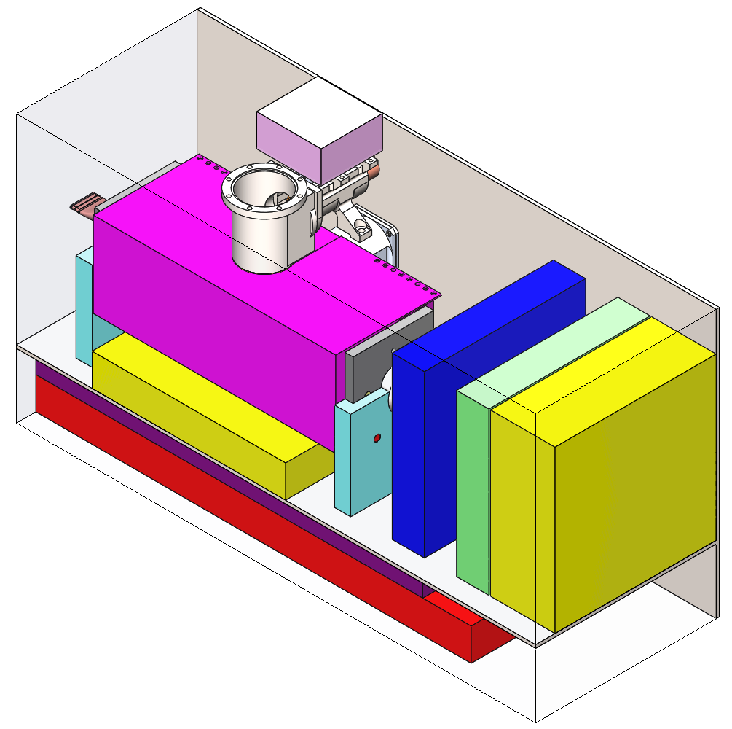
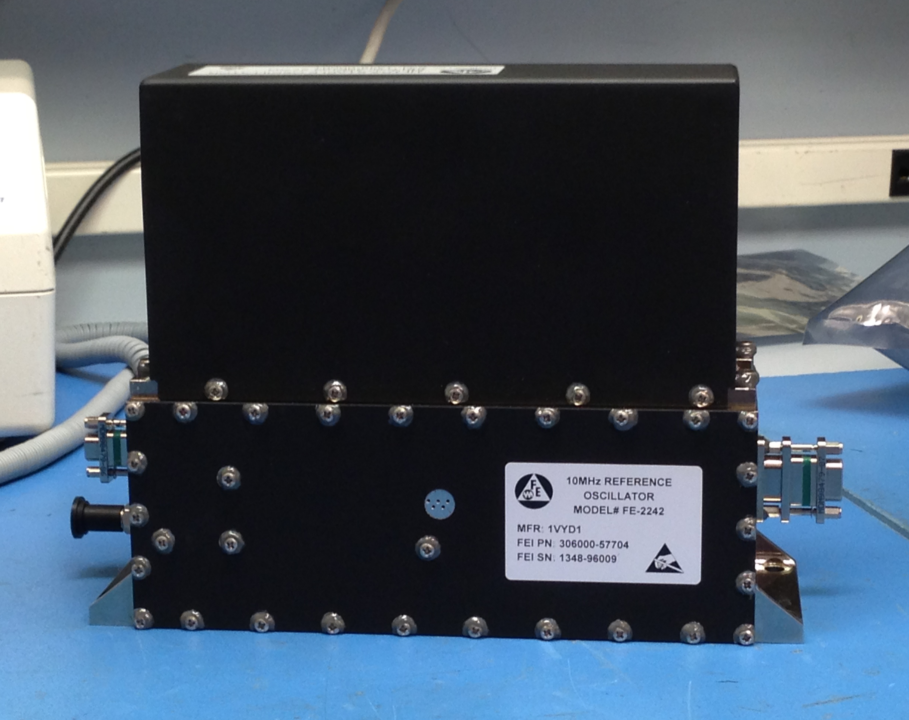
TMT Performance Goal
TMT Concept
DSAC-1
USO
50 W, 19 kg
PIU
34 W, 10 kg
+
+
1e-13 at 1 s, <1e-15 at a day, ~50 ps at a day, 34 W, 10 kg
Notes:
DSAC-2: SWaP: 50W/19kg -> 34W/10kg
Performance: 1e-13 at 1 s, 2e-13/sqrt(tau), 1e-15 at a day, 10 ps at a day
DSAC-2 selected for VERITAS, but cancelled due to a budgetary shortfall

Slide 22
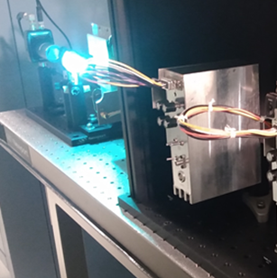
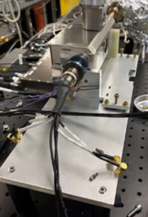
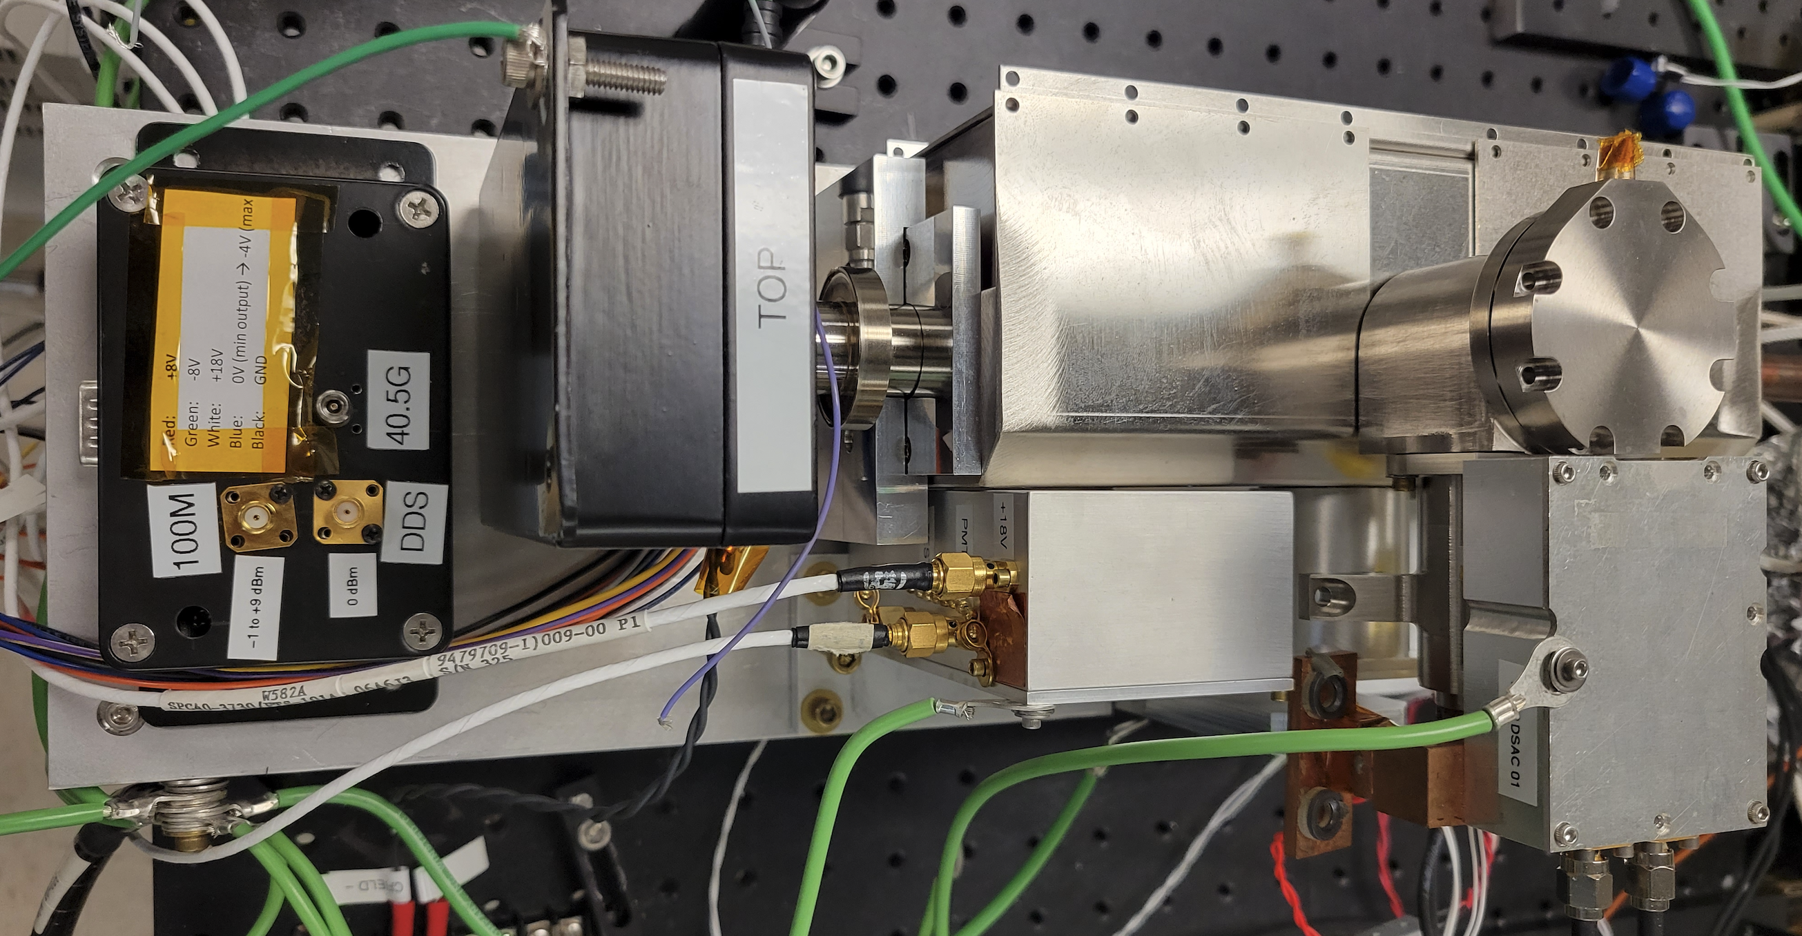


Prototype Build
3D Model
Prototype build with electronics

Slide 23
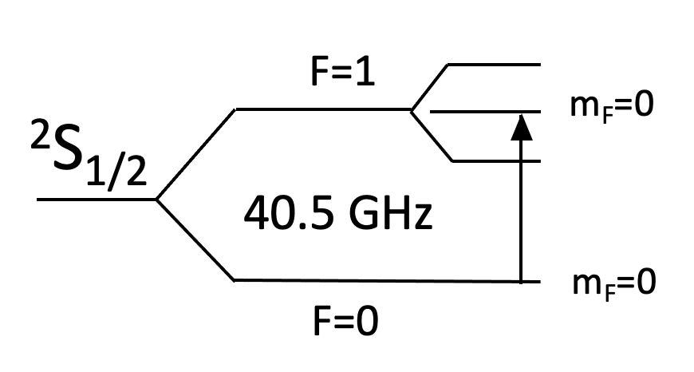
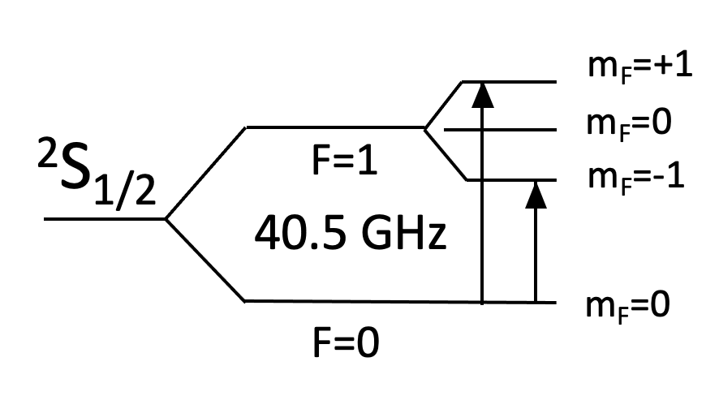
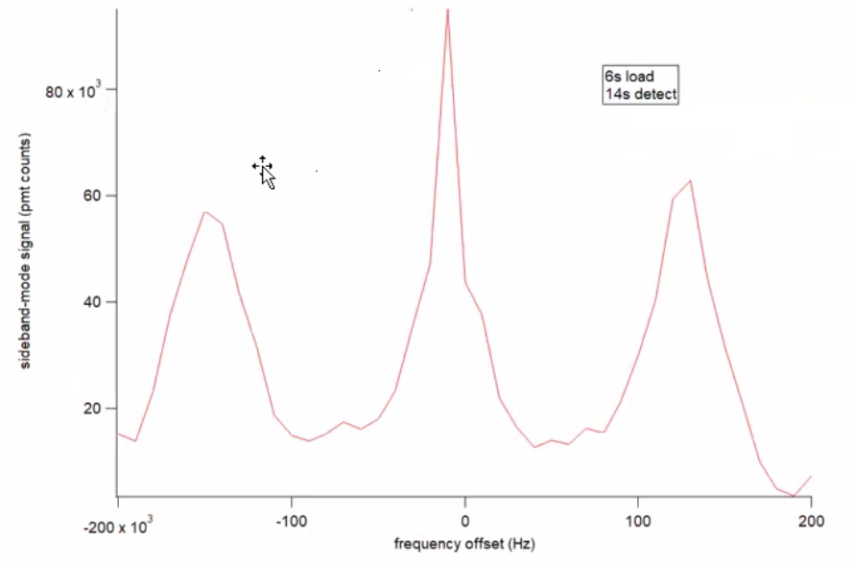
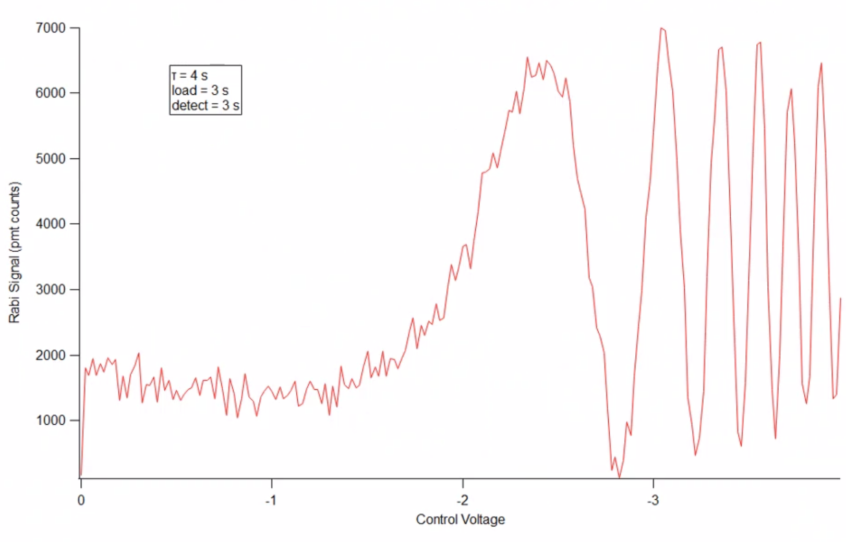
Prototype Initial Results
Clock transition spectroscopy
Zeeman spectroscopy
Trap lifetime ~ 1 day
Contrast with increasing microwave power
Initial temperature sensitivity: < 2e-14/C
4e-13/sqrt(tau) (maser LO)
Further optimization: SNR supports 3e-13/sqrt(tau)
=> excellent coherence
Preliminary – not optimized
Magnetic sensitivity: in progress

Slide 24
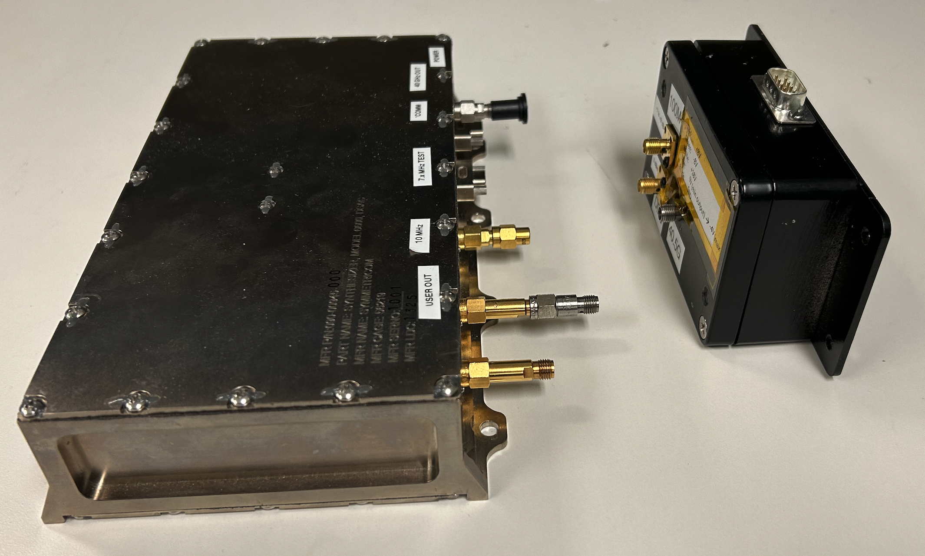
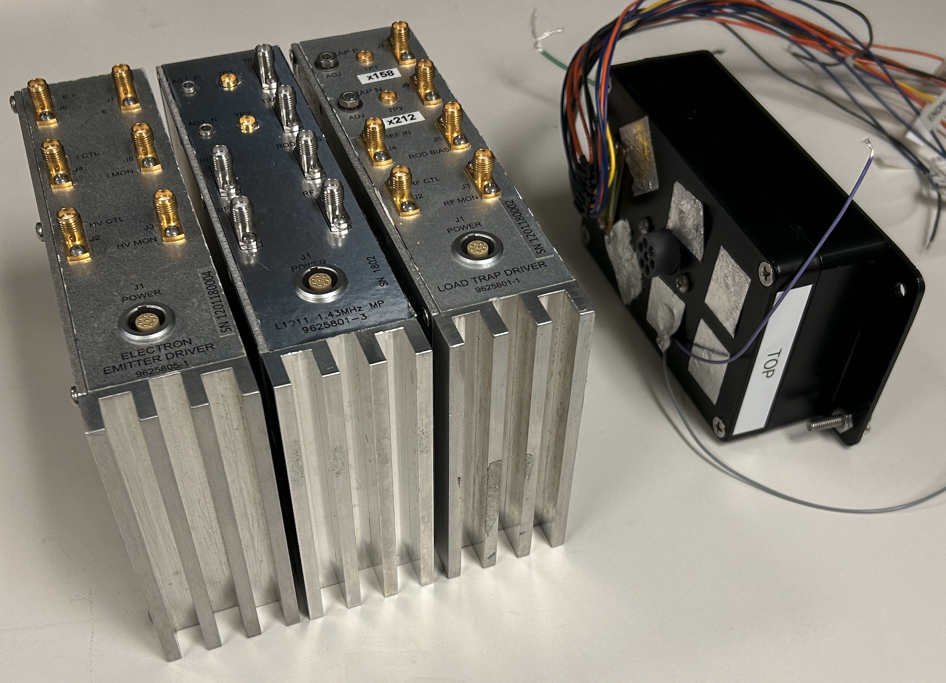
Prototype Electronics
DSAC synth
DSAC trap/EED
Prototype
Prototype

Slide 25
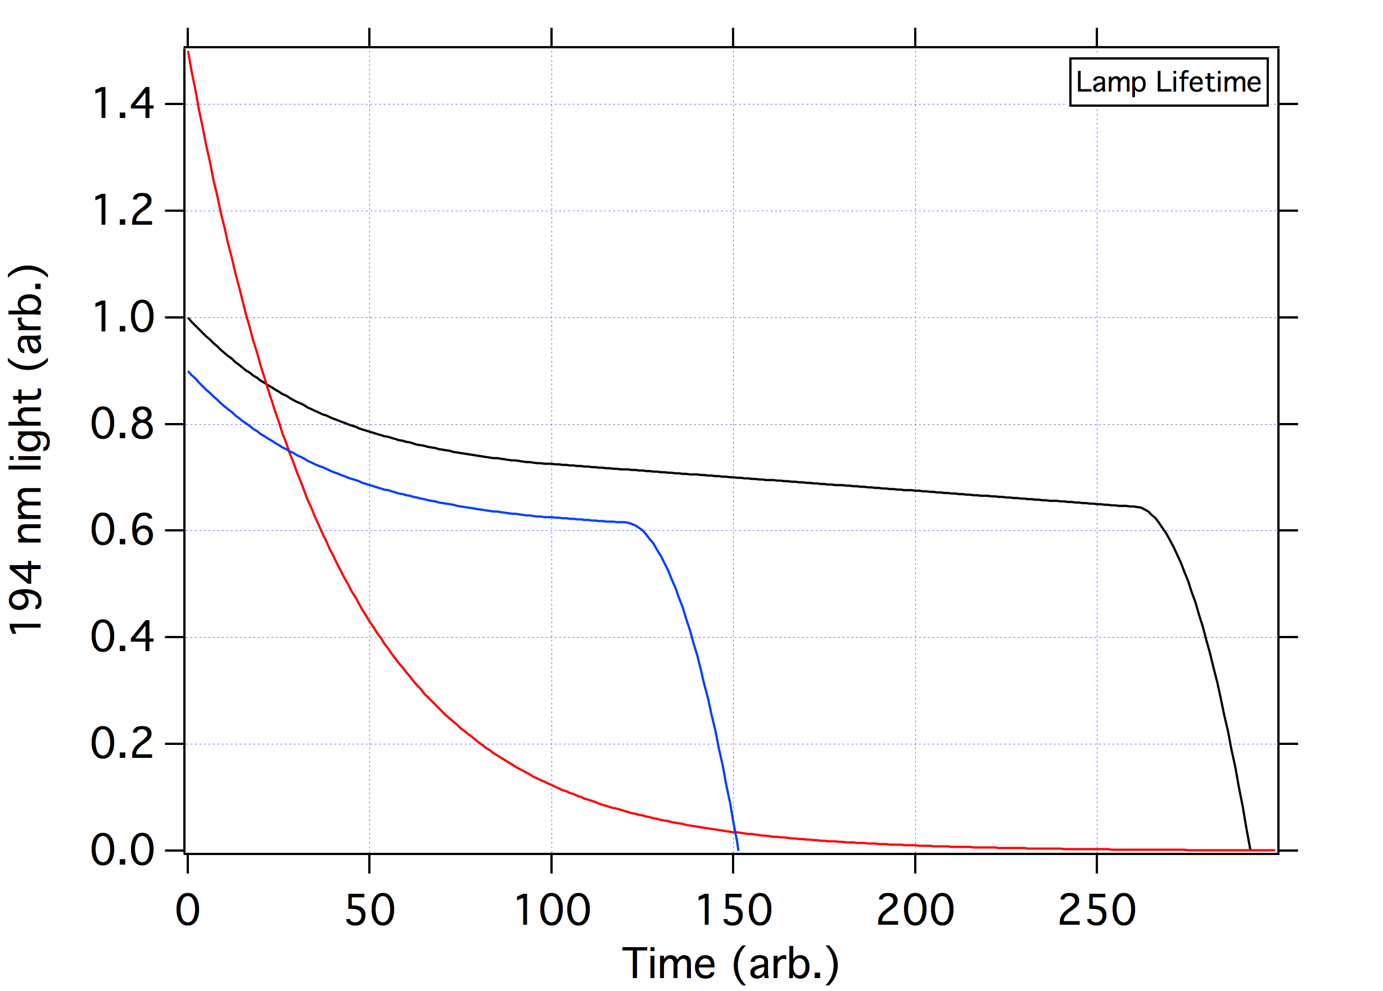
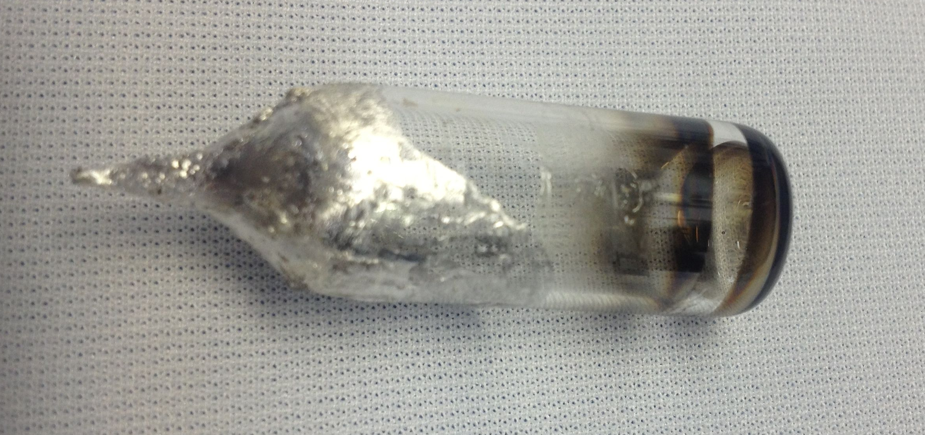
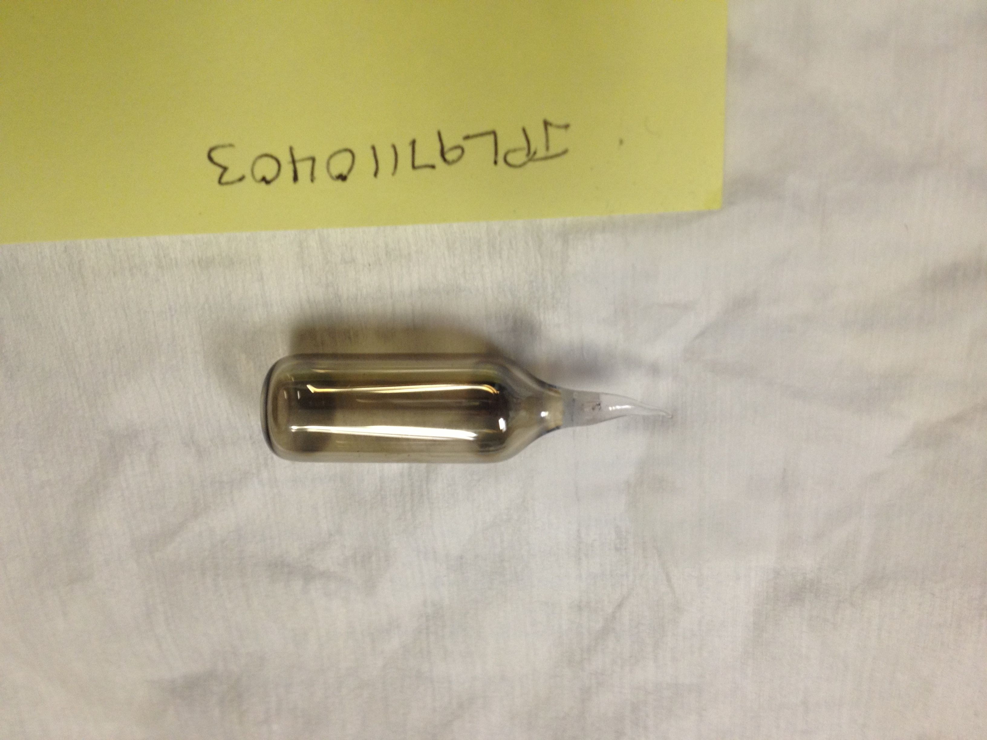
Light source aging
Too much Hg
Too little Hg
Mercury Oxide: where does the oxygen come from?
“Plasma Sheath”
Separation of charge
E field
SiO₂
+
-
+
-
High energy Hg+ wall collisions dissociate O₂
-
Need:
Incorporate sapphire
Methods to calibrate/quantify Hg
+
-
+
-
HgO recombination
Hg+/e-
neutral
+
-
-
+
-
+
-
+
-
-

Slide 26
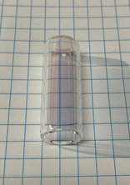
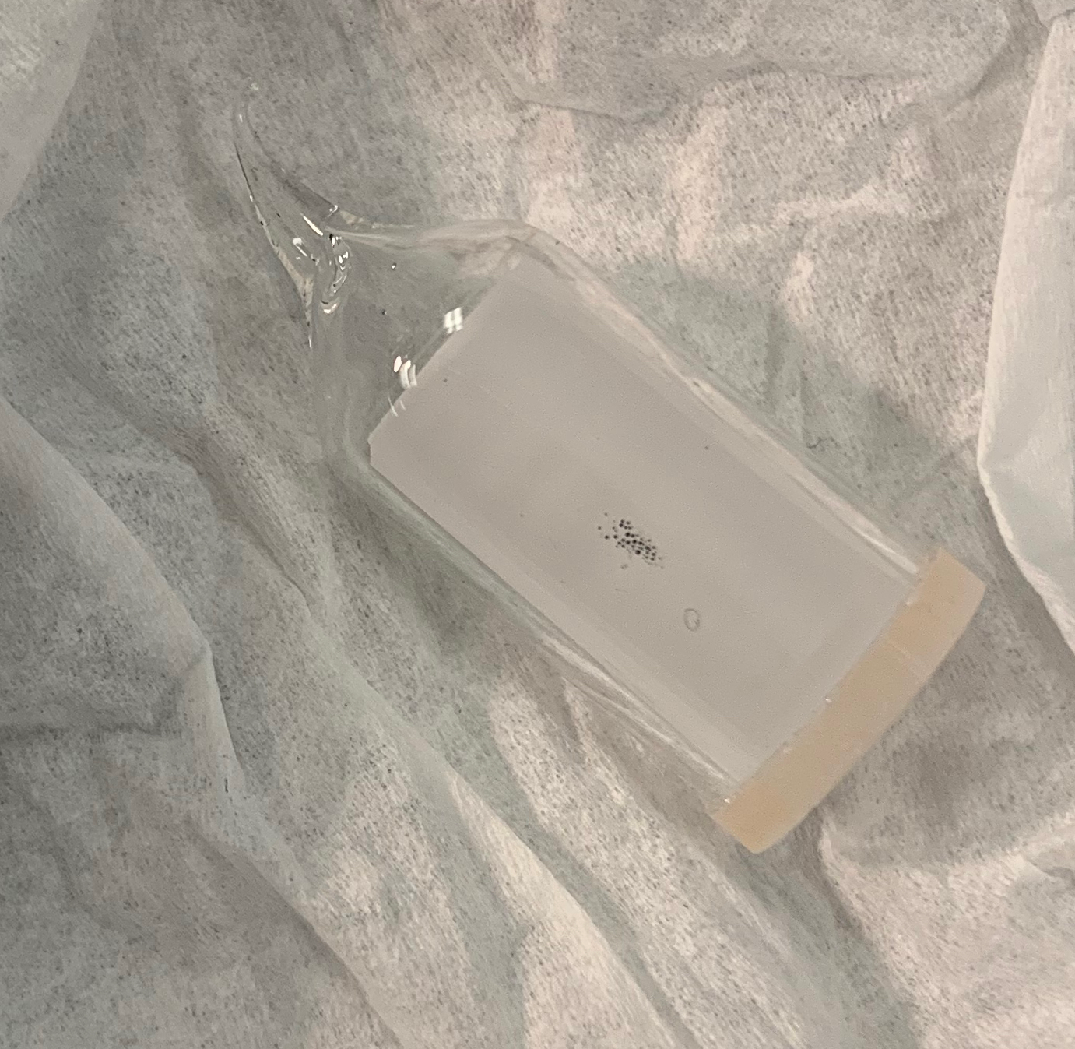




Plasma discharge light source development: Incorporating sapphire
ALD sapphire coated
Sapphire insert
Bulk sapphire
See next talk for another approach…

Slide 27










Lamp Life and Quantification
Lamp Content Quantification
Long-term spectral & life monitoring
Differential Scanning Calorimetry (DSC)
Optical Hg Drop Imaging
Ar and Hg
discharge

Slide 28
TMT Summary
Performance:
  on track for 2e-13/sqrt(tau), 1e-15 at a day
SWaP:
  on track for 10 L / 34 W
Lifetime:
  have built a sapphire-coated lamp
  Producing best clock signal
  life testing in progress

Slide 29
Science Applications

Slide 30


Deep Space Nav using 1-Way Range and a Spacecraft Clock
Deep space navigation: a science enabler
Two-way signals:
S/C is transponder, no clock
Distance + Velocity
One-way signal with bad clock:
Time delay + Doppler + Fit
One-way signal with good clock:
Time delay + Doppler + Fit
Precise, but not real time
Real-time nav, but imprecise
Real-time nav and precise
Notes:
Two-way nav: s/c transponder – precise but not real time
One-way with bad clock plus model – in situ real time, but not precise
One-way with good clock plus model – in situ real time AND precise

Slide 31





Radio Occultation
Must correct for USO drift
Depends heavily on data used
Courtesy Tatiana Bocanegra-Bahamon, JPL
RO Experiment Geometry
Ingress point
Occultation data
Credit: JAXA Akatsuki RS Team
absorption
Frequency shift
Data used for drift est.
Baseline mean:
- 7mHz (red), -2mHz (blue)
Uncertainty in RO result due to USO drift estimate
Ingress
Notes:
- RO: atmosphere leads to refraction, absorption, and frequency shift in microwave signal
Measure this => measure atmospheric characteristics
USO used to generate s/c timing
Must characterize USO drift - problematic

Slide 32






RO Simulation: DSAC vs. USO
Effect of reducing the clock error
Neglecting OD and transmission errors
propagate $σ_{f}$ through the multivariate and multistage occultation measurement model using MC simulations.
$$α\left( 90 km\right) \sim 5∙{10}^{−6} rad$$
$$n_{n}\left( 90 km\right) \sim {10}^{22}m^{−3}$$
Courtesy Tatiana Bocanegra-Bahamon, JPL
1% vs. factor of 2
Part per 1000 vs. 10%
Notes:
Tatiana Boanegra-Bahmon (JPL) simulation of RO: compare USO to DSAC
1-2 orders improvement for both refraction and df

Slide 33






Simulation Results for Venus Cruise LPI Measurement
Parametrization: $α$. LPI test with identical clocks (DSAC in space and on ground)
Multi-arc covariance analysis (using NASA-JPL MONTE software):
Current best
$α$formal uncertainty
$σ_{init}$ : accuracy of initial frequency calibration (i.e. expected to be ${10}^{−14}−{10}^{−13}$)
$σ_{c}$ : expected 10-day frequency stability
DSAC-1 verified $σ_{c}$ $<5×{10}^{−15}$)
Possible with DSAC-2
$σ_{c}$ (10-day DSAC-2 stability)
LPI/LLI slides courtesy of G. Cascioli, F. de Marchi, and L. Iess
Notes:
Perform simulation, including clock, OD, and measurement system noise
Looking just at alpha, may be able to get a 5x improvement over Galileo measurement
Note, Galileo meas. Struggled with temperature and magnetic field sensitivity – not present with DSAC

Slide 34
Summary
DSAC: first trapped ion atomic clock in space
< 3e-15 at 1 day, 3e-16/day drift, 300 ps at 1 day (meas. system limit)
Lowest environmental sensitivities
A lower SWaP breadboard prototype has been built
Enables: deep space nav, science, and applications requiring autonomy
Science examples: Relativity, Radio Occultation

Slide 35
Supporting Slides

Slide 36

DSAC 2019-2021 Operations Overview
Clock up time
Mission operations from 8/20/2019 to 9/18/2021 for a duration of 760.2
Operations periods include:
  USO on: 84.6%
  Clock on: 78.2%
  GPS data: 74.9%
10 long runs (67 days longest)
All run terminations due to S/C safe modes
2 known radiation-induced faults that impacted clock control – recovered
No known clock hardware faults
DSAC has proven to be very reliable and robust

Slide 37
Long-Term Performance: Drift
- 3 long runs, each ~ 2 months
Run #2 (early 2021):
Small ion cloud
correct for ion number
-5.0(0.8)e-16/day
Run #3 (late 2021):
Small ion cloud
-5.8(0.7)e-16/day
Run #1 (late 2020):
+3.0(0.6)e-16/day
Confirmed:
Systematic effects “corralled”
Very little linear drift with no thermal regulation – two orders magnitude less than Rb
Time keeping applications
Strength of trapped ion technology: long-term autonomous operations

Slide 38
Fundamental Science Enabled by DSAC

Slide 39

Gateway Provides Precision Time & Frequency for Science: measurements enabled by a precise clock
1/r² law of gravitation:
  All measurements to date agree that the exponent is precisely “2”,
  some theories of gravity predict a small deviation from this law.
  Precise range of a drag-free spacecraft in deep space using a DSG clock together with laser ranging from the DSG to the moon could yield an improved limit on the correction [1].
Cosmological constant (CC):
  The CC is added to Einstein’s equations to explain an observed accelerating expansion of the universe.
  Theoretical predictions disagree by many orders of magnitude with measured limits.
  Ranging to a drag free spacecraft in deep space together with a DSG clock and laser ranging to the moon could improve limits on the cosmological constant. The measurement could also be enhanced by inferred outer planetary orbits as determined by nearby precise spacecraft ranging [1, 2].
Dark Matter (DM):
  DM in some form constitutes 90% of all matter and is required to explain the structure and dynamics of galaxies. So far unobserved.
  Time variations in spacecraft ranging enabled by a DSG clock relative to a precisely known DSG orbit using laser ranging could be an indication of dark matter fluctuations on the spatial scale of the range [7].
  Similar dark matter searches could also be carried out with a network of clocks, including one on the DSG and others on earth, on the spatial scale of the earth-moon distance.

Slide 40
Gateway Provides Precision Time & Frequency for Science: measurements enabled by a precise clock
Gravitational Red Shift (GRS):
  This general relativistic effect causes clocks deep in a gravitational potential to tick slower than those higher in the potential. All measurements to date agree with GR, however GR is known to be incomplete and some new theories predict variations in the GRS.
  Due to it’s highly eccentric orbit, the DSG is an ideal platform to measure variations in the GRS by comparing a DSG clock to one on earth [5].
Lorentz Violation (LV):
  Lorentz symmetry states that physics is the same regardless of relative orientation and speed of reference frames.
  Some theories of quantum gravity predict a violation of this symmetry.
  DSG orientation and speed constantly changing relative to Earth => DSG platform is ideal for looking for LV effects by comparing a DSG clock to one on earth.
  Clock comparisons include changes in orientation (Michelson-Morley), velocity (Kennedy-Thorndike), and time dilation (Ives-Stilwell) [5, 6].
Quantum Entanglement (QE):
  correlating quantum states in systems separated by a space-like interval (not causally linked in a classical picture.)
  Entanglement has been demonstrated out to 1200 km [8]. A DSG clock could extend this to earth-moon distance by using precise timing to improve signal to noise in an entangled state measurement apparatus.
Quantum Clock Synchronization (QCS):
  An algorithm to synchronize remote clocks using quantum entanglement.
  Not yet fully demonstrated on the ground

Slide 41
Gateway Provides Precision Time & Frequency for Science
Test | Observable | Instrument | Current Best | DSAC on DSG
Space VLBI | 230+ GHz microwave signals from SMBH’s | Multiple antennae + clocks + …
1/r² cosmological constant DM vs. MOND¹[1] | S/C range | DSG clock + drag free S/C + DSG-Moon laser range² | 10⁻⁶ at 100 AU | 5x10⁻⁸ at 100 AU²
Cosmological constant [2] | Planetary orbit from S/C range | DSG clock + drag free S/C + DSG-Moon laser range³ | Λ < 10⁻³⁶ | Λ < 10⁻³⁹
Cosmological constant | Perihelion precession⁴ | Ranging between DSG and the moon | Λ < 10⁻³⁶ | Unlikely to be competitive, but needs more study⁹
Gravitational Red Shift | Clock compare: DSG to earth | DSG clock | Clock: 2.5x10⁻⁵ [3a] AI: 7x10⁻⁹ [4] | >3x10⁻⁶ [5] ~5e-6 (VERITAS)
Lorentz Violation | Clock compare DSG to earth in different reference frames | DSG clock | 1.1x10⁻⁸ [6] | >1x10⁻⁷ [5]
Local Position Invariance | Compare two isotopes in- situ in space with elliptical orbit | Dual ¹⁹⁹Hg+/²⁰¹Hg+ clock | TBD | TBD
Dark Matter | Clock compare | network of clocks⁷ | Energy scale > 10⁵ TEV for a 100 km defect size [7] | >10⁶ TEV [8]

Slide 42
Gateway Provides Precision Time & Frequency for Science
Test | Observable | Instrument | Current Best | DSAC on DSG
Quantum Entanglement | Entangled photon polarization correlations [8] | DSG clock + high precision clock elsewhere + entangled photon source¹⁰ | Demonstrate entanglement over 1200 kilometers | Extend to Earth-moon distance scale
Quantum Clock Synchronization | Time synchronization of two remote clocks | 2 DSG clocks + 1 remote clock + set of entangled qbits + method for transferring qbit phase to clocks¹¹ | Not yet fully demonstrated

Slide 43
Gateway Provides Precision Time & Frequency for Science
Notes:
¹DM = Dark Matter, MOND = Modified Newtonian Dynamics
²There is already a proposal to do 1-meter ranging with the DSN on a drag-free S/C at the outer planets (minimal solar gravitational potential). There is also a proposal to do laser ranging from the DSG to the moon at the mm level. If these two were already present, ranging from the gateway might be done at the sub-meter level, thereby improving on the DSN-based measurement.
³This is similar to the previous experiment and uses the same set up, but by virtue of the measured precision drag free satellite range, a planet position is inferred. The planetary orbit would place a limit on the cosmological constant.
⁴Use the DSG clock to do ranging from the DSG to the moon. The large eccentricity of the DSG orbit is predicted to result in a large perihelion precession as predicted by GR and could be used to place a limit on the cosmological constant. However, laser ranging should be far more precise than that using a clock.
⁵Might be better than existing clock comparisons, which are led by GPA, but not competitive with atom interferometer (AI) experiments.
⁶Willams et al., estimate that a Lorentz violation measurement could be improved by 2 orders of magnitude using the DSG highly eccentric orbit and an on board optical clock. A DSAC clock would provide 3 orders of magnitude worse stability, so the effect would be measured with 10x less precision than is already done.
⁷Cross correlation between two clocks is performed in situ or between remote clocks. For a given time scale, there should be no correlation (random noise).
⁸This is very speculative. The highly eccentric orbit may increase sensitivity to certain defect size scales not currently available.
⁹Current best measurements are based on perihelion advances of Earth and Mars. The perihelion advance of the DSG is likely to be less well known, but this needs more study.
¹⁰Quantum entanglement experiments send pairs of photons with their polarization states entangled, between two remote sites. Often the signals are greatly attenuated by the transmission distance. Precise timing on both ends enables very weak signal retrieval using narrow band detection.
¹¹Quantum Clock Synchronization protocols synchronize remote clocks using measurements on quantum systems with shared prior entanglement. A quantum measurement on one element of a pair in one location causes a wave function collapse in the other remote partner and subsequent synchronized phase evolution. However virtually all such protocols depend on having a common phase origin in the two separated systems, which is equivalent to already synchronized clocks. More recent protocols attempt to address this loophole, however it is not clear how this could be implemented in an actual DSAC-like clock. The mechanism must be demonstrated in the laboratory using real clocks before attempting a demonstration on the DSG platform.

Slide 44
Gateway Provides Precision Time & Frequency for Science
References:
[1] B. Buscaino, et al., “Testing long-distance modifications of gravity to 100 astronomical units,” PRD 92, 104048 (2015)
[2] M. Sereno, and P. Jetzer, “Solar and stellar system tests of the cosmological constant,” PRD 73, 063004 (2006).
[3] R. Vessot et al., PRL 45, 2081 (1980)
[3a] S. Herrmann, et al., PRL 121, 231102 (2018)
[4] H. Muller, A. Peters, and S. Chu, “Precision measurement of the gravitational red shift by the interference of matter waves,” Nature 463, 926 (2010).
[5] J.A. Williams and N. Yu, Deep Space Gateway Science workshop (2018)
[6] P. Delva et al., PRL 118, 221102 (2017)
[7] P Wcislo et al., “Experimental constraints on dark matter detection with optical clocks,” Nature Science 1, 0009 (2016).
[8] J. Yin, et al., “Satellite-based entanglement distribution over 1200 kilometers,” Science 356, 1140 (2017)

Slide 45

Measuring the GR gravitational red shift using DSAC on VERITAS
Measuring the GRS: Engineering vs. science
GRS currently known at 1e-5 level
Use depends on which is more precise: knowledge of GRS OR knowledge of OD, potential, and clock
For instance:
  DSAC orbit varied by 2e4 m altitude for each 100 minute orbit => GRS = 2e-12
  In DSAC orbit, GRS could only be measured at 1e-3 level – engineering
BUT, in deep space, potential change can be much larger
Eg., in cruise phase to Venus, sample *solar* potential over 4e10 meters!
Earth-Venus GRS ~ 1e-9 (solar effect at Venus is ~1e-19/m)
  Venus cruise GRS could be measured at 1e-6 level - science
F. De Marchi, et al., “Testing the Gravitational Redshift with an Inner Solar System Probe: The VERITAS Case.” Physical Review D 107, no. 6 (March 13, 2023): 064032. https://doi.org/10.1103/PhysRevD.107.064032.
LPI/LLI slides courtesy of G. Cascioli, F. de Marchi, and L. Iess
Notes:
NOTE: this is a direct measurement of the GRS – there are so-called “null red shift” measurements that place stricter limits but are technically not the same (eg., Ashby et al. PRL, 2007)
NOTE 2: Do not need an accurate clock, but do need to have full understanding of systematic effects – must show that systematics don’t vary on the same time scale as a possible LPI violation

Slide 46

LLI – LPI on VERITAS: Iess et al. analysis
Space craft GRS
Station GRS
Station 2nd order Doppler
Space craft 2nd order Doppler
$$\frac{Δν}{ν_{sc}}\left(α_{sc},α_{st},ϵ_{sc},ϵ_{st}\right)=\left(1+α_{sc}\right)\frac{U_{sc}}{c^{2}}−\left(1+α_{st}\right)\frac{U_{st}}{c^{2}}+\left(1+ϵ_{st}\right)\frac{v_{st}^{2}}{2c^{2}}−\left(1+ϵ_{sc}\right)\frac{v_{sc}^{2}}{2c^{2}}$$
Local Position Invariance (LPI)
Local Lorenz Invariance (LLI)
This parametrization can be simplified under certain assumptions:
If the two clocks are identical or based on the same kind of atomic transition:
$α_{sc}=α_{st}=α ε_{sc}=ε_{st}=ε$
LPI violation only (e.g. Delva et al. 2018):
$$α_{sc}=α_{st}=α ε_{sc}=ε_{st}=0$$
LPI/LLI slides courtesy of G. Cascioli, F. de Marchi, and L. Iess, University of Rome, VERITAS science team
Notes:
Lucian Iess and team, on VERITAS science time, use standard LPI/LLI violation parameterization

Slide 47


RO Timing Methods
USO:
  Traditional approach
  High TRL
  Large drift
2-way Ka-band microwave link to ground maser
  Emerging approach
  Maser-like stability
  May not always be possible
  Resynch overhead (“lock up time” = 2x light travel time to Earth)
DSAC
  Near-maser stability in-situ
  Vs. USO and other clocks: Lowest environmental sensitivity
  Vs. USO: No drift
  Vs. 2way: 2x lower resynch time (1-way vs. 2-way)
  Vs. 2way: Better localization (compared to 2-way)
  Vs. 2way: Reduction of solar plasma effects by 2x
Notes:
Alternatives to USO
Two-way: lock up time: 2x light travel time to earth: lost data
DSAC: no drift, no re-lock, better localization, less solar plasma

