Slide 1
Time crystals as regenerative frequency dividers
and other time and frequency applications of low noise photonic systems
Andrey B. Matsko
Jet Propulsion Laboratory, California Institute of Technology

Slide 2
Contents
Background on low loss systems and (some) of their uses at JPL
  JPL’s Frequency and Timing Advanced Instrument Development group: main activities and interests
Early studies of dissipative solitons and parametric instabilities in low loss photonic systems
  Low loss resonant (micro)systems
  Dissipative solitons in high-Q systems
  Use of dissipative solitons (and not only the solitons) in clocks and oscillators
Recent developments
  Fundamental limitations of spectral purity of photonic oscillators: theory and experiments
  Photonic time crystals as ideal frequency dividers and their use in clocks
Outlook

Slide 3
Contents
Background on low loss systems and (some) of their uses at JPL
  JPL’s Frequency and Timing Advanced Instrument Development group: main activities and interests
Early studies of dissipative solitons and parametric instabilities in low loss photonic systems
  Low loss resonant (micro)systems
  Dissipative solitons in high-Q systems
  Use of dissipative solitons (and not only the solitons) in clocks and oscillators
Recent developments
  Fundamental limitations of spectral purity of photonic oscillators: theory and experiments
  Photonic time crystals as ideal frequency dividers and their use in clocks
Outlook

Slide 4
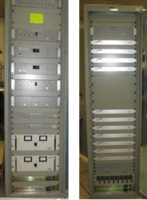
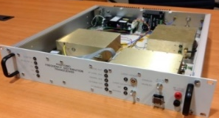
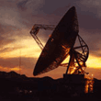
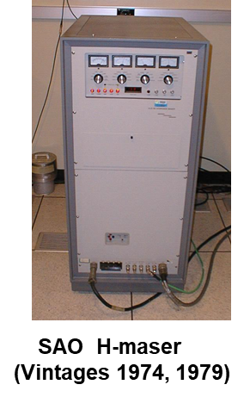
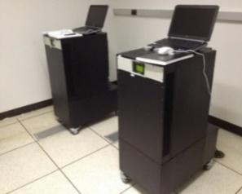
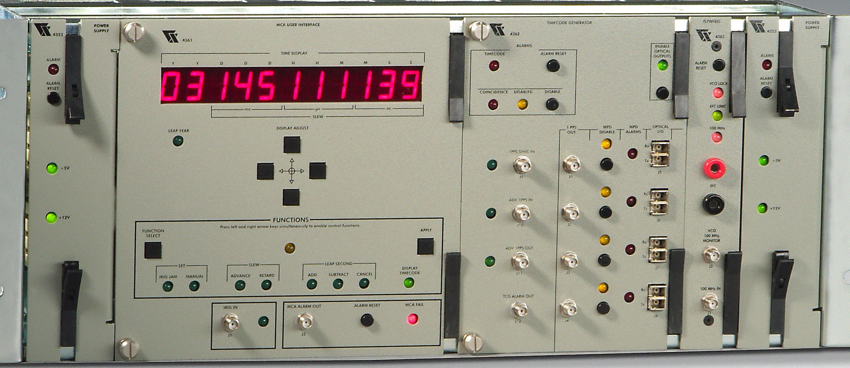

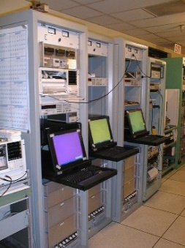
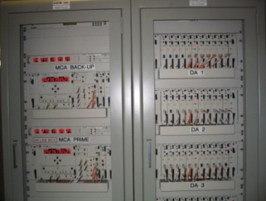
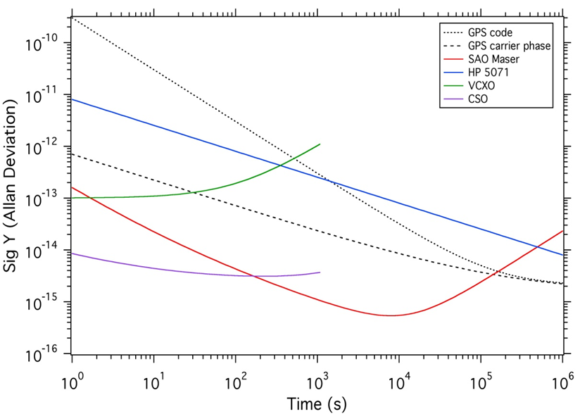
Deep Space Network Clocks and Oscillators
Photonic Frequency
Distribution
H-Masers
Time Distribution
DSS-xx
Frequency Distribution
Phase Noise Comparison @ 5 MHz
Carrier Offset | DSN Requirement (dBc/Hz) | SAO H-maser + VCO (dBc/Hz) | SAO H-maser + CSO (dBc/Hz)
1 Hz | -118 | -123 to -130 -128 (typ.) | -151 to -161
10 | -129 | -147 (typ.)
100 | -141 | -152 (typ.)
M&C, GPS
Master Clock
FTS in each DSN Cite includes:
Redundant atomic frequency standards
Redundant clocks
Signal distribution via fiber optic links
S, X, Ka phase reference combs
Performance measurement and calibration capabilities
C. Thornton and J. Border, 2003, Radiometric Tracking Techniques for Deep Space Navigation, JPL Deep Space Communications and Navigation Series (John Wiley & Sons, New York).
This is not research but hard-core engineering
Allowed operation disruption is 8 min per year

Slide 5
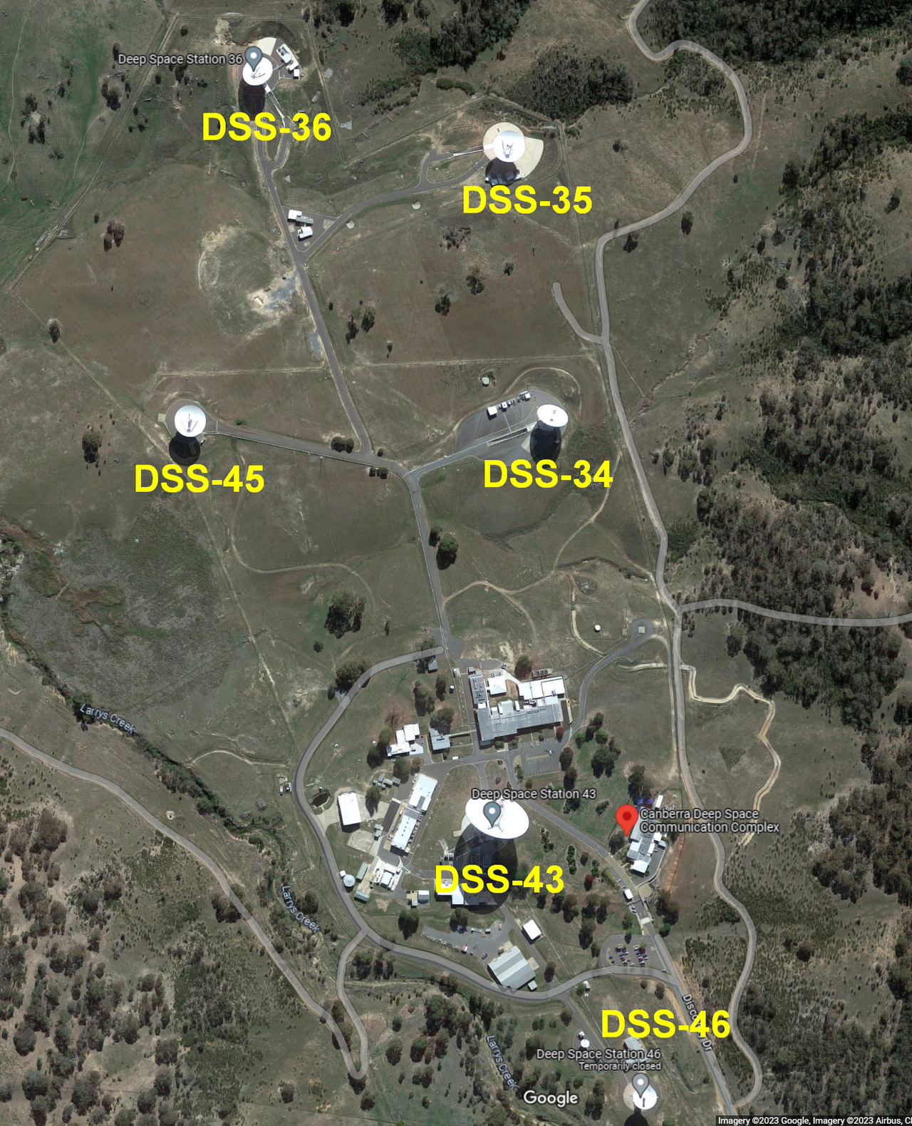
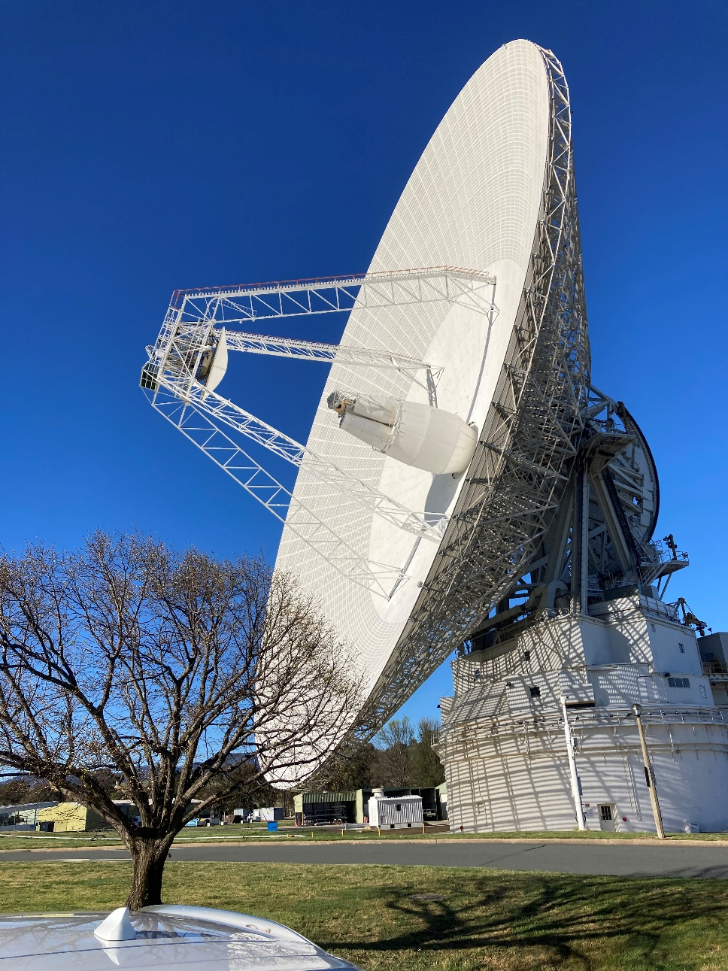
Canberra Site a Week Ago

Slide 6
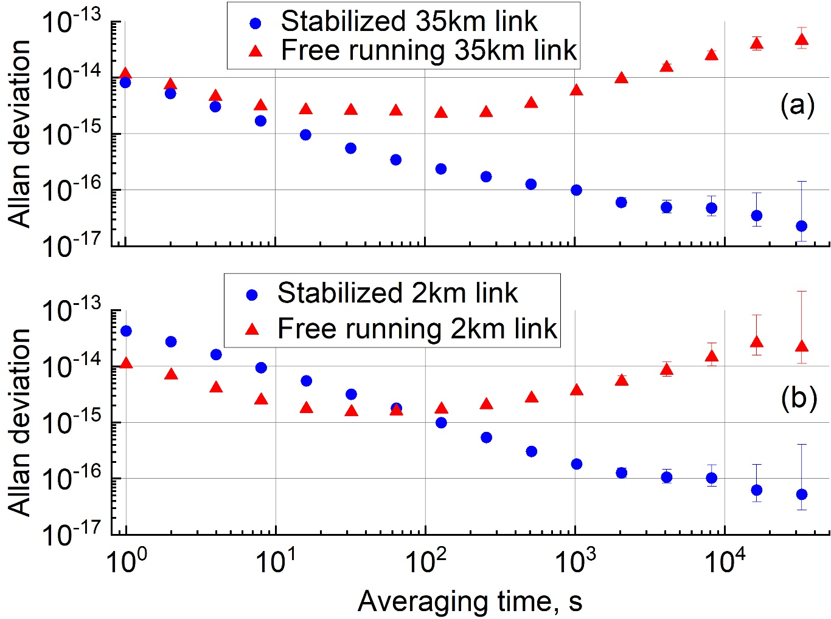
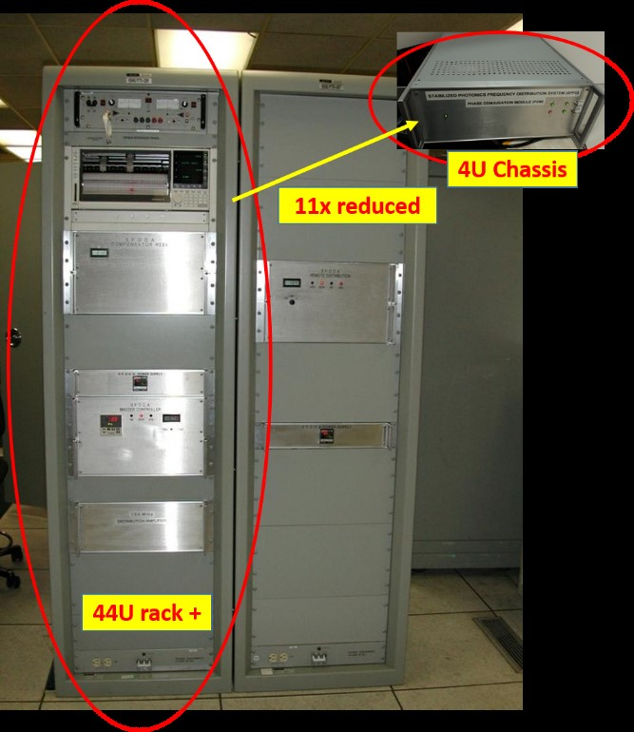
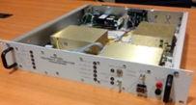
DSN Low Loss Photonics Links
JPL time and frequency group was the first one to utilize optical fibers for time and frequency transfer [G. Lutes, “Experimental optical fiber communications link,” TDA Prog. report 42-59 (Jet Propulsion Laboratory, 1980), pp. 77–85]
Stability of existing links is better than the stability of a maser.
ΔT=2C
ΔT=15C
Appl. Opt. Vol. 60, No. 12
/ 20 April 2021 / p. 3487

Slide 7

More than 20 years history of Mercury Ion Clock development
Many people have been involved
Achievable Stability:
Local Oscillator (< 10s)
SNR*Q (~10s to 1 day)
Systematic offsets/environment (> 1 day)
  Magnetic Shifts
  Number (Doppler Shifts) – QP only
  Collision Shifts
  Light Shifts – QP only
  Please note that Q is important here
Mercury Ion Clock for a NASA Technology Demonstration Mission;
IEEE UFFC Transactions, Vol. 63, No.7, July 2016.

Slide 8
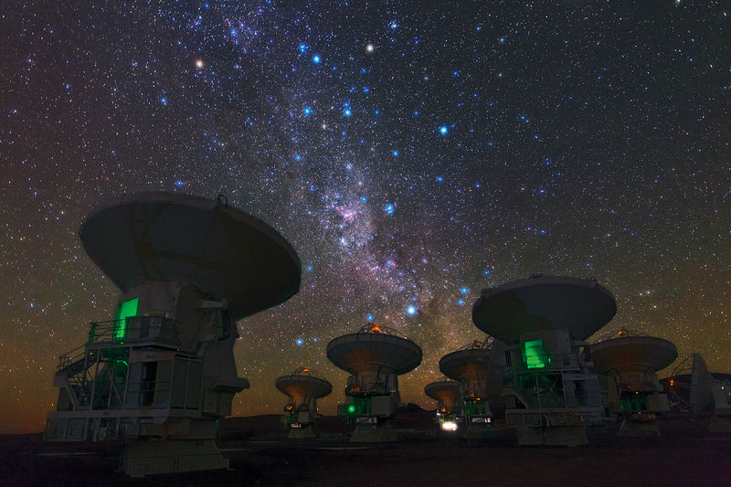
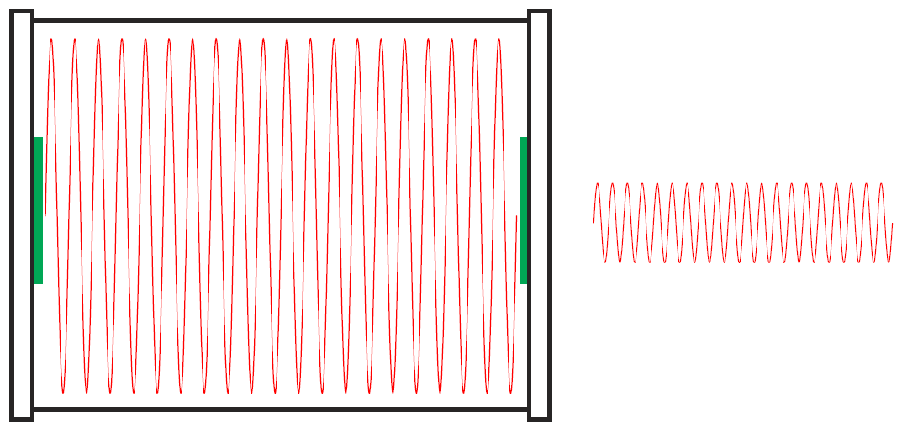
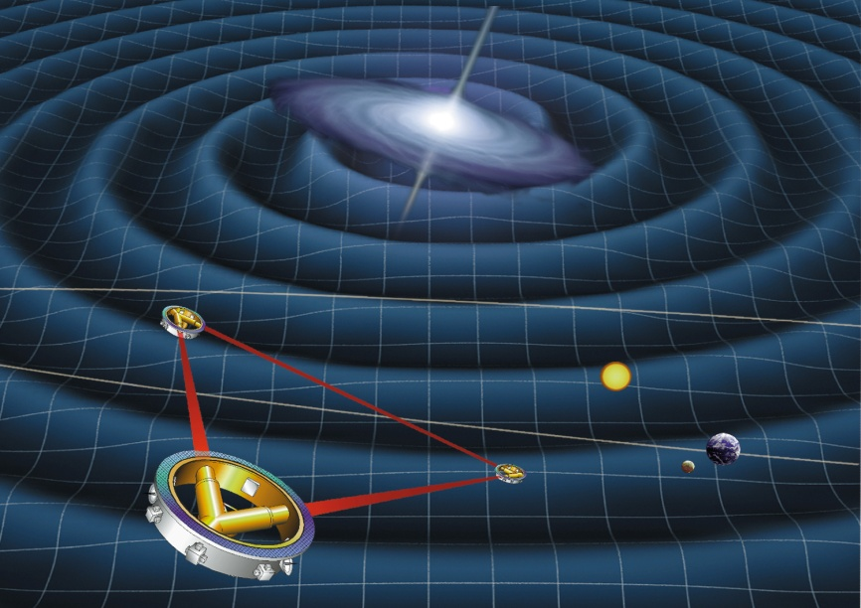
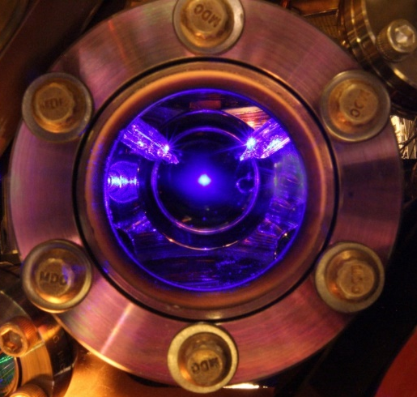
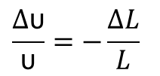
Development of Ultrastable Fabry-Perot Cavities
Stable laser based on Fabry Perot etalon:
LIGO
Laser Interferometer
Gravitational Wave Observatory
Very long baseline
interferometry
Laser
coating
substrate
LISA
Laser Interferometer Space Antenna
spacer
Laser frequency is referenced to cavity length
Optical frequency stability
Cavity length fluctuation
Optical atomic clock
$$\frac{∆\text{υ}}{\text{υ}}=−\frac{∆L}{L}$$
Highly stable optical frequency is critical in a variety of advanced research direction: optical atomic clock, gravational wave detection, very long base line interferometry, geodesy…
Wei Zhang et al.

Slide 9
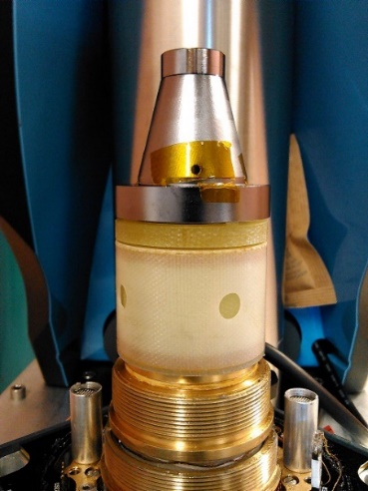

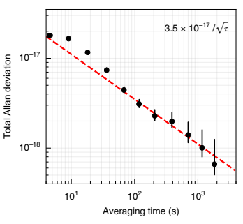
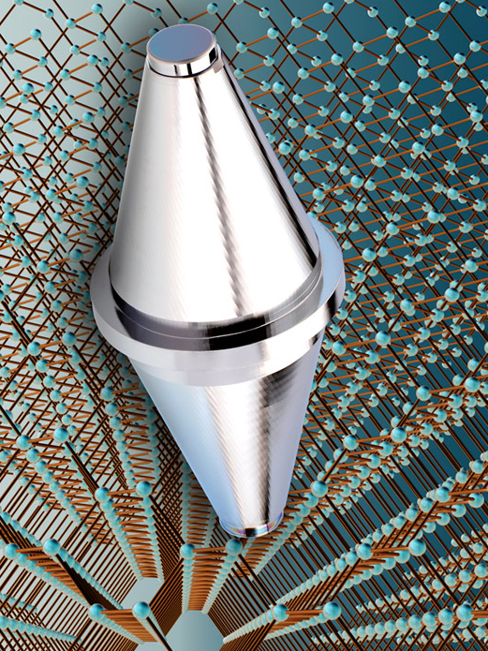
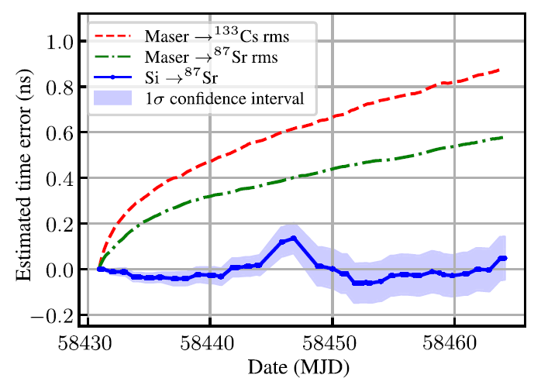
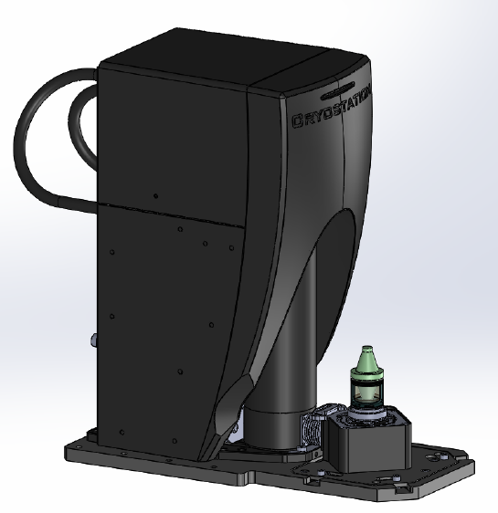

An Ultrastable Optical Cavity System Can Be Better Than Quantum Clocks
Photonics microwave generation
LO for optical clock
Frequency comb
Photodetector
A JILA silicon Fabry-Perot cavity at 4 Kelvin
frequency stability 6×10⁻¹⁷, drift <5×10⁻¹⁹/s
Sr atomic optical clock
Low noise microwave reference
Cesium fountain clock (10 GHz)
Mercury clock (40 GHz)
VLBI, Radar…
Stable Optical Carrier for time keeping
Typical results at 10 GHz
vs
Cavity vs Maser over 30 days time error X10 improvement
Wei Zhang et al.

Slide 10
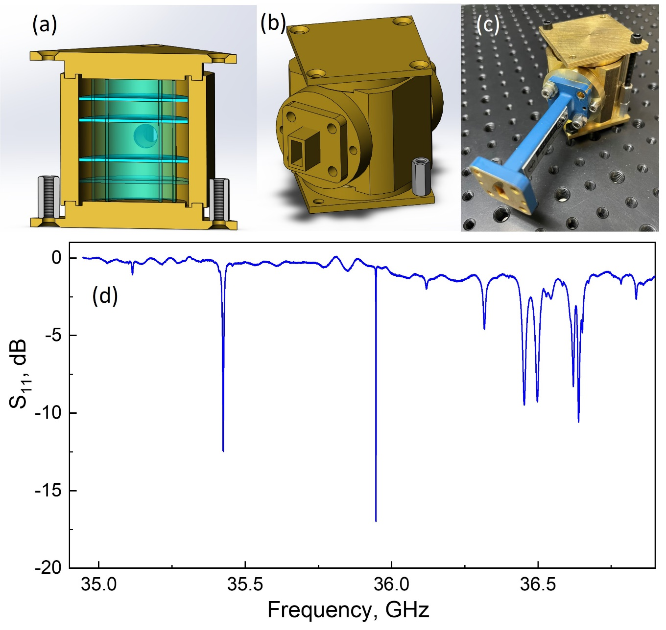
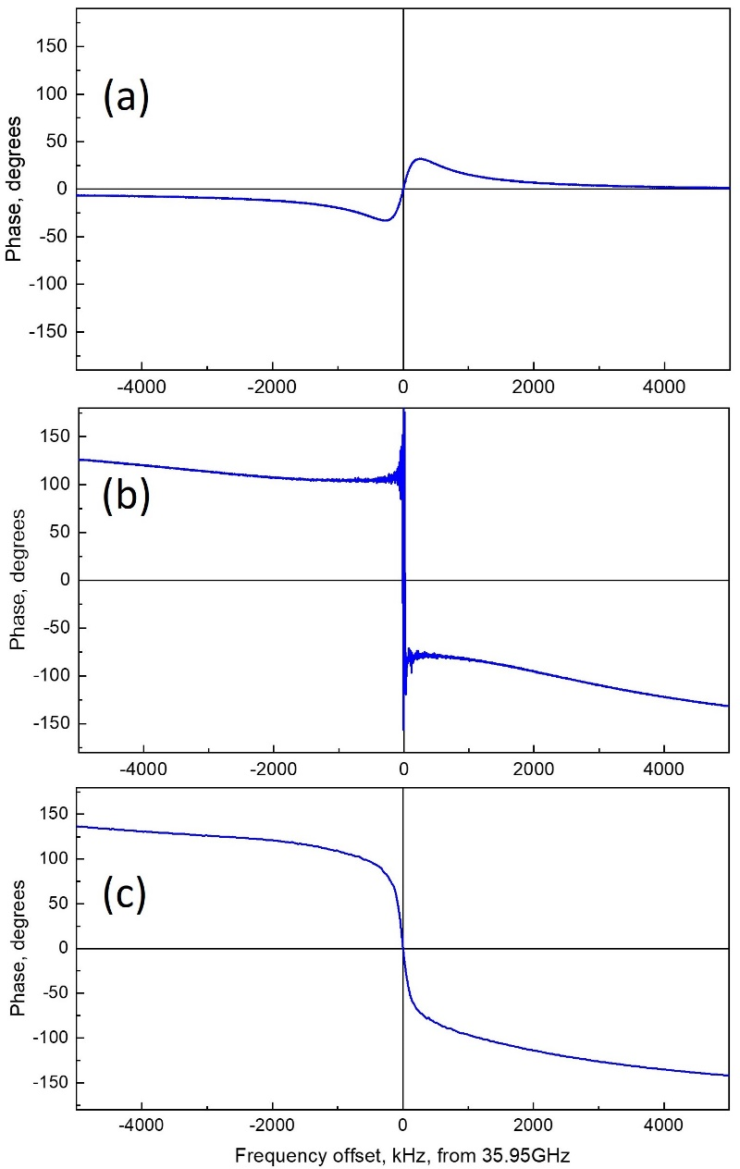
Development of Sapphire (DBR) Resonator
Goal: Support legacy of John Dick, Lute Maleki and others and develop RF oscillators based on low loss crystals.
An intrinsic Q-factor of 2×10⁵ is demonstrated at 36 GHz for the lowest order TE-mode of a sapphire DBR.
An oscillator suitable for the mercury clock operation is the next step of the development.
V. Iltchenko, et. al. TBP

Slide 11
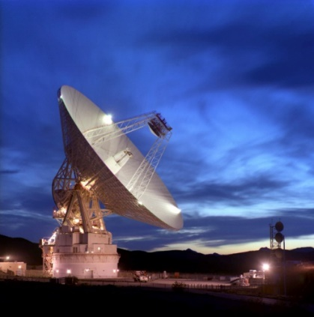
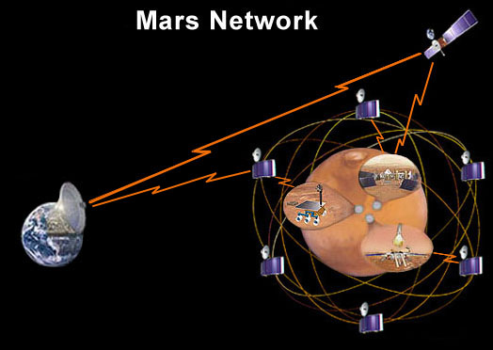
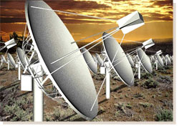
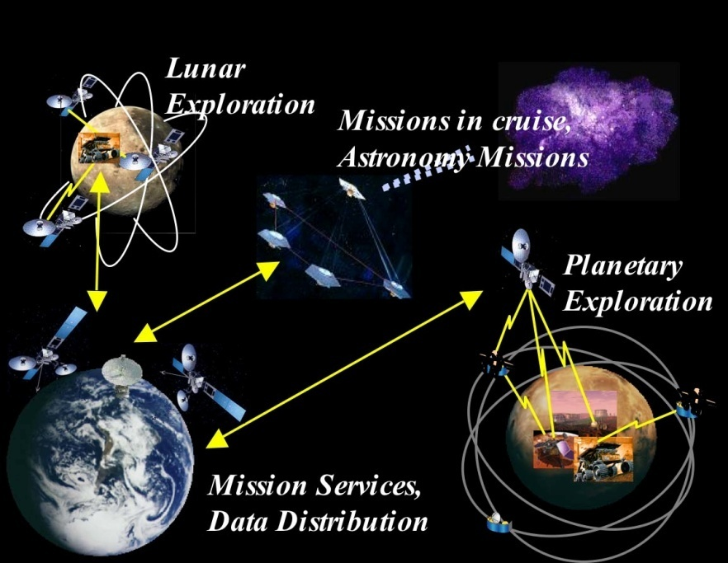
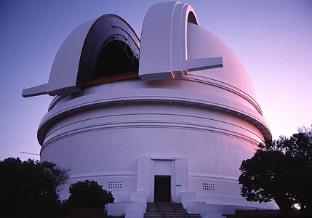
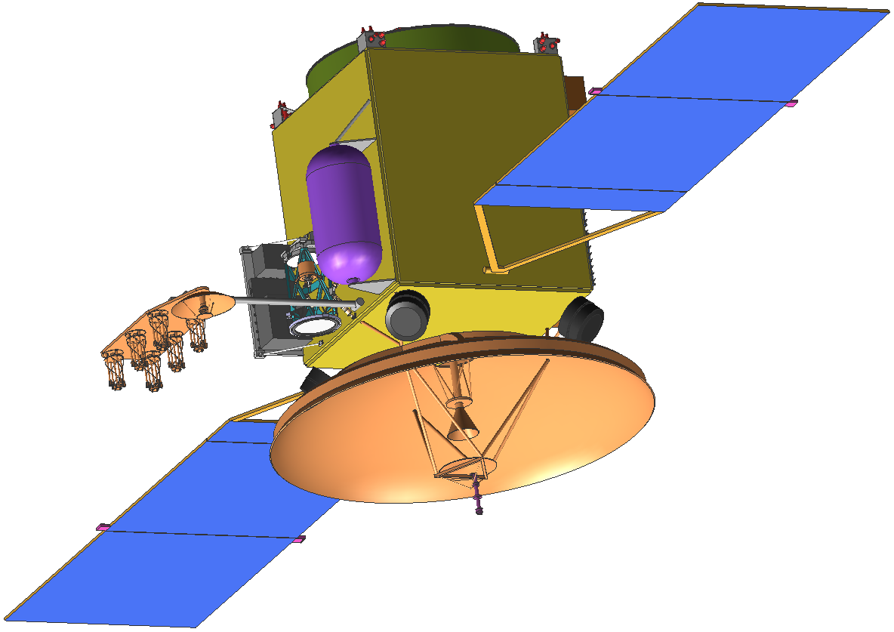
Future Drivers of the Frequency & Timing Systems Development
Today’s DSN
(S, X, Ka bands)
Planetary Networks
t
φ
Optical Communications
f
NASA Space Networking
Antenna arrays
Reliability and SWaP are in the development focus (R. Tjoelker)

Slide 12
Contents
Background on low loss systems and (some) of their uses at JPL
  JPL’s Frequency and Timing Advanced Instrument Development group: main activities and interests
Early studies of dissipative solitons and parametric instabilities in low loss photonic systems
  Low loss resonant (micro)systems
  Dissipative solitons in high-Q systems
  Use of dissipative solitons (and not only the solitons) in clocks and oscillators
Recent developments
  Fundamental limitations of spectral purity of photonic oscillators: theory and experiments
  Photonic time crystals as ideal frequency dividers and their use in clocks
Outlook

Slide 13
How the modern (micro) photonics can help to push forward our time and frequency applications?
Stable and spectrally pure (UV) lasers
Stable and spectrally pure photonic oscillators

Slide 14
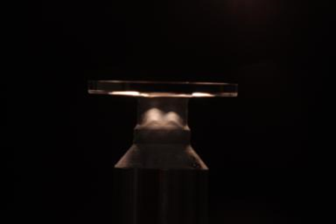
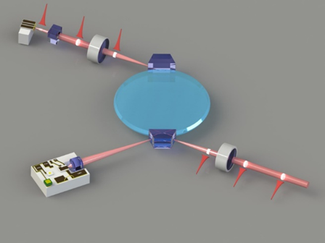
Whispering Gallery Mode Resonators
Cavities enable stable oscillators. Q-factor of a cavity is ultimately determined by the material attenuation α:
CaF₂ | 3x10⁻⁷ cm⁻¹
SiO₂ (optical fiber) | 5x10⁻⁶ cm⁻¹
Al₂O₃ | 1x10⁻⁵ cm⁻¹
SiO₂ (crystal) | 1x10⁻⁵ cm⁻¹
Si (crystal) | 8x10⁻⁵ cm⁻¹
LiNbO₃/LiTaO₃ | 1x10⁻⁴ cm⁻¹
Si₃N₄/Hydex | 1x10⁻² cm⁻¹
Polymers | 1x10⁻¹ cm⁻¹
Solid state optical resonators with dimensions ranging from 10’s of micron to a few mm, to support various applications
Extremely high Q’s (record > 10¹¹ in CaF₂) ~1x10⁹ LiTaO₃
Easy to T control/ encapsulate
Can support any broad range of wavelengths (unique feature)
A toolbox of low loss optical coupling solutions is developed
For
*Transparency of most of the optical materials is not well documented in literature and the documented values vary by an order of magnitude
E.D.Palik, “Handbook on optical
constants of solids”, Academic, NY, 1998
Andrey Matsko, WMB6, IMS2019

Slide 15
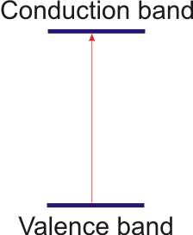
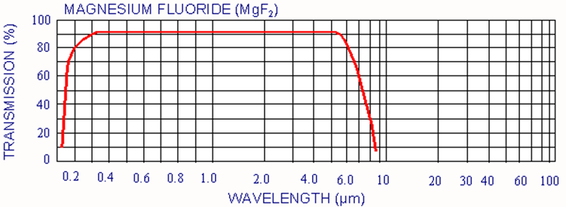
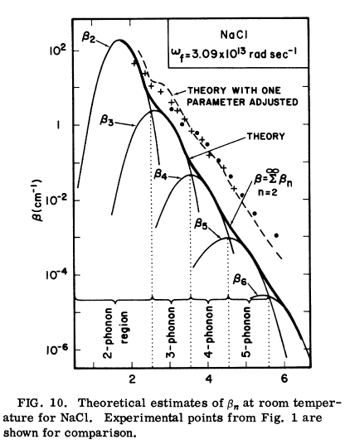
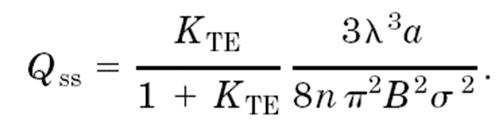
Attenuation of the material
In the center of the transparency window the attenuation is given by the impurities and scattering
The density of states is not zero at the band edge.
There are always band tails in non ideal crystals.
F. Urbach, Phys. Rev. 92, 1324 (1953)
Surface scattering is the leading effect in crystalline cavities
The multiphonon absorption occurs due to
unharmonicity of internal vibrational modes
of an ideal crystalline lattice
M. Sparks and L. J. Sham, Phys. Rev. B 8, 3037 (1973)
M.L Gorodetsky et al., Opt. Lett. 21, 453 (1996);
D.W. Vernooy et al., Opt. Lett.23, 247 (1998);
L. Collot et al., Europhys. Lett. 23, 327 (1993);
V.B. Braginsky et al., Phys. Lett. A 137, 393 (1989).

Slide 16
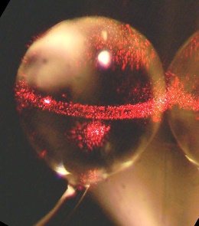
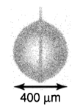
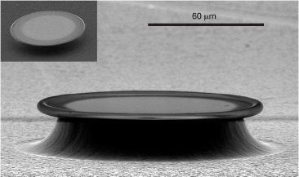
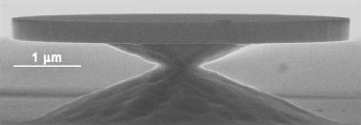
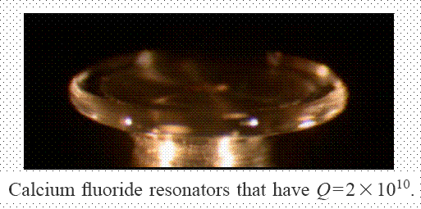
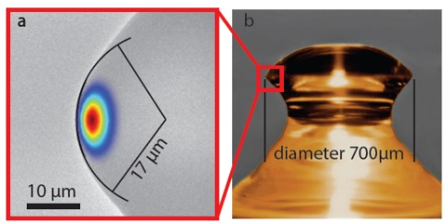
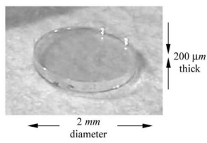
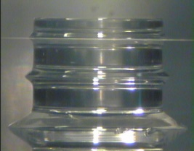
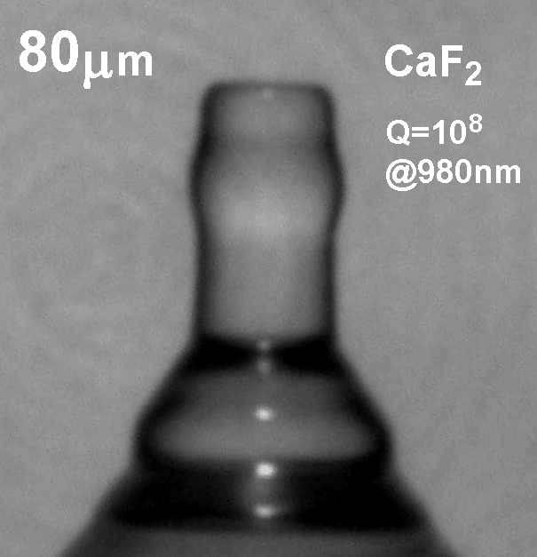
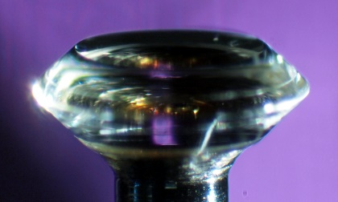
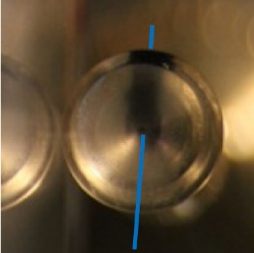
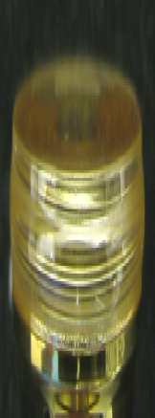
Variety of the solid state WGMRs (early results)
Please note, the first crystalline WGMRs were created well before 1996.
Fused silica: Gorodetsky et al., OL 21, 453 (1996).
Solid H₂: K. Hakuta et al. OL 27 (2002)
Fused silica: K. Vahala et al., Nature 421, 925 (2003)
Si: Appl. Phys. Lett. 85 (2004)
C. G. B. Garrett, W. Kaiser, and W. L. Bond, "Stimulated emission into optical whispering gallery modes of spheres", Phys. Rev. 124, 1807-1809 (1961).
CaF₂: Savchenkov et al, PRA 70, 051804 (2004); OE 15, 6768 (2007).
LN WGM: D.A. Cohen and A.F.J. Levi, Electron. Lett. 37 (1) , 2001.
CaF₂ Q_{m}>10⁵: J. Hofer, A. Schliesser, P. Del’Haye, and T. Kippenberg (CLEO’09)
MgF₂ resonator, C. Y. Wang, T. Herr, P. Del'Haye, A. Schliesser, J. Hofer, R. Holzwarth, T. W. Hänsch, N. Picqué, T. J. Kippenberg, arXiv:1109.2716
P. Walsh and G. Kemeny, "Laser operation without spikes in a ruby ring", J. Appl. Phys. 34, 956-957 (1963).
D. Roess and G. Gehrer, "Selection of discrete modes in toroidal lasers", Proc. of IEEE 52, 1359-1360 (1964).
LN WGM resonator,
D. Haertle, T. Beckmann, J. Schwesyg, S. Hermann, A. Zimmermann, K. Buse
Photonics West 2009
BBO resonator,
JPL, 2012
SBN resonator,
OEwaves (2012)
Grudinin et al Opt. Commun. 265, 33-38 (2006).
MgF₂ resonator,
OEwaves (2011)

Slide 17






Resonators of nearly any reasonable size can be created by mechanical polishing
Grudinin et al., Opt. Commun. 265, 33 (2006).

Slide 18
Importance of size and Q-factor for EM mixing
Cavities enable efficient nonlinear interaction
Q
V
Cavity field build-up
factor and linewidth
Small size and high optical energy density
Figure of merit for nonlinear processes:
Frequency doubling and acousto-optics: n=3
Purcell’s factor: n=1
SRS and FWM: n=2

Slide 19









Microcavity-based dissipative solitons: some early studies
A. B. Matsko et al. Opt. Lett. 37, 4856 (2012)
A. B. Matsko et al., Phys. Rev. A 85, 023830 (2012)
Multistability
Chaos
A. B. Matsko et al., Opt. Lett. 38, 525 (2013)

Slide 20
Optical clocks using high-Q microcavities

Slide 21



Optical Clocks
Now, using the high-Q cavities we can improve clocks
Reference cavities
Lasers
Locking feedback
Low SWaP
High stability
High finesse
Low environmental sensitivity
Trapping/cooling lasers
Atomic reference
LO ultrastable laser
High power and frequency stability
Low RIN and frequency noise
Low vibration sensitivity
Low RAM
Compact
Optical to RF divider
Kerr combs
Electronics and control
Low SWaP
High stability
Low environmental sensitivity
Supported by JPL, NASA, ONR, AFRL and DARPA, in collaboration with Nan Yu et al.

Slide 22



Atomic Cell Stabilized Laser: Improved Locking Due to High-Q Cavity
A frequency comb is needed to make a clock
Low relative amplitude modulaton (RAM) is essential for the accurate locking to the atomic transition.
W. Liang et al., Appl. Opt. 54, 3353-3359 (2015)
Was supported by DARPA

Slide 23




Atomic Transition Stabilized Kerr Frequency Comb
Main idea: Frequency stability can be transferred from optical frequency to microwave frequency using an optical comb. The stabilization goes through the resonator stability. Does not works well because of the efficiency dips.
A microwave signal is generated by demodulating the Kerr comb with a high-frequency photodiode. (a) The signal on logarithmic scale; (b) the same signal on linear scale; (c) optical comb used in the experiment. Linear fit of the microwave line gives a 40 Hz linewidth.
The idea still can work IF/WHEN a good single mode cavity will be created
Was supported by DARPA

Slide 24



Stabilized Blue Lasers

Slide 25




Stabilized Magenta Lasers

Slide 26
Problem to solve
Need to create a laser at 194 nm

Slide 27
RF oscillators based on dissipative solitons

Slide 28
Spectrally Pure RF Oscillators
RF oscillators are needed in a variety of systems including:
Radar
Direction finding of signals of interest
Applications related to coherent operation across multiple segmented platforms
Radar operational requirements include ever-increasing demands for lower-phase noise signal and waveform generation
RF photonic oscillators are characterized with
Existing electronic technologies cannot meet these demands concurrently within environmental and tactical requirements
High Spectral Purity
Low Environmental sensitivity
Small SWaP
Convenient Signal Distribution

Slide 29


Advantages of Nonlinear Microcavities
High transparency/Low loss materials
Low bending and radiative losses
  Allows for direct generation of high frequency
  Small size
Low vibration sensitivity
  Small size
Superior phase noise owing to high-Q
Relatively simple design
Division of the optical frequency noise
The phase noise measurement is limited by performance of the phase noise measurement setup.
Phase noise of the 28 GHz signal generated by the packaged photonic oscillator. Inset represents Laser, Resonator and Coupling optics layout. 28 GHz resonator ~ 2.5 mm in diameter. Non-soliton regime is utilized.
D Seidel et al., “Minituarized Ka-band Photonic Oscillators”, 2018 International Topical Meeting on Microwave Photonics

Slide 30


Performance Optimization
Unit 1 produces irregular combs. Unit 2 produces symmetric multi-soliton combs.
RF phase noise is comparable -> solitons are unnecessary for good RF performance.
A. Matsko, et al. "Turn-key operation and stabilization of Kerr frequency combs" 2016 IEEE International Frequency Control Symposium (IFCS).
30

Slide 31



Timing Jitter
Photonic oscillators are also ideal for 5G and 6G applications
KOEO – Kerr comb oscillator
COEO– Coupled Opto-Electronic Oscillator
W. Liang et al., Nature Commun. 6, Article no: 7957 (2015)
Was supported by DARPA

Slide 32
Problem to solve
Need to reach AD~10⁻¹³ at 1s

Slide 33
Contents
Background on low loss systems and (some) of their uses at JPL
  JPL’s Frequency and Timing Advanced Instrument Development group: main activities and interests
Early studies of dissipative solitons and parametric instabilities in low loss photonic systems
  Low loss resonant (micro)systems
  Dissipative solitons in high-Q systems
  Use of dissipative solitons (and not only the solitons) in clocks and oscillators
Recent developments
  Fundamental limitations of spectral purity of photonic oscillators: theory and experiments
  Photonic time crystals as ideal frequency dividers and their use in clocks
Outlook

Slide 34
Fundamental limitations of spectral purity of Kerr comb oscillators: theory and experiment

Slide 35
Analytical Theory of the Mode Locked Comb
Kerr frequency combs can be analyzed using Lugiato-Lefever (LL) equation accompanied by the standard high finesse cavity input-output equation:
or by two input-output equations, in the case of two optical couplers:
A. B. Matsko et al., “Whispering gallery mode oscillators and optical comb generators,” Proc. of 7th Symp. Frequency Standards and Metrology, ed. L. Maleki, pp. 539–558 (World Scientific, New Jersey, 2009).
A. B. Matsko et al., “Mode-locked Kerr frequency combs,” Opt. Lett. 36, 2845–2847 (2011).
A. B. Matsko and L. Maleki Optics Express 21 (23), 28862 (2013).

Slide 36
An Analytic Solution
The solution is assumed in an autosoliton form
Then the parameters of the solution are found using perturbed Lagrange equations derived from Lagrange operator:
H. A. Haus and A. Mecozzi, “Noise of mode-locked lasers”, IEEE J. Quantum. Electron. 29, 983–996 (1993).
A. Hasegawa, “Soliton-based optical communications: an overview,” IEEE J. Sel. Top. Quantum Electron. 6, 1161–1172 (2000).
A. B. Matsko and L. Maleki Optics Express 21 (23), 28862 (2013).

Slide 37

Steady State Formalism
Unless the pump light is filtered out the output pulses are “dark” solitons
The peak power of the pulse is comparable with the cw pump power
In the case of two couplers
A. B. Matsko and L. Maleki, OE 21, 28862 (2013)

Slide 38



Phase Noise Limit of Kerr Comb Oscillator
The noise floor drops with pulse duration decrease
A. B. Matsko and L. Maleki, OE 21, 28862 (2013)
Oscillators are useful for clocks as flywheels
Was supported by DARPA

Slide 39

Fundamental Stability of the Comb Oscillator Does not Depend on Q
Sidebands are always equidistant because of energy and photon number conservation, but the repetition rate of the comb can change.
Minimum Alan deviation for fundamental soliton Kerr comb
Minimum Allan deviation for two sidebands
A. B. Matsko, et al., Phys. Rev. A 71, 033804 (2005)
A. B. Matsko and L. Maleki, OE 21, 28862 (2013)

Slide 40


Size and Power Dependence
For the same oscillation frequency the better performance has an oscillator with larger mode volume and smaller nonlinearity
The time averaged input power is equal to time averaged output power. The energy is conserved. No attenuation is present, in the global sense. The signal is generated at the photodiode that performs the measurement.
Demodulation of the modulated light on a photodiode produces spectrally pure radio frequency signal

Slide 41
Fundamental Limitations Verified Experimentally
In collaboration with Caltech, supported by JPL/NASA

Slide 42
Timing Jitter Correlation for Two Pulses in the Same Cavity

Slide 43
Time crystals as ideal frequency dividers

Slide 44
Second coherent pump for the soliton stabilization
H. Taheri et al., Optical lattice trap for Kerr solitons. The European Physical Journal D. 2017

Slide 45
A trap for solitons
We manipulate by the pulse by tuning the second pump
H. Taheri et al., Optical lattice trap for Kerr solitons. The European Physical Journal D. 2017

Slide 46
Discrete Time Crystals
Time symmetry breaking, similar to a high order parametric oscillator. This is not a soliton trap!
The phase noise of the laser beat note is divided!
H. Taheri at al., Nature Communications 13 (1), 848 (2022).

Slide 47

Dichromatically Pumped Kerr Solitons (DTC-like)
The main idea is to match the group velocity of the beat note of the two pumps and group velocity of the dissipative soliton
A. B. Matsko and L. Maleki, Optics Letters 48, 715 (2023)

Slide 48


Time Symmetry Breaking in Dual Pumped Systems
A. B. Matsko and L. Maleki, Optics Letters 48, 715 (2023)

Slide 49
Thanks to (Recent) Collaborators
Misha Sumetsky (Aston University)
Scott Papp (NIST)
Chee Wei Wong (UCLA)
Sergey Vyatchanin (MSU)
Tobias Herr (Universität Hamburg)
Krzysztof Sacha (Uniwersytet Jagielloński)
Paolo De Natale (CNR-INO)
Simone Borri (CNR-INO)
Mario Siciliani de Cumis (CNR-INO)
and many others
Nan Yu (JPL)
Robert Tjoelker (JPL)
Eric Burt (JPL)
Vladimir Iltchenko (JPL)
Anatoliy Savchenkov (JPL)
Wei Zhang (JPL)
Mahmood Bagheri (JPL)
Siamak Forouhar (JPL)
Lute Maleki (OEwaves)
Kerry Vahala (Caltech)
Hossein Taheri (UCR)

Slide 50
Thanks for Support
JPL/Caltech
NASA
DARPA
ONR
AFOSR/AFRL
NRO

