Slide 1
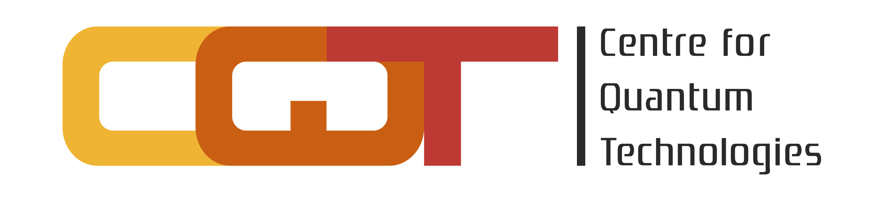

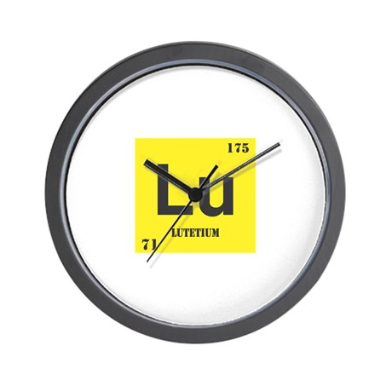
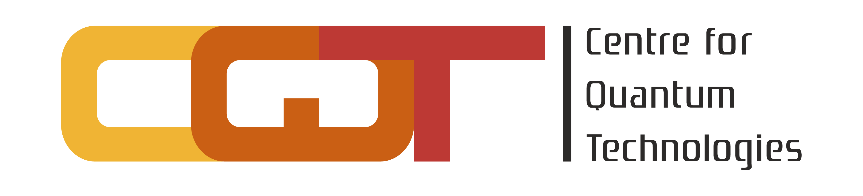

A ¹⁷⁶Lu⁺ frequency reference
Murray Barrett
9SFM 2023

Slide 2
Lutetium ¹⁷⁶Lu⁺ :
³P₁
BBR Shift at 300K
All wavelengths diode laser-based
Long lived D states
  ¹D₂ (≈0.18s : E2)
  ³D₂ (≈18s : E2)
  ³D₁ (≈ 170 h : M1)
Large hyperfine and fine-structure splittings
  Magnetic field insensitivity
Narrow cooling line
³P₀
895
622
¹D₂
646
350
³D₃
³D₂
577
³D₁
804
848
¹S₀

Slide 3
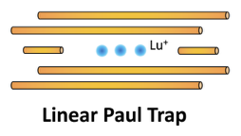
Hyperfine-averaging
848
0
Hyperfine-averaged Ramsey spectroscopy (HARS)
Interrogation time:
Clock frequency:
Laser
R. Kaewuam, et al, PRL, 124, 083202, 2020

Slide 4
Systematics – Quadratic Zeeman
Electromagnetic
Dominated by the applied dc field.
Measured to high accuracy
  Science Advances, Vol 9, No. 18, (2023)
Monitored via microwave spectroscopy

Slide 5

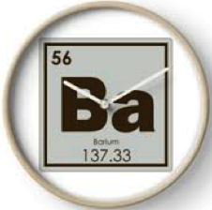
Systematics – Quadratic Zeeman
Electromagnetic
Dominated by the applied dc field.
Coupling to trap-induced rf currents.
H. C. J. Gan et al, PRA 98, 032514 (2018)

Slide 6
Systematics – Quadrupole
Electromagnetic
Dominated by the applied dc field.
Coupling to trap-induced rf currents.
Hyperfine mediated quadrupole moment
Shift assessed via Ba⁺ clock
  PRL, 124, 19, 193001, 2020
Residual moment from g-factors and theory
  PRA, 102, 5, 052834, 2020

Slide 7
Systematics
Electromagnetic
Dominated by the applied dc field.
Coupling to trap-induced rf currents.
804
Hyperfine mediated quadrupole moment
Micromotion, ac-Stark shift, BBR shift
Micromotion via sideband spectroscopy
Probe stark shift suppressed via hyper-Ramsey

Slide 8
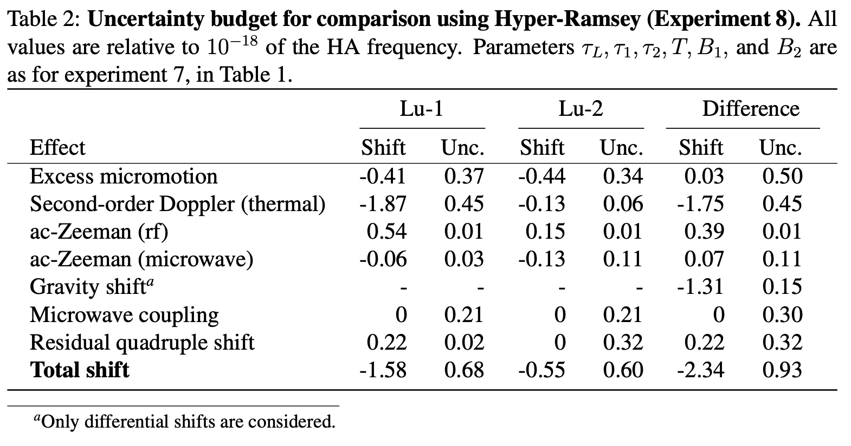
Systematics
BBR shift:

Slide 9
So how accurate is a Lu⁺ clock?
BBR shift:

Slide 10
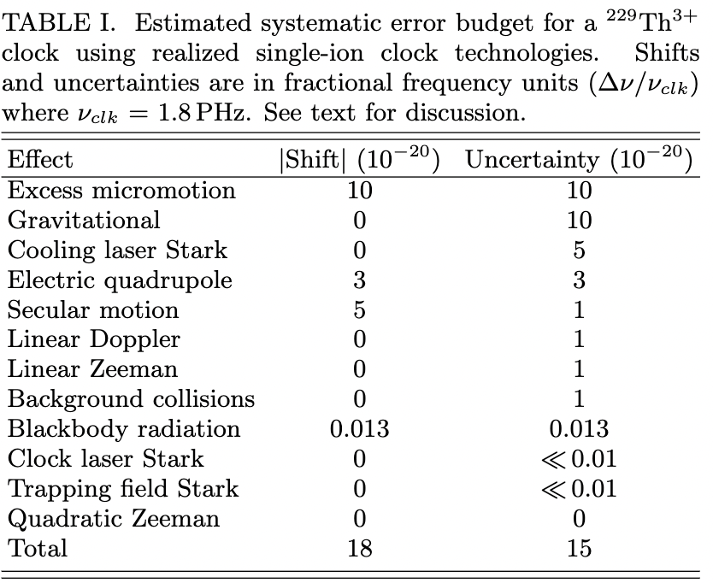
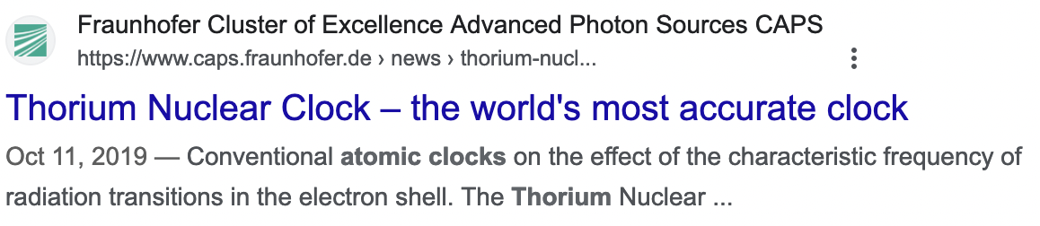
Segal’s Adage
A man with one clock knows exactly what time it is, the man with two clocks is never sure.
RF Zeeman shift

Slide 11
Stability
Loss of contrast
Because you make a comparison
So, more ions and/or longer interrogation

Slide 12
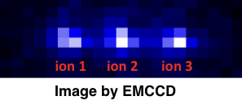
Multiple ions?
Inhomogeneous broadening
  Micromotion
  Magnetic fields
  Quadrupole moment
  AC magnetic fields

Slide 13

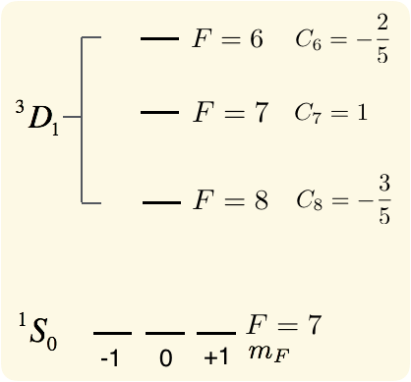
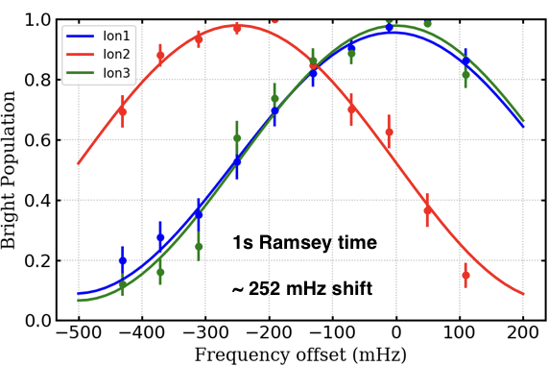
Multiple ions
Quadrupole:

Slide 14
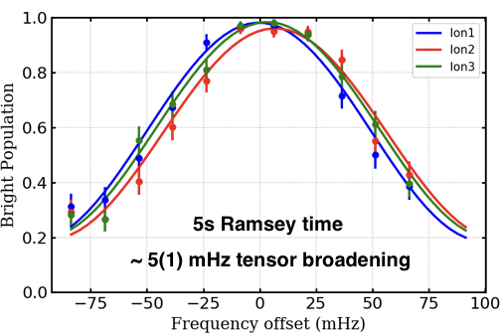
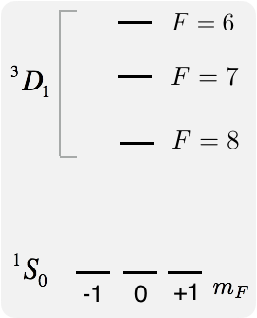
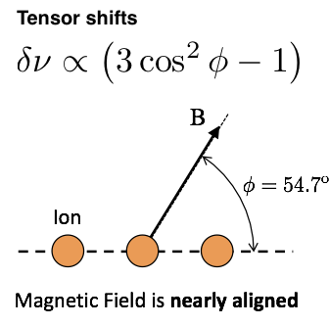
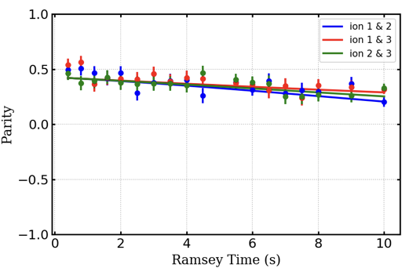
Multiple ions
T=27(6)s

Slide 15
Stability
Loss of contrast
Because you make a comparison

Slide 16
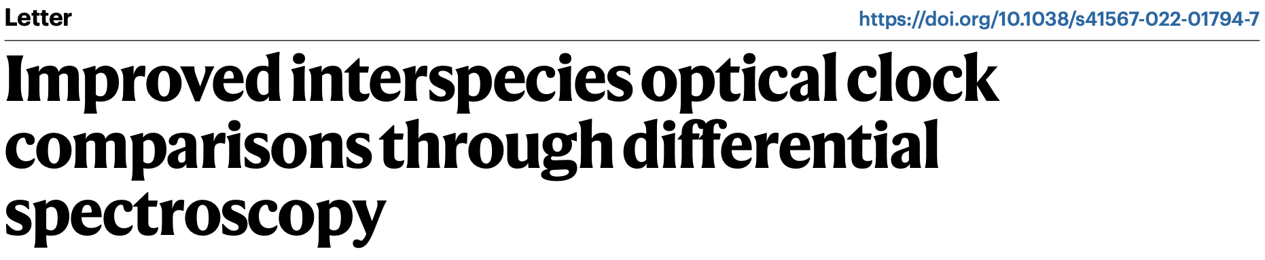
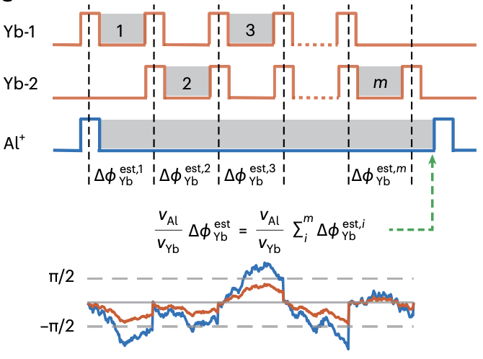
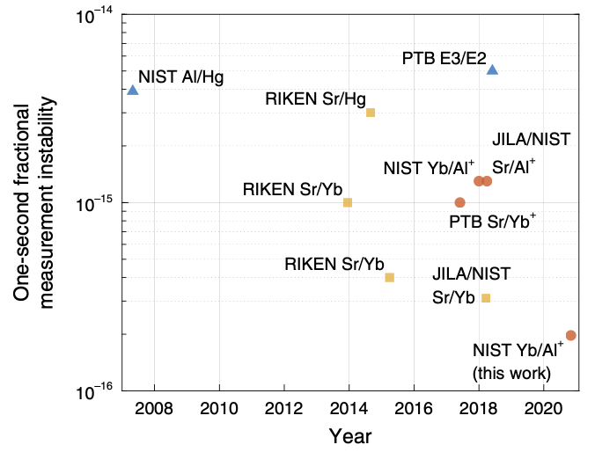
Stability

Slide 17
Verifying clock performance.
Measured clock frequency
Shift = sensitivity factor x magnitude of perturbation
determine atomic properties with sufficient precision
rigorous measurement-based methodologies to assess environment
(atomic property)
(environment)
In situ ratio measurement
Dominated by the applied dc field.
Limited by ³D₂
Hyperfine mediated quadrupole moment (³D₂?)
Micromotion, ac-Stark shift, BBR shift
³D₁
³D₂

Slide 18
A local frequency reference
NMC
CQT

Slide 19
A local frequency reference
System 1
System 2
In situ ratios determine system temperatures
Comparison on the primary determines the redshift
Comparison on the secondary confirms the temperature and redshift
The transitions are sensitive to variations, the ratio is not.

Slide 20
What lutetium has to offer…
³P₁
A technically easy path to 10⁻¹⁸ and beyond
  Long lifetimes
  Low systematics for robust < 10⁻¹⁸ operation.
  Suitable isotope for magnetic field insensitivity
  Easily accessible laser systems
  State sensitive detection channel
A pathway to ``many’’ ions.
Two clock transitions to verify clock performance.
  Similar sensitivities to alpha variation.
³P₀
895
622
¹D₂
646
350
³D₃
³D₂
577
³D₁
804
848
¹S₀

Slide 21

The group
(Left to Right)
Rattakorn Keawuam (NIMT),
Scott Bustabad (NMC),
Nakarin Jayjong,
Kyle Arnold
Me
Zhang Zhao
Zhao Qi
Qin Qichen
Michael Kang

Slide 22
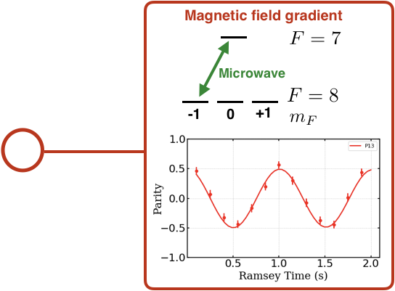
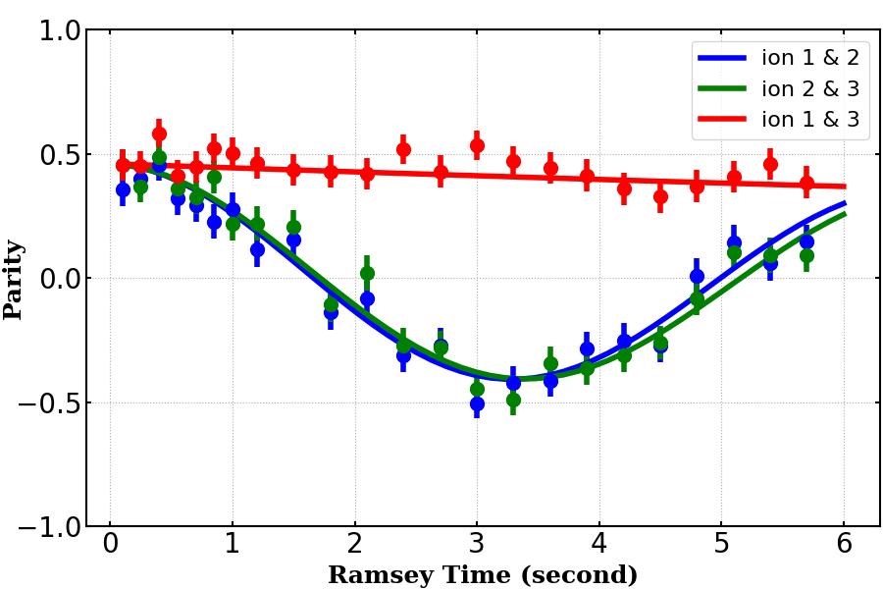
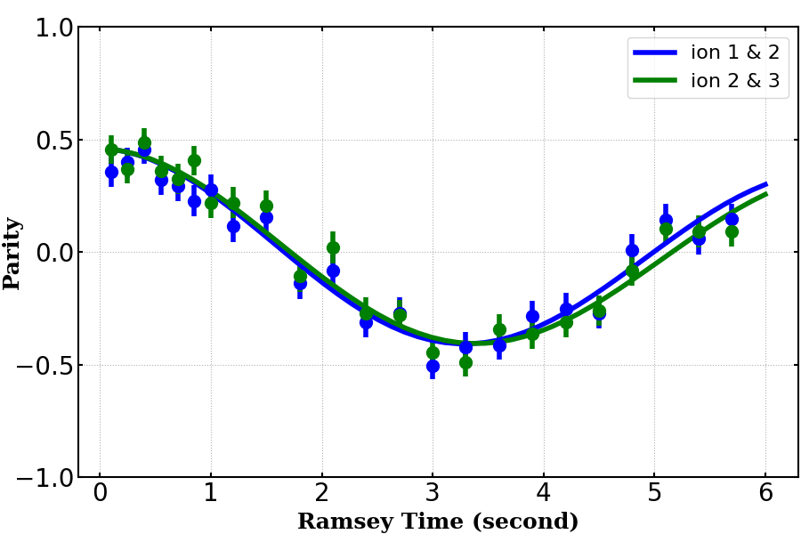
Multiple ions

Slide 23
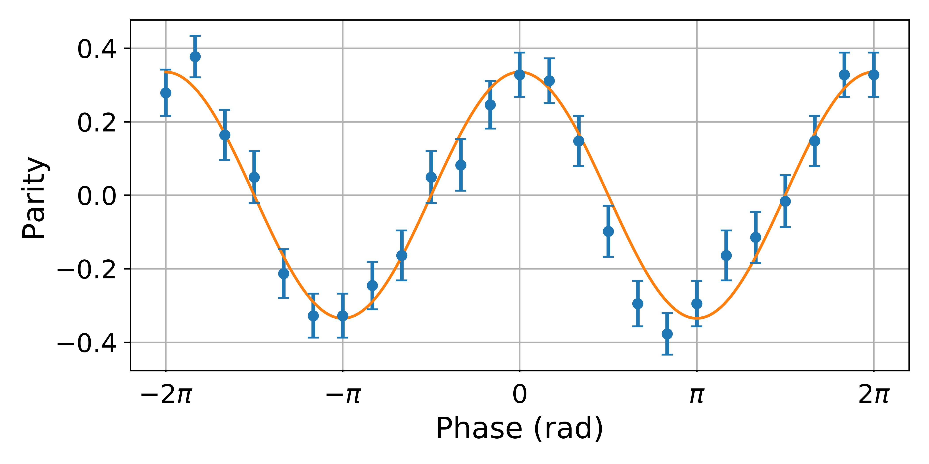

Correlation spectroscopy
$$T_{R}=744 ms$$
E. R. Clements, et al, PRL 125, 243602 (2020)
T. R. Tan, et al. PRL, 123, 063201 (2019)

Slide 24
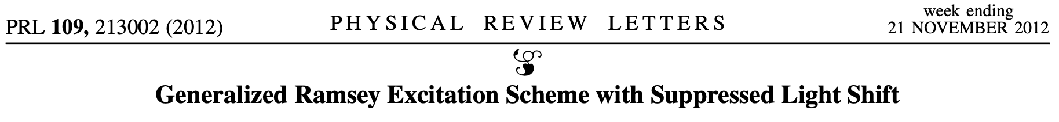
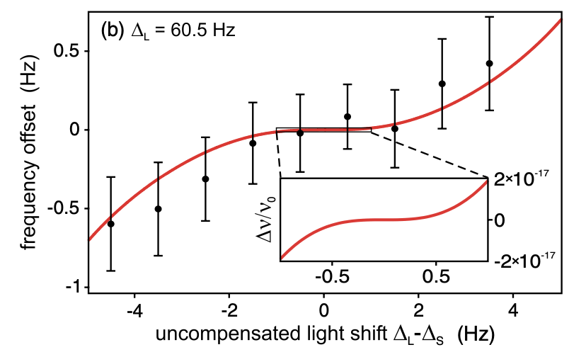
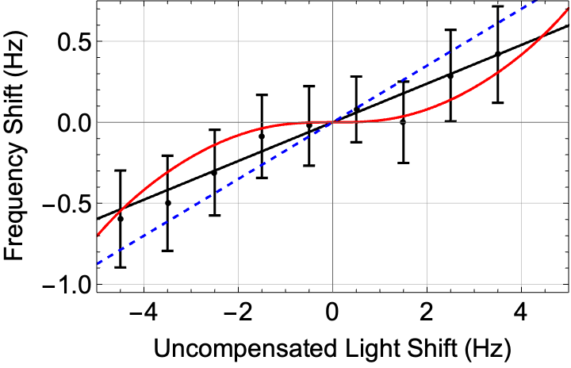
Hyper-Ramsey Suppression

Slide 25
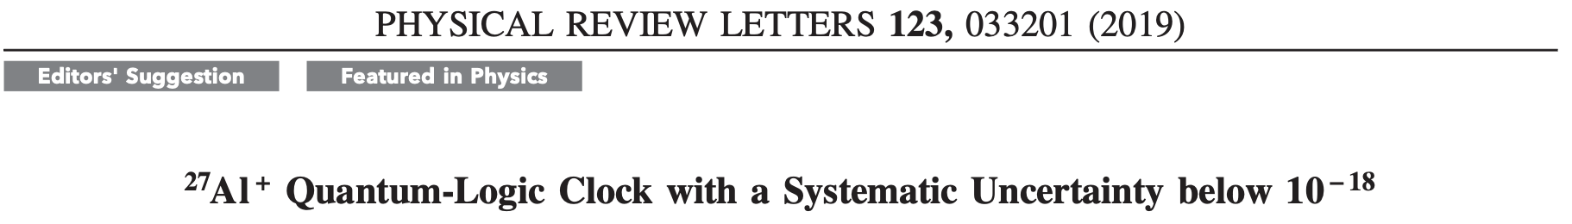
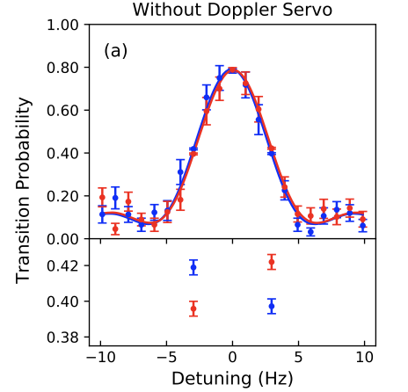
Segal’s Adage
A man with one clock knows exactly what time it is, the man with two clocks is never sure.
10⁻¹⁶ difference from counter propagating beams

Slide 26
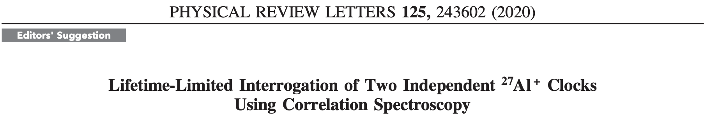
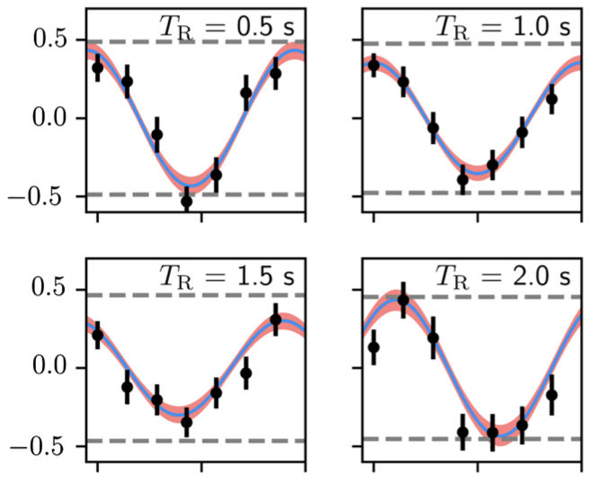
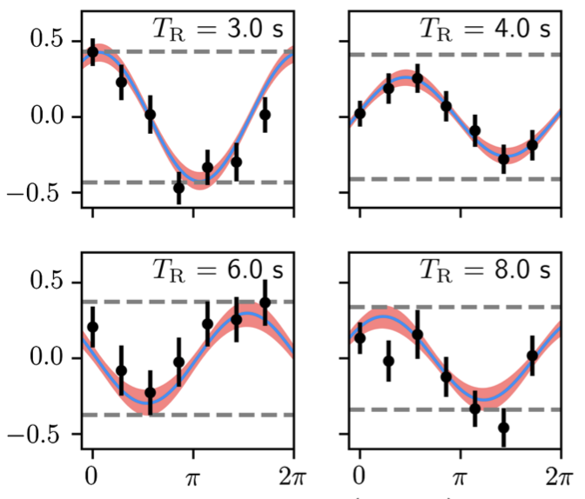
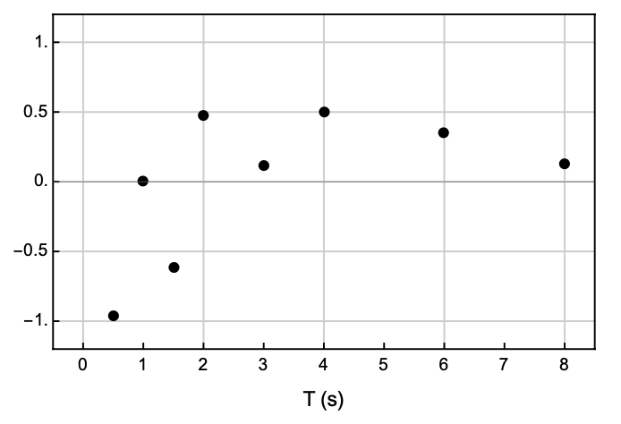
Segal’s Adage
A man with one clock knows exactly what time it is, the man with two clocks is never sure.
10⁻¹⁶ differences between two clocks

Slide 27
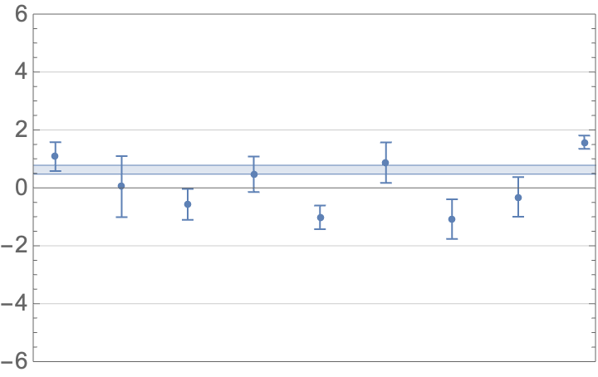
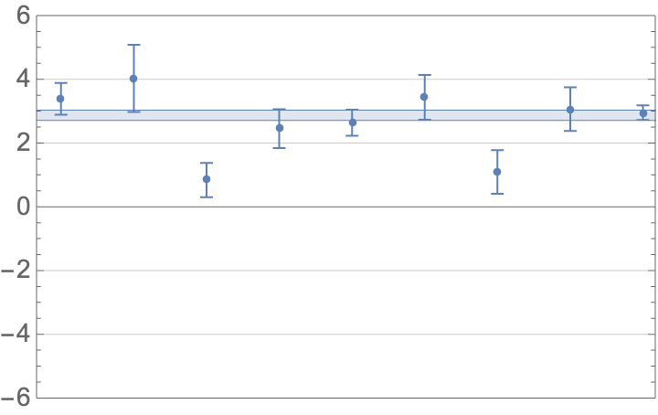
The BACON Collaboration
Yb/Sr
Yb/Sr
Underspread in the Al⁺/Sr ratio:
Overspread in the Yb/Sr ratio:
Correlation in the Yb/Sr ratio measurements with the Sr density shift

