Slide 1

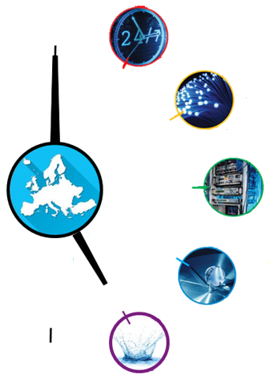
Robust optical clocks for international timescales (ROCIT)
Helen Margolis, NPL
9th Symposium on Frequency Standards and Metrology,
Kingscliff, New South Wales, Australia, 18th October 2023

Slide 2
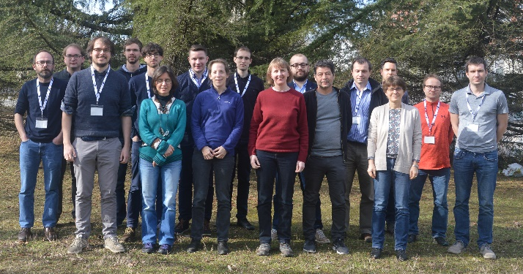
The ROCIT consortium
M9 consortium meeting
at INRIM, February 2020
Aim:
To enable European optical clocks
to contribute regularly to
International Atomic Time (TAI)
– a significant milestone on the path to the redefinition of the second
8 internal partners:
NPL (UK)
CMI (Czech Republic)
GUM (Poland)
INRIM (Italy)
LNE (France)
OBSPARIS (France)
PTB (Germany)
VTT (Finland)
6 external partners:
BGU (Israel)
CNRS (France)
LUH (Germany)
POLITO (Italy)
SRC PAS (Poland)
UMK (Poland)
2 Researcher Mobility Grants:
ROA (Spain) → NPL
ROA (Spain) → OBSPARIS
2 collaborators:
AIST/NMIJ (Japan)
TiFOON consortium (Europe)

Slide 3

Roadmap for the redefinition of the second
Validation that optical frequency standards (OFS) are at a level 100 × better than Cs
Continuity with the definition based on Cs
Regular contributions of OFS to TAI as secondary representations of the second
Availability of sustainable techniques for OFS comparisons
Knowledge of the local geopotential with a sufficient uncertainty level
Definition allowing future more accurate realisations
Access to the realisation of the new definition
Validation that optical frequency standards (OFS) are at a level 100 × better than Cs
Continuity with the definition based on Cs
Regular contributions of OFS to TAI as secondary representations of the second
Availability of sustainable techniques for OFS comparisons
Knowledge of the local geopotential with a sufficient uncertainty level
Definition allowing future more accurate realisations
Access to the realisation of the new definition
Achieved
Validation that optical frequency standards (OFS) are at a level 100 × better than Cs
Continuity with the definition based on Cs
Regular contributions of OFS to TAI as secondary representations of the second
Availability of sustainable techniques for OFS comparisons
Knowledge of the local geopotential with a sufficient uncertainty level
Definition allowing future more accurate realisations
Access to the realisation of the new definition
Mandatory criteria
Must be achieved before changing the definition
ITOC
Accuracy ∼ 0.2 m²s⁻²
or
2×10⁻¹⁸ clock accuracy
High reliability of optical frequency standards
High reliability of ultra high stability T/F links
Continuous improvement of the realization and time scales after redefinition
Regular contributions of optical clocks to UTC(k)
Availability of commercial optical clocks
Improved quality of the dissemination towards users
High reliability of optical frequency standards
High reliability of ultra high stability T/F links
Continuous improvement of the realization and time scales after redefinition
Regular contributions of optical clocks to UTC(k)
Availability of commercial optical clocks
Improved quality of the dissemination towards users
Ancillary conditions
In progress
Status should be advanced,
even if not completely
achieved at the
time of redefinition
arXiv:2307.14141v1
arXiv:2307.14141v1

Slide 4
Roadmap for the redefinition of the second
Achieved
Validation that optical frequency standards (OFS) are at a level 100 × better than Cs
Continuity with the definition based on Cs
Regular contributions of OFS to TAI as secondary representations of the second
Availability of sustainable techniques for OFS comparisons
Knowledge of the local geopotential with a sufficient uncertainty level
Definition allowing future more accurate realisations
Access to the realisation of the new definition
Mandatory criteria
Must be achieved before changing the definition
High reliability of optical frequency standards
High reliability of ultra high stability T/F links
Continuous improvement of the realization and time scales after redefinition
Regular contributions of optical clocks to UTC(k)
Availability of commercial optical clocks
Improved quality of the dissemination towards users
Ancillary conditions
In progress
Status should be advanced,
even if not completely
achieved at the
time of redefinition
arXiv:2307.14141v1

Slide 5
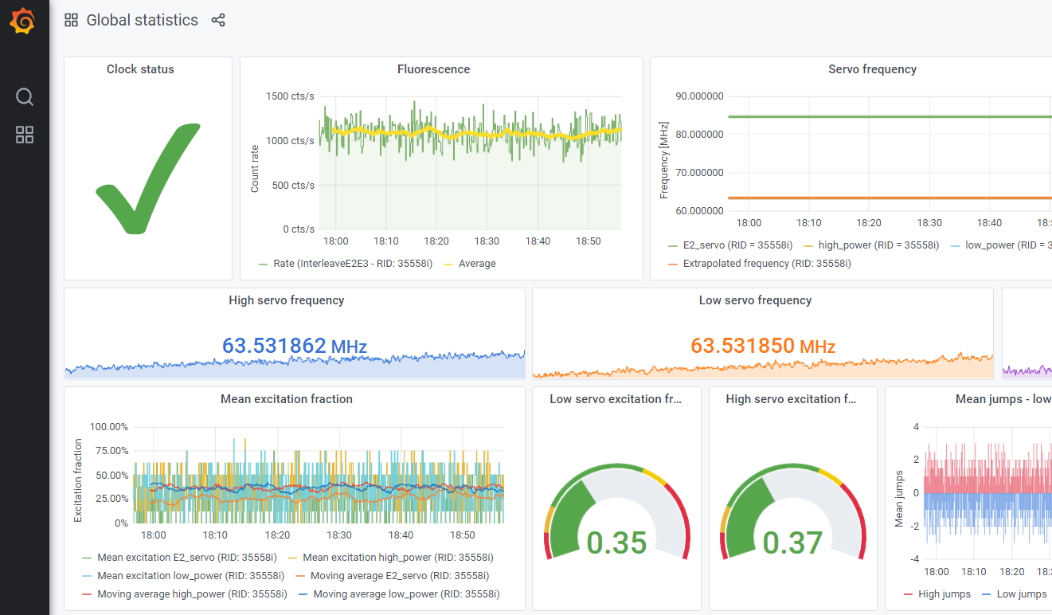

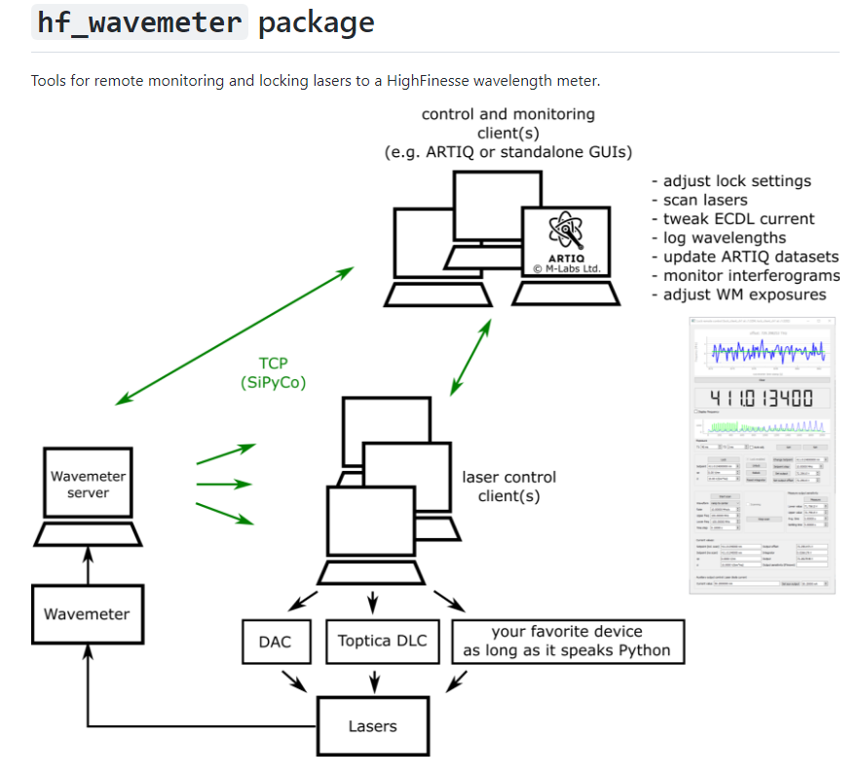
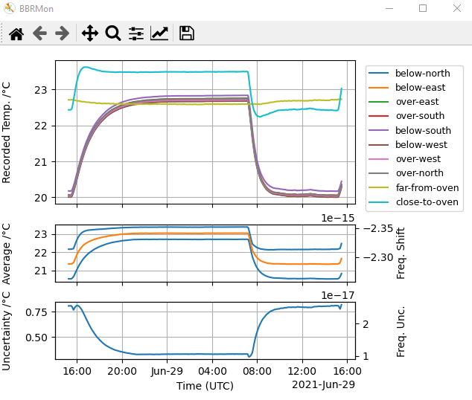
Robust optical clocks
Automatic control systems (some open source)
Robust & autonomous frequency stabilisation of laser systems
Automated optical alignment
Remote monitoring and control
Software to schedule and perform operational checks,
e.g. minimisation of micromotion in trapped ion clocks,
magic wavelength calibration in lattice clocks
Tools for on-the-fly correction of systematic frequency shifts
With sufficiently low latency for UTC(k) steering
Also useful for timely contributions to TAI and
faster data analysis in international comparisons
SYRTE-Sr2, PTB-Yb1E3 and NPL-Sr1 all achieved uptimes > 80% over 2 weeks

Slide 6
Roadmap for the redefinition of the second
Achieved
Validation that optical frequency standards (OFS) are at a level 100 × better than Cs
Continuity with the definition based on Cs
Regular contributions of OFS to TAI as secondary representations of the second
Availability of sustainable techniques for OFS comparisons
Knowledge of the local geopotential with a sufficient uncertainty level
Definition allowing future more accurate realisations
Access to the realisation of the new definition
Mandatory criteria
Must be achieved before changing the definition
High reliability of optical frequency standards
High reliability of ultra high stability T/F links
Continuous improvement of the realization and time scales after redefinition
Regular contributions of optical clocks to UTC(k)
Availability of commercial optical clocks
Improved quality of the dissemination towards users
Ancillary conditions
In progress
Status should be advanced,
even if not completely
achieved at the
time of redefinition
arXiv:2307.14141v1

Slide 7
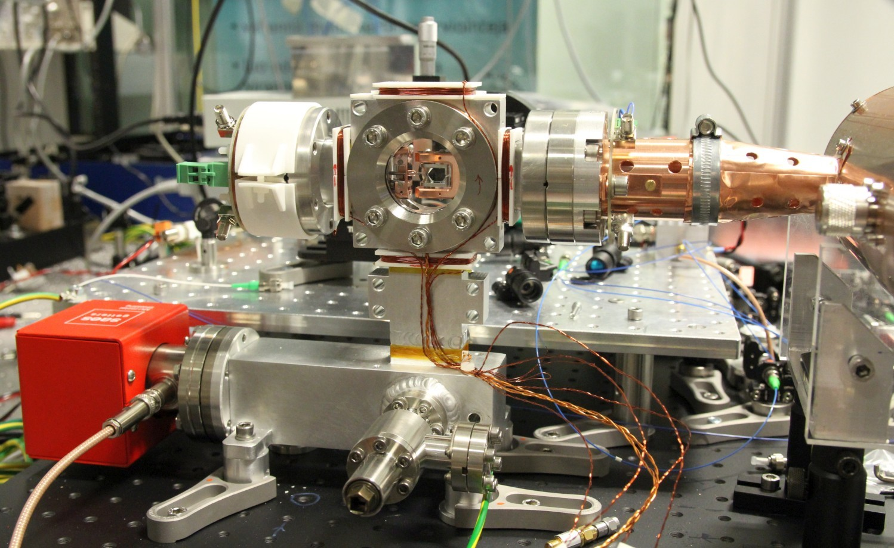
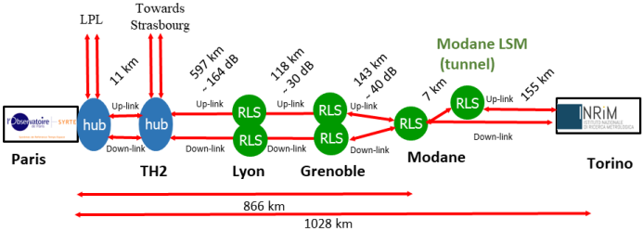
New optical clocks and a new fibre link
New optical clocks
⁸⁸Sr⁺ at VTT and ¹¹⁵In⁺ at LUH were completed and operated for the first time as part of the project
⁸⁸Sr at UMK joined international comparisons for the first time
Data also shared from ⁸⁸Sr⁺ at PTB
VTT ⁸⁸Sr⁺
LUH ¹¹⁵In⁺
New optical fibre link established from Paris to Turin
Robust performance with
long-term fractional instability
and accuracy below 10⁻¹⁸
High-accuracy optical clock comparisons
can be performed between more
European laboratories
C. Clivati et al., Phys. Rev. Applied 18, 054009 (2022)

Slide 8
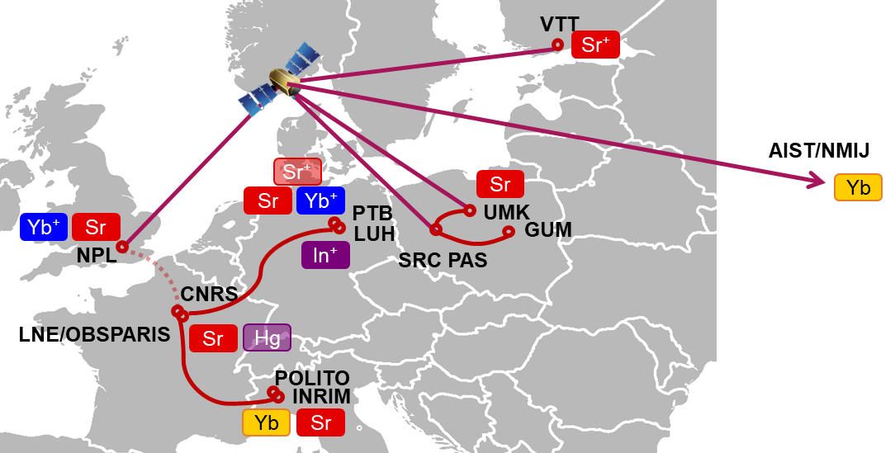
Coordinated comparison campaigns
First campaign (March 2020) badly impacted by COVID-19 pandemic
Second campaign (March 2022) much more successful
  1 month of data
  11 optical clocks in 7 different countries
  2 link technologies (fibre, GNSS)
  27 ratios measured between remote
  optical clocks (20 via GNSS, 7 via fibre)

Slide 9
March 2022 comparison campaign
Uptimes for comparisons via fibre links:
Optical fibre links between
INRIM, LNE-SYRTE and PTB
Local links between ultrastable lasers
and lasers used for long-distance links
Optical clocks

Slide 10
Remote frequency ratio measurements
Preliminary
3 ratios determined by both techniques
Source of discrepancy in 2 out of 3 cases is not yet understood
Offset is statistically significant
There is growing evidence that the problem lies with the recommended frequency value
Offset is well within uncertainty of recommended frequency value (4.3×10⁻¹⁵)

Slide 11
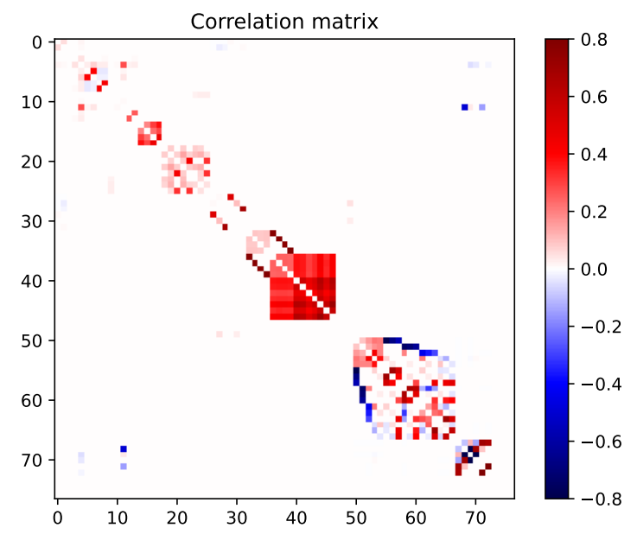
Complete body of data
79 new frequency ratio measurements
28 ratios between remote optical clocks
51 local frequency ratios
  33 absolute frequencies (26 referenced to Cs, 7 against TAI)
  15 optical frequency ratios
  3 optical v ⁸⁷Rb frequency ratios
Measurements are correlated
79 ratios implies up to 3081 correlation coefficients
(N.B. some will be zero)
313 non-zero correlation coefficients were calculated
  40 with magnitude ≥ 0.5
  135 with magnitude ≥ 0.1

Slide 12
Roadmap for the redefinition of the second
Achieved
Validation that optical frequency standards (OFS) are at a level 100 × better than Cs
Continuity with the definition based on Cs
Regular contributions of OFS to TAI as secondary representations of the second
Availability of sustainable techniques for OFS comparisons
Knowledge of the local geopotential with a sufficient uncertainty level
Definition allowing future more accurate realisations
Access to the realisation of the new definition
Mandatory criteria
Must be achieved before changing the definition
High reliability of optical frequency standards
High reliability of ultra high stability T/F links
Continuous improvement of the realization and time scales after redefinition
Regular contributions of optical clocks to UTC(k)
Availability of commercial optical clocks
Improved quality of the dissemination towards users
Ancillary conditions
In progress
Status should be advanced,
even if not completely
achieved at the
time of redefinition
arXiv:2307.14141v1

Slide 13
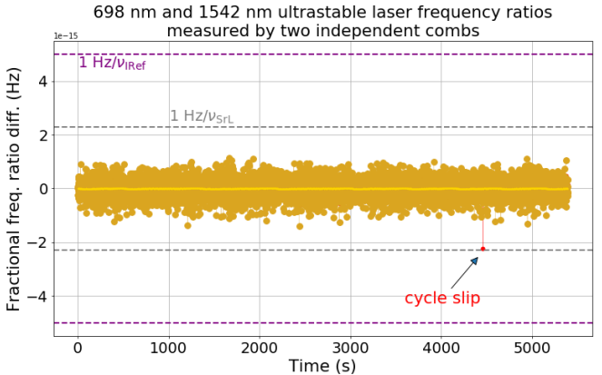
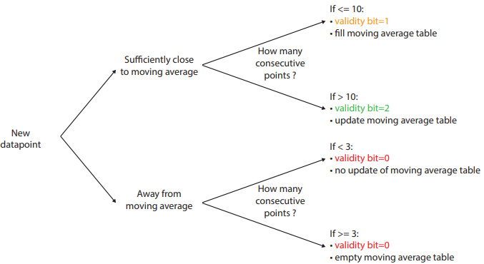
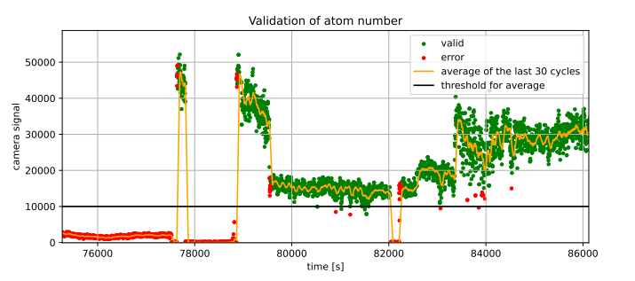
Real-time validation of optical clock data
Considered the whole metrological chain connecting optical clocks to the
flywheel oscillators (H masers)
  Local phase-compensated fibre links
  Frequency combs used for optical-microwave comparison
  Optical clocks
Effectiveness of different approaches compared
Cycle slip detection through dual measurements
Algorithms for detecting sudden changes
in frequency measurements
Validation of atom number in a Sr lattice clock

Slide 14
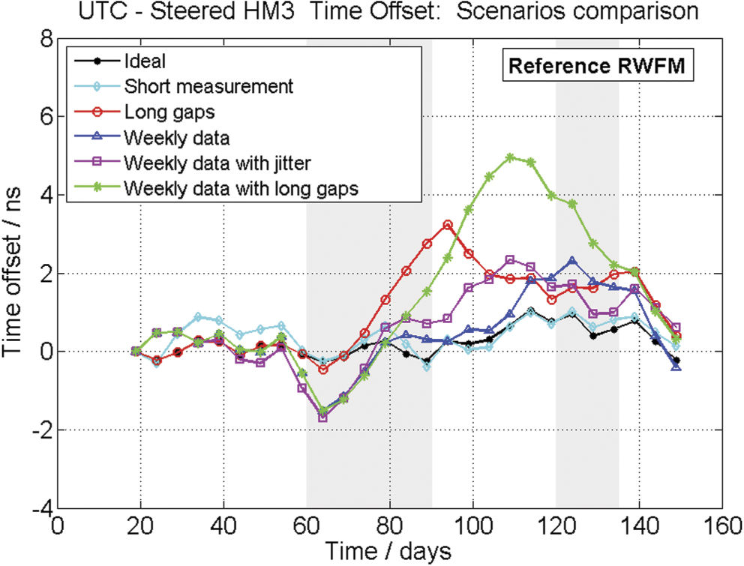
Steering algorithms
V. Formichella, L. Galleani, G. Signorile and I. Sesia, Metrologia 59, 015002 (2022)
Robust algorithm developed for generation of a time scale
based on steering an Active Hydrogen Maser (AHM)
with an optical clock
  Can deal with low uptime and long periods
  of unavailability of the optical clock
  Can take advantage of high uptime periods
  of the optical clock
Tested on both simulated and experimental (historical) data

Slide 15
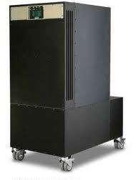
Optical steering of UTC(k) time scales
UK time scale
Frequency offset generator
Frequency steers applied 3 times a week,
based on data from NPL-CsF2 and Circular T
UTC(NPL)
HM4
Phase comparator
Experimental prototype
Frequency offset generator
UTCx(NPL)
Frequency steers applied hourly,
based on data from Sr and Yb⁺ optical clocks
HM6

Slide 16

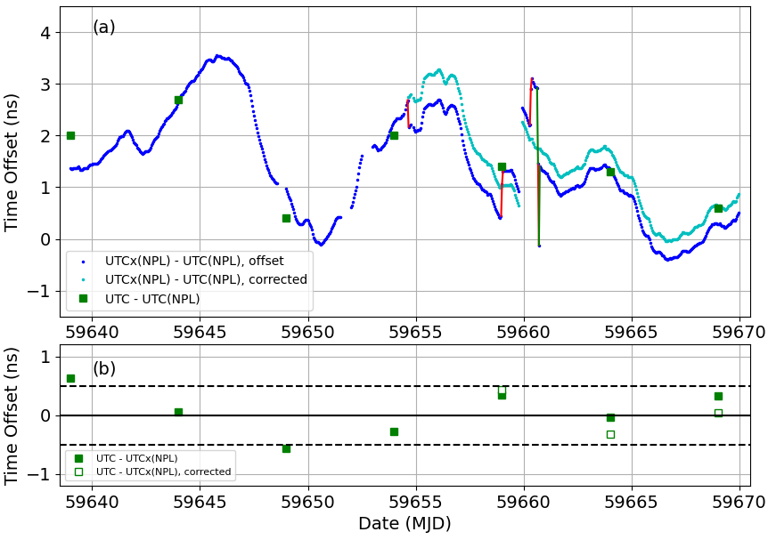
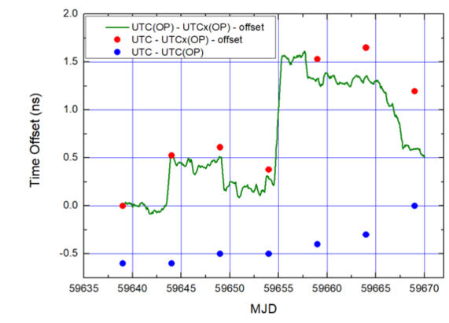
Prototype optically steered time scales
UTC(NPL)
GPS PPP
UTC(OP)
v
v
UTCx(NPL)
UTCx(OP)
Offset between the two prototype optically steered time scales lower than the typical offset between the two operational UTC(k) time scales
Sub-ns deviation from UTC, despite technical glitches and gaps in optical clock data (32.3%)

Slide 17
Roadmap for the redefinition of the second
Achieved
Validation that optical frequency standards (OFS) are at a level 100 × better than Cs
Continuity with the definition based on Cs
Regular contributions of OFS to TAI as secondary representations of the second
Availability of sustainable techniques for OFS comparisons
Knowledge of the local geopotential with a sufficient uncertainty level
Definition allowing future more accurate realisations
Access to the realisation of the new definition
Mandatory criteria
Must be achieved before changing the definition
High reliability of optical frequency standards
High reliability of ultra high stability T/F links
Continuous improvement of the realization and time scales after redefinition
Regular contributions of optical clocks to UTC(k)
Availability of commercial optical clocks
Improved quality of the dissemination towards users
Ancillary conditions
In progress
Status should be advanced,
even if not completely
achieved at the
time of redefinition
arXiv:2307.14141v1

Slide 18
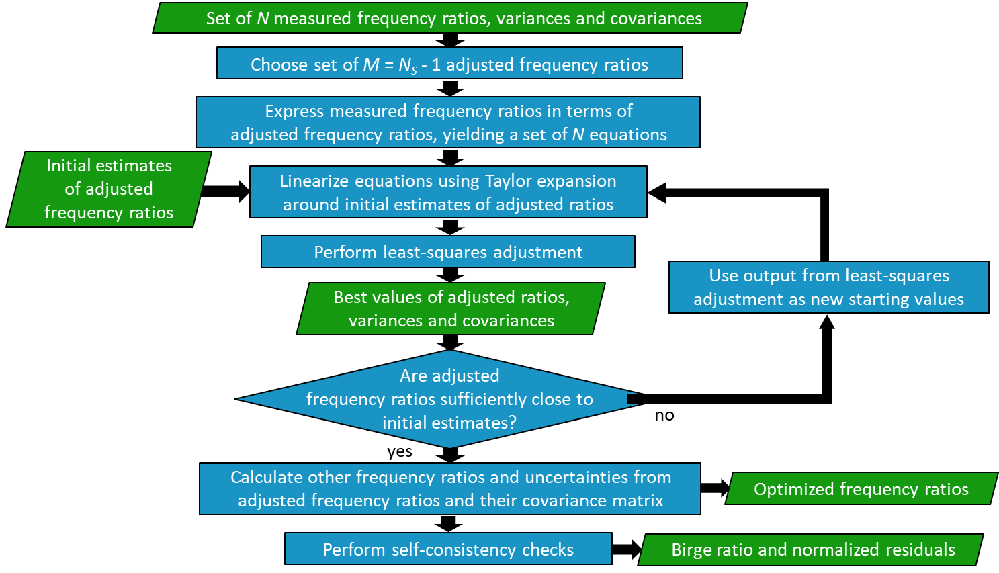
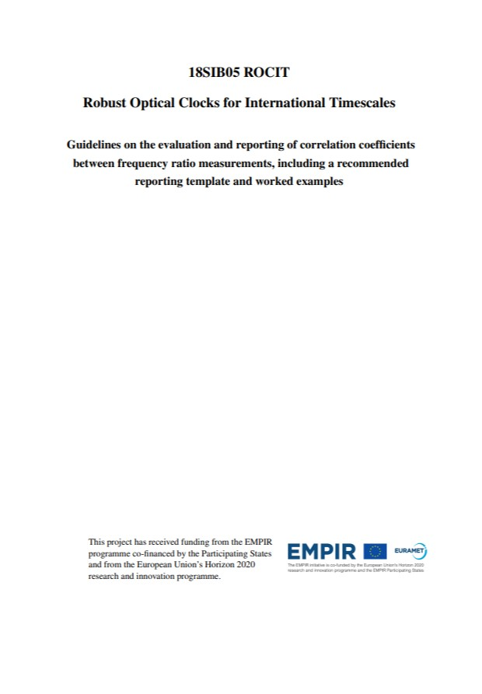
Recommended values of standard frequencies
http://www.bipm.org/en/publications/mises-en-pratique/standard-frequencies-second
Least-squares analysis procedure
Based on the approach used by CODATA to provide a
self-consistent set of recommended values of the
fundamental physical constants
H. S. Margolis and P. Gill, Metrologia 52, 628 (2015)
First used to update the list of recommended frequency values
in September 2015
Importance of correlations
Must be included to avoid biased frequency values and (usually) underestimated uncertainties
Guidelines prepared on the evaluation & reporting of correlation coefficients
between frequency ratio measurements (http://empir.npl.co.uk/rocit/project-outputs/)
Shared with the CCL-CCTF Frequency Standards Working Group (WGFS)

Slide 19
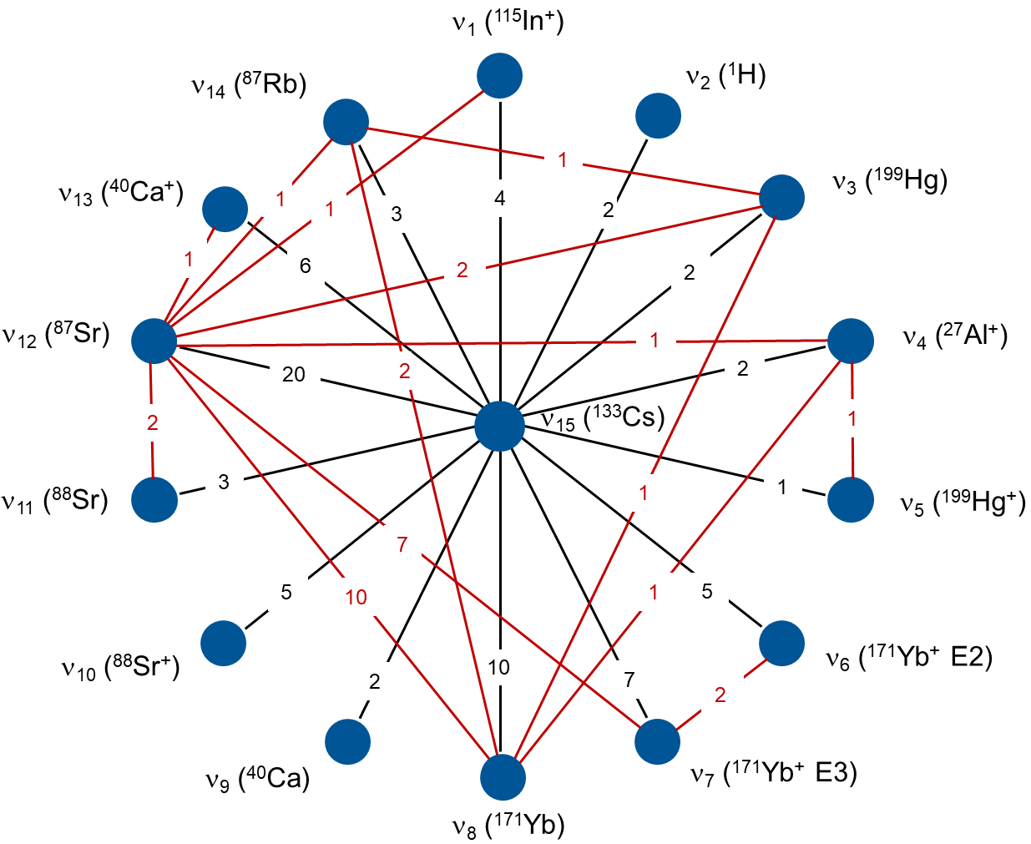
2021 update
105 input data points (72 absolute frequencies, 33 ratios)
Correlations included for the first time (483 correlation coefficients)
  Mostly arising through the use of the same primary or secondary frequency standard to access the SI second
  86 computed on an ad-hoc basis (common data, common coefficients …)
6 secondary representations of the second now have uncertainties ≤2×10⁻¹⁶

Slide 20
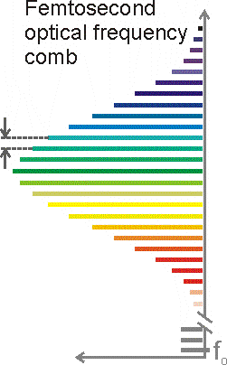
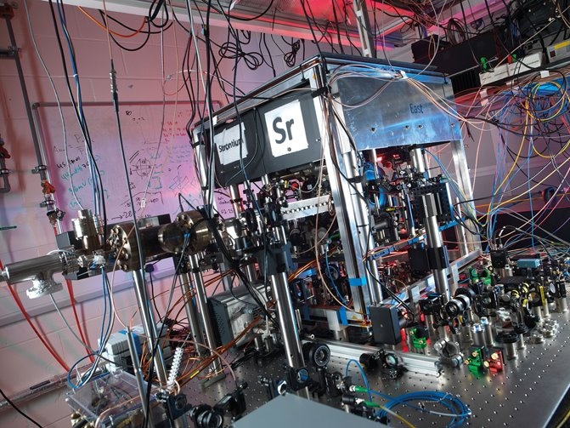
Optical clock contributions to TAI
Similar to the approach used for primary frequency standards
Calibrate a commercial clock for which phase comparison data is submitted on a continuous basis to the BIPM
Use the frequency of the optical clock as listed in the “Recommended values of standard frequencies”
Femtosecond
comb
For first submission of a new standard
  Several calibration values must be provided
  (do not need to be contiguous)
  Operation of the frequency standard and its
  uncertainty evaluation must be described
  in a peer-reviewed publication
Material must be reviewed and approved by the CCTF Working Group on Primary and Secondary Frequency Standards before the clock can be used
for steering of TAI
H-maser
f_{rep}
f₀
Sr lattice clock

Slide 21
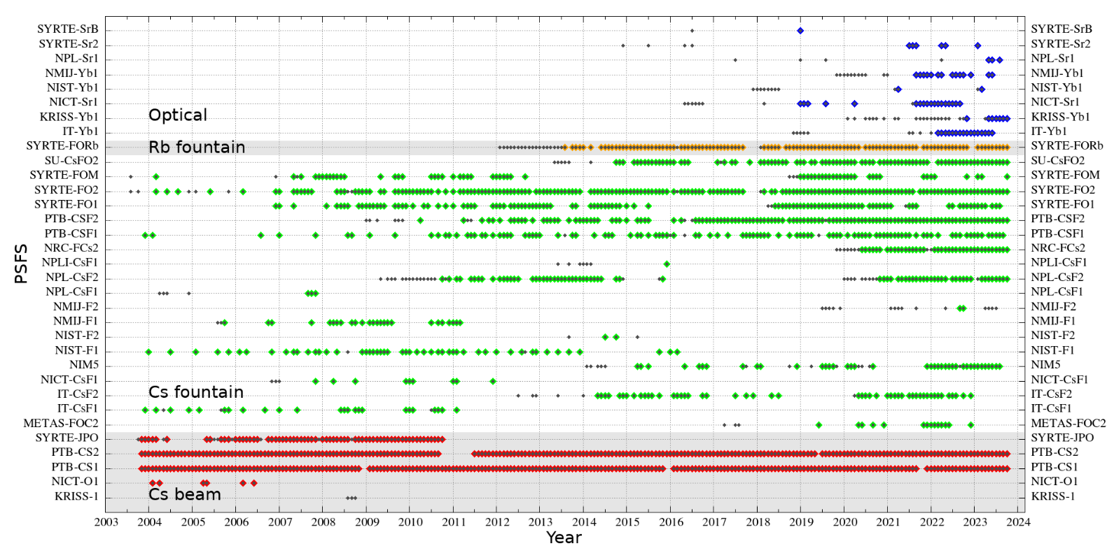
Optical clock contributions to TAI
SYRTE-Sr2
5 contributions used for TAI steering (Jun – Aug 2021 and Mar – Apr 2022)
One contribution so far in 2023
https://webtai.bipm.org/database/show_psfs.html
IT-Yb1
First contribution in Nov 2019
9 further contributions used for TAI steering (Feb – Oct 2022)
7 more since then
Highest-weight clock in July 2022!
NPL-Sr1
First contribution in March 2023
3 more since then
Almost 40% of the “on time” contributions from optical clocks
Suitable data also gathered from other optical clocks …
12 optical clocks, 55 periods ranging from 5 – 35 days,
total cumulative data acquisition period > 1000 days

Slide 22
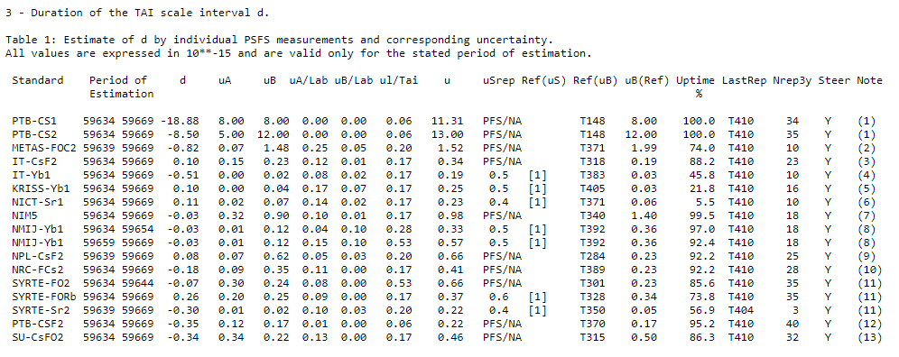
New record set in March 2022
Circular T no. 411 – 5 optical clocks contributing

Slide 23
Summary
More robust optical clocks, achieving unattended uptimes > 80 % over a few weeks
Tools for on-the-fly evaluation of systematic frequency shifts and real-time validation of optical clock data
An extensive programme of optical clock comparisons to check performance levels
First direct comparison of two prototype optically steered time scales
Guidelines on evaluating correlations between frequency ratio measurements influenced the
2021 update to the CIPM list of recommended values of standard frequencies
3 European optical clocks now contributing to TAI as secondary representations of the second

Slide 24
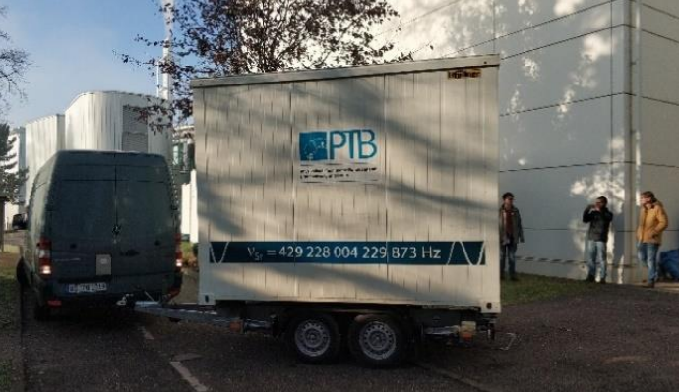
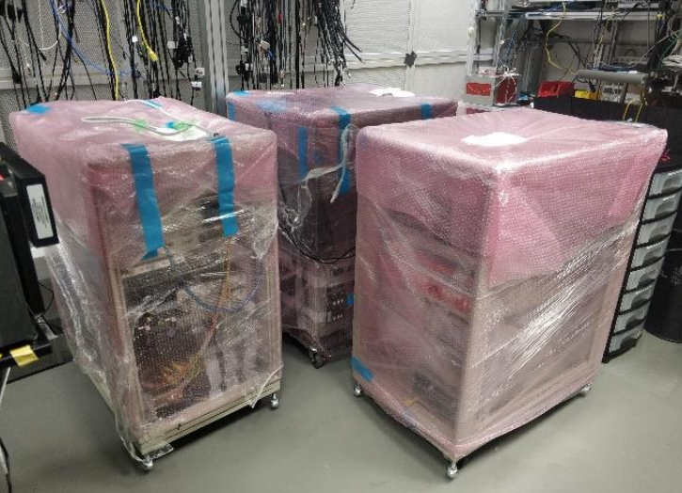
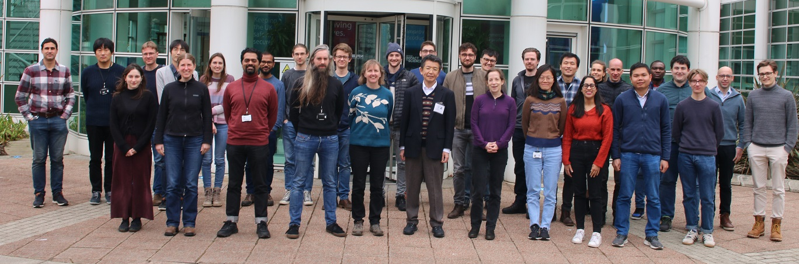

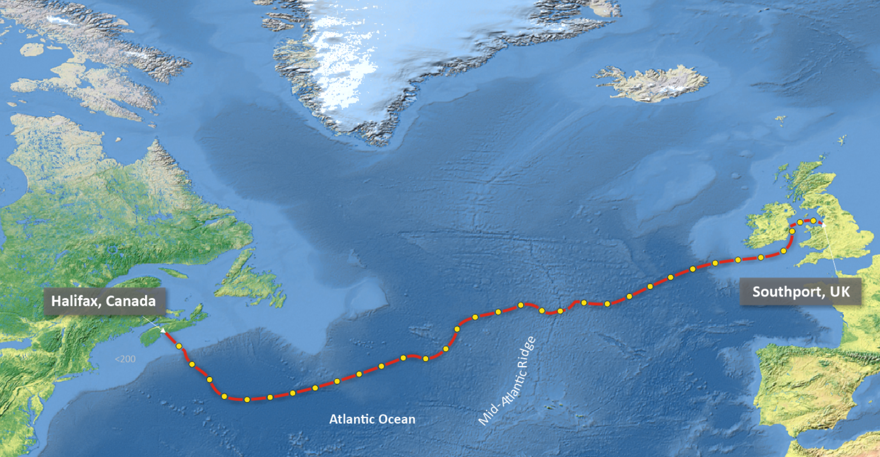
Future perspectives
International comparisons using transportable optical clocks (ICON project)
Intercontinental clock comparisons using optical fibre?
Transatlantic fibre linking Halifax and Southport (5860 km long)
So far mainly used for environmental sensing
  G. Marra et al., Science 361, 486 (2018)
  G. Marra et al., Science 376, 874 (2022)
Also offers prospects for intercontinental clock comparisons
  Environmentally induced noise lower than for terrestrial fibre

Slide 25
Thank you for listening!
http://empir.npl.co.uk/rocit/
helen.margolis@npl.co.uk

