Slide 1
NPL Cs fountain clocks –
robust design and performance
NPL Cs fountains – main features
Robust design and performance
Time scale steering
‘mini-fountain’
Krzysztof Szymaniec
9th SFSM, Kingscliff, October 2023
Notes:
Good morning, thanks for coming…
TITLE
Development, journey → now mature technology (not yet outdated!),
engineering standards (compliance)
applications

Slide 2
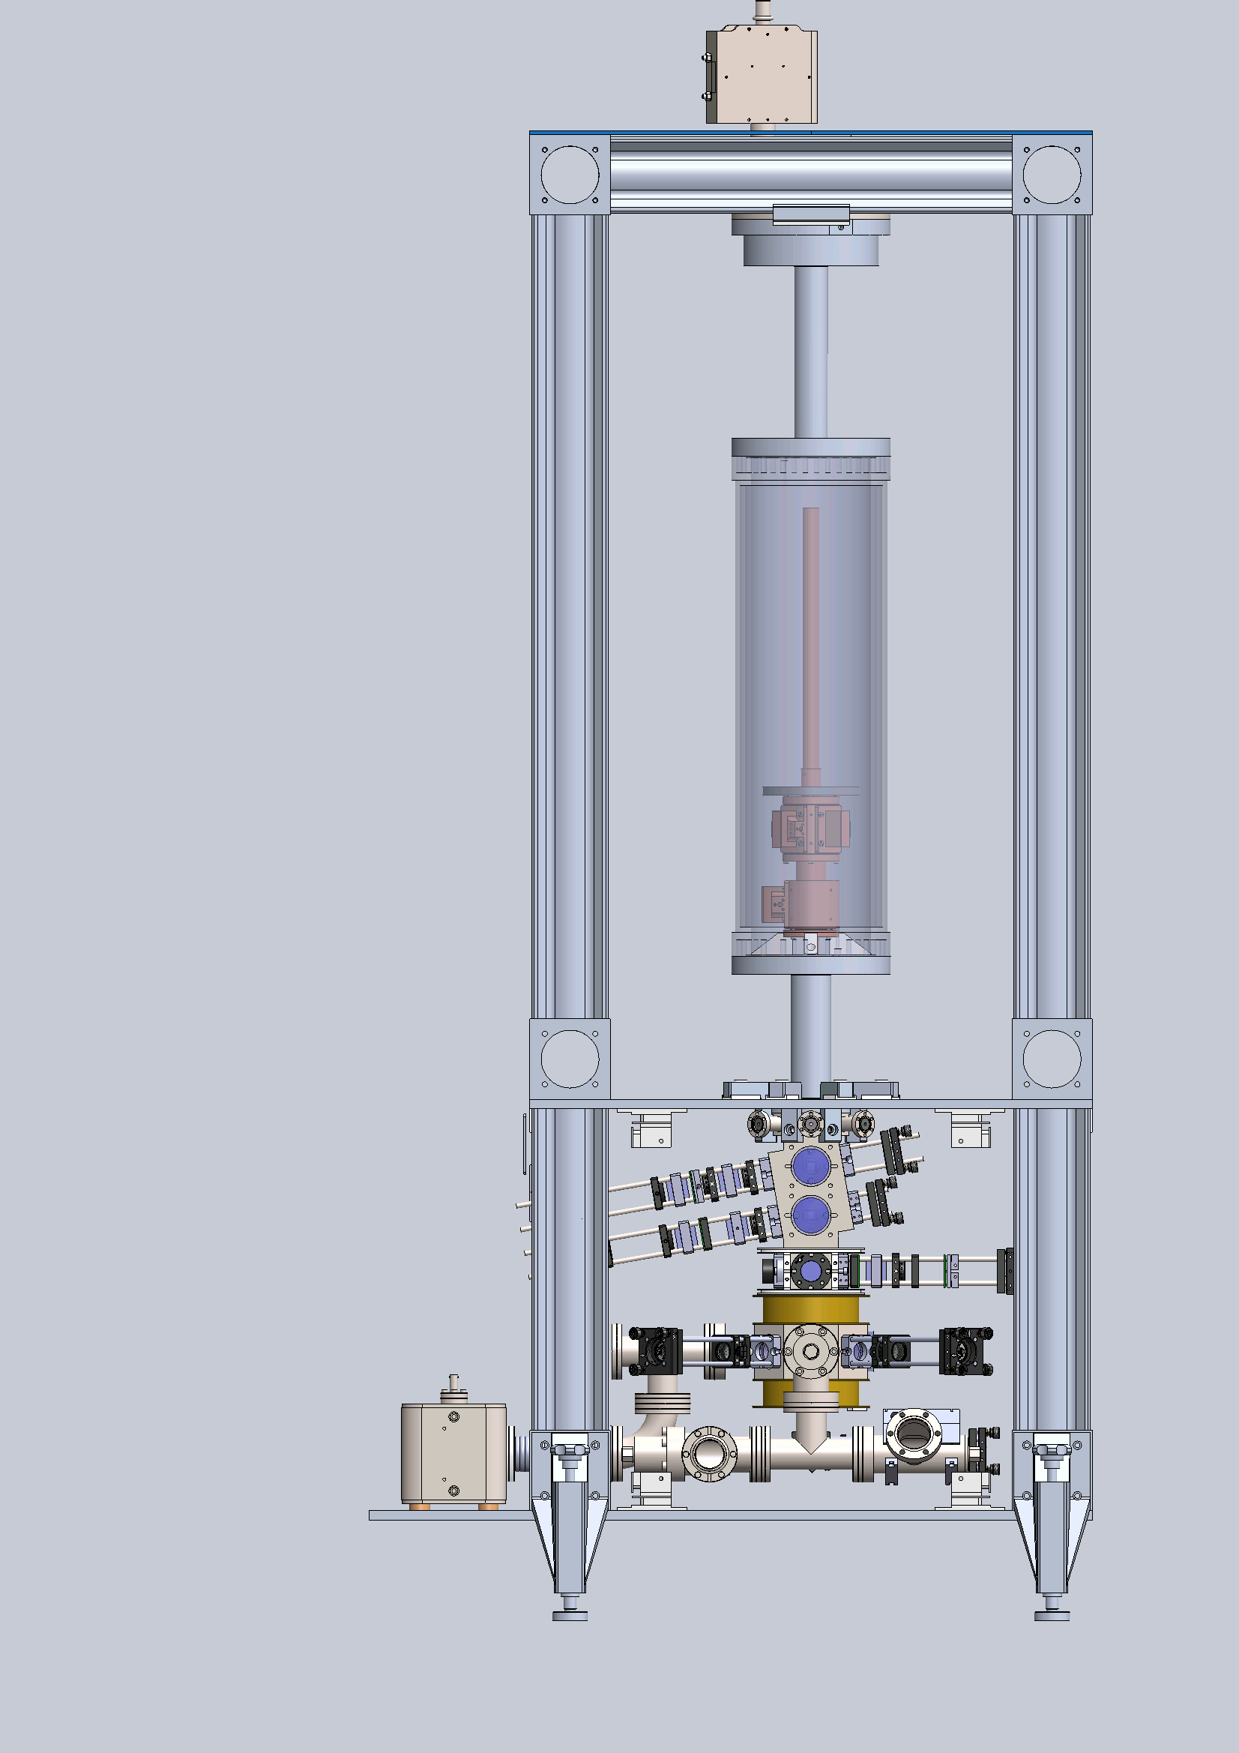
Atomic fountains – primary frequency standards
Trade-off:
SNR ~ N_{at}^{1/2}
f_{coll} ~ N_{at} / V
B
¹³³Cs
F=4
m_{F}=0
6 S_{1/2}
9 192 631 770 Hz
m_{F}=0
F=3
free flight
&
Ramsey interaction
2
3
state preparation
launch
atom cooling
state readout
1
Notes:
¹³³Cs, interrogation of hyperfine transition
Three phases: cold atom sample preparation
Ramsey interrogation (free flight)
state detection / transition probability
Cold atoms: 1-3 uK temp, up to 20% atoms returns to detection region,
0.5 s Ramsey time (between passages)
Cyclic operation (except METAS)
All above is generic fountain description, next NPL specific
Trade-off for N_{at} - strategies

Slide 3
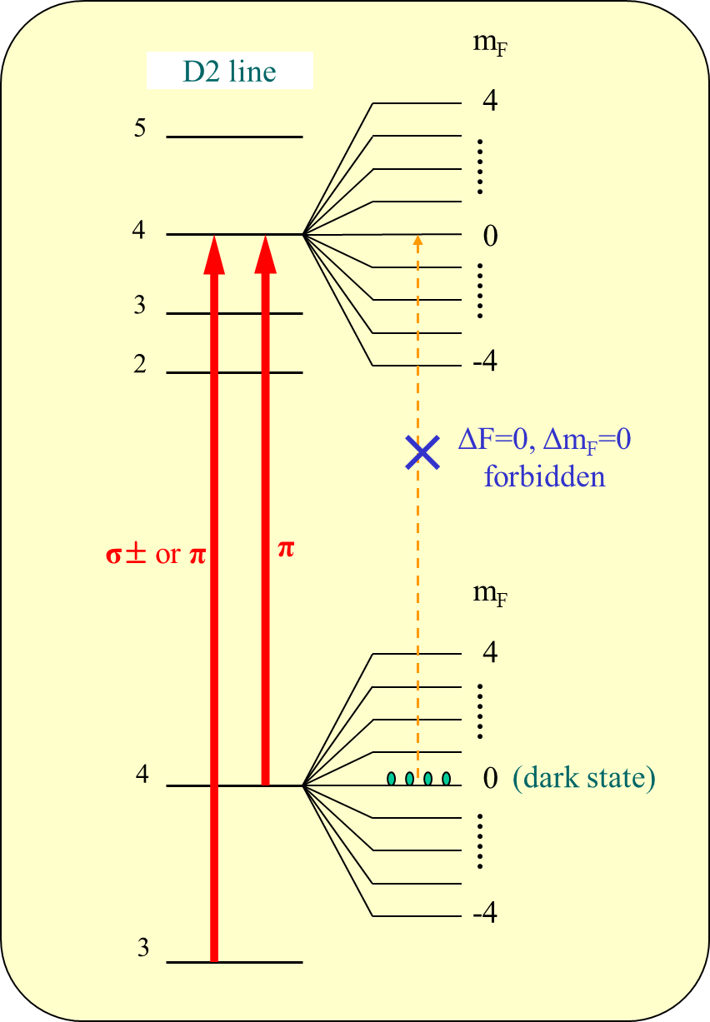
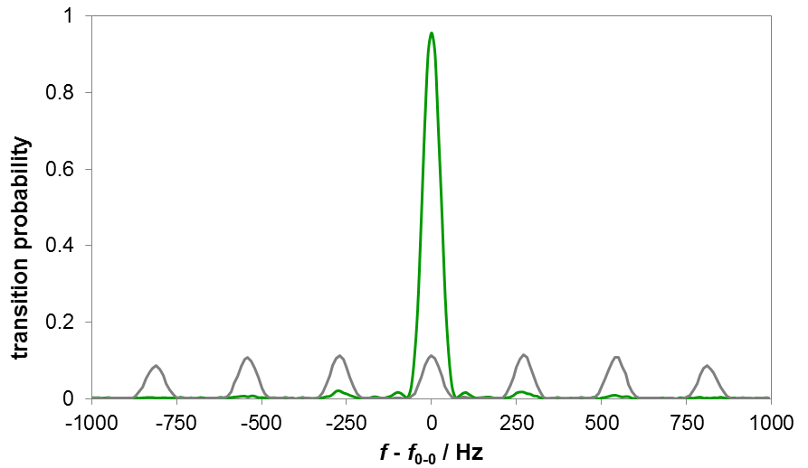
Collisional shift cancellation
Atomic fountains – NPL approach
Optical pumping
Trade-off:
SNR ~ N_{at}^{1/2}
f_{coll} ~ N_{at} / V
λ₃₀
λ₄₀
use MOT
5× gain in signal
gain reduced due to photon scattering and heating
σ₀ = 5 mm
σ₀ = 1 mm
G. Avila et al. Phys. Rev. A 36 (1987)
K.S. et al. Appl. Phys. B 111 (2013)
K.S. et al. Phys. Rev. Lett 2007, Metrologia 2010
Notes:
Discuss problem of shift proportional to density.
Shift can be controlled for small clouds – can minimise shift.
MOT is good
So OP is useful – note the heating in fountain case

Slide 4
NPL design – fountain cycle
Free flight in constant
magnetic field
Ramsey interaction I
Ramsey interaction II
State preparation
State readout (transition probability)
Optical pumping
Atom cooling and launch
Notes:
Three phases = three areas -- details next

Slide 5
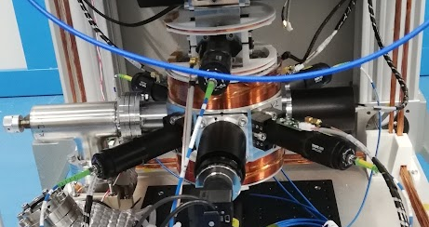
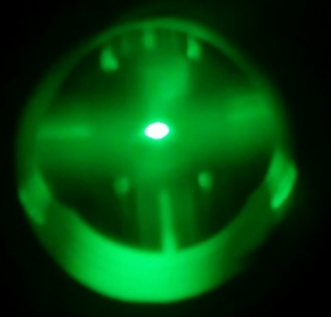
NPL design – cold atom preparation and launch
OP
MOT
Cs reservoir
(temperature controlled)
Notes:
A controlled vapour pressure of Cs is produced from a stabilised reservoir – improves atom number stability and so improves collisional shift cancellation
This vapour loads a (0,0,1) MOT optimised for high density and low temperature – low sensitivity to laser beam power and polarisation drift
Dark expansion for eddy currents decay but also control of initial cloud size
Brief molasses phase to reduce temperature to about 1uK but maintains small size.
Vertical moving molasses to launch atoms upwards on a 1m trajectory.
Pass through graphite lined apertures into improved vacuum zone to reduce background collisions
Optical pumping laser pulse to transfer as many atoms as possible into F=4, mF=0.
Pass through more apertures into UHV region P<10⁻¹⁰ mbar
Note that all of these optics are rigidly mounted and designed not to need re-adjustment
A monitoring system tracks and logs the power of each beam – can anticipate problems before they affect fountain development

Slide 6
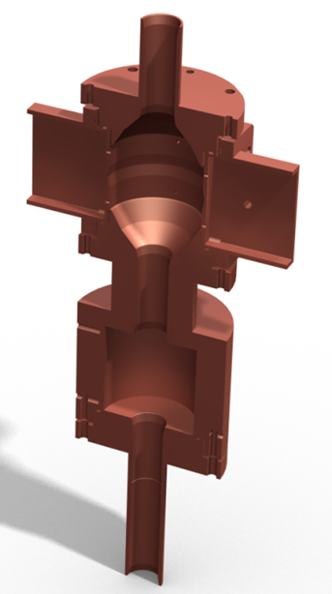
NPL design – microwave interaction
K. Gibble et al. CPEM (2012)
water jacket for temperature control
Magnetic field:
magnitude ≈ 125 nT
homogeneity ≈ 300 pT
stability < 50 pT
Temperature stability ≈ 100mK
flight-tube
(w/g below cut-off)
Ramsey cavity
State selection
(state clean-up
& density control)
Metrologia 47, 534 (2010)
Notes:
Lower microwave resonator selects atoms in the clock state; F=3, mF=0 atoms pushed away (pure state)
Control of density for the density extrapolation (collisional shift control)
---
Resonator carefully designed by Kurt Gibble to reduce distributed cavity phase shifts
Features 4 orthogonal feeding waveguides that allow measurement and reduction of some of the remaining DCP shifts
Waveguide below cut-off minimise microwave leakage (tube too narrow to support resonant m-waves)
Temperature stabilised flight-tube (water jacket)
Outside Ramsey time microwaves are detuned from resonance to suppress any residual microwave leakage

Slide 7
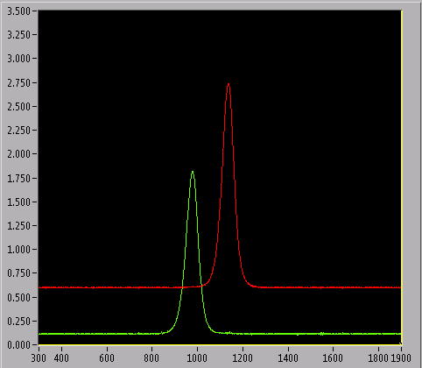
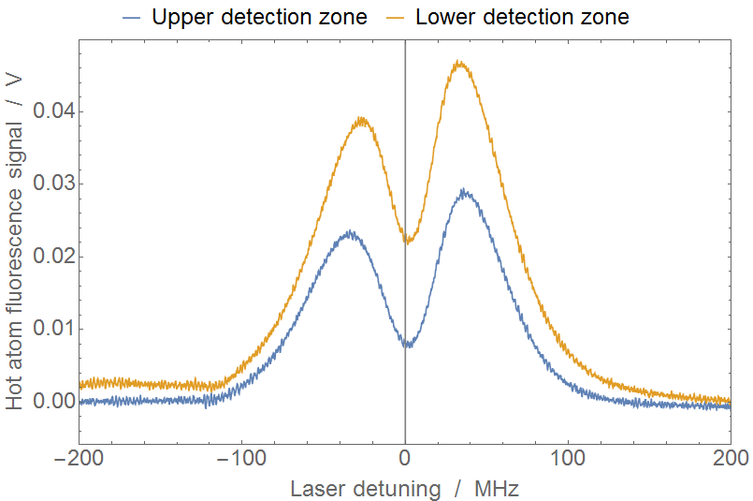
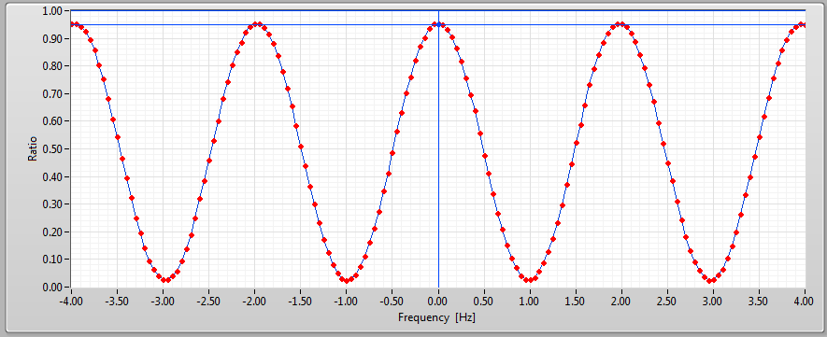
NPL design – state detection
time-of-flight
signal
LOWER
UPPER
tilted detection beams
LOWER
UPPER
Ph. Laurent et al, Appl. Phys. B 84 (2006)
Notes:
2 detection zones for state readout. Tilted beams, control of resonant background
Lower beam combined with repumper.
Servo for intensity stabilisation

Slide 8
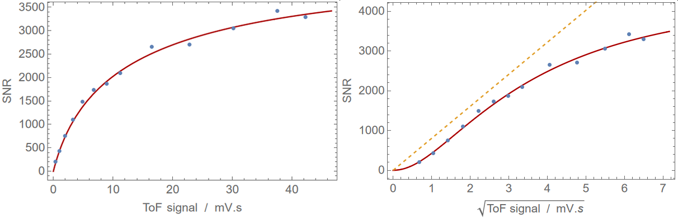
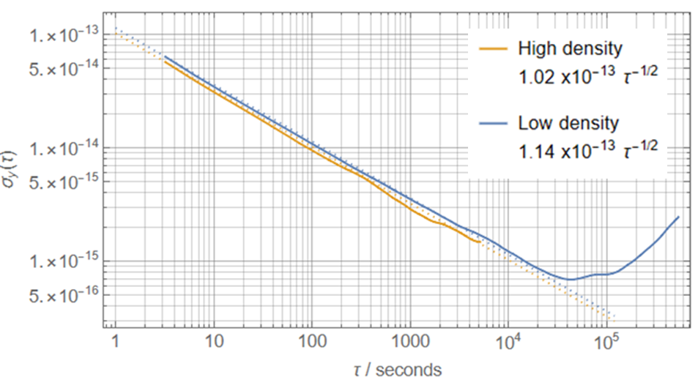
NPL design – state detection
SNR ≈ 3300
QPN limit
Short-term stability:
σ_{y}(1s) ≈ 0.3×10⁻¹³ OLO/CSO
σ_{y}(1s) ≈ 1.0×10⁻¹³ quartz
σ_{ext}(1s) ≈ 1-2×10⁻¹³ extrapolated
to zero density
Notes:
All efforts pay off – very good SNR
Short-term stability effectively degraded due to extrapolation procedure
Typically ratio H/L = 4 to 6

Slide 9
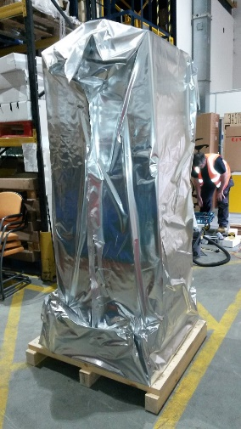
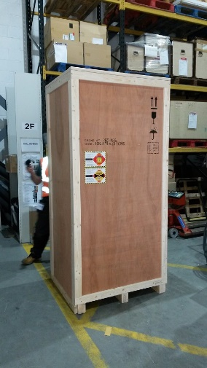
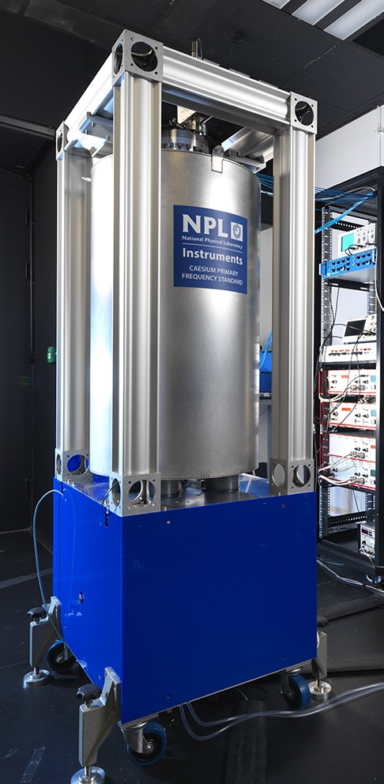
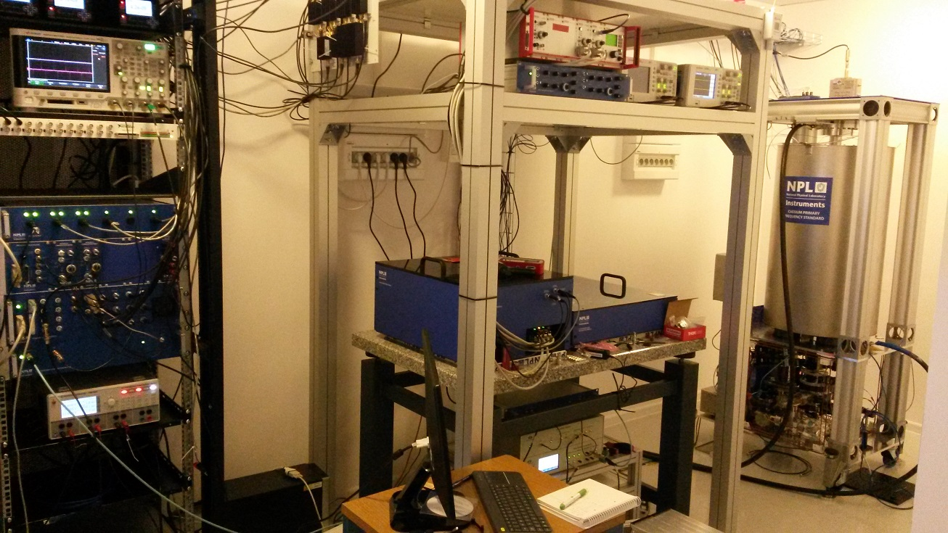
NPL design – ‘commercial’ realisations
AOS Borowiec (PL)
Notes:
‘Improved design’ - total of 7 built already, mostly for other labs
recent 2 for RETSI: 1st operational, 2nd in progress.
2015 model – note small table for optics (already compact)
Transport to Canada by air, issue with Cs.

Slide 10
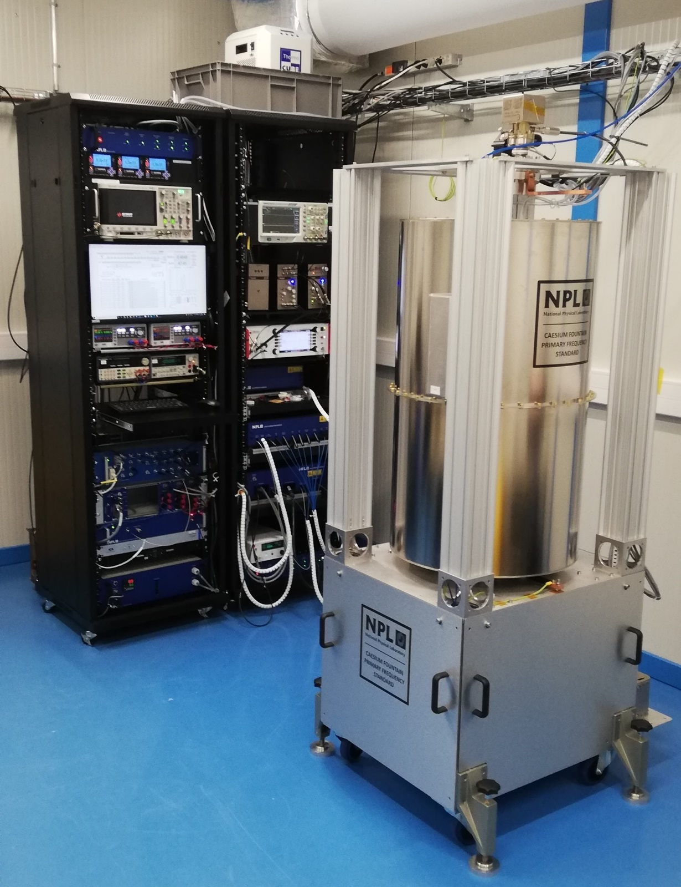
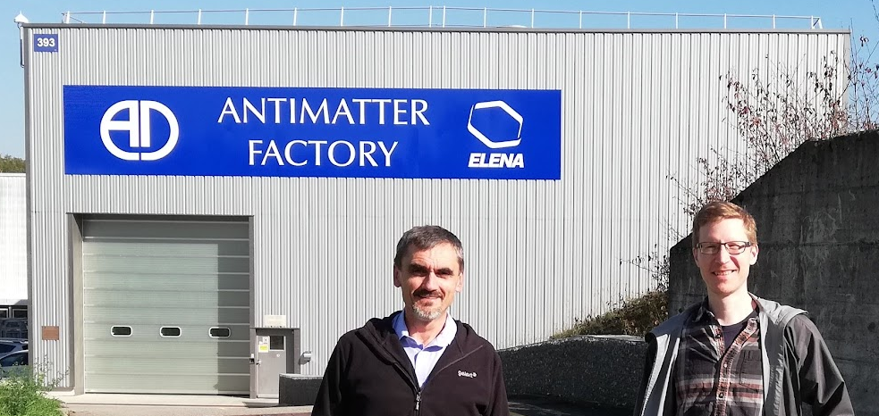
NPL design - ‘commercial’ realisations
reduced structure height (<2 m max)
added rigidity (for transport)
lighter magnetic shields
smaller ion pumps (added getter pumps)
temperature controlled Cs reservoir
temperature controlled flight tube
novel m-w cavity (minimizing phase grad.)
integrated laser beams collimators
modular optical bench (rack mounted)
engineering standards (CE mark)
CERN
ALPHA
collaboration
Notes:
2020 model at CERN - add info on ALPHA, spectroscopy of H-bar
– magnetic field noise due to antiproton decelerator
Note: even more compact optics (in racks, no table)

Slide 11
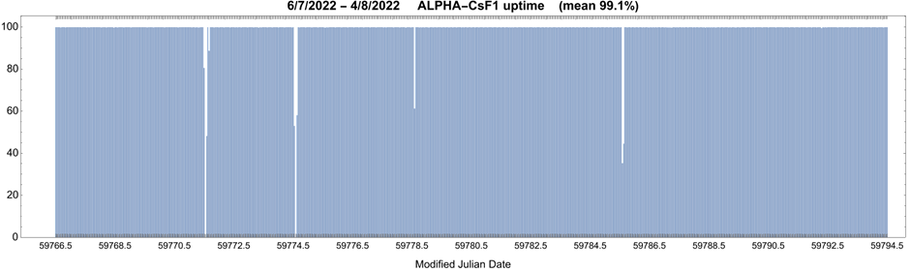
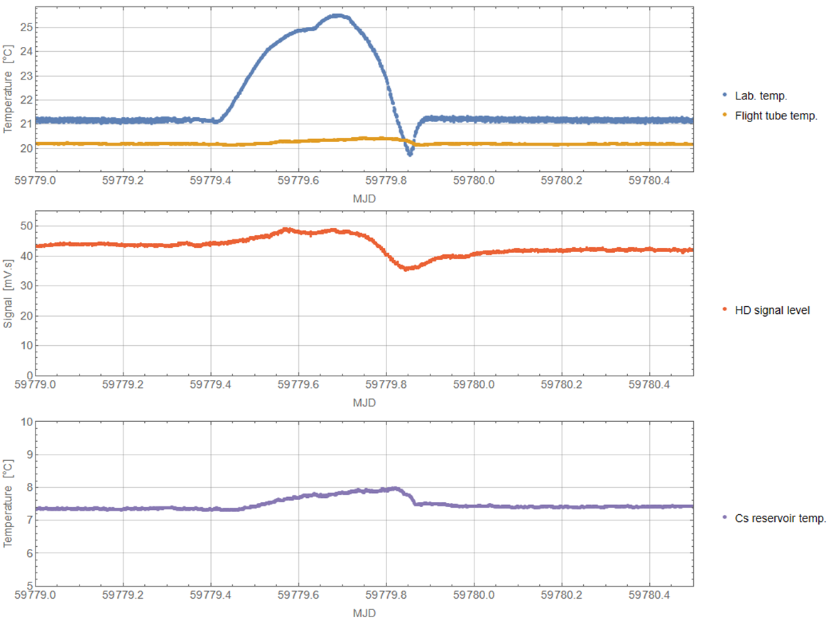
NPL build – performance
(reliability)
Failure cases:
- automation software
- temperature control (pump)
- mechanical shutters
- DBR laser diode lifetime
‘heat wave’
aircon failure
Notes:
4 weeks of interrupted operation – demo for customer, since installation >3 months solid
Flight tube temperature control system
Discuss failure cases

Slide 12
(expected accuracy)
NPL build – performance
Effect | Expected uncertainty / 10⁻¹⁶
Black-body radiation | 0.7
2nd-order Zeeman | 0.4
Microwave leakage | 0.5
Distributed cavity phase | 1.1
Gravity | 0.1
Cold collisions | 0.3
Background gas collisions | 0.3
Microwave lensing | 0.3
Total | < 2
Notes:
Evaluations vary by partner institutions – hence ‘expected’,
(Initial evaluation as ‘factory test’)
…but DCP dominates in all cases

Slide 13
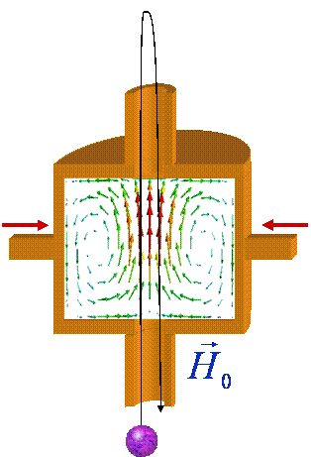
DCP (distributed cavity phase effect)
R. Li & K. Gibble,
Metrologia 41 (2004)
M-w field has travelling wave components (Doppler effect);
can be expressed as azimuthal series
H(r) = H₀(r) + (2Δω/Γ + i) ×{Σg_{m}(ρ,z) cos(mφ)}
only the lowest orders contribute: m = 0, 1, 2
K. Gibble et al.,
CPEM (2012)
m = 1
m = 2
S. Beattie et al. Metrologia 57 (2020)
need to know and control cavity crossing positions
Notes:
Plot: residual m=1 for balanced feeds in two orthogonal directions (NRC)
- lucky to see shift fairly symmetric about tilting range – if not need better control of crossing position

Slide 14
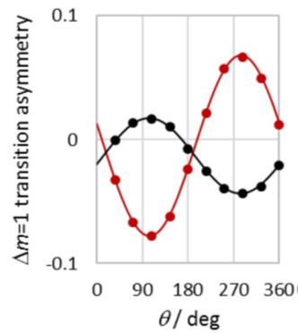
DCP – cavity crossing positions
Atoms passing off-axis see transverse component
180°phase change = cw + ccw rotation
→ split resonance of the σ transition
N. Nemitz et al.
Metrologia 49 (2012)
If cavity tilted with respect to C-field
& atoms displaced along tilt
→ the split resonance becomes asymmetric
By adding and rotating a horizontal component to C-field, measuring the asymmetry
→ get radial distance and orientation of the centre of mass of the detected atoms
ascent
descent
K. Burrows et al. Metrologia 57 (2020)
Notes:
…notes…

Slide 15
DCP – cavity crossing positions
- tilt of entire fountain
- shim coils to move the MOT
→ full control of crossing pos.
Results:
ascent & descent aligned to 50 μm
DCP (m=1) < 1×10⁻¹⁷
confirmation of the theoretical model for DCP (m=2)
(m=2) shift <1×10⁻¹⁷ if crossing centred to 0.4 mm
Notes:
Before explaining the position detection method – see the results of control: - centre of mass of the detected ensemble
Top row: tilt alone doesn’t align precisely (m=1), needed to move the MOT before launch
Bottom row: intentional displacement for m=2 component (model confirmation)

Slide 16
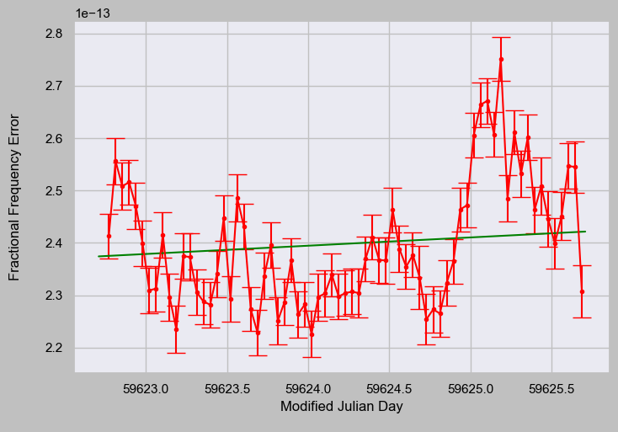
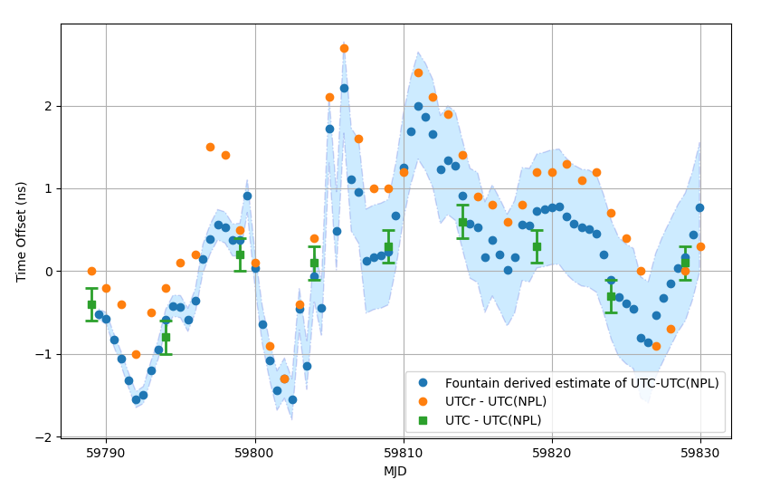
Time scale steering – time offset prediction
High uptime → fountain as a clock → best representation of UTC
Instant. frequency correction | Maser drift correction | Accumulated time offset
Extrapolated maser frequency at time of steer | Expected frequency drift before next steer (feed-forward) | Includes value reported BIPM (τ ~ 5 days) Small gaps in fount. data!
3 components of frequency steer
steers applied daily or 3/week
G.D. Rovera et al. Metrologia 53 (2016)
L. Galleani et al. Metrologia 57 (2020)
Notes:
Apply a correction to the maser frequency equivalent to our best guess at the current frequency offset between the maser and the caesium primary frequency standard. The gradient on the fit is fixed based on the frequency data since the time of the last steer
Anticipate and correct for the frequency drift which is predicted to occur from now until the time of the next steer. Intentionally oversteer so any effect averages to zero.
Additional correction for the estimate of the difference between UTC and the SI second on the geoid. Again these results are published ante factum so the most recent value is our best guess for the future behaviour of UTC

Slide 17
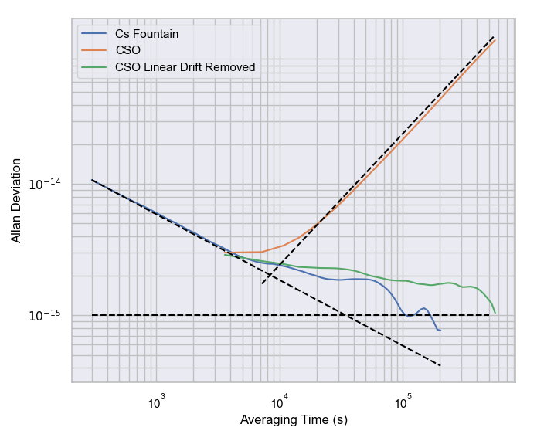
Time scale steering – flywheel oscillator
Use CSO as local oscillator and fly-wheel?
LFD is large but stable (predictable)
Need high up-time of the atomic reference
Gaps up to days tolerable
‘Maser-less’ time scale?
CSO frequency
drift
Cs fountain
white frequency
noise
A-dev
H-maser flicker noise floor
Notes:
The LFD of the CSO is 10-30 times larger than that of a hydrogen maser but stable for up to several days.
This result implies that the CSO may exhibit better stability than a hydrogen maser for all averaging times up to several days which opens up the possibility of using the CSO as not just local oscillator but also flywheel for the timescale

Slide 18
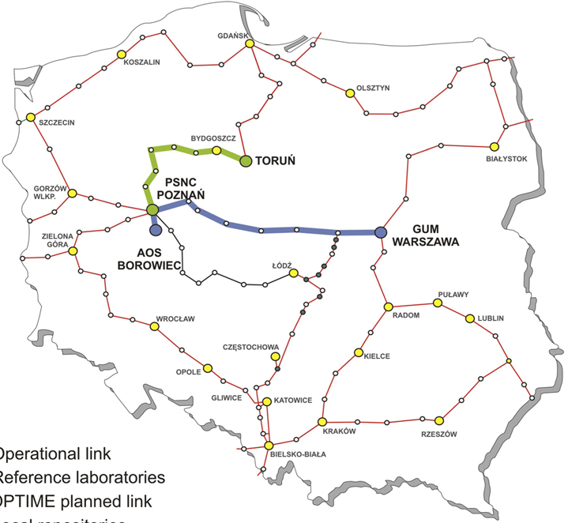
Time scale steering – remote maser reference
Results:
No degradation of short-term stability for remote maser reference as compared to the co-located reference
K. S. et al. Metrologia 55 (2018)
Notes:
Only one maser in Borowiec, but 2nd fountain 40 km away
Second test with maser at GUM in Warsaw (400 km)

Slide 19
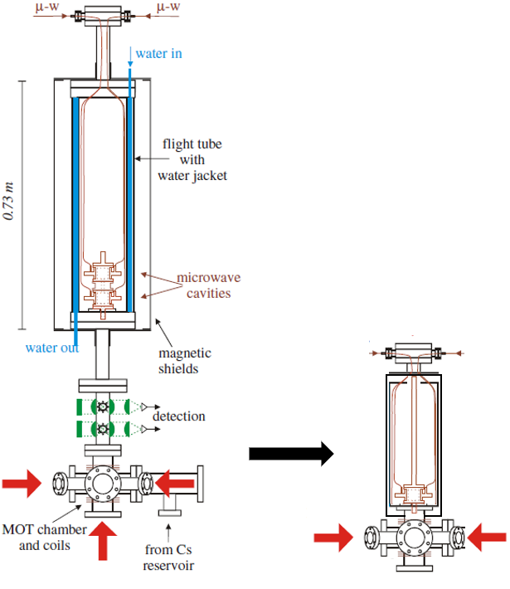
mini-fountain
Goals:
small form factor
simple and more rigid build
improved reliability (high uptime)
long-term stability/accuracy <10⁻¹⁵
short-term instability <3×10⁻¹³ (1s)
No separate detection beams and chamber
(perform detection with MOT beams)
Quartz LO → required detection SNR ≥ 600
No state-selection cavity
Reduced and simplified magnetic shielding
→ Ramsey cavity close to MOT
Fountain height preserved (above cavity)
Simpler optical bench – all in-fibre optics
Rb⁸⁷ – collisional shift easier to manage
– simpler Zeeman structure
Notes:
Cold atom clock as holdover clock, especially if run continuously

Slide 20
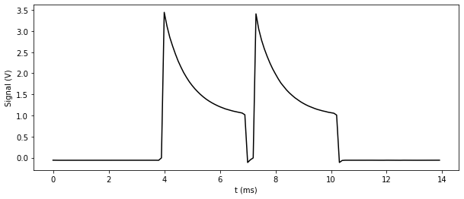
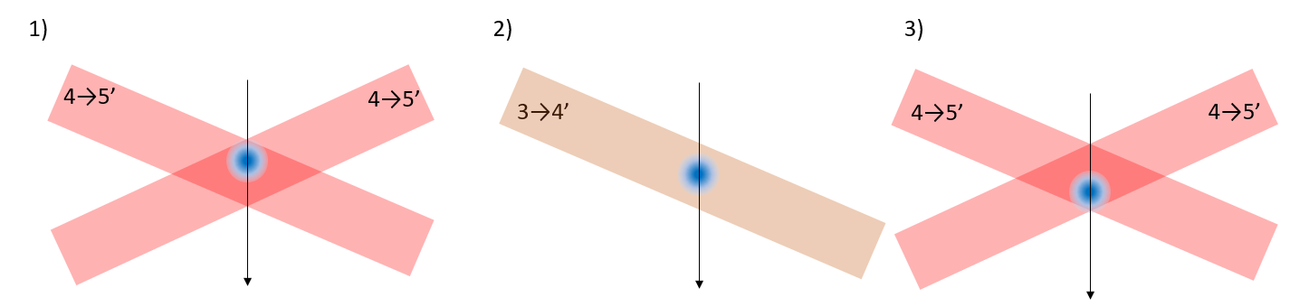
mini-fountain – detection method
Exponential decay due to pumping into F=3 by off-resonant excitation of F=4→F’=4 transition
R = N₄ / N_{total}
N₄ signal
N_{total} signal
Normalised detection with MOT beams (get signals for F=3 and F=4)
Large beam size → large fraction of atom cloud within the beams for several ms
Two separate light pulses with repump between to get N₄ and N_{total}; R = N₄/N_{total}
Background
(1)
cooling beams ON
repump OFF
fluorescence signal N₄.
(2)
cooling beams OFF
repump ON (short pulse)
all atoms back into F=4.
(3)
cooling beams ON
repump OFF (or ON
fluorescence signal N_{total}
Notes:
Detection like ‘release-recapture’ – large beams capture most of the cloud
Normalisation thanks to the second pulse after/with repump

Slide 21
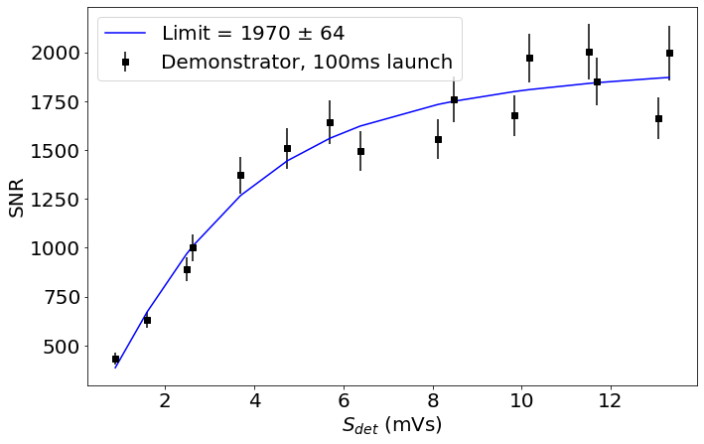
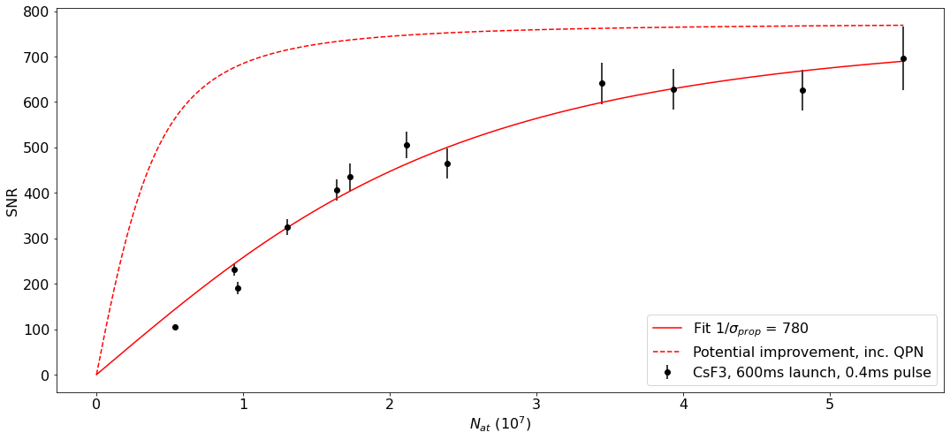
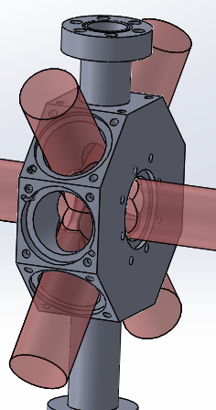
mini-fountain – detection method
N₄ signal
N_{total} signal
Background
Demo with short 100 ms launch time (0.5 m/s initial speed, 12 mm height)
Test in CsF3 (‘full size’ fountain, 600 ms)
Background from light scattered from chamber and thermal vapour
Background measured with the third pulse and subtracted
→ expect SNR > 700
(limited by technical + background noise)
Notes:
Demonstrator set-up cobbled together with an old chamber, in Cs
Further tests in CsaF3 (our experimental fountain)

Slide 22
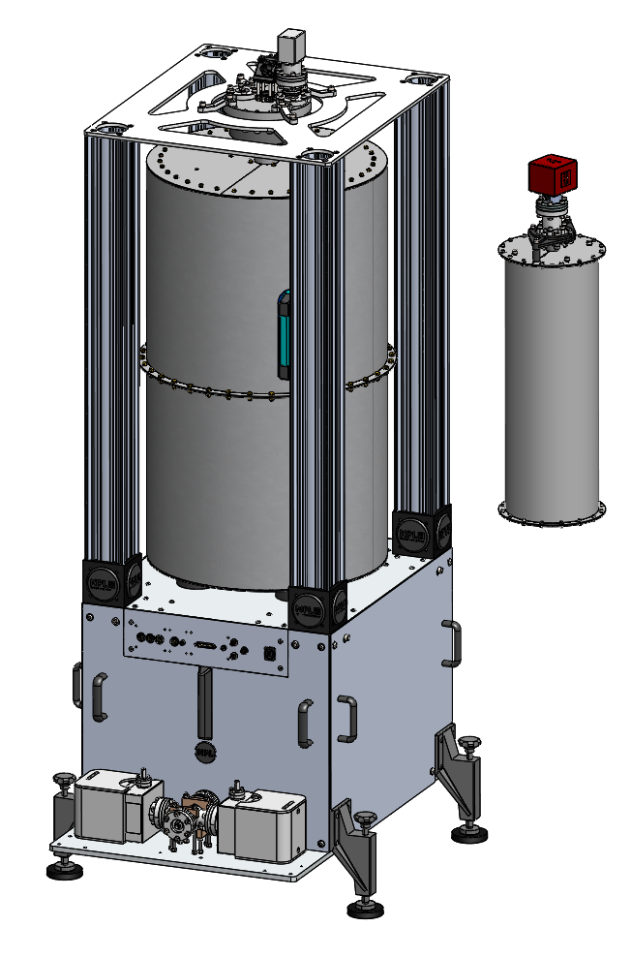
mini-fountain – physics package
Focus on long-term stability
(accuracy evaluation optional)
2nd order Zeeman: two layers of magnetic shielding
BBR: temperature stability to 1-2 K radiation from hot Rb dispensers
Cavity pulling: aim for cavity Q ≈ 5000
DCP: no independent feeds for bal./imbal. shift contained to low 10⁻¹⁶
20 × smaller in volume
Entire system in half size 19’’ rack
Tests of new detection SNR
Prototype physics package designed
Assembly underway
Fibre coupled optics (COTS) procured and tested

Slide 23
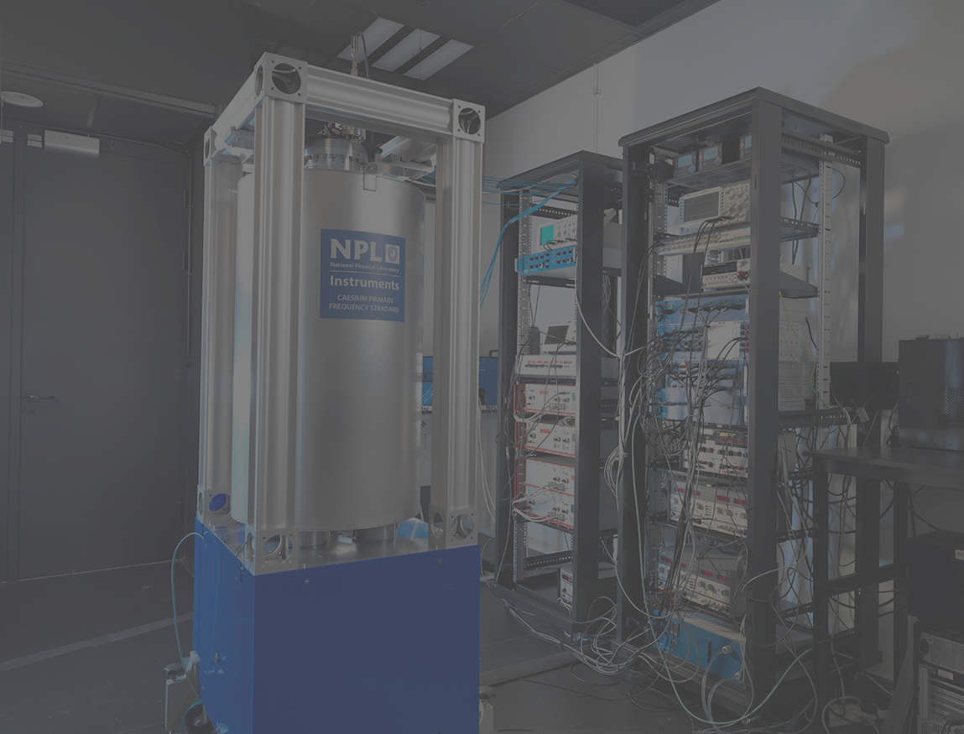
Summary
(relatively simple) NPL concept of Cs fountain clock:
- single stage MOT, optical pumping to m_{F}=0
- collisional shift cancellation → accuracy <2×10⁻¹⁶
- QPN limited stability
Robust design meeting engineering standards
- several units built for other NMIs and labs
- high uptime, weeks of uninterrupted operation
Applications to time scale steering
- ‘fountain as a clock’
- prospects of using CSO as flywheel
mini-fountain
- new detection scheme
- 20x smaller physics package (volume)
- expected performance comparable to a ‘full scale’ fountain

Slide 24
Acknowledgements
Rich Hendricks, Josh Whale, (NPL)
Andrew Wilson, Sam Walby,
Kathryn Burrows
Kurt Gibble (Penn State)
Chris Foot (Oxford)
Piotr Dunst, Bartlomiej Nagorny, (AOS, Borowiec)
Jerzy Nawrocki
Scott Beattie, Bin Jian (NRC, Ottawa)
Stefan Eriksson, Janko Nauta, (Alpha/CERN)
Edward Thorpe-Woods

