Slide 1
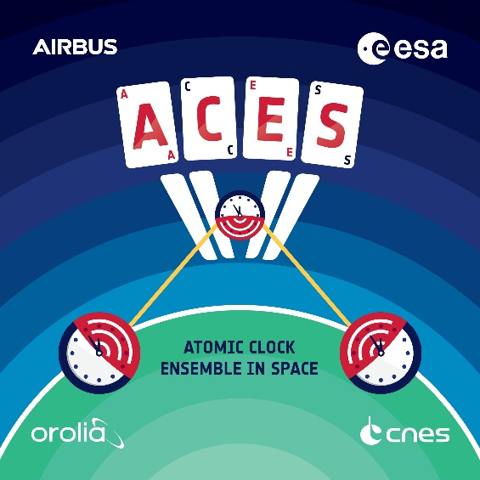
Atomic Clock Ensemble in Space
Luigi Cacciapuoti
9th Symposium on Frequency Standards and Metrology
Kingscliff – Australia
16-20 October 2023

Slide 2
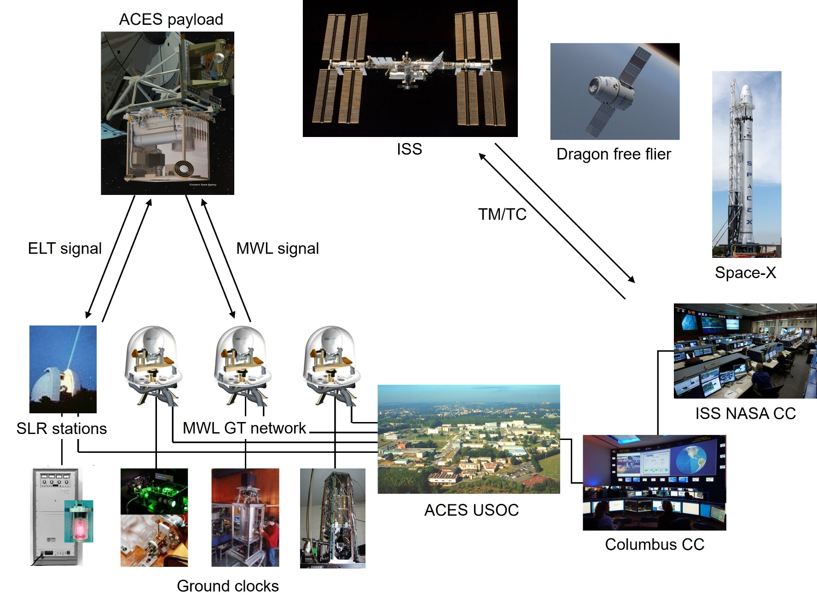
ACES mission concept

Slide 3
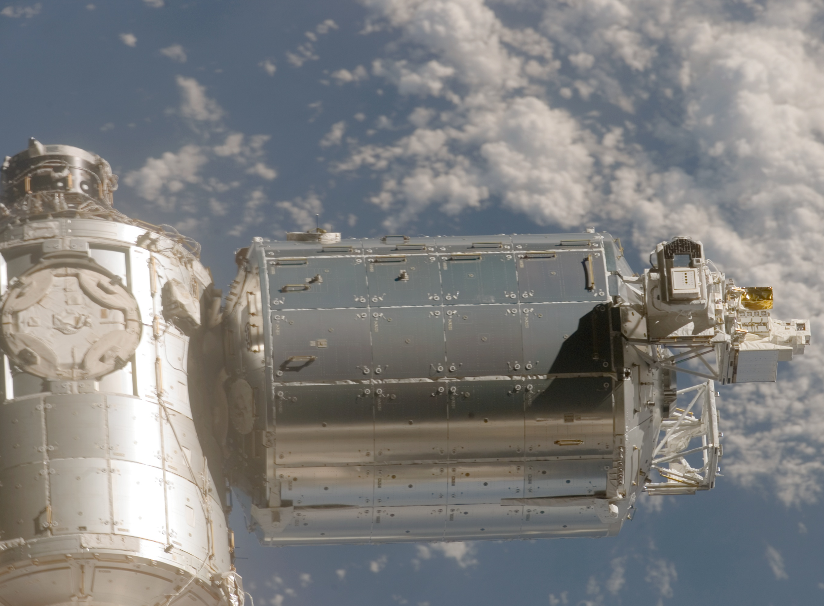
The Columbus module

Slide 4
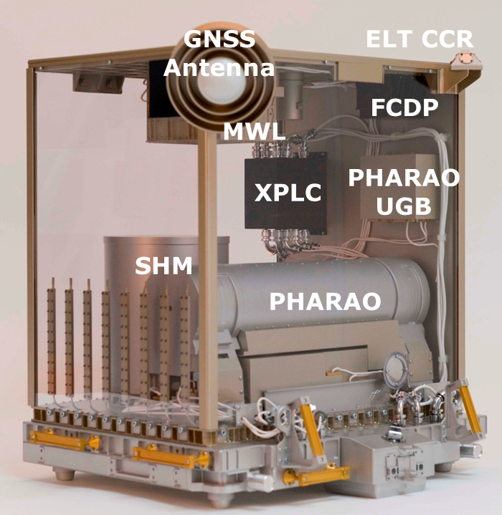
The ACES payload
PHARAO (CNES): Atomic clock based on laser cooled Cs atoms
SHM: Active hydrogen maser
FCDP: Clocks comparison and distribution
MWL : T&F transfer link
GNSS receiver
ELT: Optical link
Support subsystems
  XPLC: External PL computer
  PDU: Power distribution unit,
  Mechanical, thermal subsystems
  CEPA: Columbus External PL Adapter
Volume: 1172x867x1246 mm³
Mass: 240 kg (w/o CEPA)
Power: 600 W

Slide 5
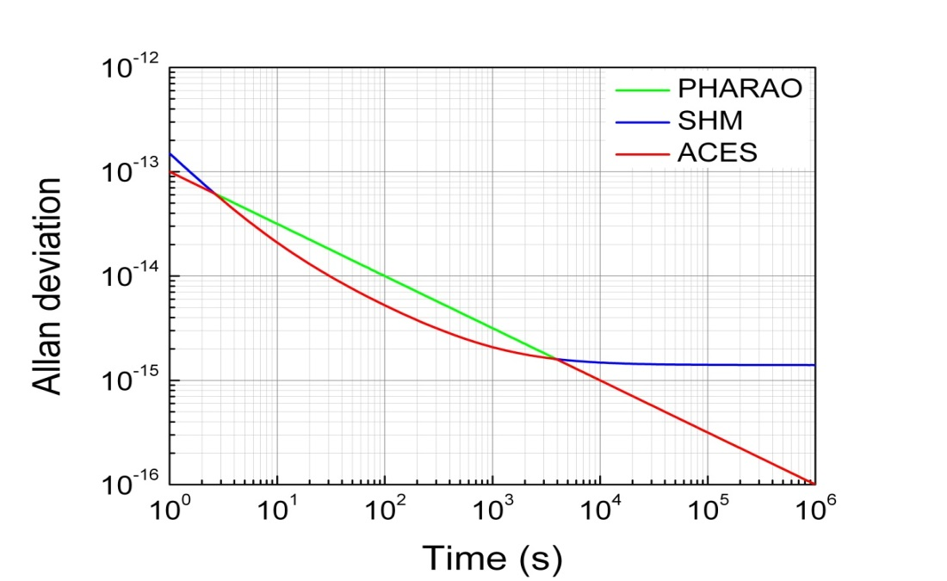
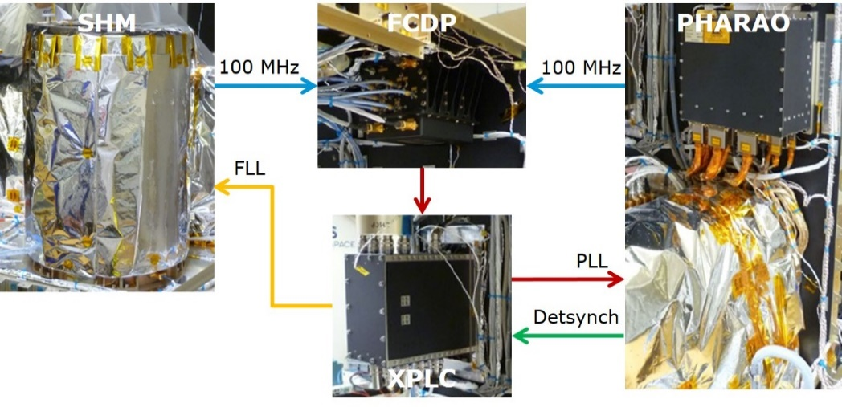
The ACES clock signal
PHARAO accuracy ~1⋅10⁻¹⁶
The ACES clock signal (red curve) combines the good short-to-medium term frequency stability of the active H-maser SHM with the long-term stability and accuracy of the Cs clock PHARAO.
Two servo-loops control the clocks with two different time constants: the short-term servo-loop (PLL) steers PHARAO local oscillator on SHM (1-2 s time constant); the long-term servo-loop (FLL) corrects SHM against long term drifts (100-500 s time constant).

Slide 6
PHARAO and ACES stability
PHARAO stability in autonomous mode
ACES stability with STSL and LTSL closed and in the presence of magnetic and thermal perturbations

Slide 7
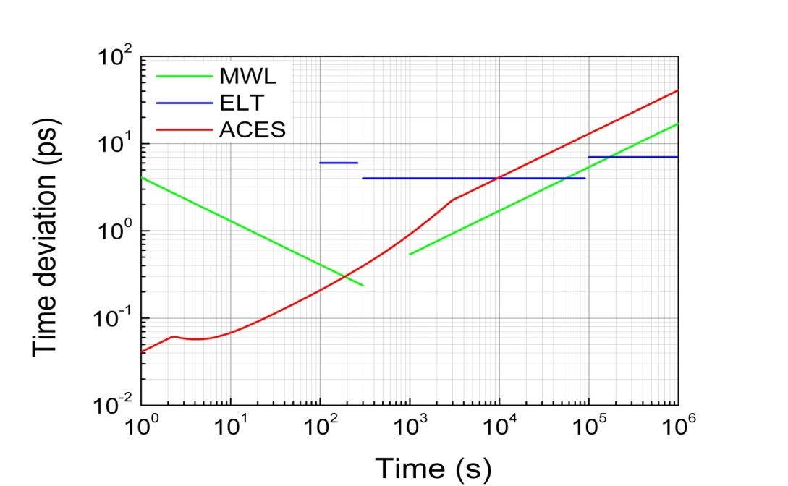
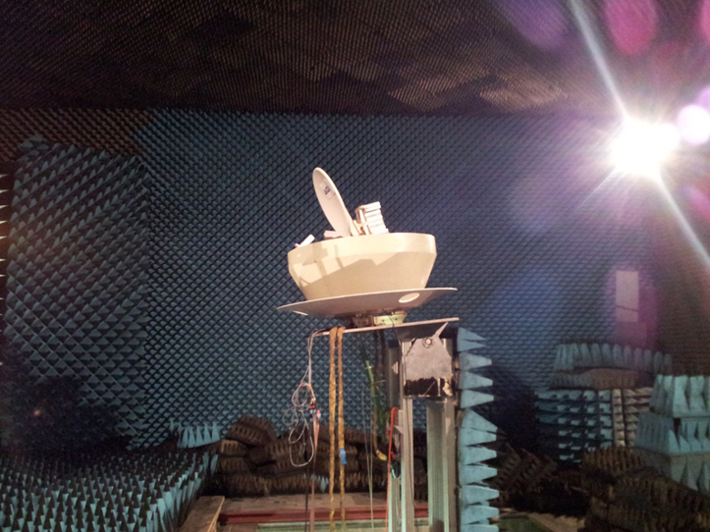
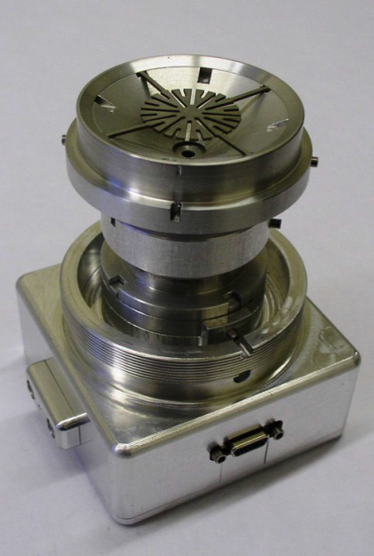
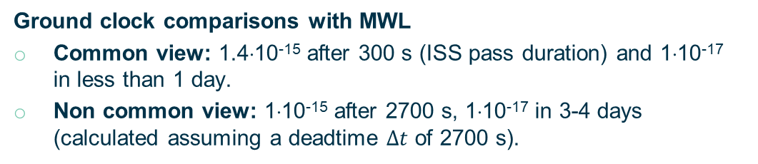
ACES time & frequency links
MWL ground terminal
ELT detector
Ground clock comparisons with MWL
Common view: 1.4⋅10⁻¹⁵ after 300 s (ISS pass duration) and 1⋅10⁻¹⁷ in less than 1 day.
Non common view: 1⋅10⁻¹⁵ after 2700 s, 1⋅10⁻¹⁷ in 3-4 days (calculated assuming a deadtime $∆t$ of 2700 s).

Slide 8
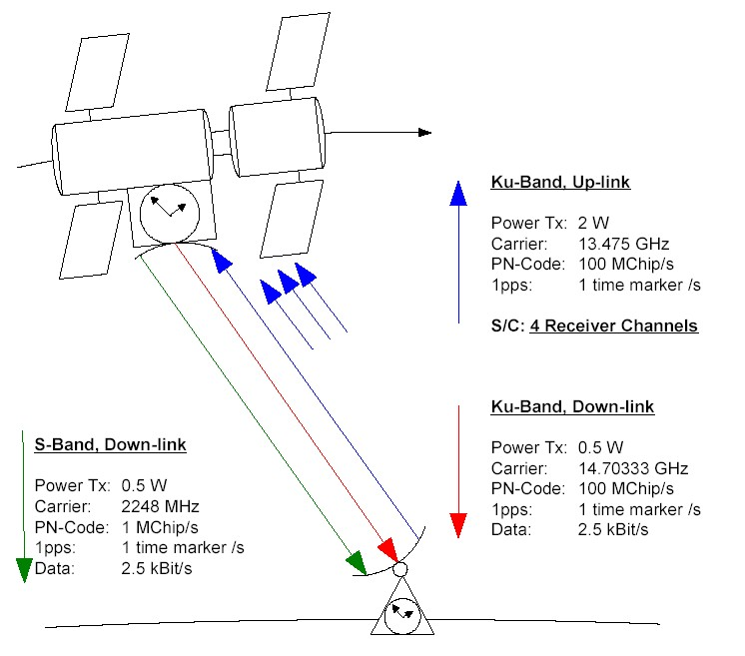


MWL
Two-way link:
    Removal of the troposphere time delay (8.3-103 ns)
    Removal of 1st order Doppler effect
    Removal of instrumental delays and common mode effects
Additional down-link in the S-band:
    Determination of the ionosphere TEC
    Correction of the ionosphere time delay (0.3-40 ns in S-band, 6-810 ps in Ku-band)
Phase PN code modulation: Removal of 2π phase ambiguity
High chip rate (100 MChip/s) on the code:
    Higher resolution
    Multipath suppression
Carrier and code phase measurements (80 ms sampling time)
Data link: 2 kBits/s on the S-band down-link to obtain clock comparison results in real time
Up to 4 simultaneous space-to-ground clock comparisons

Slide 9
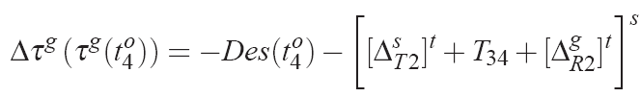
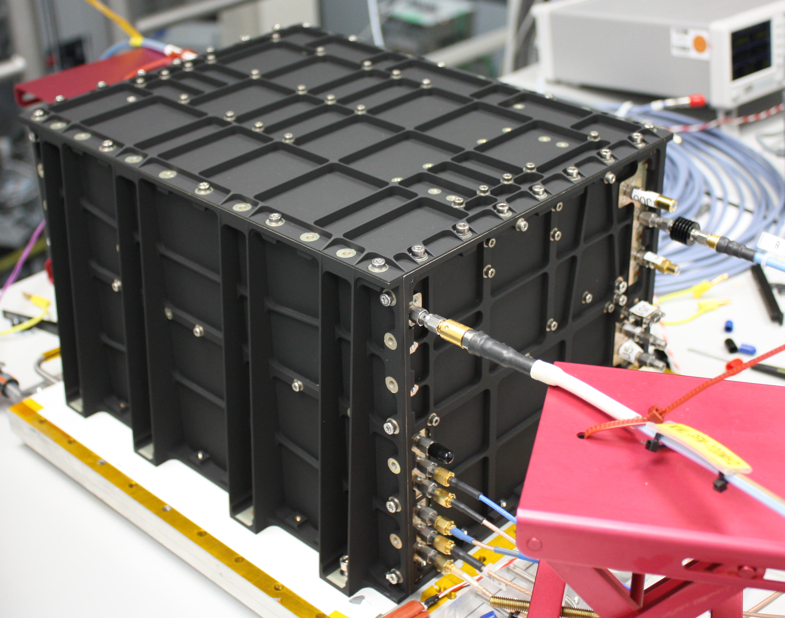

MWL measurements and scientific products
Code and carrier phase measurements on Ku-band up/down-link
and S-band down-link
where
Scientific Products |  | …from
Space-to-ground Desynchronization
Ionosphere Total Electron Content
Range + Tropospheric Delay | &

Slide 10
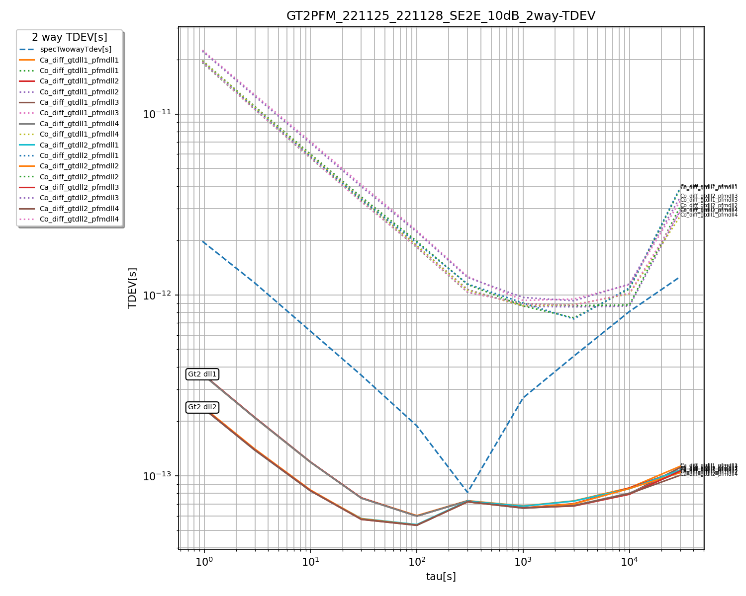
MWL PFM performance - Static
MWL Time deviation [s]: 2-way combination of common clock measurements under static conditions (no signal dynamics)

Slide 11
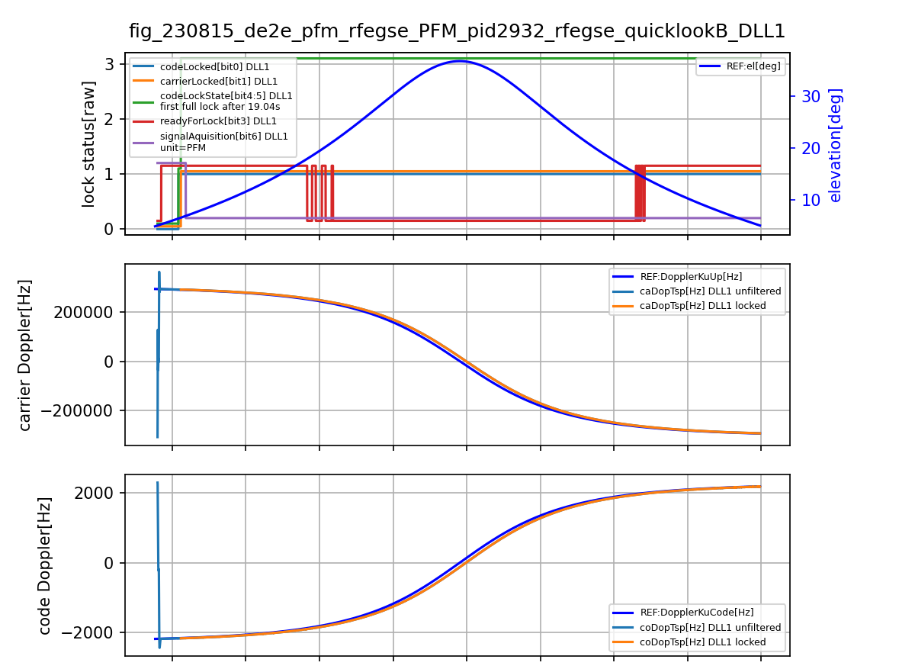
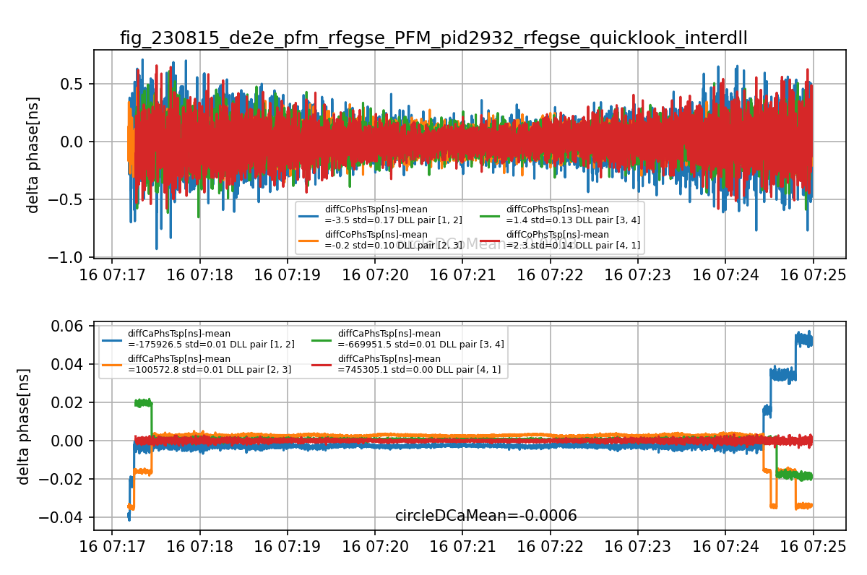
MWL PFM performance – Signal dynamics
4 DLLs simultaneously tracking the same signal
DLLx – DLLy code and carrier phase

Slide 12
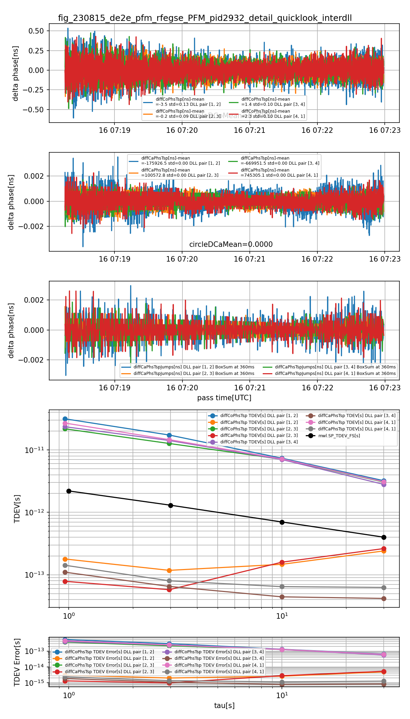
MWL PFM performance – Signal dynamics
DLLx – DLLy code and carrier phase data after removing data containing carrier cycle slips
Time Deviation [s] of DLLx – DLLy code and carrier phase data

Slide 13
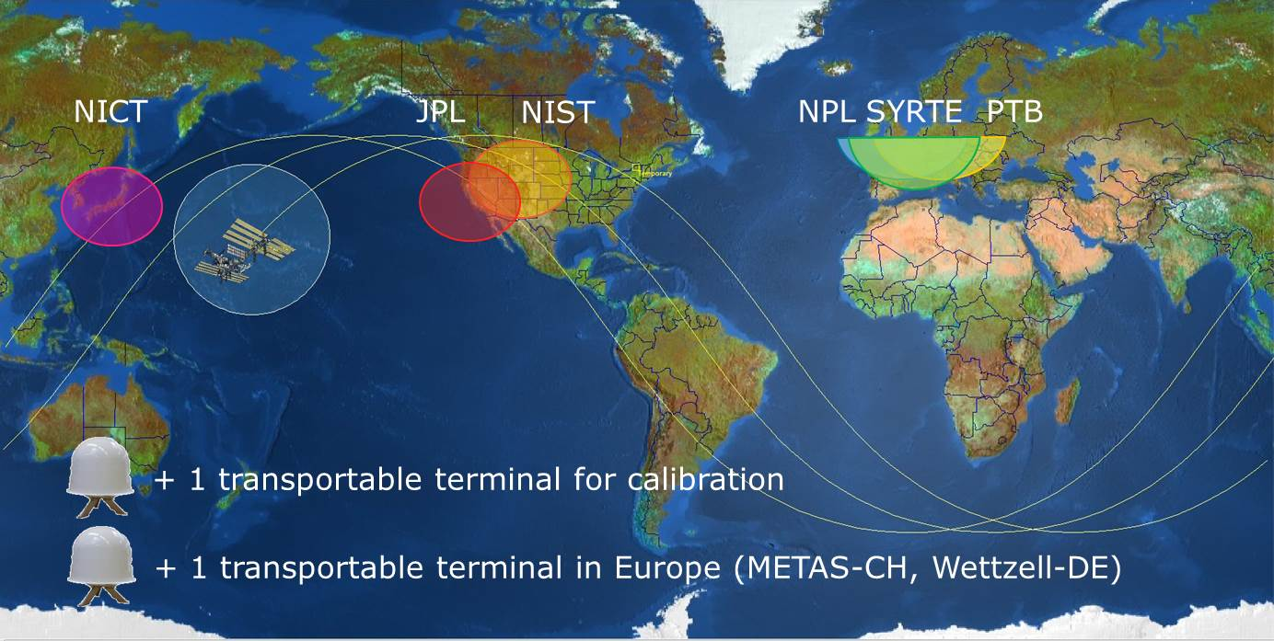
ACES MWL network

Slide 14
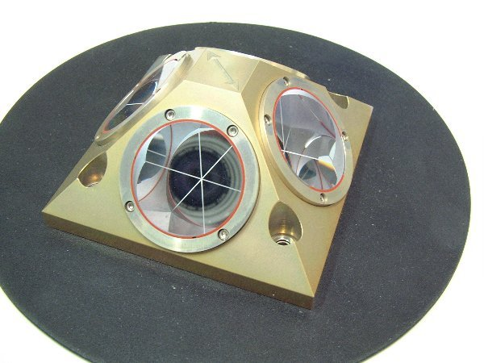
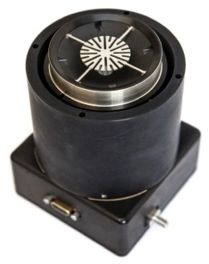
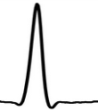
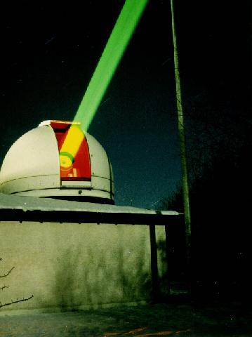



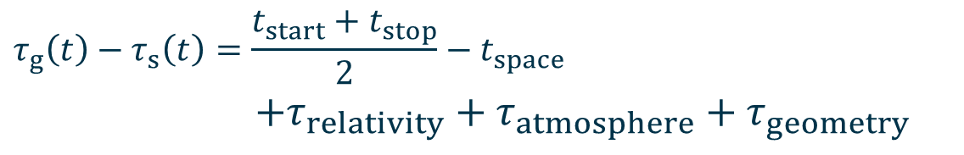


European Laser Timing (ELT)
TM/TC
ACES
Power
$$t_{space}$$
ACES Time Scale
(MWL)
$$t_{stop}$$
$$t_{start}$$
$$τ_{g}\left(t\right)−τ_{s}\left(t\right)=\frac{t_{start}+t_{stop}}{2}−t_{space}$$
$$+τ_{relativity}+τ_{atmosphere}+τ_{geometry}$$
Detector package
500 grams
0.6 Watt
CTU Prague

Slide 15
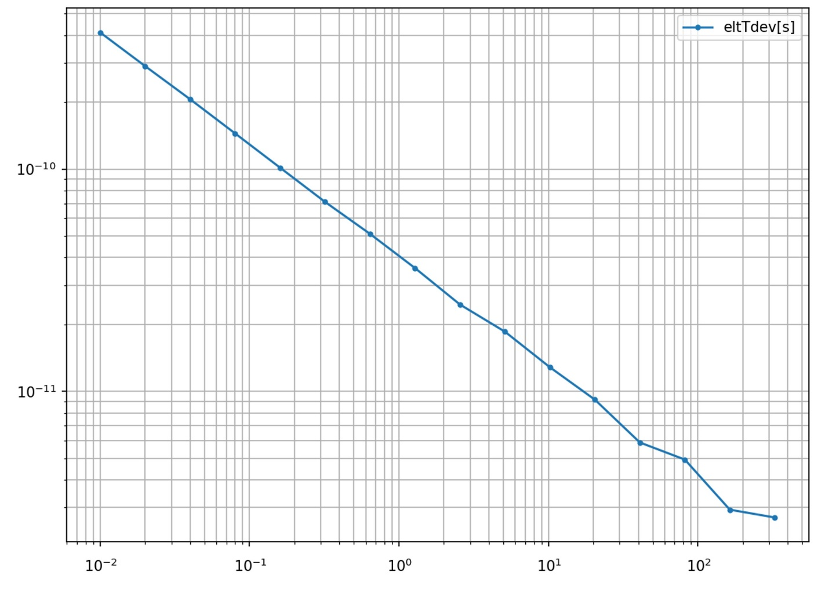
ELT performance - Preliminary
ELT detector package tested from -55°C to +60°C: K_{T}=1 ps/K
ELT Time Stability [s]: dark counts detection events vs NPET time tagging measurements at 100 Hz gate rate
ELT Calibration Campaign at Graz SLR (1 yr)

Slide 16
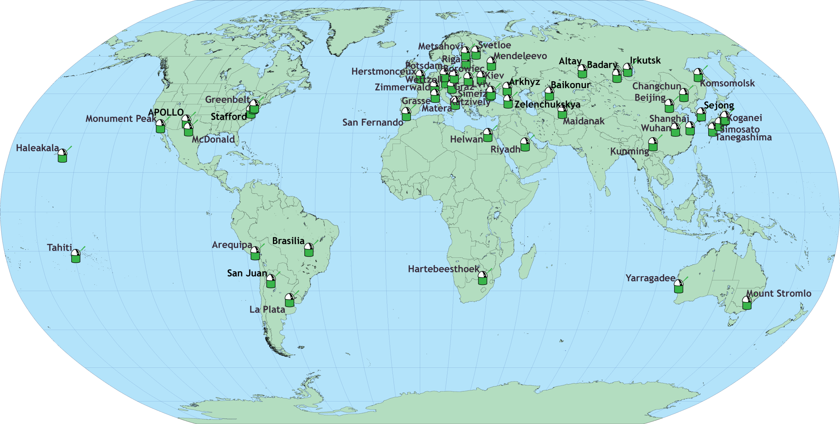
ILRS network of SLR stations
ACES as official ILRS target: Wettzell (primary station), Graz, Herstmonceaux, Potsdam, and Zimmerwald SLR stations already calibrated; other stations can join provided they comply with ISS safety requirements.

Slide 17
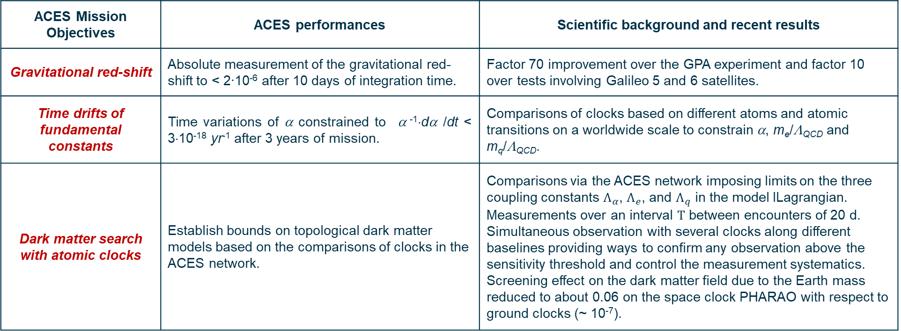
ACES – Fundamental Physics tests
ACES Mission Objectives | ACES performances | Scientific background and recent results
Gravitational red-shift | Absolute measurement of the gravitational red-shift to < 2∙10⁻⁶ after 10 days of integration time. | Factor 70 improvement over the GPA experiment and factor 10 over tests involving Galileo 5 and 6 satellites.
Time drifts of fundamental constants | Time variations of α constrained to α ⁻¹⋅dα /dt < 3⋅10⁻¹⁸ yr⁻¹ after 3 years of mission. | Comparisons of clocks based on different atoms and atomic transitions on a worldwide scale to constrain α, m_{e}/Λ_{QCD} and m_{q}/Λ_{QCD}.
Dark matter search with atomic clocks | Establish bounds on topological dark matter models based on the comparisons of clocks in the ACES network. | Comparisons via the ACES network imposing limits on the three coupling constants $Λ_{α}$, $Λ_{e}$, and $Λ_{q}$ in the model lLagrangian. Measurements over an interval $Τ$ between encounters of 20 d. Simultaneous observation with several clocks along different baselines providing ways to confirm any observation above the sensitivity threshold and control the measurement systematics. Screening effect on the dark matter field due to the Earth mass reduced to about 0.06 on the space clock PHARAO with respect to ground clocks (~ 10⁻⁷).

Slide 18
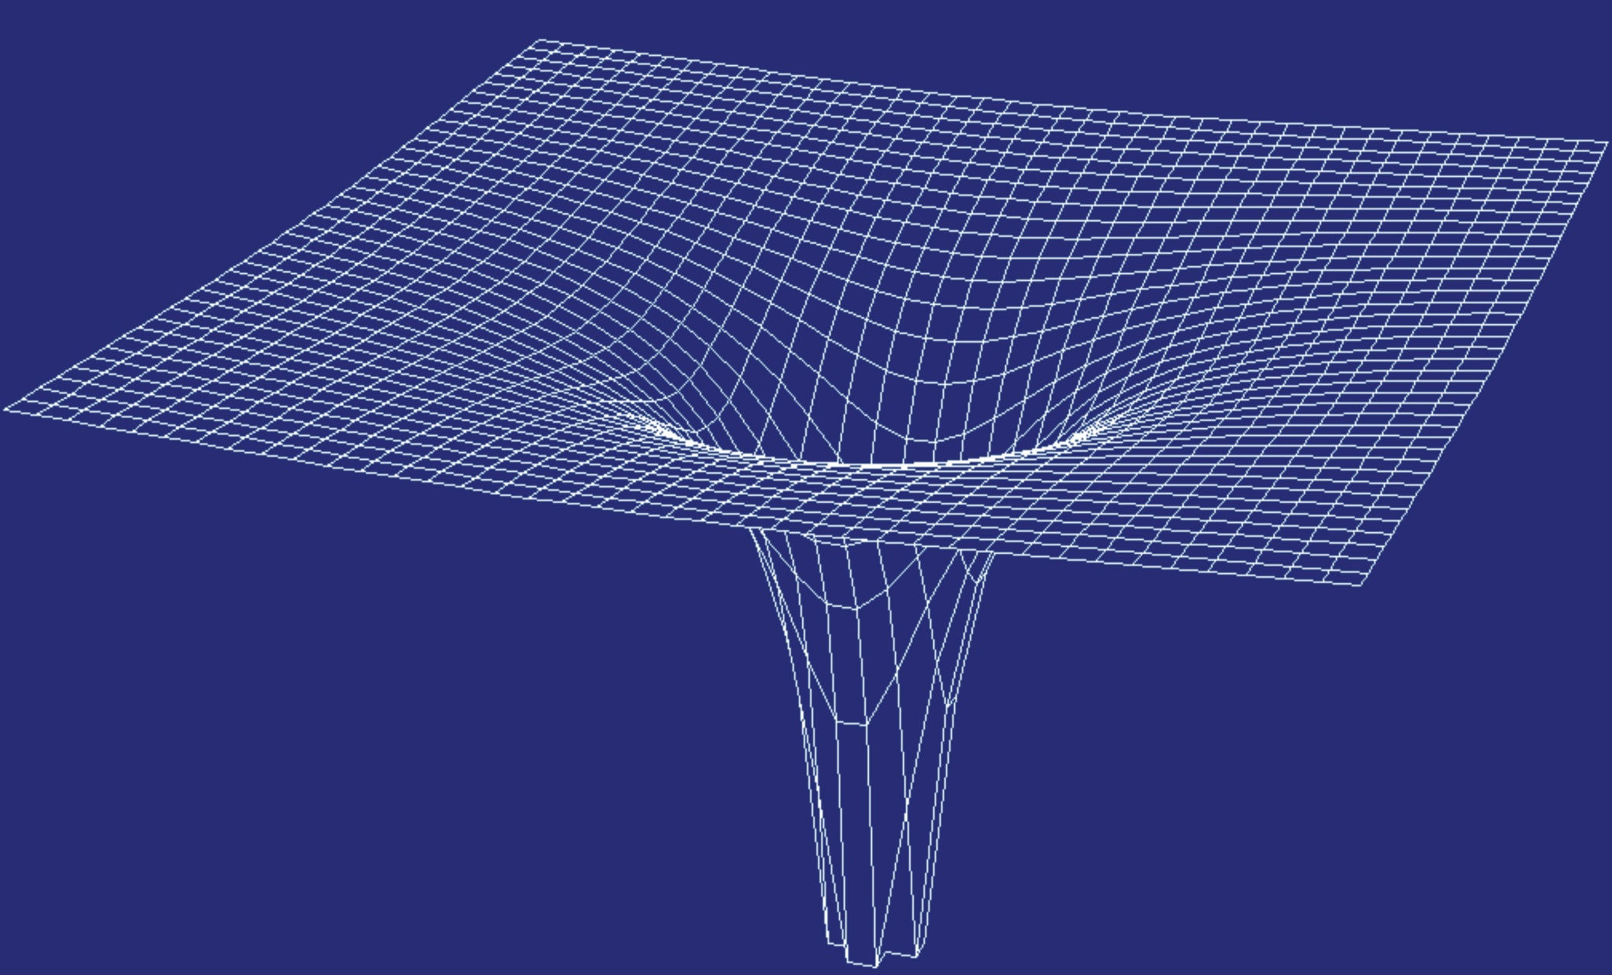
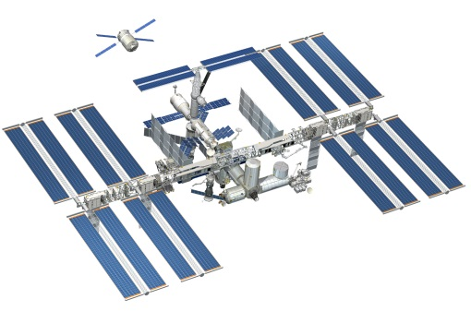
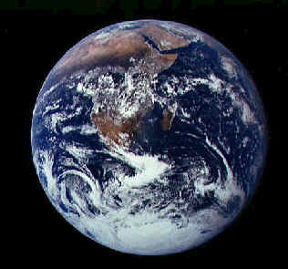


Gravitational redshift test
Frequency shifts
First order Doppler effect | 2⋅10⁻⁵
Second order Doppler effect | 3⋅10⁻¹⁰
Gravitational red-shift | 5⋅10⁻¹¹
Sagnac effect | 7⋅10⁻¹³
$$\frac{dτ_{g}}{dt}−\frac{dτ_{s}}{dt}=\frac{1}{c^{2}}\left(U\left(t,{\vec{x}}_{s} \right)−U\left(t,{\vec{x}}_{g} \right)+\frac{{v_{s}}^{2}\left(t\right)}{2}−\frac{{v_{g}}^{2}\left(t\right)}{2}\right)+O\left(\frac{1}{c^{4}}\right)$$

Slide 19
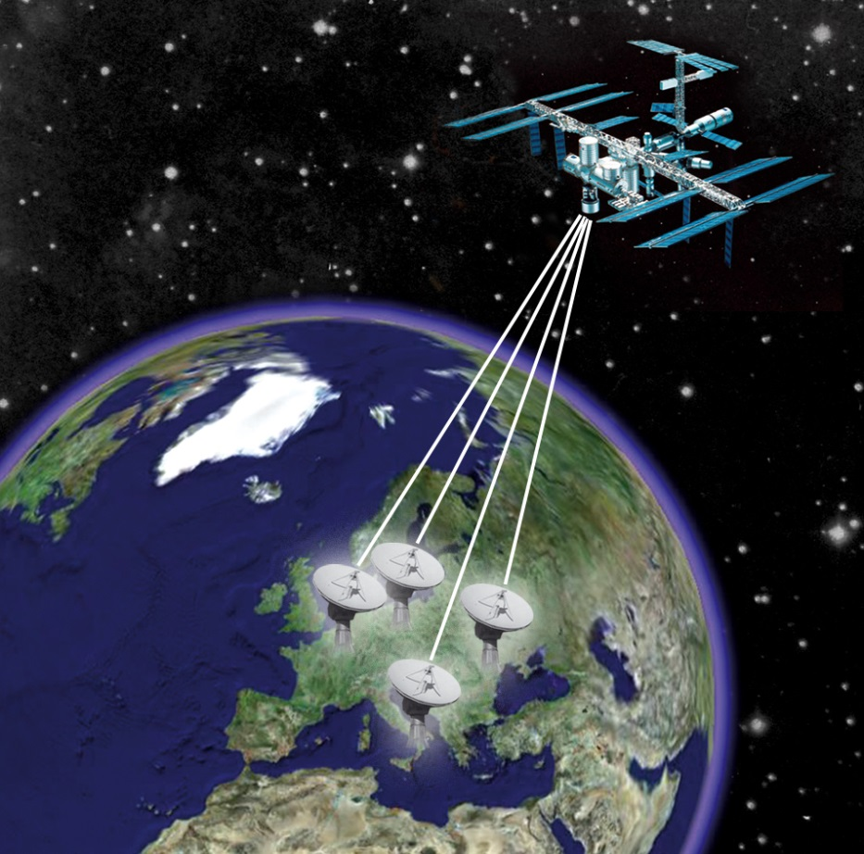
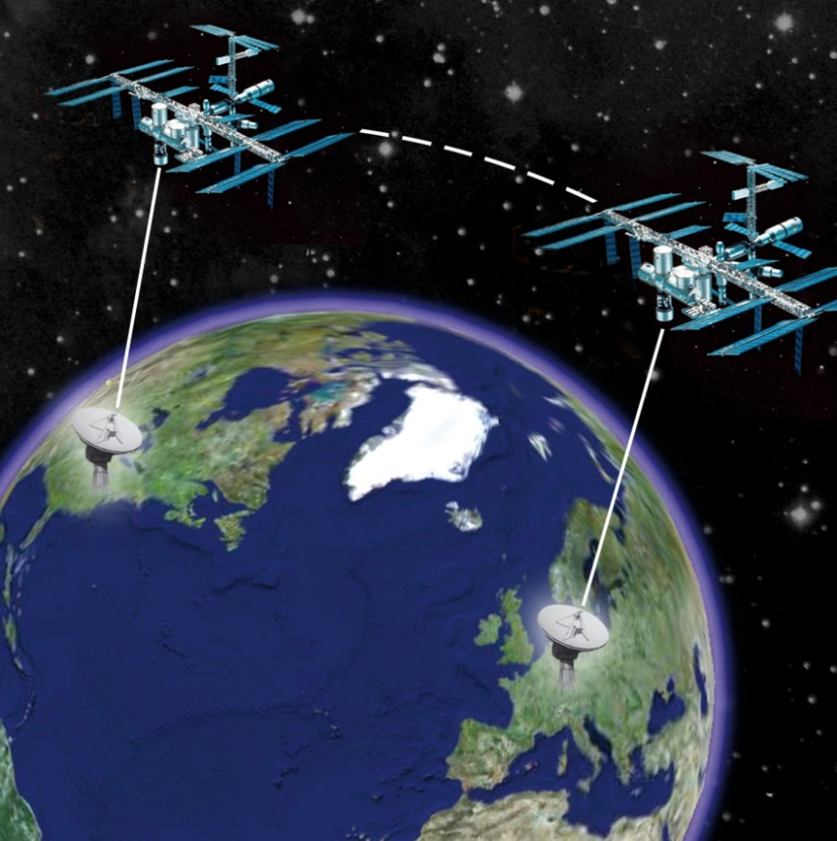
A network of atomic clocks to test fundamental physics
ACES as a relay satellite to transfer time and frequency on a worldwide scale.
Comparisons of ground clocks (microwave and optical) to better than 1⋅10⁻¹⁷.

Slide 20








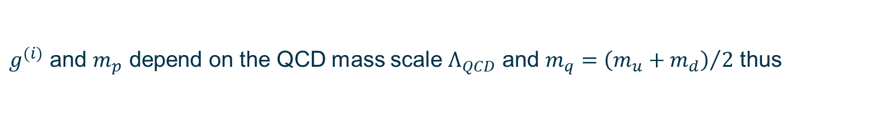
Time variations of fundamental constants
Frequency of hyperfine transitions:
Frequency of electronic transitions:
Ratios between atomic frequencies:
$g^{(i)}$ and $m_{p}$ depend on the QCD mass scale $Λ_{QCD}$ and $m_{q}={\left(m_{u}+m_{d}\right)}/2$ thus
hyperfine transitions
electronic transitions
vibrational transitions
V.V. Flambaum, Laser Spectroscopy, pp. 49-57 (2004)
V.V. Flambaum et al., Phys. Rev. D 69, 115006 (2004)

Slide 21
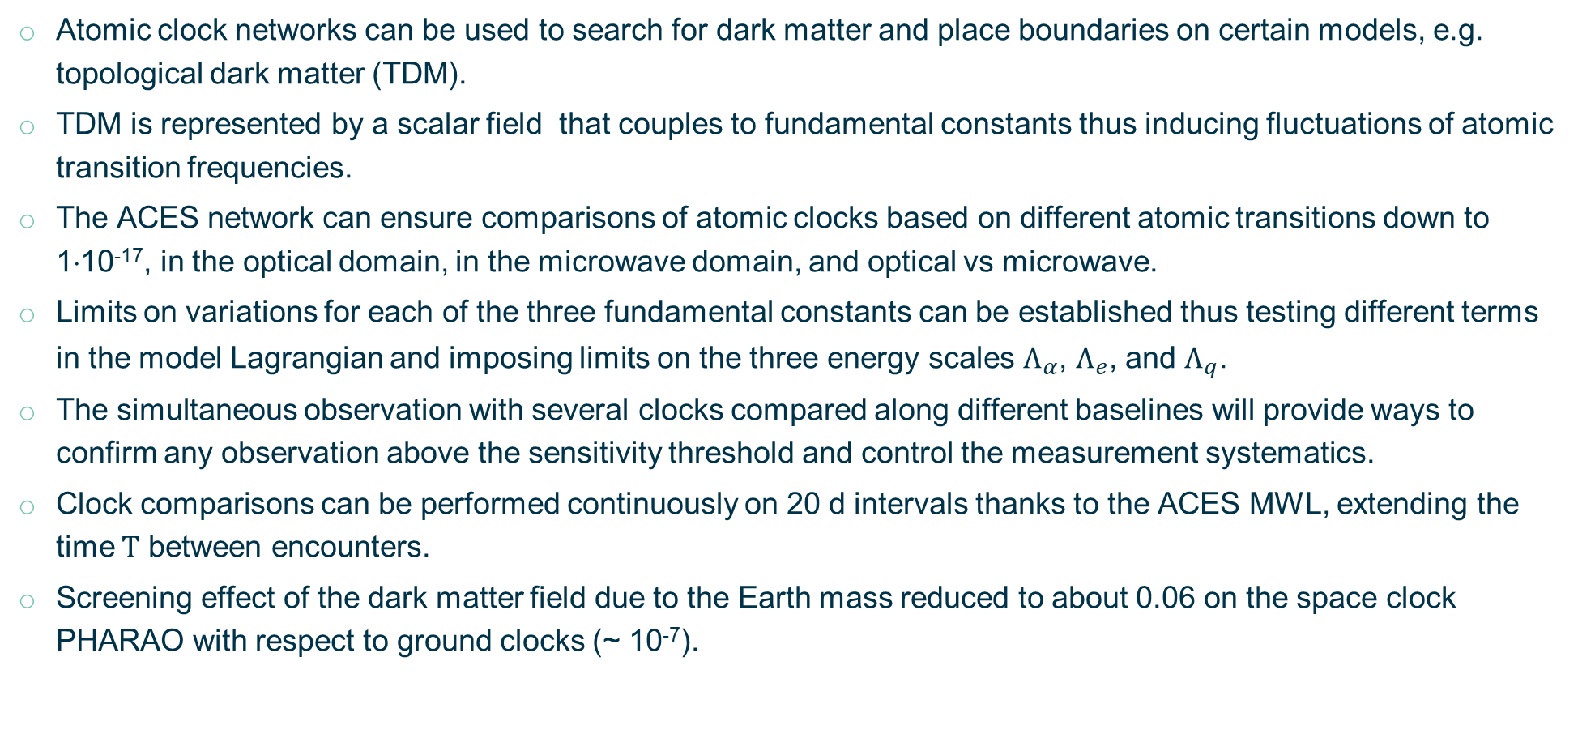
Dark matter search
Atomic clock networks can be used to search for dark matter and place boundaries on certain models, e.g. topological dark matter (TDM).
TDM is represented by a scalar field that couples to fundamental constants thus inducing fluctuations of atomic transition frequencies.
The ACES network can ensure comparisons of atomic clocks based on different atomic transitions down to 1⋅10⁻¹⁷, in the optical domain, in the microwave domain, and optical vs microwave.
Limits on variations for each of the three fundamental constants can be established thus testing different terms in the model Lagrangian and imposing limits on the three energy scales $Λ_{α}$, $Λ_{e}$, and $Λ_{q}$.
The simultaneous observation with several clocks compared along different baselines will provide ways to confirm any observation above the sensitivity threshold and control the measurement systematics.
Clock comparisons can be performed continuously on 20 d intervals thanks to the ACES MWL, extending the time $Τ$ between encounters.
Screening effect of the dark matter field due to the Earth mass reduced to about 0.06 on the space clock PHARAO with respect to ground clocks (~ 10⁻⁷).

Slide 22
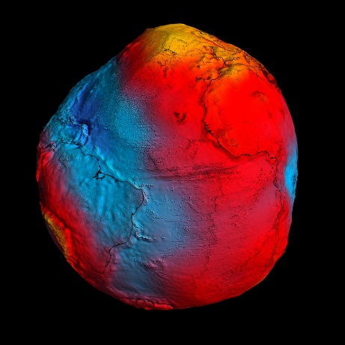
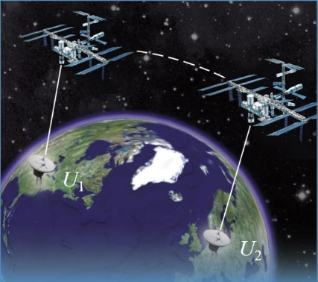
ACES – Scientific applications
Relativistic geodesy
Relativistic geodesy: mapping of the Earth gravitational potential based on the red-shift measured between two clocks at two different locations.
ACES intercontinental comparisons of optical clocks at the 10⁻¹⁷ level after 4 days, corresponding to a resolution on the local height above the geoid at the 10 cm level.
The global coverage offered by ACES will complement the results of the CHAMP, GRACE, and GOCE missions.
Clocks synchronization
MWL and ELT clocks synchronization at the 100 ps and 50 ps level, respectively.
Atomic time scales (TAI)
The PHARAO clock is accurate to 1-2⋅10⁻¹⁶.
MWL will provide means to compare atomic clocks on a worldwide scale:
  PHARAO and primary standards on ground contributing to TAI.
  Optical clock comparisons to 1⋅10⁻¹⁷ will help SI second redefinition.

Slide 23
Way-forward to the ACES launch
A first run of the ACES Integrated System Tests (IST) tests has been completed. They included:
  ACES servo-loops performance
  ACES clock signal performance evaluation
  Sensitivity under temperature and magnetic field variations
IST revealed a major anomaly: SHM getters had reached end-of-life and needed replacement.
Acceptance status of ACES:
  PHARAO clock PFM, ELT detector package, ACES GNSS system and FCDP PFM are integrated.
  SHM PFM getters have been replaced and acceptance tests completed. SHM is now integrated in the ACES payload.
  MWL PFM is completing qualification tests before final acceptance (by end 2023).
  ACES payload performance tests planned for summer 2024.
ACES PFM delivered for launch on SpaceX in end 2024 – beginning 2025.
MWL GTs deployment will start in mid 2024 (SYRTE, PTB and Wettzell); the other institutes will follow.

Slide 24









L. Cacciapuoti¹, M. Armano¹, R. Jansen¹, R. Much¹, S. Weinberg¹, P. Crescence², A. Helm², J. Kehrer², S. Koller², R. Lachaud², T. Niedermaier², F.X. Esnault³, D. Massonnet³, J. Pittet⁴, P. Rochat⁴, S. Liu⁵, W. Schaefer⁵, T. Schwall⁵, I. Prochazka⁶, A. Schlicht⁷, U. Schreiber⁷, P. Delva⁸, P. Laurent⁸, M. Lilley⁸, P. Wolf⁸, C. Salomon⁹
¹European Space Agency, ESTEC, Noordwijk, The Netherlands
²Airbus Defence and Space, Friedrichshafen, Germany
³CNES, Toulouse, France
⁴Orolia Switzerland (Spectratime), Neuchˆatel, Switzerland
⁵Timetech, Stuttgart, Germany
⁶Czech Technical University in Prague, Prague, Czech Republic
⁷Technical University of Munich, Munich, Germany
⁸SYRTE, Observatoire de Paris-PSL, CNRS, Sorbonne Université, LNE, Paris, France
⁹Laboratoire Kastler Brossel, ENS, Paris, France

