Slide 1
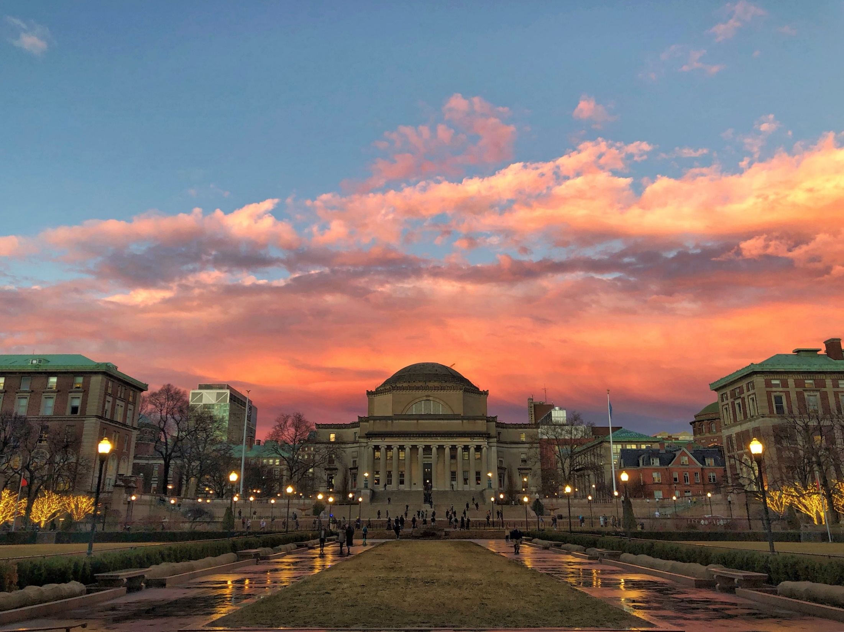

Vibrational Molecular Lattice Clock
Tanya Zelevinsky
Columbia University, New York

Slide 2
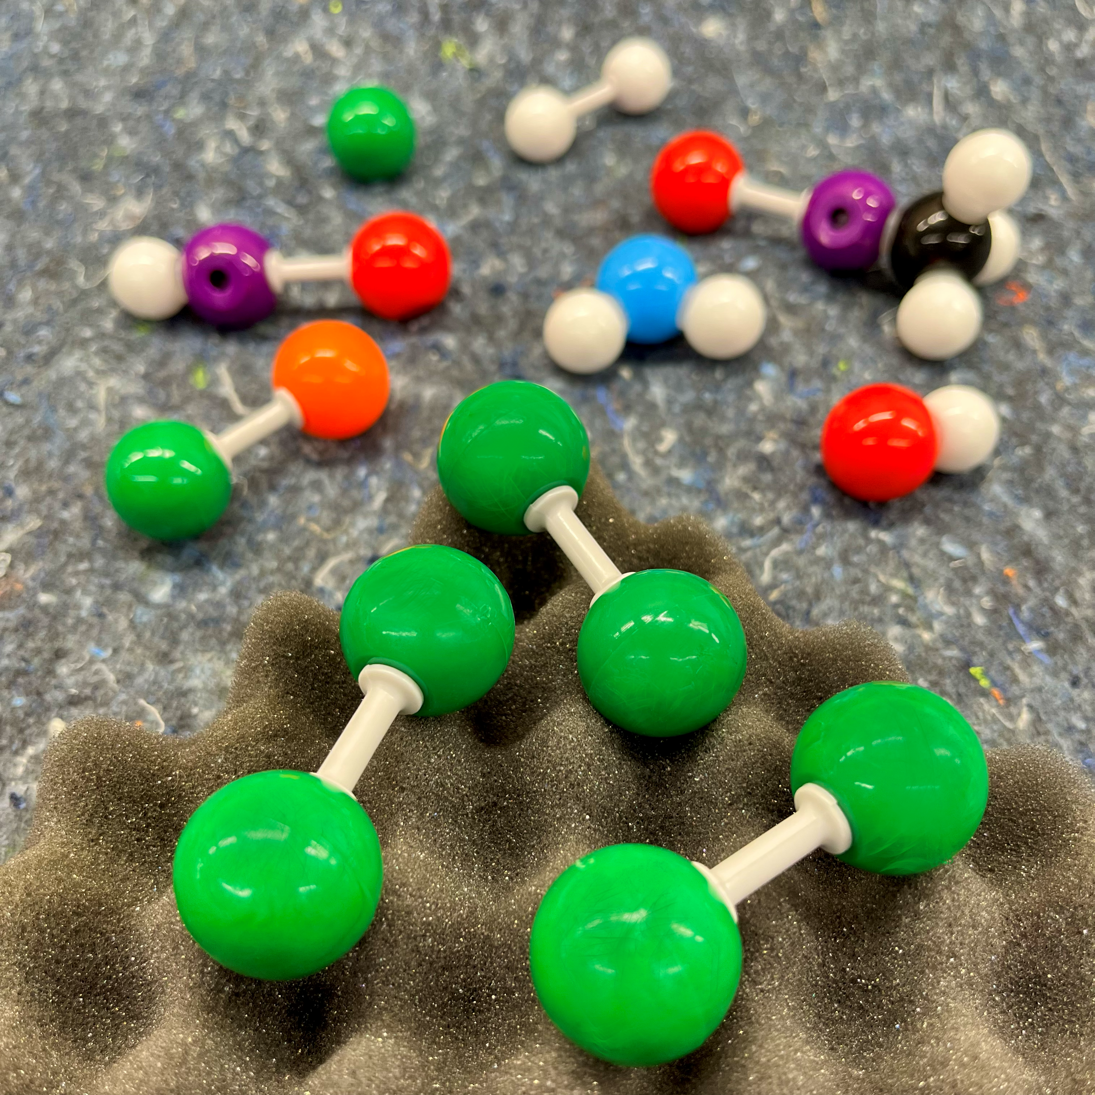
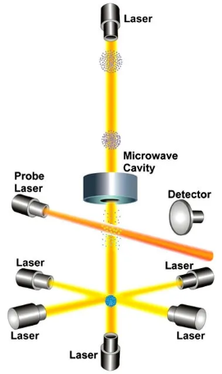
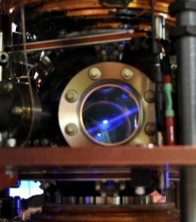
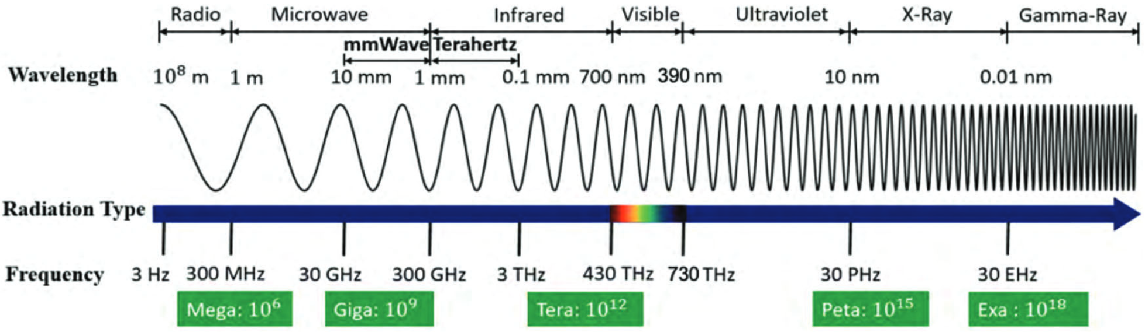
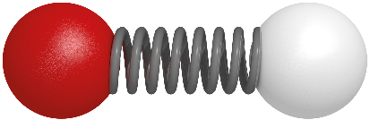
Metrology with molecules
Atomic
hyperfine
Atomic
optical
Molecular
ro-vibrational
(simple dynamics!)
nanowerk.com

Slide 3
Metrology with molecules
Molecular clocks:
Limits of precision and coherence with molecular states
Metrology with atoms & molecules
Precise measurements of fundamental phenomena
New level of precision for molecular physics and QED
Coherence in optical traps for clocks, qubits, quantum chemistry

Slide 4
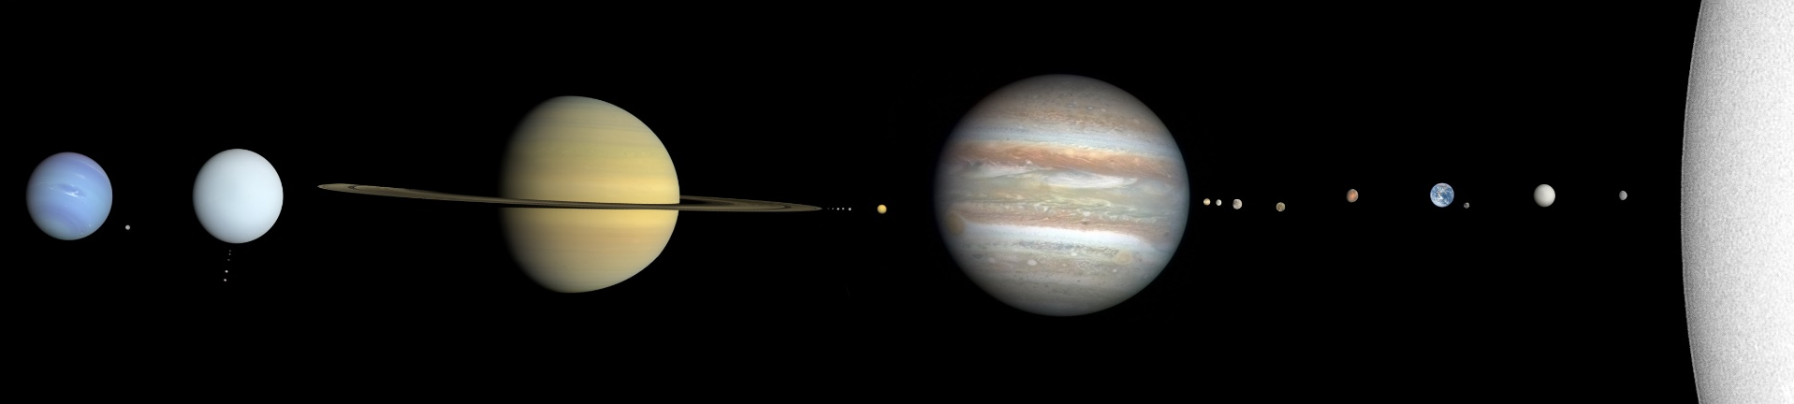
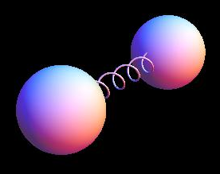
Science with molecular clocks
Newtonian gravity at large scales: Well-understood
1 mm –… galactic size
wikimedia.org
Gravity at nanometer scales: Nearly unknown
0.5 - 5 nm

Slide 5
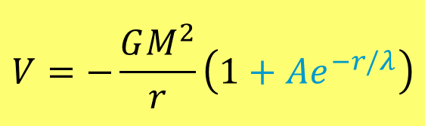
Science with molecular clocks
Nanoscale mass-dependent forces
0.5 - 5 nm
$$V=−\frac{GM^{2}}{r}\left(1+{Ae}^{−r/λ}\right)$$
Hypothetical
“Yukawa” correction

Slide 6
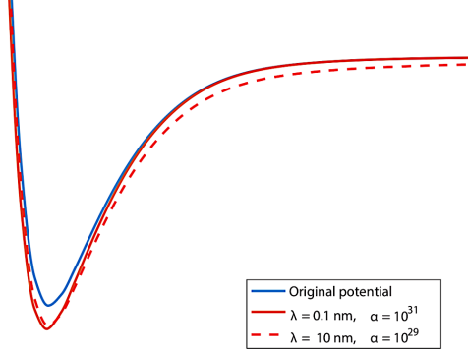
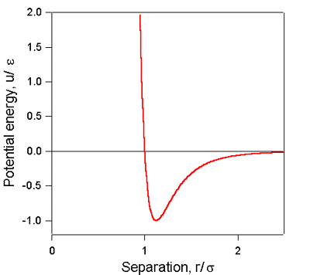
Science with molecular clocks
Nanoscale mass-dependent forces
Energy
0.5 - 5 nm
$$V=−\frac{GM^{2}}{r}\left(1+{Ae}^{−r/λ}\right)$$
0.5
1
5
Bond length (nm)
Hypothetical
“Yukawa” correction

Slide 7
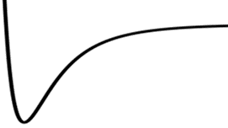
Science with molecular clocks
Nanoscale mass-dependent forces
Vibrational modes
Energy
0.5 - 5 nm
$$V=−\frac{GM^{2}}{r}\left(1+{Ae}^{−r/λ}\right)$$
0.5
1
5
Bond length (nm)
Hypothetical
“Yukawa” correction
Explore a range of lengths

Slide 8
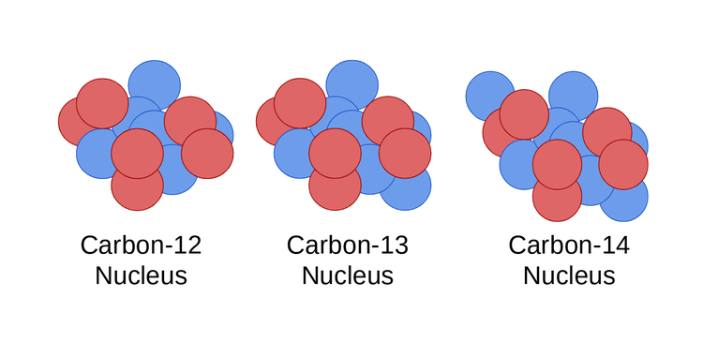
Science with molecular clocks
Nanoscale mass-dependent forces
Isotopes
of strontium atom
0.5 - 5 nm
$$V=−\frac{GM^{2}}{r}\left(1+{Ae}^{−r/λ}\right)$$
Hypothetical
“Yukawa” correction
Explore a range of masses

Slide 9
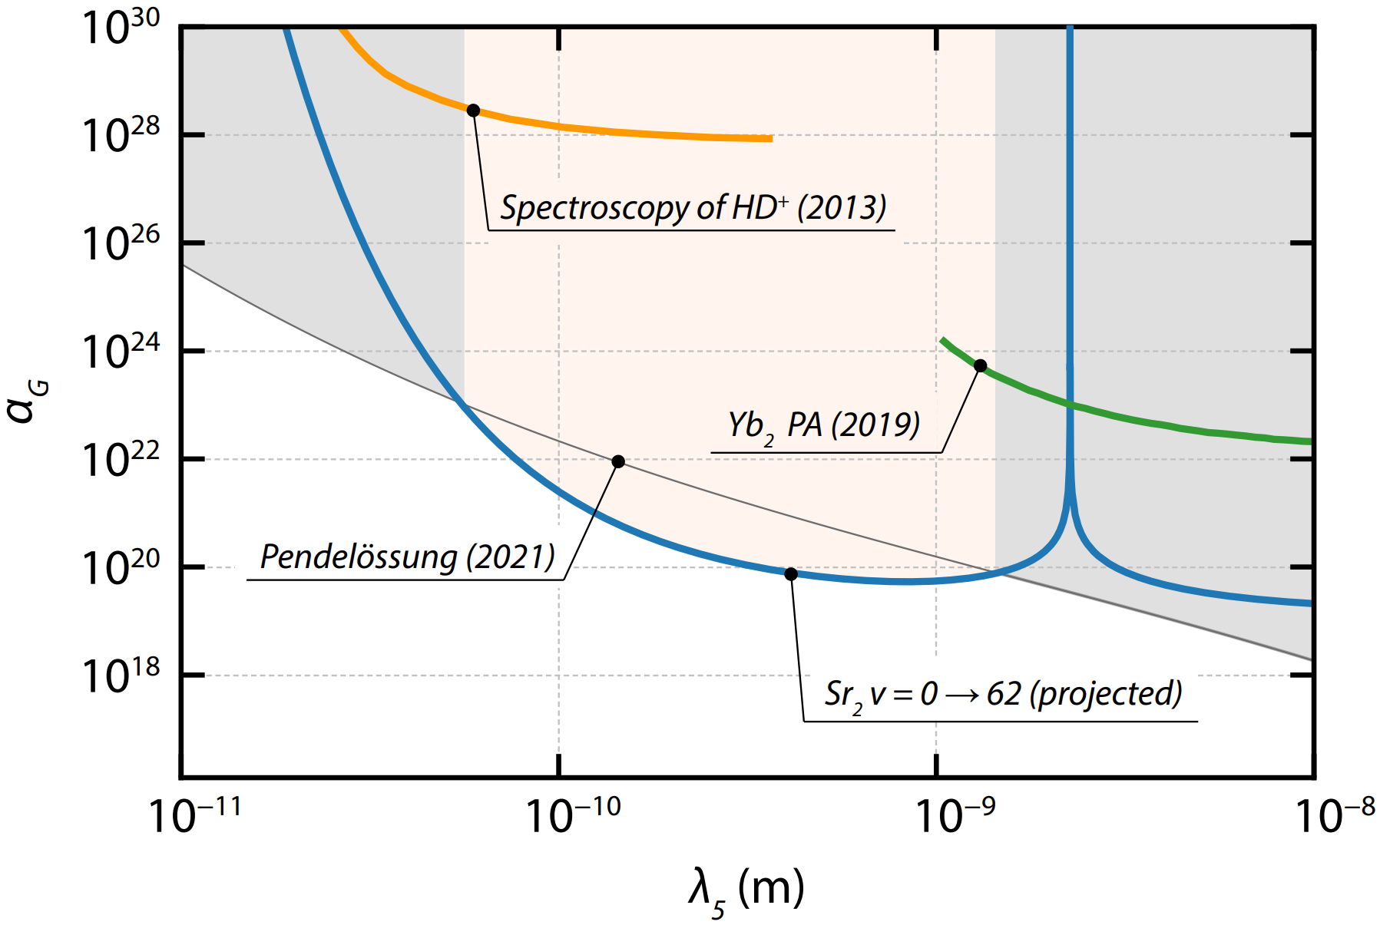
5th force with molecular clock
Current experimental capability
E. Tiberi, Ph.D. thesis (2023)
E. J. Salumbides et al., PRD 87, 112008 (2013)
B. Heacock et al., Science 373, 1239 (2021)
M. Borkowski et al., Sci. Rep. 9, 14807 (2019)
Notes:
Neutron Pendellösung interferometry to make precision measurements of the (220) and (400) neutron-silicon structure factors. “Structure factors describe how incident radiation is scattered from materials such as silicon and germanium and characterize the physical interaction between the material and scattered particles.”

Slide 10
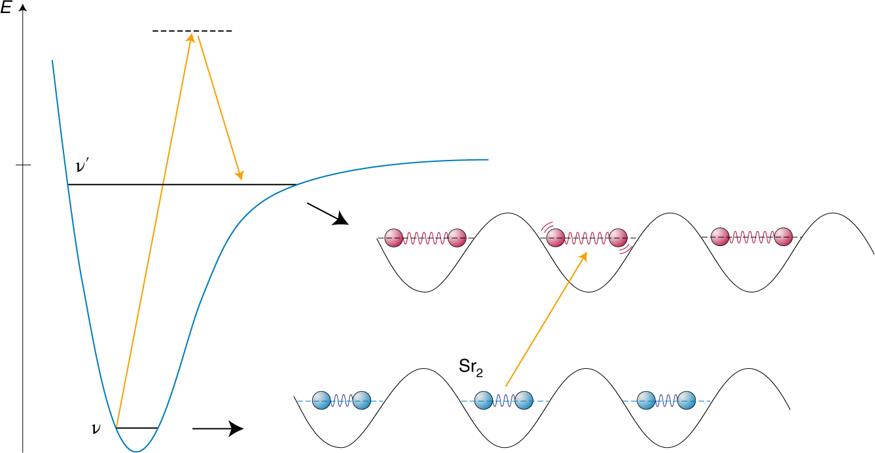
Vibrational molecular lattice clock
Maintain long-term coherence
between quantum states!
N. Poli, Nature Phys. 15, 1106 (2019)

Slide 11
Vibrational molecular lattice clock
lattice
Stark shift
magic
lattice
molecular
states
Raman
probes
lattice
$|1$⟩
$|2$⟩
S. S. Kondov et al., Nature Phys. 15, 1118 (2019)
(v,J)

Slide 12
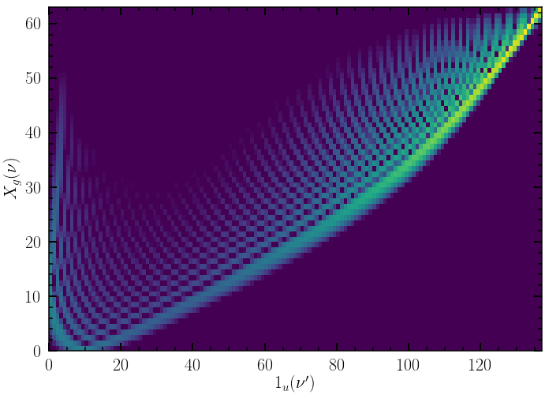
Magic trapping wavelengths
Trap light scattering limits coherence: Choose best λ!
lattice
Ground-state levels
Excited-state levels

Slide 13
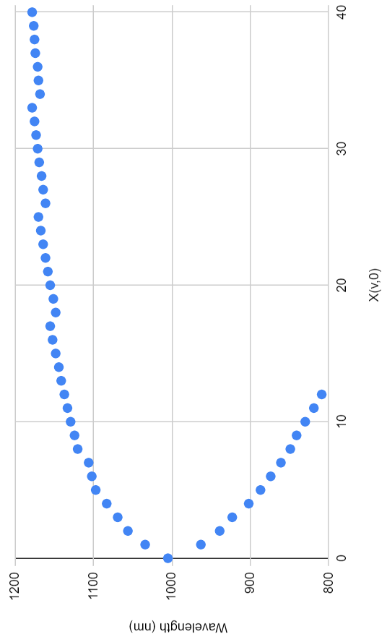
Magic trapping wavelengths
Molecules offer many choices
Lower clock-state v
Wavelength (nm)
Notes:
The best magic wavelengths are for v ~ < 10;
800 nm cutoff is because of running into the 0u+ potential.

Slide 14
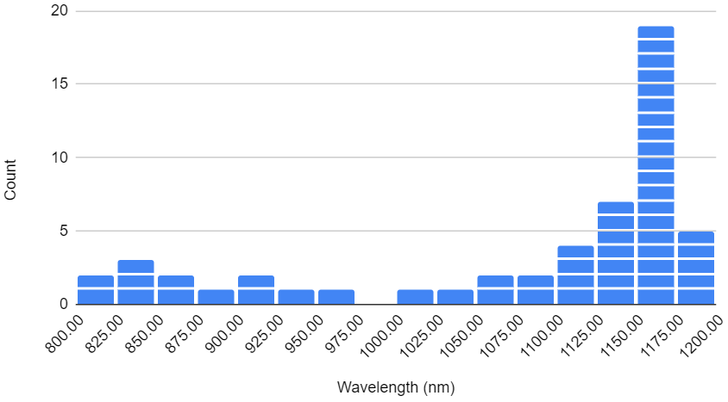
Magic trapping wavelengths
Molecules offer many choices
Lower clock-state v
# of occurrences
Wavelength (nm)
Wavelength (nm)
Notes:
The best magic wavelengths are for v ~ < 10;
800 nm cutoff is because of running into the 0u+ potential.

Slide 15
Magic trapping wavelengths
Molecules offer many choices
Lower clock-state v
# of occurrences
Wavelength (nm)
Wavelength (nm)
Notes:
The best magic wavelengths are for v ~ < 10;
800 nm cutoff is because of running into the 0u+ potential.

Slide 16
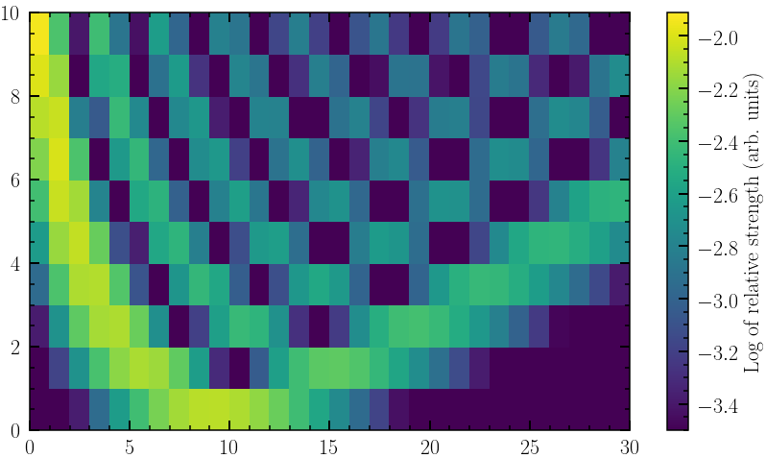
Magic wavelengths
Trap light scattering limits coherence: Choose best λ!
Ground-state levels
Excited-state levels

Slide 17
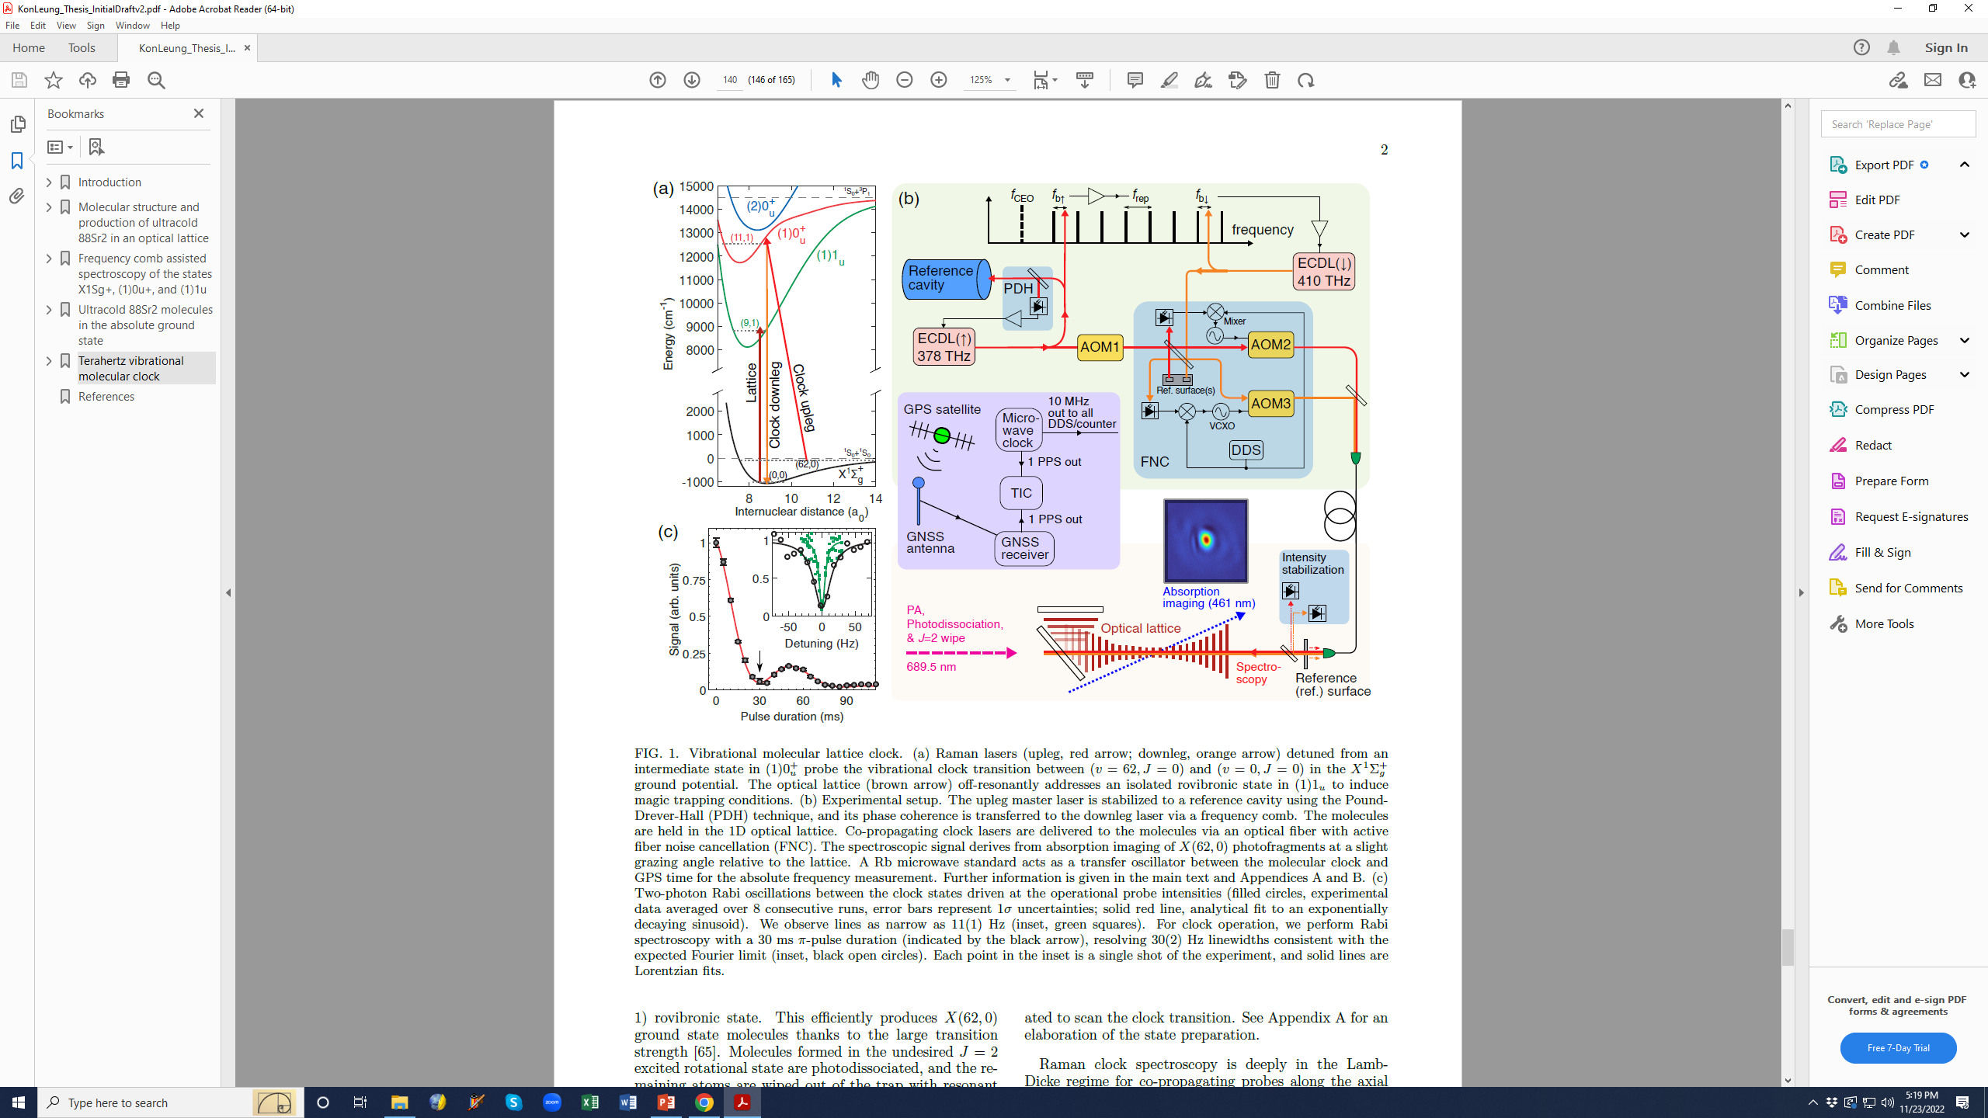
Molecular lattice clock
Coherence in magic lattice : ×10⁴
10 Hz
K. H. Leung et al., Phys. Rev. X 13, 011047 (2023)
Q = 3×10¹²
Q (intrinsic) > 10²⁶
Notes:
30-ms pi pulses for clock operation, shown with black arrow, resolving 30(2) Hz linewidths. Green line: 11(1) Hz wide. (Density variations are smaller over 30 ms than they would be over a 100-ms pi-pulse.)

Slide 18
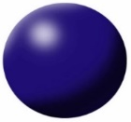


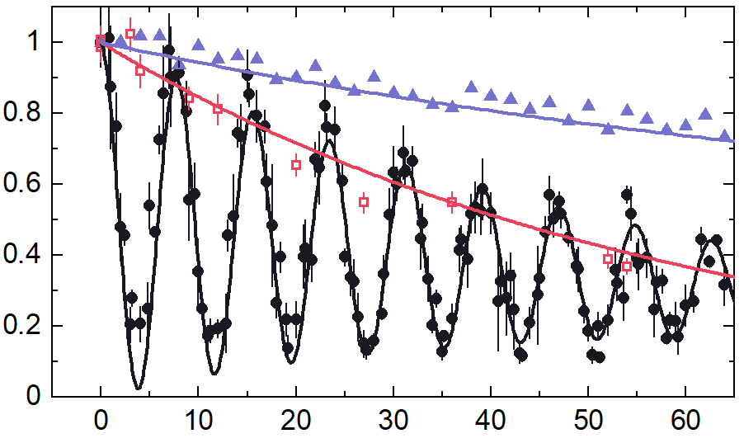
Molecular lattice clock
Coherence in magic lattice
V = 4
V = 62
| ⟩ + | ⟩
~100 ms coherence
collisions
lattice
ms
K. H. Leung et al., PRL 125, 153001 (2020)
Notes:
[908 nm lattice]

Slide 19
Ultracold collisions
Molecule loss versus vibrational state
Most
weakly
bound
Most
deeply
bound
K. H. Leung et al., NJP 23, 115002 (2021)

Slide 20
Molecular lattice clock
Coherence in magic lattice
V = 4
V = 62
| ⟩ + | ⟩
~100 ms coherence
collisions
lattice
ms
K. H. Leung et al., PRL 125, 153001 (2020)
Notes:
[908 nm lattice]

Slide 21
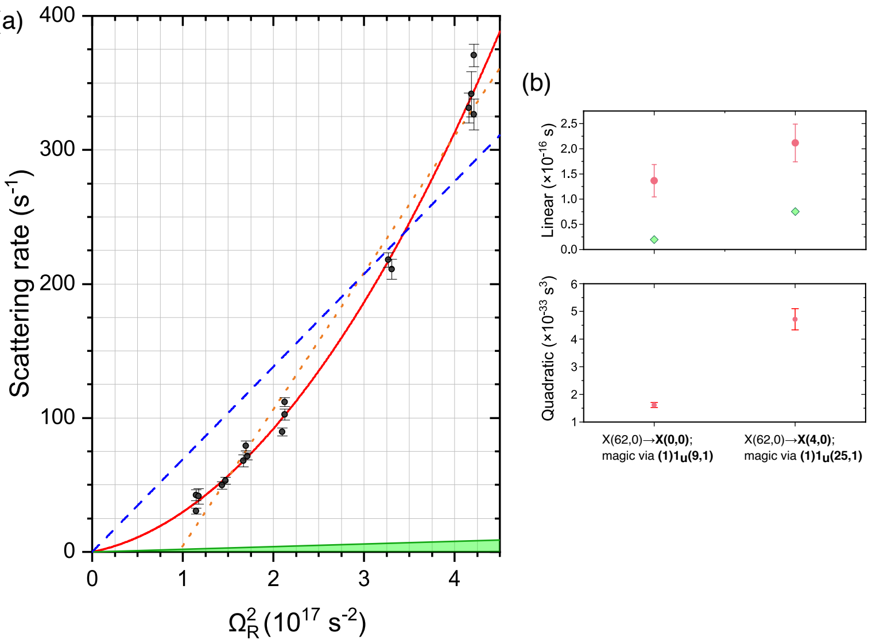
Lattice light scattering
Two-photon?
Lattice light intensity
K. H. Leung, PhD thesis (2023)
Notes:
Angular Rabi frequency is calibrated from the dispersive light shift curves. For the 1004.7723 nm magic wavelength.

Slide 22
Lattice light scattering
Two-photon?
different clock transitions
Lattice light intensity
K. H. Leung, PhD thesis (2023)
Notes:
Angular Rabi frequency is calibrated from the dispersive light shift curves. For the 1004.7723 nm magic wavelength.

Slide 23
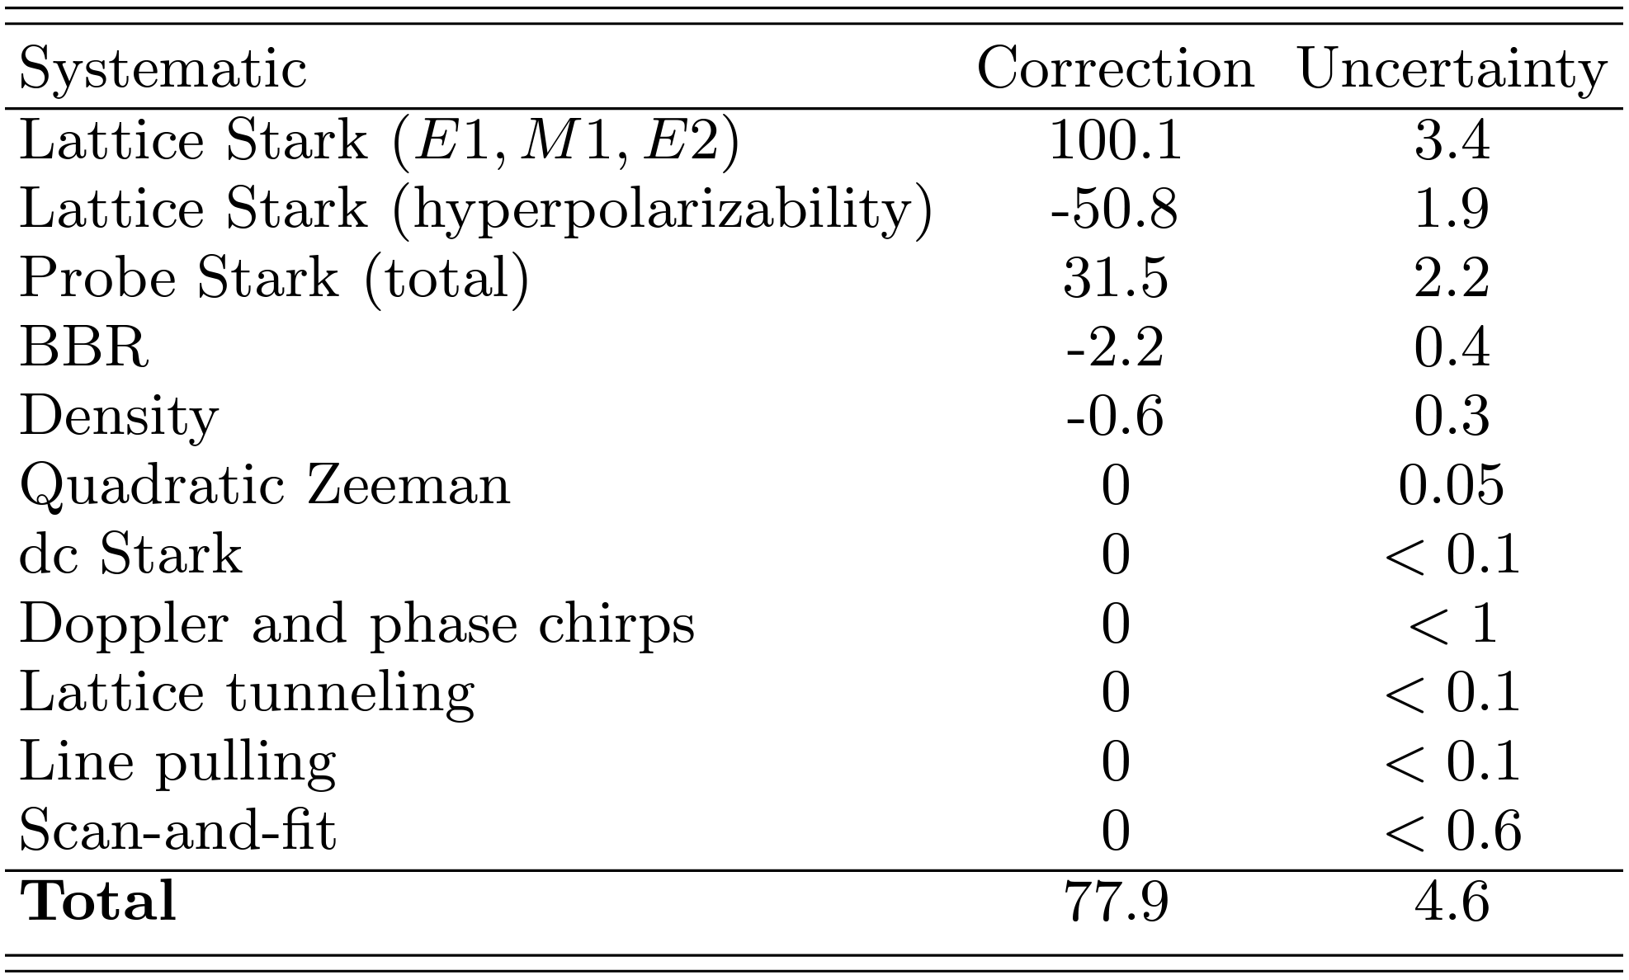

Clock precision & accuracy
Systematic effects:
What can cause the clock frequency to shift?
$$×{10}^{−14}$$
✗
K. H. Leung et al., Phys. Rev. X 13, 011047 (2023)

Slide 24
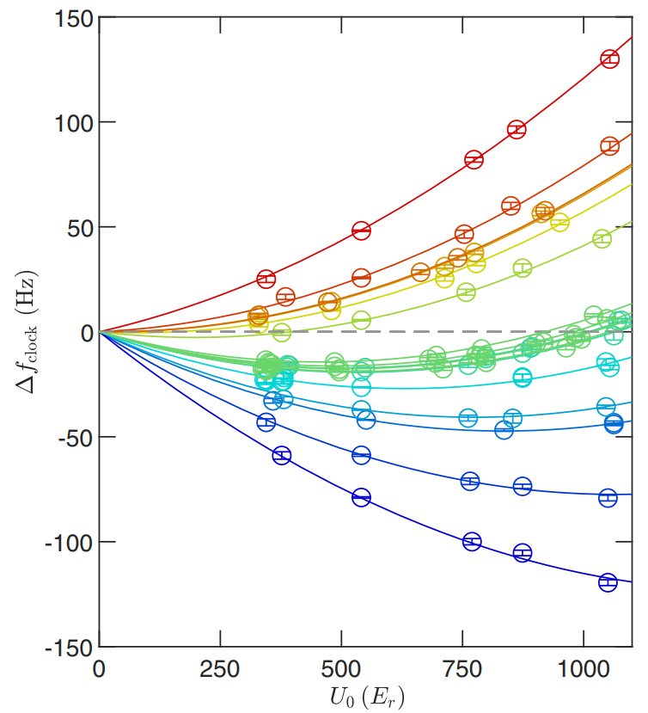
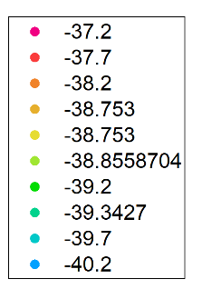
Clock shifts: Lattice light intensity
Clock shift (Hz)
Lattice detuning
(MHz)
Lattice trap depth (E_{recoil})
K. H. Leung et al., Phys. Rev. X 13, 011047 (2023)

Slide 25
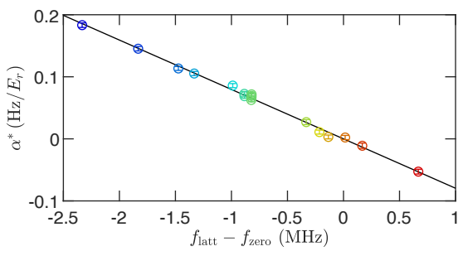
Clock shifts: Lattice light intensity
Polarizability +
Hyperpolarizability
Polarizability
Hz / E_{recoil}
Clock shift (Hz)
Lattice frequency detuning (MHz)
Lattice detuning
(MHz)
Lattice trap depth (E_{recoil})
K. H. Leung et al., Phys. Rev. X 13, 011047 (2023)

Slide 26
Clock shifts: Lattice light intensity
operationally
non-magic
lattice…
Polarizability +
Hyperpolarizability
Polarizability
Hz / E_{recoil}
Clock shift (Hz)
Lattice frequency detuning (MHz)
Lattice detuning
(MHz)
Lattice trap depth (E_{recoil})
K. H. Leung et al., Phys. Rev. X 13, 011047 (2023)

Slide 27
Clock shifts: Lattice light intensity
operationally
magic
lattice
Polarizability +
Hyperpolarizability
Polarizability
Hz / E_{recoil}
Clock shift (Hz)
Lattice frequency detuning (MHz)
Lattice detuning
(MHz)
Lattice trap depth (E_{recoil})
K. H. Leung et al., Phys. Rev. X 13, 011047 (2023)

Slide 28
Clock shifts: Lattice light intensity
operationally
magic
lattice
Polarizability +
Hyperpolarizability
Polarizability
Hz / E_{recoil}
Clock shift (Hz)
Lattice frequency detuning (MHz)
Lattice detuning
(MHz)
~4×10⁻¹⁴ uncertainty
Lattice trap depth (E_{recoil})
K. H. Leung et al., Phys. Rev. X 13, 011047 (2023)

Slide 29
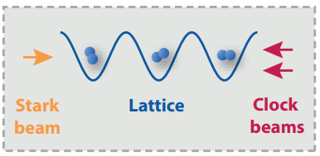
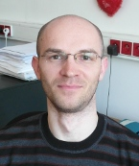
Clock shifts: BBR
Purely vibrational BBR shifts?
Wojtek Skomorowski

Slide 30
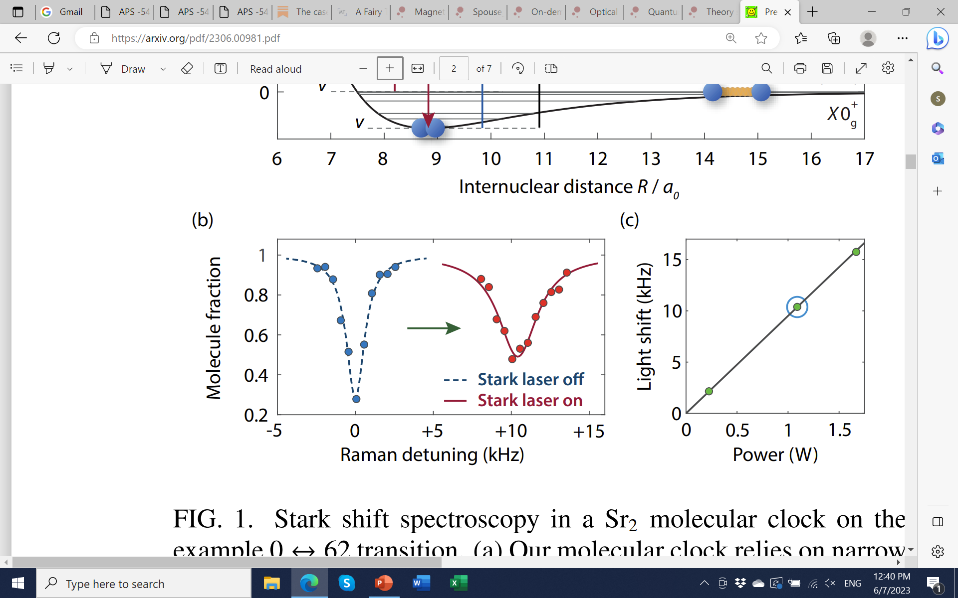
Molecular polarizabilities
DC to infrared
IR Stark shift measurement (2 μm)
using clock transitions
B. Iritani et al., arXiv:2306.00981

Slide 31
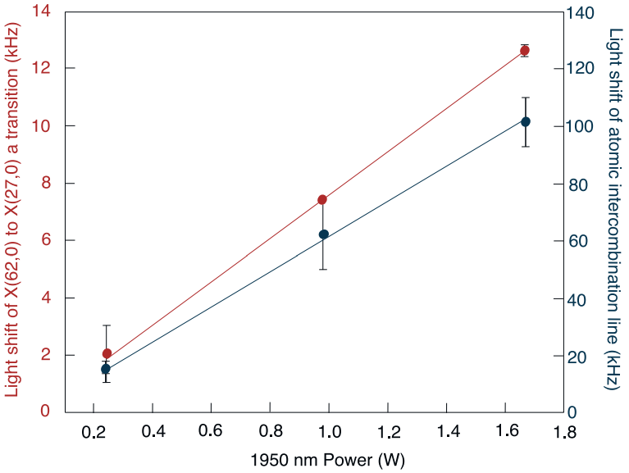
Molecular polarizabilities
DC to infrared
IR Stark shift measurement (2 μm)
using clock transitions
Use well-known atomic
¹S₀ → ³P₁ light shift
for calibration
B. Iritani et al., arXiv:2306.00981

Slide 32
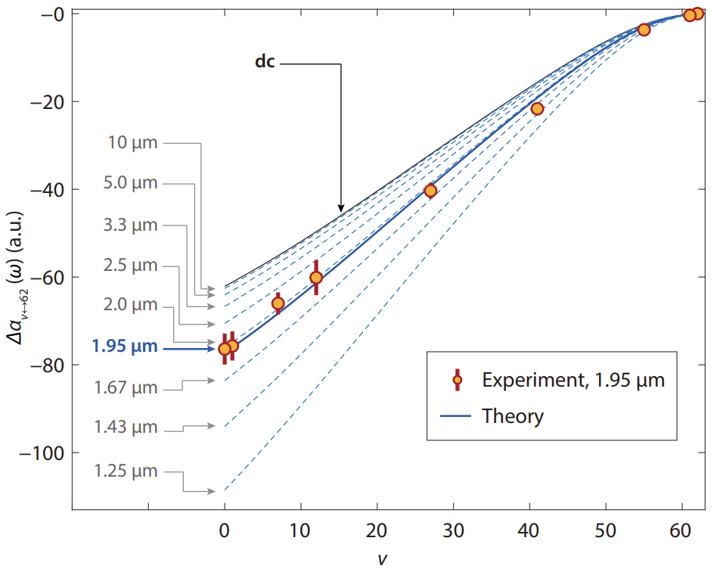
Molecular polarizabilities
DC to infrared
IR Stark shift measurement (2 μm)
using clock transitions
IR Stark shifts, all vibrational states:
Measurement & calculations
“Molecular” dynamic polarizability
B. Iritani et al., arXiv:2306.00981
Notes:
In homonuclear molecules, only electronic transitions contribute to polarizabilities and BBR shifts. To first calculate the electronic polarizability, we employ the approach based on asymmetric analytical derivative of the coupled-cluster energy with single and double excitations (CCSD),as implemented in the Q-Chem5 package. We use the ECP28MDF pseudopotential together with its dedicated valence basis set. In the second step, we calculate the polarizability of each vibrational level v by averaging the electronic polarizability over the level’s vibrational wavefunction. It is valid only when the adiabaticity condition is maintained, that is, the ground-state potential does not cross any of the excited-state potentials if shifted upwards by the lattice photon energy.

Slide 33



Clock shifts: BBR
IR Stark shifts, all vibrational states:
Measurement & calculations
Net BBR shift:
$$𝒪({10}^{−14})$$
BBR shift uncertainty:
“Molecular” dynamic polarizability
$${<5×10}^{−16}$$
Dynamic correction:
$$η\sim 0.5\%$$
B. Iritani et al., arXiv:2306.00981

Slide 34
Clock shifts: Probe light intensity

Slide 35
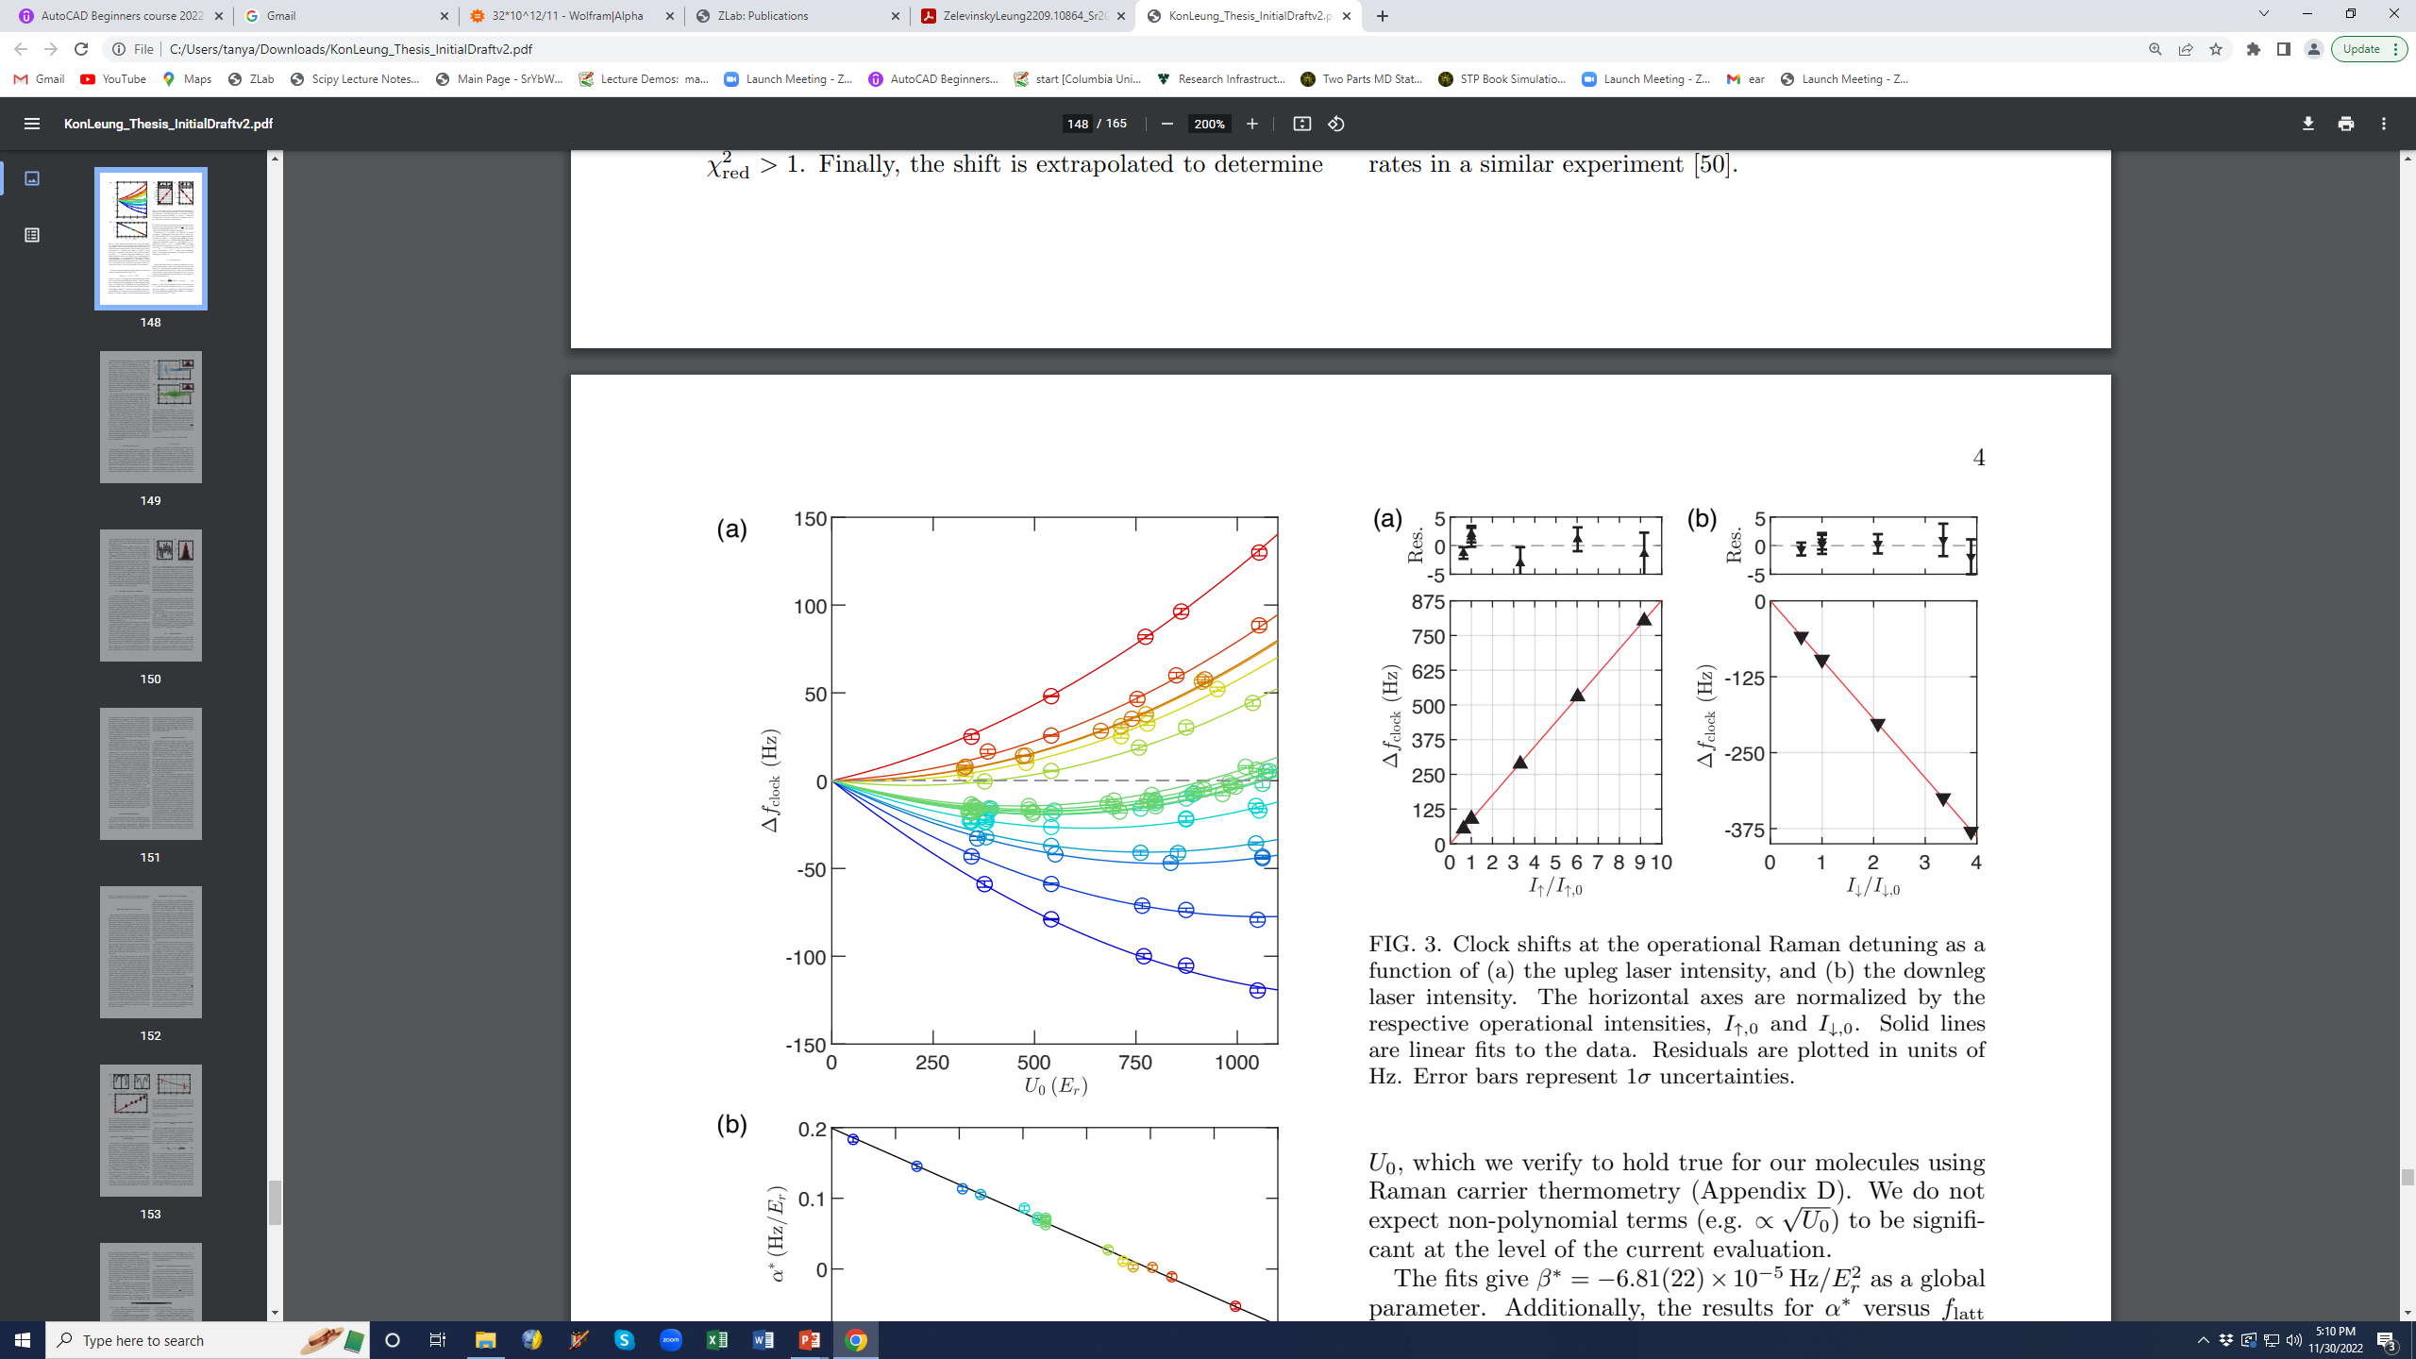
Clock shifts: Probe light intensity
K. H. Leung et al., Phys. Rev. X 13, 011047 (2023)

Slide 36
Clock shifts: Probe light intensity
First-order
cancellation
~2×10⁻¹⁴ uncertainty
K. H. Leung et al., Phys. Rev. X 13, 011047 (2023)

Slide 37
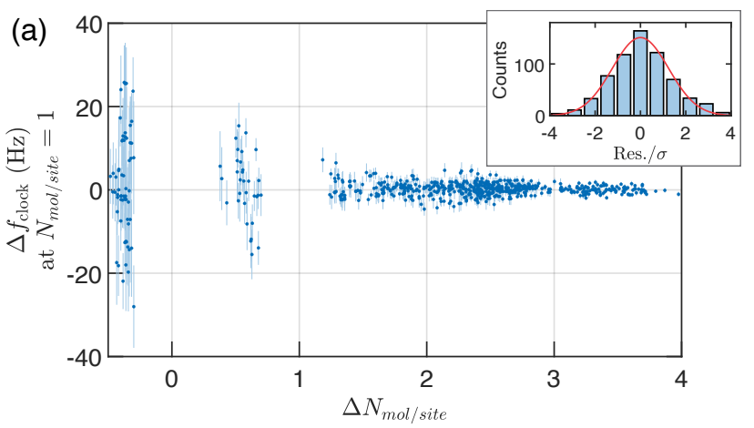
Clock shifts: Molecule density
Varying density of molecules
Linear density shifts, extrapolated to operating density
K. H. Leung et al., Phys. Rev. X 13, 011047 (2023)
~3×10⁻¹⁵ uncertainty
Notes:
Assuming linear density shifts, we scale our differential measurements to find ∆f_clock at the normal operating value of N_mol/site = 1. A single constant fits this data.

Slide 38
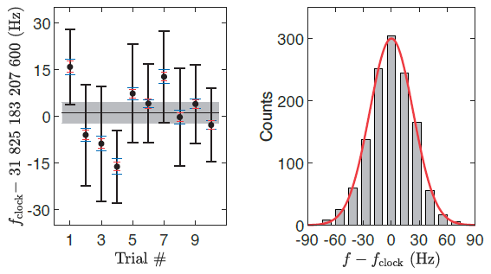
Absolute frequency measurement
Comparison to Cs atomic time standard
K. H. Leung et al., Phys. Rev. X 13, 011047 (2023)
1×10⁻¹³ uncertainty
Notes:
GNNS = Global Navigation Satellite System.

Slide 39
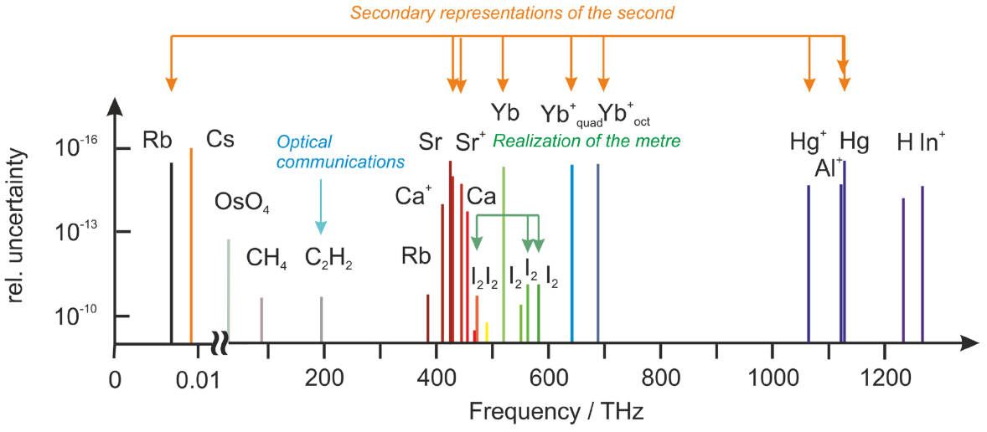
Frequency standards
2017 recommendations
F. Riehle et al., Metrologia 55, 188 (2018)

Slide 40
Frequency standards
2017 recommendations
Sr₂
F. Riehle et al., Metrologia 55, 188 (2018)

Slide 41


Molecular clocks, QED, and 5th force
Born-Oppenheimer approximation
Beyond B-O
adiabatic
nonadiabatic
relativistic, QED
finite-nuclear-size
$$E_{tot}≈E_{el}+E_{vib}+E_{rot}$$
$$μ=\frac{m_{e}}{{Am}_{p}}$$
$$μ^{2}$$
$$α^{2}μ, α^{3}μ$$
$${\left(r_{c}/a_{0}\right)}^{2}$$
$${}_{ }^{1}Σ$$
Aleksander Wozniak

Slide 42
Molecular clocks, QED, and 5th force
Born-Oppenheimer approximation
Beyond B-O
adiabatic
nonadiabatic
relativistic, QED
finite-nuclear-size
$$E_{tot}≈E_{el}+E_{vib}+E_{rot}$$
$$μ=\frac{m_{e}}{{Am}_{p}}$$
$$μ^{2}$$
$$α^{2}μ, α^{3}μ$$
$${\left(r_{c}/a_{0}\right)}^{2}$$
$${}_{ }^{1}Σ$$
Aleksander Wozniak
⁸⁴Sr, ⁸⁶Sr, ⁸⁸Sr dimers:
6 mass combinations, $\sim 6×60$ transitions
→ Fit 5+ parameters

Slide 43
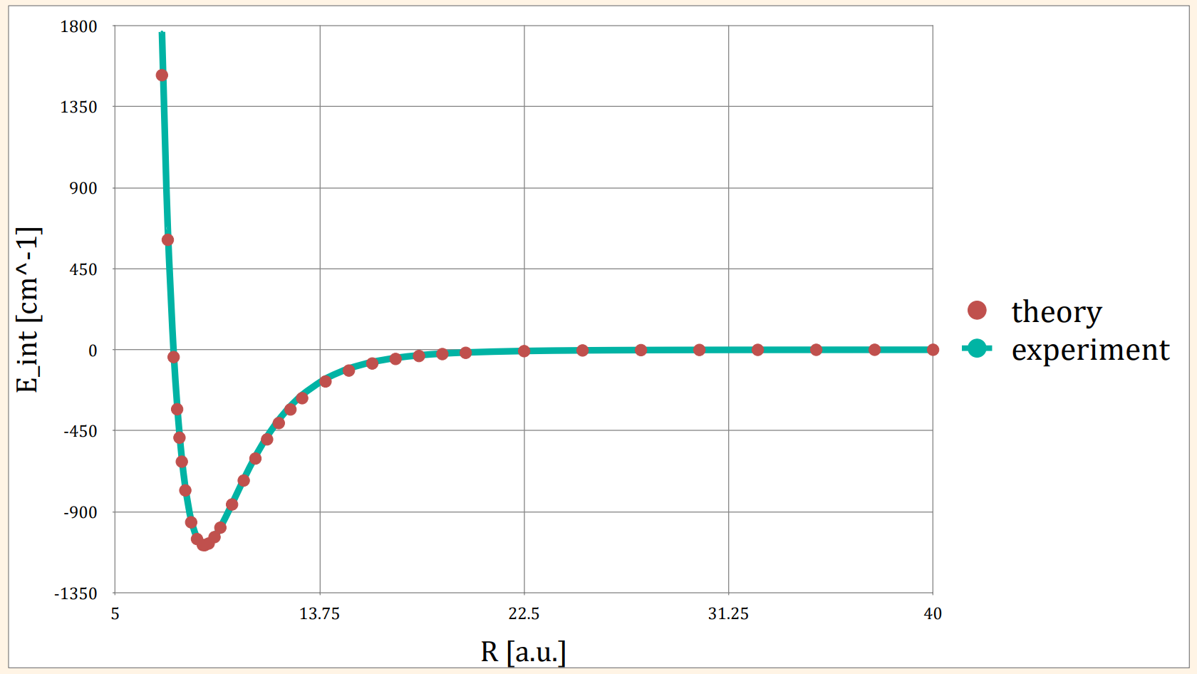
Sr₂ molecular structure
Initial numerical results
short range
long range
Energy (cm⁻¹)
10%
0.1%
Internuclear separation (Bohr)
Credit: A. Wozniak
A. Stein et al., EPJD 57, 171 (2010)

Slide 44
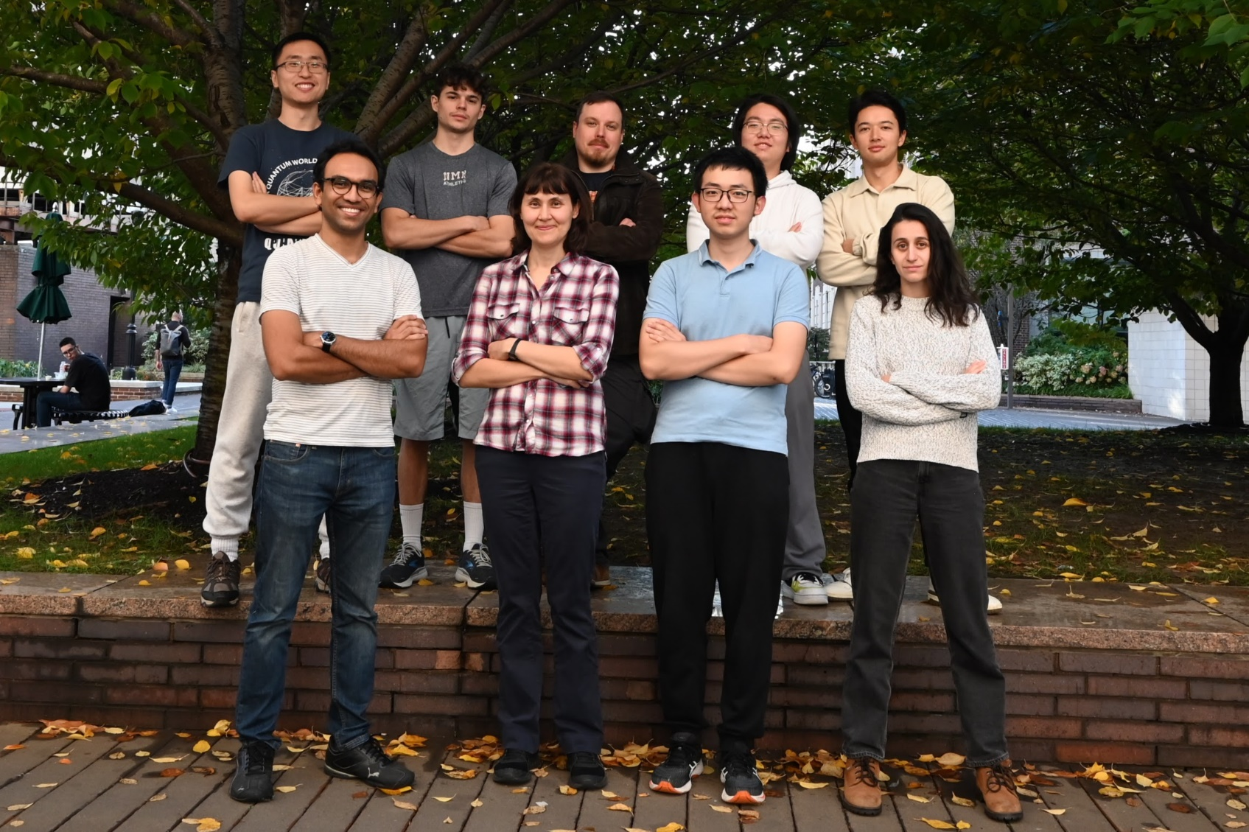
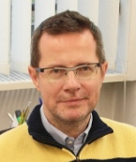
ZLab
Not pictured:
Jianhui Li
Sr theory:
Robert Moszynski et al.
Clockwise, from top left: Qi Sun, Isaac Pope, Mateusz Borkowski,
Jinyu Dai, Brandon Iritani, Emily Tiberi, Perry Zhou, TZ, Debayan Mitra

