Slide 1
The Skotos (dark) connection of Neutrinos
Shreyashi Chakdar
schakdar@holycross.edu
College of the Holy Cross, MA
in collaboration with K.S. Babu and Vishnu P.K
arXiv: 2409.09008
International Joint Workshop on SM and Beyond 2024
& 3rd Gordon Godfrey Workshop on Astroparticle Physics
USNW, Sydney
Dec 10, 2024

Slide 2


DM and $ν$origin story
Origin of neutrino mass and dark matter two pressing puzzles in PPC
addressed by hidden sectors containing new particles/symmetries
Radiative connection: long history of radiative $m_{ν}$ mechanisms
DM and $m_{ν}$ are related radiatively?
Flavor/Horizontal symmetries:
Non-Abelian discrete symmetries still of continuous interest to explain PMNS
Complementarity:
Use DD, Colliders, Precision to constrain DM/BSM physics

Slide 3
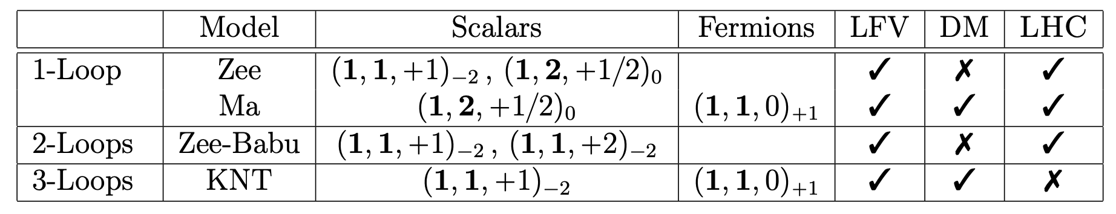
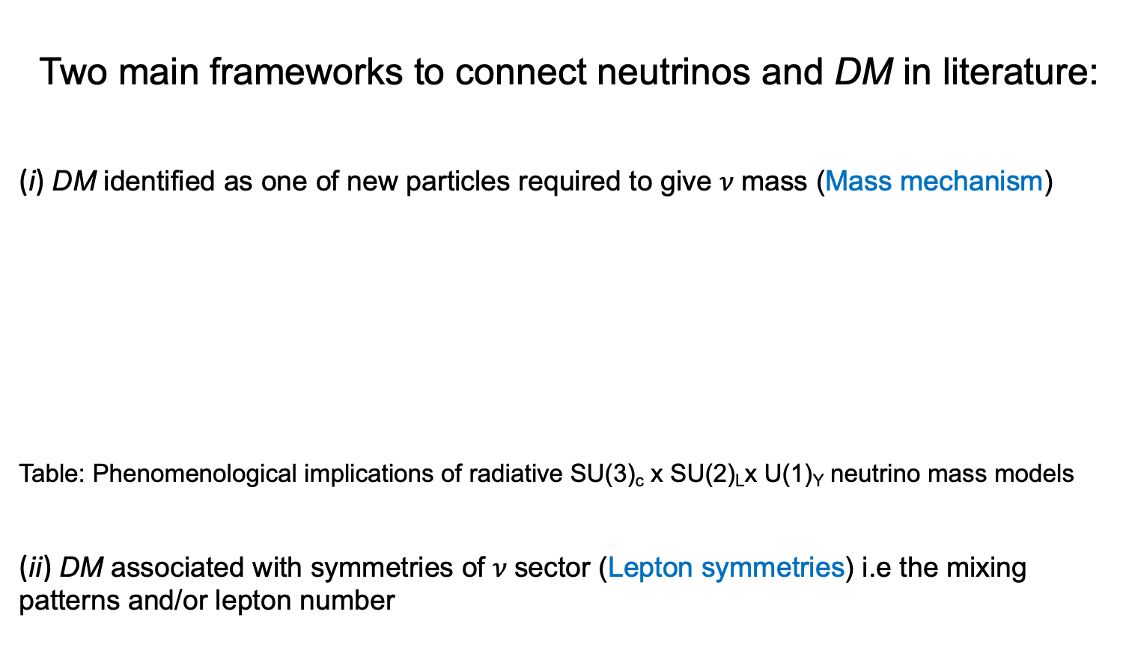
The Dark connection of neutrinos?
Two main frameworks to connect neutrinos and DM in literature:
(i) DM identified as one of new particles required to give $ν$mass (Mass mechanism)
Table: Phenomenological implications of radiative SU(3)_{c} x SU(2)_{L}x U(1)_{Y} neutrino mass models
(ii) DM associated with symmetries of $ν$sector (Lepton symmetries) i.e the mixing patterns and/or lepton number
Notes:
In light of available data and theoretical ideas, broadly speaking
Krauss-Nasri-Trodden

Slide 4
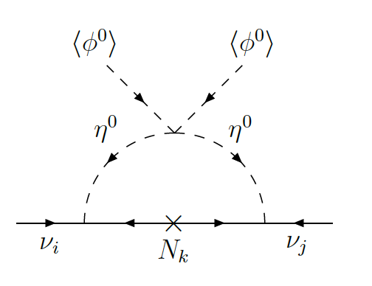

The Scotogenic model
Scotogenic Model = SM + 3 singlet Fermions (N_{1,2,3}) + scalar doublet ($η)$ + dark Z₂
[Ma, hep-ph/0601225]
Particles in loop odd under dark Z₂
Majorana mass of N completes loop
Mass splitting ($λ_{5}$($η^{†}φ)2 )$ makes loop finite
Either $η_{0}$ or N are DM candidate
The yukawas that enters into $m_{ν}$ also generates
LFV processes however the bounds only constrain
combination of yukawa coupling elements
cancelations possible safe in Ma model
Discrete symmetry is usually put in by hand in Scotogenic theories
Masses of RH neutrino has to be assumed to be at TeV scale
Notes:
- The additional Z₂ symmetry prevents from receiving a nonzero vev and allows N_{i} or $η$ to act as a DM candidate particle

Slide 5

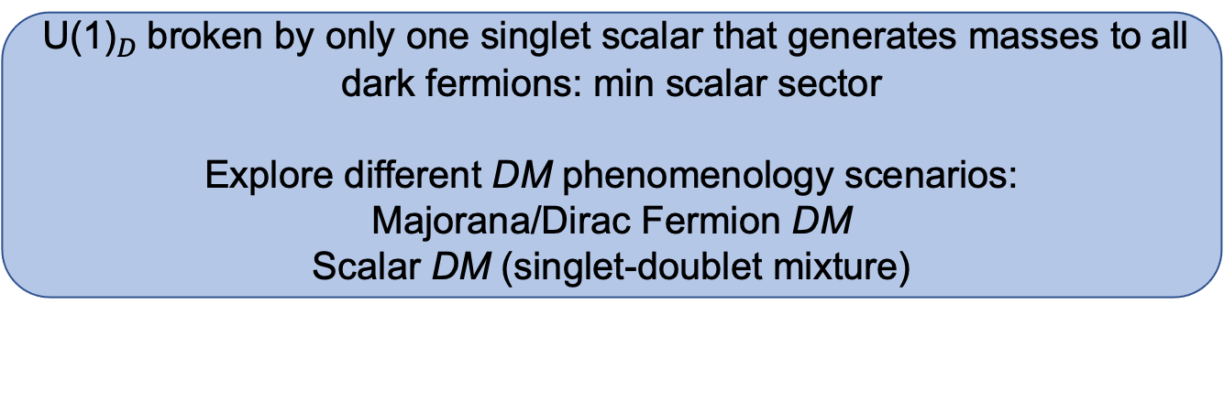
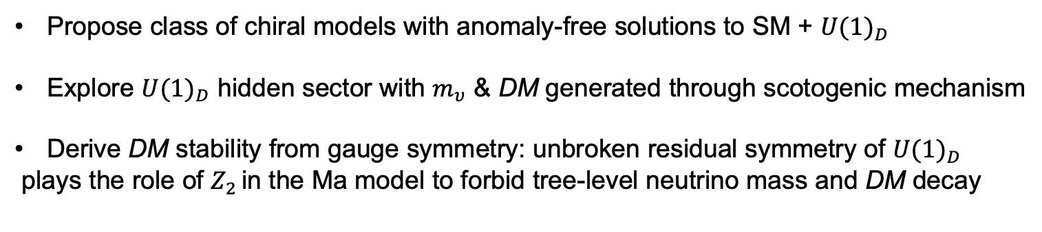
This Talk
Propose class of chiral models with anomaly-free solutions to SM + ${U(1)}_{D}$
Explore ${U(1)}_{D}$ hidden sector with $m_{υ}$ & DM generated through scotogenic mechanism
Derive DM stability from gauge symmetry: unbroken residual symmetry of ${U(1)}_{D}$
plays the role of $Z_{2 }$in the Ma model to forbid tree-level neutrino mass and DM decay
${ \text{U}\text{(1)}}_{D}$broken by only one singlet scalar that generates masses to all dark fermions: min scalar sector
Explore different DM phenomenology scenarios:
Majorana/Dirac Fermion DM
Scalar DM (singlet-doublet mixture)
Ma
Anomaly cancellations
Fermion mass
Minimality of scalar sector
Scotogenic mechanism

Slide 6
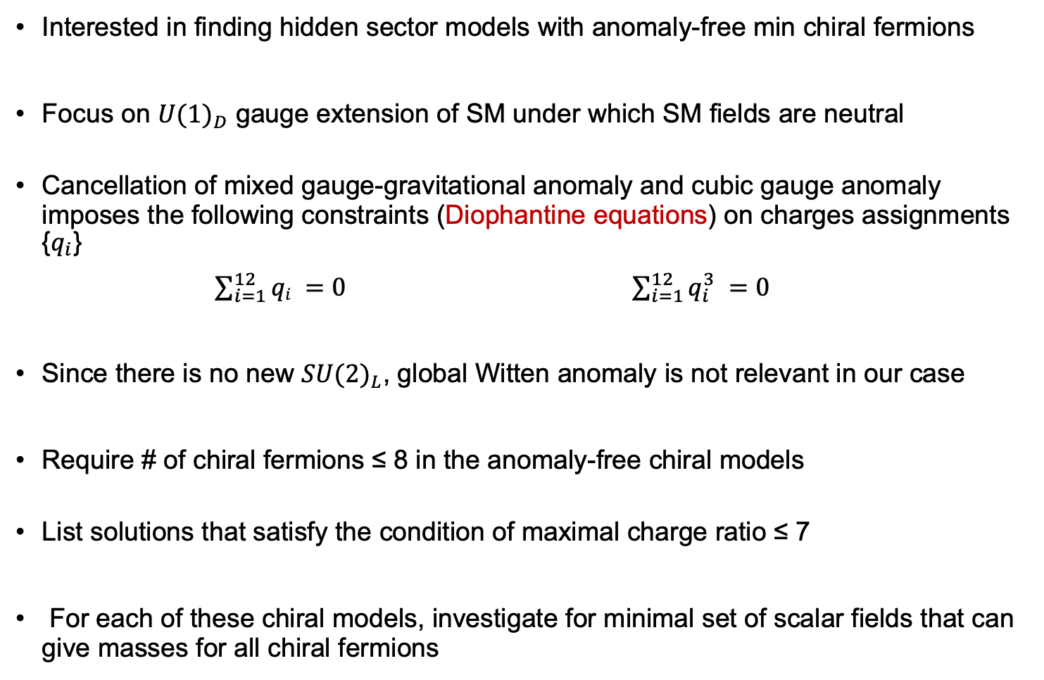
Anomaly-free chiral fermion models
Interested in finding hidden sector models with anomaly-free min chiral fermions
Focus on ${U(1)}_{D}$ gauge extension of SM under which SM fields are neutral
Cancellation of mixed gauge-gravitational anomaly and cubic gauge anomaly imposes the following constraints (Diophantine equations) on charges assignments {$q_{i}$}
$\sum_{i=1}^{12}{qi =0}$ $\sum_{i=1}^{12}{q_{i}^{3} =0}$
Since there is no new ${SU(2)}_{L}$, global Witten anomaly is not relevant in our case
Require # of chiral fermions ≤ 8 in the anomaly-free chiral models
List solutions that satisfy the condition of maximal charge ratio ≤ 7
For each of these chiral models, investigate for minimal set of scalar fields that can give masses for all chiral fermions

Slide 7
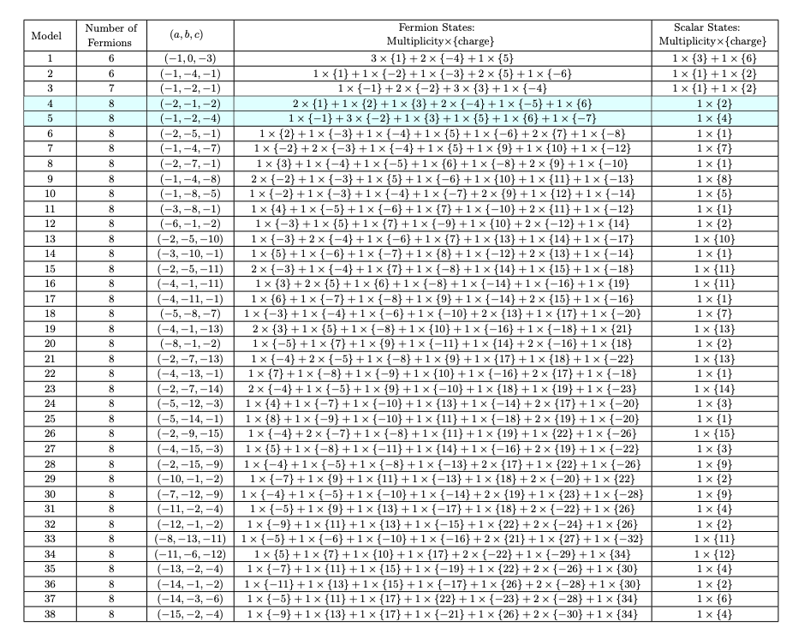
Anomaly free chiral fermions
Notes:
we present a complete set of relevant anomaly-free solutions to the general problem of the generation of Dirac neutrino masses
at one-loop with chiral fermions. Each of the solutions leads to a unique model with its specific phenomenological implications.

Slide 8
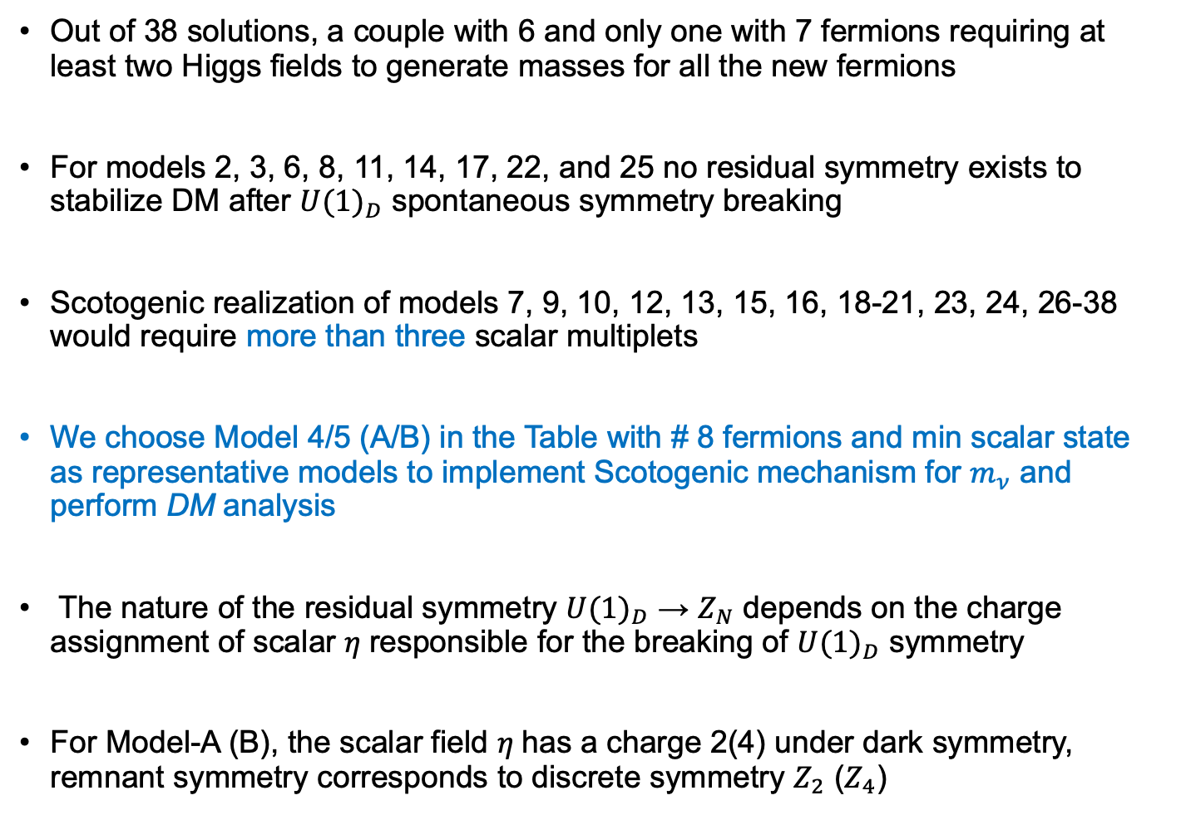
Findings
Out of 38 solutions, a couple with 6 and only one with 7 fermions requiring at least two Higgs fields to generate masses for all the new fermions
For models 2, 3, 6, 8, 11, 14, 17, 22, and 25 no residual symmetry exists to stabilize DM after ${U(1)}_{D}$ spontaneous symmetry breaking
Scotogenic realization of models 7, 9, 10, 12, 13, 15, 16, 18-21, 23, 24, 26-38 would require more than three scalar multiplets
We choose Model 4/5 (A/B) in the Table with # 8 fermions and min scalar state as representative models to implement Scotogenic mechanism for $m_{ν}$ and perform DM analysis
The nature of the residual symmetry ${U(1)}_{D}$ → $Z_{N}$ depends on the charge assignment of scalar $η$responsible for the breaking of ${U(1)}_{D}$ symmetry
For Model-A (B), the scalar field $η$has a charge 2(4) under dark symmetry, remnant symmetry corresponds to discrete symmetry $Z_{2}$ ($Z_{4}$)

Slide 9
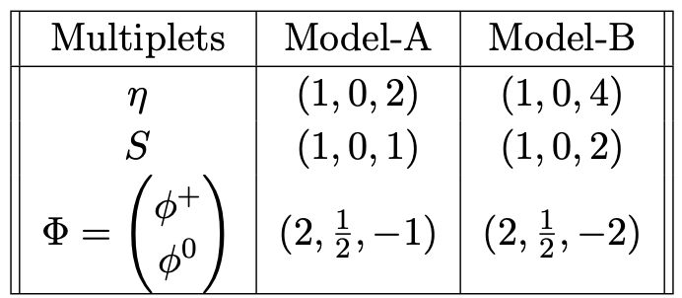

Representative models
Anomaly-free charge assignments (multiplicity $×$charge)
BSM scalar sector of Model-A(B) with quantum numbers under ${SU(2)}_{L}$ $×{ U(1)}_{Y}$ $×{ U(1)}_{D}$
Model A: 2 × {1} + 2 × {−4} + 1 × {2} + 1 × {3} + 1 × {−5} + 1 × {6}
Model B: 1 × {1} + 3 × {2} + 1 × {-3} + 1 × {-5} + 1 × {−6} + 1 × {7}
Notes:
SU (2)L × U (1)Y × U (1)D

Slide 10
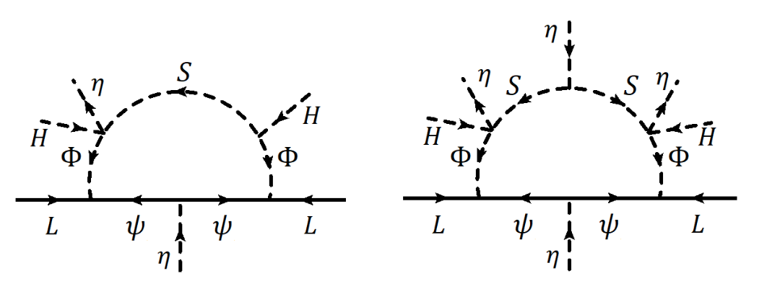
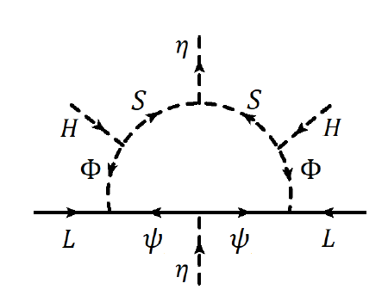
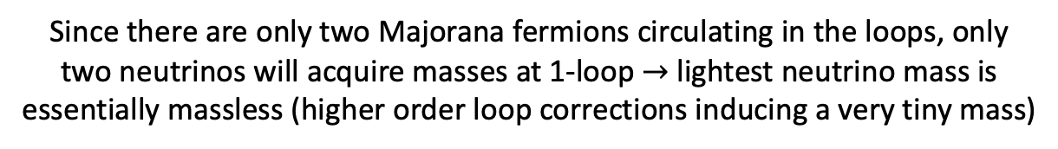
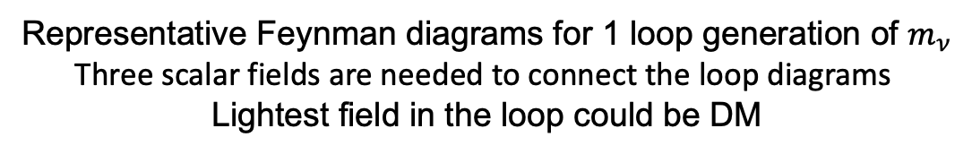
Neutrino mass generation
Representative Feynman diagrams for 1 loop generation of $m_{ν}$
Three scalar fields are needed to connect the loop diagrams
Lightest field in the loop could be DM
Since there are only two Majorana fermions circulating in the loops, only
two neutrinos will acquire masses at 1-loop $→$lightest neutrino mass is
essentially massless (higher order loop corrections inducing a very tiny mass)

Slide 11
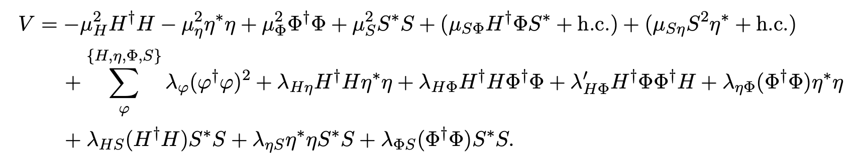
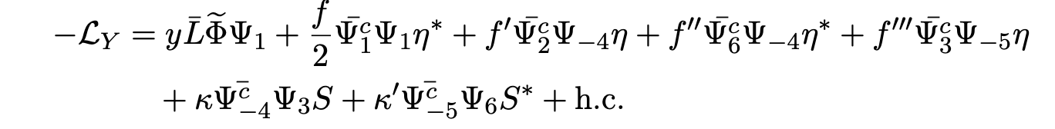
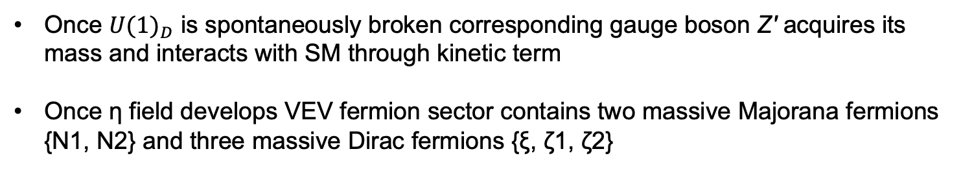
Formalism
Scalar potential for Model A
${U(1)}_{D}$ gauge symmetry is broken down to $Z_{2}$ensuring DM stability
Once ${U(1)}_{D}$ is spontaneously broken corresponding gauge boson Z′ acquires its mass and interacts with SM through kinetic term
Once η field develops VEV fermion sector contains two massive Majorana fermions {N1, N2} and three massive Dirac fermions {ξ, ζ1, ζ2}
Yukawa Lagrangian (fermionic dark matter)

Slide 12

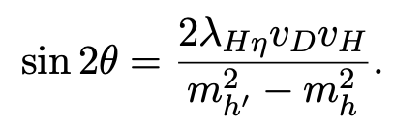

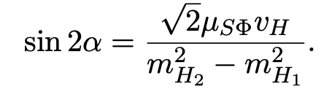

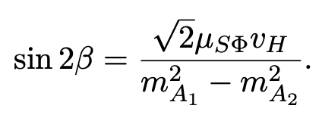

Masses and mixings
Scalar doublet H and $η$ mix and is defined by $h$, $h^{′}$and mixing angle $θ$
,
For mixing between Re($φ^{0}$) and Re(S) with mass eigen states $H_{1}$ and $H_{2}$:
‘
For mixing between Im($φ^{0}$) and Im(S) with mass eigen states $A_{1}$ and $A_{2}$:

Slide 13
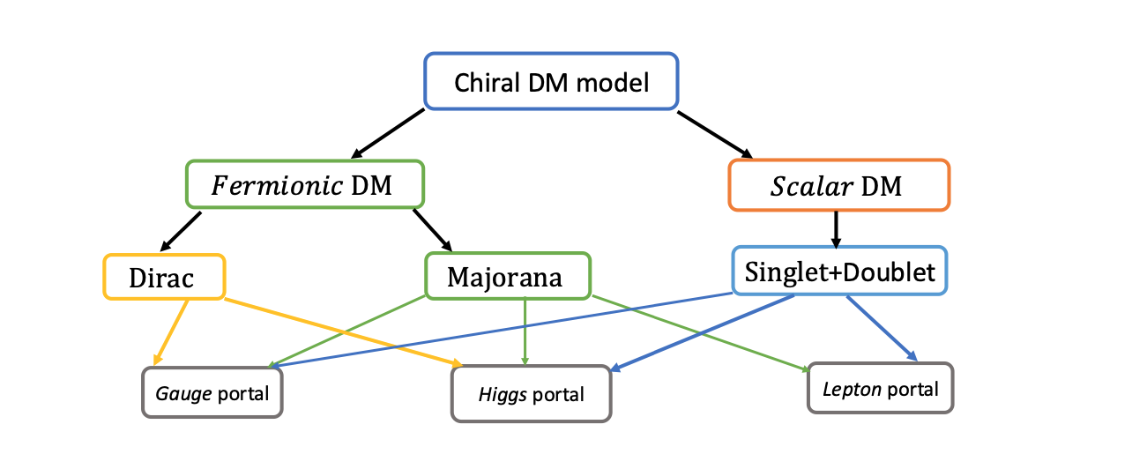
All possible DM candidates in this scenario
Fermionic DM is less explored in Scotogenic scenarios!

Slide 14
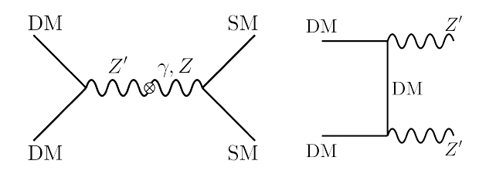

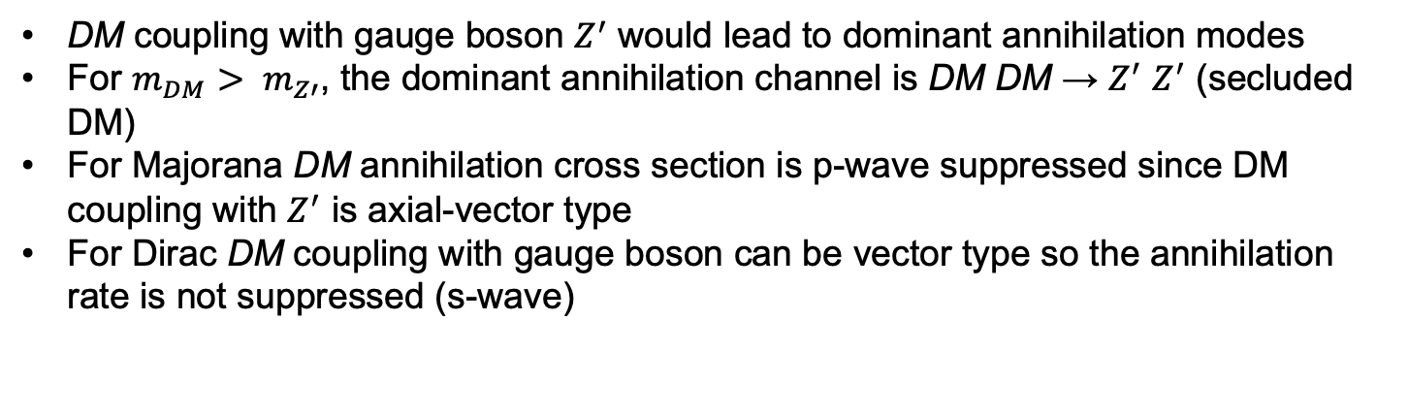
Fermion DM phenomenology (gauge portal)
$2m_{DM}$ $< m_{h^{′}, h}$
Feynman diagrams that contribute to the annihilation of Majorana DM
DM coupling with gauge boson $Z^{′}$ would lead to dominant annihilation modes
For $m_{DM}$ $> m_{Z′}$, the dominant annihilation channel is DM DM → $Z^{′}$ $Z^{′}$ (secluded DM)
For Majorana DM annihilation cross section is p-wave suppressed since DM coupling with $Z^{′}$ is axial-vector type
For Dirac DM coupling with gauge boson can be vector type so the annihilation rate is not suppressed (s-wave)

Slide 15
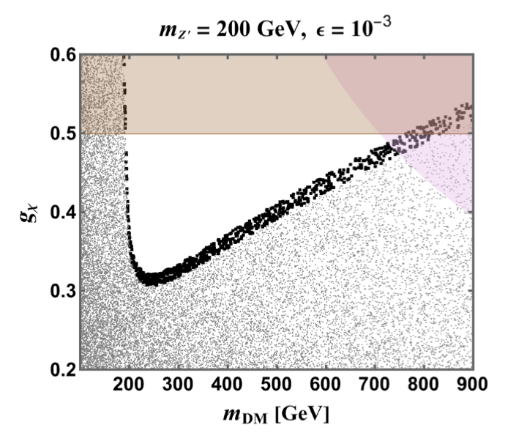
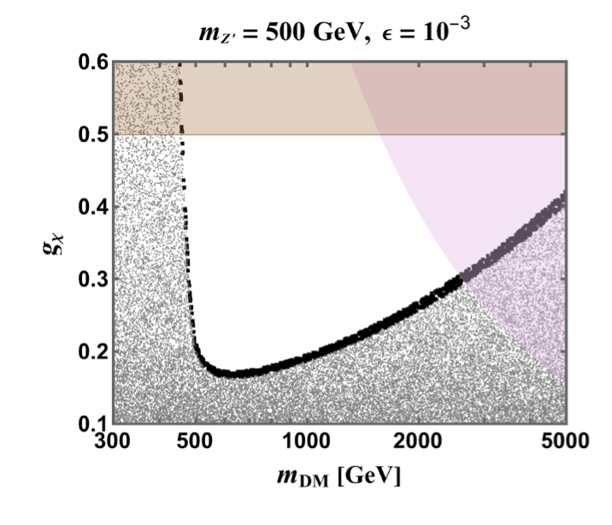
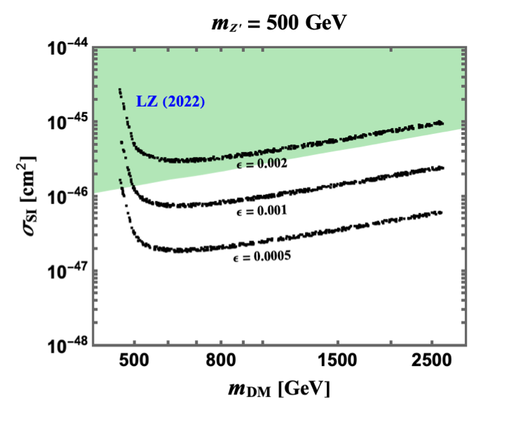
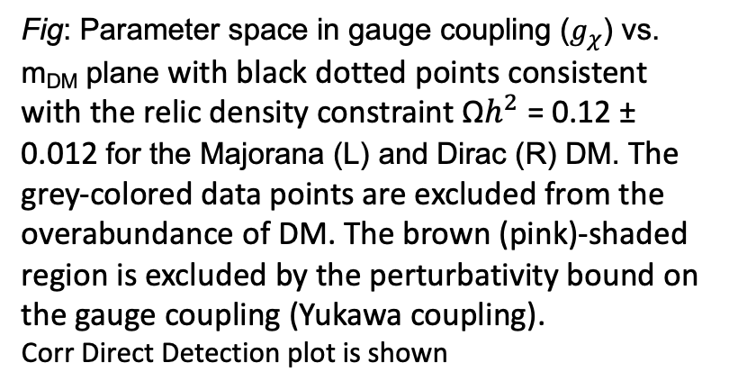
Fermion DM phenomenology (gauge portal)
Fig: Parameter space in gauge coupling ($g_{χ}$) vs. m_{DM} plane with black dotted points consistent with the relic density constraint Ω$h^{2}$ = 0.12 ± 0.012 for the Majorana (L) and Dirac (R) DM. The grey-colored data points are excluded from the overabundance of DM. The brown (pink)-shaded region is excluded by the perturbativity bound on the gauge coupling (Yukawa coupling).
Corr Direct Detection plot is shown
Notes:
Brown region= perturbative limit

Slide 16
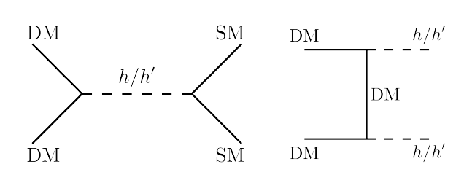
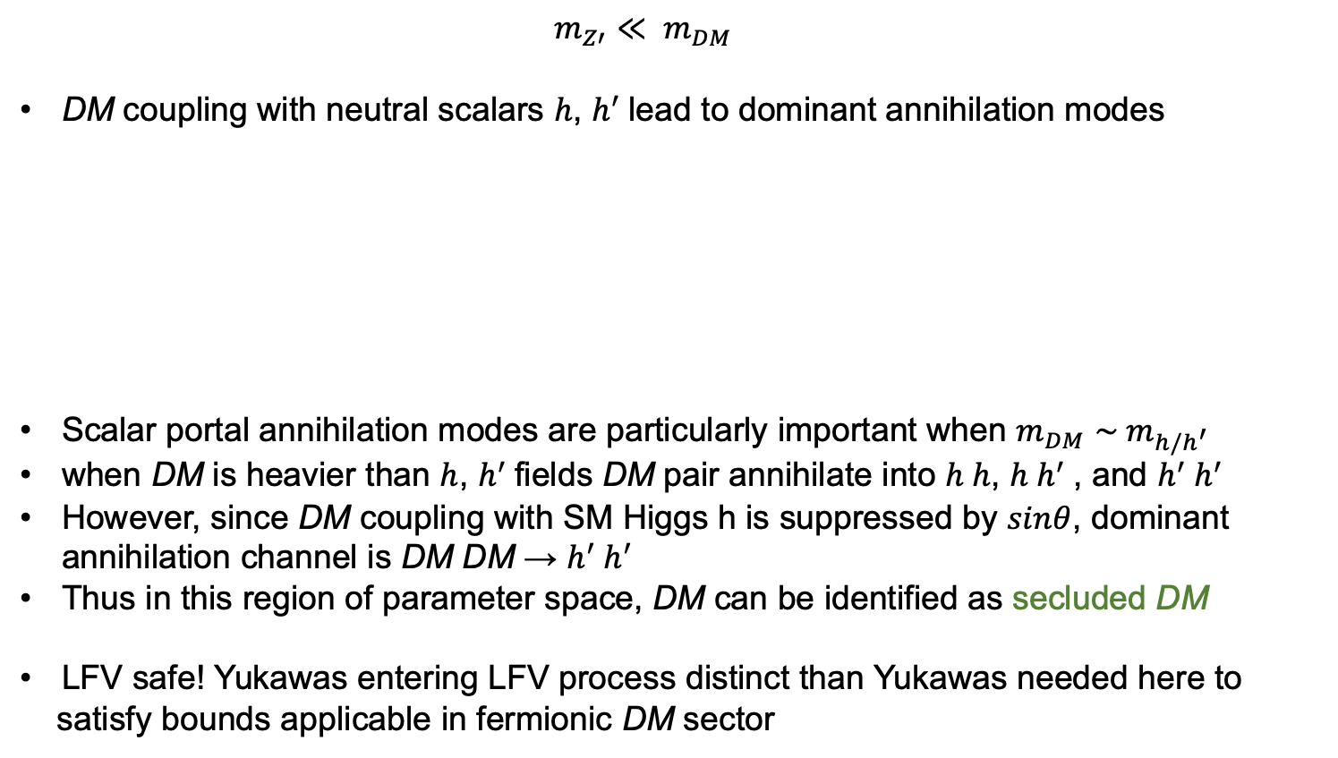
Fermionic DM pheno (Higgs portal)
$m_{Z′}$ $≪ m_{DM}$
DM coupling with neutral scalars $h$, $h^{′}$lead to dominant annihilation modes
Scalar portal annihilation modes are particularly important when $m_{DM}$ $\sim m_{h/h^{′}}$
when DM is heavier than $h$, $h^{′}$fields DM pair annihilate into $h h$, $h h^{′}$, and $h^{′}$ $h^{′}$
However, since DM coupling with SM Higgs h is suppressed by $sinθ$, dominant annihilation channel is DM DM → $h^{′} h^{′}$
Thus in this region of parameter space, DM can be identified as secluded DM
LFV safe! Yukawas entering LFV process distinct than Yukawas needed here to
satisfy bounds applicable in fermionic DM sector

Slide 17
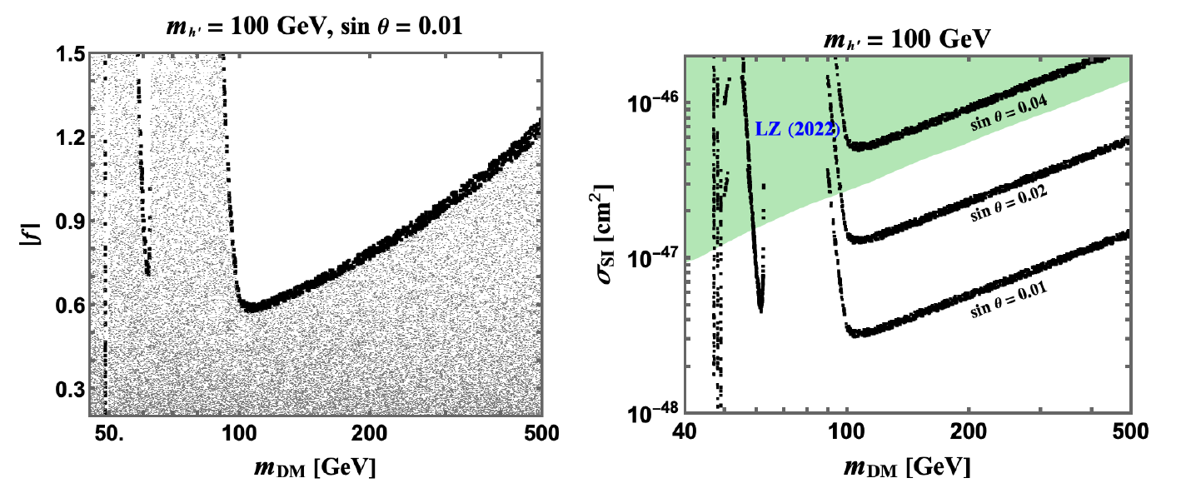
Fermionic DM pheno (Higgs portal)
Fig L: Parameter space in Yukawa coupling (f) vs. m_{DM} plane consistent with relic density constraint for Majorana DM
Fig R: Spin independent cross section vs. m_{DM}
consistent with DD constraints for Majorana DM
Mixing angle sin θ > 0.04 is excluded from the LZ experiment for $m_{h′}$= 100 GeV.
Notes:
Only scalar portals included in the plots

Slide 18
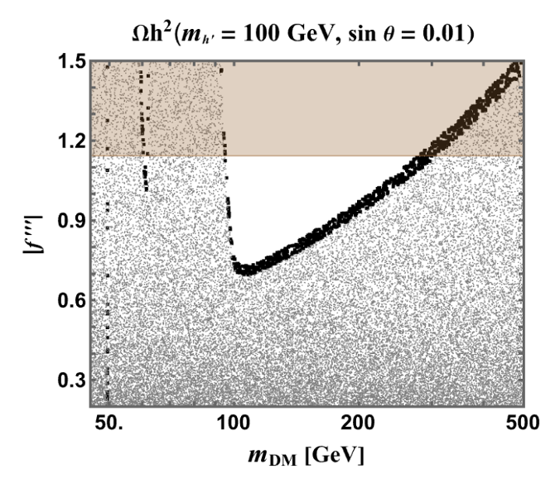
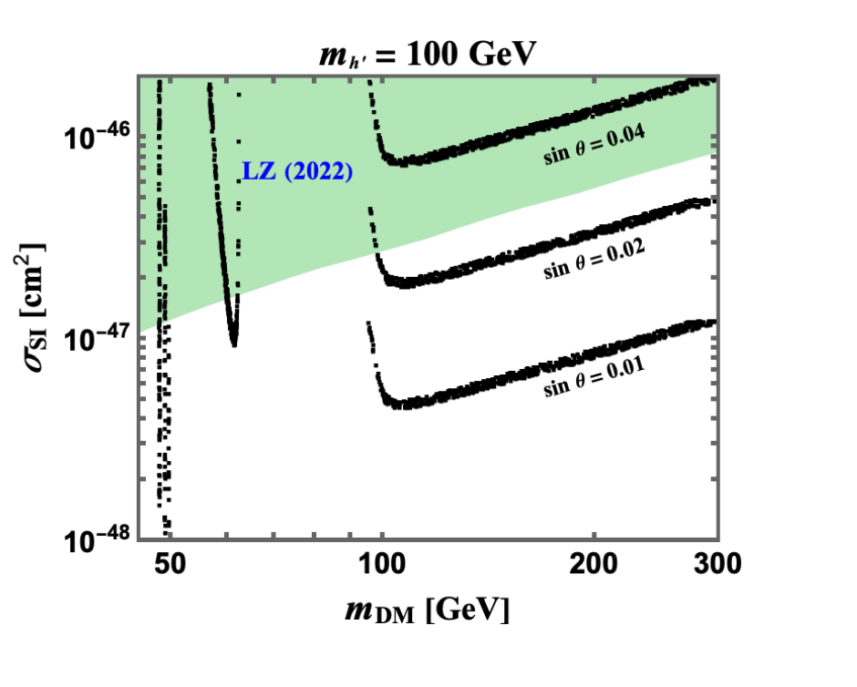
Fermion DM phenomenology (Dirac)
Fig: Parameter space in Yukawa coupling (f’’’) vs. m_{DM} plane consistent with relic density constraint for Dirac DM
Fig: Spin independent cross section vs. m_{DM}
consistent with DD constraints for Dirac DM
Since DM coupling with neutral scalar states h and h′ is similar for both Majorana and Dirac DM, corresponding DM phenomenology is also similar for both cases

Slide 19
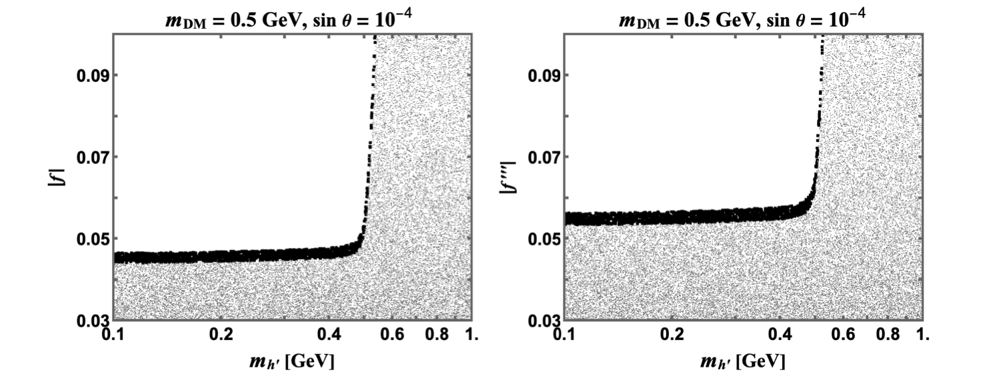
Fermionic DM phenomenology (low mass)
Fig: Parameter space in Yukawa coupling (f, f ′′′) vs. scalar mass (m_{h’}) plane consistent with the relic density constraint for the Majorana (left) and Dirac DM for low mass region

Slide 20
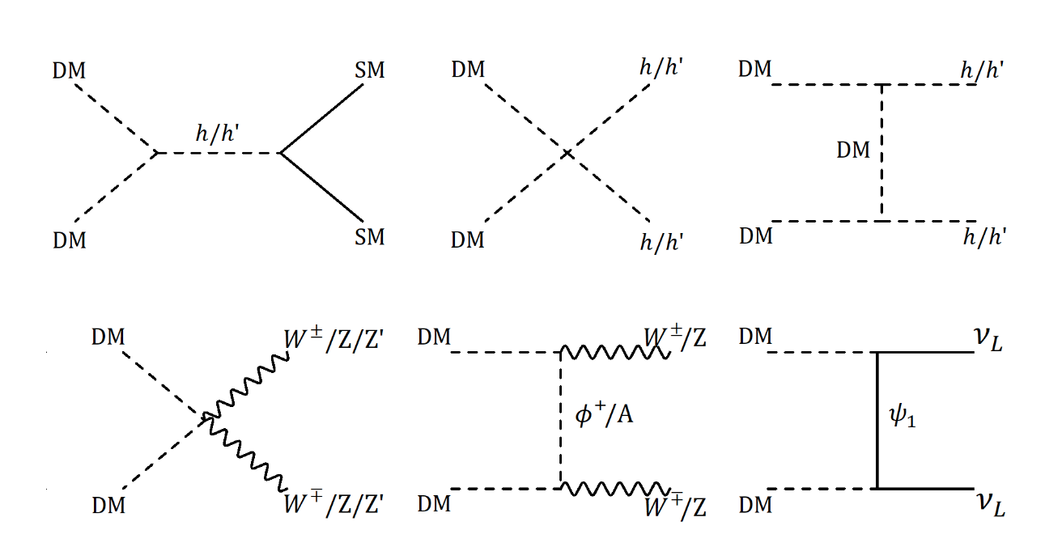
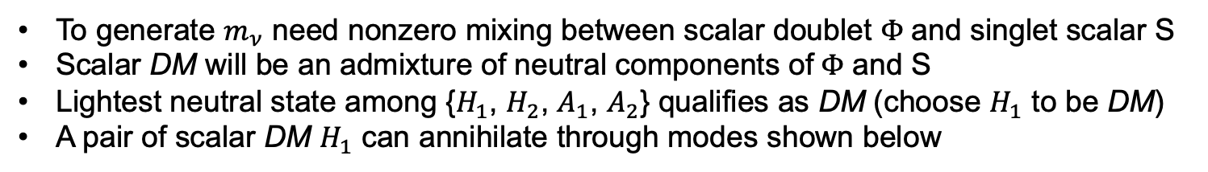
Scalar DM phenomenology
To generate $m_{ν}$ need nonzero mixing between scalar doublet $Φ$and singlet scalar S
Scalar DM will be an admixture of neutral components of$Φ$ and S
Lightest neutral state among {$H_{1}$, $H_{2}$, $A_{1}$, $A_{2}$} qualifies as DM (choose $H_{1}$ to be DM)
A pair of scalar DM $H_{1}$ can annihilate through modes shown below
Feynman diagrams that contribute to the annihilation of scalar DM

Slide 21
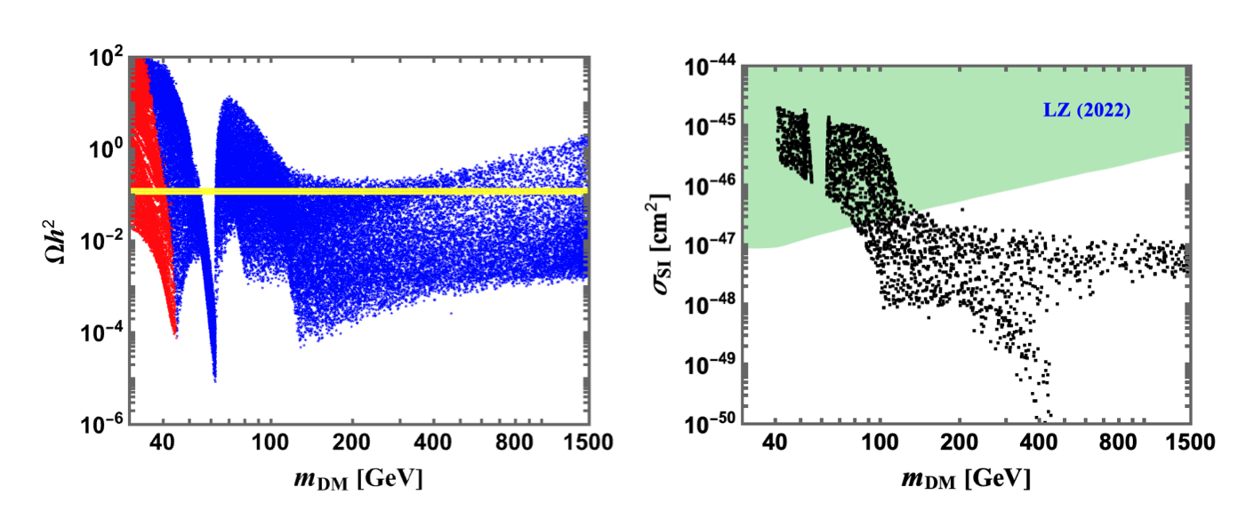
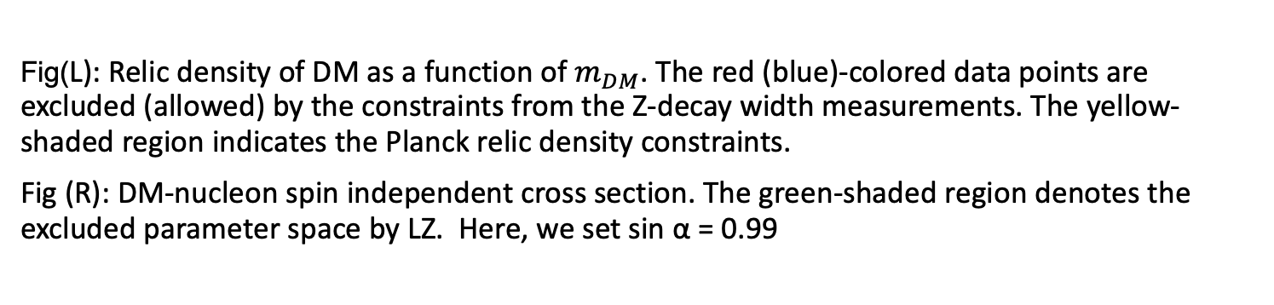
Scalar DM phenomenology
Fig(L): Relic density of DM as a function of $m_{DM}$. The red (blue)-colored data points are excluded (allowed) by the constraints from the Z-decay width measurements. The yellow-shaded region indicates the Planck relic density constraints.
Fig (R): DM-nucleon spin independent cross section. The green-shaded region denotes the excluded parameter space by LZ. Here, we set sin α = 0.99

Slide 22
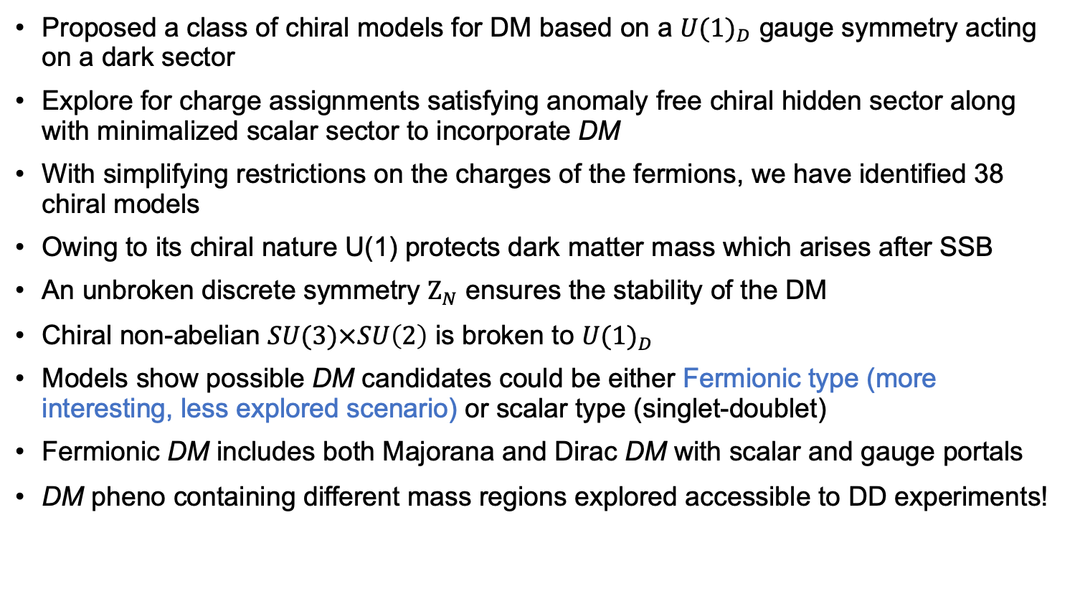
Take Home points
Proposed a class of chiral models for DM based on a ${U(1)}_{D}$ gauge symmetry acting on a dark sector
Explore for charge assignments satisfying anomaly free chiral hidden sector along with minimalized scalar sector to incorporate DM
With simplifying restrictions on the charges of the fermions, we have identified 38 chiral models
Owing to its chiral nature U(1) protects dark matter mass which arises after SSB
An unbroken discrete symmetry $Ζ_{N}$ ensures the stability of the DM
Chiral non-abelian $SU(3)×SU\left(2\right)$ is broken to ${U(1)}_{D}$
Models show possible DM candidates could be either Fermionic type (more interesting, less explored scenario) or scalar type (singlet-doublet)
Fermionic DM includes both Majorana and Dirac DM with scalar and gauge portals
DM pheno containing different mass regions explored accessible to DD experiments!
Thank you for your attention

