Slide 1
Early Universe phase transitions in a classically Scale Invariant Standard Model
Joshua Cesca
University of Sydney
Sydney Consortium for Particle Physics and Cosmology

Slide 2
Contents
Motivation for scale invariance
How scale invariance is realised
Initial implications and viability of scale invariance
Linear sigma model of chiral and electroweak symmetry breaking
Implications of the model
  Gravitational waves
  Primordial black holes
2

Slide 3

Motivation for scale invariance
The hierarchy problem
Formulate the Standard Model in terms of a cutoff energy scale for new physics, $Λ$.
Physical mass $m_{phys}$ of the Higgs differs from the bare mass $m_{bare}$
$$m_{h phys}^{2} =m_{h bare}^{2}+A Λ^{2}+B m_{h bare}^{2}\log{\frac{Λ^{2}}{m_{h bare}^{2}}}+…$$
$m_{h phys}≈125 GeV$ $Λ>{10}^{4} GeV$
No symmetry protecting the Higgs
$$G_{F}\left(x−y\right) = + + + . . .$$
3

Slide 4




Motivation for scale invariance
Classical Scale Invariance as a solution
Scaling transformation:
Classical scale invariance: $S→S$ $ℒ→λ^{4}ℒ$
Spontaneously broken by a quantum anomaly
Technical naturalness
  Energy: $E→λ E$
  Momentum: $p →λ p$
  Distance: $x→λ^{−1} x$
  Time: $t→λ^{−1}$t
  Scalar field amplitude: $φ→λ φ$
  Fermion field amplitude: $ψ→λ^{3/2}$ $ψ$
Classical scale invariance in the UV is broken by the anomaly
Radiative corrections to $m_{h phys}$ are $∝$ the anomaly and can remain small
4

Slide 5





How Scale invariance is Realised
Promotion of dimensionful parameters
$Λ$ - Energy cutoff scale
$λ_{0}$- Cosmological constant
$λ_{h}$ - Higgs self-interaction parameter
$v_{h}$ - Higgs vacuum expectation value
$λ_{χ}$ - Dilaton self-interaction parameter
$v_{χ}$ - Dilaton vacuum expectation value
$ξ$ – Higgs-dilaton coupling strength
$α$ – ratio between $Λ$ and $v_{χ}$
Replace all dimensionful parameters ($m_{h}$, $Λ$, $λ_{0}$) with $χ$ and a dimensionless parameter
$χ$ develops a vacuum expectation value $v_{χ}$ (dimensional transmutation)
All other scales are set by $v_{χ}$
$$V\left(H\right)={{λ_{h}(Λ) (H}^{†}H −v_{h}^{2}(Λ))}^{2}+λ_{0}(Λ)$$
$$Λ→αχ$$
$$V\left(H,χ\right)={{λ_{h}(αχ) (H}^{†}H −\frac{ξ(αχ)}{2}χ^{2})}^{2}+λ_{χ}(αχ)χ^{4}$$
$$Λ=αv_{χ}$$
$$m_{h}^{2}=λ_{h}(αv_{χ})ξ(αv_{χ})v_{χ}^{2}$$
$$λ_{0}=λ_{χ}(αv_{χ})v_{χ}^{4}$$
5

Slide 6
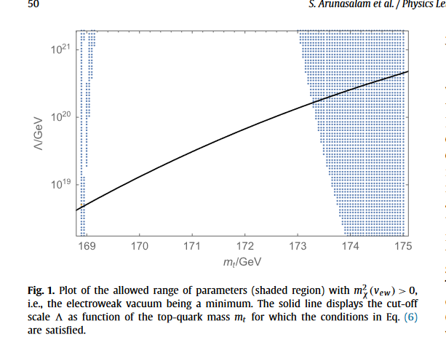

Initial implications and Viability of scale invariance
Existence of a minimum
Minimisation conditions ${\frac{∂V}{∂χ}}_{χ=v_{χ}, h=v_{h}}=0$ , ${\frac{∂V}{∂h}}_{χ=v_{χ}, h=v_{h}}=0$
Vanishing cosmological constant $V\left(v_{h},v_{χ}\right)=0$
Experimental top mass:
$$m_{t}=172.52±0.14±0.30$$
Borderline but modified by other new physics
Arunasalam et al., 2017
6

Slide 7

Initial implications and Viability of scale invariance
Coupling and mass of the dilaton
Assuming $α≡\frac{Λ}{v_{χ}} \sim 1$ and $Λ∼1019 GeV$
Then for $m_{h}≈125 GeV$, $ξ\left(Λ\right)=2\frac{v_{h}^{2}}{v_{χ}^{2}}\sim {10}^{−34}$ so a very weak coupling between $h$ and $χ$
Dilaton develops a mass at second loop level (assuming a vanishing cosmological constant): $m_{χ}^{2}= \frac{β^{′}λχ\left(Λ\right)}{4 ξ\left(Λ\right)}v_{h}^{2}\left(Λ\right)\sim {{(10}^{−8} eV)}^{2}$
Makes it a light dark matter candidate!
7

Slide 8
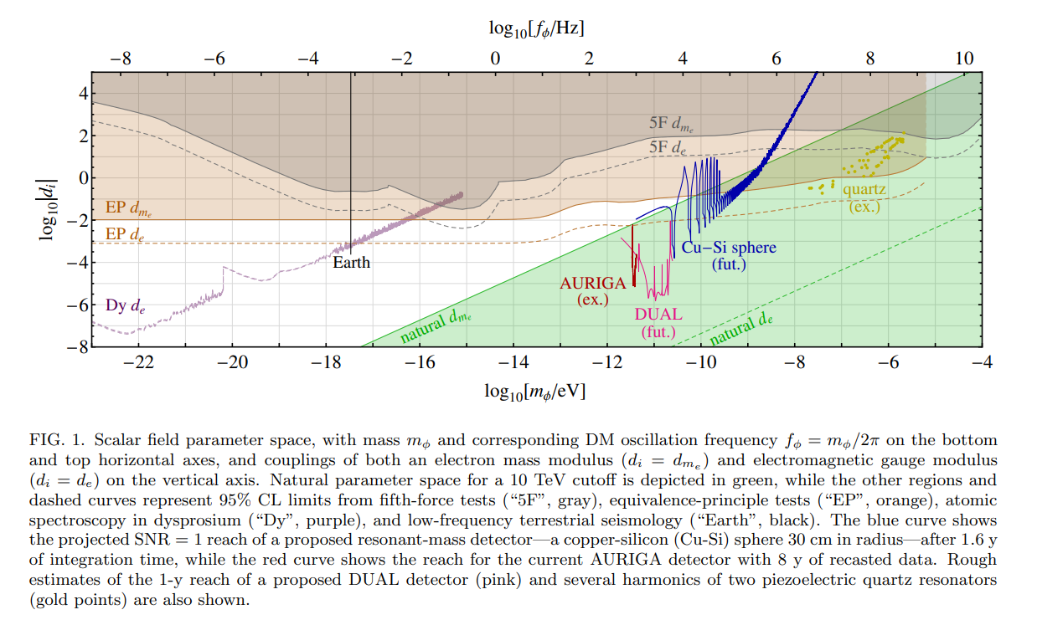


Initial implications and Viability of scale invariance
Fifth force and equivalence-Principle constraints
$ℒ⊃\frac{χ}{Λ} d_{m_{e}}m_{e}\overline{ψ}ψ$
No tree-level coupling to electron mass so expect $d_{m_{e}}∼{10}^{−2}$
$≈$ this model
Arvanitaki, Dimopoulos, and Tilburg, 2016
8

Slide 9
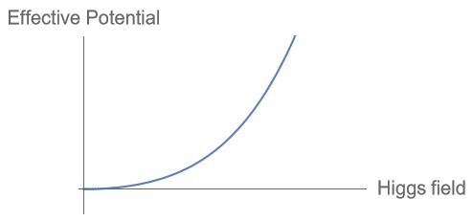
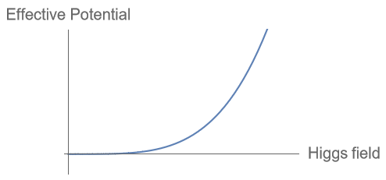
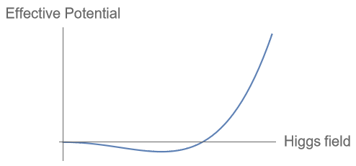
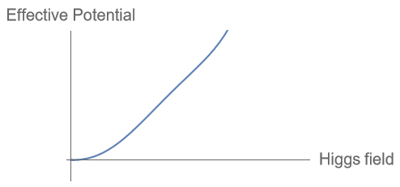
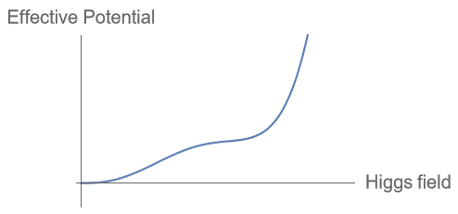
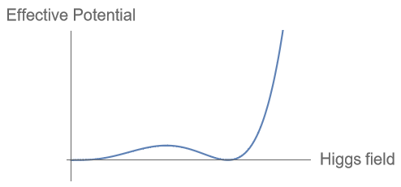

Initial implications and Viability of scale invariance
The electroweak phase transition
Increasing time
T = 0
Decreasing temperature
Standard Model:
Scale invariant Standard Model:
(along $\frac{∂V}{∂χ}=0$)
T = 0?
9

Slide 10
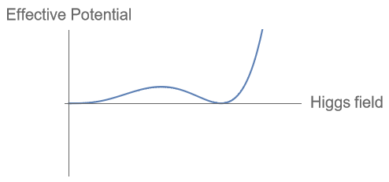
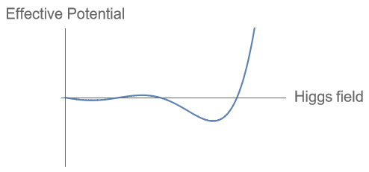
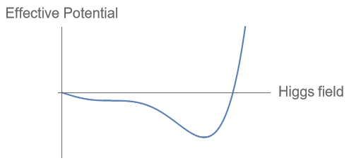

Initial implications and Viability of scale invariance
The chiral phase transition
Yukawa couplings: $Vyukawa{=y}_{u}^{ij}Q^{i}u^{j}\tilde{H}+y_{d}^{ij}Q^{i}d^{j}H+h.c.$ are linear in the Higgs field
When the quark condensate $\left\langle \overline{q}q\right\rangle ≠0$, the Yukawa terms contribute a linear term to the Higgs effective potential
Naively expect:
Increasing time
Decreasing temperature
10

Slide 11
Initial implications and Viability of scale invariance
Cosmological timeline
Hadronization and Chiral symmetry breaking
T ≈ 150 MeV
Electroweak PT
T ≈ 140 GeV
Baryogenesis
T ≳ 4 MeV
Standard Model:
Chiral and Electroweak PTs T ≈ 25 MeV
Hadronization
T ≈ 85 MeV
Baryogenesis
T ≳ 4 MeV
Scale invariant Standard Model:
11

Slide 12


Linear sigma model of chiral and electroweak symmetry breaking
Model checklist
Should be $SU{\left(6\right)}_{V}×SU{\left(6\right)}_{A}$ symmetric (except for a mass term)
Needs an order parameter $σ$ and symmetry breaking potential $V\left(σ\right)$ to model the chiral symmetry breaking
Integrating out $σ$ should reduce the theory to the usual non-linear sigma model of pions
$$ℒ =\frac{f_{π}^{2}}{4}Tr\left(∂_{μ}{U∂}^{μ}U\right)+κ Tr\left(UM\right)+h.c.$$
Should be classically scale invariant
$$U=e^{2i\frac{Π^{a}T^{a}}{f_{π}^{2}}}$$
12

Slide 13





Linear sigma model of chiral and electroweak symmetry breaking lagrangian and effective potential
$σ$ – Chiral transition order parameter
$Π^{a}$ - 35 pion fields
$T^{a}$ - 35 SU(6) generators
$y_{i}$ - Yukawa couplings
$n_{f}$ - Number of flavours = 6
$Λ_{QCD}$ - QCD confinement scale
$$ℒ =Tr\left(∂_{μ}{Φ∂}^{μ}Φ\right)−λ_{σ}{\left(Tr\left(Φ^{†} Φ\right)−n_{f}v_{σ}^{2}\right)}^{2}+λ_{κ} Tr\left(Φ^{†} ΦΦM\right)+h.c.$$
  Effective potential:
  $$V_{0}\left(σ,h\right)= \frac{λ_{σ}}{4}σ^{4}−\frac{λ_{κ}y_{t}}{2 n_{f}^{3/2}}σ^{3}h$$
  With 1-loop radiative and thermal corrections:
  $V_{CW}\left(σ,h\right)=\sum_{i}{g_{i}\frac{m_{i}^{4}(σ,h)}{64 π^{2}}\log{\frac{m_{i}^{2}(σ,h)}{Λ_{QCD}^{2}}}}$
  $$V_{T}\left(σ,h,T\right)=\sum_{i}{g_{i}\frac{T^{4}}{2π^{2}}J_{B}(\frac{m_{i}^{2}(σ,h)}{T^{2}})}$$
$Φ={\frac{σ}{\sqrt{2n_{f}}}e}^{i\sqrt{2n_{f}}\frac{Π^{a}T^{a}}{σ^{2}}}$
$$M=diag(y_{u}, y_{d}, y_{c}, y_{c}, y_{b}, y_{t})\frac{h}{\sqrt{2}}$$
Dominant contribution from:
$i=W^{±}, Z, π_{25}, π_{26},…,π_{35}$
13

Slide 14
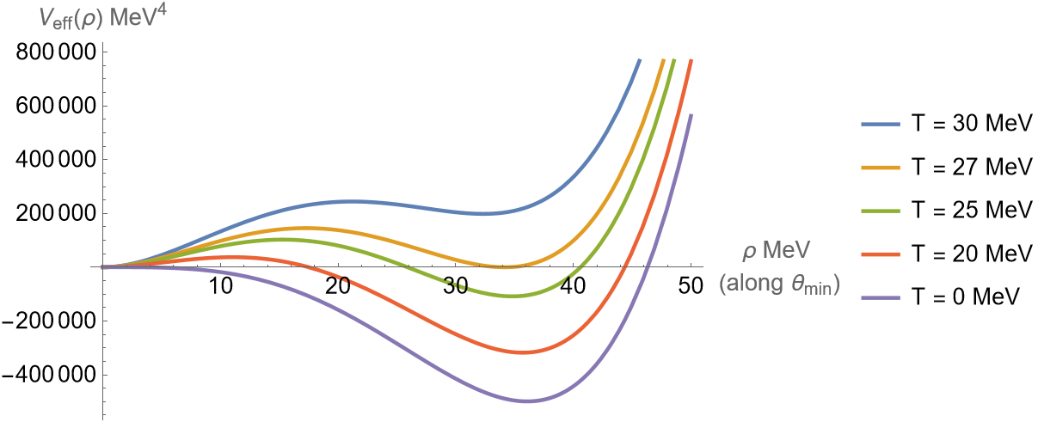

Implications of the model the effective potential
Sigma field:
$$σ=ρ\sin{θ}$$
Higgs field:
$$h=ρ\cos{θ}$$
$$θ_{min}≈0.67$$
Critical temperature:
$T_{c}=27$ MeV
14

Slide 15



Implications of the model
First order phase transition
Metastable vacuum means the electroweak phase and chiral phase transitions are now first-order
False vacuum
False vacuum
Gravitational Waves
True Vacuum
True Vacuum
Semiclassical approximation for tunnelling (in the high-T limit) gives $S(T)$
Gives the percolation temperature
$T_{p}≈26$MeV
Calculate the transition probability $Γ(T)$
15

Slide 16

Implications of the model
Speed of bubble walls and energy budget
Where does the released vacuum energy go?
$$\frac{F_{net}}{A}=\frac{F_{driving}}{A}−\frac{F_{friction}(v_{w})}{A}$$
If $\frac{F_{net}}{A}$ > 0 for all $v_{w}$ then we get a runaway bubble, and the energy mostly goes to the walls
Otherwise, we get a terminal velocity $v_{w}$ and the energy is mostly deposited inside the bubble
$$∂^{2}ρ+\frac{∂ V_{eff}(ρ,T)}{∂ρ}−\frac{∂_{μ}ρ u^{μ} f\left(ρ\right)}{\sqrt{1+{\left(∂_{μ}ρ u^{μ} g\left(ρ\right)\right)}^{2}}}=0$$
Gives a terminal velocity $v_{w}=0.99986$ (thanks to scale invariance and 0 cosmological constant)
16

Slide 17
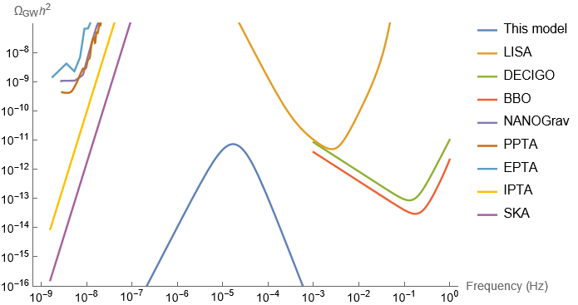


Implications of the model
Gravitational waves
$Ω_{GW}h^{2}=2.65×{10}^{−6} \frac{H}{β}{\left(\frac{k_{v}α}{1+α}\right)}^{2}{\left(\frac{100}{g_{∗}}\right)}^{1/3}v_{w}{\left(\frac{f}{f_{sw}}\right)}^{3}{\left(\frac{7}{4+3{\left(\frac{f}{f_{sw}}\right)}^{2}}\right)}^{7/2}$
3 sources of gravitational waves:
  Collision of bubble walls
  Sounds waves (dominant here)
  Magnetohydrodynamic turbulence
Ratio of latent heat to radiation energy $α=\frac{ε_{vac}}{ε_{rad}}≈0.09$
Ratio of transition rate to Hubble scale $\frac{β}{H(T_{p})}≈4000$
Fraction of latent heat that goes into bulk motion of the plasma $κ_{v}≈0.1$
$$f_{sw}=1.9×{10}^{−5}Hz\frac{1}{v_{w}}\frac{β}{H}\left(\frac{T}{100GeV}\right){\left(\frac{g_{∗}}{100}\right)}^{1/6}$$
17

Slide 18



Implications of the model
Primordial black holes from late-time nucleation
Radiation energy density scales as $a{\left(t\right)}^{−4}$ while vacuum energy density doesn’t scale
So later nucleating patches become over-dense compared to earlier patches
If the over-density $δ\left(t_{late}\right)≡\frac{ε_{rad}^{late}\left(t_{late}\right)−ε_{rad}}{ε_{rad}}$ reaches a critical value $δ_{c}≈0.5$, it collapses to a primordial black hole
$\max\left(T_{late}\right)=12.5$ MeV
$P\left(T_{late}\right)=\exp\left(\frac{−4π}{3} \frac{T_{late}}{H\left(T_{late}\right)}\int_{T_{late}}^{T_{c}}{\frac{dT}{H\left(T\right)} {\left(\frac{S\left(T\right)}{2π}\right)}^{\frac{3}{2}} e^{−S\left(T\right)}}\right)=exp⁡(−4×{10}^{36})$
$$\frac{Ω_{PBH}}{Ω_{m}}≈0$$
18

Slide 19

Implications of the model
Primordial black holes from inflation over-densities
The critical over-density for collapse $δ_{c}$ depends on the equation of state of the fluid
Near a first order phase transition the equation of state drops, $ω_{min}≈\frac{g_{∗}^{−}}{{4g}_{∗}^{+}−g_{∗}^{−}}$
Mass given by $M_{PBH}≈\frac{4π}{3}{\left(c_{s}H^{−1}\right)}^{3}ε_{rad}$
For the confinement transition:
$T≈85$ MeV, $g_{∗}^{+}≈106.75$, $g_{∗}^{−}≈62.75$, $ω_{min}≈\frac{1}{6}$ , $M_{PBH}≈1\text{M}\text{☉}$
For the chiral/electroweak transition:
$T≈25$ MeV, $g_{∗}^{+}≈62.75$, $g_{∗}^{−}≈10.75$, $ω_{min}≈\frac{1}{22}$ , $M_{PBH}≈1\text{0}\text{M}\text{☉}$
19

Slide 20
Conclusion
The scale invariant extension solves the Hierarchy problem
It has only a small effect on the Standard Model today, adding just one more light, weakly interacting particle but leaving the rest intact
But it has a significant impact on cosmological history which may one day be detectable in the gravitational wave background or in the presence of primordial black holes
20

Slide 21
future work
Effect on baryogenesis
Tunnelling rate for electroweak phase transition before T=7 MeV
Interactions between the dilaton and SM particles
Formation of primordial black holes
17

Slide 22
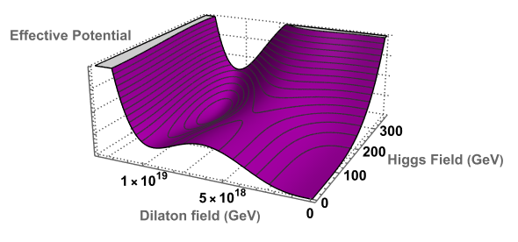

Initial implications of scale invariance
The Higgs-Dilaton effective potential (at zero temperature)
$$V\left(Φ,χ\right)={ \frac{λh(αχ)}{4}(h2−ξ(αΛ)χ^{2})}^{2}+λ_{χ}(αχ)χ^{4}$$
True vacuum
Barrier
False Vacuum
Two degenerate vacua separated by a potential barrier
8

Slide 23



Features of the model finite temperature corrections to the effective potential
$T$ – Temperature of the universe
$mi(h)$– Field-dependent mass of particle i
$λ_{h}$ - Higgs self-interaction parameter
$yt$ – Top quark Yukawa coupling parameter
$g$ – SU(2)_{L} coupling parameter
$g′$ – U(1)_{Y} coupling parameter
Temperature corrections are of the form $\sum_{i}{\frac{T^{4}}{2π^{2}}J_{B}(\frac{m_{i}^{2}(h)}{T^{2}})}$
Thermal bosonic function is $J\left(y\right)=\int_{0}^{∞}{dx x^{2}\ln\left(1−e^{−\sqrt{x^{2}+y}}\right) }$
Adds a term to the effective potential $V_{T}\left(h\right)=\frac{1}{24}\left(2λ_{h}+3y_{t}^{2}+\frac{9}{4}g^{2}+\frac{3}{4}{g^{′}}^{2}\right)T^{2}h^{2}$
9

Slide 24


Motivation for the model
The Hierarchy Problem
$m_{h}$ - Observed Higgs mass
$m_{h0}$ - Bare Higgs mass
$Λ$ - Energy cutoff scale
$μ$ - Measurement energy
A, B – computed values, expected to be O(1)
$m_{h}=125 GeV$ $Λ>{10}^{4} GeV$
Naturalness problem: $\frac{m_{h}}{Λ}≪1$
One-loop corrected Higgs mass in the effective theory:
$$m_{h }^{2}\left(μ,Λ\right)=m_{h0}^{2}(Λ)+A Λ^{2}+B{ m}_{h0}^{2}(Λ)\ln{\frac{Λ^{2}}{μ^{2}}}$$
Other particle masses are protected by symmetries
3

Slide 25
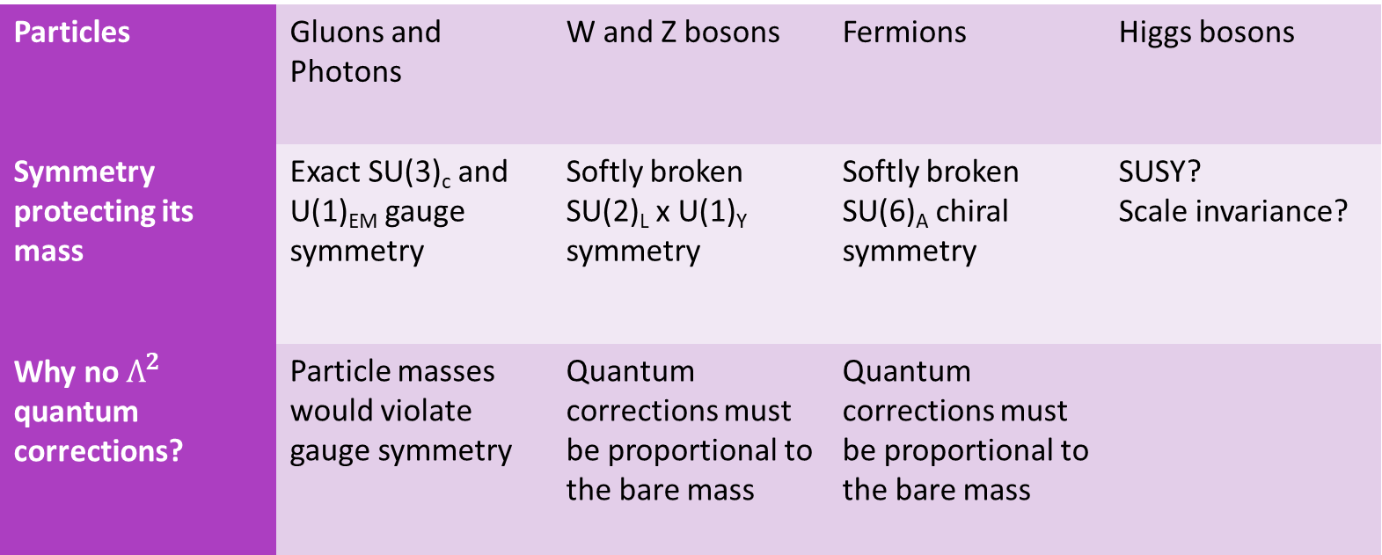
Motivation for the model
Why the other particles don’t have a hierarchy Problem
Particles | Gluons and Photons | W and Z bosons | Fermions | Higgs bosons
Symmetry protecting its mass | Exact SU(3)_{c} and U(1)_{EM} gauge symmetry | Softly broken SU(2)_{L} x U(1)_{Y} symmetry | Softly broken SU(6)_{A} chiral symmetry | SUSY? Scale invariance?
Why no $Λ^{2}$ quantum corrections? | Particle masses would violate gauge symmetry | Quantum corrections must be proportional to the bare mass | Quantum corrections must be proportional to the bare mass
4

Slide 26
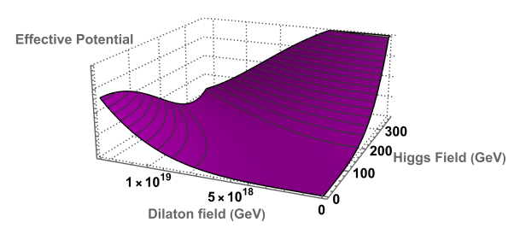

Tree level:
  $$V\left(h,χ\right)=\frac{λ_{h}}{4}({ h^{2}−ξχ^{2})}^{2}$$
Flat direction

Slide 27
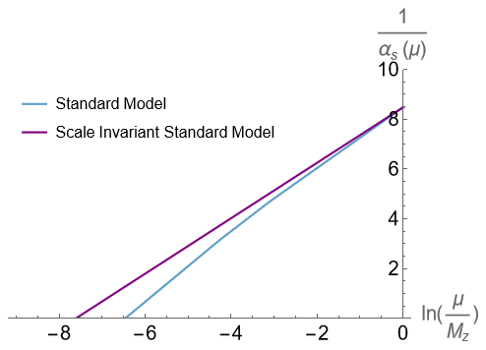


Consequences of the model
Running of the Strong coupling
$α_{s}(μ)$ – Strong coupling strength
$μ$ - Measurement energy
$N_{f}$ - Number of quarks with masses below $μ$
$\frac{1}{α_{s}(μ_{1}^{2})}−\frac{1}{α_{s}\left(μ_{2}^{2}\right)}=\frac{33−2N_{f}}{12π}\ln{(\frac{μ_{1}^{2}}{μ_{2}^{2}})}$
$Λ_{QCD}$ is defined as when $\frac{1}{α_{s}}→0$
Standard Model: $Λ_{QCD}≈340$ MeV
Scale invariant Standard Model (6 massless quarks): $Λ_{QCD}≈18$ MeV
12

