Slide 1
Environmental neutron measurement at the Gran Sasso laboratory in the NEWSdm experiment
T. Shiraishi - Kanagawa Univ.
On the behalf of the NEWSdm collaboration
14 Dec. 2023 CYGNUS 2023 (Sydney)

Slide 2
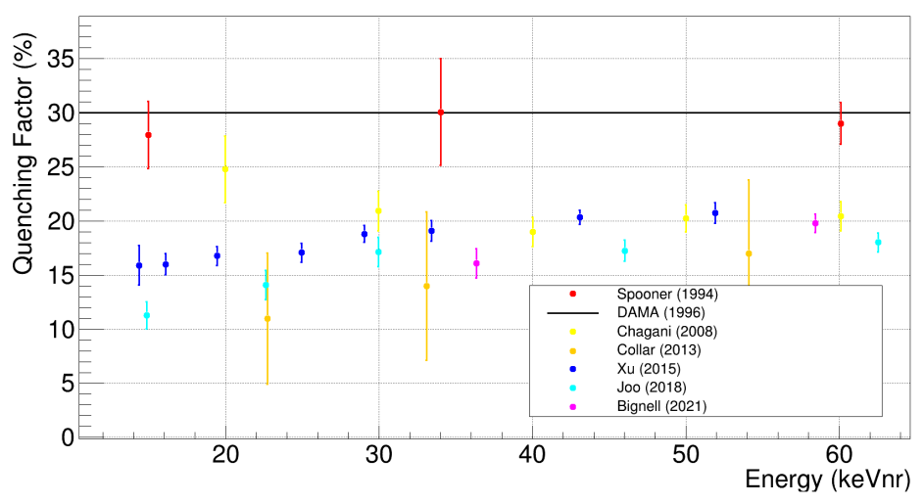
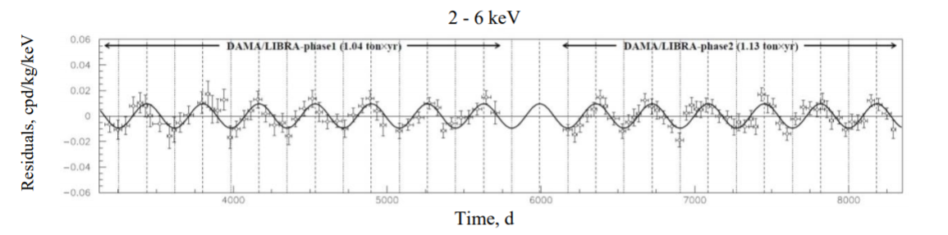
For the Verification of DAMA Signal
DAMA claims signal around 2 – 6 keVee
Many experiments agree that quenching factor of Na is ~20%
22 years annual modulation
R. Bernabei et al., Nucl. Phys. At. Energy 19, 307 (2018)
D. Cintas et al, J. Phys.: Conf. Ser. 2156, 012065 (2021)
Assuming DAMA signal as neutron background, its energy corresponding to 80 – 250 keV
→ Neutron spectrum measurement including sub-MeV region is needed to verify the DAMA signal!

Slide 3
Environmental Neutron Measurement @LNGS
H. Wulandari, et al., Astropart. Phys. 22 (2004) 313.
A. Rindi, et al., Nucl. Inst. Meth. A, 272 (1988) 871.
No spectrum and directional data in sub-MeV
⁶Li liquid scintillator
(Hall A)
Plastic Scintillator
(Hall C)
BF₃ Counter
(Hall A)
³He Counter (Tunnel)
Neutron Detector | Energy Range | γ-ray rejection power | Energy Resolution | Directionality
Liquid Scintillator | 1MeV − 100MeV | Bad | Good | None
BF₃ ,³He Proportional Counter | Thermal − 20MeV | Good | None | None
Proton-recoil Proportional Counter | 10keV − 2MeV | Bad | Good | None
Nano Imaging Tracker (NIT) | Thermal & 100 keV − | Good | Good | Good

Slide 4
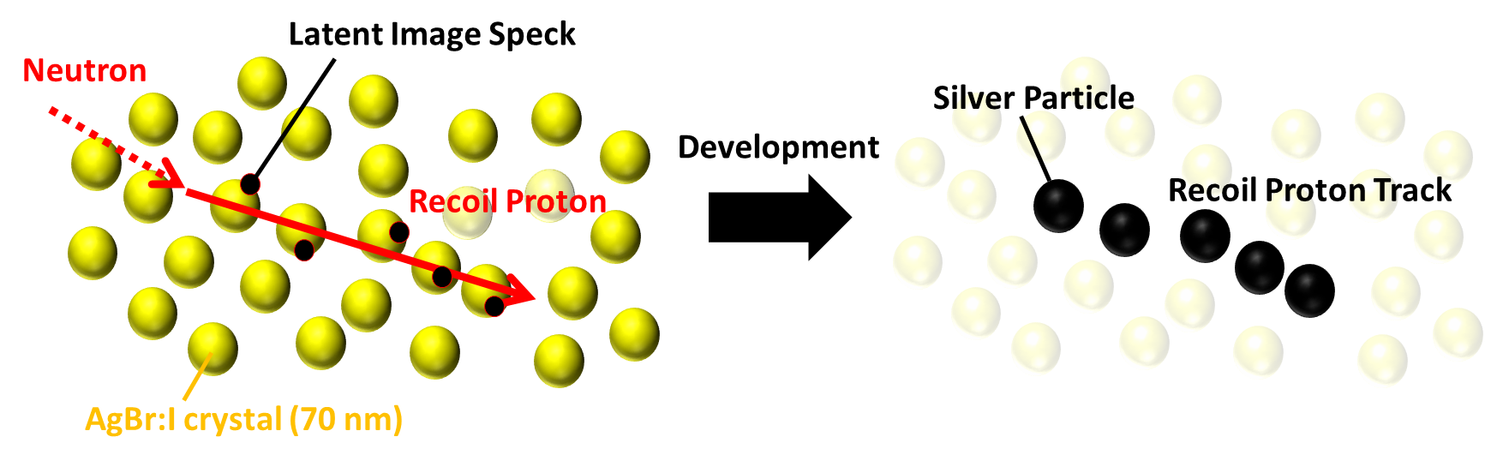
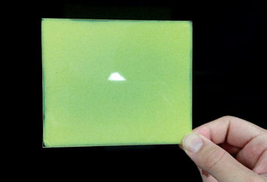
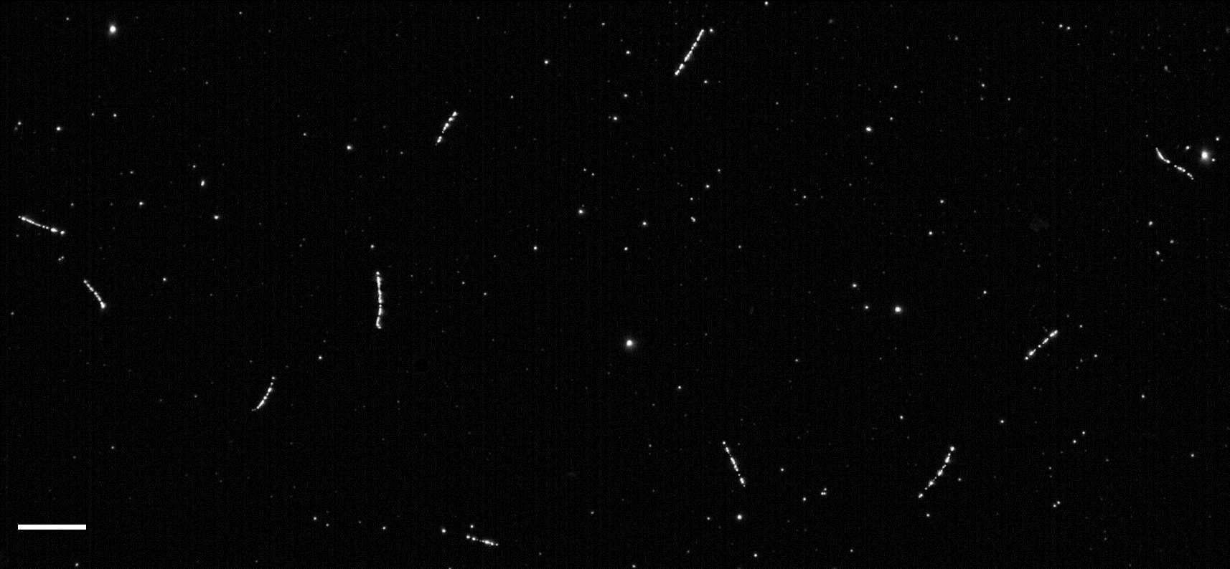

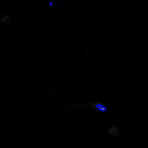
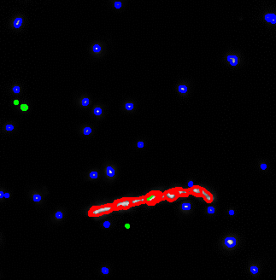
Neutron Detection Principle by Nano Imaging Tracker (NIT)
NIT film
H atomic fraction ~ 40%
Optical Microscope Image
880 keV Neutron
10 μm
5 μm
Sub-micrometric
3D tracking
Proton range
Neutron
θ
Ep ~ 600 keV
T. Shiraishi, et al., PTEP 2021 4, 043H01 (2021)
10 μm
T. Shiraishi, et al., Phys. Rev. C 107, 014608 (2023)

Slide 5
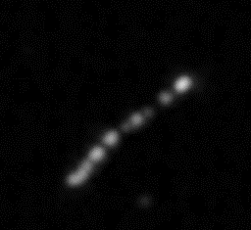
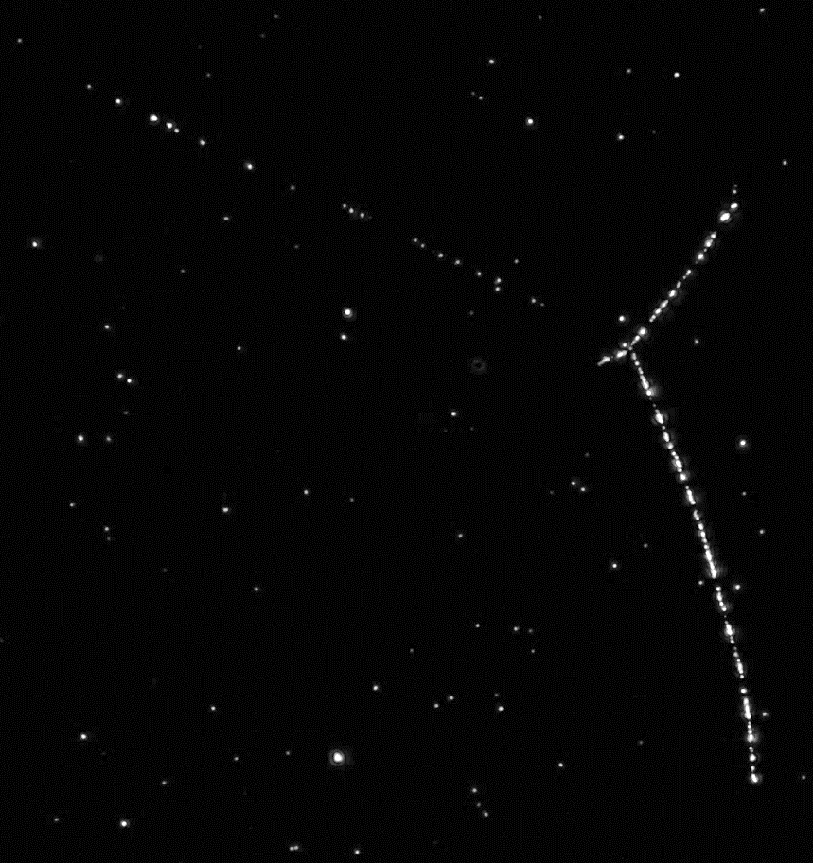

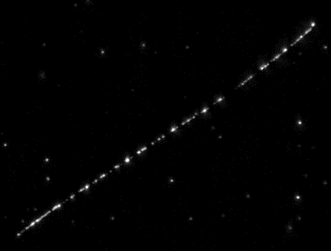
Neutron Detection Methods for Various Energies
Neutron Energy
meV (thermal neutron)
100 keV (~ 1 µm)
Sub-GeV −
Neutron Capture
Proton Elastic Scattering
Deep Inelastic Scattering
Self-contained target
p (6.5 µm)
880 keV neutron
3 fragments
n + ¹⁴N → p + ¹⁴C + 0.62 MeV
2 barn @ 26meV
Recoil proton
(580 keV)
Additional target
Nuclear recoil
θ
⁷Li (2.5 µm)
³H (41 µm)
α (4.8 µm)
Vertex
10 µm
70 µm
Boron powder
α (7.3 µm)
Reconstruct 3D trajectory with sub-micron accuracy
→ can obtain position, energy and direction
n + ¹⁰B → α + ⁷Li + 2.31 MeV
4000 barn @ 26meV
n + ⁶Li → α + ³H + 4.78 MeV
950 barn @ 26meV

Slide 6
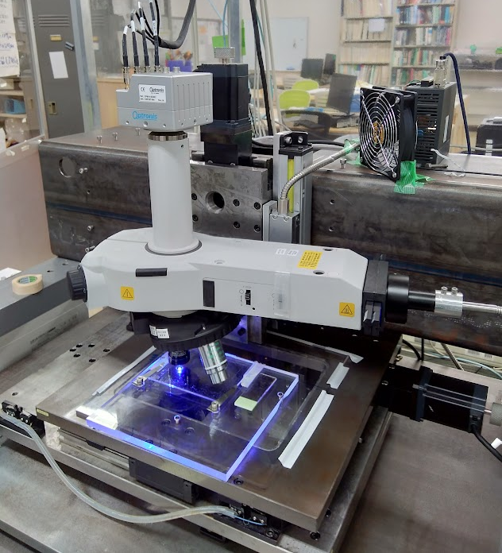
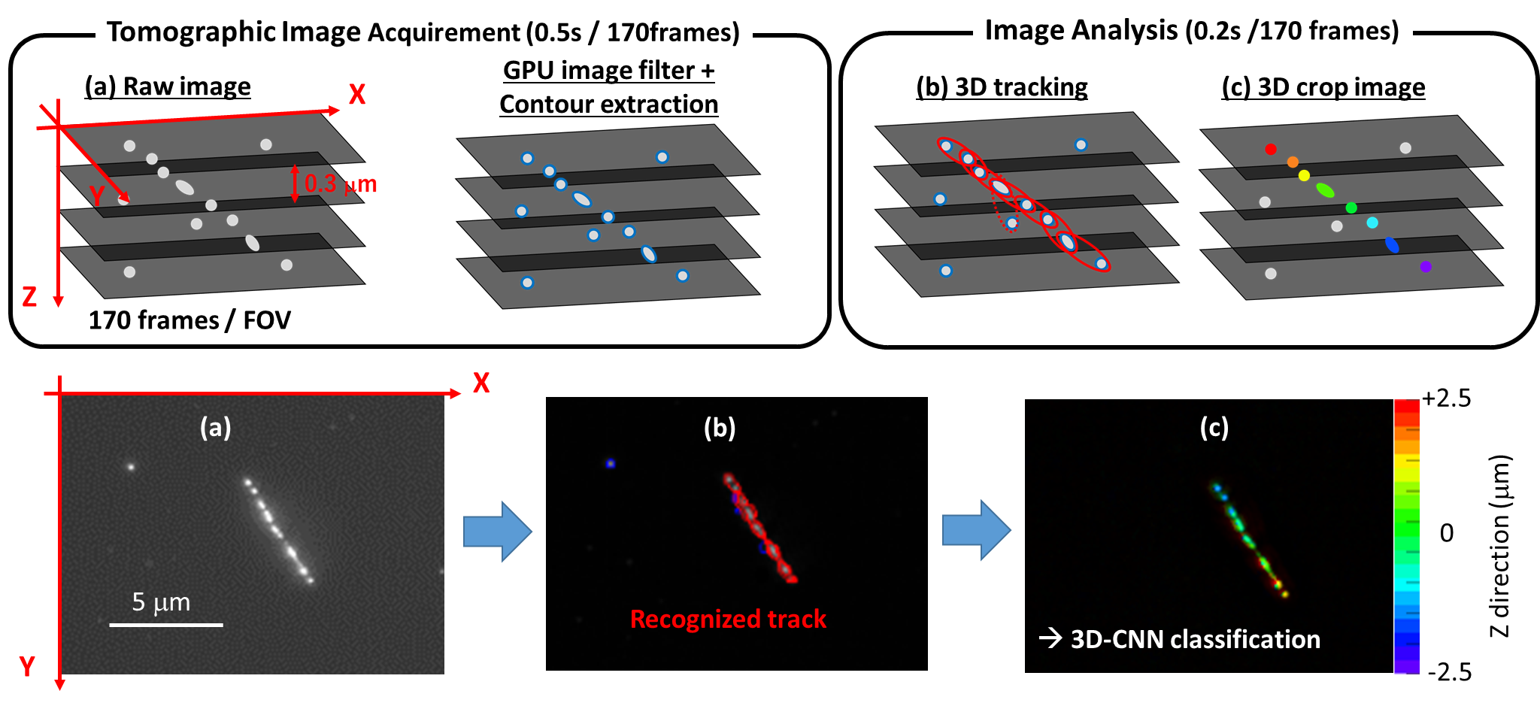
High-speed Readout and Image Processes
PTS system @ Toho Univ.
High-speed Camera
Z-drive
Epi-illumination microscope
Light guide
(Blue LED)
6
Objective lens
XY-drive
Achieving 0.5 kg/year/machine with 1 μm range cut
Under constructing an upgraded PTS machine in Kanagawa Univ.
→ expected to be 1.5 kg/year/machine until Apr. 2024
T. Shiraishi, et al., PTEP 2021 4, 043H01 (2021)
T. Shiraishi, et al., Phys. Rev. C 107, 014608 (2023)

Slide 7
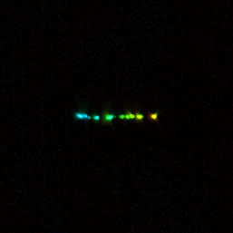
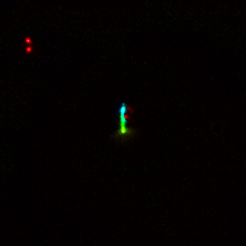
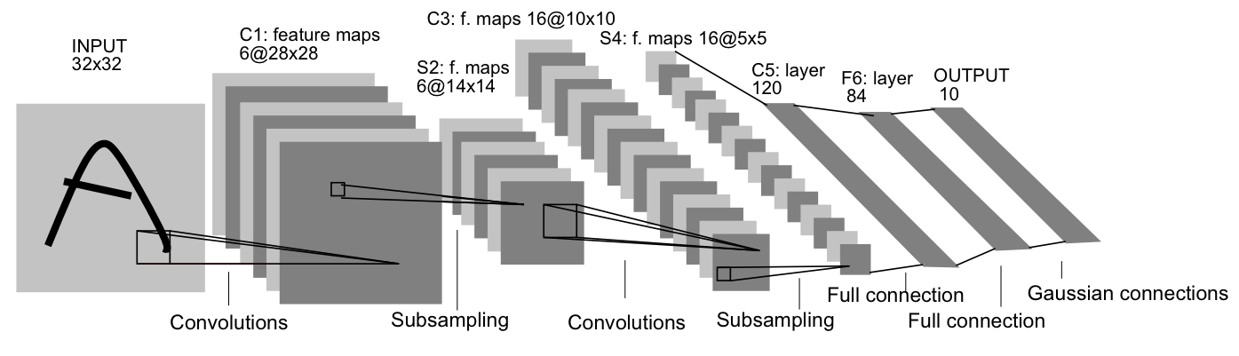
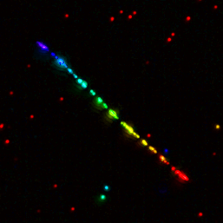
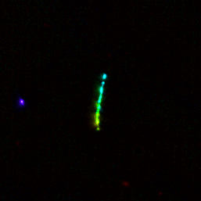
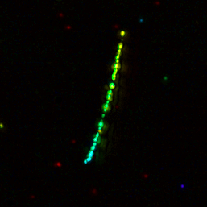
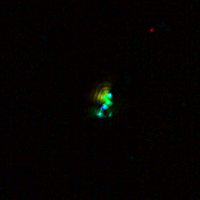
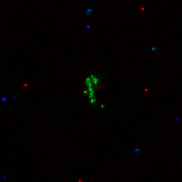
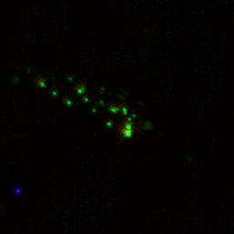
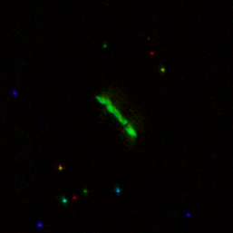
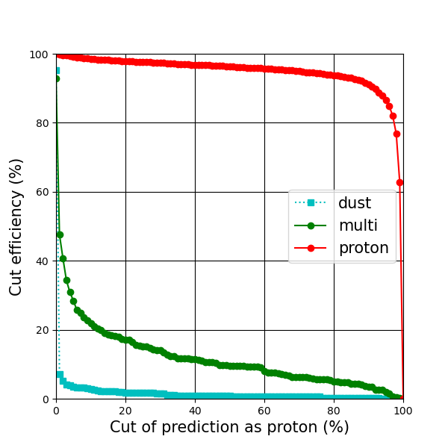
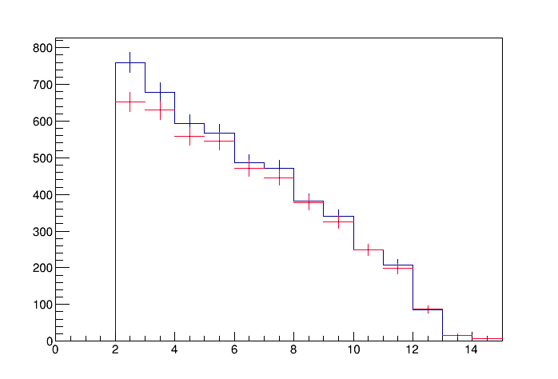
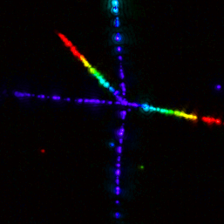
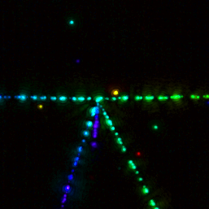
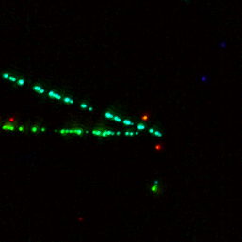
Convolutional Neural Network
*still using 2Dconv for 3D image ☹
Training Samples
Input image size
256 x 256 x 20
Proton or alpha
Dust
CNN selection effect
(705 keV neutron sample)
CNN cut efficiency
Blue: All data
Red：CNN selected
Multi-prong
Rp (μm)
Signal probability (%)

Slide 8
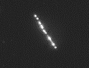
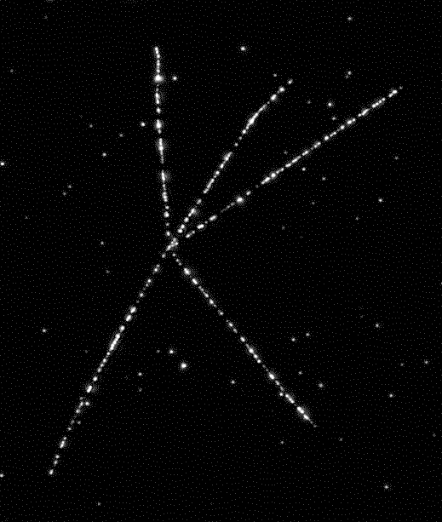
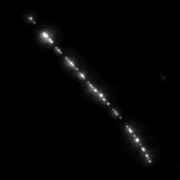
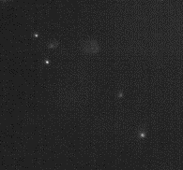
Background in Neutron Detection
Recoil proton signal
α-ray
Th star (²²⁸Th → ²⁰⁸Pb)
Topological or Range cut
Single-α in U series
5.3 μm
（0.5 MeV）
²¹²Bi
²²⁸Th
50μm
²¹⁰Po (24.5 μm)
5 μm
²¹⁶Po
Clearly distinguishable
²²⁴Ra
²²⁰Rn
γ-ray (β-ray)
50μm
Exposed 5x10⁷ γ-ray/cm² from ²⁴¹Am and ⁶⁰Co
(5 years accumulation of environmental γ-ray)
There is no background in sub-MeV region
(2 - 14 μm → 0.25 - 1 MeV in proton energy)
MeV region can be analyzed excluding single-α (especially ²¹⁰Po peak around 24 μm)
5 μm
Environmental γ-rays cannot become background

Slide 9
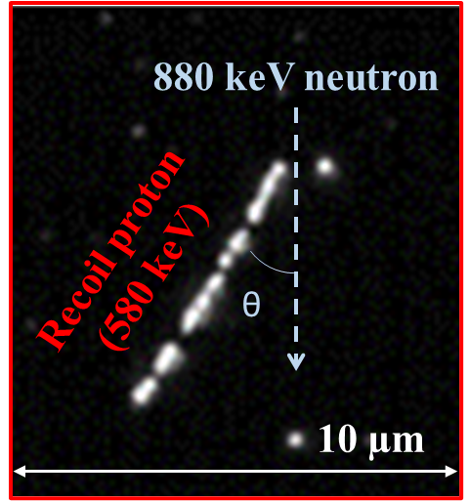
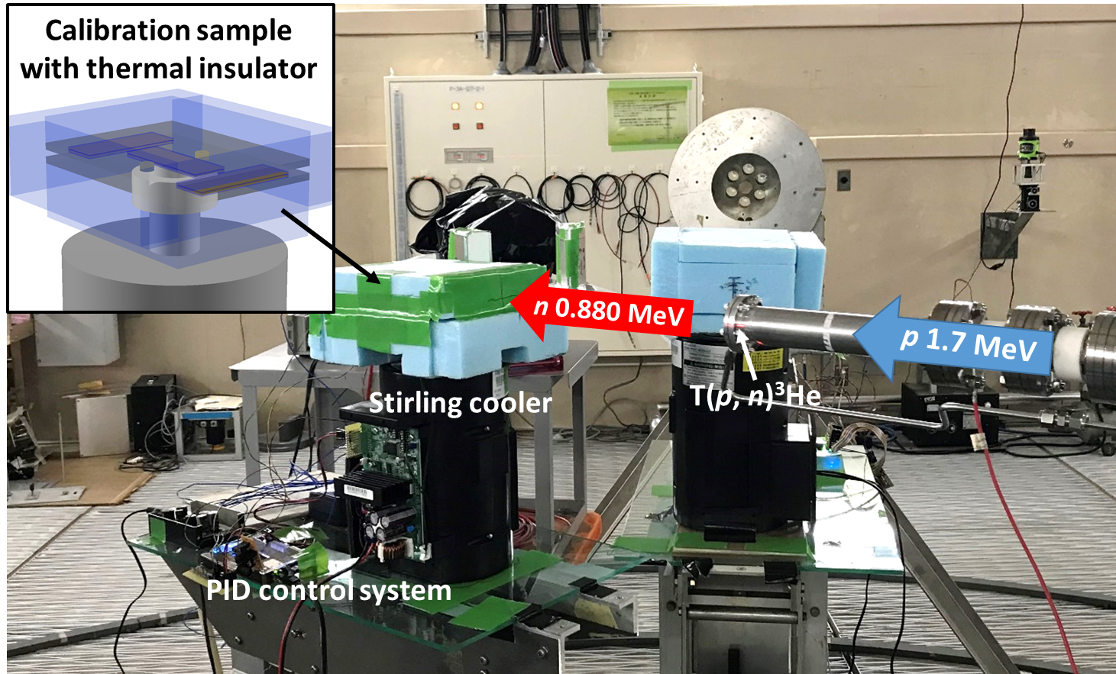
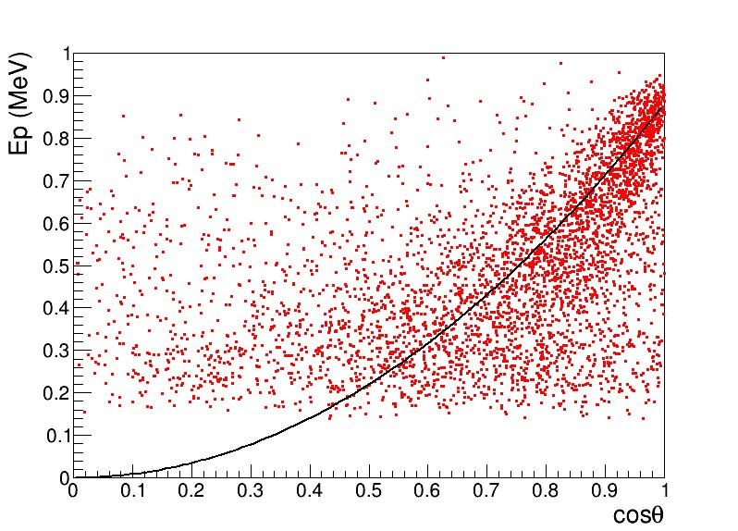
Calibration with Monochromatic Sub-MeV Neutron
Monochromatic 880 keV neutron exposure from T(p n)³He reaction at AIST
Data of recoil proton
Exposed 7.9 hours with a stable temperature at -26℃
Range cut (1 μm)
En cos²θ

Slide 10
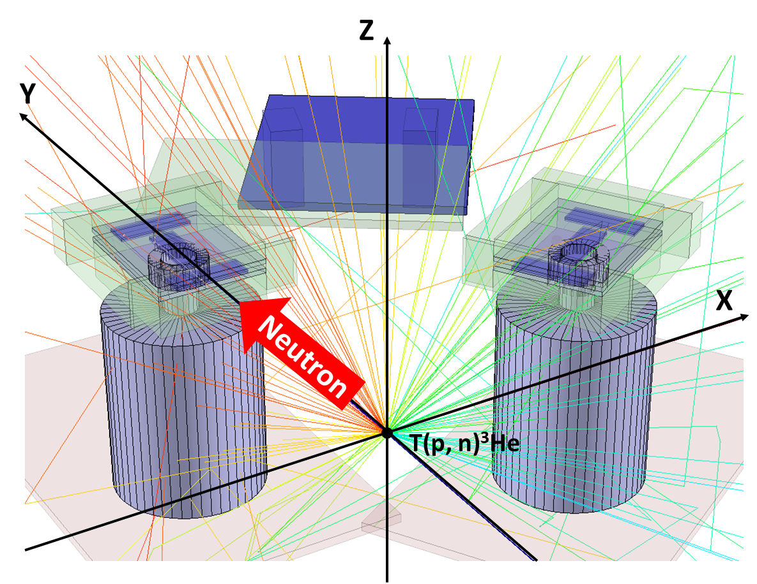
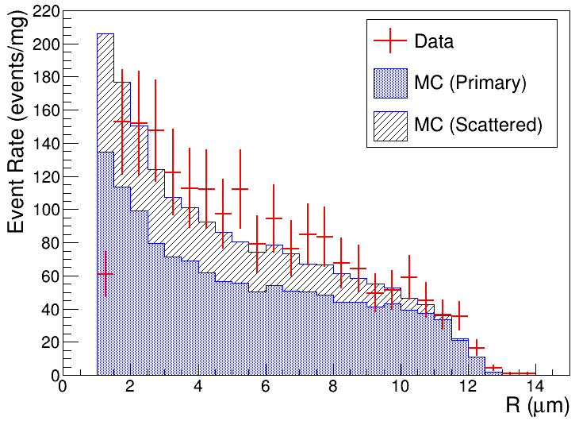
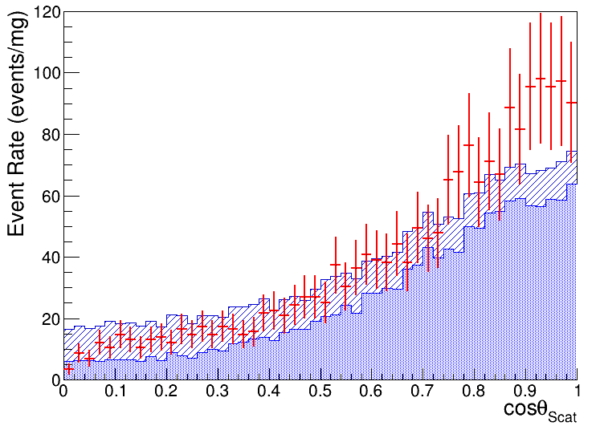
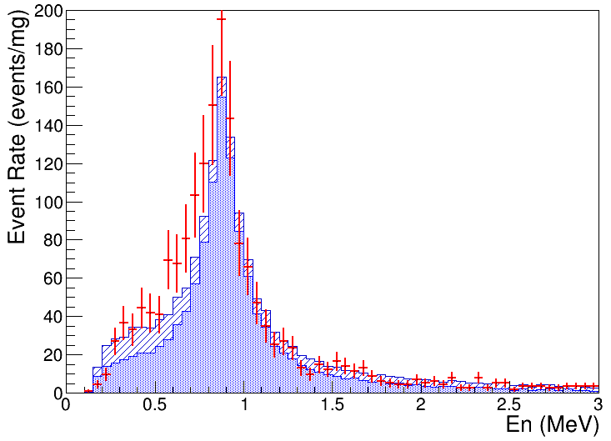
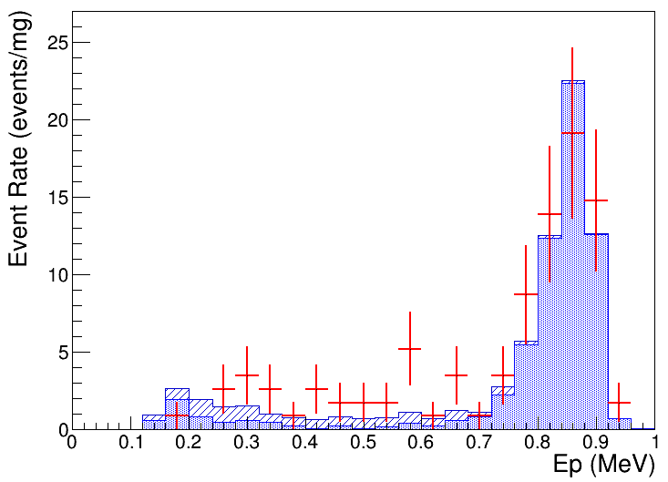



Calibration – Comparison with Simulation
GEANT4 simulation
Proton Range
Scattering Angle
Neutron Energy
Proton Energy of Head-on Collision
0.88 MeV
*Color corresponding to neutron energy
$$\frac{ΔE_{n, FWHM}}{E_{n}}≅0.31$$
$$\cos{θ_{Scat}>0.98}$$
Detected recoil protons are almost good agreement with kinematical expectation
Detection efficiency for R < 1.5 μm (< 200 keV) is not 100%
$$E_{n}=E_{p} /\cos^{2}{θ}$$

Slide 11
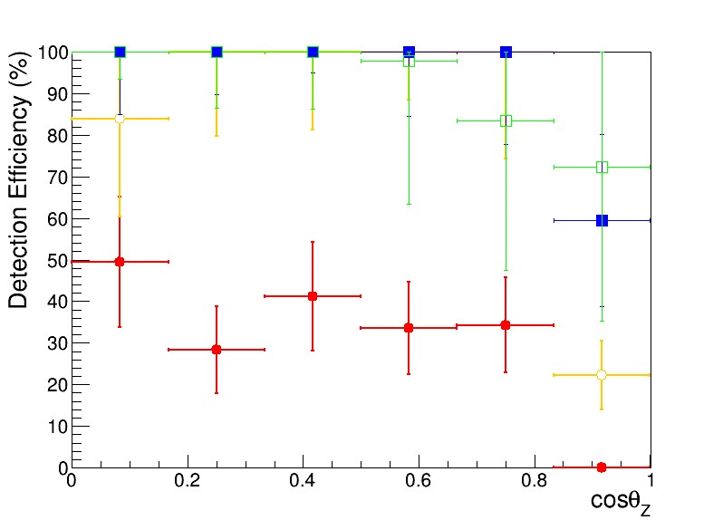
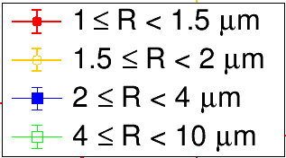
Calibration – Angular and Range Dependency of Detection Efficiency
Horizontal Vertical
NIT
θz
Base
Z
Almost same efficiency

Slide 12
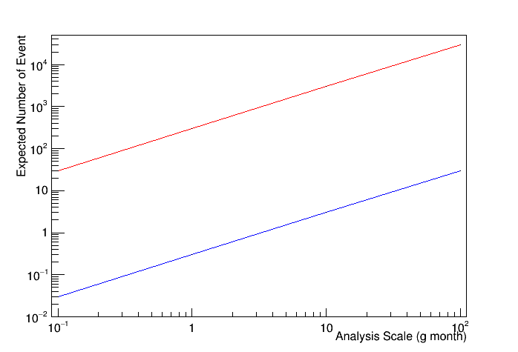
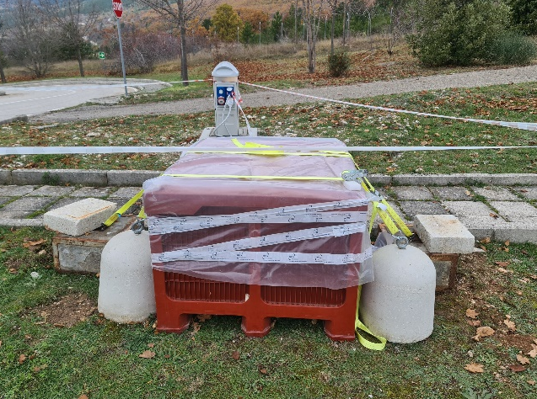
Environmental Neutron Measurement by NIT @ LNGS
n-Run2
(May 2022)
Motivation of Surface Run
Demonstration of spectrum measurement for environmental neutron and CR-DM search
There is no detailed data in the sub-MeV region even on the surface ground
n-Run1
(Nov. 2021)
Surface ground
n-Run4
(Oct. 2023)
Refrigerator Box
12cm
n-Run3
(Jan. 2023)
Sample2
Thermal
Insulator
10cm
Compressor
Underground
Sample1
Without shielding!
because there is no sensitivity for muon and gamma

Slide 13
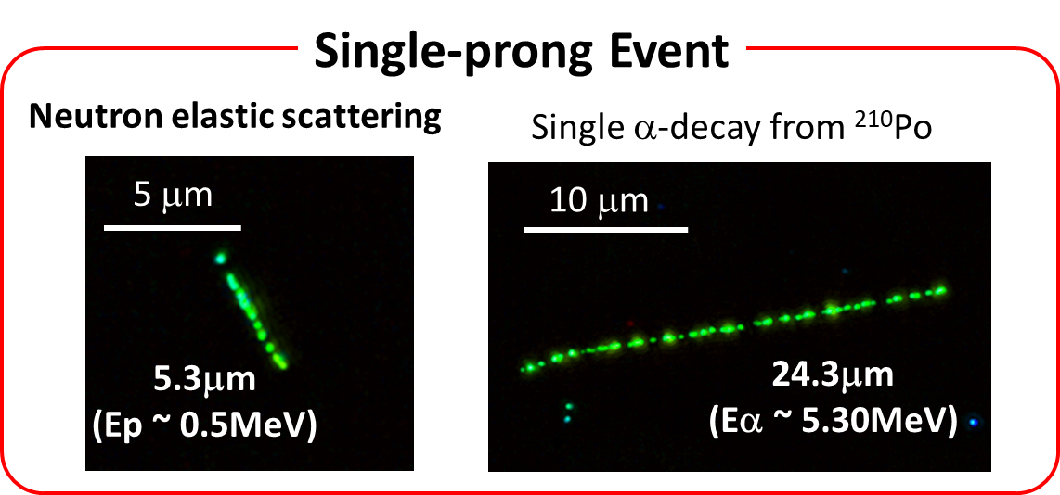
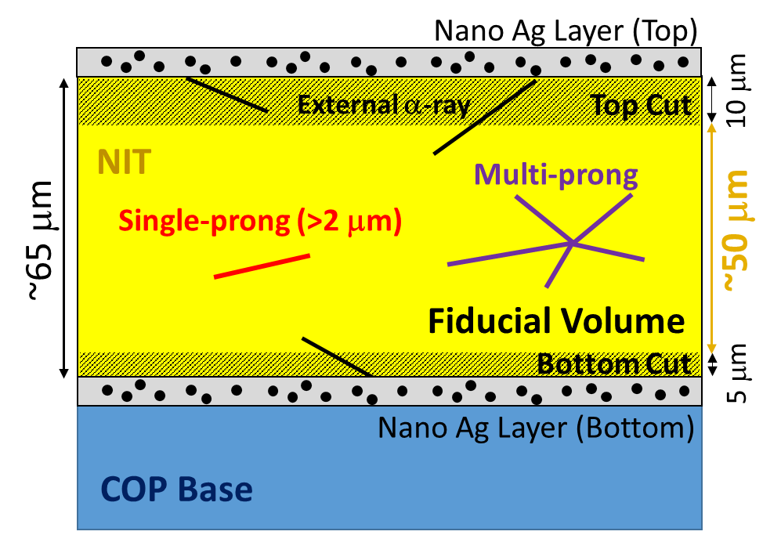
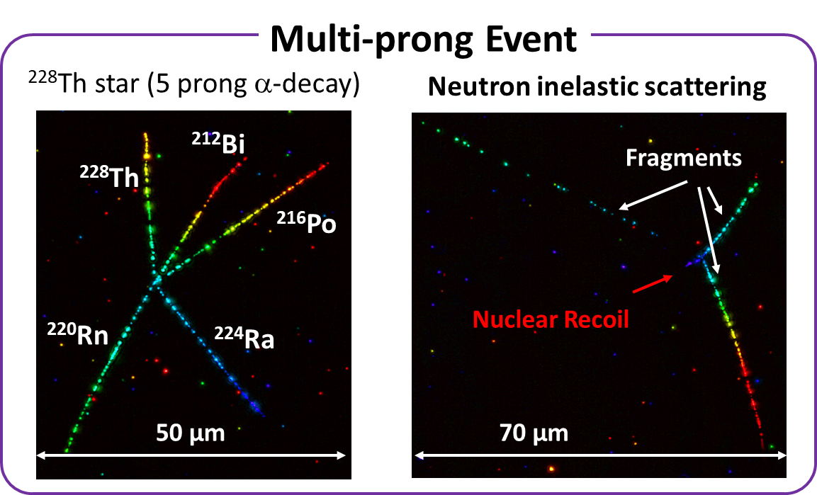
Event Classification
External α-rays are excluded by fiducial volume cut, then events are topologically classified to Single-prong and Multi-prong
Unfortunately, n-Run1 samples accumulated a lot of Radon, we focused on sub-MeV region (2~14μm → 0.25~1MeV) of Single-prong event to analyze with background free

Slide 14
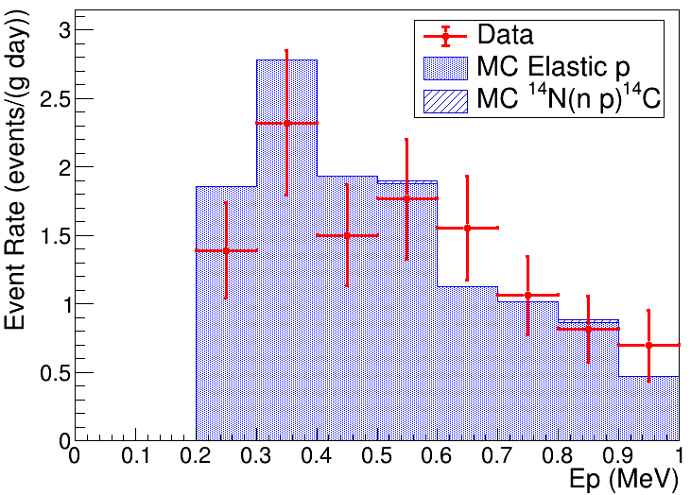
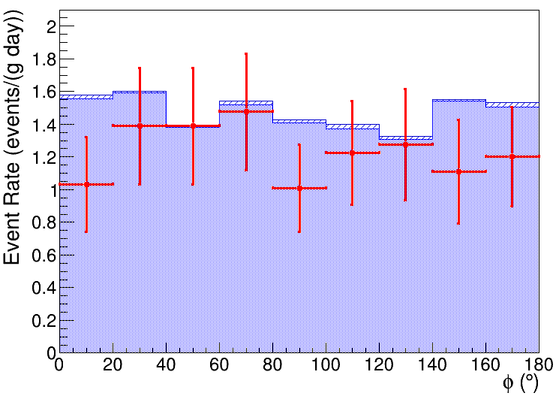
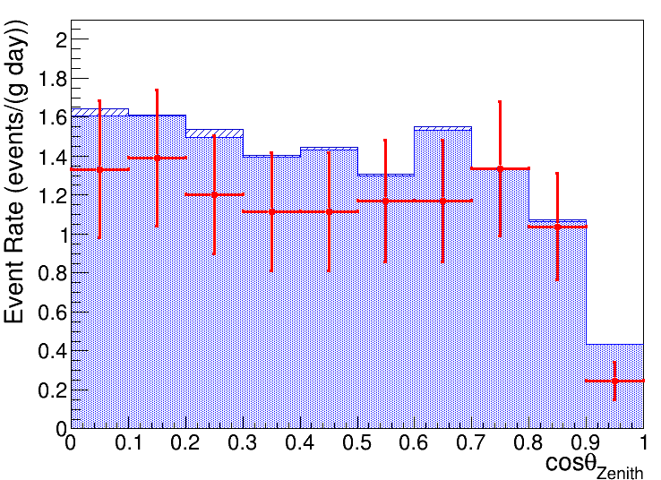
Data/MC Comparison (n-Run1)
MC : Geant4 + PARMA model
T. Sato, PLOS ONE 10, e0144679 (2015)
T. Sato, PLOS ONE 11, e0160390 (2016)
Proton Energy
Plane Angle
Zenith (= Z)
θ_{Zenith}
φ
X
Horizontal sample
Zenith Angle
Number of Events
MC : 11.9±0.5 event/g/day
Data : 11.1 ± 0.6(stat.) ± 2.4(sys.) event/g/day
Neutron Flux [0.25 ~ 10 MeV]
PARMA model : 9.0 x 10⁻³ cm⁻² s⁻¹
Data : (8.4±1.8) x 10⁻³ cm⁻² s⁻¹
→ Due to low efficiency for vertical
T. Shiraishi, et al., Phys. Rev. C 107, 014608 (2023)

Slide 15
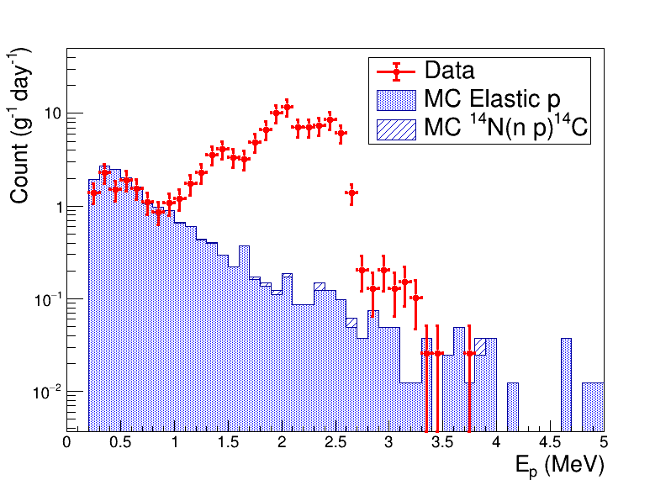

MeV Region (n-Run1)
Proton Energy
Track Range
²¹⁴Po
n-Run1
²¹⁰Po
sub-MeV
²¹⁰Po
(Long life-time)
²¹⁴Po
(short life-time)
Sub-MeV

Slide 16


Reduction of ²¹⁴Po Contamination at Drying
Hall F (NEWSdm facility)
Proton Energy
²¹⁴Po
n-Run2, n-Run3
(climatic chamber)
n-Run1
²¹⁰Po
sub-MeV
1 order
n-Run1
(granite table)
more 2 order
n-Run4
(Radon free room, CR1 @ Hall C)

Slide 17


n-Run1 and n-Run2 Results
Sub-MeV region
Track Range
¹⁴N + n → p 584keV + ¹⁴C 42keV
track range ~ 6.5μm
Sub-MeV
²¹⁰Po
(Long life-time)
¹⁴N(n p)¹⁴C
Q=626keV
²¹⁴Po
(short life-time)
As expected
  sub-MeV signal increase
  ²¹⁰Po-alpha increase
  Offset background in MeV decrease
Thermal neutron signal can be seen significantly
Thermalized due to surrounding materials?
or attenuation by water contained in rock was suppressed?

Slide 18


n-Run1 and n-Run2 Results (*after reference subtraction)
Proton energy spectrum (linear scale)
(log scale)
¹⁴N(n p)¹⁴C
²¹⁰Po
²¹⁴Po
Thanks to reduced ²¹⁴Po contamination, MeV spectrum close to the simulation

Slide 19
Neutron Run Go to Underground
 | Installed Place | ²¹⁴Po contamination (/g) | Exposure Time (days) | Experimental Scale (g*month) | Analyzed Scale (g*month) | Proton Energy Threshold (keV)
n-Run1 (Nov. 2021 - ) | Surface ground | O(1000) | 29 | 2 | 1.3 | 250
n-Run2 (May 2022 - ) | Surface ground | O(100) | 58 | 20 | 2.1 | 250
n-Run3 (Jan. 2023 - ) | Underground Hall C & F | O(100) | 120 | 30 | 1.4 | 100
n-Run4 (Nov. 2023 - ) | Underground Hall C | O(1) (using CR1) | 120 | 100 | --- | 100
Analysis ongoing
Exposure ongoing
At least 10 g*month scale is needed for underground neutron measurement

Slide 20


n-Run3 (Underground) Result
Proton Energy in sub-MeV
Preliminary
Track Range
²¹⁰Po
Proton energy
Sub-MeV neutron signal clearly decreased because of underground
There are time-independent signal-like tracks below 300 keV
  → Non-physical events

Slide 21




n-Run3 (Underground) Result
²¹⁰Po
Proton Energy in sub-MeV
Preliminary
Mask
cosθz < 0.05 && range < 3μm
Horizontal Vertical
Signal-like tracks found below 300 keV are all horizontal!
~ 150 keV
~ 150 keV
If we avoid low energy & horizontal angle region, there is no excess in sub-MeV region

Slide 22


n-Run3 (Underground) Result
²¹⁰Po
Wet condition
ρ ~ 1 g/cm³
Dry
ρ = 3.1 g/cm³
～1mm
50μm
Horizontal Vertical
Mis-reconstruction
Signal-like tracks found below 300 keV are all horizontal!
~ 150 keV
~ 150 keV
Mis-reconstruction of α-track from ²¹⁴Po accumulated at wet condition?
→ Should be checked by next n-Run4 (low ²¹⁴Po contamination)

Slide 23


n-Run3 α-ray Analysis
n-Run3 4 month
Range distribution
α energy
²¹⁰Po 5.3 MeV
²³⁴U, ²³⁰Th, ²²⁶Ra
~ 4.7 MeV
²³⁸U 4.2 MeV

Slide 24
Intrinsic α Activity
α Multiplicity | Expected # of event by Ge detector (g⁻¹ month⁻¹) | # of event from n-Run1 (g⁻¹ month⁻¹) | # of event from n-Run3 (g⁻¹ month⁻¹)
5 (²²⁸Th to ²⁰⁸Pb) | 16±2 (Th) | 15±5 | 15±3
1 (²³⁸U) | 2.1±0.5 (U) | --- | 8.4±1.4
1 (²³⁴U, ²³⁰Th, ²²⁶Ra) | 6.3±1.5 (U) | --- | 26±3
1 (²¹⁰Po) | 2.1±0.5 (U) +²²²Rn contaminated | 165±16 | 790±23
γ-ray measurement by Ge detector
(²²⁸Th: 6.0±0.6 mBq/kg)
(²²⁶Ra: 0.8±0.2 mBq/kg)
²¹⁰Po seems to be increased from n-Run1

Slide 25
Summary
→ T. Shiraishi, et al., PTEP 2021 4, 043H01 (2021)
3-dimensional sub-micrometric tracking technique has been developed for NIT analysis
  Achieved 100 keV threshold analysis for recoil proton with 0.5 kg/year/machine
  Analysis speed will be further upgraded to 1.5 kg/year/machine
Neutron run in Gran Sasso
  Surface run (n-Run1, nRun2)
    Succeeded to measure neutron spectrum and direction
    ²¹⁴Po contamination problem was found
      → Solved by using radon free room at the sample preparation in current experimental scale
  Underground run (n-Run3, nRun4) Preliminary
    Aiming 100 g*month scale to measure neutron spectrum
    Unknown horizontal background were found in < 300 keV
      Maybe mis-reconstruction of alpha accumulated at the begging of sample preparation?
      If we avoid this region, there is no signal in sub-MeV region as expected
    n-Run4 with further 2 orders lower ²¹⁴Po contamination is now ongoing
→ T. Shiraishi, et al., Phys. Rev. C 107, 014608 (2023)

Slide 26
Backup

Slide 27

α-ray accumulation in drying condition
Wet condition
ρ ~ 1 g/cm³
After dry
ρ = 3.1 g/cm³
Dry
～1mm
50μm
Track
Silver Grain
If α-ray create tracks at wet condition, tracks become longer & darker & horizontal because of
Low mass density
Low crystal density
Shrink less than 1/10 thickness

Slide 28







Comparison of Nuclear Emulsion
OPERA type
Nano Imaging Tracker (NIT) type
AgBr:I crystal (SEM)
AgBr:I crystal (SEM)
200nm crystal
44nm crystal
500nm
500nm
Optical microscope image
Optical microscope image
Ion
Ion
Range ~ 200nm
1 µm
1 µm
100μm
100μm
500MeV/n Fe ion
60keV C ion
500MeV/n Fe ion
60keV C ion

Slide 29


High Energy Ion Track in NIT
Spallation of 150 GeV Lead Beam
C 290 MeV/n
Ar 500 MeV/n
Fe 500 MeV/n
Multiplicity
Emitting angle
Energy
Brightness (dE/dx)
Pb
Xe 150 GeV
Pb 150 GeV
50 μm

Slide 30

Actual Multi-prong Events from n-Run1
Th Star event
(5-prong α-decay from ²²⁸Th to ²⁰⁸Pb)
Deep Inelastic Scattering by neutron
29.6μm (6.06MeV)
→ ²¹²Bi
1 short + 3 fragment
25.0μm
(5.41MeV)
→ ²²⁸Th
High dE/dx
(16.3μm)
35.2μm (6.80MeV)
→ ²¹⁰Po
Low dE/dx
(> 52μm)
Short
(4.2μm)
30.8μm (6.22MeV)
→ ²²⁰Rn
27.7μm (5.80MeV)
→ ²²⁴Ra
High dE/dx
(46.7μm)
*Projection Image
70 μm
50 μm

Slide 31



Analysis flow (n-Run2)
Chain tracking (2um) → CNN (2um) → Manual check
  CNN training sample
    Signal
      AIST 880keV neutron @ -26 deg. (EGS012 wash4)
      n-Run2 2 month signal @ -15 deg. (EGS016)
    Noise
      n-Run2 2 month noise @ -15 deg. (EGS016)
Effect of CNN cut to n-Run2 range distribution
Applied cut
95% noise rejection
with 99% efficiency
Range (um)

Slide 32











Classification
27 μm
Signal
(R >= 3.5 μm)
Signal
(1 <= R < 3.5 μm)
Noise

Slide 33

1st Surface Run (n-Run1) for Environmental Neutron Measurement @ LNGS
n-Run1 Setup
Motivation
Demonstration of spectrum measurement for environmental neutron and CR-DM search
There is no detailed data in the sub-MeV region even on the surface
Refrigerator Box
12cm
Sample2
Thermal
Insulator
10cm
Compressor
Sample1
* Recoil protons are accumulated O(2) events /(g month) on the surface

Slide 34


Single-prong Analysis Result (n-Run1)
Detectable neutron spectrum with 2 < R < 14 μm
(0.25 < Ep < 1 MeV)
Range spectrum of Single-prong signal
¹⁴N(n p)¹⁴C reaction
(Q = 0.62 MeV)
0.25 < En < 10 MeV
9.0 x 10⁻³ cm⁻² s⁻¹ @ LNGS surface
Observed signal increase consistent with environmental neutron signal
Assumed neutron spectrum expected by PARMA model
T. Sato, PLOS ONE 10, e0144679 (2015)
T. Sato, PLOS ONE 11, e0160390 (2016)

Slide 35


Simulation for Surface LNGS-run
T. Sato, PLOS ONE 10, e0144679 (2015)
T. Sato, PLOS ONE 11, e0160390 (2016)
Zenith angular dependency of neutron spectra expected by PARMA model
Conditions for PARMA model
Altitude : 1400 m.s.l. Date : 1 Dec. 2021
Latitude : 42.5 deg Longitude : 13.6 deg
Surrounding environment : Ground
Water fraction in ground : 20%
En < 1MeV is almost isotropic
Zenith Angle
Anisotropy
En > a few MeV is anisotropic

Slide 36



Expected Result from Next Run
Analysis scale vs Expected neutron events
3g 1year
Expected Sky Map assuming the flat neutron angle
3g 1month
(Next Run)
$$θ_{y}$$
Surface
Underground
$$θ_{x}$$

Slide 37
2nd Surface Neutron Run (n-Run2)
 | Condition | Exposure Time on Surface (day) | Analyzed Mass (g) | Average Rainfall in Assergi (mm/day)
n-Run1 (Run start from 24 Nov. 2021) | Dried on granite table Run @ -20℃ | 2 | 0.65 | 4 **
 |  | 29 | 1.35 | 4 **
n-Run2 (Run start from 25 May 2022) | Dried in chamber Run @ -15℃ | 0 | 0.95 | ---
 |  | 58 | 1.08 | 1.4
** Estimation from Nov. – Dec. 2022 data

Slide 38



Neutron Flux
Log
Angle-integrated neutron flux on LNGS surface with water fraction in rock = 20%
Linear
PARMA model take into account the neutron reflection by surface ground
Especially, epi-thermal neutrons flux depends on water fraction in rock
*Expected by PARMA model
thermal
epi-thermal
fast

Slide 39


Underground Neutron Sources
(α n) reaction in the rock by ²³⁸U, ²³²Th(, ²³⁵U)
Spontaneous fission of ²³⁸U
μ spallation
  Negligible in <10MeV region at LNGS underground
H. Wulandari et al., Astropart. Phys., 22, 313-322 (2004)
ρ = 2.71 g/cm³
Estimate myself using NeuCBOT and GEANT4 simulation

Slide 40



Neutron Spectrum at LNGS Underground
Tunnel structure by GEANT4
Attenuation
n
Original
After attenuation
Neutrons attenuated by water contained concrete
→Spectrum spread to thermal region

Slide 41

μ spallation
J.M. Carmona et al., Astropart.Phys. 21 (2004) 523-533
Underground muon rate is about 6 order less than Surface
Almost negligible

Slide 42
Calibration with ion implantation system

Slide 43




Accelerators in our laboratory
1MV Tandem Pelletron Ion Accelerator
Acceleration Voltage : 0.5 - 1 MV
Ion : He⁺⁺, H, Li, B, C, O, Si, Ni, Cu, ...
Valence : 1, 2, ???
Detector : Si semiconductor detector x 2
Beam size : φ 2 mm
Analysis : RBS-channeling, PIXE, Nuclear Reaction, ERDA
Low Velocity Ion Implantation
Acceleration Voltage : 5 ~ 200 kV
Temperature : –196 ~ 1000℃
Ion : H, He, B, C, N, O, F, Si, P, Ar, Ti, Fe, Co, Ge, Kr, Xe, CO, CD₄, ...
Valence : 1, 2, 3, (4)
Beam current : 10 pA ~ 100 μA

Slide 44


Detecting directly exposed protons
150 keV proton
↓
↓
↓
↓
↓
Automated detection
↓
↓
↓
↓
Ion implanter @ Kanagawa Univ.
↓
5 µm
↓
Recognized tracks

Slide 45

Detecting directly exposed protons
Detection event vs location(mm)
Detection event vs location(mm)
Detection event vs location(mm)
Beam
150keV
100keV
・・・
IFM
IFM
NIT
NIT
X(mm)
１
１
Count
80keV
Count
60keV
5mm
50keV
5mm
40keV
30keV
Ion
Beam
Ion
Beam
X(mm)
X(mm)
Ion exposure ➡ Move the plate up ➡ Ion exposure with different energy ・・・
➣One sample is exposured with protons of multiple energies.
・Beam areas and Mask areas are created.

Slide 46
Detecting directly exposed protons
Detection event vs location(mm)
Detection event vs location(mm)
Beam
150keV
100keV
・・・
IFM
IFM
NIT
NIT
Mask
X(mm)
１
１
Count
80keV
Count
60keV
5mm
50keV
5mm
40keV
30keV
Ion
Beam
Ion
Beam
X(mm)
X(mm)
Ion exposure ➡ Move the plate up ➡ Ion exposure with different energy ・・・
➣One sample is exposured with protons of multiple energies.
・Beam areas and Mask areas are created.

Slide 47

Detecting directly exposed protons
150keV angle distribtion
Efficiency=
(#of detection@NIT)/(#of deteciotn@IFM)
For improvement...
Use high-density NIT？
➤increase the silver density
➤Decrease crystal size
1σ=4.5
×:0.7μmCut
×:0.2μmCut
3σ
With angle information
・The angle distribution is Gaussian-fitted,
and only components with angles within
3σ of it are considered as detection events.
*With angle information: Gaussian fit results for angle distribution
Number of components with angles within 3σ

Slide 48

Detecting directly exposed protons
Detection event vs location(mm)
150keV
100keV
IFM
NIT
１
Count
80keV
60keV
Measured Energy (keV)
5mm
50keV
40keV
30keV
Ion
Beam
Exposure Energy(keV)
X(mm)
X(mm)
Ion exposure ➡ Move the plate up ➡ Ion exposure with different energy ・・・
➣One sample is exposured with protons of multiple energies.
・Beam areas and Mask areas are created.
・The correlation between irradiation energy and irradiation position is also visible.

Slide 49


Detecting directly exposed protons
Ep (measured)
ー150keV
ー100keV
ー80keV
Ep150~80くらいのEp分布で
エネルギー分解能を持つことを示す
100KeVがエネルギー分解能を持つ
Efficiency=
(#of detection@NIT)/(#of deteciotn@IFM)
Energy resolution
47%(@100keV)
×:0.7μmCut
×:0.2μmCut
Ep(keV)
Angular distribution
ー150keV
ー100keV
ー80keV
irradiation direction
*With angle information: Gaussian fit results for angle distribution
Number of components with angles within 3σ
φ(°)

Slide 50







Implementing CNNs to improve efficiency of analysis
Noise
Results the signal classified using
the learning model.
Recoil proton tracks selected
from880 keV neutron beam
samples were automatically
classified using CNN.
Noise99.5% cut
Noise99.9% cut
・γ-ray exposeured sample
・n-Run2 sample
Signal
ああ
・Neutron exposured sample
・n-Run2 sample
The selection accuracy is 20-50% at around 1 μm,
and almost 100% at 2 μm and above.

Slide 51
Monochromatic Neutron Calibration

Slide 52


Calibration with Monochromatic Sub-MeV Neutron
PID control system
Monochromatic 880 keV neutron exposure at AIST
Sample temperature profile

Slide 53


Analysis of 880keV Sample
Optical Mark (LT)
Beam center
Attenuation by NIT or glass
X projection is uniform

Slide 54

Simulation
Neutron Scattering Model:
G4HadronElasticPhysicsHP
G4HadronPhysicsShielding
Electromagnetic Model:
G4EmLivermore
Tracking step for recoil proton: 0.1μm
Angular dependency of Energy and Flux in T(p, n)³He reaction is considered
*Line color corresponding to neutron energy

Slide 55




Simulation of Neutron Exposure
Considering energy and fluence for each angle
Color corresponding to neutron energy
Energy
Fluence

Slide 56


Correlation of Proton Energy and Range in NIT
(GEANT4)
NIT density : 3.2 g/cm³
E ≈ 60.68 + 553.16 $\sqrt{R}$ - 474.59 $\sqrt[3]{R}$ (keV)

Slide 57

Angular dependency
AIST 2019 : 880keV neutron sample
0 < cosθz < 0.1
0.1 < cosθz < 0.2
0.2 < cosθz < 0.3
0.3 < cosθz < 0.4
0.4 < cosθz < 0.5
Data
Simulation
0.5 < cosθz < 0.6
0.6 < cosθz < 0.7
0.7 < cosθz < 0.8
0.8 < cosθz < 0.9
0.9 < cosθz < 1.0

Slide 58


Neutron Exposure from ⁷Li(p n)⁷Be@ AIST
25 Aug. 2022
Behind the attenuator
Nuclear-reaction Method
Proton-recoil Method
Attenuator
n 200 keV
n 100 keV
Following nuclear reactions occurred after attenuation
n + ¹⁰B → α + ⁷Li + 2.31MeV
n + ⁶Li → α + T + 4.78MeV
⁷Li(p n)⁷Be

Slide 59


Detected event in Boron or Lithium contained sample
n + ¹⁰B → α + ⁷Li + 2.31MeV
② n + ⁶Li → α + T + 4.78MeV
⁷Li (~2.5μm)
T (~41μm)
α (~4.8μm)
Boron powder
Vertex
α (~7.3μm)

Slide 60

Detected event in Boron or Lithium contained sample
③ n + ¹⁴N → p + ¹⁴C + 0.62MeV
There are too many events around 6.5 μm…
p (~6.5μm)

Slide 61



Atom | Mass fraction | Mol / Ag mol |  | σ @ 1eV
N | 3.74% | 0.694 | ¹⁴N 99.6% | 0.3 barn
B | 0.042% | 0.01 | ¹⁰B 20% | 620 barn
Expectation of event rate:
event(N/B) $\sim \frac{0.694}{0.01}×\frac{0.996}{0.2}×\frac{0.3}{620}=0.17$
Simulation in B contained NIT
Polyetheren
B contained NIT

Slide 62
Calibration of α-ray detection

Slide 63
Radon Daughter Contamination
Sample | Condition | Analyzed mass (g) | # of internal event (/g) | # of top α (/cm²)
Run16 ID1 Aside | Dry in Rn free room (shielded) | 0.24 | 4 +- 4 | 0.9 +- 0.2
Run16 ID1 Bside |  | 0.47 | 4.3 +- 3.0 | 1.1 +- 0.2
Run16 ID2 Aside | Dry in Rn free room (no-shielded) | 0.50 | 8.0 +- 4.0 | 0.3 +- 0.1
Run16 ID2 Bside
Run15 ID3 Aside | Dry in Rn free room + Hall F (35min) | 0.27 | 4 +- 4 | 0.48 +- 0.14
Run15 ID3 Bside |  | 0.38 | 3 +- 3 | 1.1 +- 0.2
Run15 ID5 Aside | Dry with buffer box in Rn free room | 0.58 | 43 +- 9 | 0.40 +- 0.09
Run13 ID11 | N2 purged dry | 0.16 | < 14 (90% C.L.) | 0.1 +- 0.1
Run13 ID8 | Normal dry | 0.08 | 650 +- 90 | 50 +- 3
Run7 | Normal dry in Shield | 0.44 | 220 +- 20 | 11.0 +- 0.5
n-Run1 | Dry outside chamber | 0.65 | 2200 +- 60 | 280 +- 6
(Almost thin tracks)

Slide 64


Calibration of alpha-ray Energy (E_{α}) by Th star
Th Decay Chain
Suggested by Valeri
²²⁸Th (6±1) mBq/kg
(Ge Detector)
→ 15 events/(g 28day)
Th star event is useful for calibration of run condition, such as brightness or E-R relation
It should be accumulated during run, and 5 prong event can be identified as ²²⁸Th to ²⁰⁸Pb
  5.423, 5.685, 6.288, 6.779, [8.785 or 6.051] MeV
~64%
10 μm
~36%
2002年アイソトープ手帳

Slide 65



α-energy calibration with Th star
²¹²Po (64%)
n-Run1 Sample 2 & 3
²¹⁶Po
²²⁰Rn
²¹²Bi (36%)
²²⁴Ra
²²⁸Th
$$E_{α, fit}≈−2.111+1.511×\sqrt{R_{α}} \left(MeV\right)$$
ΔE_{α,FWHM} / E_{α} ~ 5%
Geant4 Simulation

Slide 66


Concerning the excess in MeV region
- Understanding for ²¹⁰Po contamination -
²²⁸Th (6±1) mBq/kg
(Ge Detector)
Multiplicity of α in 1event | Expected number of event (31day * 0.71g) | Number of event from Data
5 (²²⁸Th to ²⁰⁸Pb via ²¹²Po) | 6.4 (Ge) | 5
5 (²²⁸Th to ²⁰⁸Pb via ²⁰⁸Tl) | 3.6 (Ge) | 3
4 (²²⁴Ra to ²⁰⁸Pb via ²¹²Po or ²⁰⁸Tl) | ~1 (Ge) | 1
4 (²²⁶Ra to ²¹⁴Bi) | 1.5 (Ge) | 2
3 (²²²Rn to ²¹⁴Bi) | ~0.1 (Ge) +²²²Rn contaminated | 3
1 (²³⁸U, ²³⁴U, ²³⁰Th) | respectively 1.5 (Ge) | Respectively < 3
1 (²¹⁰Po) | 1.5 (Ge) +²²²Rn contaminated | 80?
²²⁶Ra 0.8 mBq/kg (Ge)
Contaminated from air

Slide 67


Eα Spectrum
U decay chain
²¹⁴Po peak (7.687MeV) ???
→ ²¹⁴Po should be 3prong!
No time dependence excess
→ Short life time alpha decay?
Can this seem as
internal 1prong???
²¹⁰Po peak (5.304MeV) have time dependence
→ Accumulate during the Run
2002年アイソトープ手帳

Slide 68


²¹⁴Po (dry)
n-Run1 29day data
²¹⁰Po (dry, -20℃)
²¹⁰Po (dry)
²¹⁴Po (dry, 20℃)
Th α level
²¹⁴Po (wet)
²¹⁸Po or ²²²Rn (wet)???
²¹⁸Po or ²²²Rn (wet)???
²¹⁴Po (wet, 20℃)

Slide 69


²¹⁰Po (dry)
²¹⁴Po (dry)
Horizontal
LNGS Run2021 28day sample
²¹⁰Po (dry, -20℃)
²¹⁴Po (dry, 20℃)
Brightness > 1500
Vertical
²¹⁸Po or ²²²Rn (wet)???
²¹⁴Po (wet)
Th α level
²¹⁸Po or ²²²Rn (wet)???
²¹⁴Po (wet, 20℃)
Brightness < 1500

Slide 70
2prong Anomaly
Multiplicity | # of event from 2day sample (/g) | # of event from 28day sample (/g)
3 (²²²Rn to ²¹⁰Pb) | 3 +- 3 | 6 +- 3
2 | 72 +- 14 | 83 +- 11
1 (>30μm ²¹⁴Po like) | 1770 +- 70 | 2470 +- 60
3prong is too few if we assume as contamination of ²²²Rn
2prong/1prong ratio ~ 4%
2prong cannot be explained by ²²²Rn contamination
Why 2prong detected such too many?

Slide 71

2prong Analysis
Longer due to wet
Horizontal → wet like
(θz1 > 80° && θz2 > 80°)
²¹⁴Po (7.687MeV)
Non-Horizontal → dry like
(θz1 < 80° && θz2 < 80°)
2prong is likely double α-decay of ²¹⁸Po and ²¹⁴Po
²¹⁸Po
(6.003MeV)

Slide 72
Can these be explained by Radioactive Aerosol?
Gas
Radioactive Aerosol (0.1~1μm diameter)
β
β
²¹⁰Pb
α
²²²Rn
α
α
α
²¹⁸Po⁺
²¹⁴Pb
²¹⁴Bi
²¹⁴Po
²²⁶Ra
Rock
3.8d
3.1m
27m
20m
160μs
Contamination
3prong
2prong
1prong
Why is 3prong too few from data???
 | 2prong/1prong ratio
Rough expectation by contamination of Radioactive Aerosol | 6.6% (from life time ratio)
Data (GS 2day sample) | 4.1%
Data (GS 28day sample) | 3.3%
²¹⁸Po is known to be injected up to a few μm depth in Silicon or Cupper

Slide 73
Intrinsic Activity (Chamber dry & Underground)
n-Run3 4 month sample
α source | Energy (MeV) | Event Rate (events/g/4month) | Total Activity (mBq/kg)
²¹⁸Po, ²¹⁴Po (Rn short decay) | 6.003, 7.687 | 50 +- 12
²¹⁰Po (Rn long decay) | 5.304 | 1138 +- 56 | 10.97 +- 0.54
²³⁴U, ²³⁰Th, ²²⁶Ra | 4.775, 4.668, 4.784 | 103 +- 17 | 10.0 +-1.6
²³⁸U | 4.198 | 33 +- 10 | 3.2 +- 0.9
Confirmed to be 2 orders less by CR1 dry
Contaminated from air
Accumulated during Run
These activities are almost 3.3 mBq/kg respectively
According to Fabio’s paper (Astropart. Phys. A 80, 16 (2016)),
²²⁶Ra activity is 2.4 mBq/(1kg high deionized gelatin) → 0.8 mBq/(1kg NIT)
Because of radiative equilibrium, ²³⁴U, ²³⁰Th, ²²⁶Ra, ²³⁸U should be same activity

Slide 74
Multi-prong Neutron Inelastic Scattering

Slide 75


Multi-prong Analysis
Candidates
μ spallation (photo-Nuclear)
μ⁻ capture (p + μ- → n + v_{μ} : CC weak interaction)
N(Z, A) + μ- → N'(Z-1, A)* + v_{μ}
N‘(Z-1, A)* → N’(Z-??, A-??) + (n + p + α …)
Neutron inelastic scattering
We found 17 events/(0.65g*28day) with multiplicity >= 3 after excluding α-decay
Rough estimation of the number of fragments by Geant4
Multi-prong Analysis
Count (/0.65g/28day)
~50 event
< 0.01 event
< 0.01 event
More likely neutron inelastic scattering!
*Projection Image

Slide 76

Interesting Multi-prong Event from 28day sample
Projected Image
What is this ???
1short + 4fragment (Multiplicity 5)
Thin top-out
(> 38.9μm)
Short
(2.1μm)
Bright bottom-out
(> 35.3μm)
Grey bottom-out
(> 72.1μm)
Grey bottom-out
(> 125.5μm)

Slide 77



Kink and 2prong Events are Excluded in Current Analysis
2fragment ?
2prong α decay ?
1short + 1fragment ?
Rutherford scattering ?
1short + 1fragment ?
Rutherford scattering ?
Bright
(53.3μm)
Short
(2.3μm)
Short
(1.4μm)
Bright
(15.5μm)
Bright
(88.6μm)
Grey
(50μm)
Although I feel there are many kink and 2prong events, they are rejected in current analysis because they might be Rutherford scattering or 2prong of α-ray
They might be included after reduction of MeV excess

Slide 78

Topological Analysis of Neutron Inelastic Scattering
Comparison of Simulation and Data
Preliminary
Data
Event rate (/0.65g/28day)
Data is topologically similar to Simulation?
  Geant4 probably has big systematic errors for nFragment because there are no data.
For more detail kinematical analysis, Fragment's Angle, Range (Energy), and Brightness (dE/dx) should be used.
Excluded from current analysis

Slide 79










Kinematics of Neutron Inelastic Scattering
(Suggested by Gianni and Sato-san)
Nuclei
$\vec{p_{n}}$ : Neutron initial momentum
$\vec{p_{N}}$ : Recoil Nuclei momentum
$\vec{p_{i}}$ : Fragment momentum
neutron
N
Initial State
n
$$\vec{p_{n}}$$
If assume $\vec{p_{N}} ≈\vec{p_{n}}$, transverse momentum (p_{T}) balance can be calculated
Transverse momentum (p_{T}) should be a good kinematical parameter because it is Lorenz invariant!
$$p_{T} Vector Sum≡\left|\sum_{i}{\vec{p_{Ti}}}\right|$$
n
Final State
N
$$\vec{p_{n}}$$
$$θ_{n}$$
$$\vec{p_{N}}$$
fragment
f
$$\vec{p_{N}}$$
$$θ_{N}$$
$$\vec{p_{Ti}}$$
$$\vec{p_{i}}$$

Slide 80

Relative angle to incident neutron
Relative angle to recoil nuclei
Fragment
Fragment
Nuclei
Trying to calculate kinematical parameter on the MC-base…
p_{T} Vector Sum cannot be 0 due to:
  Cannot include p_{T} of recoil Nuclei
  Missing p_{T} by neutron
Incident Direction
Relative p_{T} to recoil nuclei
Vector sum of relative p_{T} to recoil nuclei
Fragment

Slide 81

CNO
Ag
Br
I
Recoil Nuclei
Fragment

Slide 82


Muon Simulation in NIT
Simulation μ⁻ Spectrum
EXPACS (PARMA model) @ LNGS
Input to Geant4
Flux (/cm²/s/MeV)
10keV~500GeV μ- flux : 0.0114 /cm²/s
Eμ⁻ (MeV)
Physics Model
Muon Photo-Nuclear Interaction
Muon Capture
Radioactive Decay
Livermore for EM
Eμ⁻ (MeV)

Slide 83


Neutron Simulation in NIT
Simulation Neutron Spectrum
EXPACS (PARMA model) @ LNGS
Flux (/cm²/s/MeV)
Input to Geant4
10keV~1GeV n flux : 0.0192 /cm²/s
En (MeV)
Neutron Physics Model
Elastic : NeutronHPElastic
Inelastic : NeutronHPInelastic
EM : Livermore
En (MeV)

Slide 84

Neutron Inelastic Simulation in NIT
Extract only “Inelastic” of neutron physics process
Atomic Mass of Recoil Nuclei
Atomic Mass of Recoil Nuclei vs Fragment particles
¹²C(n α)⁹Be
Ag
Count (/0.65g/28day)
Br
CNO
I

Slide 85

Neutron Inelastic Simulation in NIT
Extract only “Inelastic” of neutron physics process
Range of Recoil Nuclei and Fragment
Count (/0.65g/28day)
Fragment
Recoil nuclei, almost CNO, is up to 10 μm in maximum
We identified shortest track with less than 10 μm as recoil nuclei, and remained tracks as fragments
Recoil Nuclei

