Slide 1
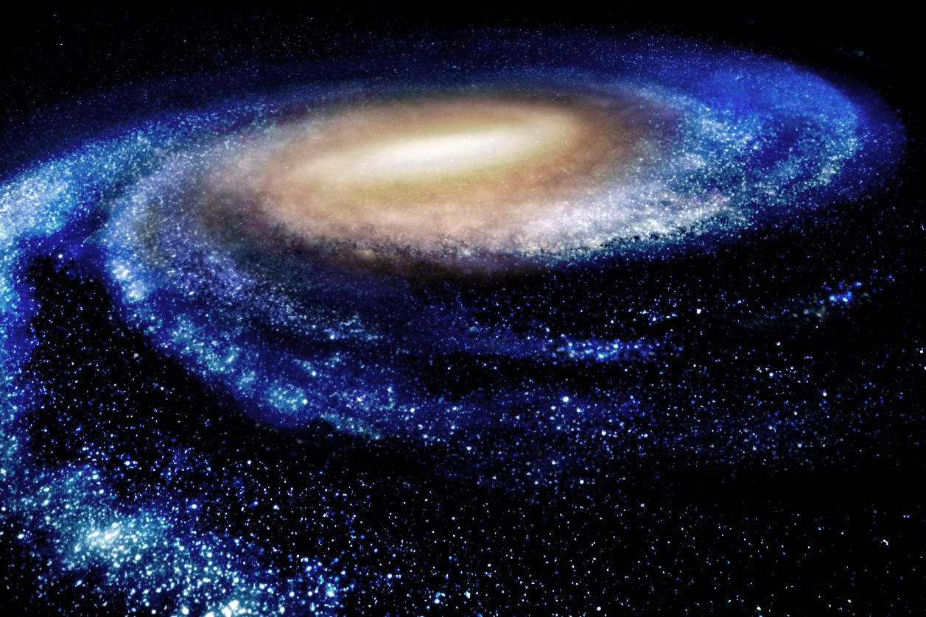




NEWAGE/
CYGNUS-KM
Dec 11th, 2023
CYGNUS 2023
Sydney, Australia
Introduction
Latest results
Activities
Summary
Kentaro Miuchi
(Kobe University)

Slide 2
Introduction
Introduction
Latest results
Activities
Summary

Slide 3
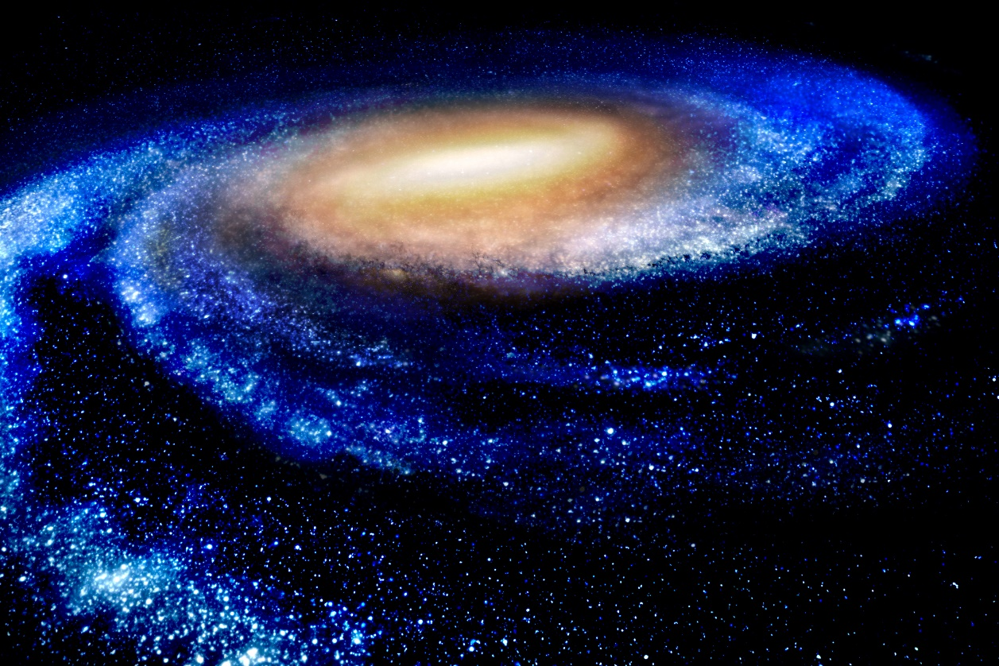
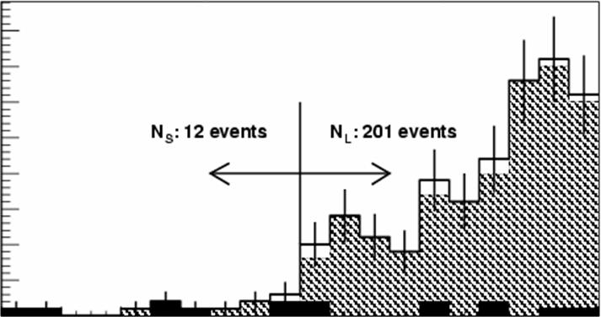
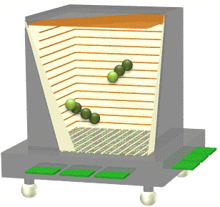
DM HALO
“CYGNUS” concept
v₀=220km/s
G. C.
WIMP-wind detection
Solar System
CYGNUS
v☉=230km/s
Dec.
directionality
(expected)
Jun.
@ LAB
M=80GeV
σ=0.1pb
detector:
low pressure gas
emulsions
diamond detectors, scintillators...
nucleus
-1
cosθ
1

Slide 4

NEWAGE history
SKYMAP
(measured DATA)
μ-PIC(MPGD) based TPC
  3-D tracks SKYMAP
CF4 gas for SD search
Proposal PLB 578 (2004) 241
First direction-sensitive limits
  PLB654 (2007) 58 ~10⁴pb
Underground results
PLB686 (2010) 11, PTEP(2023)ptad120 26 pb
lower BG, larger volume
PTEP (2023) ptad120
limits

Slide 5
Fluorine advantage
arXiv 2008.12587
even 10m³ detector
can start exploring Xe neutrino floor

Slide 6
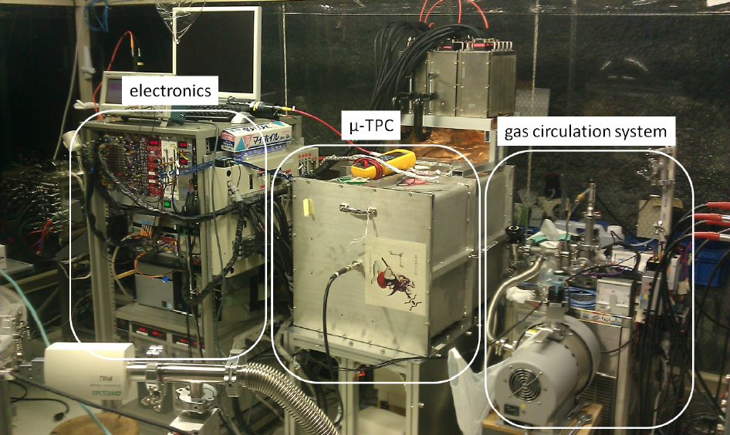
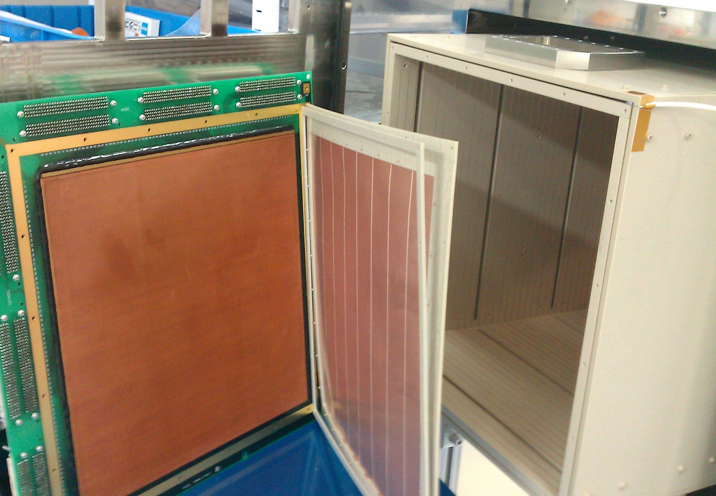
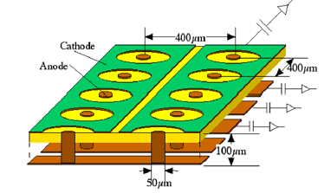
NEWAGE detector
Kamioka underground
NEWAGE-0.3b’’
Detection Volume: 31×31×41cm³
Gas: CF4 at 0.1atm (50keVee threshold)
Gas circulation system with cooled charcoal
NEWAGE-0.3b’
μ-TPC
μ-PIC
- 31×31cm²
- pitch : 400μm
- gain : ~1000
- made by DNP, Japan
Drift length: 41cm
PEEK + copper wires

Slide 7
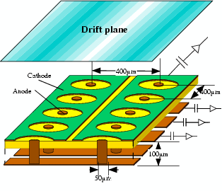
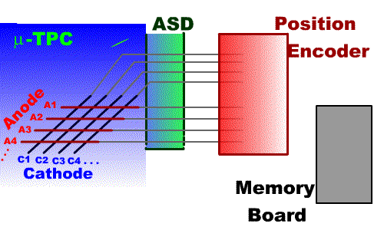
Key technology: Gaseous Time Projection Chamber
  2-dimensional image: Micro Patterned Gaseous Detector (MPGD)
  timing information: 3rd dimension
  realtime 3-dimensional tracking
MPGD：
GEM, micromegas, μ-PIC
μ-PIC
TPC principle
E
x
y
drawback: small mass O(kg) / m³

Slide 8
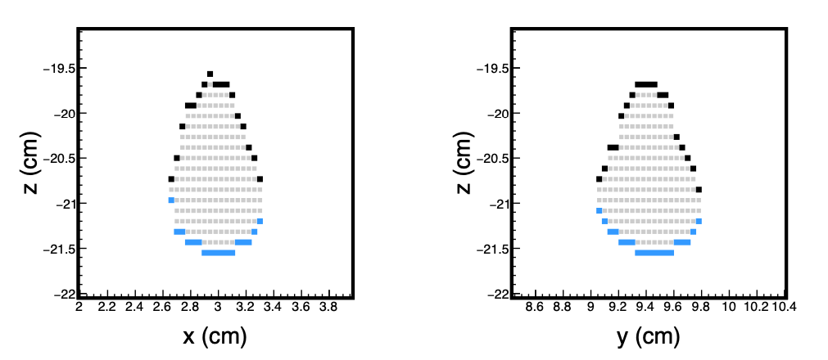
track data
Data we record
+summed waveform
TOT
(time-over-threshold)
Interestingly, 2d strip was found to be the “ideal” for us.
“FOMs”
7
(Anode strips)
(Cathode strips)
2008.12587

Slide 9
Publications since last CYGNUS
  DM search
    First limits from a 3d-vector directional dark matter search with the NEWAGE-0.3b' detector
    PTEP, (2020) ptaa147 DOI: 10.1093/ptep/ptaa147
    “Direction-sensitive dark matter search with a low-background gaseous detector NEWAGE-0.3b”
    PTEP (2021) ptab053
    "Direction-sensitive dark matter search with three-dimensional vector-type tracking in NEWAGE”,
    PTEP(2023)ptad120
  Technical papers
    Development of a low-α emitting μ-PIC as a readout device for direction-sensitive dark matter detectors
    NIM A Volume 977, 11 October 2020, 164285
    Development of an alpha-particle imaging detector based on a low radioactive micro-time-projection chamber
    NIM A Volume 953, (2020), 163050 , arXiv1903.01090
    LTARS: analog readout front-end ASIC for versatile TPC-applications
    JINST (2020) 15 T09009
    Development of a Negative Ion Micro TPC Detector with SF6 Gas for the Directional Dark Matter Search
    JINST (2020), P07015
    "Test of low radioactive molecular sieves for radon filtration in SF6 gas-based rare-event physics experiments"
    JINST (2021) 16 P06024
  Future physics
    "Detection capability of Migdal effect for argon and xenon nuclei with position sensitive gaseous detectors"
    PTEP(2020) ptaa162
    "Directional direct detection of light dark matter up-scattered by cosmic-rays from direction of the Galactic center”,
    JCAP07(2023)061,

Slide 10
Latest results
PTEP (2023) ptad120
Introduction
Latest results
Activities
Summary

Slide 11
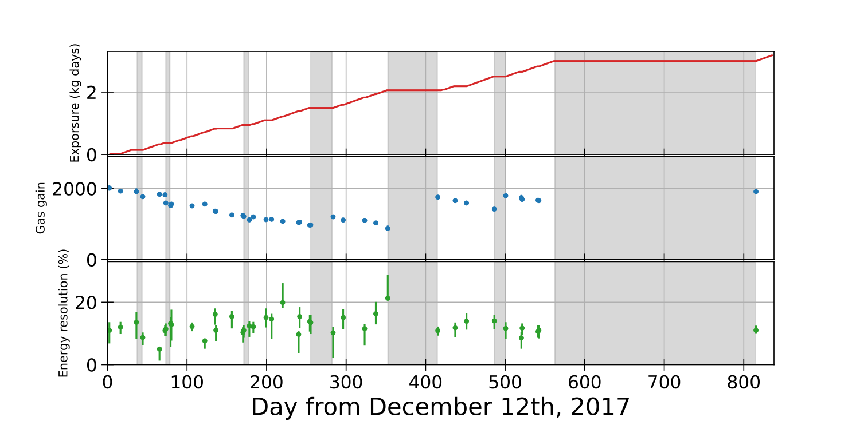
Underground measurements
  28 × 24×41cm³ fiducial volume (10g)
  out of 31 × 31×41cm³ active volume
  318 live-days
PTEP (2023) ptad120
Exposure [kg*days]
Gas gain
Energy resolution

Slide 12
Event selections
  Additional selection applied with multi-variate analysis
  to reject electron recoil (ER) events

Slide 13
Event selections
  Additional selection applied with multi-variate analysis
  to reject electron recoil (ER) events
  at a cost of some efficiency loss

Slide 14
Results: sky maps
sky map
@detector galaxy coordinate
sky map
@detector coordinate
no “unexpected” was seen

Slide 15
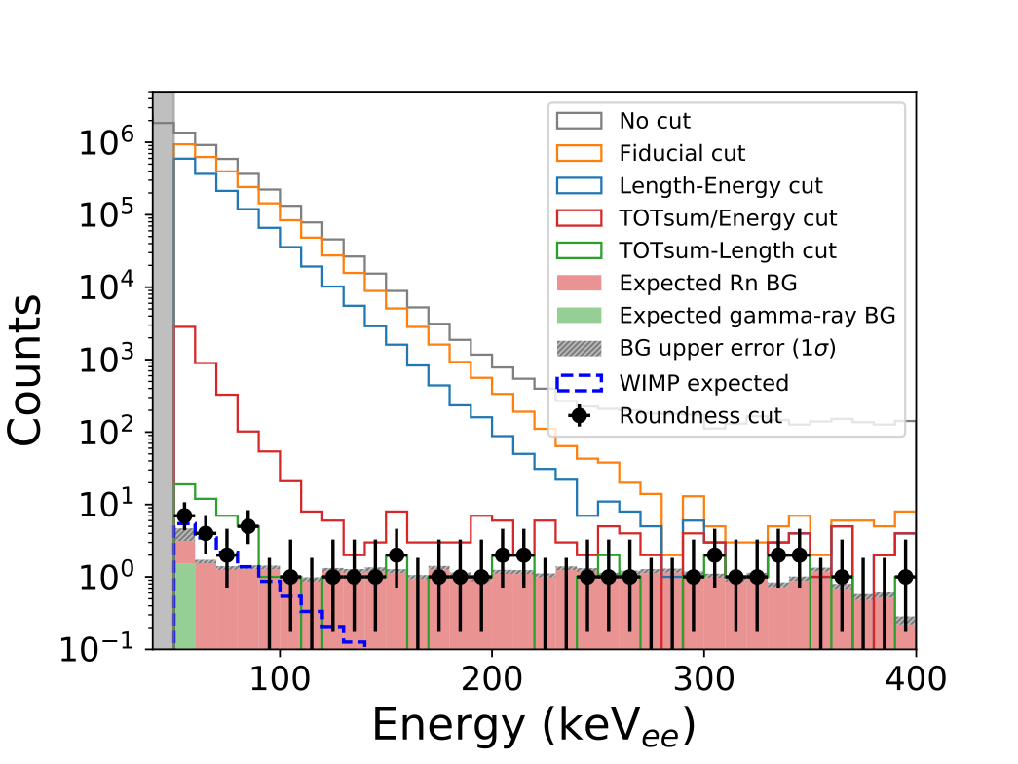
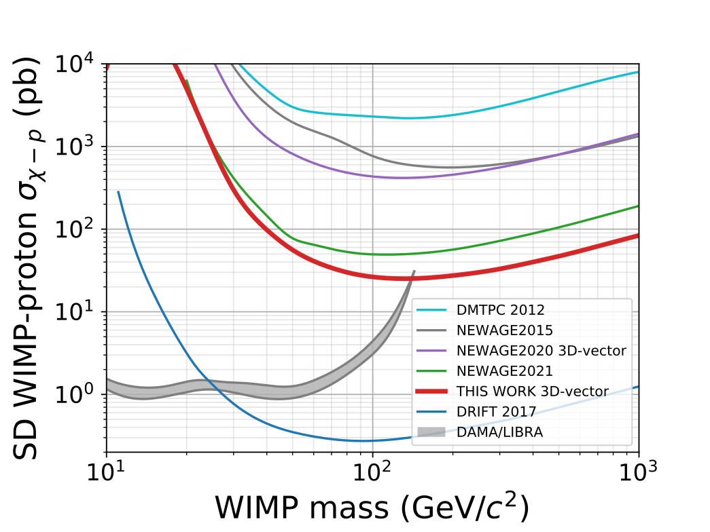
Results
  Best limits with directional analysis
  ×～2 improvement in a DM mass range of > 100 keV
  Cutting into DAMA/LIBRA interpretation region
  Best limits with directional and head-tail analysis
  ×10 improvement from NEWAGE2020 (first head-tail analysis)
energy spectrum
PTEP (2023) ptad120
cross section limits

Slide 16
Activities
Introduction
Latest results
Activities
Summary

Slide 17
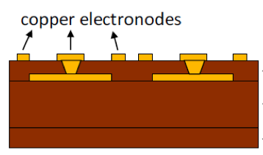
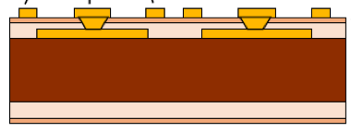
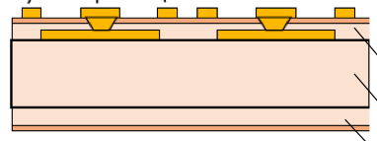
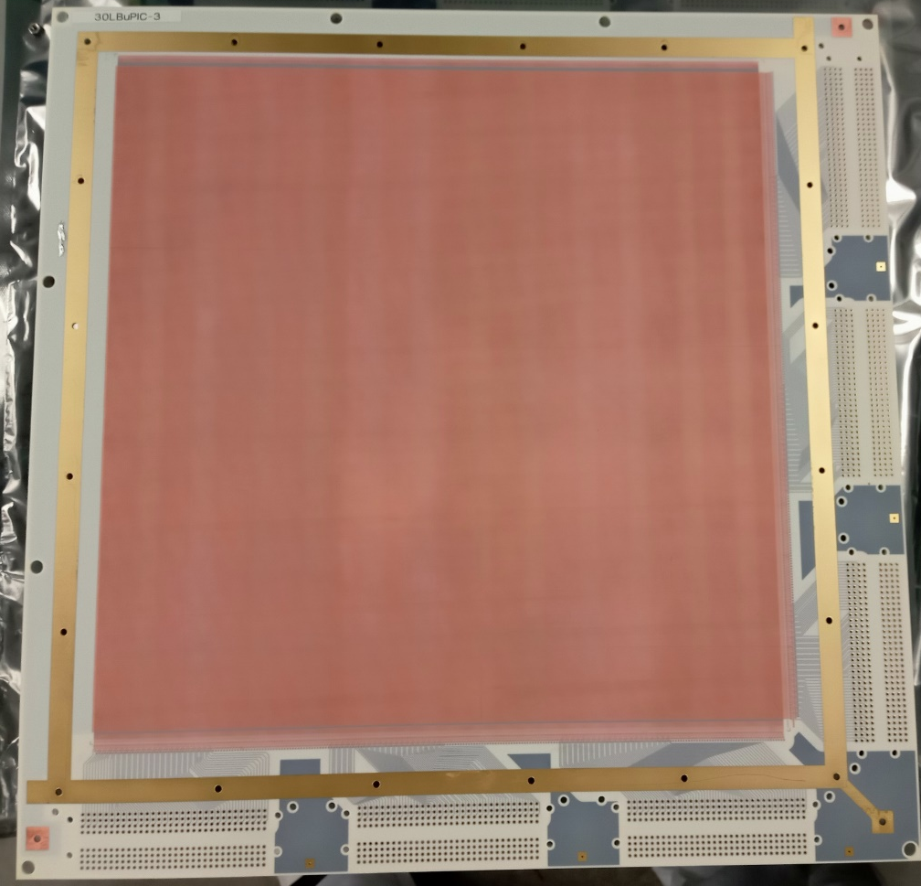
Making μ-PIC low BG
Original design
Low surface alpha version
(LAμ-PIC: 2017-)
Low-BG μ-PIC
(2020, 2023)
Polyimide
w/ glass cloth
(Rn contaminated)
Polyimide
w/o glass cloth
Quartz + Resin
(Shinetsu)
Polyimide
w/ glass cloth
LBGμ-PIC (DNP)
Radon emanation measurement:
LAμ-PIC: 2.3 ± 0.5 [mBq / μ-PIC]
30 cm
LBGμ-PIC (2023) : <0.10 [mBq / μ-PIC]
(90% C.L.)
paper in preparation
30 cm

Slide 18
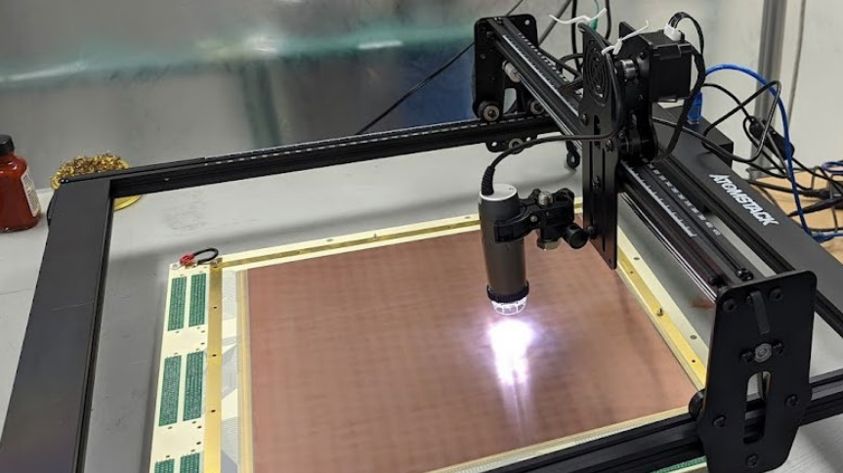
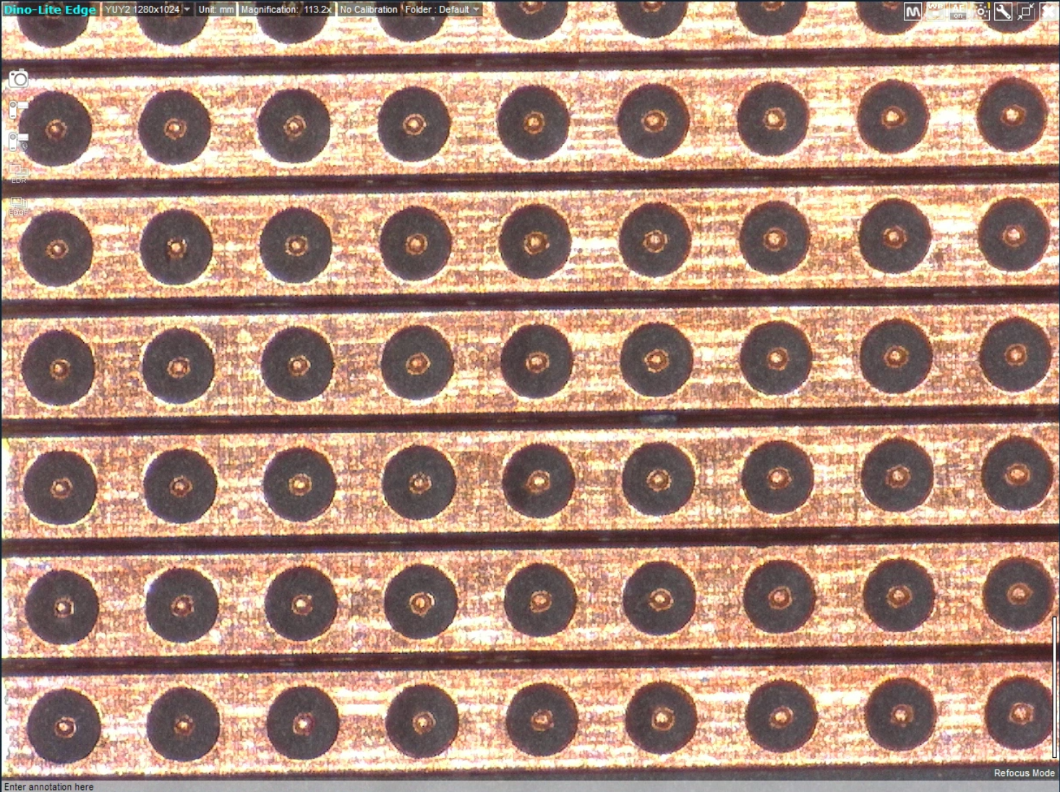
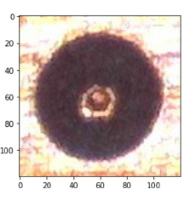
Visual inspection (R.Namai)
CNCmachine
(atomstack a5 10w)
~×100
1μ-PIC/day
USB microscope
（DINOAM4815ZTL）
  anode pixel formation matters
  ”brightness” =
  (anode - cathode) / cathode
anode
cathode

Slide 19
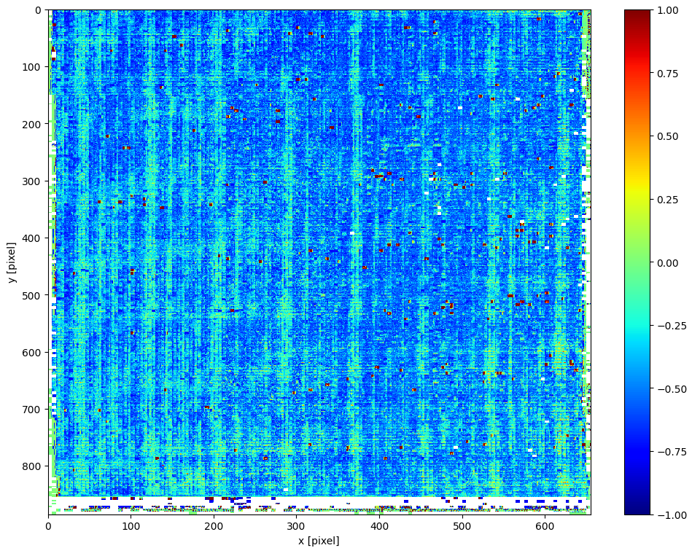
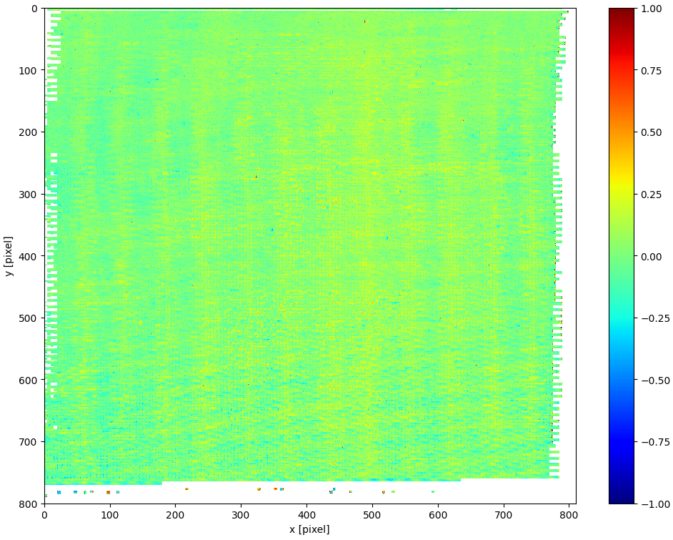
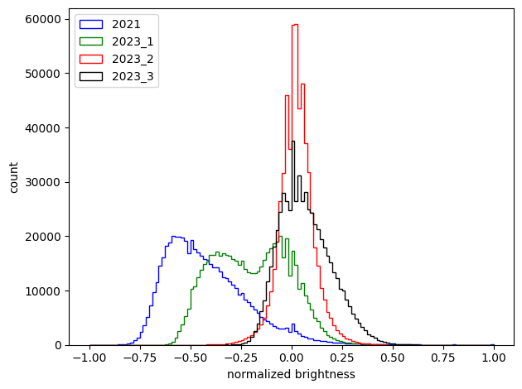
Anode “brightness” comparison
brightness histogram
brightness map
(model 2020)
brightness map
(model 2023)
2023
2020
Model 2020 had line structure.
Same pattern was seen in the gas gain
Great improvement was seen for model 2023.

Slide 20
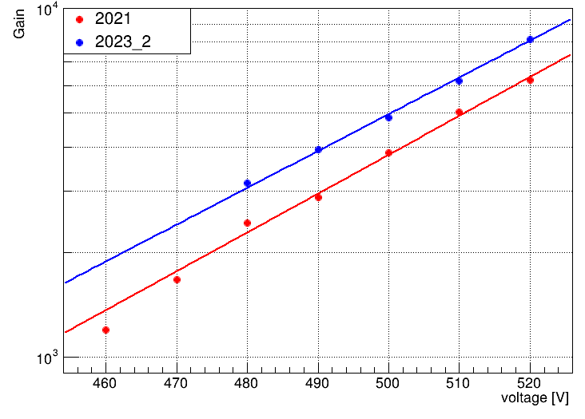
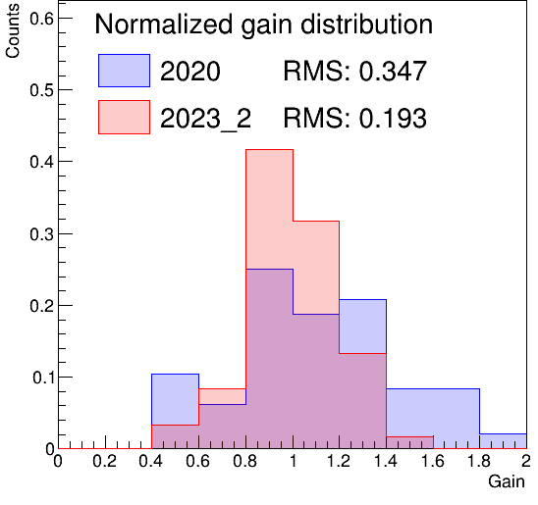
Low BG μ-PIC performance
gas gain distribution
2020
gas gain curves
2023_2
test w/ Ar+C2H6 gas
requirement for DM search
2023 model shows sufficient performance

Slide 21
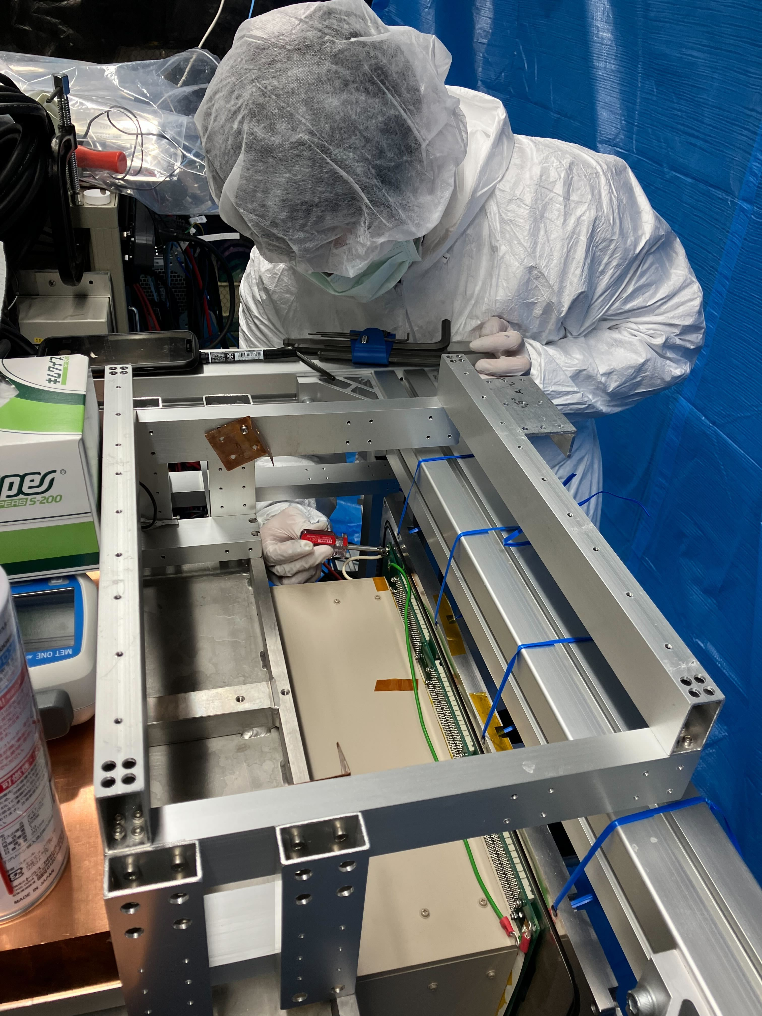
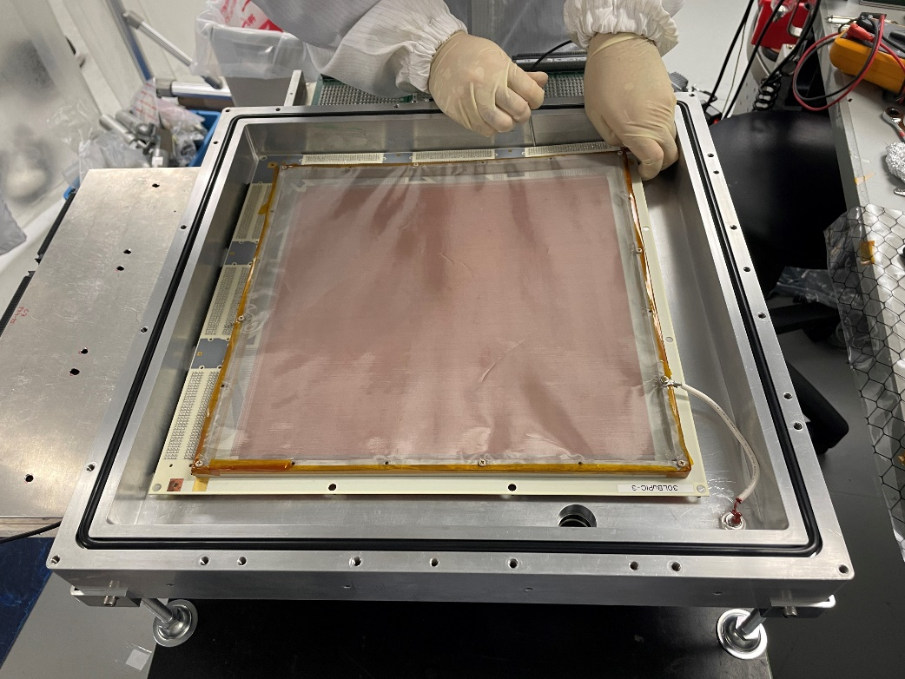
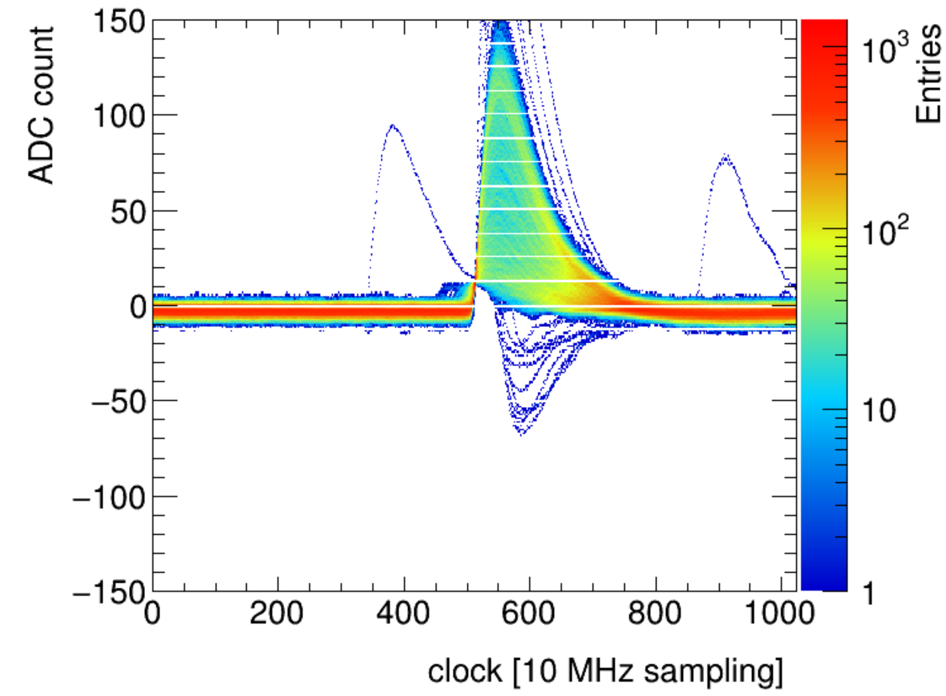
Low BG μ-PIC for Kamioka run
test with a GEM
⁵⁵Fe Waveform
CF₄/76torr
Installation Nov. 2023
NEWAGE-0.3ｂ’’’ : commissioning ongoing

Slide 22
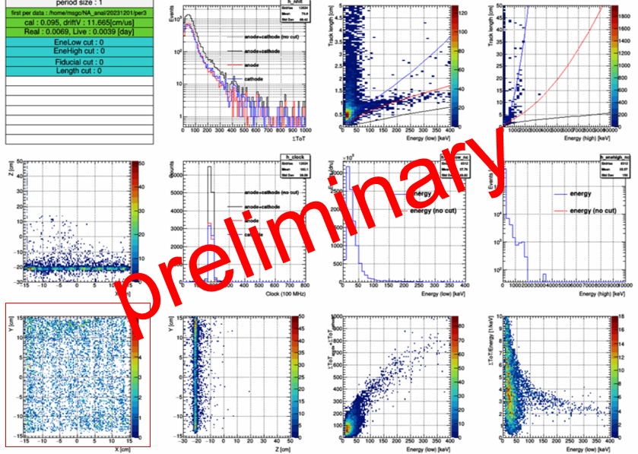
NEWAGE-0.3b’’’status: so far so good!
  Details will be reported in a few months
Quick look results
good PIDs
well-ballanced X/Y signals
flat response

Slide 23
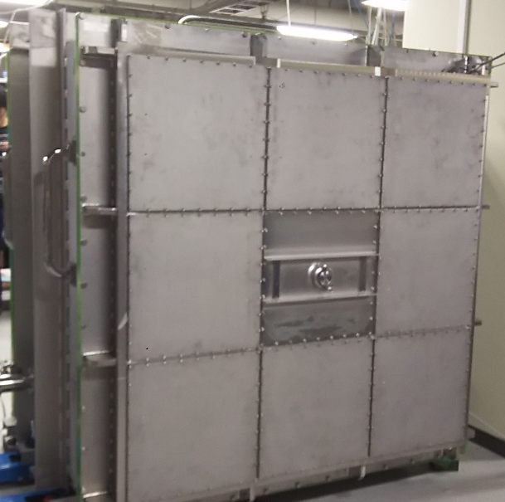
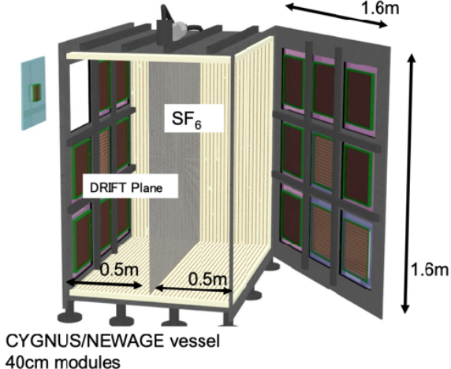
“CYGNUS”-KM chamber
S. Higashino
C/N-1.0 chamber (18pcs × 40×40 cm² windows)
Originally we planned to use resistive sheet for the field cage.
Performance degradation was seen in a long-term use...
C/N-1.0 chamber
40cm
C/N-1.0 concepts
Acrylic + copper ribbon
filed cage
▲C/N-1.0

Slide 24
Low BG Molecular Sieve production (H. Ogawa)
  production procedure established
JINST (2021) 16P06024
Radon capture test
This work
(Nihon University)
Commercially available one
(Sigma-Aldrich)
Results
  Better performance
  Repeating O(kg) productions

Slide 25
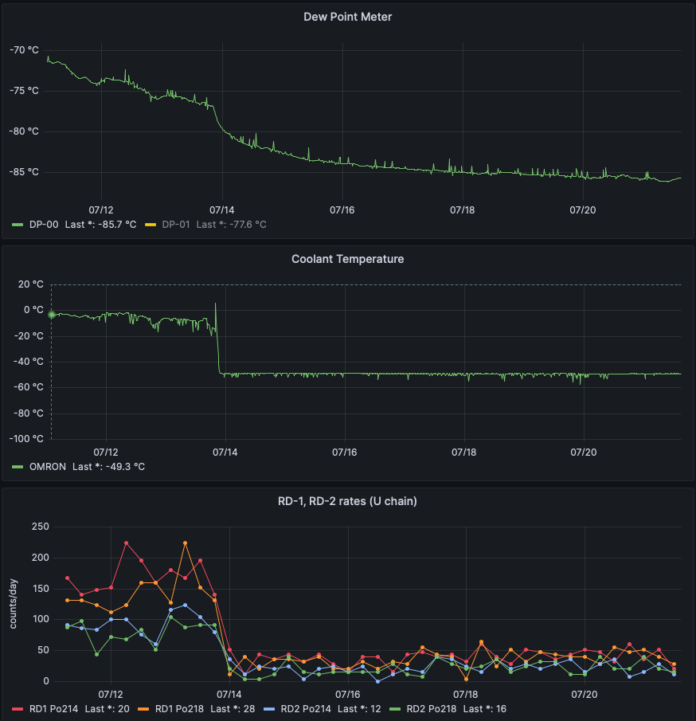
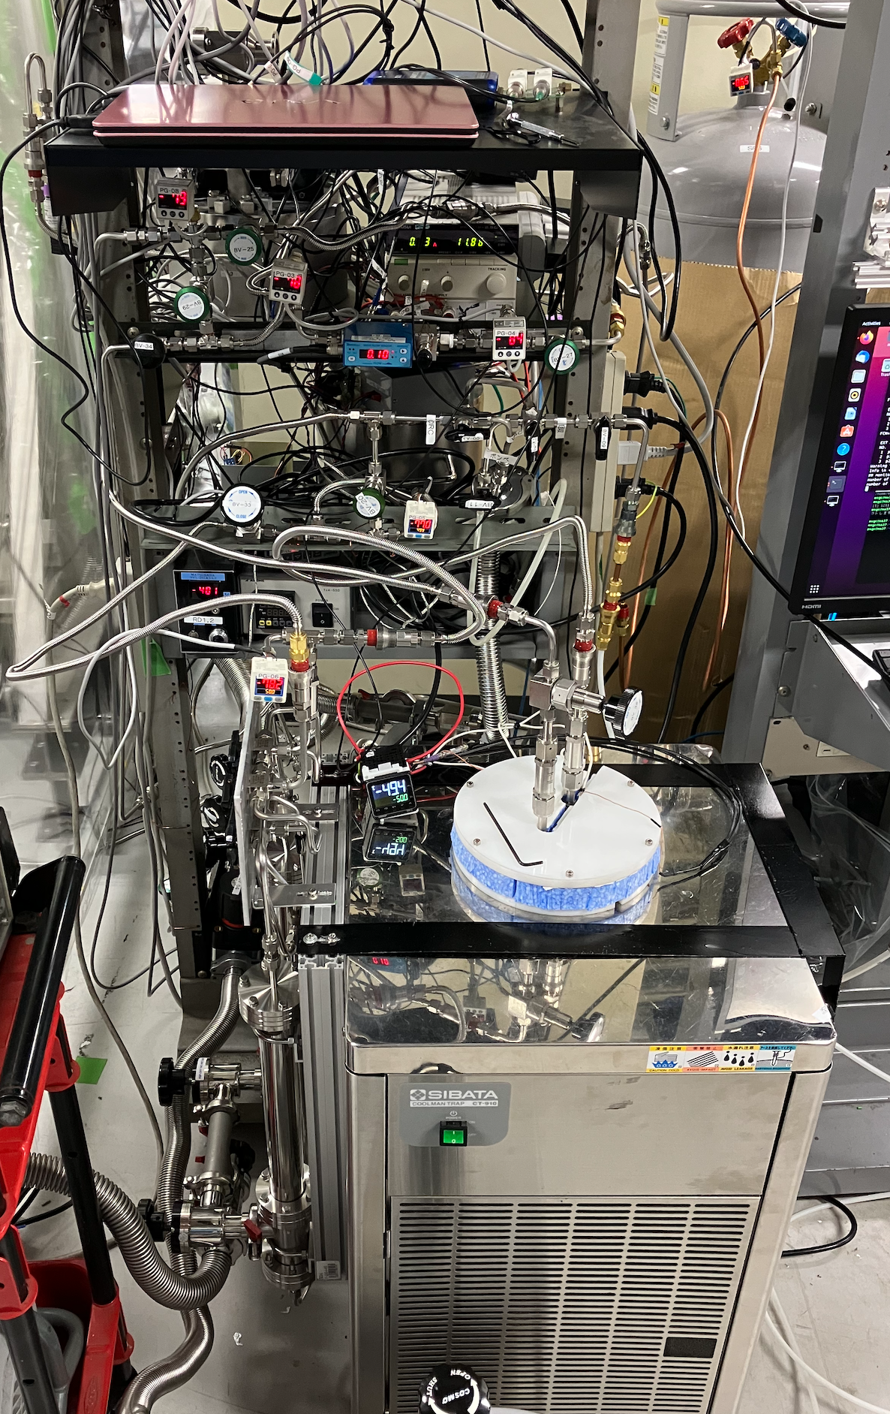
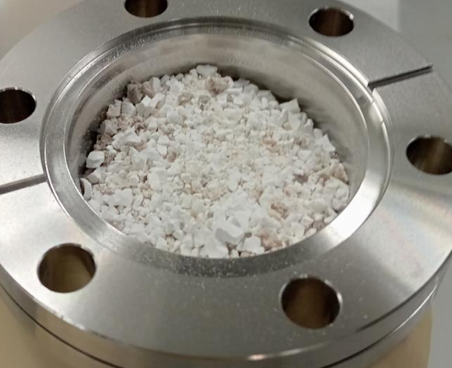
Gas circulation system
operation snapshot
Dew point [℃]
low-BG zeolite (5A)
Rn detector (×2)
Coolant temp. [℃]
Rn filter
Rn rate [count/day]
refrigerator
(cold trap)
ready for housing detectors

Slide 26
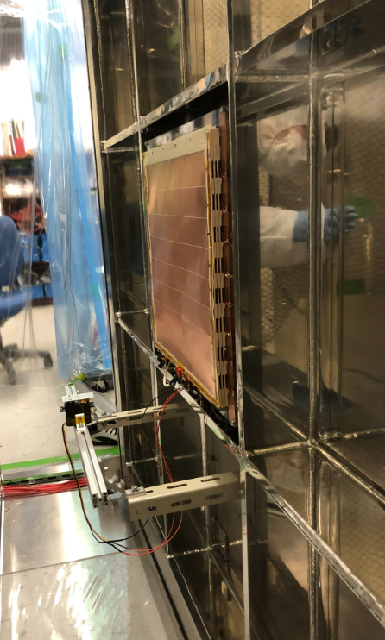
Detectors for C/N-1.0
Two requirements for the detector modules
  Electronics needs to fit 46 × 46 cm².
  Detector top needs to be at the electrical ground level.
C/N-1.0 inner view
C/N-1.0 outer view
C/N-1.0 concept
46 cm
DETECTOR TOP

Slide 27
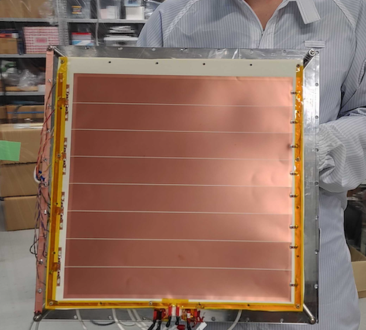
Two Kobe modules for C/N-1.0 (M. Ofuji)
  Module-0: larger, w/o tracking for BG measurement
  Module-1: smaller, w/ tracking as a DM detector
module-0
module-
30 cm
10 cm
10 cm
GEM
+μ-PIC
30 cm
3 GEMs
30×30 cm² detection area
read by 8 pads
8 readout channels
GEM + μ-PIC
10 × 10 cm² detection area
read by 256 strips
Track reconstruction

Slide 28
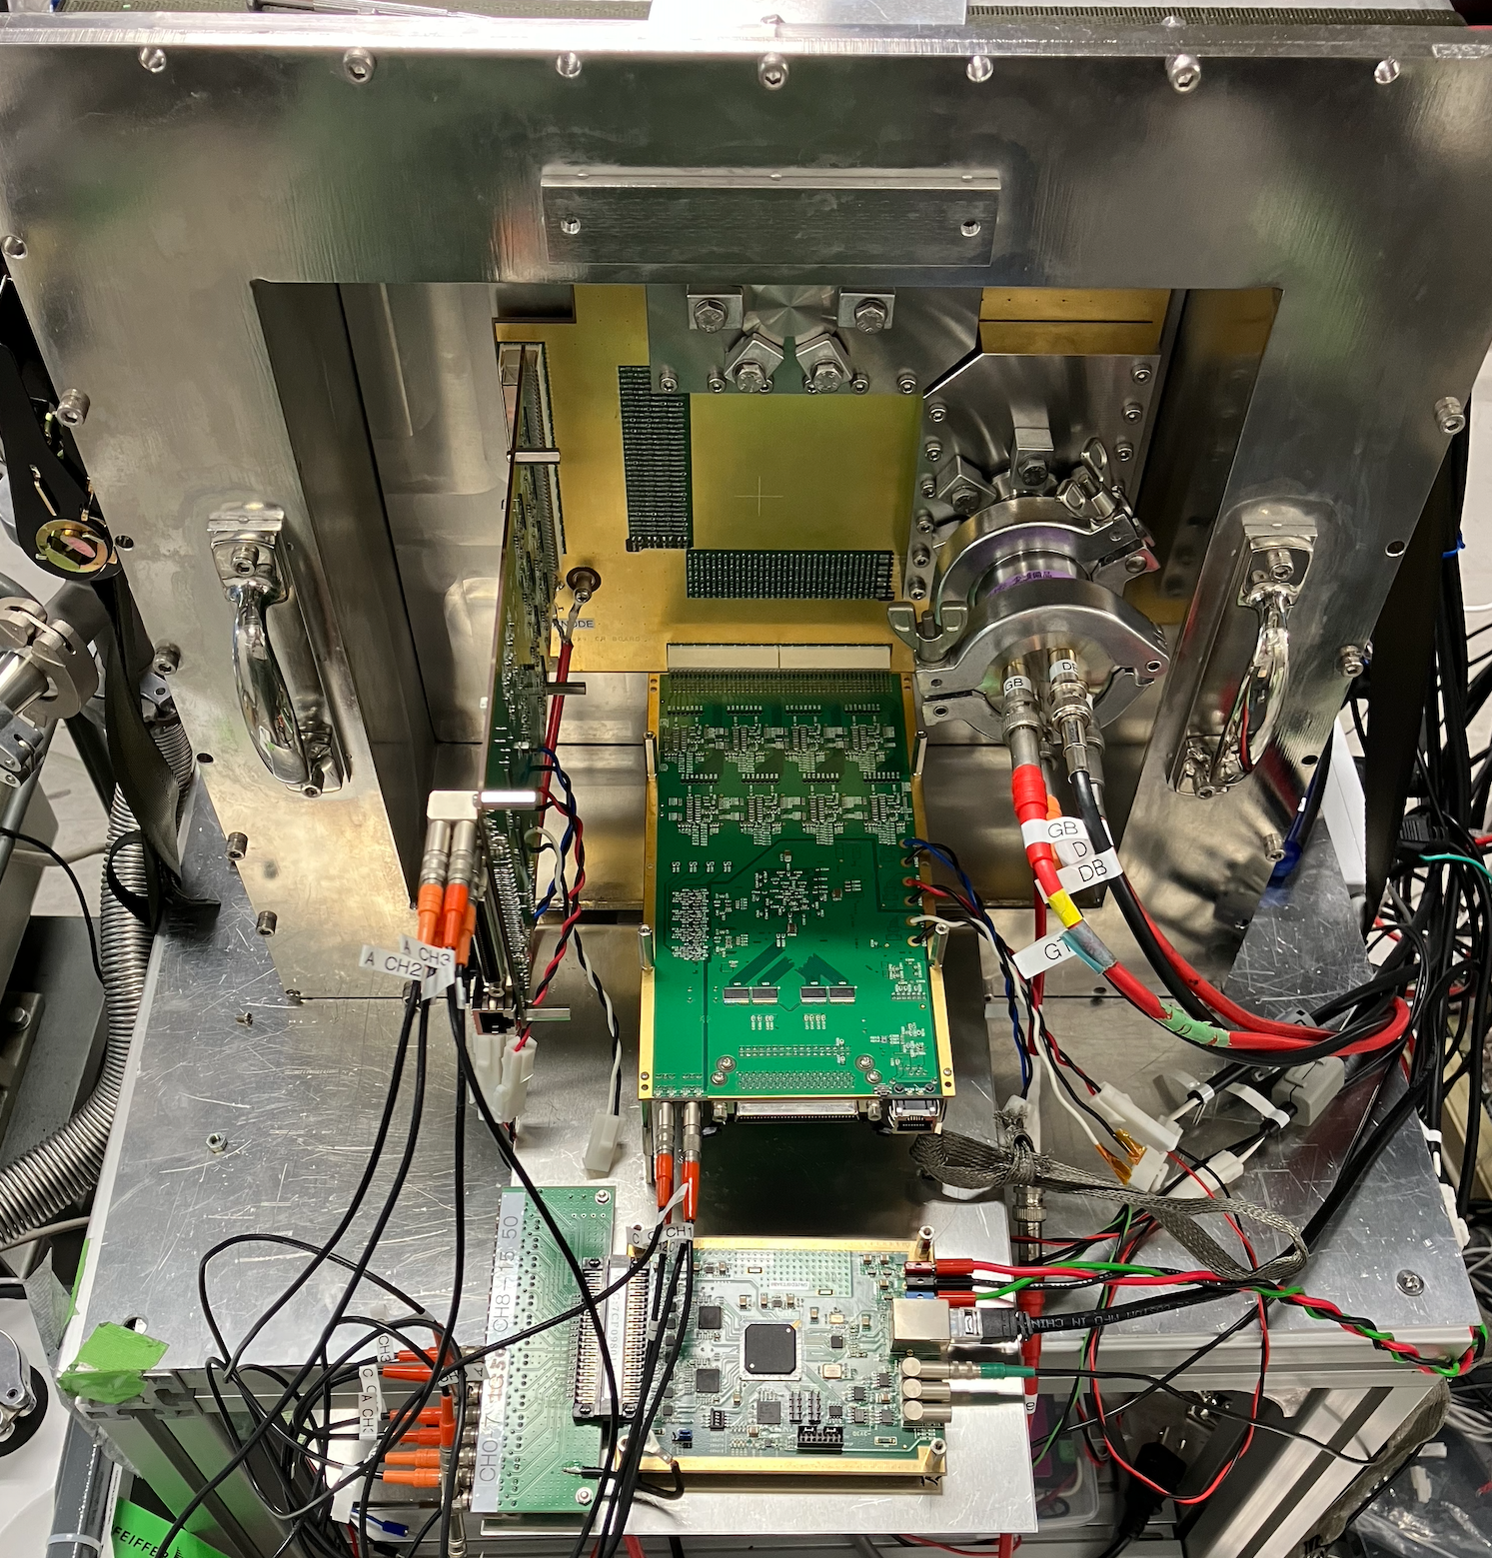
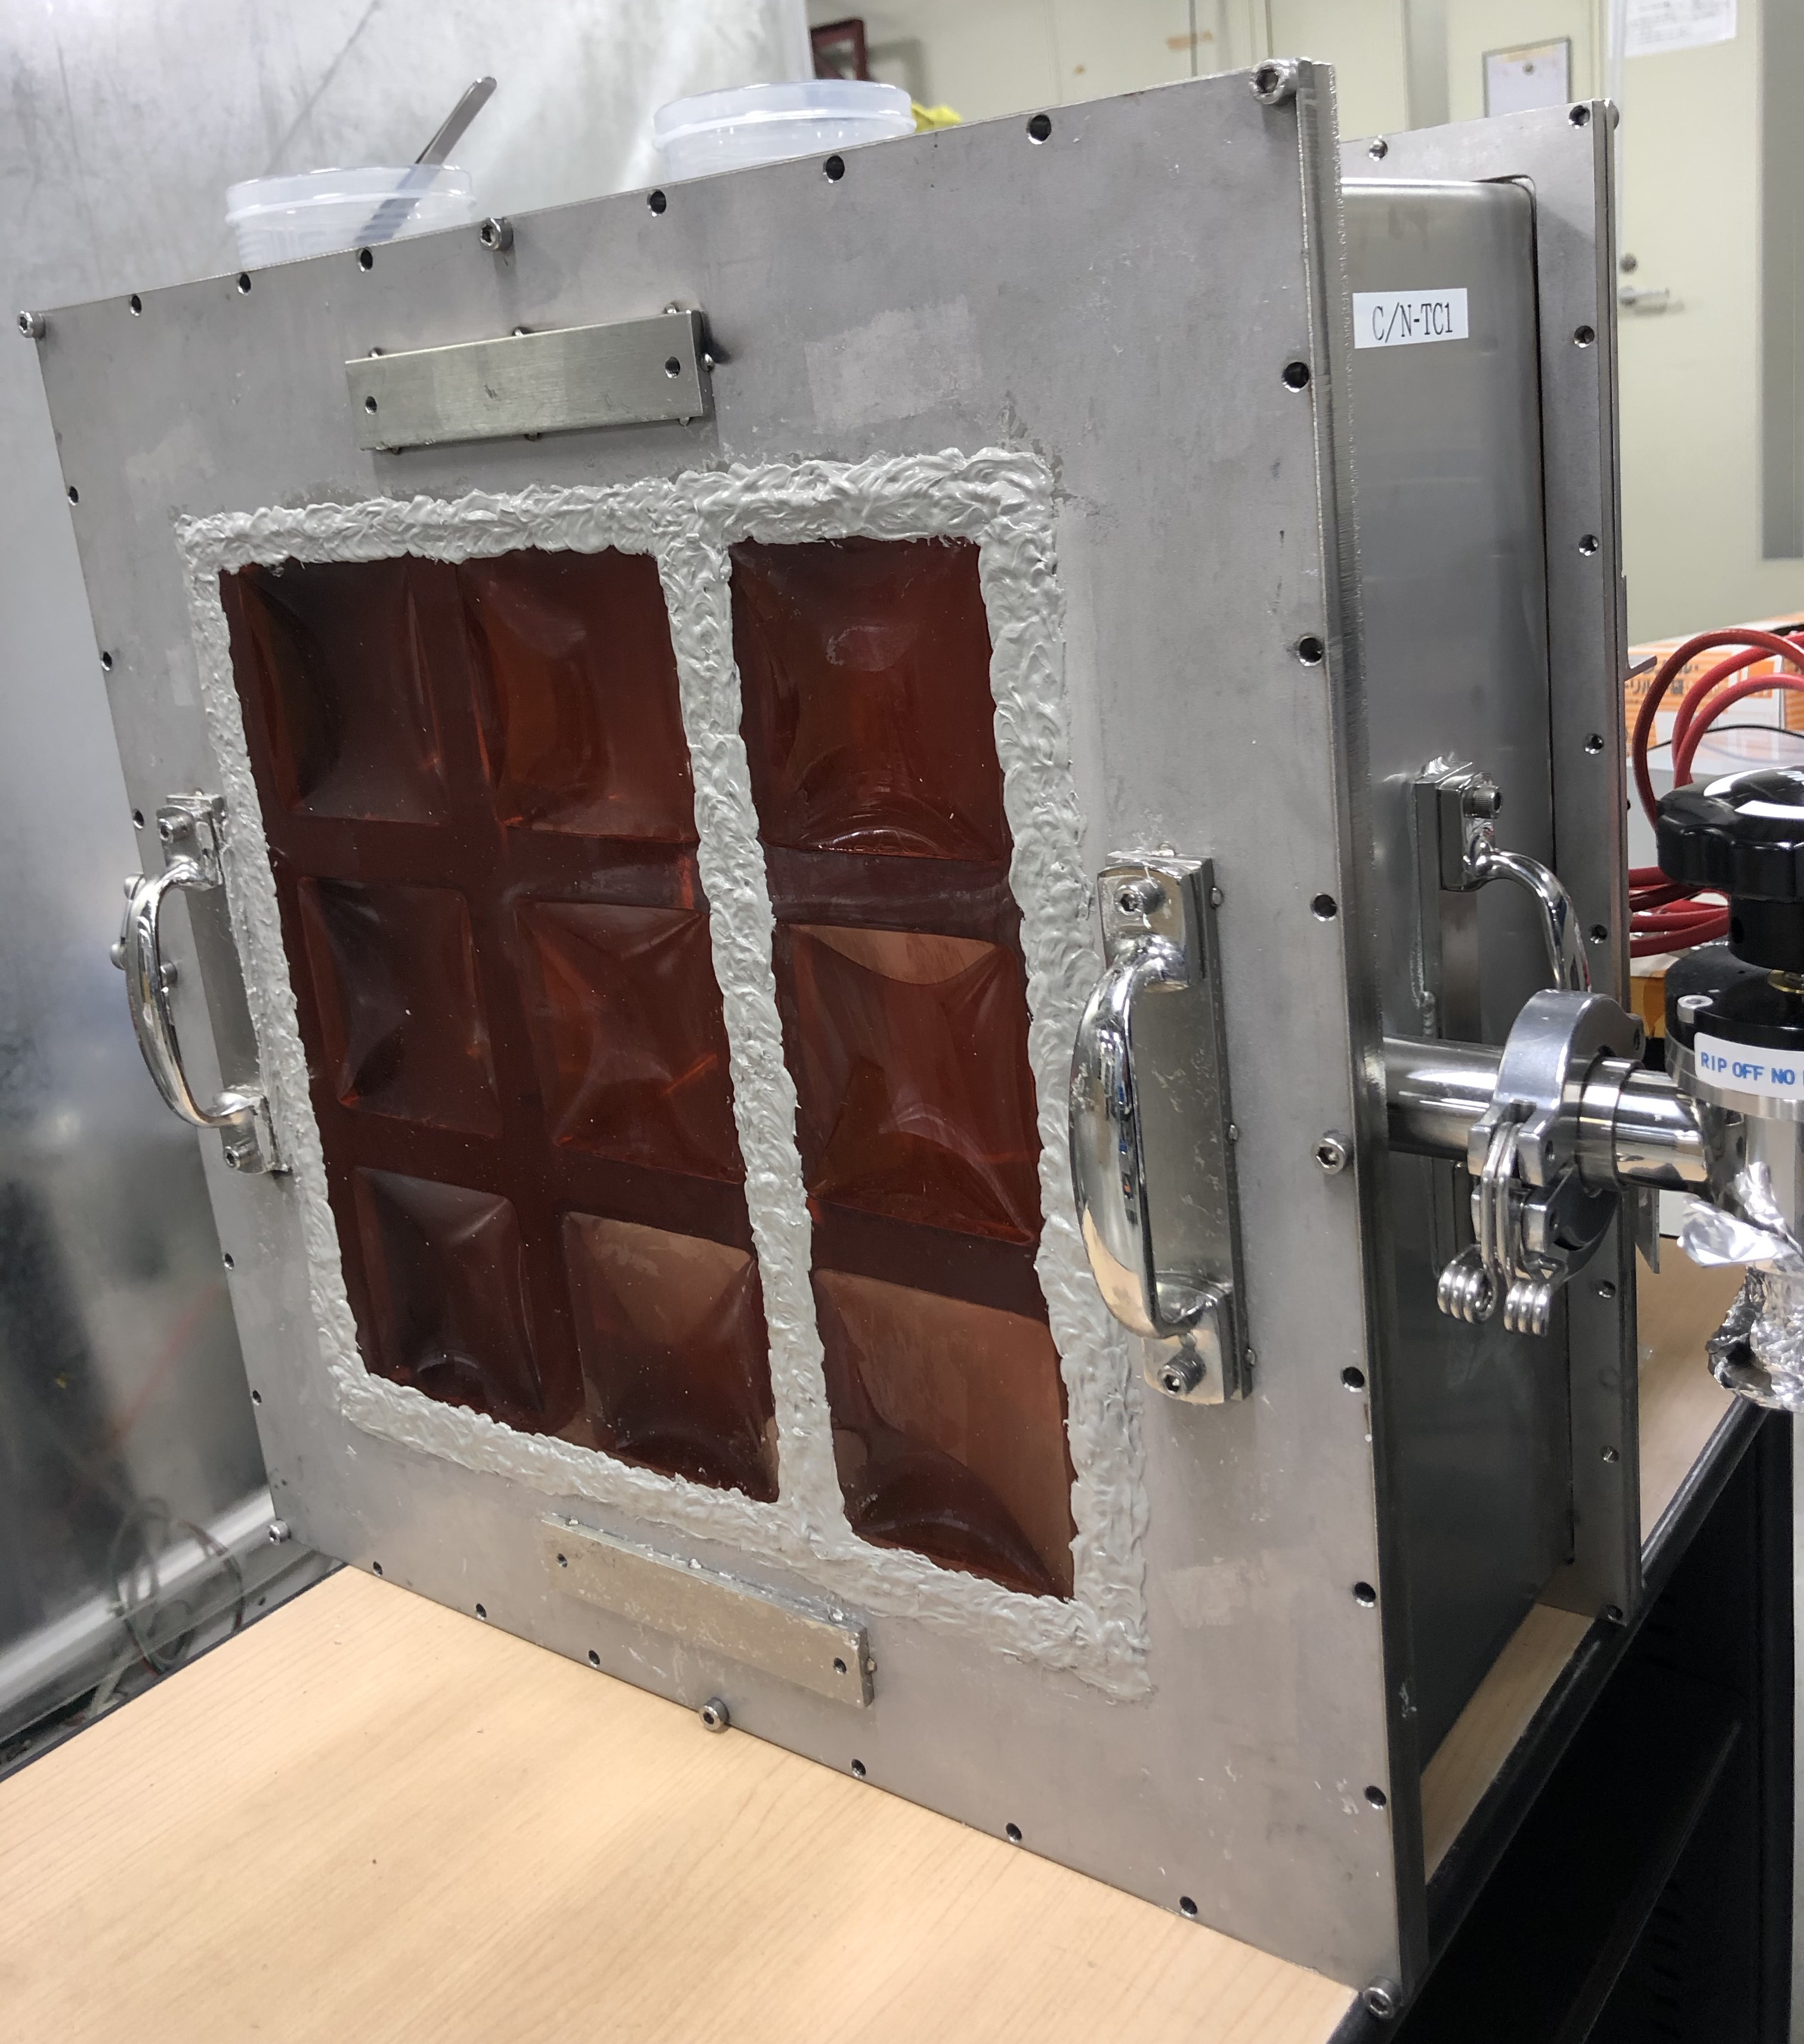
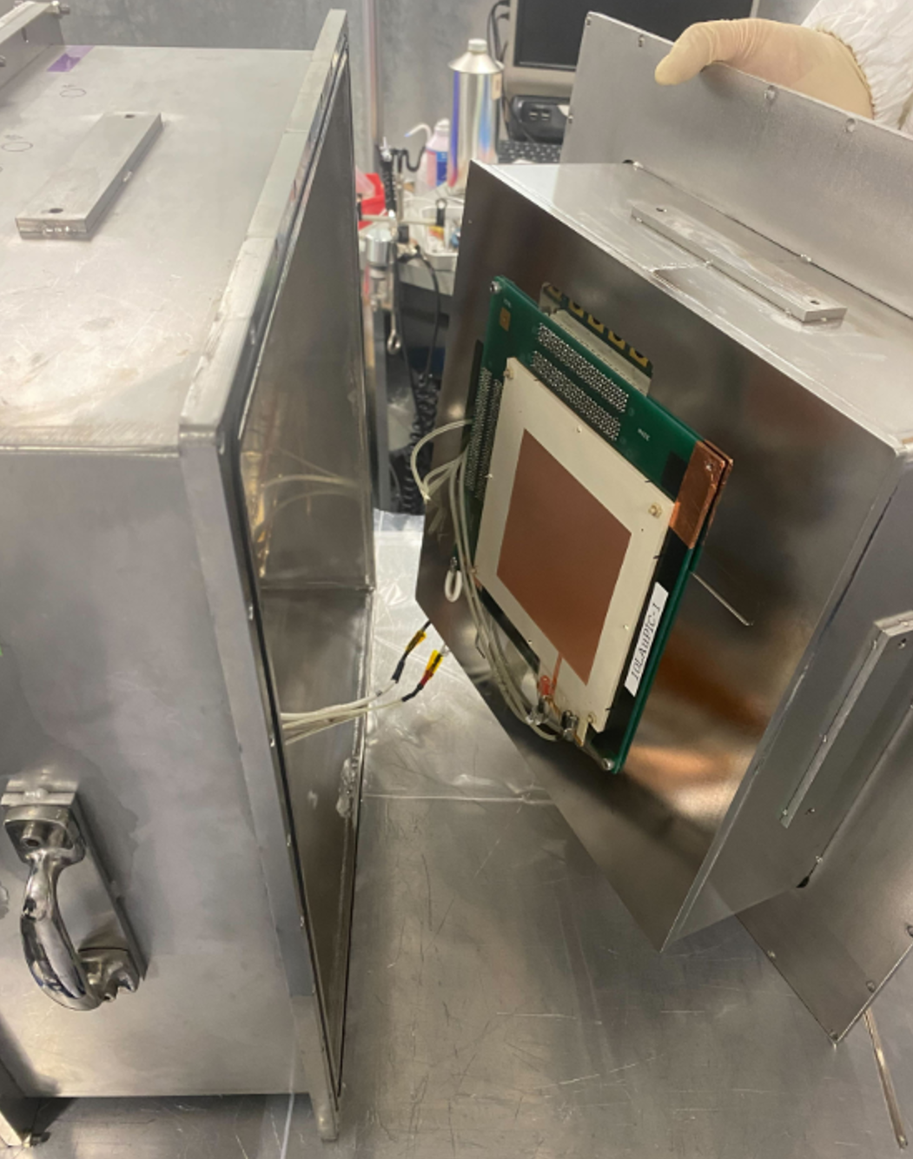
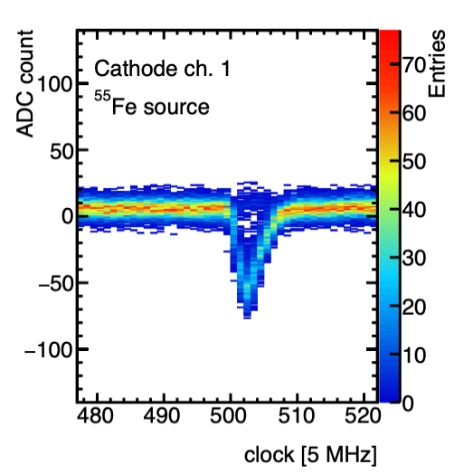
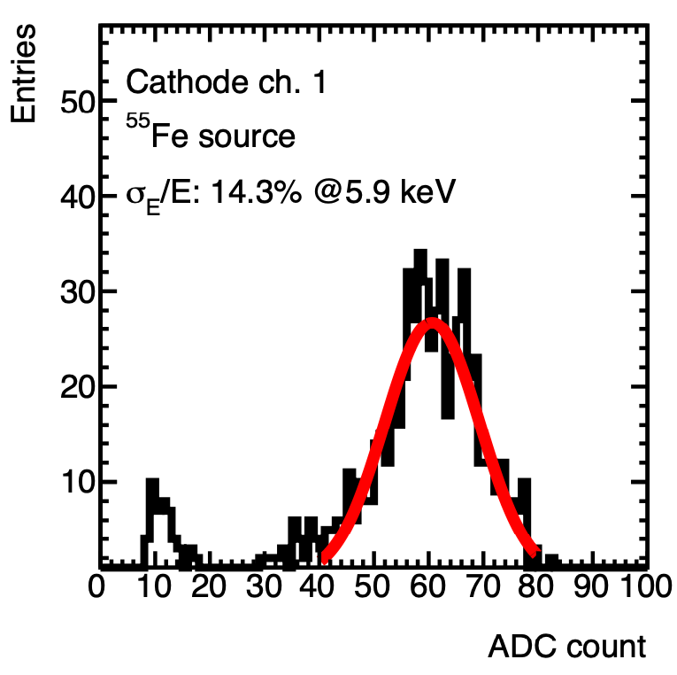
Module-1 test status
  being tested in a test chamber
Back
Front
Inside
pre-amplifiers
boards
ADC board
  Fundamental test as a gas detector was completed.
  Tracking performance is being tested

Slide 29
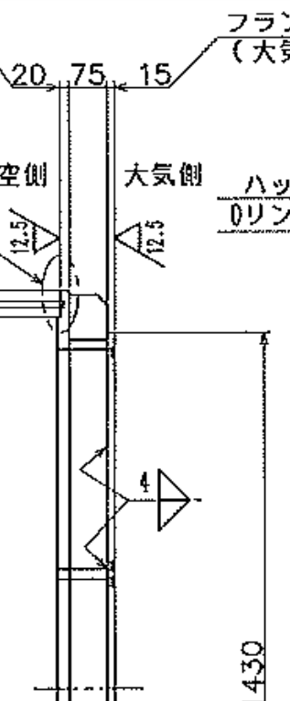
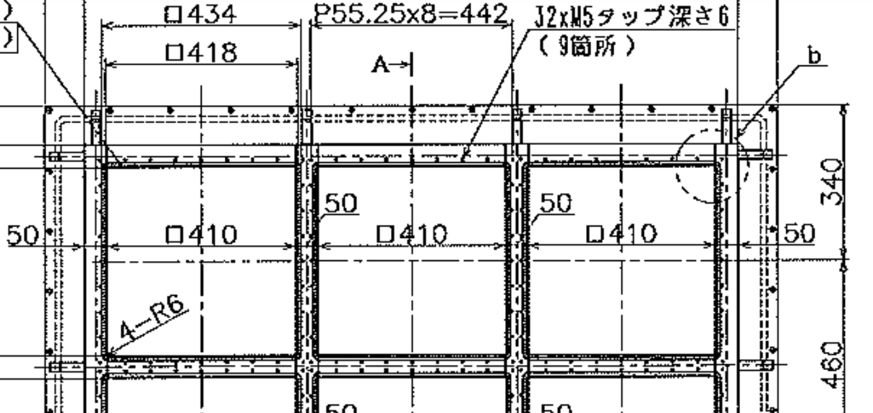
Details to welcome your modules...

Slide 30
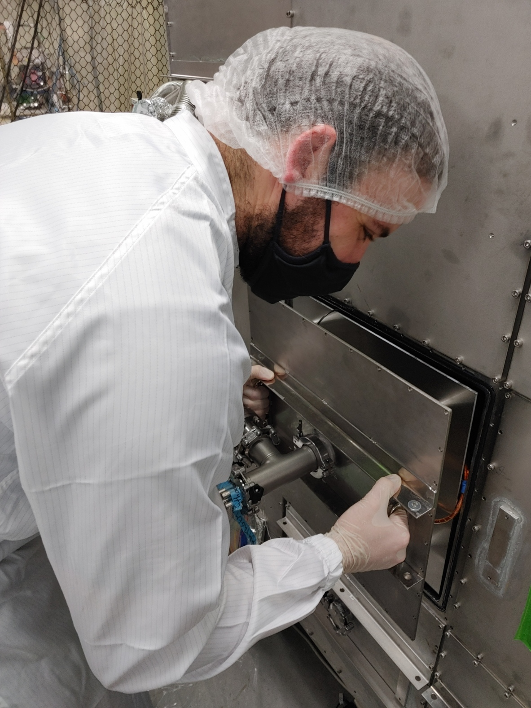
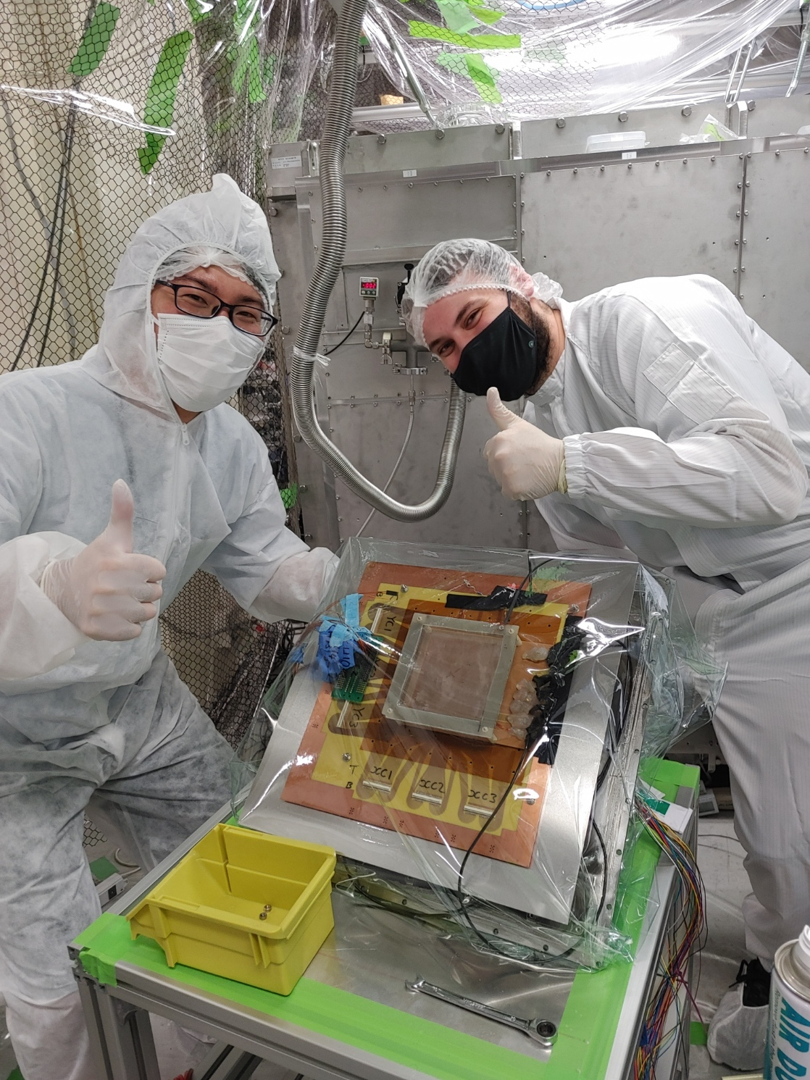
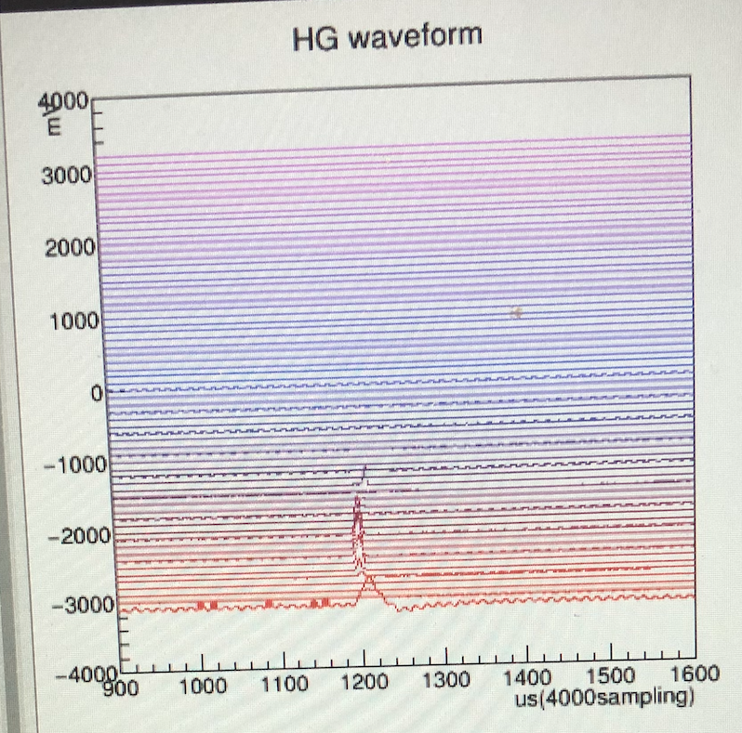
and, actually welcomed.
  Sheffield MICROMEGAS detector test
first light
super preliminary
Sep 2022
Sep 2022

Slide 31
Negative ion TPC Study
no “S1” signal
Pioneered by DRIFT group
Minority carrier discovery (CS₂+O₂, Occidental group)
  use several ion species with different drift velocities
SF₆ discovery (2015, UNM group).
  z-fiducialization 7.3mm FWHM
small diffusion
⇒ ｚ fiducialization possible ⇒LOW BG !
z-fidutilization (SF₆)
minority carriers (CS₂ )
Phys of DU 9-10 (2015) 1
2017 JINST 12 P02012

Slide 32
Nuclear tracks detection in SF₆
  strip readout + dedicated ASICs
  z-reconstruction
  tracking
    T. Ikeda+
    JINST (2020), P07015
    alpha-ray tracks
    setup
    z-reconstruction

Slide 33
ASIC development for negative ion TPCs
  “LTARS” series with Liq. argon groups at KEK, Iwata
  LTARS 2018 at hand
    T. Kishishita+
    JINST (2020) 15 T09009
    LTARS 2018 SPECS
    noise level

Slide 34
“TIGAr”, a compact board to fit with C/N-1.0
    T. Shimizu (Waseda)

Slide 35
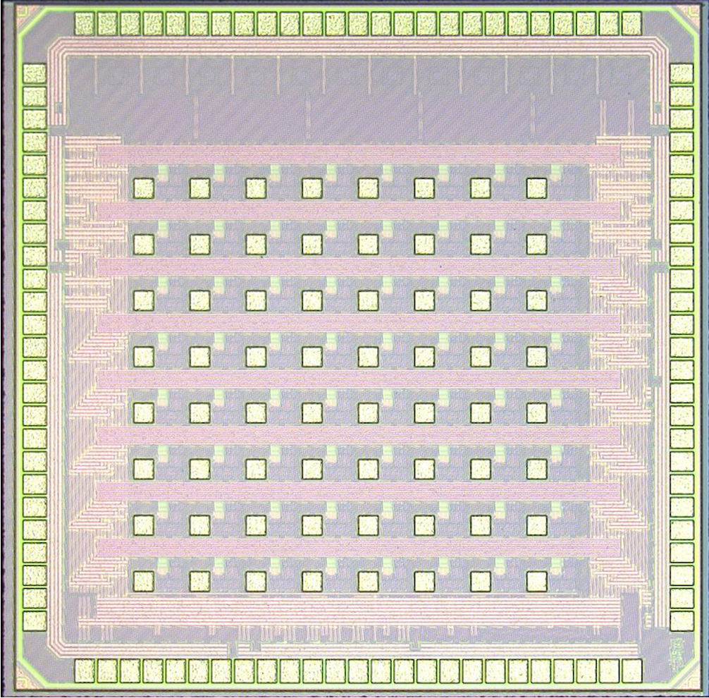
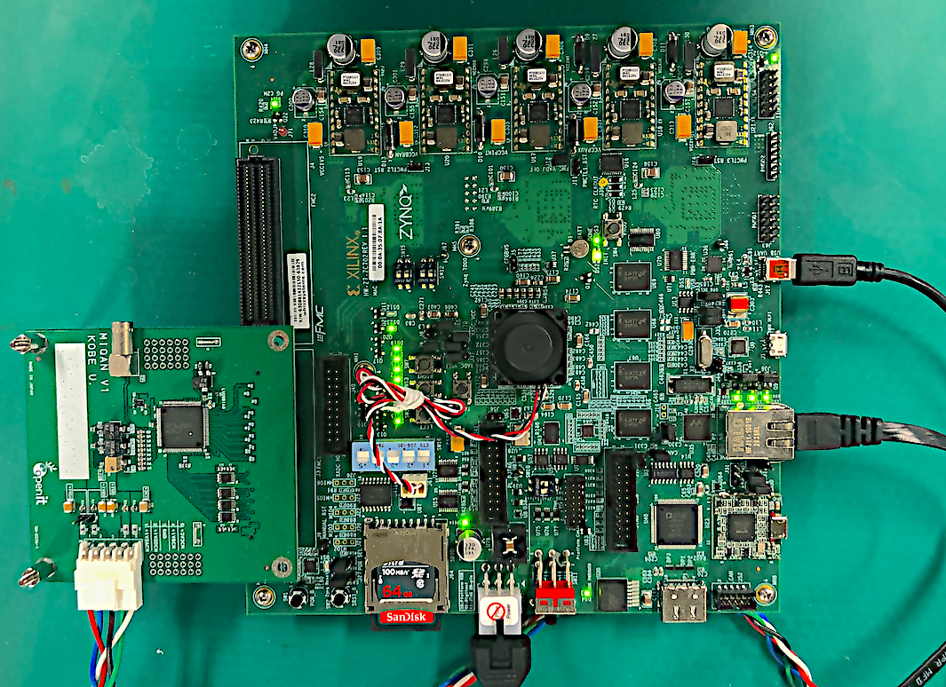
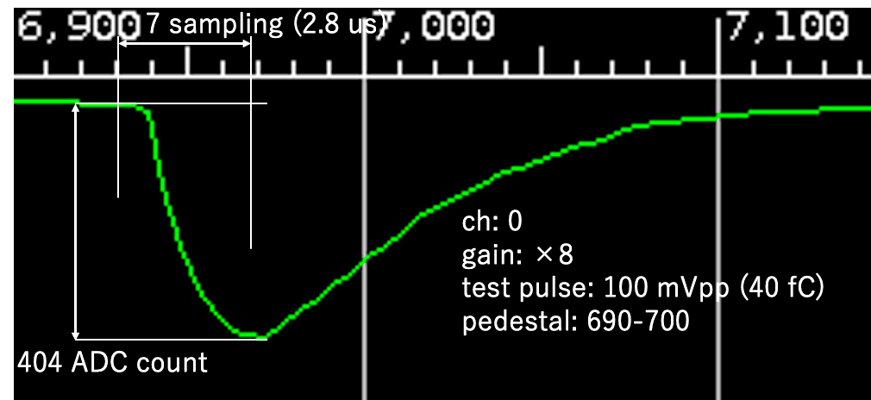
PIXEL readout (QPIX NEO v1)
S. Higashino
Energy threshold is limited due to electrode’s strip pitch (400 μm)
  Started to develop fine granularity “pixel” readout detector
  64 ch ASIC developed and testing its performance
2 mm
SoC (ZYNQ) board
Xilinx: ZC702
Test pulse waveform
for a particular ch.
2 mm
ADC count
34
readout ASIC
(155 um)² pixel pad
connecting to electrodes
by bump bonding
Test board
ASIC mounted
Analog circuit + ADC
successfully working!

Slide 36
α-ray Imaging
H.Ito
NIM A Volume 953, (2020), 163050
Reusing NEWAGE-0.3a
measuring samples of various experiments

Slide 37
MIRACLUE (MIGDAL study)
PTEP 2021 013C01
Ar (1atm) and Xenon (8 atm) gas
  direct interests in DM search
start with existing technologies
  less R&D
    K. Nakamura (Tohoku)

Slide 38
Characteristic X-ray channel for 2-cluster detection (first step)
  less BG
Low energy (565keV) neutrons (@AIST, Japan)
  less BG
expected signature
（2-cluster distance）
PTEP 2021 013C01

Slide 39
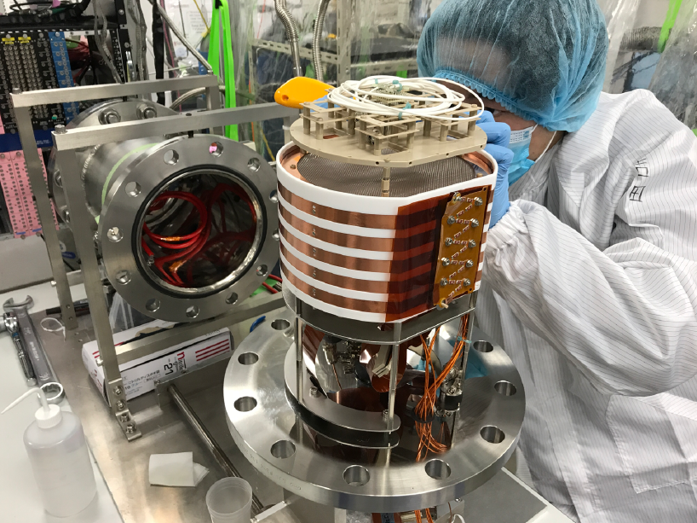




High pressure Xenon TPC
  Xenon TPC worked with neutron beam successfully
  Energy & topology were measured
  Analysis for Migdal branching is ongoing
Xenon TPC
Measured energy spectrum with 565keV neutron beam
Xe X-ray
(Used for calibration)
#2
#1
“2 cluster“ event
#4
ELCC
1cm pitch EL readou
t
#3
No. | Energy [keV] | Note
#1 | $$79.3±0.14$$ | escape peak of #2
#2 | $$109.7±0.08$$ | ¹⁹F(n,γ) 110keV
#3 | $$166.5±0.74$$ | escape peak of #4
#4 | $$196.5±0.25$$ | ¹⁹F(n,γ) 197keV

Slide 40
Cosmic-ray up-scattered DMs(CR-DM)
JCAP07(2023)061
K. Nagao
Light (1~100MeV) DMs would be up-scattered at Galactic Center by cosmic-ray protons
Can be detected with directional detectors
Studied for gaseous TPCs and emulsions
also in Nicole’ｓ talk
expected recoils
Incoming DM maps
@Galactic coordinate

Slide 41
Results
  Need LARGE exposures
  CYGNUS framework (even with emulsions) is necessary

Slide 42


SUMMARY
new limits
Since last CYGNUS,
new powder
new tracks
new detector
new playground
Waiting
for
new targets
your
detectors

