Slide 1
Progress in directional DM detection with quantum diamond sensors
Daniel Ang
Quantum Technology Center, University of Maryland
CYGNUS 2023

Slide 2
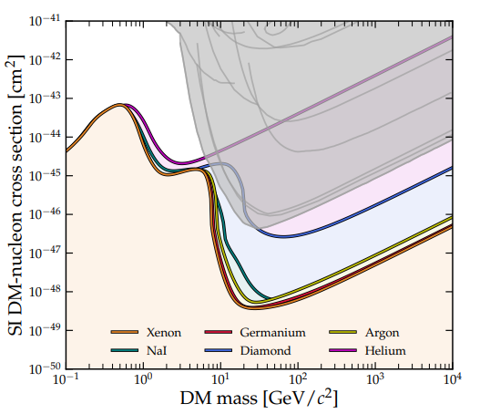
Introduction
Goal: overcome solar neutrino fog by using nitrogen vacancy (NV) centers in diamond as directional DM detector
Strengths:
  Solid-state → can pack more material in smaller volume
  Complementary material to existing detectors
  Can take advantage of state-of-the-art techniques in quantum sensing with NV centers
O'Hare, PRL 127, 251802 (2021)
Ebadi et al., AVS Quant. Sci. 4, 044701 (2022)

Slide 3
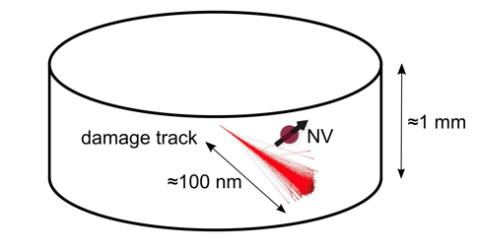
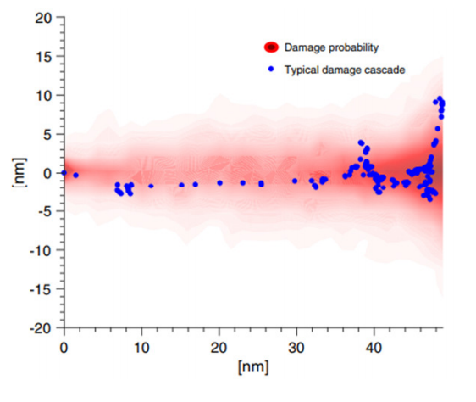
Detector principle
1-100 GeV WIMP → 10-100 keV nuclear recoil → 10-100 nm damage track in NV-enriched diamond
Locate and characterize damage track w/ NV spectroscopy
Deduce initial recoil direction and distinguish between solar neutrinos vs. DM
SRIM simulation for 30 keV recoil
Rajendran et al., PRD 9, 035009 (2017)

Slide 4
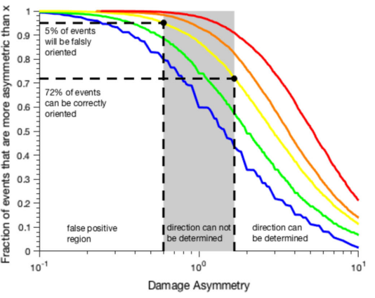
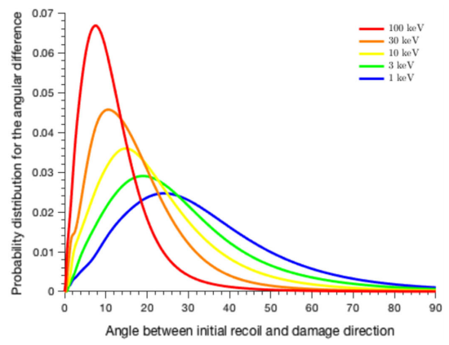
Estimated directional performance
Based on SRIM simulations
Angular difference to initial recoil
Head/tail identification
Rajendran et al., PRD 9, 035009 (2017)

Slide 5
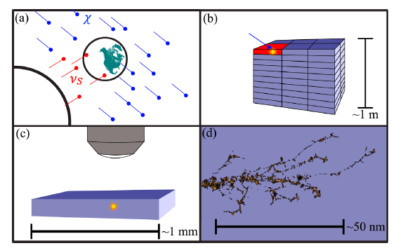
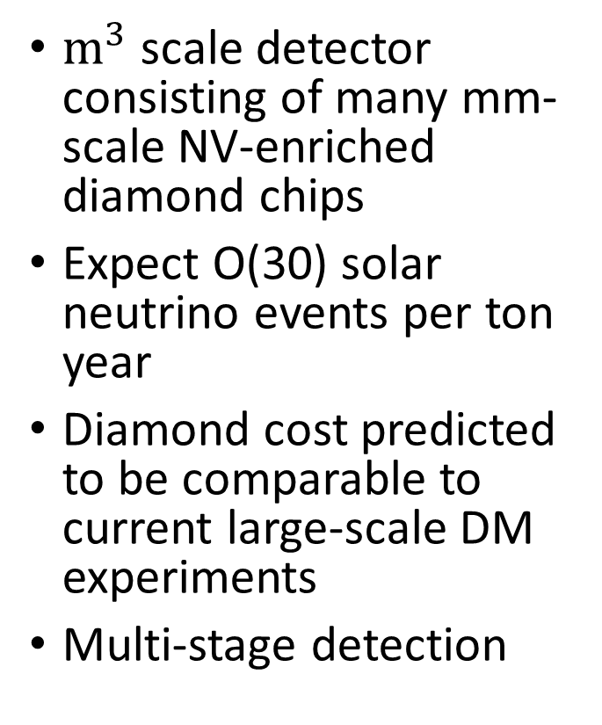
Detector scheme
$m^{3}$ scale detector consisting of many mm-scale NV-enriched diamond chips
Expect O(30) solar neutrino events per ton year
Diamond cost predicted to be comparable to current large-scale DM experiments
Multi-stage detection

Slide 6
Detector scheme
Stage 1: mm-scale real time detection
Stage 1: real-time event detection
Similar working principle as conventional DM detector
Charge, phonon, or photon collection
Localize event to mm-scale chip within detector
Extract chip of interest

Slide 7
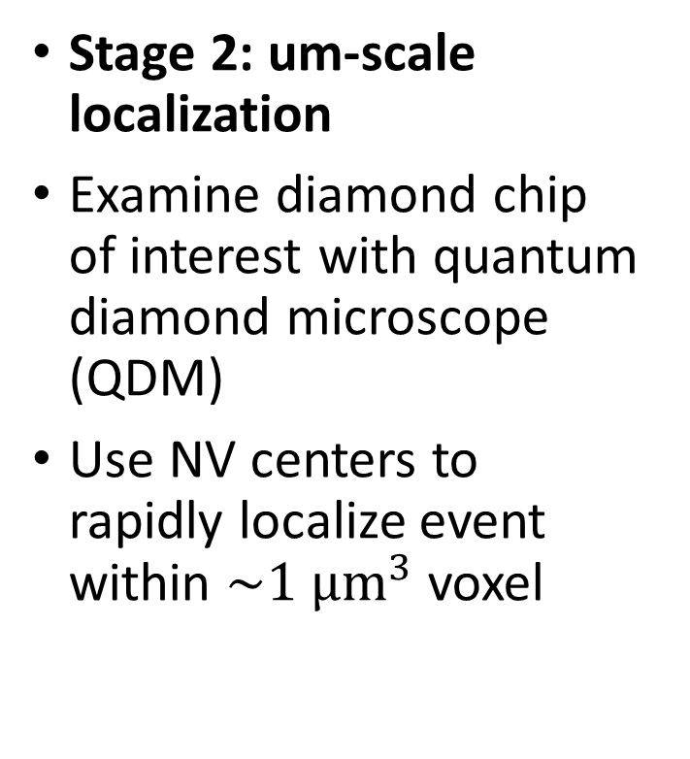
Detector scheme
Stage 2: um-scale localization
Examine diamond chip of interest with quantum diamond microscope (QDM)
Use NV centers to rapidly localize event within $\sim 1 μm^{3}$ voxel
Stage 2: um-scale localization

Slide 8
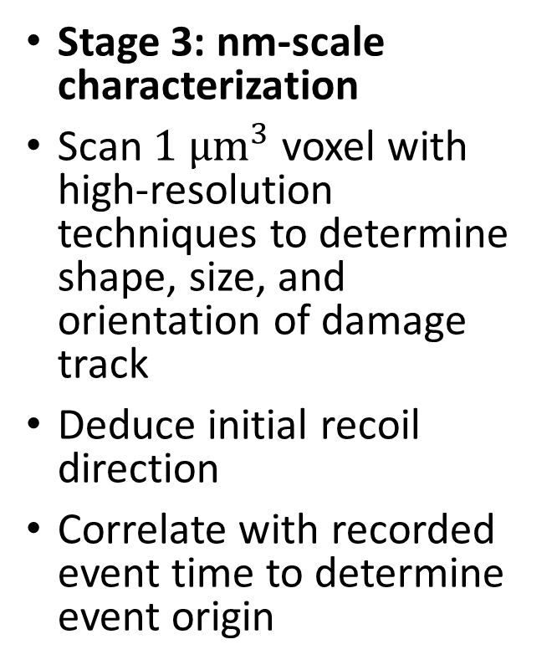
Detector scheme
Stage 3: nm-scale characterization
Scan $1 μm^{3}$ voxel with high-resolution techniques to determine shape, size, and orientation of damage track
Deduce initial recoil direction
Correlate with recorded event time to determine event origin
Stage 3: nm-scale characterization

Slide 9
General detector requirements
Low background diamonds
  No pre-existing features that resemble WIMP tracks
Imaging with high resolution
Fast and efficient scanning to keep up with event rate
  Goal: complete stages 1-3 in < 3 days

Slide 10
Stage 1: Diamond as a general DM detector
Several favorable properties (Kurinsky et al., PRD 99, 123005 (2019))
  Semiconductor with wide bandgap (5.4 eV)
  Lower mass compared to other solid-state detectors
  Can be manufactured with high purity
High detection efficiency possible via charge, photon, or phonon collection
Can be used as a DM detector via nuclear recoil, electron recoil, or absorption
Active research efforts in other groups (e.g. CRESST collaboration)
Abdelhameed et al., Eur. Phys. J. C 28:851 (2022)
G. Angloher et al., arxiv:2310.05815 (2023)

Slide 11
Stage 2: micron scale localization
Method 1: Use diamonds with pre-existing NV centers
  Measure strain shift caused by damage track
Method 2: Use diamonds with low NV density, high N concentration
  Detect new NVs created by damage track
NV centers are key component!

Slide 12
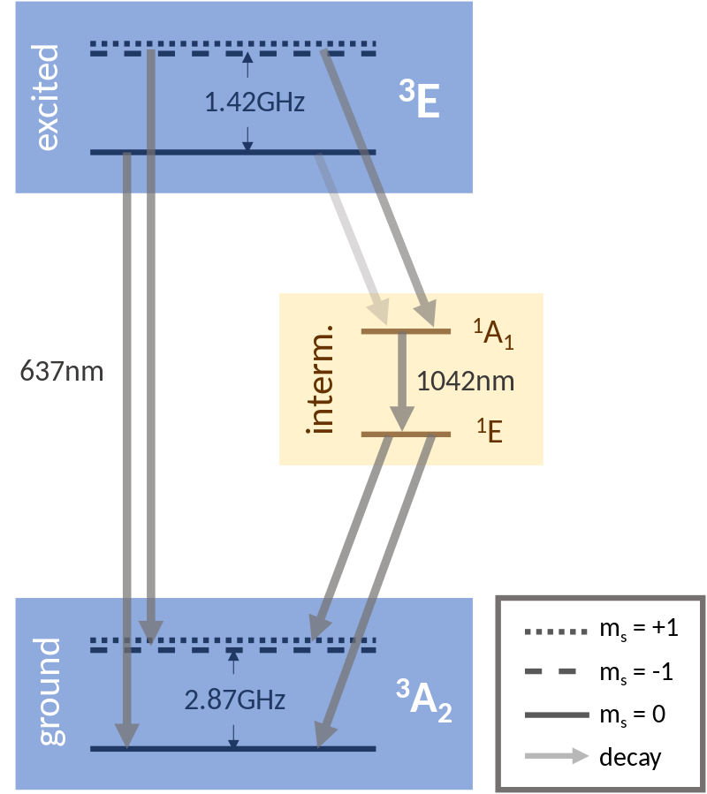
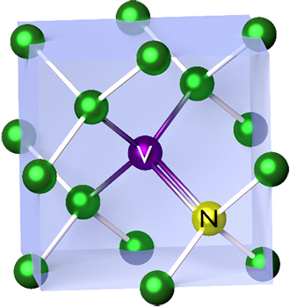
Nitrogen vacancy centers in diamond
Optical initiation/readout:
532 nm excitation
640-800 nm emission
Coherent state manipulation
MW
Spin-1 ground state

Slide 13
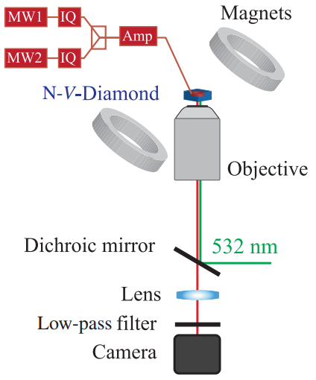
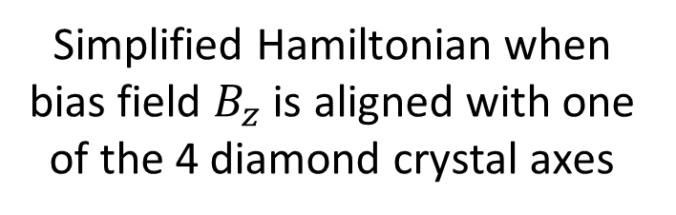
Nitrogen vacancy centers in diamond
Simplified Hamiltonian when bias field $B_{z}$ is aligned with one of the 4 diamond crystal axes
Temperature-dependent
Magnetic field
Crystal strain
Quantum diamond microscope (QDM)

Slide 14
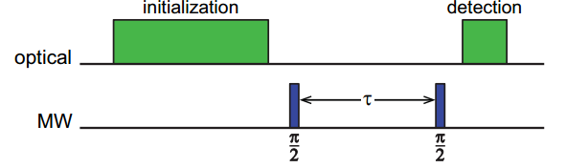
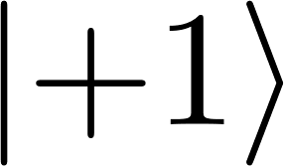
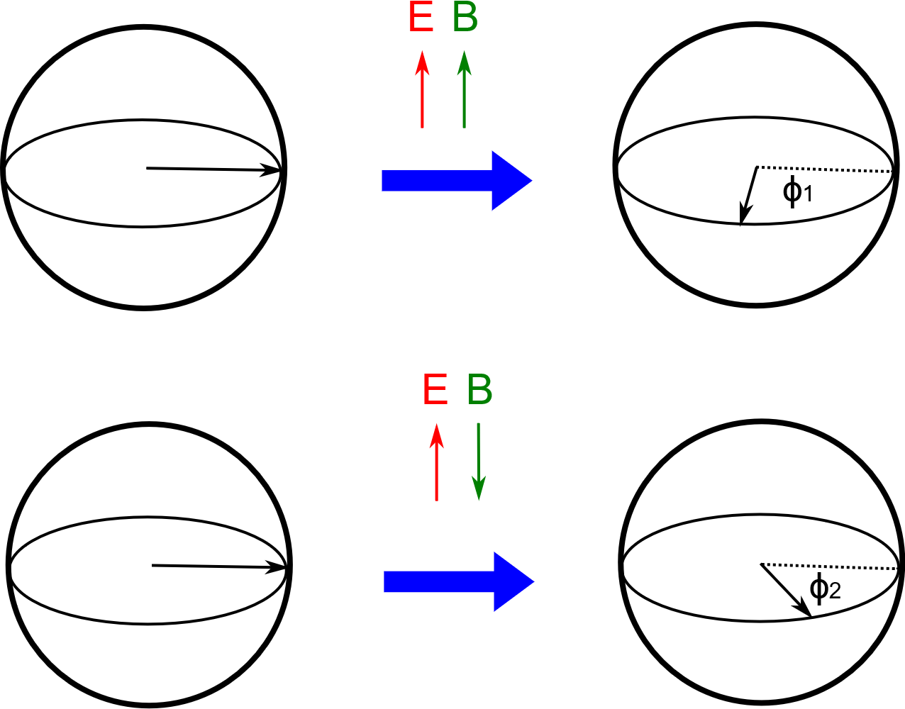


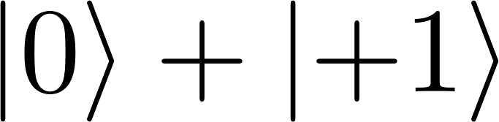
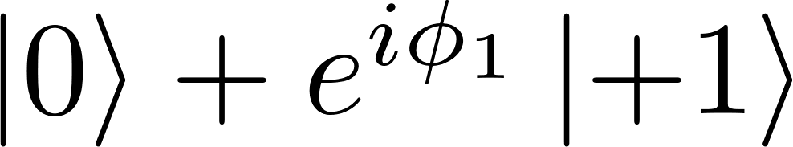
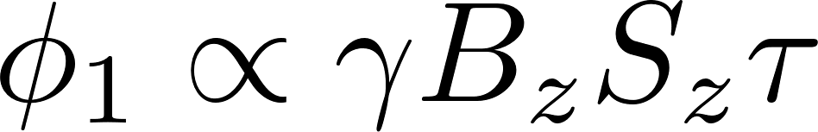

Example of quantum sensing with NVs
Ramsey DC magnetometry
$$τ$$

Slide 15
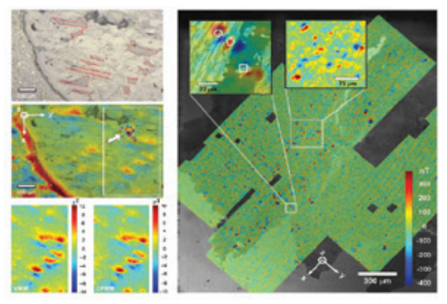
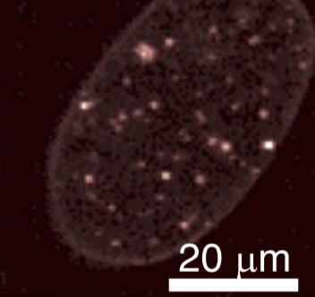
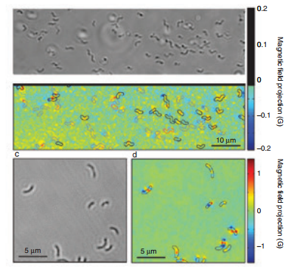
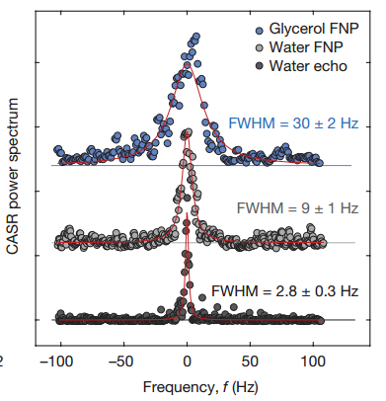
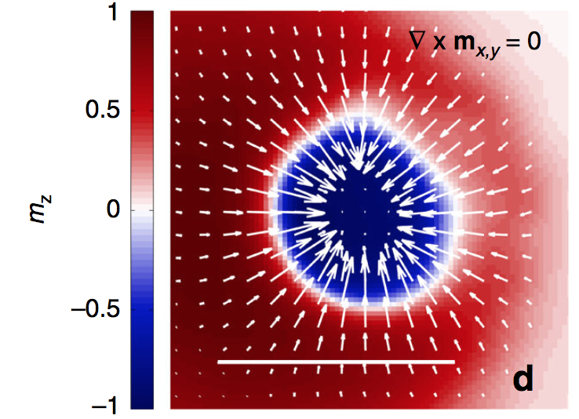
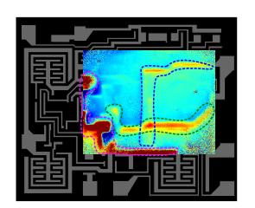
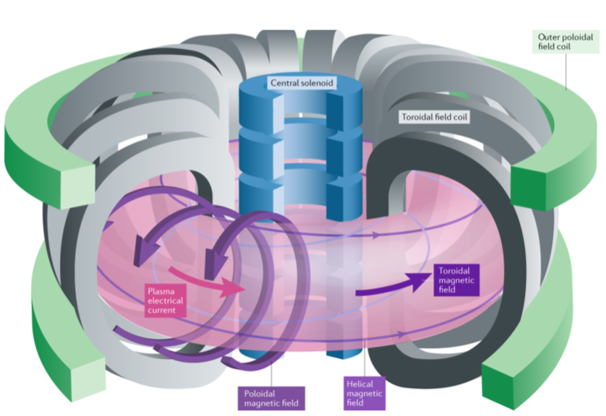
Diverse applications of NVs
Geoscience
Nanoscale in situ thermometry
Bio-imaging
NMR
IC imaging
Condensed matter physics
Extreme environment sensing
Levine et al., Nanophotonics 8 (11): 1945-1973 (2019)
Glenn et al., Nature 555, 351–354 (2018)
Geoscience
Notes:
IC imaging from Kehayias, https://www.osti.gov/servlets/purl/1826099

Slide 16
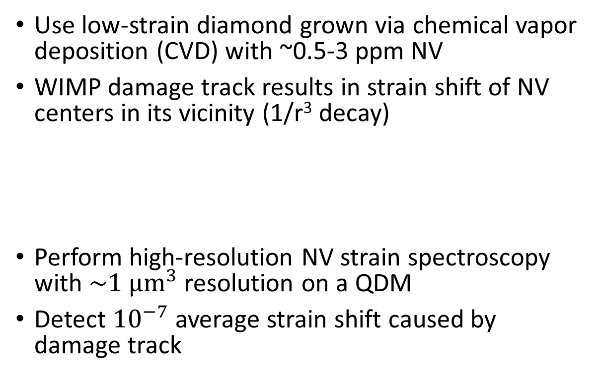
Stage 2 detection, method 1:
NV strain sensing
Use low-strain diamond grown via chemical vapor deposition (CVD) with ~0.5-3 ppm NV
WIMP damage track results in strain shift of NV centers in its vicinity (1/r³ decay)
Perform high-resolution NV strain spectroscopy with $\sim 1 μm^{3}$ resolution on a QDM
Detect ${10}^{−7}$ average strain shift caused by damage track
Strain shift
Widefield QDM

Slide 17
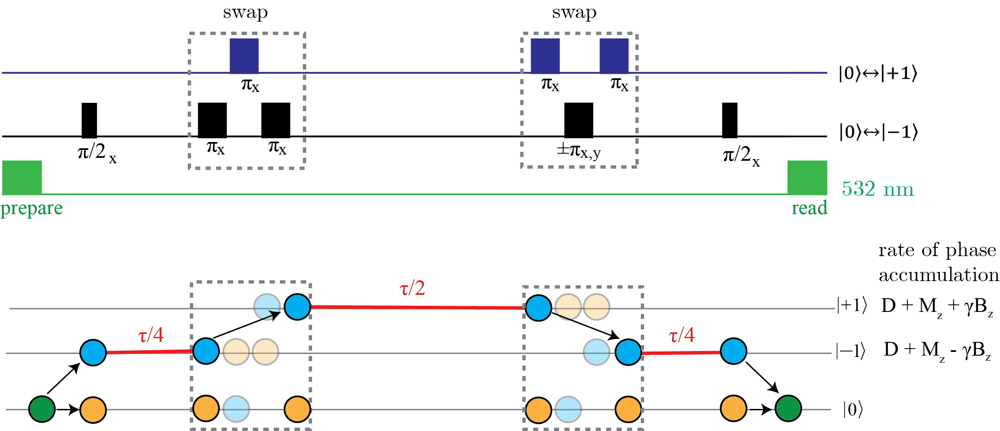

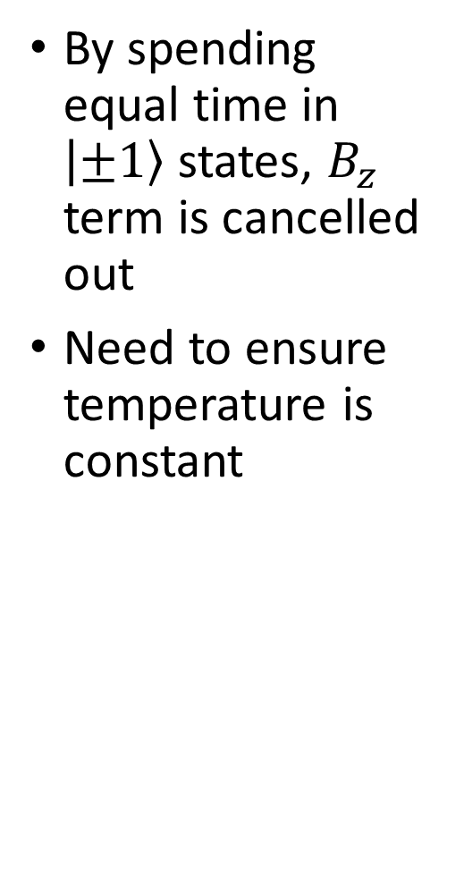
Strain CPMG pulse protocol
By spending equal time in $\left|±1\right\rangle$states, $B_{z}$ term is cancelled out
Need to ensure temperature is constant
M. Marshall et al., PR Applied 17, 02401 (2022)

Slide 18
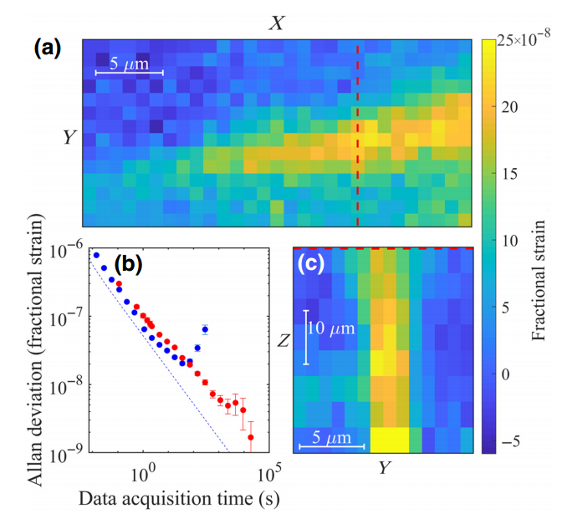
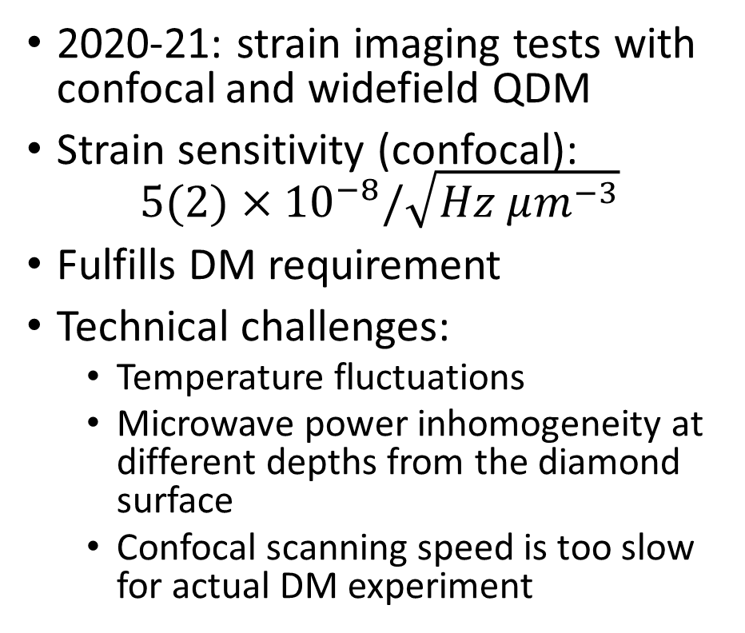
3D strain imaging with confocal microscope
2020-21: strain imaging tests with confocal and widefield QDM
Strain sensitivity (confocal):
$5(2)×{10}^{−8}/\sqrt{Hz μm^{−3}}$
Fulfills DM requirement
Technical challenges:
  Temperature fluctuations
  Microwave power inhomogeneity at different depths from the diamond surface
  Confocal scanning speed is too slow for actual DM experiment
M. Marshall et al., PR Applied 17, 02401 (2022)

Slide 19
Widefield strain imaging
Widefield strain imaging with similar level of strain sensitivity
150 x 150 um² FOV, 1 s averaging time
~2 days to scan whole diamond volume
Observed natural strain features (50-100 um length scales)
Limitation: only 2D
M. Marshall et al., PR Applied 17, 02401 (2022)
Notes:
Picture

Slide 20

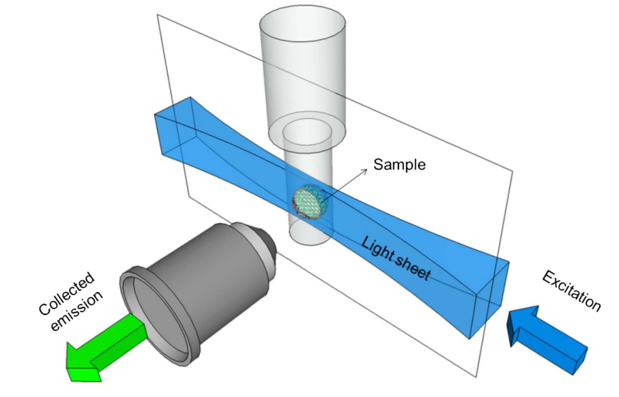
Towards rapid 3D strain imaging
Light sheet microscopy (optical sectioning)
State-of-the-art LSMs can achieve ~1 um axial resolution and mm-scale FOVs
Already used in DM searches with color centers in other solid-state detectors (PALEOCCENE collaboration)
Currently building a prototype LSM @ UMD for 3D NV strain imaging
Developing custom resonators w/ ARL to improve MW homogeneity
Vladimirov et al., doi:10.1101/2023.06.16.545256 (2023)
Alfonso et al., arXiv:2203.05525 (2023)
Olarte et al., Adv. Opt. Phot. 10 (1), 111-179 (2018)

Slide 21
Stage 2, Method 2:
Fluorescence from created NVs
Use HPHT diamonds with ~200 ppm nitrogen
  Low number of pre-existing NVs
WIMP damage track creates vacancies
Annealing at high temperature (800 C) results in some vacancies attaching to nitrogen atoms and becoming NVs
Identify damage track location by detecting optical fluorescence from NVs

Slide 22
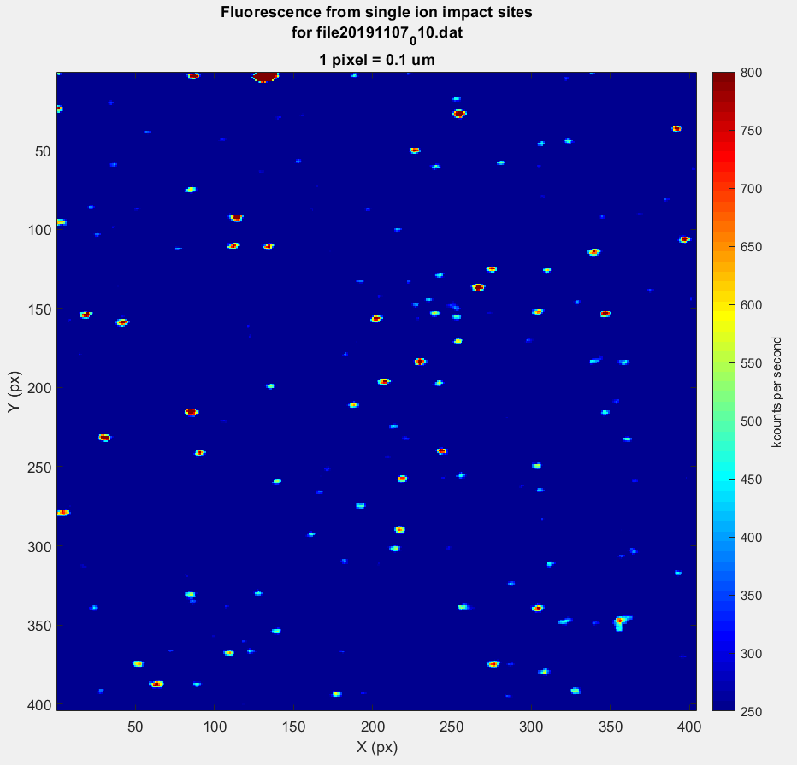
Stage 2, Method 2:
Fluorescence from created NVs
Advantages:
  HPHT diamond is cheaper
  Detect fluorescence only - no quantum sensing techniques required (simpler)
Disadvantages:
  Annealing may affect directional detection performance
  Higher impurities may make charge collection (stage 1) more difficult
Further studies required to determine best method
Preliminary
NVs created as result of 385 keV ion implantation @ Innovion

Slide 23

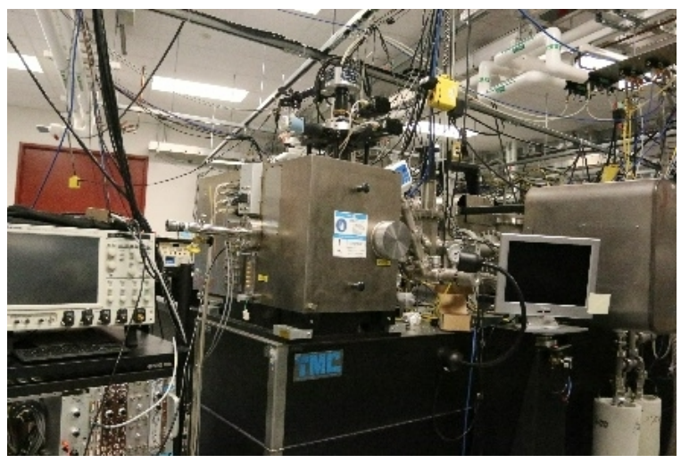
Artificial signal injection
Active research cooperation with Ion Beam Laboratory in SNL
Microbeam facility:
  Can inject single carbon ions into diamond sample
  Minimum energy of 800 keV
  3 um spatial resolution

Slide 24
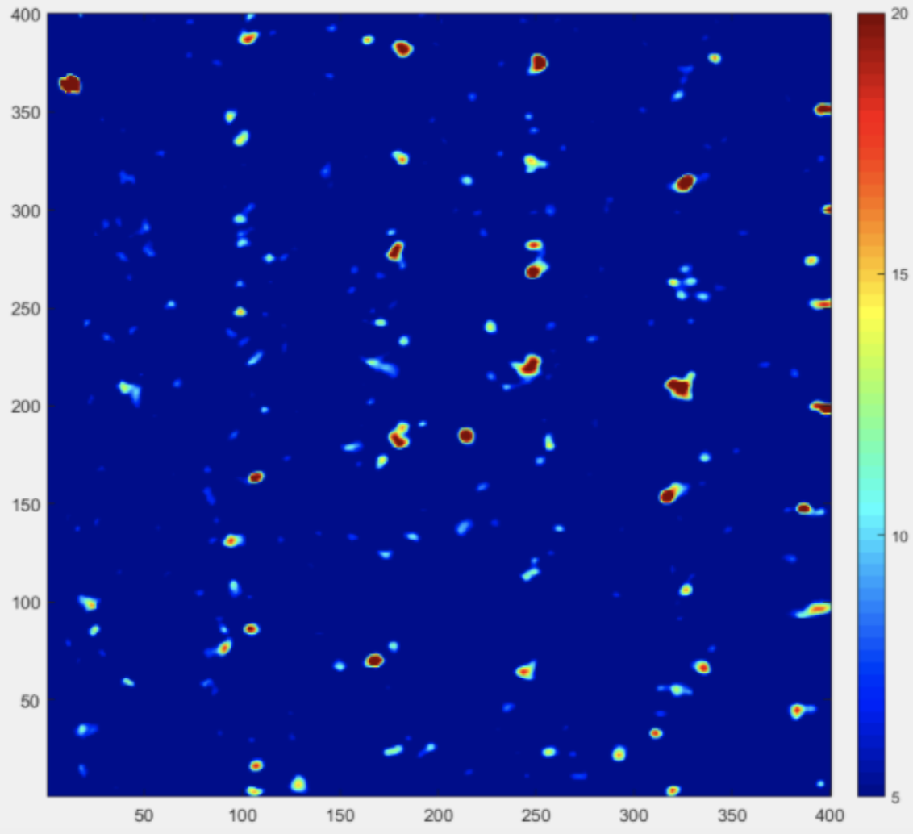
Artificial signal injection
Spring 2021 implantation:
  HPHT sample (method 2)
  Observed created NVs in a grid pattern as expected
  High background due to sample prep
  Ion beam not optimized
Fall 2023 implantation: currently analyzing data
Further implantations planned:
  Use CVD samples to look for strain shift (method 1)
  Nanobeam facility: <25 keV energy
Preliminary
HPHT (method 2) implantation result, 2021

Slide 25

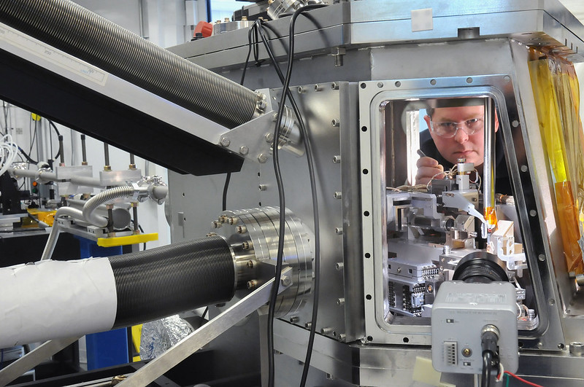
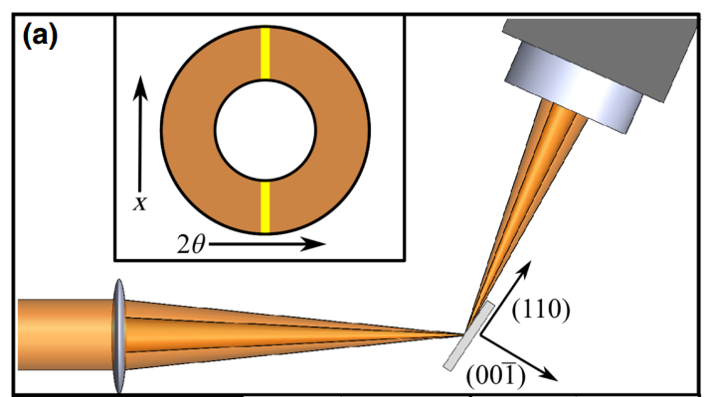
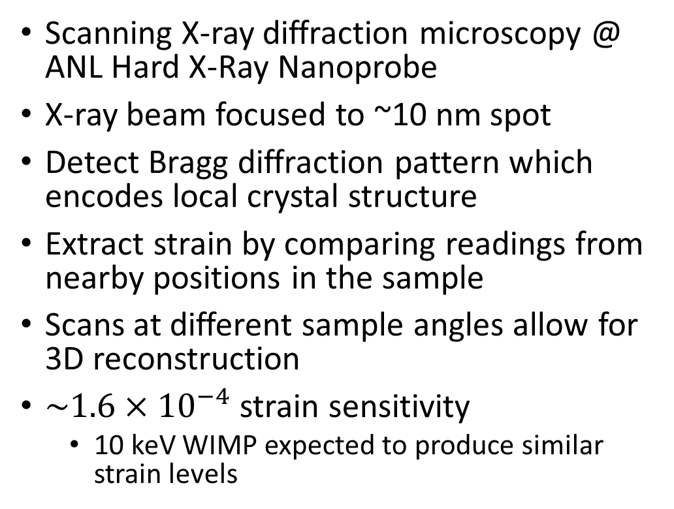
Stage 3: nm scale scanning
Scanning X-ray diffraction microscopy @ ANL Hard X-Ray Nanoprobe
X-ray beam focused to ~10 nm spot
Detect Bragg diffraction pattern which encodes local crystal structure
Extract strain by comparing readings from nearby positions in the sample
Scans at different sample angles allow for 3D reconstruction
$\sim 1.6×{10}^{−4}$ strain sensitivity
  10 keV WIMP expected to produce similar strain levels
Marshall et al., PR Applied 16, 054032 (2021)

Slide 26
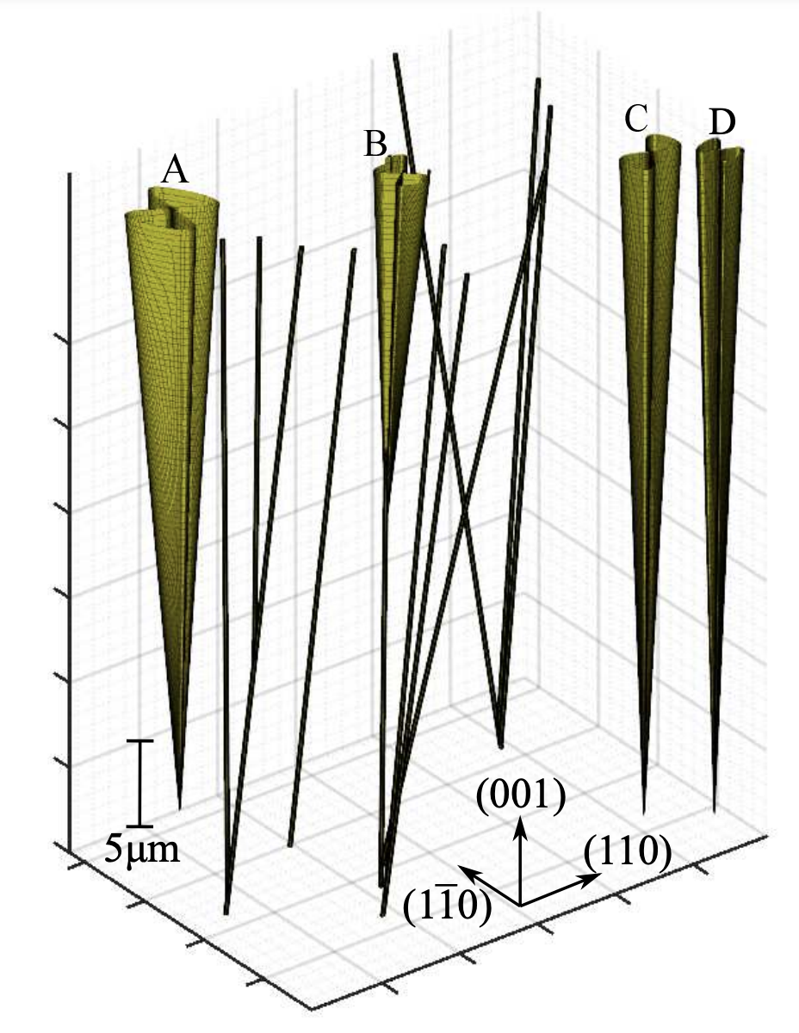
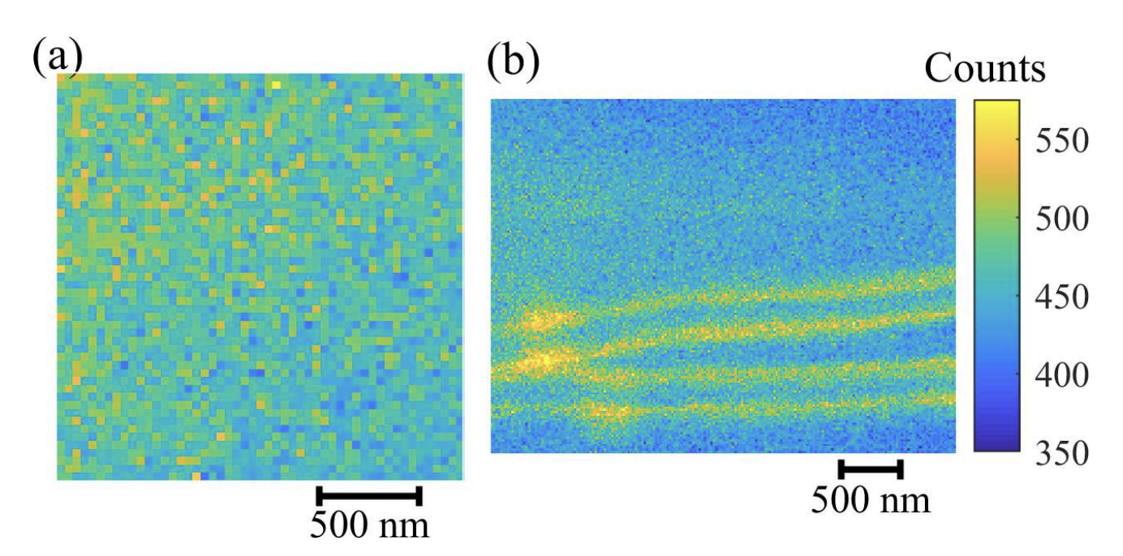
Low strain regions exhibit no natural features that could be mistaken for WIMP damage tracks
Future: repeat SXDM scans with implanted samples
Con: only a few SXDM facilities available in the world
3D reconstruction of pre-existing strain features (from CVD growth)
Low strain regions
Marshall et al., PR Applied 16, 054032 (2021)
Notes:
Higher counts = more strain

Slide 27
Stage 3 alternative method: super-resolution spectroscopy of NV centers
Image damage track by looking at strain shift on single NVs in its vicinity
  Employ pattern recognition/machine learning techniques to determine initial recoil detections
  Optimize density of NVs (typically 1/(30 nm)³) based on damage track size
Requires optical microscopy below the diffraction limit
  Super-resolution NV imaging techniques have been previously developed in our group
Advantage: setup could be deployed locally near DM detector

Slide 28
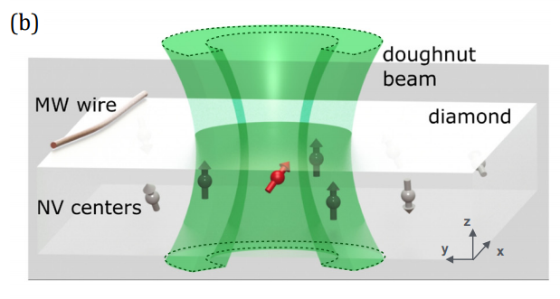
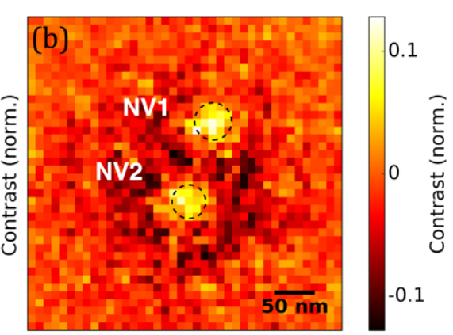
Spin-RESOLFT: “turn off” signal from all except single NV by using doughnut laser beam
Localized NV position to 5 nm uncertainty
Imaged magnetic fields to 20 nm lateral resolution
Can be straightforwardly extended to image strain
Limitation: only 2D imaging of near-surface NVs
Jaskula et al., Opt. Express 25, 11048 (2017)

Slide 29
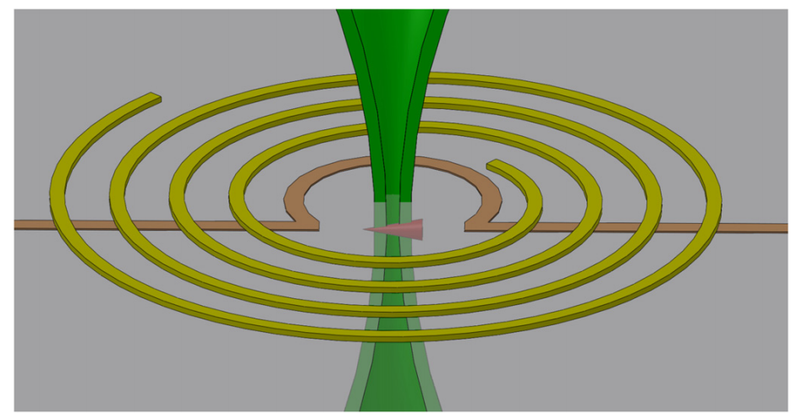
Proposal to achieve 3D super-resolution
Lateral 2D imaging using doughnut beam (spin-RESOLFT)
Add z-resolution by applying magnetic field gradient along z
Zeeman shift gradient created: selectively address z by tuning MW frequencies
Etching techniques can also be used to make damage track closer to surface
Arai et al., Nat. Nano. 10, 859–864 (2015)
Marshall et al., Quantum Sci. Tech. 6, 024011 (2021)

Slide 30

Molecular dynamics simulations
Earlier work used SRIM to model WIMP damage tracks
Currently performing new simulations with LAMMPS
  Classical n-body simulation
  Keeps track of all atoms in the lattice
  Use REBO interaction potentials known to be empirically accurate for diamond lattice
Will allow more accurate prediction of directional detection performance and imaging capabilities required
Preliminary result from a 30 keV nuclear recoil
Rajendran et al., PRD 9, 035009 (2017)
Image credit: Max Shen

Slide 31
Progress and future plans
2017: initial proposal (Rajendran et al., PRD 9, 035009)
2019-22: experiments at Harvard University
  Marshall et al., PR Applied 16, 054032 (2021): Demonstrated nm-scale X-ray diffraction spectroscopy at required sensitivity
  Marshall et al., PR Applied 17, 02401 (2022): Demonstrated um-scale confocal and widefield strain spectroscopy at required sensitivity
  Marshall et al., Quantum Sci. Tech. 6, 024011 (2021): development roadmap

Slide 32

Progress and future plans
2023: move to Quantum Technology Center, University of Maryland
  New personnel
  Rebuilding strain imaging capabilities
  Pursuing further research: LSM, ion implantation, improved simulations, …
32

Slide 33
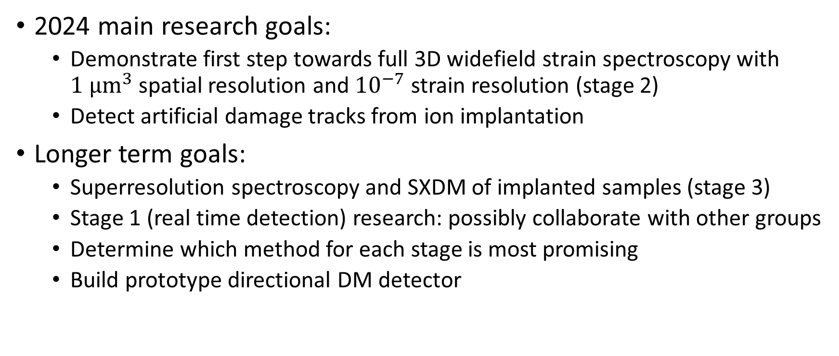
Progress and future plans
2024 main research goals:
  Demonstrate first step towards full 3D widefield strain spectroscopy with $1 μm^{3}$ spatial resolution and ${10}^{−7}$ strain resolution (stage 2)
  Detect artificial damage tracks from ion implantation
Longer term goals:
  Superresolution spectroscopy and SXDM of implanted samples (stage 3)
  Stage 1 (real time detection) research: possibly collaborate with other groups
  Determine which method for each stage is most promising
  Build prototype directional DM detector

Slide 34
Summary and conclusion
NV centers in diamond are a new, promising method of directional detection of WIMPs that can potentially overcome the neutrino fog
Required imaging techniques for each stage are either already demonstrated or all within reach
Substantial experimental progress has been made on demonstrating required strain sensitivity:
  Stage 2: strain imaging
  Stage 3: X-ray diffraction imaging
Clear development path for the next few years

Slide 35






QTC Dark Matter team
Other collaborators
Smriti Bhalerao (UMD)
Michael Titze, Ed Bielejec (Sandia)
Johannes Cremer, Mason Marshall, Mark Ku, David Phillips, Pauli Kehayias (Harvard)
Martin Holt, Nazar Delegan, F. Joseph Heremans (Argonne)
Daniel Ang
(QTC staff scientist)
Prof. Ron Walsworth (PI)
Graduate students:
Funding:
Argonne National Lab
Department of Energy
Army Research Laboratory
UMD QTC and Clark School of Engineering
Xingxin Liu
Jiashen Tang
Reza Ebadi
Max Shen

