Slide 1
Graph Neural Networks: The Next Tool to Uncover the Top Quark
By Anthony Little
University of Sydney
27th June 2022

Slide 2
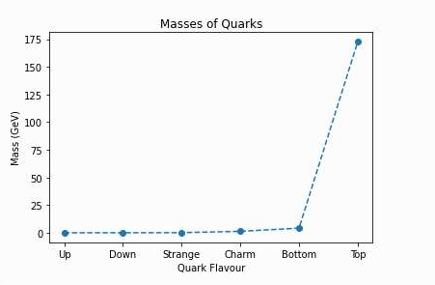
What's there to uncover and why?
The Top quark is the heaviest fundamental particle
Mass much larger than any other fermion, similar to a gold atom in mass
Mass result of large Yukawa Coupling with Higgs Field
Beyond Standard Processes may decay into the Top
Research into the Top may lead to New Physics in these areas
Figure: Masses of all quarks
D. Chakraborty et al. Top Quark Physics, Annu. Rev. Nucl. Part. Sci. 2003, 53:301-51
R.L. Workman et al. (Particle Data Group), to be published in Prog. Theor. Exp. Phys. 2022, 083C01.

Slide 3
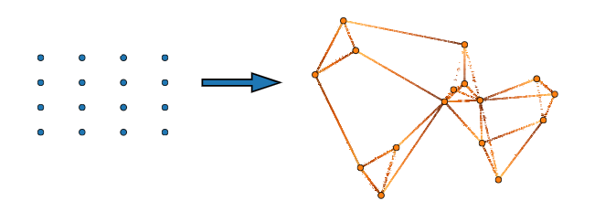
Why are Graphical Neural Networks an answer?
Graphs are flexible for particle detection data which is naturally unordered and heterogenous
  Used for other processes beyond my own
Outputs can be made on node, edge and graph-level data
Through message passing nodes can update their properties to be better identified
  Identify decay products to reconstruct Top quark
Attention mechanisms help determine strengthen of connections
  Which nodes are important and can be grouped to create subgraph
Figure: GNN connecting neighbouring nodes through shared quantities
Jonathan Shlomi et al. Mach. Learn.: Sci. Technol. 2021, 2 021001

Slide 4
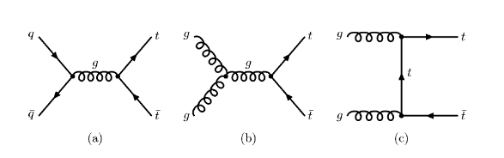
How do we know they will work?
Graph Neural Networks within Particles physics is fast growing field
Have only been tested on simulated data, but have shown much promise
My work will test GNN’s on a very common process: Top pair production
This process is very common background for many unknown and BSM processes
Figure: Leading Order processes of Top pair production
D. Chakraborty et al. Top Quark Physics, Annu. Rev. Nucl. Part. Sci. 2003, 53:301-51

Slide 5
My Work and the Future
I will be using fast, simple and generic (not detector specific) Monte Carlo simulation
  MadGraph/Pythia (Particle Generation)
  Delphes (Detector Simulation)
This Monte Carlo simulation paired with the Top pair process is overall not breaking into New Physics
It is testing the efficiency and ability of GNN’s prediction of the data
  How well can it predict the amount of Top quarks and their properties?
  How well can it distinguish different events?
Produces evidence of a basic level of GNN’s capabilities and adaptability

