Slide 1
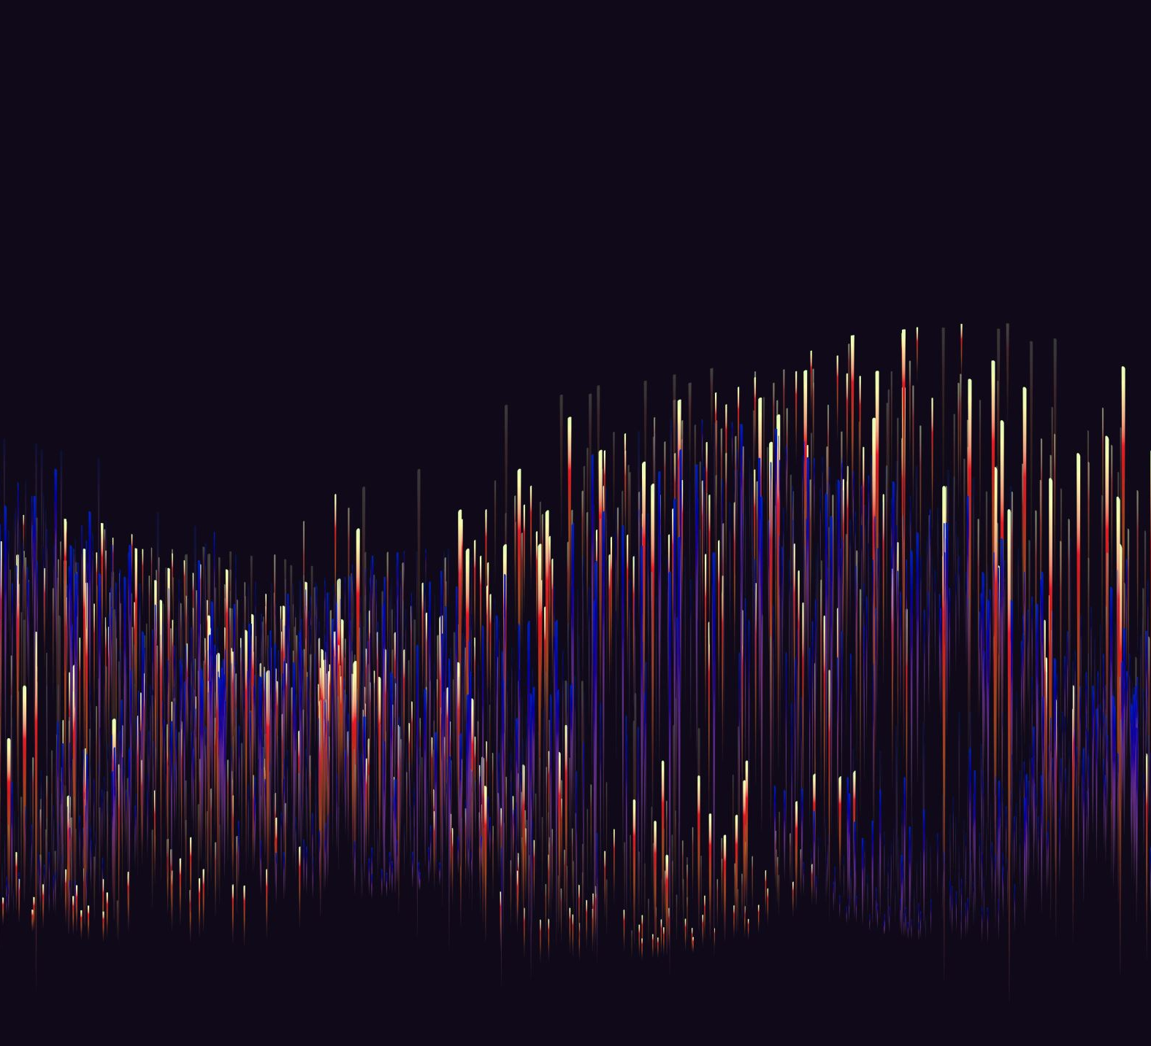
Domain Walls and the Companion Axion Model
Pavadol Yamsiri
In Collaboration with CIaran O’Hare
Syndey CPPC Meeting

Slide 2
BackGround: Axions
A theoretical elementary particle, first introduced as the solution to the strong CP problem by Peccei and Quinn in 1977¹.
Interesting as a cold dark matter candidate:
  Non-zero mass
  Weak couplings to other SM particles
Yet to be observed.

Slide 3
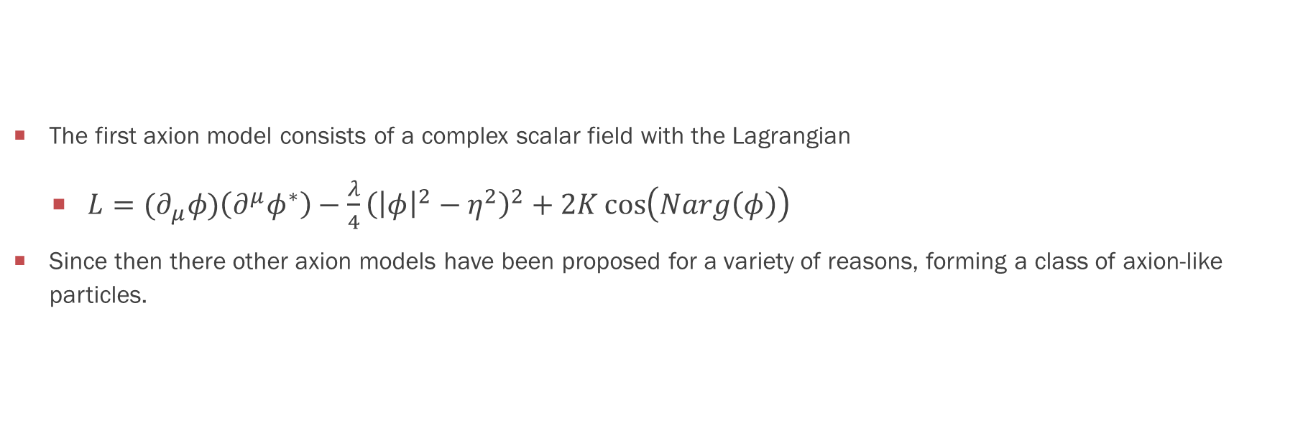
Axion Models
The first axion model consists of a complex scalar field with the Lagrangian
  $L={(∂}_{μ}φ)\left(∂^{μ}φ^{∗}\right)−\frac{λ}{4}{\left({\left|φ\right|}^{2}−η^{2}\right)}^{2}+2K\cos\left(Narg\left(φ\right)\right)$
Since then there other axion models have been proposed for a variety of reasons, forming a class of axion-like particles.

Slide 4
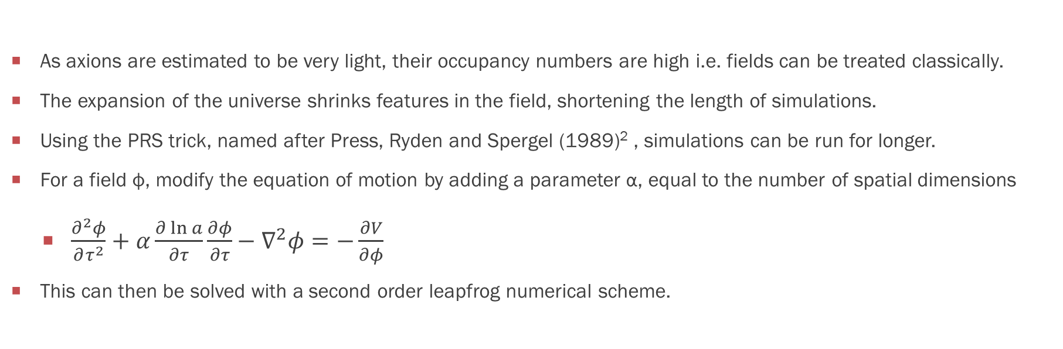
Simulating Fields (PRS TRICK)
As axions are estimated to be very light, their occupancy numbers are high i.e. fields can be treated classically.
The expansion of the universe shrinks features in the field, shortening the length of simulations.
Using the PRS trick, named after Press, Ryden and Spergel (1989)² , simulations can be run for longer.
For a field ф, modify the equation of motion by adding a parameter α, equal to the number of spatial dimensions
  $\frac{∂^{2}φ}{∂τ^{2}}+α\frac{∂\ln{a}}{∂τ}\frac{∂φ}{∂τ}−∇^{2}φ=−\frac{∂V}{∂φ}$
This can then be solved with a second order leapfrog numerical scheme.

Slide 5
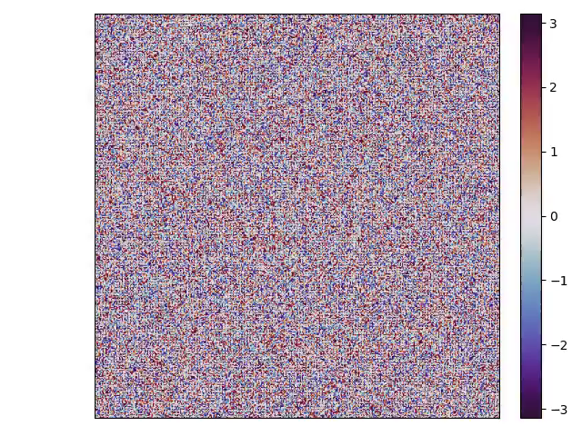
Figure 1a: Axion field simulation for N = 1
Figure 1b: Axion field simulation for N = 4

Slide 6
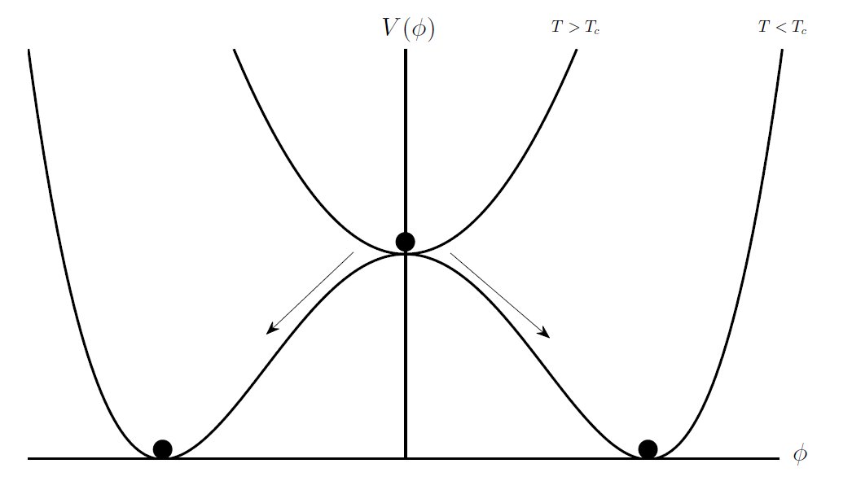
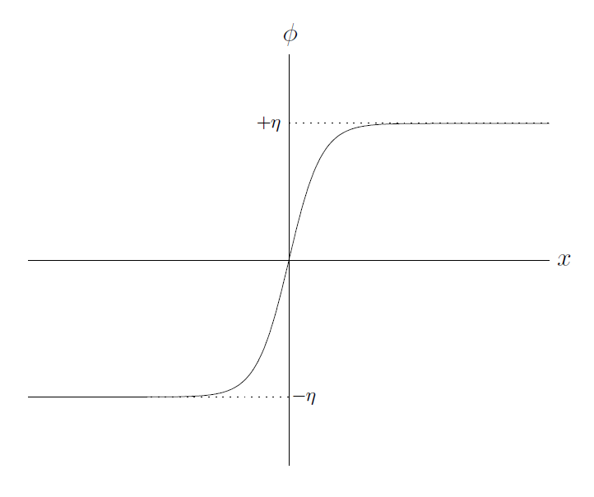
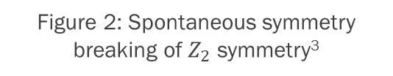
Topological Defects
Topological defects occur during spontaneous symmetry breaking.
Domain walls are a type of topological defect.
The energy density of domain walls would dominate the energy of the Universe. This is not observed however.
Other types of cosmological defects include:
  Cosmic strings
  Textures
Figure 2: Spontaneous symmetry breaking of $Z_{2}$ symmetry³
Figure 3: Kink solution of domain wall³

Slide 7
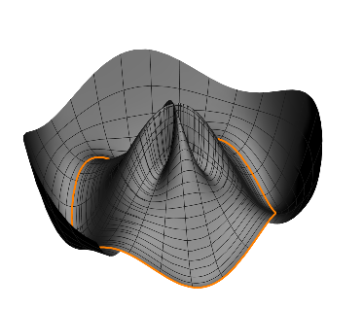
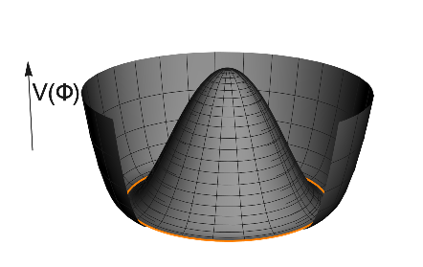
Axion Potential
Figure 5: Symmetry broken potential for N = 4
Figure 4: Peccei-Quinn potential before symmetry breaking

Slide 8
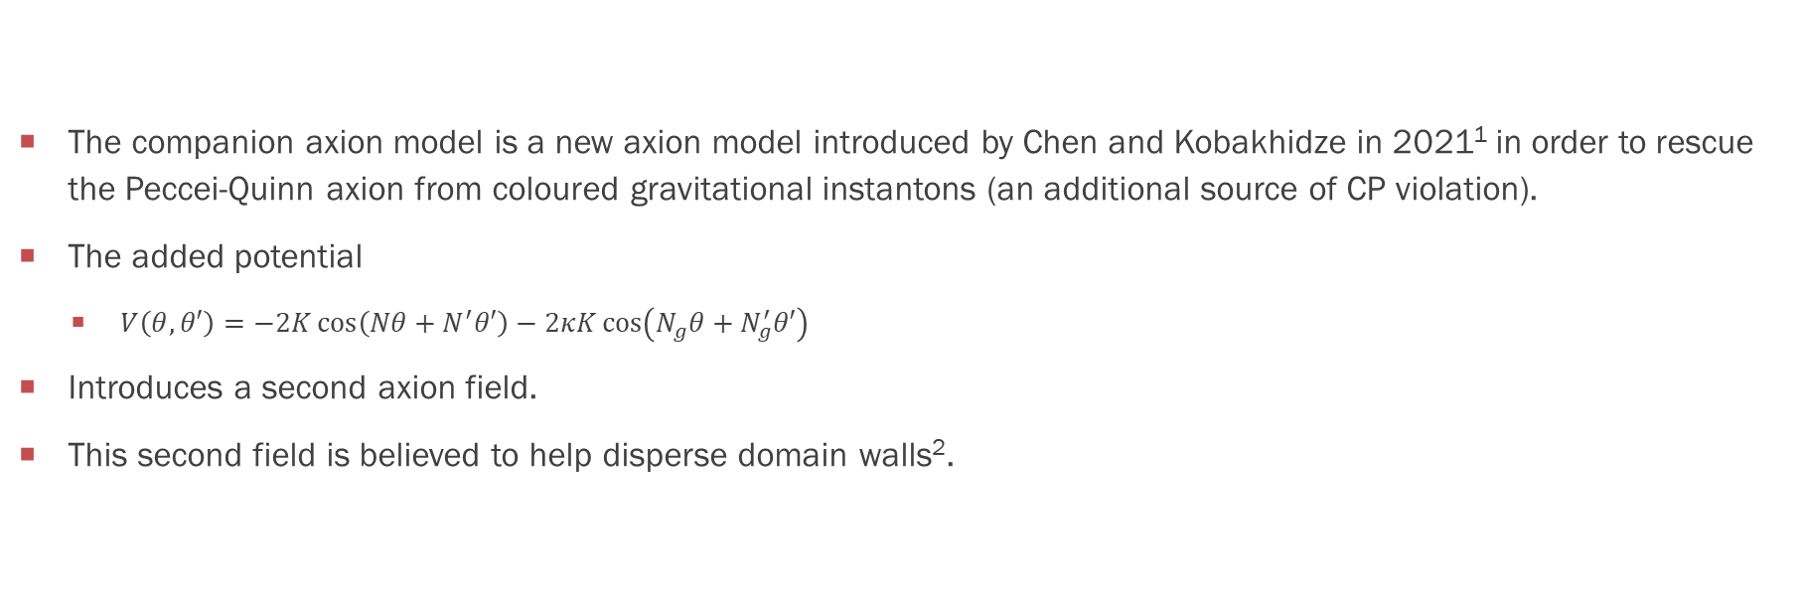
Companion axion Model
The companion axion model is a new axion model introduced by Chen and Kobakhidze in 2021¹ in order to rescue the Peccei-Quinn axion from coloured gravitational instantons (an additional source of CP violation).
The added potential
  $V\left(θ,θ′\right)=−2K\cos\left(Nθ+N^{′}θ′\right)−2κK\cos\left(N_{g}θ+N_{g}^{′}θ′\right)$
Introduces a second axion field.
This second field is believed to help disperse domain walls².

Slide 9
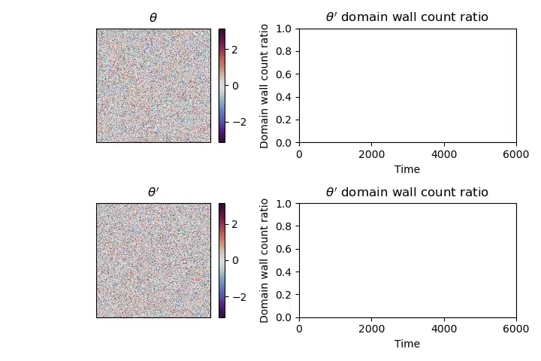
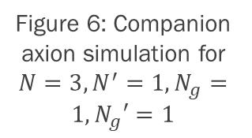
Figure 6: Companion axion simulation for $N=3,N^{′}=1,N_{g}=1,N_{g}′=1$

Slide 10
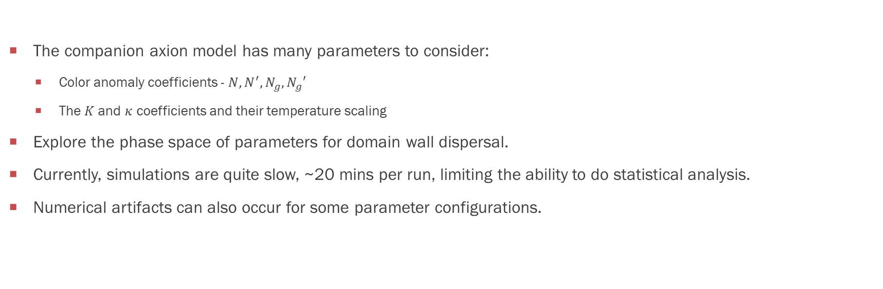
Plans for the Future
The companion axion model has many parameters to consider:
  Color anomaly coefficients - $N, N^{′}, N_{g},N_{g}′$
  The $K$ and $κ$ coefficients and their temperature scaling
Explore the phase space of parameters for domain wall dispersal.
Currently, simulations are quite slow, ~20 mins per run, limiting the ability to do statistical analysis.
Numerical artifacts can also occur for some parameter configurations.

Slide 11
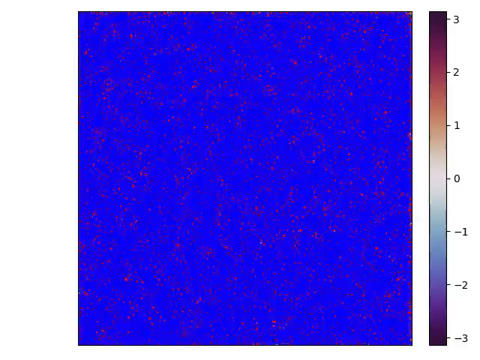

AppenDix: Single Axion Highlighting
N=1
N=4

Slide 12
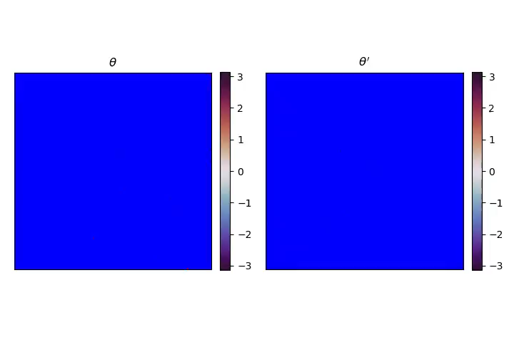
AppenDix: Companion Axion Highlighting

