Slide 1


Make a magnet precess
Pavel Fadeev
Sydney
08.12.2022

Slide 2
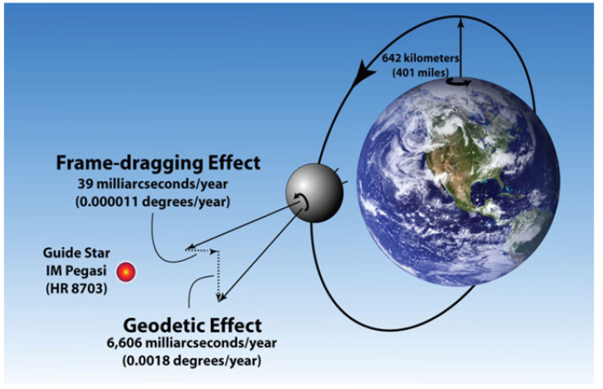
Gravity Probe B measures GR effects
1
C.W. F. Everitt et. al., PRL 106, 221101 (2011)

Slide 3
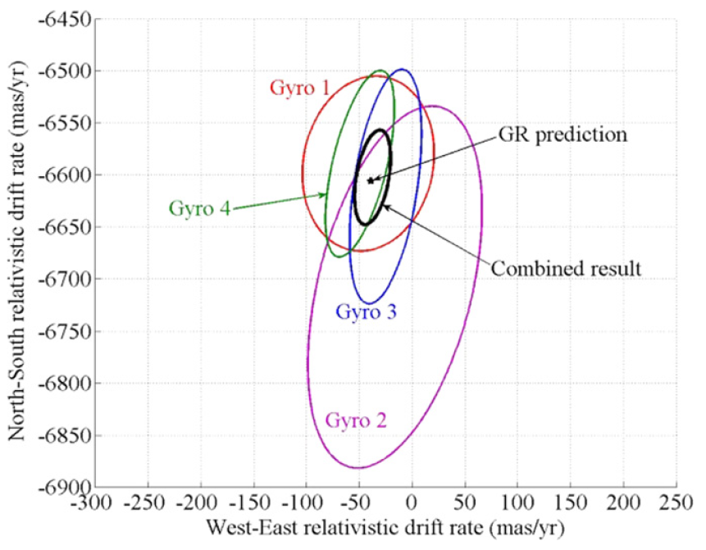
Gravity Probe B measures GR effects
2
C.W. F. Everitt et. al., PRL 106, 221101 (2011)

Slide 4
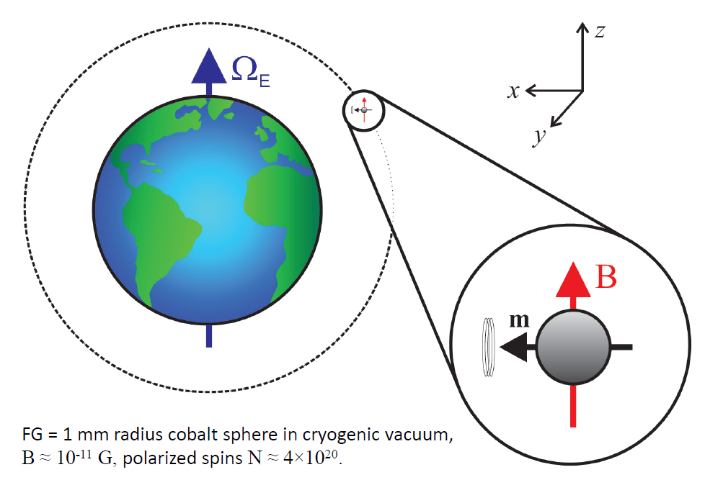
Gravity Probe Spin, a space mission
1 mm radius cobalt sphere in cryogenic vacuum, $B^{∗}≈{10}^{−11}G$, $N={10}^{20}$ polarized spins
P. Fadeev, C. Timberlake, T. Wang, A. Vinante, Y. B. Band, D. Budker, A. O. Sushkov, H. Ulbricht, and D. F. Jackson Kimball, Quantum Sci. Technol. 6, 024006 (2021).
3

Slide 5
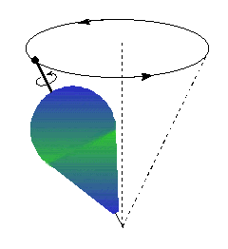
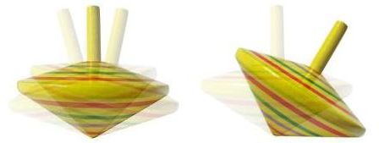
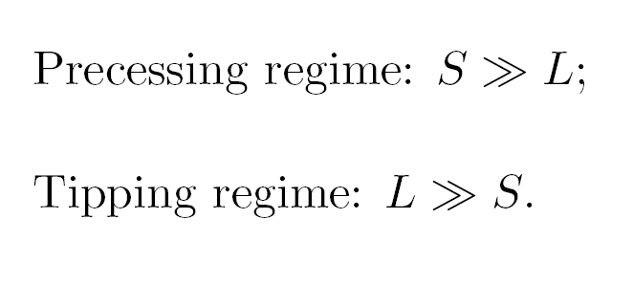
Two regimes of motion
4

Slide 6
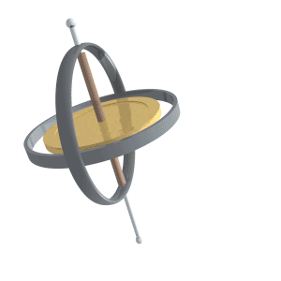
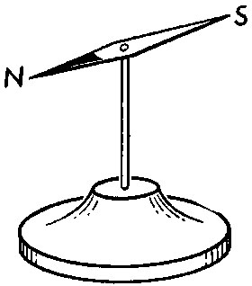
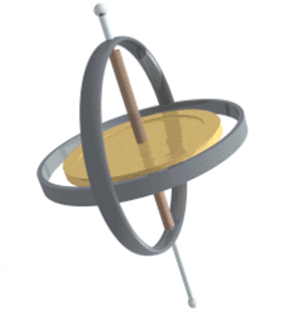

Ferromagnetic Gyroscope
For precession to dominate
$$L≪S$$
In other words
$$I Ω≪N ℏ$$
Threshold frequency
$$Ω^{∗}=\frac{Nℏ}{I}$$
Threshold magnetic field
$$B^{∗}=\frac{ℏΩ^{∗}}{g μ_{B}}$$
5

Slide 7
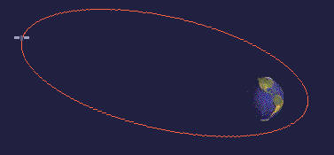
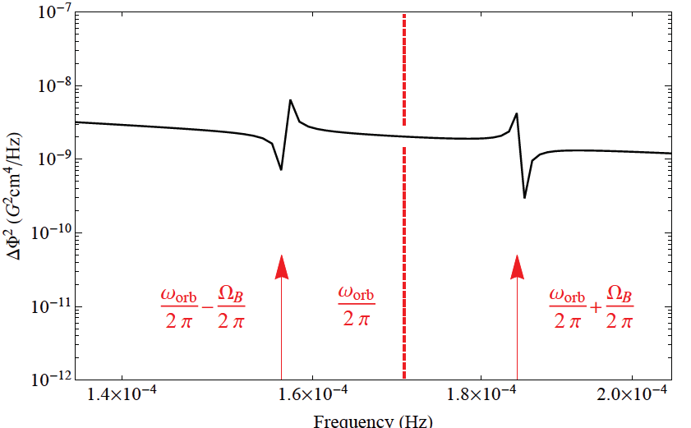
Spectrum of a difference between two magnets
6
Notes:
http://www.satellites.spacesim.org/english/anatomy/orbit/elliptic.html

Slide 8
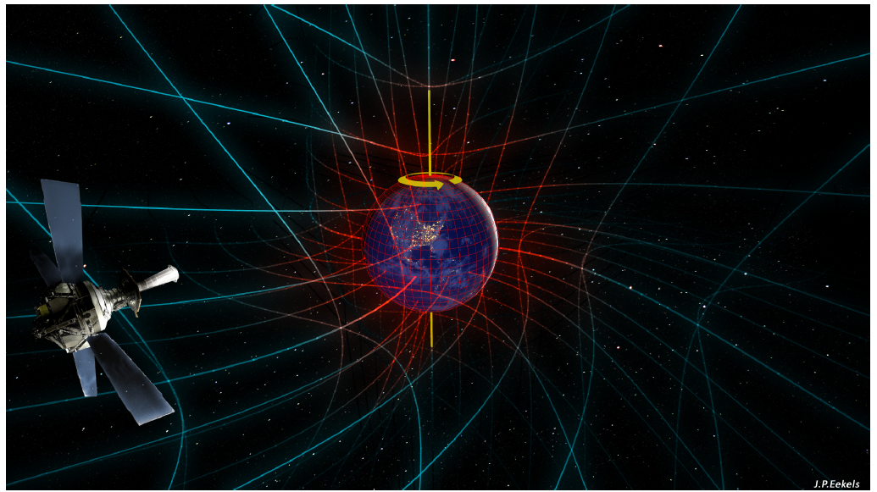
Ferromagnetic Gyroscope in freefall
7
Notes:
Figures courtesy J P Eekels, 2015] https://arxiv.org/pdf/1504.05774.pdf

Slide 9
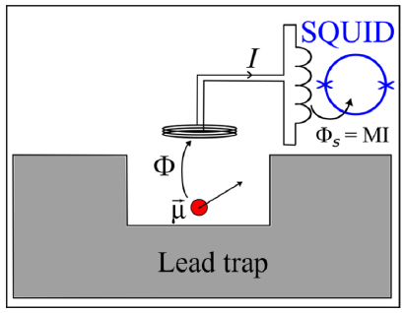
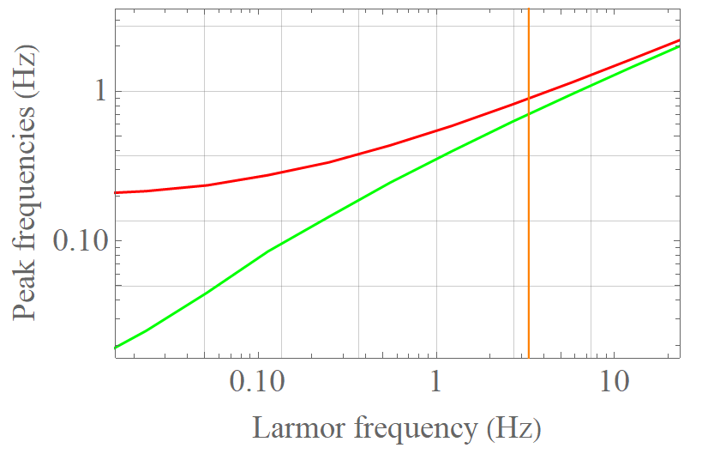
Proof-of-principle device in the lab
P. Fadeev, C. Timberlake, T. Wang, A. Vinante, Y. B. Band, D. Budker, A. O. Sushkov, H. Ulbricht, and D. F. Jackson Kimball, Quantum Sci. Technol. 6, 024006 (2021).
8

Slide 10
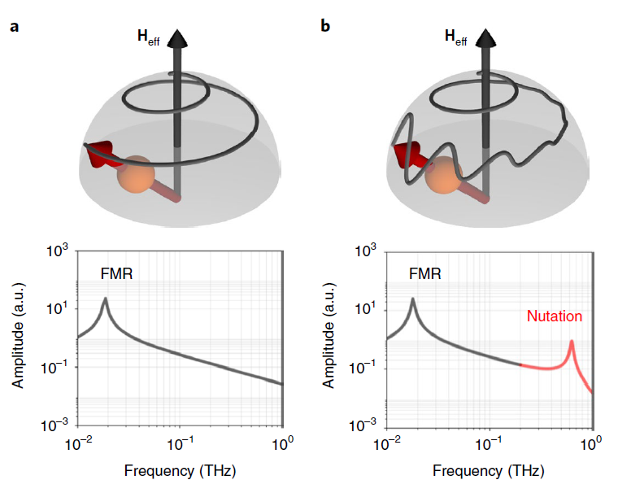
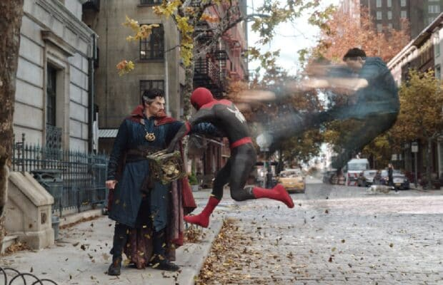
Inertial spin dynamics in ferromagnets
9

Slide 11

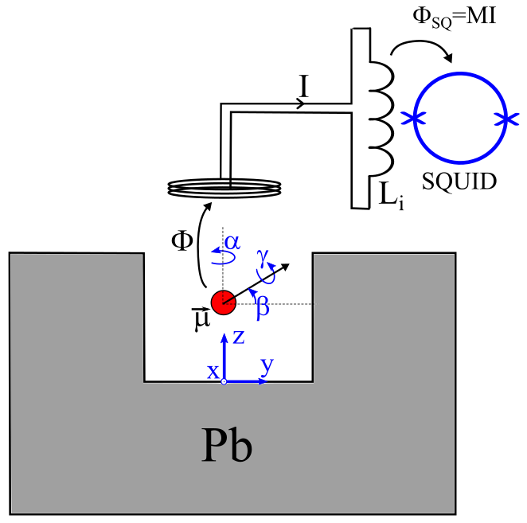
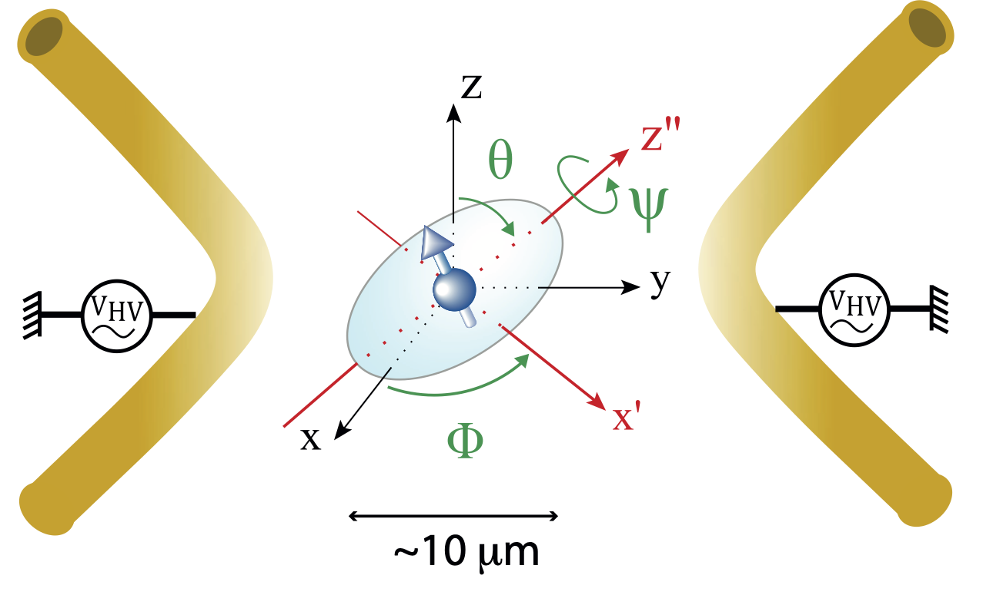
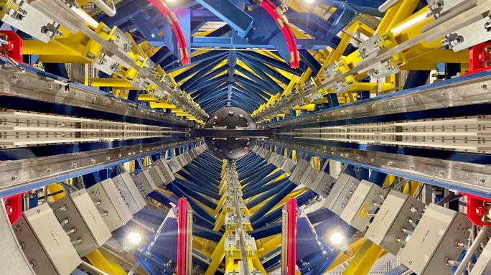
LeMaQuMe
Levitated Magnets for Quantum Metrology
Partners: CNR-IFN Trento (IT), CNRS Paris, (FR), JGU Mainz,
LUH Hannover, Uni Ulm (DE), Uni Latvia (LV), Ben Gurion Uni (Israel)
External Partners: Southampton (UK), Boston, California East Bay (US)
Three platforms for levitated micro/nanomagnets
SUPERCONDUCTING
TRAPS
PAUL TRAPS &
CIRCUIT TRAPS
FREE-FALL
(EINSTEIN ELEVATOR)
10

Slide 12
Thank you
pavelfadeev1@gmail.com

