Slide 1
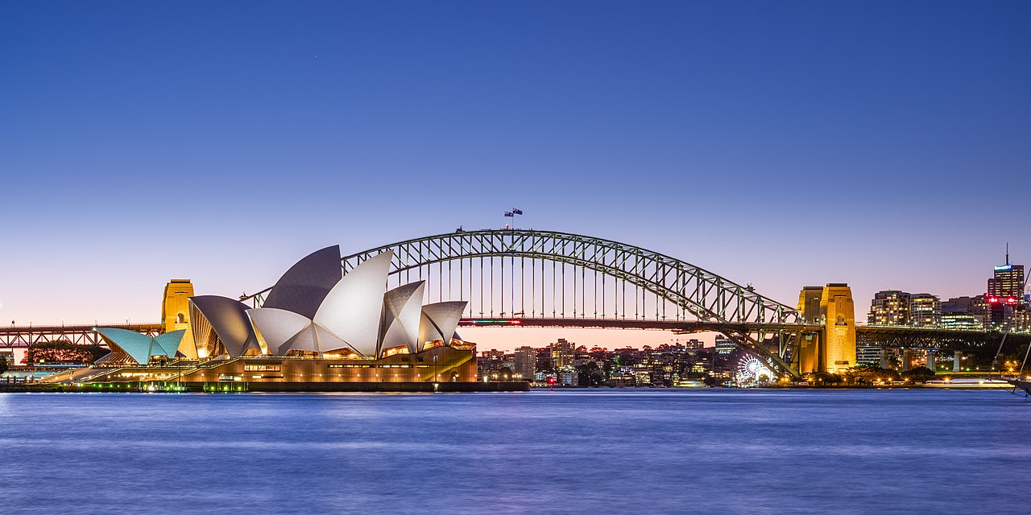


Searches for Axion Dark Matter at IBS-CAPP
The Dark Side of the Universe 2022
Dec. 05. 2022 USNW
SungWoo YOUN
Center for Axion and Precision Physics Research (CAPP)
Institute for Basic Science (IBS)

Slide 2

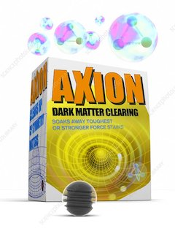
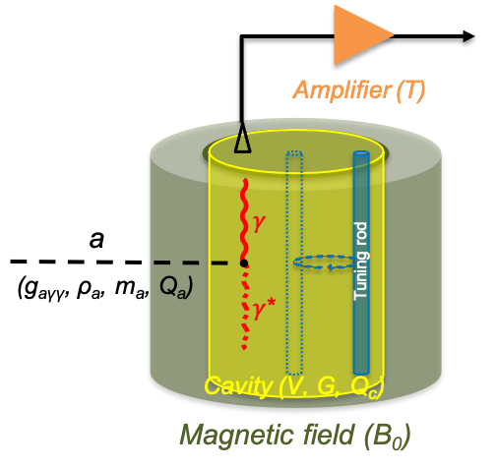
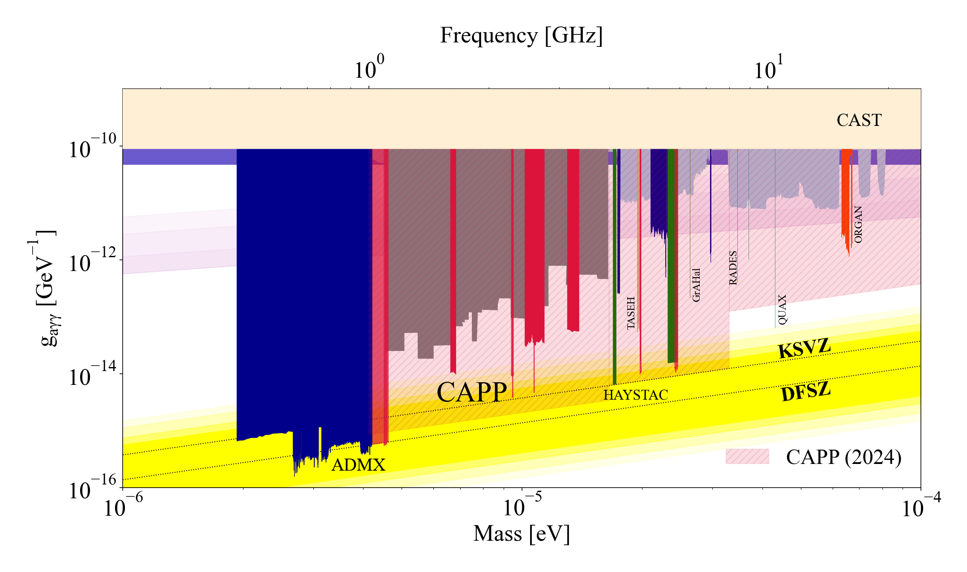
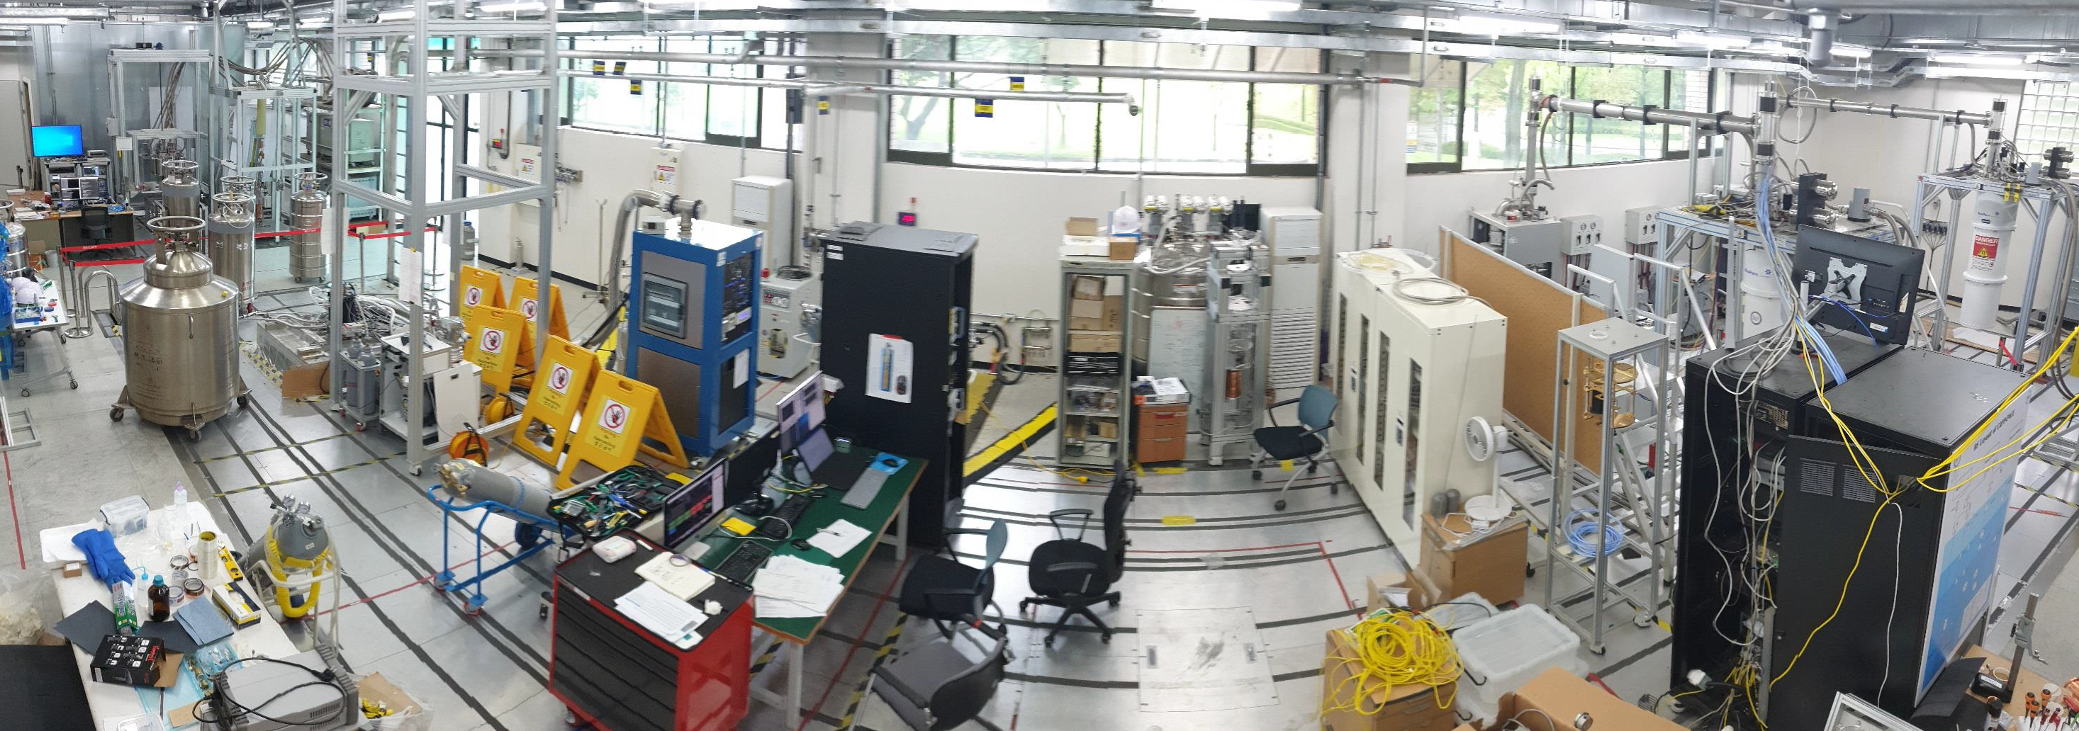
Outline
Axion dark matter
  Theoretical background
  Experimental search strategies
Axion research at IBS-CAPP
  Ongoing experiments
  Search highlights
  R&D efforts
  Prospects
Summary

Slide 3
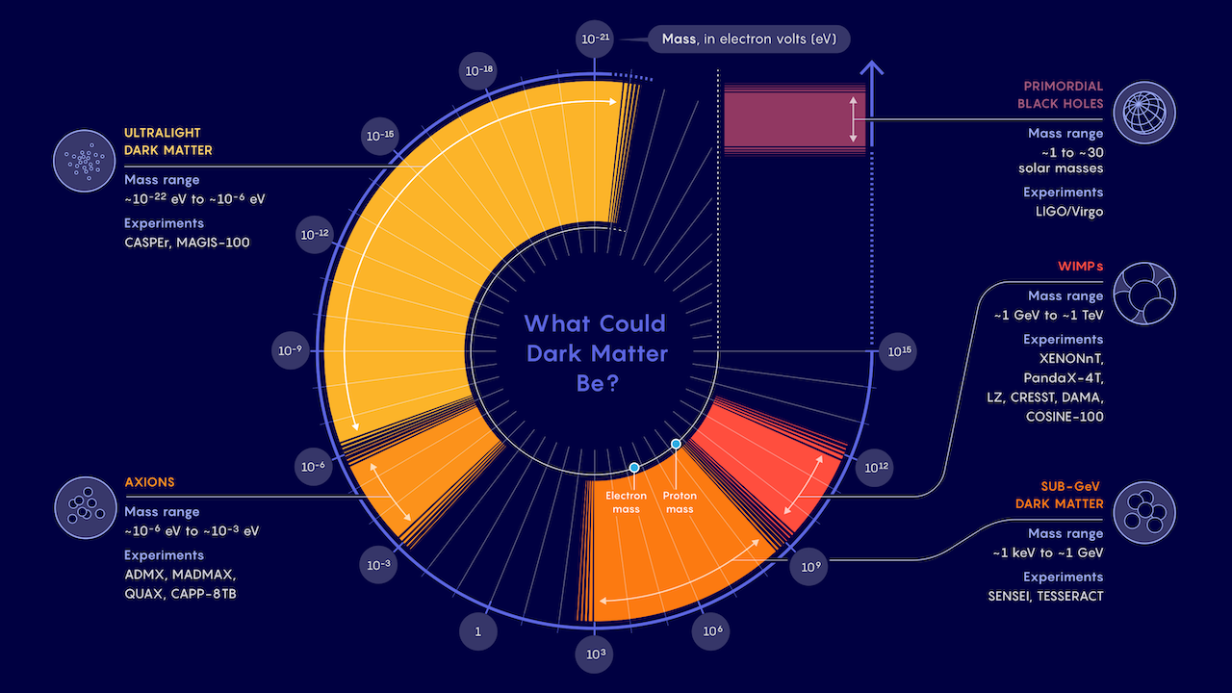
Dark matter business expanding
WIMPs may be down, but not out
Samuel Velasco/Quanta Magazine

Slide 4
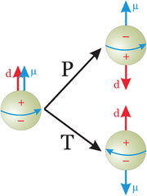
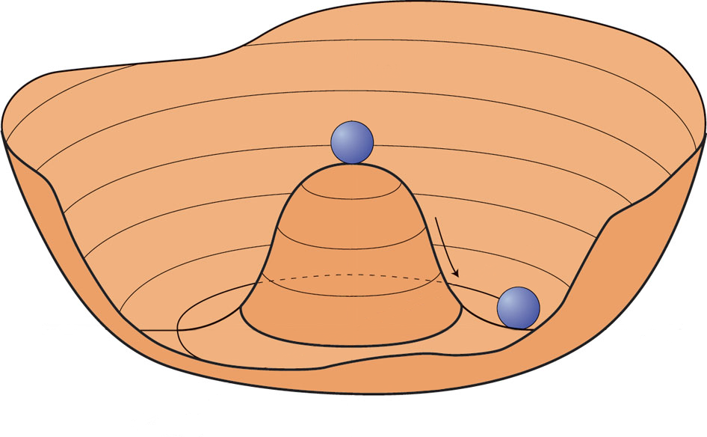
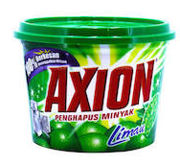

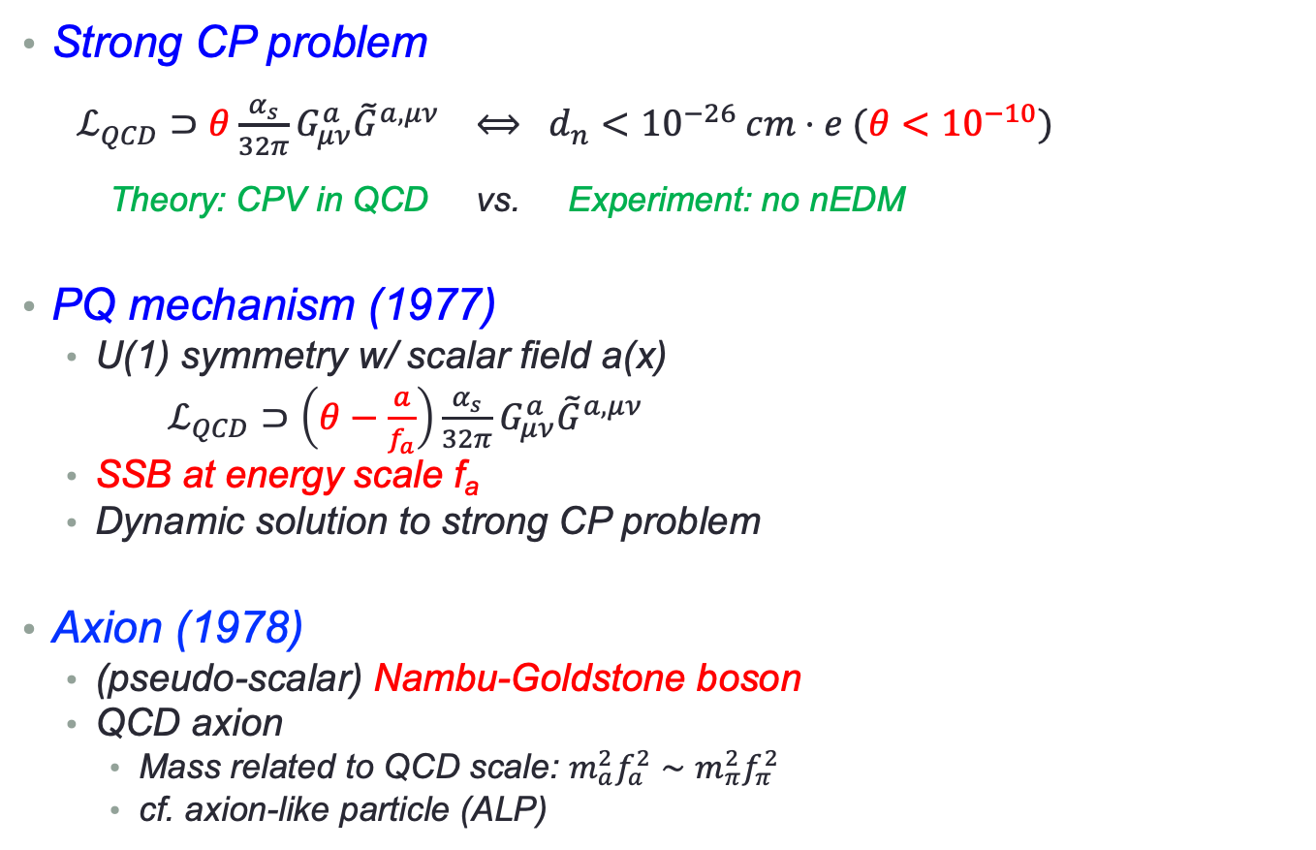
Strong CP problem and axion
Strong CP problem
  $ℒ_{QCD}⊃θ\frac{α_{s}}{32π}G_{μν}^{a}{\tilde{G}}^{a,μν} ⟺ d_{n}<{10}^{−26} cm⋅e (θ<{10}^{−10})$
    Theory: CPV in QCD vs. Experiment: no nEDM
PQ mechanism (1977)
  U(1) symmetry w/ scalar field a(x)
  $ℒ_{QCD}⊃\left(θ−\frac{a}{f_{a}}\right)\frac{α_{s}}{32π}G_{μν}^{a}{\tilde{G}}^{a,μν}$
  SSB at energy scale f_{a}
  Dynamic solution to strong CP problem
Axion (1978)
  (pseudo-scalar) Nambu-Goldstone boson
  QCD axion
    Mass related to QCD scale: $m_{a}^{2}f_{a}^{2}∼m_{π}^{2}f_{π}^{2}$
    cf. axion-like particle (ALP)
CPV
Spontaneuous symmetry breaking
$$a(x)=θ×fa$$

Slide 5
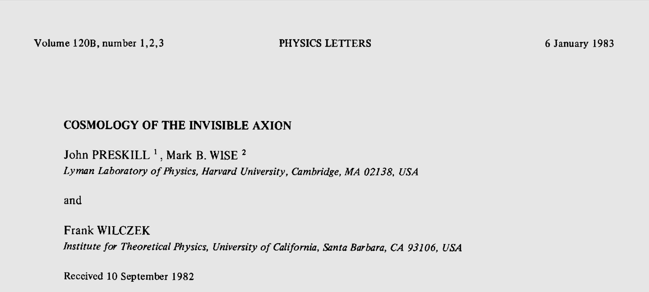
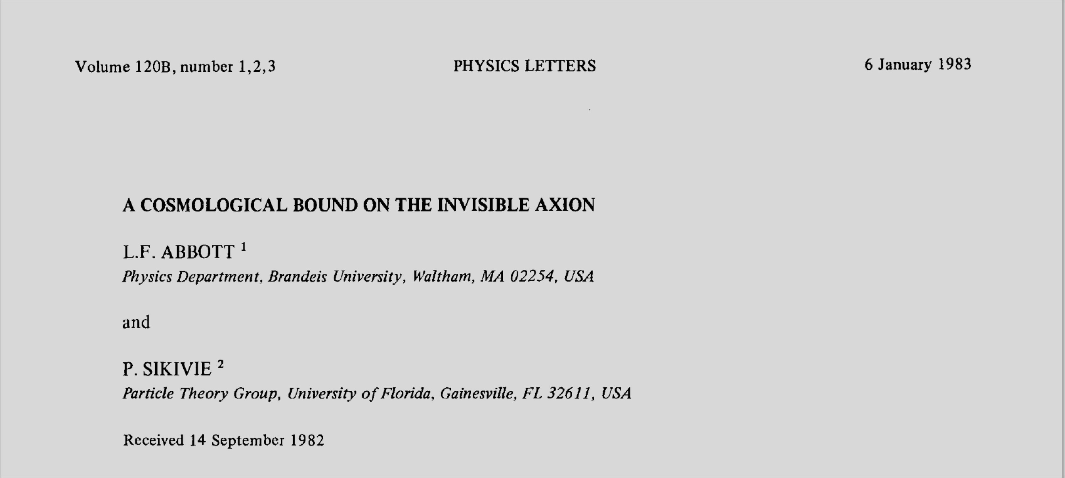
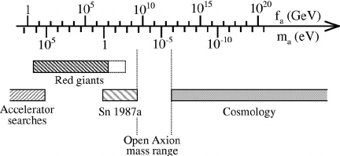
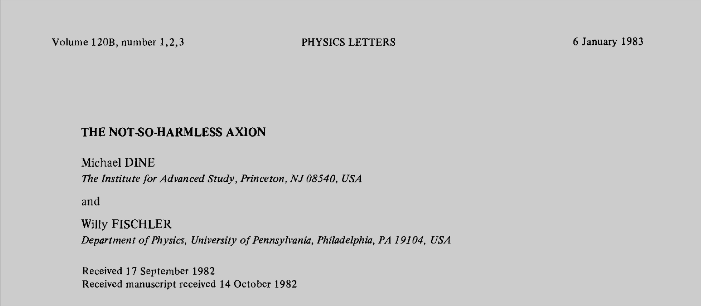

Invisible axion and dark matter
Invisible axion (1979)
  Very light axion
  SSB at a very large f_{a} (i.e. produced in early universe)
  $m_{a}≈6 μeV\frac{{10}^{12} GeV}{f_{a}}$
Cosmological implication (1983)
  May account for dark matter
  10⁻⁶ eV < m_{a} < 10⁻² eV
    Cosmological constraints
    Astrophysical observations
Dark matter axion ?

Slide 6
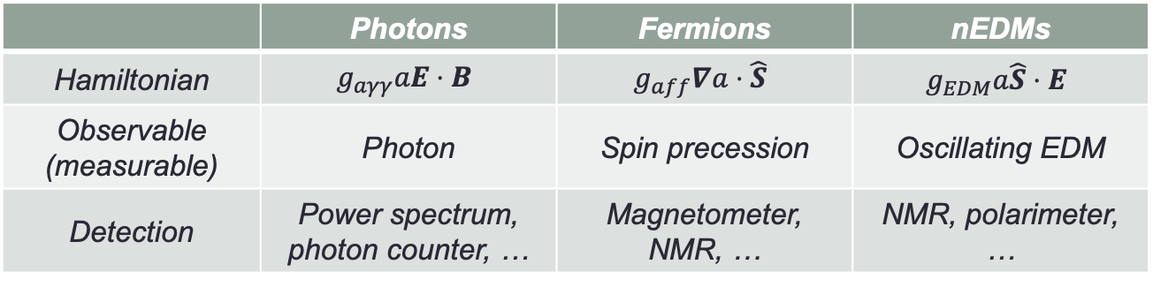
Couplings and models
Axion coupling to SM
Axion models
 | Photons | Fermions | nEDMs
Hamiltonian | $$g_{aγγ}aE⋅B$$ | $$g_{aff}∇a⋅\hat{S}$$ | $$g_{EDM}a\hat{S}⋅E$$
Observable (measurable) | Photon | Spin precession | Oscillating EDM
Detection | Power spectrum, photon counter, … | Magnetometer, NMR, … | NMR, polarimeter, …
U(1)_{PQ} x SU(3)_{c}²
From R. Ziegler
Origin of QCD anomaly:
SM fermions BSM fermions
Spontaneous PQ breaking:
2Higgs 2Higgs+singlet Higgs+singlet
PQWW DFSZ KSVZ
Peccei, Quinn, Wilczek, Weinberg (1978)
Dine-Fischler-Srednicki-Zhitnitsky (1980)
Kim-Shifman-Vainshtein-Zakharov (1980)

Slide 7
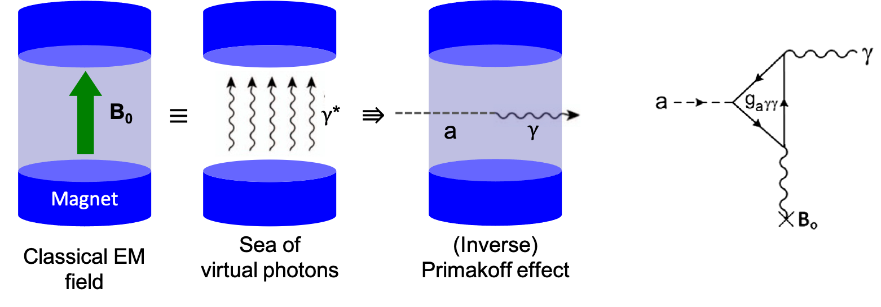
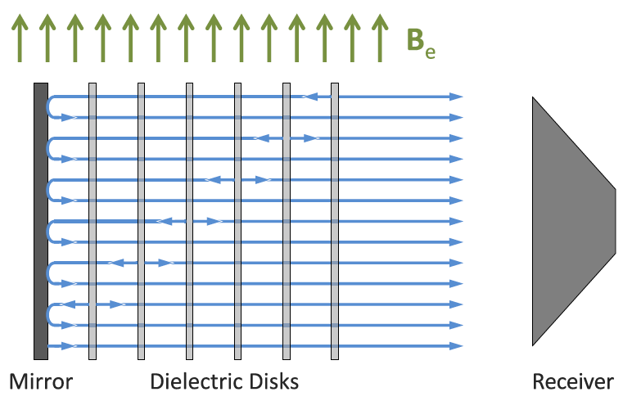
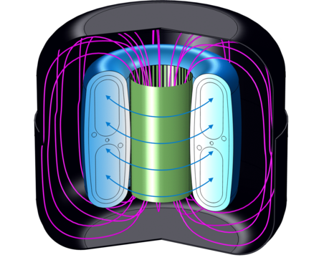
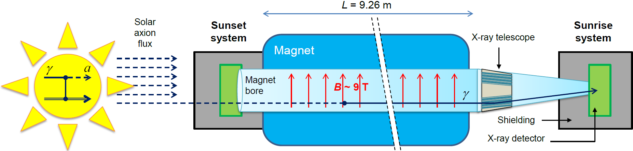
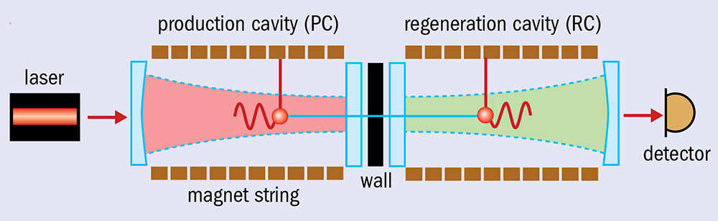


Search strategies
Detection principle
  Sikivie effect (1983)
Detection methods
  Haloscope
    Dark matter halo
    ADMX, CAPP, MADMAX, DM radio, …
  Helioscope
    Solar axions
    CAST, IAXO
  Light shining through walls
    Lab production
    OSQAR, ALPS (II)
$$γ$$
$γ$*

Slide 8
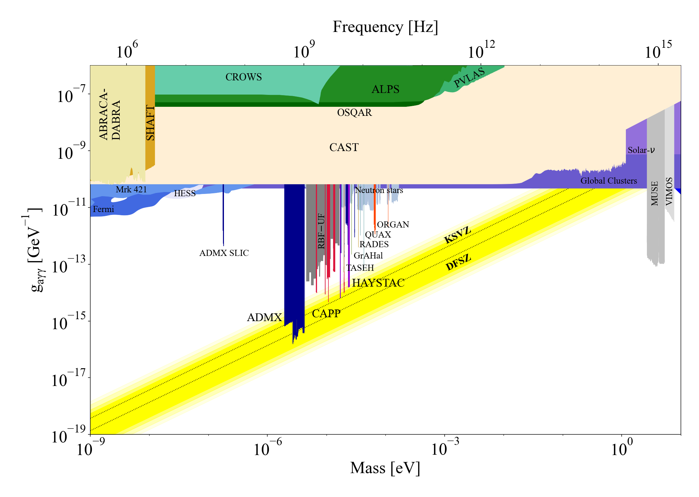
Axion searches

Slide 9
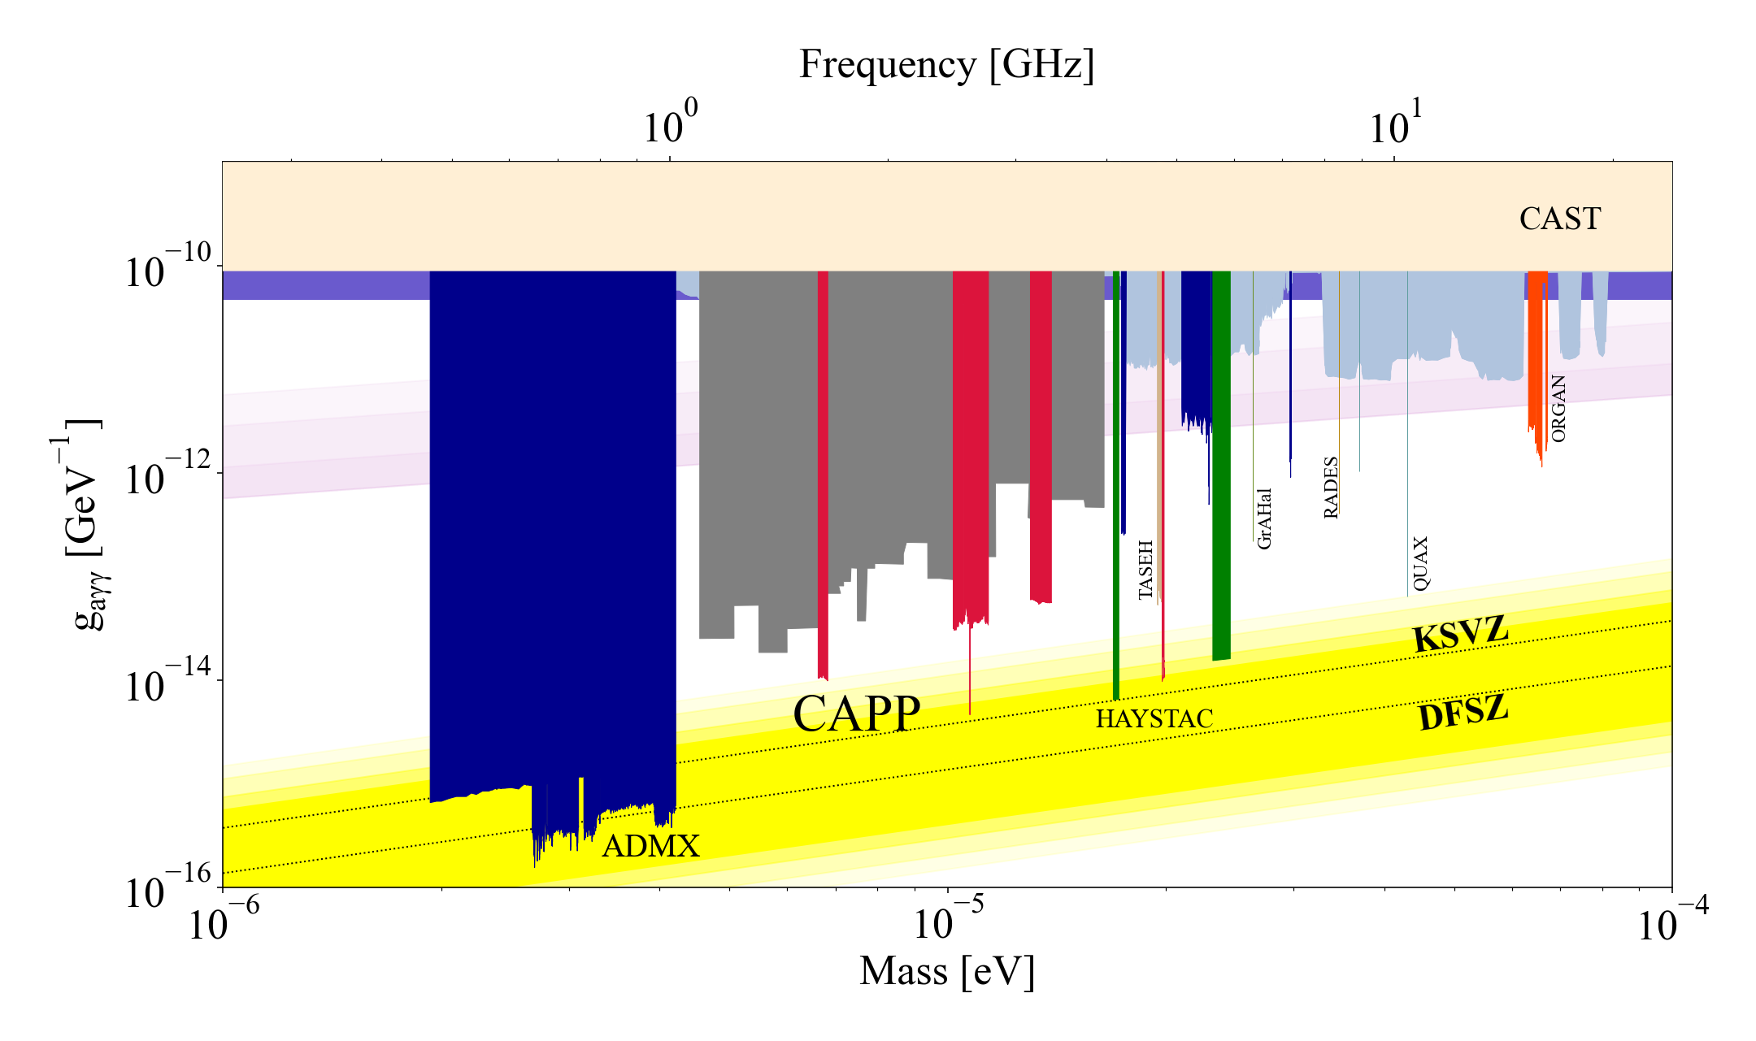
Haloscope searches

Slide 10
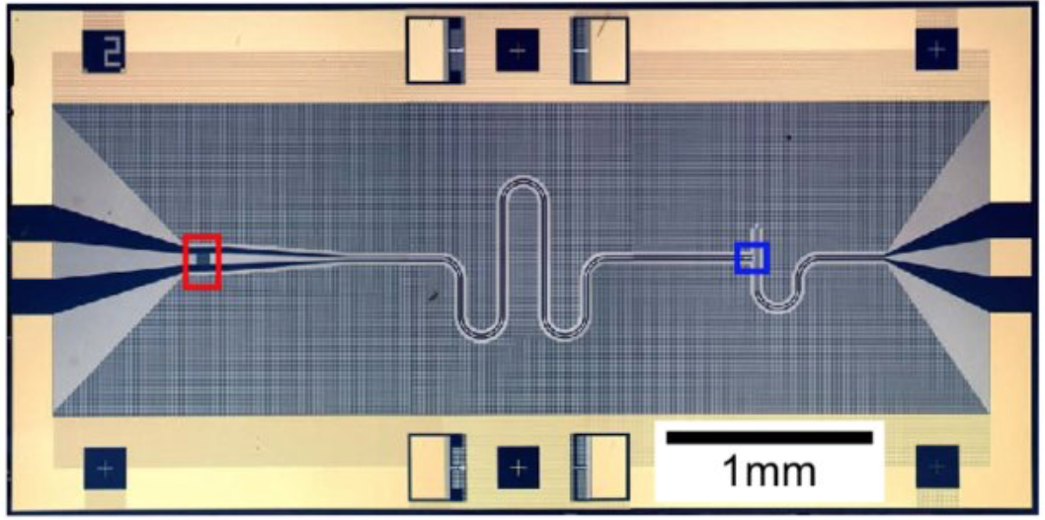
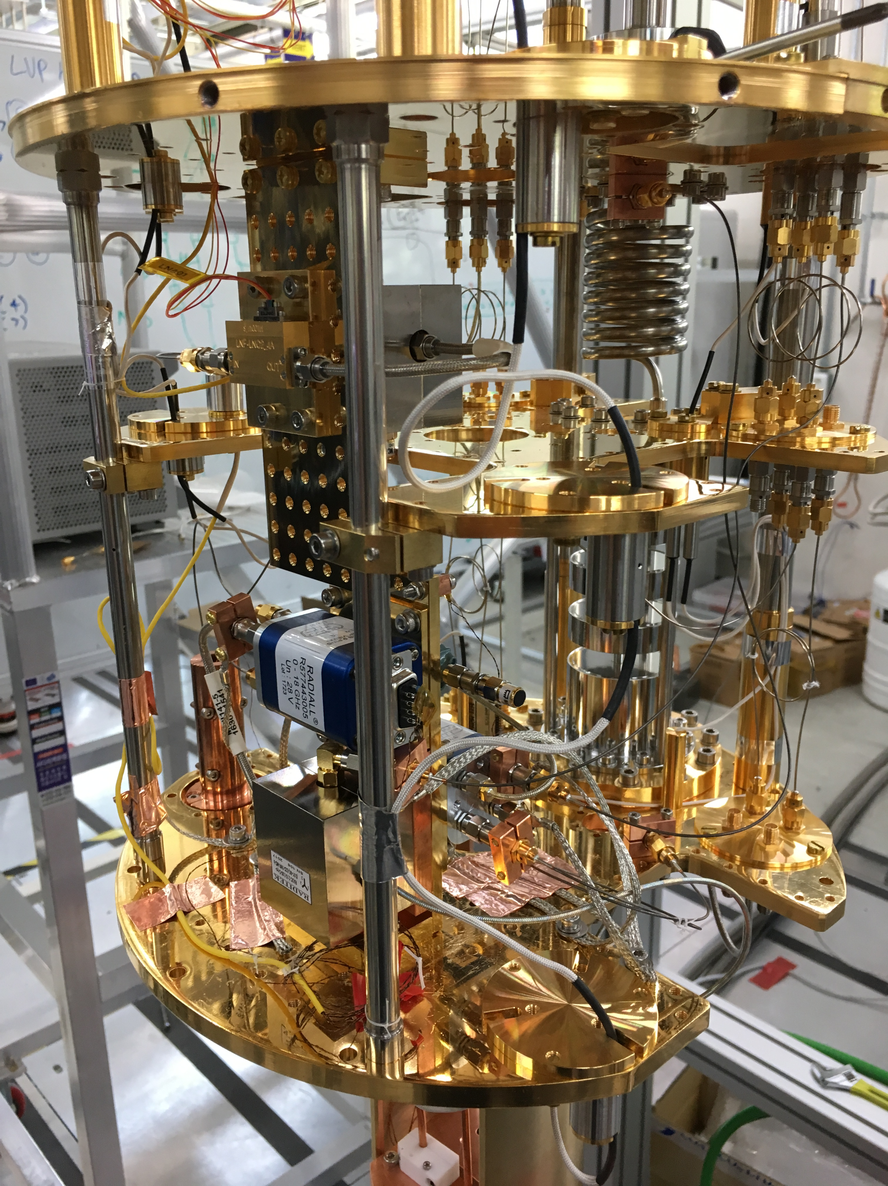
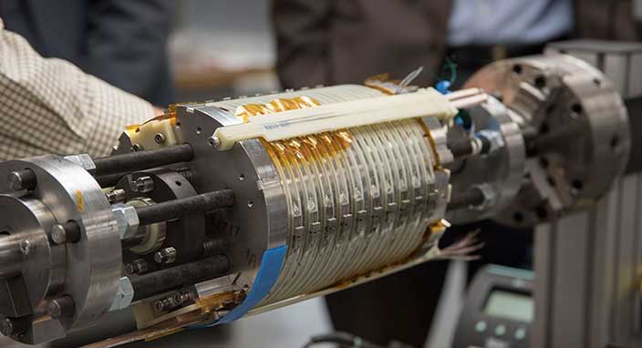
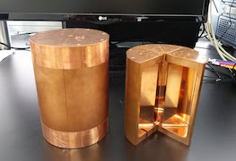



Cavity haloscope – in a nutshell
Most sensitive for ueV axions
Quantum noise limited amplifier T
Cryogenics T
P ~ 10^{–23} W
Signal amplification w/ minimal noise added
Lowering thermal noise
$$a$$
$$γ$$
Tunable High-Q resonator
V, Q, C, Δf
High field Magnet B
$γ$*
Small-scale experiments!
Boosting a→γγ conversion rate
Resonant frequency tuning

Slide 11
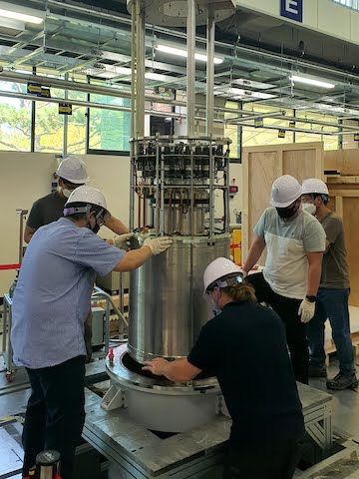
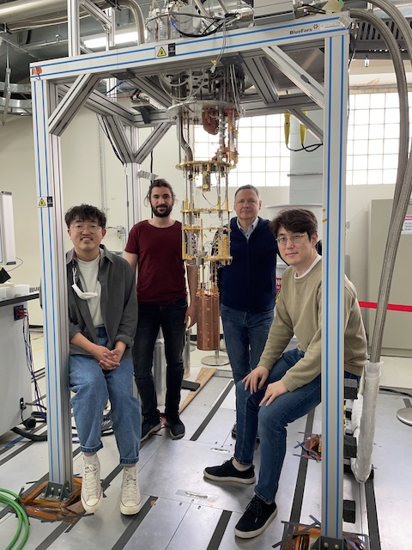
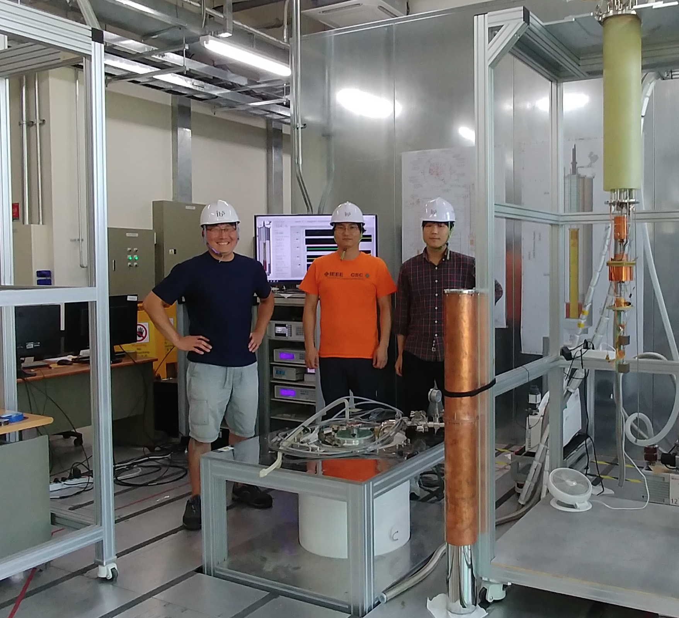
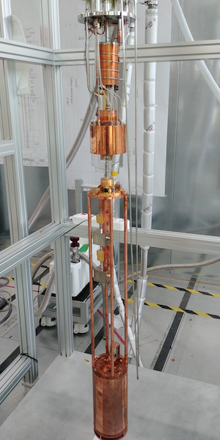
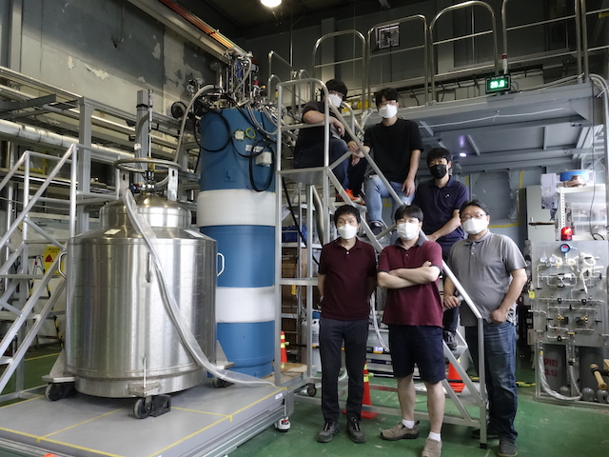
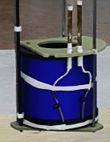
IBS-CAPP (since 2013)
CAPP-9T
CAPP-12TB
CAPP-18
CAPP-PACE
CAPP-8TB

Slide 12
Equipment at CAPP
Refrigerators
Magnets
Experiments
Manufacture | Model | T_{B} [mK]
BlueFors (BF3) | LD400 | 10
BlueFors (BF4) | LD400 | 10
Janis | HE-3-SSV | 300
BlueFors (BF5) | LD400 | 10
BlueFors (BF6) | LD400 | 10
Oxford | Kelvinox | 30
Leiden | DRS1000 | 5
Manufacture | B_{max} [T] | Bore [mm]
AMI | 12 | 96
Cryo Magnetics | 9 | 125
AMI | 8 | 125
AMI | 8 | 165
SuNAM | 18 | 70
Oxford | 12 | 320
Name
CAPP-12T
CAPP-9T
CAPP-8T (PACE)
CAPP-8TB
CAPP-18T
CAPP-12TB
Conducting parallel experiments targeting different mass regions!
Notes:
Start, describe, discuss, make a few wards

Slide 13
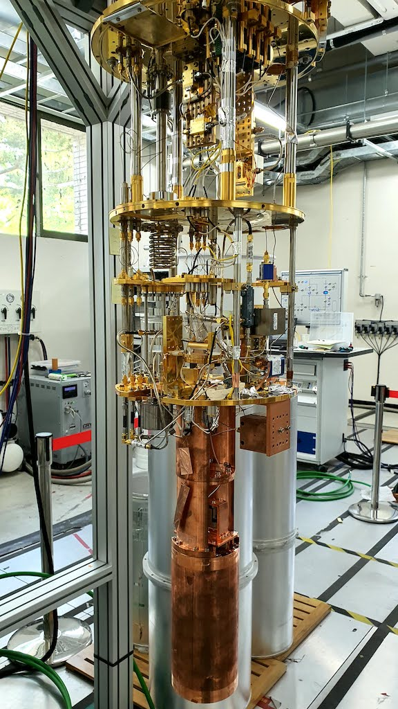
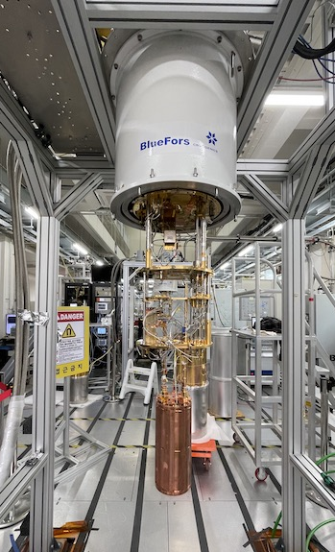
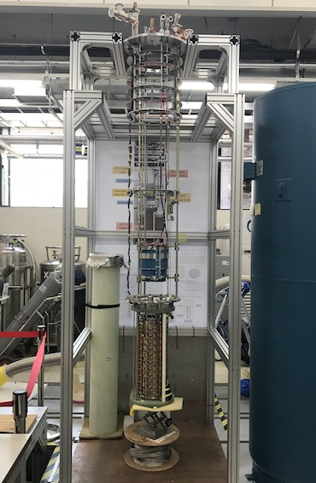
Search highlight – published
CAPP-9T
(9T/125mm)
Multiple-cell cavity
PRL 125 221302 (2020)
CAPP-PACE
(8T/125mm)
Pilot experiment
PRL 126 191802 (2021)
CAPP-8TB (8T/165mm)
Pilot experiment
PRL 124 101802 (2020)
CAPP-18T
(18T/70mm)
HTS + JPC
PRL 128 241805 (2022)

Slide 14
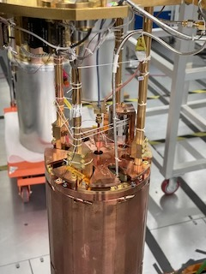
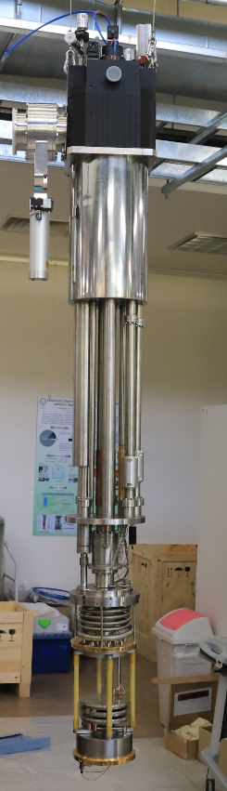

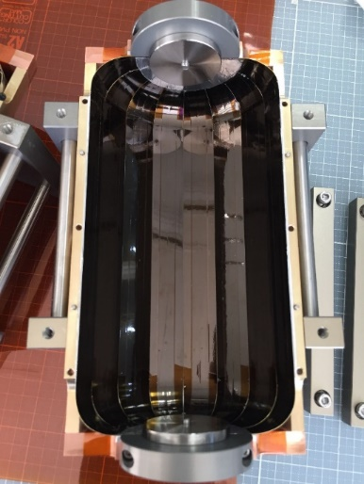
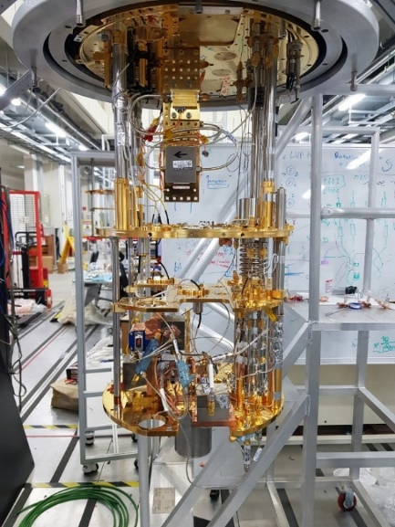
Search highlight – to be published
CAPP-8TB
(8T/165mm)
8-cell pizza cavity
JPA (~400 mK)
KSVZ
CAPP-12TB
(12T/320mm)
Flagship experiment
T_{cav} < 30 mK
~3 MHz/day @ DFSZ
DFSZ club!
arXiv:2210.10961
CAPP-PACE
(12T/320mm)
JPA w/ QLN (~200 mK)
HTS SC cavity (Q ~ 0.5 M)
KSVZ
arXiv:2207.13597

Slide 15
R&D efforts needed

Slide 16
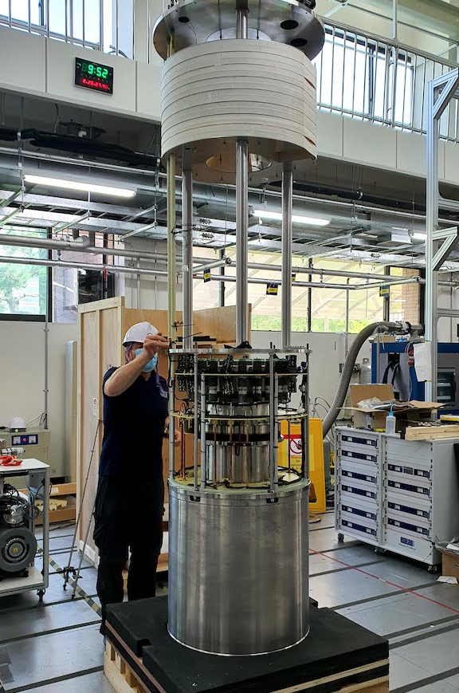
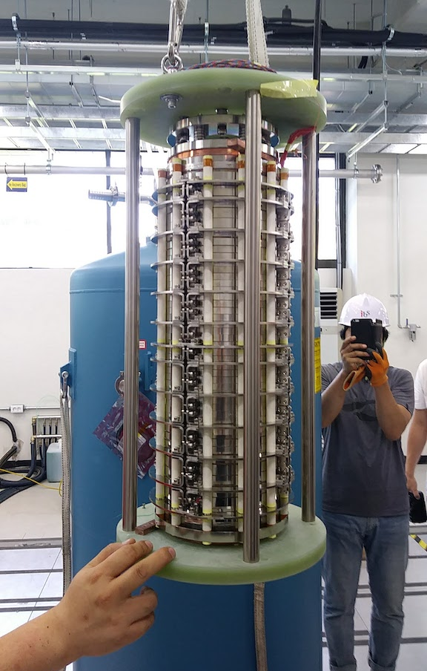
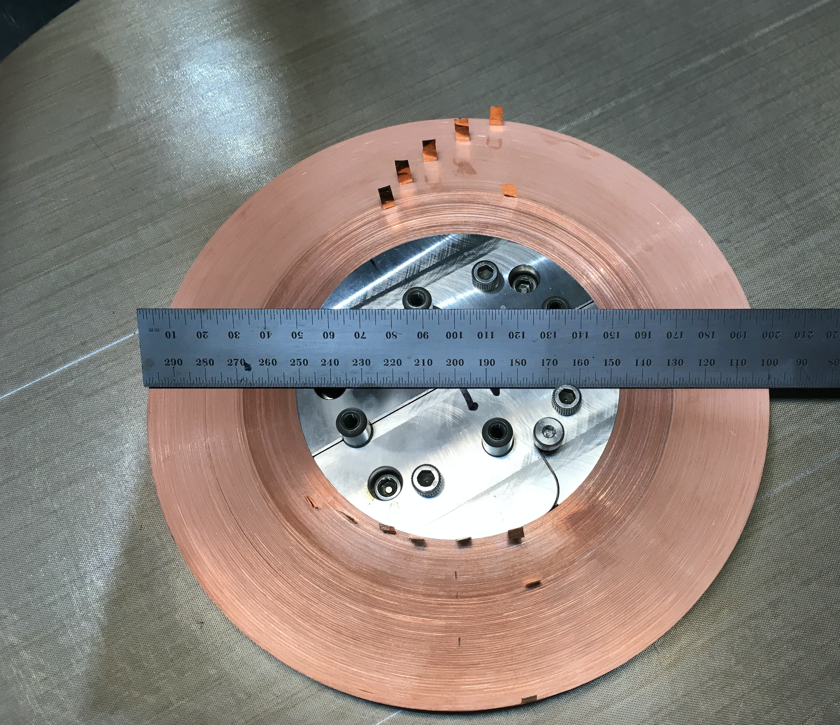
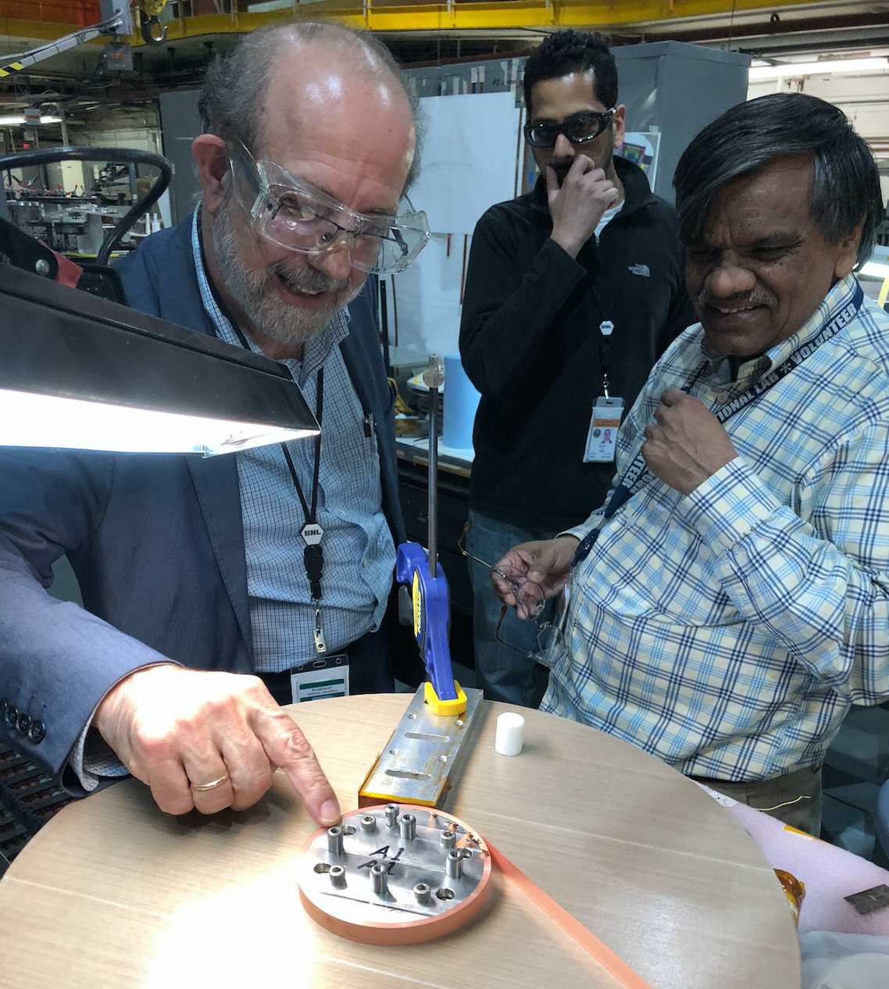
High-field magnets
Magnet | CAPP-12TB | CAPP-18T | CAPP-25T
Manufacturer | Oxford | SuNAM | IBS-BNL
B_{max} @ 4 K | 12 T | 18 T | 25 T
Bore (clear) | 320 mm | 70 mm | 100 mm
SC material | Nb₃Sn | GdBCO | YBCO
Delivery | 2020 | 2017 | ?
Frequency | > 1 GHz | > 4 GHz | > 3 GHz
Sensitivity | DFSZ | KSVZ | DFSZ

Slide 17
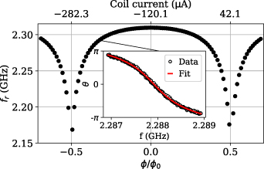
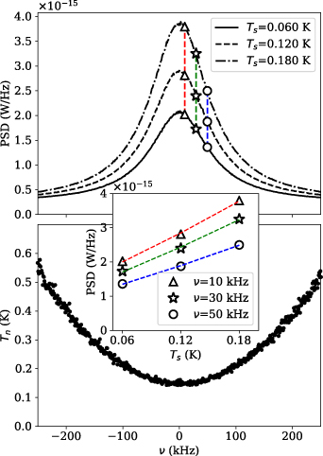
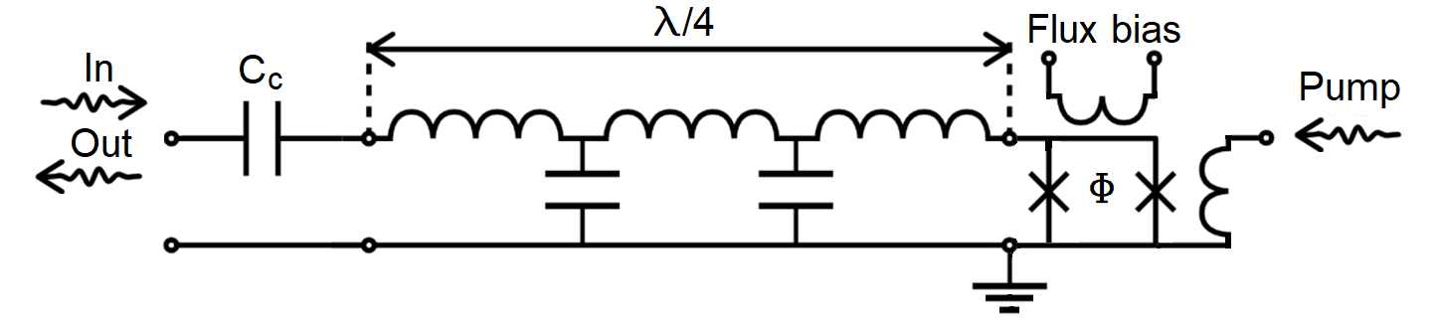
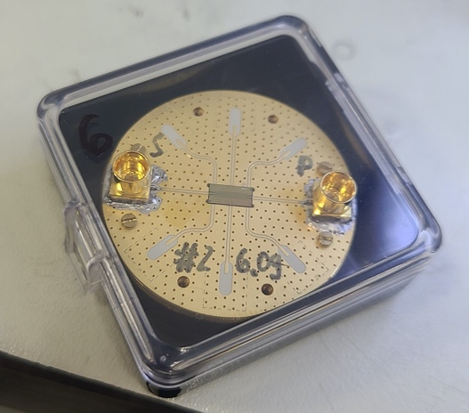
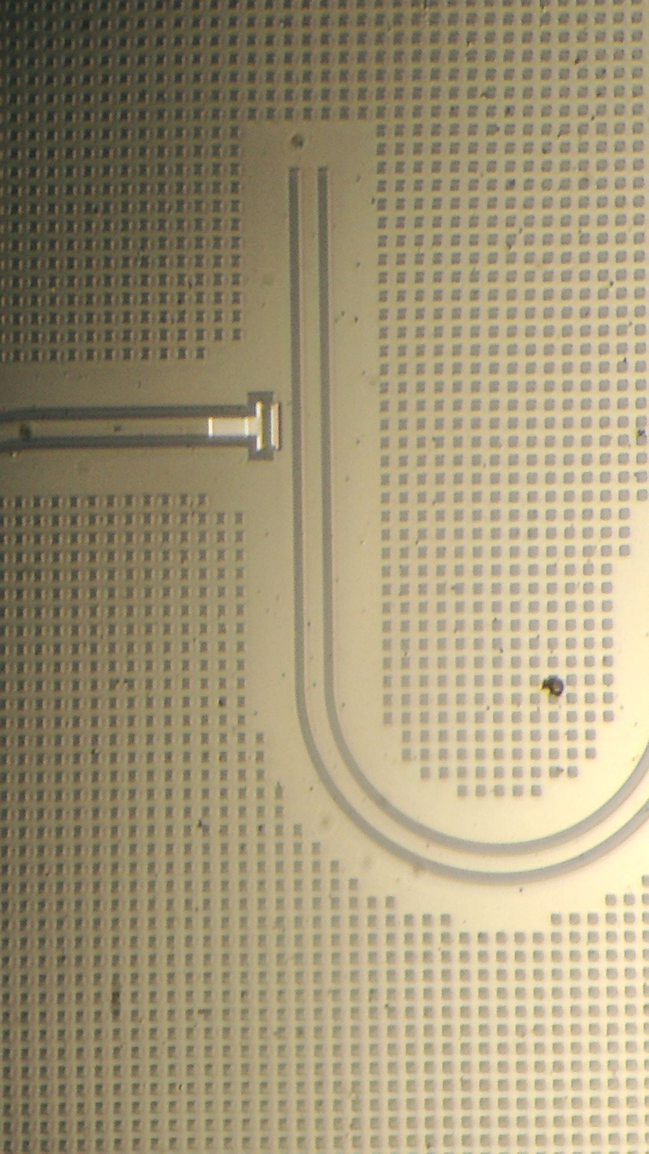
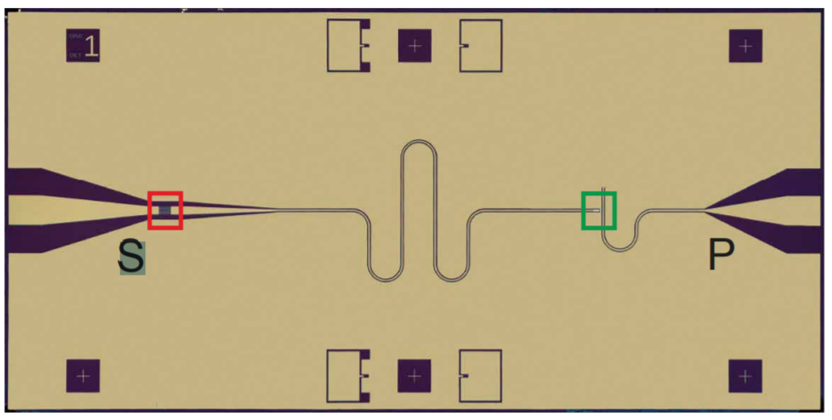


QNL amplification
Flux-driven Josephson parametric amplifiers
SST 34 085013 (2021)
Frequency tuning
$$I_{C}=IC_{c}cos\left(\frac{πΦ}{Φ_{0}}\right)$$
Parametric amplification
$$L\left(I\right)=L_{0}\left[1+\frac{1}{2}\frac{I^{2}}{I_{c}^{2}}\right], L_{o}=\frac{Φ_{0}}{2πI_{c}}$$
SQUID
(nonlinear inductance)
Standard quantum limit
>25 JPAs covering 1 to 6 GHz (U. of Tokyo & RIKEN)

Slide 18







Superconducting cavities
PRA 17 6 (2022)
AMSC
TM010
TM011
 | 1st generation | 2nd generation | 3rd generation
Material | YBCO | GdBCO | EuBCO+APC
Substrate | NiW | Hastelloy | Hastelloy
Volume [L] | 0.3 | 1.5 | 1.5 | 0.2
Frequency [GHz] | 6.9 | 2.3 | 2.2 | 5.4
Q-factor | 0.33 M | 0.5 M | 4.5 M | 13 M

Slide 19










High freq. approach
Multiple-cell (pizza)
Higher-mode (wheel)
Photonic crystal
PLB 777 412 (2018)
Mode | f_{rel} | Q_{rel} | V_{rel} | C_{abs}
TM₀₁₀ | 1 | 1 | 1 | 0.69
TM₀₃₀ | 3.6 | 1.9 | 1 | 0.05
arXiv:2205.08885 (2022)
JPG 47 035203 (2020)
vs.
Larger volume
Simpler receiver chain
~4 x f_{TM010}
f $∝$ spacing
~10 x f_{TM010}
Boosting effect

Slide 20
Searches at CAPP – projection

Slide 21
Summary
Axions could address fundamental questions
  Strong CP problem and dark matter mystery
Haloscope is the most sensitive method
  Probing theoretical models
IBS-CAPP is a leading group in axion hunting
  Tremendous effort to build the world’s best infrastructure
  Several haloscopes are ongoing
  DFSZ and KSVZ
  Magnet / JPA / SC cavity / high frequency
Next a couple of years must be exciting
  Covering a wide range 4–100 ueV (1–25 GHz)
  Uncovering the nature of dark matter

Slide 23


WISP zoo
Pseudo-scalar
WISP
Axion
  PQ solution to strong CP problem (1977)
  $$m_{a}f_{a}\sim Λ_{QCD}$$
  Invisible axion (1979)
  Dark matter candidate (1983)
Mili-chaged particle
.
.
.
J^{p} = 0–
J^{p} = 0⁺
Axion-Like Particle (ALP)
  Generic axion w/o solving strong CP problem
  $$m_{a}f_{a}≁Λ_{QCD}$$
ALP
Chameleon
Axion
Scalar
  Chameleon (2003)
    Dark energy candidate
J = 1
Hidden photon
Vector
  Hidden photon
    Gauge field in hidden sector
Others
  Mili-charged particle, …

Slide 24





Where are dark matter axions?
Different PQ breaking scenarios
=> Different mass ranges
=> Different search strategies
Depending on $λComp$ w.r.t. $Dexp$
Theoretical scenarios
Photon coupling
Fermion/gluon coupling
Quasistatic regime
$$λComp≫D_{exp}$$
Cavity regime
$$λComp \sim D_{exp}$$
Radiation regime
$$λComp≪D_{exp}$$

Slide 25

Detector of halo axions
Most sensitive approach in $μ$eV regime
  Microwave photons resonantly converted from axions
Conversion signal power (a→γγ)
Signal-to-noise ratio (SNR)
Scanning rate (F.O.M.):
- theoretical parameters
- experimental parameters
Cavity Q factor
Axion Q factor
Coupling constant
Effective volume
Axion number density
Magnetic field
Integration time
Axion bandwidth (~10⁻⁶ f)
System noise temperature

