Slide 1
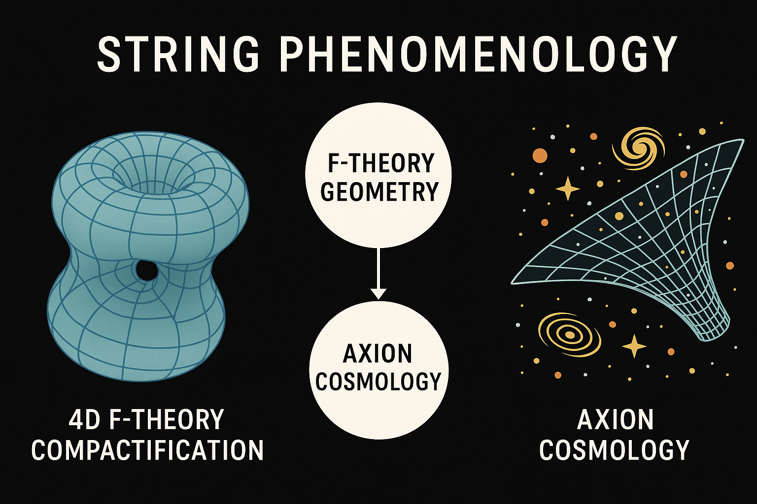
F-theory Ensembles, f&m
Yunhao Zhu (Claude)
Parallel Session,
String Pheno 2025

Slide 2
Outline
Introduction for the Ensemble
Theoretical background: F-theory & Axion Physics
Results

Slide 3
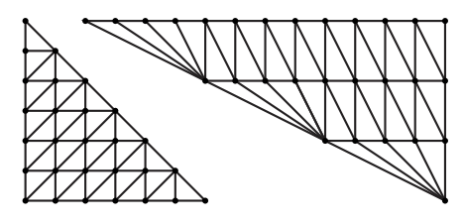
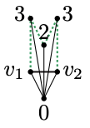

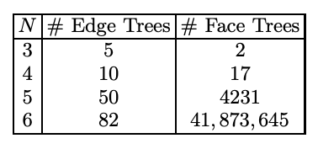
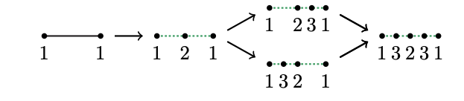
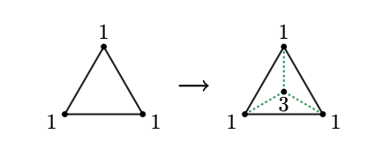

Models-Trees
Tree Ensemble: F-theory ensembles, obtained by building blocks on a smooth weak-Fano toric threefold $B_{i}$, FRST of 3d reflexive polytopes by Kreuzer and Skarke (KS). with $35≤h^{1,1}≤2591$ closed string axions
FRST: Facet of polytopes, edge between 2 points $v_{1}$ and $v_{2}$ on 3d reflexive polytopes, “blowup edges”, subdividing cones:
$v_{e_{i}}=a_{i}v_{1}$+ $b_{i}v_{2}$, height $h=a_{i}+b_{i}$
Blow up faces:
$v_{e_{i}}=a_{i}v_{1}$+ $b_{i}v_{2}+c_{i}v_{3}$, height $h=a_{i}+b_{i}+c_{i}$
# of trees:
comprising more than $\frac{4}{3}×2.96×{10}^{755}$ manifolds
J. Halverson, C. Long and B. Sung, On Algorithmic Universality in F-theory Compact-
ifications, Phys. Rev. D96, 126006 (2017), arXiv:1706.02299 [hep-th].
Fig 2: The largest facets in the two 3d reflexive polytopes with the most number of interior points.
Fig. 1: Blow up Edge Trees
and Face Trees

Slide 4
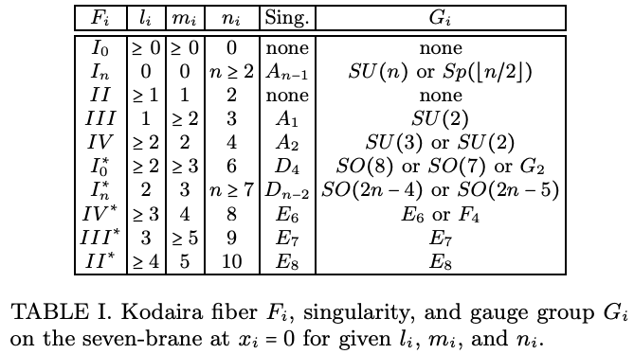

Elliptic Fiber & Kodaira
4d F-theory: Elliptic fibrations X over $B_{i}$:
$y^{2}=x^{3}+fxz^{4}+gz^{6}$, $f∈Γ(𝒪\left(−4K_{B}\right))$, g$∈Γ(𝒪\left(−6K_{B}\right))$
For a typical $B_{i}$, f and g take the form:
$f=\tilde{f}∏_{i}{x_{i}}^{l_{i}}$, g$=\tilde{g}∏_{i}{x_{i}}^{m_{i}}$,
Discriminant
$Δ=4f^{3}+27g^{2}=$ $\tilde{Δ}∏_{i}{x_{i}}^{min⁡(3l_{i},{2m}_{i})}=$ $\tilde{Δ}∏_{i}{x_{i}}^{n_{i}}$
Such a 7-brane is a non-higgsable 7-brane.
Kodaira Classification:

Slide 5



Axion Dynamics
The superpotential with gluino condensation:
Kähler Potential:$K=−2\log{𝒱}+K_{\text{other}}$, where $K_{\text{other}}=\log{(\frac{g_{s}^{4}}{128})}$
Relative effective Lagrangian:
$$ℒ⊃−\frac{1}{2}M_{\text{pl}}^{2}K_{ij}\left(∂_{μ}θ^{i}\right)\left(∂^{μ}θ^{j}\right)−\sum_{I}{Λ_{I}^{4}}\cos\left(2πQ_{Ia}θ^{a}+δ_{I}\right)$$
Instanton scale:
At the totdcskc

Slide 6
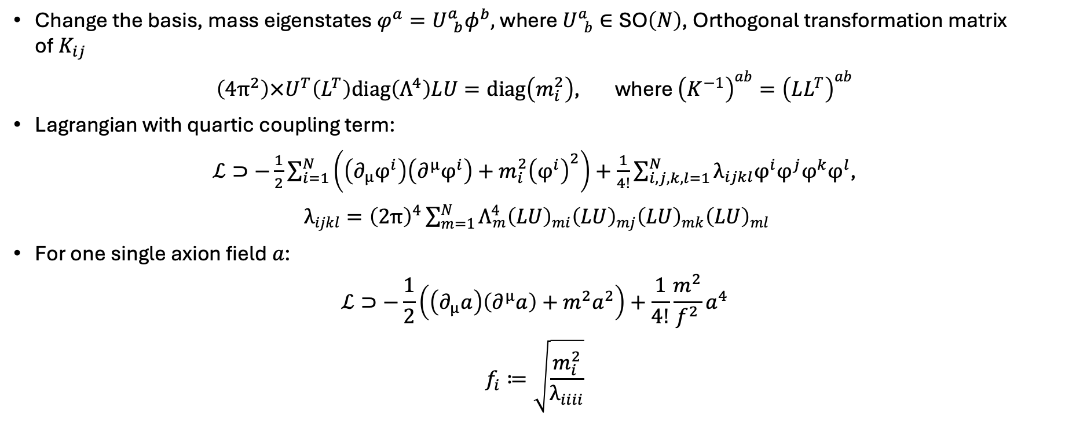
Axion Mass and Decay Constants
Change the basis, mass eigenstates $φ^{a}=U_{ b}^{a}φ^{b},$ where $U_{ b}^{a}∈\text{SO}\left(N\right)$, Orthogonal transformation matrix of$K_{ij}$
$\left(4π^{2}\right)×U^{T}\left(L^{T}\right)\text{diag}\left(Λ^{4}\right)LU=\text{diag}\left(m_{i}^{2}\right)$, where ${\left(K^{−1}\right)}^{ab}={\left(LL^{T}\right)}^{ab}$
Lagrangian with quartic coupling term:
$ℒ⊃−\frac{1}{2}\sum_{i=1}^{N}{\left(\left(∂_{μ}φ^{i}\right)\left(∂^{μ}φ^{i}\right)+m_{i}^{2}{\left(φ^{i}\right)}^{2}\right)}+\frac{1}{4!}\sum_{i,j,k,l=1}^{N}{λ_{ijkl}φ^{i}φ^{j}φ^{k}φ^{l}}$,
$λ_{ijkl}={\left(2π\right)}^{4}\sum_{m=1}^{N}{Λ_{m}^{4}{\left(LU\right)}_{mi}{\left(LU\right)}_{mj}{\left(LU\right)}_{mk}{\left(LU\right)}_{ml}}$
For one single axion field $a$:
$$ℒ⊃−\frac{1}{2}\left(\left(∂_{μ}a\right)\left(∂^{μ}a\right)+m^{2}a^{2}\right)+\frac{1}{4!}\frac{m^{2}}{f^{2}}a^{4}$$
$$f_{i}≔\sqrt{\frac{m_{i}^{2}}{λ_{iiii}}}$$
V. M. Mehta, M. Demirtas, C. Long, D. J. E. Marsh, L. McAllister and M. J. Stott, Superradiance in string theory, JCAP 07 (2021) 033, [2103.06812].

Slide 7
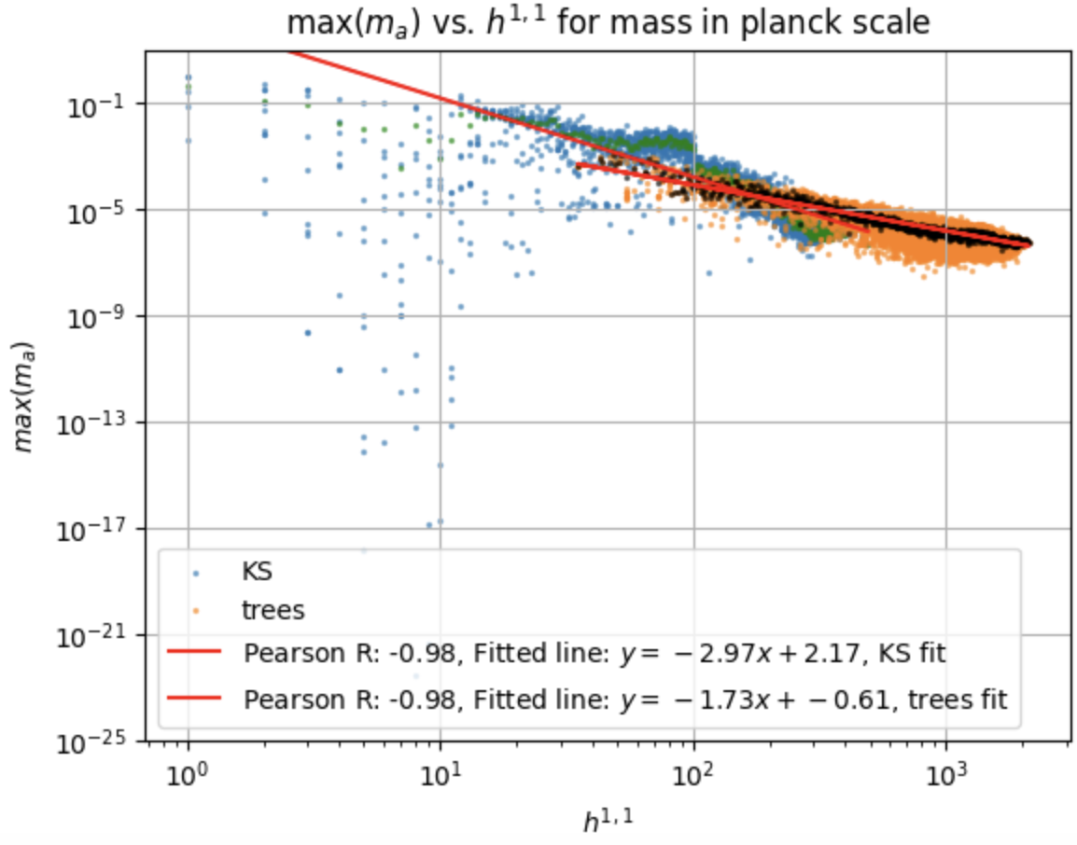
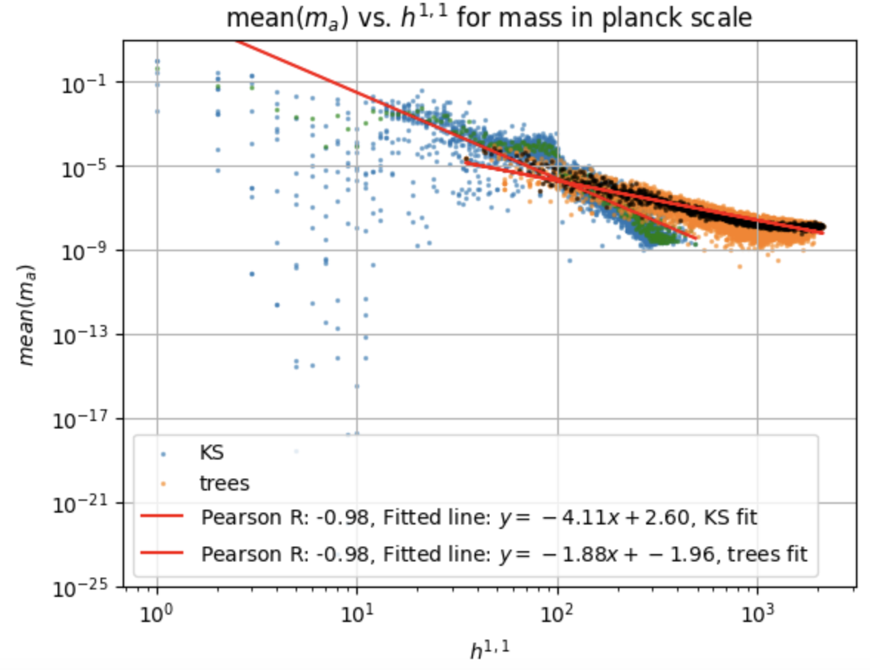
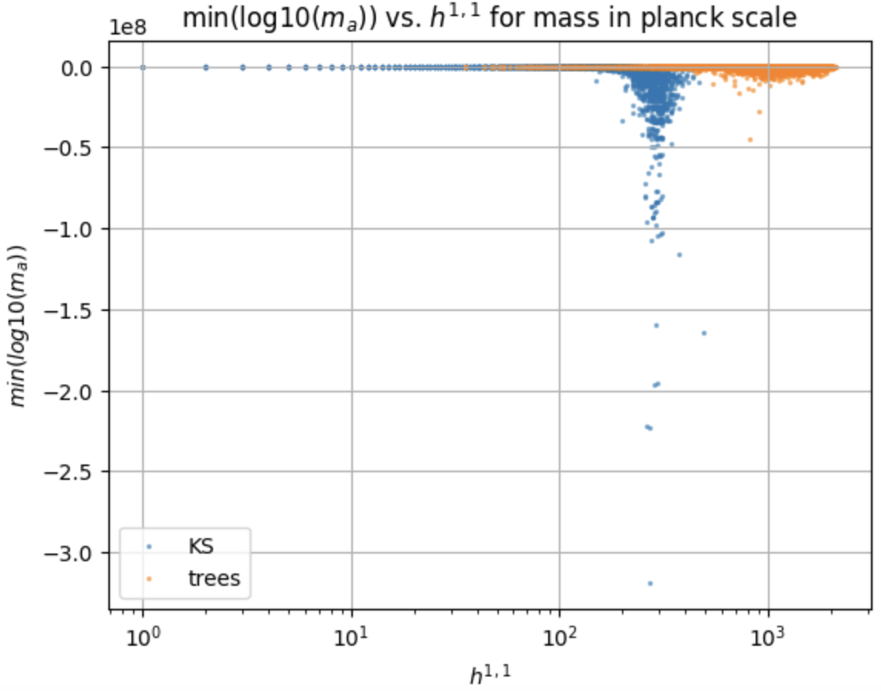
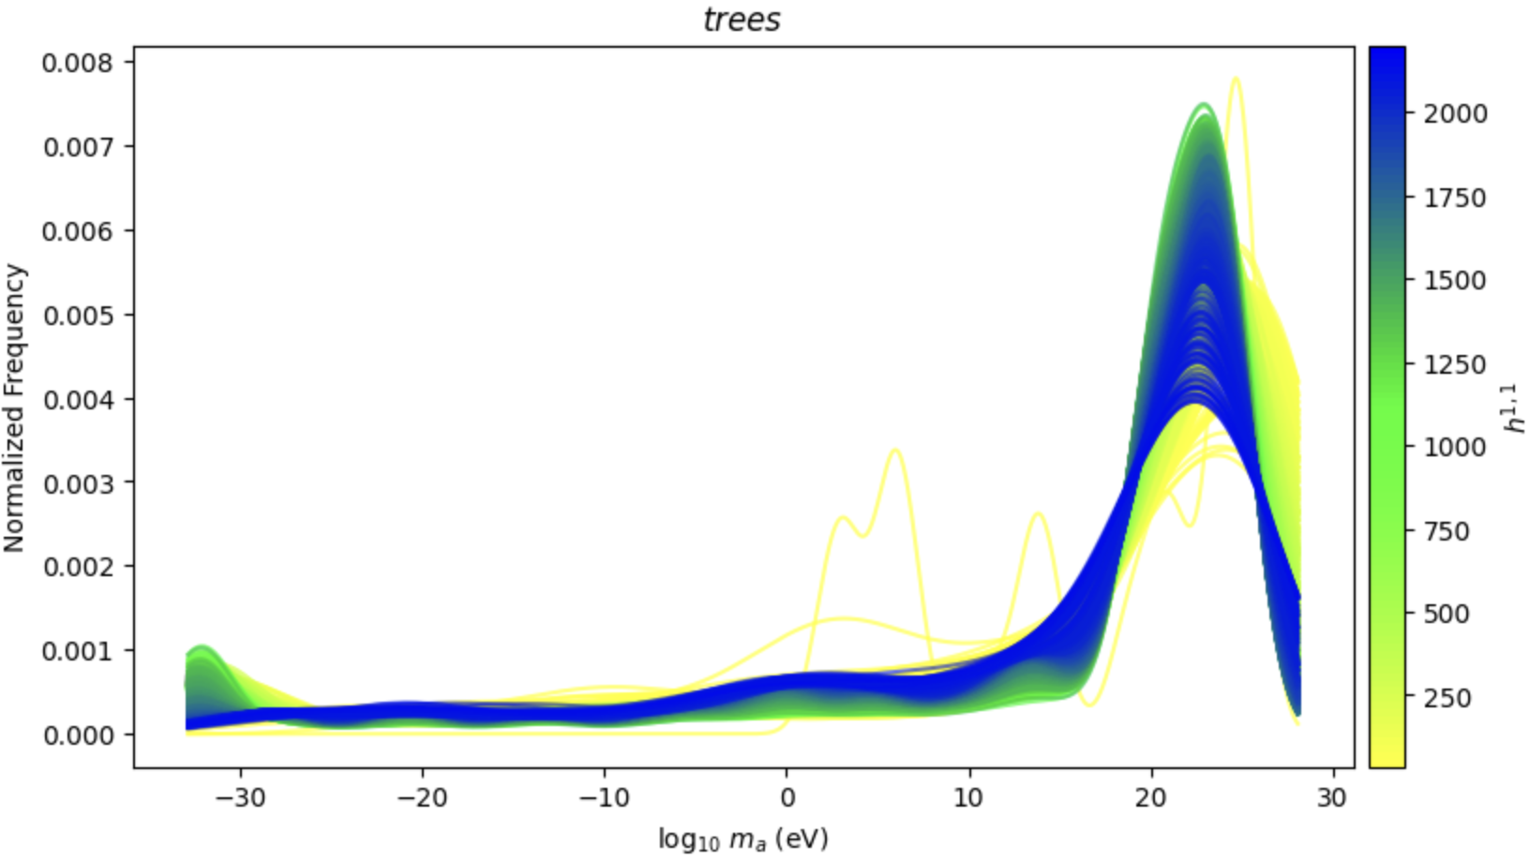



$m_{a}$ and $f_{a}$ Computations
Fig. 5: statistics of $m_{a}$ vs. $h^{1,1}$
We construct algorithms based on instanton scales and Kähler metrics for $m_{a}$ and $f_{a}$
Compare to the mpmath because numpy can only precise around ${10}^{−15}$ planck mass, and many $m_{a}$ below today’s Hubble scale (${10}^{−61}$ planck mass).
The algorithms make the $m_{a}$ very precise, and $f_{a}$ precise for those $m_{a}$ above Hubble scale, enough for the resulting cosmology

Slide 8
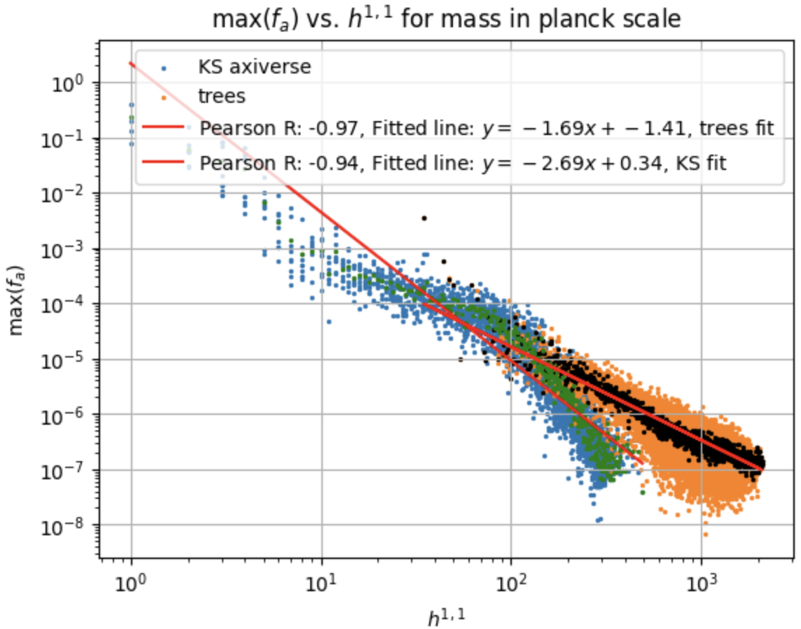
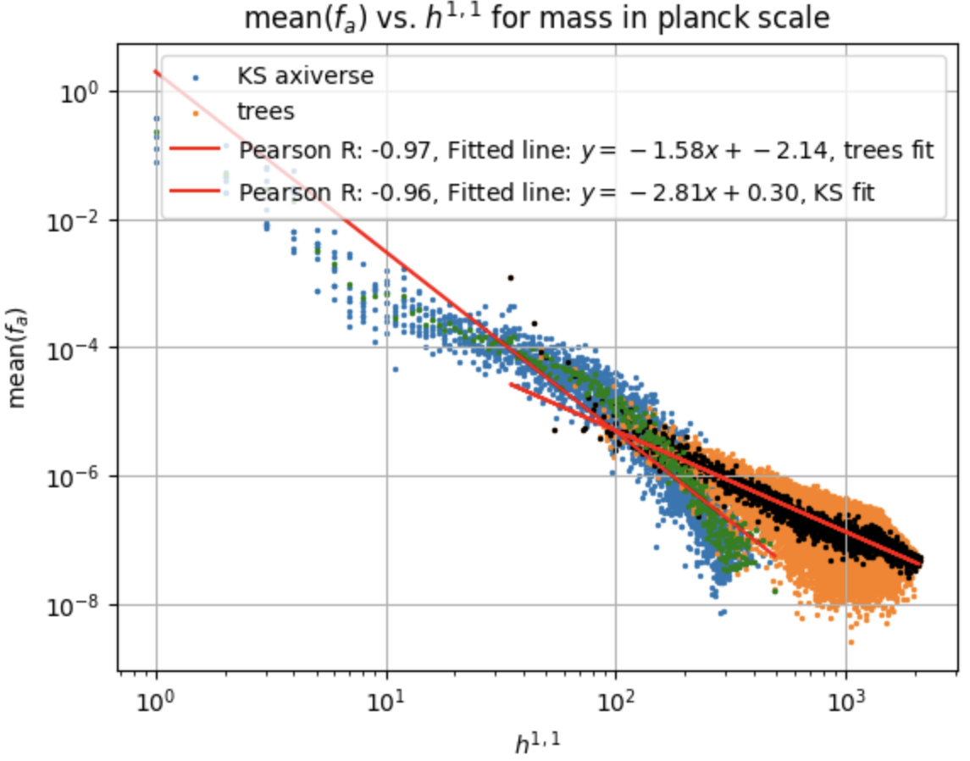
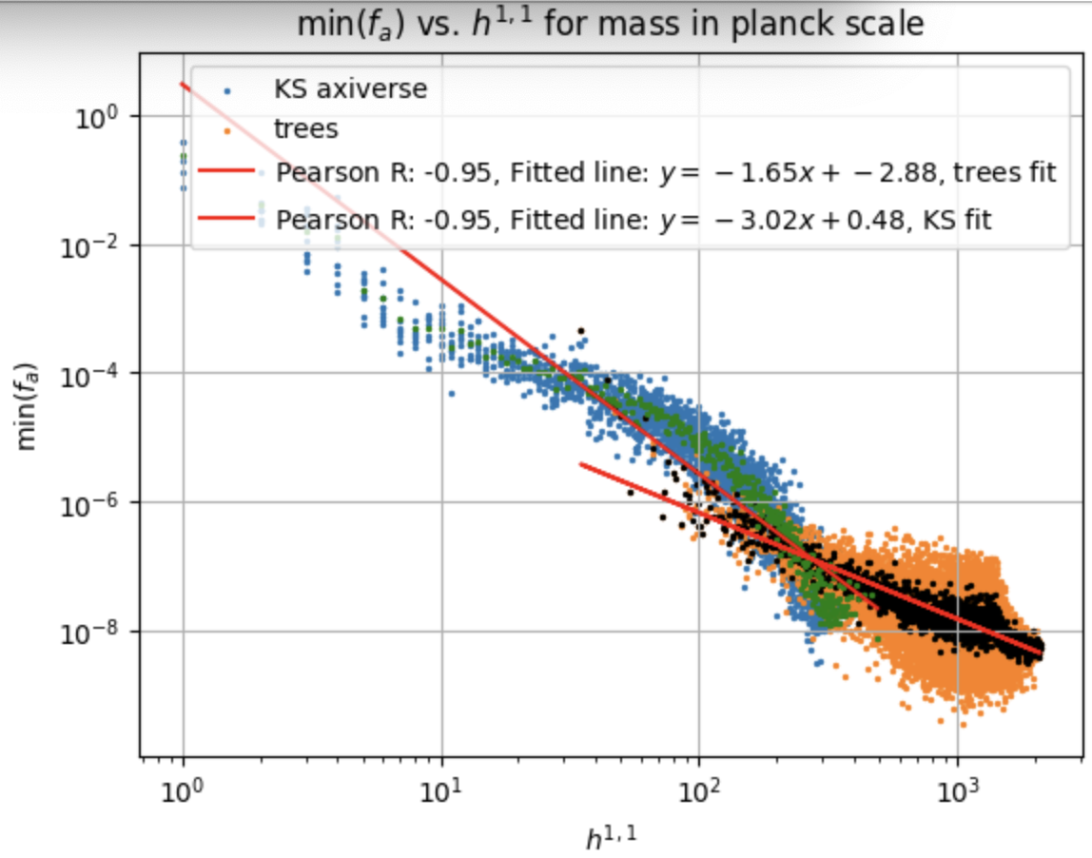
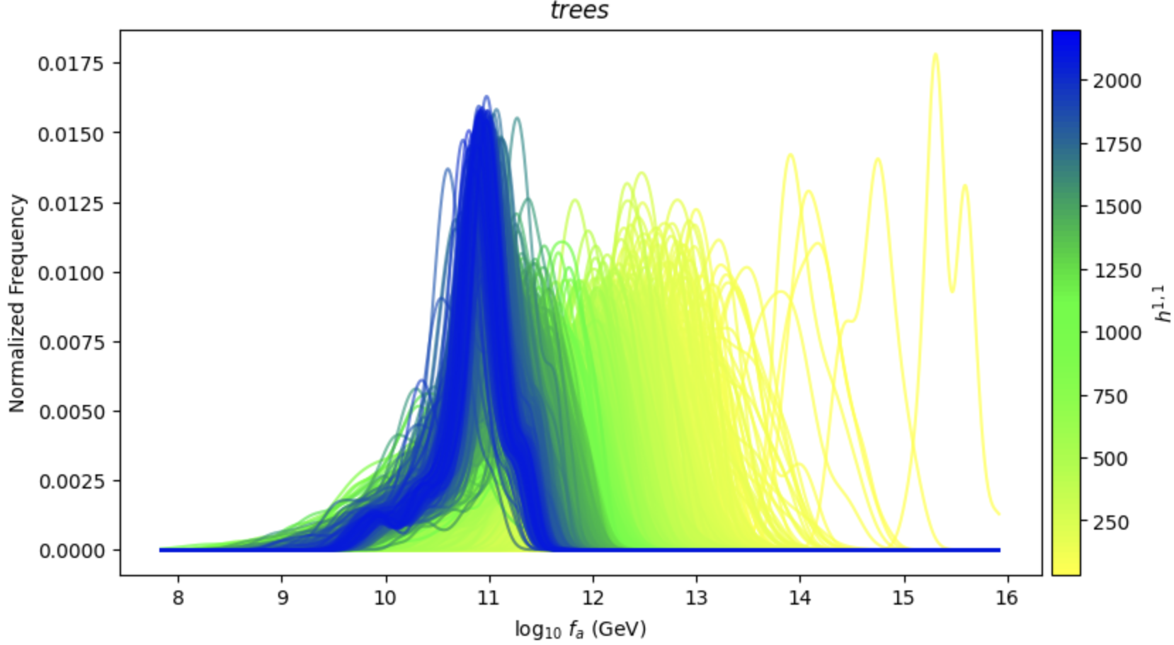

$f_{a}$ Computations
Fig. 6: statistics of $f_{a}$ vs. $h^{1,1}$

Slide 9
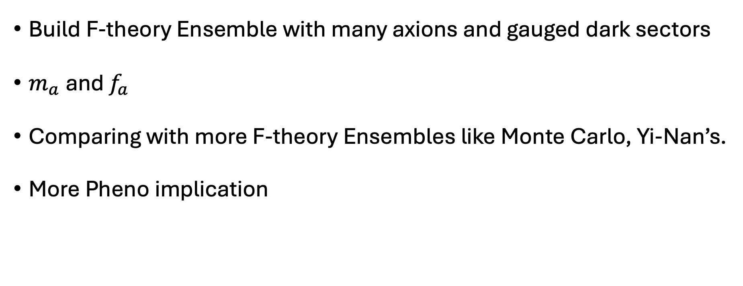
Conclusion
Build F-theory Ensemble with many axions and gauged dark sectors
$m_{a}$ and $f_{a}$
Comparing with more F-theory Ensembles like Monte Carlo, Yi-Nan’s.
More Pheno implication

