Slide 1
No Need To Be Vexed:
CY Hypersurfaces from Reflexive Polytopes Beyond FRSTs
Elijah Sheridan
Cornell University
String Phenomenology 2025
July 8, 2025
(Based on upcoming work with Nate MacFadden)

Slide 2

Motivation
In string theory (and mathematics), it is important to enumerate & compute data (topological & geometric) for Calabi-Yau threefolds
Toric geometry enables this by reducing topology/geometry to combinatorics
In particular, we have long understood a toric geometric correspondence:
fine, regular, star triangulations
(FRSTs) of reflexive polytopes
smooth Calabi-Yau
hypersurfaces
Batyrev ‘93
Kreuzer & Skarke ‘00
This is also a statement about Kahler moduli space (different FRSTs of same polytope → CYs related by flops)

Slide 3
Upshot
fine, regular, star triangulations
(FRSTs) of reflexive polytopes
smooth Calabi-Yau
hypersurfaces
Toric geometry can be used to extend the LHS significantly, enumerating more computable CYs and mapping out significantly more of the Kahler moduli space:
fine, regular fans of reflexive polytopes
smooth Calabi-Yau
hypersurfaces

Slide 4
Talk Outline
Toric Geometry
CY Hypersurfaces in Toric Varieties
Results
Outlook (future directions)

Slide 5
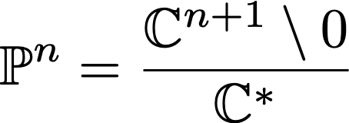
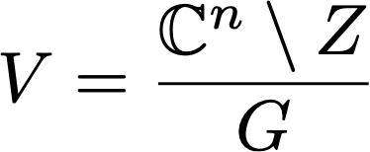
Toric Geometry
Idea: toric varieties generalize
(complex) projective space
Notes:
\mathbb{P}^2

Slide 6

Toric Geometry
Toric varieties are encoded combinatorially by fans (collection of cones)
Notes:
\mathbb{P}^2

Slide 7
Toric Geometry
Fans have “coarse” and “fine” data:
1D cones and higher-D cones
4
Triangulation
of polytope
2
Slice
(“toric diagram”)
5
3
1
Fan

Slide 8
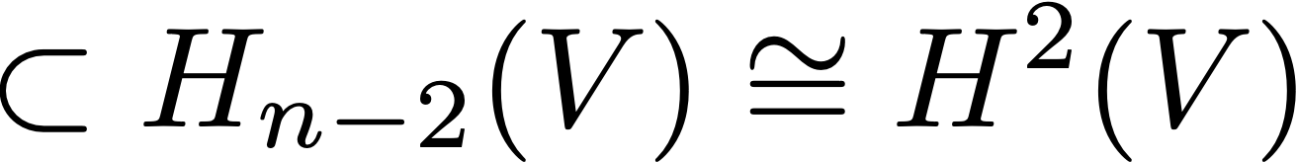
Toric Geometry
Toric varieties with same 1D cones are related by a birational morphism (isomorphism away from measure zero set)
The secondary fan organizes these birationally related toric varieties

Slide 9
CY Hypersurfaces
Calabi-Yau hypersurfaces inherit this cone structure from the ambient toric variety: it becomes (part of) the extended Kahler cone (union of Kahler cones related by flops)
In this way, studying the combinatorics of toric birational geometry (e.g., counting fans)
enumerates CYs
enables topological/geometric computations
maps out Kahler moduli space

Slide 10
CY Hypersurfaces
To achieve a smooth hypersurface, one must avoid:
Intersection with ambient space singularities
“Intrinsic” singularities
(F = dF = 0)
Dim ≥ 1 generically
intersects
Dim 0 (point-like) only intersects on basepoint locus
Only can happen on basepoint locus (Bertini’s theorem)

Slide 11

CY Hypersurfaces
Toric varieties s.t. anticanonical -K is Cartier and nef
fine, regular, star triangulations
(FRSTs) of a reflexive polytope.
Batyrev 93’
These ensure that ambient singularities are point-like and the anticanonical hypersurface has no basepoints.
However, this is sufficient but not necessary for smoothness,
and a priori FRSTs do not exhaust all fans! What about the others?

Slide 12
Results
We studied non-FRST fans — “vex triangulations” — arising from reflexive polytopes, including
Structure of anticanonical hypersurface basepoint loci (where singularities can arise)
Necessary conditions for avoiding ambient toric singularities
Enumeration of all fans (FRST & vex) with h^{1,1} ≤ 6
Berglund, Huang, Taylor,
Wang (unpublished)
“FRST”
vs.
“Vex”

Slide 13
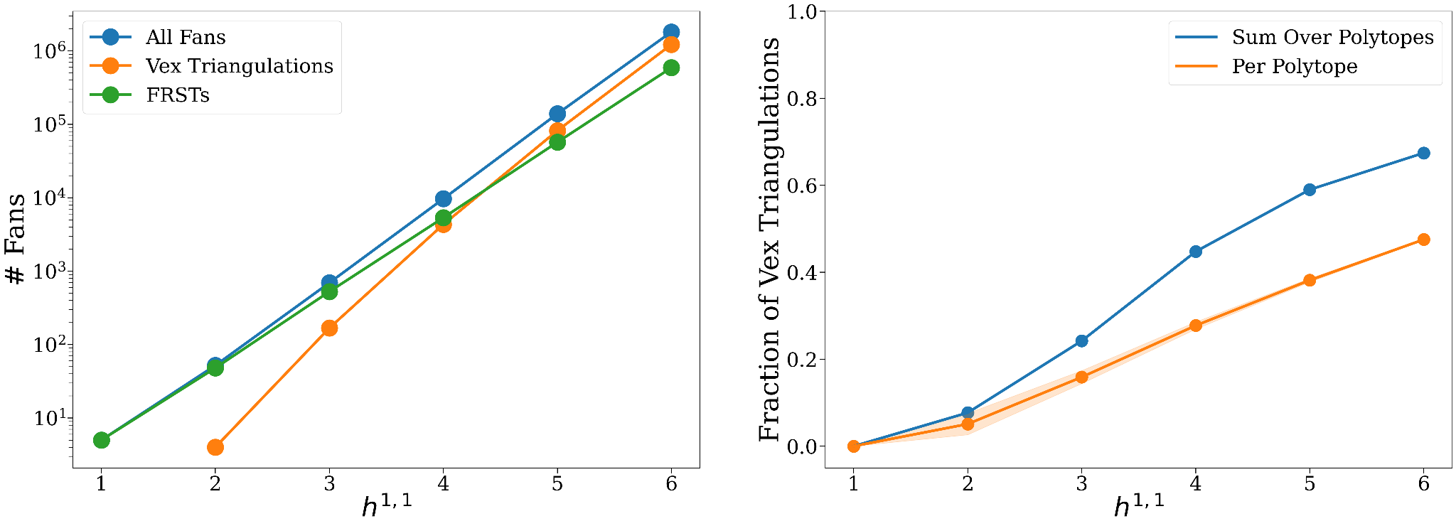
Results

Slide 14
Results
NT = “non-toric”...
…or maybe not?
NT
NT
NT
Vex
NT
FRST
Vex
FRST
FRST
A paradigmatic
cartoon of the
extended
Kahler cone…
-K
Vex
FRST
Vex
Vex
Vex
Vex
Secondary Fan
(“Toric Part”)

Slide 15
Conclusion & Outlook
There are more vex triangulations than FRSTs: to explore the full string landscape — discrete topologies & continuous moduli spaces — one is motivated to step past FRSTs
Vex triangulations enable computational power for a larger set of CYs
What next?
  Continue studying CY hypersurfaces
  in vex triangulations (esp. smoothness)
  Apply newfound control over CY birational
  geometry (e.g., for line bundle cohomology)
  Compare phenomenological consequences of
  FRST & vex CYs
Moritz & ES, in prep.
Constantin, Lukas, & ES, in prep.
Gendler, ES, Stillman, & Wu, in prep.
Carta, Gendler, Marsh, Moritz, ES, …, WIP.

