Slide 1
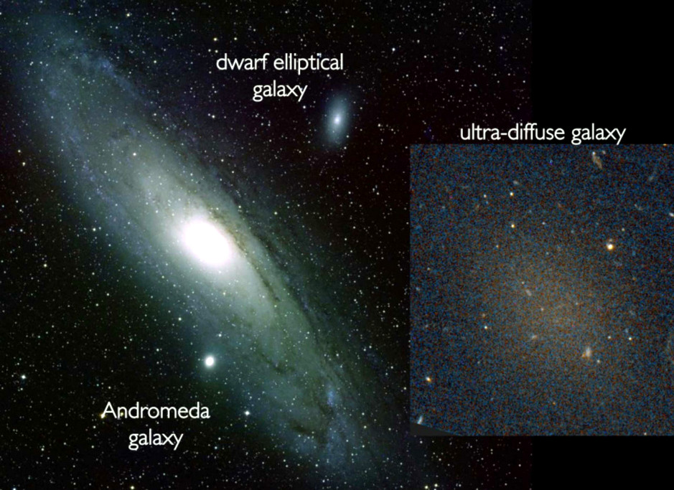
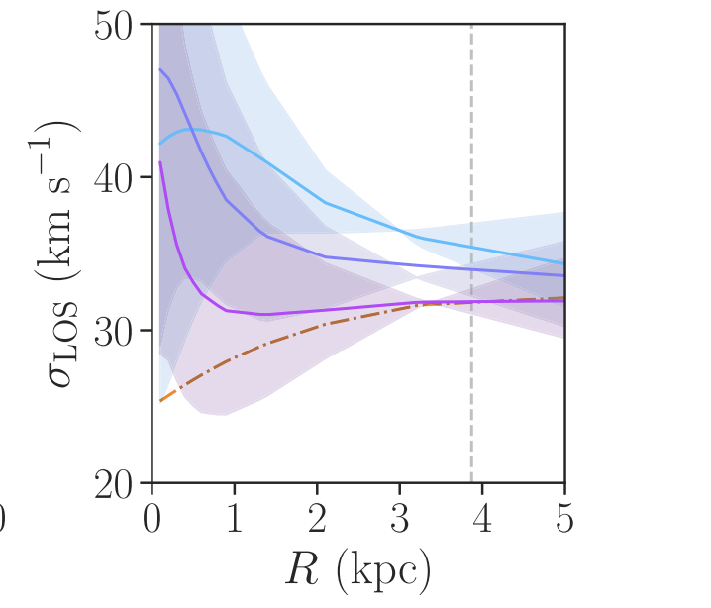
Ultra Diffuse Galaxies – A New Regime for Testing Dark Matter
Notes:
UDGs, discovered in 2015, have stellar mass of dwarfs but sizes and DM halos of giants. Simple structures with no bulge or central black hole. Predicted vel. Disp. Curves for a 10^11 Mo halo. Dashed line is a cold DM profile. Colours represent 3 different Axion masses. Thus measuring sigma at ~1 kpc (the soliton core) is diagnostic of cold vs fuzzy (ultra-light) DM.

