Slide 1
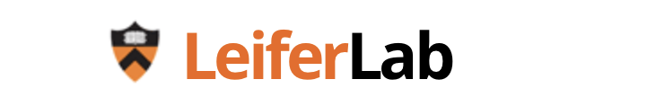
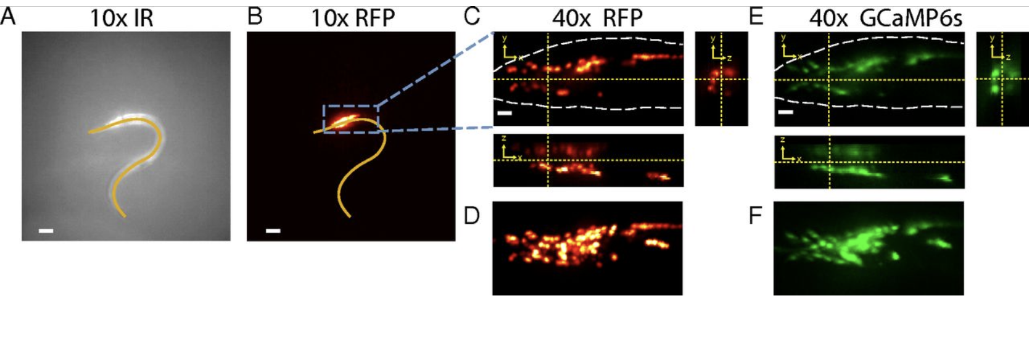
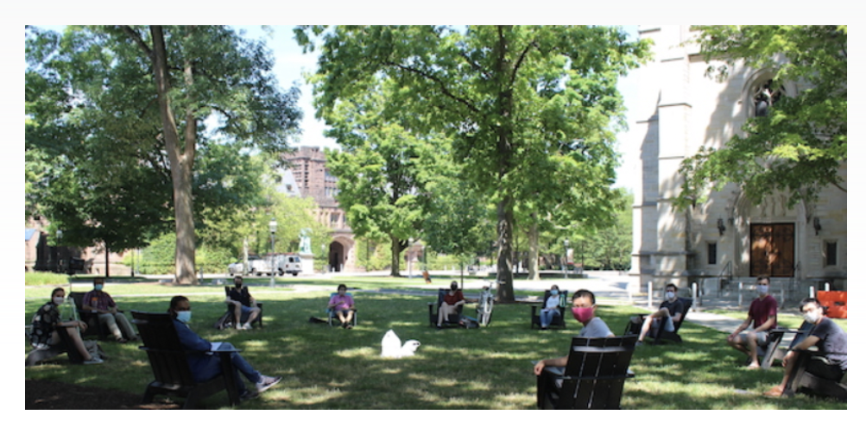
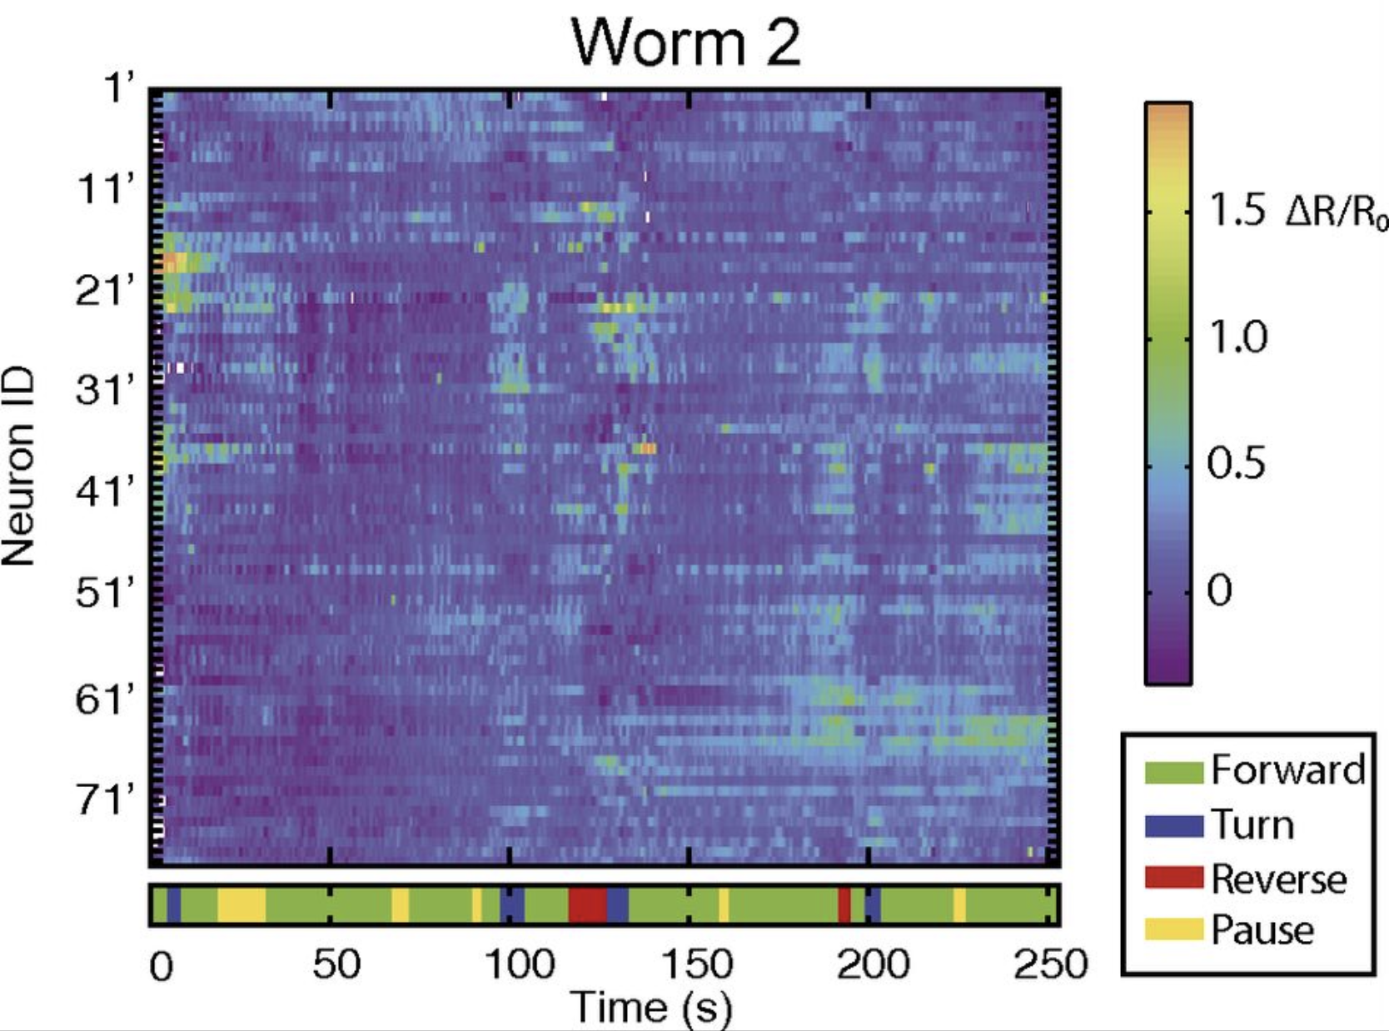
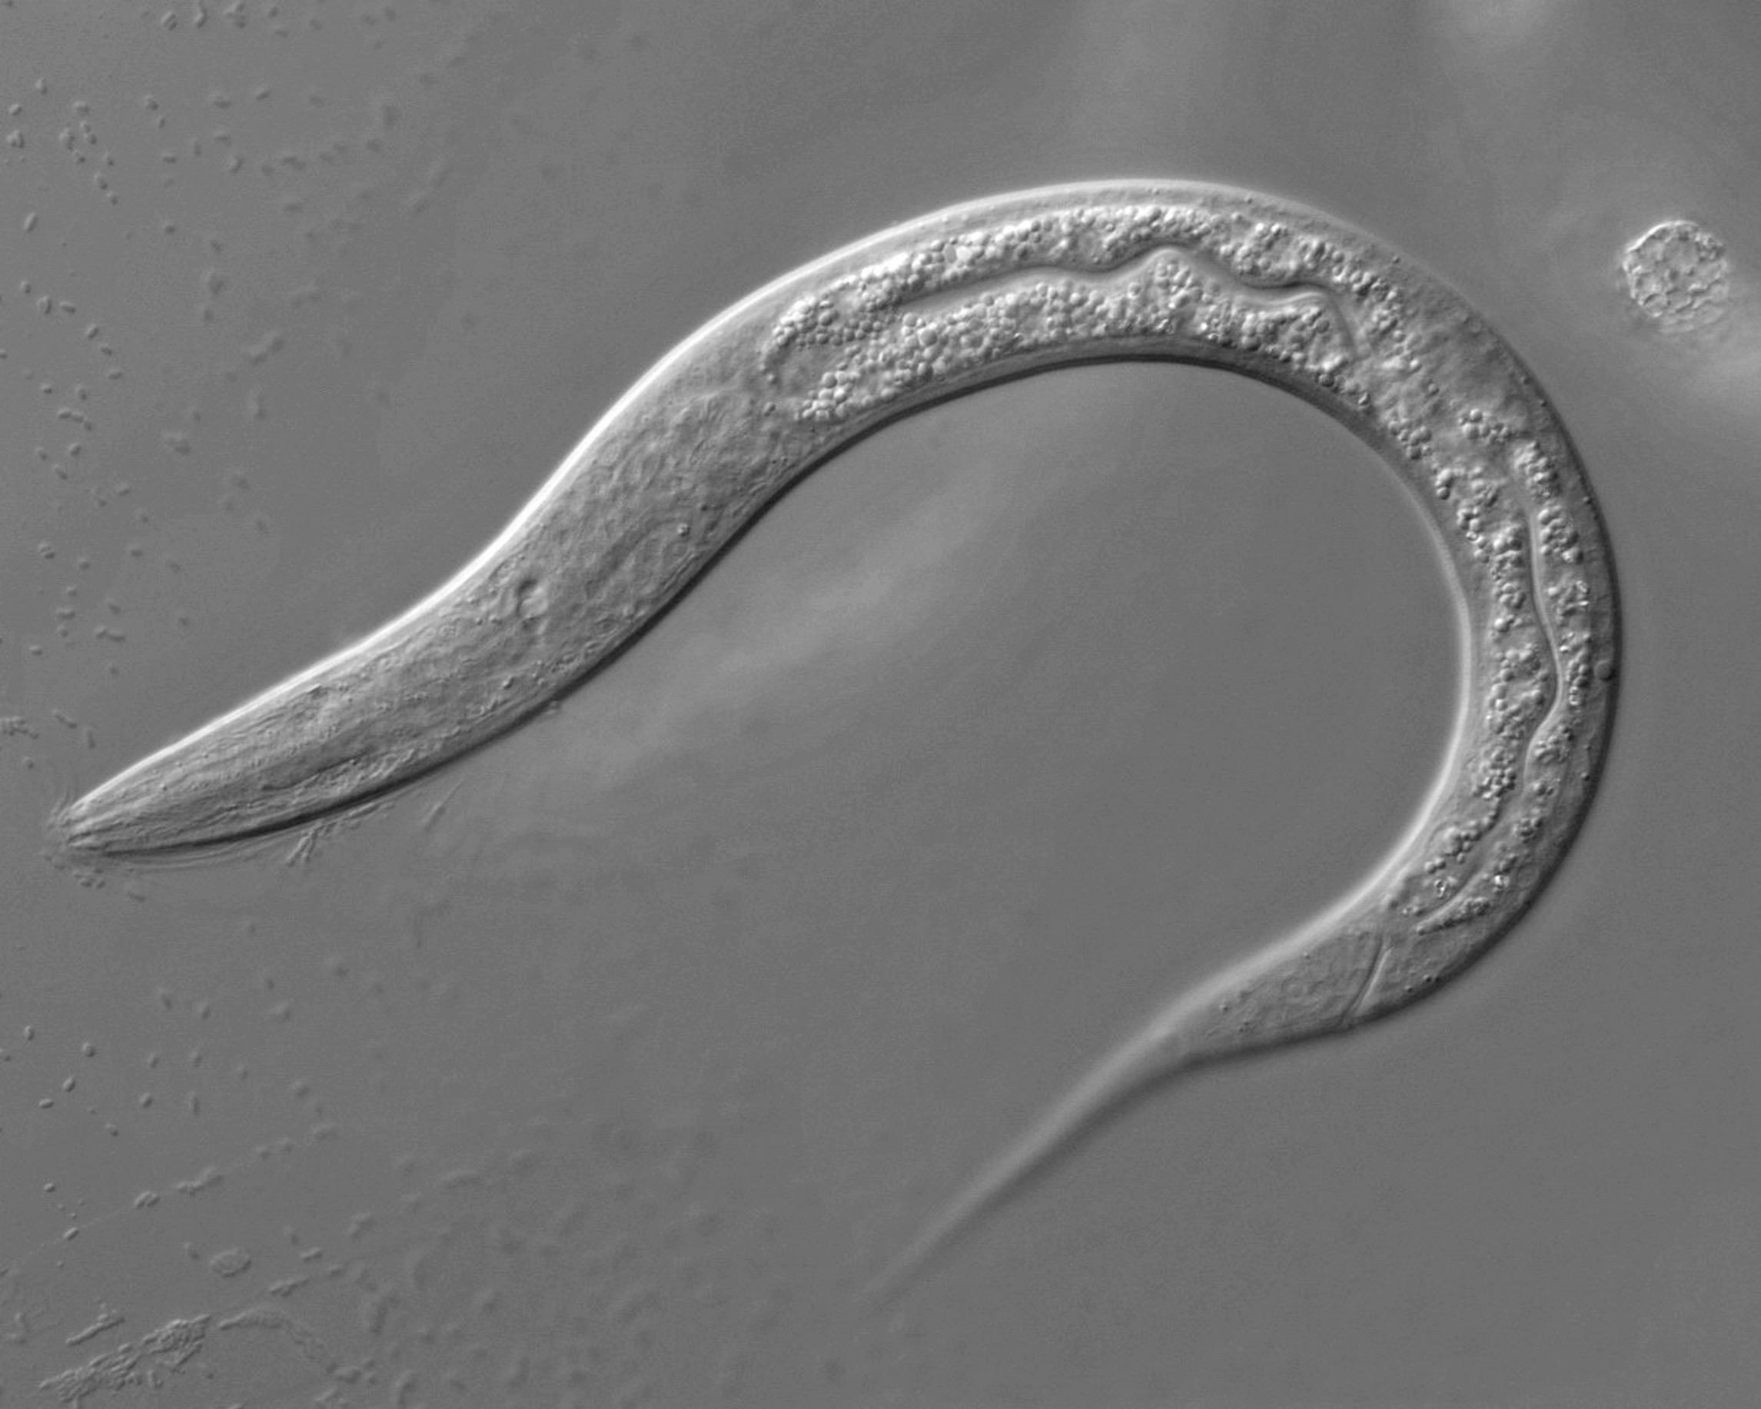
Studying Neural Dynamics of Behavior in C. elegans
How do a collection of neurons work together to receive information from the environment, encode that information, and then process it to generate purposeful behavior?
Nguyen et al. 2016
Nguyen et al. 2016
Sophie Dvali sdvali@princeton.edu

Slide 2
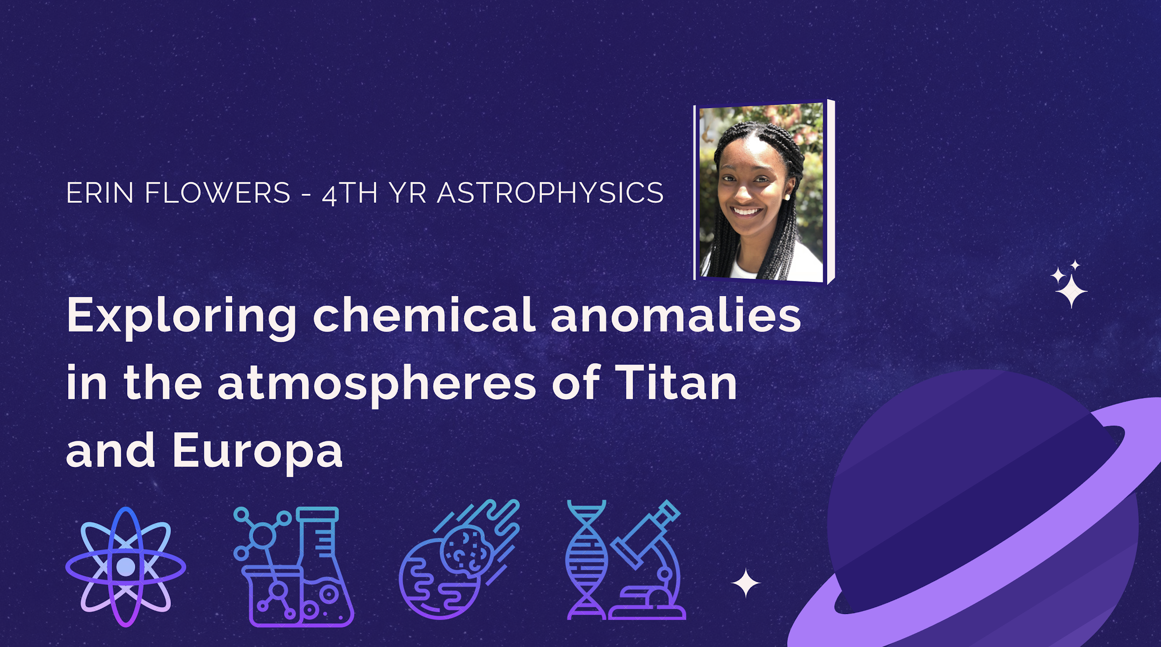
eflowers@princeton.edu

Slide 3
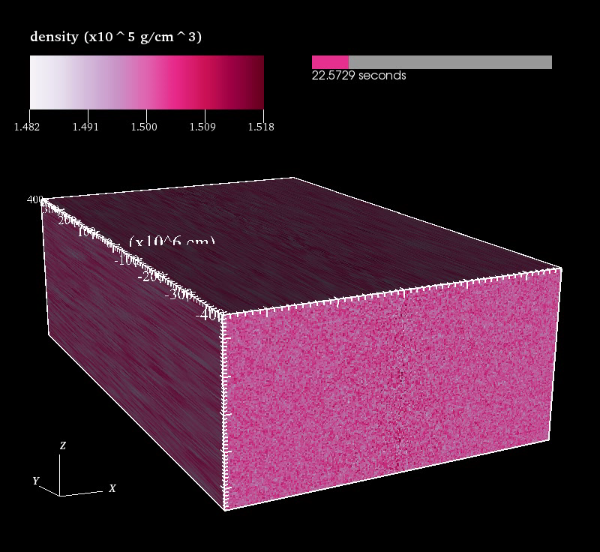
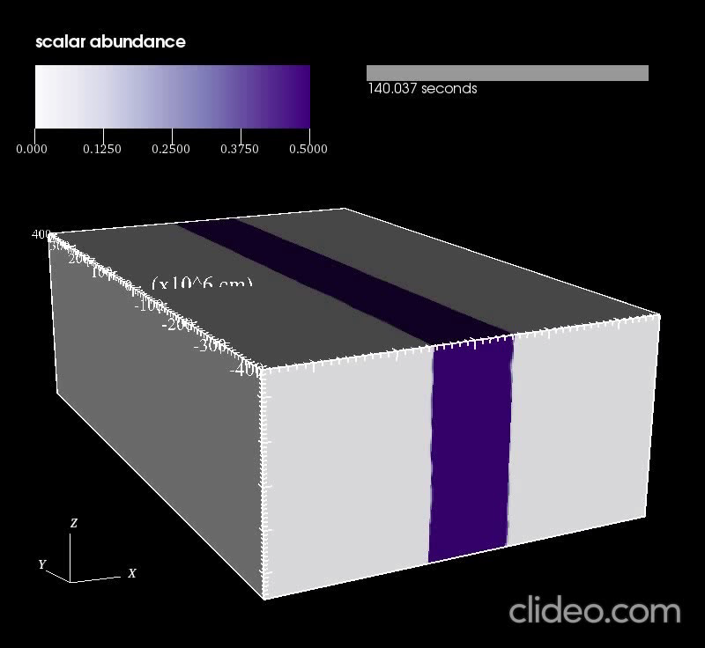
Magneto-hydrodynamic Models of White Dwarf Disruptions
          Goni Halevi (AST G4) ghalevi@princeton.edu

Slide 4
Elijah Kolmes
ekolmes@princeton.edu

Slide 5
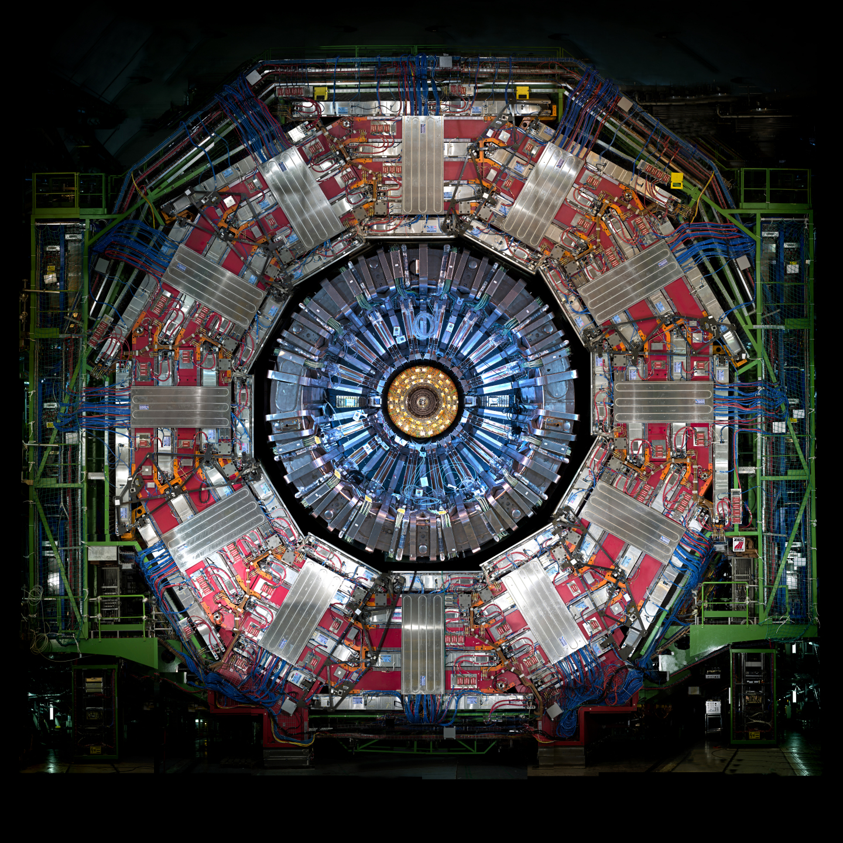
Gillian Kopp
gkopp@princeton.edu

Slide 6
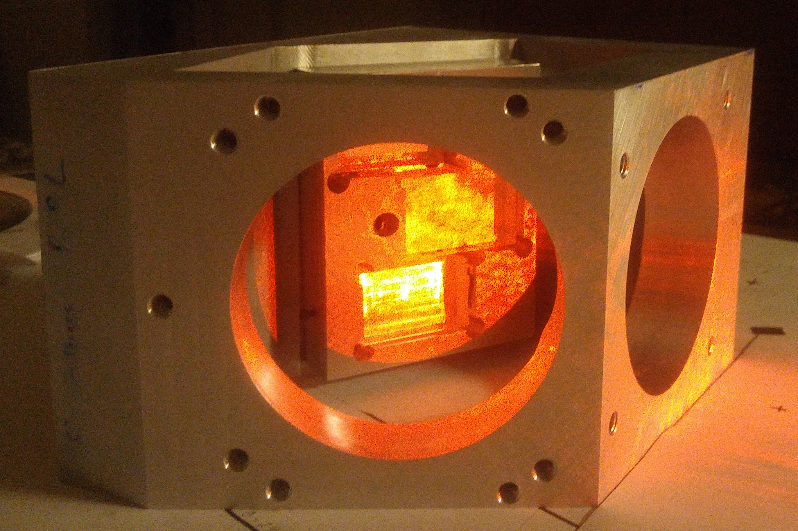
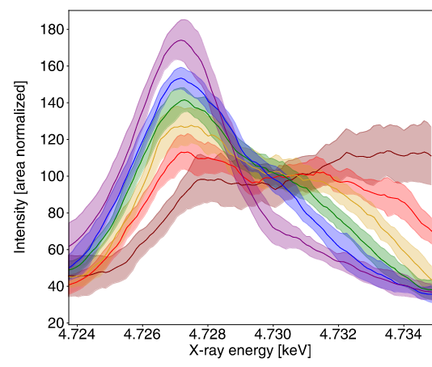
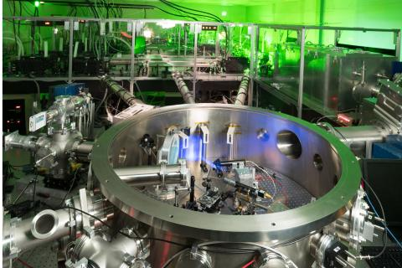
Brian Kraus
Program in Plasma Physics
X-ray Spectroscopy of Solid-Density Plasmas
bkraus@princeton.edu
10 J into 1 μm² in 40 fs
→ ~ 10²² W / cm²
Ti²⁰⁺

